Slide 1
Topic 1 Lesson 4
Types of Bonds
Textbook pgs.38-46

Slide 2
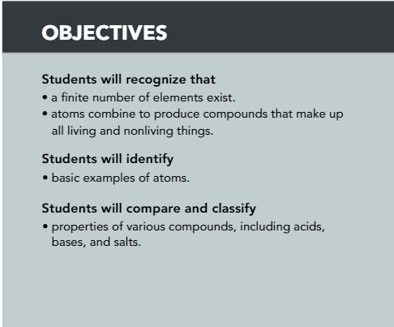
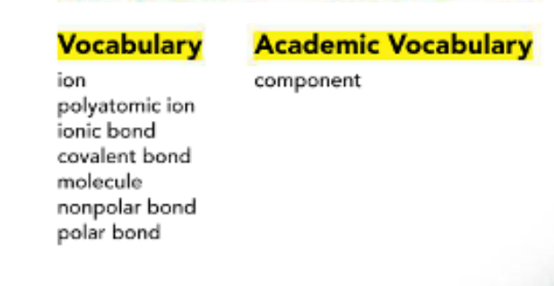

Slide 3
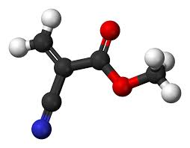
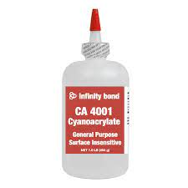

Bonding and Compounds
What do the elements carbon, hydrogen, oxygen, and nitrogen have in common?
They all nonmetals and each element is a Component of cyanoacrylate, a strong glue that is used to bind objects together to connect the skin after surgery.
And to reveal fingerprints to help solve crime.

Slide 4
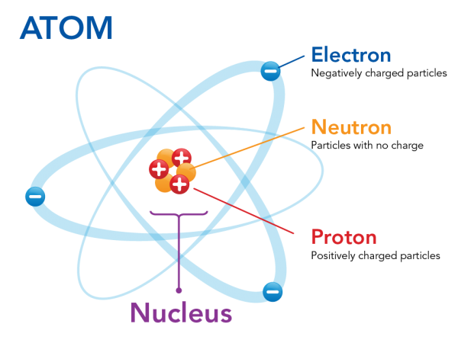
Do you remember, what is the charge of an atom?
Atom has no overall charge.

Slide 5
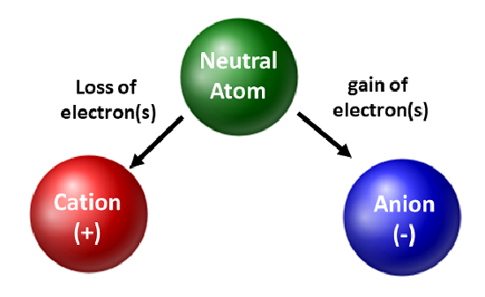
What will happen if an atoms lose or gain electrons?
Atom will become ion

Slide 6
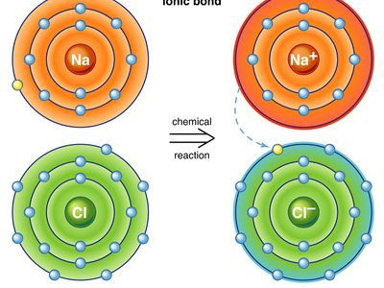
Ions
An ion is an atom or group of atoms that has either a positive or negative charge.
When a neutral atom loses a valence electron, it loses a negative charge. It becomes a positive ion.
When a neutral atom gains an electron. it gains a negative charge. It becomes a negative ion.
An atoms is stable when its outermost energy level if filled with electrons.

Slide 7
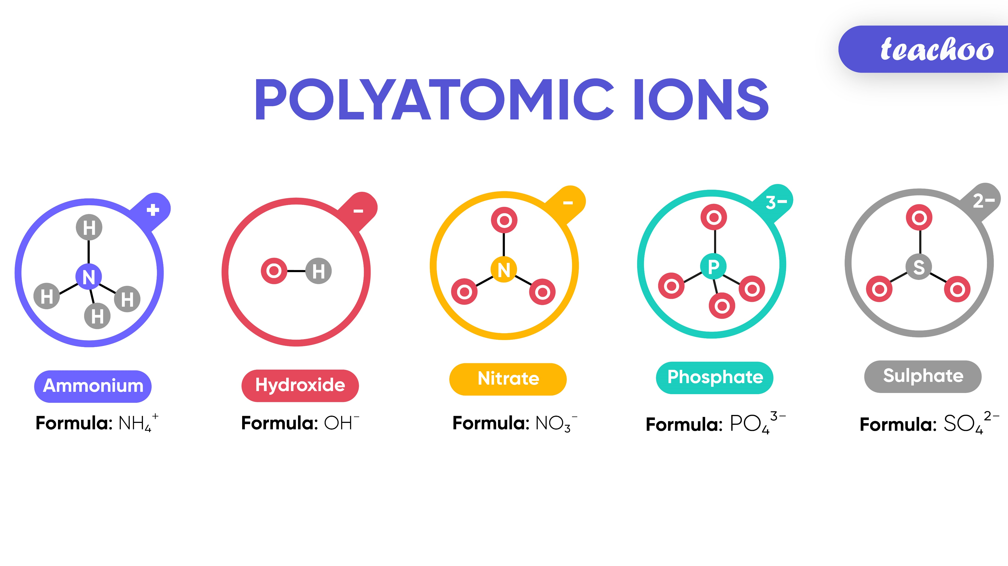
Polyatomic ion
Notice that some ions are made of several atoms for example:
The ammonium ion (NH4+)is made of 1 nitrogen atom and 4 hydrogen atoms
polyatomic ion : An ion made of more than 1 atom.

Slide 8
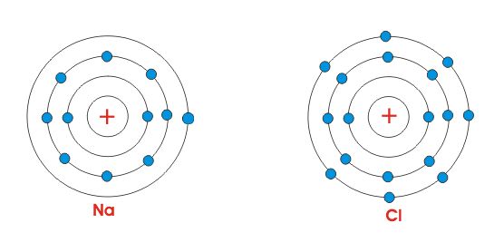
Ionic Bonding
When atoms that easily lose electrons react with atoms that easily gain electrons, they transfer valence electrons to form an ionic bond.
This transfer gives each type of atom a more stable arrangement of electrons
EX: Sodium atoms and Chlorine atoms react to form Sodium Chloride (Table salt)
ionic bond usually form when a metal combines with nonmetal

Slide 9
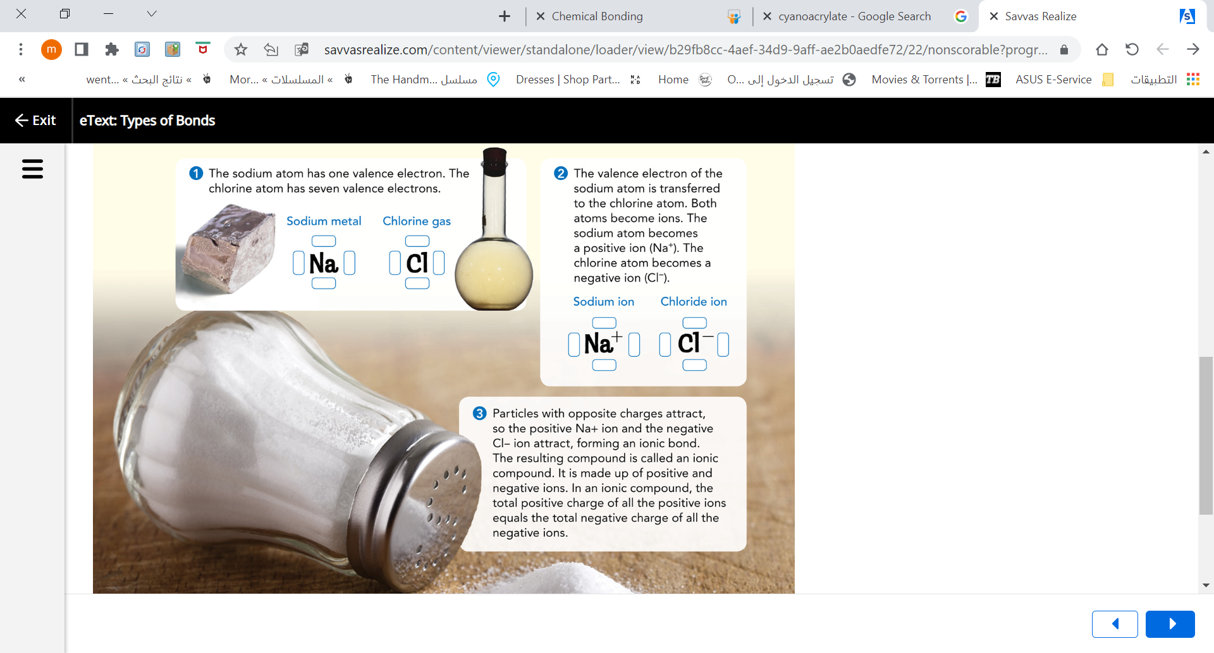
Formation of an ionic Bonds

Slide 10
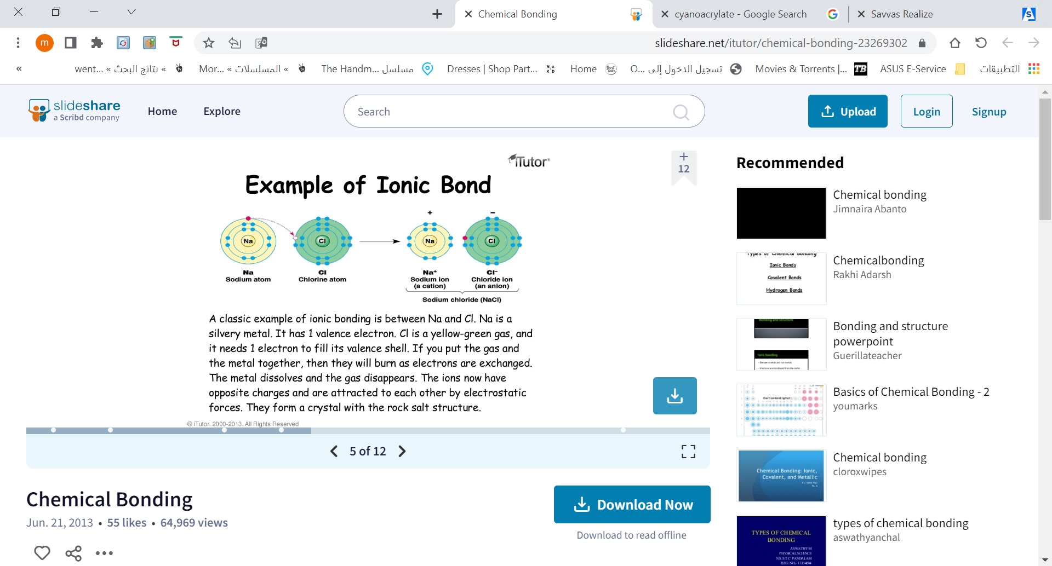
Ionic Bonding
Is one way elements form compounds.
Its involves the attraction between ions of opposite charge.

Slide 11
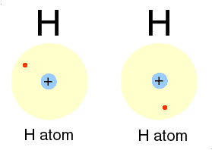

Covalent Bonding
Type of chemical bond in which there is a sharing of electrons between two atoms is called covalent bond
While ionic bond usually form when a metal combines with nonmetal, covalent bond usually between nonmetals atoms.

Slide 12
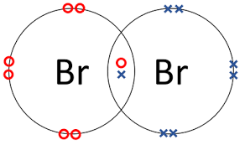
Molecule : is a neutral group of atoms joined by covalent bonds.
sometimes, sharing occurs between two atoms of the same element
EX: Two Bromine atoms shared a pair of electron and formed a covalent bond, the two bonded bromine atoms form a molecule.

Slide 13
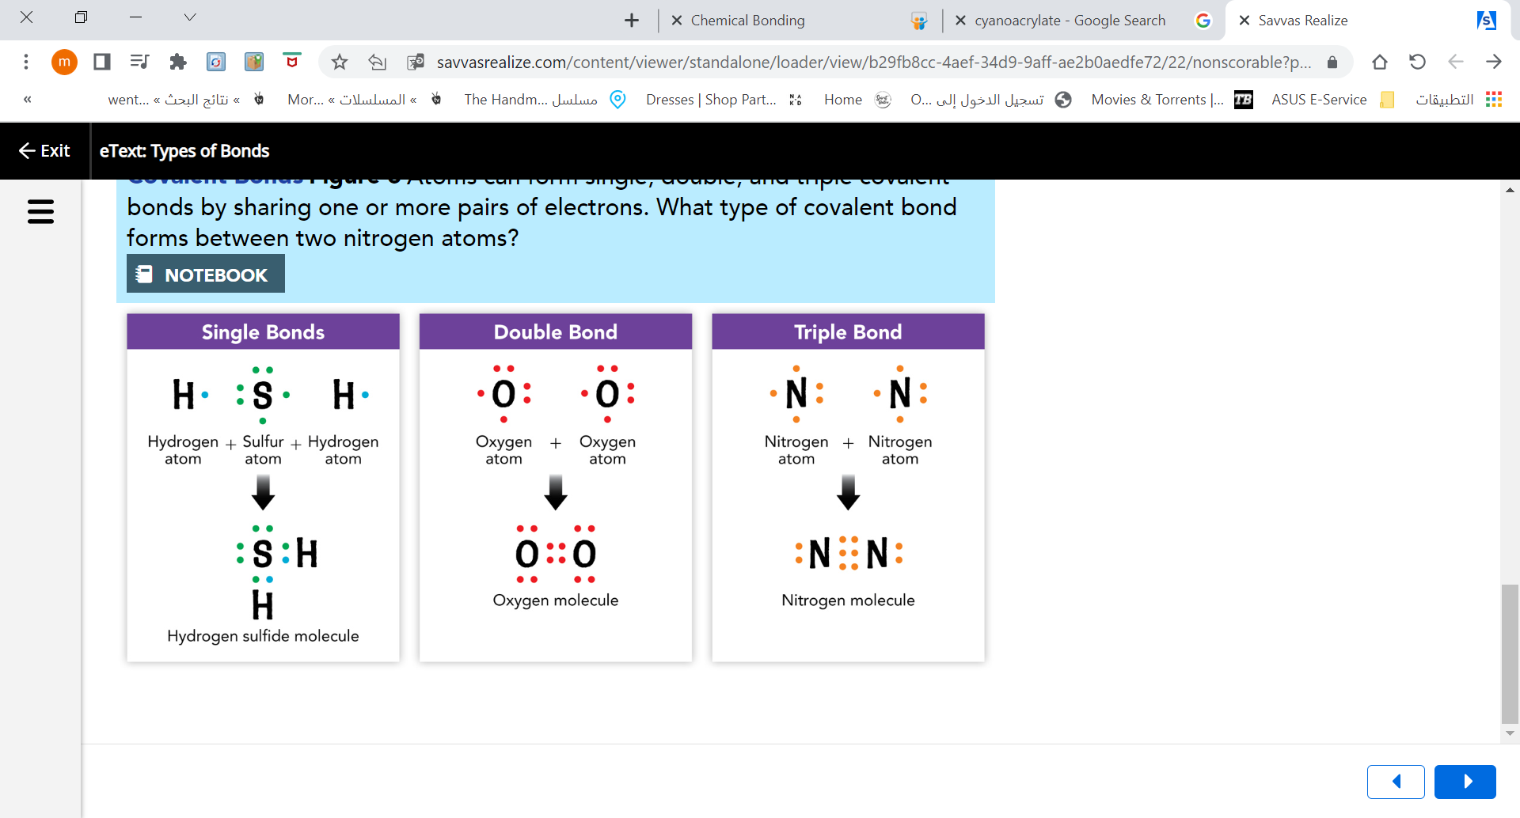
Number of Bonds
Atoms can form single, double, and triple covalent bonds by sharing one or more pairs of electrons

Slide 14
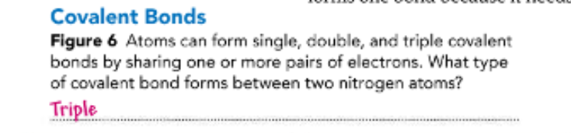
Assess your understanding pg.42

Slide 15

Polarity

Slide 16
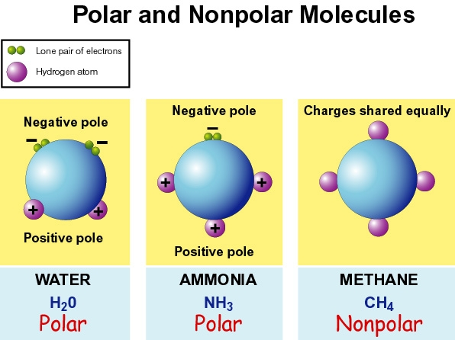
Polarity
If two atoms pull equally on the electrons, neither atom becomes charged. This happened when identical atoms are bonded. A covalent bond in which electrons are shared equally is a nonpolar bond.
When electrons in a covalent bond are shared unequally, the atoms with the stronger pull gains a slightly negative charge. The atom with the weaker pull gains a slightly positive charge. A covalent bond in which electrons are shared unequally is polar bond.

Slide 17
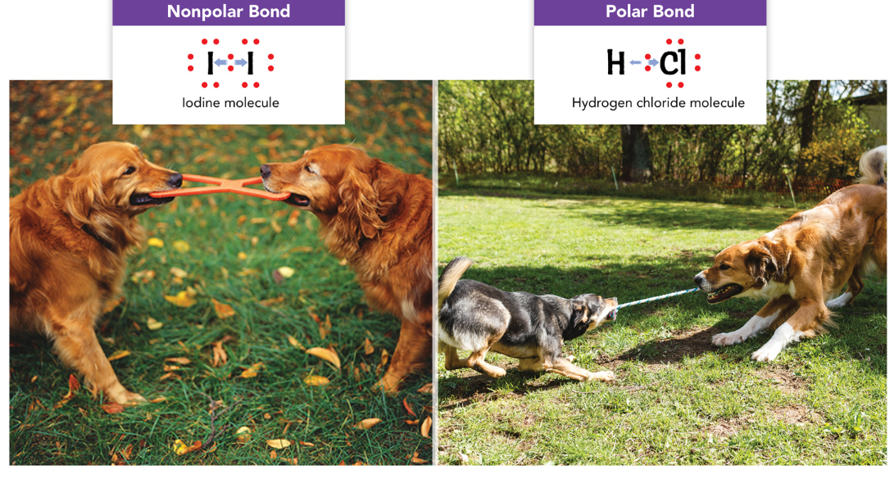

Slide 18
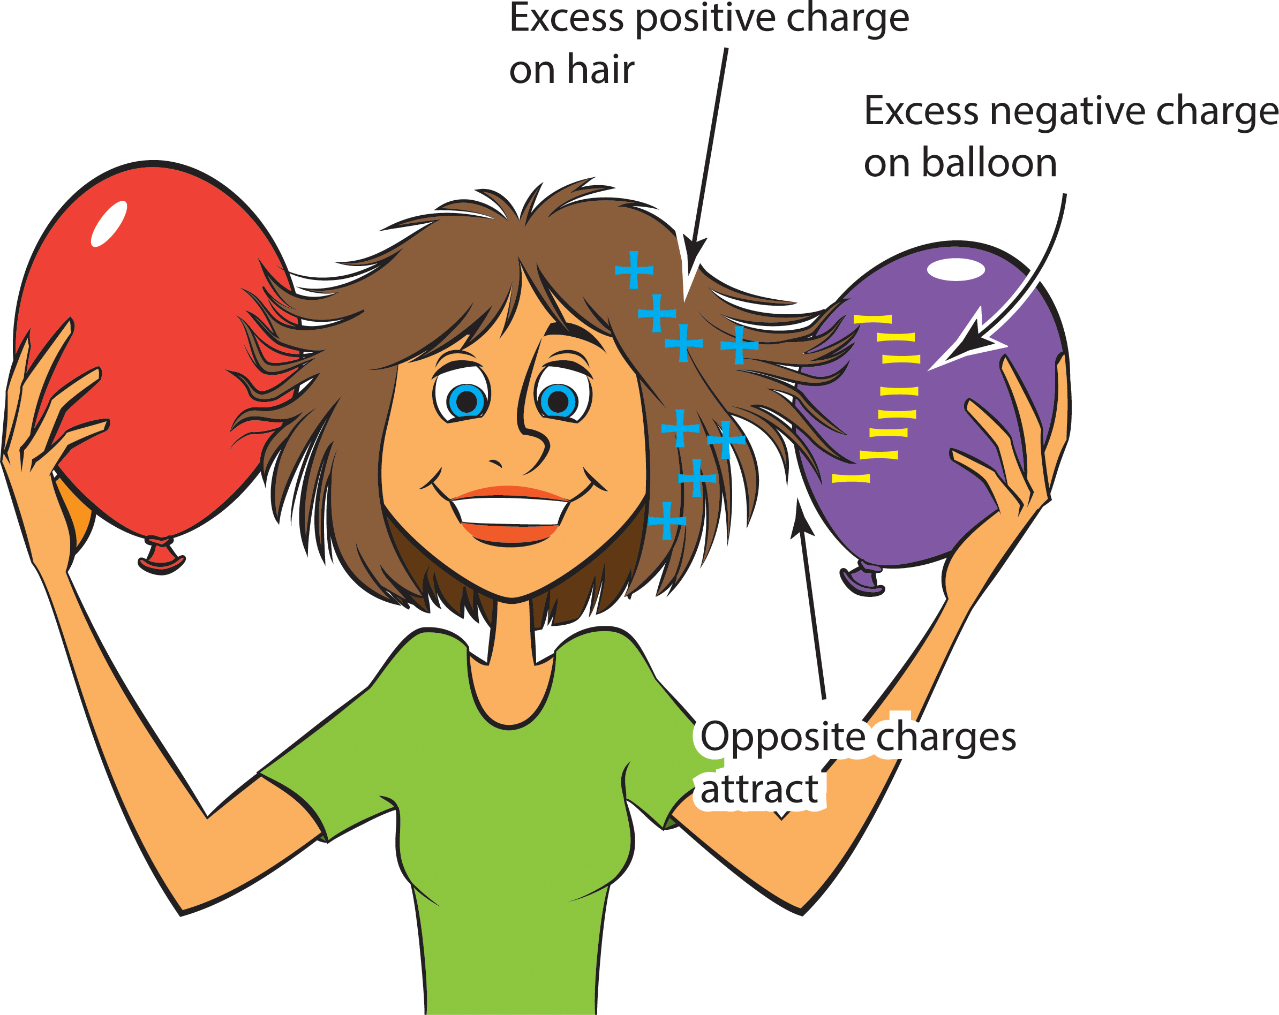
Polar Bonds in Molecules

Slide 19
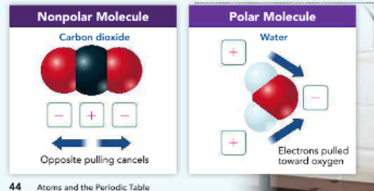
Polar Bonds in Molecules
A molecule is polar if it has a positively charged end and a negatively charged end.
not all molecules containing polar bonds are polar overall.
EX: In a carbon dioxide molecule (CO2), the oxygen atoms attract electrons more strongly than the carbon atom does. The bonds between the oxygen and carbon atoms are polar.
But, the two oxygen atoms pull with equal strength in opposite directions.
The attractions cancel out, so the molecule is nonpolar

Slide 20
Polar Bonds in Molecules
A water molecule (HO), with its two polar bonds, is itself polar
the two hydrogen atoms are at one end of the molecule, and the oxygen atom is at the other end.
The oxygen atom attracts electrons more strongly than the hydrogen atoms.
As a result, the end of the molecule with the oxygen atom has a slight negative charge. The end of the molecule with the hydrogen atoms has a slight positive charge

Slide 21
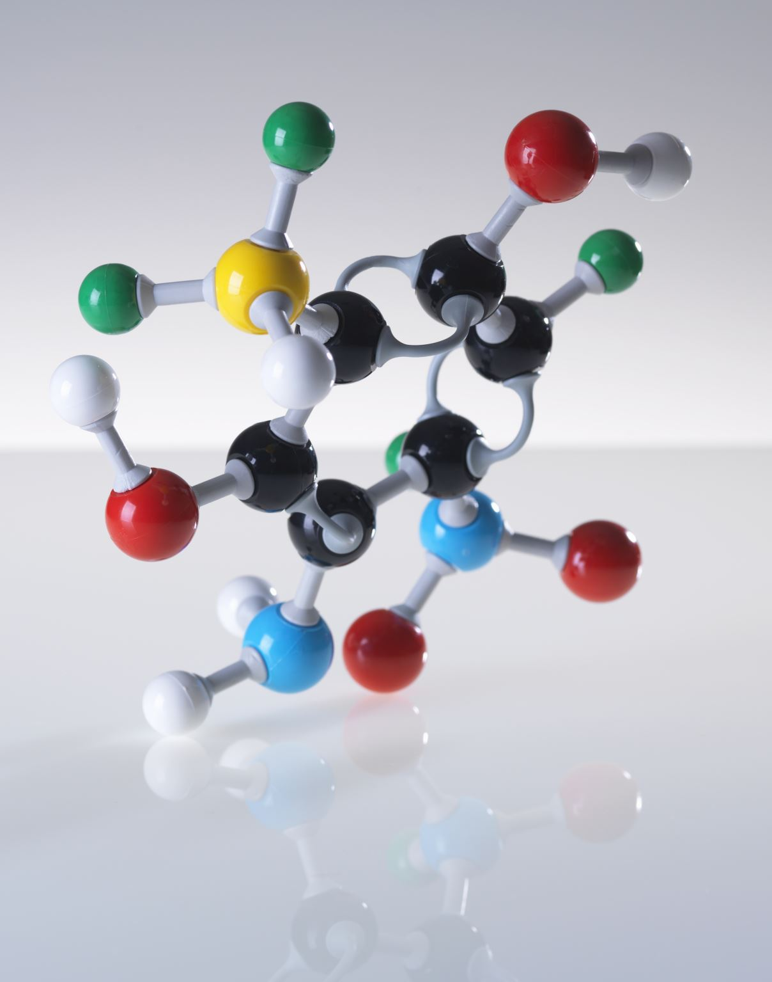
Properties of compounds
Resulting compounds have properties that are different from their component elements
Properties of ionic compounds are different from covalent compounds

Slide 22
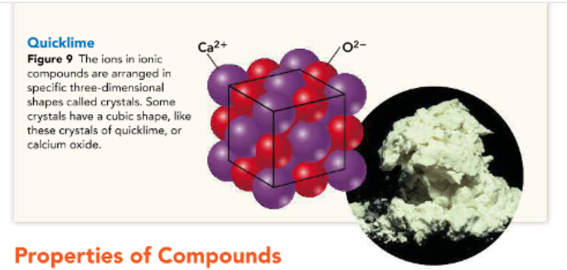
Properties of ionic compounds:
Form hard crystals (3D shape)
High melting points as attraction between negative and positive ions is great!
Conduct electricity when dissolved in water or melted as ions will be free to move
EX: crystals of quicklime (calcium oxide) has a melting point of 2,613 C

Slide 23
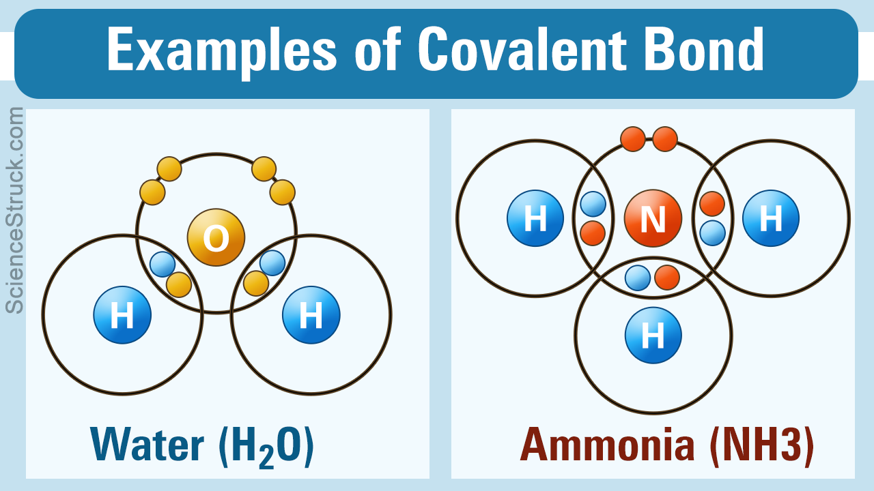
Properties of covalent compounds
Covalent compounds exist as molecules.
Because bonds do not have to be broken, their melting points are relatively low
Do not conduct heat or electricity

Slide 24

H.W
Page 47,Q1,2 and 5

Slide 25


