Slide 1







Topic 2 Lesson 3
Modeling Chemical Reactions
Textbook pgs.90-96

Slide 2
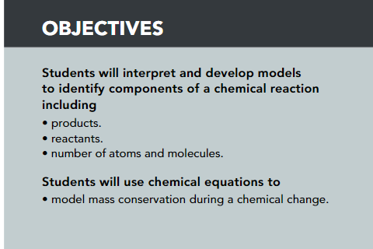
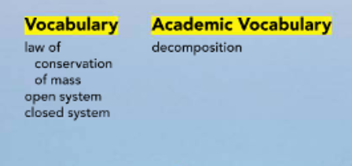

Slide 3
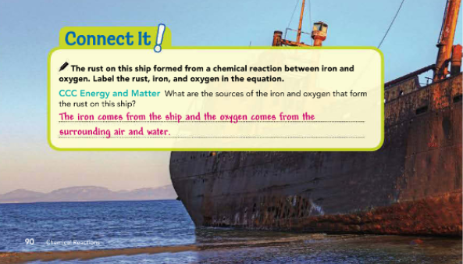

Slide 4
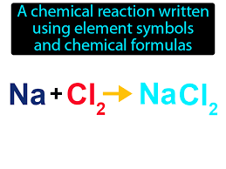
Chemical equations
are shorter than sentences, but they contain all of the necessary pieces of information to summarize a chemical reaction.
a scientist needs to learn how to read and write chemical equations.

Slide 5
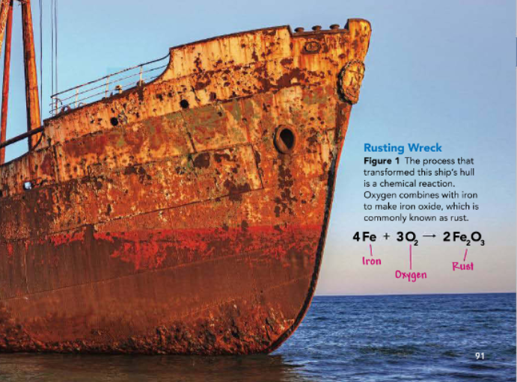
Chemical equations
The chemical equation that summarizes the reaction that makes rust is shown in the caption for Figure 1. The chemical equation conveys three things:
1-the identities of the molecules involved in the reaction
2-the elements that make up those molecules,
3-the molecules are products or reactants.

Slide 6
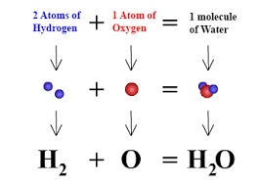
Formulas
A chemical formula combines the symbols of different elements to represent molecules.
For example, the formula for water is H2O.
H is the symbol for hydrogen, and O is the symbol for oxygen.
The subscript number next to a letter shows how many atoms of that element are in the molecule.
There are two hydrogen atoms in water.
If there is no subscript it means there is only one atom of that element.
There is only one atom of oxygen in water.

Slide 7
Structure of an Equation
All chemical equations share a basic structure.
A chemical equation indicates the substances involved in a reaction and the substances that are formed as a result of the reaction.
The formulas for the reactants are written on the left, followed by an arrow. The arrow means "yields," or "reacts to form." The formulas for the products are written to the right of the arrow.
If there are two or more reactants, they are separated by a plus sign (+).
If two of more products form, they are also separated by a plus sign.
Reactant + Reactant → Product + Product
The numbers in front of each component in the equation show how many particles of the reactants are needed and how many particles of the products are formed during the reaction.
The numbers, called coefficients, balance the equation so that that number of atoms in the reactants equals the number of atoms in the products.

Slide 8
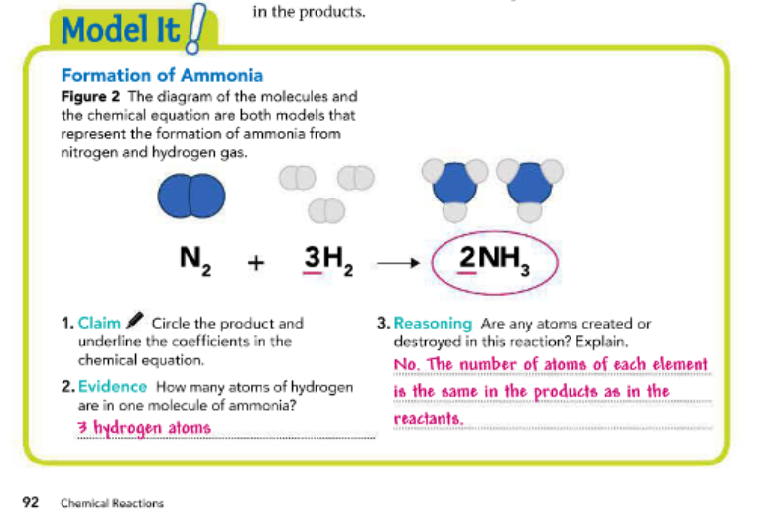

Slide 9
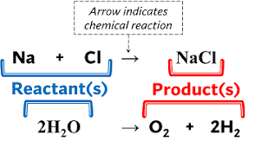

Slide 10
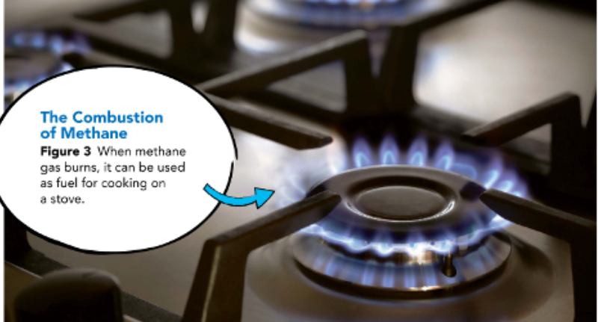


Chemical Reactions and Equations
The number of reactants and products can vary.
Some reactions have only one reactant or product.
Other reactions have two, three, or more reactants or products.
For example, the reaction that occurs when limestone, or calcium carbonate (CaCO3), is heated has one reactant and two products (CaO and CO2).
The reaction that occurs when methane gas (CH4) is burned in the presence of oxygen features two reactants and two products.
that the flame that provides the energy for the reaction as shown in Figure 3 is not itself a reactant. Only the substances that are chemically rearranged in the reaction are shown in the equation.

Slide 11
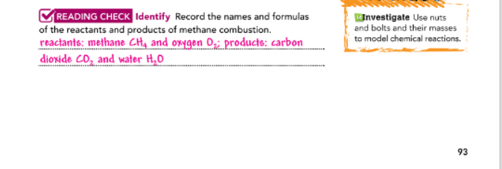

Slide 12
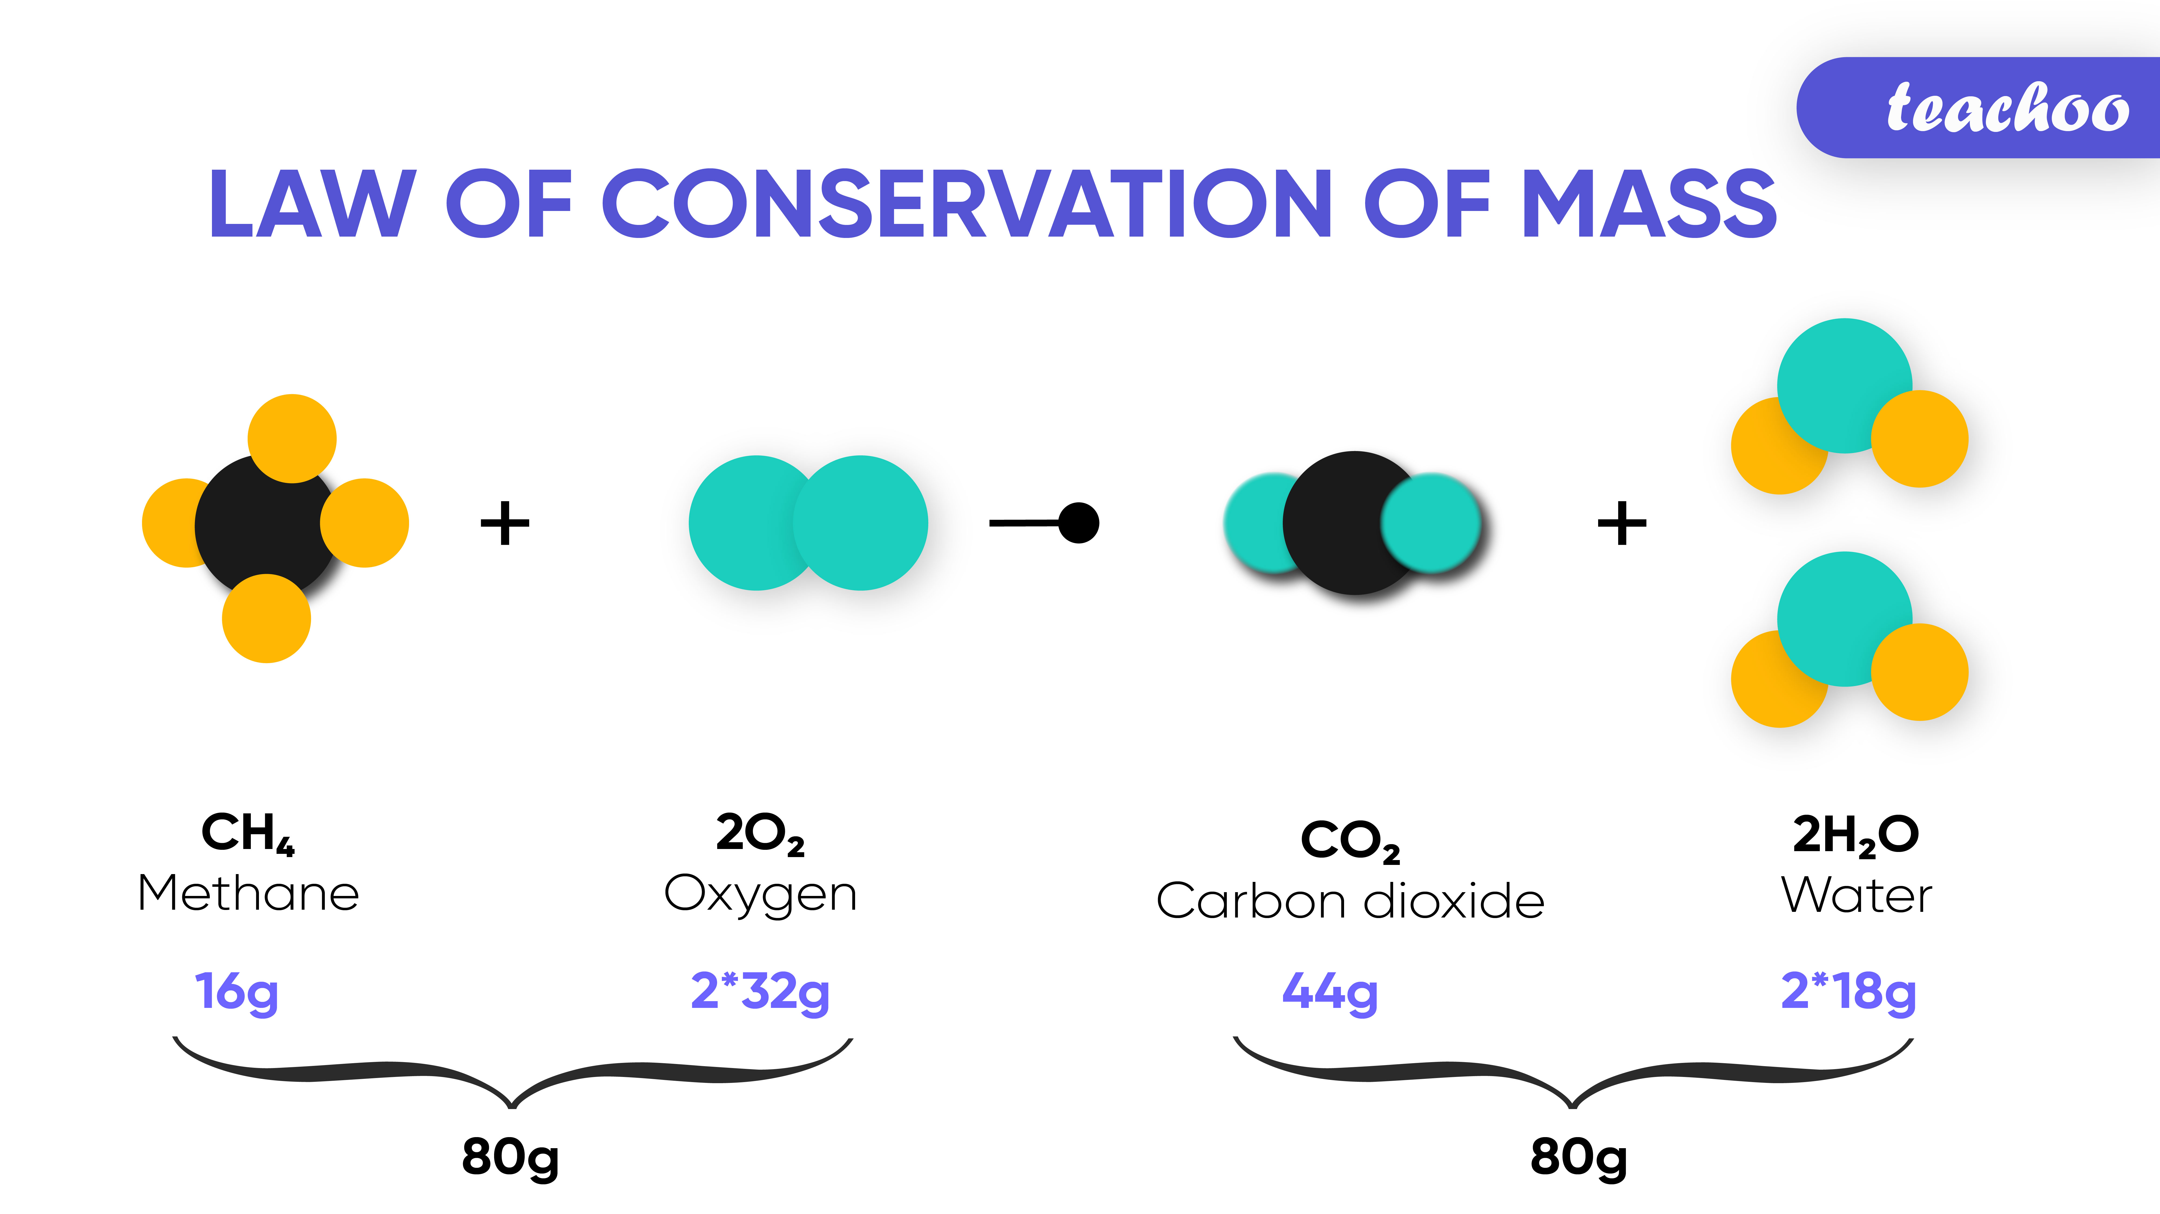
Law of Conservation of Mass
During a chemical reaction, matter is neither created nor destroyed. This is the law of conservation of mass.
When reactants form new products, the new products always have the same amount of matter as the reactants.
All atoms that are present at the beginning of a chemical reaction are present at the end of the reaction.
Even though products may have different properties and may look and behave very differently from the reactants, the total mass does not change. This is why coefficients are used to balance equations.

Slide 13
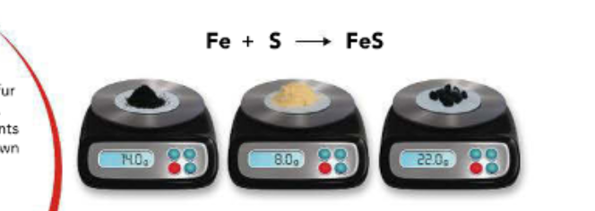
Law of Conservation of Mass
For example,
in the reaction such as the one that produces iron sulfide, the sum of the masses of iron and sulfur equals the mass of the iron sulfide they produce (Figure 4).
An atom of iron bonds with an atom of sulfur, and the masses of the individual atoms combine when they form molecules.
If there is more iron than can bind with sulfur, or more sulfur than can bind with iron, the leftover reactant will still be present, as will its mass.

Slide 14
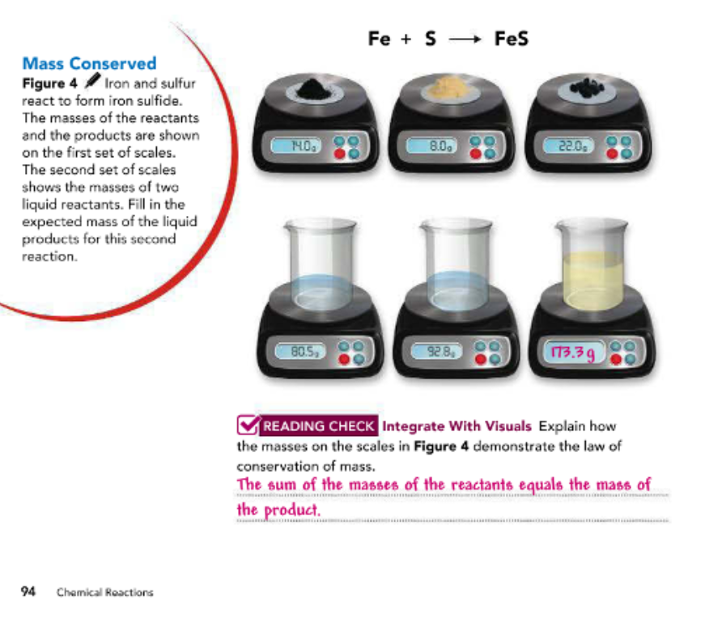

Slide 15
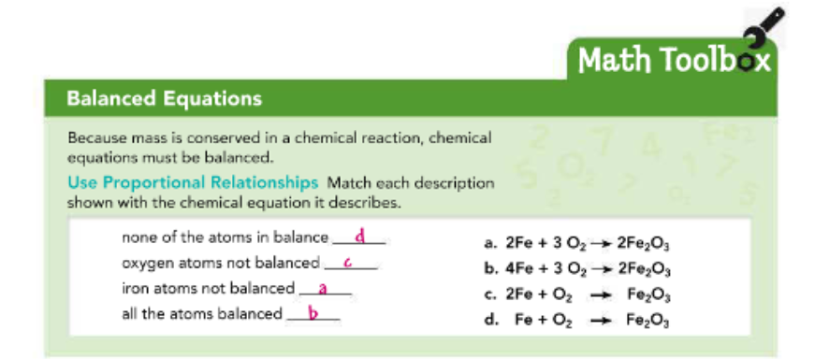
Pg.95

Slide 16

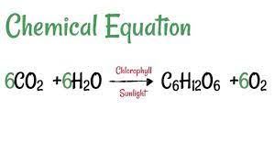
Open Systems
Some reactions may appear to violate the principle of conservation of mass. Recall that photosynthesis is a chemical reaction that plants use to make food. Carbon dioxide from the air, and water absorbed from soil, are reactants that produce sugar and oxygen, thanks to the energy provided by sunlight. But if you measure the mass of a plant as it grows, it will seem like a huge amount of mass is appearing out of nowhere. This is because most plants we see are in an open system, where matter can enter and escape. The flow and invisibility of the carbon dioxide gas that plants convert to food and structures-stems, trunks, leaves, and so on-makes it very difficult to know just how much carbon dioxide is involved (Figure 5A).

Slide 17
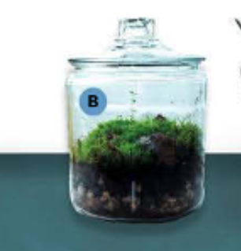
Closed Systems
A closed system is a better place in which to measure the movement of matter and study reactions that involve gas. The sealed system in Figure 5 allows scientists to manipulate and analyze the contents of the system, including plants, without worrying that invisible gases may be moving into or out of the system.

Slide 18
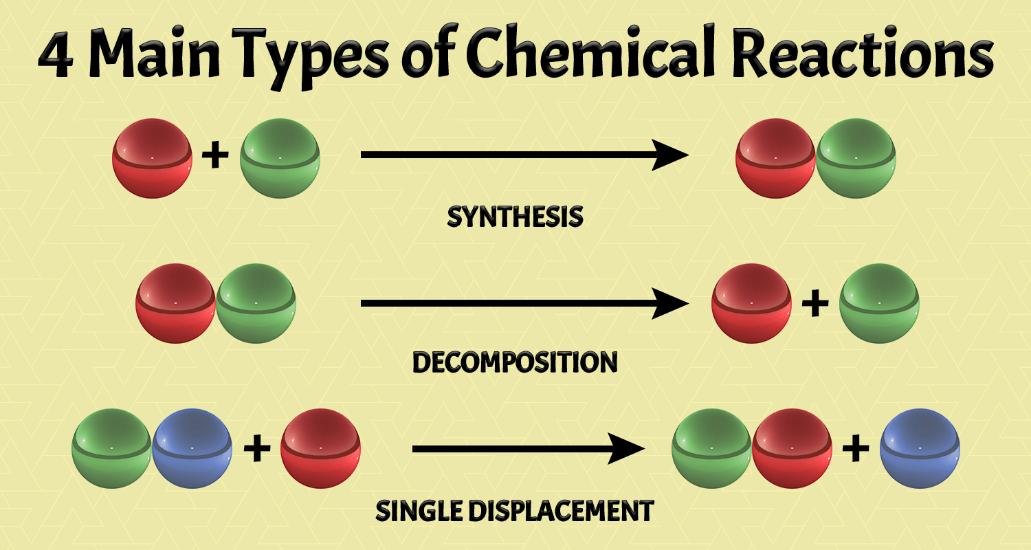

Slide 19
Types of Chemical Reactions
There are three general types of chemical reactions.
1-Synthesis
To synthesize is to put things together. When two or more elements or compounds combine to make a more complex substance, it's called a synthesis reaction, also known as a combination reaction.
The reaction that produces magnesium oxide is a synthesis reaction.
2Mg + 02 → 2MgO

Slide 20
2-Decomposition
The opposite of a synthesis reaction is a decomposition reaction, in which compounds break down into simpler products. You may have a bottle of hydrogen peroxide (H2O2) in your house to clean cuts. If you keep such a bottle for a very long time, you'll have water instead.
Hydrogen peroxide decomposes into water and oxygen gas.
2H2O2 → 2H2O + O2

Slide 21
3-Replacement
When one element replaces another element in a compound, or if two elements in different compounds trade places, it's a replacement reaction.
When potassium iodide and lead nitrate react, the potassium and lead change places.2KI + Pb(NO3)2 → Pb2 + 2KNO3
Also note that a subscript is applied to the nitrate (NO) in the second reactant. This means there are two nitrates with a single lead (Pb) atom. On the product side of the equation, the coefficient is used because it applies to both the potassium (K) atom and the nitrate.

Slide 22
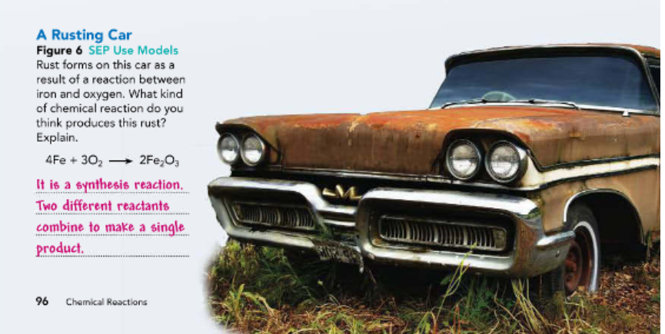

Slide 23
