Slide 1

LIGHT

Slide 2

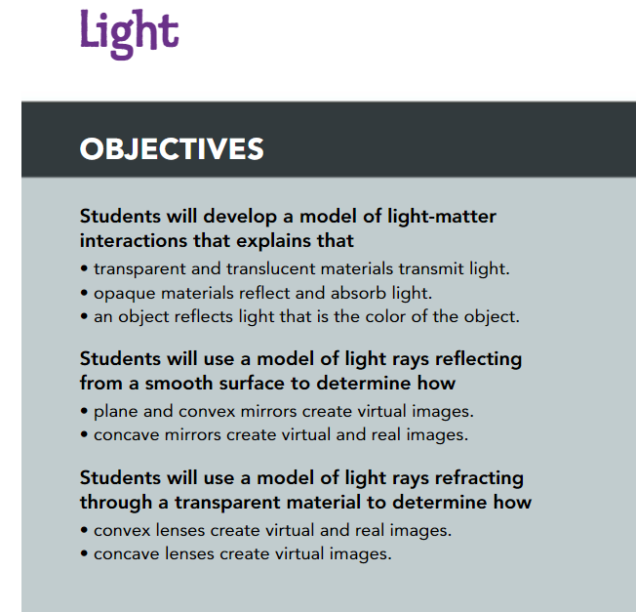
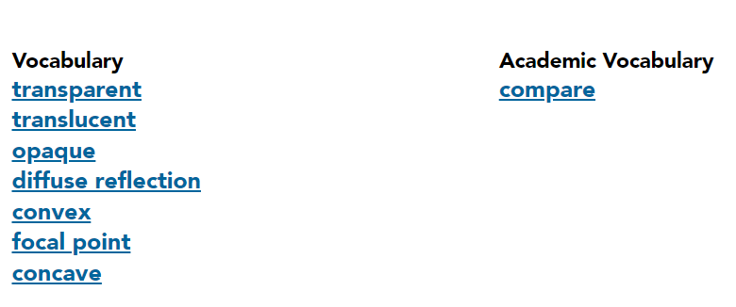

Slide 3
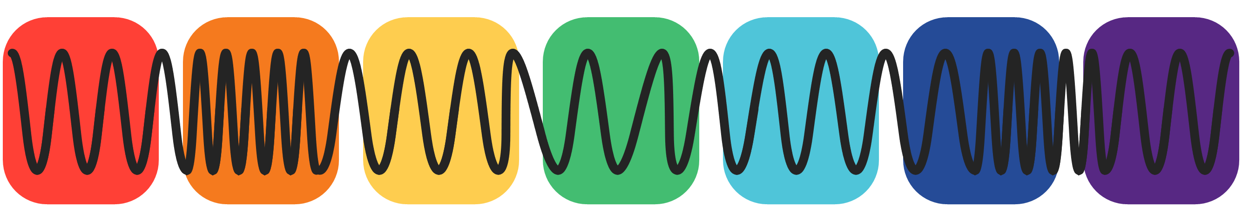
Light, Color, and Objects:
When people talk about light, they are usually referring to then part of the electromagnetic spectrum that is visible to humans.
This light interacts with the world around us to determine what we see and how it appears.
Materials can be classified based on how much light transmits through them.

Slide 4
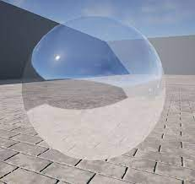
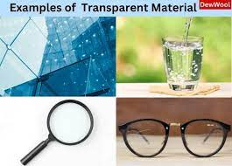
A material that transmits most of the light that strikes it is transparent.
You can see through a transparent object, such as (a window pane or the plastic wrap on a package).

Slide 5
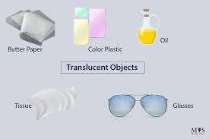
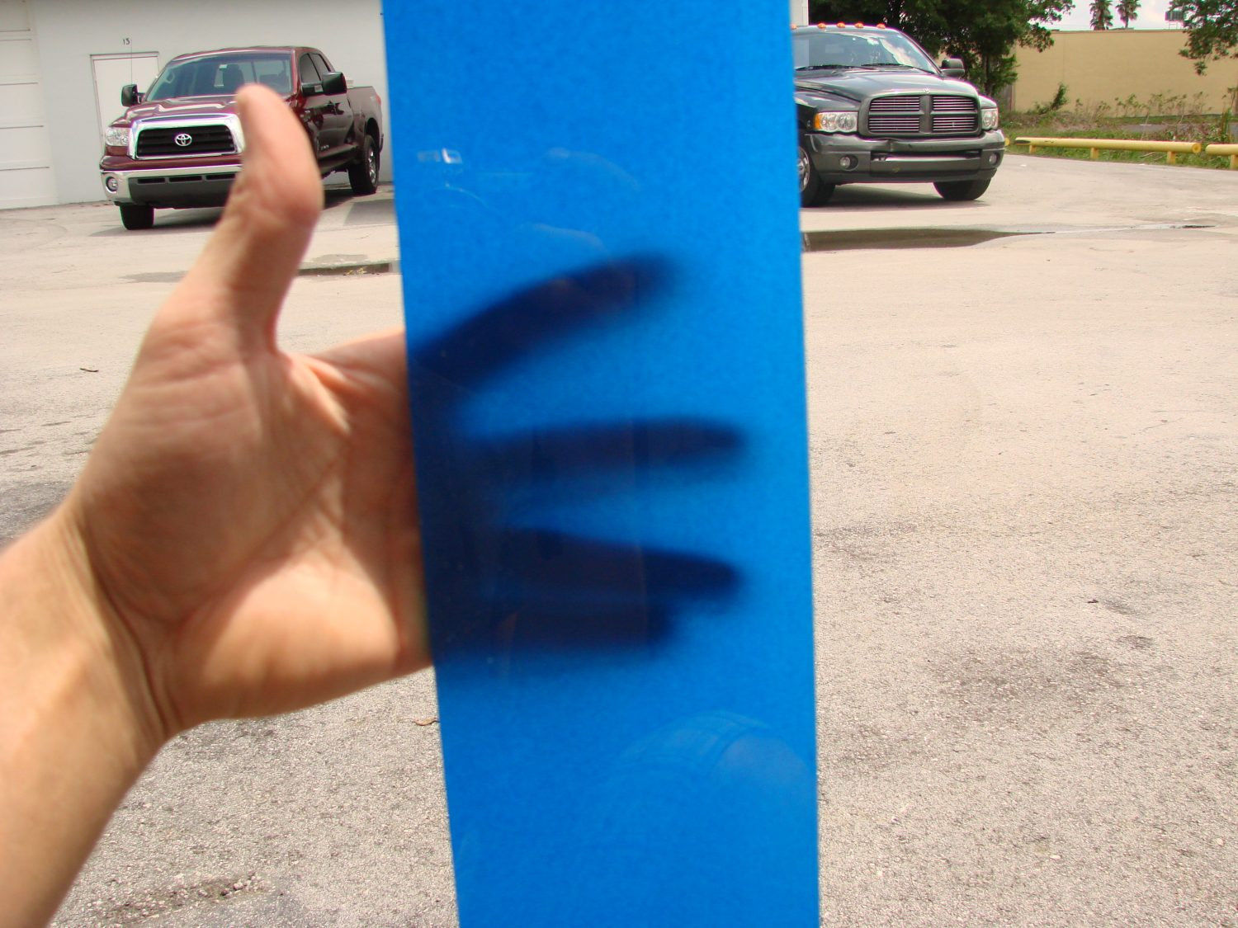
A translucent material scatters the light that passes through it. You might be able to see through a translucent material, but the the image will look blurred.
Waxed paper and gelatin desserts are examples of translucent materials.

Slide 6
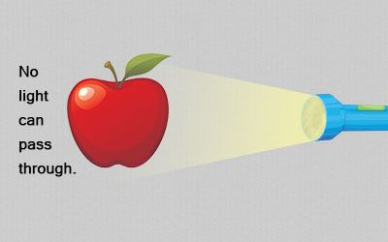
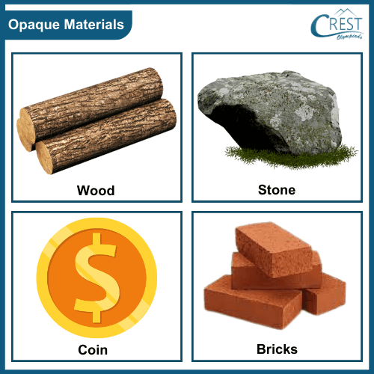
A material that reflects or absorbs all of the light that strikes it is called opaque.
A book, a marshmallow, and a hippopotamus are all opaque.
you can't see through them because light does not transmit through them.

Slide 7
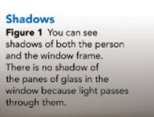
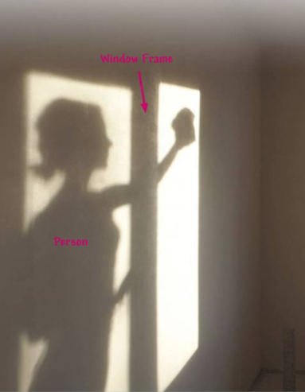
433

Slide 8
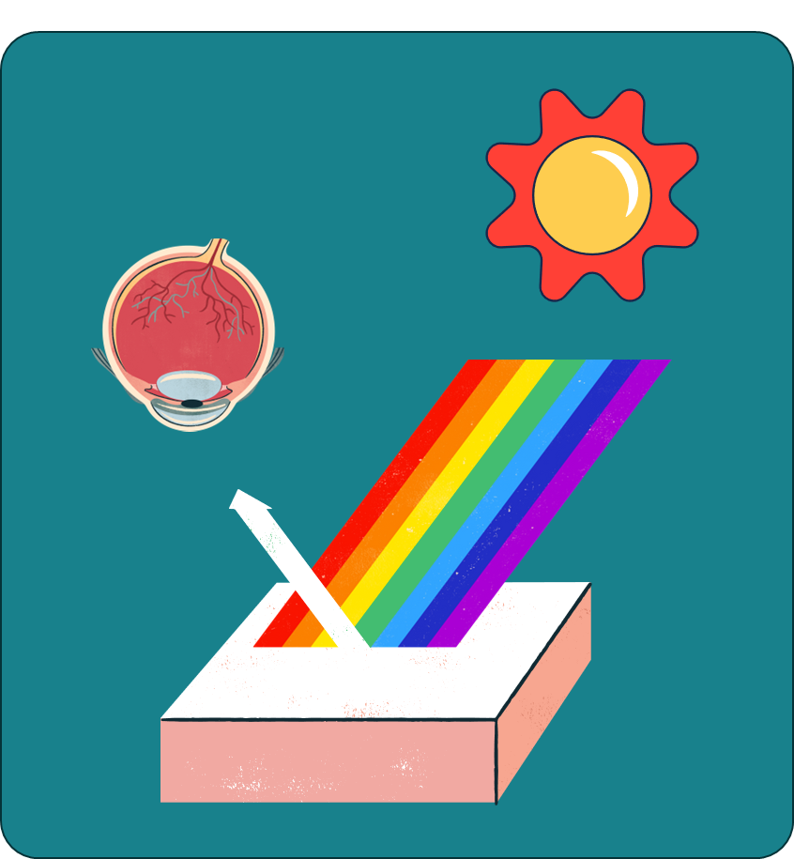
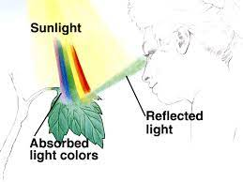
The Color of Objects :
white light is a mixture of all of the colors in the rainbow.
When white light shines on an object, some of the colors of light are reflected and some are absorbed.

Slide 9
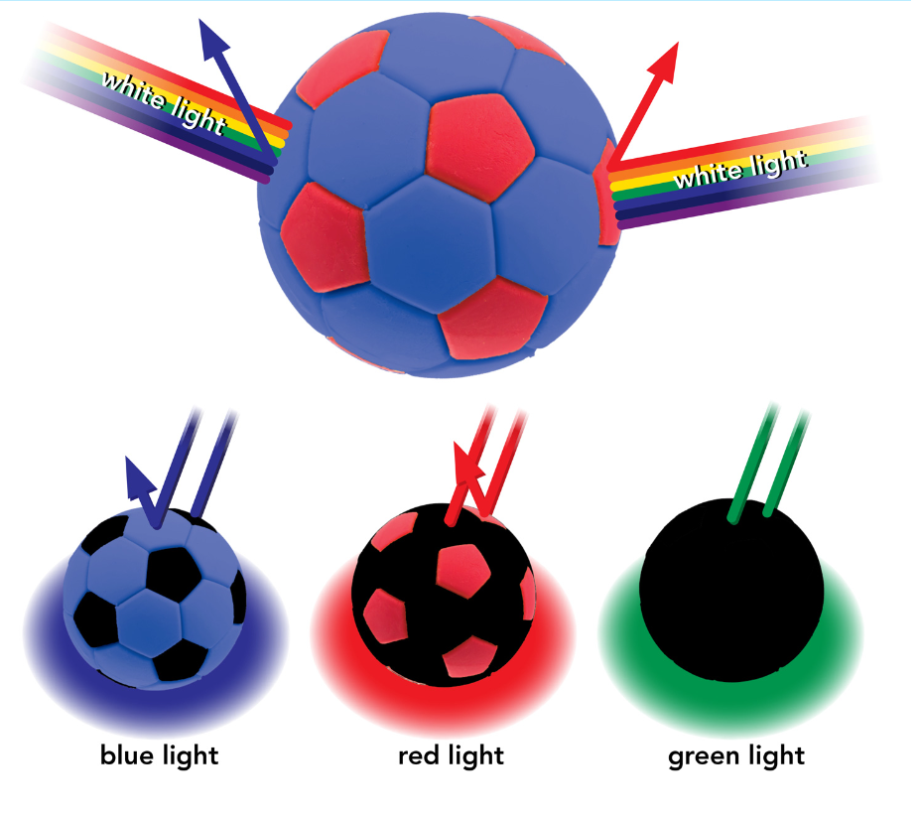
The Color of Objects :
The color of an opaque object is the color of light that the object reflects. It absorbs all other colors.
Under white light, the soccer ball in Figure 2 appears blue and red.
It reflects blue and red wavelengths of light and absorbs all other colors.

Slide 10

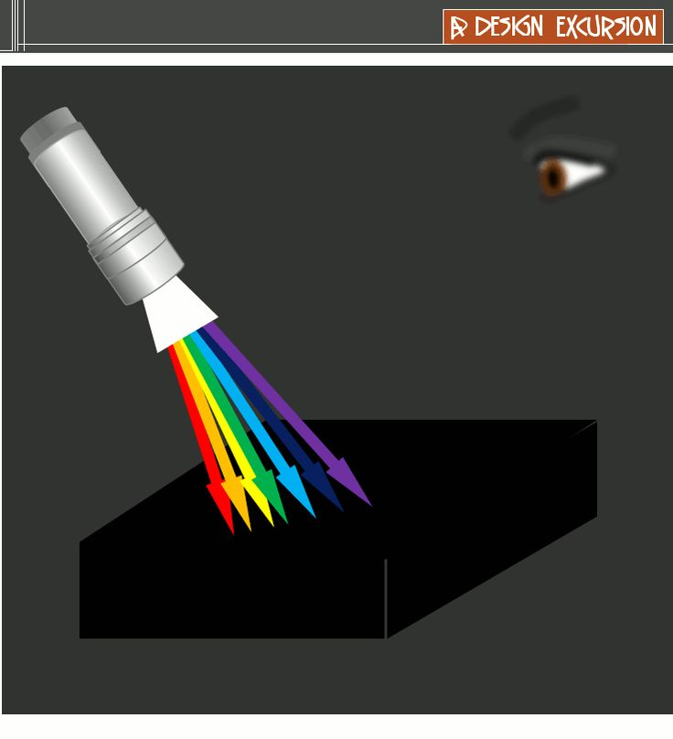
Other objects, such as a brown tree trunk, do not appear as basic colors of light. These objects reflect more than one color of light. Brown is a combination of red and green, so a brown object reflects both red and green light, and it absorbs all other colors.
If an object appears black, then it absorbs all colors of light. A white the object reflects all light.

Slide 11
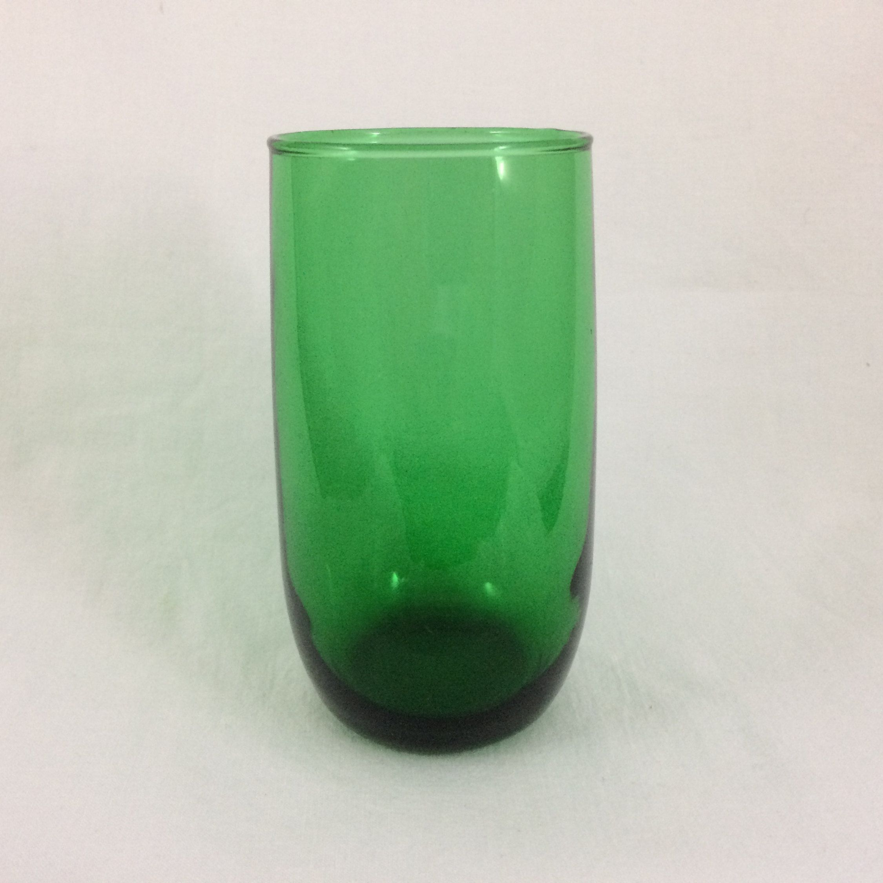
The color of a transparent or a translucent object is the color of light that passes through it.
For example, the color of a clear, green drinking glass is green because green light is the only color of light that passes through it.

Slide 12

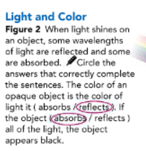
434

Slide 13
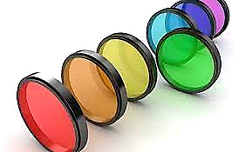
Color Filters:
Color Filters Perhaps you have looked at an object that has a colored light shining on it. You might have noticed that the color of the object looks different than it does when white light shines on it.
The color of the light might come from white light shining through a colored filter-a tinted piece of glass or plastic.

Slide 14
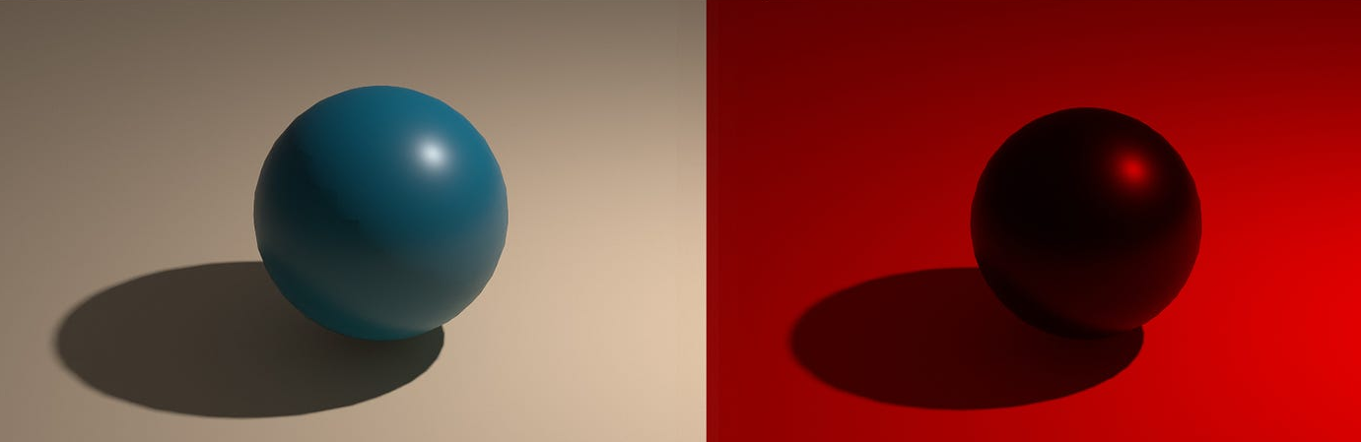
For example, transmits only red light. When light shines through a red filter onto an object, any part of the object that is red, looks red. Any other color looks black.
Color filters are often used in photography and movies.
They are part of the special effects that create different moods for scenes.

Slide 15
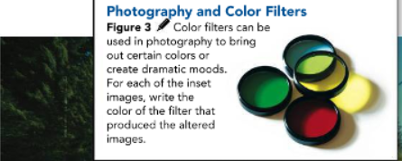
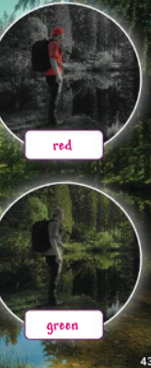
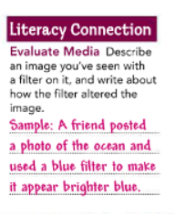
435

Slide 16
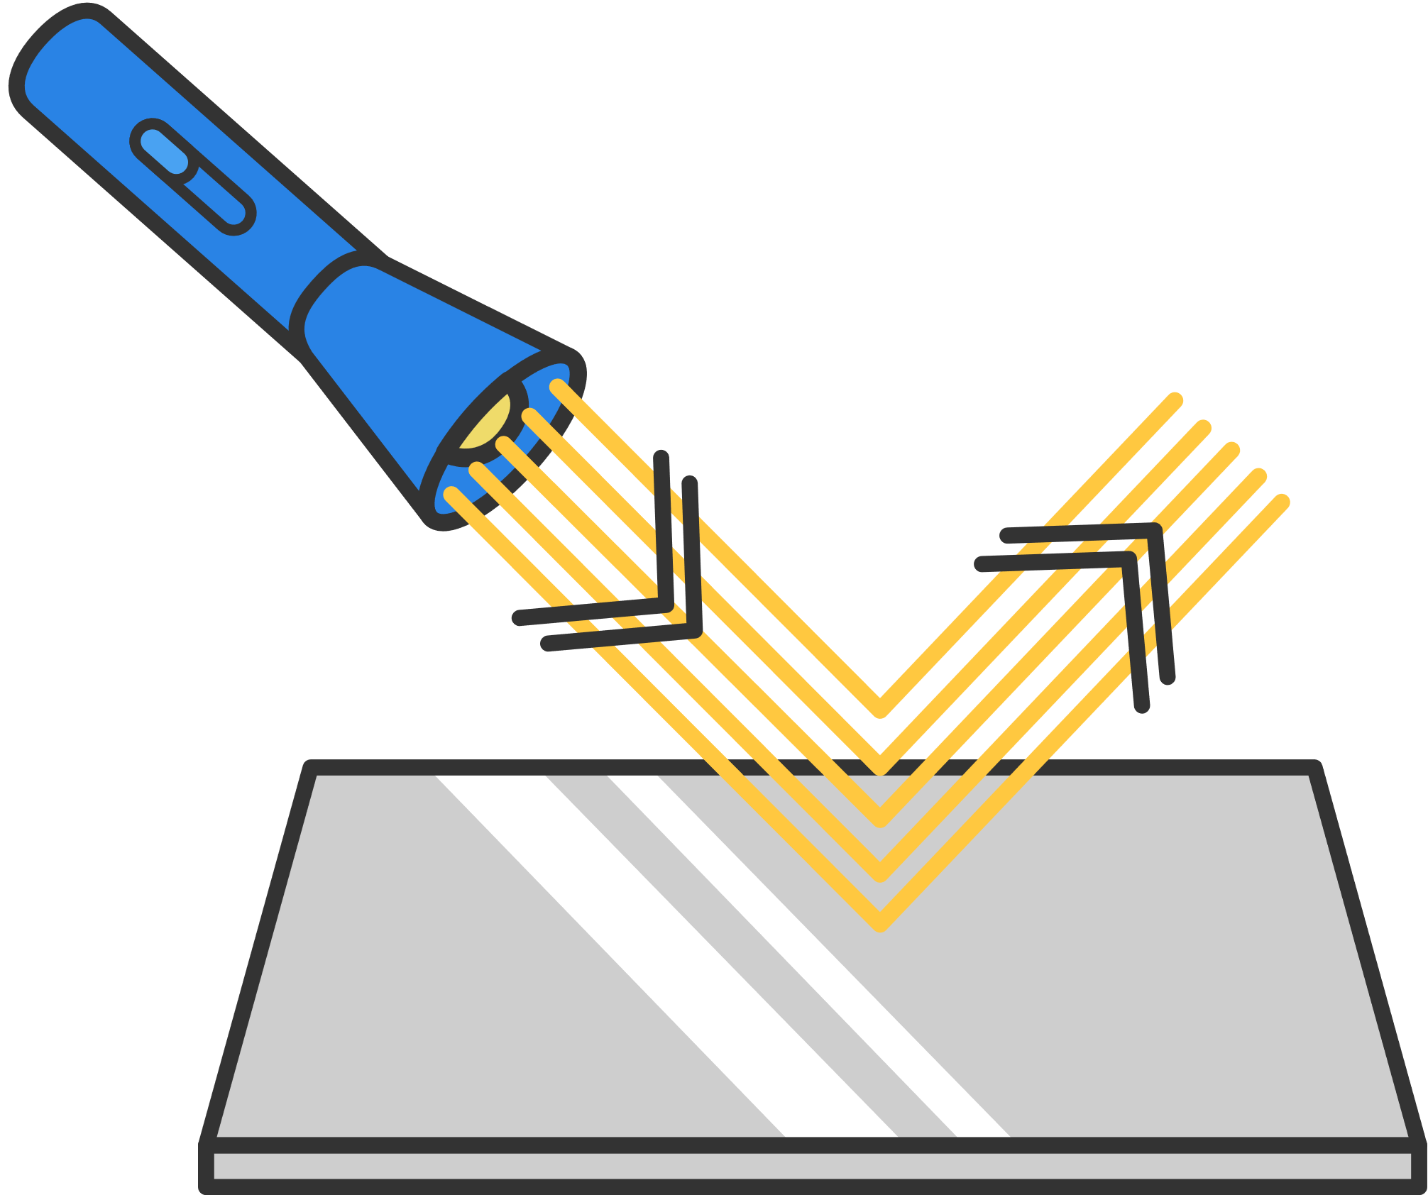
Reflecting Light
Sometimes light is transmitted through materials. Like (other electromagnetic radiation, light can also be reflected).
The reflection of light occurs when parallel rays of light bounce off a surface.
Reflected light is how you see your image in a mirror, but reflected light is also why you see a distorted image or no image at all on the surface of rippling water on a lake.

Slide 17
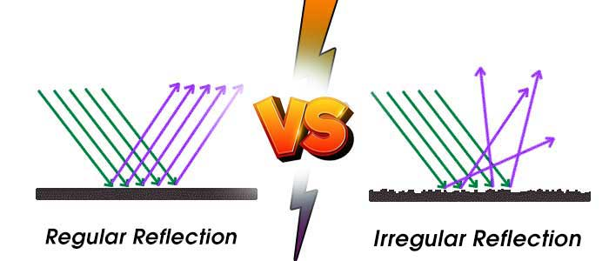
The difference lies in whether the light undergoes regular reflection or diffuse reflection.
Regular reflection occurs when parallel rays of light hit a smooth surface. the trees are reflected because light hits the smooth surface of the water, and the rays all reflect at the same angle. As a result, the reflection is a clear image.

Slide 18
In diffuse reflection, parallel rays of light hit an uneven surface.
The angle at which each ray hits the surface equals the angle at which it reflects.
The rays, however, don't bounce off in the same direction because the light rays hit different parts of the surface at different angles.

Slide 19
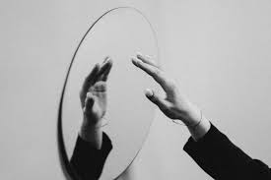
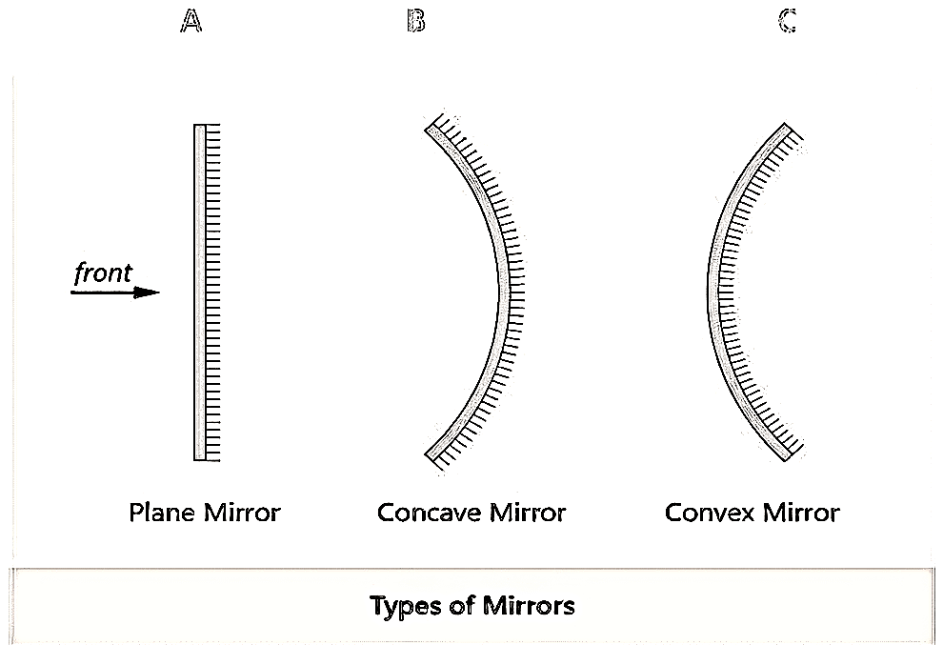
Mirror Images :
Mirror images the most common way to form a clear image using reflected light is with a mirror.
There are three different types of mirrors-plane, convex, and concave.

Slide 20
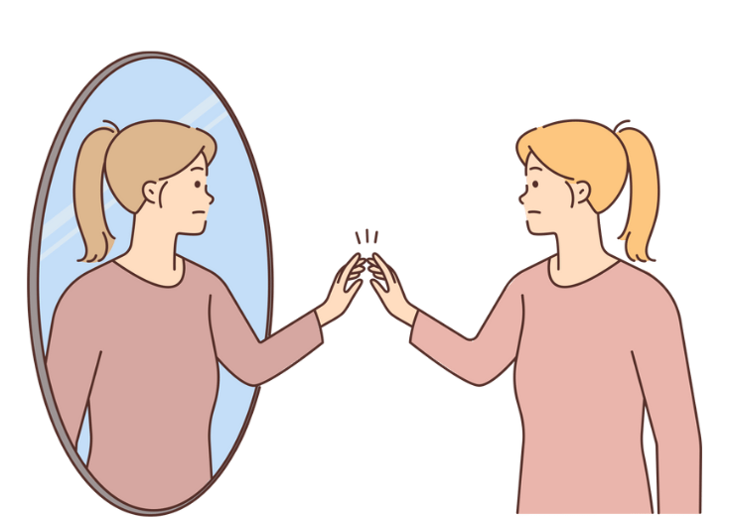
The types of mirrors are distinguished by the shape of the surface of the mirror.
The mirror you have hanging on a wall in your home probably is a flat mirror, also known as a plane mirror. The image you see in the mirror is called a virtual image, which is an image that forms where light seems to come from.

Slide 21
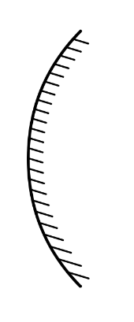
Convex Mirrors
Convex Mirrors To visualize a convex mirror, think about a metal bowl. A convex mirror is like the outside of the bowl because it is a mirror with a surface that curves outward.
If you look at an image in the outside of the bowl, it is smaller than the image in a plane mirror.

Slide 22
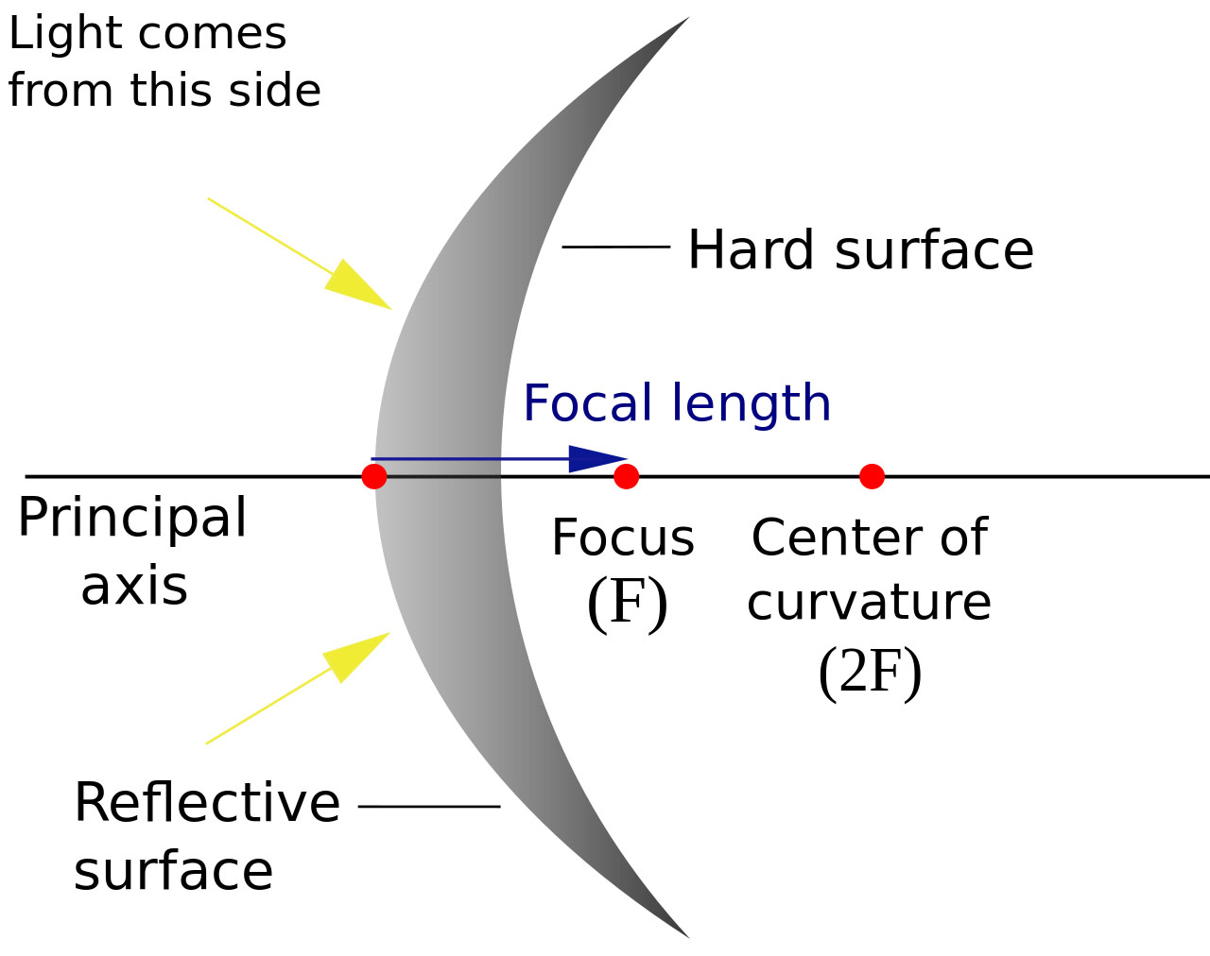
To understand how these images form, look at the optical axis and the focal point of the mirror. The optical axis is an imaginary line that divides a mirror in half.
The focal point is the location at which rays parallel to the optical axis reflect and meet.
The light reflects off the curved surface such that the image appears to come from a focal point behind the mirror.

Slide 23
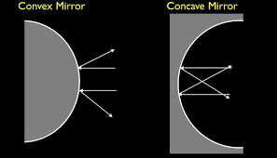
Concave Mirrors:
Concave Mirrors Just as a convex mirror is like the outside of a shiny bowl, a concave mirror is like the inside of the bowl. The surface of a concave mirror curves inward.
The image that forms from a concave mirror depends on whether the object is between the focal point and the mirror or farther away from the mirror than the focal point.

Slide 24
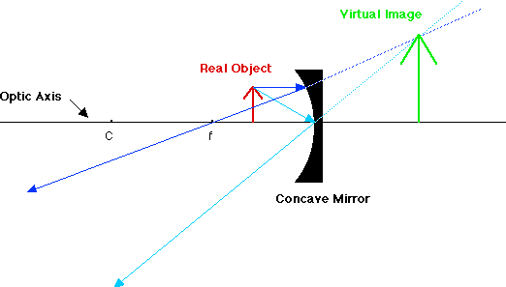
If the object is farther from the mirror than the focal point is, then reflected light rays cross past one another, and the image is inverted.
This image is called a real image.
If the object is between the focal point and the mirror, then the image is not inverted and is larger than the actual object.
This image is a virtual image.

Slide 25
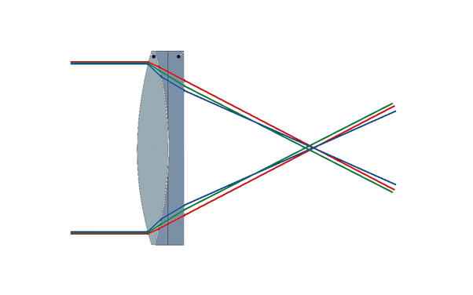
Lenses:
Light not only reflects, as it does with a mirror, but it also bends, or refracts.
A lens is a curved piece of transparent material that refracts light.
Every time you look through a telescope, a microscope, or a pair of eyeglasses, you are looking through a lens. Just like a mirror.
A lens is either convex or concave, based on its shape.

Slide 26
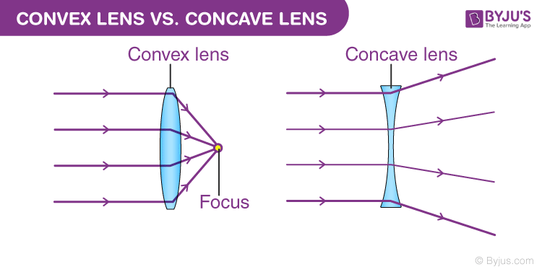
Convex Lenses:
Convex Lenses are thicker in the middle and thinner at the edges.
As light passes through the lens, it refracts toward the center of the lens.
The more curved the lens is, the more the light refracts.
A convex lens can produce either a virtual image or a real image depending on where the object is located relative to the focal point of the lens.

Slide 27
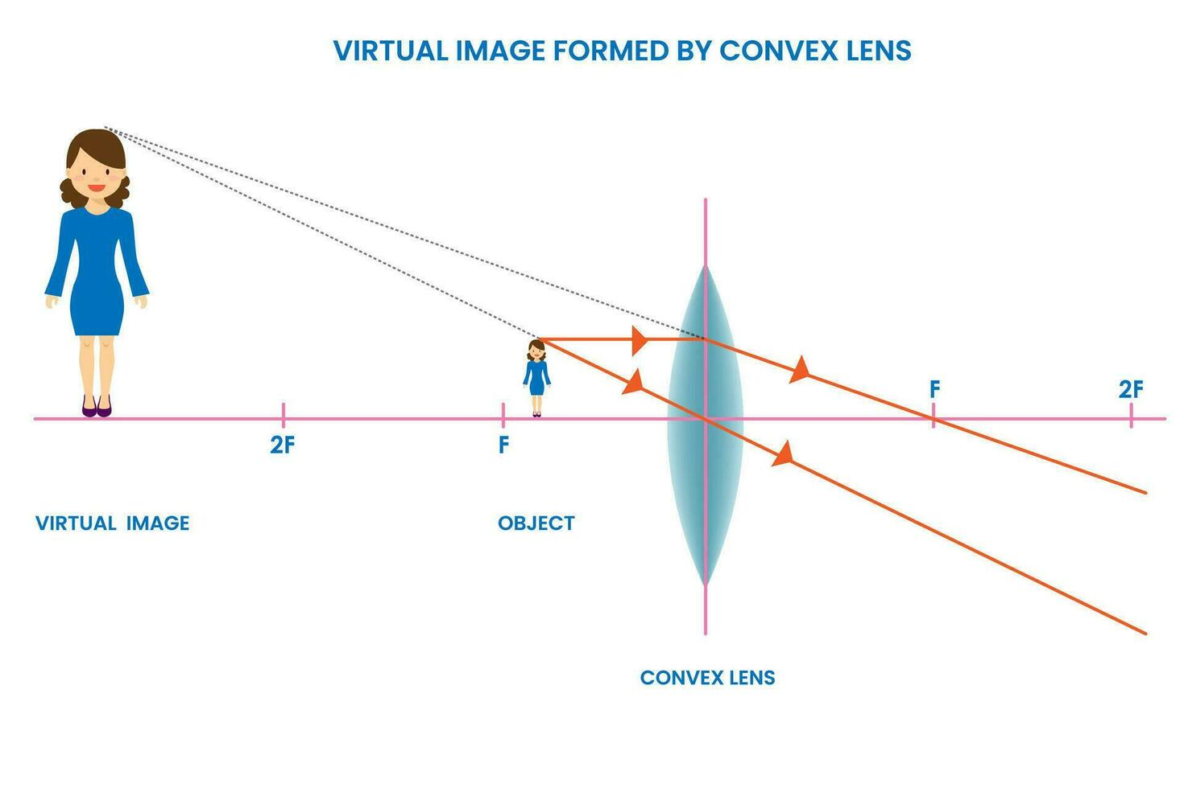
If the object is between the lens and the focal point, then a virtual image forms.
This image is larger than the actual object. You may have observed this when using a magnifying glass.

Slide 28
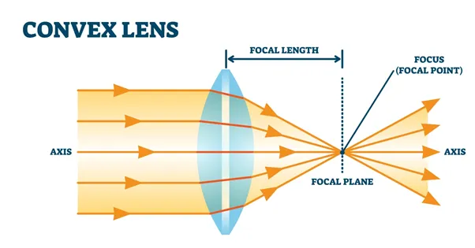
If the object is farther away from the lens than the focal point is, then a real image forms. This image can be larger, smaller, or the same size as the object.
Both a convex lens and a concave mirror focus light, and the type of image formed. depends on the location of the object compared to the location of the focal point.

Slide 29
Concave Lenses:
Concave Lenses are thinner at the center than they are at the edges.
When light rays travel through the lens, the rays are bent away from the optical axis, so the rays never meet.
Because the rays never meet, concave lenses form only virtual images, and these images are upright and smaller than the objects.

Slide 30
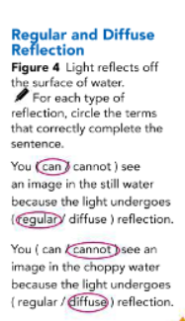
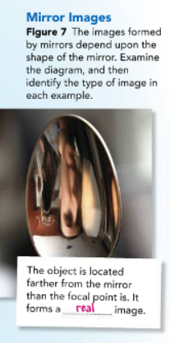
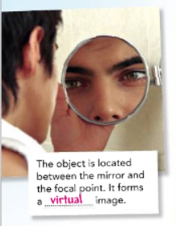

Slide 31
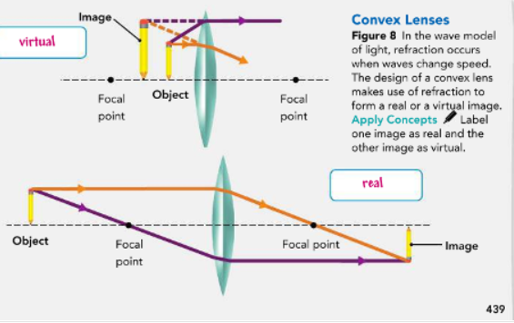
439

Slide 32
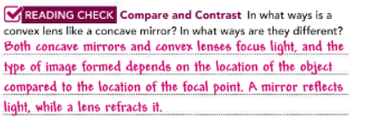
440

Slide 33
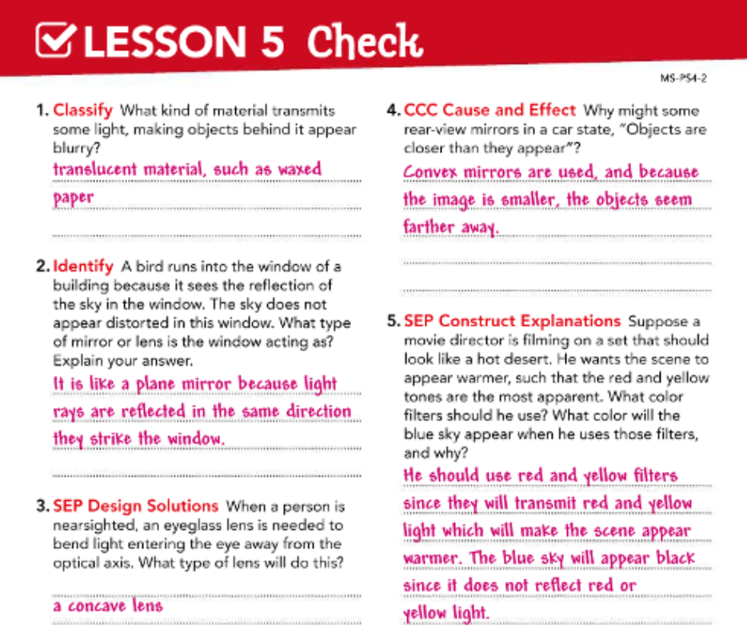

Slide 34
Thank you

