Slide 1
T10 Information Technologies
L1 Electric Circuits
Pg. 504

Slide 2


Brain workout!

Slide 3
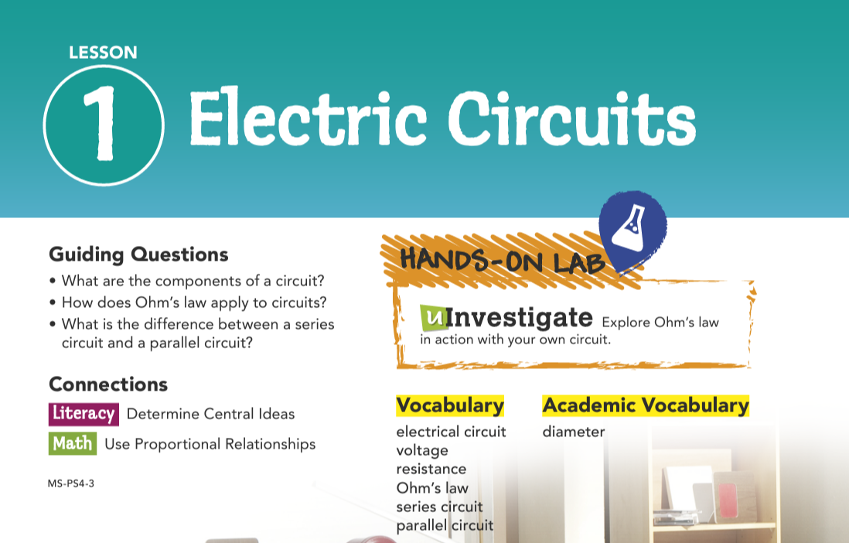

Slide 4

Parts of a Circuit
The wall clock in Figure 1 is part of an electrical circuit. An electrical circuit is a complete, unbroken path that electric charges can flow through.
A circuit consists of a few basic parts: a source of electrical energy, conducting wires, and a device that runs on the electrical energy. In a wall clock batteries are the source of electrical energy. Conducting wires connect the batteries to a motor attached to the clock's arms. The motor runs on electrical energy—converting the batteries' energy to the clock's motions. Circuits sometimes also contain switches. When a switch is closed, charges can flow through the circuit. When a switch is open, the circuit is broken and charges cannot flow. A light switch in your home is used to open and close the circuit that sends electrical energy from a power plant to your light bulb.
Even though energy in circuits is used to power devices, the energy is always conserved. The electrical energy does not get used up—instead, it is transformed from one form to another. For example, in a table lamp, the electrical energy is transformed into light and heat.

Slide 5
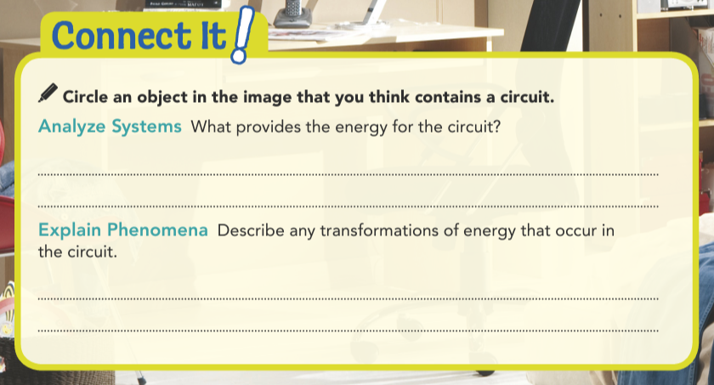
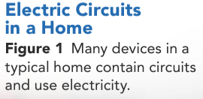
Electricity provides the energy for the lamp next to the bed.
Electrical energy transforms into light.

Slide 6
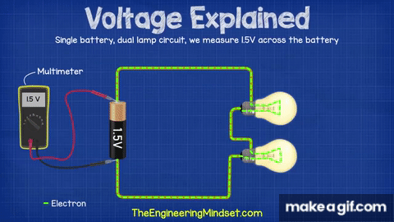
Voltage
Electric current flows through a circuit because of differences in electric potential energy in the electric charges.
In circuits, it is helpful to think about the electric potential energy per charge, or electric potential, at different points in a circuit.
Voltage is the difference in electric potential energy per charge between two points in a circuit.
So, voltage is the difference in electric potential. Voltage is measured in volts (V).

Slide 7
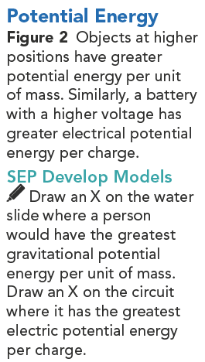

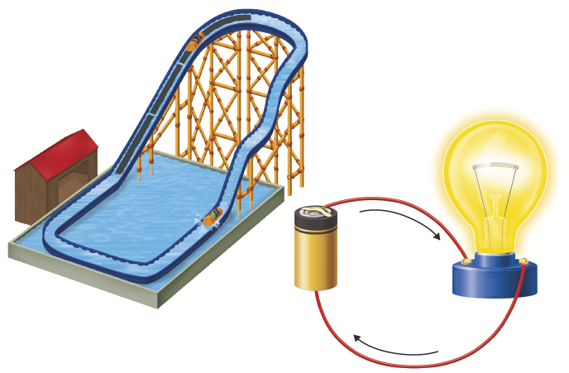
Voltage
A typical battery has two ends. One end has a higher electric potential than the other.
The end with higher electric potential is called the positive end, and the end with lower electric potential is the negative end.
The difference in electric potential is the battery's voltage.
For example, the positive end of a 12-volt battery has an electric potential 12 volts higher than the negative end.
When the battery is connected within a circuit, this voltage causes current to flow.
The current moves from the positive end through the circuit and back to the negative end.
The current flows naturally, much like water on a water slide (Figure 2).

Slide 8
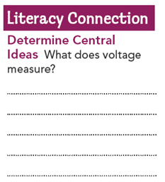
Voltage
As the current flows through the circuit, the electric potential energy is converted to other forms of energy.
As a result, the electric potential drops as the charges move through the circuit.
When the charges reach the battery, they need to regain potential energy if the current is going to continue.
The battery supplies the charges with energy by converting chemical energy (from chemicals within the battery) to electrical energy.
The directions of current and voltage were originally defined for positive charges.
It was later discovered that negatively-charged electrons flow through a wire circuit.
It can be confusing, but remember that what we call electric current goes in the opposite direction of the actual flow of electrons.
It measures the difference in potential energy per charge between two points.

Slide 9
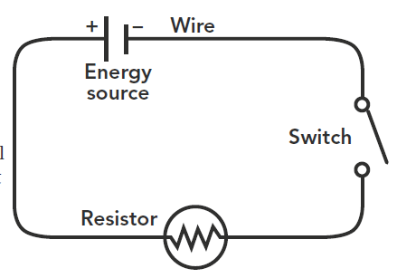
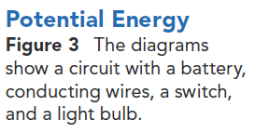
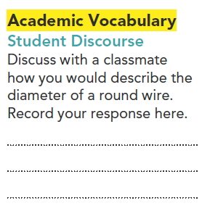
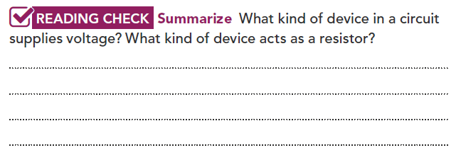
Resistance
Objects that run on electricity act as resistance to the flow of current.
Resistance is a measure of how difficult it is for current to flow through an object.
It takes more energy for charges to move through objects with higher resistance.
Therefore, there is a greater drop in electric potential as the current flows through the circuit.
Objects that provide resistance are called resistors.
A light bulb, for example, acts as a resistor (Figure 3).
An energy source such as a battery supplies voltage. Objects that use energy or obstruct current flow act as resistors.
It is the full width of the wire or distance across the face of it.

Slide 10
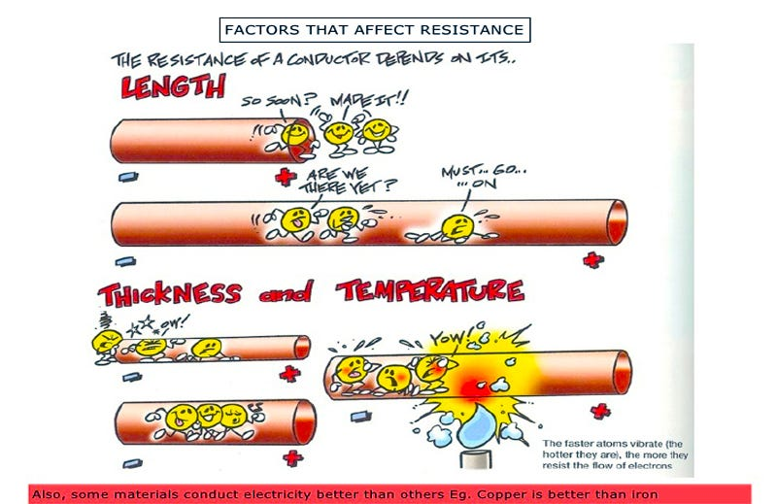
Resistance
The resistance of an object depends on its diameter, length, temperature, and material.
Objects with a smaller diameter and longer length are more difficult to flow through.
In the same way, it is more difficult to sip a drink through a narrow and long straw than a wide and short straw.
Current also flows more easily through an object when it is cold than when it is hot.
Warmer particles vibrate more and obstruct the flow of current.
Current also flows more easily through materials that are good conductors.
The conductors have electrons that are more loosely bound, so the charges can move more easily.
GOOD CONDUCTORS

Slide 11
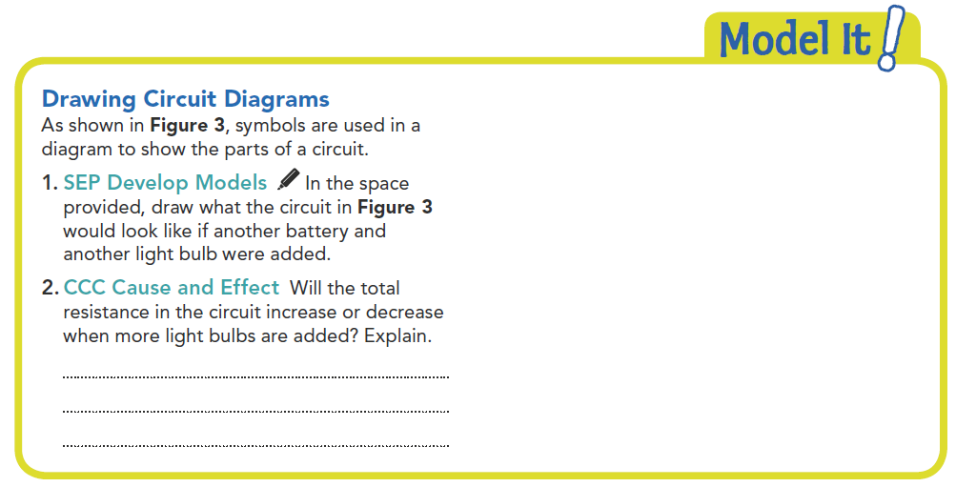
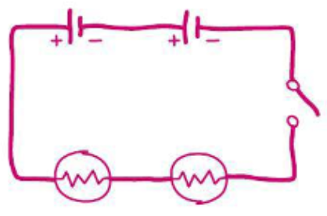
Resistance will increase. Light bulbs are resistors, so more of them will provide more resistance.

Slide 12


Slide 13
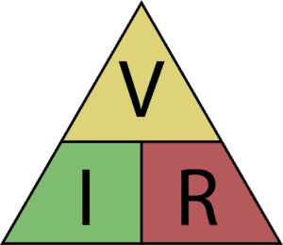
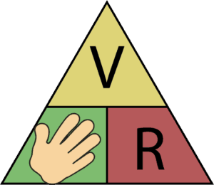

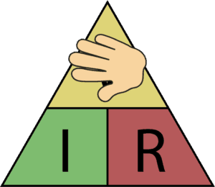

Ohm's Law
About 200 years ago, scientist Georg Ohm experimented with electric circuits.
He measured the resistance of a conductor and varied the voltage to find the relationship between resistance and voltage.
He found that changing the voltage in the circuit changes the current but does not change the resistance of the conductor.
When voltage increases, current increases but resistance does not change.
Ohm came up with a law for this relationship.
Ohm's law states that resistance in a circuit is equal to voltage divided by current.
Resistance is measured in ohms (Ω).
This means that one ohm of resistance is equal to one volt (V) divided by one amp (A).
If you increase voltage without changing resistance, then current must increase as well.
Solving this equation for voltage, you obtain:
If you increase the resistance of a circuit without changing the voltage, then the current must decrease.

Slide 14
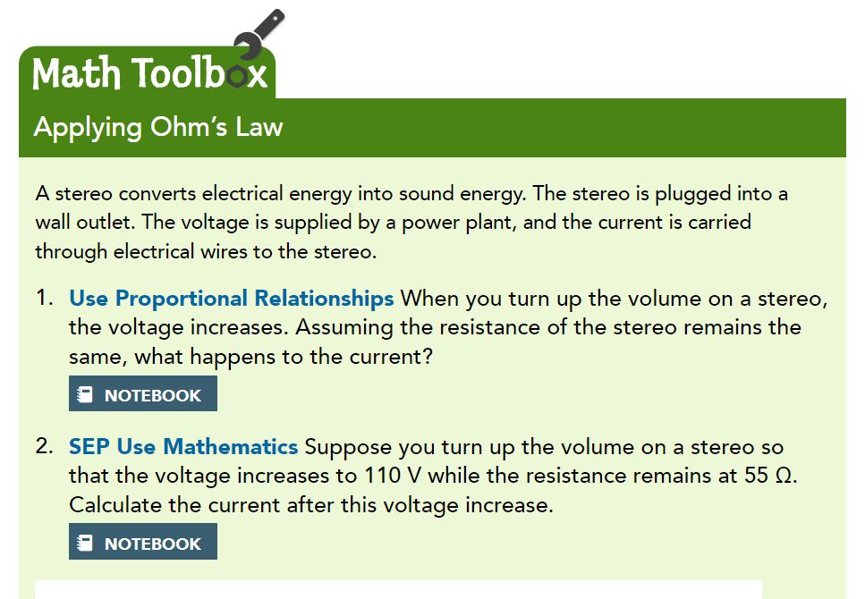


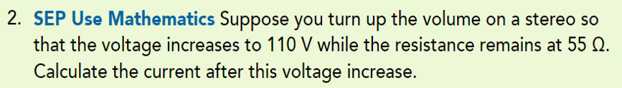
The current increases.
Voltage = current X Resistance; Current = Voltage / Resistance
Current = 110 V / 55 Ω
= 2 A

Slide 15
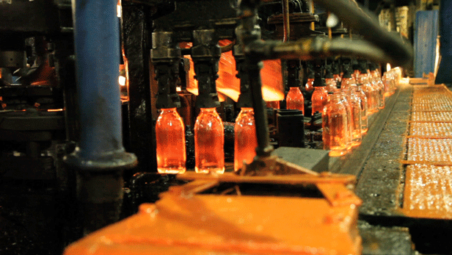
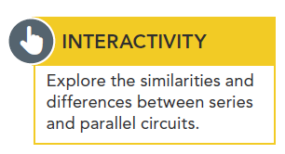
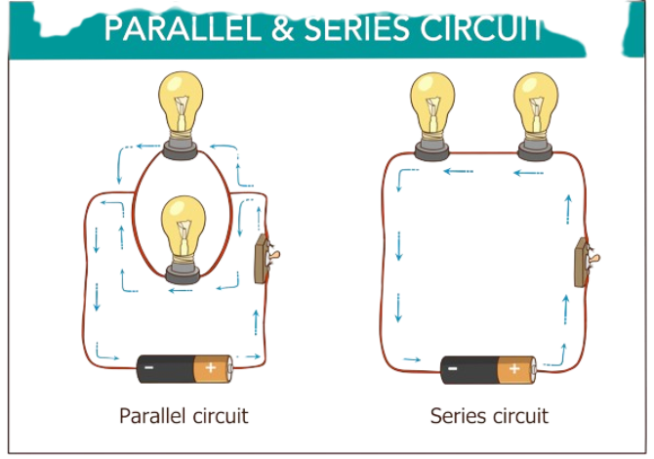
Series and Parallel Circuits
Different situations may call for different types of circuits.
Suppose a factory uses multiple machines in an assembly line to recycle glass bottles.
If the glass-melting machine breaks down but the bottles keep moving, there could be a major safety hazard as the bottles pile up!
To prevent this problem, the machines can be wired so that if one machine breaks, then the circuit is broken and all other machines stop working as well.
This is called a series circuit.
Series Circuits
In a series circuit, all parts of the circuit are connected one after another along one path.
Parallel Circuits
In a parallel circuit, different parts of the circuit are on separate branches.

Slide 16
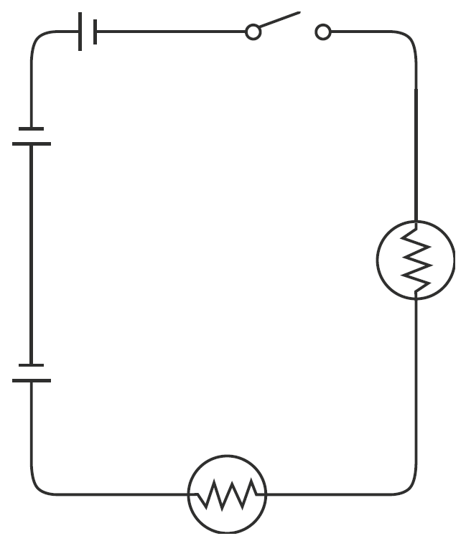
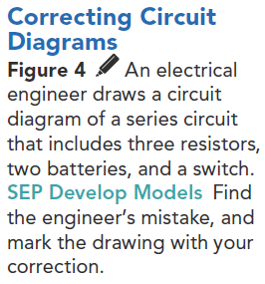

Series Circuits
In a series circuit, all parts of the circuit are connected one after another along one path (Figure 4).
There are advantages to setting up a circuit this way, as in the example of the recycling factory.
However, it can sometimes be a disadvantage.
The more devices you add to the circuit, the more resistance there is.
As you learned with Ohm's law, if voltage remains the same and resistance increases, then current decreases.
Adding more light bulbs to a string of lights causes them to shine less brightly.
The circuit would have more resistance and the current would decrease, causing the bulbs to appear dimmer.

Slide 17
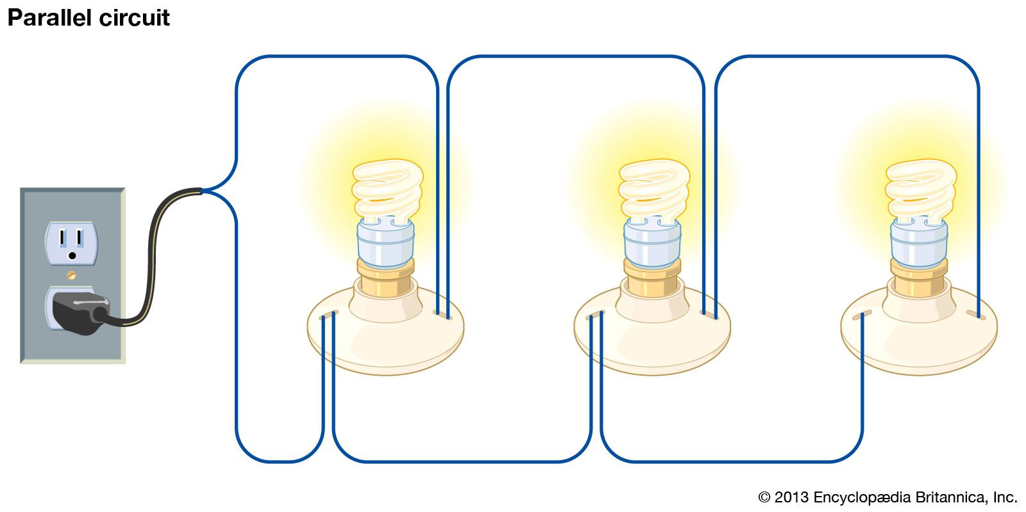

Parallel Circuits
In other situations, you may want each device in a circuit to be wired so that if one device breaks, the others still work.
For instance, when one overhead light burns out in the kitchen, you don't expect the other lights to go out, leaving you in the dark.
In situations like this, you should use a parallel circuit, in which different parts of the circuit are on separate branches.
As shown in Figure 5, there are several paths for the current to take in a parallel circuit.
A series circuit has all of its devices along one path. A parallel circuit has different branches for different devices.

Slide 18
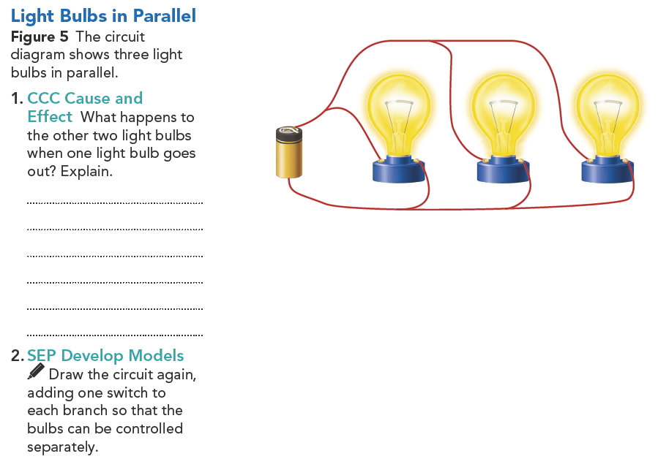
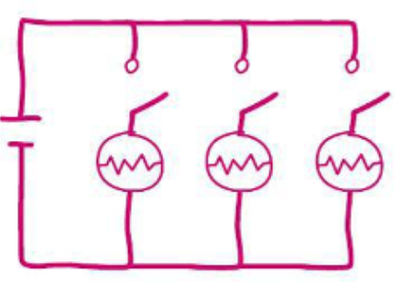
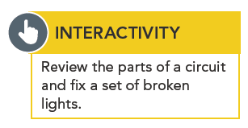
Parallel Circuits
Surprisingly, adding resistors in parallel to the circuit actually causes resistance to decrease.
How is this possible?
Adding a branch opens up another path for current to flow.
This is similar to adding another pipe for water to flow through.
Therefore, resistance in the circuit decreases and current increases.
However, the additional current flows down the new path, so it does not affect the other devices.
If a string of lights is set up along a parallel circuit, then each new bulb you add will glow as brightly as those originally on the strand.
They keep glowing because they are still connected to the battery. They do not glow any brighter or dimmer.

Slide 19
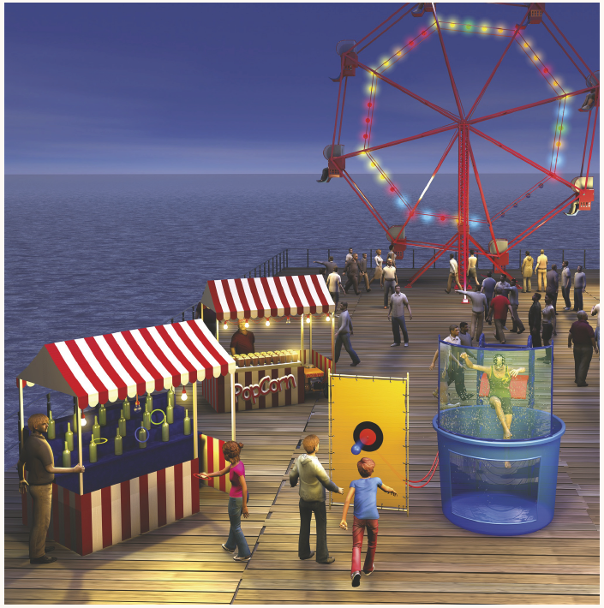
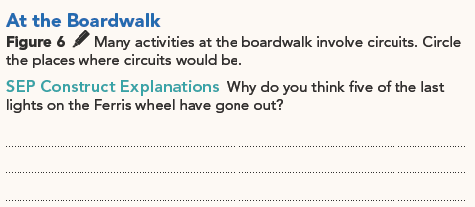
The Ferris wheel is probably lit using parallel circuits, with each section of lights on a separate circuit. One section is not working, but it does not affect the other sections.

Slide 20
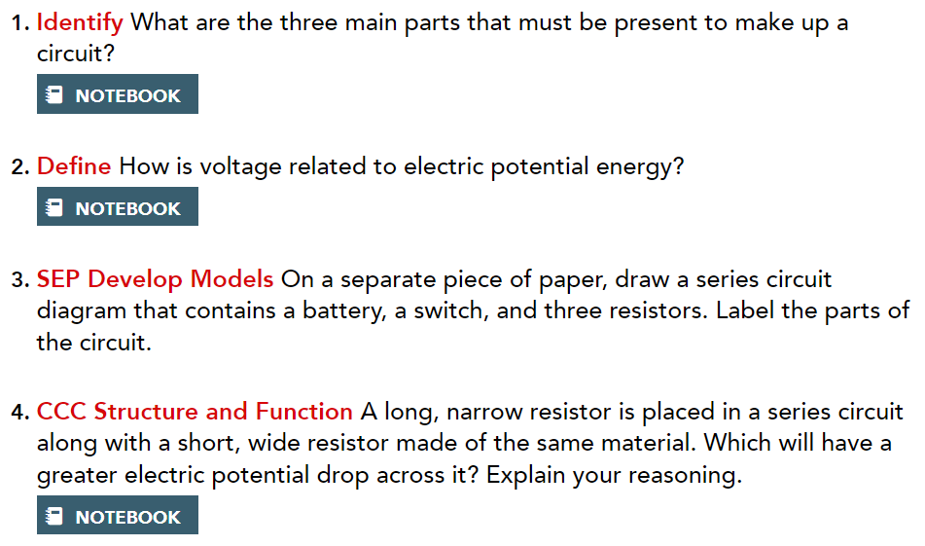
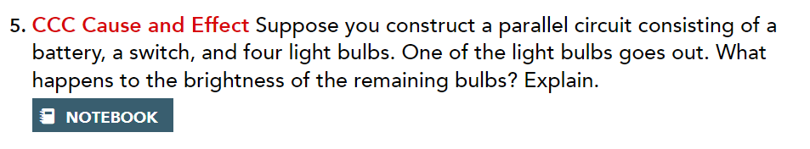
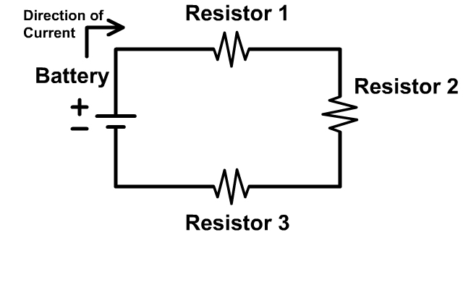
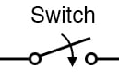
A source of electrical energy, connecting wires, and a device that runs on the energy.
The long, narrow resistor will have the greater voltage drop. It is long and narrow, so it has a higher resistance because resistance increases as diameter decreases and length increases. Higher resistance means greater voltage drop in a series circuit.
Voltage is the difference in electric potential energy per charge between two points in a circuit.
The other light bulbs will continue burning as bright as they were before. The branch of the circuit with the burnt-out light bulb no longer provides a path for the current. Current can still flow along the other branches, so the other branches are unaffected.

Slide 21
Thanks!

