Slide 1

Chapter 1 Lesson 3
Bonding and the periodic table

Slide 2
Objectives:
Explain the role of valence electrons in the bonding of
atoms.
Describe how the properties of atoms are affected when atoms bond together.
Compare the properties of metals and nonmetals.
Describe and compare the properties of atoms.
Explain the role of valence electrons in the structure and function of atoms.

Slide 3
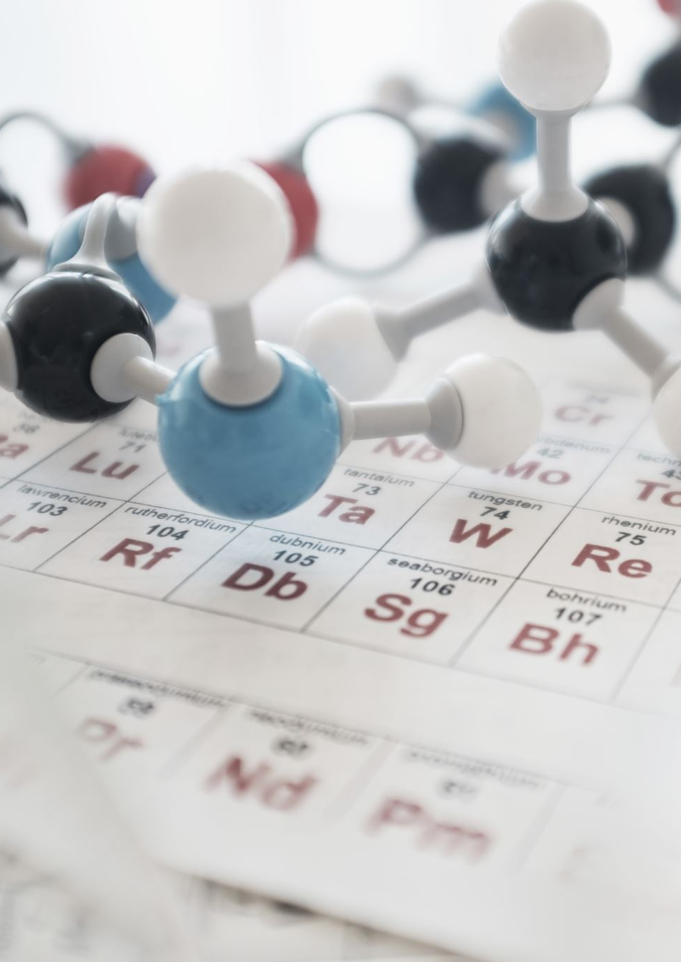
Elements and the Periodic Table
Scientists might find it helpful to have elements organized in the periodic table, but is this helpful in everyday life?

Slide 4

In Figure 1, you see the explosion of the airship known as the Hindenburg. On May 6, 1937, this hydrogen filled airship left Frankfurt, Germany, on a flight to Lakehurst, New Jersey. As the Hindenburg attempted to land, a spark came into contact with the hydrogen used to fill the airship, causing an instantaneous explosion that killed 36 people.
Hydrogen is located in Group 1 of the periodic table.
All the elements in this group are very radioactive, so hydrogen readily reacts with other elements.
If hydrogen is so reactive, why was it used in the airship in the first place?
  The periodic table tells you that hydrogen is the lightest element, and so the airship easily rose into the air when filled with this gas.
Is there another gas that would have been better?
  The next lightest element is helium, a noble gas.
Noble gases are in Group 18, and they are not reactive.
Airships today are filled with helium, with much safer results.

Slide 5
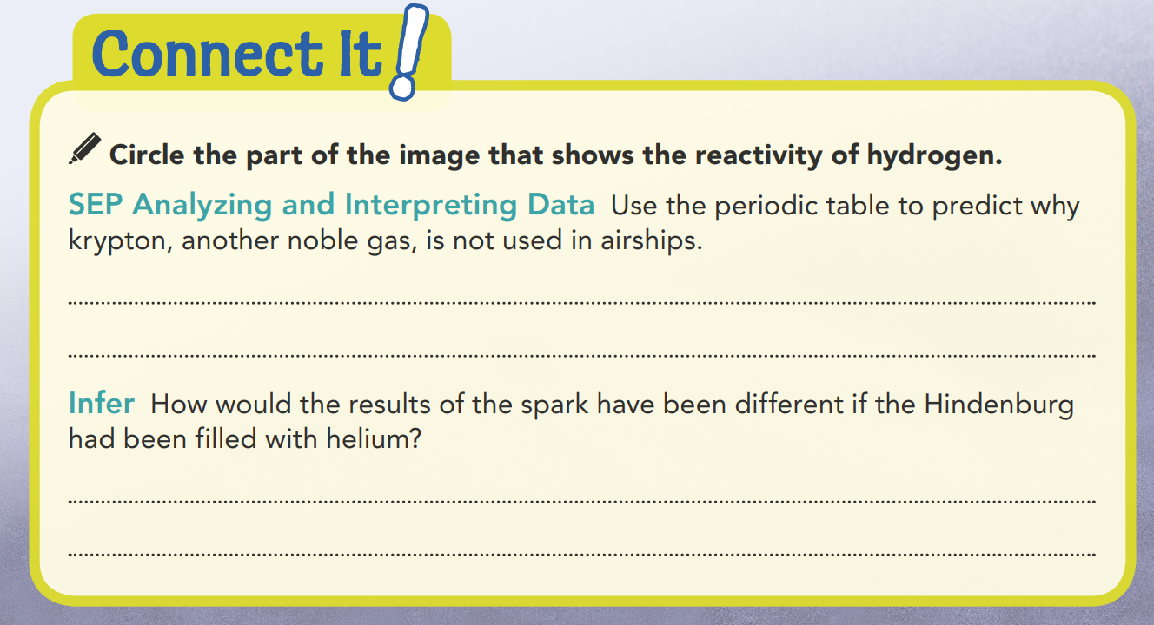

It has a high atomic mass, so the airship would not rise.
Helium does not burn, so there would have been no explosion.

Slide 6
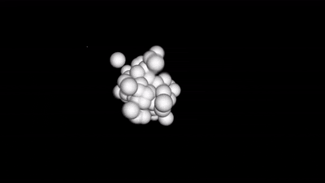
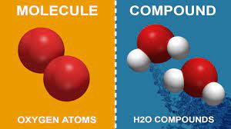

Bonding
Most things you see in the world around you are not made up of individual elements.
They are made from compounds, or substances that form when atoms from two or more elements bond together.

Slide 7

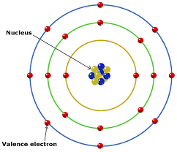
To understand how bonding works, you must first learn about valence electrons and the role they play in the bonding process.

Slide 8
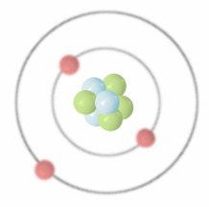
The electrons of an atom are found in different energy level
  The first energy level is the closest to the nucleus. It can hold a maximum of two electrons.
  The second energy level can hold up to 8 electrons. Larger atoms have even more energy levels that can hold different numbers of electrons.
  Electrons in higher energy levels have higher amounts of energy.

Slide 9

Valence Electrons
  The valence electrons of an atom are those electrons that have the highest energy. They are in the outermost energy level.
    Each atom has a certain number of valence electrons.
    The number of valence electrons is specific to each element.

Slide 10
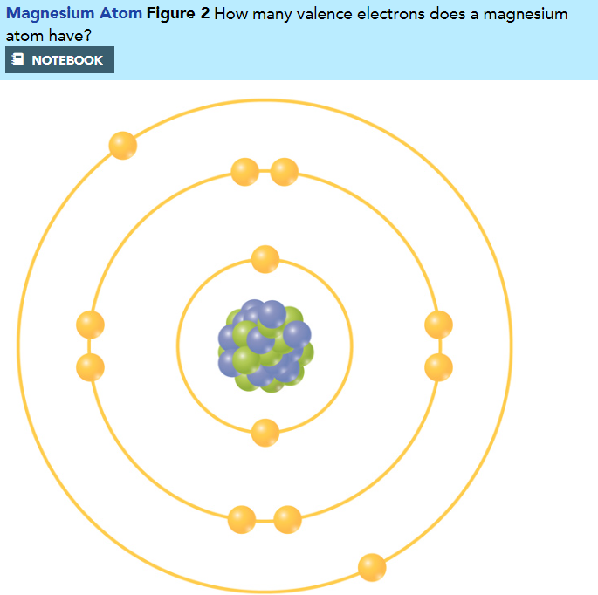
Valence Electrons
2
An atom may have from one to eight valence electrons, depending on the element.
One way to show the number of valence electrons in an element is to draw the electrons in an atom.
This Bohr-model diagram shows the arrangement of the electrons in the magnesium atom.
The electrons in the outermost energy level are the valence electrons

Slide 11
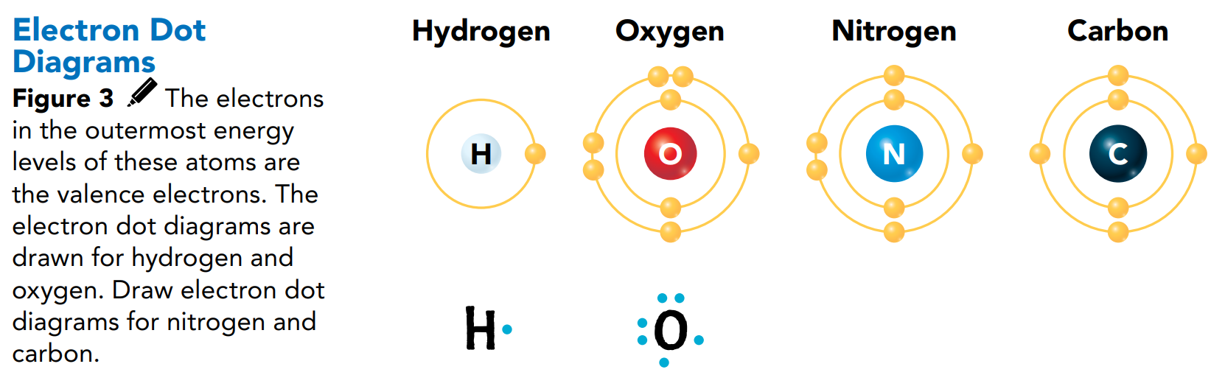
Electron Dot Diagrams
Another way to show the number of valence electrons in an element is by drawing an electron dot diagram.
An electron dot diagram includes the symbol for the element surrounded by dots, as shown in Figure 3.
The top, bottom, left, and right parts of the diagram can each hold up to two dots.
Each dot stands for one valence electron.
N
C

Slide 12
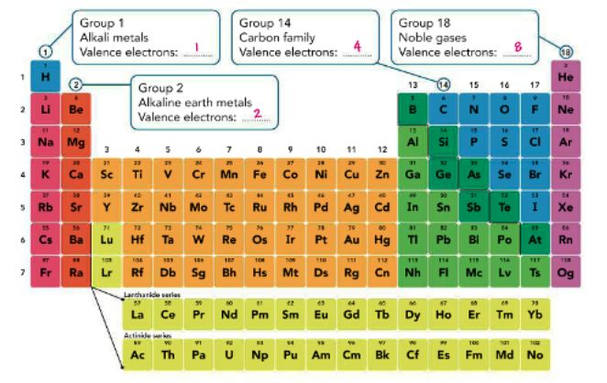
How do valence electrons relate to the periodic table?

Slide 13
Valence Electrons and the Table:
The periodic table is shown in Figure 4.
An interpretation of the table gives you information about the valence electrons in atoms.

Slide 14
Valence Electrons and the Table:
The elements are organized by increasing atomic number. Therefore, the number of valence electrons Increases from left to right across each period.
Each period begins with an element that has one valence electron and ends with an element that has eight electrons (except for Period 1, since helium has only two valence electrons).
For Periods 2 and 3, Group 1 elements have one, Group 2 elements have two, Group 13 elements have three, Group 14 elements have four, and so on to Group 18, which has eight valence electrons.

Slide 15
Valence Electrons and the Table:
Now, if you ignore helium and Groups 3 through 12, you may notice a pattern among the other groups.
The elements within a group have the same number of valence electrons.
The elements in each group have similar properties
Groups 3 through 12 follow a different pattern and are more difficult to predict

Slide 16
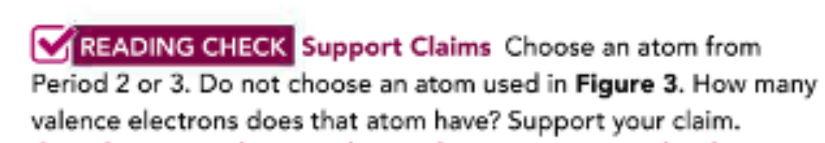
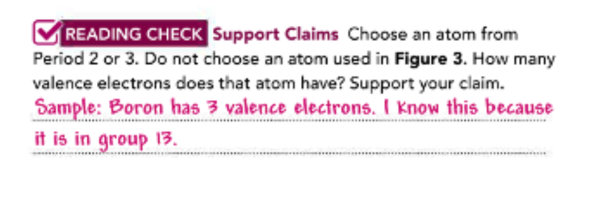

Slide 17
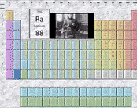
Take out your connect lab activity worksheet

Slide 18
Bonding and Periodic Properties
Elements are classified as metals, nonmetals, or metalloids, depending on their physical and chemical properties.
What makes an element a metal, a nonmetal, or a metalloid?
Metals The periodic table shows that most elements are metals. Their properties, both chemical and physical determined by their valence electrons.
The ease and speed with which an element combines, or reacts, with other substances is called its reactivity, and reactivity is based on the interactions of valence electrons.

Slide 19
Chemical Properties of Metals
-one to three valence electrons. Metals do not react with other metals, but they do react with other elements tend to lose their valence atoms, making them highly reactive
-metals with 1 valence electron are especially reactive.
-The loosely-held valence electrons in metal atoms determine how metals bond.
-Most metals are crystalline solids
A metal crystal is composed of closely-packed, positively-charged metal atoms. The valence electrons drift among the atom.
Each metal atom is held in the crystal by a metallic bond- an attraction between a positive metal atom and the electrons surrounding it.

Slide 20
Metals:
The periodic table shows that most elements are metals.
Their properties, both chemical and physical, are determined by their valence electrons.
The ease and speed with which an element combines, or reacts, with other substances is called its reactivity, and reactivity is based on the interactions of valence electron

Slide 21
Chemical Properties of Metals
Metals generally have one to three valence electrons.
Metals do not react with other metals, but they do react with other elements.
Many of these elements tend to lose their valence electrons easily to other atoms, making them highly reactive.
Metals with only one valence electron are especially reactive.
The loosely-held valence electrons in metal atoms determine how metals bond.
Most metals are crystalline solids, 1 metal crystal is composed of closely-packed, positively-charged metal atoms.
The valence electrons drift among the atoms.
Each metal atom is held in the crystal by a metallic bond –an attraction between a positive metal atom and the electrons surrounding it.

Slide 22
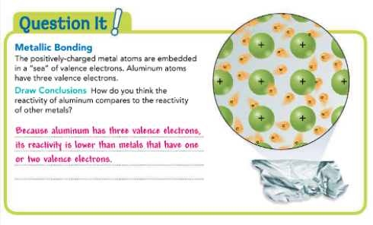
The activity shows the metallic bonds that hold aluminum foil together.

Slide 23
Physical Properties of Metals
The physical properties of metals include malleability, ductility, and conductivity.
A malleable material is one that can be hammered or rolled into flat sheets or other shapes.
A ductile material is one that can be pulled out, or drawn, into long wires.
The easy movement of valence electrons in metals is what makes metals malleable and ductile.
The movement of valence electrons also makes most metals good thermal and electrical conductors.
Thermal conductivity is the ability of an object to transfer heat.
Other physical properties of metals include luster, magnetism, low specific heat, high density, and solid state at room temperature.
A material that has a high luster is shiny and reflective.
Specific heat is the amount of energy required to raise the temperature of 1 gram of a material by 1 degree Celsius.
Metals with low specific heats require only a small amount of heat energy to raise their temperatures.
A few metals also share the property of magnetism. Iron, cobalt, and nickel are all magnetic metals.
Most metals are solids at room temperature. Mercury is a metal that is liquid at room temperature.

Slide 24


Slide 25
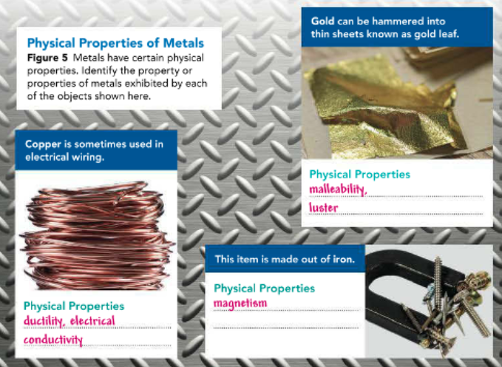
Electrical conductivity is the ability of an object to carry electric current. (You can see many of these physical properties of metals in Figure 5.)

Slide 27
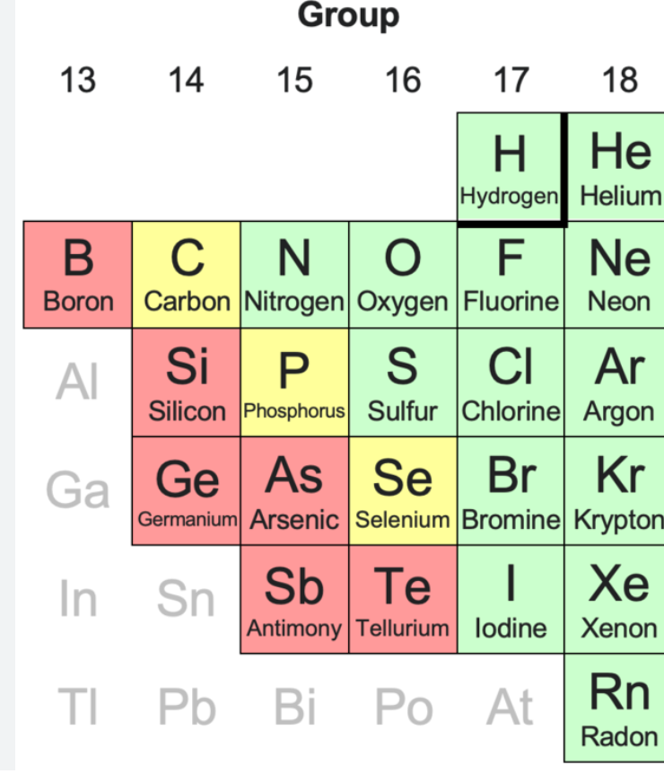
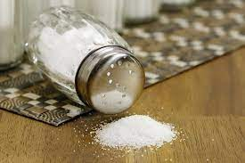
Nonmetals
Non-Metals are elements on the right of the periodic table
They can be gases, liquids or solids
Non-metals don’t conduct electricity as well: they are insulators except graphite
Nonmetals have a much wider variety of properties than metals. Nonmetals have several properties in common.

Slide 28
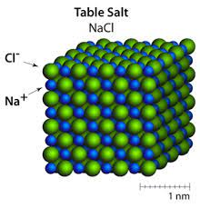
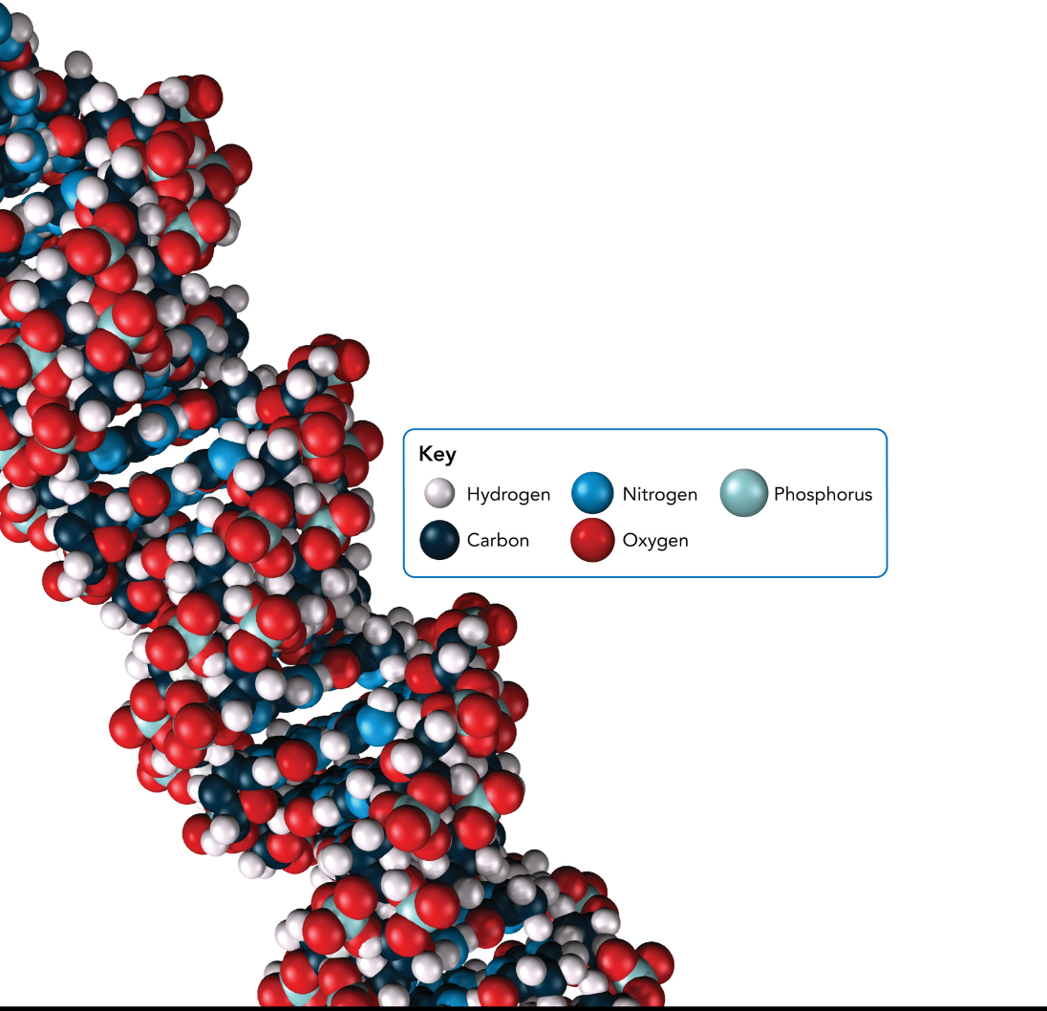
Chemical Properties: You know that atoms of metals do not react with atoms of other metals.-
Atoms of nonmetals, however, react with both metals and other nonmetals. For example, the metal sodium and the nonmetal chlorine react to form table salt (NaCI).
The nonmetals nitrogen and oxygen react to form several different compounds.
Some nonmetals form DNA, as shown in Figure 6.
While many compounds that contain nonmetals are essential to life, some nonmetals, such as the halogens, are poisonous and highly reactive.
Still others, such as the noble gases, are nonreactive. These levels of reactivity, as with metals, are based on the number of valence electrons In the atoms of the elements.

Slide 29
Physical Properties:
-A nonmetal is an element that lacks most of the properties of a metal.
-In general, nonmetals are poor conductors of electric current and heat.
-Solid nonmetals tend to be dull and brittle. If you were to hit most solid nonmetals with a hammer, they would break or crumble into a powder.
-Also, nonmetals usually have lower densities than metals.
-Many nonmetals are gases at room temperature. The air you breathe contains mostly nitrogen and oxygen.
-Some nonmetal elements, such as carbon, sulfur, and iodine, are solids at room temperature. Bromine is the only nonmetal that is a liquid at room temperature.

Slide 30
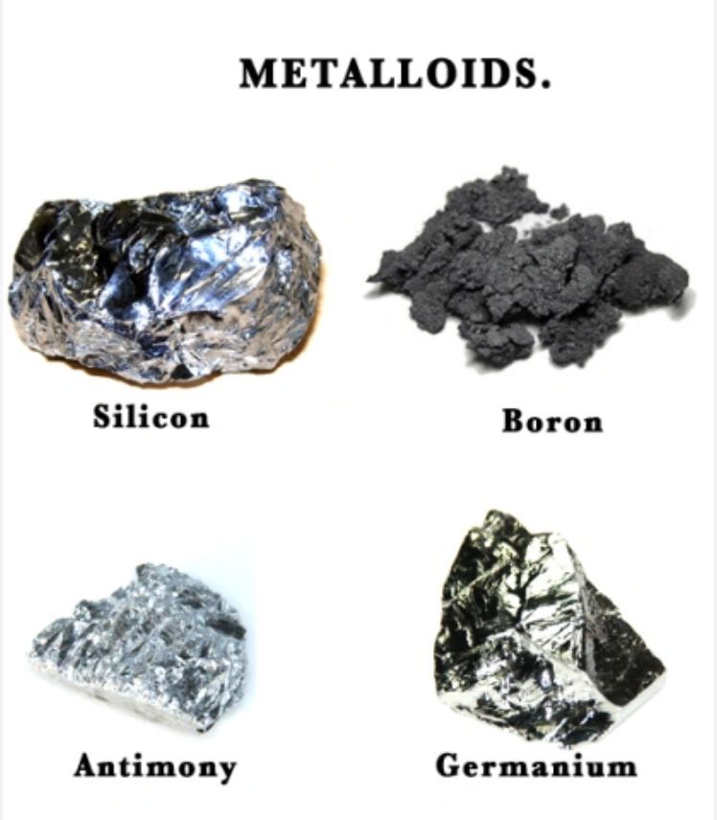
Metalloids
Metalloids are elements located along a stair-step line between the metals and nonmetals
The metalloids have some properties of metals and some properties of nonmetals.
All metalloids are solids o at room temperature.
Metalloids are also brittle, hard, and somewhat reactive The most common metalloid is silicon (5D). Ordinary sand, which is a compound of silicon and oxygen, is the main com- ponent of glass. A compound of boron (B) and oxygen is added during the process of glassmaking to make heat-resistant glass.

Slide 31
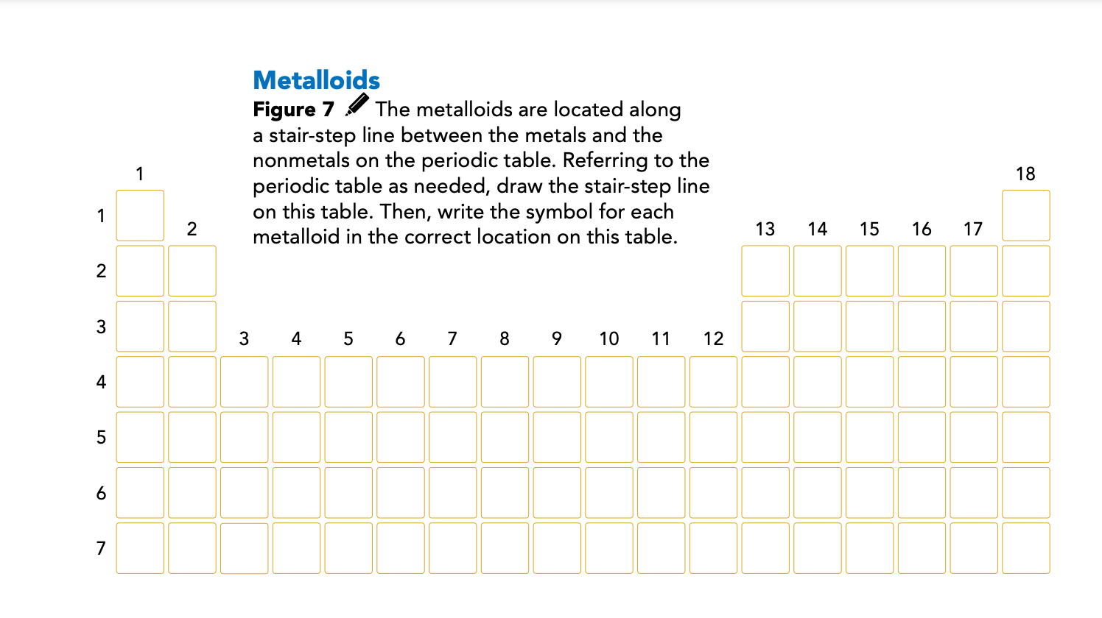

Slide 32


A metalloid's most useful property is its ability to conduct electric current. The conductivity of a metalloid varies depending on temperature, exposure to light, or the presence of Impurities. For this reason, metalloids such as silicon and germanium (Ge) are used to make semiconductors.
A semiconductor is a substance that can conduct electric current under some conditions but not under other conditions Semiconductors are used to make computer chips transistors, and lasers. Semiconductors are also used in solar cells, such as the ones shown in Figure 8 - page 35

Slide 33
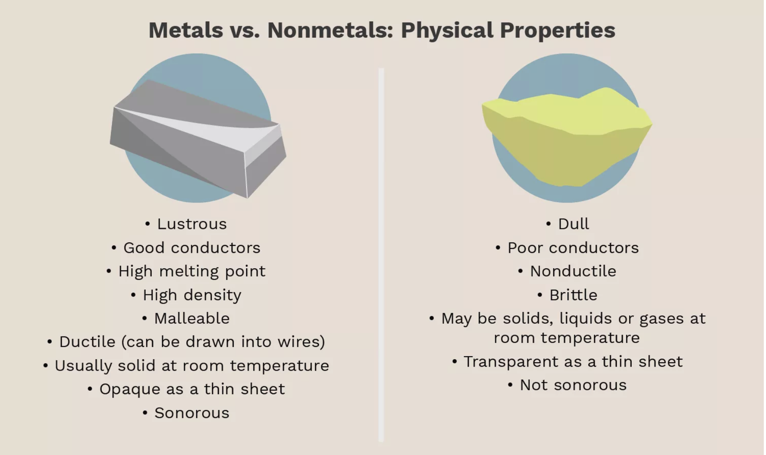

Slide 34
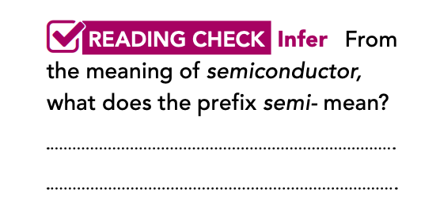
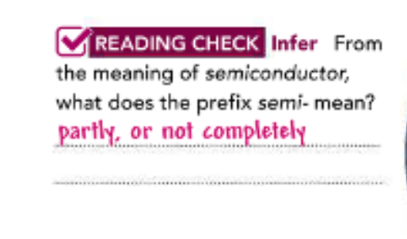

Slide 35

H.W
Question page 36

Slide 36


