Slide 1
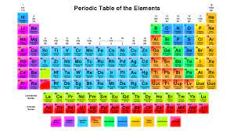
Topic 1 Lesson 2
The Periodic Table
Textbook pgs.15-26

Slide 2

Objectives:
1-Define meaning of atomic mass and atomic number.
2-spot difference between Mendeleev’s and modern periodic tables
3-distinguish groups and periods of Periodic table
Vocabulary:
Atomic mass
Periodic Table
Chemical symbol
period
group

Slide 3
Pgs. 19,20
Pgs. 16,17,18
02
01
Pgs. 23,24
Pgs. 21,22
04
03
TABLE OF CONTENTS
Organizing the Elements
Mendeleev's Work
Using the Periodic Table
The Periodic Table
Pgs. 25,26,27
05
Groups Containing Metalloids and Nonmetals
Halogens, Noble Gases, and Hydrogen
Lesson 2 Check
Periods in the Periodic Table
Lanthanides and Actinides
Transuranium Elements
Groups in the Periodic Table

Slide 4
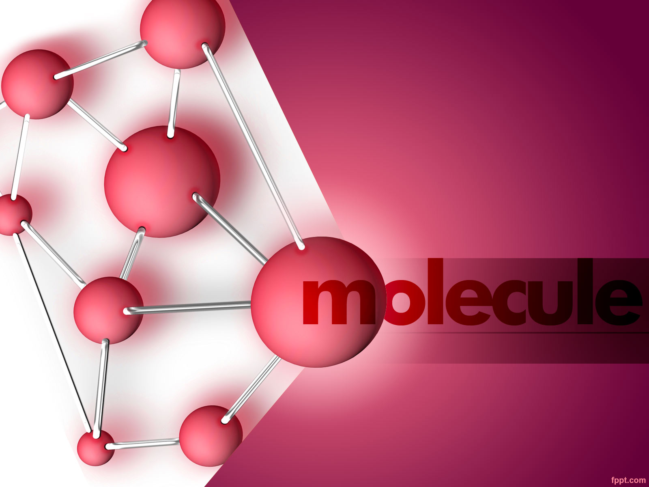
Organizing the Elements
Mendeleev's Work
Pgs. 16,17,18

Slide 5
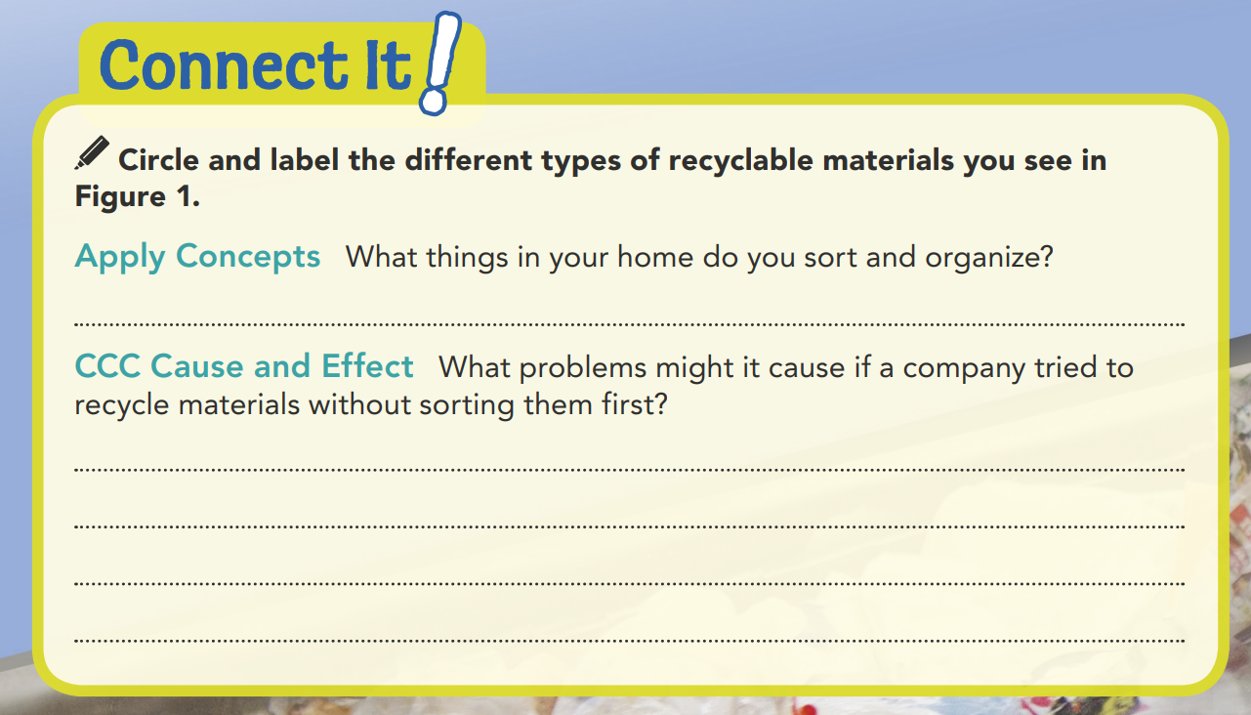
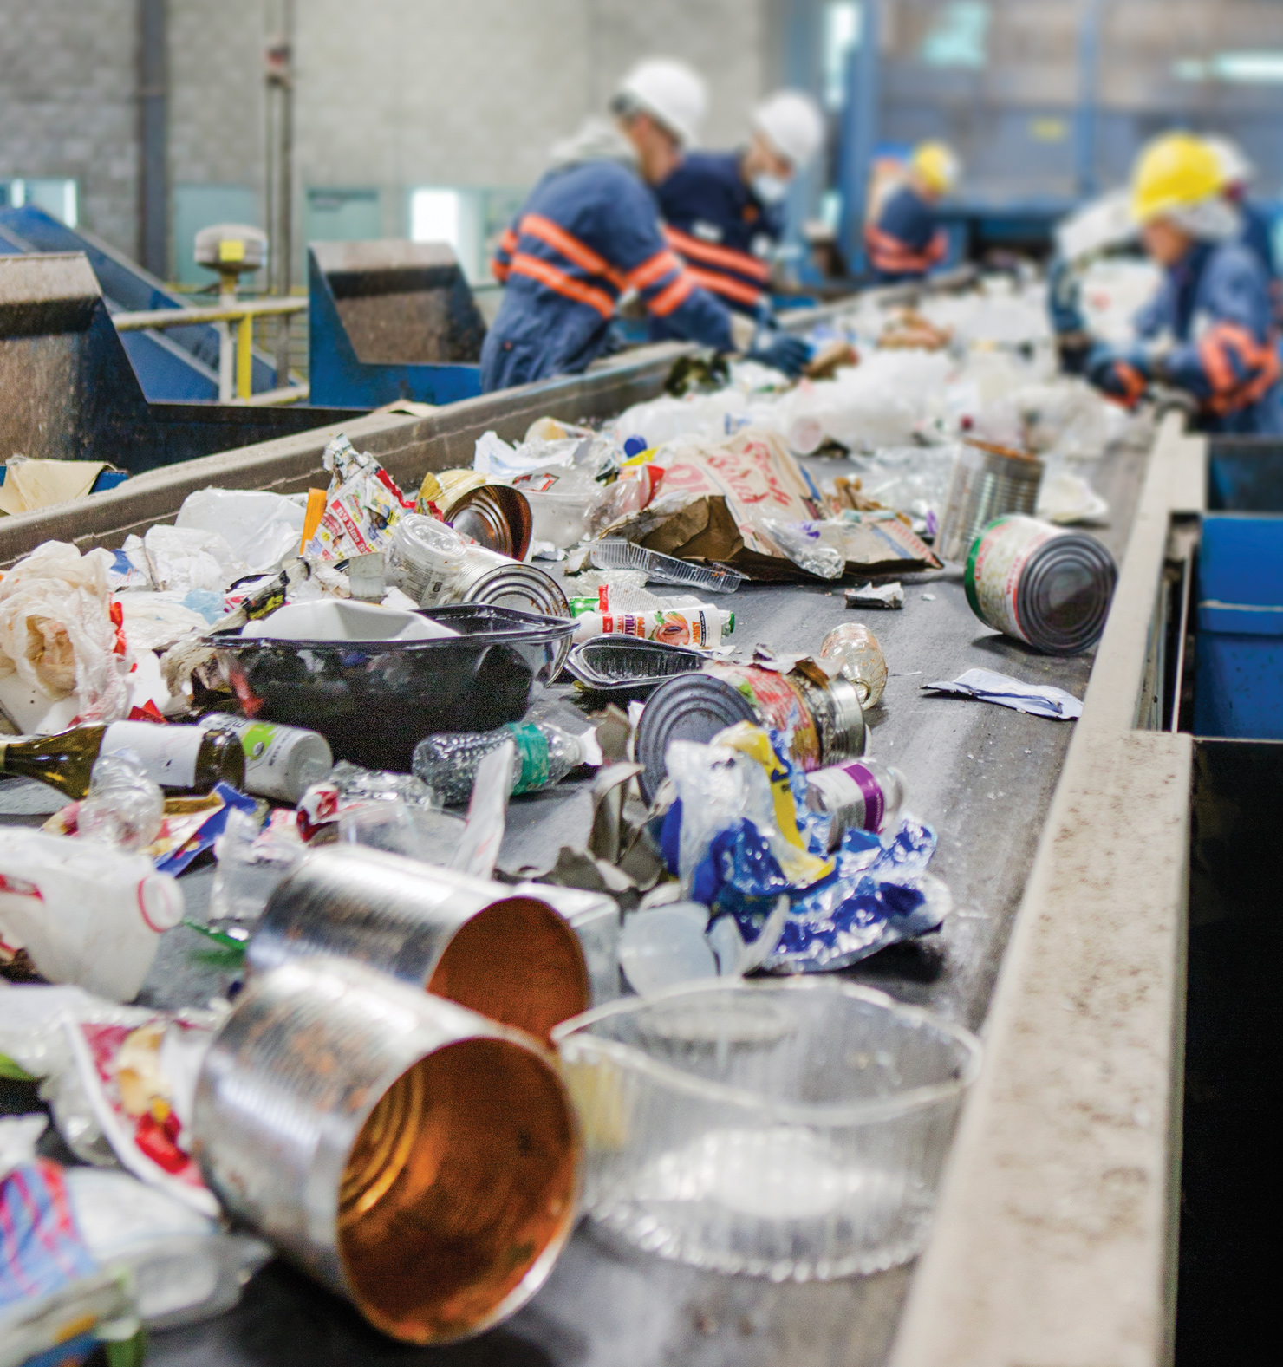
metal
plastic
paper
Clothes, cans of food in cupboard, books
plastic
Different materials are recycled in different ways, so what works for one material, such as paper, would not work for another material, such as glass.
Notes:
Connect It! Describe the methods used in the organization.
Ask:
• Which methods make the most sense to you?
(sort clothes by type, sort DVDs by name, sort kitchen utensils by use)
• What are some other techniques that you could use to sort these items?
(sort clothes by color, sort DVDs by genre, sort utensils by material they are made from)

Slide 6

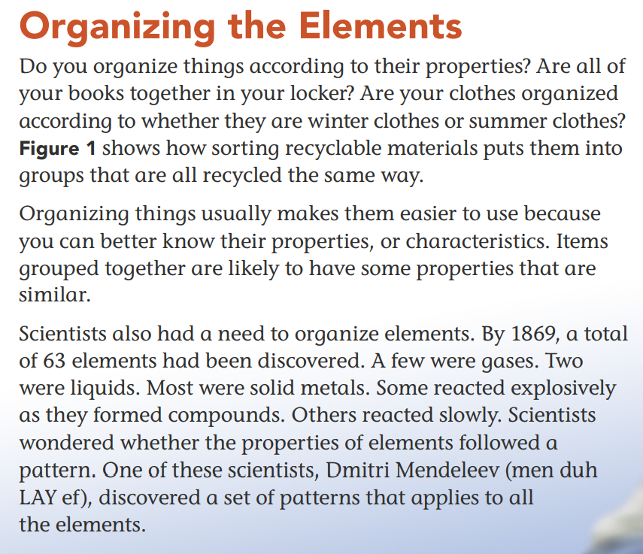
1869 – 63 elements
Few gases
2 liquid
Most solid metals
Reacted explosively when forming compounds
Reacts slowly
Dmitri Mendeleev
Notes:
Activate Prior Knowledge Help students appreciate the contribution of Mendeleev by explaining that establishing a pattern allowed Mendeleev to make predictions about the existence of elements that were not known at the time. Have them brainstorm some examples from daily life of things that follow a pattern. (Sample answers: days of the week, phases of the moon, sunrise and sunset, tides, class schedules)

Slide 7
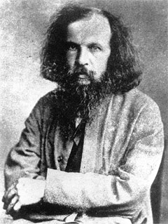
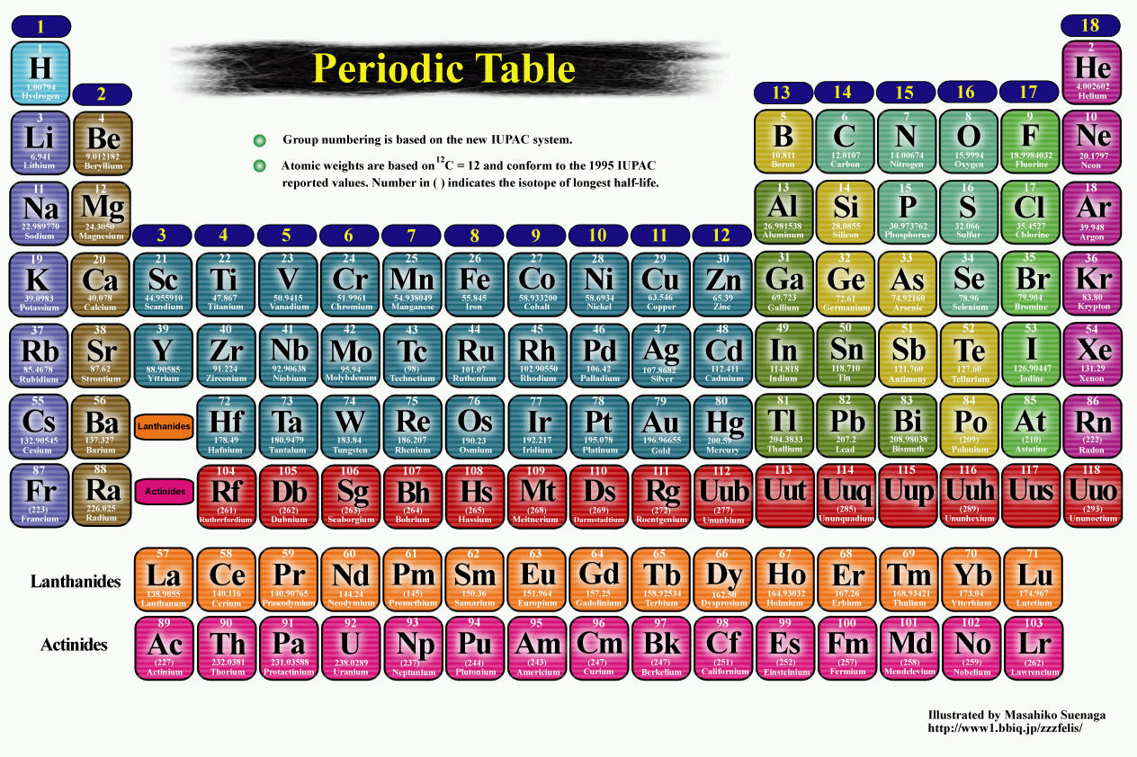
Mendeleev’s work
I made the PERIODIC TABLE !

Slide 8
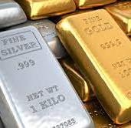
Mendeleev’s work
Mendeleev knew that some elements had similar chemical and physical properties.
For example, silver and copper are both shiny metals.
Mendeleev noted each elements
melting point, density and color, and also the elements atomic mass.

Slide 9
Mendeleev's Work
Mendeleev knew that some elements had similar chemical and physical properties. For example, silver and copper are both shiny metals. Mendeleev thought these similarities were important clues to a hidden pattern. To find that pattern, Mendeleev noted each element's melting point, density, and color. He also included the element’s atomic mass.
As you read in the previous lesson, scientists use atomic mass units (amu) to determine the mass of an element. An element's atomic mass is the average mass of all the isotopes of that element. Mendeleev noticed that a pattern of properties appeared when he arranged the elements in order of increasing atomic mass. He found that the pattern of the properties repeated regularly.
Similar physical and chemical properties
Hidden pattern
Element’s melting point, density, color and atomic mass
Arranged in increasing atomic mass

Slide 10
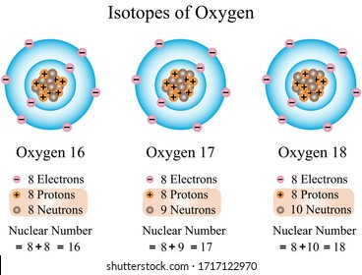
Atomic Mass
is the average mass of all the isotopes of that element.
Scientists use atomic mass unit (amu) to determine the mass of an element.
Atomic mass=
16+17+18 / 3 =
17 amu

Slide 11
What is the PERIODIC TABLE?

Slide 12
What is the PERIODIC TABLE?
It is a chart showing all the elements arranged according to the repeating pattern of their properties.
Periodic means
‘’in a regular,
repeated pattern

Slide 13

What is the PERIODIC TABLE?
how is the modern periodic table different from Mendeleev’s periodic table?
Mendeleev’s periodic table | Modern periodic table
He arranged his table according to each element’s atomic mass | Modern periodic tables are arranged in order of increasing atomic number

Slide 14
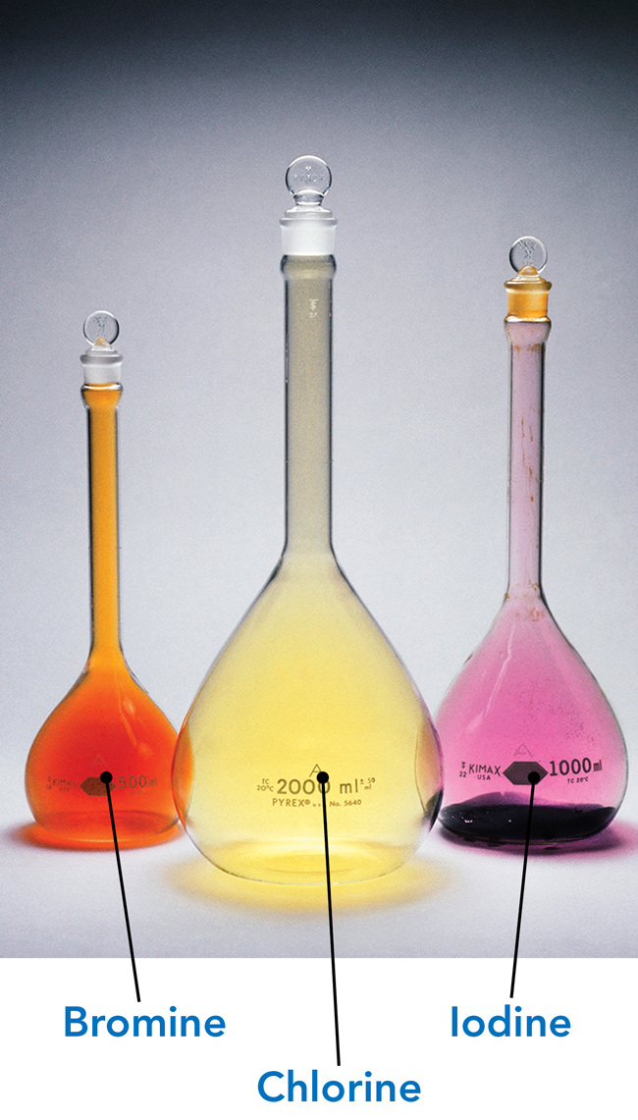
The Periodic Table
The periodic table is a chart showing all of the elements arranged according to the repeating pattern of their properties. (The word periodic means "in a regular, repeated pattern.") Mendeleev created the first periodic table in 1869. He arranged his table according to each element's atomic mass. Figure 2 shows three elements that have similar properties and were, therefore, grouped together.
In his periodic Mendeleev also left blank spaces. He predicted that the blank spaces would be filled by elements that had not yet been discovered. He even correctly predicted the properties of some of those new elements.
Mendeleev's table has indeed changed over time, as scientists discovered new elements and learned more about atomic structure. We now know that the number of protons in an atom's nucleus, indicated by the atomic number, is related to the chemical properties of an element. Therefore, modern periodic tables are arranged in order of increasing atomic number instead of by increasing atomic mass.

Slide 15
The modern table shows additional elements that had not been discovered during Mendeleev’s time. Also, elements are now listed according to increasing atomic number instead of increasing atomic mass.

Slide 16


Slide 17
Using the Periodic Table
The Periodic Table
Pgs. 19,20

Slide 18
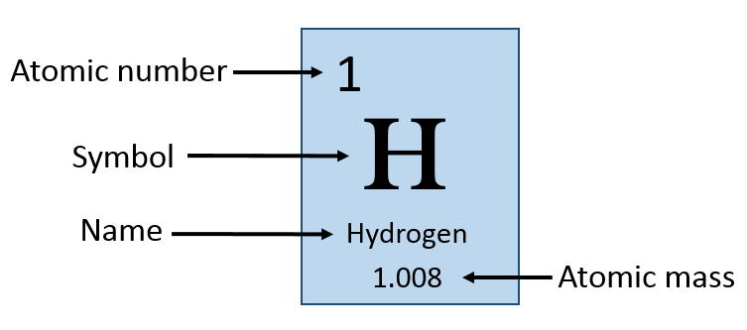
Using the Periodic Table
The periodic table contains:
1- the name of each elements,
2-atomic number (shown at the top of each cell)
3-and it’s atomic mass.(shown at the bottom of each cell)
4-the chemical symbol : two or one letter abbreviation for the element. (shown in the center of each cell)

Slide 19
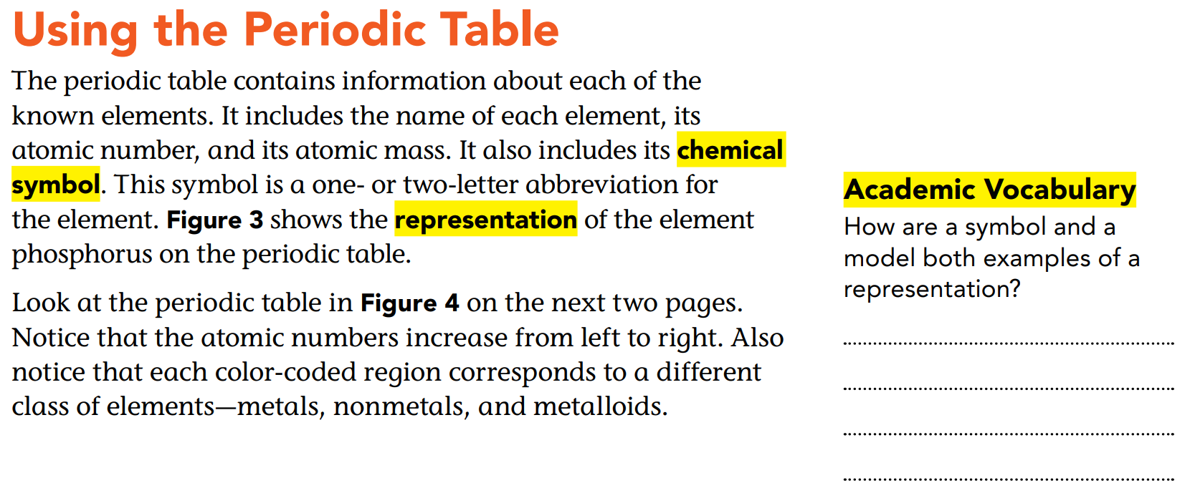
Both describe or help to visualize someone or something.

Slide 20
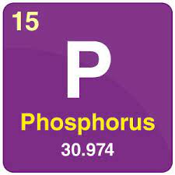
Representation : a drawing or image of an actual thing. Here is a representation of the element Phosphorus on the periodic table
1- the name is phosphorus
2-atomic number = 15
3-atomic mass = 30.974
4-the chemical symbol is P

Slide 21
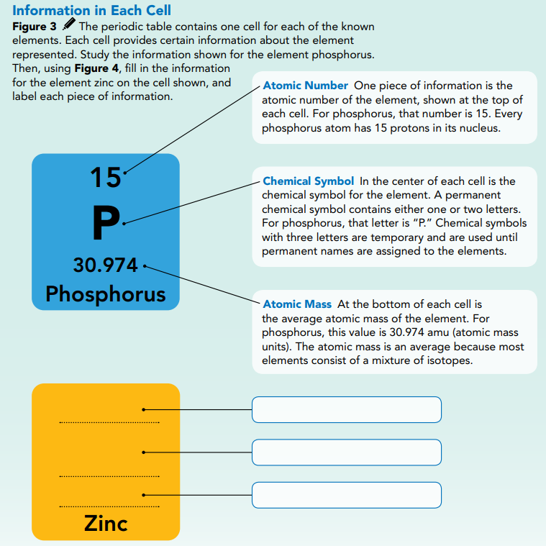
30
Atomic Number
Zn
Chemical Symbol
65.38
Atomic Mass
Notes:
Identify the abbreviations of SAR and RUH. List them on the board and discuss why they are useful.
How are chemical symbols like these abbreviations? How are they different? (Both are a shorthand way of representing a name. They are also easily recognizable by people who use them often. They are different because chemical symbols can be one or two letters, while state abbreviations are always two letters.)
Assess on the Spot What information about elements is provided in the periodic table. The modern periodic table is an essential tool of science because of the information it contains.
Ask:
• What four pieces of information are included in each element square of the periodic table? (atomic number, chemical symbol, name, and atomic mass)
• What is the atomic number? (the number of protons in the nucleus of an atom of an element)
• What do you know about the structure of an atom of a particular element from the element’s atomic number?(the number of protons and electrons)

Slide 22
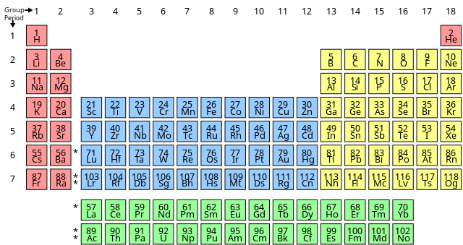
Atomic Number
Atomic number increases
The atomic number increase from left to right.
This refers to how many protons an atom of that element has.
No two elements, have the same number of protons.
Notes:
Look at the periodic table on the page. Find elements that were named for scientists. Many of the scientists for whom elements have been named did their research on atoms or subatomic particles.
Ask:
• What two scientists who developed models of the atom have elements named for them? (Rutherford: rutherfordium, 104; Bohr: bohrium, 107)
• What is the atomic number of the element named for Mendeleev? (101)
• What other names do you recognize? (You will likely recognize Einstein and possibly Nobel and Curie. Other people who have elements named after them include Meitner, Copernicus, Fermi, and Seaborg.)

Slide 23
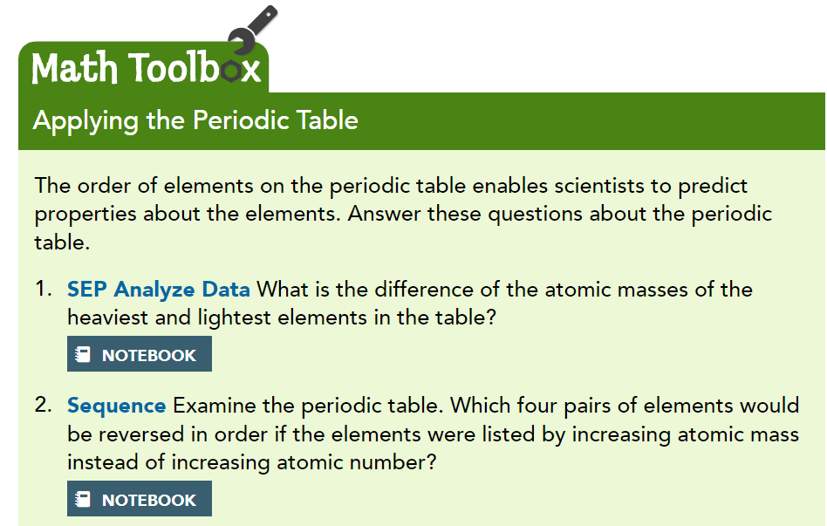
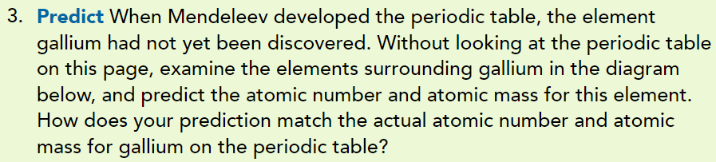
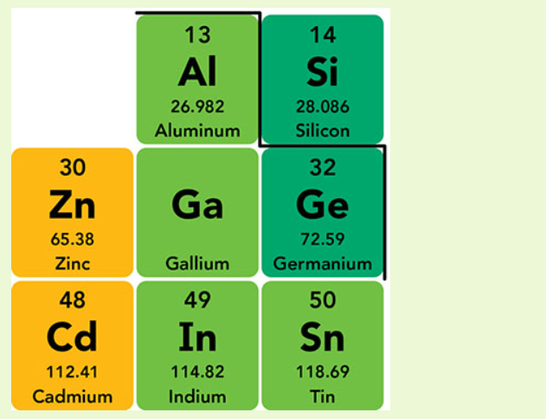
Atomic number is 31. Atomic mass should be around 69, or halfway between the values for Zinc and germanium.
293
Cobalt (27) and nickel(28), tellurium(52) and iodine(53),
lawrencium(103) and rutherfordium(104),
flerovium(114) and moscovium(115).

Slide 24
Periods in the Periodic Table
Lanthanides and Actinides
Pgs. 21,22

Slide 25
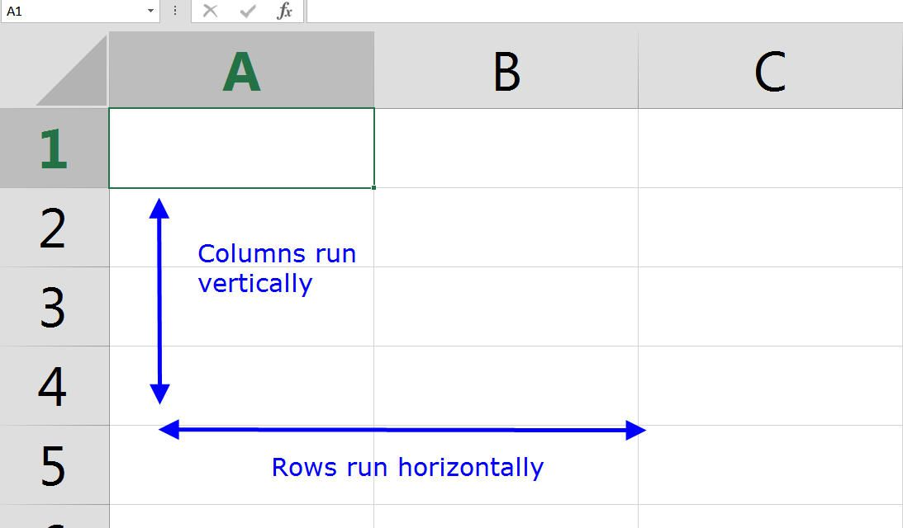
What is the difference between a column and a row ?

Slide 26
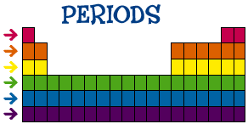
Rows are called “Periods”
Metals are shown on the left of the table and nonmetals are located on the right.
Metalloids are found between the metals and nonmetals.
-This pattern is repeated in each period so an element’s properties can be predicted by its location in the periodic table.

Slide 27
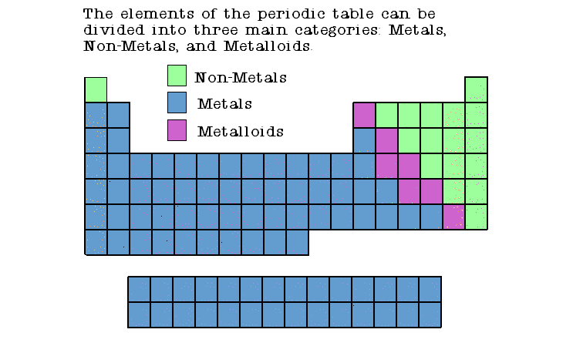

Slide 28
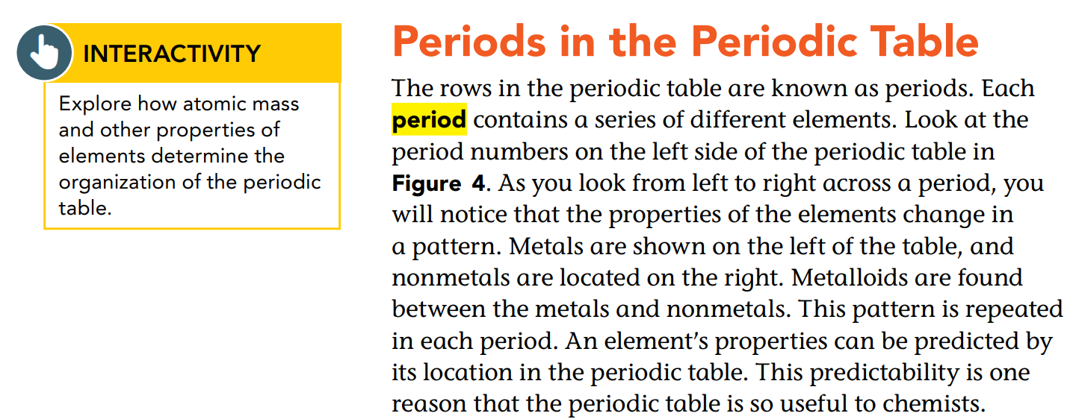

Slide 29
Lanthanides and Actinides
Two additional rows standing alone, and are placed off the table to save space and to make the rest of the table easier to read.
Lanthanides
Actinides

Slide 30
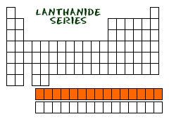
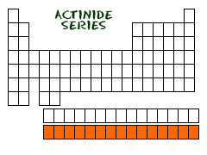
Lanthanide :
These elements are all found in nature.
Rare Earth metals
Most known element is
Lanthanum(La) which is used in a major component in batteries for hybrid cars and in permanent magnets.
Actinides :
Most of the Actinides are not found in nature but made in lab except two elements only called Uranium and Thorium found in nature.
The common characteristic: radioactive.

Slide 31
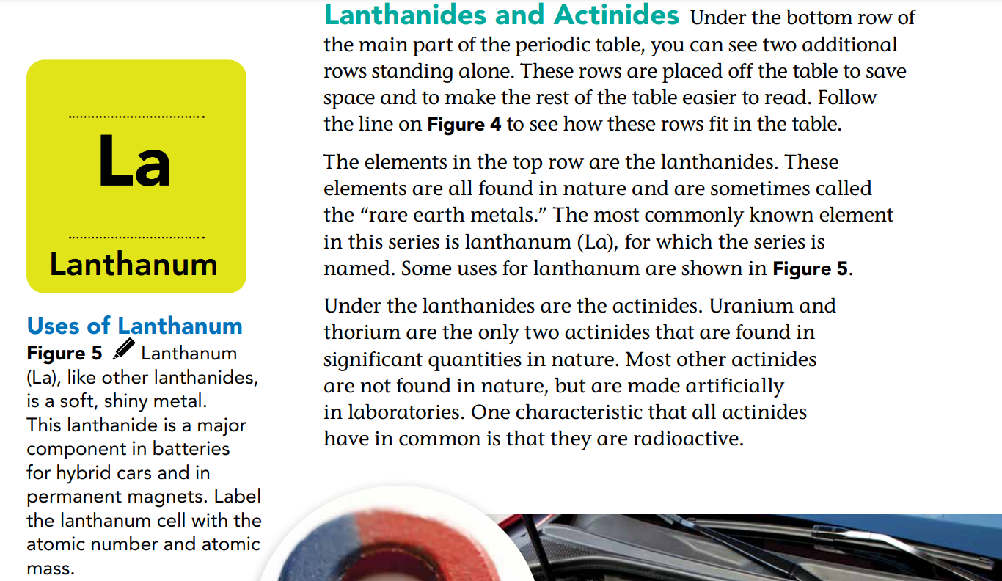
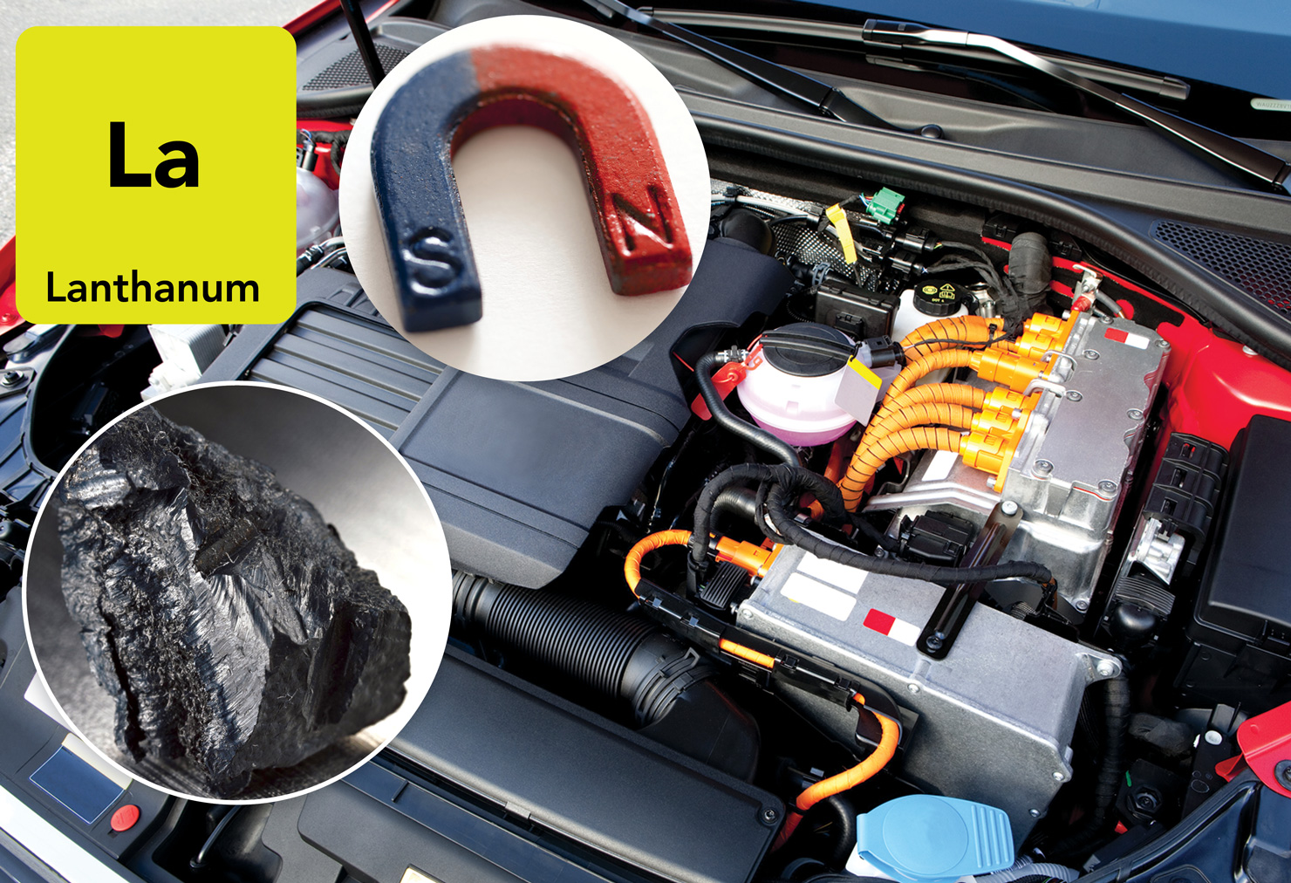
57
138.91

Slide 32
Transuranium Elements
Groups in the Periodic Table
Pgs. 23,24

Slide 33


Slide 34
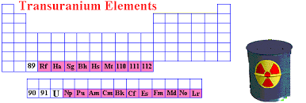
Transuranium Elements
None of the elements is stable
Not found in the nature they are made in the lab when the nuclear particles are forced to crash into one another.

Slide 35
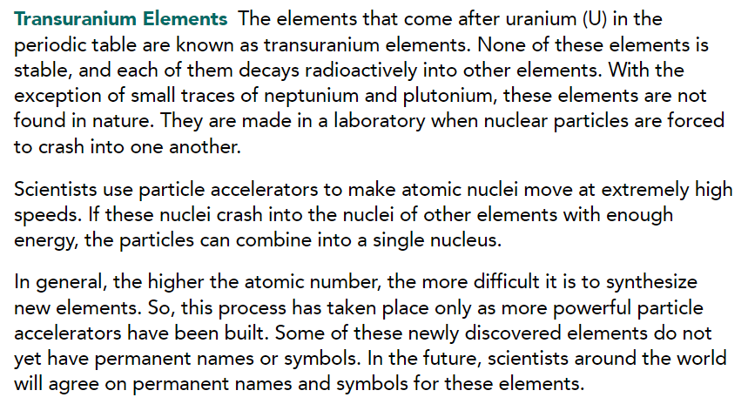

Slide 36
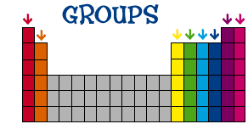
Columns are called “Groups” or Families

Slide 37
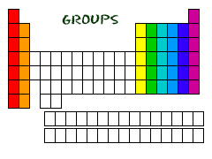
Column = group = families
What do elements in a group have in common?
They have similar characteristics with the other elements in their family.
Group: patterns can be used to classify elements that have similar characteristics into a specific group or family.
We have 7 periods and 18 group in the periodic table.

Slide 38
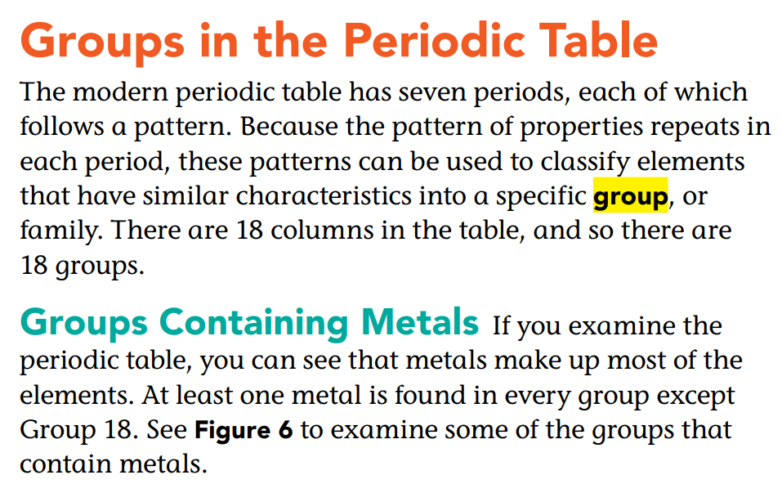

Slide 40
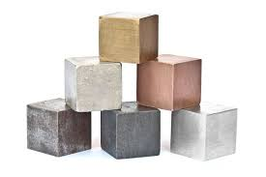
Metals
Metals make up most of the elements.
At least one metal is found in every group except group 18.

Slide 41
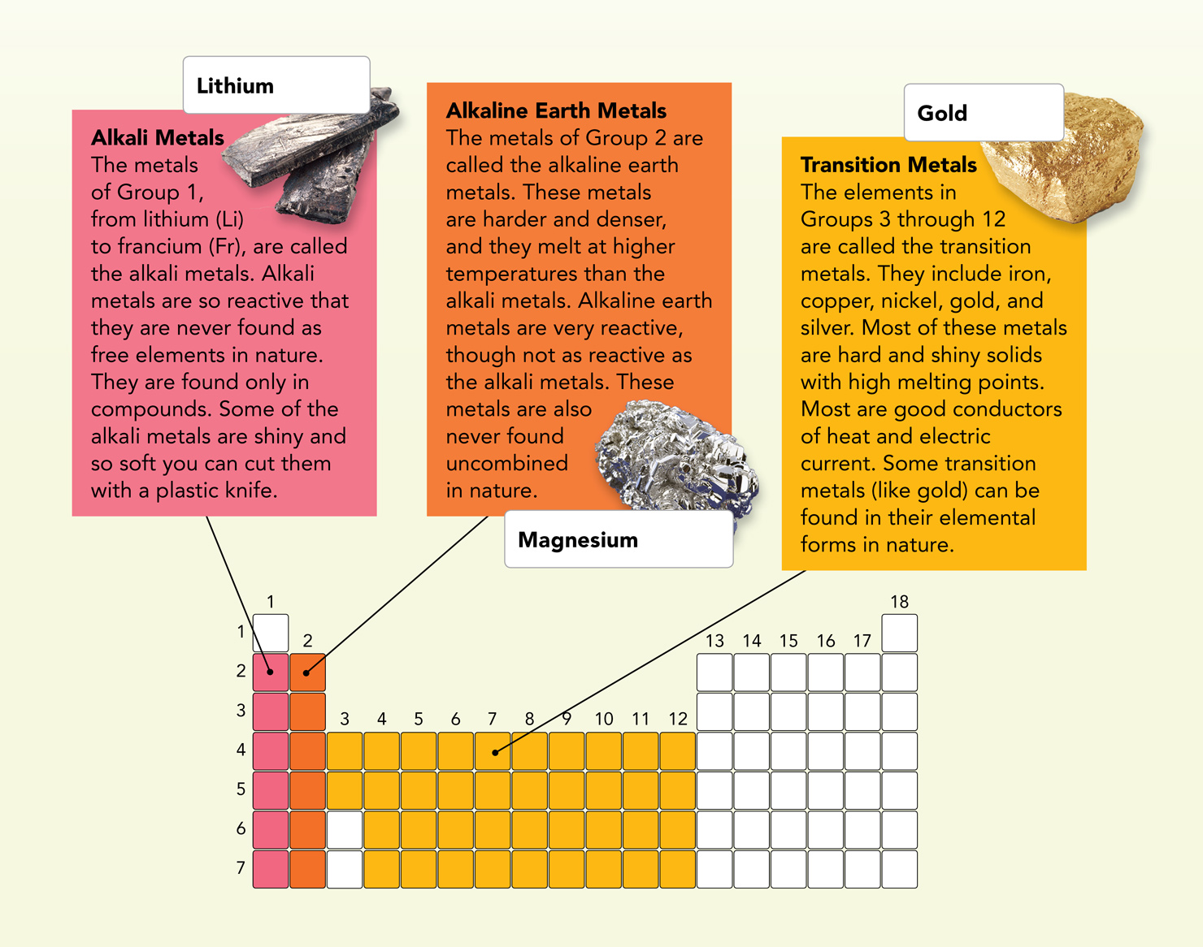
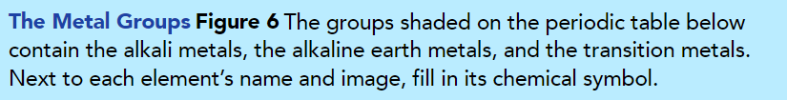
Li
Au
Mg

Slide 42
Groups Containing Metalloids and Nonmetals
Halogens, Noble Gases, and Hydrogen
Lesson 2 Check
Pgs. 25,26,27

Slide 43
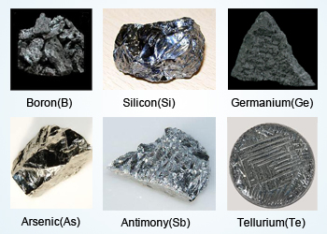
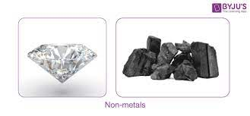
Metalloids and nonmetals
Metalloids have some properties of metals and nonmetals.
Metalloids
Non-metals

Slide 44
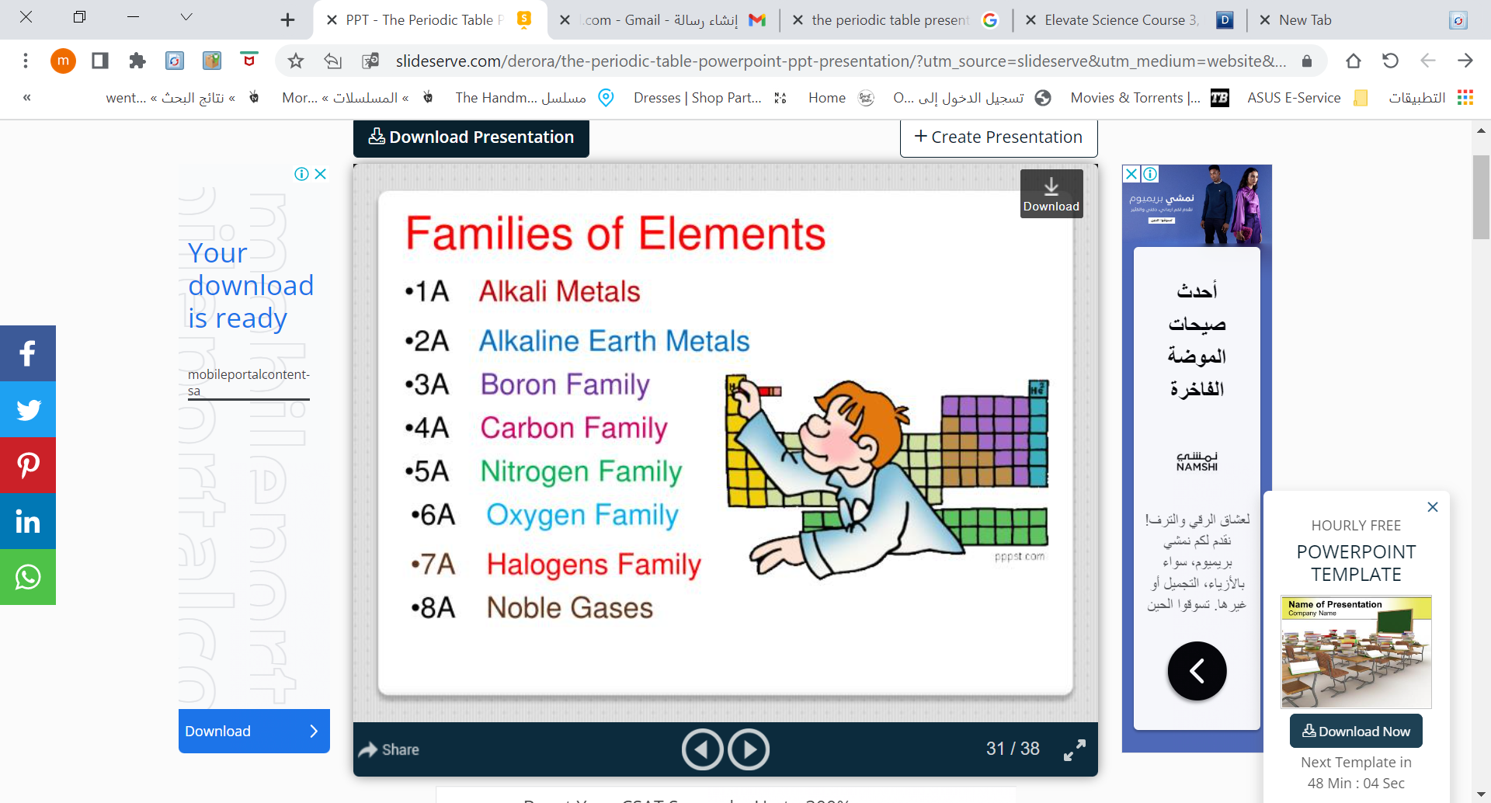

Slide 45
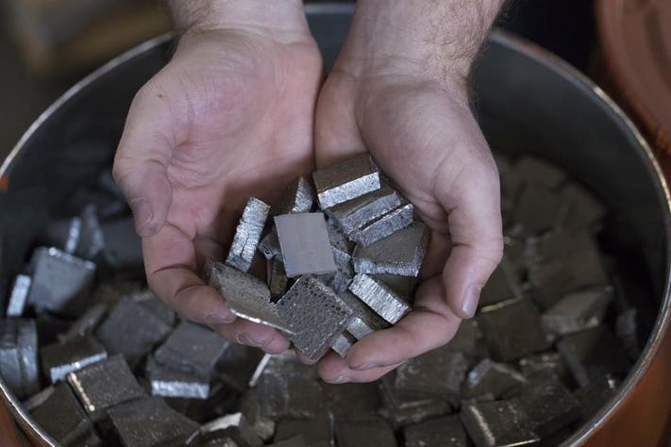
Alkali Metals EX. Lithium (Li)
Some of them are so shiny and so soft you can cut them with a plastic knife.

Slide 46
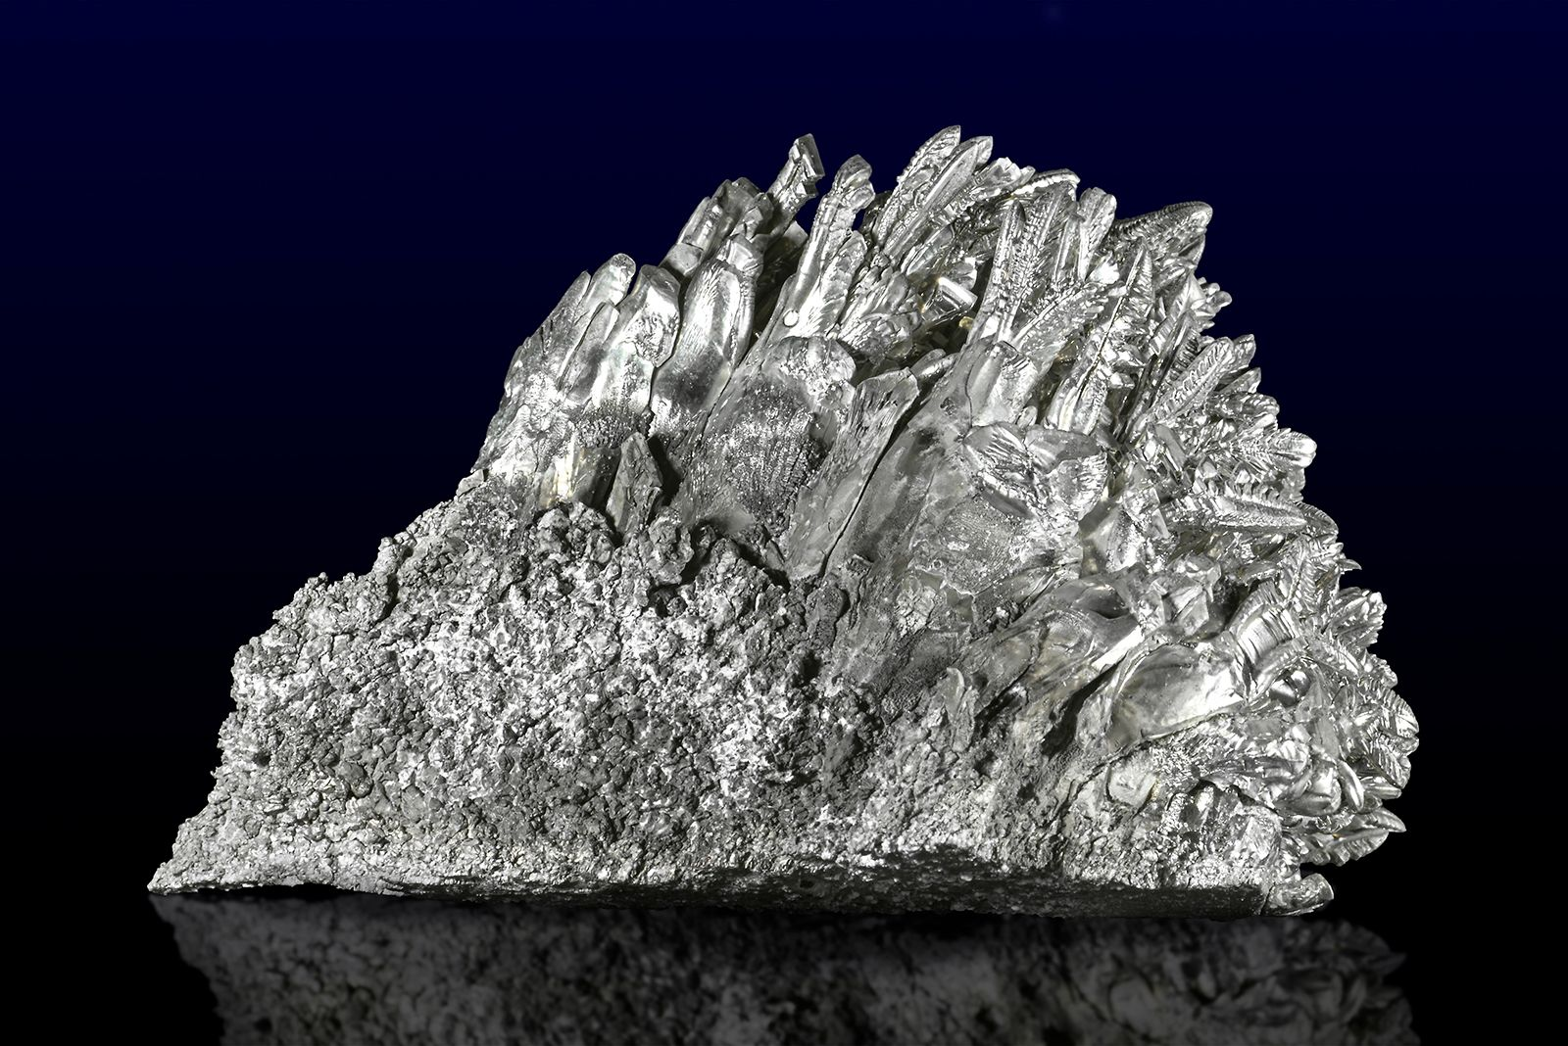
Alkaline Earth Metals EX. Magnesium(Mg)
They are harder and denser and melt at higher temperatures than alkali metals..

Slide 47
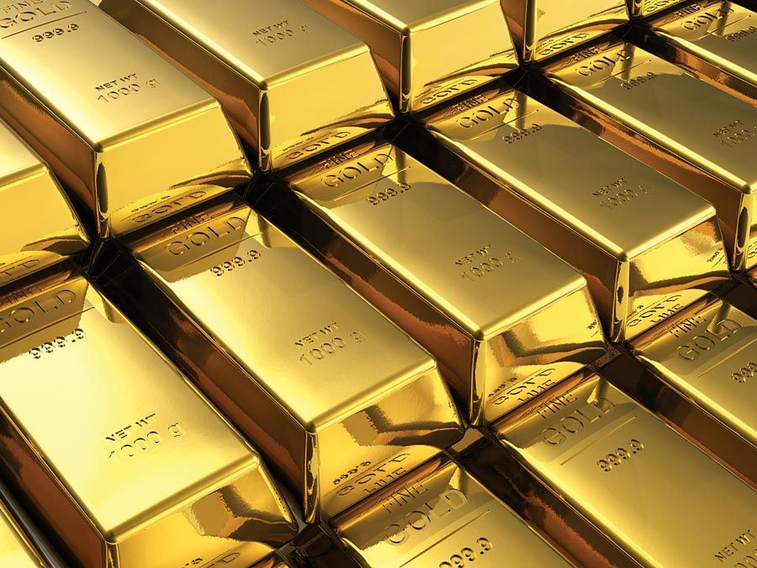
Transition Metals EX. Gold(Au)
They include iron, copper, nickel, gold, and silver.
Most of them are good conductors of heat and electric current.

Slide 48
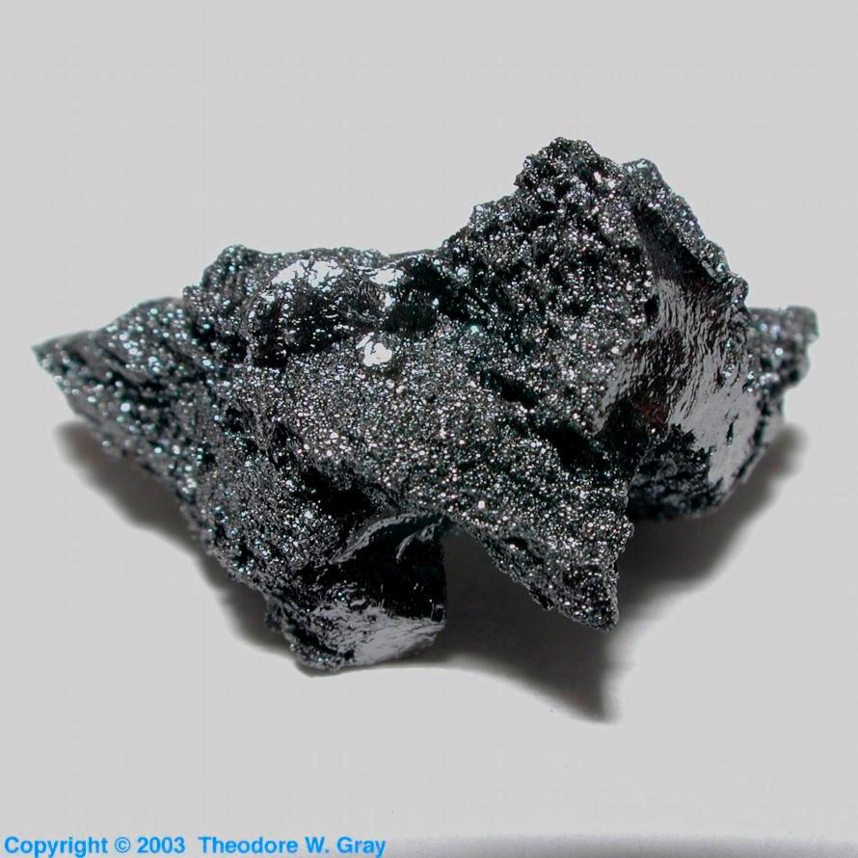
The Boron Family EX. Boron(B)
Metalloid Boron is used in materials of high strength and light weight, such as fiberglass.

Slide 49
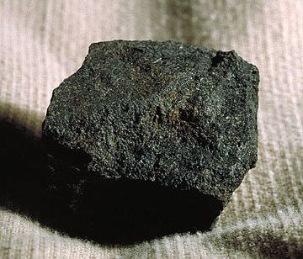
The Carbon Family EX. Carbon(C)
Carbon is a non-metal
Proteins, DNA, and Fats all contain carbon.

Slide 50
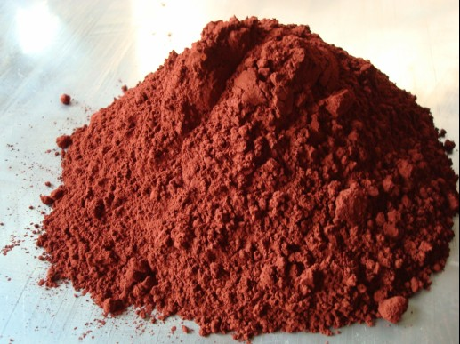
The Nitrogen Family EX. Phosphorus(P)
Phosphorus and nitrogen are examples of it
Nitrogen makes up about 78 % of Earth’s atmosphere.

Slide 51
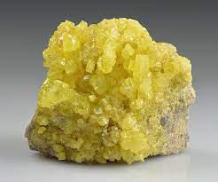
The Oxygen Family EX. Sulfur(S)
Sulfur and Oxygen are examples of it
Oxygen is a gas at room temperature but Sulfur is a solid.

Slide 52
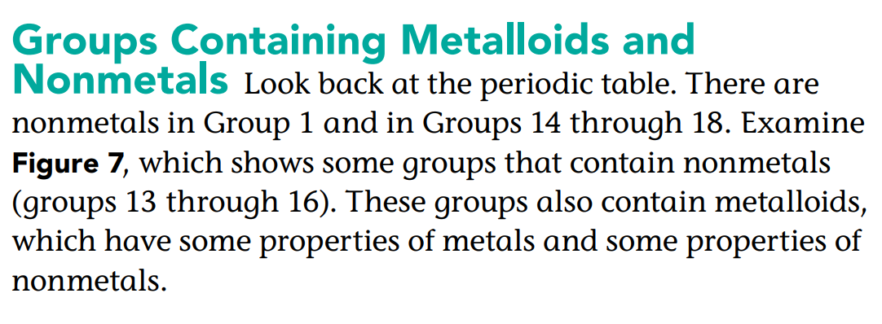
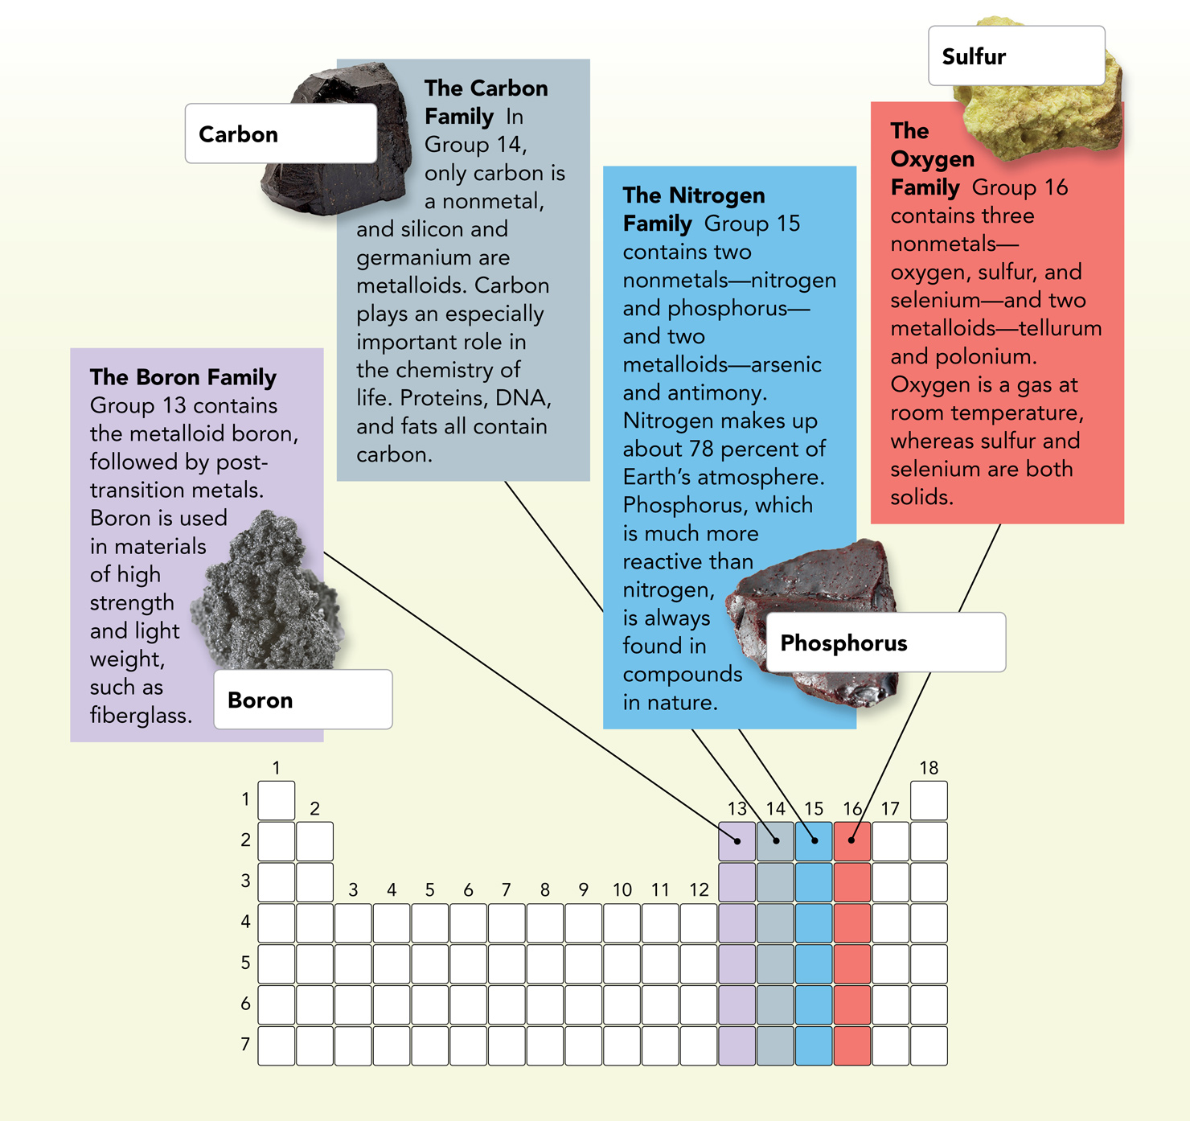
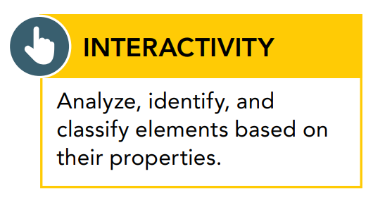

S
C
P
B

Slide 53

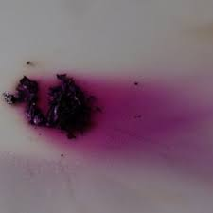
Halogens, Noble Gases, and Hydrogen
Halogens | Noble Gases | Hydrogen
The most reactive non-metals Halogens means ‘’salt-forming’’ | The least reactive non-metals They don’t ordinarily form compounds. | -found alone in the upper left corner of the Periodic Table -it has the simplest atom -rarely found on Earth as a pure element because most of it combine with oxygen in water -most of Sun is composed of hydrogen.
EX: Iodine | EX: Helium (used to inflate balloons and make them float)

Slide 54
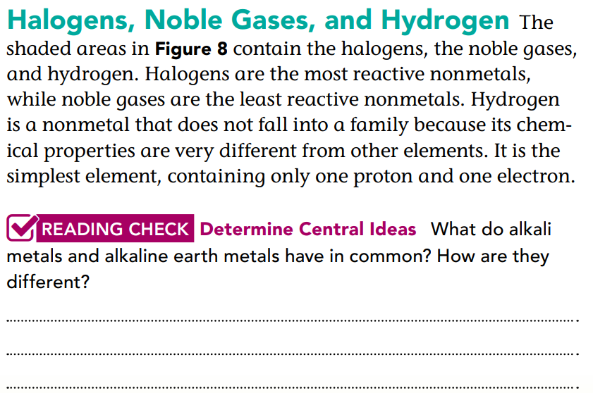
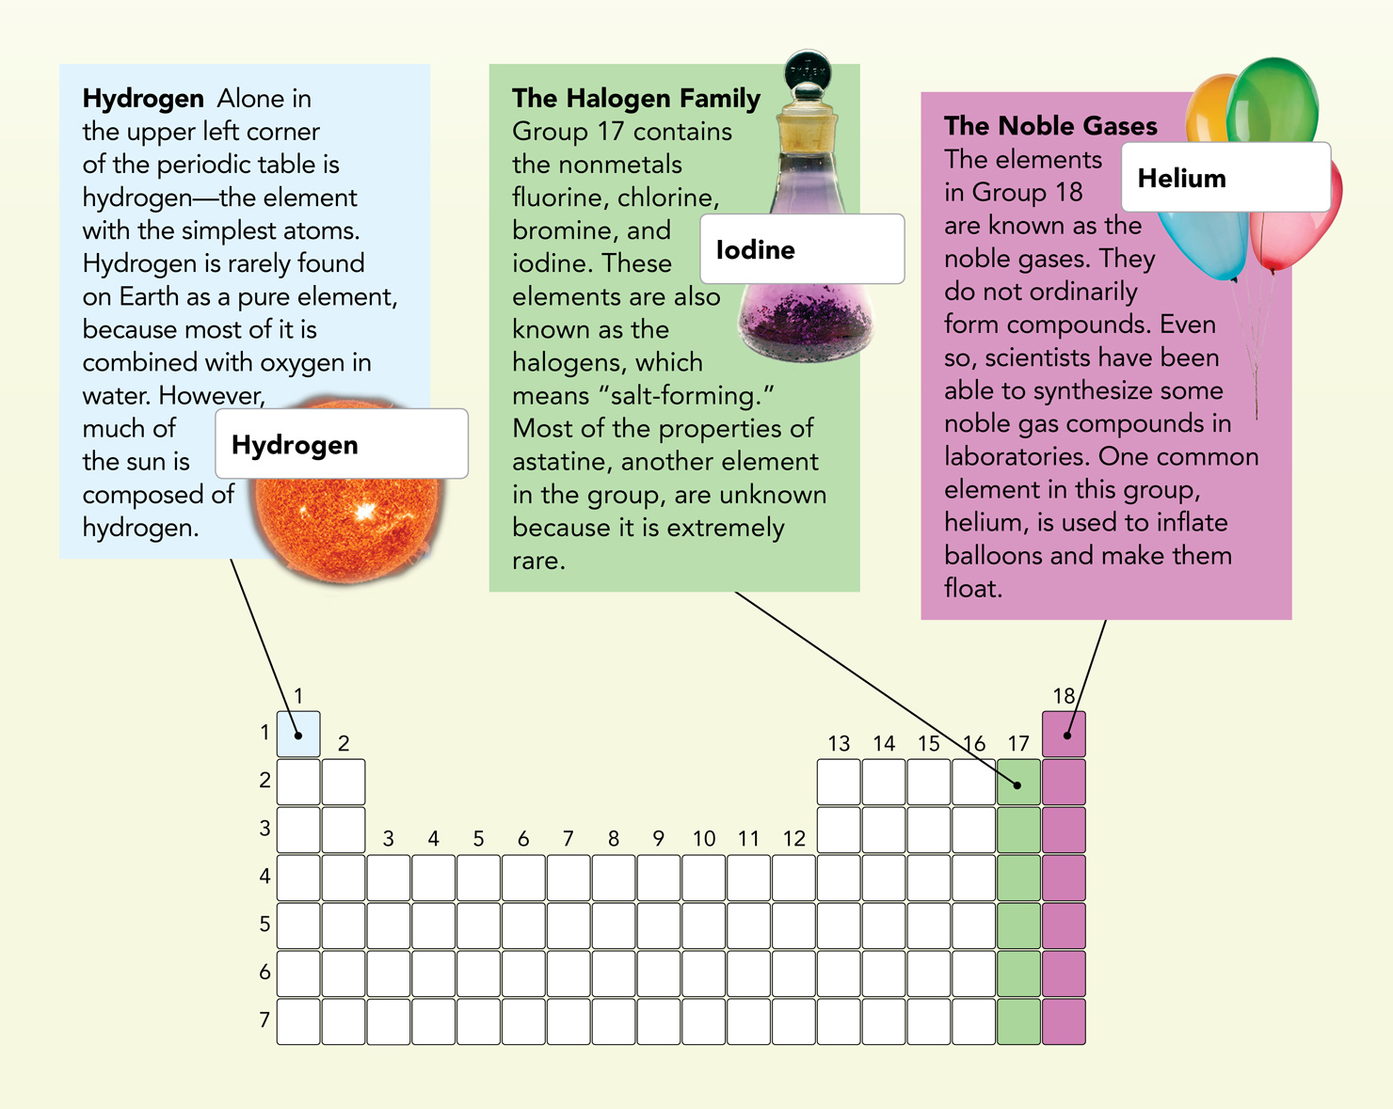
He
I
H
Both groups of metals are found only as compounds and are highly reactive. Alkaline earth metals are harder and denser than alkali metals, and they have higher melting points.

Slide 55
1. SEP Communicate Information In addition to properties of elements, list at least two other things or events that are periodic.
2. Explain Phenomena Assume that one particular atom of rhodium (Rh) has a mass of 102. Why does this number not exactly match the atomic mass of 102.91 listed on the periodic table for this element?
days on a calendar, months of the year, seasons, phases of the moon
Atomic mass is an average of the mass of all isotopes in a sample. Many atoms have more neutrons than the atom mentioned, so the average mass is higher.

Slide 56
Use Figure 4 to answer question 3.
3. CCC Patterns What element is found in Group 6 and Period 4? Based on its location, is this element more similar to tungsten or to iron? Explain.
4. SEP Engage in Argument The noble gases in Group 18 were some of the last natural elements to be discovered. Why do you think this is so?
Elements are often discovered when they react with other elements or are found in compounds, but noble gases rarely react with other elements, and they are not commonly found in compounds.
The element is chromium. It is more similar to tungsten because chromium and tungsten are in the same group.

Slide 57


