Slide 1
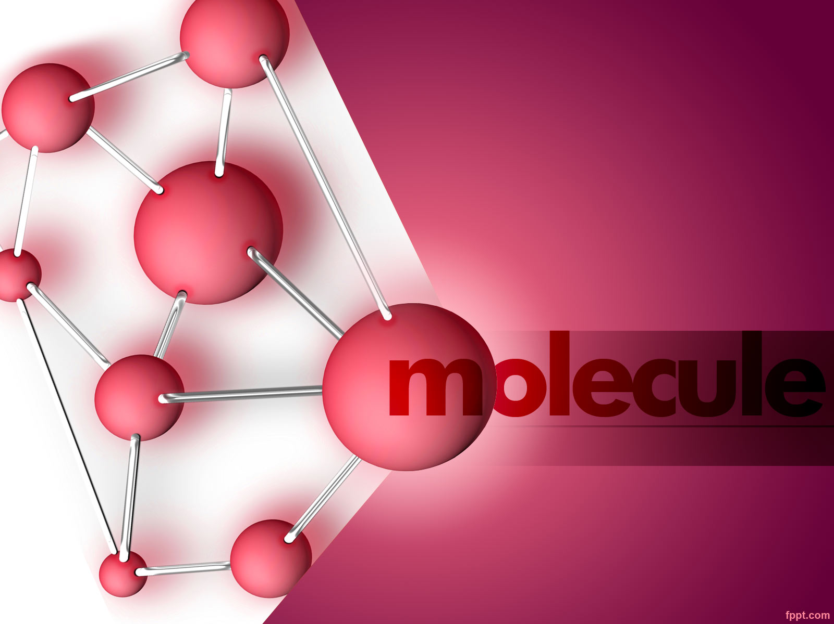
Grade 8
T1 Atoms and the Periodic Table
L1 Atomic Theory

Slide 2
Objective
Students will identify and describe the properties of
• electrons.
• protons
• neutrons.
Students will describe the development of atomic theory, including
• the historical atomic models of Dalton, Thomson, Rutherford, and Bohr.
• how data from experiments caused the theory to change.
• the basics of modern atomic theory.
Students will cite evidence that supports the modern model of the atom, including
• Rutherford's gold-foil experiment.
• Chadwick's discovery of the neutron.

Slide 3
Pgs. 6, 7
Pgs. 4, 5
02
01
Pgs. 10, 11
Pgs. 8, 9
04
03
TABLE OF CONTENTS
Development of Atomic Theory
The First theories on Atoms
Thomson’s Model
Rutherford's Model
Pgs. 12,13
05
Isotopes
Lesson Check
Rutherford’s Theory
Bohr’s Model
Cloud Model
A Modern Model of the Atom
Particle Charges
Comparing Particle Masses
Atomic Number

Slide 4
Development of Atomic Theory
Pgs. 4, 5

Slide 5
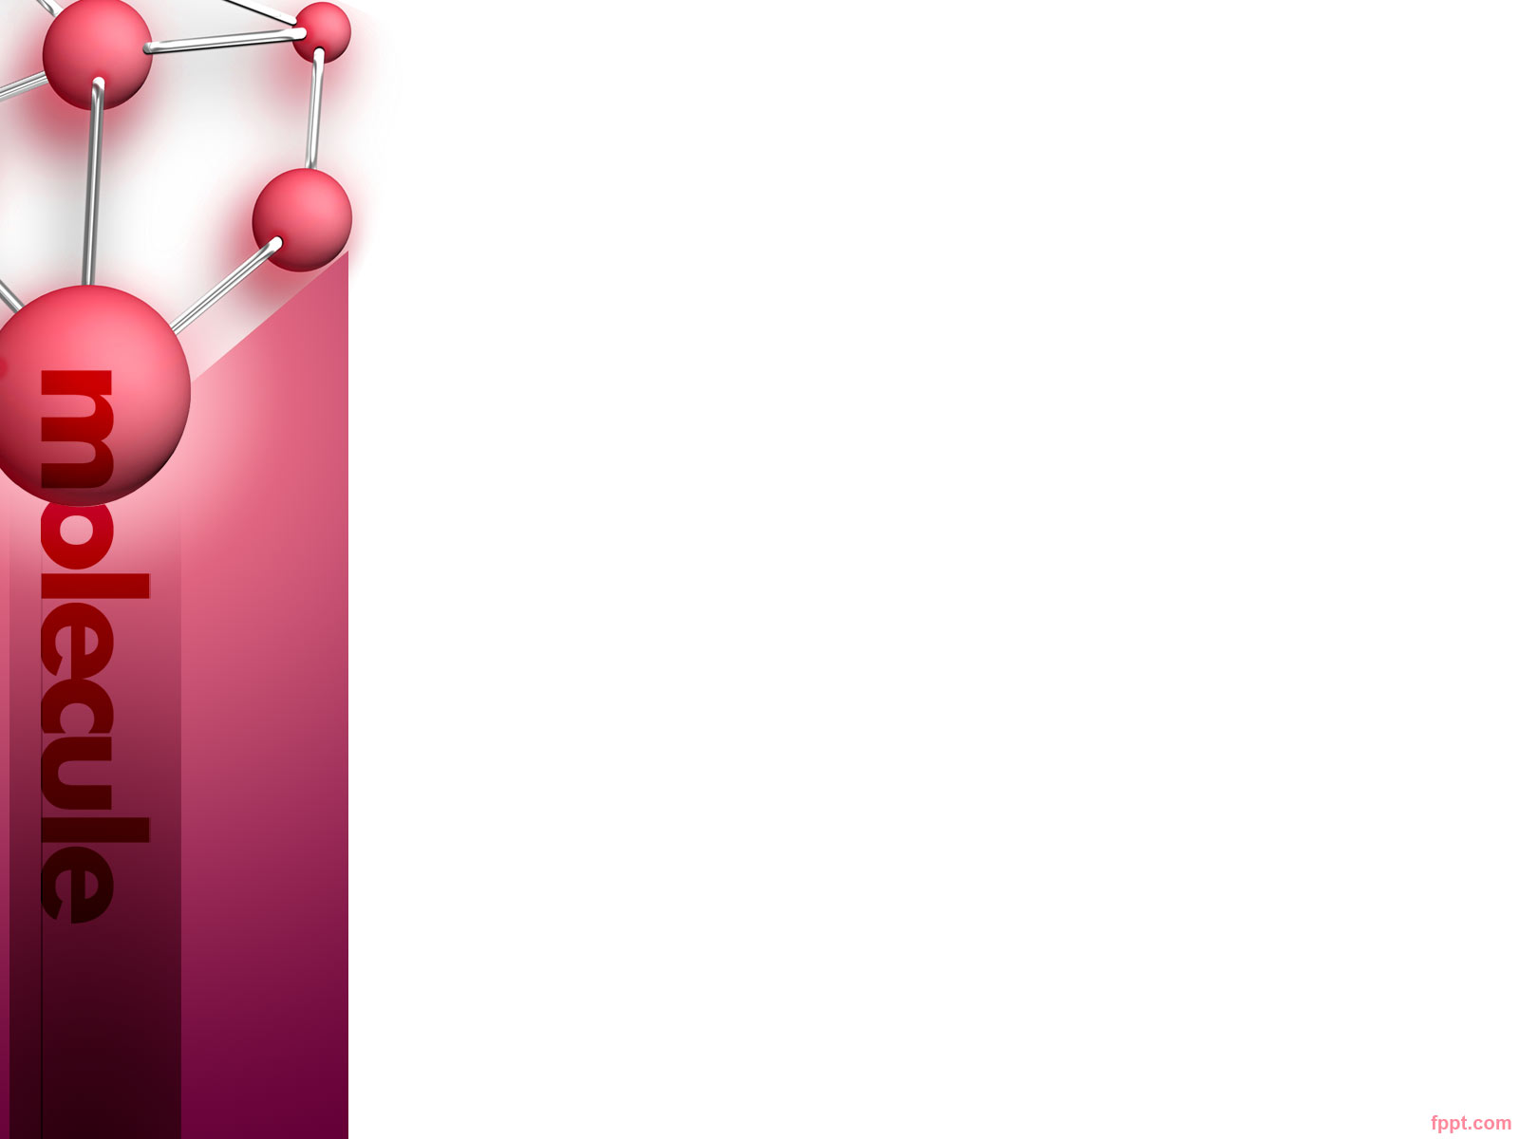
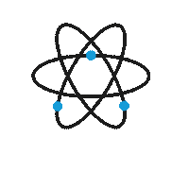
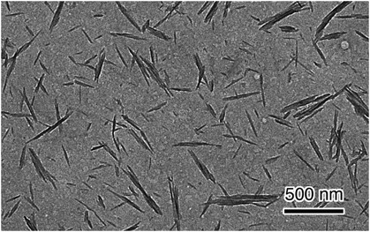
Why nanowhiskers are used in fabrics?
Cellulose nanowhiskers (CNWs) are generally extracted from natural cellulose-based materials including plants, bacteria, and sea creatures by using hydrolysis methods. It is sized by several nanometers to a few tens of nanometers in diameter and several 100 nm in length. They have been molecularly hooked onto natural and synthetic fibres to impart stain resistance to clothing and other fabrics.

Slide 6
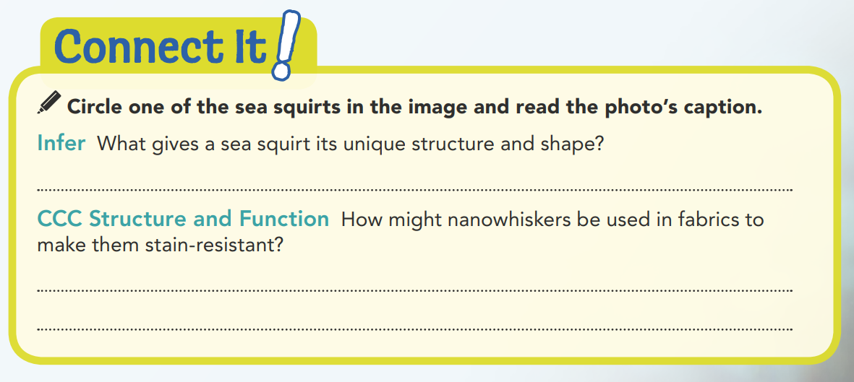
Nanowhiskers
Nanowhiskers are small and spaced so close together that they form a barrier that prevents substances from touching the fabric.

Slide 7
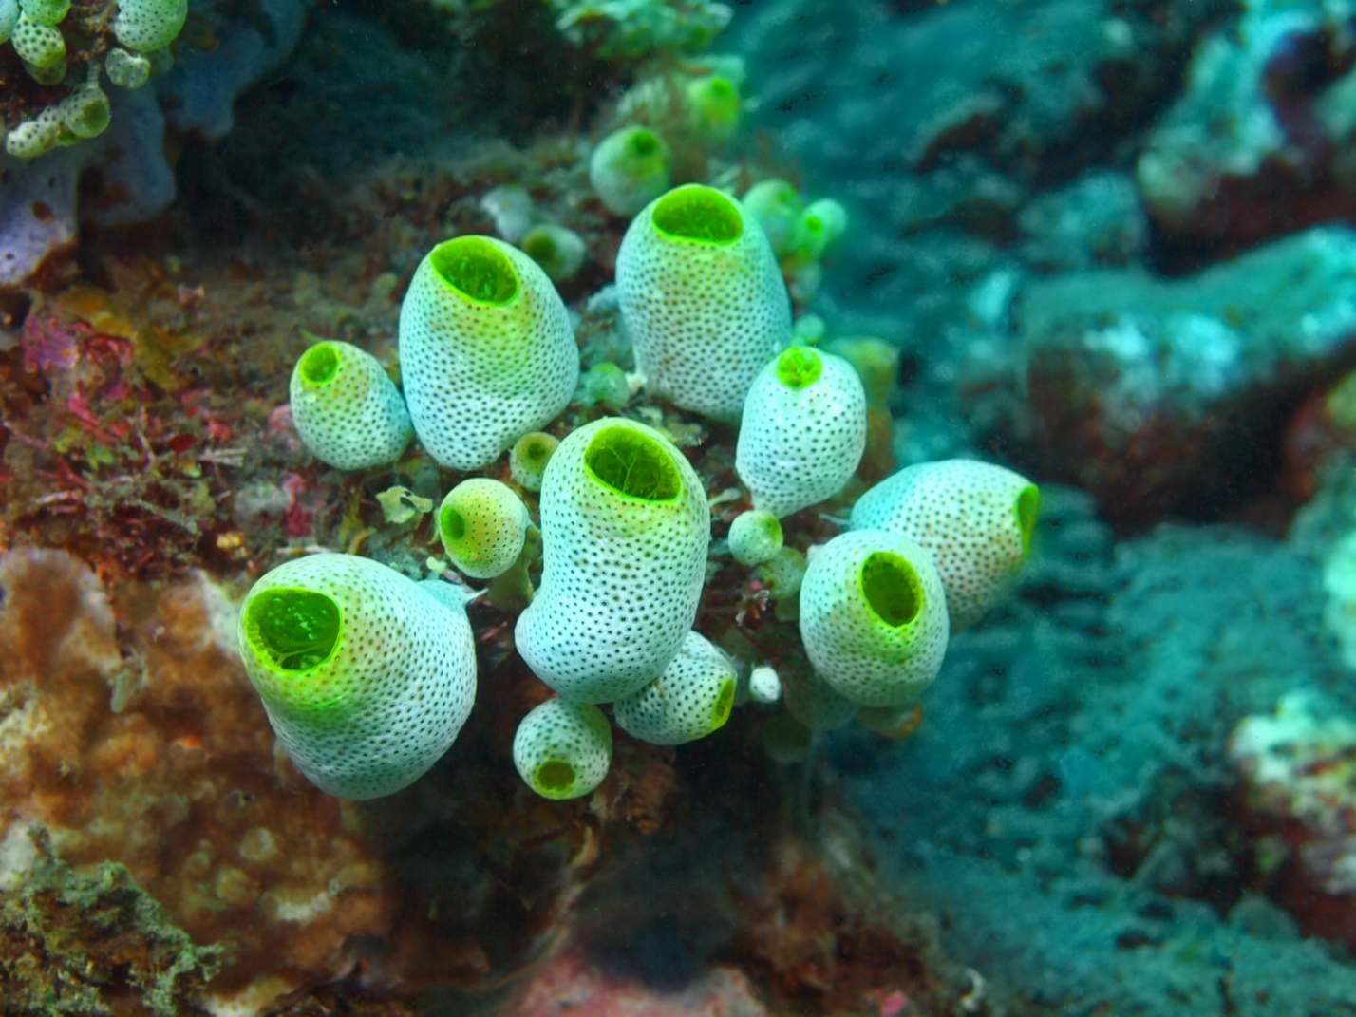

Slide 8
Development of Atomic Theory
What's more than 16,000 times thinner than a human hair and can be used in fabrics to repel stains and odors? It's a nanowhisker!
Nanowhiskers are tiny threads that measure about 10 nanometers (1 nm = 0.000000001 m) in length and 1.5 nanometers in diameter. They are often made of carbon or silver. Scientists have found that the carbon-based material that makes up the structure of a sea squirt, shown in Figure 1, is made of nanowhiskers. These nanowhiskers are similar to the cellulose fibers that make up cell walls in plants.

Slide 9
Development of Atomic Theory
What does a nanowhisker have to do with atoms?
Both of these things are so small that it's difficult to imagine how tiny they are. However, as small as a nanowhisker is, its diameter is still about 10 times wider than the diameter of an atom. Finding the smallest bits of matter that exist has always been a core question for scientists. For a long time, it was thought that atoms were the answer to this scientific puzzle. Now we know that atoms themselves are built from even smaller particles. The quest to find the absolute smallest bit of matter continues today.

Slide 10

Development of Atomic Theory
Carbon or Silver

Slide 11
The First theories on Atoms
Thomson’s Model
Rutherford's Model
Pgs. 6, 7

Slide 12
The First Theories on Atoms
What, exactly, is an atom?
Around 430 BCE, the Greek philosopher Democritus proposed that matter was formed of small pieces that could not be cut into smaller parts. He used the word atomos, meaning "uncuttable," for these smallest possible pieces. In modern terms, an atom is the smallest particle that still can be considered an element.
Because atoms are so tiny and therefore difficult to study, scientists have created models to describe them. Over the years, these models of atoms have evolved as scientists discovered more about them.
Notes:
The development of modern atomic theory took place over many years and involved a series of models that attempted to explain something that could not be observed directly. The various models were based on experimental results and represented the most accurate, consistent, and logical explanations of what could not be observed.
Why might a theory change over time? What major change was made to Dalton’s theory?

Slide 13
The First Theories on Atoms
The study of atoms really gained speed in the 1600s. As people conducted various experiments, atomic theory began to take shape. Atomic theory grew as a series of models that developed from experimental evidence. As more evidence collected, the theory and models were revised.
John Dalton, an English chemist, conducted many experiments centered on atoms. From these experiments, he inferred that all atoms had certain characteristics:

Slide 14


The First Theories on Atoms
Dalton's Atomic Theory
All elements consist of atoms that cannot be divided.
All atoms of the same element are exactly alike and have the same mass. Atoms of different elements are different and have different masses.
An atom of one element cannot be changed into an atom of a different element by a chemical reaction.
Compounds are formed when atoms of more than one element combine in a specific ratio.

Slide 15
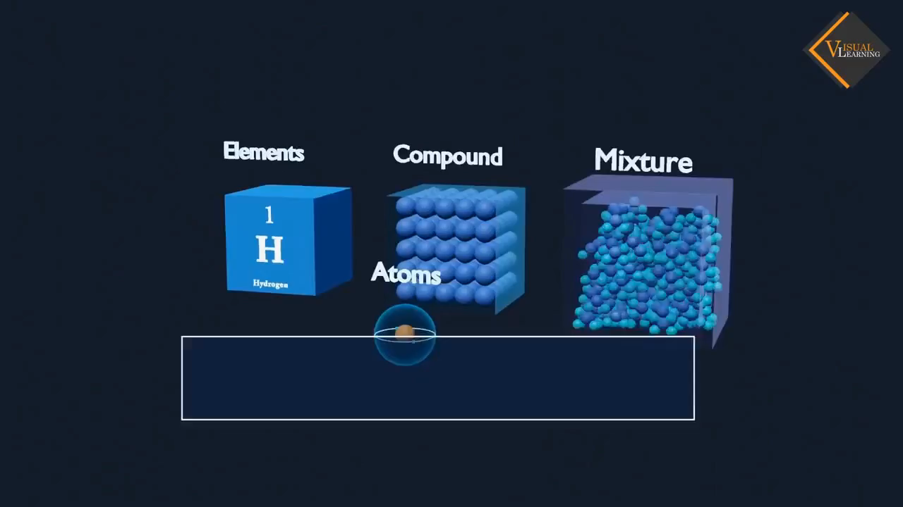
Dalton’s Theory

Slide 16
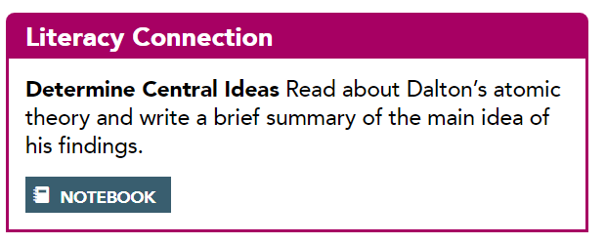
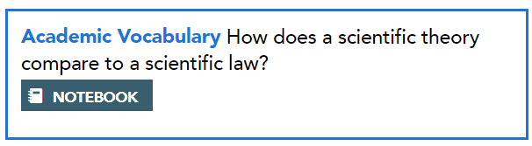
The First Theories on Atoms
Atoms are the building blocks of elements. All atoms of one element are the same. Different atoms can combine to form compounds.
A scientific law is considered to be true and does not change over time. A theory is an explanation that may change with new evidence.
Notes:
Spark a Discussion Review with students the law of charges, which states that like charges repel and unlike charges attract. Have students explain the law using the terms negatively charged particles and positively charged particles. Ask them to provide other real-world examples that involve this concept.

Slide 17
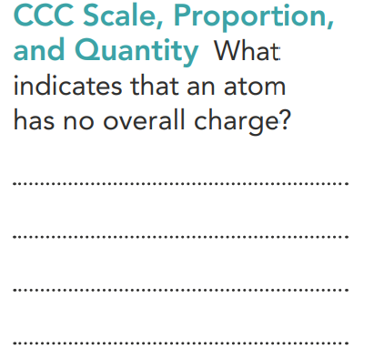
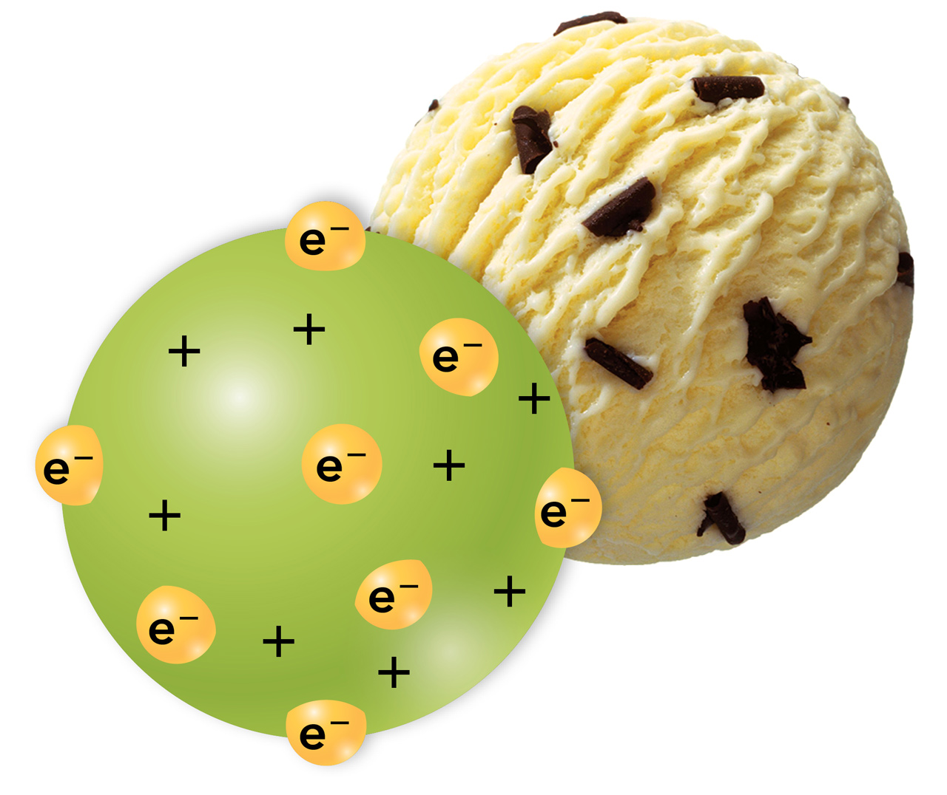
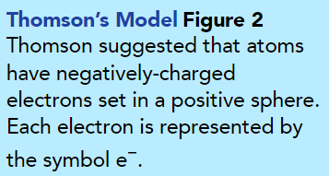
Thomson's Model
The number of positive charges equals the number of negative charges.
We now know that atoms are made of parts that are even smaller than Dalton realized. In 1897, J. J. Thomson discovered that atoms contain negatively charged particles. Each of these particles is called an electron. Yet scientists knew that atoms themselves can have no electrical charge. So, Thomson reasoned that atoms must also contain some sort of positive charge.
Thomson proposed a model like the one shown in Figure 2. He described an atom that had electrons scattered throughout a ball of positive charge. His model looked similar to a scoop of chocolate chip ice cream.
1
1
8
2
2
3
3
7
4
6
5
4
7
6
5
8
Notes:
Teach with Visuals Tell students to look at Thomson’s Model and ask them: • What model other than chocolate chip ice cream could you use to describe Thomson’s concept of an atom? (raisins in raisin bread, apple chunks in oatmeal) Make sure that students understand the significance of scattered electrons. Thomson’s model did not include any internal organization or specific location for electrons.

Slide 18
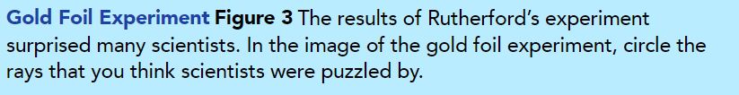
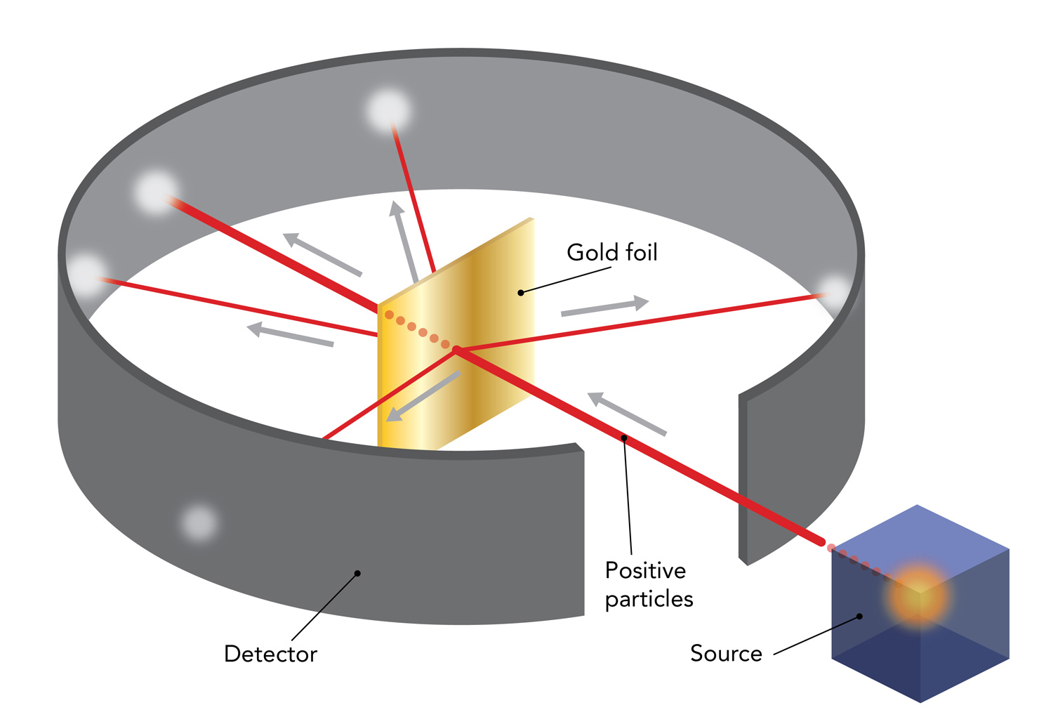
Rutherford's Model: In 1911, Ernest Rutherford found evidence that challenged Thomson's model. Rutherford's research team aimed a beam of positively-charged particles at a thin sheet of gold foil surrounded by a fluorescent-coated detector, as shown in Figure 3. Rutherford and his team predicted that, if Thomson's model were correct, the charged particles would pass straight through the foil. They also predicted that the paths of some particles would bend, or deflect, slightly because of the positive charge that was spread out in the gold atoms.
During the experiment, Rutherford observed that most of the particles passed straight through the foil with little or no deflection. But to everyone's surprise, a few particles were deflected at sharp angles by the gold foil.

Slide 19

Rutherford's Model

Slide 20
Rutherford’s Theory
Bohr’s Model
Cloud Model
Pgs. 8, 9

Slide 21
Based on his experiment, Rutherford concluded that the atom is mostly empty space but has a dense, positive charge at its center. This dense center is called the nucleus. (The plural of nucleus is nuclei.) Examine Figure 4 to explore how the results of the gold foil experiment support Rutherford's conclusions. Rutherford called a positively-charged particle in an atom's nucleus a proton.

Slide 22
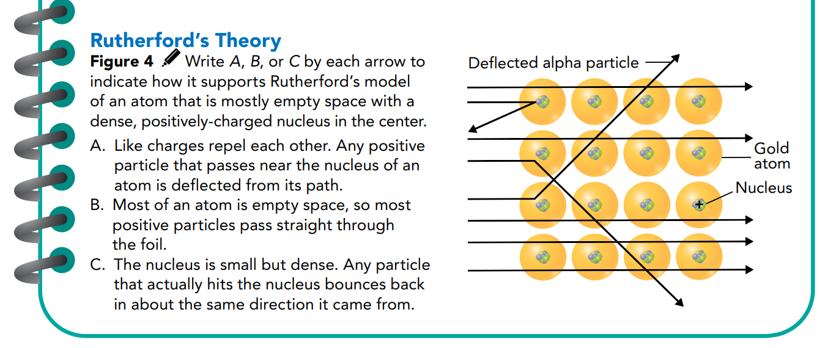
Rutherford's Model
A
B
C
B
B
B
B
A

Slide 23
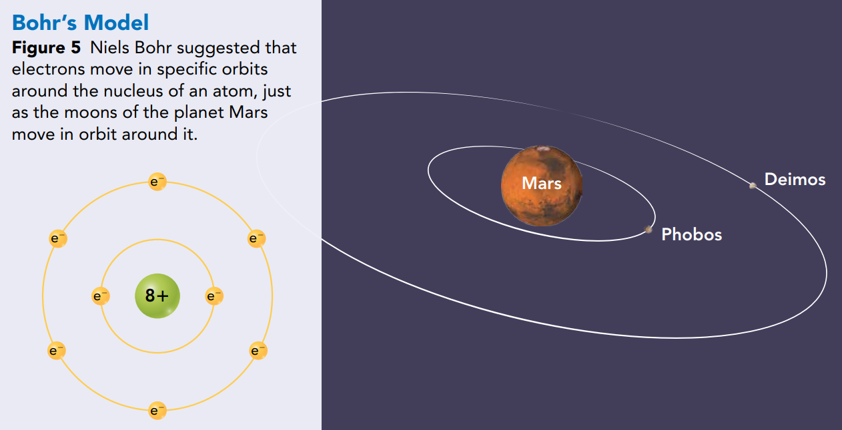
Niels Bohr, a Danish scientist, was one of Rutherford’s students. In 1913, Bohr revised the atomic model again. He suggested that electrons move only in specific orbits around an atom's nucleus. The orbits in Bohr's model look like moons orbiting a planet, as shown in Figure 5. Each possible electron orbit in Bohr's model has a fixed energy.
Bohr’s Model

Slide 24
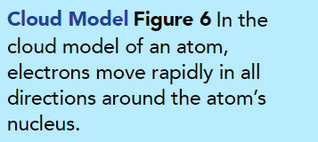
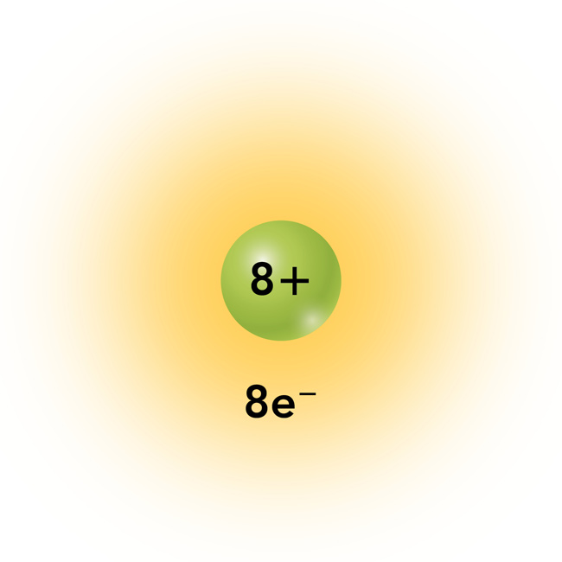
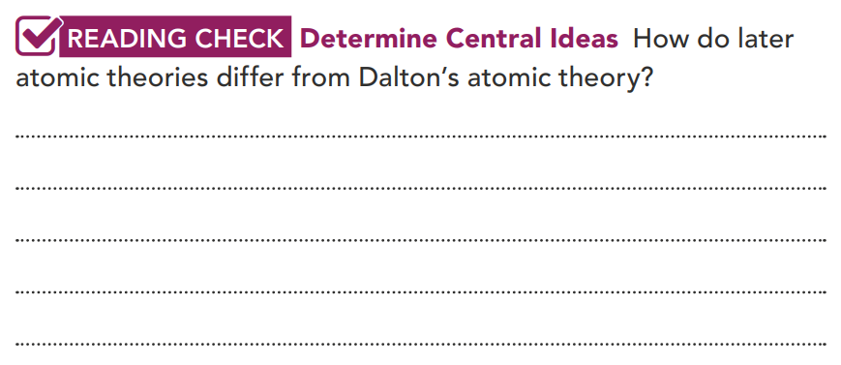
Cloud Model
The atomic model changed again in the 1920s. Around that time, scientists determined that electrons do not move in specific orbits like planets do, as Bohr suggested. Instead, electrons move rapidly within a cloudlike region around the nucleus. The orange "cloud" in Figure 6 is a visual model. It represents where electrons are likely to be found.
The main difference is that Dalton said atoms were the smallest known particles and could not be divided. Later theories stated that atoms are made of even smaller particles.

Slide 25
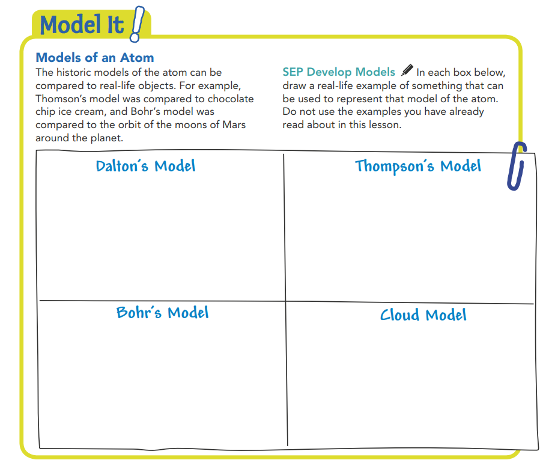
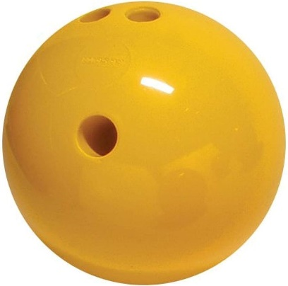
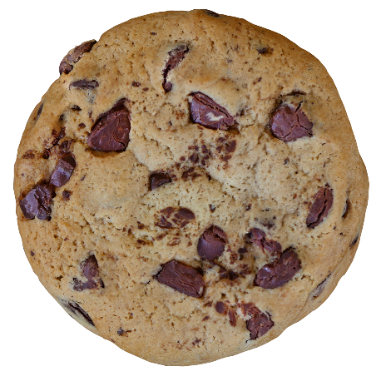
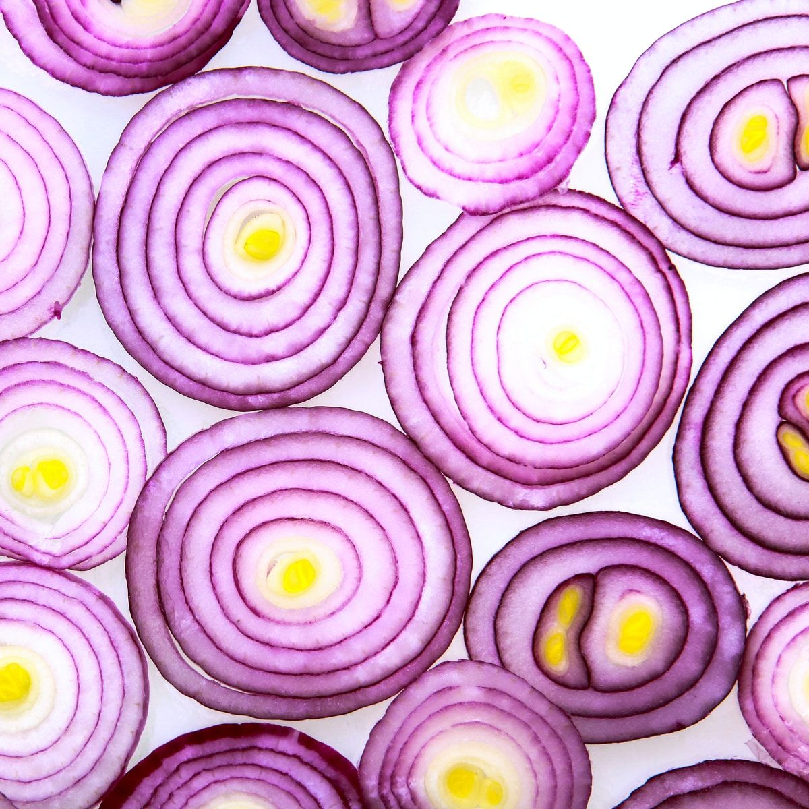

Answer the DOK questions below:
1. Identify Which was the first atomic model to include protons?
2. Describe Rutherford’s model.
3. Explain why Rutherford thought that atoms were mostly empty space.
4. Justify Although scientists know that the Bohr model is not an accurate representation of the atom, it is still used in books and online. Justify why the Bohr model is still a useful model.
Notes:
(Rutherford’s model)
(Rutherford’s model of the atom included a dense, positively charged nucleus surrounded by mostly empty space.)
(Rutherford thought that atoms were mostly empty space because most of the positively charged particles that he shot at the gold foil went straight through the foil.)
(One reason that the Bohr model is useful is because a person can easily see the particles that make up a given atom.)

Slide 26
A Modern Model of the Atom
Particle Charges
Comparing Particle Masses
Atomic Number
Pgs. 10, 11

Slide 27
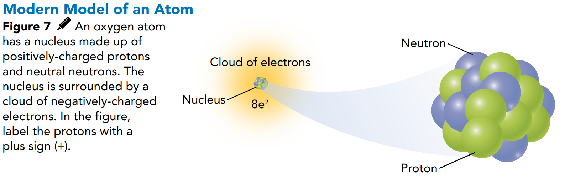
In 1932, English scientist James Chadwick showed that another particle exists in the nucleus of atoms. This particle is called a neutron. It took scientists a long time to find this particle because it has no electric charge.
Since Chadwick's discovery, scientists have learned even more about atoms. One modern model of the atom is shown in Figure 7. At the center is a tiny, dense nucleus containing protons and neutrons. All around the nucleus is a cloudlike region of moving electrons. Neutrons, protons, and electrons are known as subatomic particles. A subatomic particle is any particle smaller than an atom.
Most of an atom is made up of the space in which the electrons move. This space is huge compared to the space taken up by the nucleus. Imagine holding a pencil while standing in the middle of a football stadium. If the pencil's eraser were the nucleus of an atom, its electrons would reach as far away as the top row of seats!

Slide 28
Particle Charges
In most models of atoms, protons are shown by a plus sign (+).
The symbol for a proton is p+. Electrons are shown by the symbol e, and neutrons are represented by an n.
According to the scale used for measuring charge in atoms, protons have a charge of +1 and electrons have a charge of —1.
If you count the number of protons
in Figure 7, you'll see there are eight.
There are also eight electrons.
Because these amounts are even, the
charges balance, making the atom neutral.
The number of neutrons present does
not affect the charge of an atom because
neutrons have a charge of zero.
1
8
2
6
4
3
7
5

Slide 29
Comparing Particle Masses
When it comes to the masses of particles, protons and neutrons are about equal. Electrons, however, are much, much smaller. It takes almost 1,840 electrons to equal the mass of one proton or neutron. Therefore, protons and neutrons make up almost all the mass of an atom.
Figure 8 compares the charges and masses of the three types of atomic particles. Atoms are much too small to be described by standard units of mass, such as grams. So, scientists usually measure atoms using atomic mass units (amu). A proton or a neutron has a mass equal to about one amu.

Slide 30


Atomic Number
You have read that all atoms of an element are the same, and atoms of different elements are different. What can atoms tell us about elements?
The number of protons in the nucleus of an atom is the atomic number of that atom's element. The definition of an element is based on its atomic number. For example, every oxygen atom has eight protons, so the atomic number of oxygen is 8.
Atomic number = protons

Slide 31
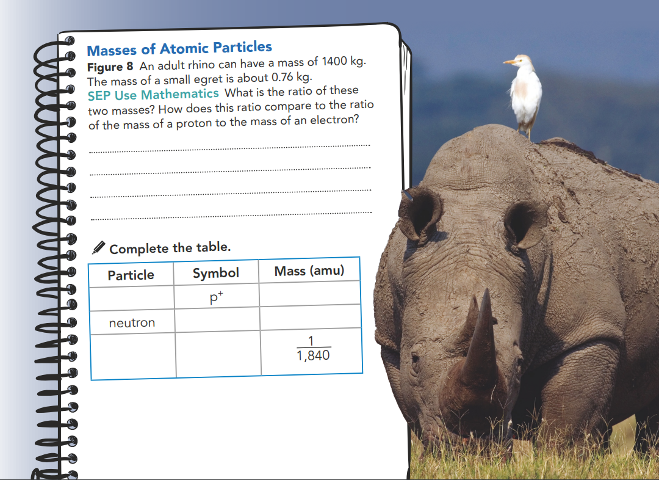
1400 : 0.76 = 1842 : 1, is about the same as the proton : electron mass ratio.
proton
1
n
1
electron
e ¯

Slide 32


Slide 33
Isotopes
Lesson Check
Pgs. 12, 13

Slide 34
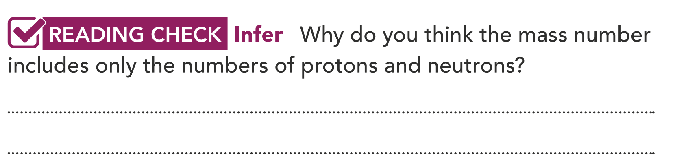
Isotopes
All atoms of an element have the same number of protons. The number of neutrons can vary. Atoms with the same number of protons and different numbers of neutrons are called isotopes. An isotope is identified by its mass number which is the sum of the protons and neutrons in the atom. The most common isotope of oxygen has a mass number of 16 (8 protons + 8 neutrons) and may be written as "oxygen-16." Most naturally-occurring oxygen is oxygen-16. The two other stable isotopes are oxygen-17 and oxygen-18. Despite their different mass numbers, all three oxygen isotopes react the same way chemically. The number of electrons affects chemical reactivity, and neutrons generally do not affect chemical reactions very much. All isotopes of oxygen have the same number of electrons.
The mass of the electron is too small to affect the overall mass.

Slide 35
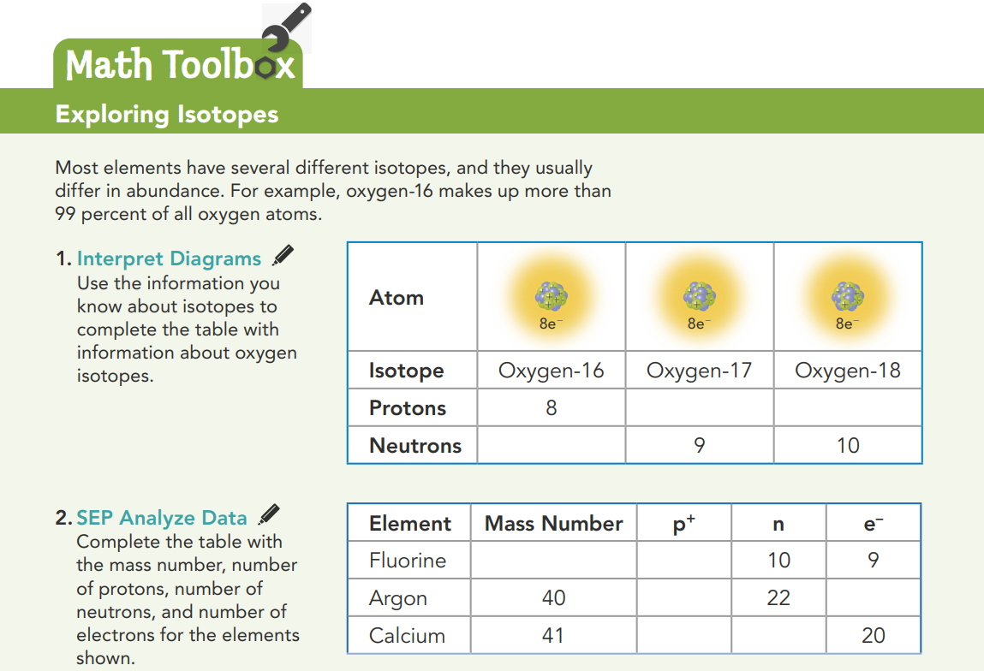
8
8
8
19
9
18
18
20
21

Slide 36
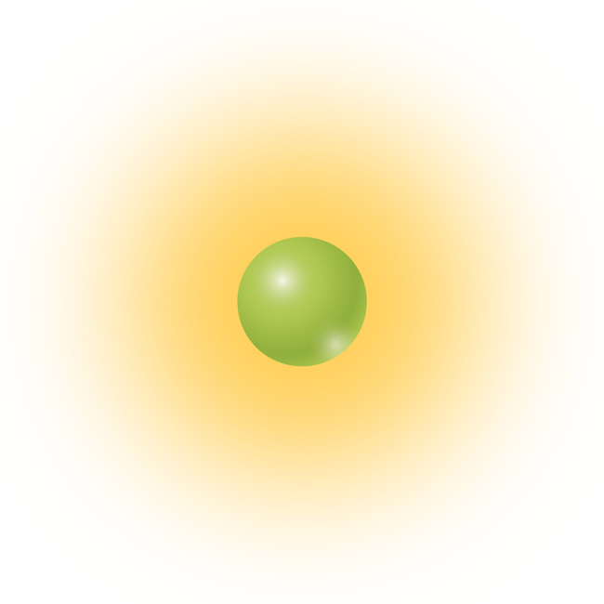
1. SEP Communicate Information How did the discovery of isotopes disprove one part of Dalton's atomic theory?
2. Apply Concepts In Rutherford's experiment, why were some particles deflected a small amount?
3. SEP Construct Explanations This diagram shows a hydrogen atom. Explain why it looks like it does.
Dalton’s theory stated that all atoms of an element were identical. Isotopes are atoms of the same element that differ in numbers of neutrons.
The green area represents one proton. There is only one proton in the nucleus of hydrogen. The orange area shows an electron cloud around the nucleus, where the electron is likely to be.
They were positively charged, and they passed near a nucleus that was also positively charged. The like charges repelled each other.

Slide 37
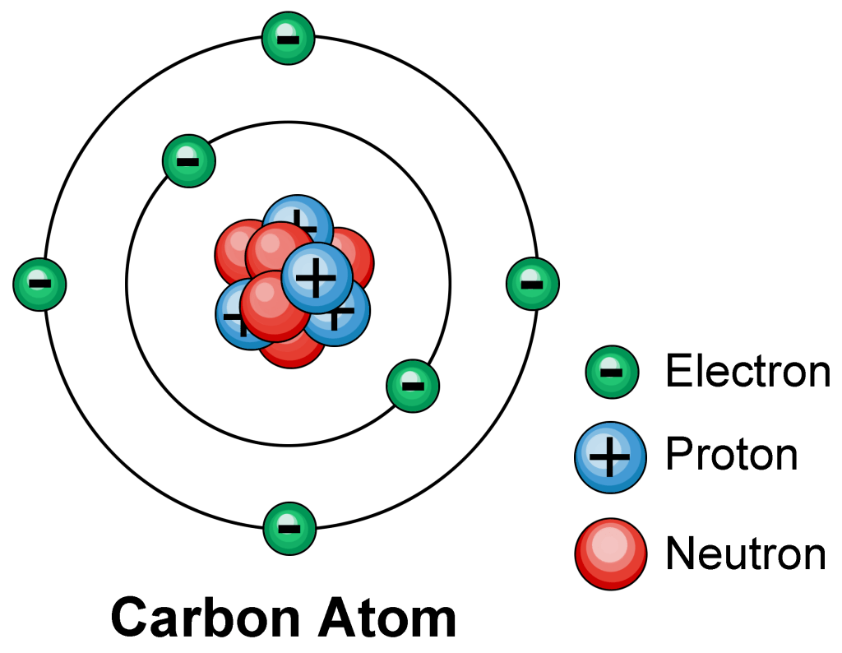
4. CCC Scale, Proportion, and Quantity An atom of chlorine has an atomic number of 17 and a mass number of 37. How many protons, neutrons, and electrons are in the atom?
5. SEP Develop Models An atom of carbon has six protons. In the space below, use the knowledge you gained in this lesson to draw a model of a carbon atom. Be sure to label the protons, neutrons, and electrons in your model, along with areas of positive and negative charge.
17 protons, 17 electrons, and 20 (37 – 17) neutrons.

Slide 38
Thanks

