Slide 1
Lesson 4 Producing Useful Materials
Pages 98 - 105

Slide 2
Objectives
Students will gather, read, and synthesize information from multiple sources in order to explain how
synthetic materials are made from natural resources.
Students will assess the credibility, accuracy, and possible bias of sources they use in order to assess how
the production and use of synthetic materials from natural resources affect society.

Slide 3

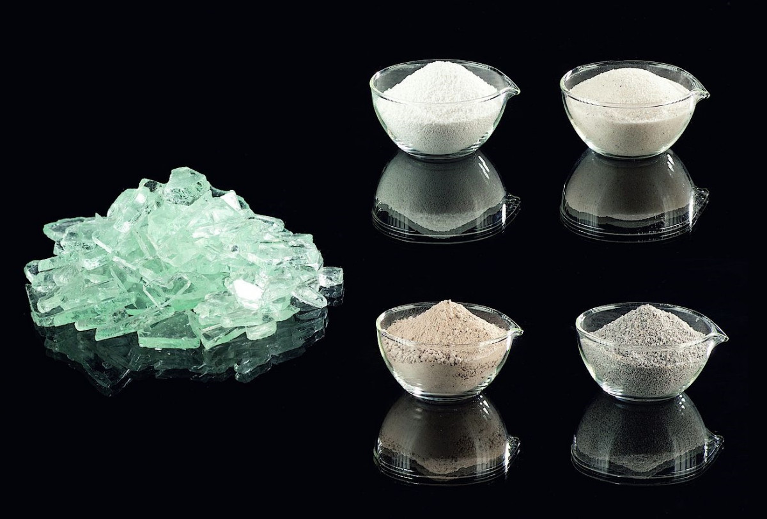
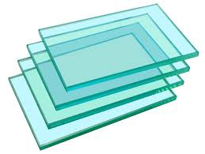

Synthetic Materials:
Chemical reactions are constantly happening all around us in nature.
Many of the products of naturally occurring reactions have properties that are useful to humans.
For instance, plants perform photosynthesis, a chemical reaction that releases oxygen, which we need to survive.
However, not all of the chemicals and materials that humans use come directly from naturally occurring reactions.
Instead, they are products of chemical reactions we induce.
Such reactions start with substances found in nature, but they result in new materials being formed.
For example, glass is made from sand and other minerals that are melted together.

Slide 4
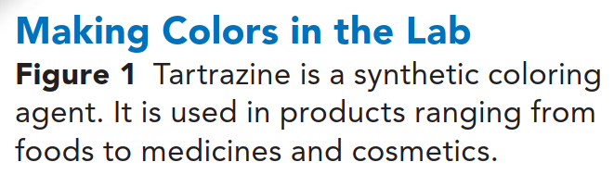
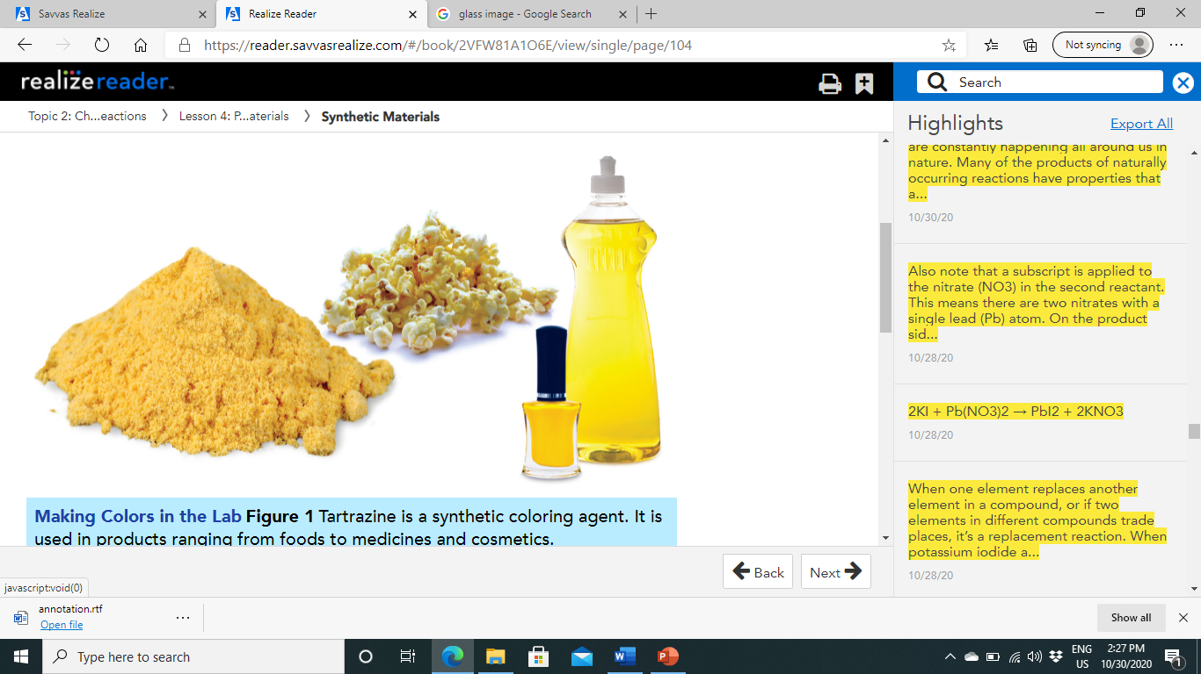
Chemicals and resources made by humans are called synthetic materials.
Synthetic materials, such as the tartrazine in Figure 1, have a wide variety of uses and have enabled great advances in engineering and technology.
Chemists are always trying out new chemical reactions to produce new materials for our ever-changing needs.
natural
artificial
artificial

Slide 5
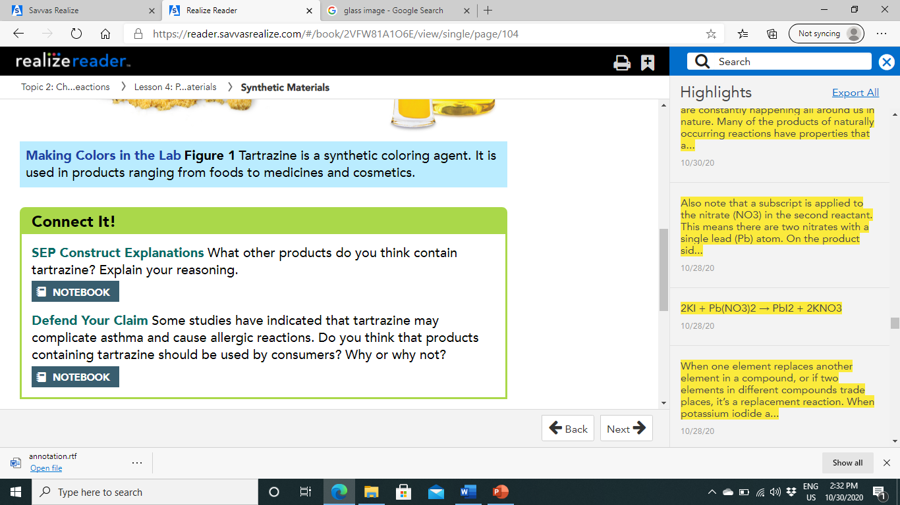
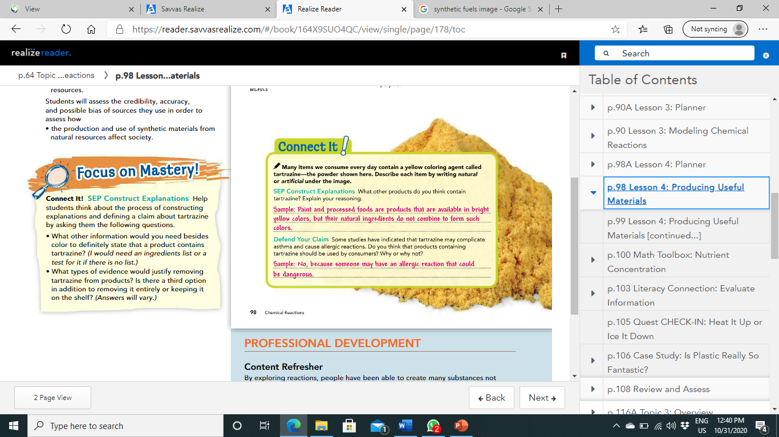
4

Slide 6
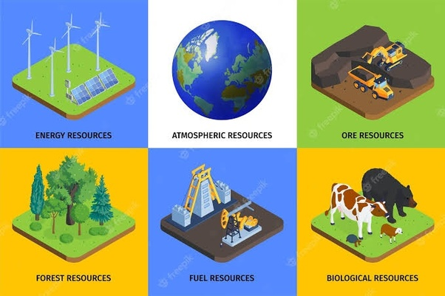
Natural Resources as Building Blocks:
All the useful materials we benefit from are synthesized from natural resources.
A natural resource is anything naturally occurring in the environment that humans use.
These resources may be pure elements, simple molecules, or complex molecules.

Slide 7

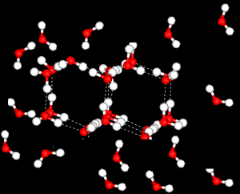
Natural Resources as Building Blocks:
Chemists assemble synthetic materials in an ordered set of steps, using chemical reactions to create the desired material.
The process can be replicated at a later time or by another lab to produce the same results.
Just the way you would build a house one brick at a time, a chemist synthesizes a material by adding molecular "blocks" one step at a time.
You build the house by moving the bricks into place by hand.
The chemist relies upon chemical reactions to move molecules into place.

Slide 8
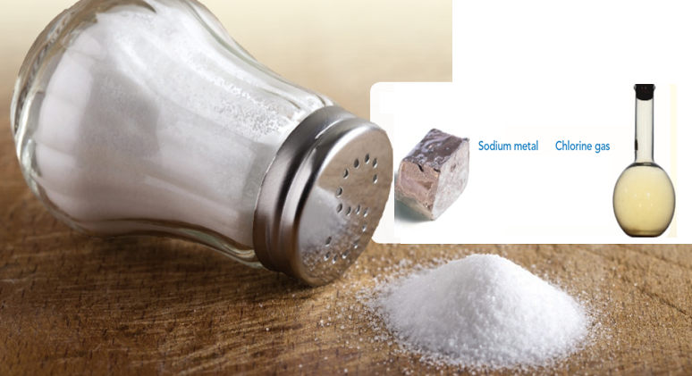
Properties of Pure Substances:
Every pure substance has characteristic physical and chemical properties that you use to identify it.
Substances react in characteristic, predictable ways, forming new materials with physical and chemical properties different from the original substances.
For example, sodium is a soft metal with a low melting point, and chlorine is a toxic gas.
When sodium burns in chlorine gas, the product formed by the reaction is sodium chloride (NaCl).
As you may recall, sodium chloride is table salt.
The reaction of two substances produces a new material with completely different properties, and we can eat it!
Sodium is a soft metal with a low melting point, and chlorine is a toxic gas.
When sodium burns in chlorine gas, the product formed by the reaction is sodium chloride (NaCl).

Slide 9
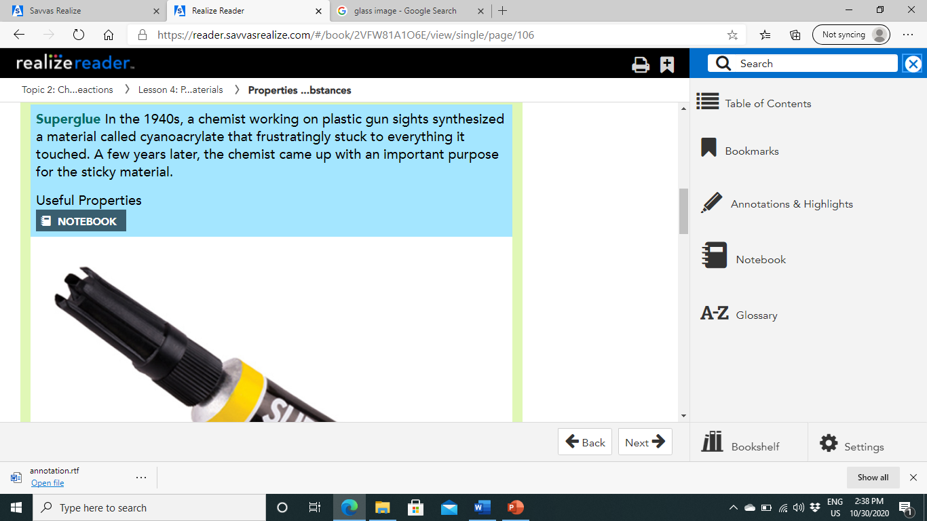

Properties of Pure Substances:
With the knowledge of the physical and chemical properties of substances and how they chemically react with each other, chemists can combine substances to produce materials that have specific structures and that serve particular functions.
This isn't to say that all synthetic materials are created on purpose, as shown in Figure 2.

Slide 10
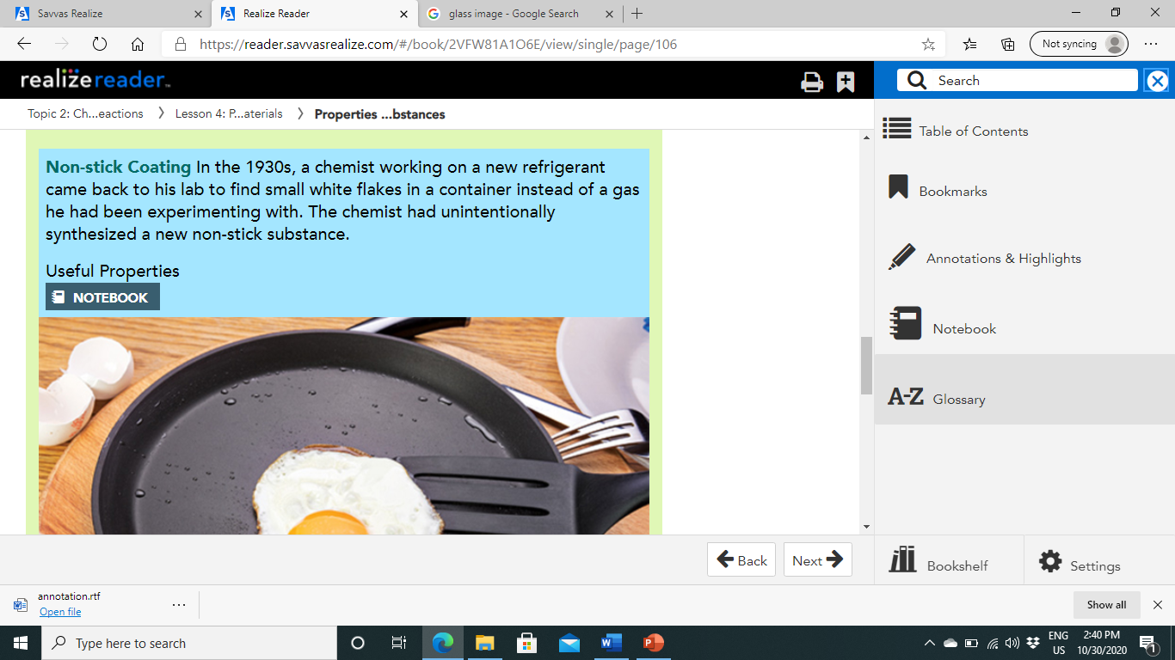
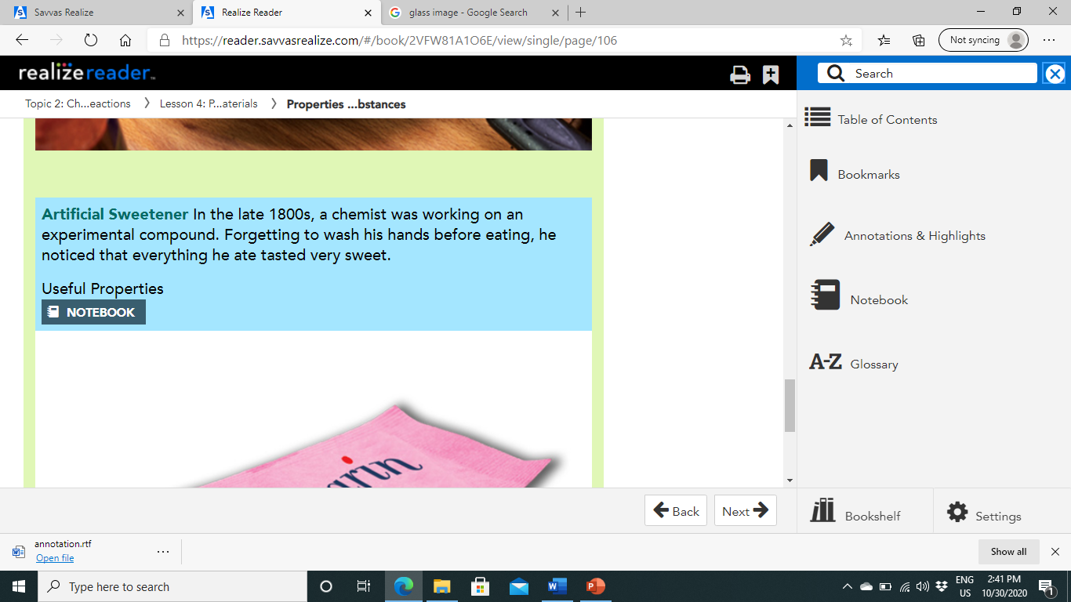



Slide 11
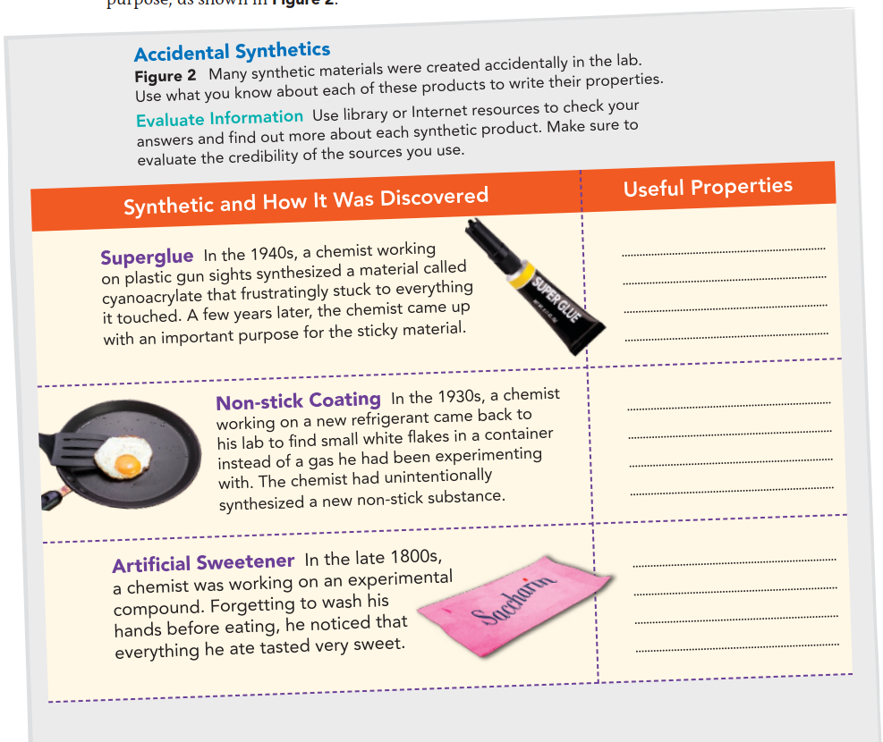
forms very strong bonds
without requiring water
or heat
High melting point,
prevents materials from
sticking to it
Tastes sweet, dissolves
easily in water

Slide 12
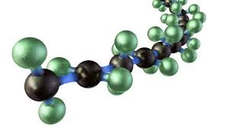
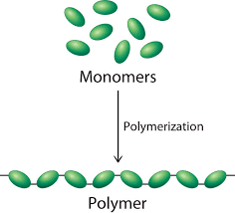
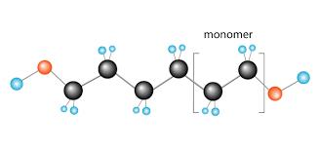
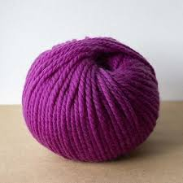
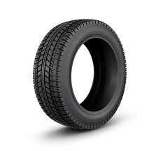

Polymers:
Many natural and artificial materials are made of polymers.
Polymers are long chains of molecules that are made up of repeating units called monomers.
Polymers occur naturally and have been used by people for centuries.
They include wool, silk, rubber, and cellulose.
Polymers have many different and important properties, such as strength, flexibility, and elasticity, all due to the structure of long molecule chains.
Polymers that don't occur naturally are synthesized in large quantities to provide clothes, building materials, and most of our material goods.
Plastic water bottles and toothbrushes (Figure 3) are made of polymers.

Slide 13
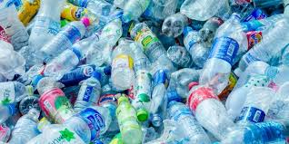
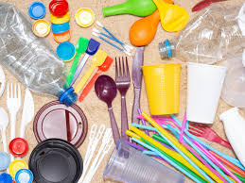
The most common synthetic polymers are plastics.
Plastics are moldable substances that are strong but flexible.
These synthetic materials are usually made from petroleum, a natural resource.
While plastics have revolutionized our lives, they also are generally resistant to breaking down and biodegrading.
They contribute to pollution when they are not recycled.

Slide 14
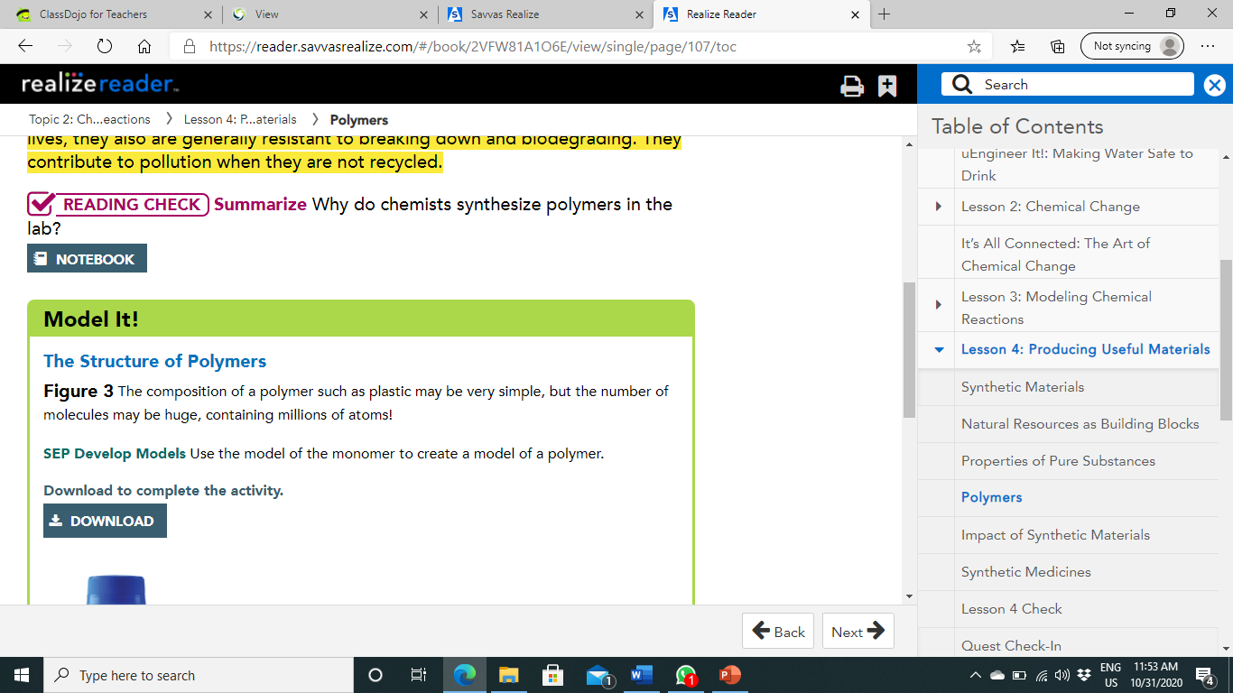
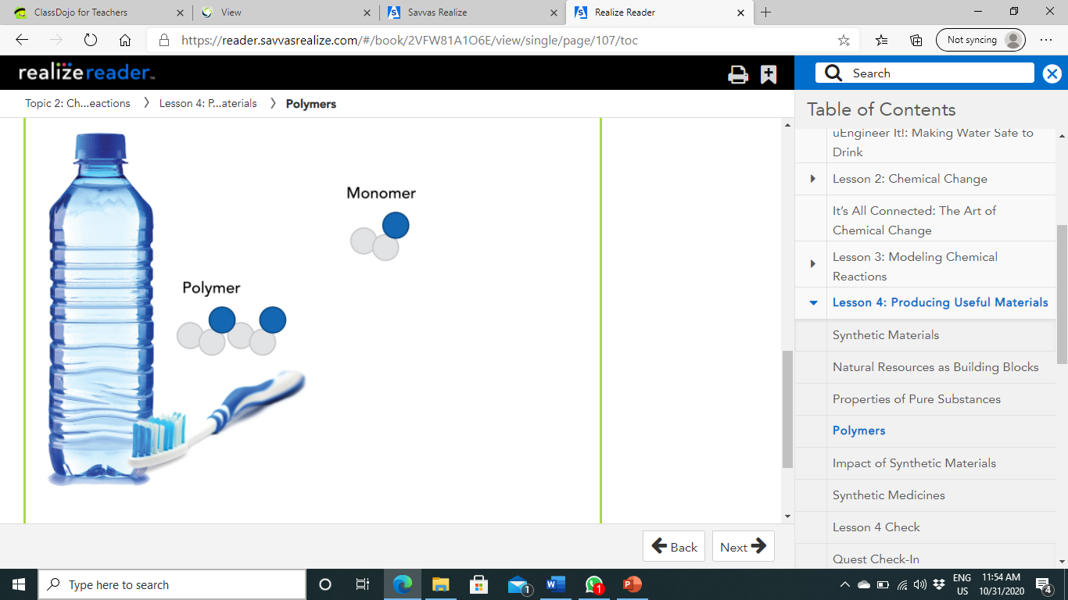
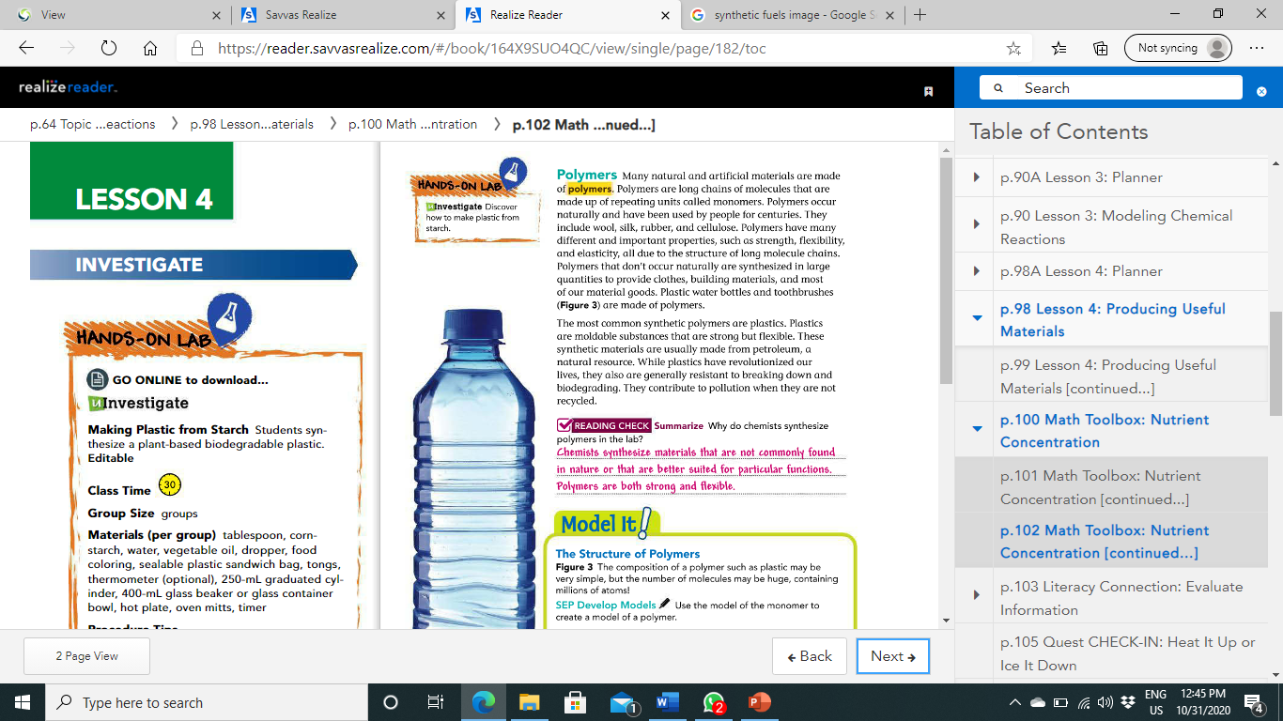
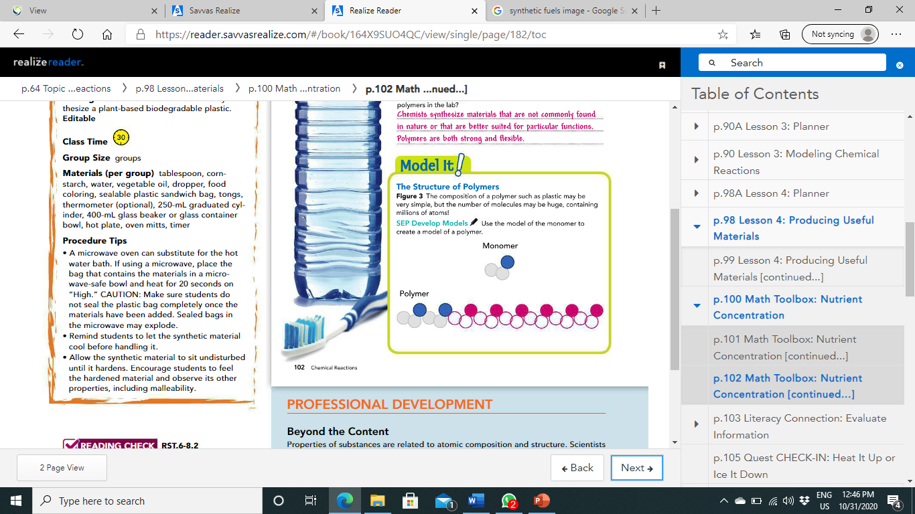

Slide 15
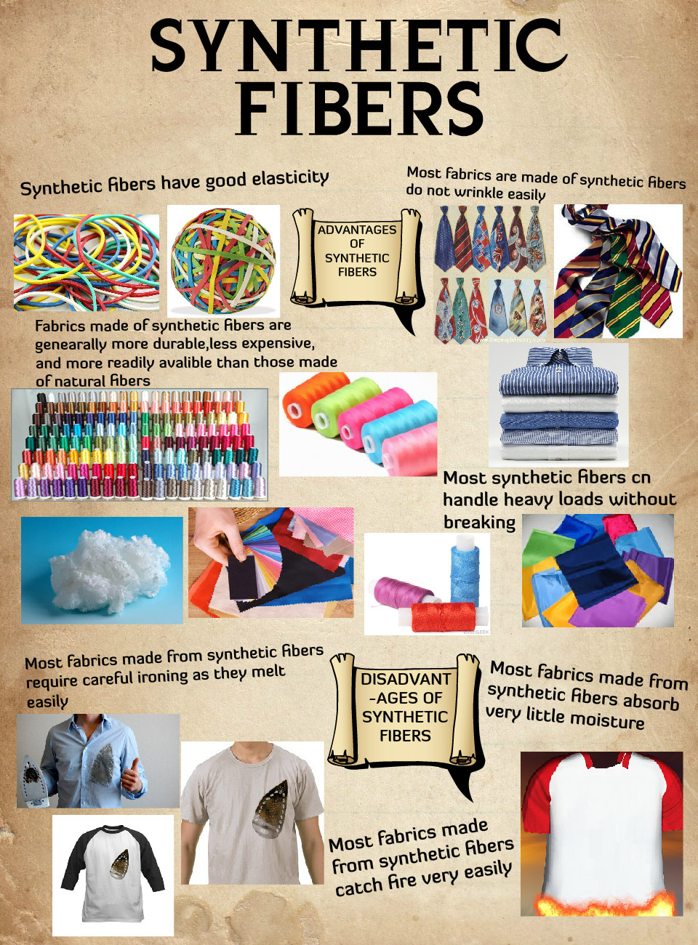
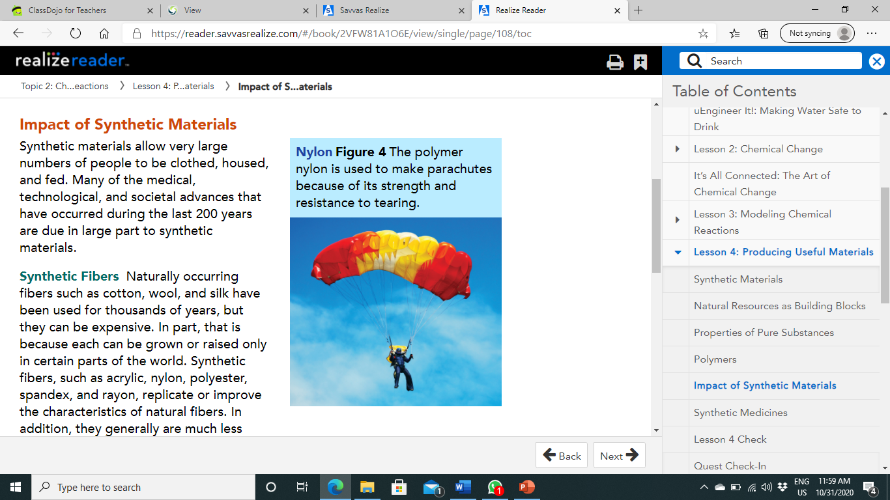
Impact of Synthetic Materials:
Synthetic materials allow very large numbers of people to be clothed, housed, and fed.
Many of the medical, technological, and societal advances that have occurred during the last 200 years are due in large part to synthetic materials.
Synthetic Fibers:
Naturally occurring fibers such as cotton, wool, and silk have been used for thousands of years, but they can be expensive.
In part, that is because each can be grown or raised only in certain parts of the world.
Synthetic fibers, such as acrylic, nylon, polyester, spandex, and rayon, replicate or improve the characteristics of natural fibers.
In addition, they generally are much less expensive to produce.
Synthetic fibers last longer, dry more quickly, and clean more easily than natural fibers, although they often burn more easily.

Slide 16
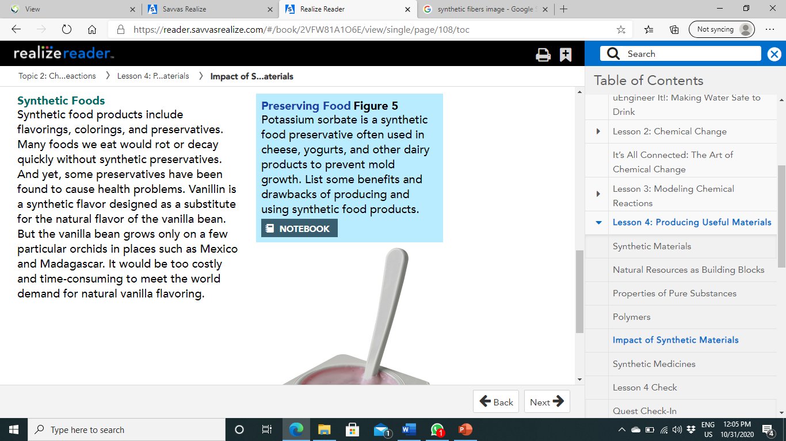
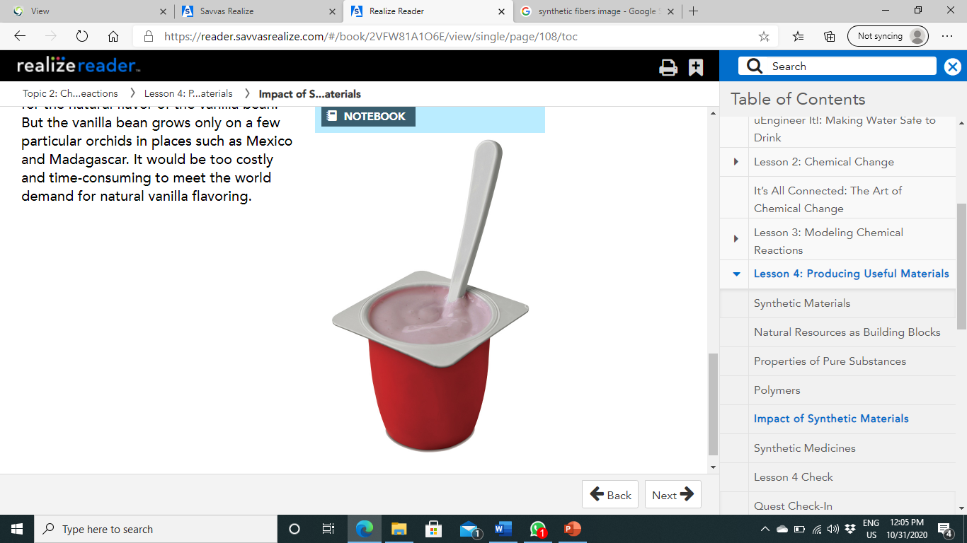
Synthetic Foods:
Synthetic food products include flavorings, colorings, and preservatives.
Many foods we eat would rot or decay quickly without synthetic preservatives.
And yet, some preservatives have been found to cause health problems.
Vanillin is a synthetic flavor designed as a substitute for the natural flavor of the vanilla bean.
But the vanilla bean grows only on a few particular orchids in places such as Mexico and Madagascar.
It would be too costly and time-consuming to meet the world demand for natural vanilla flavors.

Slide 17
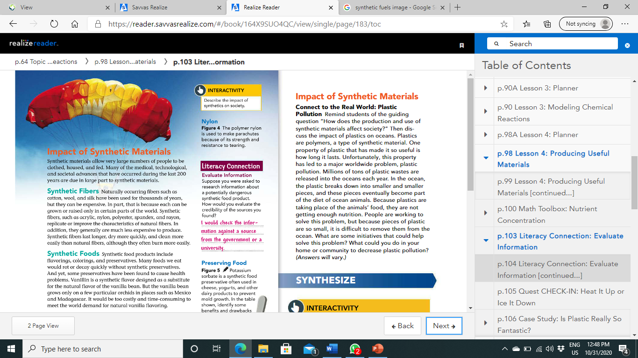
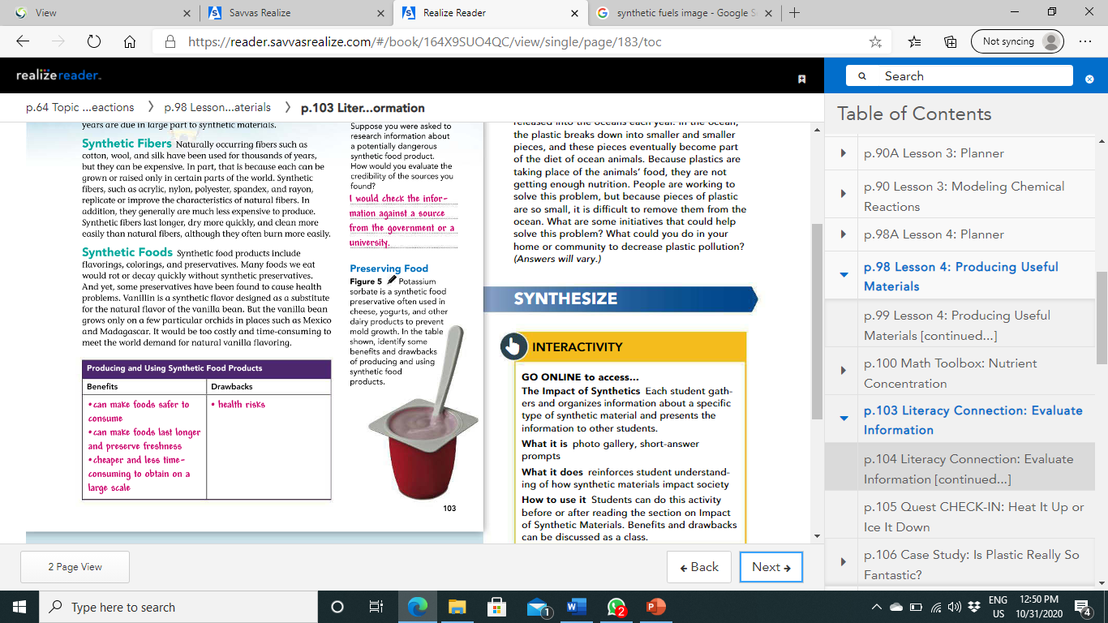

Slide 18
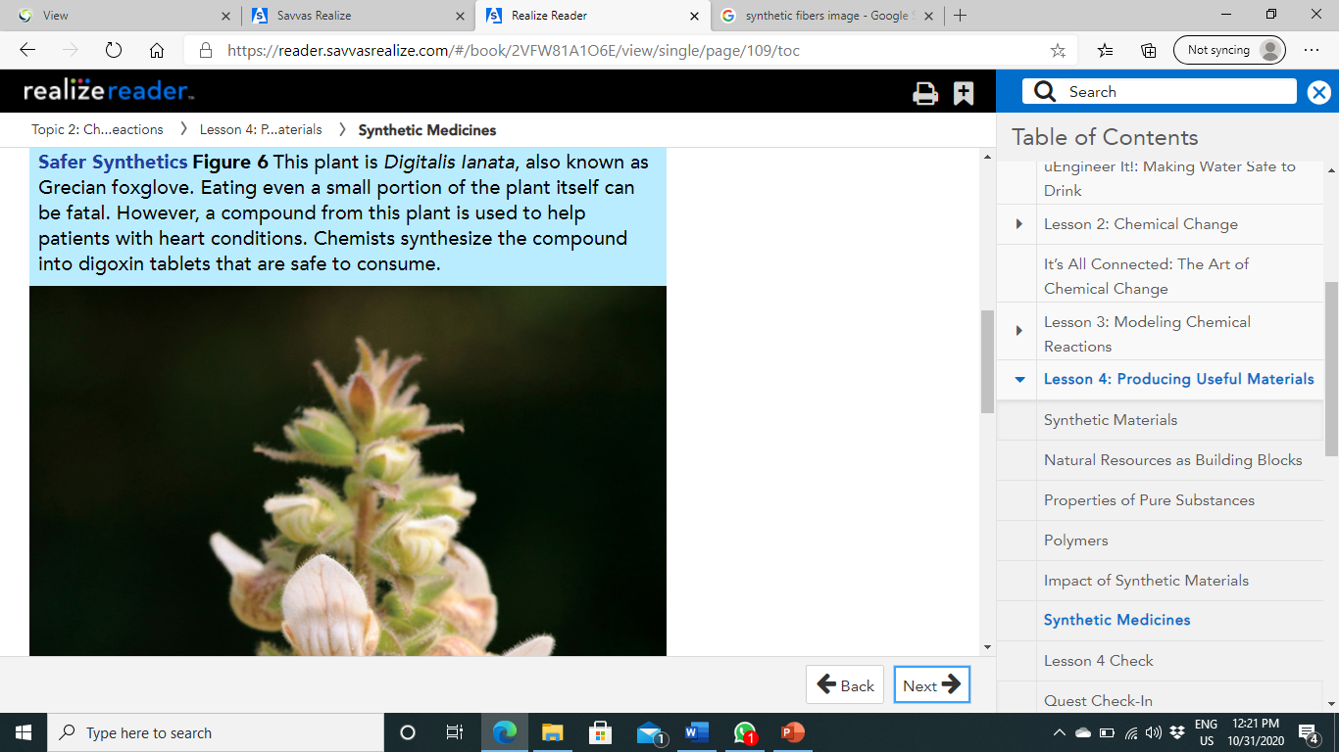
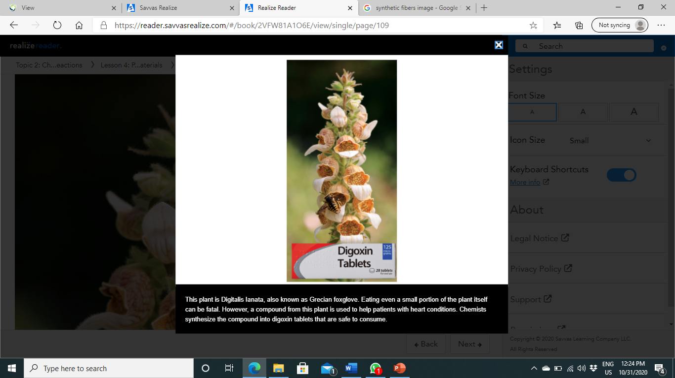
Synthetic Medicines:
If you have ever taken medicine for an illness, you have likely benefited from chemical synthesis in the form of pharmaceuticals.
Many synthetic chemicals are used to cure or reduce the effects of diseases and illnesses.
Many medical compounds have been discovered in plants.
Chemists can determine the chemical formula of these natural compounds and then produce them in large amounts and in safer forms through chemical synthesis.
Digitalis Lanata, produces a compound that benefits cardiac patients.
However, the plant is highly toxic to humans and animals.
Chemists have isolated and synthesized the compound, called digoxin, that provides the benefits without the toxic side effects.

Slide 19
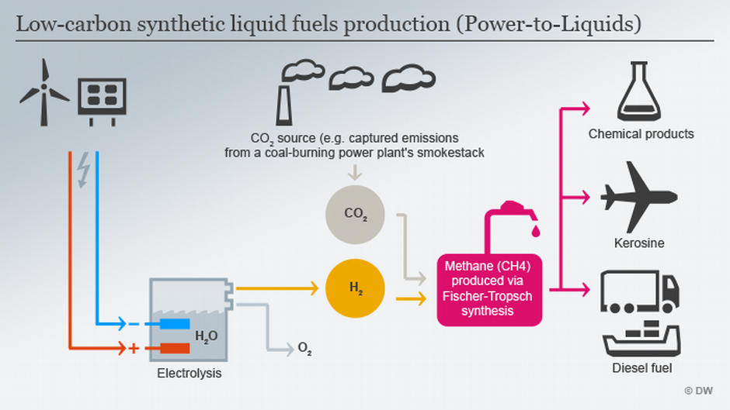
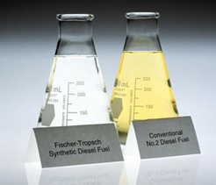
Synthetic Fuels:
One day, the world will run out of petroleum.
Cars and trains can run on electricity, but how will we power planes and boats?
Synthetic fuels of many kinds are made through chemical reactions.
Chemists have been exploring how to synthesize resources such as plants, animal oils, coal, algae, or other materials into fuels.

Slide 20
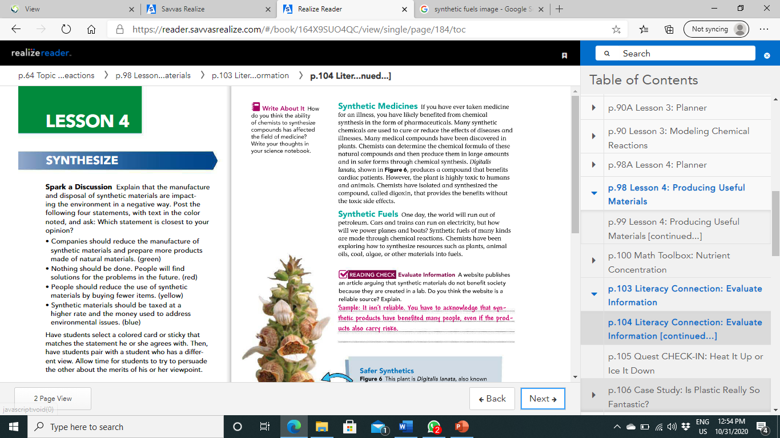

Slide 21
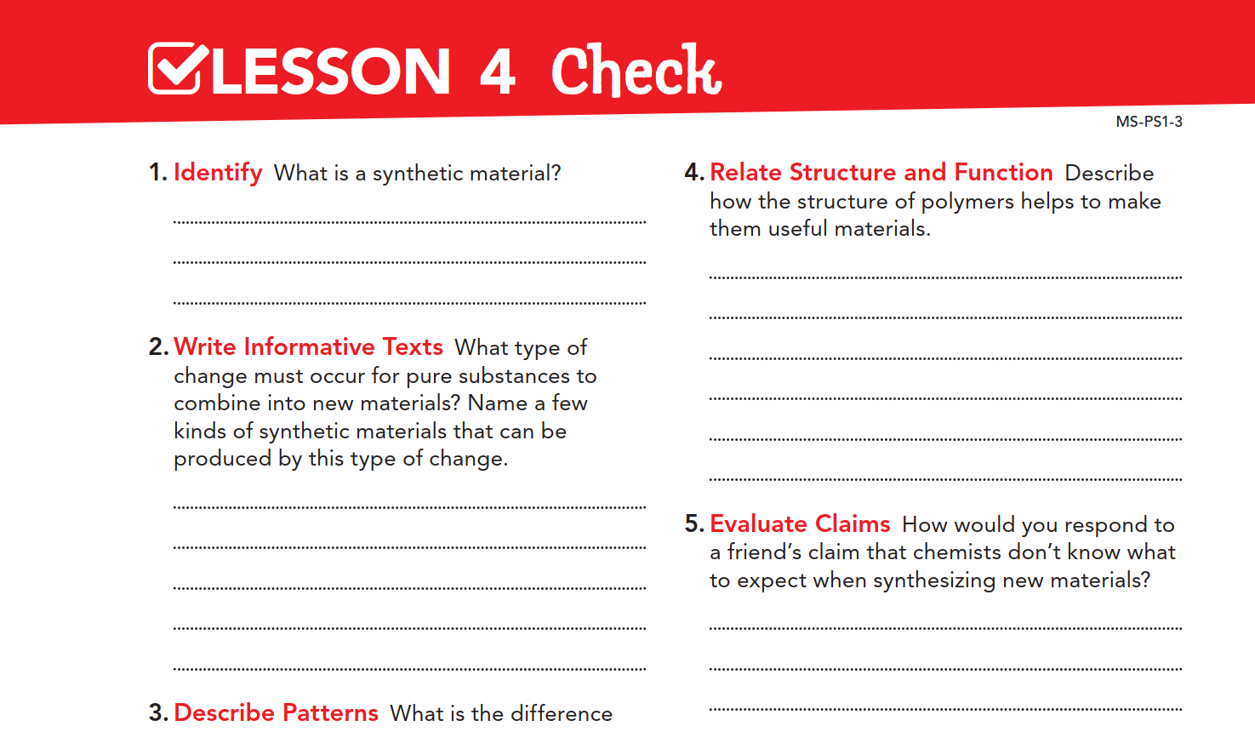
A material produced by humans that is the result of chemical reactions.
Polymers are long chains. This structure makes them durable and flexible, which are two useful qualities.
A chemical change must occur, Synthetic fuels, food products, medicines, and fibers can be produced as the result of chemical changes.

Slide 22
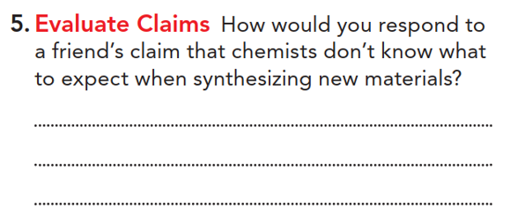
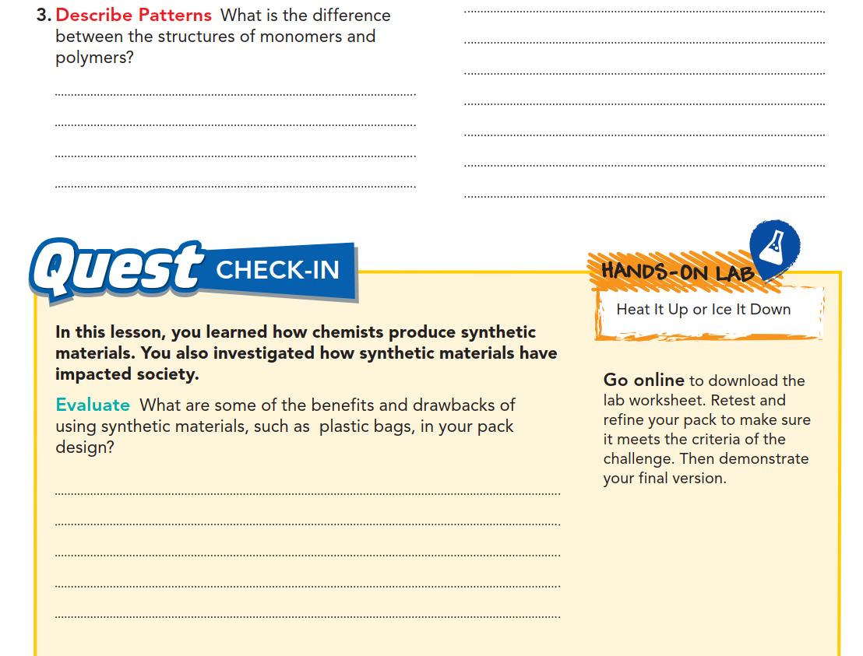
A polymer is a long chain of repeating monomers.
Pure substances can be identified by their properties, and substances combine in characteristic ways. So chemists would know what to expect when synthesizing new materials.
Synthetic materials such as plastic bags might have properties that are useful, like flexibility and the ability to hold the contents of my pack. But they may be more harmful to the environment, or they may cause allergic reactions.

Slide 23
