Slide 1

Circular and Projectile Motion
Notes:
Read the title of the Learning Experience.

Slide 2
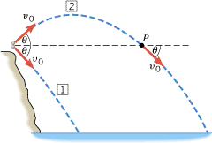
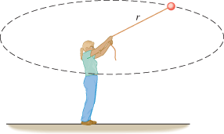
Objectives
Develop models to represent and analyze projectile motion and circular motion.
Use multiple equations and algebraic reasoning to solve projectile motion and circular motion problems.
You are standing at the edge of a cliff with a friend. You throw a rock straight out, horizontal to the ground, and your friend drops an identical rock from the same height. Which rock hits the ground first?
They both hit the ground at the same time, since their velocity vectors in the vertical
direction are the result of free-fall motion and the acceleration due to gravity.
The stone you throw outward will land farther away from the cliff, however.
If you twirl a washer on the end of a string at a consistent speed, is acceleration zero?
No, because in uniform circular motion, the direction of the velocity
is always changing, resulting in centripetal acceleration which is directed
toward the center.
Notes:
Click to reveal each of the learning objectives. Read the statements or ask a volunteer to do so.
Give students the following scenario:

Slide 3
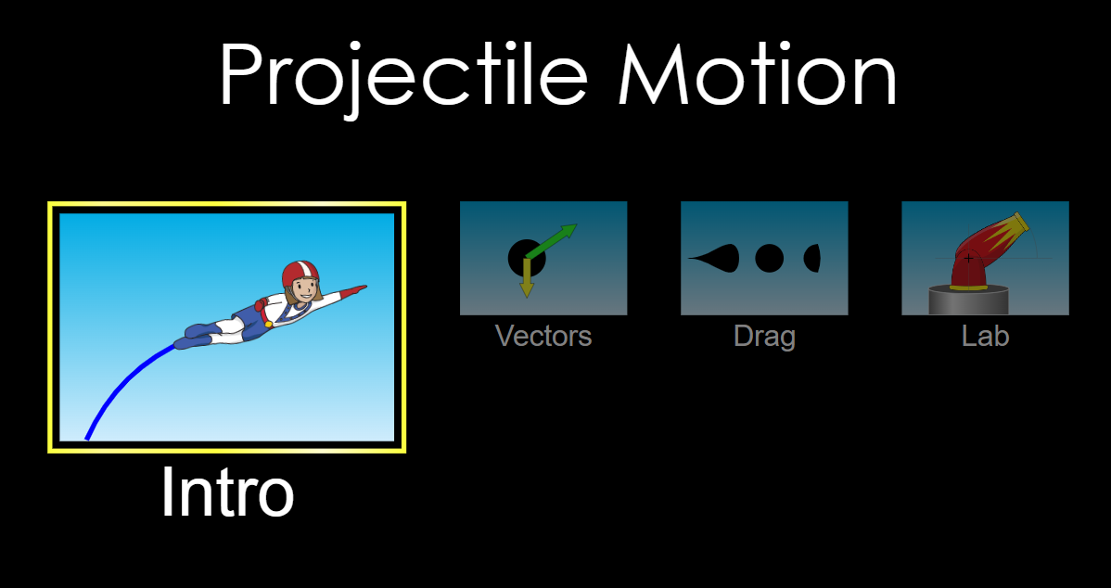
Notes:
https://phet.colorado.edu/sims/html/projectile-motion/latest/projectile-motion_all.html

Slide 4
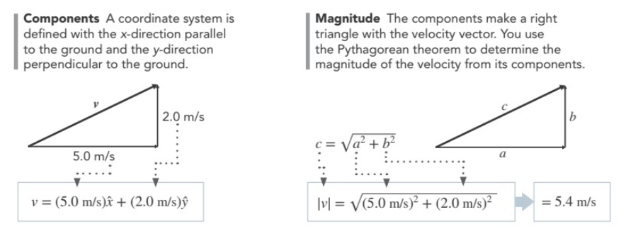
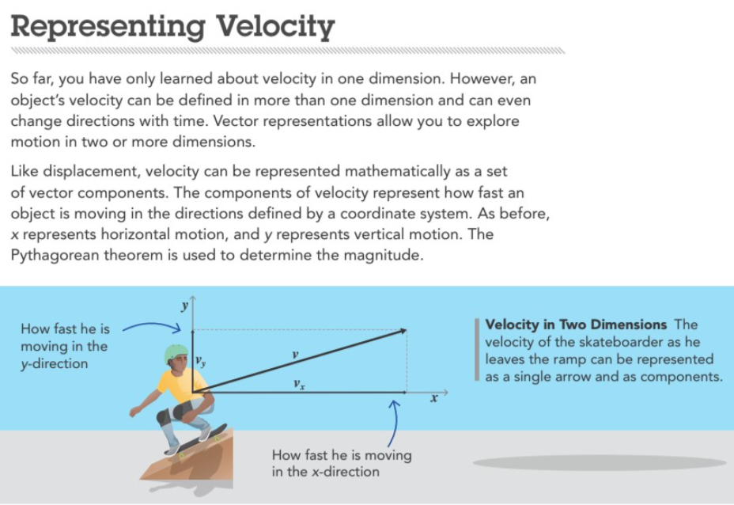

Slide 5
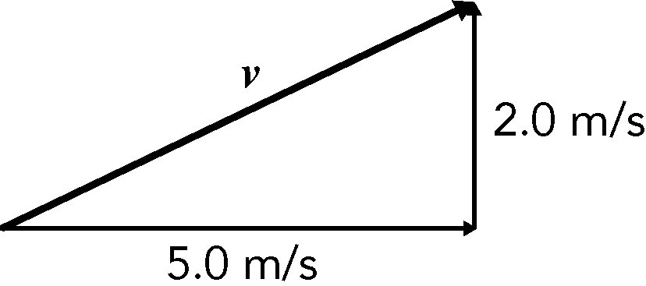
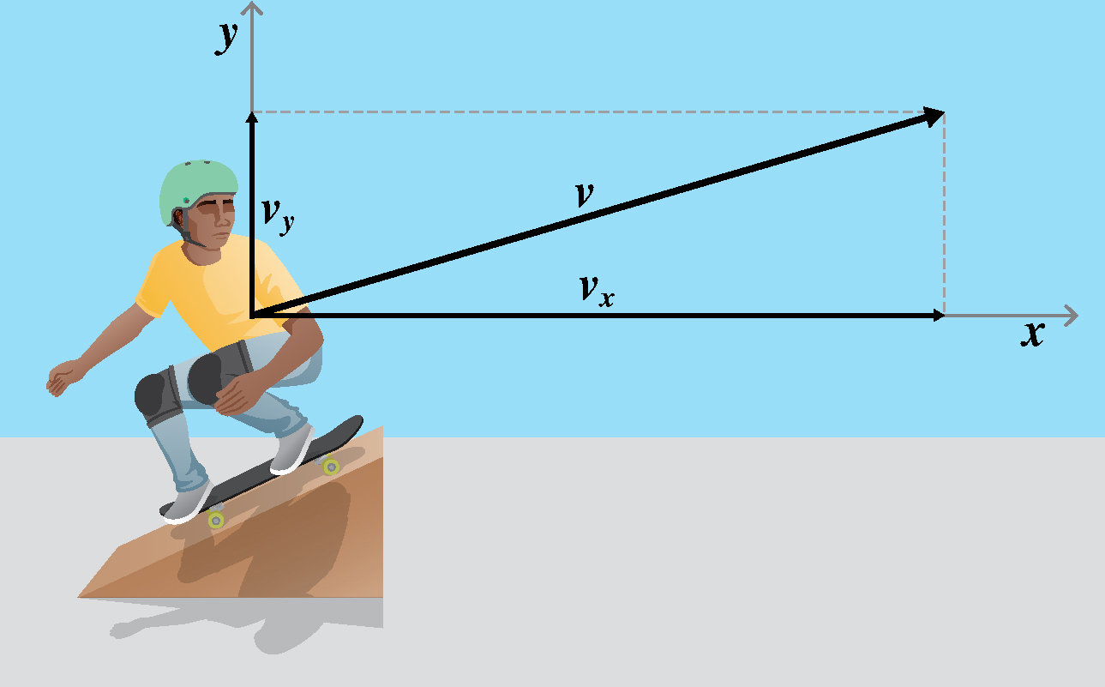
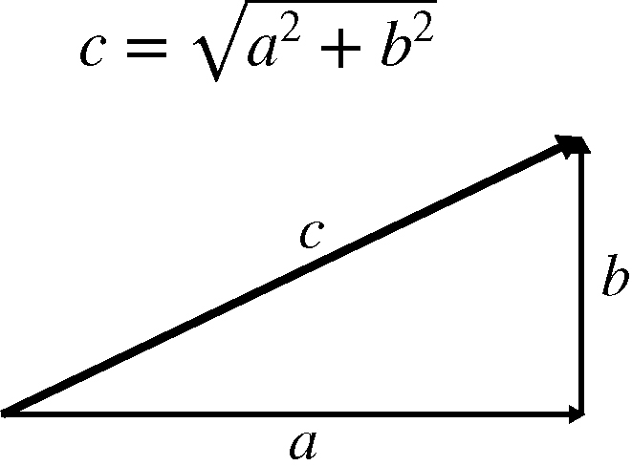
Representing Velocity
What is the magnitude of his velocity vector?
Velocity can be represented as a set of vector components which tell how fast an object is moving in the horizontal, x, and vertical, y, directions. The Pythagorean theorem is used to determine the magnitude of the velocity vector.
Using the Pythagorean theorem,
𝑐 = √(𝑎²+𝑏² ),
|𝑣| = √([(5.0 m/s)]² + [(2.0 m/s)]² ),
|𝑣| = 5.4 m/s
in the direction shown by the single velocity vector
Notes:
Read the text.
Give students a scenario of a skateboarder leaving a ramp with a 5.0 m/s x-component of velocity and a 2.0 m/s y-component of velocity.
Click to add the vector diagram.
Ask: What is the magnitude of his velocity vector?
Click to add the Pythagorean theorem equation and right triangle. (Answer: Using the Pythagorean theorem, 𝑐 = √(𝑎²+𝑏² ), |𝑣| = √(〖(5.0 m/s)]² + 〖(2.0 m/s)〗² ), |𝑣| = 5.4 m/s in the direction shown by the single velocity vector)

Slide 6
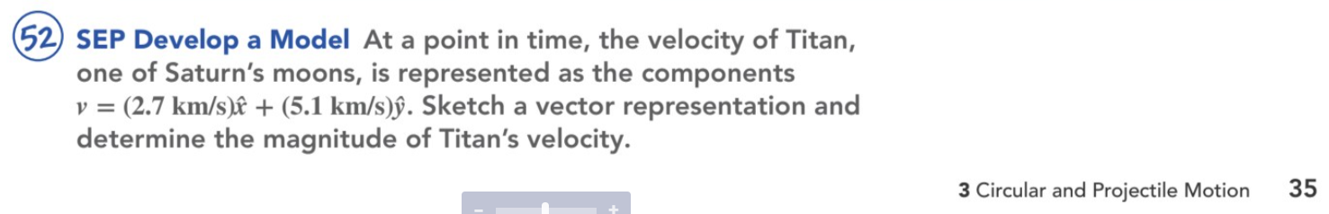

Slide 7
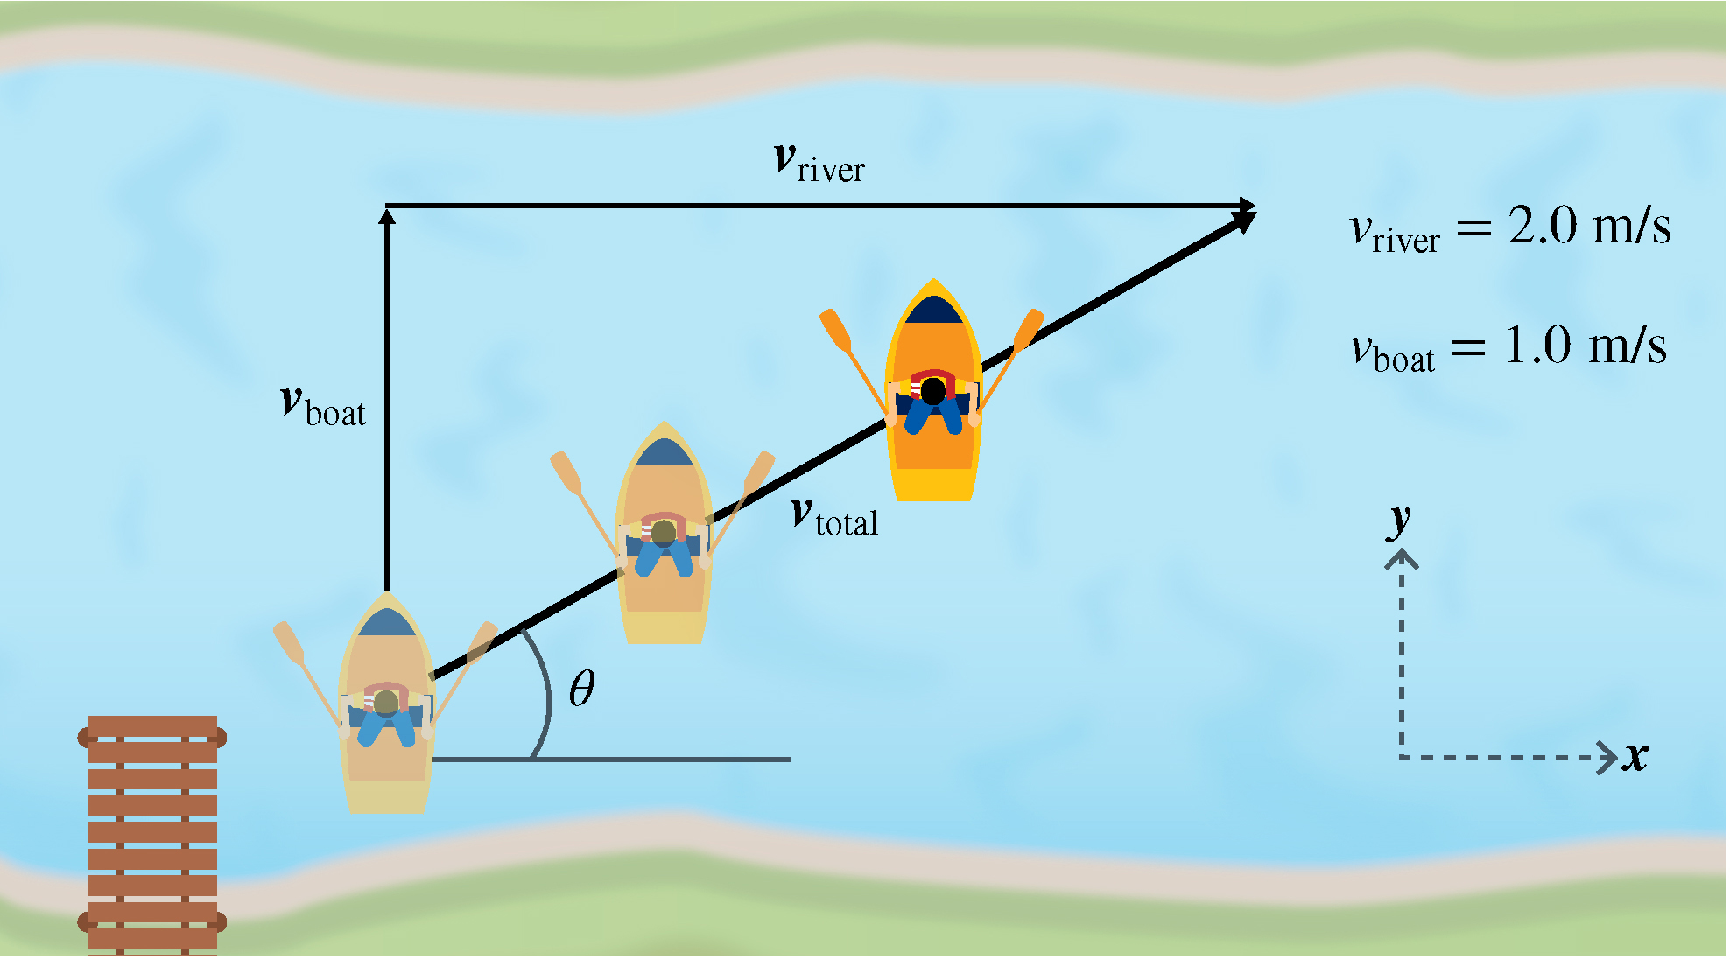
Adding Velocities in Two Dimensions
Does v_{boat} have an x-component?
No, it only has a y-component since the person is attempting to row straight across the river.
Does v_{river} have a y-component? No, it only has an x-component since the river is flowing downstream in the x direction.
How to find v_{total}, the resultant velocity.
Add the x-components from the boat and river. Add the y-components from the boat and river. The results are the x-component and the y-component of the resultant.
Use the Pythagorean theorem to find the magnitude of the resultant velocity vector.
The horizontal and vertical components of velocity are independent of each other and can be added and subtracted analytically.
Notes:
Read the text.
Does v_{boat} have an x-component? (Answer: No, it only has a y-component since the person is attempting to row straight across the river.)
Does v_{river} have a y-component? (Answer: No, it only has an x-component since the river is flowing downstream in the x direction.)
Have a volunteer explain how to find v_{total}, the resultant velocity. (Sample answer: Add the x-components from the boat and river. Add the y-components from the boat and river. The results are the x-component and the y-component of the resultant. Use the Pythagorean theorem to find the magnitude of the resultant velocity vector.)

Slide 8

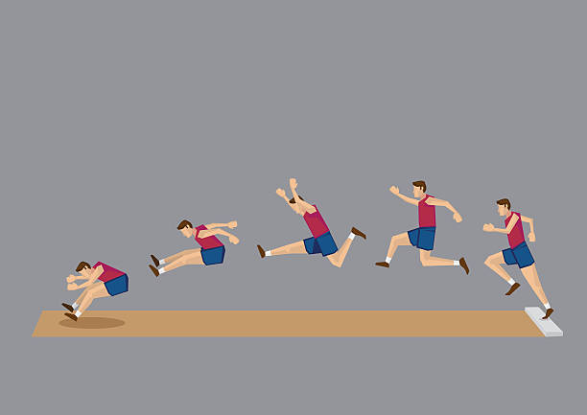
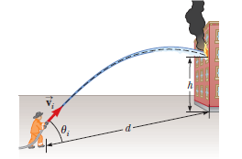
What are some common examples of projectile motion?
A softball after you throw it, your body as you fly through the air during a long jump, or a stream of water from a hose.
You analyze projectile motion by separating it into two independent one-dimensional motions, one along the horizontal axis and the other along the vertical axis.

Slide 9
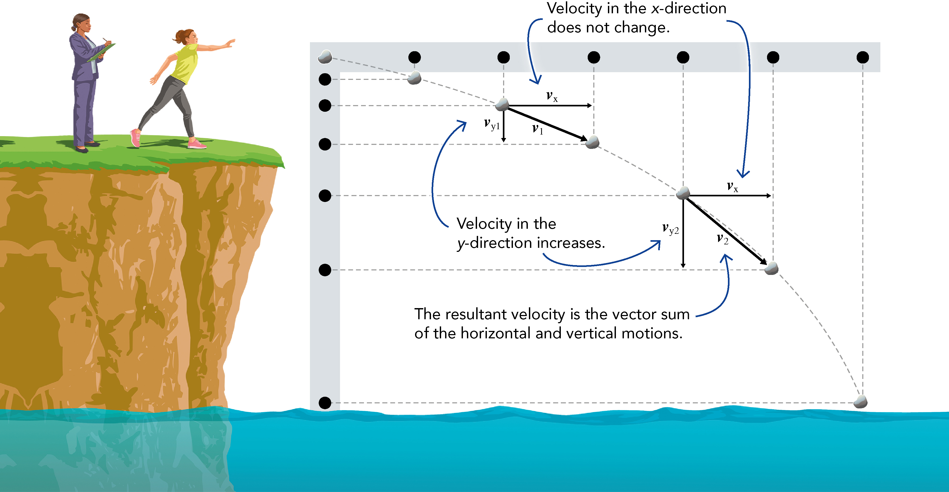
Projectile Motion
In which direction does the object experience constant acceleration?
In the vertical direction, an object in projectile motion experiences constant acceleration, g, due to gravity.
Why are the dots on the horizontal dot diagram spaced uniformly?
In the horizontal direction an object in projectile motion experiences constant velocity, so the dots are the same distance apart.
Trajectory graph is a two-dimensional dot diagram that shows the object’s total trajectory. Don’t confuse a trajectory graph with a position vs. time graph, since they look similar for the y-directed motion.
Projectile motion is the combination of uniform motion parallel to Earth’s surface and free-fall motion with constant acceleration due to gravity.
Notes:
Read the text.
Ask: What are some common examples of projectile motion? (Sample answers: A softball after you throw it, your body as you fly through the air during a long jump, or a stream of water from a hose)
Explain that you analyze projectile motion by separating it into two independent one-dimensional motions, one along the horizontal axis and the other along the vertical axis.
Ask: In which direction does the object experience constant acceleration? (Answer: In the vertical direction, an object in projectile motion experiences constant acceleration, g, due to gravity.)
Ask: Why are the dots on the horizontal dot diagram spaced uniformly? (Answer: In the horizontal direction an object in projectile motion experiences constant velocity, so the dots are the same distance apart.)
Explain that a trajectory graph is a two-dimensional dot diagram that shows the object’s total trajectory. Remind students not to confuse a trajectory graph with a position vs. time graph, since they look similar for the y-directed motion.

Slide 10
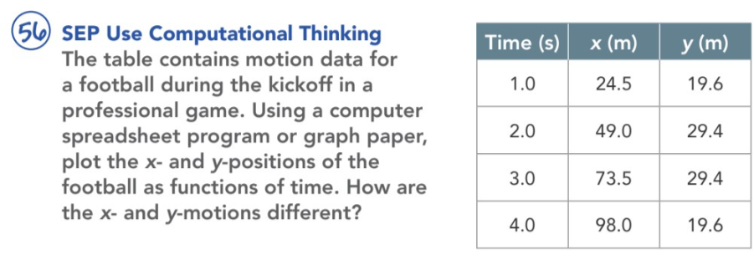
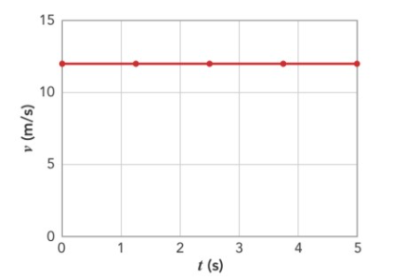

25
100
90
20
80
70
60
50
25
40
20
30
20
10

Slide 11
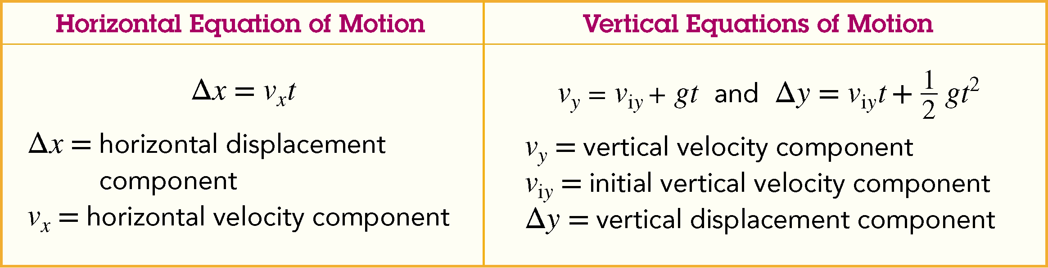
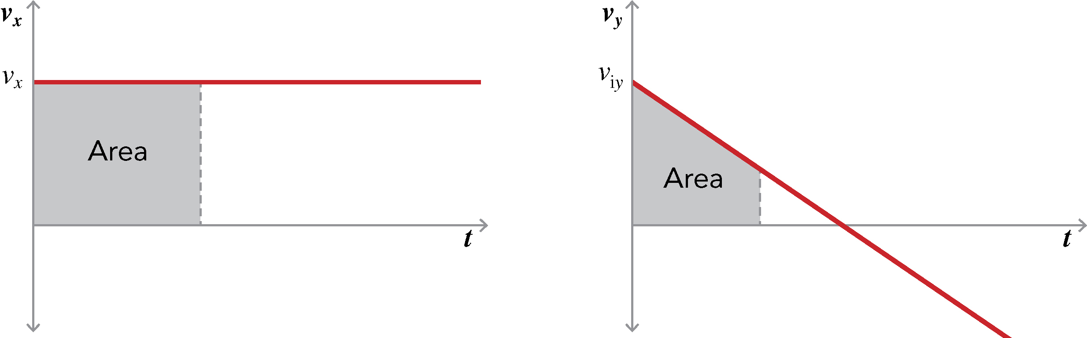
Modeling Projectile Motion
What is the horizontal displacement of a projectile dependent on?
v_{x}, because the horizontal velocity is constant
Is the vertical equations of motion look familiar.
Yes, they are similar to the equations for velocity and displacement for constant accelerated motion. For example, the acceleration, a, of a car on a road is now replaced by the acceleration, g, of gravity for objects in projectile motion.
Recall that when they modeled uniform motion, they found the displacement by finding the area under the function of a velocity vs. time graph. Likewise, for projectile motion, the horizontal displacement component equals the area under the function.
Is v_{x} affected by gravity?
No, the x and y components of velocity are independent.
Why is the slope of the graph on the right negative?
Because the acceleration due to gravity is in a downward, or negative direction, and the slope is the acceleration
The equations of projectile motion describe the horizontal and vertical components of an object’s velocity and displacement at all times.
Horizontal motion
Vertical motion
Notes:
Have a student read the text.
Click to show the horizontal and vertical equations of motion.
Ask: What is the horizontal displacement of a projectile dependent on? (Answer: v_{x}, because the horizontal velocity is constant)
Ask students if the vertical equations of motion look familiar. (Sample answer: Yes, they are similar to the equations for velocity and displacement for constant accelerated motion. For example, the acceleration, a, of a car on a road is now replaced by the acceleration, g, of gravity for objects in projectile motion.)
Click to show the velocity graphs.
Prompt students to recall that when they modeled uniform motion, they found the displacement by finding the area under the function of a velocity vs. time graph. Likewise, for projectile motion, the horizontal displacement component equals the area under the function.
Ask: Is v_{x} affected by gravity? (Answer: No, the x and y components of velocity are independent.)
Why is the slope of the graph on the right negative? (Answer: Because the acceleration due to gravity is in a downward, or negative direction, and the slope is the acceleration)

Slide 12
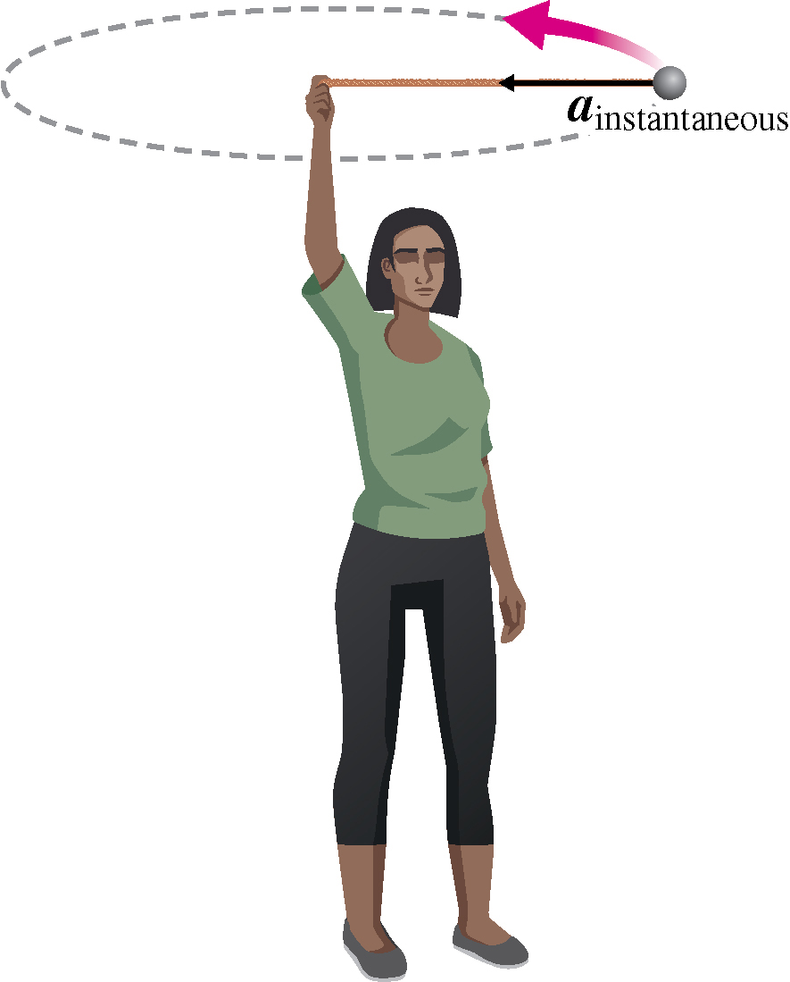
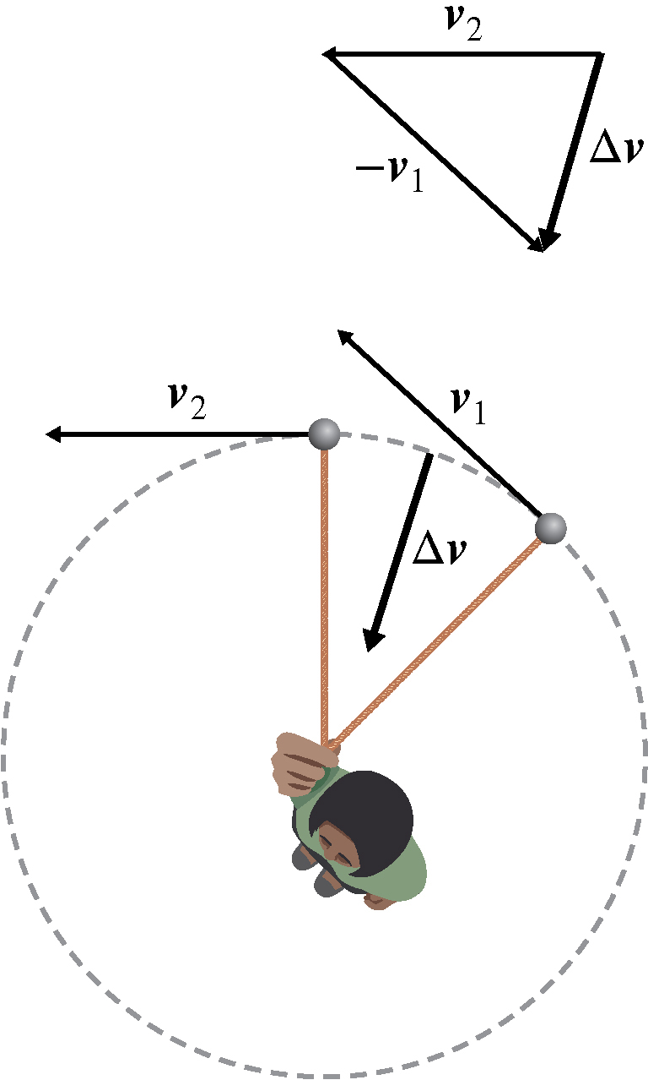
Circular Motion
Velocity is center-seeking by looking at the velocity at two instances in time.
This is the overhead view image and head-to-tail method image.
Note the head-to-tail method diagram used to determine the direction of the change in velocity.
In what direction is the change in velocity?
Toward the center
The acceleration of an object in uniform circular motion is called centripetal acceleration. The magnitude is determined by using the concept of similar triangles.
In what direction do you think the acceleration vector points?
Toward the center, the same as the direction of the change in velocity.
In uniform circular motion, an object travels in a circular path at a constant speed. The magnitude of the velocity stays the same, but the direction of the velocity constantly changes.
Notes:
Have a student read the text.
Explain that you can show the velocity is center-seeking by looking at the velocity at two instances in time.
Click to show the overhead view image and head-to-tail method image.
Prompt students to note the head-to-tail method diagram used to determine the direction of the change in velocity.
Ask: In what direction is the change in velocity? (Answer: Toward the center)
Explain that the acceleration of an object in uniform circular motion is called centripetal acceleration. The magnitude is determined by using the concept of similar triangles.
Ask: In what direction do you think the acceleration vector points? (Answer: Toward the center, the same as the direction of the change in velocity.)

Slide 13
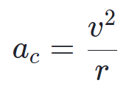
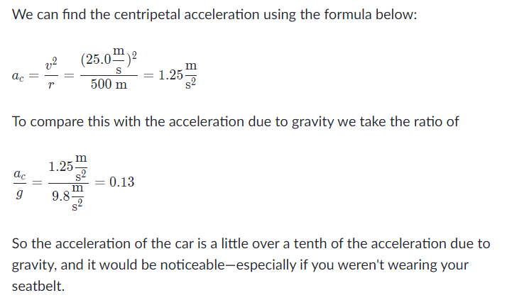
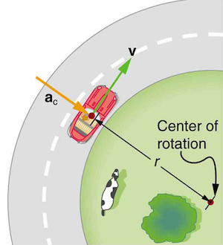
What do solved examples involving centripetal acceleration look like?
Example 1: Curving car
What is the magnitude of the centripetal acceleration of a car following a curve, see figure below, of radius 500 m at a speed of 25 m/s—about 90 km/hr? Compare the acceleration with that due to gravity for this fairly gentle curve taken at highway speed.

Slide 14
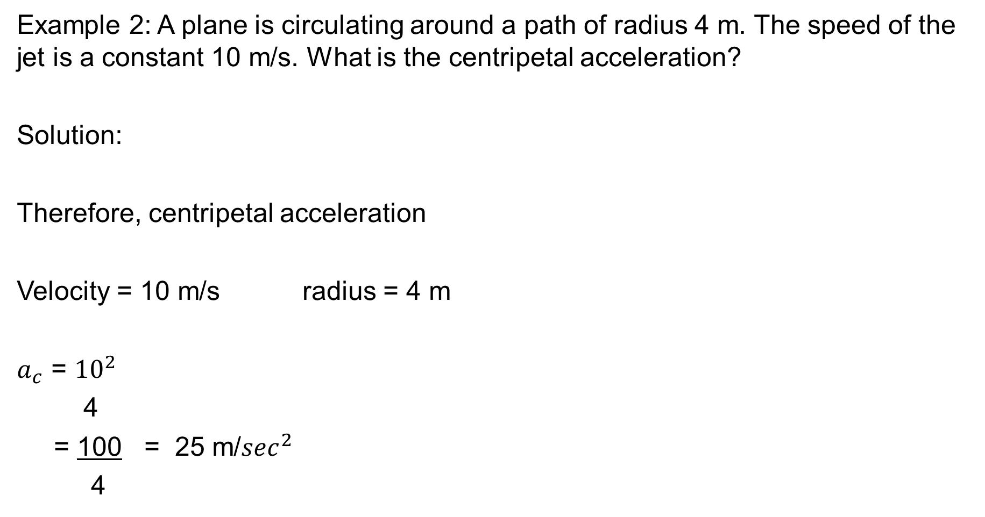
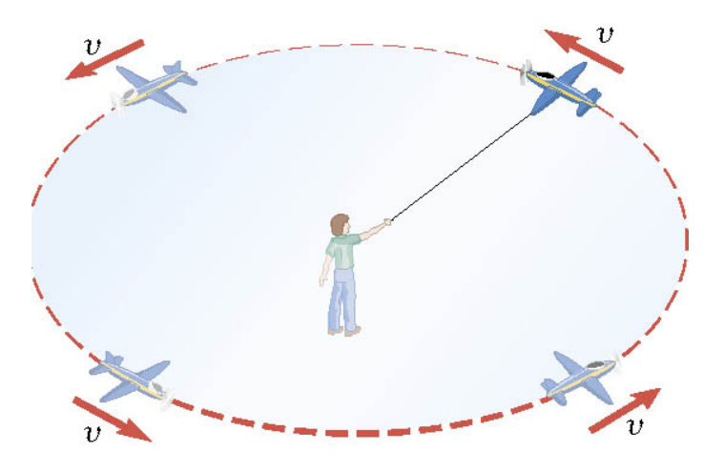

Slide 15
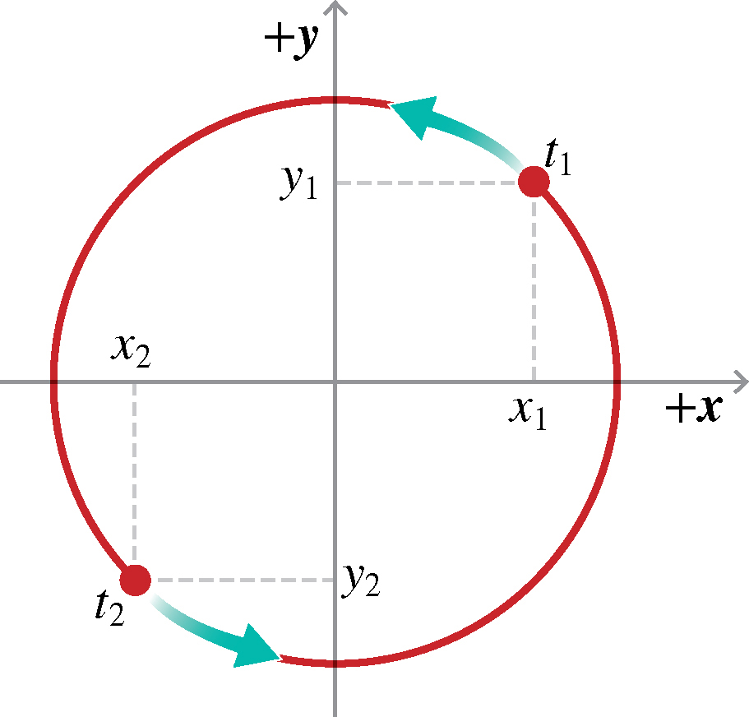
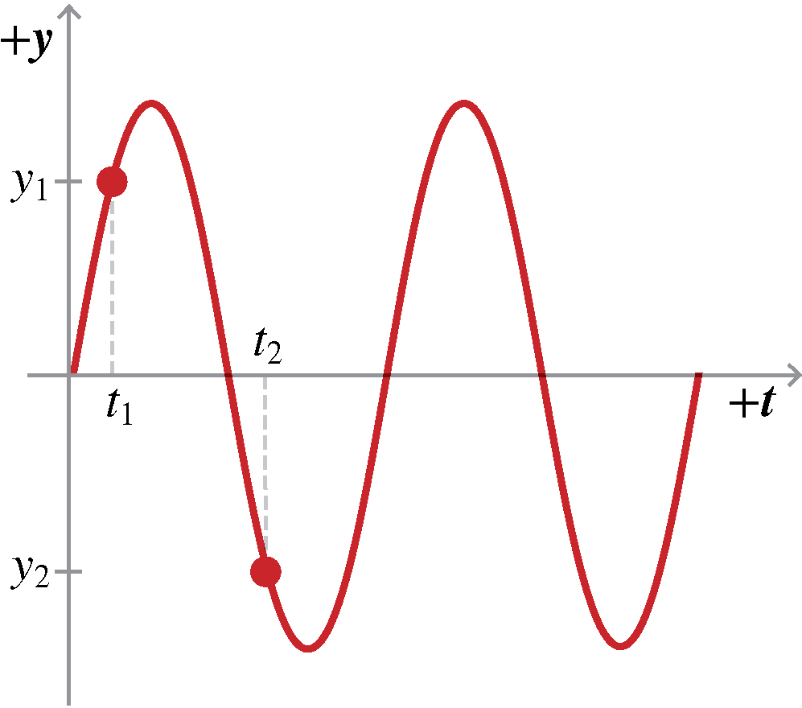
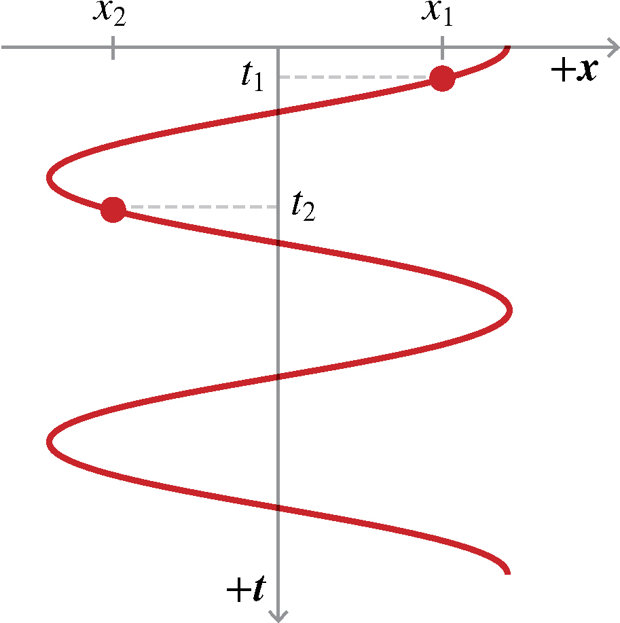
Graphing Circular Motion
Oscillatory motion is a motion in which an object repeats the same movement over and over.
What is a way to describe oscillatory motion mathematically?
Using a sine wave or a cosine wave
Which trigonometric curve describes the position graph for vertical motion?
A sine wave
Which trigonometric curve describes the position graph for horizontal motion?
A cosine wave
The trajectory graph for uniform circular motion is a circle, but the position graphs for the horizontal and vertical motions appear to oscillate like sine and cosine waves.
Sine wave
Cosine wave
Notes:
Have a student read the text.
Explain that oscillatory motion is a motion in which an object repeats the same movement over and over.
Ask: What is a way to describe oscillatory motion mathematically? (Answer: Using a sine wave or a cosine wave)
Click to show the sine and cosine waves.
Ask: Which trigonometric curve describes the position graph for vertical motion? (Answer: A sine wave)
Ask: Which trigonometric curve describes the position graph for horizontal motion? (Answer: A cosine wave)

Slide 16
If the average hang time of a professional football kick is 4.4 s, then
determine the average maximum height.
To determine the maximum height, we can use the following kinematic equation:
h = v₀t - (1/2)gt²
where:
h is the maximum height
v₀ is the initial vertical velocity
t is the time taken to reach maximum height (half of the hang time)
g is the acceleration due to gravity (approximately 9.81 m/s²)
Given:
Hang time = 4.4 s
Time to reach maximum height (t) = 4.4 s / 2 = 2.2 s
To find v₀:
At the maximum height, the vertical velocity becomes zero. We can use the following equation to find the initial vertical velocity: ¹
1. www.numerade.com
www.numerade.com
v = v₀ - gt
At maximum height, v = 0:
0 = v₀ - gt
Rearranging:
v₀ = gt
Substituting the values:
v₀ = (9.81 m/s²) * (2.2 s) ≈ 21.58 m/s
Now, we can calculate the maximum height:
h = (21.58 m/s)(2.2 s) - (1/2)(9.81 m/s²)(2.2 s)²
Calculating:
h ≈ 23.74 meters
Therefore, the average maximum height of the kick is approximately 23.74 meters.

