Slide 1

Acceleration
Notes:
Read the title of the Learning Experience.

Slide 2
Objectives
Calculate instantaneous velocity using a tangent line on a position vs. time graph.
Use mathematical representations (diagrams, graphs, and equations) to analyze the acceleration of an object.
Identify cause-and-effect relationships related to constant acceleration, including acceleration due to gravity.
Use algebraic reasoning to solve problems involving uniform or nonuniform motion.
What causes displacement to be less than distance traveled?
If an object returns to where it started, or if it takes an indirect route to a new position, displacement will be less than distance traveled.
If velocity is constant for a given time interval, what is acceleration for that time interval?
Zero
Notes:
Click to reveal each of the learning objectives. Read the statements or ask a volunteer to do so.
Ask: What causes displacement to be less than distance traveled? (Sample answer: If an object returns to where it started, or if it takes an indirect route to a new position, displacement will be less than distance traveled.) Ask: If velocity is constant for a given time interval, what is acceleration for that time interval? (Answer: Zero)

Slide 3
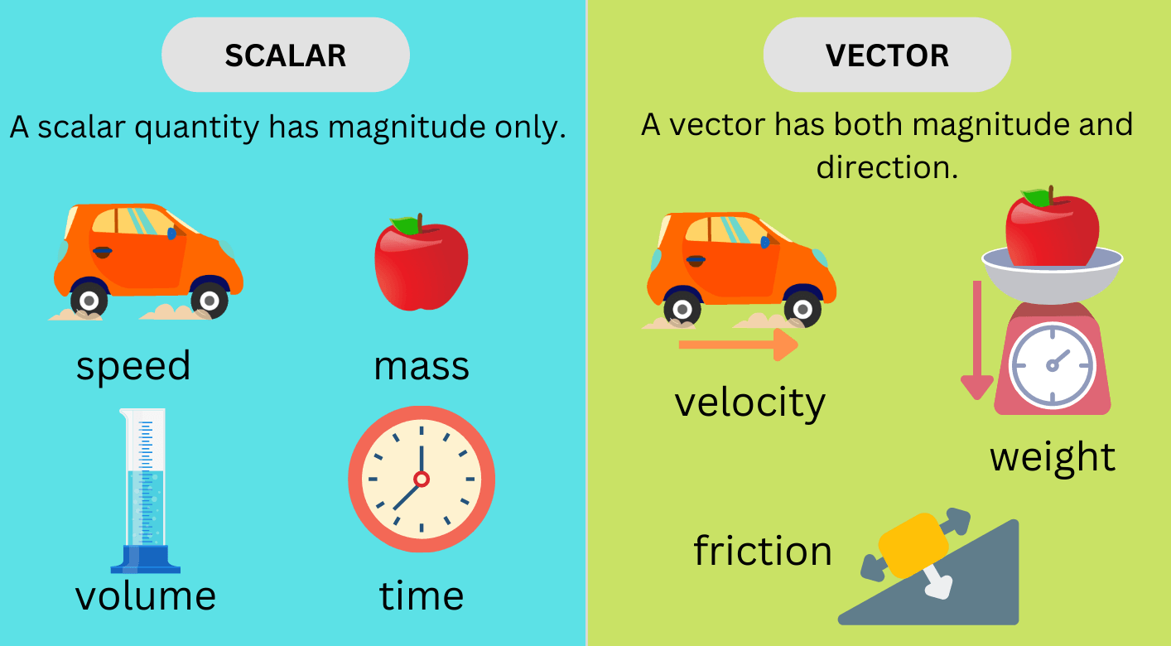
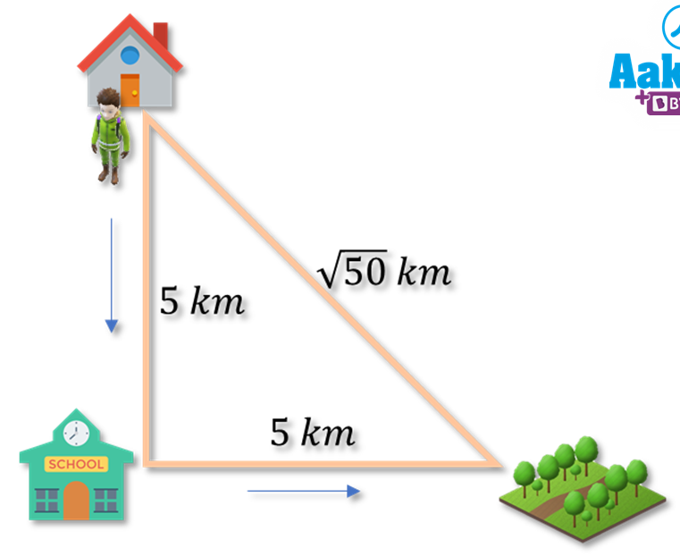
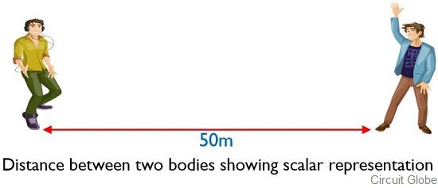
Scalars and vectors are two kinds of quantities that are used in physics and math. Scalars are quantities that only have magnitude (or size), while vectors have both magnitude and direction. Explore some examples of scalars and vectors, including distance, displacement, speed, and velocity.
Displacement

Slide 4
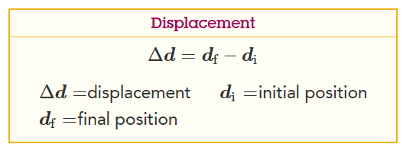
What does position mean?
The position of an object is a measure of where the object is at a particular time with respect to some reference point.
Displacement is defined to be the change in position of an object. It can be defined mathematically with the following equation:
What does displacement mean?

Slide 5
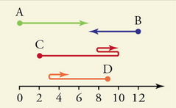
Example 1: Displacement of four moving objects
Four objects move according to the paths shown in the diagram below. Assume the units of the horizontal scale are given in meters.
What was the displacement of each object?
Object A had an initial position of 0m and a final position of 7m.
The displacement of object A can be shown with this equation:
Δx = 7m − 0m = +7m
Object B had an initial position of 12m and a final position of 7m.
The displacement of object B can be shown with this equation:
Δx = 7m − 12m = −5m
Object C had an initial position of 2m and a final position of 10m. The displacement of object C can be shown with this equation:
Δx = 10m − 2m = +8m
Object D had an initial position of 9m and a final position of 5m. The displacement of object D can be shown with this equation:
Δx = 5m − 9m = −4m

Slide 6
Example 2: Distance traveled of four moving objects Four objects move according to the paths shown in the diagram below. Assume the units of the horizontal scale are given in meters.
What was the total distance traveled by each object?
Object A travels a total distance of
7m
Object B travels a total distance of
5m
Object C travels a total distance of
8m + 2m + 2m = 12m
Object D travels a total distance of
6m + 2m = 8m

Slide 7
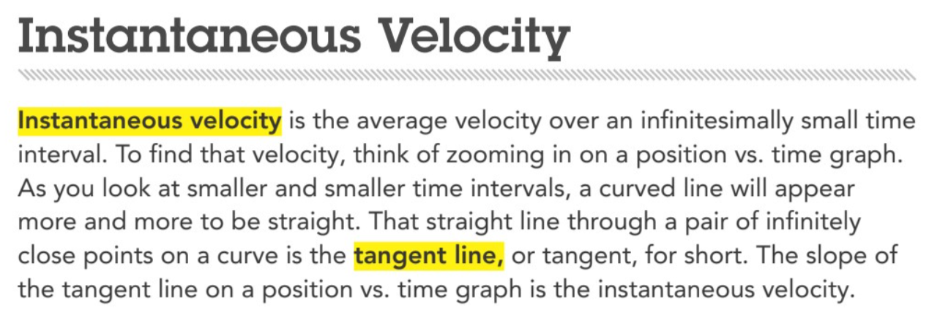

Slide 8
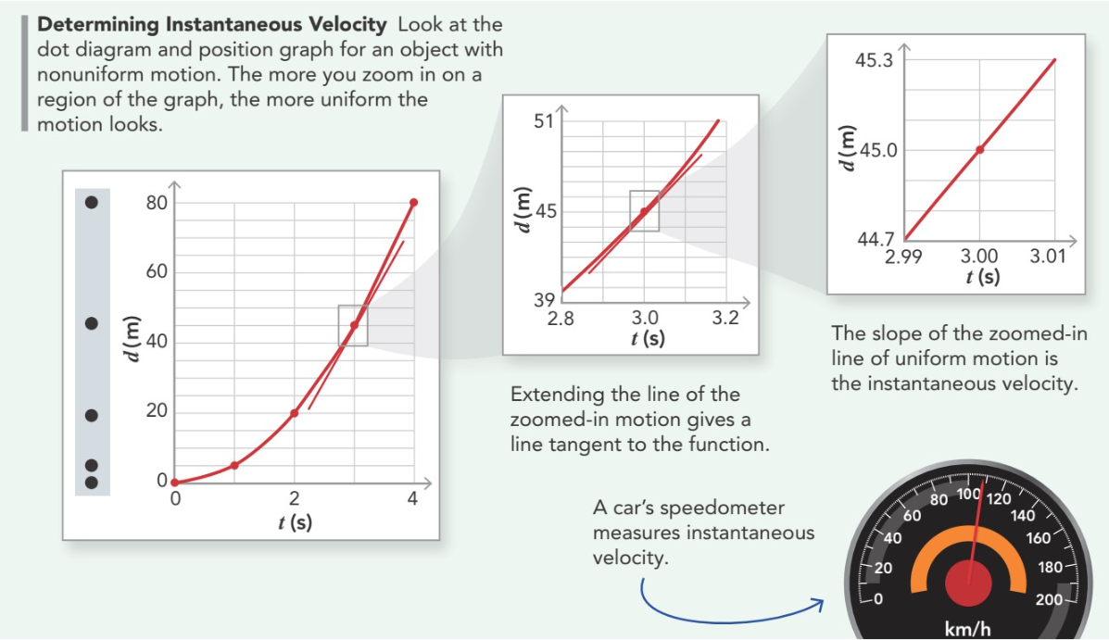

Slide 9


Slide 10
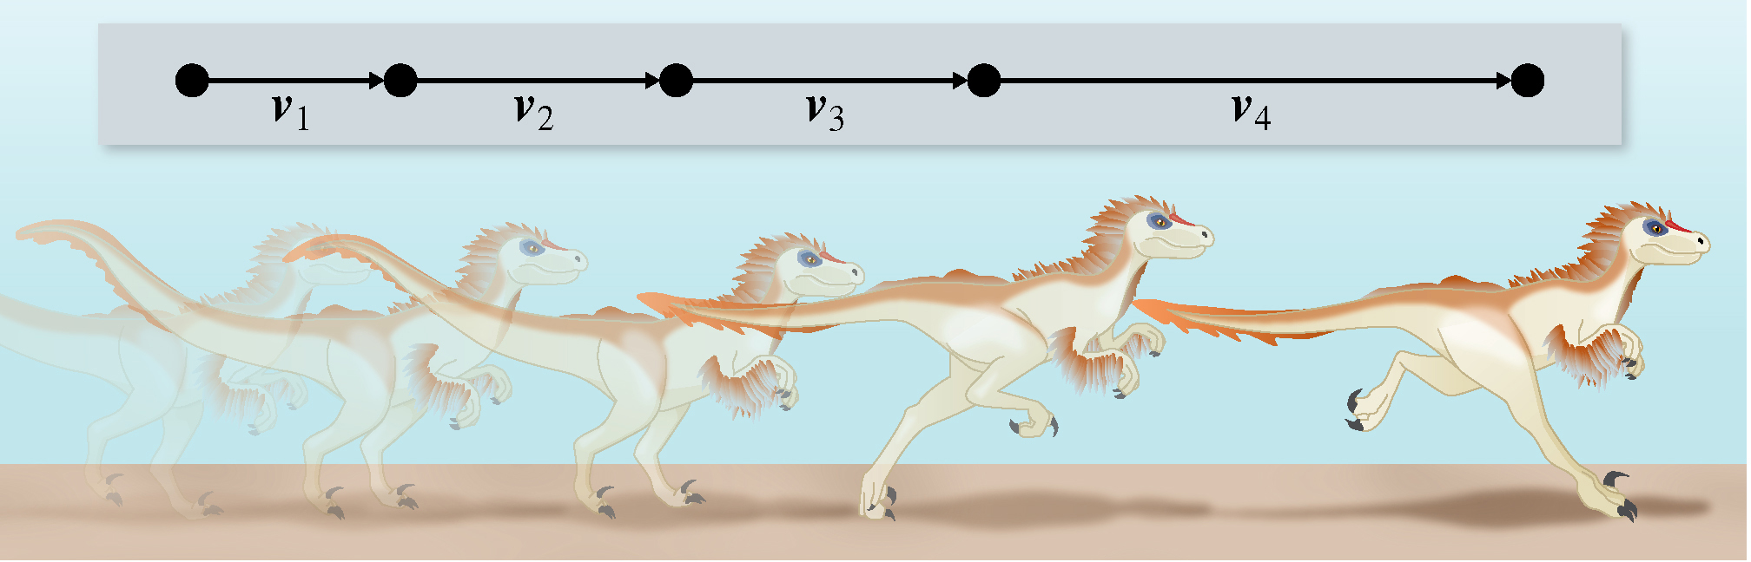
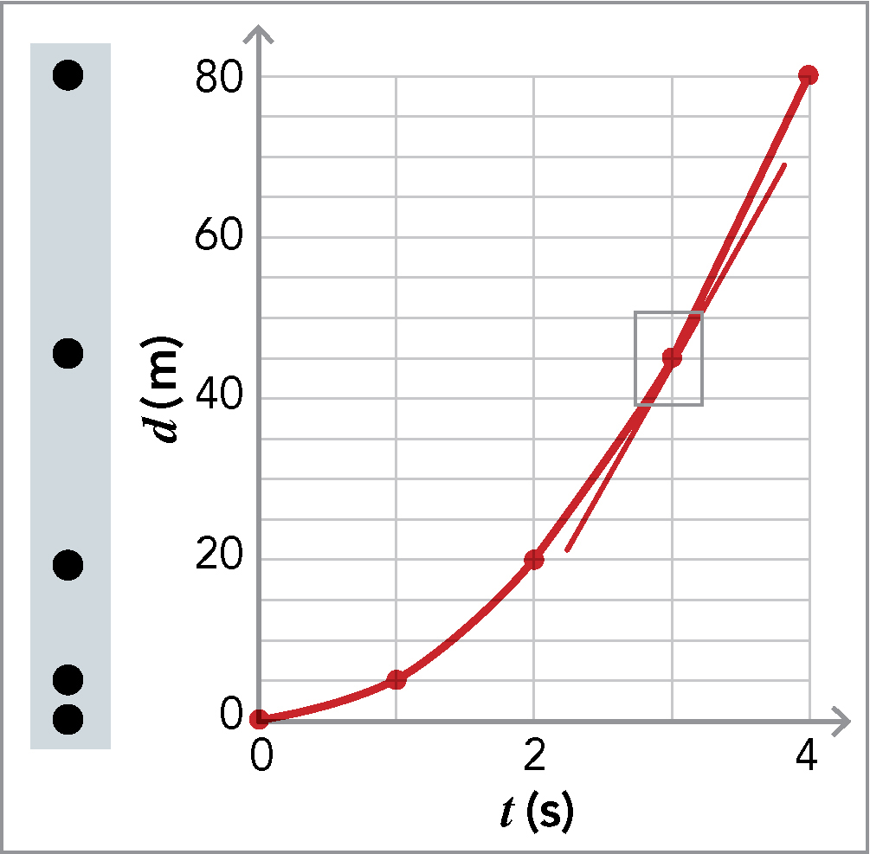
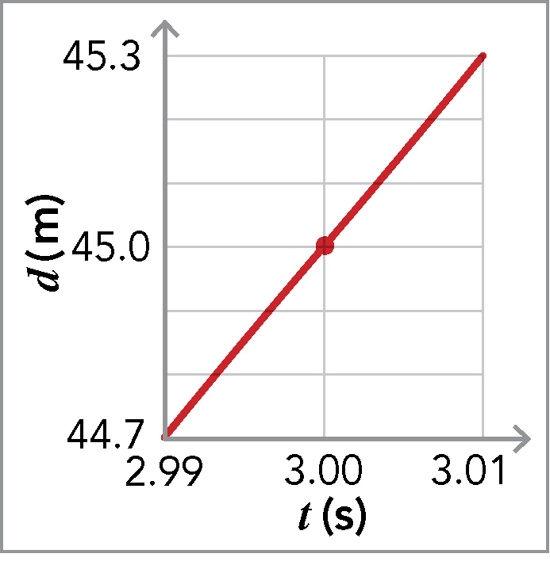
Instantaneous Velocity
Notice that for smaller time intervals, the curved line is almost straight.
The straight line through a pair of infinitely close points on a curve is the tangent line, or tangent.
? What does the slope of the tangent line on a position vs. time graph represent?
@ The instantaneous velocity.
? How can you know if the velociraptor’s instantaneous velocity is increasing, decreasing, or remaining constant?
@ The dots are farther apart, so the velociraptor’s instantaneous velocity is increasing.
Instantaneous velocity is the average velocity over an infinitesimally small time interval; it is the slope of the tangent line on a position graph.
The velociraptor’s velocity is increasing.
Notes:
Read the text.
Click to add the arrow.
Prompt students to notice that for smaller time intervals, the curved line is almost straight.
Click to show the enlarged part of the graph showing a small time interval and straight line.
Explain that the straight line through a pair of infinitely close points on a curve is the tangent line, or tangent.
Ask: What does the slope of the tangent line on a position vs. time graph represent? (Answer: The instantaneous velocity.)
Click to show the dot diagram.
Ask: How can you know if the velociraptor’s instantaneous velocity is increasing, decreasing, or remaining constant?
Click to show the text. (Answer: The dots are farther apart, so the velociraptor’s instantaneous velocity is increasing.)

Slide 11
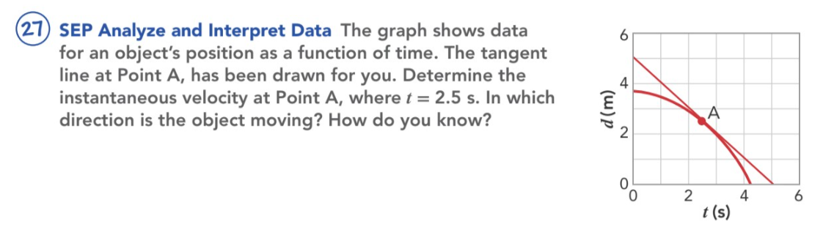
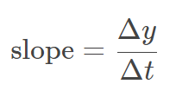

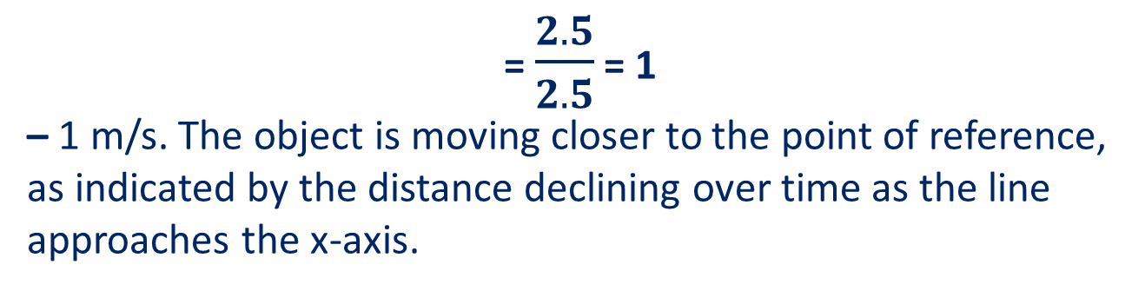

Slide 12
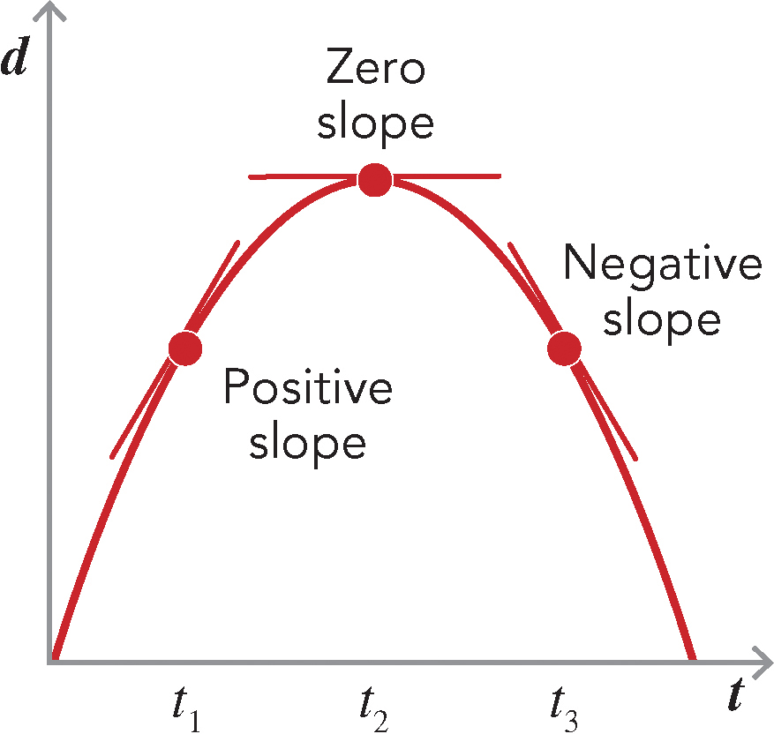
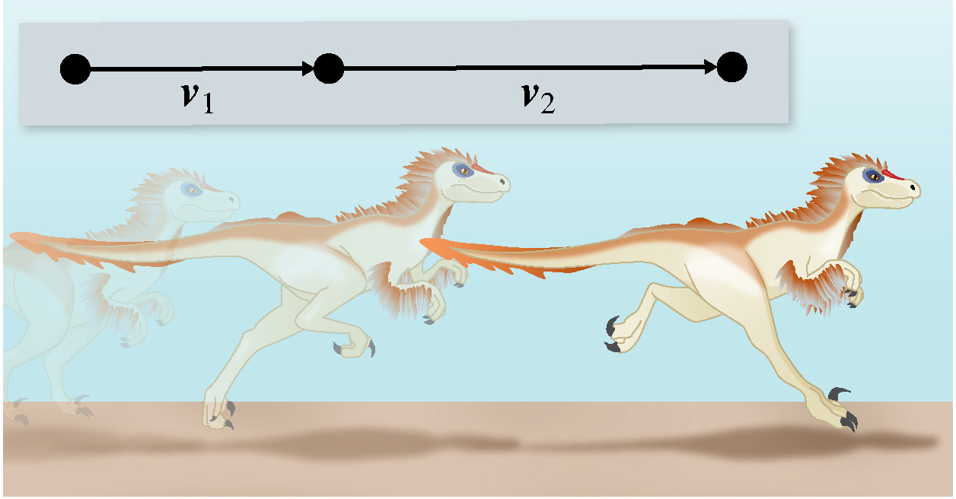
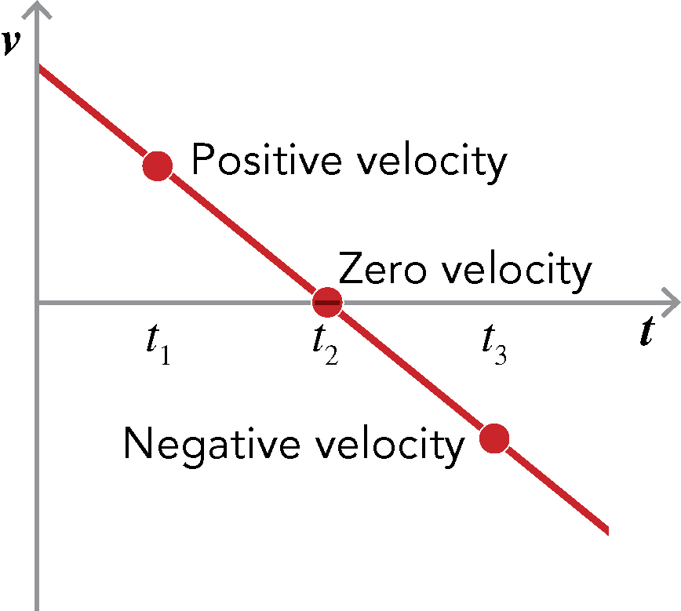
Graphs of Changing Velocity
? Where is the slope of the tangent positive on the position vs. time graph?
@ At t₁
? What does a zero slope indicate?
@ Zero velocity at that moment in time
? Does a negative slope indicate that the object is slowing down?
@ No
? What does a negative slope on a position graph indicate?
@ Negative velocity. The object is turning around and heading toward its starting position.
Recognize that the graph represents the same object during the same time period as the position graph, and records what is happening with the velocity.
? What does negative velocity represent?
@ Movement in the negative direction
The time derivative of a function is the rate at which the value of the function changes with time, which is the slope of the curve at that point.
Zero slope
Negative slope
Positive slope
Use the head-to-tail method to find 𝚫v, the change in velocity of the velociraptor.
The head-to-tail method of finding 𝚫v = v₂ − v₁. Place the tail of v₁ at the head of v₂ but going in the opposite direction to subtract. Measure the length of the difference. Since v₂ is greater, the answer is positive.
If the velocity on a velocity vs. time graph based on the dot diagram of the velociraptors would be increasing, decreasing, or staying the same.
Answer: Increasing. The raptor covers more distance in the same time period, and therefore v₂ > v₁.
Positive velocity
Zero velocity
Negative velocity
Notes:
Have a student read the text.
Where is the slope of the tangent positive on the position vs. time graph?
Click to label the positive slope. (Answer: At t₁)
Click to label the zero slope.
Ask: What does a zero slope indicate? (Answer: Zero velocity at that moment in time)
Click to label the negative slope.
Ask: Does a negative slope indicate that the object is slowing down? (Answer: No)
Ask: What does a negative slope on a position graph indicate? (Answer: Negative velocity. The object is turning around and heading toward its starting position.)
Click to show the velocity vs. time graph.
Prompt students to recognize that the graph represents the same object during the same time period as the position graph, and records what is happening with the velocity.
Click to label the negative velocity.
Ask: What does negative velocity represent? (Answer: Movement in the negative direction)
Click to show the dot diagram and its text.
Read the text.
Explain the head-to-tail method of finding 𝚫v = v₂ − v₁. Place the tail of v₁ at the head of v₂ but going in the opposite direction to subtract. Measure the length of the difference. Since v₂ is greater, the answer is positive.
Ask students if the velocity on a velocity vs. time graph based on the dot diagram of the velociraptors would be increasing, decreasing, or staying the same. (Answer: Increasing. The raptor covers more distance in the same time period, and therefore v₂ > v₁.)

Slide 13
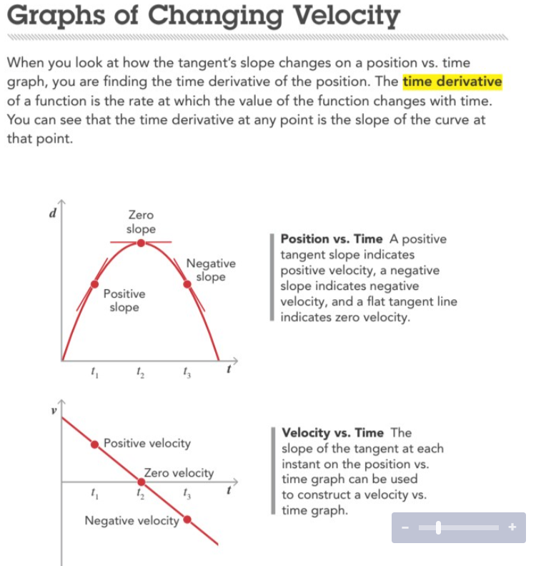
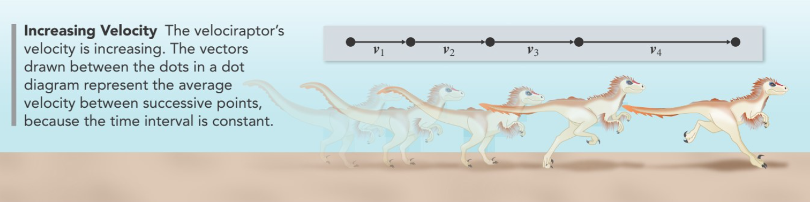

Slide 14
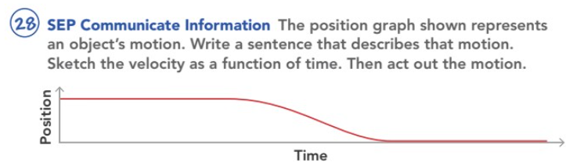
The object is at a constant position away from the point of reference for about 2/5 of the time, then gets closer at a fairly steady velocity for 1/5 of the time, then is very close to the reference point for the remainder of the time. The flat lines suggest the object is at rest at those two positions.
Velocity graphs should start with a horizontal line indicating zero velocity for some time, then the curve should be below the horizontal axis to indicate a negative velocity, followed by another flat portion on the horizontal axis to indicate the object is at rest again.
Positive velocity
Zero velocity

Slide 15
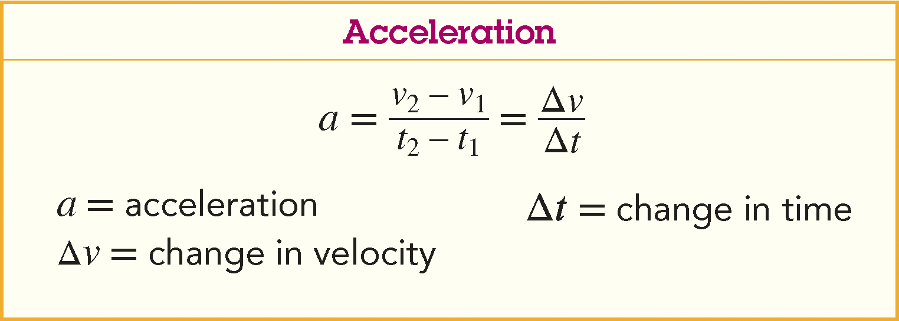
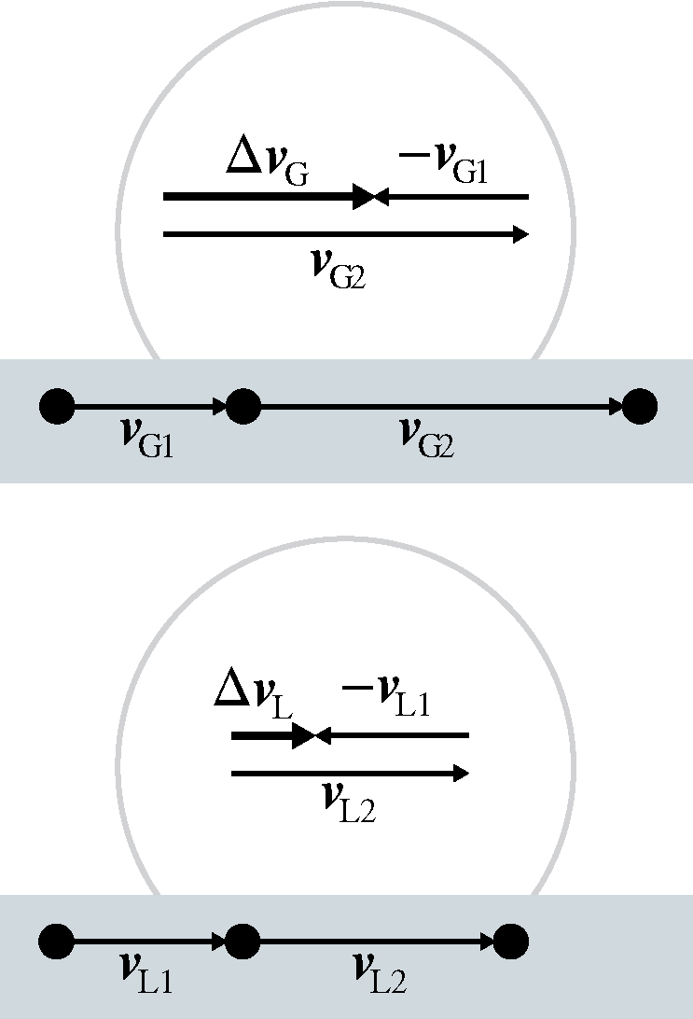
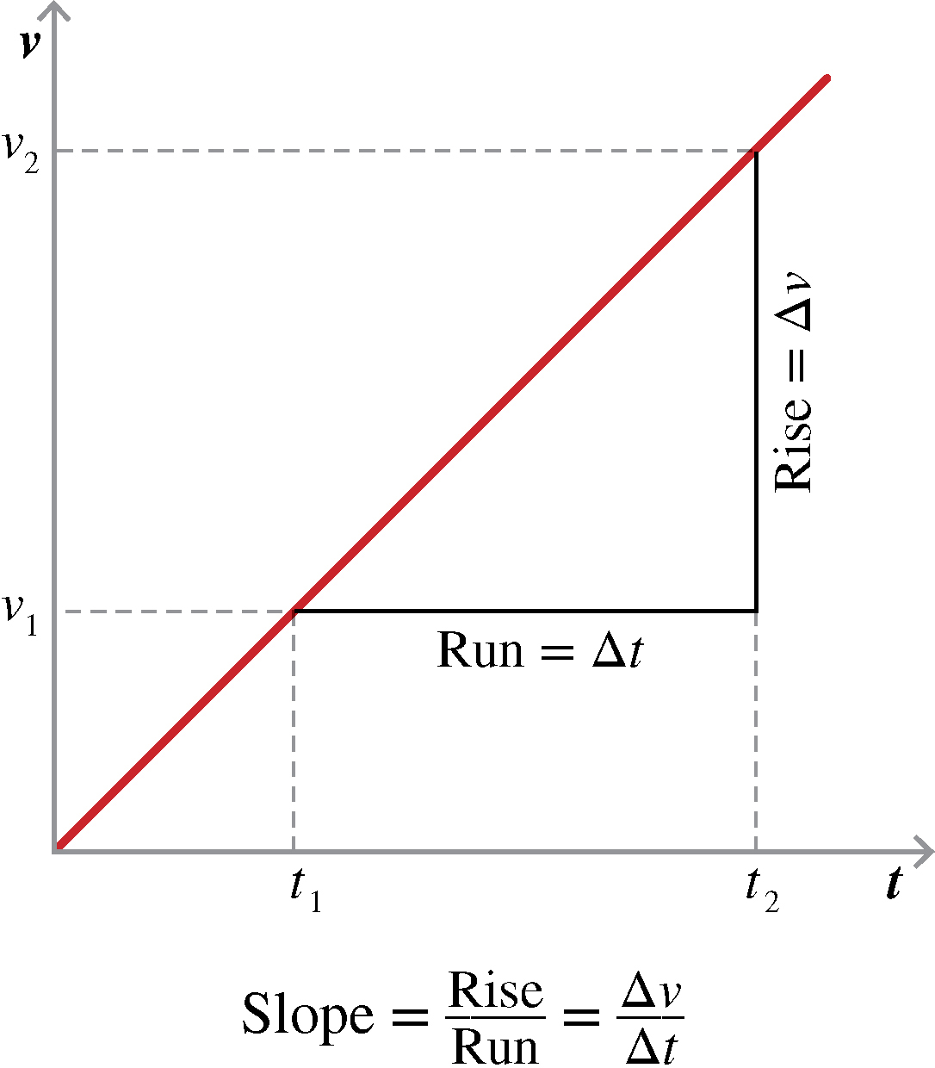
Acceleration
Constant accelerated motion is motion with a constant acceleration.
What the equation for acceleration reminds them of.
Answer: Finding the slope of a line
See that for constant accelerated motion, acceleration is the slope of the line of a velocity vs. time graph.
What would a steeper slope indicate?
Answer: Greater acceleration
𝚫v = v₂ − v₁,
and to change the direction of the subtracted vector as shown in the diagrams.
To subtract, place the tail of v₁ at the head of v₂ but going in the opposite direction. Measure the length of the difference. The answer indicates the direction of the acceleration.
Acceleration is a vector that is the time derivative of velocity.
Use the head-to-tail method and the velocity vectors from a dot diagram to determine the direction of the acceleration.
Notes:
Have a student read the text.
Explain that constant accelerated motion is motion with a constant acceleration.
Click to show the equation.
Ask a volunteer what the equation for acceleration reminds them of. (Sample answer: Finding the slope of a line)
Click to show the velocity vs. time graph.
Prompt students to see that for constant accelerated motion, acceleration is the slope of the line of a velocity vs. time graph.
Ask: What would a steeper slope indicate? (Answer: Greater acceleration)
Click to show the head-to-tail text.
Have a student read the text.
Remind students that 𝚫v = v₂ − v₁, and to change the direction of the subtracted vector as shown in the diagrams. To subtract, place the tail of v₁ at the head of v₂ but going in the opposite direction. Measure the length of the difference. The answer indicates the direction of the acceleration.

Slide 16
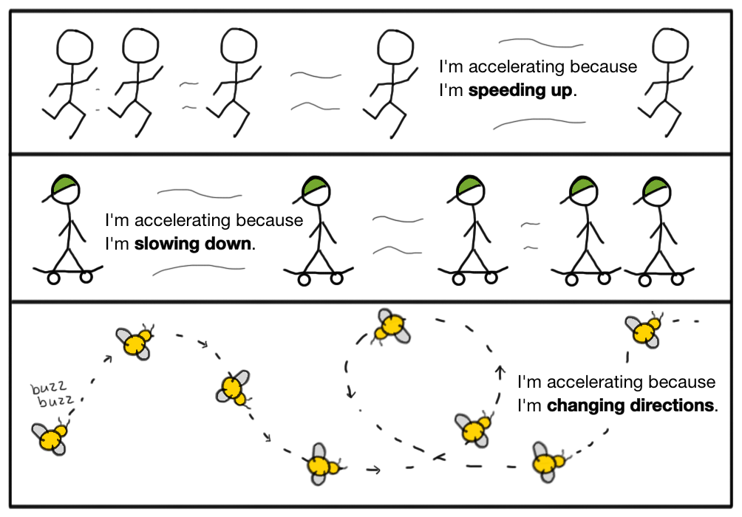

Slide 17
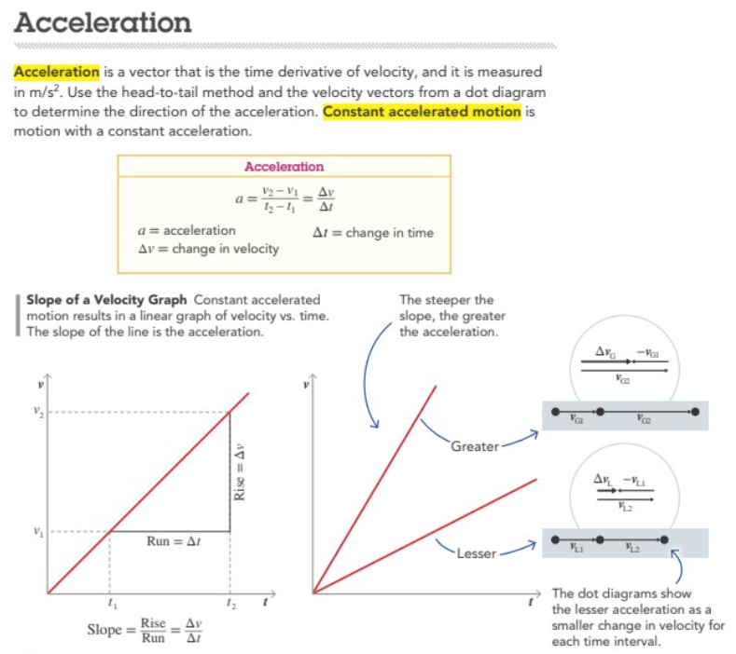
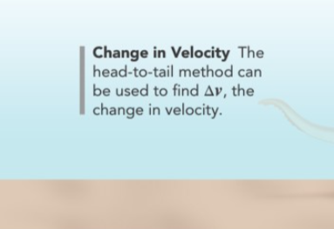
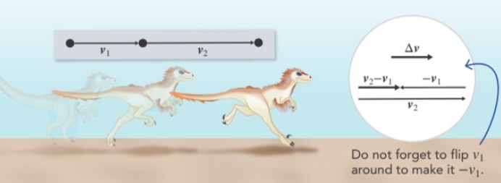

Slide 18
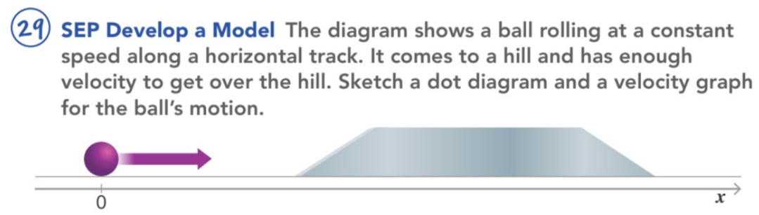
The dot diagram should have 1) several dots spaced X units apart for the motion before the ramp, 2) several increasingly closer (<X) dots to indicate the motion up the first ramp, 3) a series of dots of equally spaced apart (<X) to represent the platform, 4) a series of dots of increasing distance representing the second ramp (inverse of the first ramp), 5) followed by a series of dots that is like the first section. Velocity graphs should have 1) a horizontal line at positive velocity, 2) a slight curve downward (first ramp), 3) a second horizontal line at a lower velocity than the first, 4) a slight curve upward (second ramp), 5) a horizontal line at the original positive velocity.

Slide 19
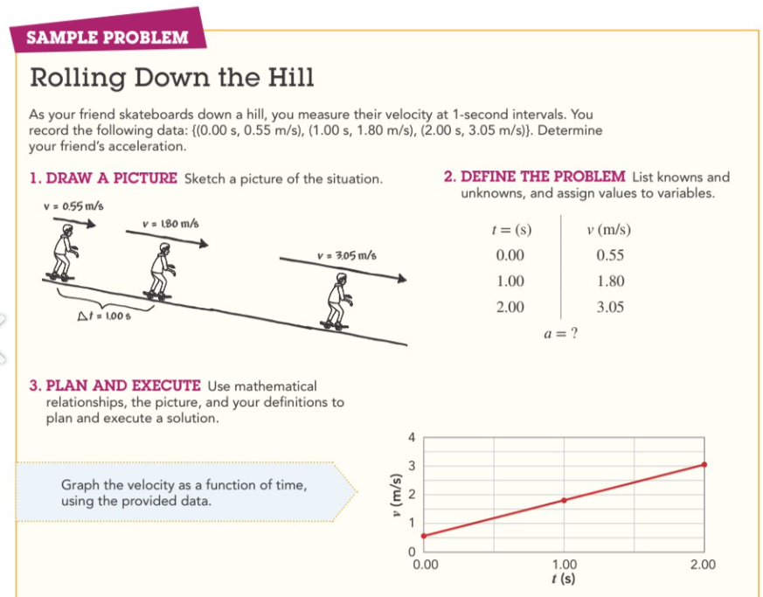
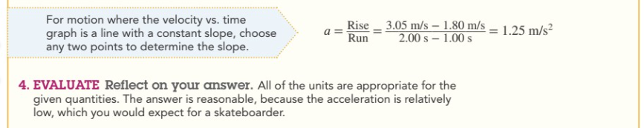

Slide 20
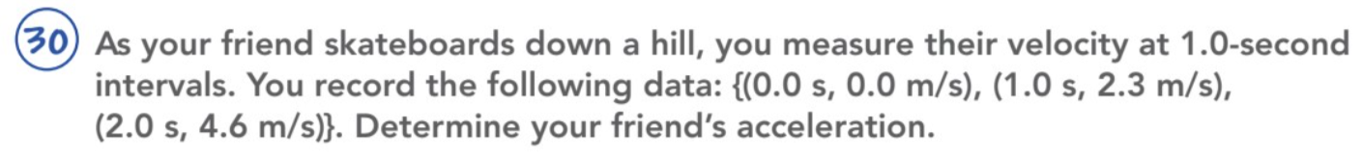
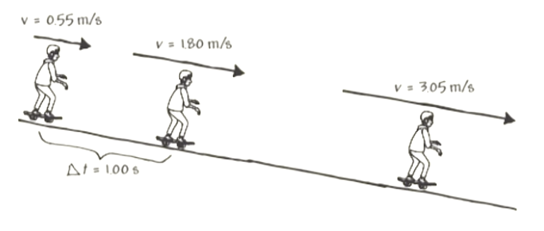
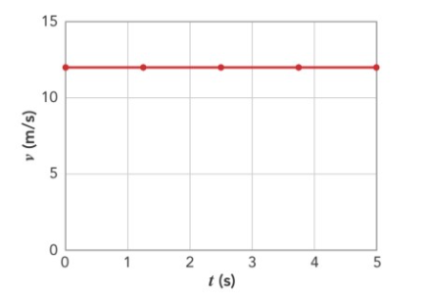

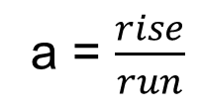
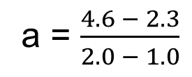
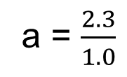
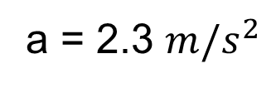
t (s) v (m/s)
0.0 0.0
1.0 2.3
2.0 4.6
v=0.0m/s
v=2.3m/s
v=4.6m/s
10
25
8
20
6
4
2

Slide 21

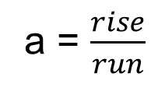
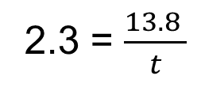
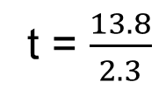
t = 6 seconds
t = 6 - 4
t = 2 seconds since time 4 seconds was the last recorded time.
Notes:
2 seconds (acceleration would reach 13.8 m/s2 at time = 6 seconds, which is 2 seconds since
time = 4)

Slide 22
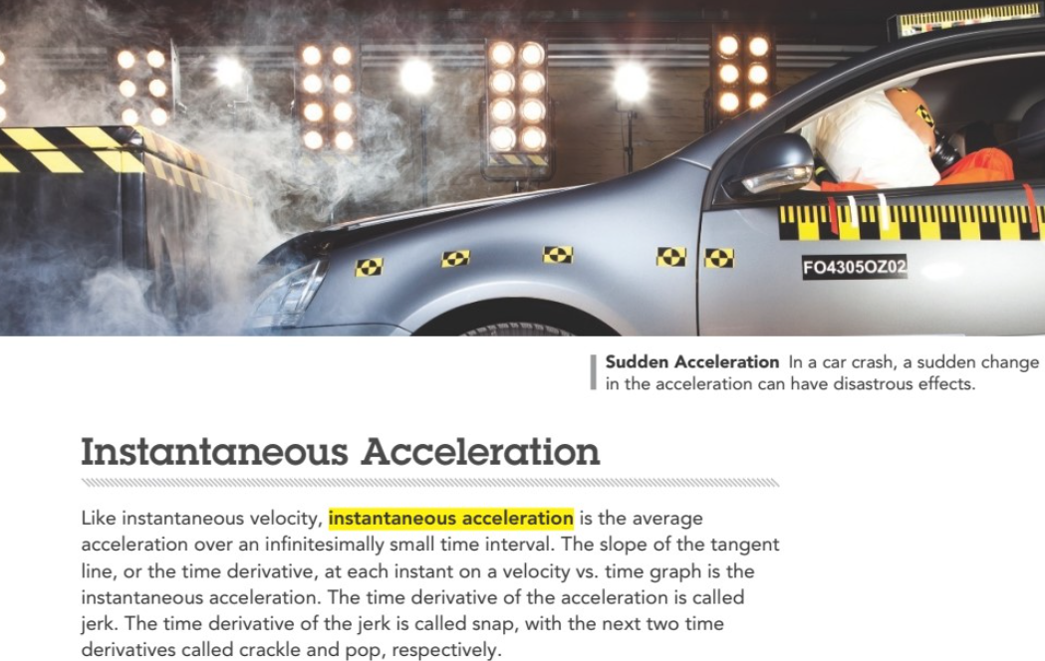

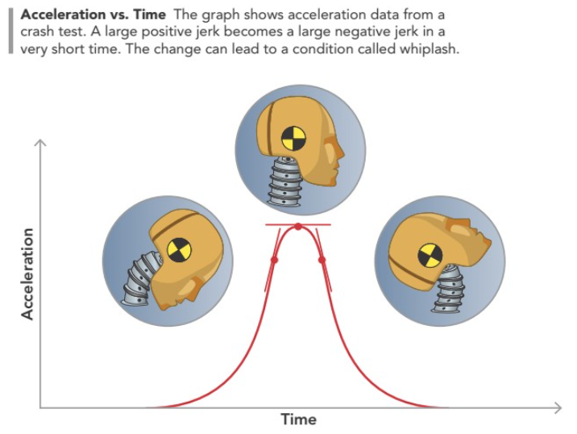

Slide 23
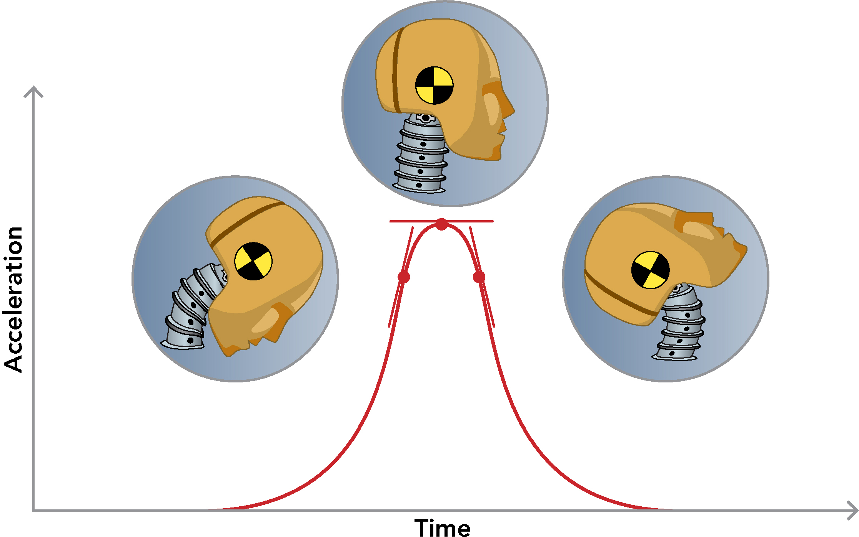
Instantaneous Acceleration
The time derivative of the acceleration is called jerk. The time derivative of the jerk is called snap, with the next two time derivatives called crackle and pop, respectively. In a crash, a large positive jerk becomes a large negative jerk in a very short time, as shown in the diagram. The change can lead to a condition called whiplash.
What scenario could lead to a large acceleration in a short time.
Answer: Being rear-ended in a car
Instantaneous acceleration is the average acceleration over an infinitesimally small time interval. The slope of the tangent at an instant on a velocity vs. time graph is the instantaneous acceleration.
Whiplash can occur in a car crash.
Notes:
Read the text.
Explain that the time derivative of the acceleration is called jerk. The time derivative of the jerk is called snap, with the next two time derivatives called crackle and pop, respectively. In a crash, a large positive jerk becomes a large negative jerk in a very short time, as shown in the diagram. The change can lead to a condition called whiplash.
Ask: What scenario could lead to a large acceleration in a short time. (Sample answer: Being rear-ended in a car)

Slide 24
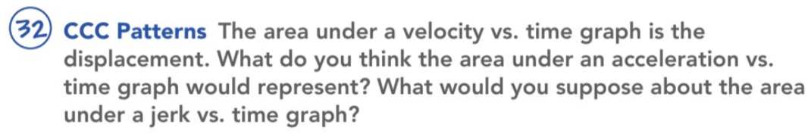
The area under an acceleration vs. time graph represents the change in velocity. The area under a jerk vs. time graph would represent the change in acceleration.

Slide 25
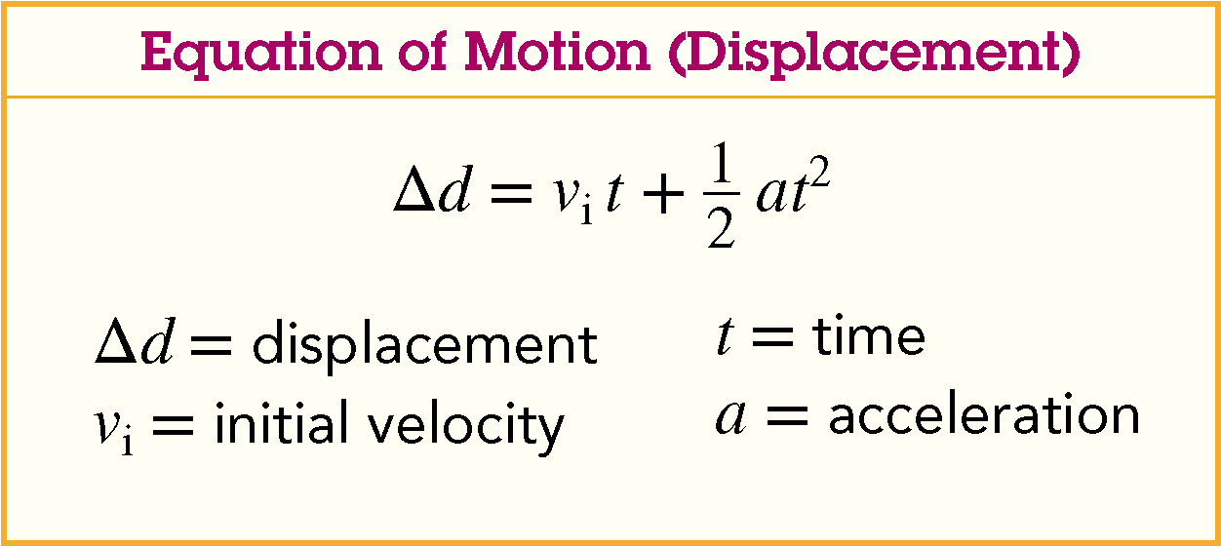
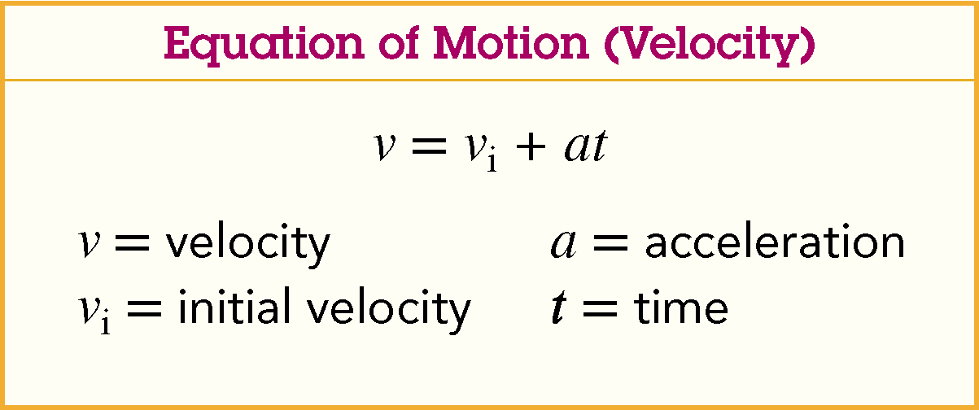
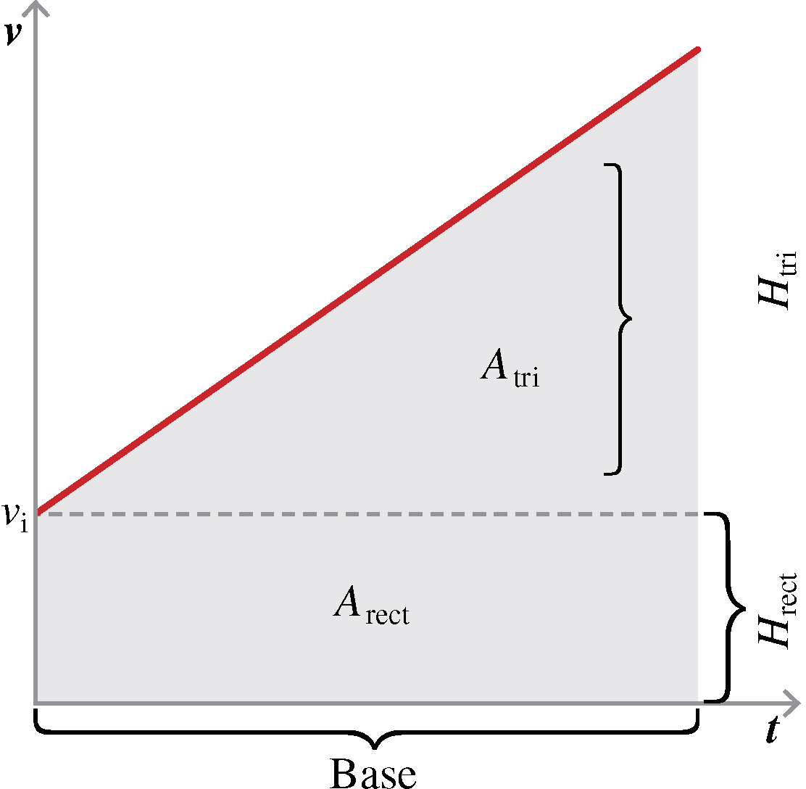


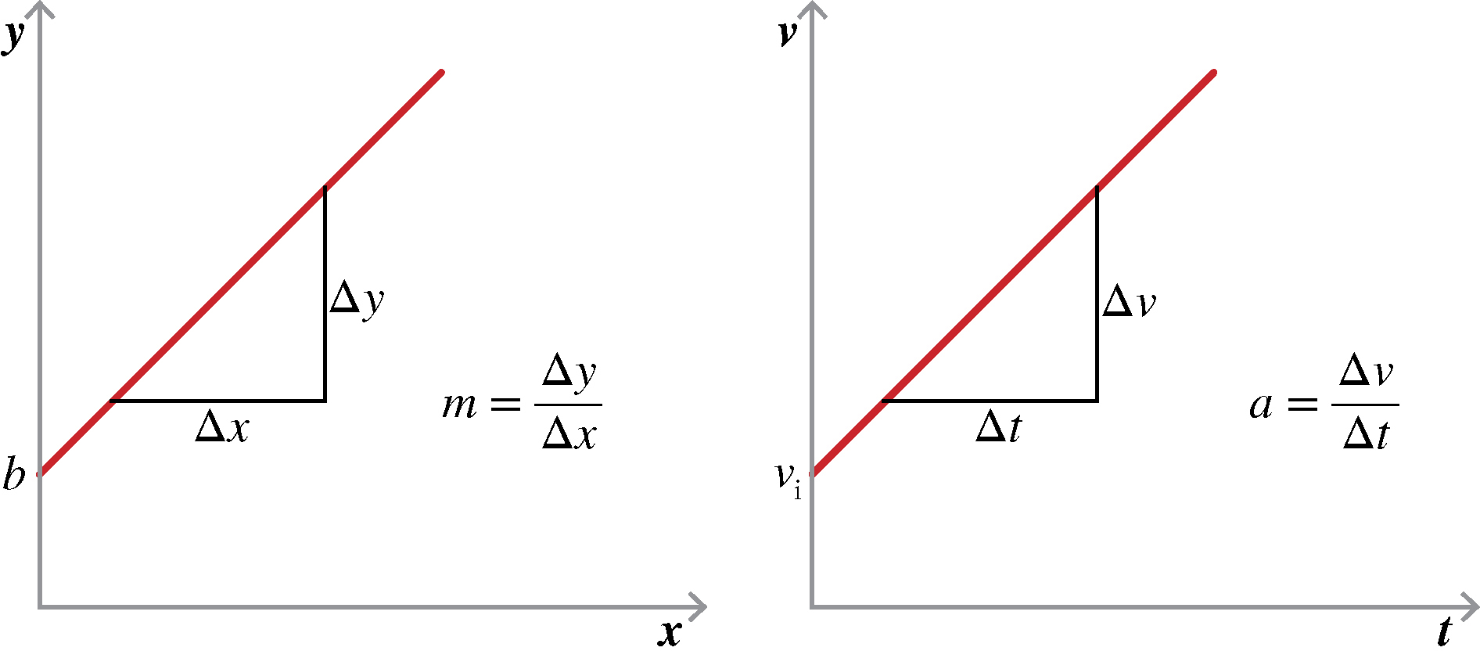
Constant Acceleration
You can construct an equation for constant accelerated motion from the velocity vs. time graph for an object.
The general equation for a line can be used to produce a mathematical expression for the velocity.
Discuss the similarities of the two equations.
Notice that it is the same equation for velocity as on the graph; the terms have simply been rearranged.
When you calculate the area under a curve on a graph, you are finding the integral. The resulting integral of the velocity vs. time graph for constant accelerated motion provides an equation for displacement as a function of time.
In problems where velocity was constant, they calculated the area under the line using base times height to find the displacement of the object.
Similarly, for constant accelerated motion, they can calculate the area under the function to find displacement. The sum of the area of the rectangle and the area of the triangle is the displacement for the time period highlighted.
The first term is the area of the rectangle and the second term is the area of the triangle.
The two equations that describe an object’s velocity and displacement are called equations of motion.
Notes:
Read the text.
Explain that students can construct an equation for constant accelerated motion from the velocity vs. time graph for an object.
Click to show the general equation for a line.
Explain that the general equation for a line can be used to produce a mathematical expression for the velocity.
Click to show the velocity equation.
Prompt students to discuss the similarities of the two equations.
Click to add the boxed velocity equation showing variables.
Prompt students to notice that it is the same equation for velocity as on the graph; the terms have simply been rearranged.
Click to show the second velocity graph.
Explain that when you calculate the area under a curve on a graph, you are finding the integral. The resulting integral of the velocity vs. time graph for constant accelerated motion provides an equation for displacement as a function of time.
Remind students that in problems where velocity was constant, they calculated the area under the line using base times height to find the displacement of the object.
Similarly, for constant accelerated motion, they can calculate the area under the function to find displacement. The sum of the area of the rectangle and the area of the triangle is the displacement for the time period highlighted.
Click to show the boxed displacement equation.
Explain that the first term is the area of the rectangle and the second term is the area of the triangle.

Slide 26
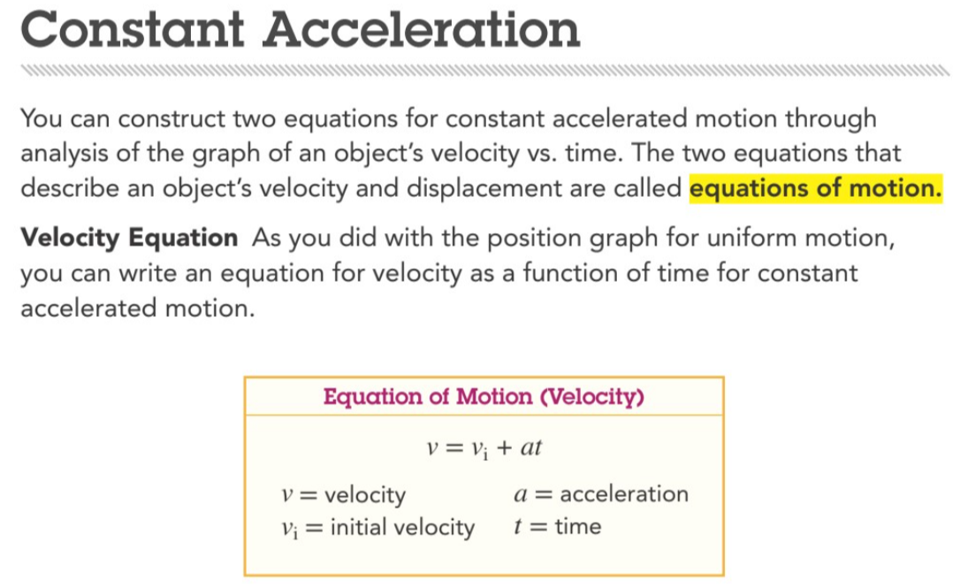

Slide 27
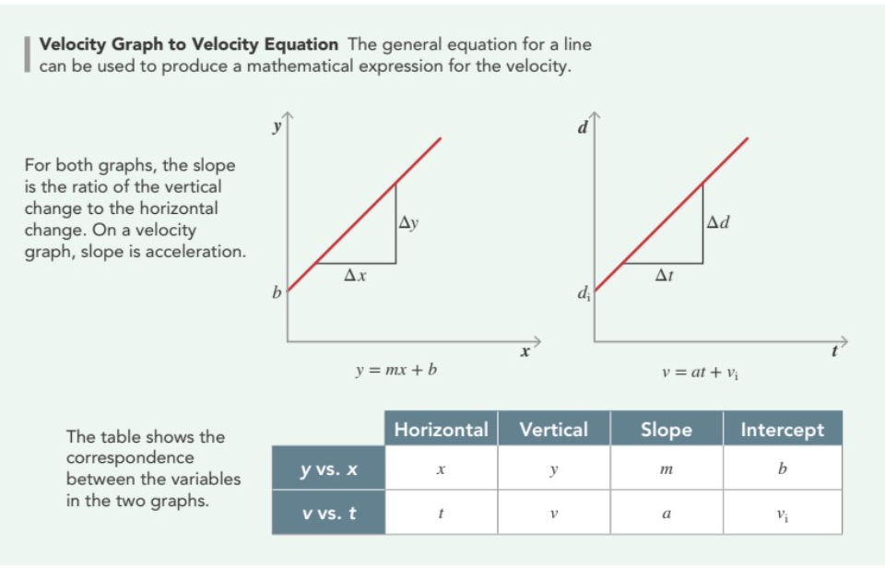

Slide 28
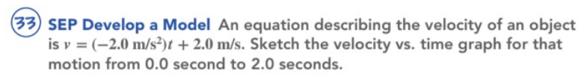


Velocity (m/s)
Notes:
Graphs should have a y-axis that ranges from -2.0 to 2.0, and an x-axis that ranges from 0 to at least 2. The line should intercept the y-axis at 2.0 and run down and to the right through the x-axis at 1 and reach -2.0 below the x-axis.

Slide 29


Which one do you think is constant accelerated motion and accelerated motion that is not constant?
constant accelerated motion
accelerated motion that is not constant
Notes:
The first graph should have a straight line, as on the page. The second graph should have a nonlinear curve that indicates accelerated motion that is not constant.

Slide 30


Slide 31


Slide 32



Slide 33

If accelerated motion is not constant, there’s no way to have a single value for a in the equation of motion displacement.

Slide 34



The third equation is derived from the other two
equations of motion by solving for time in one equation and substituting the result in the other.
The third equation does not have time in it. So, it would be useful when time is unknown or
cannot be measured directly.

Slide 35



Slide 36






10
20
30
Δd = 40 + 5 = 45m

Slide 37




Slide 38



Slide 39


















12.2 m

Slide 40







$$v_{i}=0 m/s$$
$v_{f}=26.8$ m/s
t $=3.5 s$
a $=$ $\frac{26.8}{3.5}$
a $=7.65 m/s^{2}$

Slide 41


Slide 42


Slide 43


Acceleration Due to Gravity
A body in free fall experiences a constant acceleration toward the center of Earth called acceleration due to gravity, g, which has a constant magnitude of 9.8 m/s² toward the ground.
Notes:
Have a student read the text and define free fall. (Answer: An object falling without resistance under the influence of Earth’s gravity is in free fall.)
Ask: Why are the dots closer together at the top of the dot diagram? (Sample answer: Because gravity slows the woman down as she reaches her top position)
Click to show the position, velocity, and acceleration graphs.
Have a volunteer explain the shape of the position graph. (Sample answer: Her position is not changing as fast as she reaches the top, and her total displacement is zero.)
Ask: Why is the acceleration negative on the acceleration vs. time graph? (Sample answer: Because acceleration in this case is the acceleration due to gravity which is a downward acceleration)

Slide 44

The upward dot diagram shows that the magnitude of velocity is highest in the first interval, then decreases more with each interval.
In the downward diagram, the opposite is true, indicating maximum magnitude of velocity upon returning to the trampoline. Both indicate that acceleration is working downward.

Slide 45



Slide 46





Since the paper is going in upward direction it is going in positive side of y axis hence both have positive and not negative.
1.5m
43. 0.55 seconds

Slide 47






- (Because it is falling down)
Δy = -10 x 3.2 + ½ (-9.8) (3.2 x 3.2)
Δy = -32 + ½ (-9.8) (10.24)
Δy = -32 – 50.176
? m
Δy = - 82.176 meters
44. 82 meters

Slide 48








To calculate the kangaroo's vertical speed when it leaves the ground, we can use the following equation:
$v^{2}=v_{i}^{2}+2 X a X h$
where:
• v is the final velocity (which is 0 at the highest point)
• $v_{i}$ is the initial velocity (what we want to find)
• a is the acceleration due to gravity (-9.8 ${m/s}^{2}$)
• h is the height of the jump (1.8 m)
$0^{2}=v_{i}^{2}+2 X −9.8 X 1.8$
$0^{2}=v_{i}^{2} −35.28$
$− v_{i}^{2}= −35.28$
$v_{i}= \sqrt{35.28}$
$v_{i}=$ 5.9 m/s
1.8m
45. 5.9 m/s

Slide 49







$v^{2}=v_{i}^{2}+2 X a X h$
where:
• v is the final velocity (which is 0 at the highest point)
• $v_{i}$ is the initial velocity (13.1 m/s)
• a is the acceleration due to gravity (-9.8 ${m/s}^{2}$)
• h is the height of the jump (we have to find)
$0^{2}={13.1}^{2}+2 X −9.8 X$h
$0^{2}=171.61 −$ 19.6 x h
$− 171.61= −19.6$ x h
$\frac{171.61}{19.6}=$ h
h $=$ 8.75 m
46. 8.76 m

Slide 50


Slide 51


Slide 52


