Slide 1
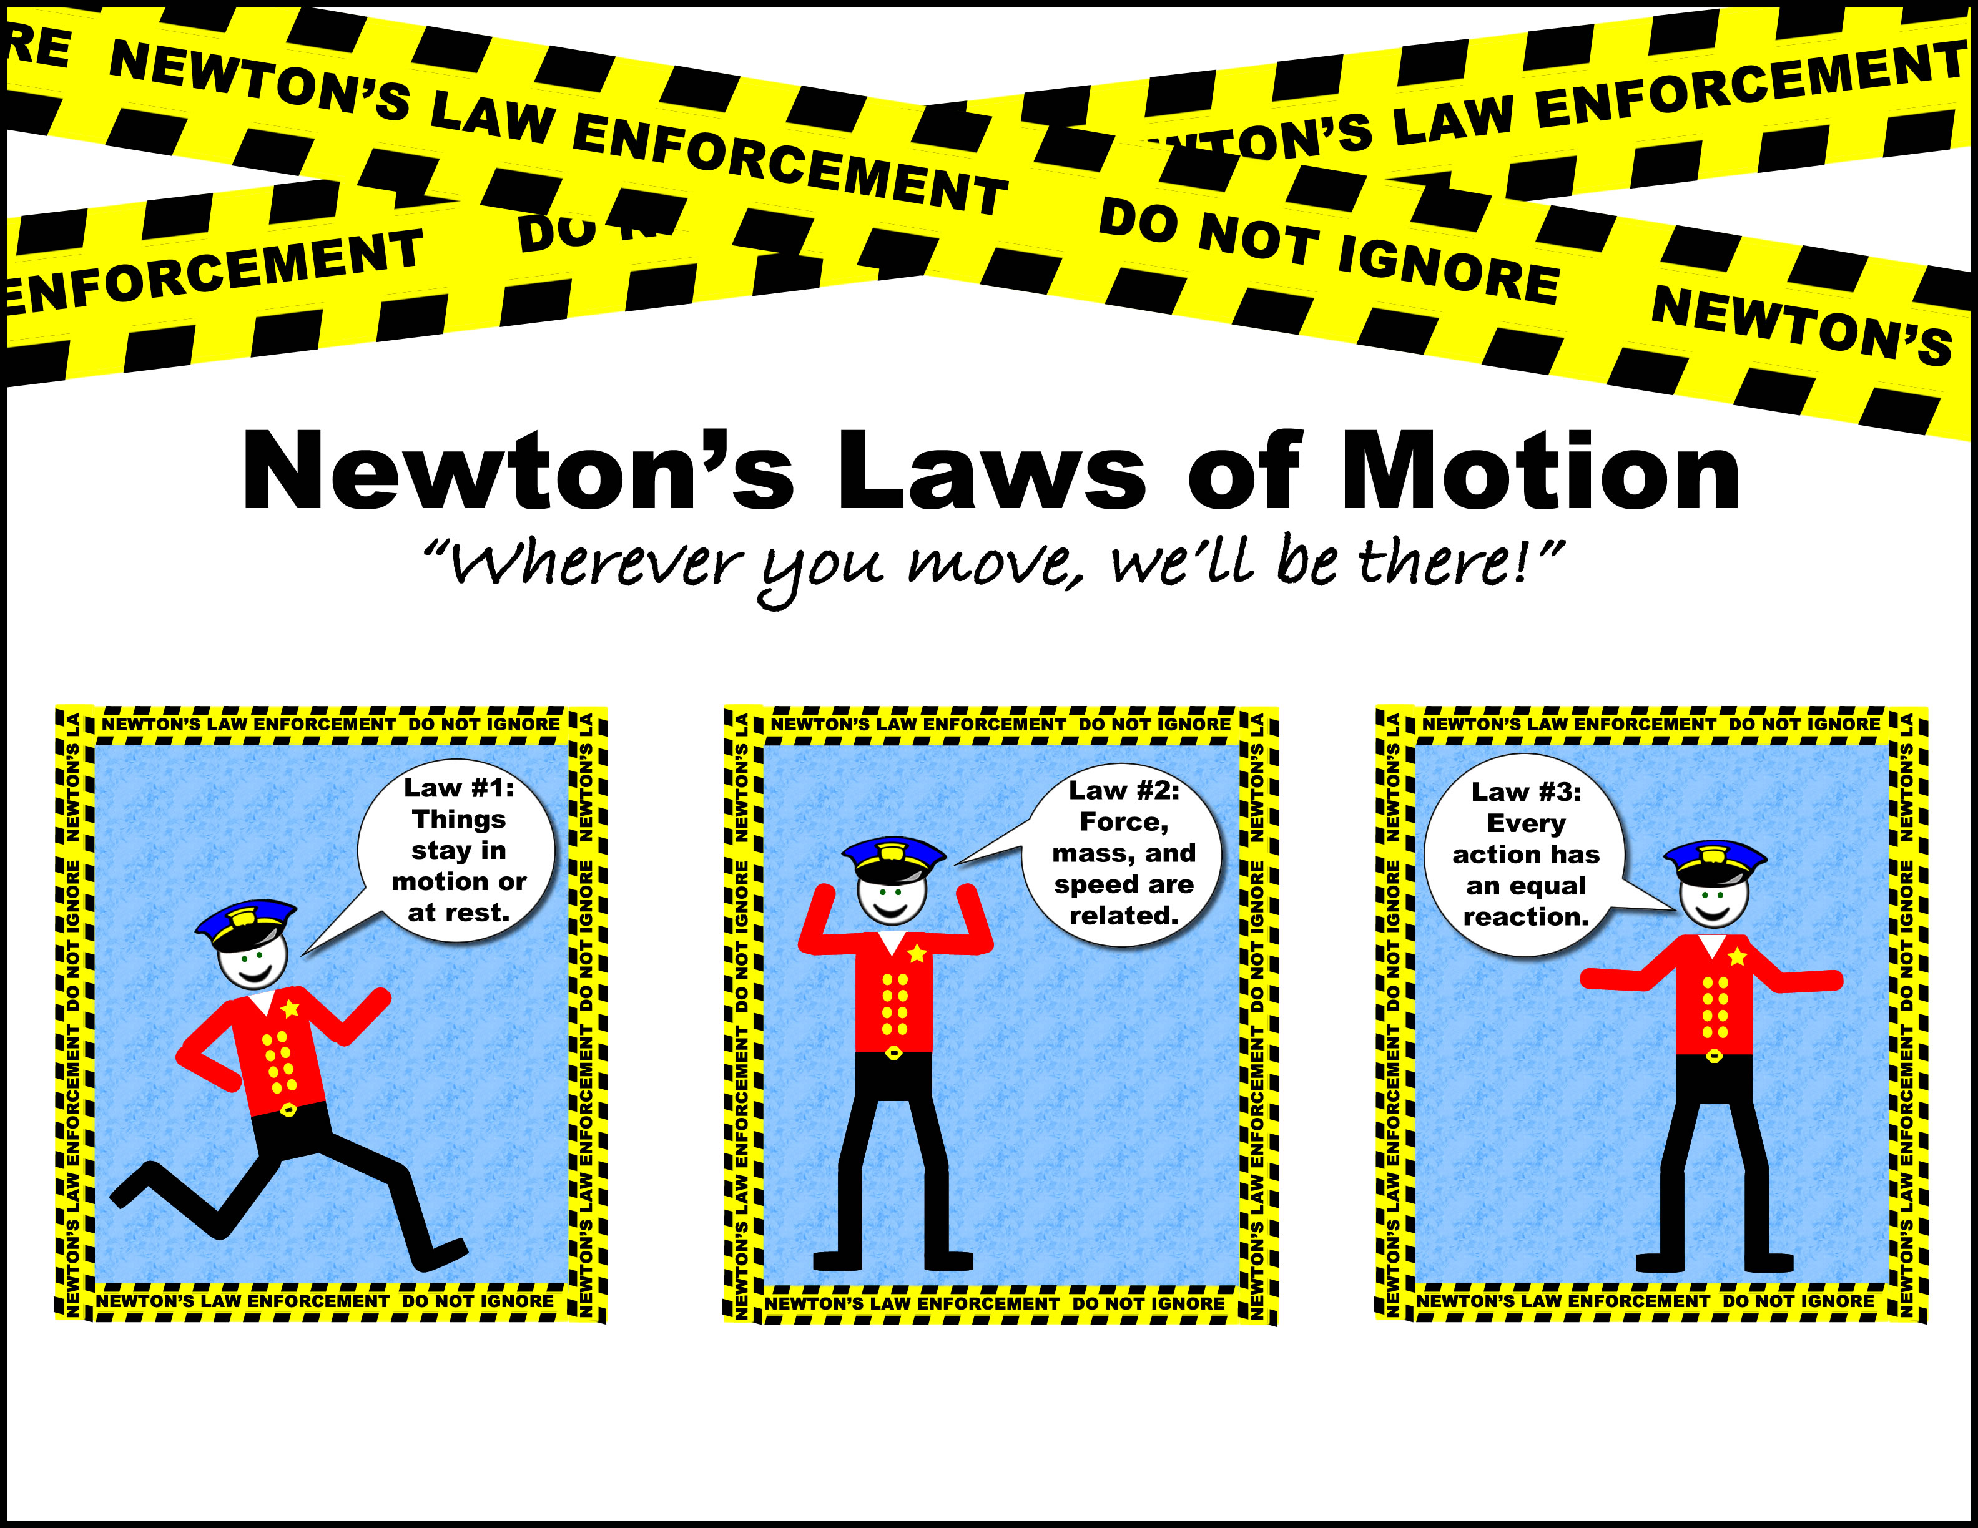
Lesson 3 Newton’s Laws of Motion

Slide 2
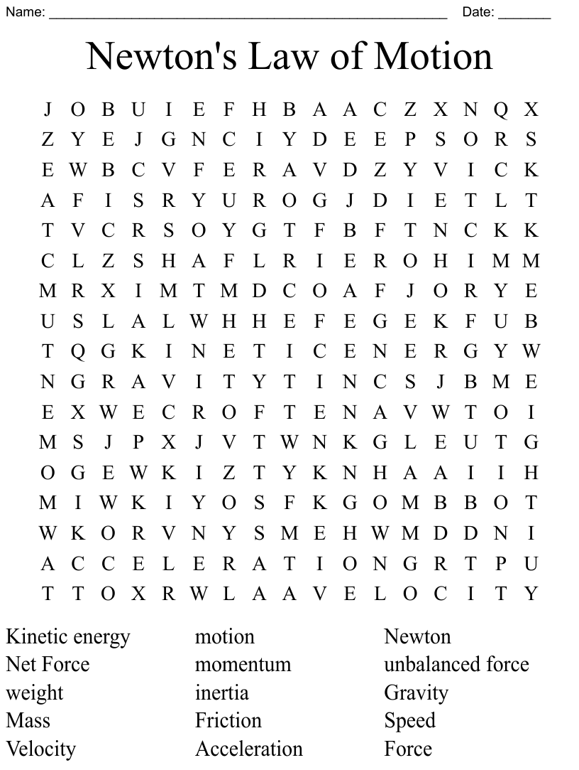

Slide 3
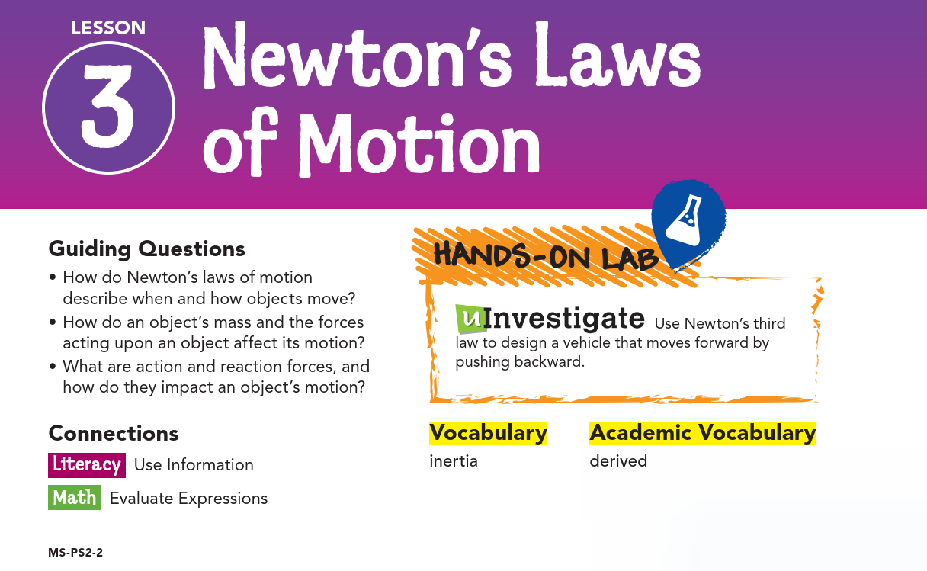

Slide 4

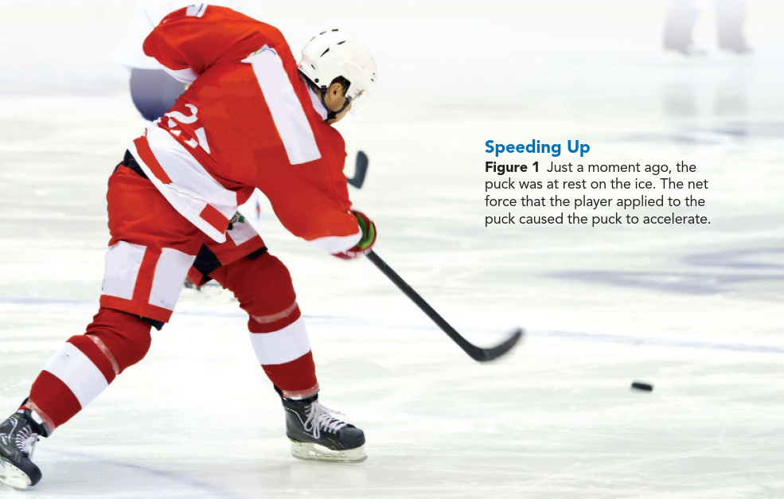
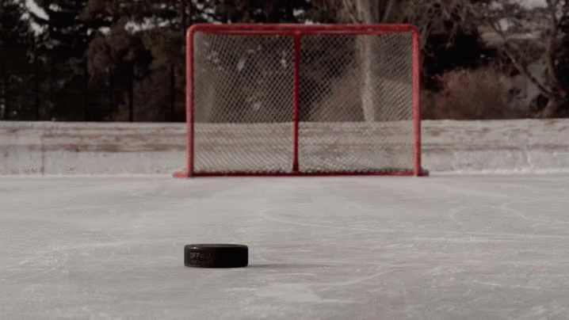
Newton's First Law of Motion:
If you were watching an ice-hockey game, you would be surprised if a puck that was sitting still suddenly started moving without being hit.
You would also be surprised if a moving puck suddenly stopped in the middle of the ice.
Your surprise would be the result of knowing that a net force must act upon an object to cause a change in motion.
This natural phenomenon that you observe in the world demonstrates Newton's first law of motion.
Notes:
https://www.youtube.com/watch?v=5oi5j11FkQg

Slide 5
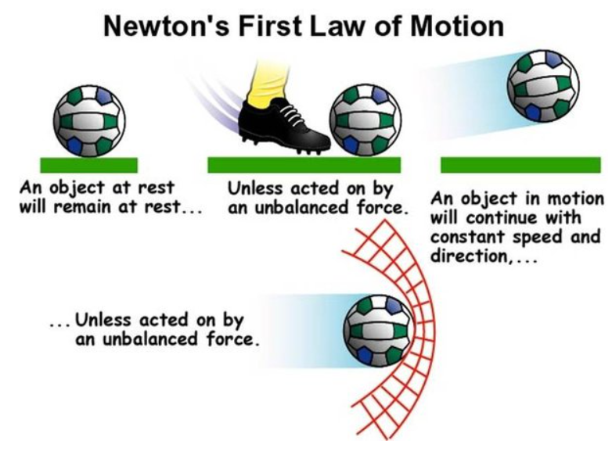
Newton's first law of motion states that an object at rest will remain at rest unless acted upon by a nonzero net force.
Therefore, a hockey puck that is sitting still will remain at rest unless a player hits it, applying a net force.
This law also states that an object moving at a constant velocity will continue moving at a constant velocity unless acted upon by a nonzero net force.
You can see this law in action when a hockey puck slides in a straight line across the ice.
The motion remains constant until it hits something like the net of the goal or another hockey stick.

Slide 6

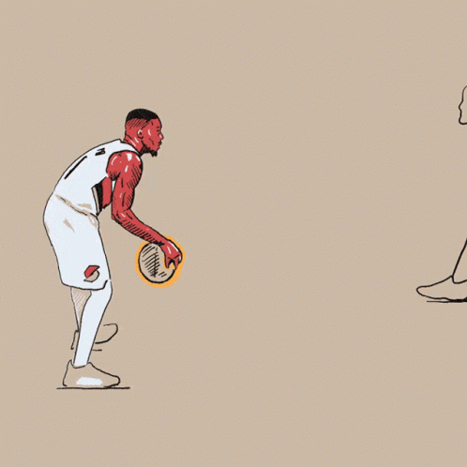
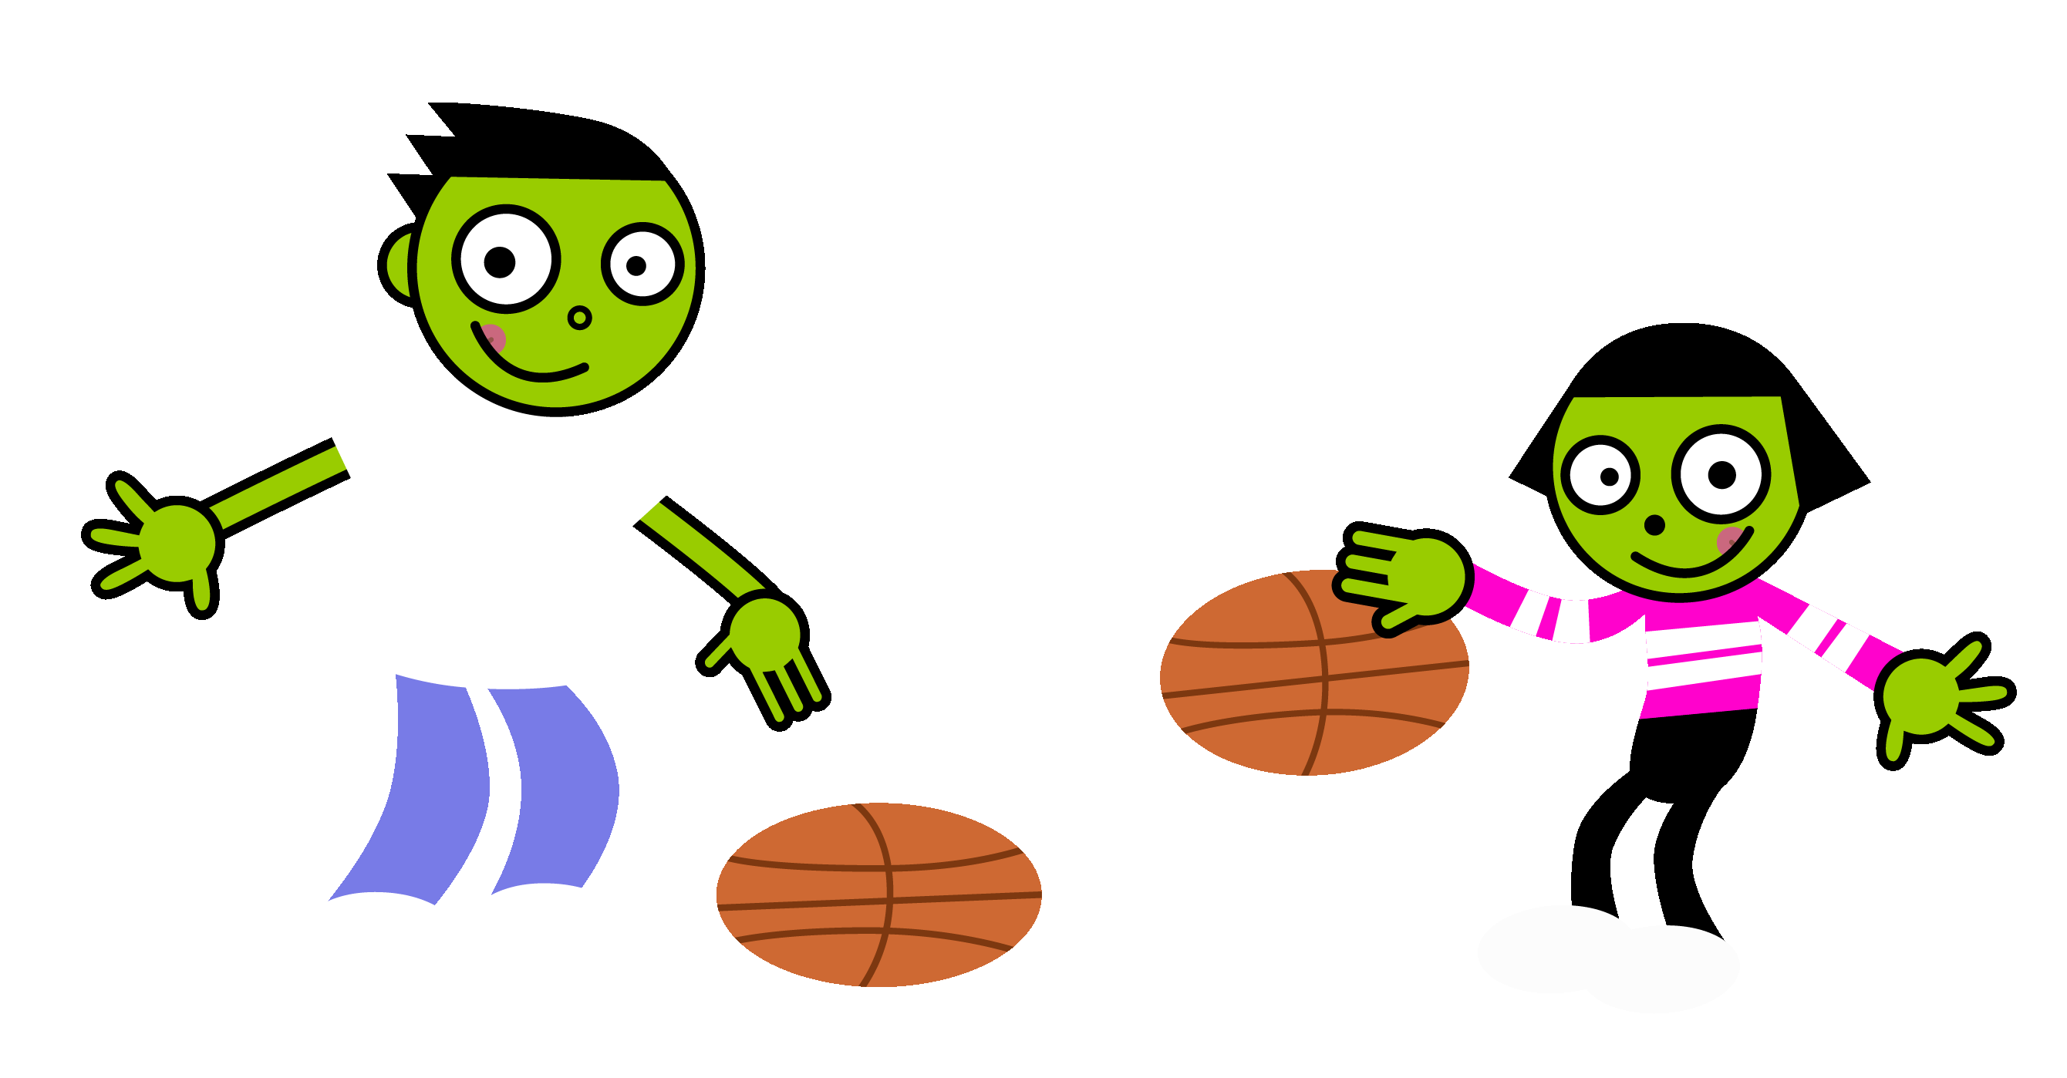
A simple statement of Newton's first law of motion is that if an object is not moving, it will not start moving until a net force acts on it.
If an object is moving, it will continue at a constant velocity until a net force acts to change its speed or its direction.
If there is a net force acting on an object, it will accelerate.

Slide 7
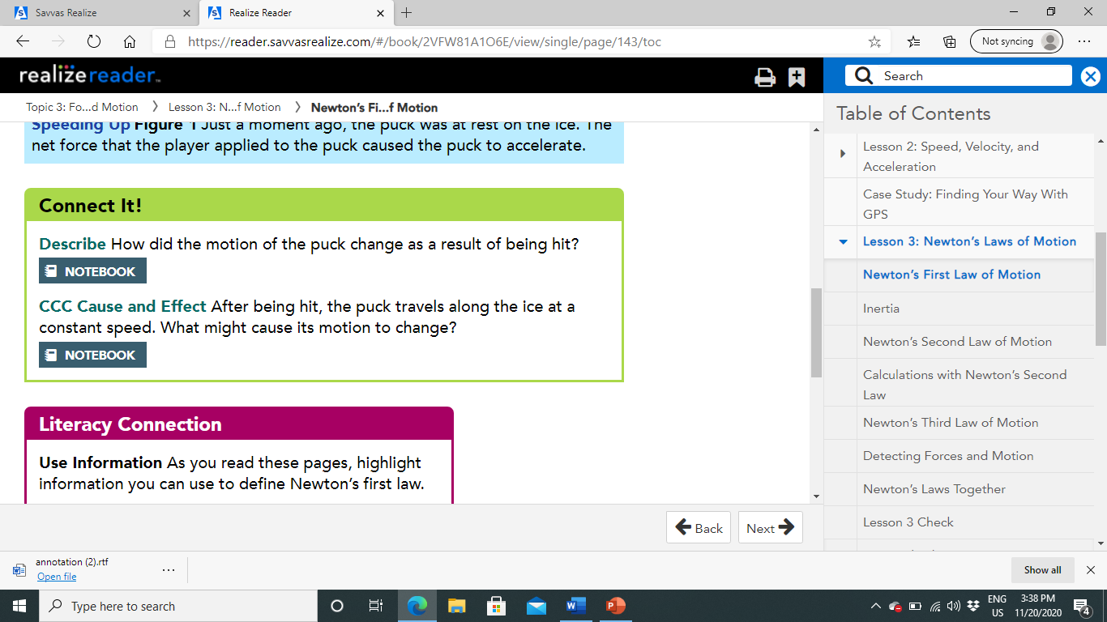
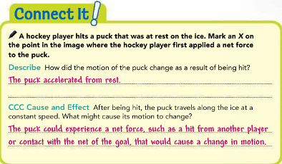

Slide 8
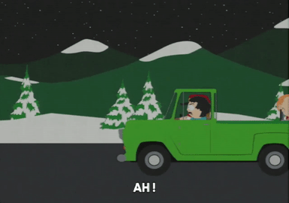
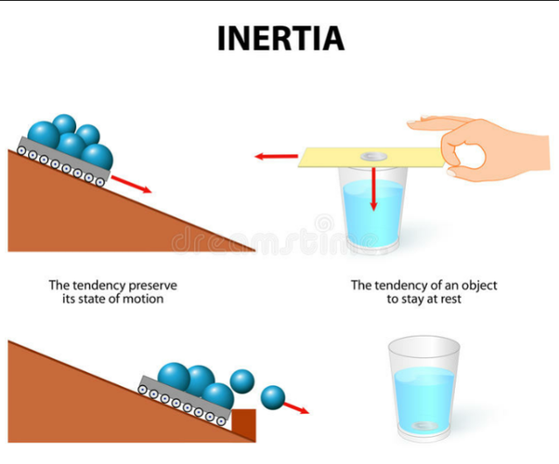
Inertia:
Resistance to change in motion is called inertia.
So Newton's first law is also called the law of inertia.
Inertia explains many common events, including why seat belts and air bags are used in vehicles.
If you are riding in a moving car, you are moving at the same speed the car is moving.
When brakes apply a force to the car, the car decelerates.
The brakes did not apply a force to you, however, so inertia keeps you moving forward at the same speed and direction you were going before the car decelerated.
A force, such as the pull of a seat belt, is needed to pull you back.

Slide 9
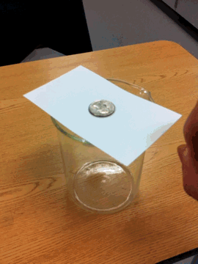
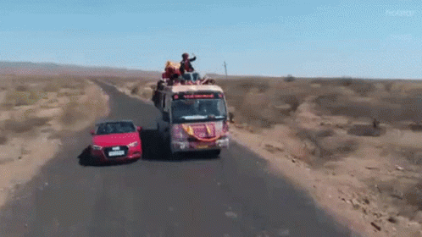

Slide 10

Inertia and Mass:
Which object you or the car is harder to stop?
Based on your own experience, you can probably figure out that the car is harder to stop.
That is because it has more mass.
The more massive object has a greater inertia.

Slide 11
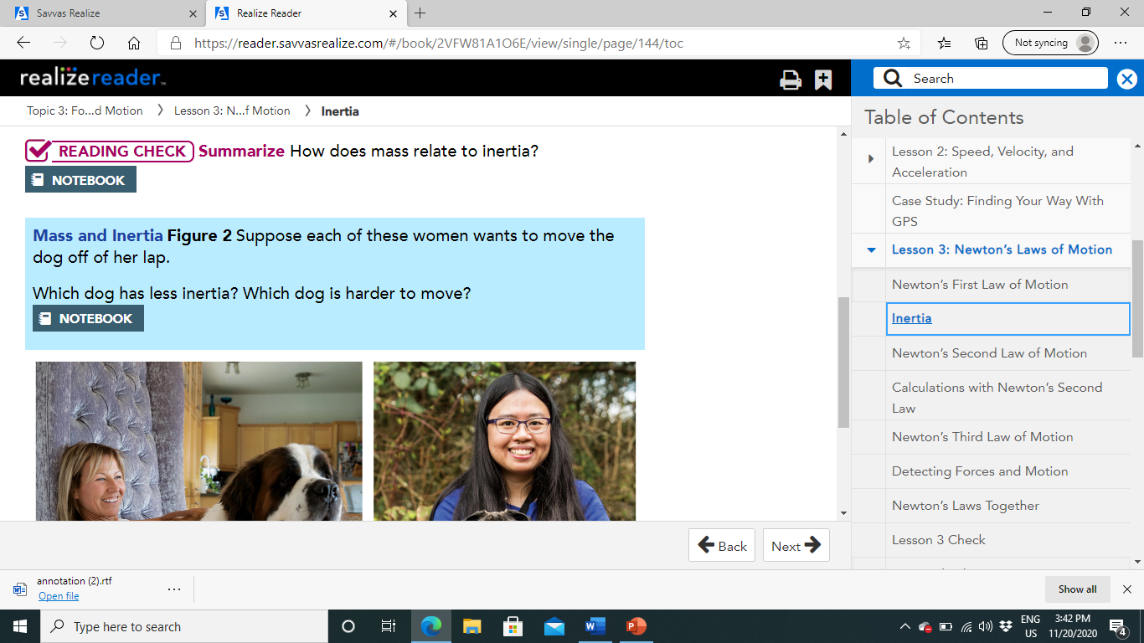
The object of bigger mass has greater inertia

Slide 12
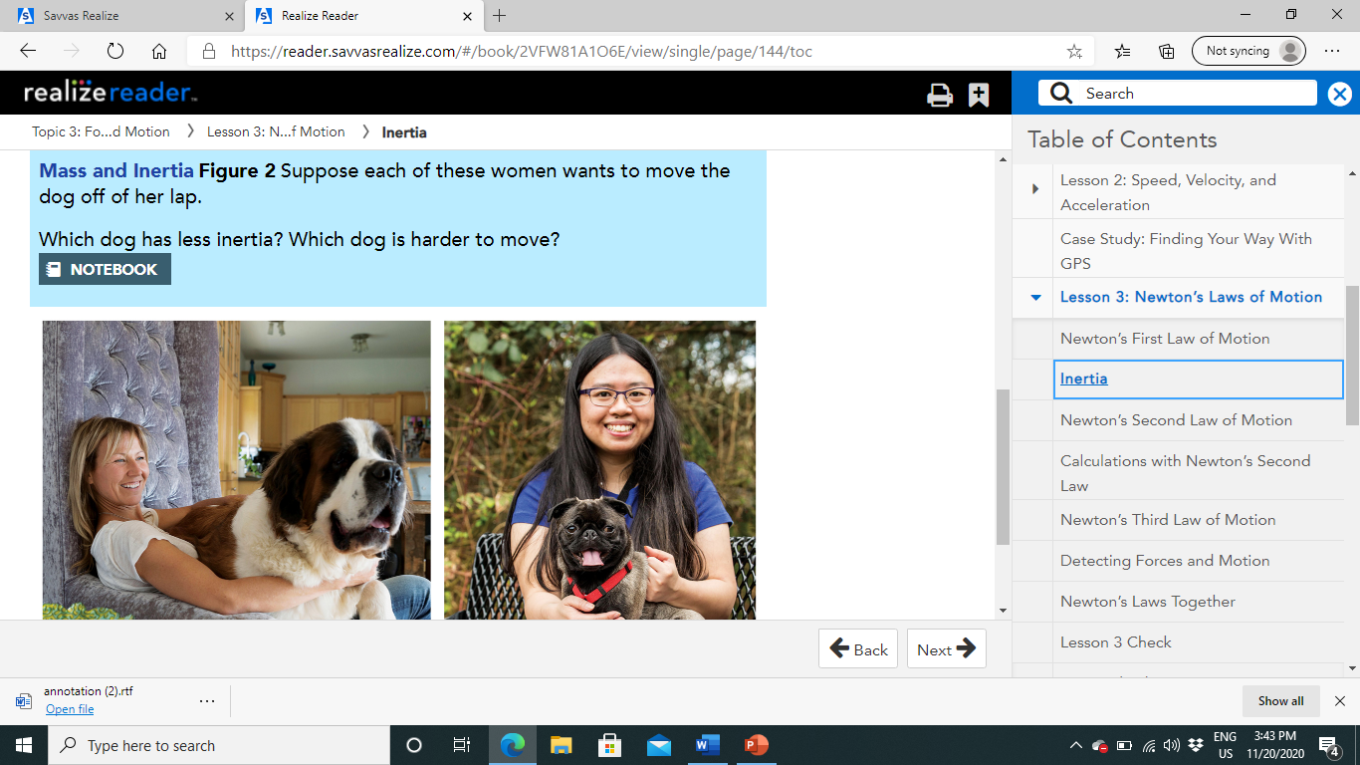
Harder to move
Less inertia

Slide 13
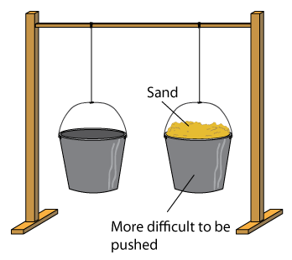
Once Newton had described the connection between inertia and mass, he next figured out how to find the acceleration of an object when a force acted on it.

Slide 14
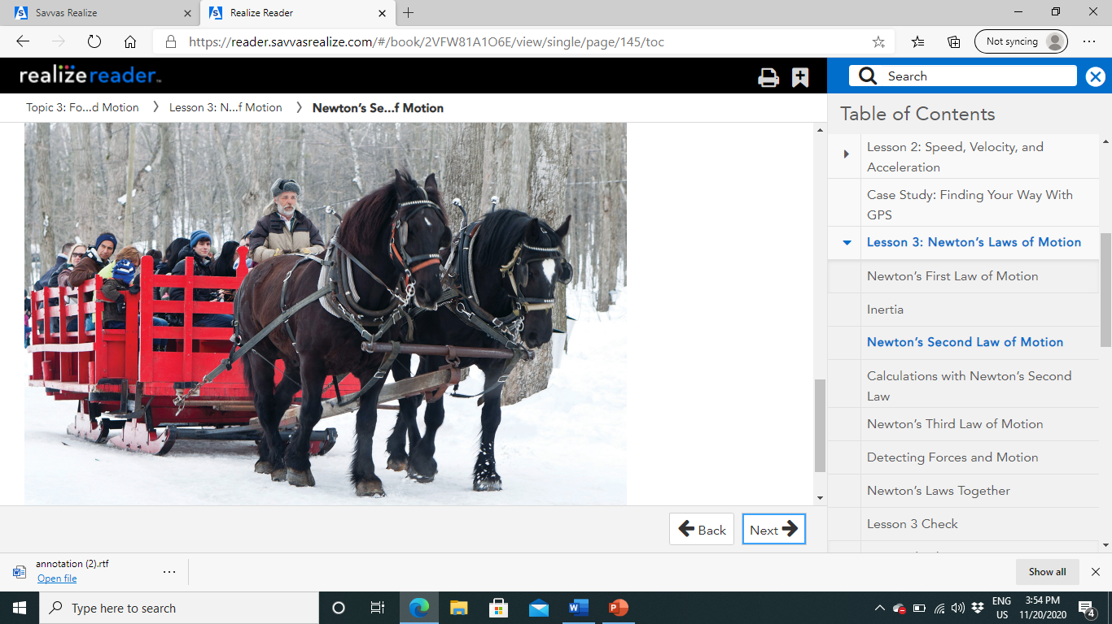
Newton's Second Law of Motion:
Newton's first law stated that inertia exists for an object.
Newton then explained that an object's mass directly affects how much force is needed to accelerate the object.
Changes in Acceleration and Mass:
Suppose that you apply a constant net force on an object.
How does changing the mass of the object affect its acceleration?
You can see this with a horse-drawn sleigh.
The horses provide a steady force.
If the sleigh is empty, it will accelerate quickly when the horses pull on it.
If the sleigh is full of people, it has a greater inertia and will accelerate slowly.
The acceleration of the sleigh will change depending on the mass of the load it carries.
Newton understood these relationships and found a way to represent them mathematically.
Notes:
https://www.youtube.com/watch?v=8YhYqN9BwB4

Slide 15
Calculating Force:
Newton's second law of motion states that the size and direction of a net force equals the mass times the acceleration.
The net force will have the same direction as the acceleration.
This relationship can be written as follows:
Net force=Mass x Acceleration
If the net force and mass are known, the resulting acceleration can be derived by using this equation:
Acceleration=Net force / Mass

Slide 16
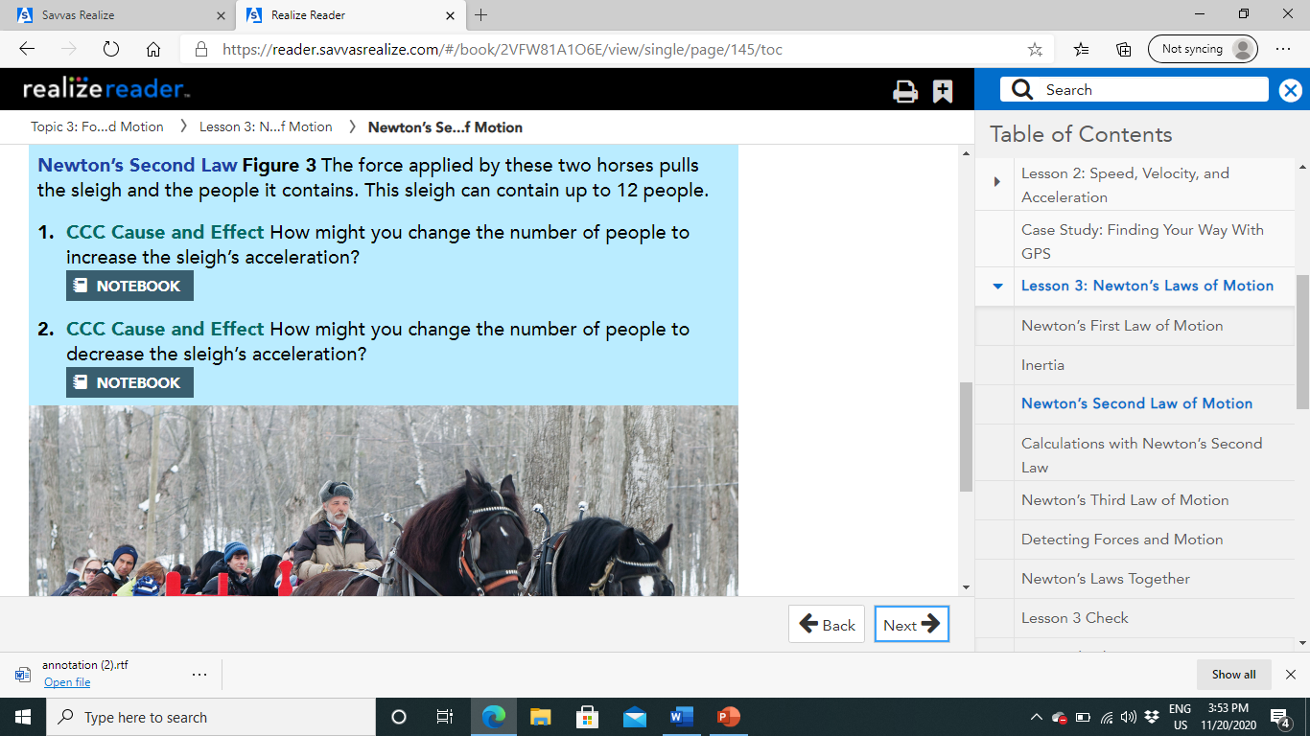
I will decrease the number of people
I will increase the number of people

Slide 17
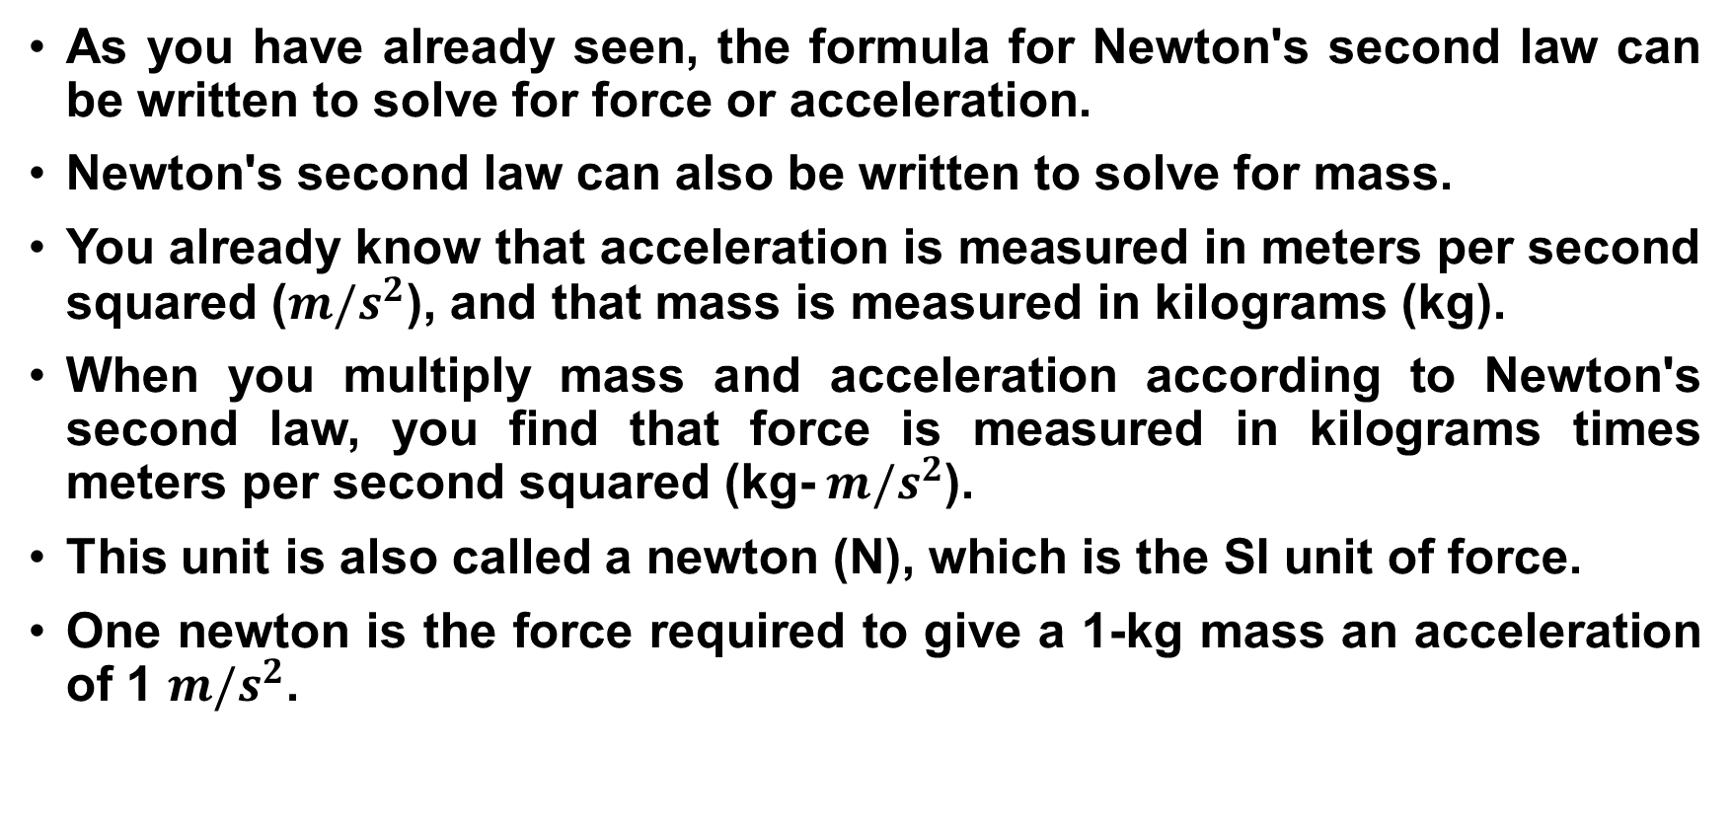
Calculations with Newton's Second Law:
As you have already seen, the formula for Newton's second law can be written to solve for force or acceleration.
Newton's second law can also be written to solve for mass.
You already know that acceleration is measured in meters per second squared (${m/s}^{2}$), and that mass is measured in kilograms (kg).
When you multiply mass and acceleration according to Newton's second law, you find that force is measured in kilograms times meters per second squared (kg- ${m/s}^{2}$).
This unit is also called a newton (N), which is the SI unit of force.
One newton is the force required to give a 1-kg mass an acceleration of 1 ${m/s}^{2}$.

Slide 18
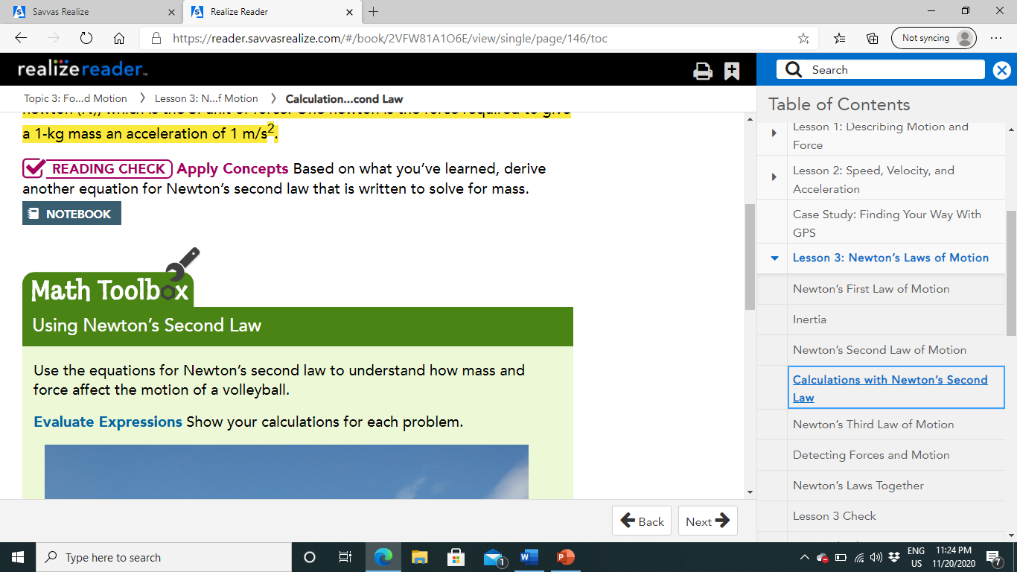
Mass= Net force
Acceleration

Slide 19
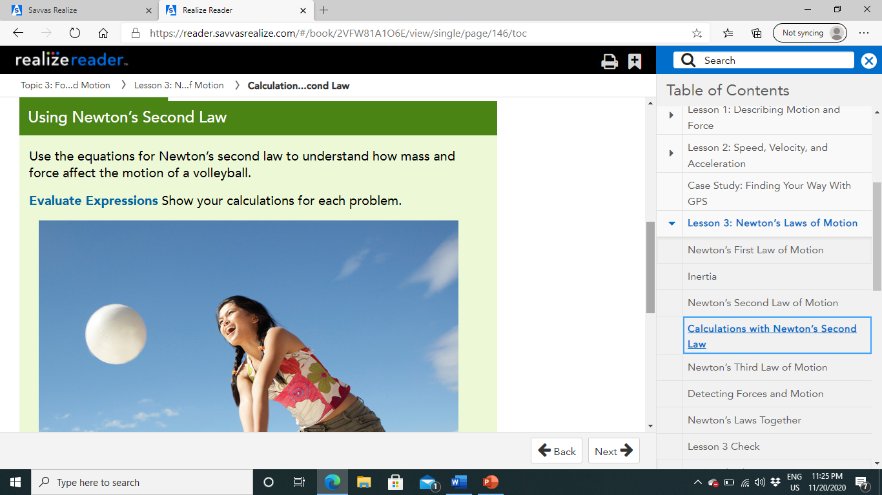
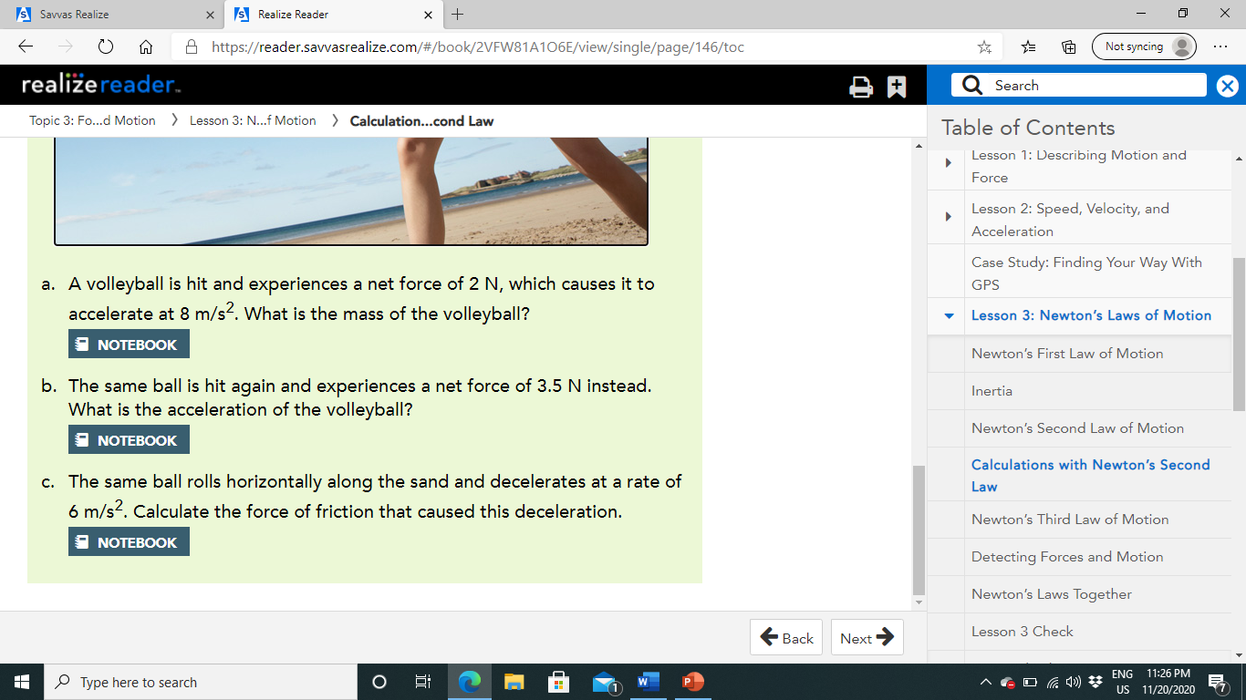
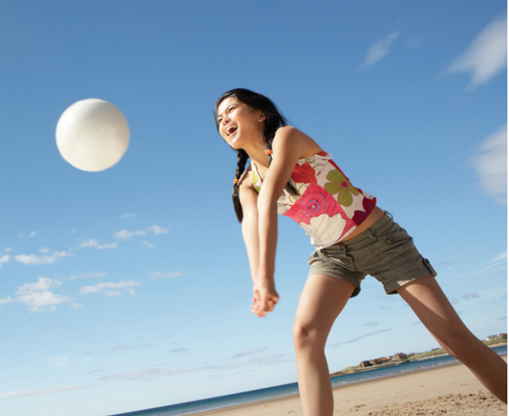


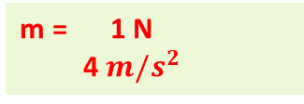
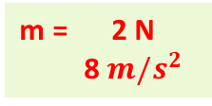
Mass = Net force
Acceleration
m = 2 N
8 ${m/s}^{2}$
m = 1 N
4 ${m/s}^{2}$
m = 0.25 kg
Acceleration = Net force
mass
a = 3.5 N
0.25 kg
a = 14${m/s}^{2}$
Net force = Acceleration X mass
F = 0.25 kg X 6 ${m/s}^{2}$ = 1.5 N

Slide 20
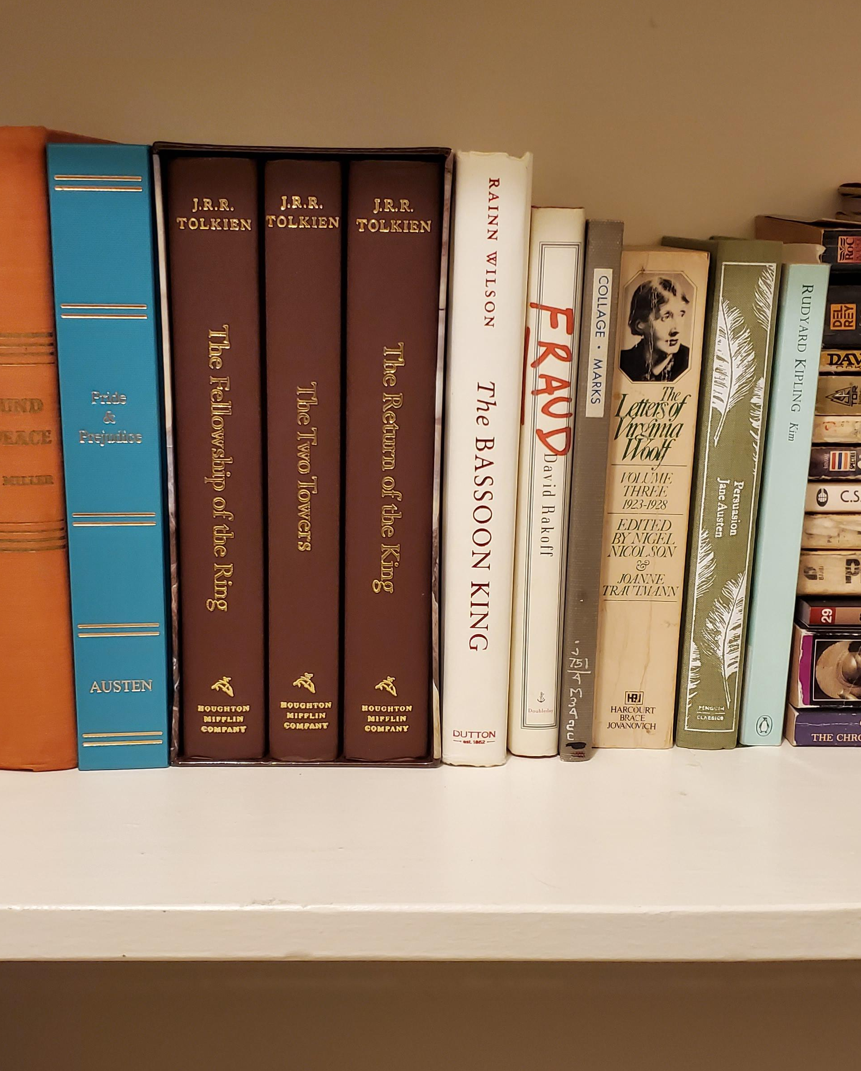
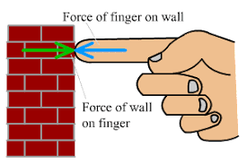
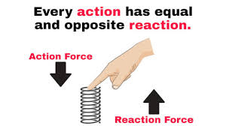
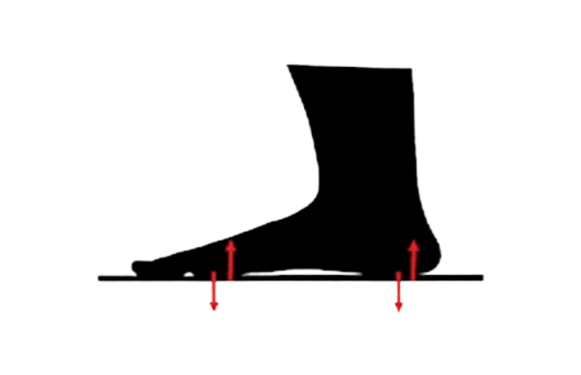
Newton's Third Law of Motion:
Force of gravity
A library is full of shelves of books.
Gravity pulls each book down.
If the shelf did not push upward on each book with equal force, the books would fall through the shelf.
The force exerted by the shelf is equal in strength and opposite in direction to the force the books exert on the shelf.
Newton's third law of motion states that if one object exerts a force on another object, then the second object exerts a force of equal strength in the opposite direction on the first object.
Another way to state Newton's third law is that for every action there is an equal (in strength) but opposite (in direction) reaction.
Force exerted by shelf
Notes:
https://www.youtube.com/watch?v=TVAxASr0iUY

Slide 21
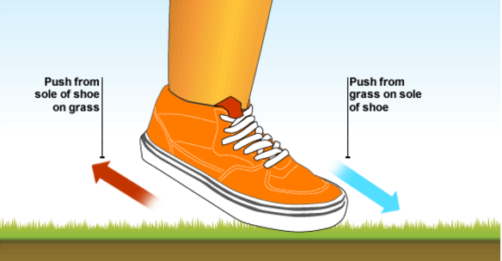
Action-Reaction Pairs:
An action force is always paired with a reaction force.
Pairs of action and reaction forces are all around you.
When you walk, you push backward on the ground with your feet.
Think of this as an action force.
The ground pushes forward on your feet with an equal and opposite force.
This is the reaction force.
You can walk only because the ground pushes you forward!

Slide 22
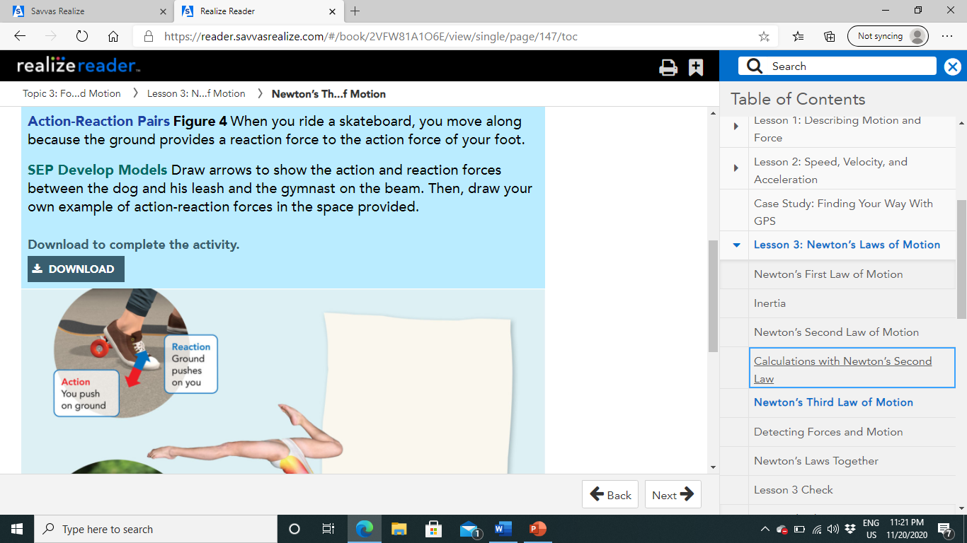
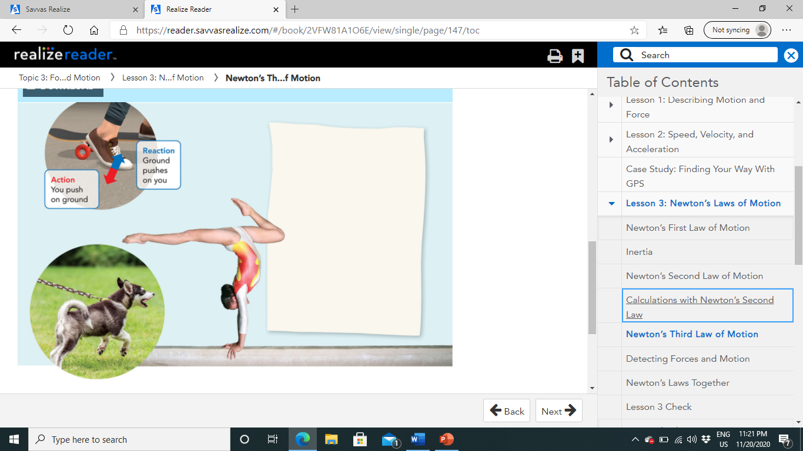

Slide 23
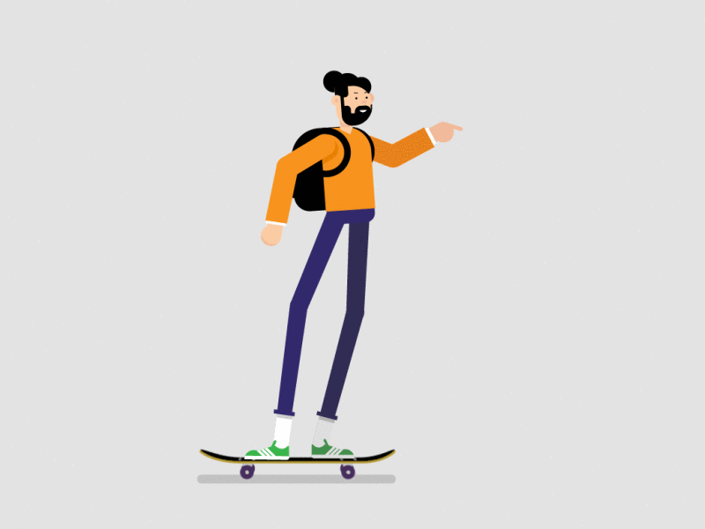
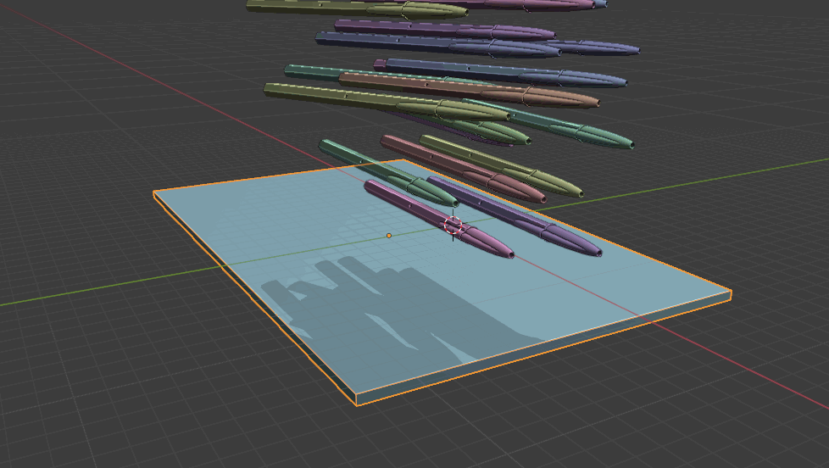
Detecting Forces and Motion:
Some results of action-reaction forces are easily observed.
If you were the skateboarder, you could feel the force of the ground on your foot.
You could see and feel the skateboard accelerate.
If you drop your pen, gravity pulls the pen downward and you can see it fall.
But some changes caused by action-reaction forces are not as easily detected.
When you drop your pen, the pen pulls Earth upward with an equal and opposite reaction force, according to Newton's third law.
You see the pen fall, but you don't see Earth accelerate toward the pen.
Remember Newton's second law.
If mass increases and force stays the same, acceleration decreases.
The same force acts on both Earth and your pen.
Because Earth has such a large mass, its acceleration is so small that you don't notice it.

Slide 24
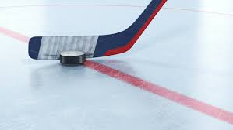
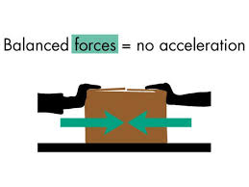
Balanced and Action-Reaction Forces:
You have learned that two equal forces acting in opposite directions on an object, balance each other and produce no change in motion.
So why aren't the action-reaction forces in Newton's third law of motion balanced as well?
In order for forces to balance, they must act on the same object.
Action-reaction forces are not balanced because they act on different objects.
When a hockey player hits a puck with his stick, the action force is the force of the stick on the puck.
The reaction force is the force of the puck on the stick.
So one force acts on the puck, while the other acts on the stick.
The puck has a much smaller mass than the player and his stick, so you see the puck accelerate.

Slide 25
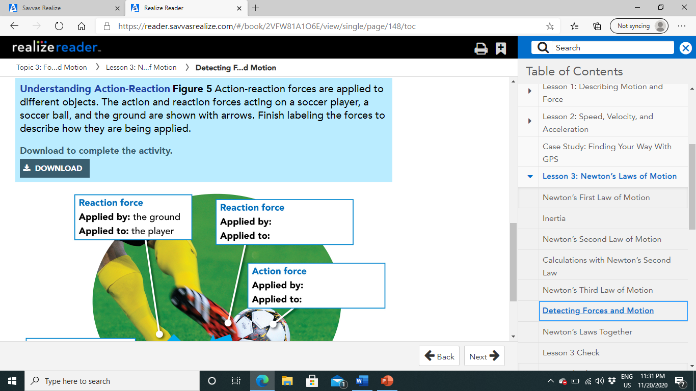
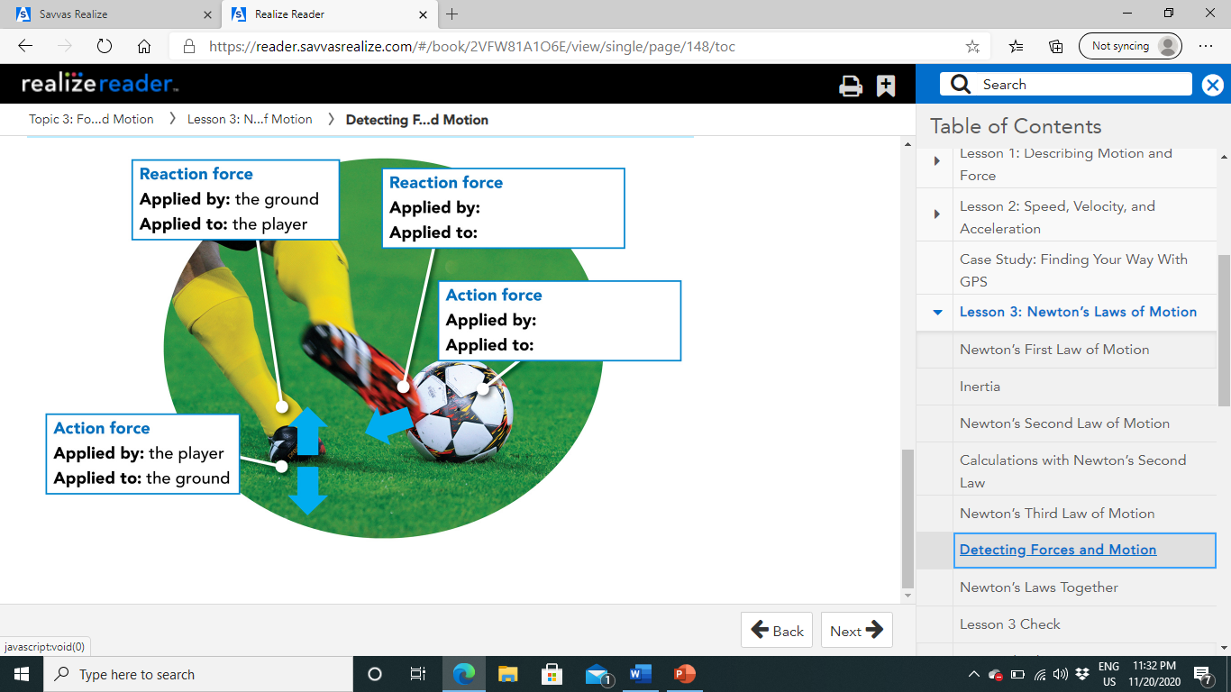
The ball
The Player
The player
The ball

Slide 26
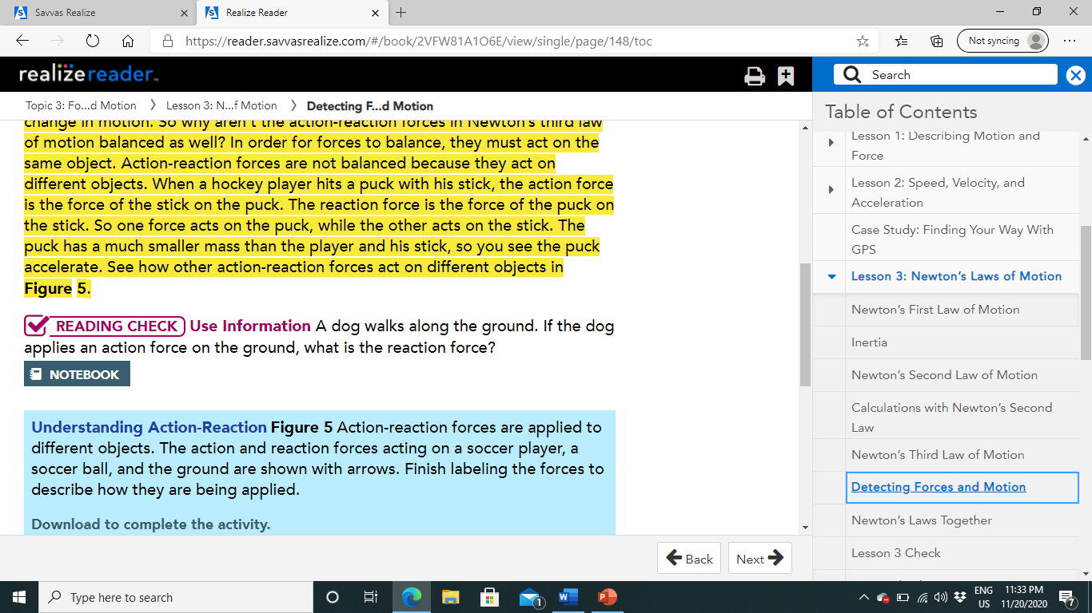
The force applied by the ground on the dog

Slide 27
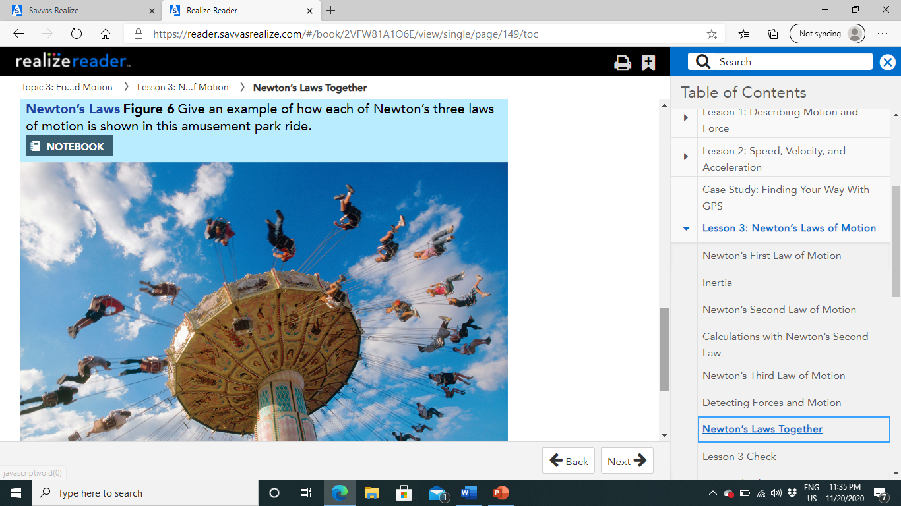
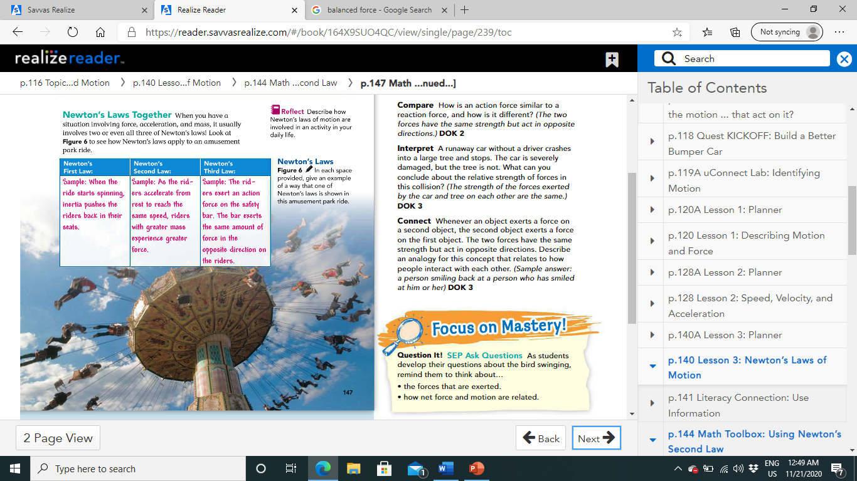
Newton's Laws Together:
When you have a situation involving force, acceleration, and mass, it usually involves two or even all three of Newton's laws! Look at Figure 6 to see how Newton's laws apply to an amusement park ride.

Slide 28
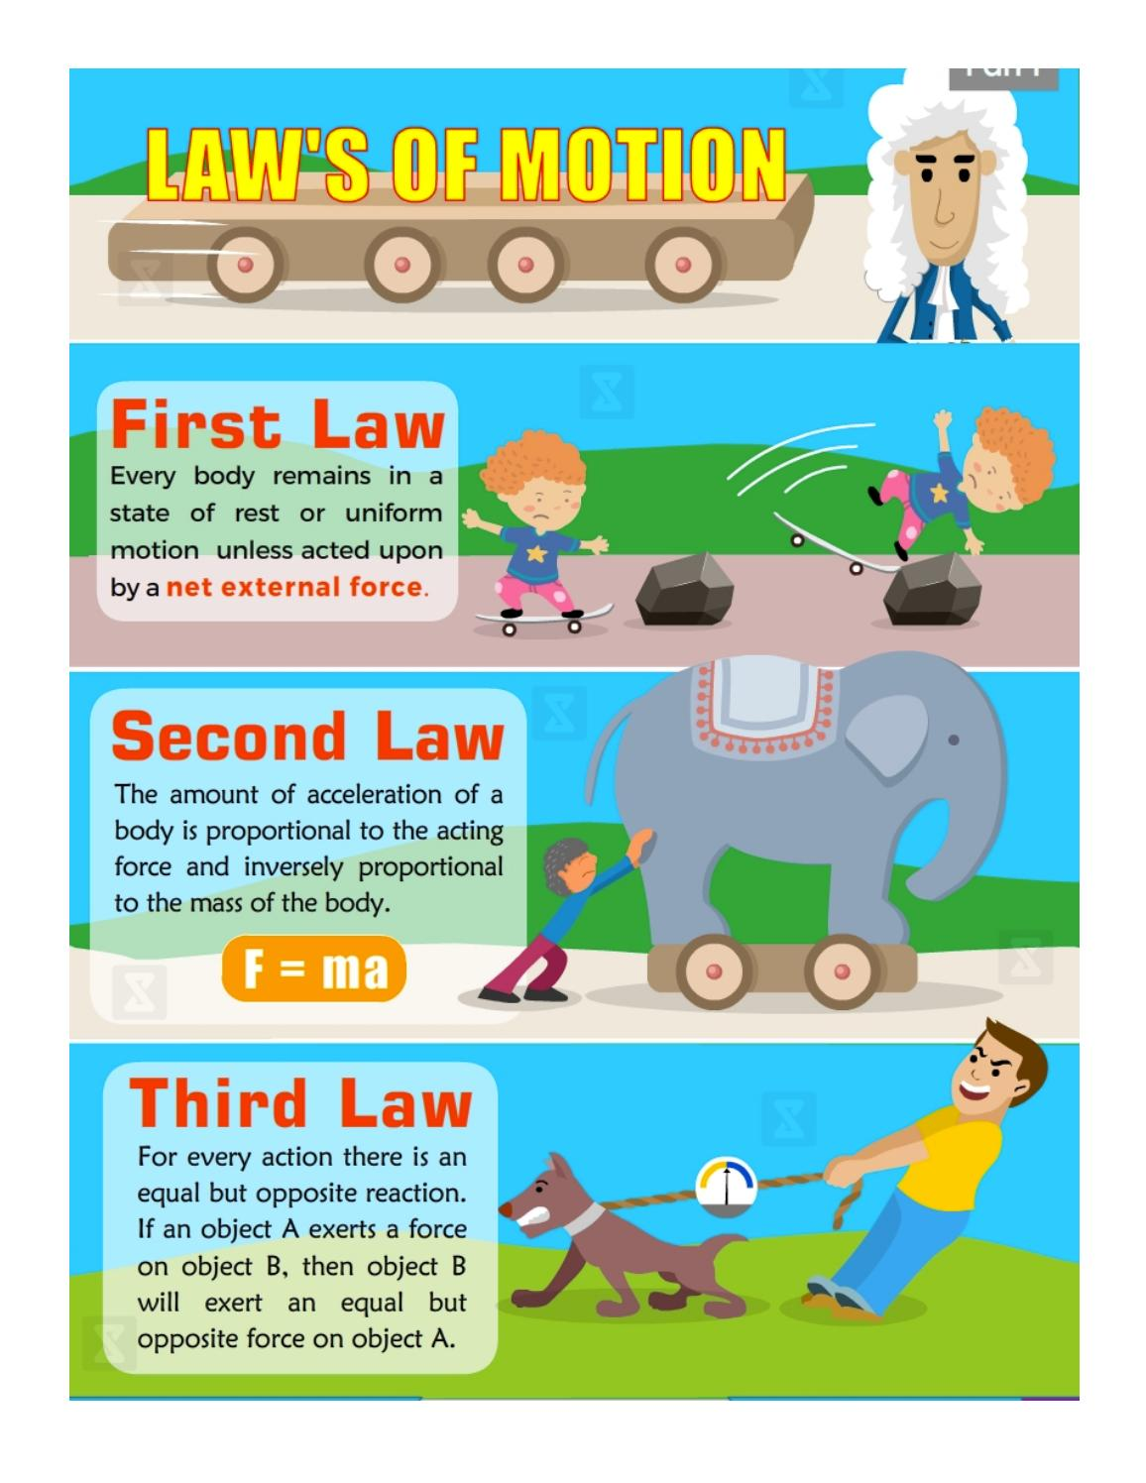
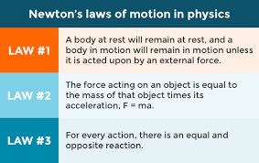

Slide 29
