Slide 1
L1 Determining Ages of Rocks
Topic 6 History of Earth
Pg. 302

Slide 2
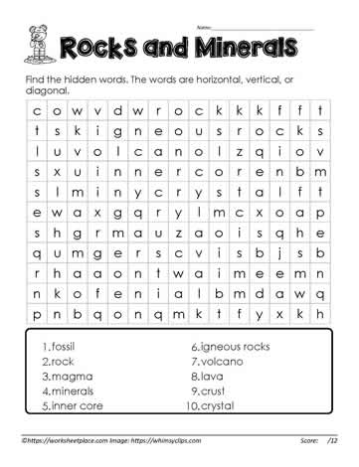


Brain Workout

Slide 3
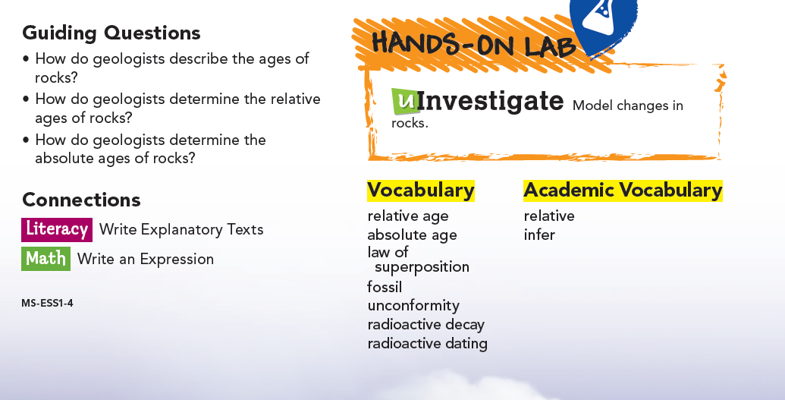

Slide 4
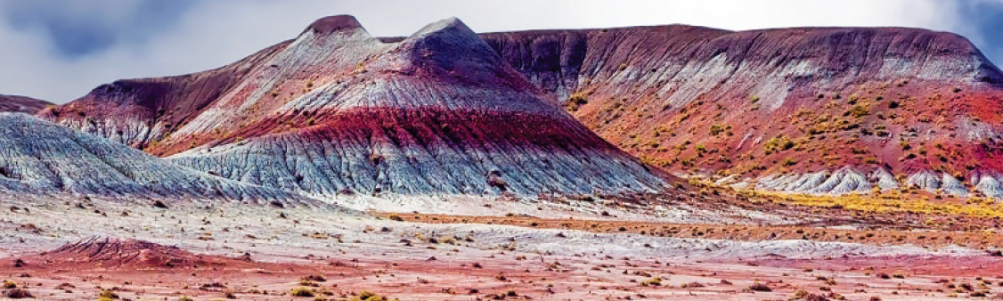
Describing the Ages of Rocks
If you visit the Painted Desert in Arizona, you will find rock layers that look grey, red, green, blue, and even purple.
If you're curious, you might start by asking "How did these colorful rocks form?" Your next question would probably be "How old are these rocks?"
In other words, you would want to describe the ages of the rocks.
Geologists have two ways to describe the age of a rock: age relative to another rock and age in number of years since the rock formed.

Slide 5


Describing the Ages of Rocks - Relative Age
The relative age of a rock is its age compared to the ages of other rocks.
You probably use the idea of relative age when you compare your age with someone else’s.
For example, if you say that you are older than your brother but younger than your sister, you describe your relative age.

Slide 6
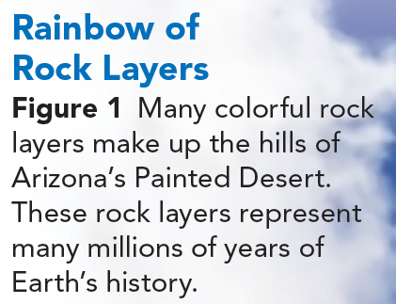
Describing the Ages of Rocks - Absolute Age
The relative age of a rock does not provide its absolute age.
The absolute age of a rock is the number of years that have passed since the rock formed.
It may be impossible to know the exact absolute age of some rocks, so geologists often use both absolute and relative ages.
Why do geologists want to analyze and describe the ages of rocks?
Evidence of past events occurs in rocks.
That evidence shows that Earth has changed and evolved over time due to natural processes.
Rock layers like those in Figure 1 form a record of Earth's history of change, known as the geologic record.
By studying clues in Earth's rocks and determining their ages, geologist can organize past events in sequence to better understand Earth's history.

Slide 7
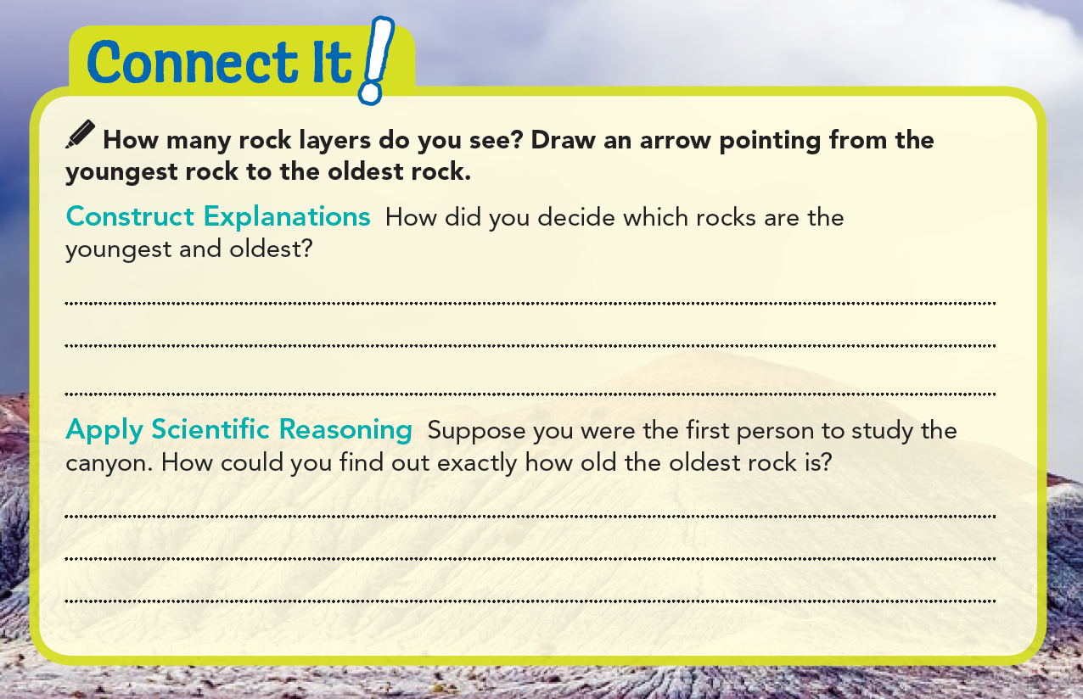
The oldest rocks are buried the deepest, so they must be on the bottom. That also means the youngest rocks must be at the top.
I could take rock samples from the bottom of the canyon and conduct tests to find out how old the parts making up the rock are. I could look for fossils of a known age in the rock.

Slide 8

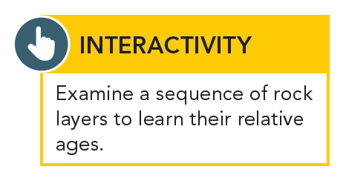

I am behind my desk.
Relative age determines whether rocks are older or younger than other rocks. Absolute age represents the number of years that have passed since a given rock formed.

Slide 9
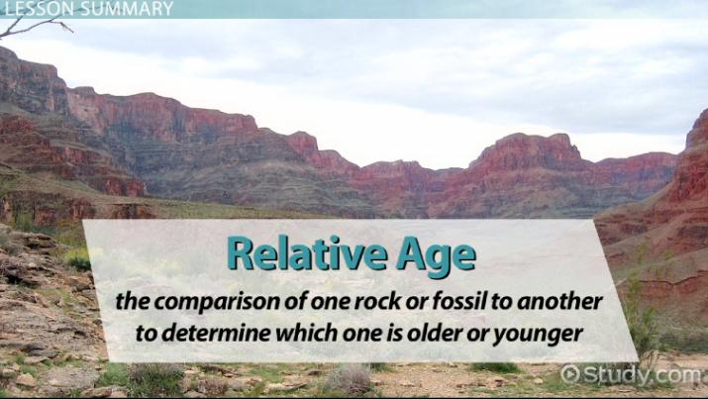
Determining Relative Ages of Rocks
Geologists use many methods to determine the age of Earth’s rocks.
To find a rock's relative age, they analyze the position of rock layers.
They also look for a variety of clues in rocks, such as fossils.
These methods provide ways to find relative ages, but not absolute ages, of rocks.

Slide 10
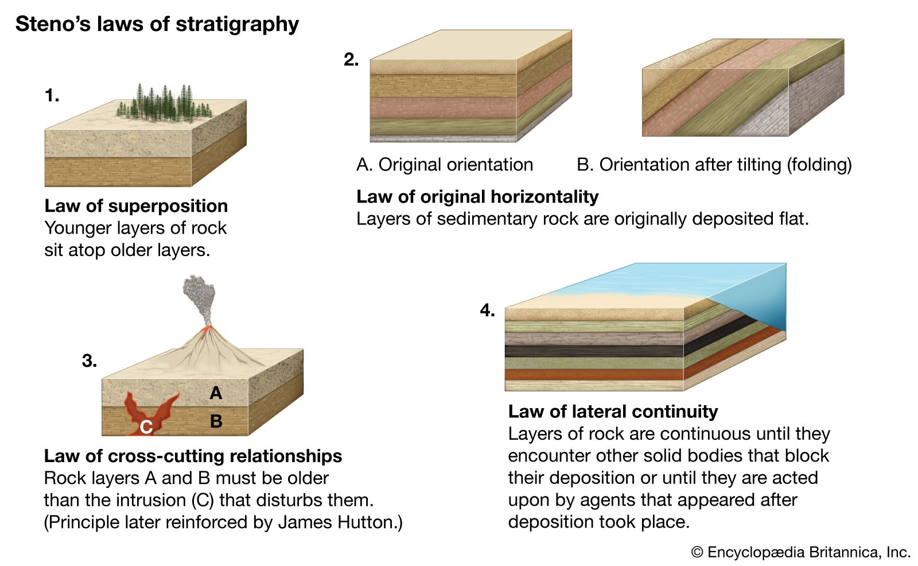
Position of Rock Layers
Sedimentary rock usually forms in horizontal layers, or strata.
Geologists use the law of superposition to determine the relative ages of sedimentary rock layers.
According to the law of superposition, in undisturbed horizontal sedimentary rock layers, the oldest layer is at the bottom and the youngest layer is at the top.
The higher you go, the younger the rocks are.
The lower or deeper you go, the older the rocks are.

Slide 11
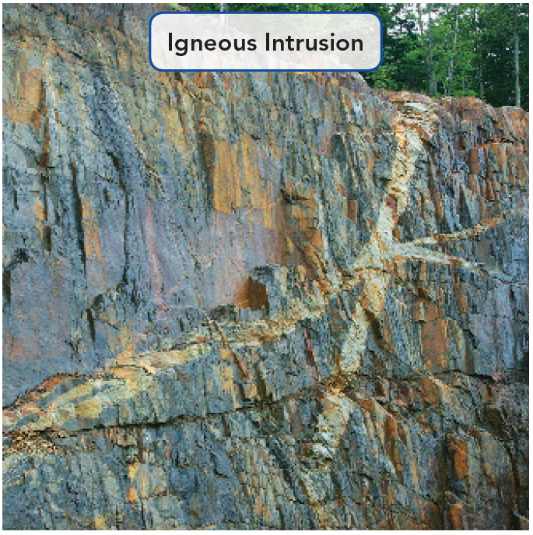
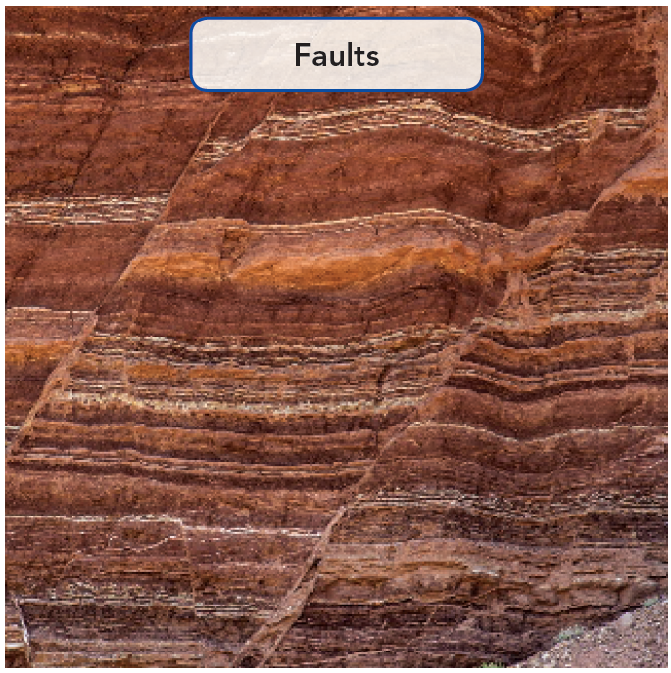
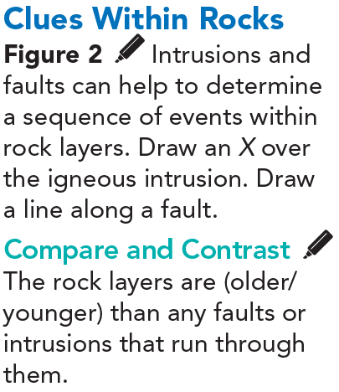

Clues from Igneous Rocks - Clues from Faults
Magma is molten material beneath Earth's surface.
Lava (magma that reaches the surface) can harden on the surface to form an igneous extrusion.
Magma can also push into layers of rock below the surface.
The magma can harden and form an igneous intrusion, like the one shown in Figure 2.
An extrusion is younger than the rock it covers.
An intrusion is younger than the rock around it.
More clues come from the study of faults. A fault, like the one shown in Figure 2, is a break in Earth’s crust.
Forces inside Earth cause movement of the rock on opposite sides of a fault.
A fault is always younger than the rock it cuts through.
To determine the relative age of a fault, geologists find the relative age of the youngest layer cut by the fault.

Slide 12
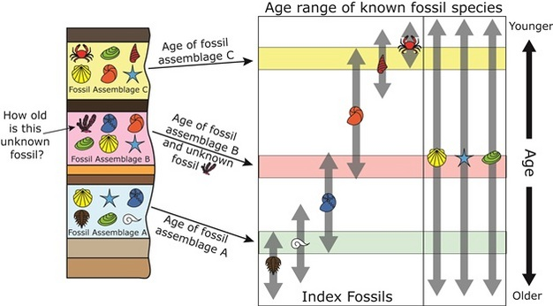
Using Fossils
The preserved remains or traces of living things are called fossils.
They most often occur in layers of sedimentary rock.
Fossils preserved in rock layers provide physical evidence about the history of life on Earth and how Earth has changed over time.
Certain fossils, called index fossils, help geologists to match and date rock layers, even if those layers are far apart or in different locations.
An index fossil is a fossil of an organism that was widely distributed and existed for a geologically short period of time.
Fossils from organisms that lived for a long geologic time might show up in multiple rock layers, but index fossils show up in only a few layers.

Slide 13
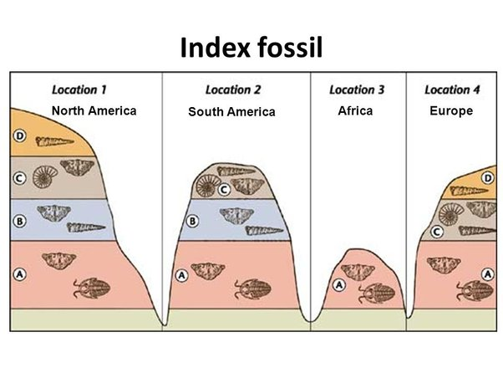
Using Fossils
Index fossils are useful because they tell the relative ages of the rock layers in which they occur.
Geologists infer that layers with matching index fossils are the same age.
You can use index fossils to match rock layers and find their relative age.
Look at the diagram in Figure 3, which shows rock layers from four different locations.
Notice that two of the fossils are found in only one rock layer.
These are index fossils.

Slide 14

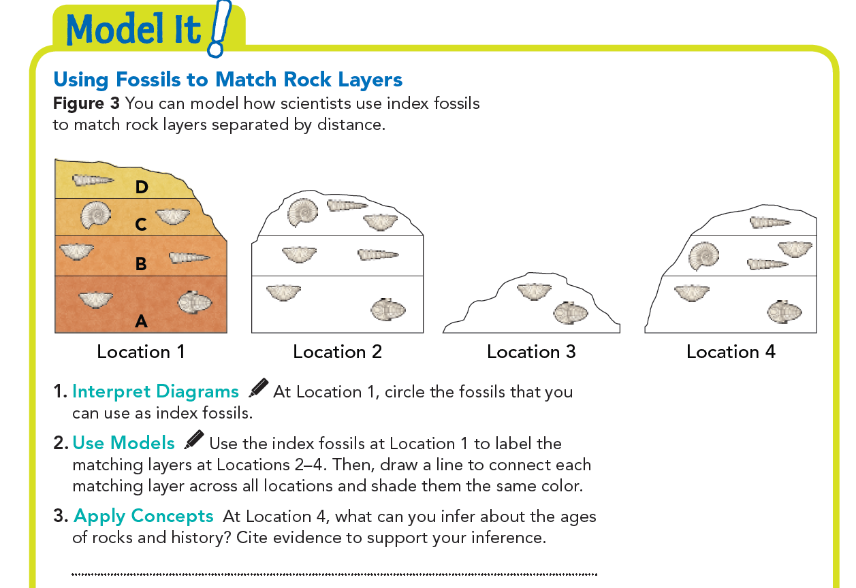


I can infer that my friend’s dog is young because it is still growing.
C
D
B
C
A
A
A
Layer B eroded away at Location 4. The fossils indicate that the other layers match layers A, C, and D.

Slide 15

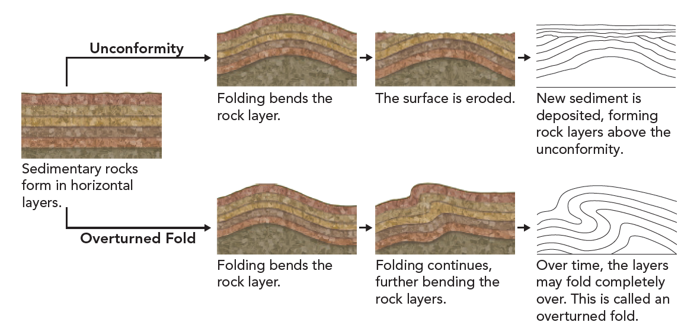
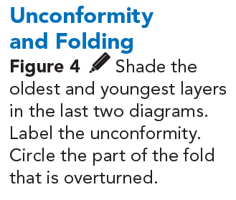

Changes in Rocks
The geologic record of sedimentary rock layers is not complete.
In fact, erosion destroyed most of Earth's geologic record over billions of years.
Gaps in the geologic record and folding can change the position in which rock layers appear.
As was shown in Figure 2, motion along faults can also change how rock layers line up.
These changes make it harder for scientists to reconstruct Earth's history.
Figure 4 shows how the order of rock layers may change.

Slide 16
Gaps in the Geologic Record
When rock layers erode, an older rock surface may be exposed.
Then deposition begins again, building new rock layers.
The surface where new rock layers meet a much older rock surface beneath them is called an unconformity.
An unconformity is a gap in the geologic record.
It shows where rock layers have been lost due to erosion.

Slide 17
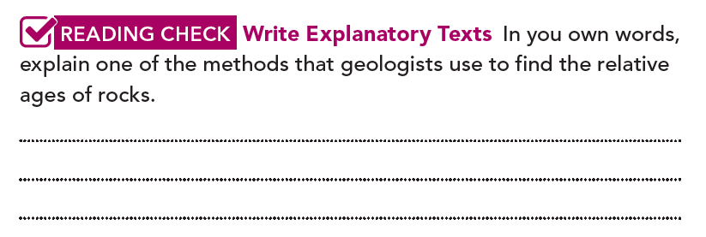
Folding
Sometimes, forces inside Earth fold rock layers so much that the layers are turned over completely.
In this case, the youngest rock layers may be on the bottom!
Samples from many different areas are needed to give a complete geologic record.
Geologists compare rock layers in many places to understand a complete sequence.
Geologists use the law of superposition, which states that in undisturbed horizontal sedimentary rock layers, the oldest layer is at the bottom.

Slide 18
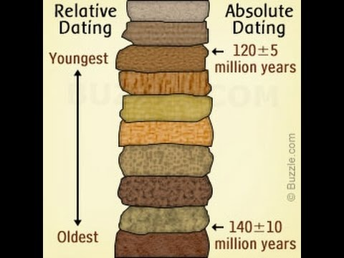
Determining Absolute Ages of Rocks
Geologist use different methods to determine the absolute age of Earth's rocks. To find a rock's absolute age, they use certain elements in rocks that change over time.

Slide 19
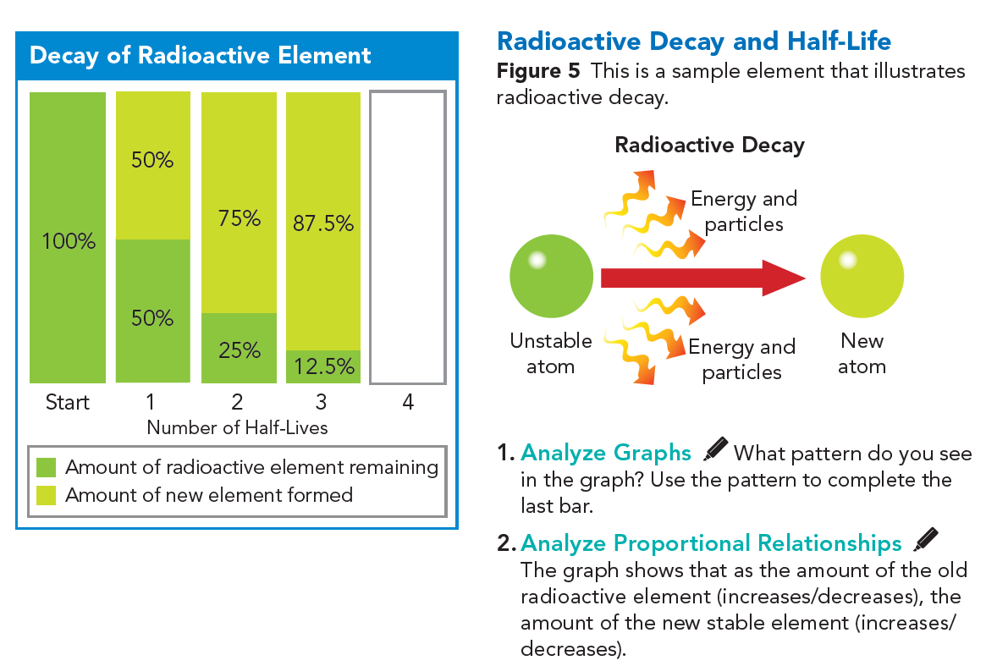

Radioactive Decay
An element is said to be radioactive when its particles become unstable and release energy in the form of radiation.
This process is called radioactive decay.
During radioactive decay, the atoms of one element break down to form atoms of another element.
Radioactive elements occur naturally in some igneous rocks.
As an unstable radioactive element decays, it slowly changes into a stable element.

Slide 20
Radioactive Decay
The amount of the radioactive element decreases, but the amount of the new element increases, causing the overall composition of elements in the rock to change.
Each radioactive element decays at its own constant rate, represented by its half-life.
The half-life of a radioactive element measures the time it takes for half of the radioactive atoms to decay.
You can see in Figure 5 how a radioactive element decays over time.
Scientists use the half-life ratio to calculate the age of the rock in which a radioactive element is found.

Slide 21
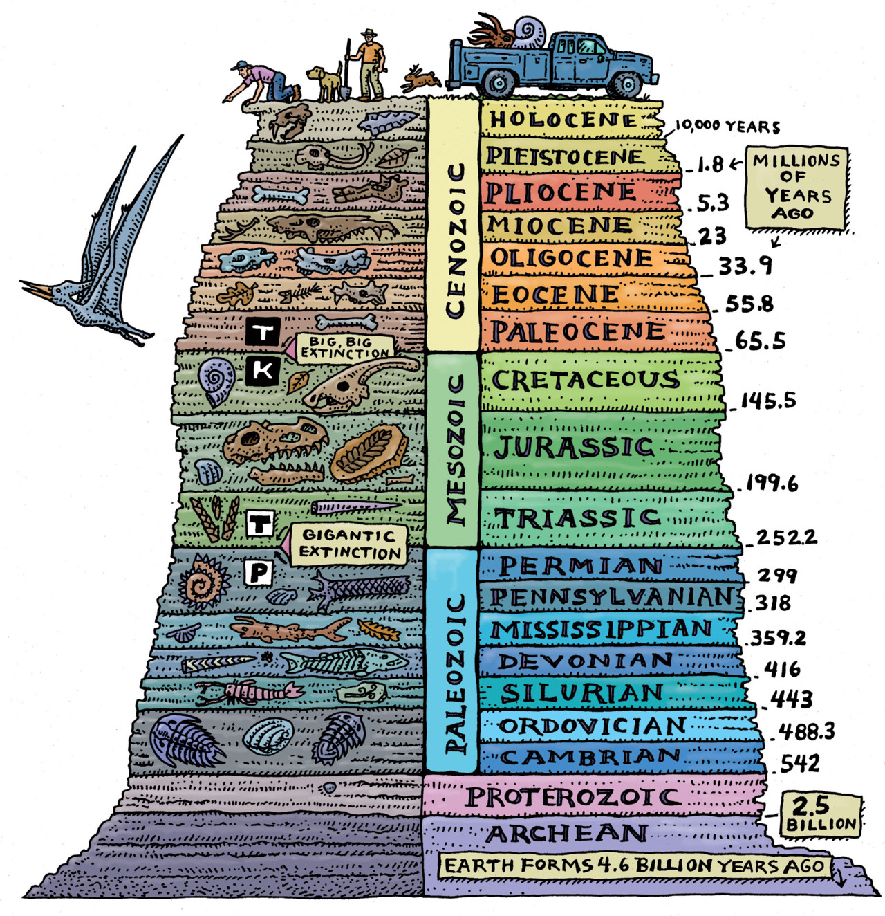
Radioactive Dating
Geologists use radioactive dating, or radiometric dating, to determine the absolute ages of rocks.
In radioactive dating, scientists first determine the amount of a radioactive element in a rock sample.
Then they compare that with the amount of the stable element into which the radioactive element decays.
They use this information and the half-life of the element to calculate the age of the rock.

Slide 22
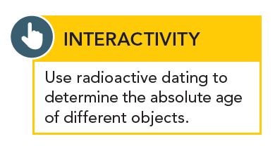
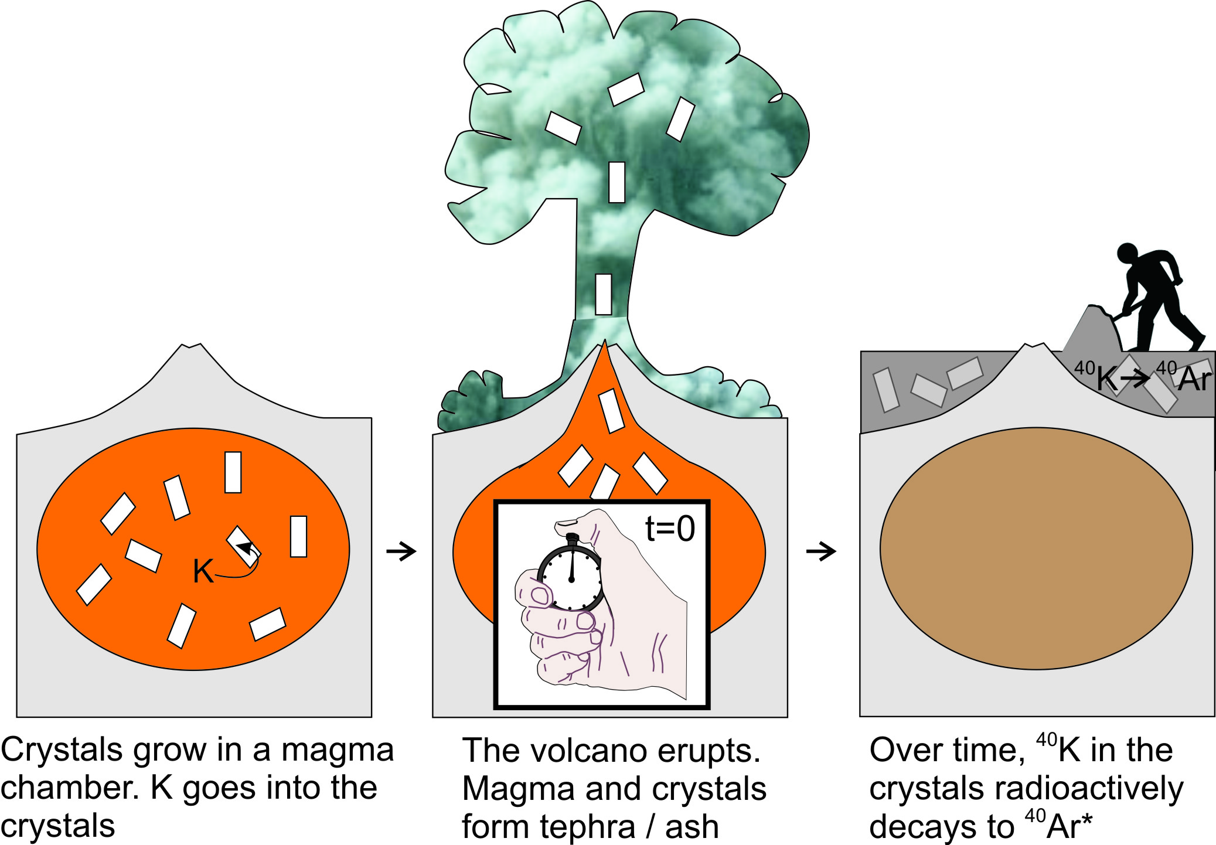
Radioactive Dating - Potassium-Argon Dating
Scientists often date rocks using potassium-40.
This form of potassium decays to stable argon-40 and has a half-life of 1.3 billion years.
Potassium-40 is useful in dating the most ancient rocks because of its long half-life.

Slide 23
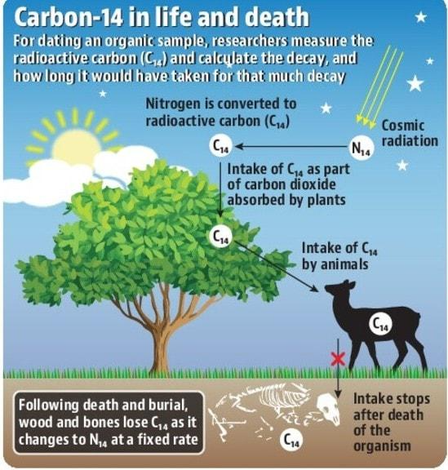
Radioactive Dating - Carbon-14 Dating
Scientists can date plant and animal remains using carbon-14.
All organisms contain carbon, including this radioactive form.
Carbon-14 decays to stable nitrogen-14 and has a half-life of only 5,730 years.
Therefore, this method can't be used to date remains older than about 50,000 years because the amount of carbon-14 left would be too small to measure accurately.

Slide 24
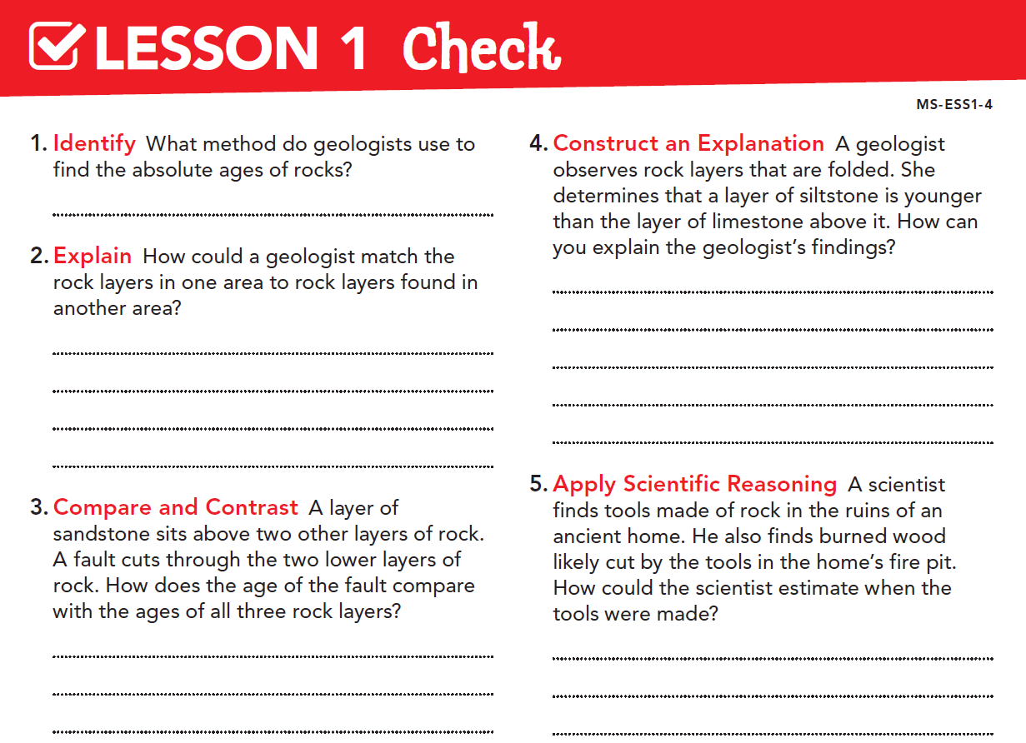
Radioactive dating
The limestone formed below the siltstone. After the rock layers formed, forces inside Earth raised and folded them, overturning their original order.
The geologist could look for index fossils in the rock layers and match them to fossils found in the other area.
The fault is younger than both of the lower rock layers, but is older than the top layer of sandstone.
The scientist could use carbon-14 radioactive dating to find the age of the wood. The tools are probably about the same age.

Slide 25


Slide 26
