Slide 1
Topic 3 Lesson 3.2: Plant structures for reproduction

Slide 2
Objectives
Students will be able to discuss and explain:
• How do plants reproduce?
• How do seeds become new plants?
• reproductive cycles in plants.
• the structures and sequence of events in plant reproduction.
• Which specialized plant structures affect the probability of
successful reproduction?
Students will cite textual evidence to
• identify aspects of the text that lead to conceptual understanding
of plant reproduction and seed dispersal.

Slide 3
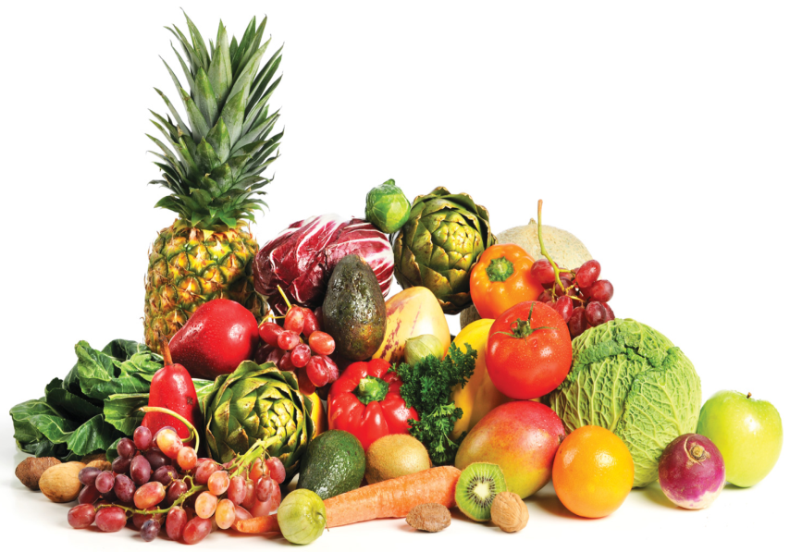
Plant Reproduction
Different types of plants have different structures and
methods that help them reproduce. But the goal is the
same .i.e. to produce new generations of life.
When a seed, like ones from the fruits & vegetables
in Figure 1, is planted in healthy soil and gets plenty of
water and sunlight, it can grow into an adult plant.
But this is just one part in the process of how plants
reproduce. A lot must first happen in a plant’s life
before it can produce a seed that can grow into a plant.
Surprisingly to some, plants are like animals in that
reproduction requires a sperm cell fertilizing an egg cell for a new organism to begin. To ensure successful reproduction, plants have evolved specialized structures over time.
Connect it
Where in the fruit are seeds found and what is their purpose?
___________________________________________________________________________________________________________________________________________________________________________________________________

Slide 4
Plant Reproduction
Different types of plants have different structures and
methods that help them reproduce. But the goal is the
same .i.e. to produce new generations of life.
When a seed, like ones from the fruits & vegetables
in Figure 1, is planted in healthy soil and gets plenty of
water and sunlight, it can grow into an adult plant.
But this is just one part in the process of how plants
reproduce. A lot must first happen in a plant’s life
before it can produce a seed that can grow into a plant.
Surprisingly to some, plants are like animals in that
reproduction requires a sperm cell fertilizing an egg cell for a new organism to begin. To ensure successful reproduction, plants have evolved specialized structures over time.
Connect it
Where in the fruit are seeds found and what is their purpose?
The seeds are usually found inside the fruits. Their purpose is to grow into a new plant.

Slide 5
Plant Life Cycles
Plants have complex life cycles that include two different stages:
The sporophyte stages:
During the sporophyte stage, a plant produces the spores that will eventually develop into gametophytes.
The gametophyte stages:
During the gametophyte stage, male and female gametophytes produce sex cells that will eventually be involved in the process of fertilization.
Fertilization:
A process which occurs when a sperm cell unites with an egg cell to produce a new organism.

Slide 6
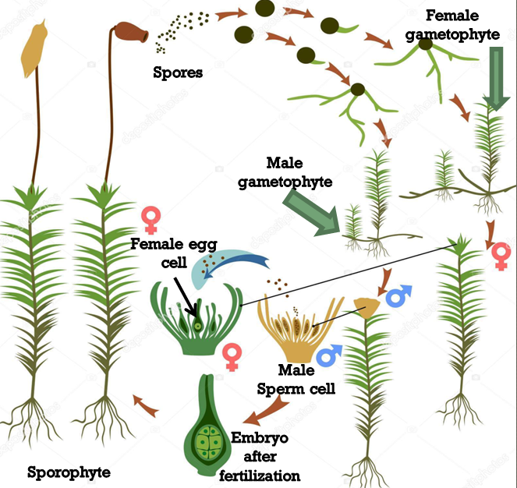
Nonvascular and Seedless Vascular Plants
Mosses and other nonvascular plants produce
sporophytes that resemble small trees or flowers.
The sporophytes release spores that grow into
male and female gametophytes. These gameto-
phytes produce the sperm & egg cells that are
needed for a zygote or fertilized egg, to form and
develop into a newsporophyte as is shown in
Figure. The life stages of seedless vascular plants,
such as ferns, are similar to nonvascular plants in
some ways. Sporophytes produce spores that
develop into gametophytes.But fern gametophytes
have both male and female structures that produce
sex cells. When a sperm cell fertilizes an egg cell,
a new sporophyte begins to develop.
Learning check:
What is the purpose of the sporophyte stage?
______________________________________________________________________________________________________________________________________________________________________________________________________________________________________________________

Slide 7
Nonvascular and Seedless Vascular Plants
Mosses and other nonvascular plants produce
sporophytes that resemble small trees or flowers.
The sporophytes release spores that grow into
male and female gametophytes. These gameto-
phytes produce the sperm & egg cells that are
needed for a zygote or fertilized egg, to form and
develop into a new sporophyte as is shown in
Figure. The life stages of seedless vascular plants,
such as ferns, are similar to nonvascular plants in
some ways. Sporophytes produce spores that
develop into gametophytes. But fern gametophytes
have both male and female structures that produce
sex cells. When a sperm cell fertilizes an egg cell,
a new sporophyte begins to develop.
Learning check:
What is the purpose of the sporophyte stage?
This stage of the plant life cycle forms the spores that will grow into gametophytes which produce the egg and the sperm cells

Slide 8
Other Vascular Plants
The two other types of vascular plants are:
Gymnosperm:
In gymnosperms, the gametophytes develop inside cones.
Angiosperms
In an angiosperm like the one shown in Figure, they develop inside flowers.
The male gametophyte in these types of plants is called pollen. Pollen contains cells that will mature into sperm cells. The eggs are present in tiny structures inside ovary called ovules. For reproduction to occur, pollen must travel to the female gametophyte so it can fertilize egg cells.
Pollination:
The process of transferring pollen from male reproductive structures to female reproductive structures in plants is called pollination.
Pollination must occur in these plants before fertilization can occur.

Slide 9
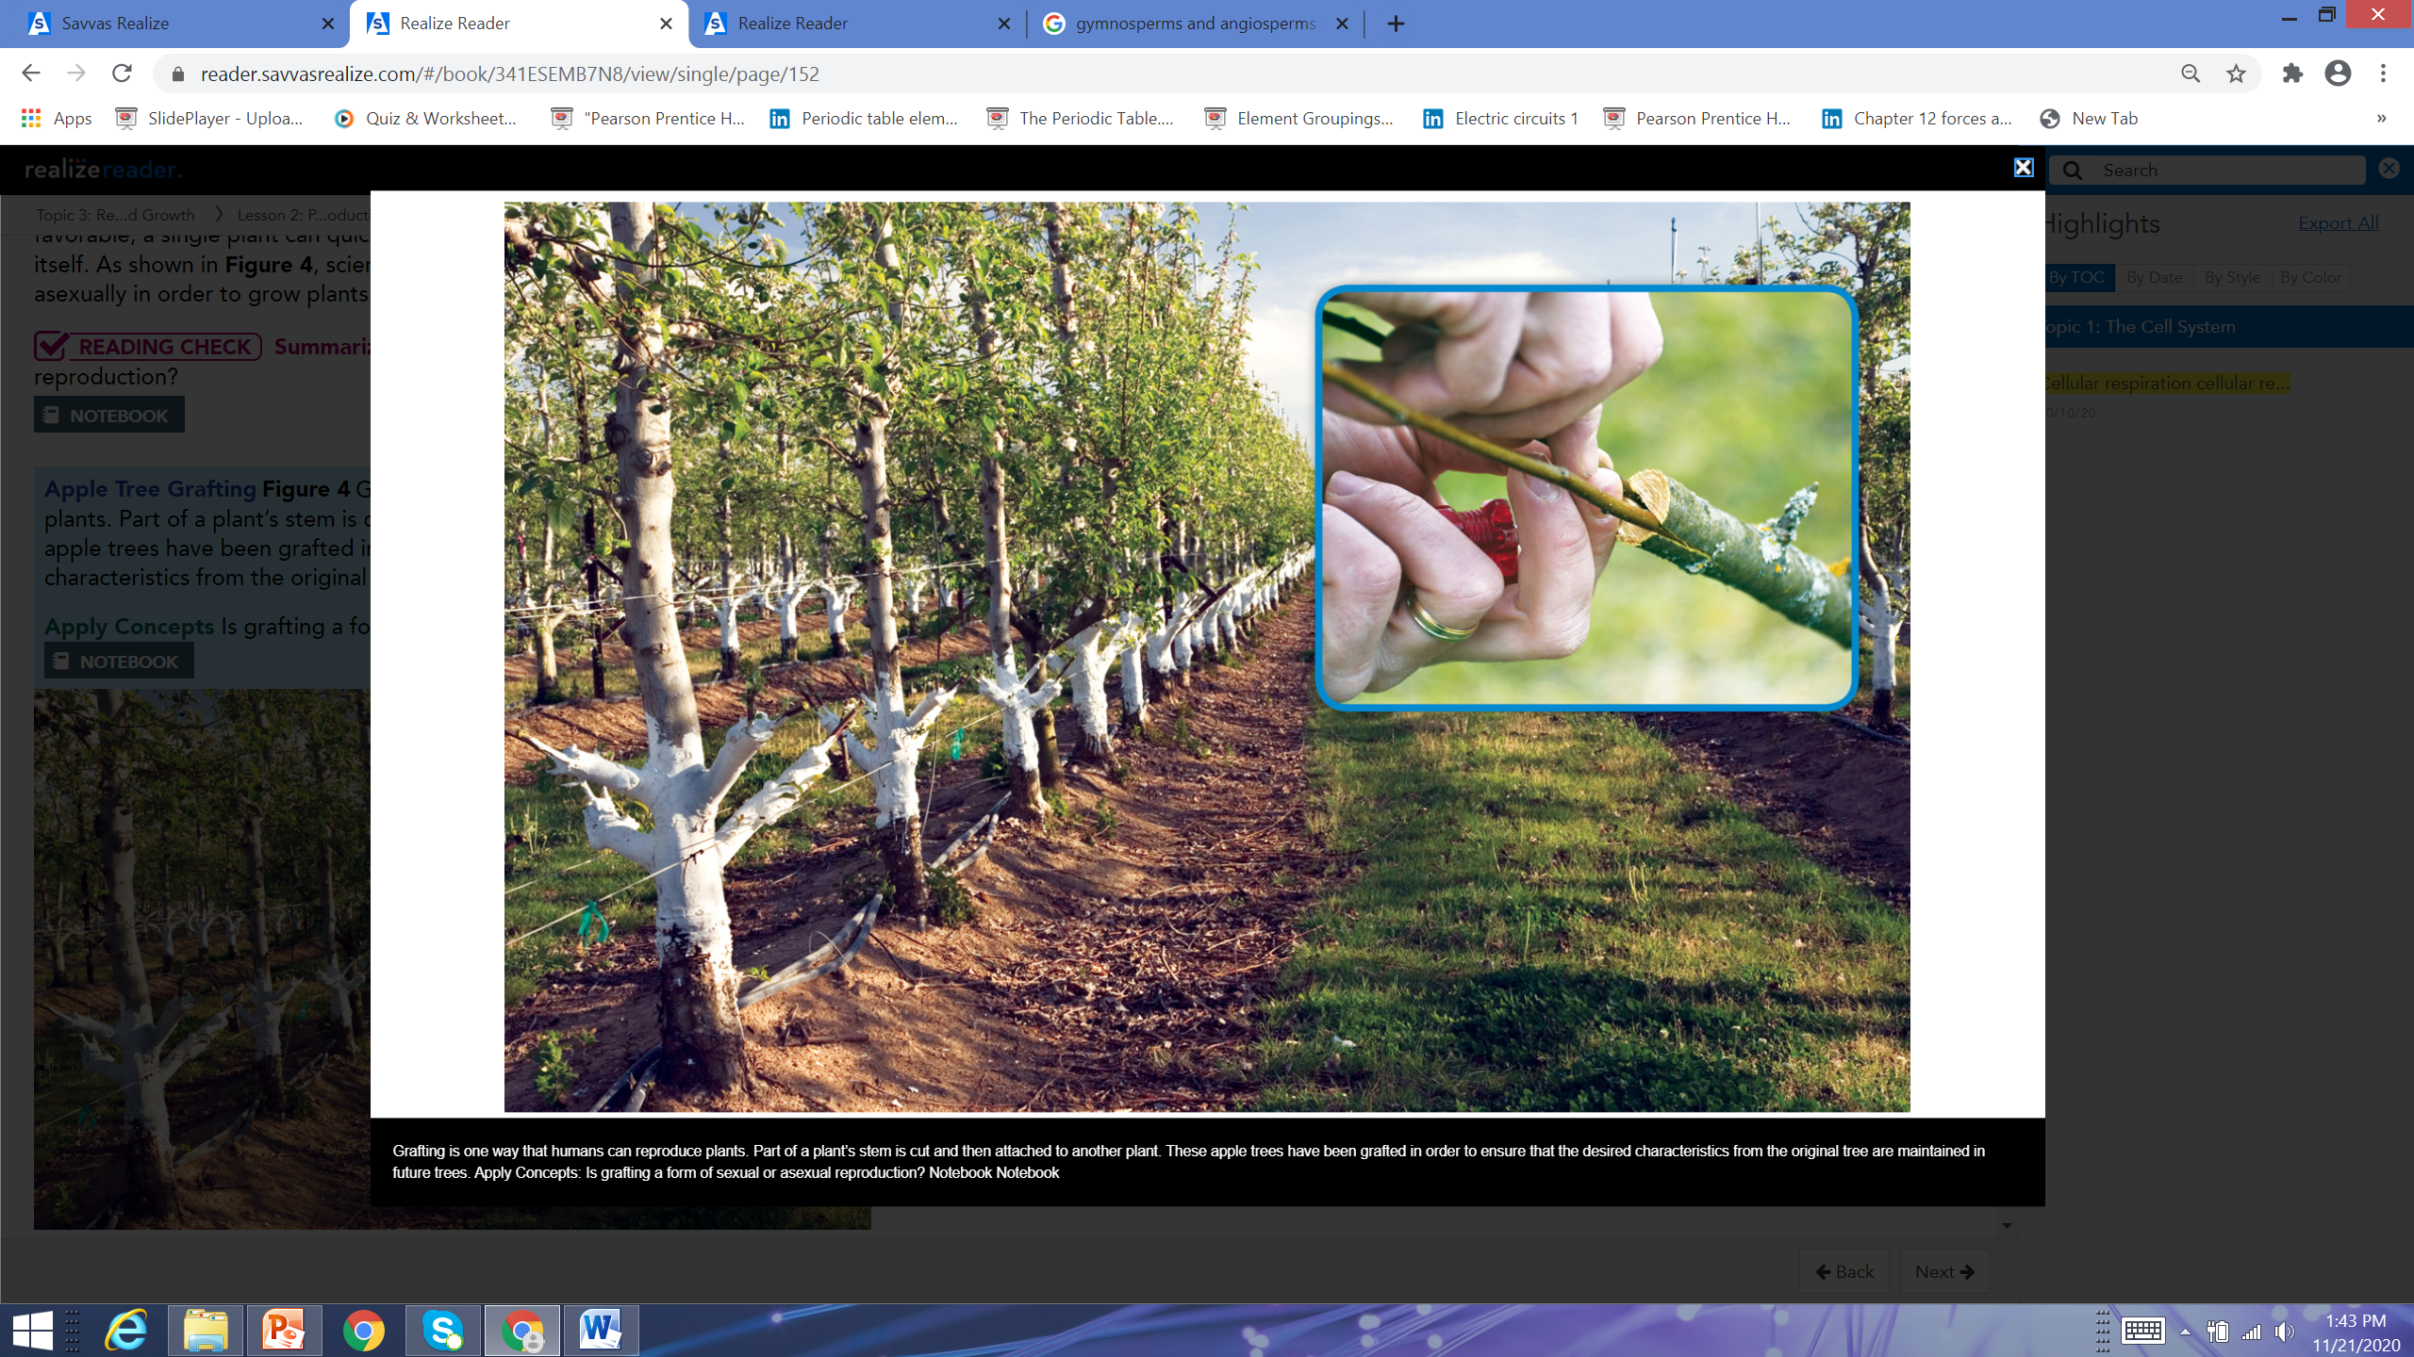
Structures for Reproduction
Over time, plants have evolved body structures that help them reproduce. Different types of plants have evolved different structures in response to their environments and their unique needs. Reproduction is one of the reasons for this diverse variety in the different plant types.
Asexual Reproduction: Though sexual reproduction is the dominant way that plants reproduce, many plants also undergo asexual reproduction. New plants can grow from the roots, leaves, or stems of a parent plant. If conditions are favorable, a single plant can quickly spread by producing many exact copies of itself. Scientists can use a plant's ability to reproduce asexually in order to grow plants with favorable characteristics. e.g.
Grafting:
It is one way that humans can reproduce
plants. Part of a plant's stem is cut and then
attached to another plant. These apple trees
have been grafted in order to ensure that the
desired characteristics from the original tree
are maintained in future trees.
Reading Check: What is the benefit of asexual reproduction?
It requires only one parent plant. It also allows a plant to spread more
quickly.

Slide 10
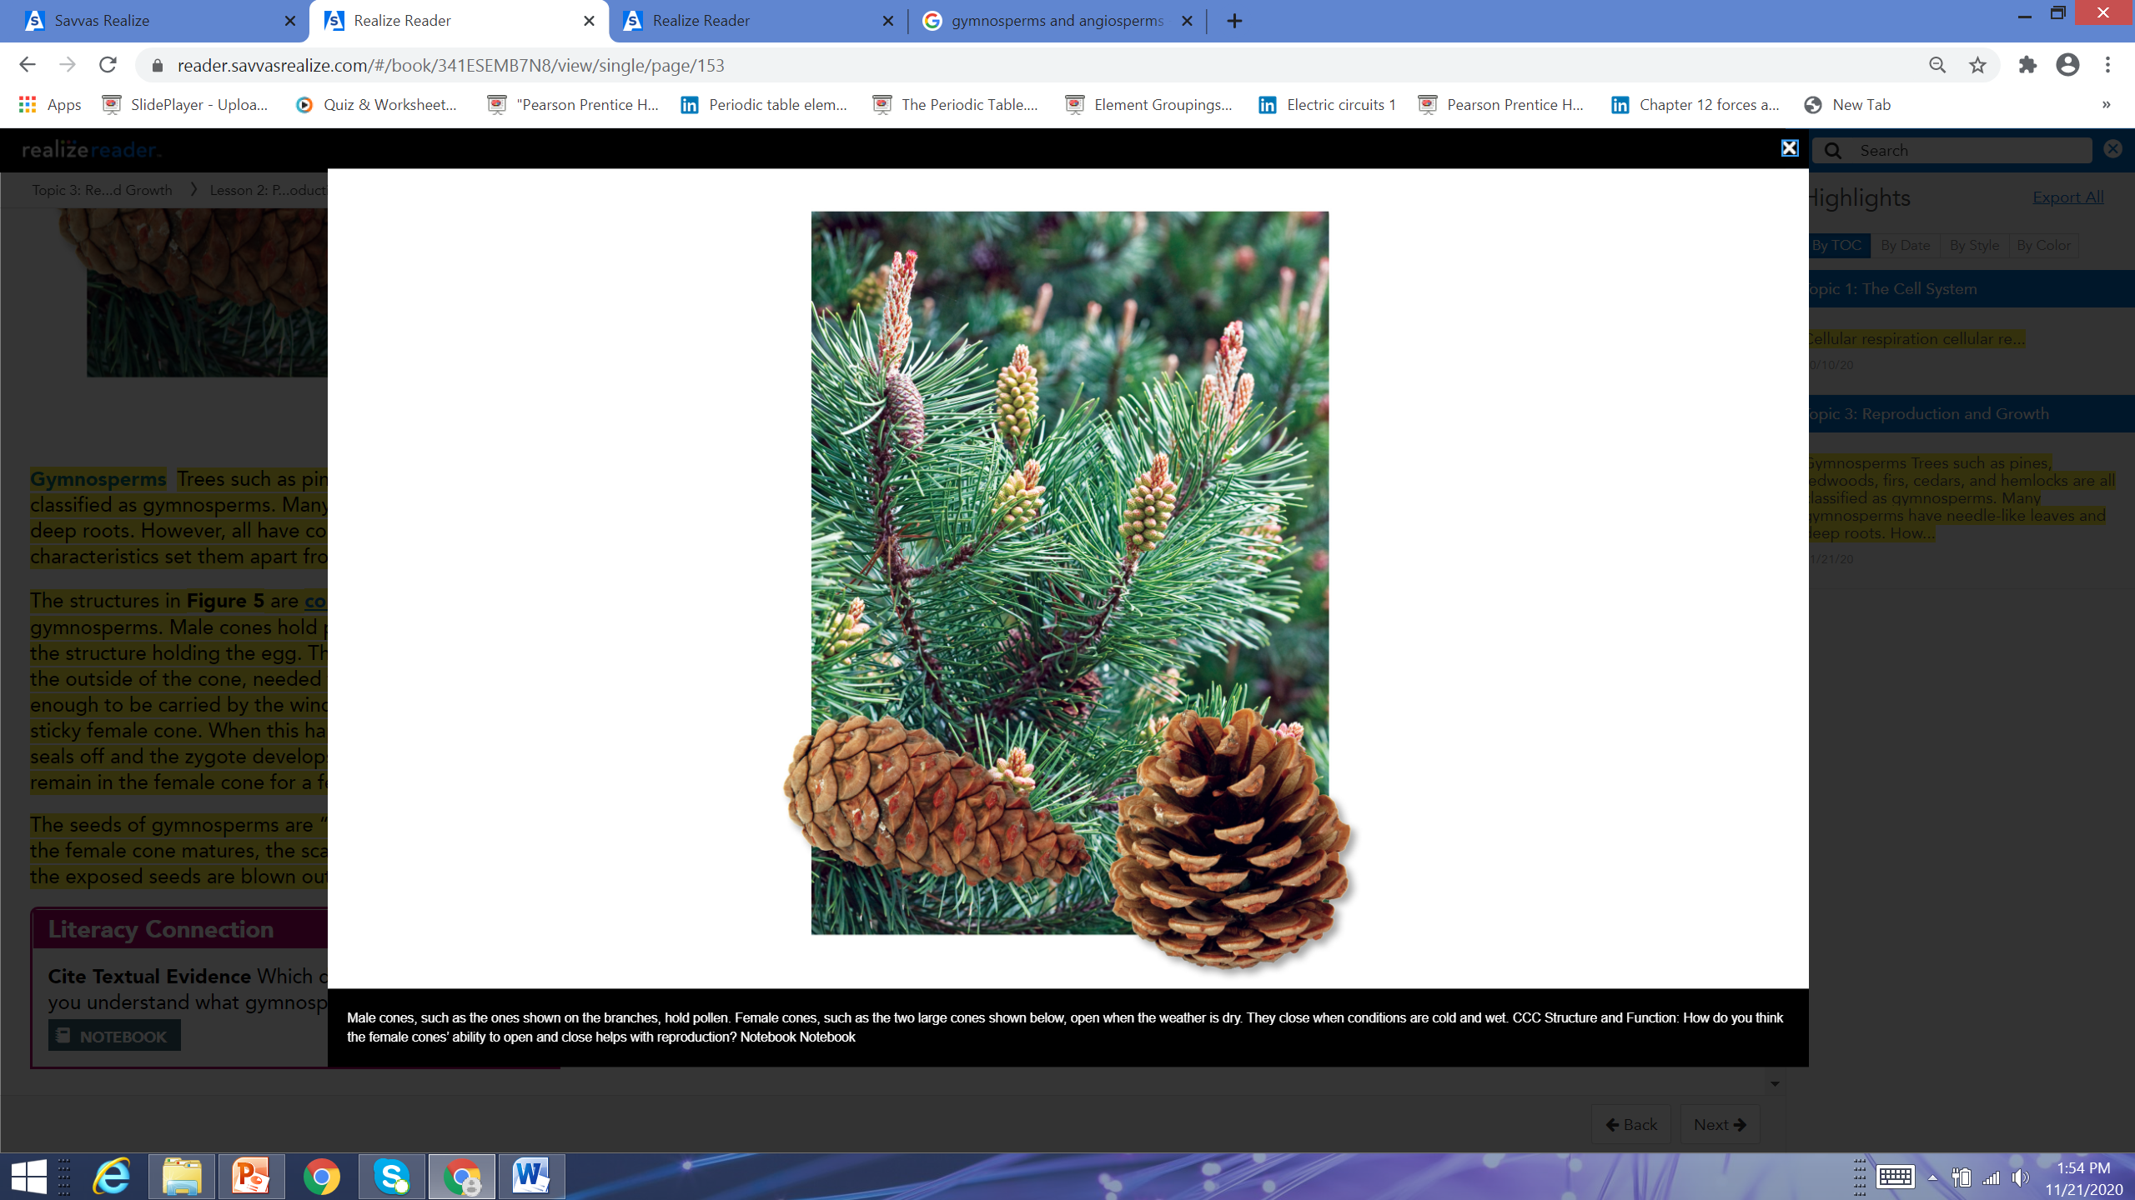
Gymnosperms
Trees such as pines, redwoods, firs, cedars, and hemlocks are all classified as gymnosperms. Many gymnosperms have needle-like leaves and deep roots. However, all have cones and unprotected seeds. These two characteristics set them apart from other vascular plants. The structures in Figure 5 are cones, which are the
reproductive structures of gymnosperms. Male cones
hold pollen, whereas the female cone has an ovule, the
structure holding the egg. The female cone also makes
a sticky substance on the outside of the cone, needed
for pollination. Pollen from male cone is light enough to
be carried by the wind. When the wind blows, pollen
may land on the sticky female cone. When this happens,
the egg may become fertilized. The ovule seals off & the
zygote develops into a plant embryo in the seed. Seeds
can remain in the female cone for a few years, until they
mature. The seeds of gymnosperms are "naked," meaning
they are unprotected. Once the female cone matures, the
scales open, exposing the seeds. As wind blows, exposed
seeds are blown out of the cone and spread by the wind.
Reacding check: How do you think the female cone’s ability to open and close helps with reproduction?
In cold wet conditions, the wind is not likely to blow the seeds far from the parent tree. Its better when the wind can blow the seeds far away.

Slide 11
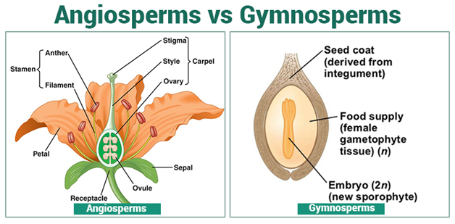
Angiosperms
All angiosperms share two important characteristics. They all produce flowers and fruits that contain seeds. The angiosperm life cycle begins when pollen forms in the flower’s anthers. These structures are found at the end of the stamens, which are the male reproductive structure. The female reproductive structure is the pistil and has three parts: the stigma, style, and ovary. When pollen falls on the stigma, pollination may occur, which can lead to fertilization. Some angiosperms are pollinated by the wind, but most rely on animals called pollinators, such as bees and hummingbirds. When an organism enters a flower to obtain food, it becomes coated with pollen. Some of the pollen can drop onto the flower’s stigma as the animal leaves. The pollen can also be brushed onto the stigma of the next flower the animal visits. If the pollen falls on the stigma of a similar plant, fertilization can occur. A sperm cell joins with an egg cell inside an ovule within the ovary at the base of the flower. The zygote then begins to develop into the seed’s embryo.
Other parts of the ovule develop into the rest of the seed.
Additional structures help a flowering plant to reproduce
successfully.
Colorful, often pleasantly-scented petals
surround the plant’s reproductive organs
and attract pollinators. Green sepals protect the
growing flower. The flower is what develops the
fruit—the ripened ovary and other structures of
an angiosperm enclosing one or more seeds.

Slide 12
Seed Dispersal
Fruits are the means by which angiosperm seeds are dispersed. Often the scent and color of fruit attracts animals to the plant. Animals eat the fruit and then the seeds in it pass through the animal’s digestive system. As the animal moves around, seeds are deposited in different areas in the animal’s dung, or droppings. The droppings have an added benefit of providing nutrients and moisture for the seed. In other cases, seeds disperse by falling into water or being carried by the wind. Seeds with barbs attach to fur or clothing and are carried away. Others are ejected by the seed pods and scattered in different directions. Seeds dispersed far from the parent plant have a better chance of surviving. Distance keeps the new plant from competing with the parent plant for light, water, and nutrients. When a seed lands in a spot with suitable conditions, germination may occur.
Germination:
It occurs when the embryo sprouts out of the seed.
Reading Check:
How do the examples of seed dispersal given in the above text help you understand the role of seed dispersal in plant reproduction?
Each example describes a way that the seeds are carried from one place to another. This helps me see how scattering seeds help plants to reproduce.

Slide 13
Learning Check

Slide 14
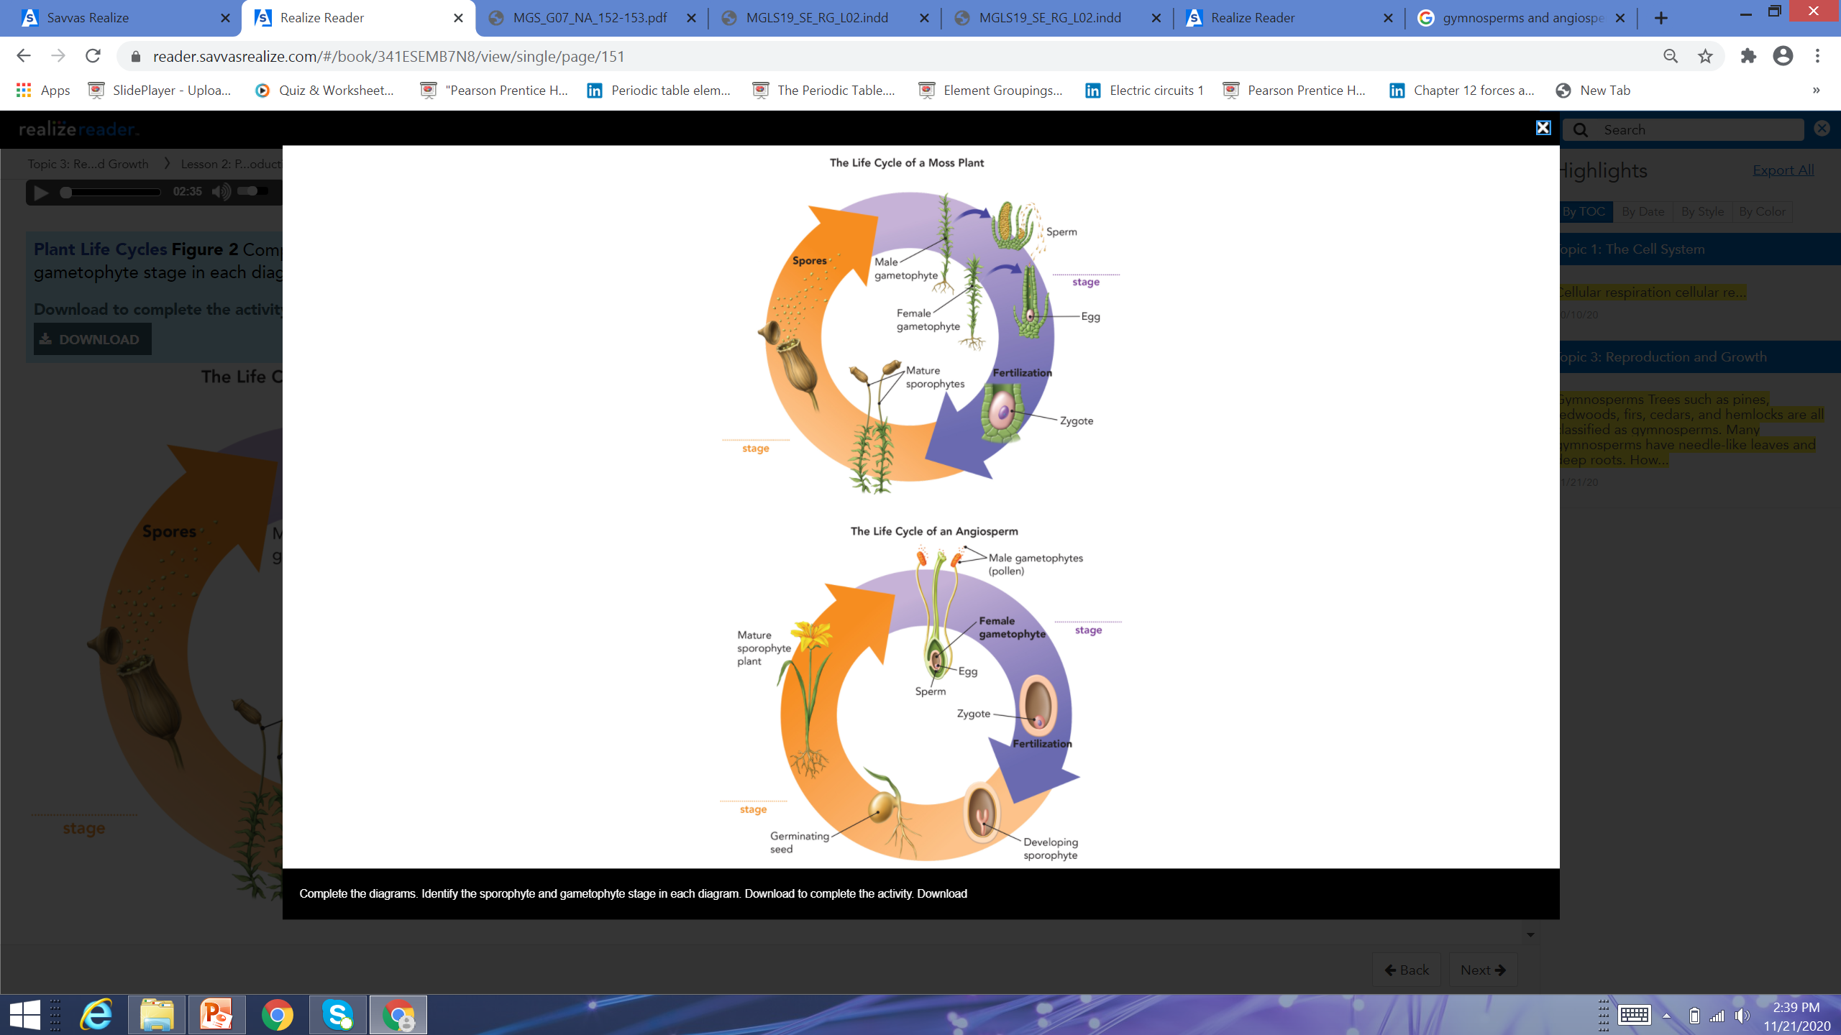
Complete the diagrams. Identify the sporophyte and gametophyte stage in each diagram

Slide 15
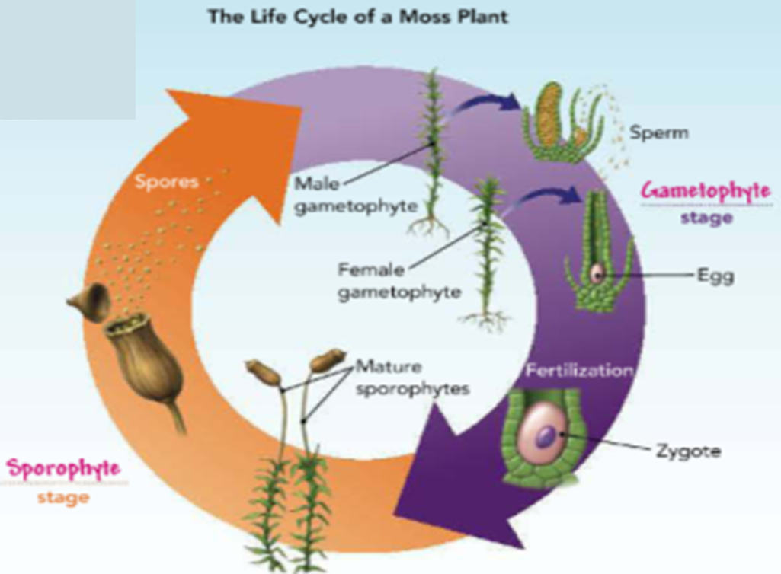
Complete the diagrams. Identify the sporophyte and gametophyte stage in each diagram

Slide 16

Complete the diagrams. Identify the sporophyte and gametophyte stage in each diagram

Slide 17
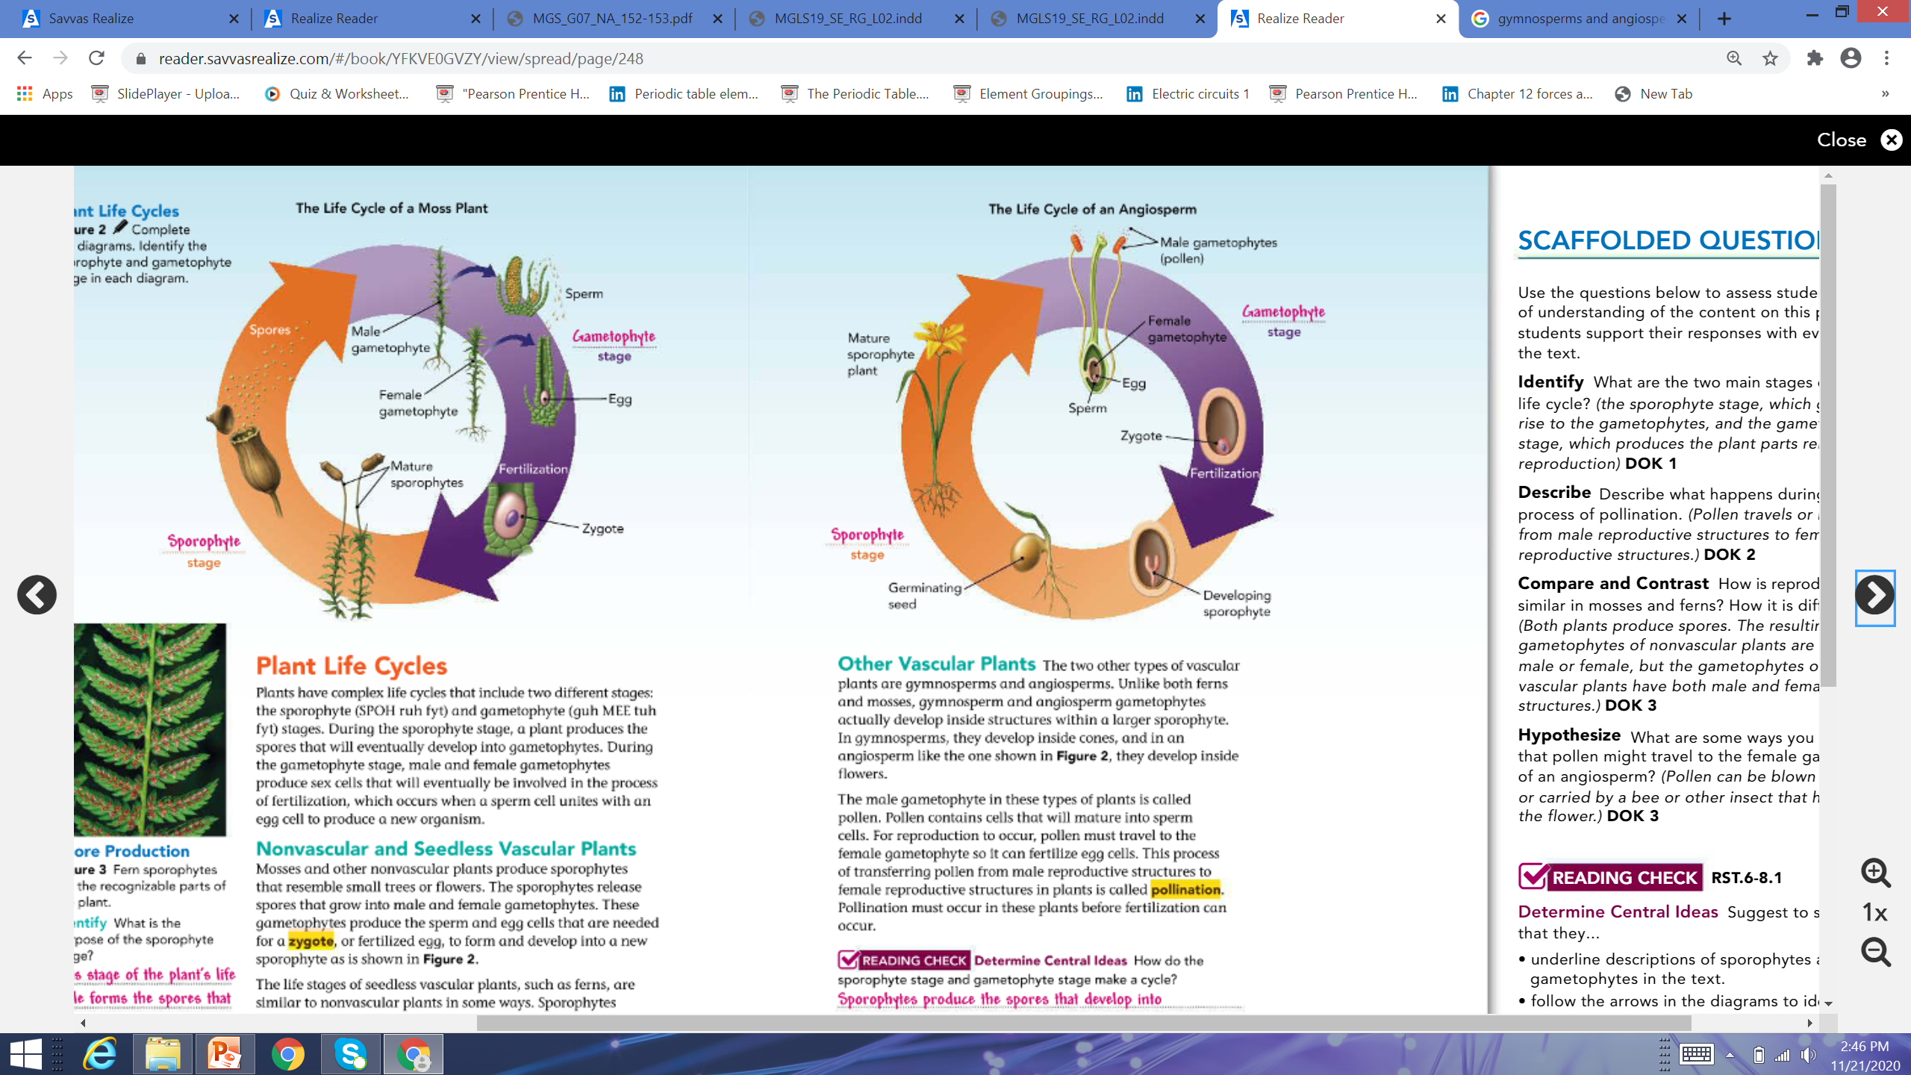
Complete the diagrams. Identify the sporophyte and gametophyte stage in each diagram

Slide 18
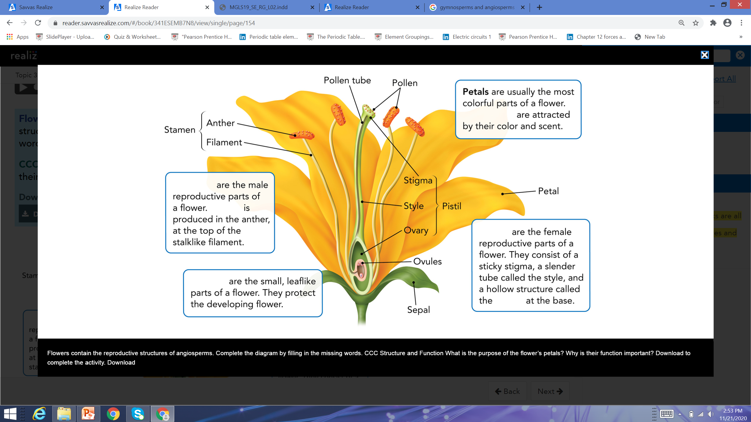
Comlpete the diagram by filling the missing words

Slide 19
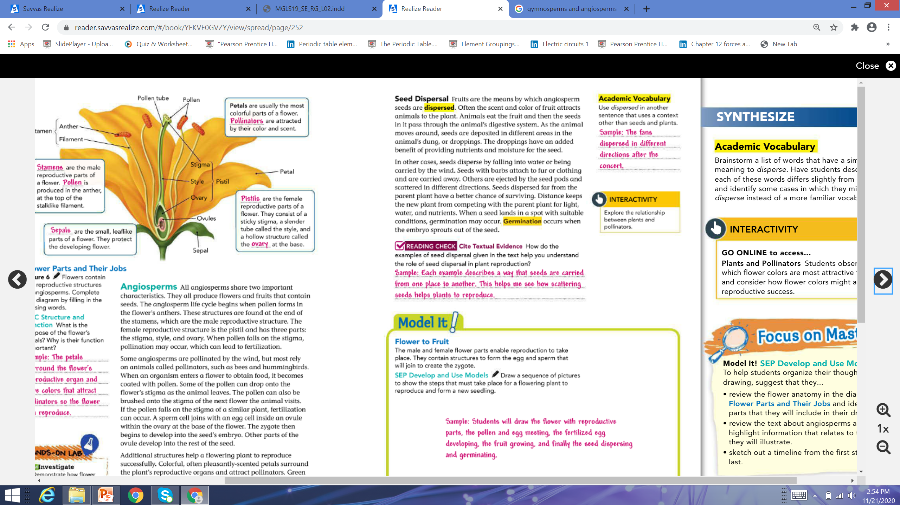
Complete the diagram by filling the missing words

Slide 20
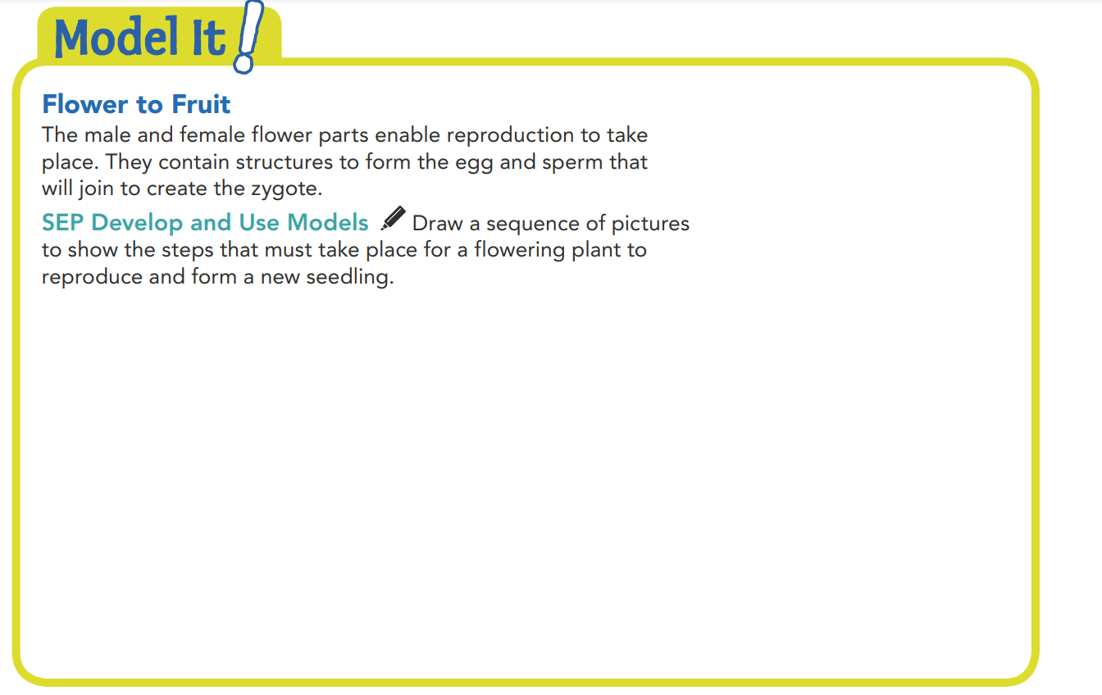
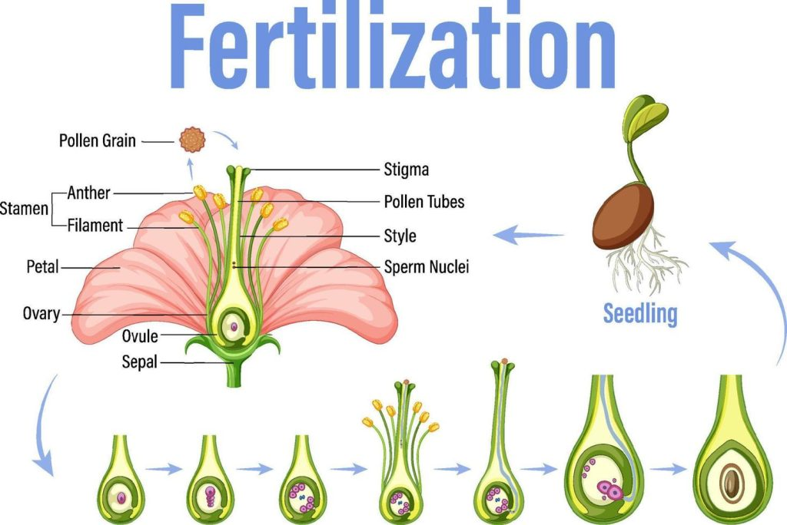

Slide 21
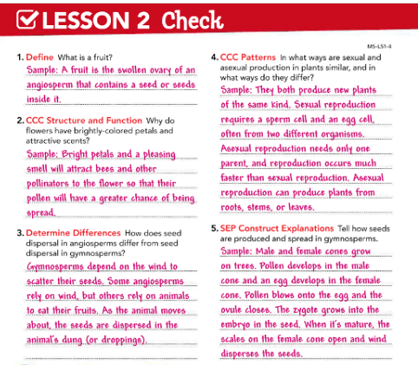
Notes:
https://www.youtube.com/watch?v=W-daJxfe4As

