Slide 1
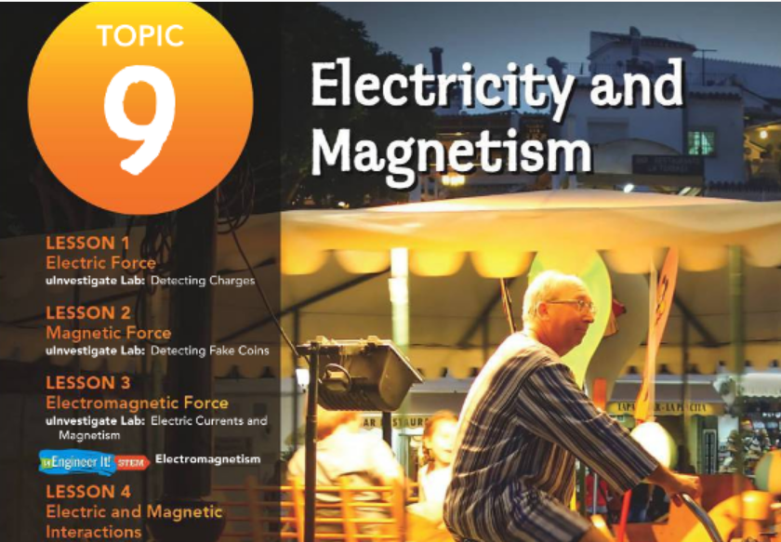

Pg 472
Guiding Questions
How does electricity relate to magnetism?
How can you describe the magnetic field produced by a current?
What are the properties of solenoids and electromagnets?

Slide 2
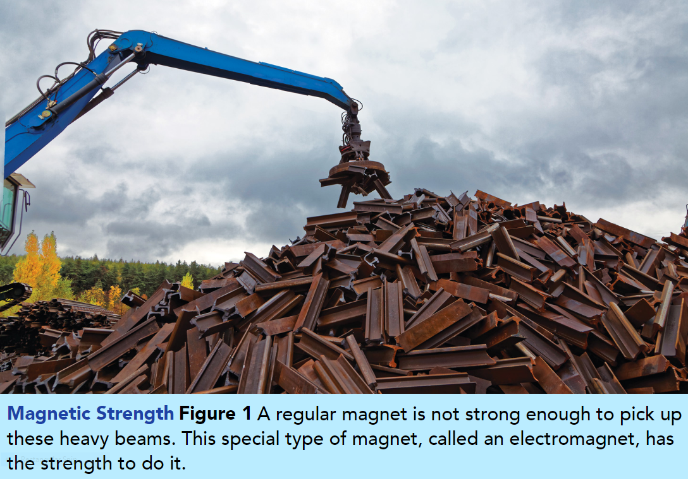
Pg 473
Electromagnetic Principles
Have a look at Figure 1. How is this crane’s magnet strong enough to lift these heavy metal beams?
The answer may surprise you.
The magnetic field of this crane is actually generated by an electric current!
The relationship between electricity and magnetism is called electromagnetism.
https://www.youtube.com/watch?v=-mQsQaX0miM

Slide 3

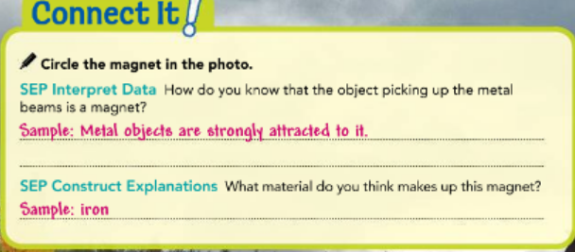
Pg 473
Electromagnetic Principles
Electromagnetism was first discovered by a scientist named Hans Christian Ørsted.
During a class he was teaching, he brought a compass near a wire that had an electric current running through it. He noticed that the compass needle changed direction when it was near the wire.
He placed several different compasses near a wire and found out that the compass needles changed direction when a current passed through the wire.
The compass needles did not change direction when no current flowed. Ørsted concluded that an electric current produces a magnetic field, so electricity and magnetism are related.

Slide 4
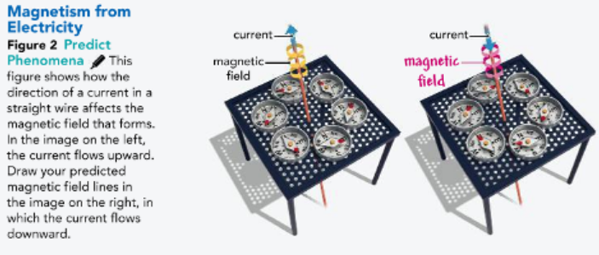
Magnetic Fields and Current
Pg 474
When you examine Figure 2, you can see that the magnetic field produced by a current has a certain direction.
This field also has a certain strength. How can the field change? It can change in direction and strength, and it can be turned off or on. To turn the magnetic field off or on, simply turn the current off or on.

Slide 5
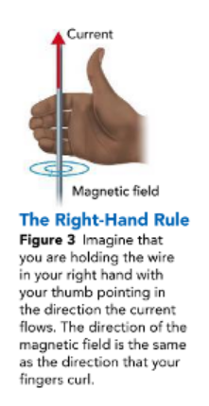
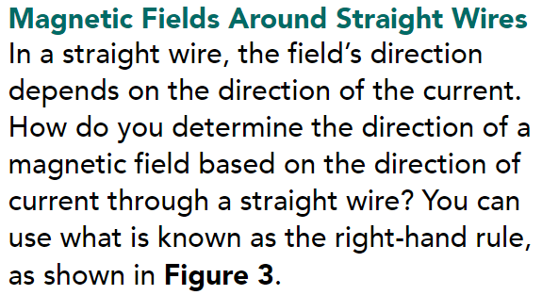
Magnetic Fields and Current
Pg 474
https://www.youtube.com/watch?v=oEEYMhPY5tY
To change the strength of a magnetic field around a current carrying straight wire, change the amount of current running through the wire. If current is increased, the magnetic field becomes stronger. If the current is decreased, the strength of the magnetic field decreases.

Slide 6
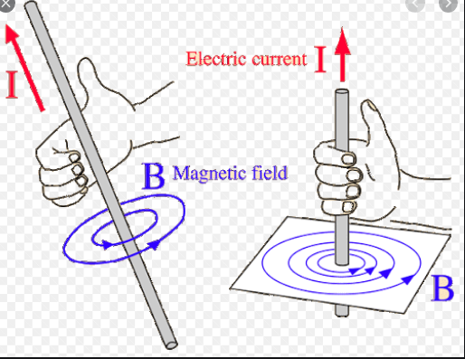
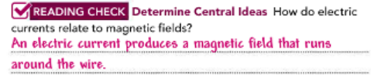
Magnetic Fields and Current
Pg 474
To change the strength of a magnetic field around a current carrying straight wire, change the amount of current running through the wire.
If current is increased, the magnetic field becomes stronger. If the current is decreased, the strength of the magnetic field decreases.

Slide 7
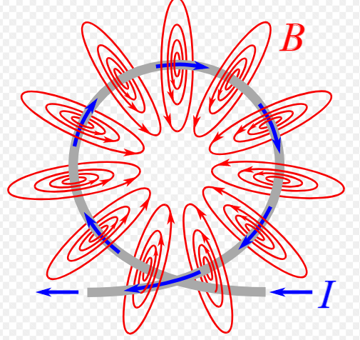
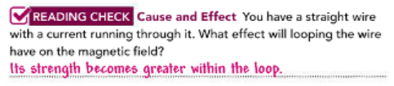
Magnetic Fields Around Wire Loops
Pg 475
Suppose you have a loop of wire rather than a straight wire. The magnetic field formed around the loop of wire is in many ways like the field formed when a current flows through a straight wire.
The direction of the field depends on the direction of the current and can be determined by using the right-hand rule.
The field can be turned off or on by turning the current off or on. The strength of the field depends on the strength of the current.
https://www.youtube.com/watch?v=te8MO8jVh5k

Slide 8
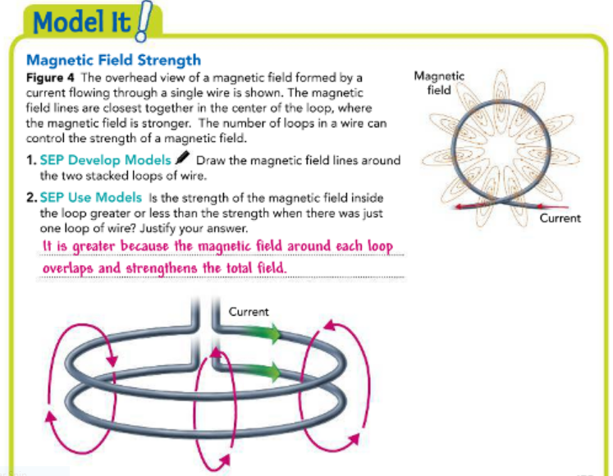
Magnetic Fields Around Wire Loops
Pg 475
There is one main difference, however, when a current flows through a loop of wire. Look at Figure 4, which shows a current flowing through a loop of wire and the magnetic field it produces. Shaping a wire into a loop can increase the strength of the magnetic field within the loop.

Slide 9
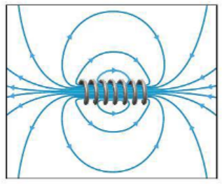
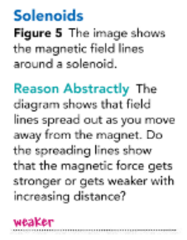
Solenoids and Electromagnets
Pg 476
There are many practical uses of coiling a current-carrying wire to make a strong magnetic field. Two devices that strengthen a magnetic field by running a current through coiled wire are solenoids and electromagnets.
A solenoid is a coil of wire with a current running through it, as shown in Figure 5.
It is similar to stacked loops of wire. In a solenoid, the magnetic field is strengthened in the center of the coil when a current runs through the coil. One end of a solenoid acts like the north pole of a magnet, and the other end acts like the south pole.
https://www.youtube.com/watch?v=NT6er8XDkfU

Slide 10
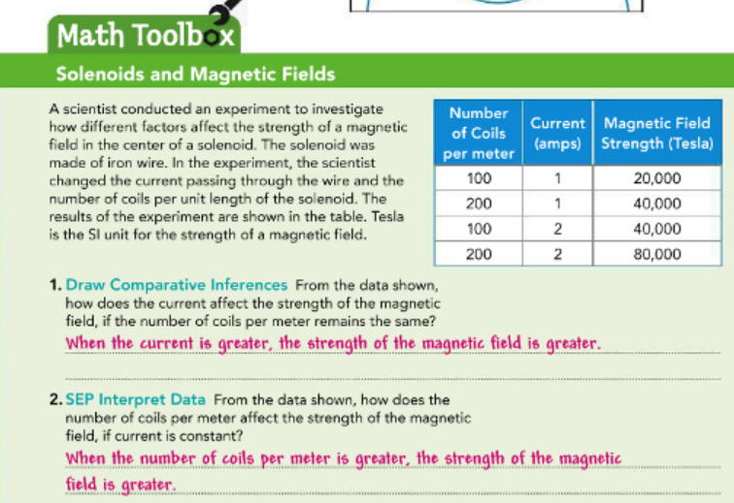
Pg 476

Slide 11
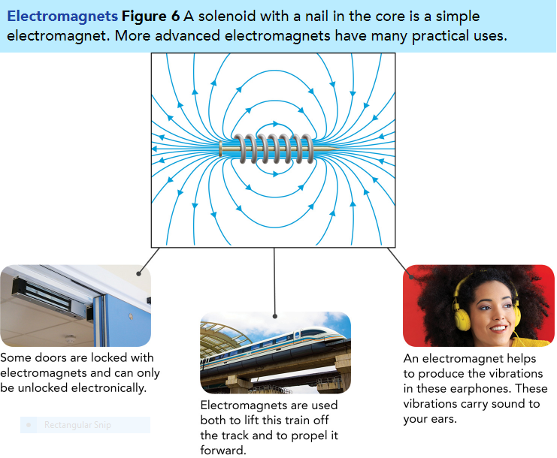
Pg 477
Field Strength and Solenoids
You can increase the strength of the magnetic field inside a solenoid by increasing the number of coils or loops of wire. Winding the coils closer together also produces a stronger magnetic field.
As in a straight wire, increasing the current through the solenoid wire will also increase the magnetic field.
https://www.youtube.com/watch?v=qy7bIeBh-0c

Slide 12
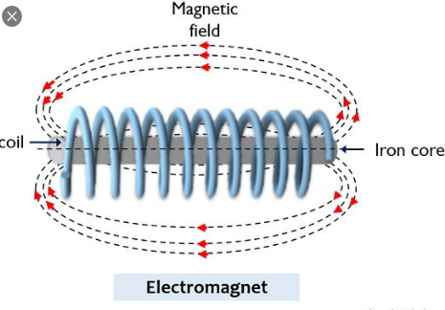
Electromagnets
Pg 477
What else can you do to a solenoid to make the magnetic field even stronger? You add a ferromagnetic material to it.
A ferromagnetic material is a substance that becomes a magnet when exposed to a magnetic field.
The elements iron, nickel and cobalt are ferromagnetic. As shown in Figure 6, a solenoid with a ferromagnetic core is called an electromagnet.
https://www.youtube.com/watch?v=IKIBDny8jPg

Slide 13
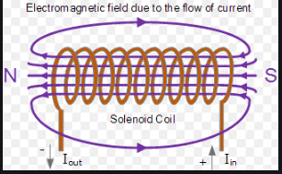
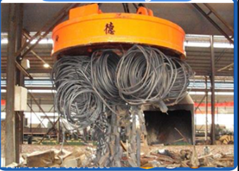

Electromagnets
Pg 477
When a ferromagnetic material is placed within a solenoid, both the current and the magnetized material produce a magnetic field.
This combination produces a magnetic field that is stronger than that produced by the solenoid alone. As in a solenoid, the magnetic field of an electromagnet increases when the number of coils , the closeness of the coils, or the current increases.

Slide 14
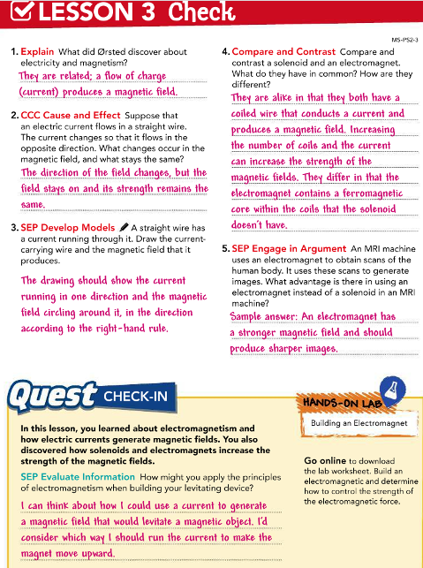
Pg 478

Slide 15


