Slide 1
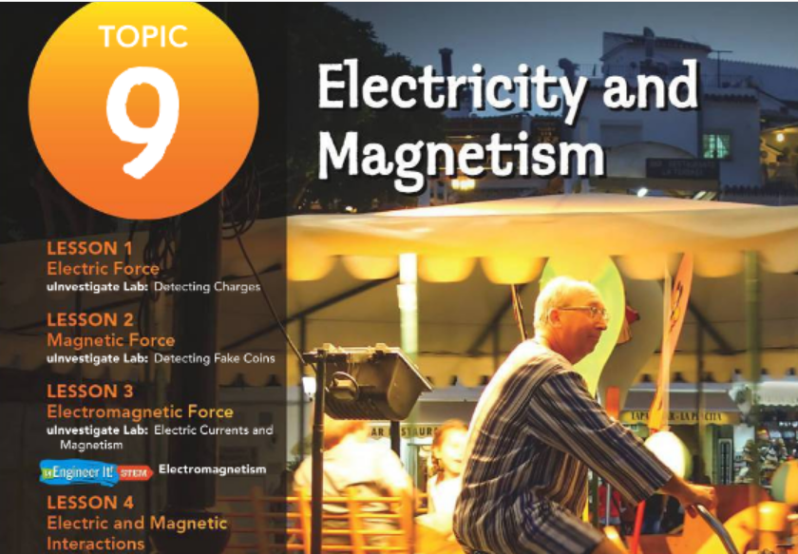

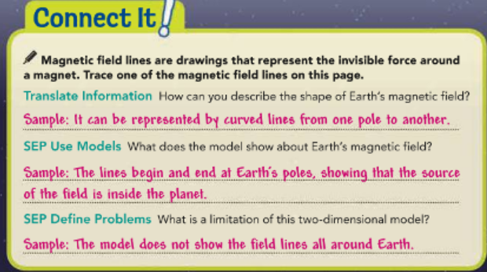
Lesson
Pg 464
Guiding Questions
How can you change the magnetic force and potential energy between objects?
How can you detect and describe a magnetic field?

Slide 2
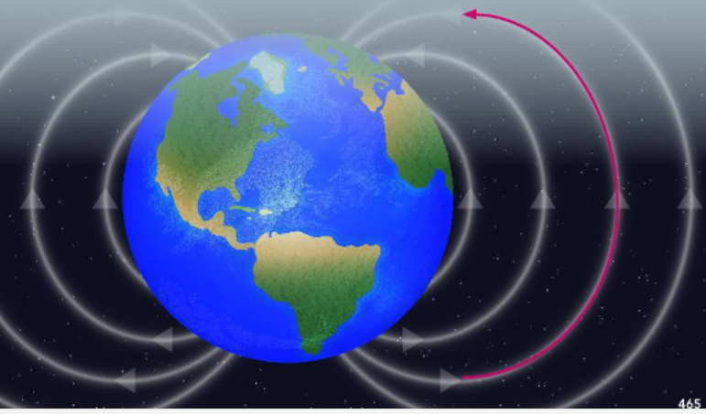
Magnetic field lines are drawings that represent the invisible force around a magnet. Trace one of the magnetic field lines on this page.
Magnetic Force and Energy
Pg 465
A magnet attracts iron and materials that contain iron. Magnets can be any size, from the ones you use in the kitchen to the entire Earth and beyond.
People can use magnetic compasses in navigation because the whole planet acts as a magnet (Figure 1).
Magnetic field lines are drawings that represent the invisible force around a magnet. Trace one of the magnetic field lines on this page.
https://www.youtube.com/watch?v=R4ht2RcWVlI

Slide 3
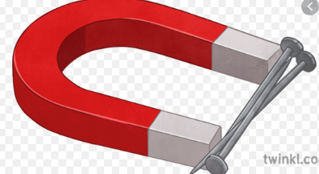
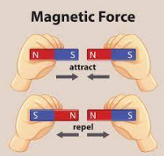
Magnetic Force and Energy
Pg 465
Magnets attract iron and some other materials–usually metals. They attract or repel other magnets. This attraction or repulsion is called magnetism.
The interaction between a magnet and a substance containing iron is always an attraction. Magnets themselves can either attract or repel one another, depending on how they are placed.

Slide 4
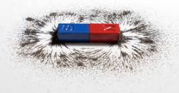
Magnetic Force and Energy
Pg 465
Magnetism can be a permanent or temporary property of a material.
Some materials, containing iron or certain other metals, can become permanent magnets after interacting with other magnets.
On the other hand, temporary magnetism can occur in different ways.

Slide 5
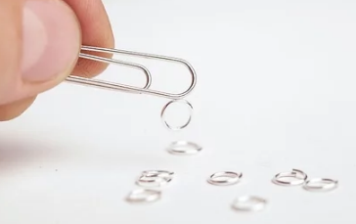
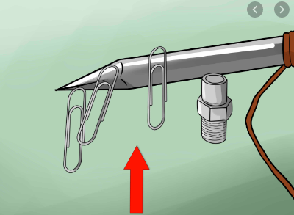
Pg 465
Magnetic Force and Energy
An iron or steel object that is touching a magnet can become a magnet itself as long as the contact exists.
For example, you can make a chain of paper clips that hangs from a permanent magnet.
Another type of temporary magnet is created when an electric current flows through a conductor. This kind of magnet exists as long as the current is flowing.

Slide 6
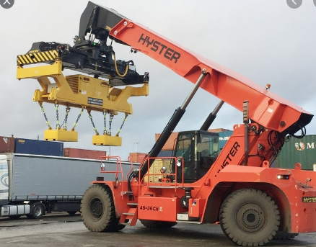
Magnetic Force
Pg 466
Magnetism is caused by a force that can act at a distance. This magnetic force is a push or pull that occurs when a magnet interacts with another object.
Some large magnets can attract objects from many meters away and are powerful enough to lift a car or truck.

Slide 7
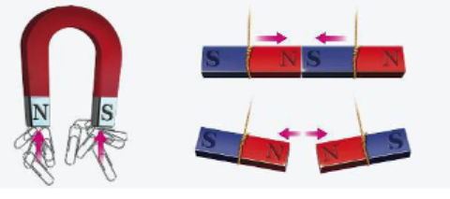
Magnetic Force
Pg 466
Push or Pull Figure 2
SEP Develop Models Magnets can either push or pull. Draw arrows on the paperclips and on the bar magnets to show the direction of the magnetic force.
How do you know if the magnetic force between two objects will be a push or a pull?
A magnet always exerts a pull on a magnetic object that is not itself a magnet. If you place the ends of the horseshoe magnet in Figure 2 near a pile of paper clips, the paper clips always move toward the magnet.
They never move away. Every magnet has two ends, called magnetic poles, where the magnetic force is strongest. One pole is known as the north pole and the other is known as the south pole.
https://www.youtube.com/watch?v=Mp0Bu75MSj8

Slide 8
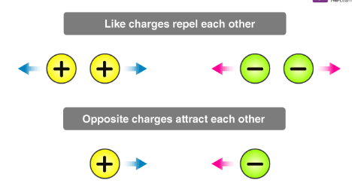
Magnets and Potential Energy
Magnets nd Potential Energy
Pg 466
Recall the ways in which the potential energy of a system of electrical charges can change. As you apply a force to move opposite charges away from each other, the electric potential energy of the system increases.
The same is true of magnets. Opposite poles naturally attract each other, so you must put energy into the system to pull them apart. As you apply a force to separate the two opposite poles, the potential energy of the system increases.
https://www.youtube.com/watch?v=nThGHGEwFMg

Slide 9
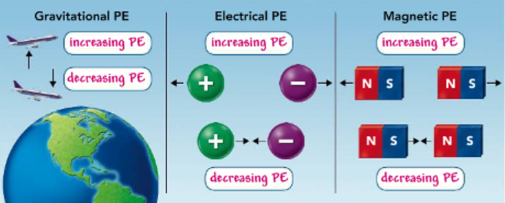
Magnets and Potential Energy
Pg 467
When the magnetic force between opposite poles pulls them together the potential energy of the system decreases. On the other hand, like poles repel each other.
To push them together, you have to transfer energy to the system. This increases the potential energy of the system.
Use the Figure 3 activity to summarize these changes in potential energy.
Potential Energy Figure 3
The gravitational force between the plane and Earth is an attractive force. The forces between opposite charges and opposite magnetic poles are also attractive. Label the locations of increasing and decreasing potential energy in the images.

Slide 10
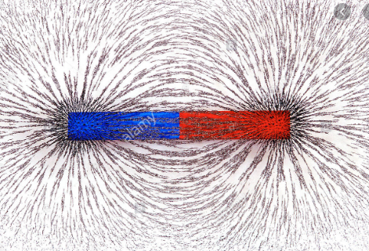
Magnetic Fields
Pg 467
The magnetic force is strongest at a magnet’s poles. That is why the paper clips tend to stick to the horseshoe magnet at its ends.
There is an area of magnetic force that surrounds a magnet. This area of force is the magnetic field of the magnet.
This field is the source of magnetic energy. It allows magnets to attract objects at a distance.

Slide 11
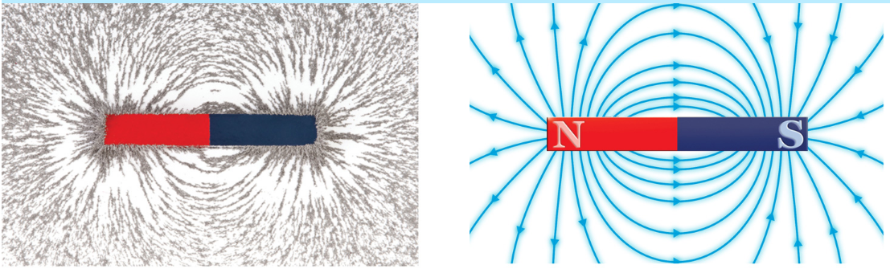
Magnetic Fields
Pg 467
The magnetic field extends from one pole to the other pole of the magnet. You cannot see a magnetic field, but if you place tiny pieces of iron near a magnet, they will arrange themselves along the magnetic field.
Their arrangement looks a lot like lines, so illustrations of magnetic fields are drawn with lines, as shown in Figure 4.
Visualizing Magnetic Fields Figure 4
The magnetic field around a bar magnet causes iron filings to form the arrangement shown. This arrangement can also be represented by magnetic field lines. The field is strongest where the lines are closest together.

Slide 12
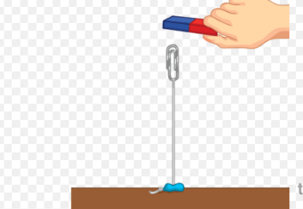
Magnetic Fields
Pg 467
Objects containing iron, such as steel paper clips, experience a force when they are in a magnetic field.
These objects line up with the field around them. Particles inside the objects can also line up with the field.
When the particles in an object line up with the field, the object becomes a temporary magnet.
https://www.youtube.com/watch?v=R4ht2RcWVlI&t=59s

Slide 13
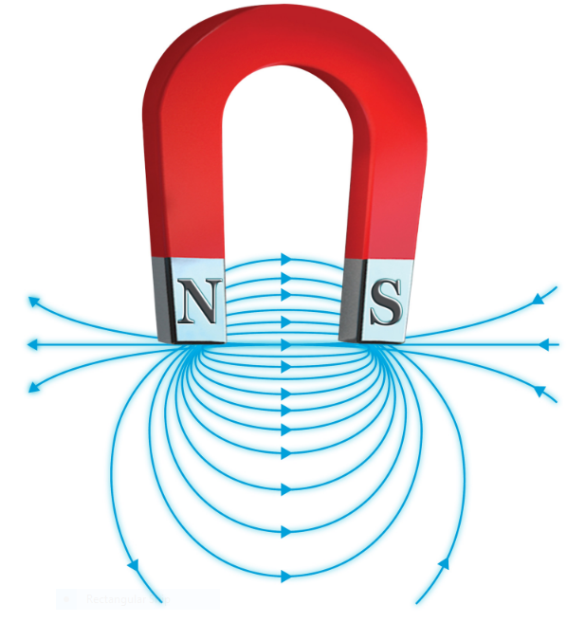
Single Magnetic Fields
Pg 468
The lines in Figure 4 and Figure 5 show a single magnetic field—a field that is produced by one magnet.
Single magnetic field lines spread out from one pole, curve around the magnet to the other pole, and make complete loops.
Arrows on the lines point from the north pole to the south pole to indicate the direction of the field.
When the lines are close together, the magnetic field is stronger than it is where the lines are far apart.
Magnetic field lines never cross one another.

Slide 14
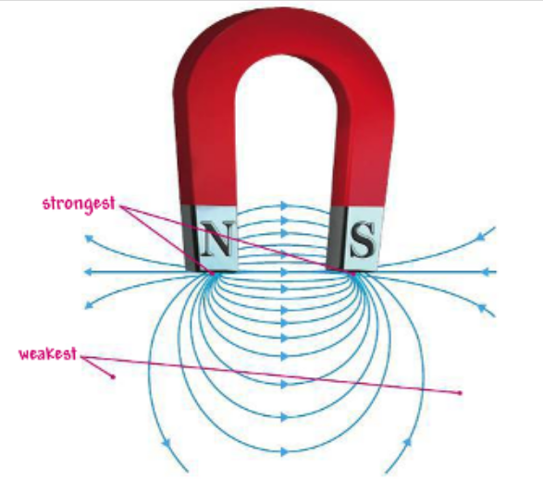
Magnetic Field Lines Figure 5
These lines show the shape of the field around the magnetic poles of a horseshoe magnet.
Combined Magnetic Fields
The magnetic fields of two magnets placed near each other will interact with one another.
When two like poles are close together, the poles and the magnetic fields around them repel one another.
When two opposite poles are close together, the fields combine to form a strong magnetic field between the two magnets, as shown in Figure 6.
As in a single magnetic
Pg 468
Add labels to the illustration to show where the magnetic field is strongest and where it is weakest.

Slide 15
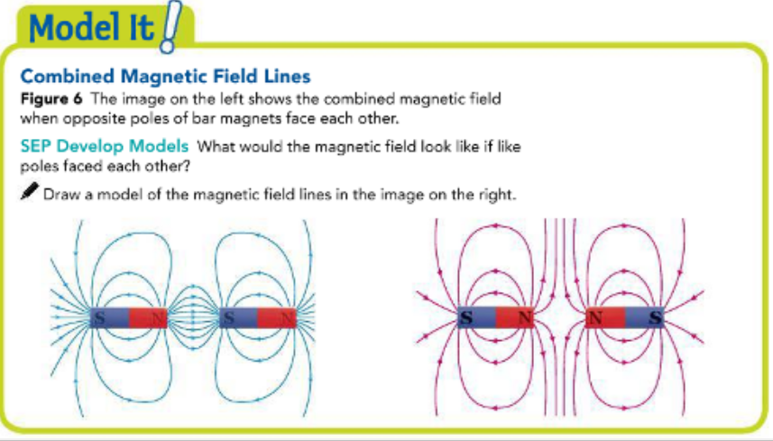
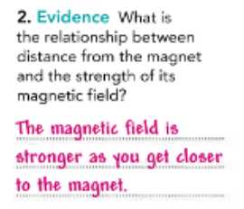
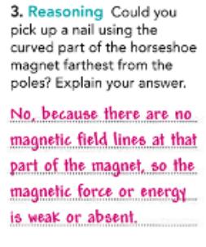
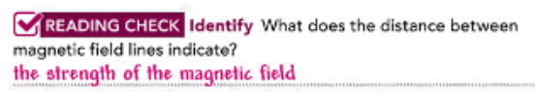
Magnetic Field Lines
Pg 468
https://www.youtube.com/watch?v=e44-IbTo3C4

Slide 16
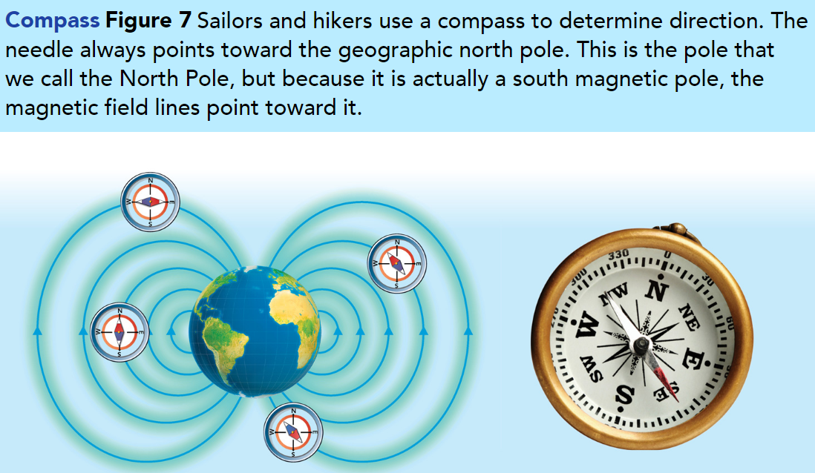
Earth’s Magnetic Field
Pg 469
Earth itself acts as a very large magnet.
Materials in the core of the planet generate a magnetic field that surrounds the planet. This magnetic field is very similar to the field that surrounds a bar magnet.
The magnetic poles of Earth are located near the geographic poles. These are the points where the magnetic field is strongest.
The magnetic field lines pass out of the core and through the rocky mantle. They also loop through the space surrounding Earth. The magnetic field is three-dimensional and it is shaped like a donut, as shown in Figure 7.
https://www.youtube.com/watch?v=OsQNHFlF8w4

Slide 17
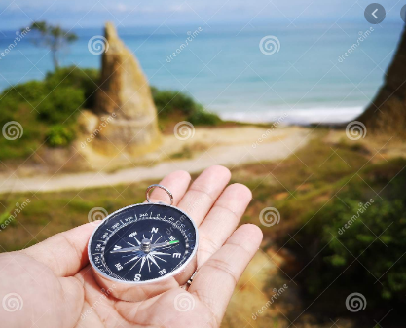
Earth’s Magnetic Field
Pg 469
People have used this magnetic field for many centuries for navigation. A compass, shown in Figure 7, is a magnetized needle that can turn easily.
The needle interacts with Earth’s magnetic field. One end is attracted to the north magnetic pole and the other end to the south magnetic pole.
People can use a compass to determine the direction in which they are traveling.

Slide 18
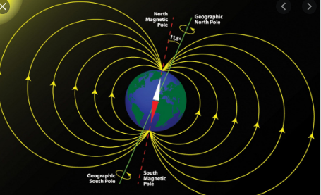
Protecting Life on Earth
Pg 470
There is a constant stream of particles that flows from the sun toward Earth. This stream is known as the solar wind.
These particles have electric charges and they have a lot of energy as they move very rapidly through space. If they were to reach the surface of Earth, the particles in the stream could harm living things.
Fortunately, Earth’s magnetic field protects us.
Electrically charged particles interact with magnetic forces. Earth’s magnetic field changes the motion of the charged particles.
They flow toward the north and south poles and then past Earth into space.

Slide 19
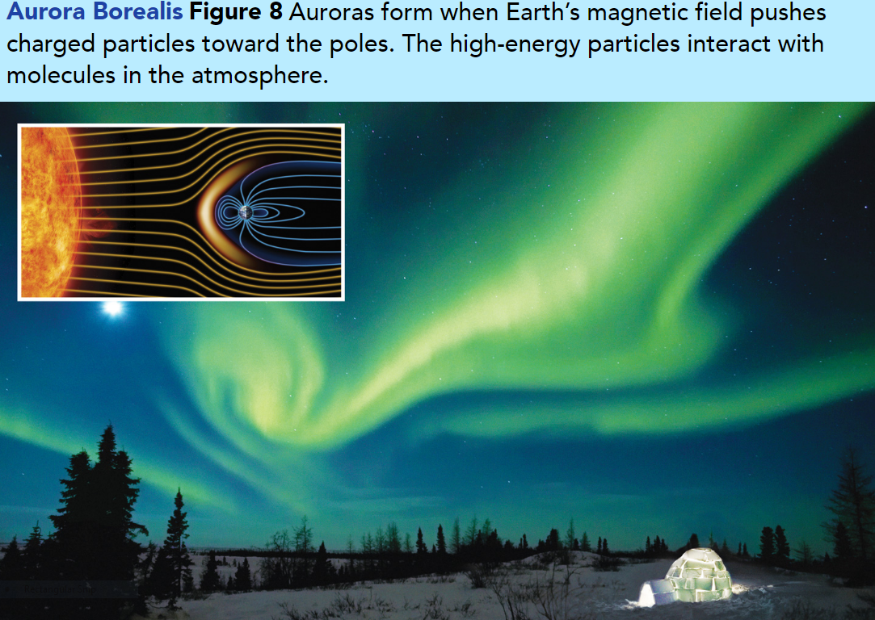
Protecting Life on Earth
Pg 470
Although you cannot see this protective field, you can sometimes see evidence of it working.
Auroras, sometimes called the “Northern Lights,” are glowing displays in the night sky.
As these energetic electrically charged particles travel along the magnetic field lines, they sometimes collide with gas atoms in the upper atmosphere.
These collisions cause the atoms to give off light. The result is often more spectacular than a fireworks show (Figure 8).
https://www.youtube.com/watch?v=HlV41w8ySmA

Slide 20
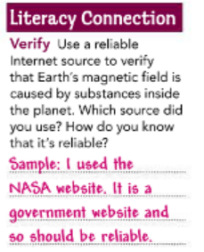
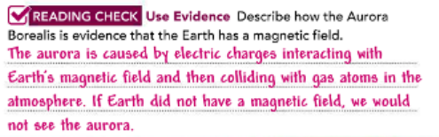
Pg 470

Slide 21
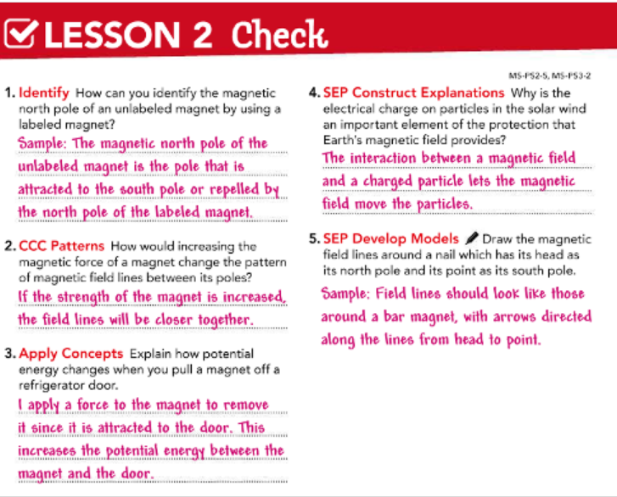
Pg 471

Slide 22


