Slide 1


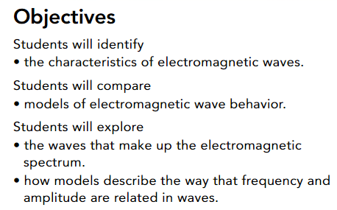
Guiding Questions
What makes up an electromagnetic wave?
How can you model electromagnetic wave behavior?
What kinds of waves make up the electromagnetic spectrum?
https://www.youtube.com/watch?v=7v2gs8rdQzU&t=51s

Slide 2
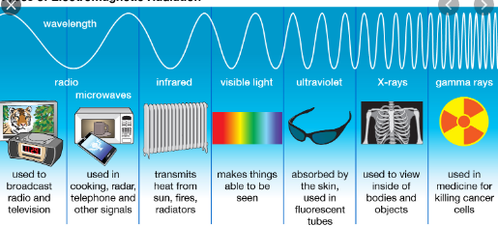
Characteristics of Electromagnetic Waves
A wave made up of a combination of a changing electric field and a changing magnetic field.
* As you read this book, you are surrounded by waves. There are radio waves, microwaves, infrared rays, visible light, ultraviolet rays, and tiny amounts of X-rays and gamma rays.
* These waves are all electromagnetic waves.
* An electromagnetic wave is made up of vibrating electric and magnetic fields that can move through space at the speed of light.
* The energy that electromagnetic waves transfer through matter or space is called electromagnetic radiation.

Slide 3
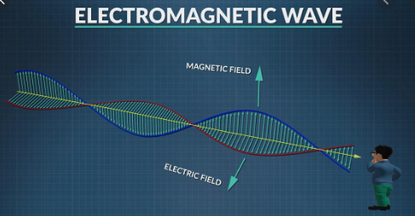
Characteristics of Electromagnetic Waves
Electromagnetic waves do not require a medium such as air, so they can transfer energy through a vacuum.
This property makes them different from mechanical waves, which do require a medium.
Mechanical waves are caused by a disturbance or vibration in the medium, while electromagnetic waves are caused by a source of electric and magnetic fields.
Those fields are produced by the movement of charged particles.

Slide 4
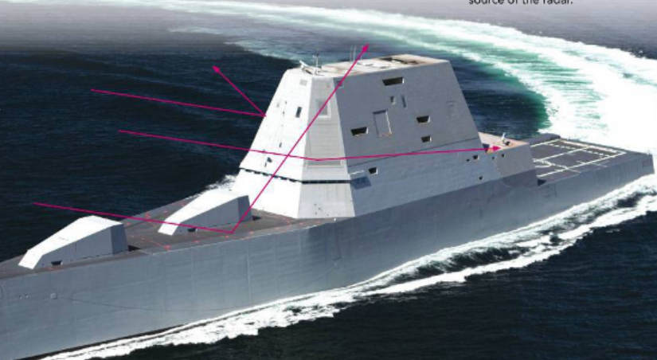
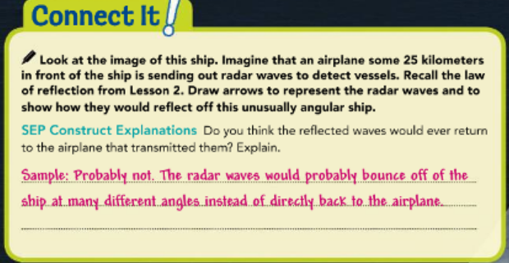
Characteristics of Electromagnetic Waves
Radar is a technology that uses microwaves, a type of
electromagnetic wave, to detect objects in the
atmosphere.
The vessel in Figure 1 is the U.S. Navy′s attempt at using stealth technology to deflect radar.
Its angular surface causes the microwaves to deflect away from the radar source.
Stealth Ship Figure 1
The U.S.S. Zumwalt is the first in a class of “stealth” destroyers. Much of its hull and other structures have surfaces that are angled upward. This means radar waves will be deflected away from the source of the radar.

Slide 5
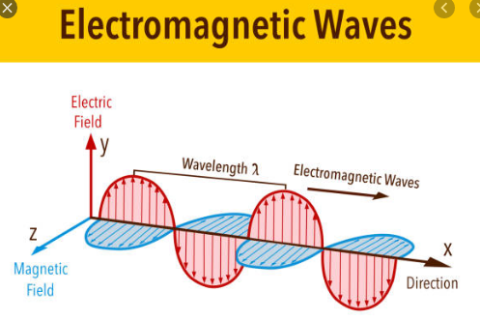
Models of Electromagnetic Wave Behavior
Light is mysterious in that it can behave as either a wave or a particle depending on the situation.
A wave model can explain most of the behaviors, but a particle model best explains others.
Light is an electromagnetic wave, which is a transverse wave.
Light has many properties of transverse waves, but it can sometimes act as though it is a stream of particles.
https://www.youtube.com/watch?v=aCTRjVEmeC0

Slide 6
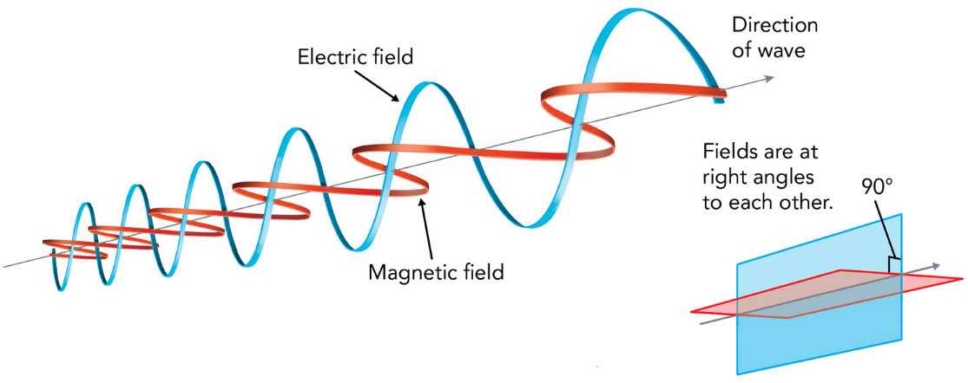
Wave Model of Light
* One way to visualize light is using a wave model.
* The wave originates due to a disturbance of a
charged particle. The disturbance results in
vibrating electric and magnetic fields, which are
oriented perpendicular to each other as shown
in Figure 2.
* The two vibrating fields reinforce each other,
causing energy to travel as light through space or
through a medium.
A ray of light consists of many of these traveling
disturbances, vibrating in all directions.
Electromagnetic Waveform Figure 2
An electromagnetic wave consists of vibrating electric and magnetic fields.

Slide 7
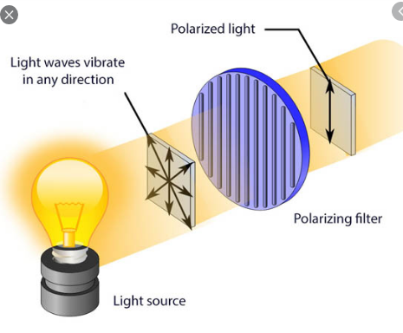
Wave Model of Light
A polarizing filter acts as though it has tiny slits aligned in only one direction. The slits can be horizontal or vertical.
When light enters the filter, only waves whose vibrating electric fields are oriented in the same direction as the slits can pass through it.
The light that passes through is called polarized light. Polarized sunglasses block out some waves of light so that your eyes are not exposed to as much radiation.

Slide 8
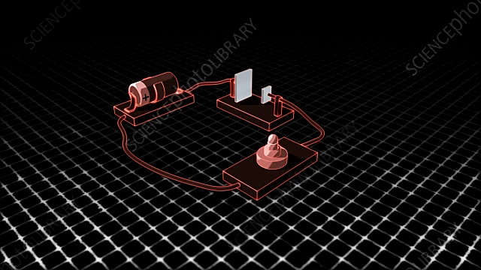
Particle Model of Light
The wave model of light does not explain all of its properties. For example, when a beam of high-frequency light shines on some metals, it knocks some tiny particles called electrons out of the metal. This is called the photoelectric effect.
However, lower-frequency light such as red light doesn’t have enough energy to knock the electrons out.
The photoelectric effect can be explained by thinking of light as a stream of tiny packets, of energy instead of as a wave. Each packet of light energy is called a photon. For the effect to occur, each photon must contain enough energy to knock an electron free from the metal.
Metals emit electrons when light is shone on them
https://www.sciencephoto.com/media/589800/view/photoelectric-effect

Slide 9
Particle Model of Light
One property of light that the wave model explains but the particle model does not is diffraction.
When light passes through a narrow enough slit, instead of forming one image of the slit on a screen, it spreads out and produces a striped pattern of light and dark areas.
This is similar to a water wave passing through a narrow channel and then spreading out on the other side.
https://www.youtube.com/watch?v=0b0axfyJ4oo

Slide 10
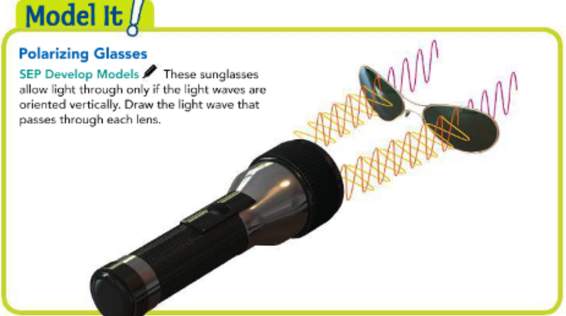
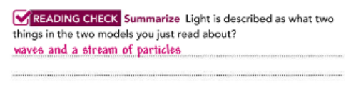
Particle Model of Light

Slide 11
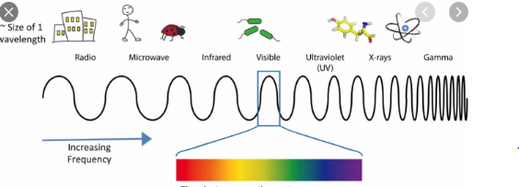
Wavelength and Frequency
If you use a wave model for electromagnetic waves, the waves have all of the properties that mechanical waves do. Namely, each wave has a certain amplitude, frequency, wavelength, wave speed, and energy.
Electromagnetic waves are divided into categories based on their wavelengths (or frequencies). Visible light, radio waves, and X-rays are three examples of electromagnetic waves.

Slide 12
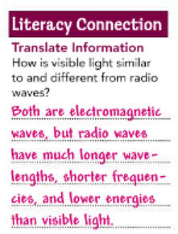

Wavelength and Frequency
each has properties that make it more useful for some purposes than for others. If you tried to microwave your food with radio waves, or make a phone call with X-rays, you wouldn’t get very far! All electromagnetic waves travel at the same speed in a vacuum, but they have different wavelengths and different frequencies.

Slide 13
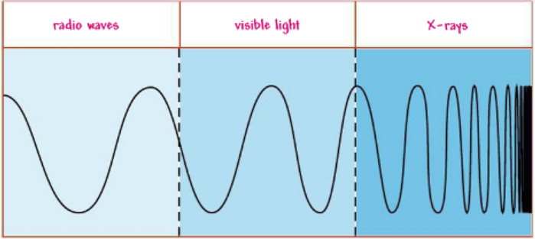
Wavelength and Frequency
Wavelengths and Frequencies Figure 3
Use the information from the text to label the three wavelength ranges shown in the diagram as either X-rays, radio waves, or visible light.
As you can see in Figure 3, wavelength and frequency are related. In order for a wave to have a high frequency, its wavelength must be short.
Waves with the shortest wavelengths have the highest frequencies.
Frequency is also related to energy. Higher
frequency waves have more energy, while lower
frequency waves have less energy.
Visible light is the only range of wavelengths your eyes can see. A radio detects radio waves, which have much longer wavelengths than visible light.
X-rays, on the other hand, have much shorter wavelengths than visible light.

Slide 14
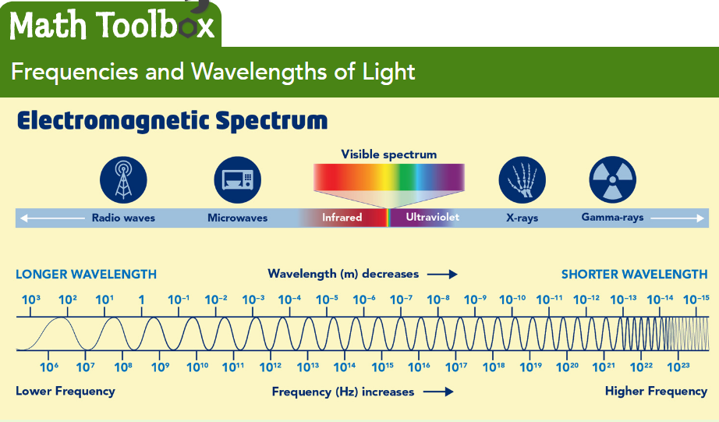
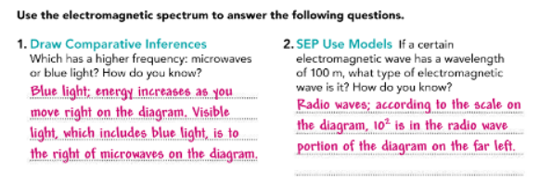
The Electro Magnetic Spectrum
There are many different types of electromagnetic waves. The complete rang of electromagnetic waves placed in order of increasing frequency is called the electromagnetic spectrum.
Electromagnetic spectrum is made p of radio waves, microwaves, infrared rays, visible light, ultraviolet rays, X-rays, and gamma rays.
Radio Waves Electromagnetic waves with longest wavelength and shortest frequencies are radio waves.
Radio waves are used in mobile phones.
* Towers receives and transmit radio waves along s
network that connects mobile phones to each other, to
the internet, and other networks.

Slide 15
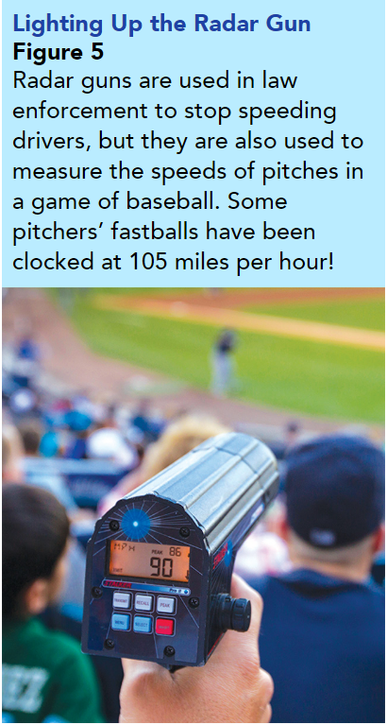
The Electro Magnetic Spectrum
Microwaves have shorter wavelengths and higher frequencies than radio waves. When you think about microwaves, you probably think of microwave ovens.
But microwaves have many other uses, including radar. Radar is a system that uses reflected microwaves to detect objects and measure their distance and speed.
Radar guns, such as the one in Figure 5, are used to measure the speed of a baseball pitch.
Police also use them to detect cars that are traveling over the speed limit.
https://www.youtube.com/watch?v=m4t7gTmBK3g

Slide 16
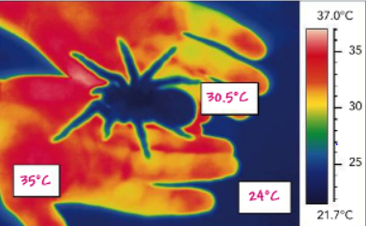
The Electro Magnetic Spectrum
Infrared Rays
If you turn on an electric stove’s burner, you can feel it warm up before the heating element starts to glow.
The invisible heat you feel is infrared radiation, or infrared rays.
Infrared rays are electromagnetic waves with wavelengths shorter than those of microwaves.
An infrared camera uses infrared rays instead of visible light to take pictures called thermograms such as the one in Figure 6.
Thermogram Figure 6
Label the blank spaces rectangles on the thermogram with temperatures in degrees Celsius.

Slide 17

The Electro Magnetic Spectrum
Visible Light
Electromagnetic waves that you can see are called visible light. Visible light waves have shorter wavelengths and higher frequencies than infrared rays.
Recall that light waves bend, or refract, when they enter a new medium, such as water or glass.
Light from the sun contains electromagnetic waves of many frequencies, both visible and invisible.
Sunlight passing through a prism splits into its different frequencies, forming a rainbow pattern.
After rainy conditions, rainbows such as the one in Figure 7 can also form in the sky.

Slide 18
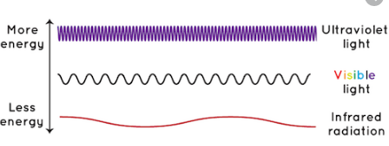
The Electro Magnetic Spectrum
Ultraviolet Rays
Electromagnetic waves with wavelengths just shorter than those of visible light are called ultraviolet rays, or UV rays for short.
UV rays have higher frequencies than visible light, and carry more energy. Sunscreen helps protect your skin from some of the sun’s harmful UV rays.

Slide 19
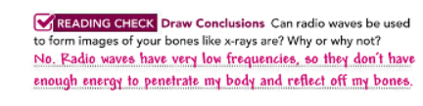
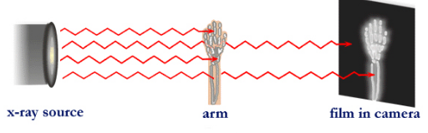
The Electro Magnetic Spectrum
X-rays
Electromagnetic waves with wavelengths shorter than those of ultraviolet rays are X-rays. Because of their high frequencies, X-rays carry more energy than ultraviolet rays and can penetrate most matter. However, dense matter, such as bone, absorbs X-rays. Therefore, X-rays are used to make images of bones and teeth in humans and animals.

Slide 20
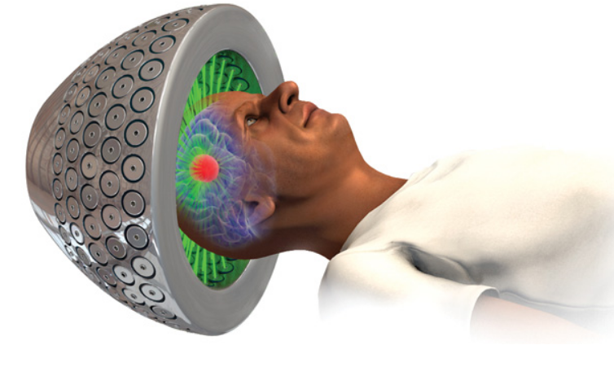
The Electro Magnetic Spectrum
Gamma Rays
Electromagnetic waves with the shortest wavelengths and highest frequencies are gamma rays. They have the greatest amount of energy of all the electromagnetic waves. Gamma rays are dangerous, but they do have beneficial uses. Radiosurgery shown in Figure 8, is a tool that uses several hundred precisely focused gamma rays to target tumors, especially in the brain. The blast of radiation at the point where the beams cross destroys the targeted tumor cells.
Radiosurgery Figure 8
The combination of 200 beams of gamma rays can leave tumor cells unable to reproduce, which can stop tumors from growing.
https://www.youtube.com/watch?v=4TpX3TW8fIk
https://www.youtube.com/watch?v=57YdbiEmmvQ

Slide 21
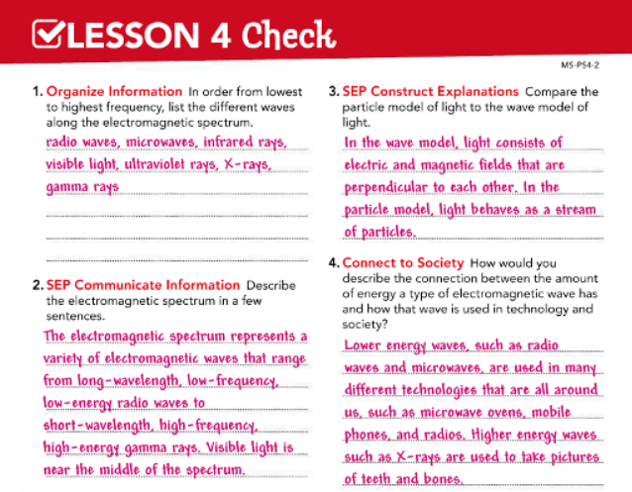
https://www.youtube.com/watch?v=U-9Lkq-3XAo

