Slide 1
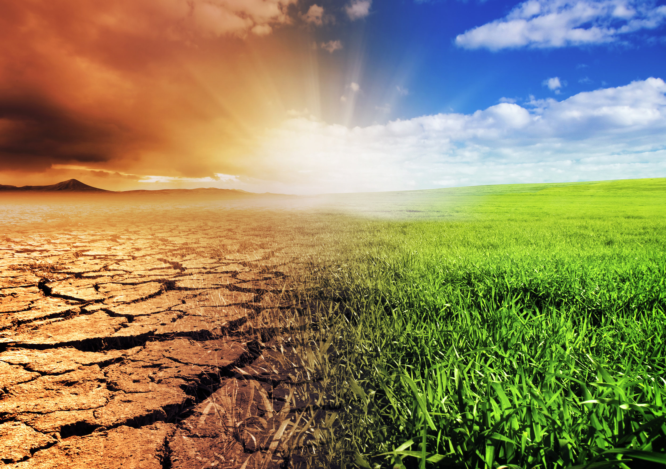

Topic 8

Slide 2
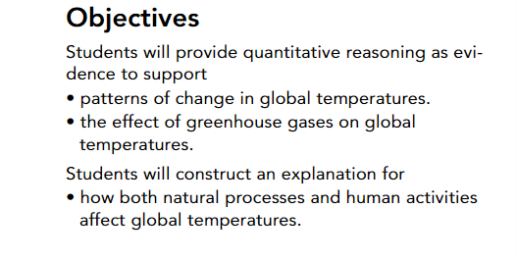
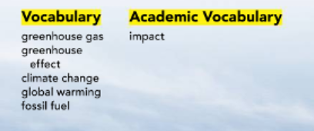

Slide 3
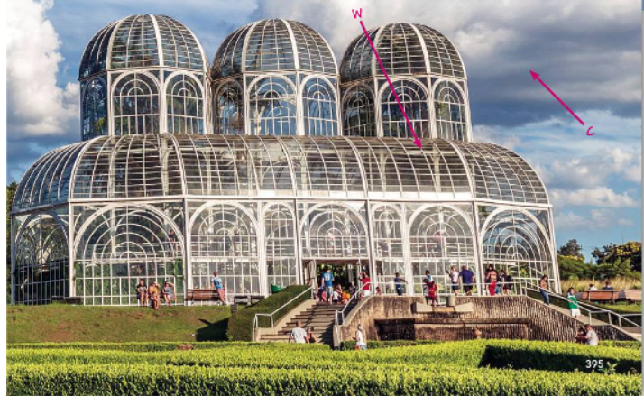
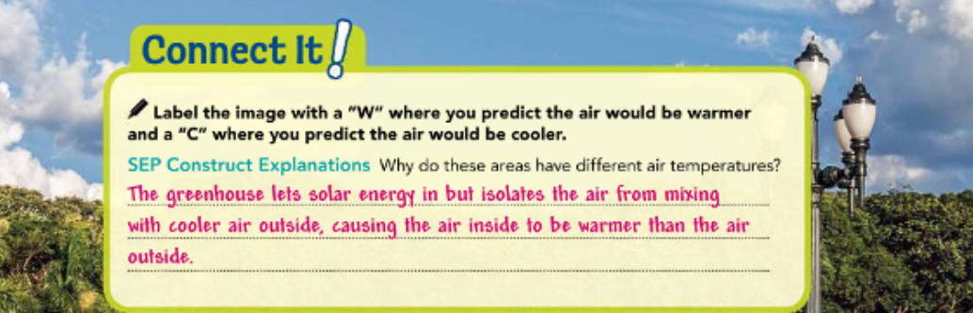
Pg.394, 395

Slide 4
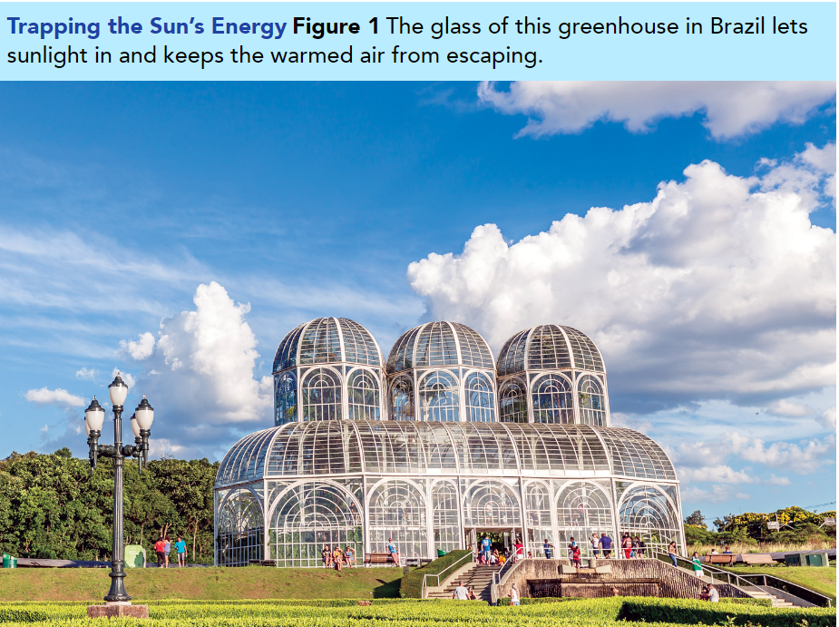

Slide 5
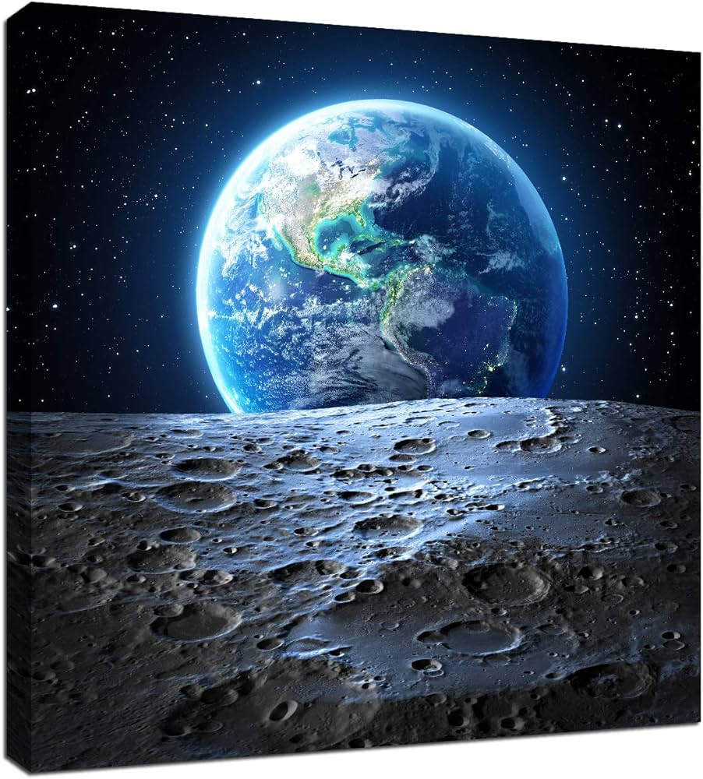
Studying Earth’s Climate
Earth has an amazing variety of climates, from the dry, cold polar regions to the wet, hot tropics. Scientists study climates to :
1-better understand how the atmosphere, water, land masses, and solar energy all interact within a climate.
2-They look at causes of changes in climates in the past and predict how climates may change in the future.
Greenhouse Effect While the differences between climates may seem extreme, Earth’s overall climate patterns remain fairly stable compared to conditions in space.
This is because of gases in the atmosphere, which help to regulate energy in the system.

Slide 6

The greenhouse in Figure 1 absorbs thermal energy from the sun to warm the air inside.
*Gardeners add water and soil to create the special climate conditions the plants inside the greenhouse need to survive.

Slide 7
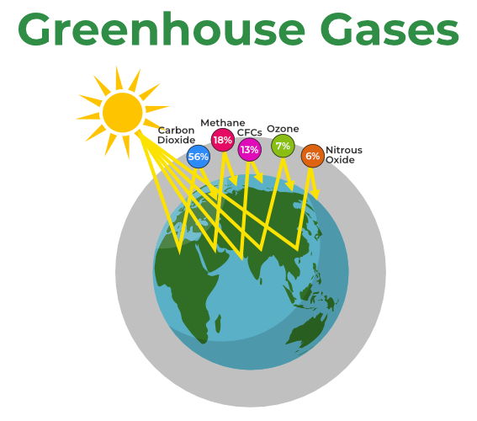
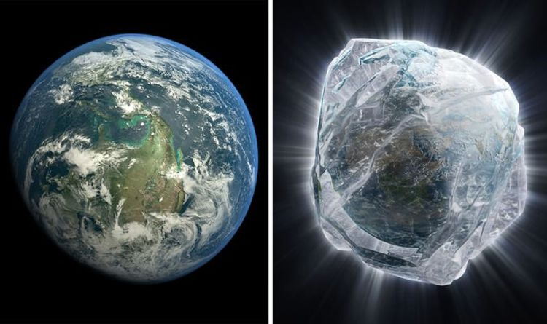
*Certain gases in the atmosphere, called greenhouse gases, such as water vapor, carbon dioxide, methane, and nitrous oxide, absorb much of the heat leaving Earth’s surface.
*The greenhouse effect is the process by which these gases trap heat, keeping Earth warm.
Without greenhouse gases, thermal energy would radiate from Earth’s surface and escape directly into space, making our planet too cold to support life.

Slide 8
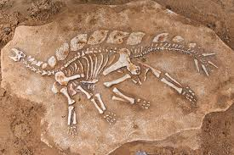
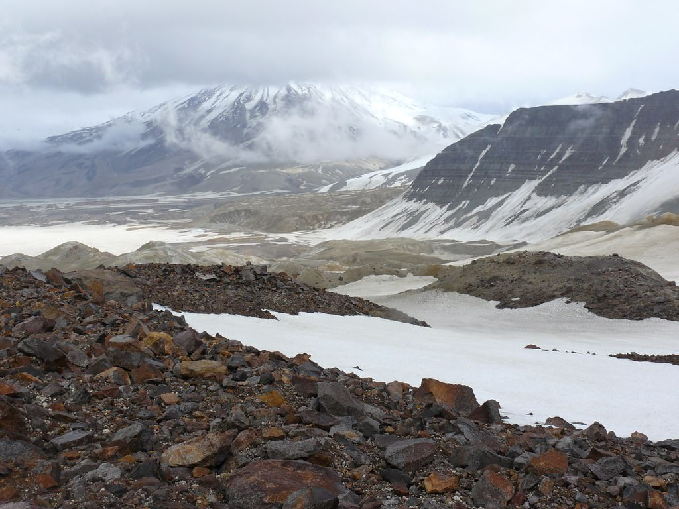
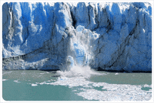
How do scientists study the climate of the distant past?
Scientists use a wide variety of methods to gather data about past conditions.
1-Fossils: Fossils of warm-weather plants found in Antarctica suggest that, at some time earlier, Antarctica’s climate was much warmer.
2-Rock deposits from glaciers: in now–warm regions suggest colder conditions.

Slide 9
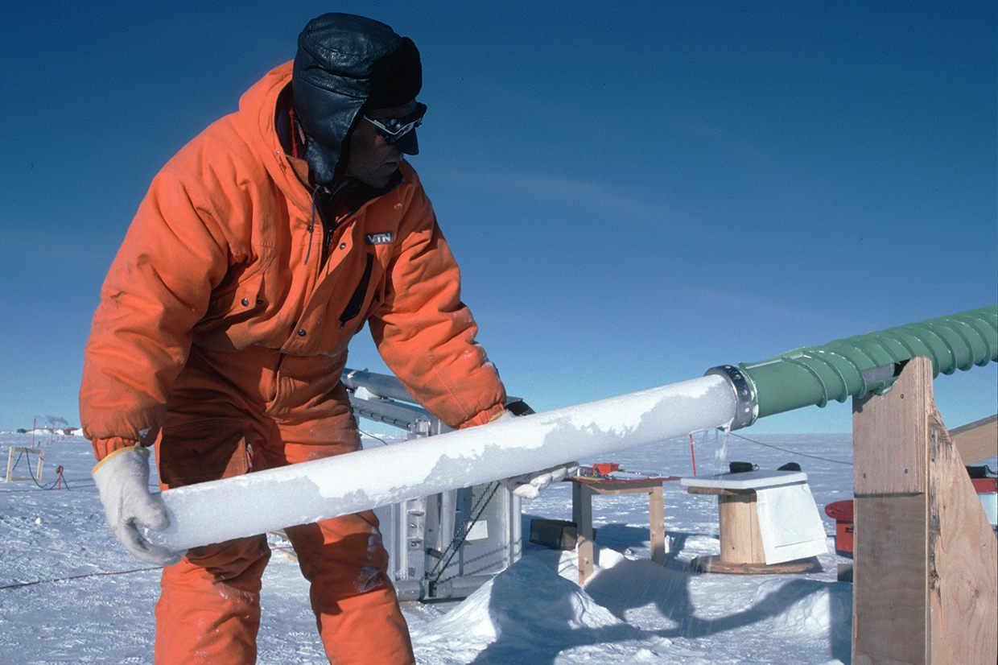
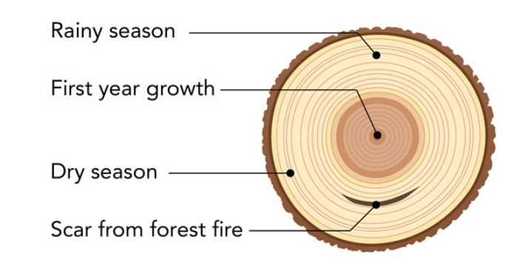
How do scientists study the climate of the distant past?
Scientists use a wide variety of methods to gather data about past conditions.
3-The ice cores: which look like glass rods, contain air bubbles and particles such as volcanic ash, sea salt, and dust. By analyzing these materials, scientists can reconstruct climate factors in Earth’s past and how they have changed.(Scientists collect ice cores by drilling down through layers of ice, sometimes kilometers thick. )
4-growth rings of trees: record climate conditions as the tree lived and grew each year. The tree rings shown in Figure 2 show how events and climate conditions in the past shaped the tree’s growth.

Slide 10

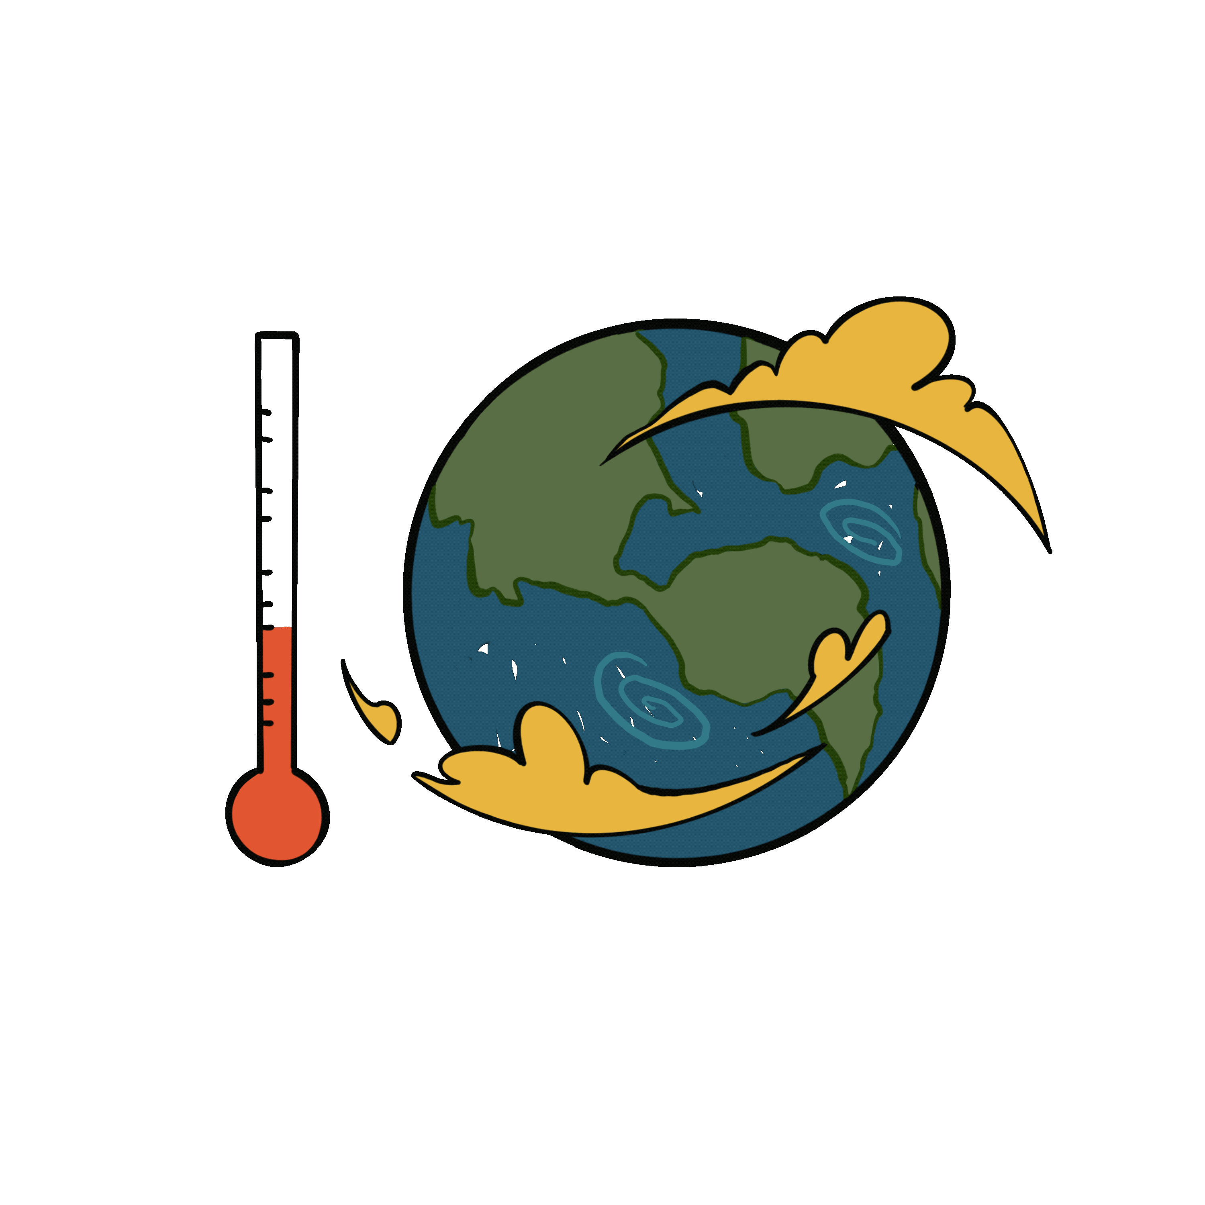
Climate change
is a sudden or gradual change in Earth’s climate.
By studying Earth’s climate history in the past, scientists can better understand how conditions change over time, and the effects of gradual or sudden climate changes.

Slide 11
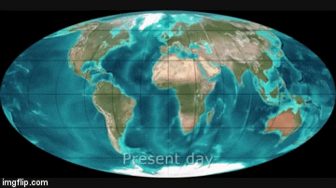
Natural Processes
Natural processes that affect climate and may cause climate change include:
1-the movements of continents: Recall that landmasses and bodies of water are factors that regulate climate. Earth’s continents gradually shift and move. As the size and position of continents and oceans have changed, so too has the climate. This process occurs very slowly and continues to this day.

Slide 12
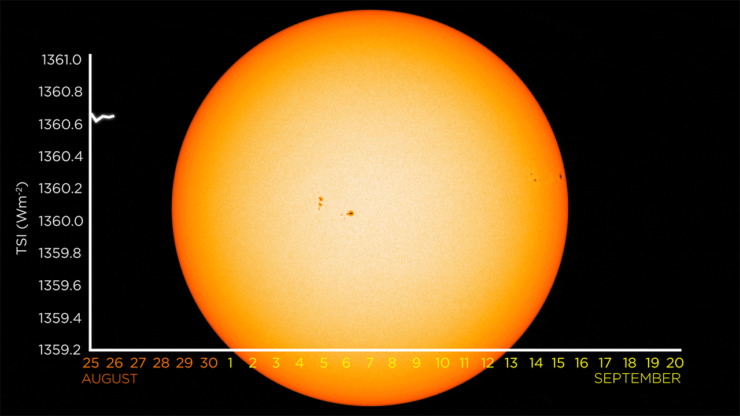
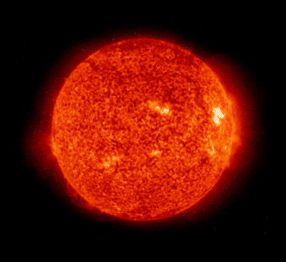
Natural Processes
Natural processes that affect climate and may cause climate change include:
2- fluctuations in solar radiation: Significant climate changes in the past resulted from fluctuations in solar radiation. Like all stars, our sun goes through cycles of energy production. The energy output of the sun varies, as does Earth’s tilt and orbit around the sun. Small changes over large periods of time can have big impacts on the climate.

Slide 13
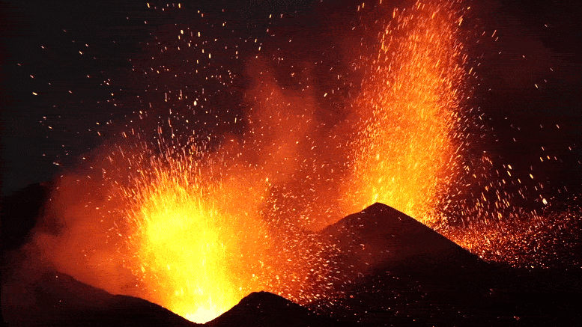
Natural Processes
Natural processes that affect climate and may cause climate change include:
3- volcanic eruptions that disturb the atmosphere.
Volcanic eruptions may cause sudden changes in climate by disturbing the atmosphere. In the past, major eruptions have caused short-term global cooling when ash and aerosol particles, or tiny particles suspended in gas, temporarily blocked solar energy. Some scientists theorize that large–scale volcanic eruptions could cause long-term warming by releasing massive amounts of greenhouse gases into the atmosphere.

Slide 14
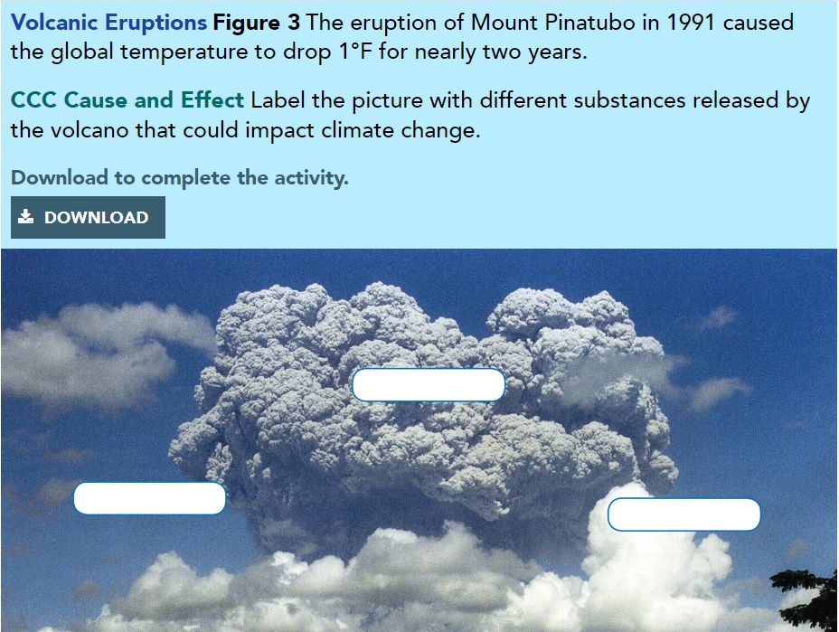
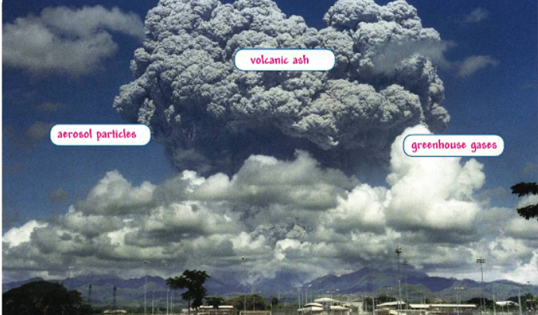
Pg.397

Slide 15
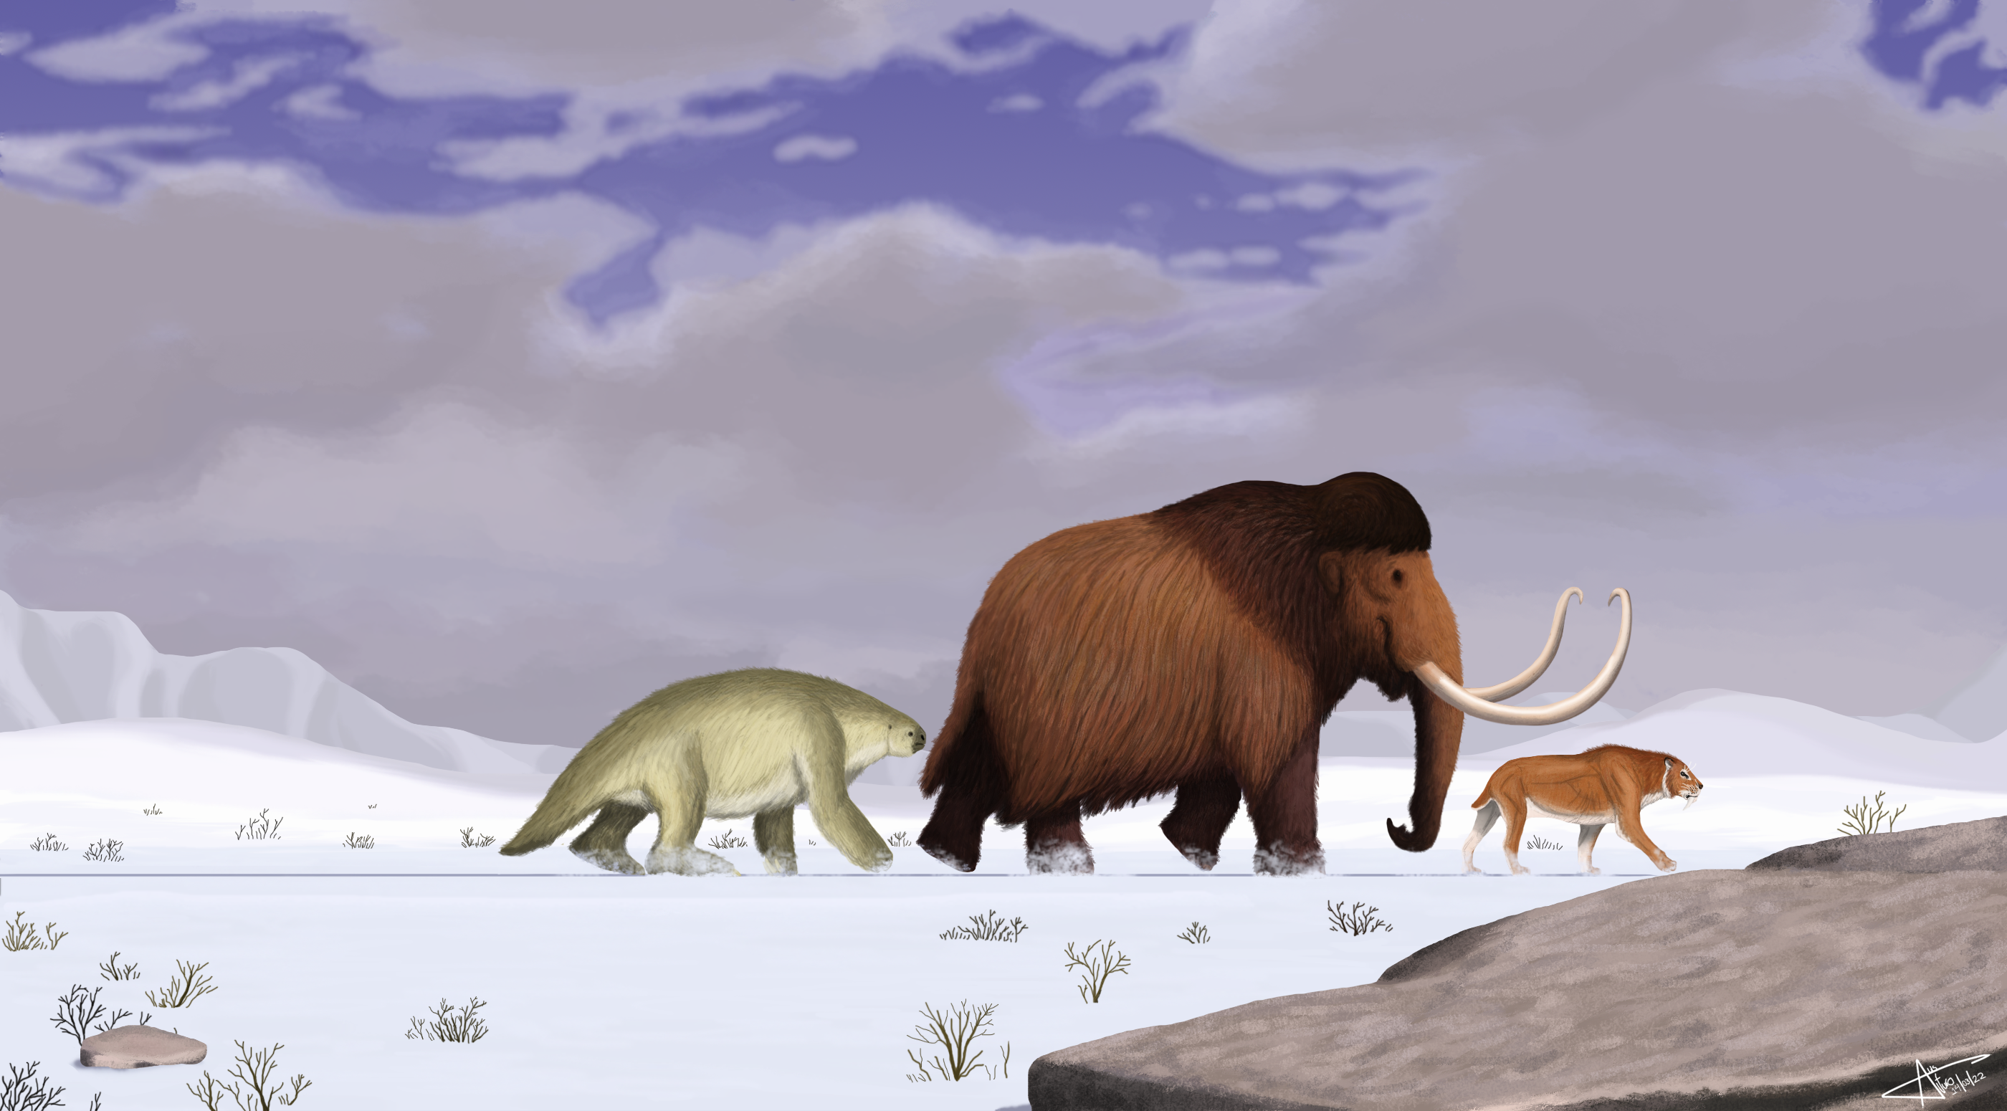
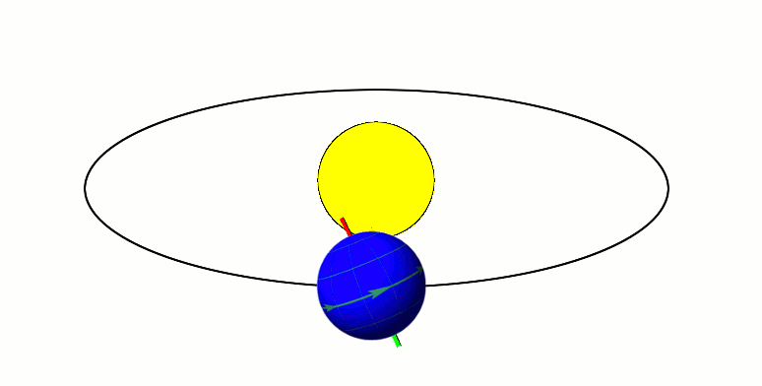
Ice Ages
The most researched examples of dramatic climate change in Earth’s past are ice ages. During these periods, Earth’s climate was 5 to 15 degrees Celsius cooler, causing huge glaciers to extend well beyond the ice caps.
Scientists have used evidence from cores of ice and the ocean floor to estimate that there have been about 40 cooling cycles in the past 2.5 million years.
Variations in the tilt of Earth’s axis and orbit around the sun occur at regular intervals, and this can impact climate.

Slide 16
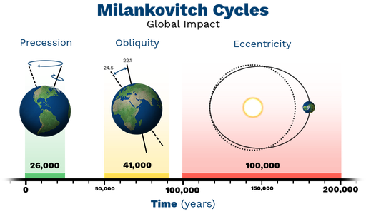
Ice Ages
A mathematician named Milutin Milankovitch discovered the pattern. Every 40,000 to 100,000 years, variations in Earth’s tilt and orbit result in a period of unusually cool summers in the Northern Hemisphere. Milankovitch theorized the lack of snow melt in the cool summer caused a build-up of reflective ice and snow. This, in turn reflected solar energy even more, causing the cooling trend to escalate. The most recent ice age, which ended about 10,000 years ago, coincided with one of these intervals in which Earth received and retained less energy from sunlight.

Slide 17
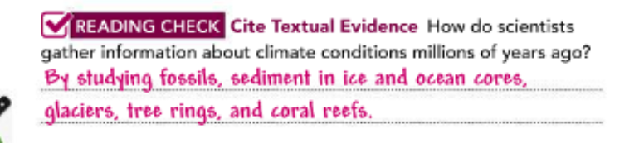
Pg.398

Slide 18
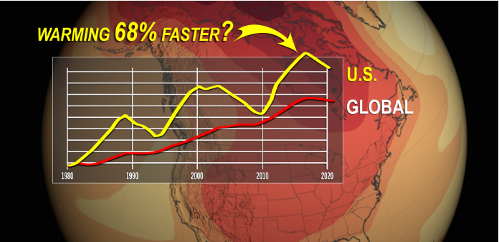
Recent Climate Change
Evidence of Earth’s past suggests that most climate change takes place over long periods of time—thousands or even tens of thousands of years. However, over the past century, scientists studying the climate have observed a clear and alarming trend in the data.
Global surface temperature measurements from the past 140 years indicate that the average global temperature has been rising. This gradual increase in temperature is called global warming.
In addition to measuring average temperature changes, scientists also gather data about the concentration of greenhouse gases, such as carbon dioxide and methane, in the atmosphere. They also measure changes in annual Arctic sea ice coverage and overall sea levels around the world. All of these data suggest that global warming is occurring at a surprisingly fast rate.
In the Earth’s overall geologic timescale, massive climate changes that happen over millions of years have different causes and different impacts on the planet. Even small changes can have a huge impact on Earth when they happen in such a short amount of time. The graph in Figure 4 measures temperature changes in only the past 140 years. By studying Earth’s climate past, scientists hope to predict some of the impacts of the current climate change.

Slide 19
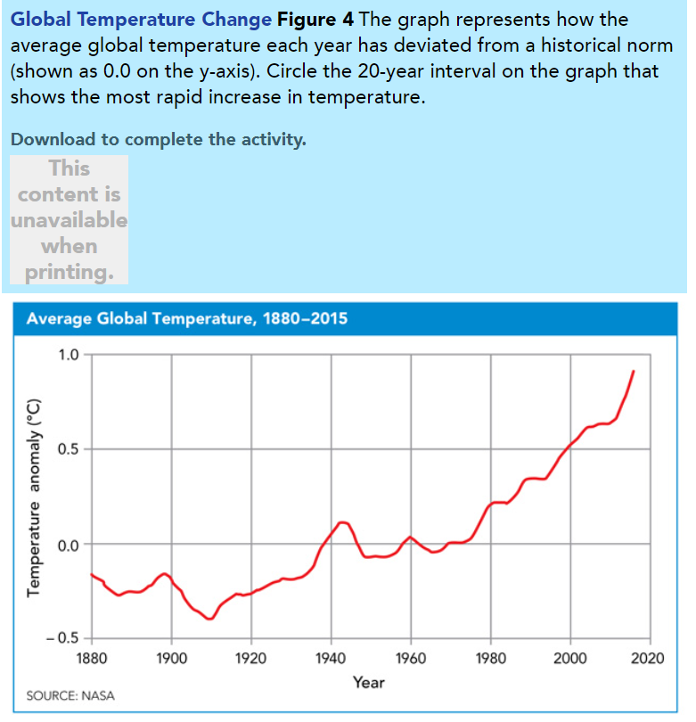
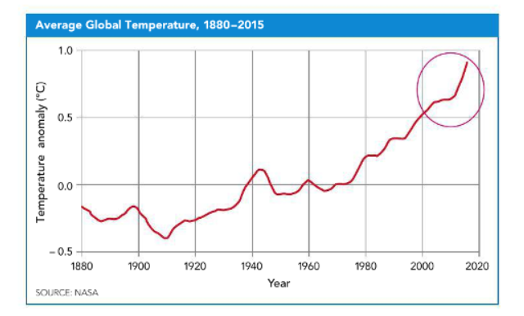
Pg.399

Slide 20
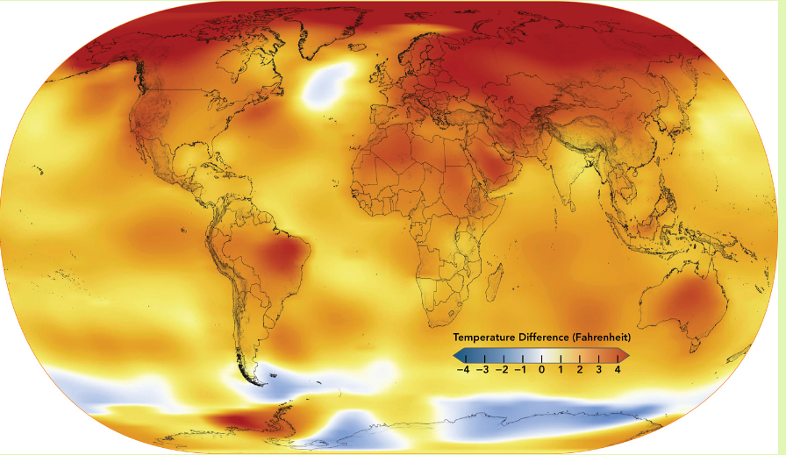
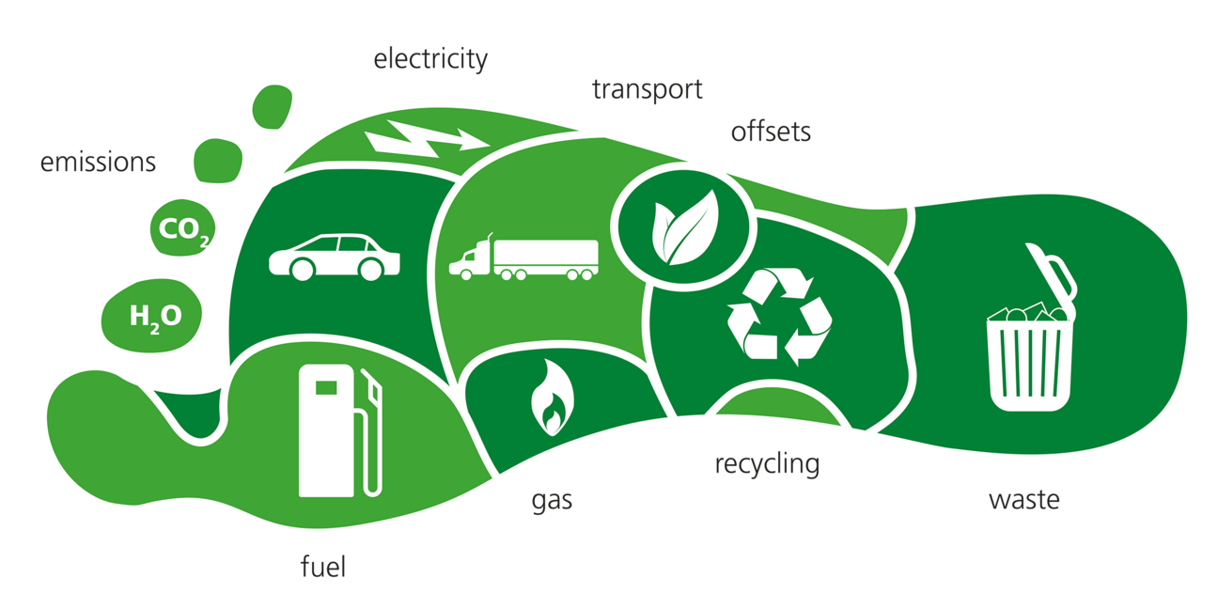
Human activities
some of which are shown in Figure 5, change Earth’s surface faster than any geologic process. By releasing greenhouse gases, such as carbon dioxide and methane, human activities have an impact on global temperatures.
Our activities increase the concentration of greenhouse gases in the atmosphere, which causes the average global temperature to rise.
Much of these greenhouse gases come from humans burning fossil fuels, which are substances formed from the remains of organisms. These substances release a great deal of energy when burned. But they also release carbon dioxide and other greenhouse gases. The amount of greenhouse gases emitted through human activity is sometimes referred to as our carbon footprint. When we make changes to the land, water, or air around us, we are leaving a carbon footprint that causes major changes in Earth’s climate.

Slide 21
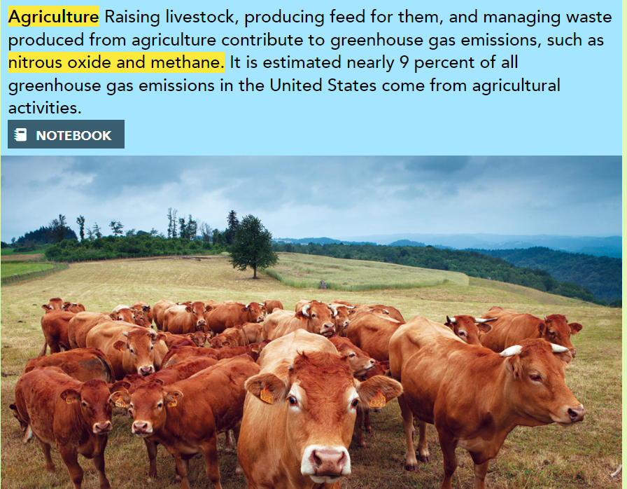

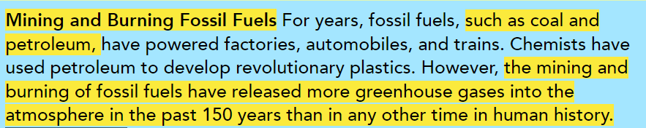
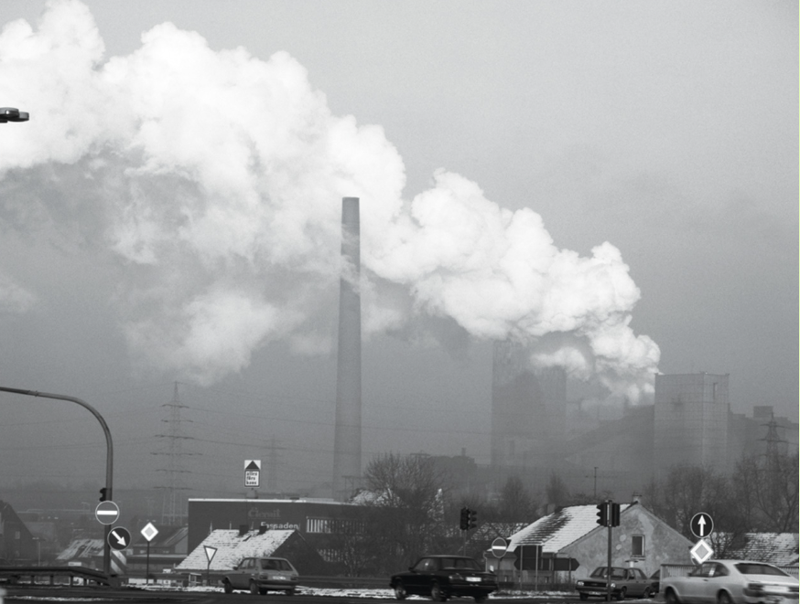



Slide 22
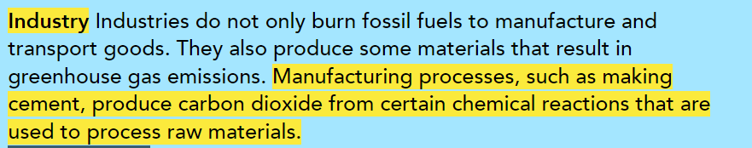
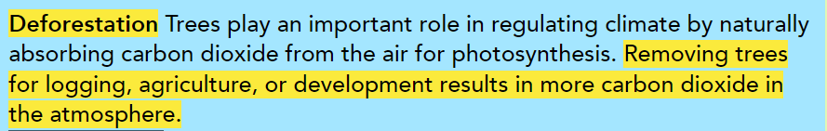
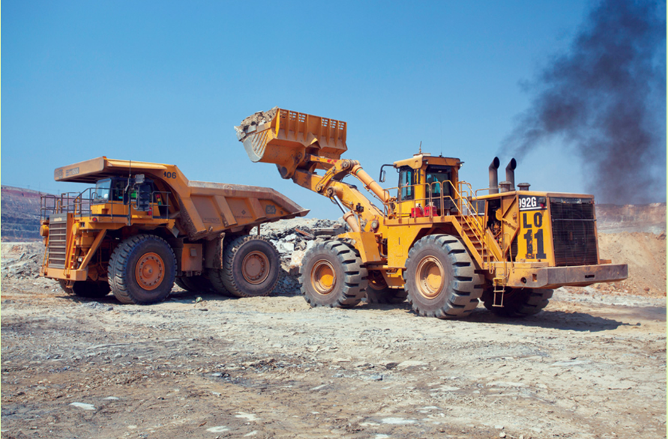
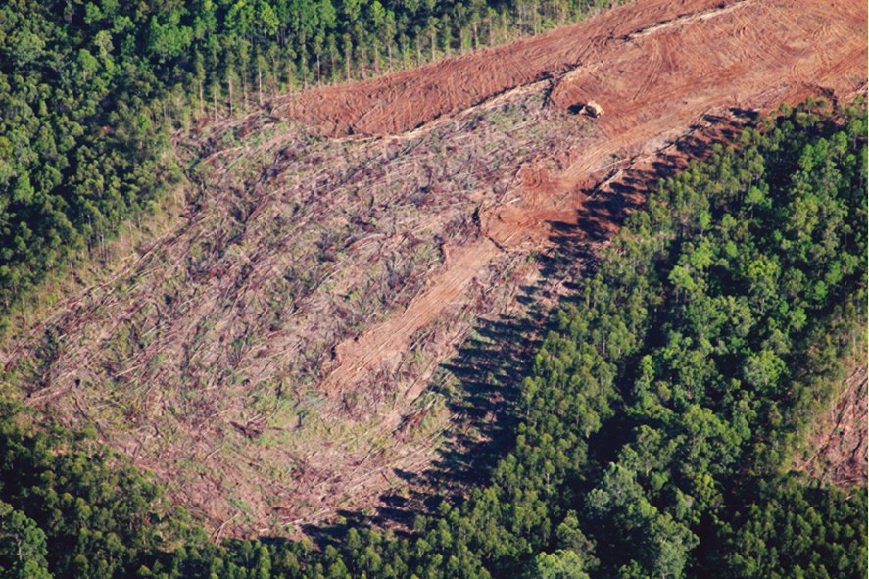
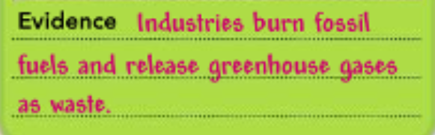


Slide 23
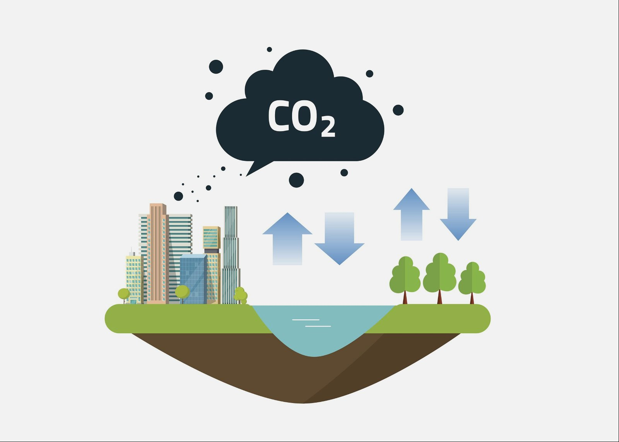
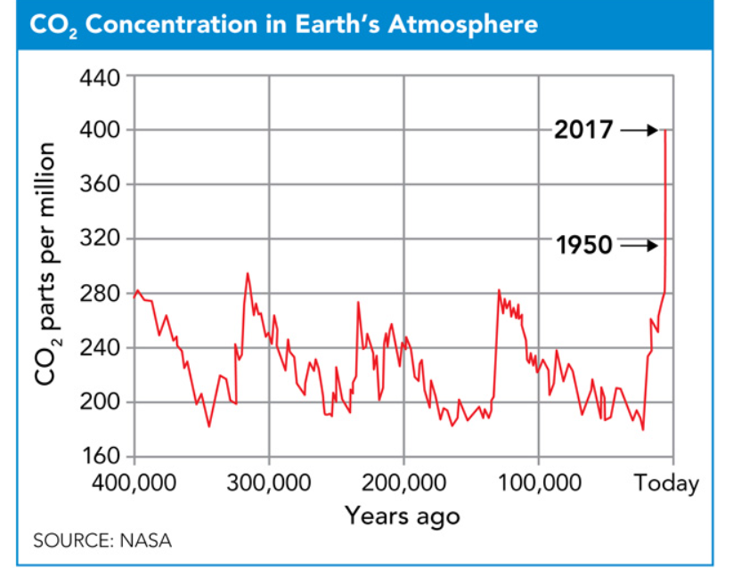
Carbon Dioxide Concentrations
Carbon, like other forms of matter such as water, moves through the land and ocean in a natural cycle. Photosynthetic organisms absorb carbon dioxide from the atmosphere. That carbon is stored and used through life processes until it is released again as carbon dioxide into the atmosphere. Because carbon dioxide is a greenhouse gas, its levels in the atmosphere regulate Earth’s global temperature. If there is very little carbon dioxide in the atmosphere, then Earth will not retain enough solar energy to have a stable climate. When carbon dioxide levels are high, global temperatures can rise.
Carbon dioxide concentrations in the atmosphere are constantly being exchanged through natural processes, absorbed by Earth’s oceans and locked up in the biosphere in substances such as fossil fuels. Human activities in the past century have upset the balance of these processes. As a result, they have directly impacted the rising concentrations of carbon dioxide in the atmosphere, as shown in Figure 6.

Slide 24
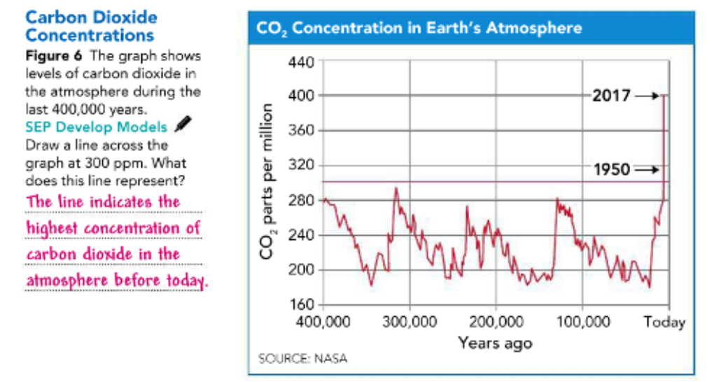
Pg.402

Slide 25
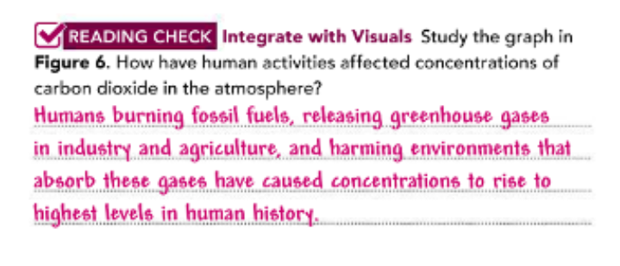
Pg.402

Slide 26
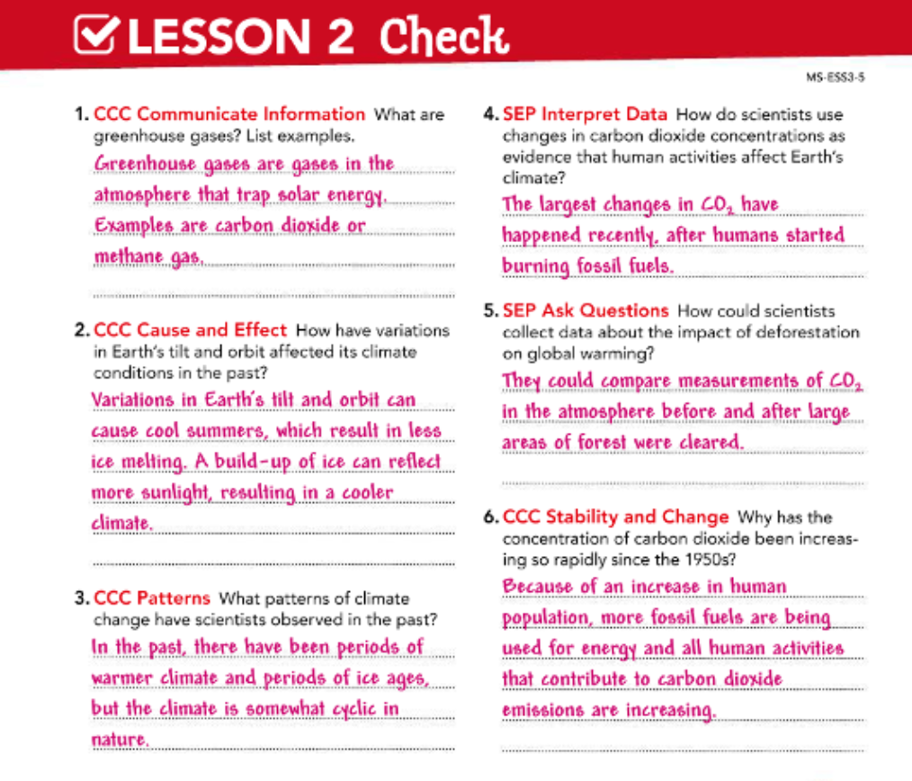
Pg.403

Slide 27


