Slide 1
SUPPLYING ENERGY

Slide 2
OBJECTIVES
1. Know the functions of the main nutrients
2. Understand the digestive process

Slide 3

SUPPLYING ENERGY
Notes:
https://www.savvasrealize.com/content/viewer/standalone/loader/view/0186b842-81dc-3a32-96b9-38bbe709fa52/24/nonscorable?programId=e1d0bee1-ee55-343d-8d51-31959c750e5b&programVersion=22&containerId=6cec71db-5397-3a86-b730-62942607810c&containerVersion=22&backUrl=https:%2F%2Fwww.savvasrealize.com%2Fdashboard%2Fprogram%2Fe1d0bee1-ee55-343d-8d51-31959c750e5b%2F22%2Ftier%2F0b9c164b-047d-3f99-8b51-bbf84c217422%2F22%2Flesson%2F6cec71db-5397-3a86-b730-62942607810c%2F22&locale=en&programName=Elevate%20Science%20Course%202&rootProgramId=e1d0bee1-ee55-343d-8d51-31959c750e5b

Slide 4
FOOD AND ENERGY
All of our activities (running, walking, talking, jumping etc) require energy.
Cells require energy for all the processes that go on inside our body, including
breathing, thinking, and growing.
Living things get energy from food.
Plants make their own food.
Animals and decomposers get their food by eating other organisms and breaking it down into its component parts.
Digestion is the process by which your body breaks down food into small
nutrient molecules.

Slide 5
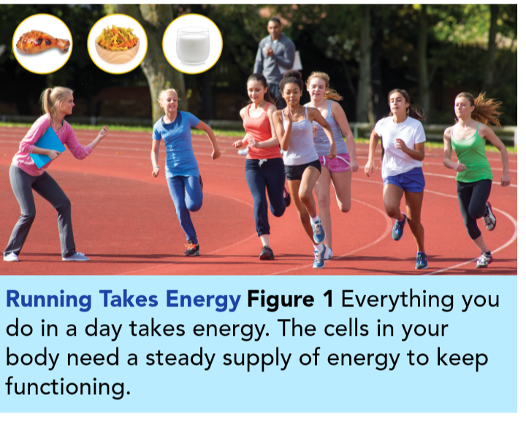

Slide 6
Nutrients
These are the substances in food that provide the raw materials the body’s cells need to carry out all their essential processes.
Some nutrients are broken down and used for energy.
Other nutrients are used to repair damaged cells or to help you grow.
Your body needs nutrients to perform every function.
Therefore, you constantly need nutrients from food to keep up with the body’s demand

Slide 7
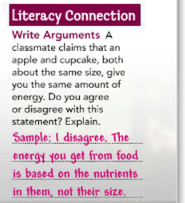

Slide 8
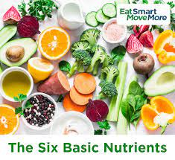
Main Nutrients
The purpose of digestion is the absorption of six important nutrients you get
from food, namely:
carbohydrates
proteins
fats
vitamins
minerals
water.

Slide 9
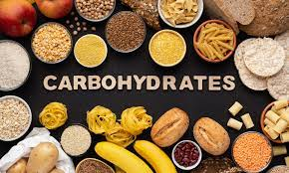
Carbohydrates :
Energy-rich organic compound, such as sugar or a starch, made up of the elements carbon, hydrogen, and oxygen.
They can be quickly broken down and the body can use the energy released in this process.
This energy is measured in Calories. High Calorie foods can give you more energy than low Calorie foods.

Slide 10
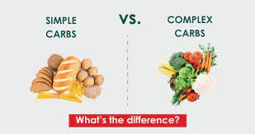
A carbohydrate can be simple or complex, depending on the size of its molecules.
Simple carbohydrates, are smaller molecules and taste sweet. For example, donuts, cakes and pies
Complex carbohydrates, such as fiber, are larger molecules.
Whole grains, such as brown rice, are considered healthy sources of complex carbohydrates. They are high in fiber and nutrients.

Slide 11
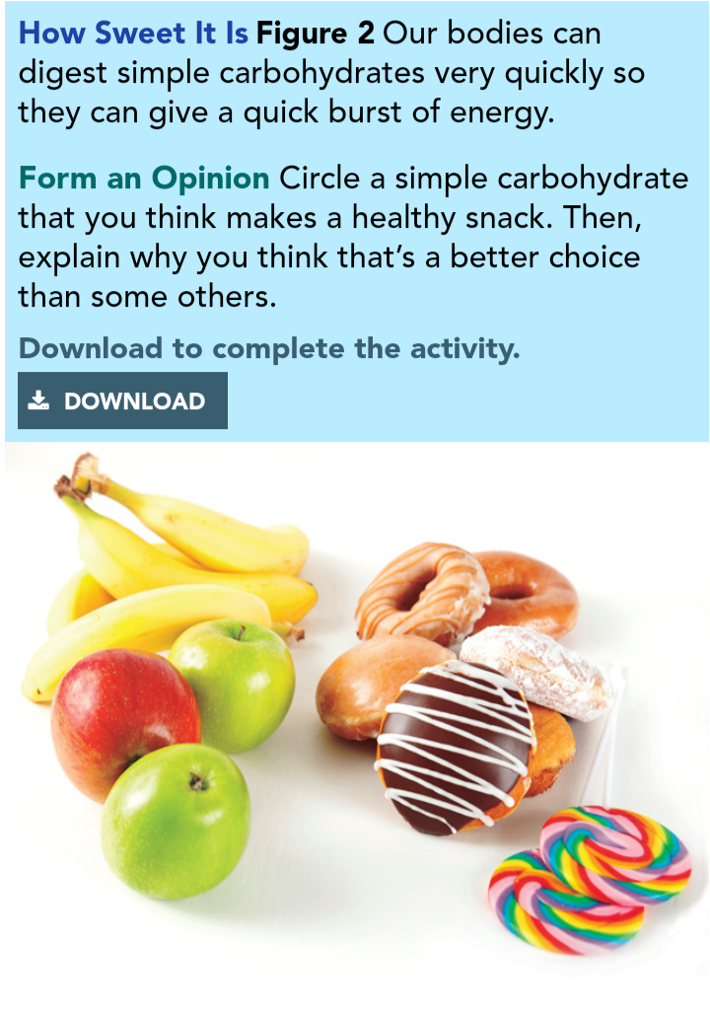

Slide 12
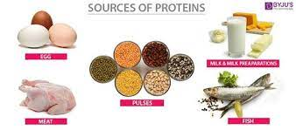
Proteins
Your body needs protein for growth and body repair.
Proteins are made of smaller components called amino acids.
Beans, beef, chicken, eggs, fish, and nuts are all protein sources.

Slide 13
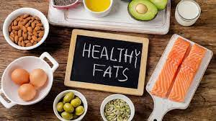
Fats
While carbohydrates provide quick energy, fats provide a concentrated energy source.
The body also uses fats for long-term energy storage.
There are two main types—saturated fat and unsaturated fat.
Saturated fats usually come from animal products, such as lard. They are solid at room temperature.
Unsaturated fats usually come from plant products and are oils, such as olive oil. They are liquid at room temperature.
People should limit saturated fat intake because they are linked to heart disease and other illnesses

Slide 14
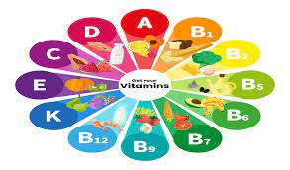
Vitamins
Vitamins are nutrients that help your body with chemical reactions.
They do not provide any energy or building materials, but without them, you would not be able to function.
Your body can make small amounts of some vitamins, such as vitamins D and K, but most have to be taken in through your diet.

Slide 15
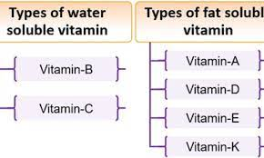
Vitamins can be fat-soluble or water-soluble.
Fat-soluble vitamins, such as A and K, are stored in the fatty tissues of the body and released when needed.
Water-soluble vitamins, such as vitamin C, dissolve in water and are not stored in large amounts by the body. Citrus fruits, such as oranges, are high in vitamin C.

Slide 16
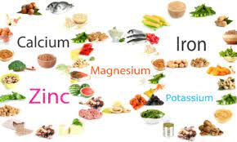
Minerals
Minerals are nutrients that are not made by the body, but are needed to carry out chemical processes.
Calcium for bones and iron for blood are two examples of minerals that are taken in through the diet.
Calcium is common in dairy products, such as milk and cheese.
Iron is found in meat and leafy green vegetables, such as spinach.

Slide 17
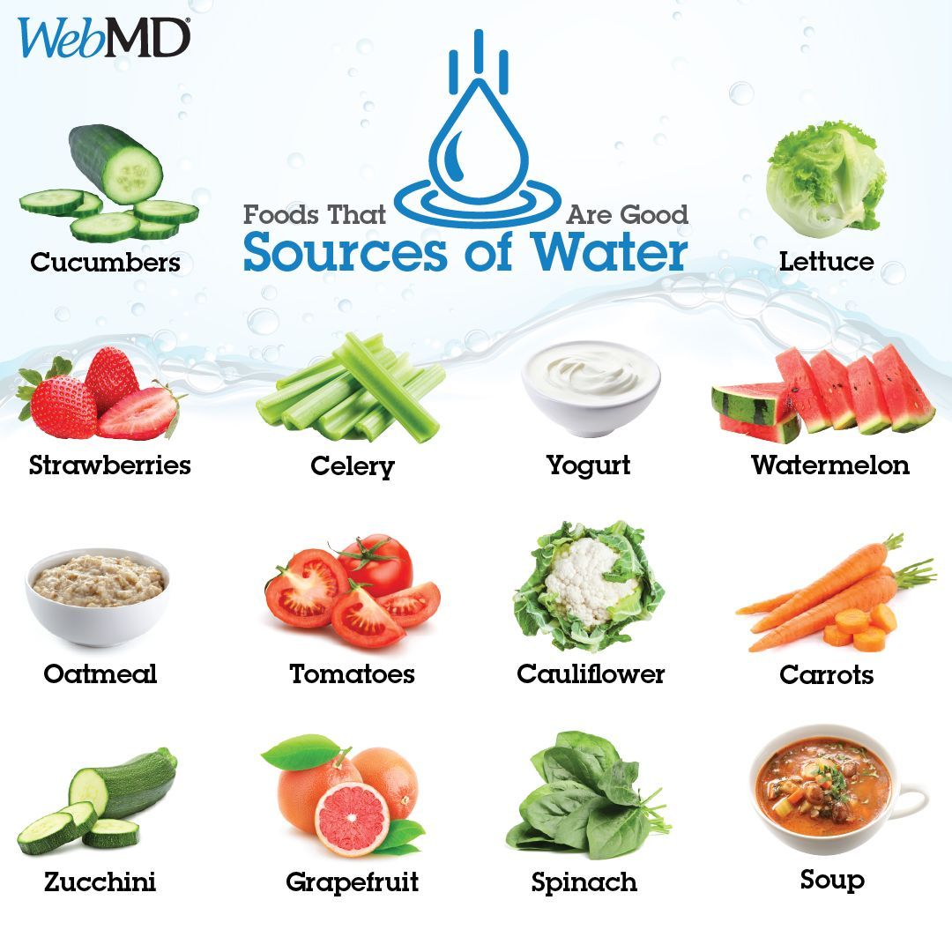
Water
Of the six nutrients you need, water is the most important.
While the human body can go a few weeks without eating food, it could only survive a few days without water.
Survival time without water hinges on both environmental conditions and level of activity.
For example, someone hiking in the desert under a blazing sun needs more water than someone in cooler conditions.
You get water from much of the food you eat, but you still need to drink water every day.

Slide 18
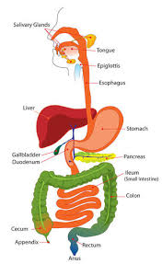
THE DIGESTIVE PROCESS
Digestion can be classified into two main types—mechanical and chemical.
Mechanical digestion involves the physical breakdown and movement of food.
Chemical digestion, as the name suggests, involves the chemical breakdown of food.

Slide 19
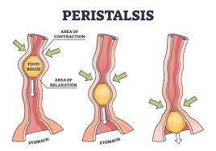
Mechanical Digestion
The mouth and stomach are the main places where mechanical digestion happens.
The movement of the food through the oesophagus and the intestines is also part of mechanical digestion.
Waves of smooth muscle contractions that move food through the esophagus toward the stomach are called peristalsis.

Slide 20
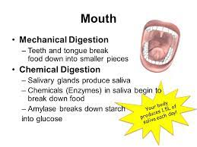
Chemical Digestion
Chemical digestion begins in the mouth.
Fluid called saliva is released from glands in the mouth and plays an important role in both mechanical and chemical digestion.
Your saliva contains chemicals. Some of these chemicals are called enzymes.
Enzymes are proteins that speed up chemical reactions in the body.
Enzymes cause the food to break down faster.

Slide 21
Chemical digestion starts in the mouth, with an enzyme found in saliva.
This acts specifically on the carbohydrate starch.
Saliva also moistens the food so it can be easily swallowed.
Chemical digestion continues in the stomach, where other enzymes and hydrochloric acid further break down food.
The partially-digested material then passes into the small intestine, where most chemical digestion takes place

Slide 22
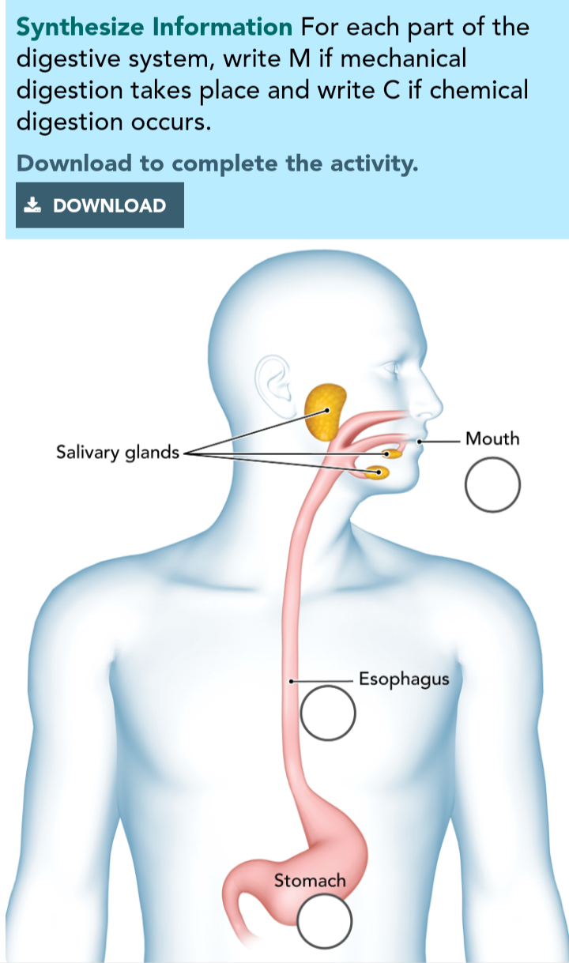

Slide 23
THE LOWER DIGESTIVE SYSTEM
By the time food leaves the stomach, it has been broken into very small parts and some of the nutrients have been released.
Most of the carbohydrates and proteins have been digested, but fats still remain as large molecules.

Slide 24
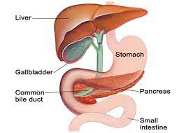
The Small Intestine, Liver, and Pancreas
The majority of chemical digestion and nutrient absorption into the blood takes place in the small intestine.
Other organs, including the liver and pancreas, secrete enzymes into the small intestine to aid with the breakdown of fats and any remaining proteins and carbohydrates.
These organs play other roles in the body, but their primary role is to help with the digestion process.

Slide 25
The liver produces an enzyme called bile.
Bile breaks down fat into small fat droplets in the small intestine.
This allows fat to be digested.
Bile is stored in another small organ called the gall bladder.
When needed, the gall bladder releases bile into the small intestine.
The liver is also responsible for filtering blood and storing certain vitamins.
The pancreas produces an enzyme called trypsin, which breaks down proteins.
The pancreas also makes insulin, a chemical involved in a system that monitors blood sugar levels.
When a person has Type 1 diabetes, the pancreas does not produce as much insulin as it should.

Slide 26
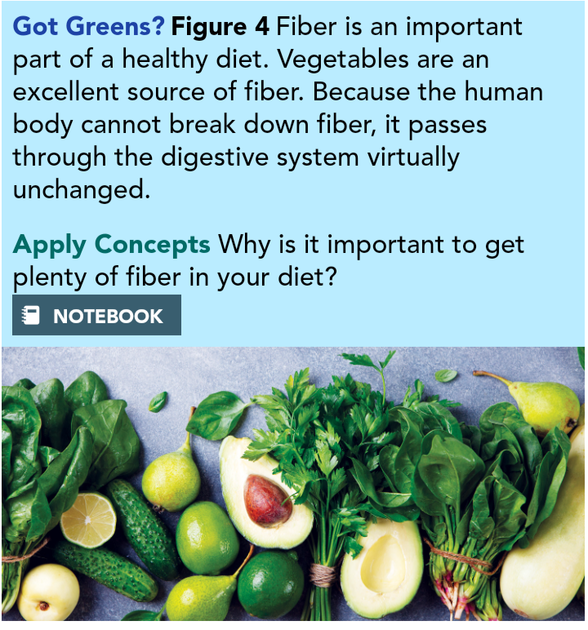

Slide 27
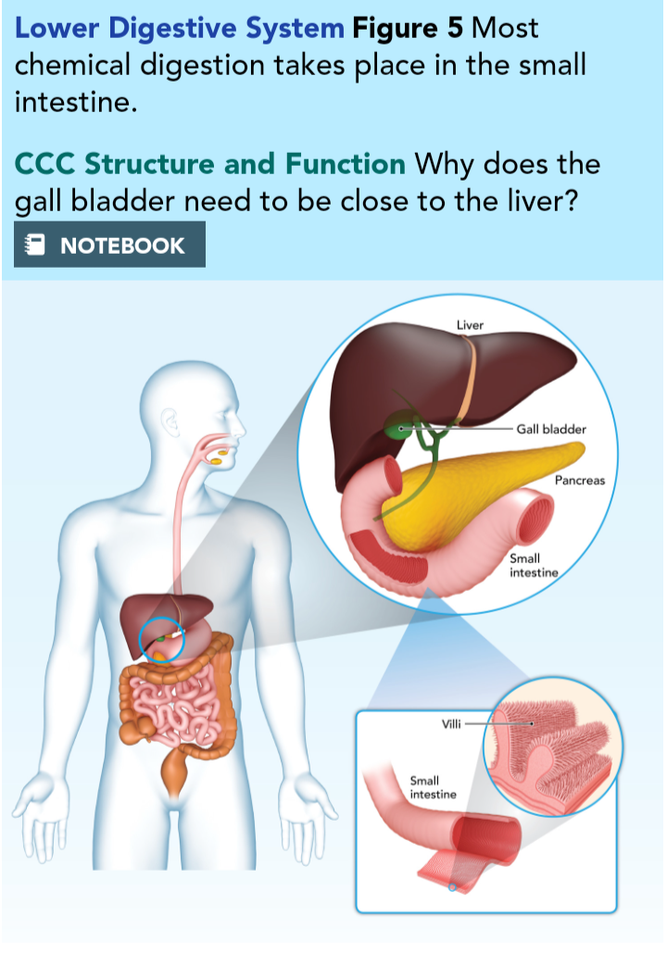

Slide 28
The Large Intestine
The last stage of digestion occurs in the large intestine.
The large intestine is actually shorter than the small intestine—1.5 m versus 6–8 m.
It is in the large intestine that water from food is reabsorbed and waste products are compacted and prepared for elimination from the body.
There are many bacteria present in the large intestine. Fortunately, most of them are not dangerous. In fact, many of them are useful.
Some of the bacteria produce vitamin K.
The last section of the large intestine is called the rectum. This is where waste collects until it is time for elimination.
The solid waste products leave the body through an opening called the anus

Slide 29
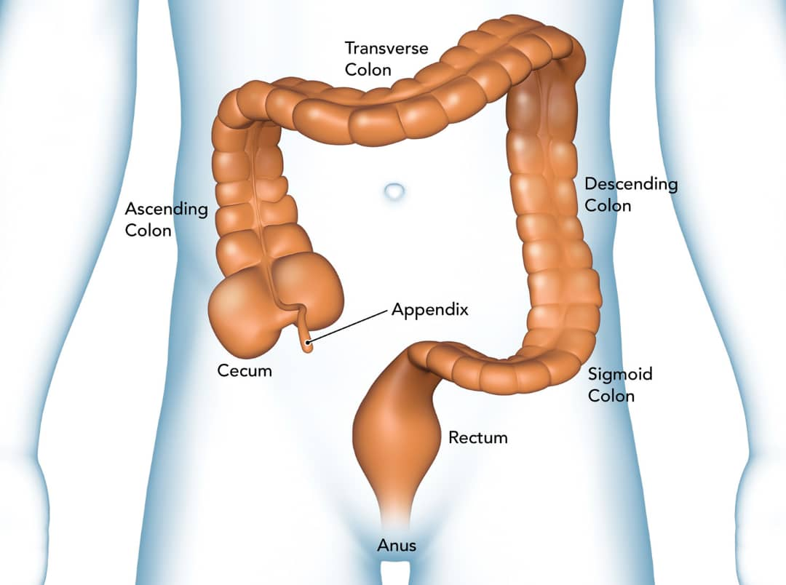

Slide 30
The Digestive System as a Whole
It is important to realize that the digestive system is related to many other systems in the human body.
For example, after nutrients are absorbed in the small intestine, they are transported around the body in the blood.
The pumping of the heart and the rest of the circulatory system make sure all of your cells get the nutrients they need

Slide 31
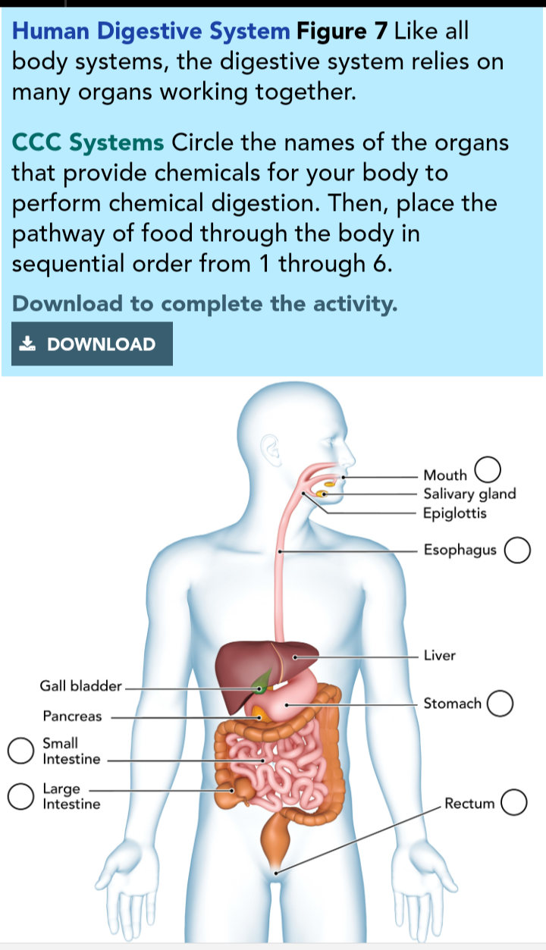

Slide 32
THANK YOU

