Slide 1
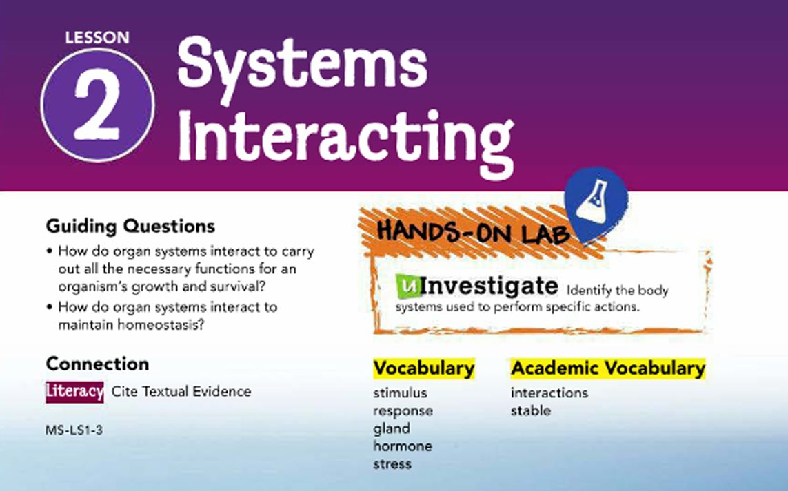

Slide 2
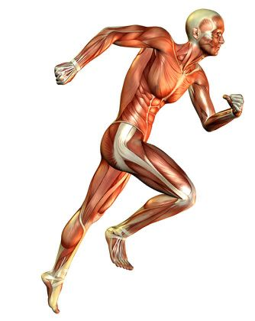
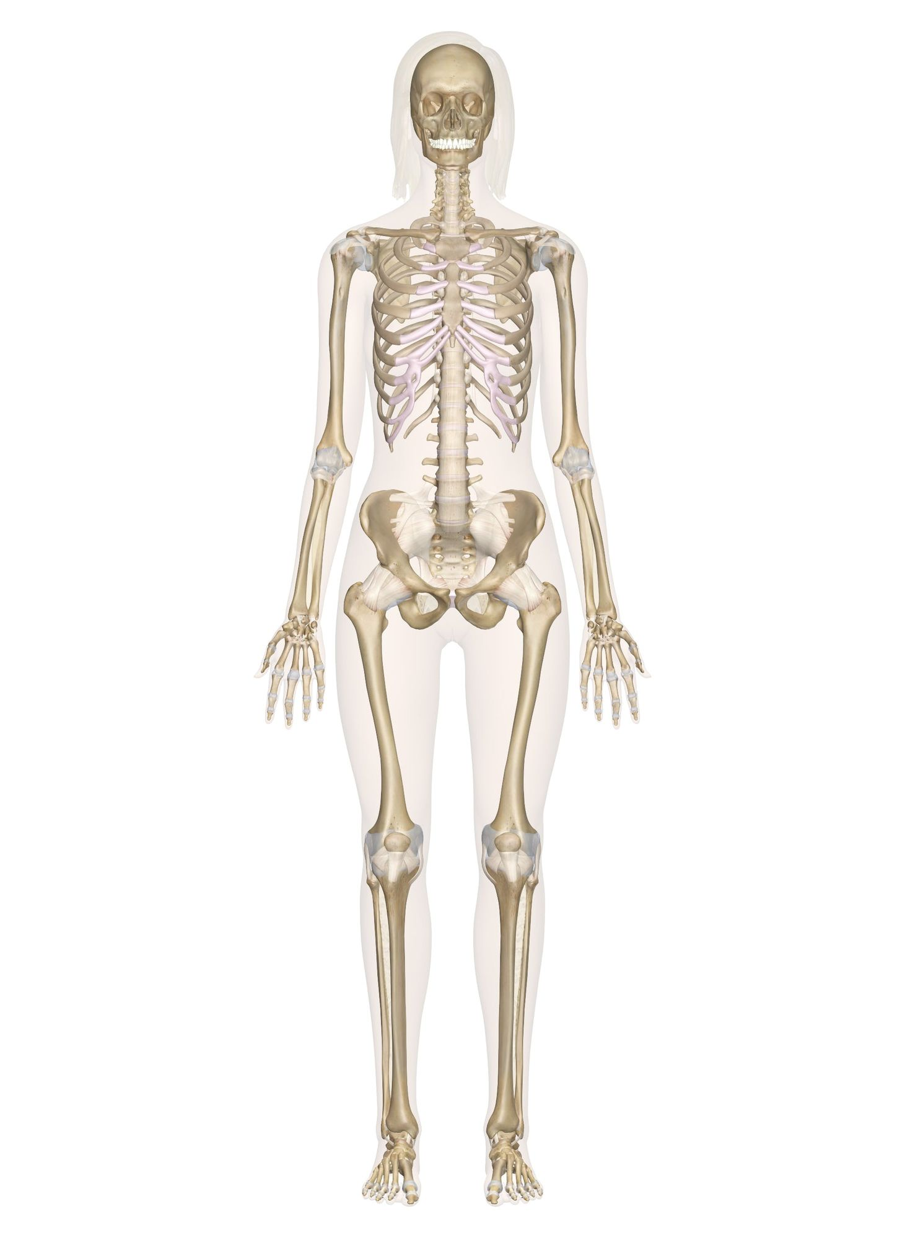
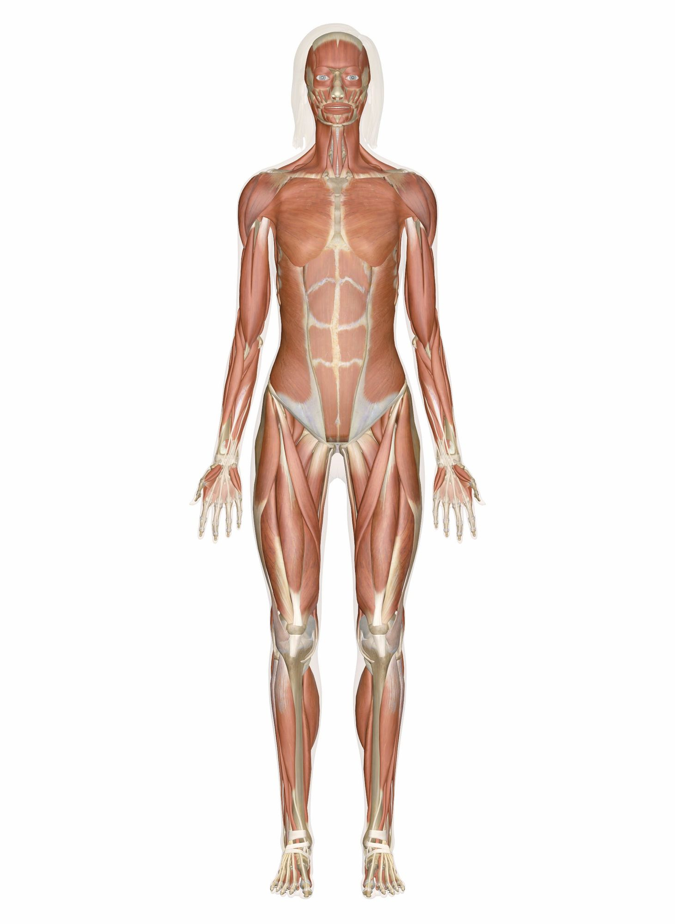
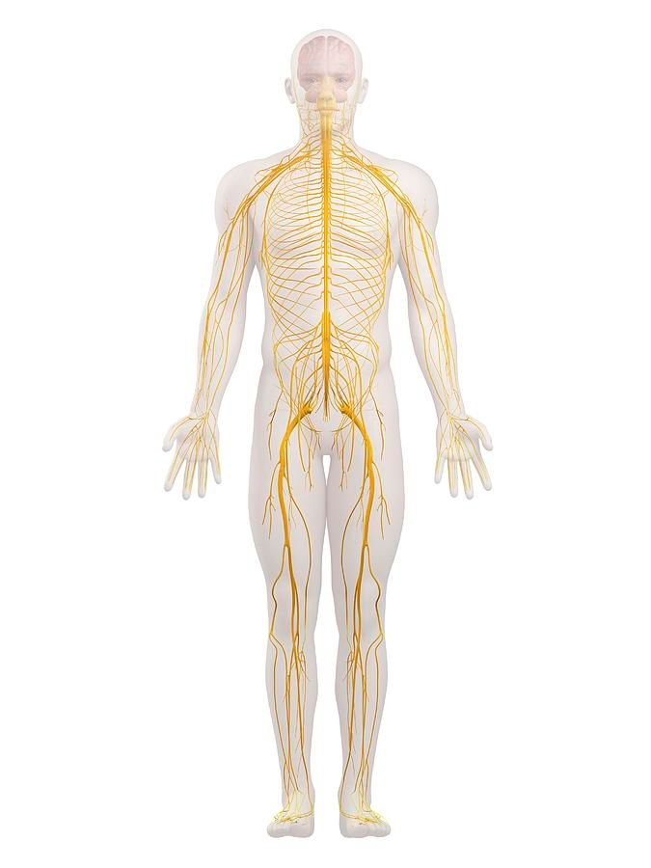
Movement
Interactions between the skeletal, muscular and nervous system make the human body move.
Skeletal muscles are attached to the bones of the skeleton and provides the force that moves bones.
MUSCULAR SYSTEM
SKELETAL SYSTEM
NERVOUS SYSTEM

Slide 3



Slide 4
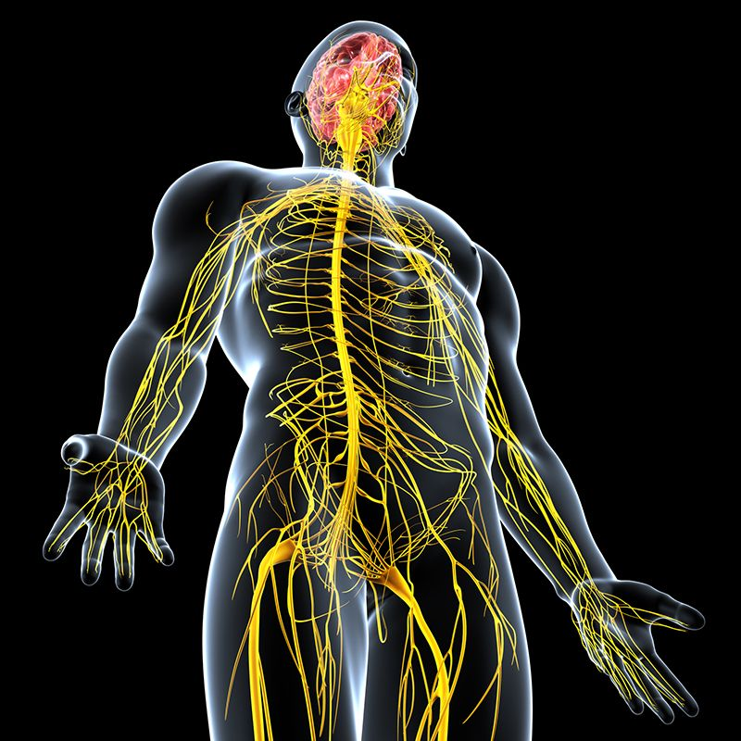
Controlling Body Functions
Electric signals from nerves
The nervous system has
2 ways of controlling body functions.
Electric signals from the nerves.
Chemical signals from the endocrine system.

Slide 5
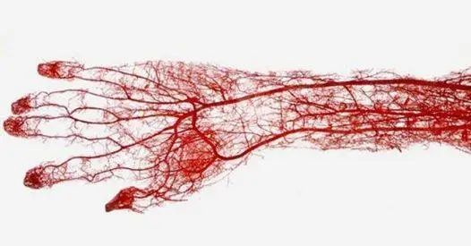
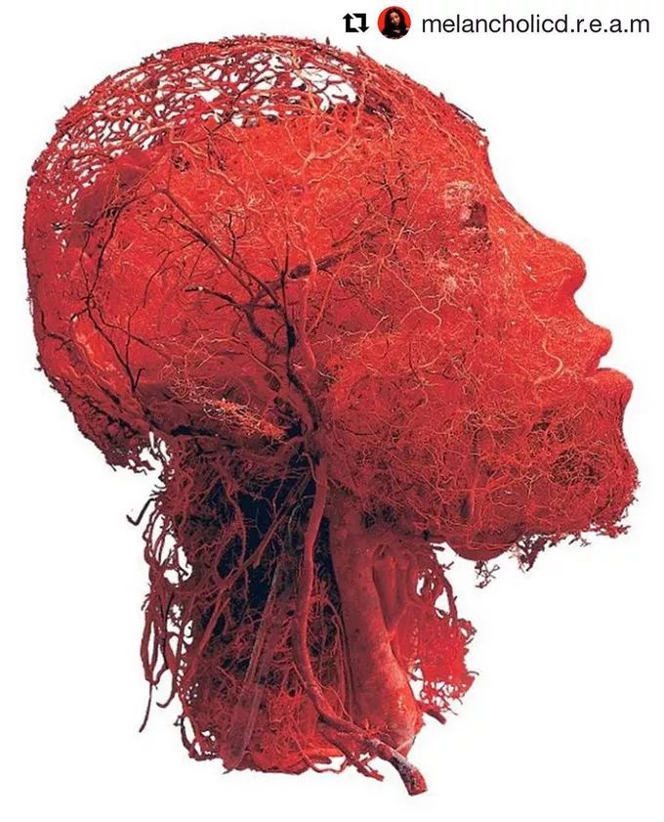
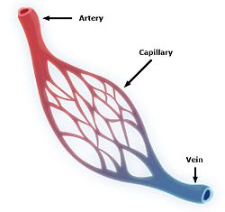
Transporting Materials
All the cells need oxygen and nutrients and need to get rid of carbon dioxide and other wastes.
Blood vessels from the circulatory system carry nutrients to and wastes from the body.
Blood vessels divide into smaller and smaller branches until the tiniest called capillaries, are only as wide as one blood cell.
They pass near every cell in the body.
Blood picks up oxygen from the lungs and food molecules from the intestines and deliver them to the needy cells.
At the same time blood collects carbon dioxide from the cells and and return it to the lungs and also collects waste products from the cells which are filtered from the blood by kidneys in the excretory system and passed out from the body as urine.
Blood vessels in human head

Slide 6
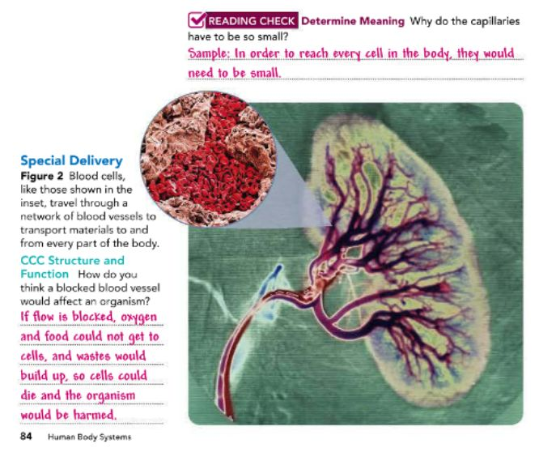

Slide 7
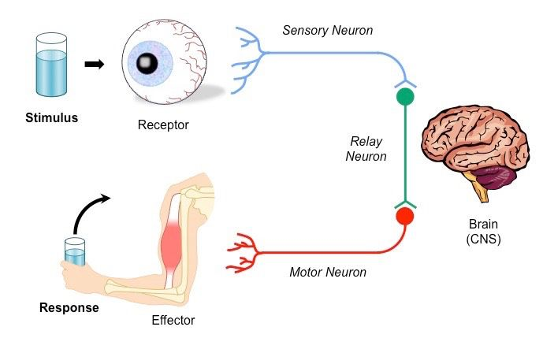
Stimulus and Response
Any change or signal in the environment that make an organism react in some way is called stimulus.
An action or change in behavior that occurs as a result of a stimulus is called response.

Slide 8
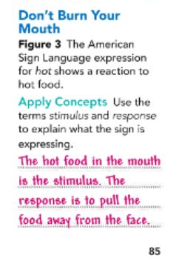
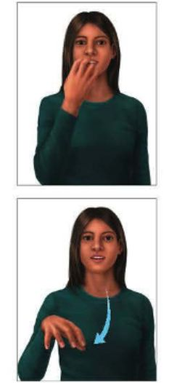

Slide 9
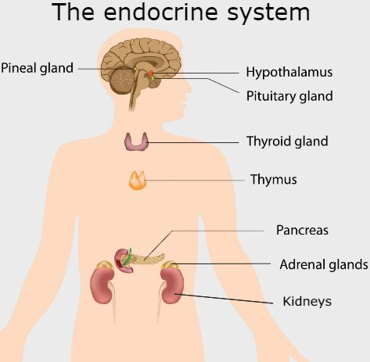
Hormonal Control
The endocrine system uses chemical signals instead of nerves to control body functions.
The endocrine system is made up of many glands, organs that produce and release chemicals either through tiny tubes called ducts or directly into the bloodstream.
The chemical produced by an endocrine gland is called a hormone.
Hormones are carried through your body by the circulatory system. These chemicals affect many body processes.
One hormone interacts with the excretory system and the circulatory system to control the amount of water in the bloodstream.
Another hormone interacts with the digestive system and the circulatory system to control the amount of sugar in the bloodstream.

Slide 10
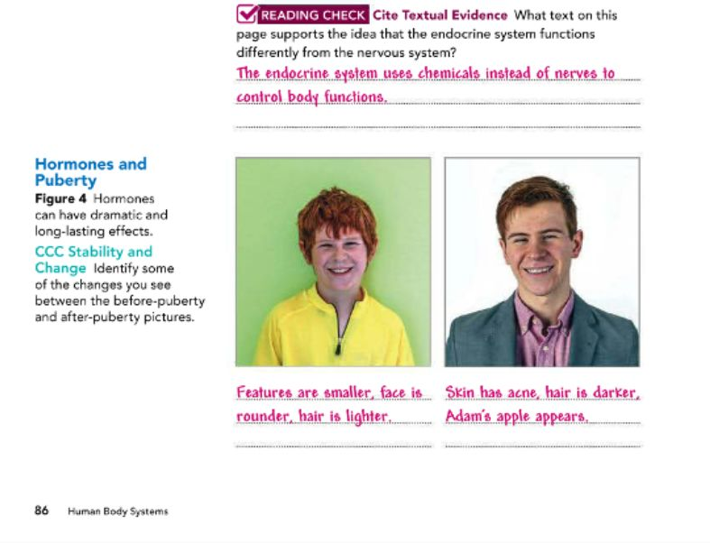

Slide 11
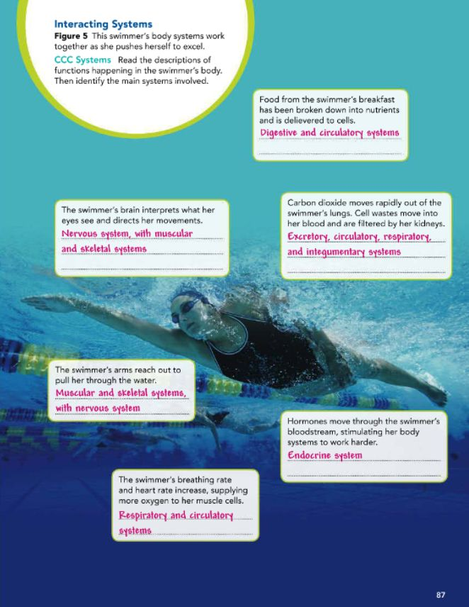

Slide 12
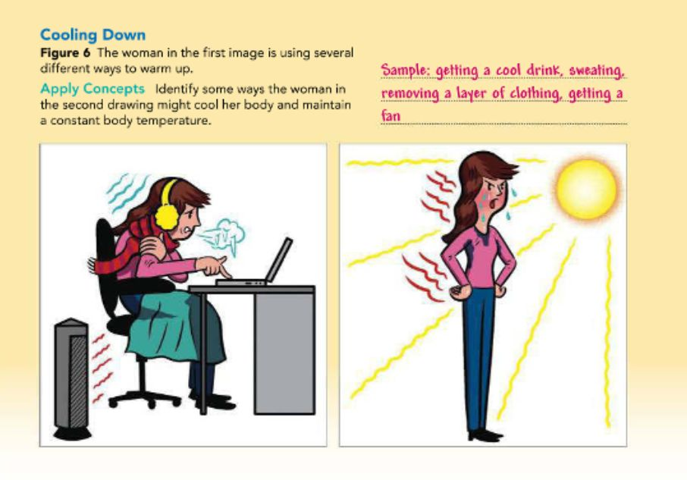
Pg.88

Slide 13
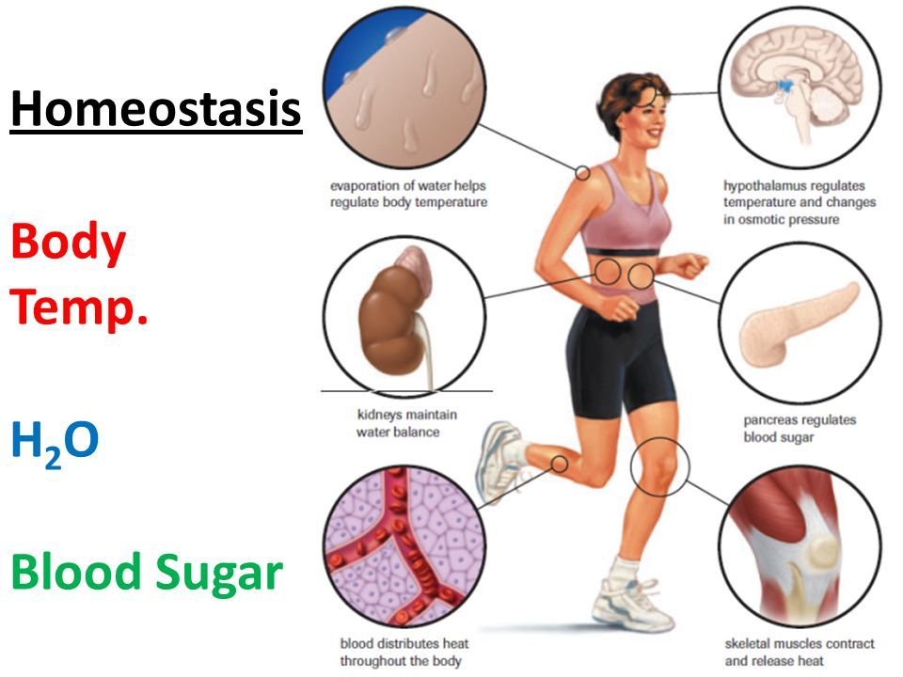
Homeostasis
Your body only functions well around 37°C.
Whether the weather is below freezing or roasting hot, your body's temperature must stay stable and remain close to 37°C.
Homeostasis is the condition in which an organism's internal environment is kept stable in spite of changes in the outside environment.

Slide 14
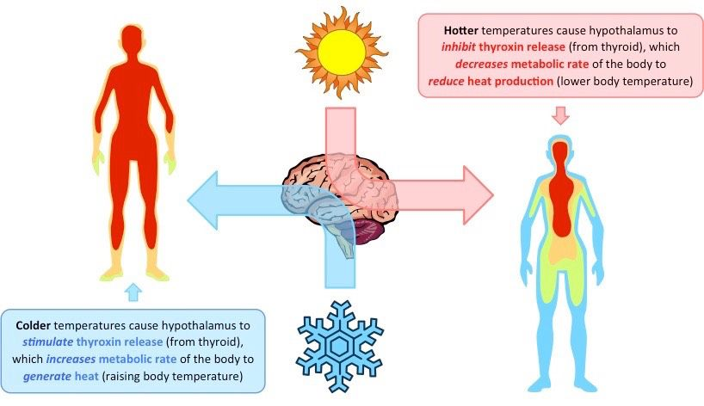
Regulating Temperature
When your body temperature starts to fall too low, your nervous system sends out signals to your other systems to take action to warm you up.
Your skin, which is part of the integumentary system, develops goosebumps. Your muscles cause you to shiver. You tend to move your large muscles to generate heat.
All of these actions help to raise your temperature back to normal.

Slide 15
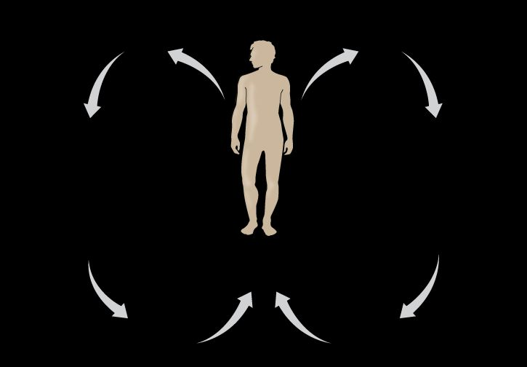

Slide 16
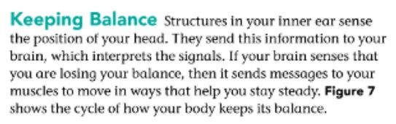
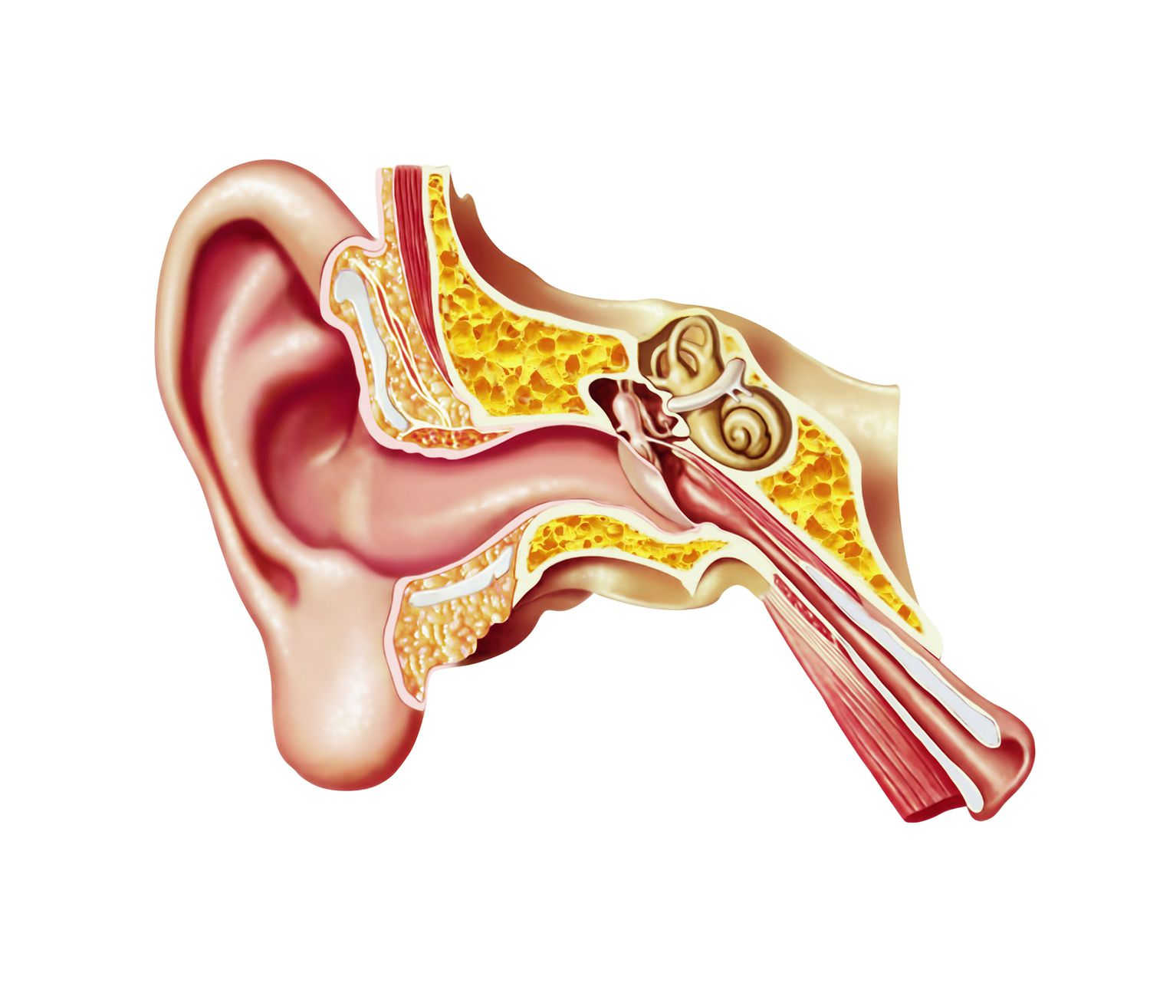
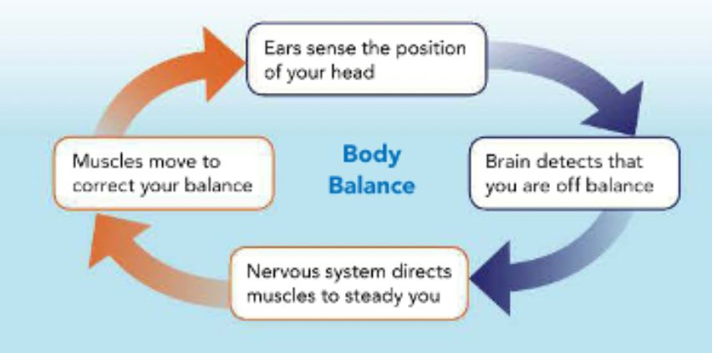
Keeping body balance

Slide 17
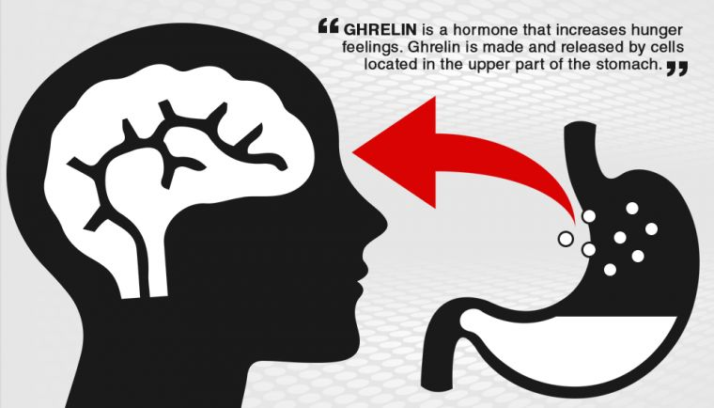
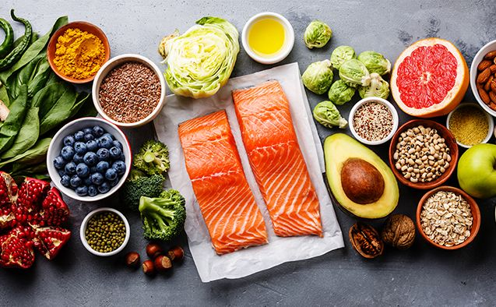
Meeting Energy Needs of the Body
When the cells in your body need more energy, hormones from the endocrine system signal the nervous system to make you feel hungry.
After you eat, other hormones signal your brain to make you feel full.

Slide 18
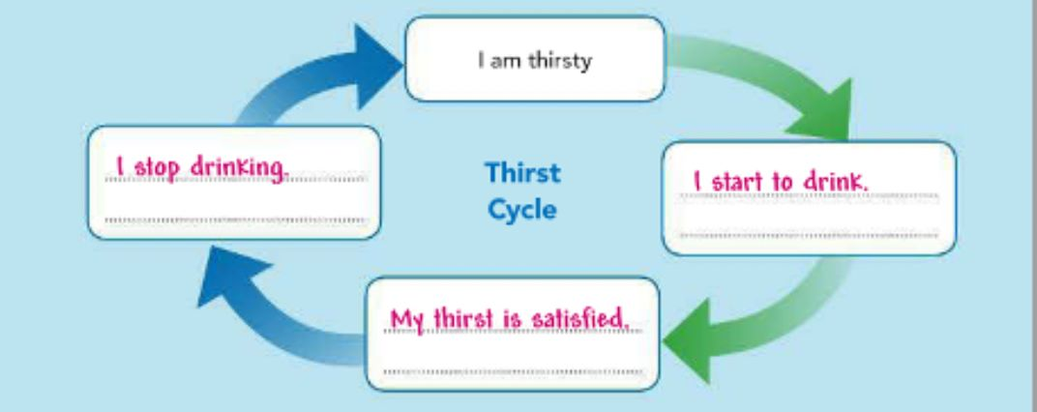
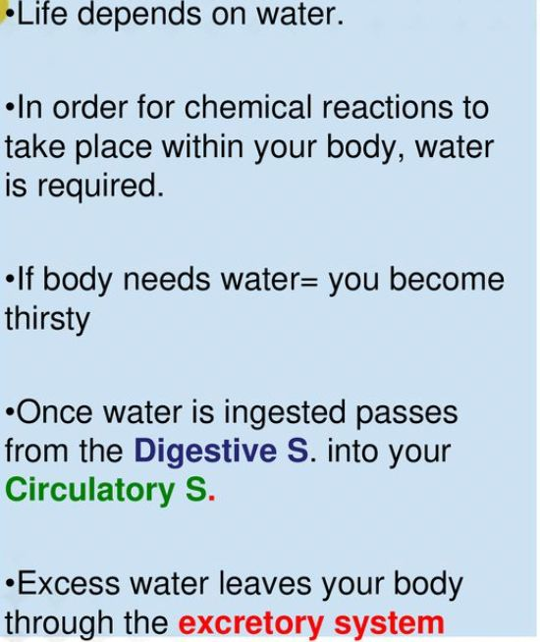

Maintaining Water Balance in the Body

Slide 19
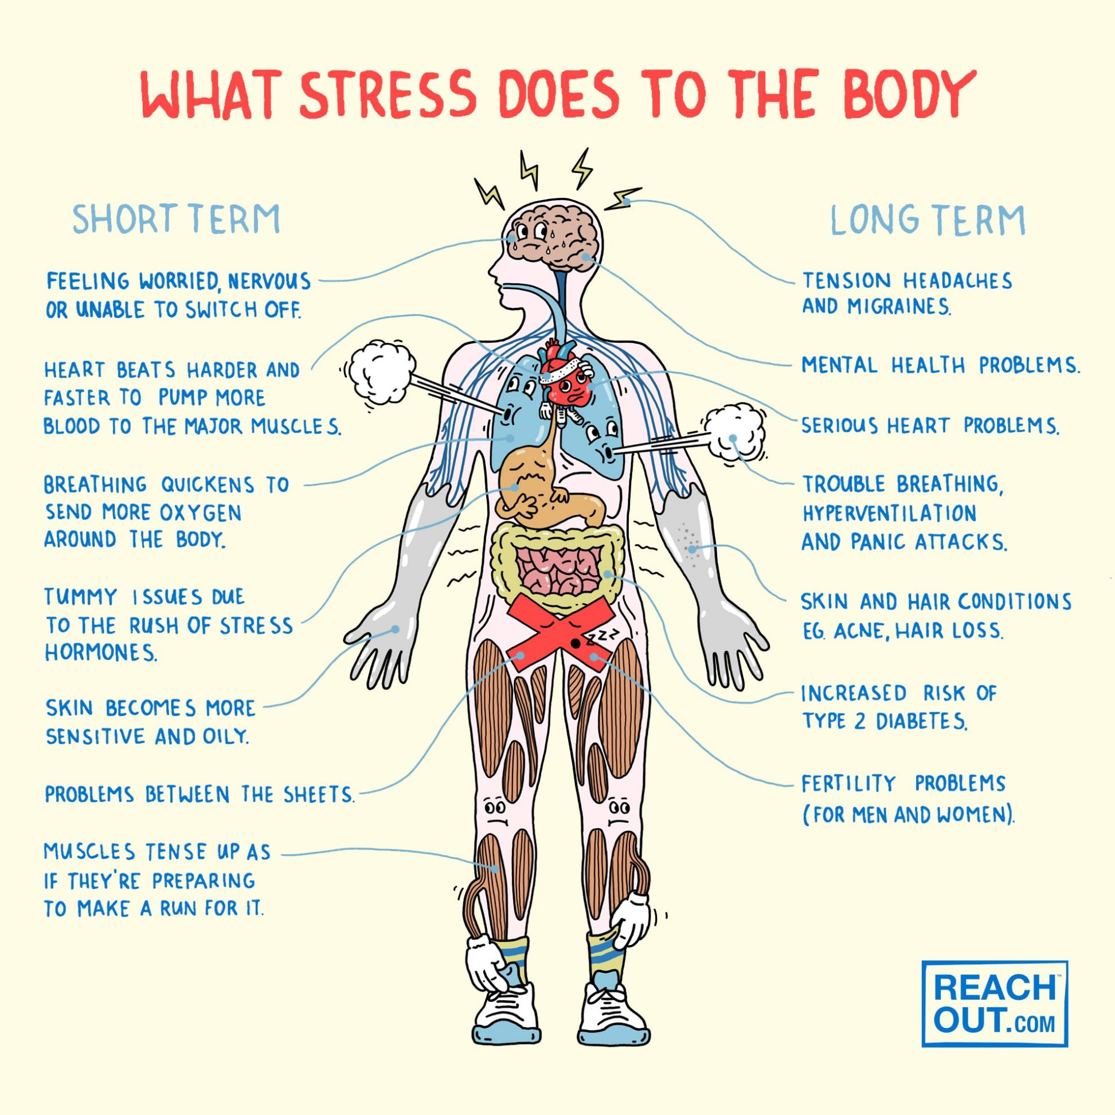
Managing Stress
Managing Stress In general, stress is the reaction of a person's body to potentially threatening, challenging, or disturbing events. Each person experiences stress differently.
Some stress is unavoidable. If stress is over quickly, then the body returns to its normal, healthy condition.
However, too much stress for too long a time can be unhealthy. Ongoing stress can disrupt homeostasis and weaken your body's ability to fight disease.
Stress also can cause depression, headaches, digestion problems, heart problems, and other health issues. Finding ways to reduce and relieve stress is an important part of a healthy lifestyle.

Slide 20
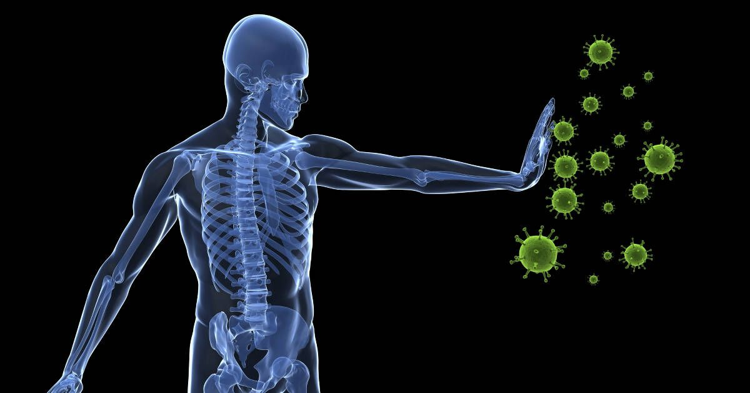
Fighting Disease
When your body systems are in balance, you are healthy. Germs that cause disease can disrupt homeostasis and make you sick.
The immune system includes specialized cells, that attack and destroy germs, such as viruses and bacteria.
When you are sick, these cells temporarily increase in number.
Fighting infection sometimes causes your body temperature to go up.
As you get well, your fever goes away and your energy comes back.

Slide 21
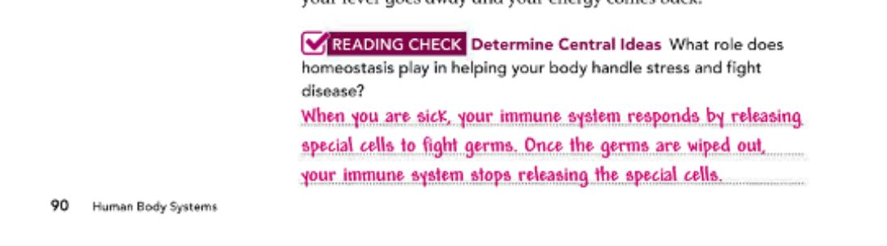

Slide 22
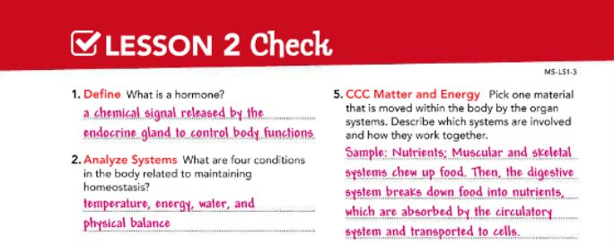

Slide 23
