Slide 1
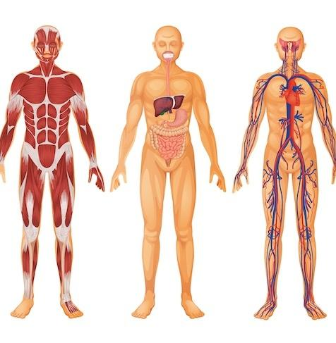
Body Organization

Slide 2
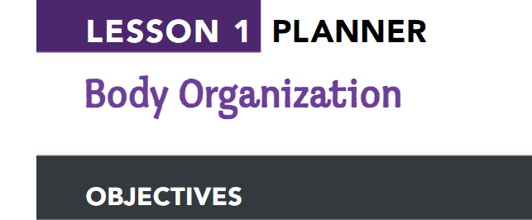
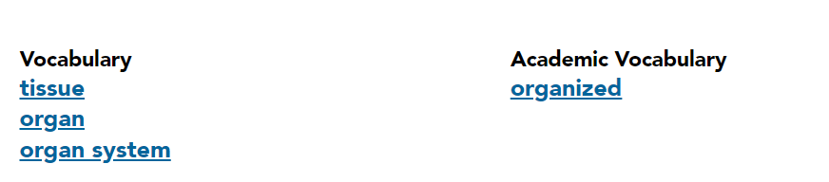
Students will use textual evidence to
• list the levels of organization in the body.
• describe the organization of body systems.
• describe the function of cells, tissue, organs, and body systems.

Slide 3
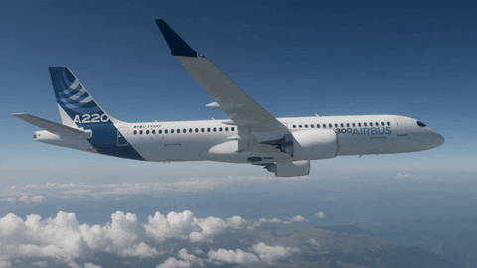
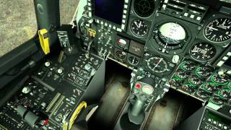
Organization of the Body
The pilot and the co-pilot must be skilled at operating the instrument panels. They have to be able to steer the plane safely through all sorts of conditions.
all of its systems must be in good working order. The plane's steering system, brake system, lights, tires, and jet engines are all vital to a safe flight.

Slide 4
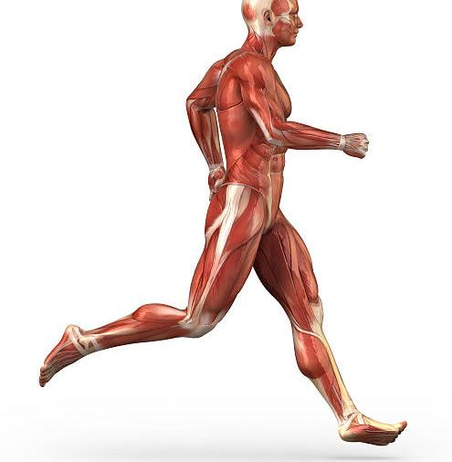
How is the human body organized?
Our body is organized into systems that work together.
When you walk up the stairs or ride a bike, your nervous, skeletal, and muscular systems are working together to move your body.
your digestive and circulatory systems work together to help the cells in your body get the energy they need to function
Each system is made up of smaller parts, with the smallest being the cells that form the basic units of every living thing.

Slide 5
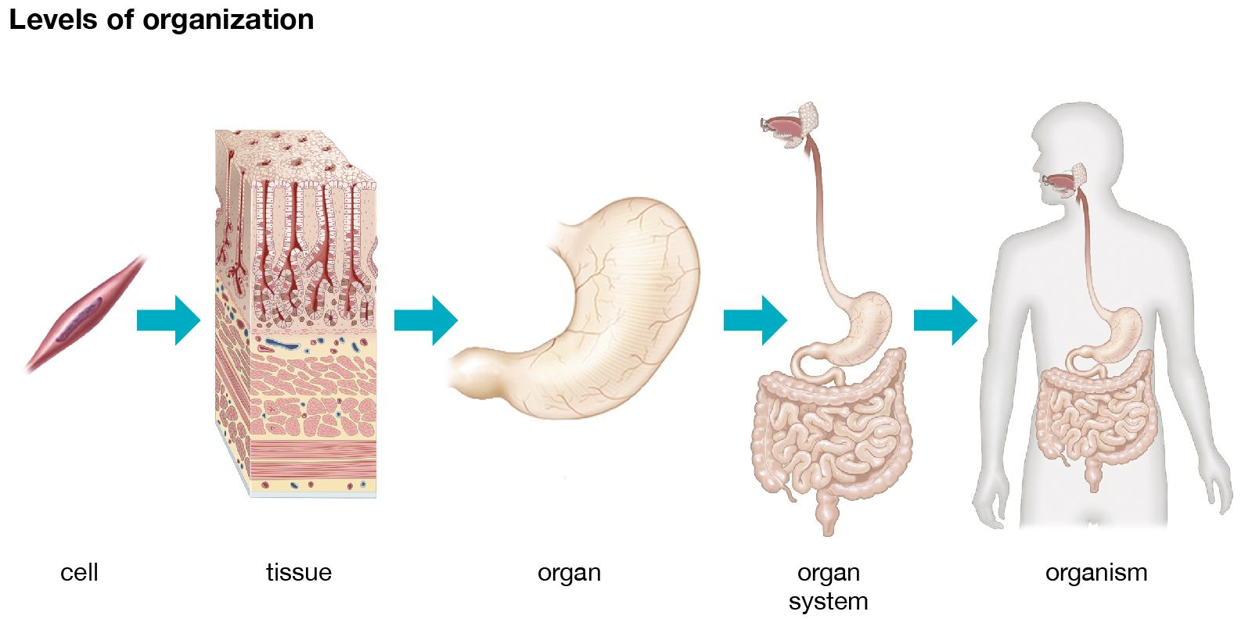
How is the human body organized?
The human body is organized at different levels, starting with the cell . Cells are organized into tissues, and tissues form organs. Organs are organized into organ systems such as the skeletal and muscular systems.

Slide 6
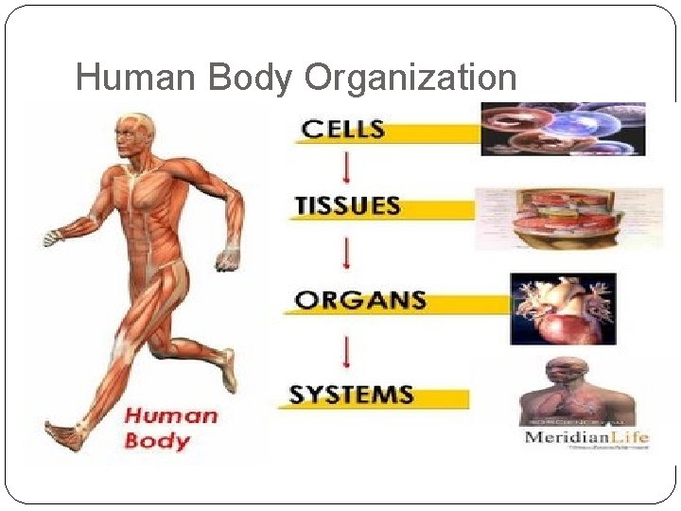
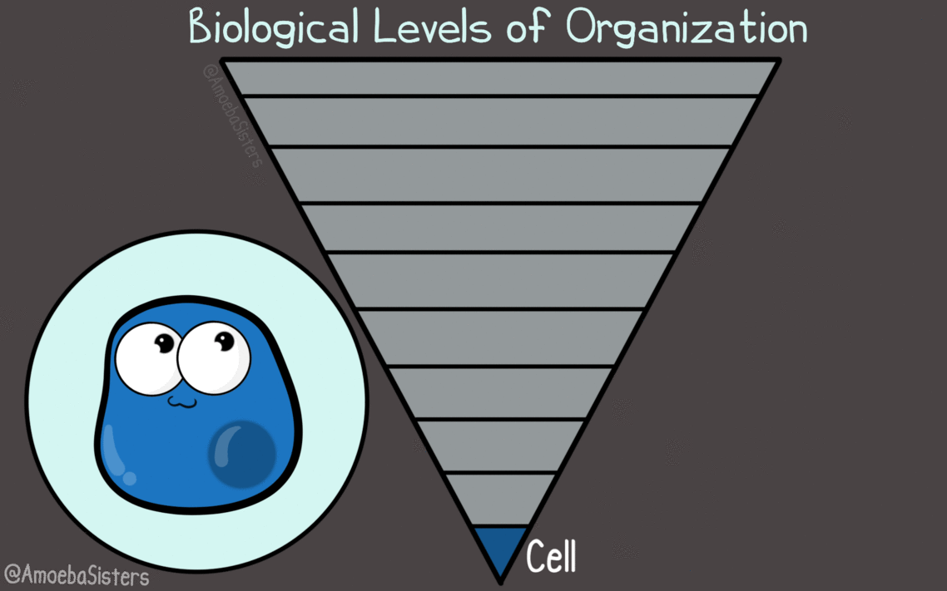
What are the levels of organization?
Cells
Tissues
Organs
Organ system

Slide 7
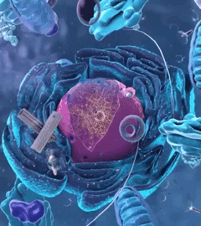
Cell

Slide 8
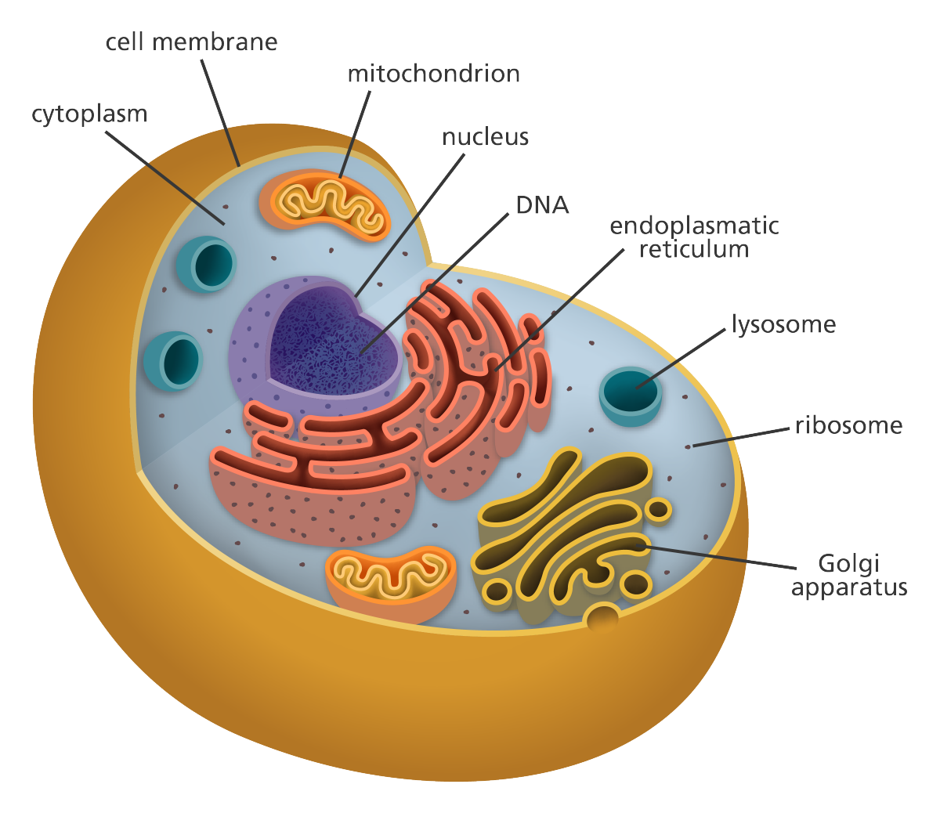
Cells
Cells are the basic building blocks of all living things.
The human body is composed of trillions of cells.
They provide structure for the body, take in nutrients from food, convert those nutrients into energy, and carry out specialized functions.
Cells have many parts, each with a different function.
You are alive because specialized cells are performing their functions throughout your body.

Slide 9
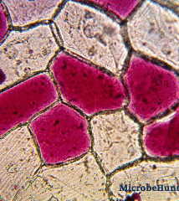
Tissue

Slide 10
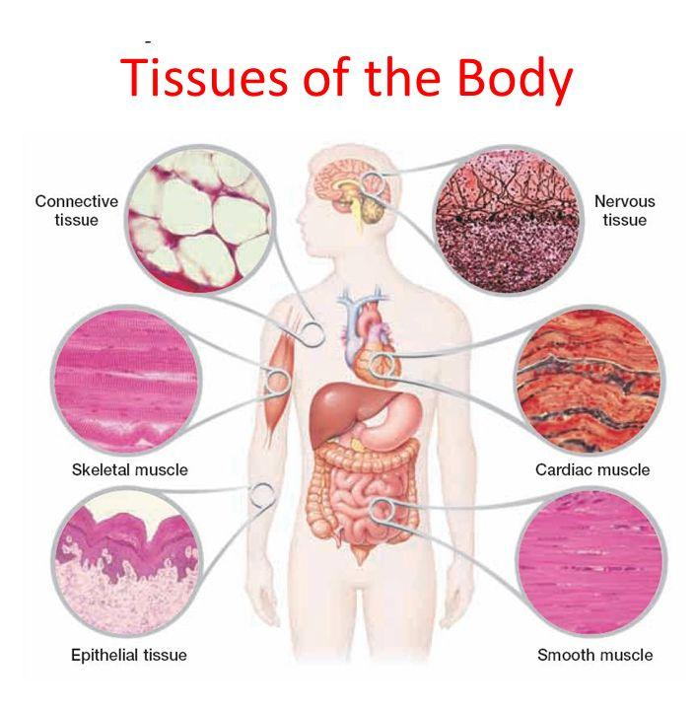
Tissue
Tissue is a group of cells that have similar structure and that function together as a unit.
There are 4 basic types of tissue
Connective tissue
Epithelial tissue
Muscle tissue
Nervous tissue.

Slide 11
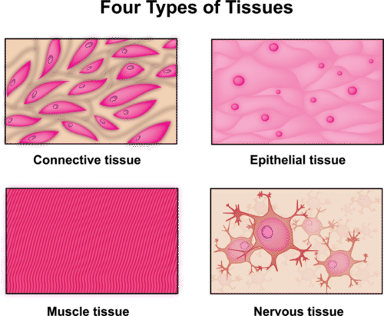
Types of tissue
Muscle tissue contracts, or shortens, to make parts of your body move.
Connective tissue such as bone and fat, provides support for your body and attaches all of its parts together.(bone, blood, and lymph tissues).
Nerve tissue- it is made up of nerve cells (neurons) and is used to carry "messages" to and from various parts of the body.
Epithelial tissue- present in the skin that protects your insides from damage. It covers the inner and outer surfaces of your body.

Slide 12
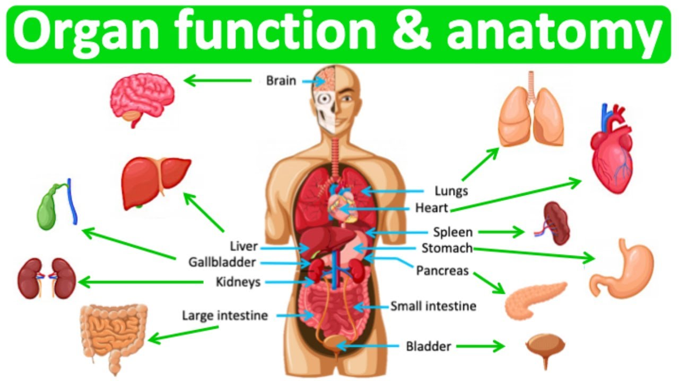
Organ &Organ System

Slide 13
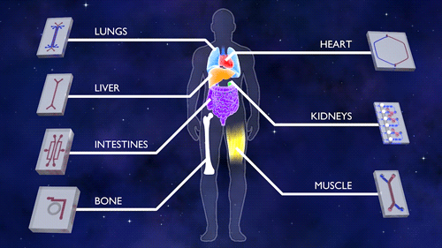
Organ
An organ is a body structure composed of different kinds of tissues that work together.
Each organ has a specific function in the body. Because Its structure is more complex.
the job of an organ is usually more complex than that of a tissue.

Slide 14
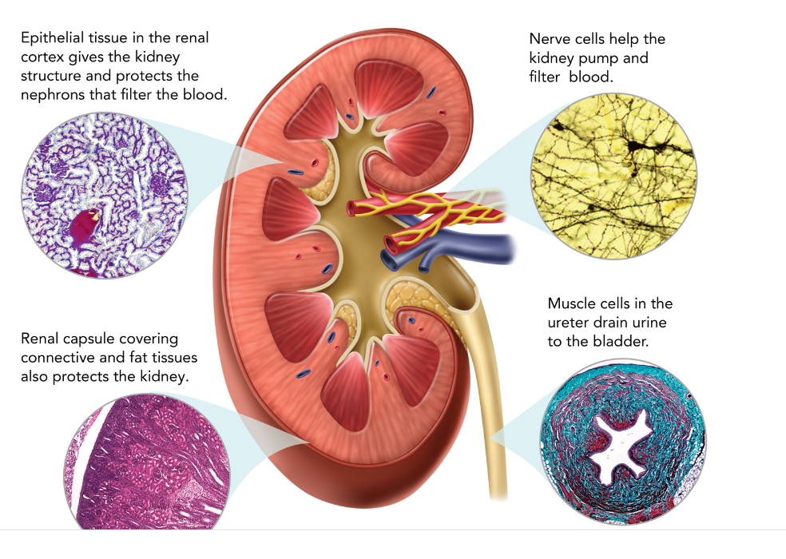
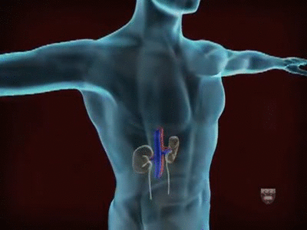
Kidney
kidneys remove waste from your blood and form urine.
Each kidney contains muscle, connective. and epithelial tissues, and nervous tissue connects to the kidney and helps to control its function.
Each tissue contributes in a different way to the kidney’s job of filtering blood.
your kidneys are part of your excretory system. The excretory system also includes the skin, lungs, and liver.

Slide 15
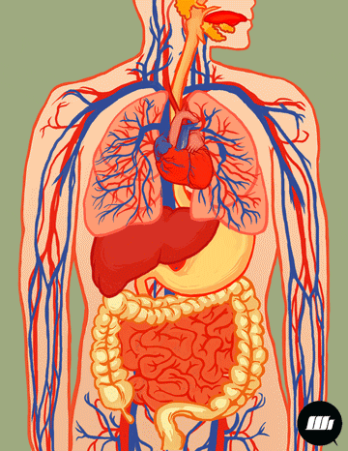
Human organ System
Every organ is part Of an organ system.
a group Of organs that work together, performing major functions.
11 organ system keep the human body running smoothly.
All of the systems work together to support proper functioning.

Slide 16
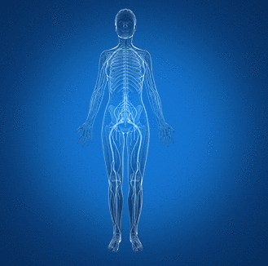
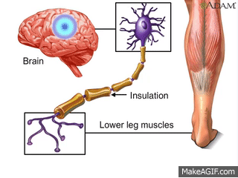
Control Systems
1- Nervous system
Your body communicates using the nervous system.
It is made of brain, spinal cord, and nerves.
It sends information through nerve cells (neurons) to control your actions.

Slide 17
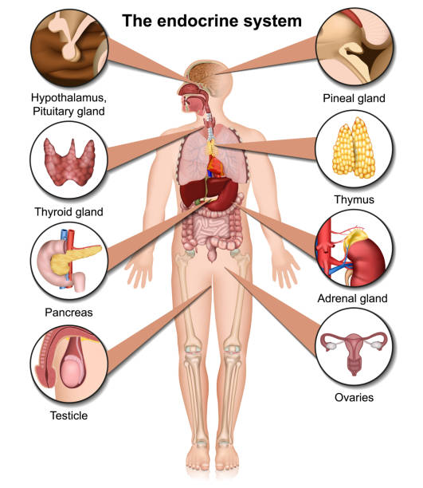
Control Systems
2- Endocrine system
a collection of glands that produce important chemicals that affect your energy level, body temperature, digestion and even your moods.

Slide 18
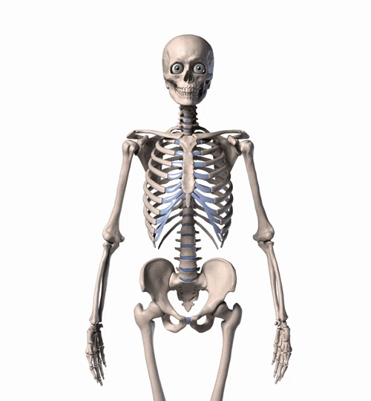
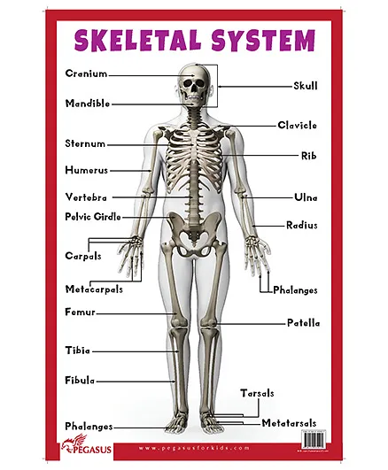
Structural Systems
3-Skeletal system
system includes your bones and connective tissue.
The main functions of the skeletal system is to support your body, protect your organs, make blood cells, and store minerals.

Slide 19
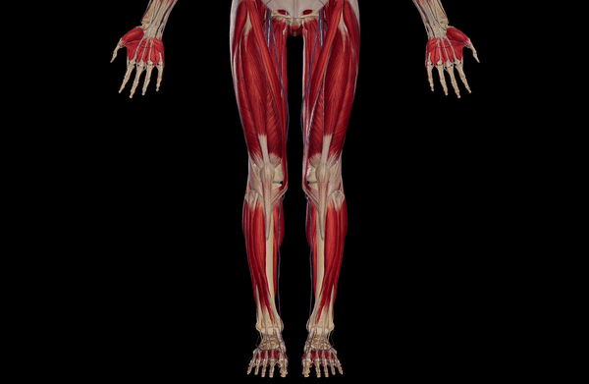
Structural Systems
4-Muscular system
It includes 650 muscles that control your movements.
It keeps the blood and food moving through your body.

Slide 20
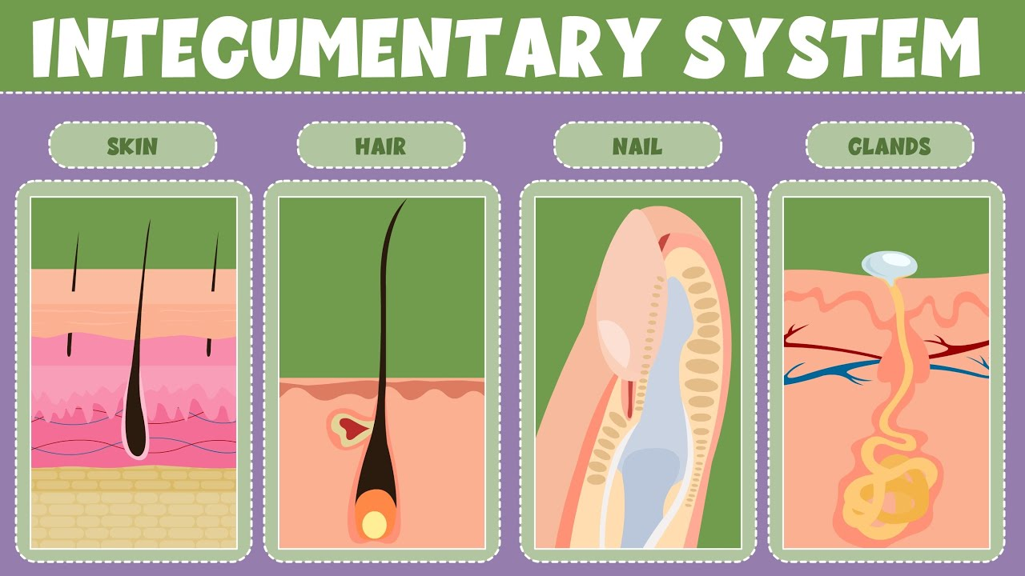
Structural Systems
5-Integumentary system
protects your body from outside damage.
Skin, hair and nails are all part of the integumentary system.

Slide 21
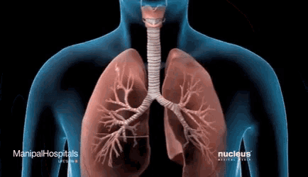
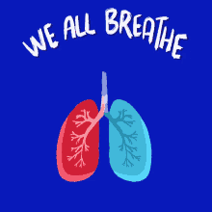
Oxygen and transport systems
6-Respiratory system
brings in oxygen and moves out carbon dioxide by the way of lungs.

Slide 22
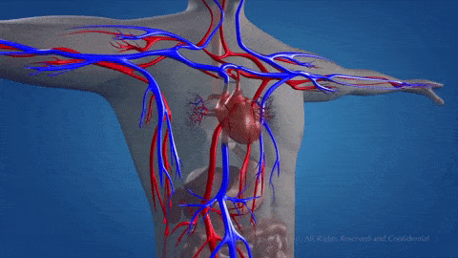
Oxygen and transport systems
7-Circulatory system
carries oxygen-rich blood to all parts of your body.
It also transports nutrients, wastes, disease-fighting cells all over your body through your blood stream.

Slide 23
Food and waste processing systems
8-Digestive system
can be thought of as a tube that runs through our body starting from the esophagus where the food is squeezed down to the stomach.
in the stomach the food is broken down by acids. Next it travels through the intestines where the useful substances pass through the intestinal walls into the blood.

Slide 24
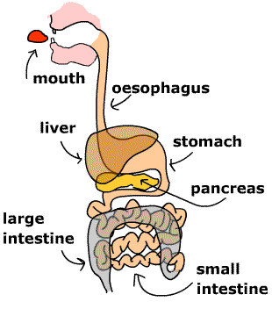
Food and waste processing systems
8-Digestive system
The liver, pancreas and the intestines produce substances that help break down food.
Some parts of the food that cannot be digested pass out of your body as waste.
The food enters and exits your body without ever entering the tissues in your body.

Slide 25
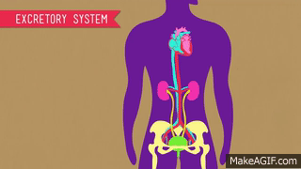
Food and waste processing systems
9-Excretory system
consists of kidneys, sweat glands, lungs and liver that gets rid of the waste products and toxic substances in your body

Slide 26
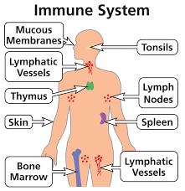
Defense System
10-Immune system
-is your defense system against infections.
-Lymph nodes and lymph vessels trap bacteria and viruses.
-"Swollen glands" are lymph nodes that have grown larger to tight off an infection.
-White blood cells produced inside your bones also attack and destroy bacteria and other causes of disease.

Slide 27
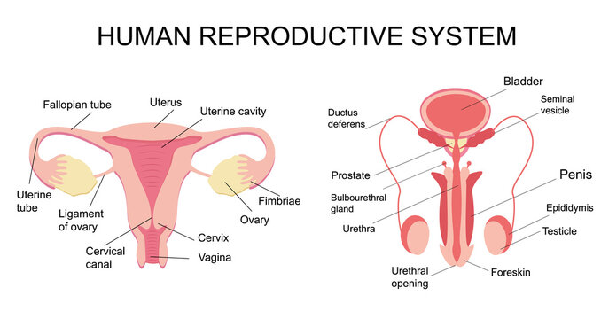
11-Reproductive system
The reproductive system is responsible in producing sperm (in male), egg (in female).
(in female) nurturing the fetus until birth.

Slide 28
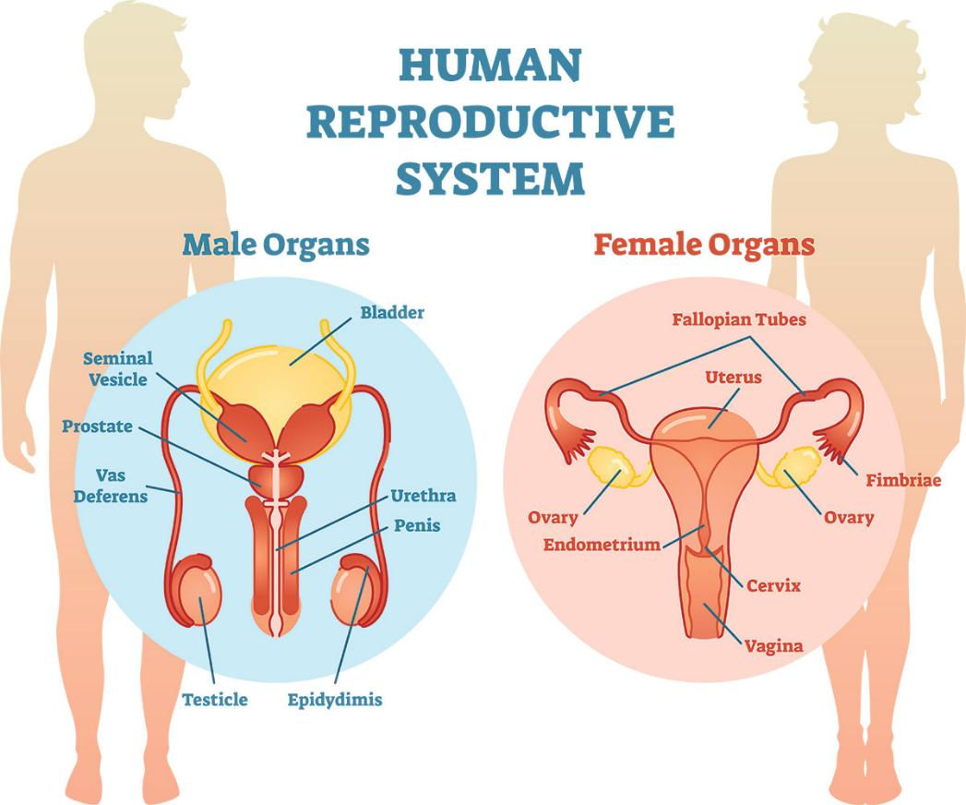
11-Reproductive system
Male reproductive organs include the testes (also known as testicles) and penis.
Female reproductive organs include ovaries, uterus and vagina.
It takes a whole organ system to produce a human.

Slide 29
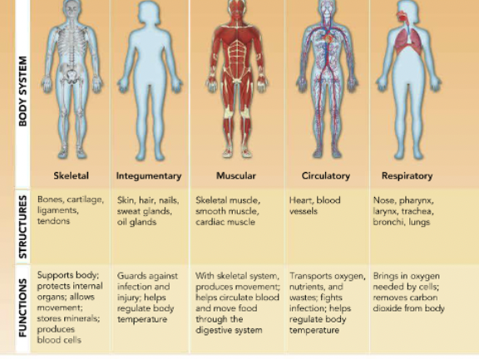
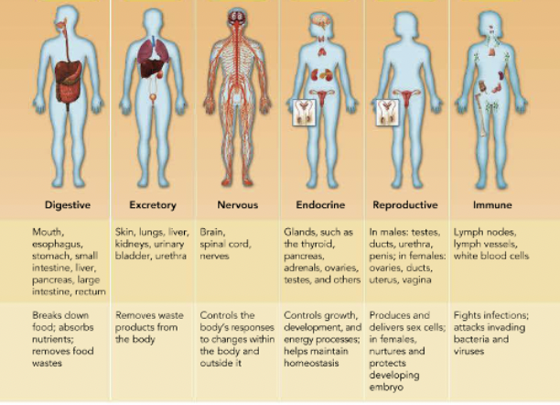

Slide 30
READING CHECK
Summarize Text What type Of cells work together to make a tissue?
Similar cells that perform the same function work together to make a tissue

Slide 31
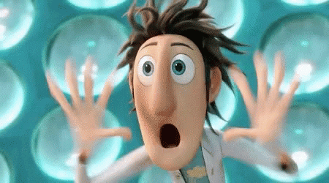
READING CHECK
Support Author's Claim How is the human body similar to an airplane?
Both are organized systems require control & must work together.

Slide 32
READING CHECK
Identify an example of how multiple body systems work together to perform a specific function.
To enable us to breathe the circulatory & muscular systems need to together

