Slide 1
Topic 1:
Lesson 6:
Cellular respiration

Slide 2
Objectives
01/10/2023
Students will be able to:
Define cellular respiration
Understand how organisms use cellular respiration to break down food to provide energy?
Explain how cells can release energy without using oxygen
Realize that living systems follow the Laws of Conservation of Mass and Energy

Slide 3
Important terms used
Cellular respiration: It is the process in which oxygen and glucose undergo a complex series of chemical reactions inside cells, releasing energy.
Photosynthesis: The process by which plants make their food by using carbon dioxide and water releasing glucose and oxygen.
Fermentation: The release of energy from food without using oxygen is called fermentation.
- Alcoholic fermentation: The fermentation in which the end product is an alcohol, carbon dioxide and a little energy.
- Lactic acid fermentation: The fermentation in which the end product is lactic acid.
Law of conservation of mass: In a chemical reaction, matter is neither created nor destroyed.

Slide 4
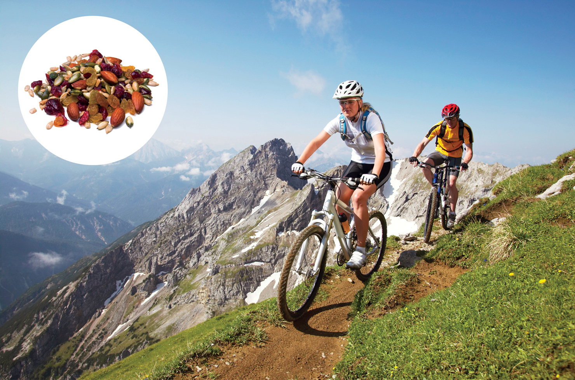

Food for Energy
Figure 1 Biking takes a lot of energy! Your body uses cellular respiration to get energy from the food you eat, such as trail mix.

Slide 5
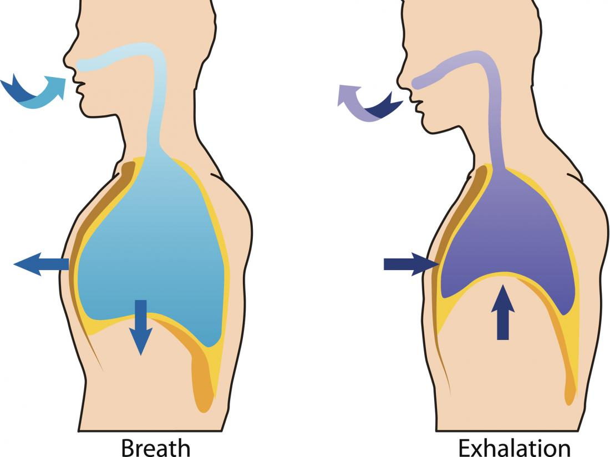
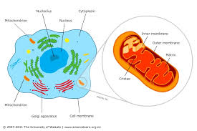
Difference between breathing & respiration
Breathing:
The physical movement of air in and out of your lungs.
Breathing brings oxygen into your lungs.
Respiration:
Cells use oxygen in cellular respiration to break down energy-rich compounds and release energy.

Slide 6
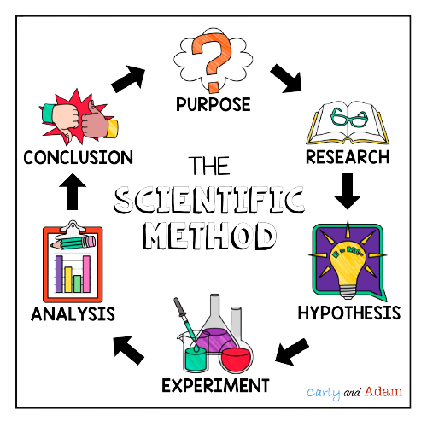
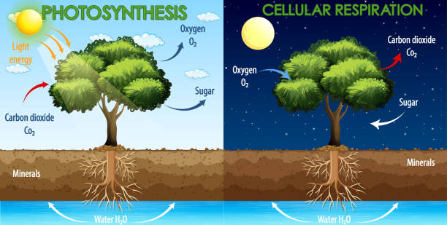

Scientific Method
Do plants need cellular respiration like animals and humans?
1- Yes, plants like animals and humans need cellular respiration
2- No, plants only need photosynthesis
Hence, plants also needs to release the energy that has been gained from photosynthesis and in turn helps it to grow!
1- Yes, plants also needs energy to grow
2- No, if plant does only photosynthesis then it is only eating, how will it use it’s energy!
Notes:
The food is ready in plant cells but how to consume it to take the energy? By respiration Same as human glucose is ready in cells but how to consume it ? By respiration

Slide 7
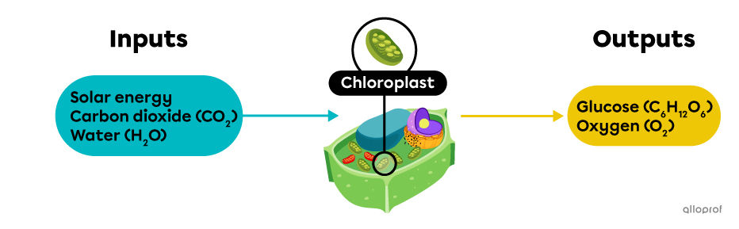
Photosynthesis
Making and Obtaining Food
Plants make their own food through the process of photosynthesis.
Autotrophs, or producers: are able to create their own food in the form of glucose, an energy-giving sugar.
EX: Plants and algae and some bacteria.
Heterotroph, or consumer :
An organism that cannot make its own food.
such as the sea urchin or otter.

Slide 8
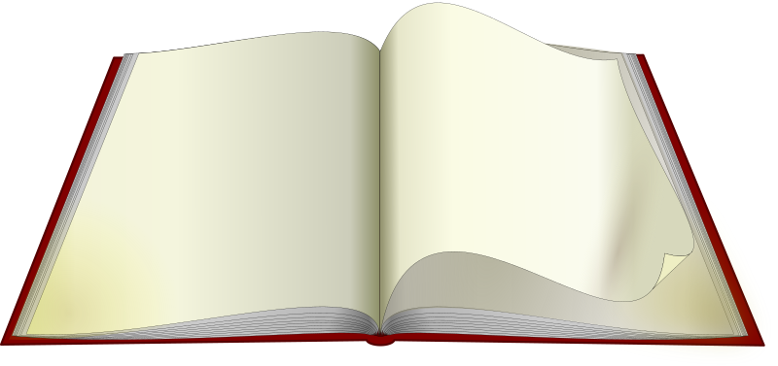
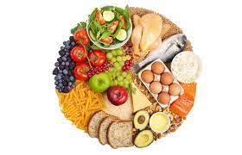
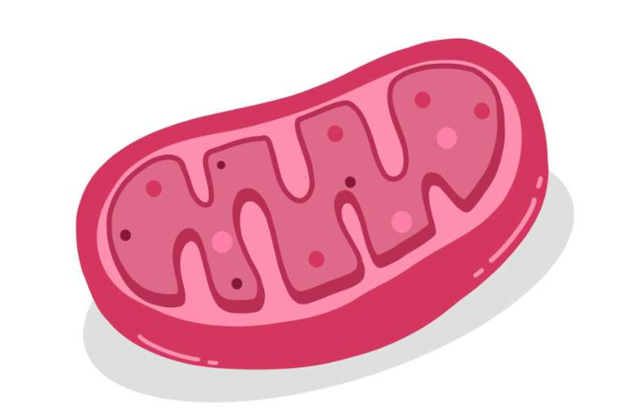

Energy and Cellular respiration
Open pg. 51 to highlight
Cellular respiration
It is the process in which oxygen and glucose undergo a complex series of chemical reactions inside cells, releasing energy.
All living things need energy. Therefore, all living things carry out cellular respiration.

Slide 9
Difference between breathing & respiration
Breathing:
The physical movement of air in and out of your lungs.
Breathing brings oxygen into your lungs.
Respiration:
Cells use oxygen in cellular respiration to break down energy-rich compounds and release energy.

Slide 10
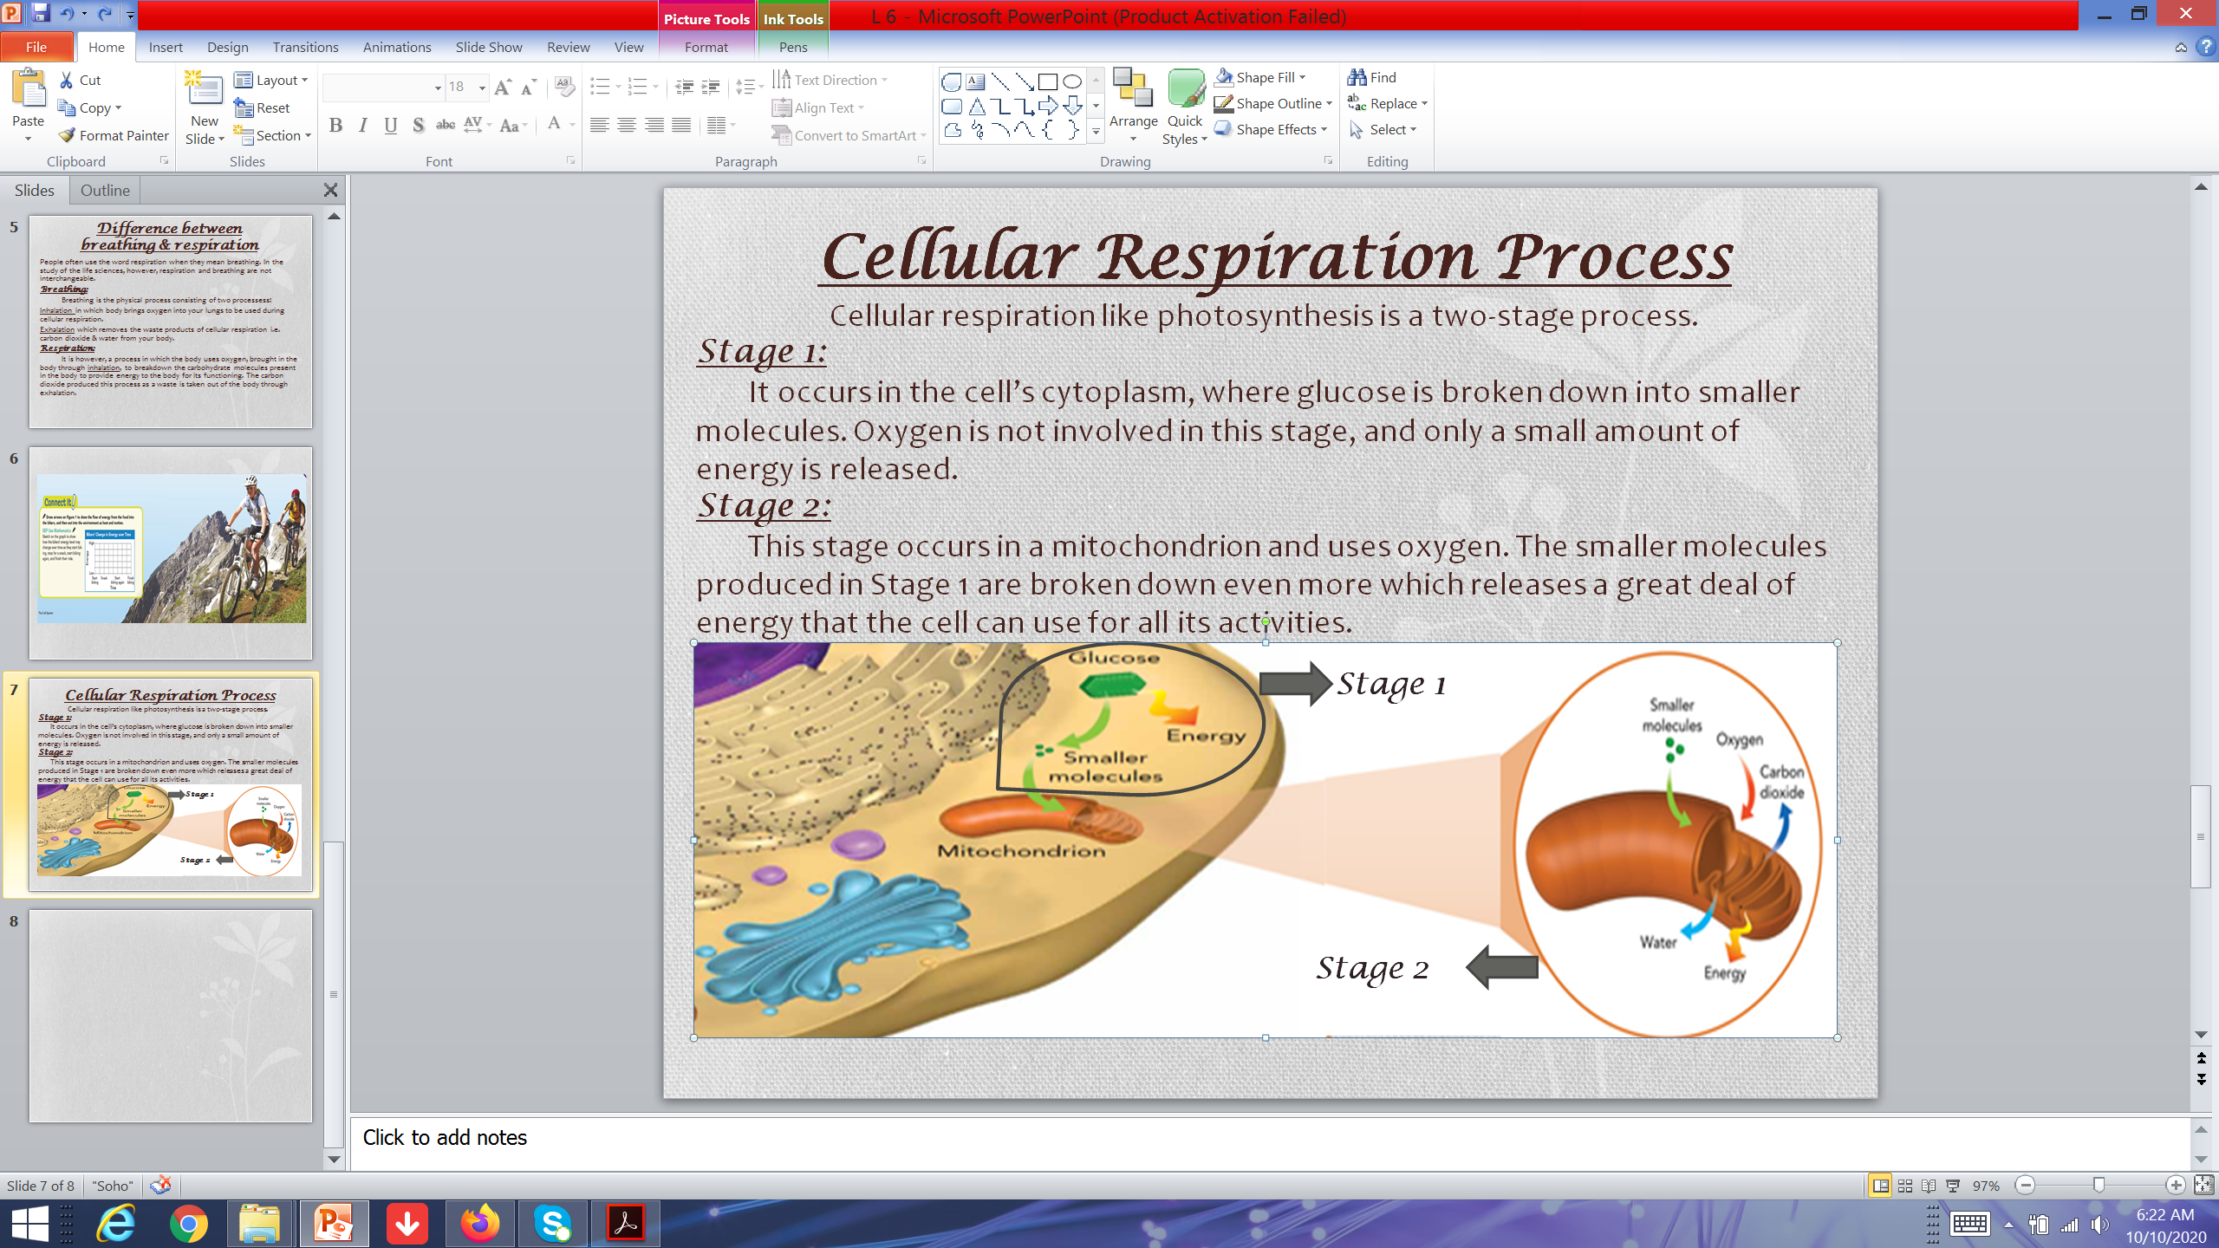
Cellular Respiration Process
Cellular respiration like photosynthesis is a two-stage process.
Stage 1:
It occurs in the cell’s cytoplasm, where glucose is broken down into smaller molecules. Oxygen is not involved in this stage, and only a small amount of energy is released.
Stage 2:
This stage occurs in a mitochondrion and uses oxygen. The smaller molecules produced in Stage 1 are broken down even more which releases a great deal of energy that the cell can use for all its activities.

Slide 11
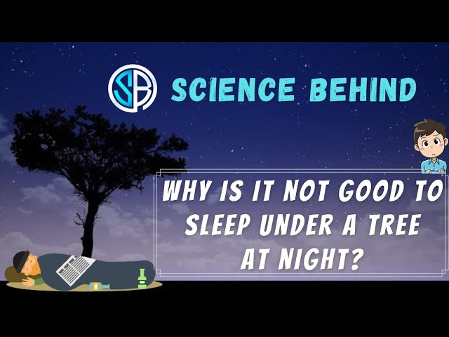
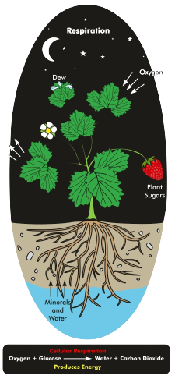

Slide 12
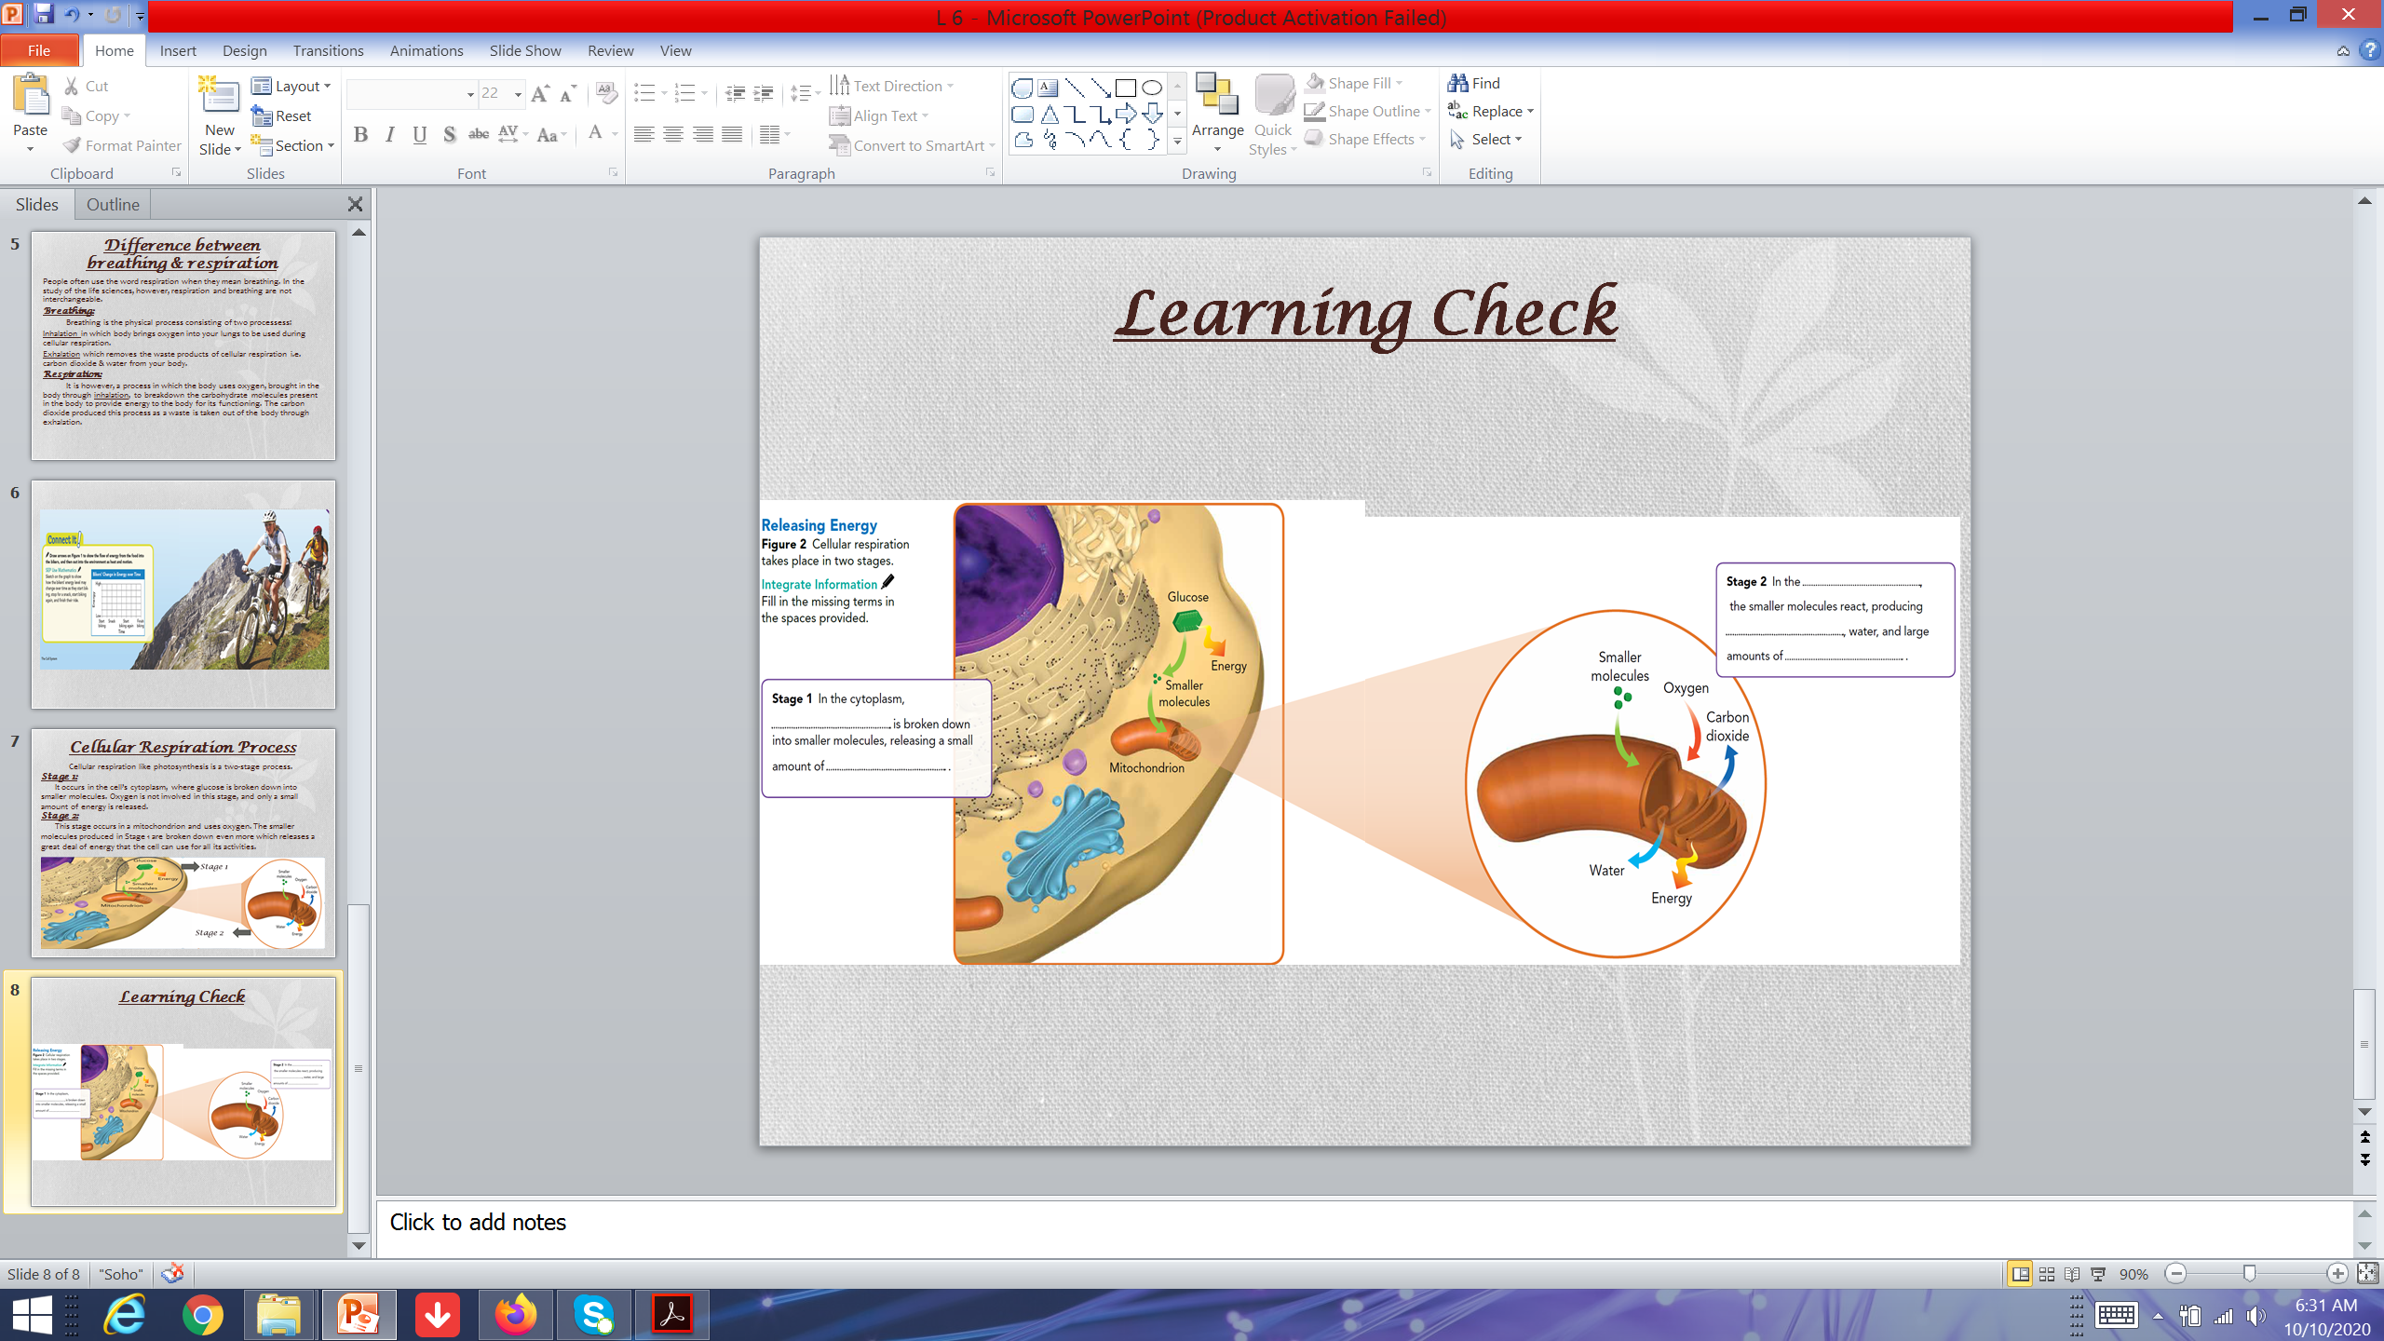
Learning Check- pgs.52,53

Slide 13
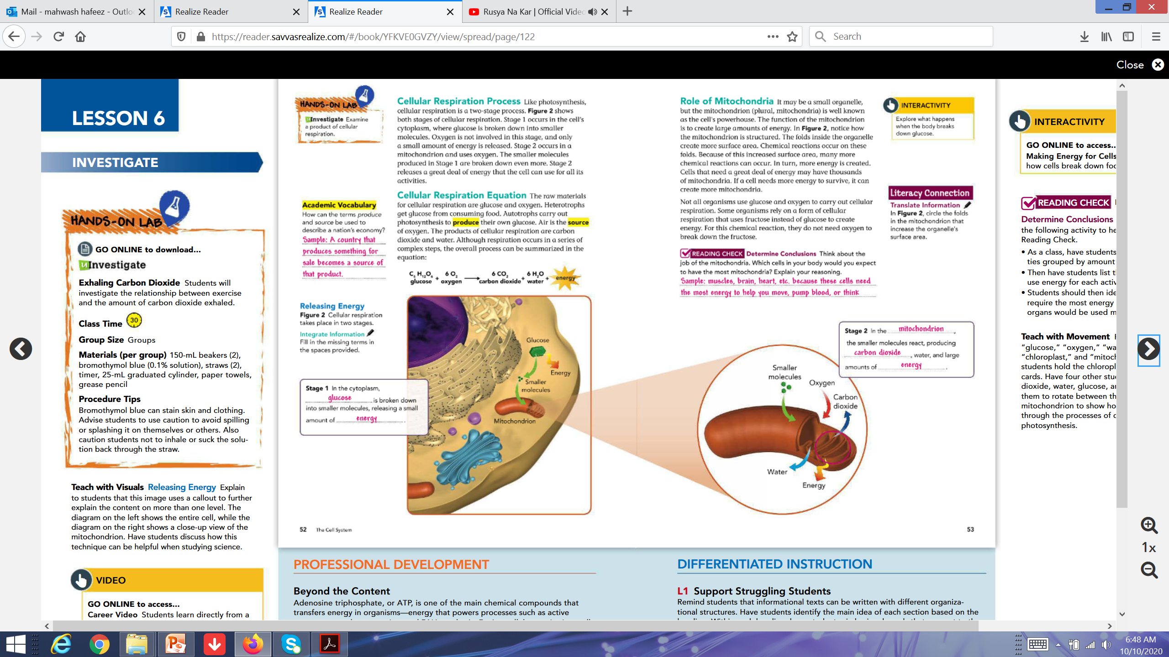
Learning Check- pgs.52,53

Slide 14
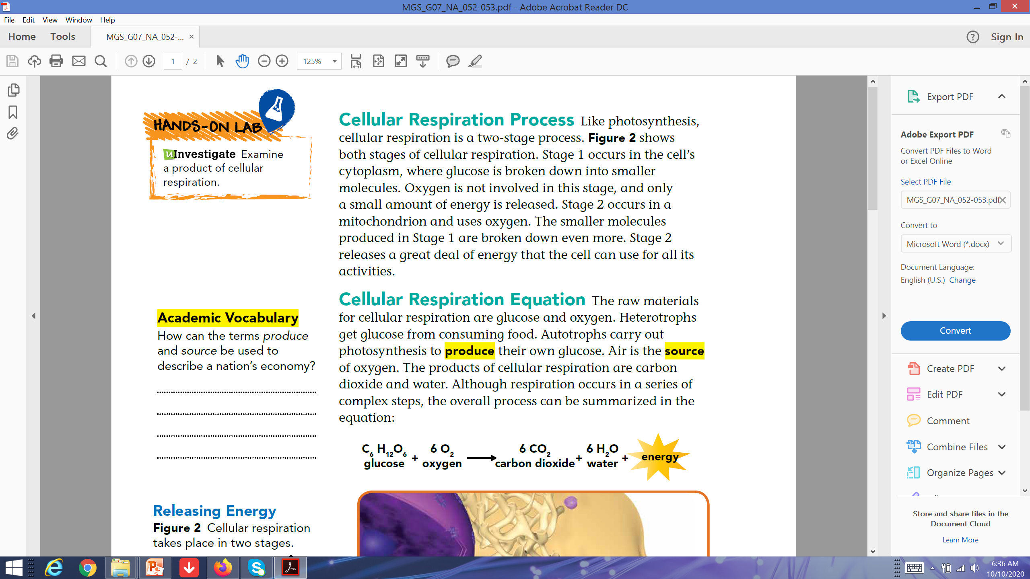
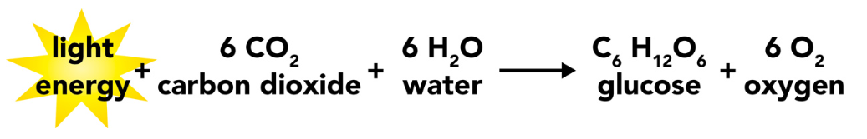
Cellular Respiration Equation
The raw materials for cellular respiration are glucose and oxygen. Heterotrophs get glucose from consuming food.
Autotrophs carry out photosynthesis to produce their own glucose.
Air is the source of oxygen.
The products of cellular respiration are carbon dioxide and water.
Although respiration occurs in a series of complex steps, the overall process can be summarized in the equation:

Slide 15
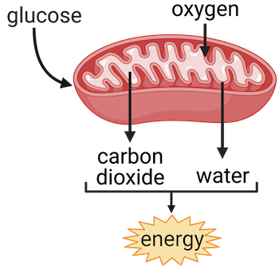
Role of Mitochondria
Mitochondria is well known as the cell's powerhouse. The function of the mitochondrion is to create large amounts of energy. The folds inside the organelle create more surface area. Chemical reactions occur on these folds. Because of this increased surface area, many more chemical reactions can occur. In turn, more energy is created.
Cells that need a great deal of energy may have thousands of mitochondria or it can create more mitochondria. Not all organisms use glucose and oxygen to carry out cellular respiration. Some organisms rely on a form of cellular respiration that uses fructose instead of glucose to create energy. For this chemical reaction, they do not need oxygen to break down the fructose.

Slide 16
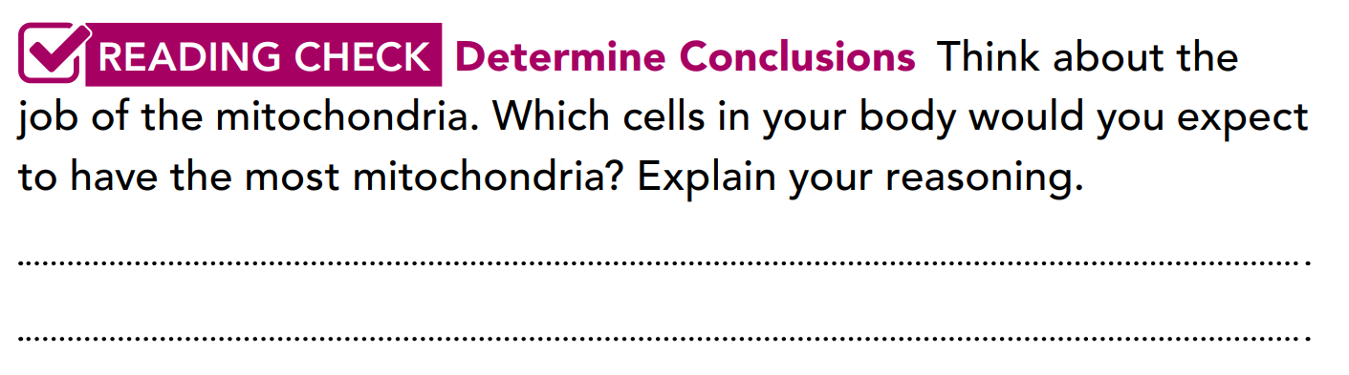
Learning Check- pgs.53
Muscles, brain, heart, etc. because these cells need the most energy to help you move, pump blood, or think

Slide 17
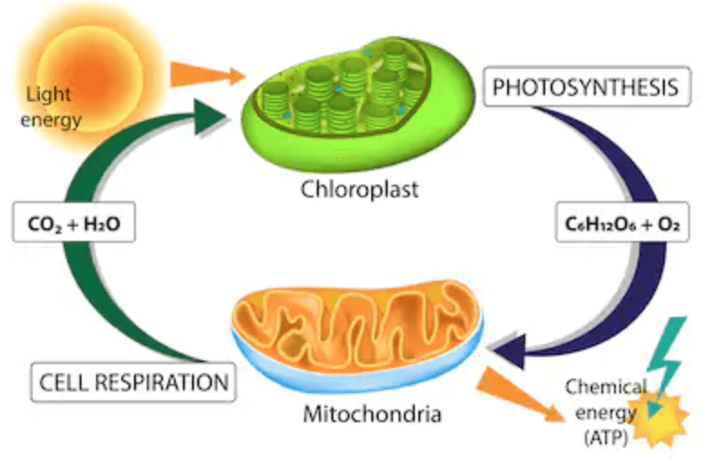

Slide 18
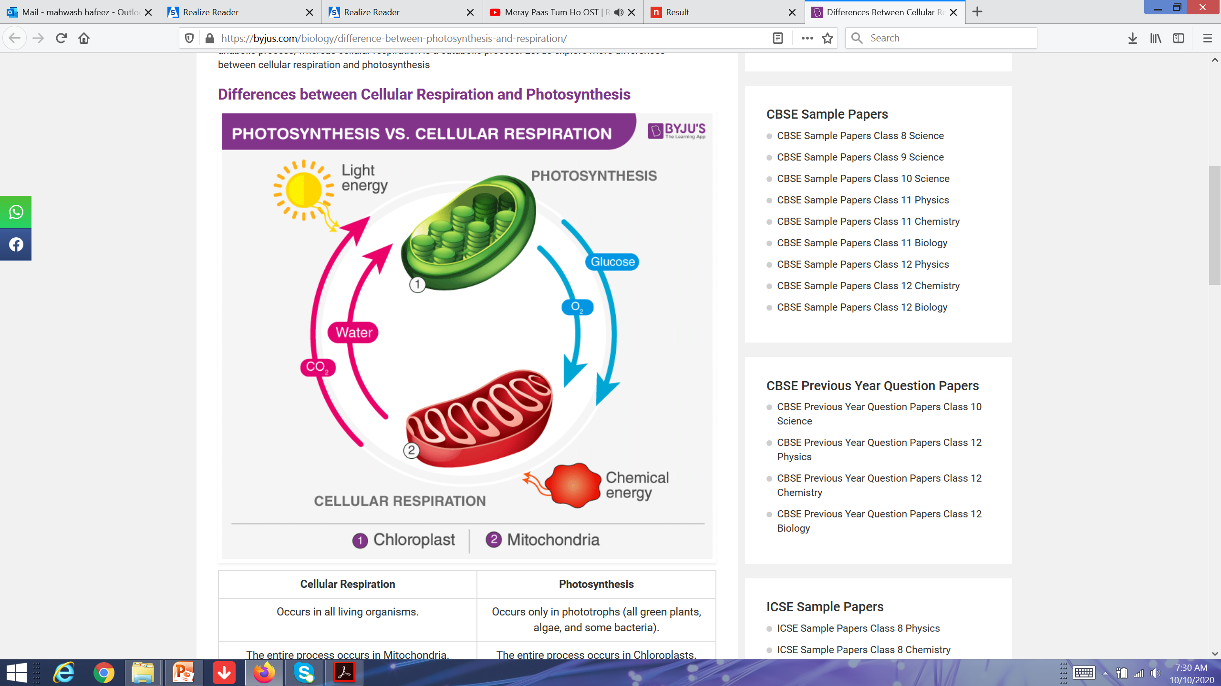
Comparing Two Energy Processes
Photosynthesis and cellular respiration can be thought of as opposite processes.
The two processes form a cycle,
keeping the levels of oxygen and
dioxide molecules relatively stable
in Earth’s atmosphere.
The energy released through
cellular respiration is used or lost
as heat. Matter and energy is
neither created or destroyed in
this cycle.

Slide 19
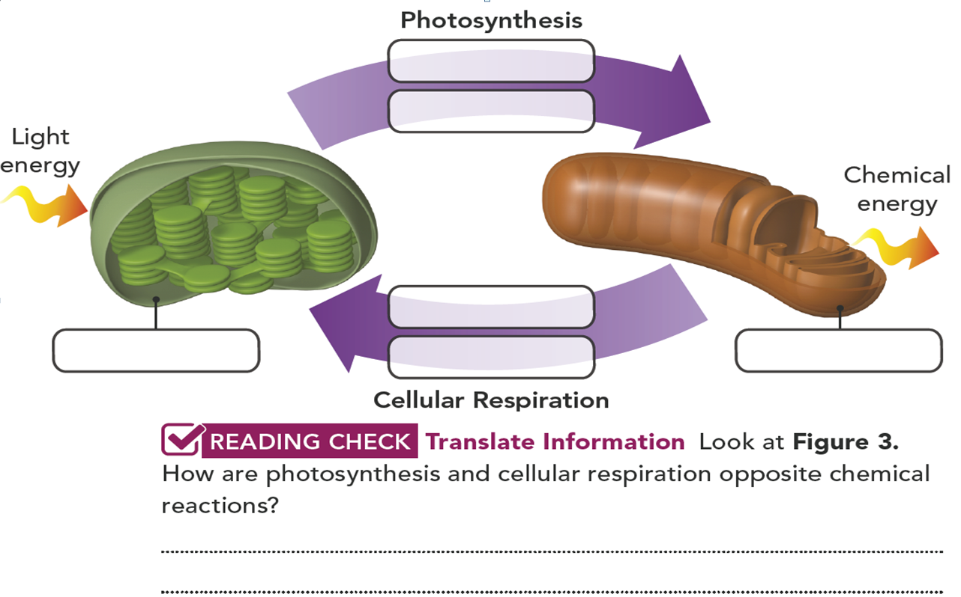
Label the diagram to complete each of the processes.pg.54

Slide 20
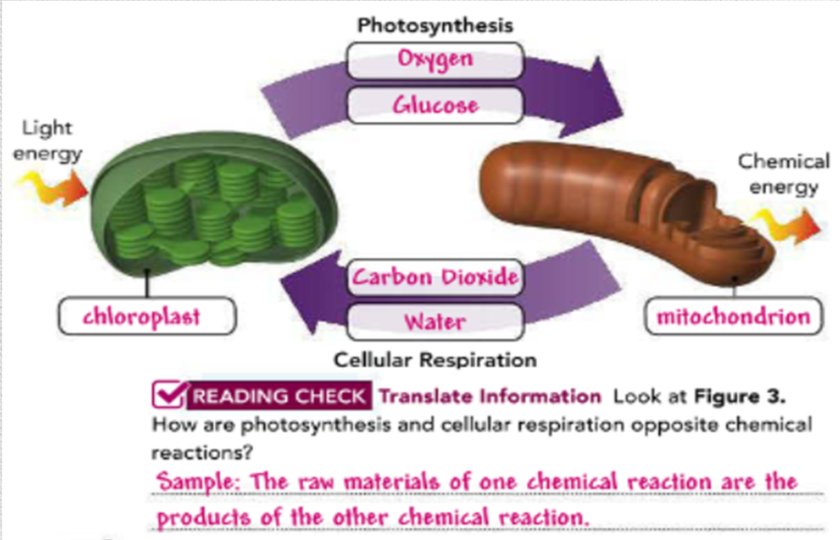
Label the diagram to complete each of the processes.

Slide 21
Fermentation
The release of energy from food without using oxygen is called fermentation.
It is very useful in environments with limited oxygen, such as in the intestines. However, fermentation releases much less energy than cellular respiration with oxygen. It can be of two types:
1-Alcoholic Fermentation
2-Lactic acid fermentation

Slide 22
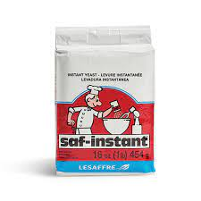
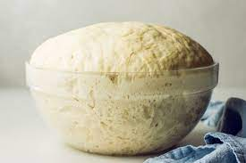
Alcoholic Fermentation:
Alcoholic fermentation takes place in live yeast cells, a unicellular fungi, and in other single-celled organisms.
This type of fermentation produces alcohol, carbon dioxide, and a small amount of energy.
Bakers use these products of fermentation as carbon dioxide produced creates gas pockets in bread dough and causes it to rise.

Slide 23


Lactic acid fermentation:
During heavy exercises, we start to breathe faster because our muscle cells uses up oxygen faster than it could be replaced. Without enough oxygen, fermentation takes place. Our body supplies energy to our muscle cells by breaking down glucose without using oxygen. A compound called lactic acid is a product of fermentation in muscles.

Slide 24
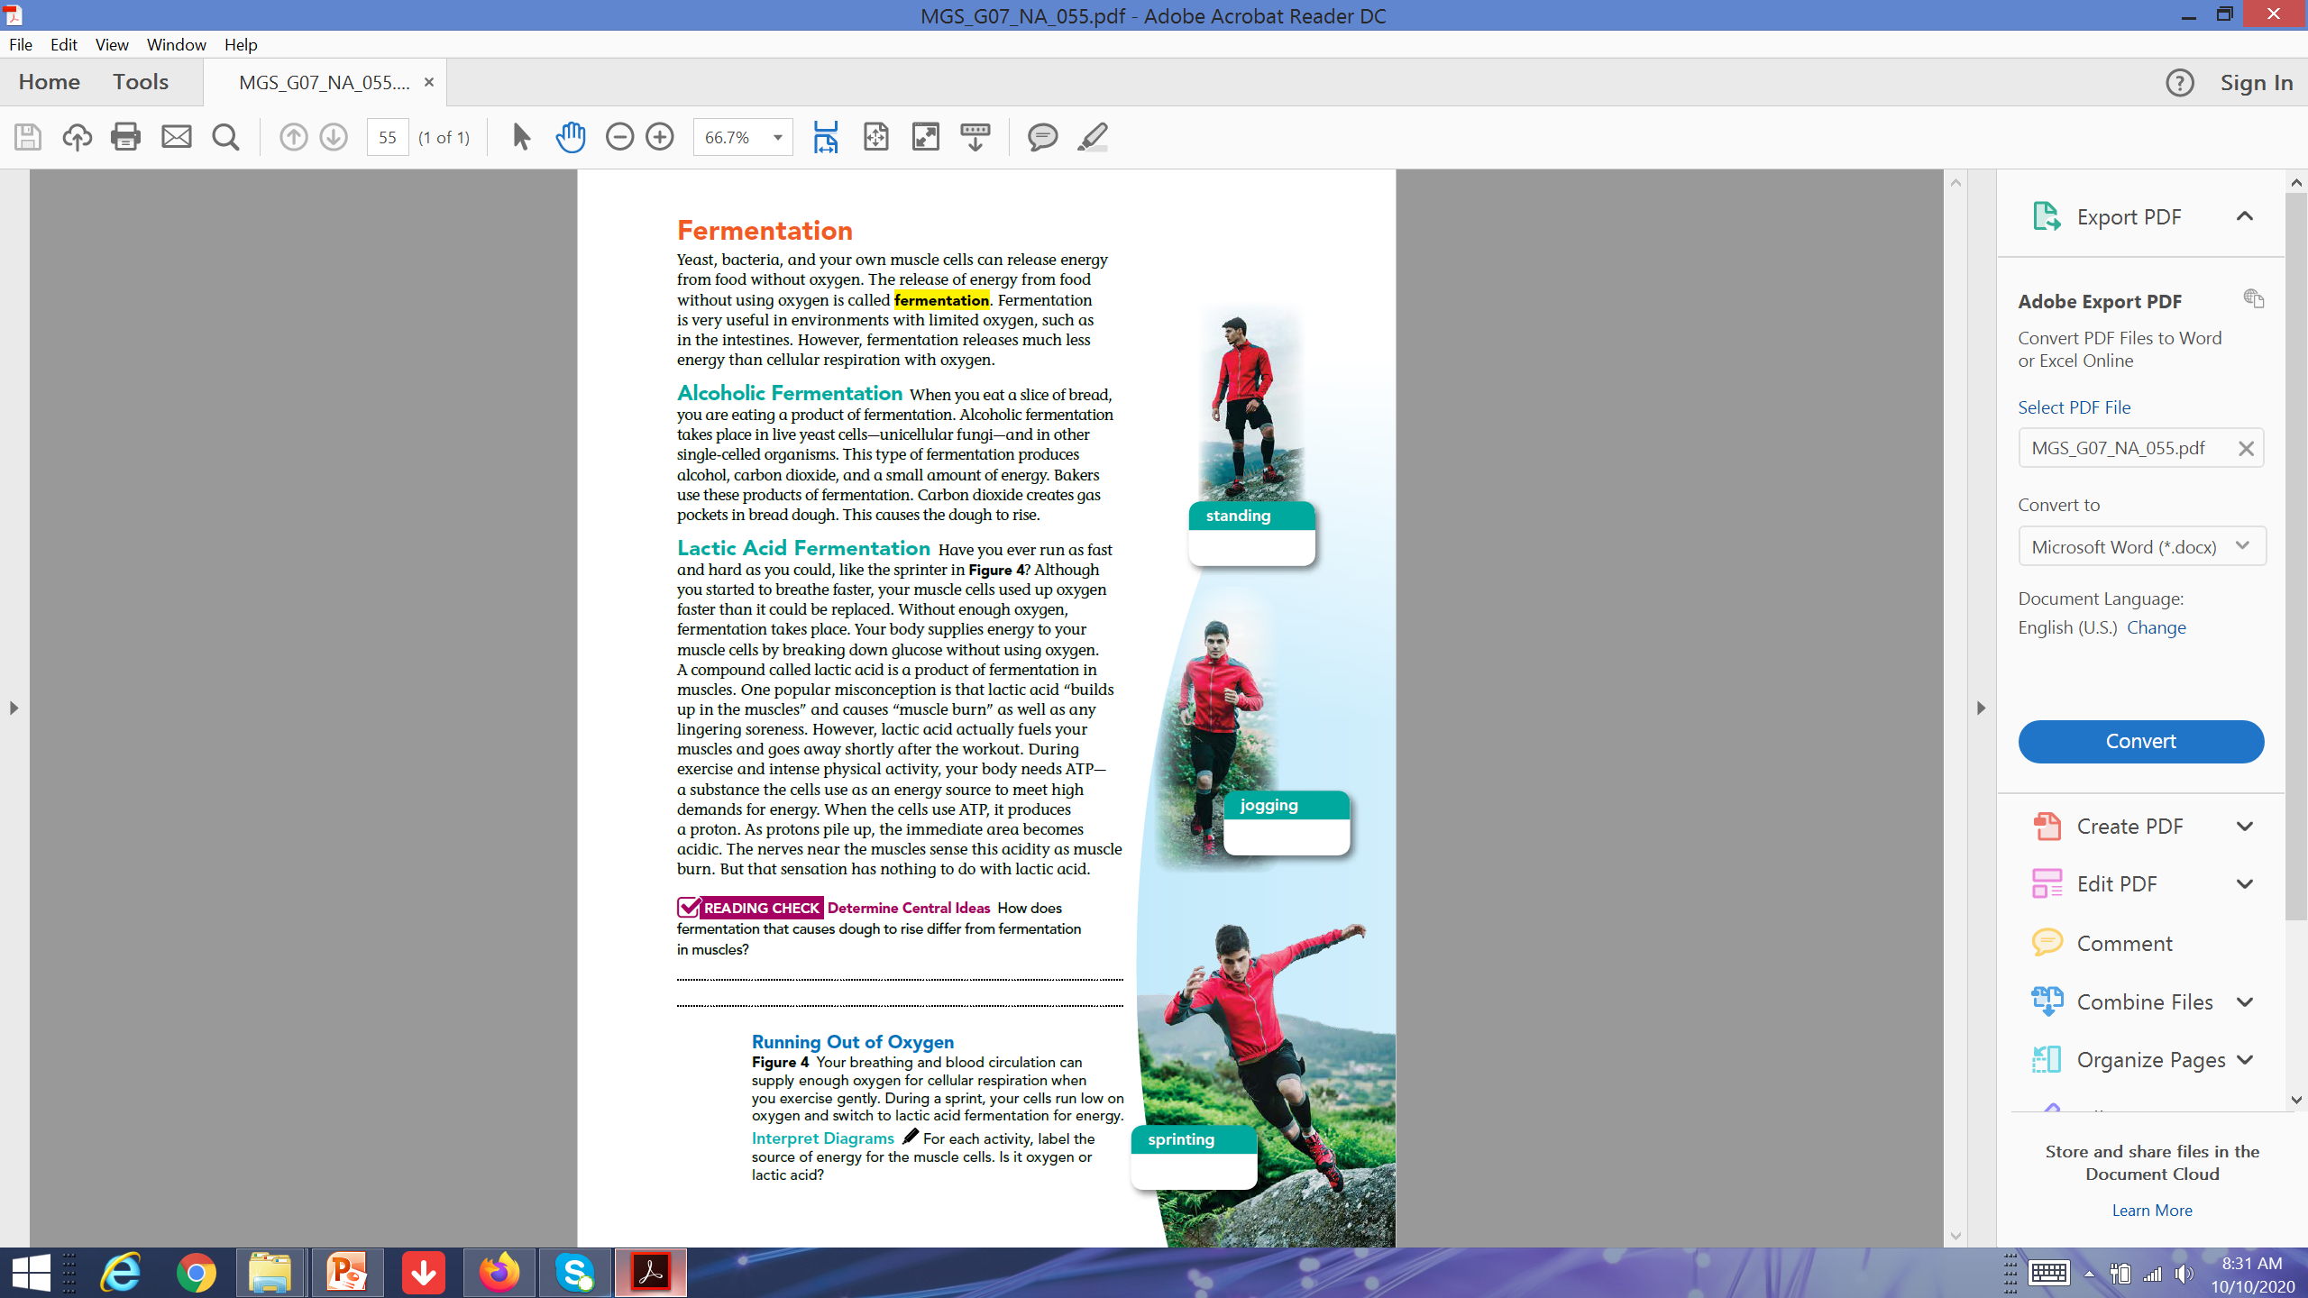

oxygen
oxygen
Lactic acid

Slide 25
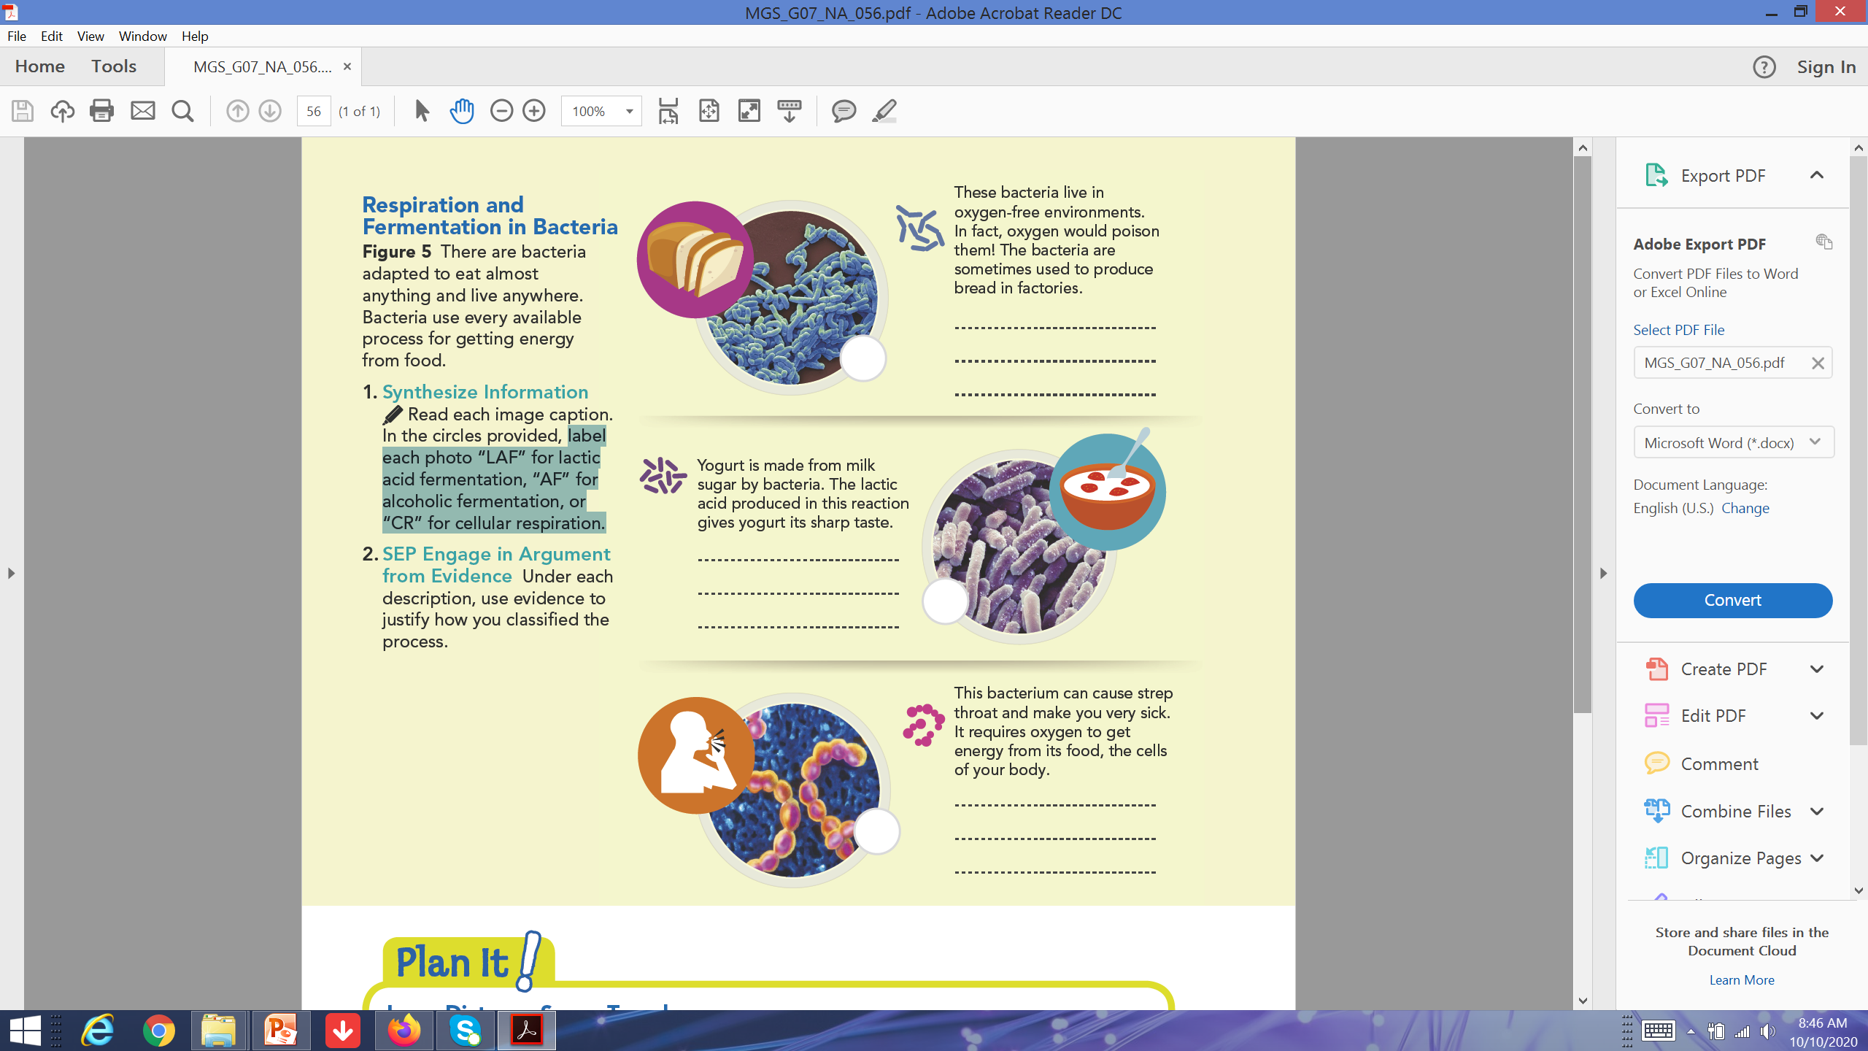
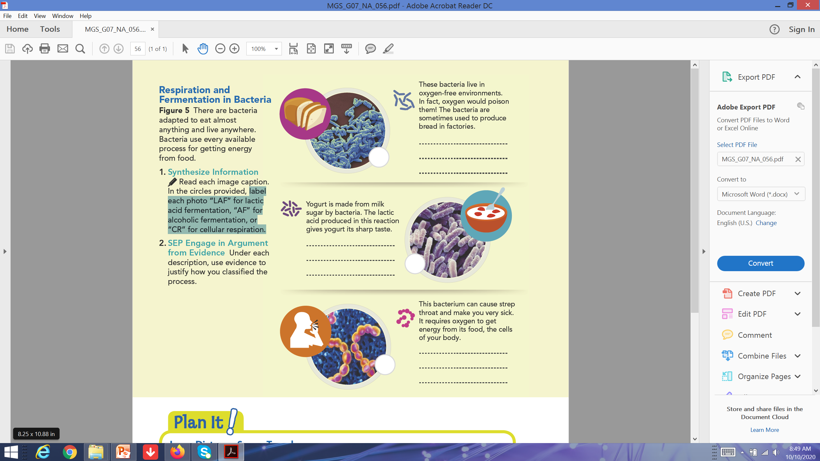
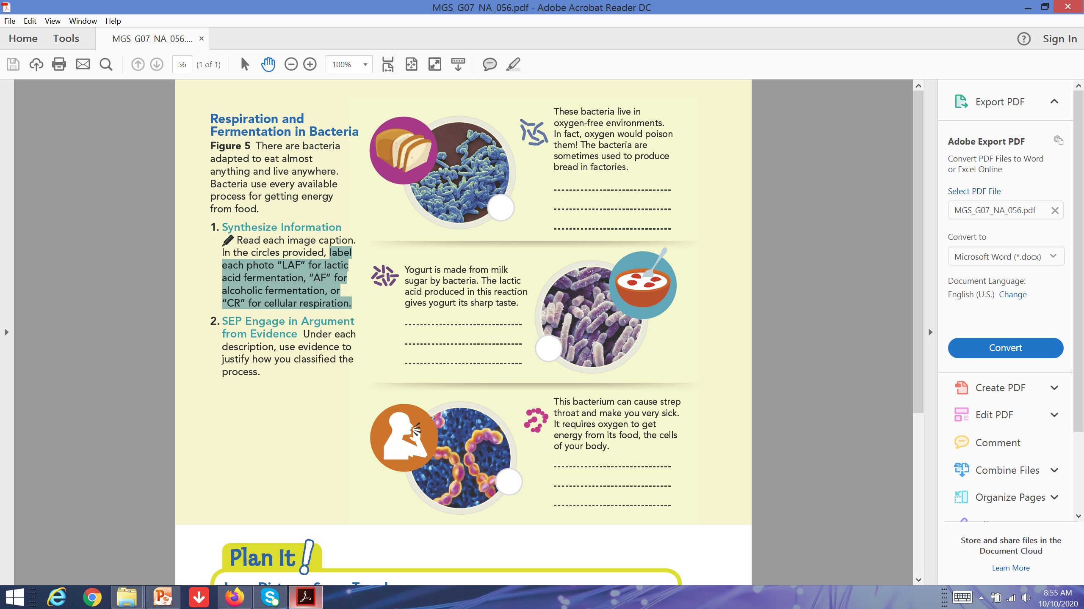

Learning Check.pg.56
Respiration and Fermentation in Bacteria
Bacteria is adapted to eat almost anything and live anywhere. They use every available process for getting energy from food.
Using the information given with each figure, label each photo with “LAF” for lactic acid fermentation, “AF” for alcoholic fermentation, or “CR” for cellular respiration.

Slide 26
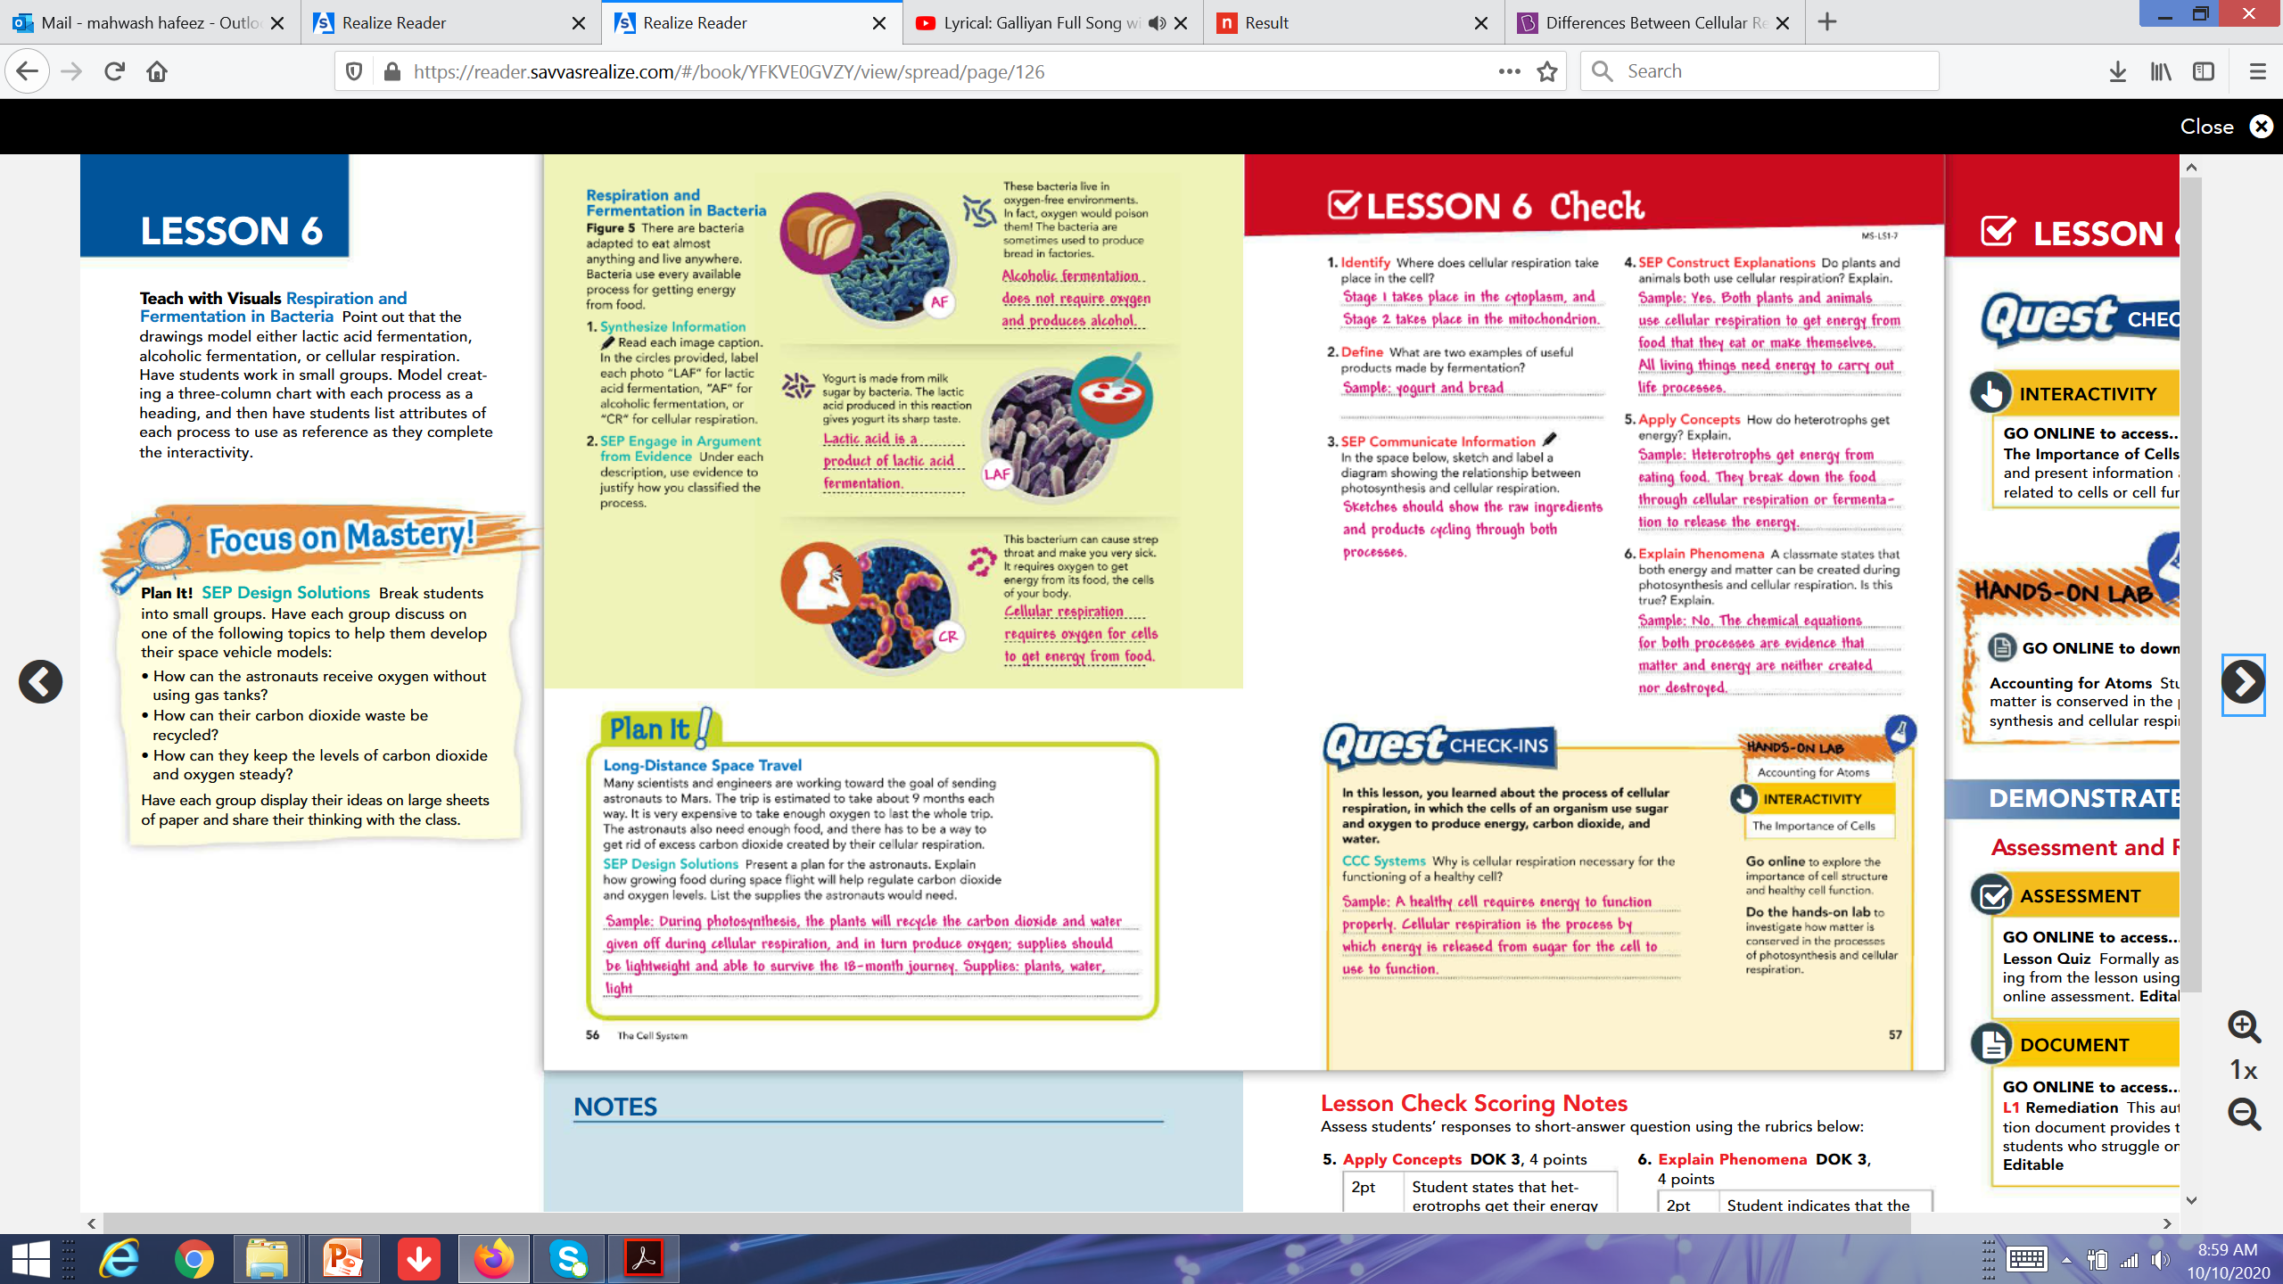

Learning Check
Respiration and Fermentation in Bacteria
Bacteria is adapted to eat almost anything and live anywhere. They use every available process for getting energy from food.
Using the information given with each figure, label each photo with “LAF” for lactic acid fermentation, “AF” for alcoholic fermentation, or “CR” for cellular respiration.
LAF
CR
AF

Slide 27

H.W
page 57.Q.1-4

