Slide 1

Slide 1
PAGE#40
CH#1
L#5
PHOTOSYNTHESIS

Slide 2
Vocabulary Words
Photosynthesis
Autotroph
Heterotroph
Chlorophyll

Slide 3
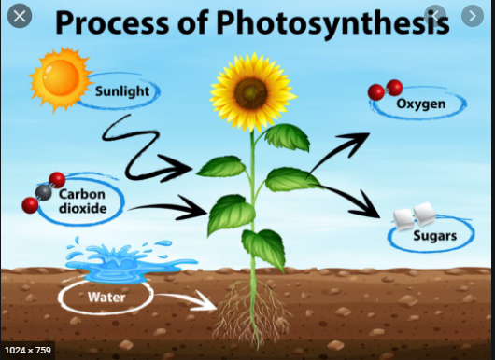
Photosynthesis

Slide 4

Photosynthesis

Slide 5
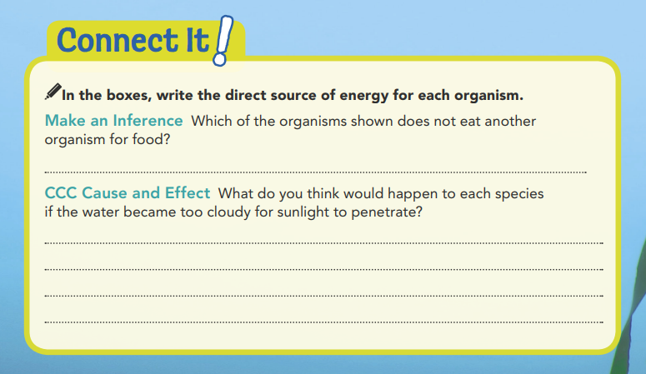
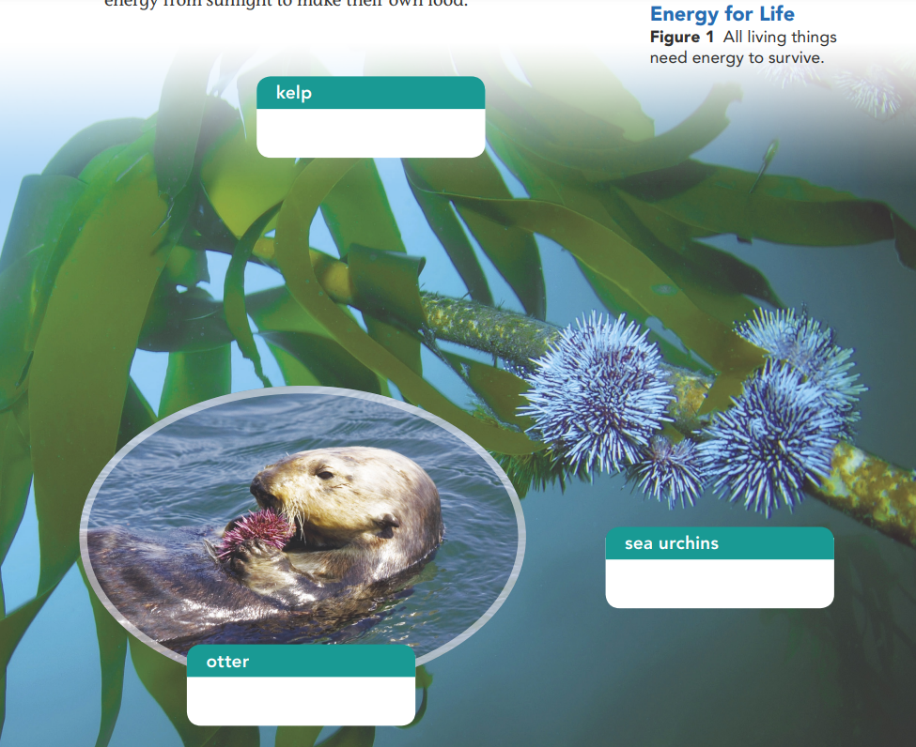

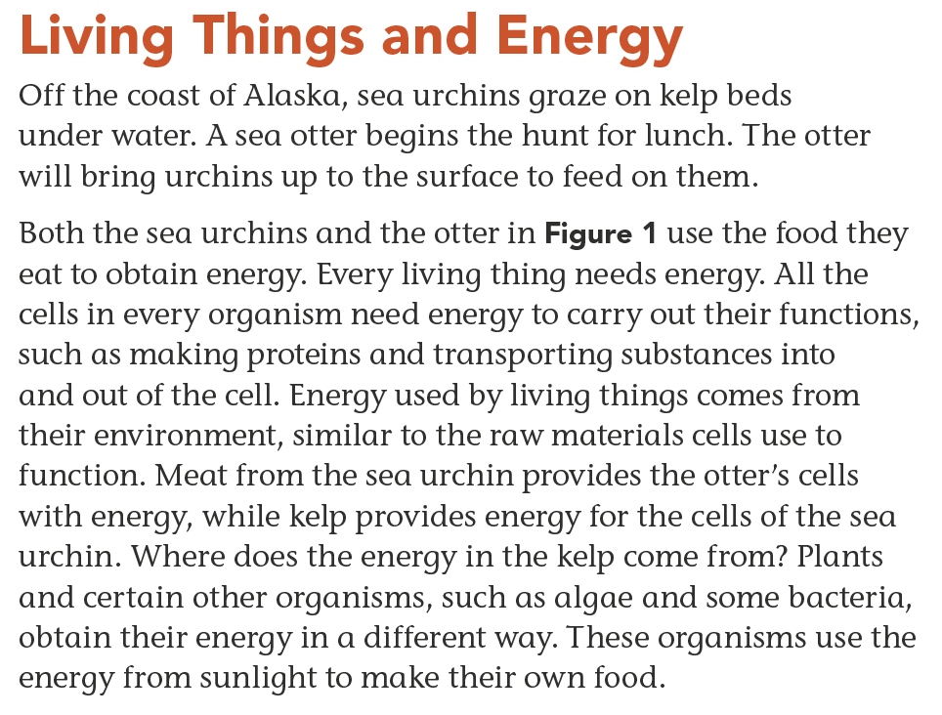
Sunlight
Kelp
The kelp would stop growing without sunlight. The urchins would starve, and so would the otters.
Kelp
Sea Urchins

Slide 6
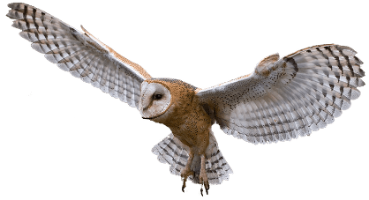


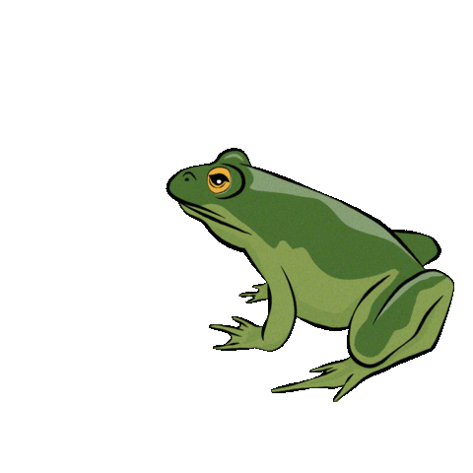
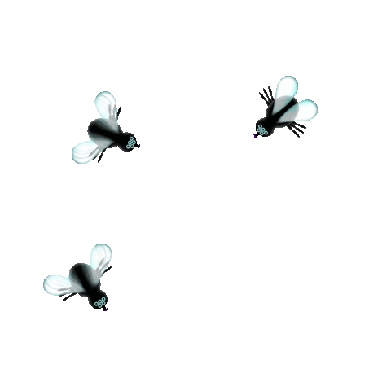
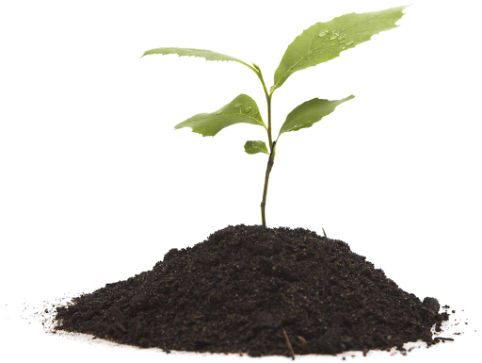
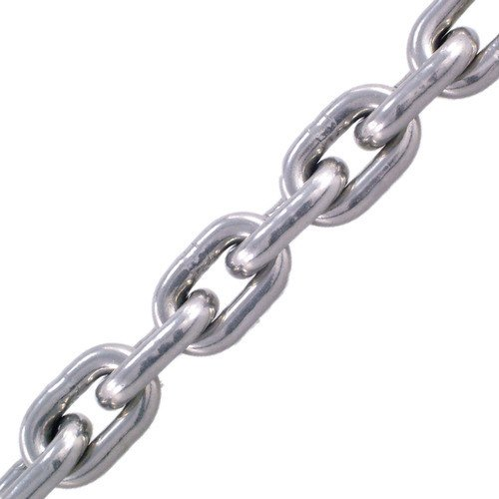
Sun gives plant
energy.
Owl eats Frog.
Insect eats plant.
Frog eats insect.
This is called as a Food Chain.

Slide 7
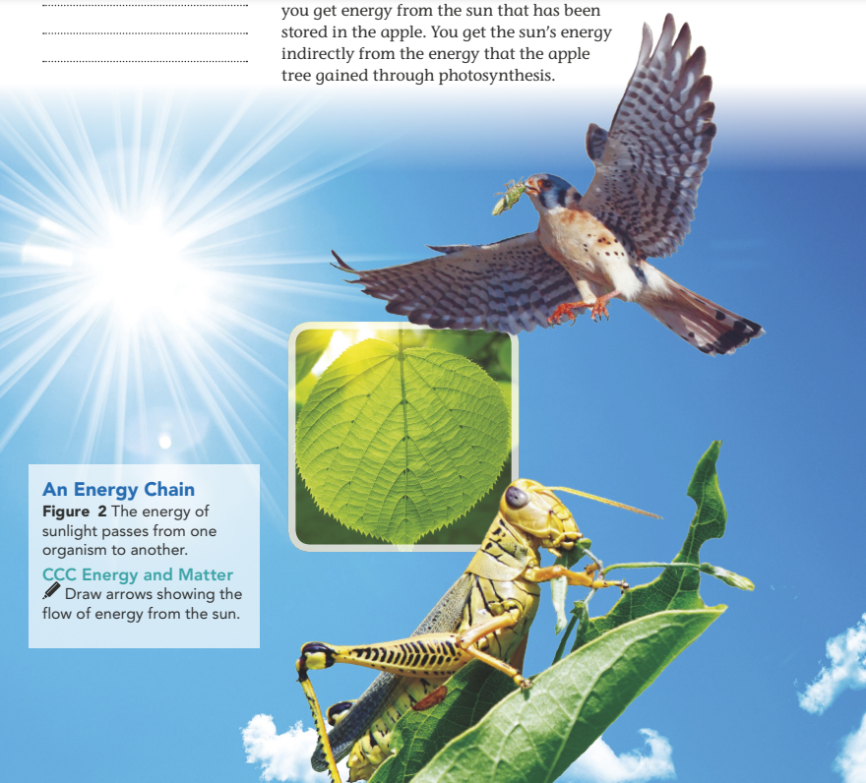
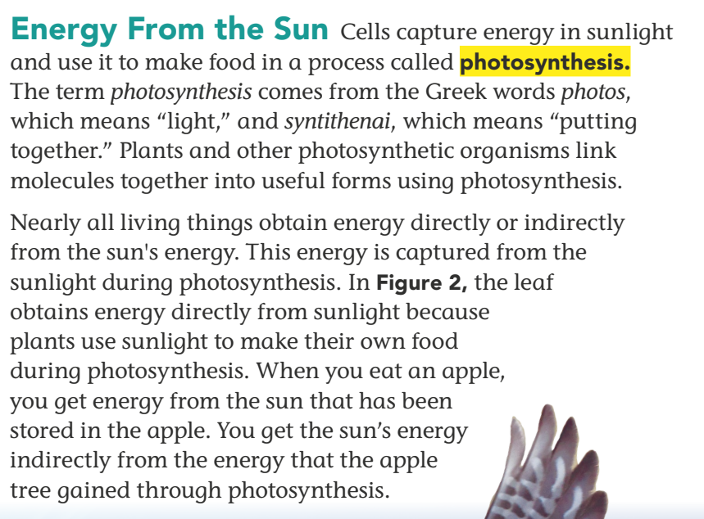

Slide 8
What are Autotrophs ?
Autotrophs
or producers, are able to create their own food in the form of glucose, an energy-giving sugar. Plants and algae, as well as some bacteria, are autotrophs.

Slide 9
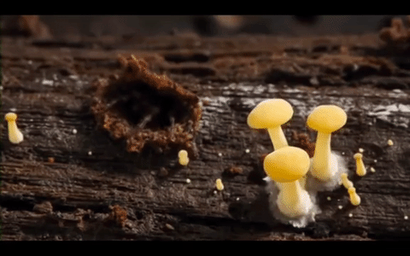
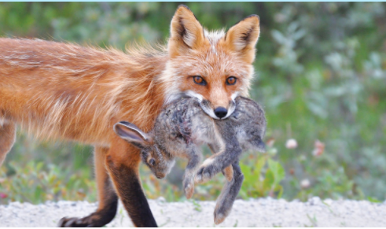
What Are heterotrophs ?
An organism that cannot make its own food, such as the sea urchin or otter, is a consumer, or a heterotroph. Many heterotrophs, like the fox, obtain food by eating other organisms.
Some heterotrophs, such as fungi, absorb their food from other organisms.

Slide 10
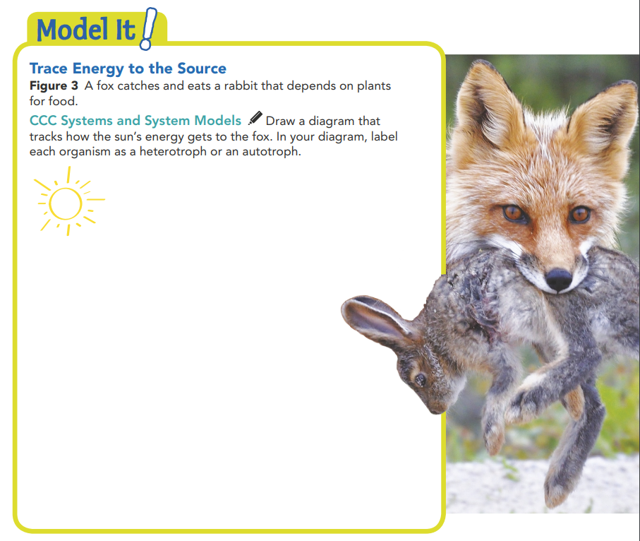
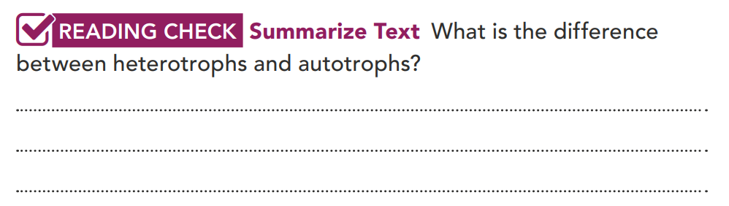
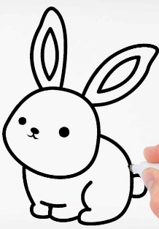
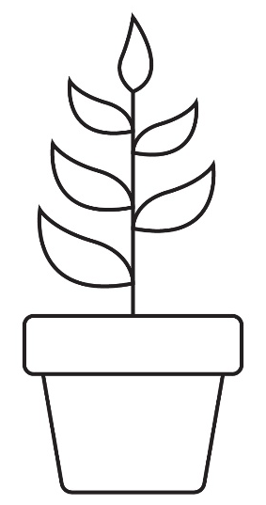
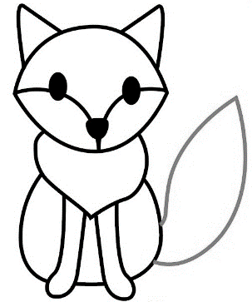
Autotrophs can create their own food, but heterotrophs have to find food.
heterotroph
autotroph
heterotroph

Slide 11
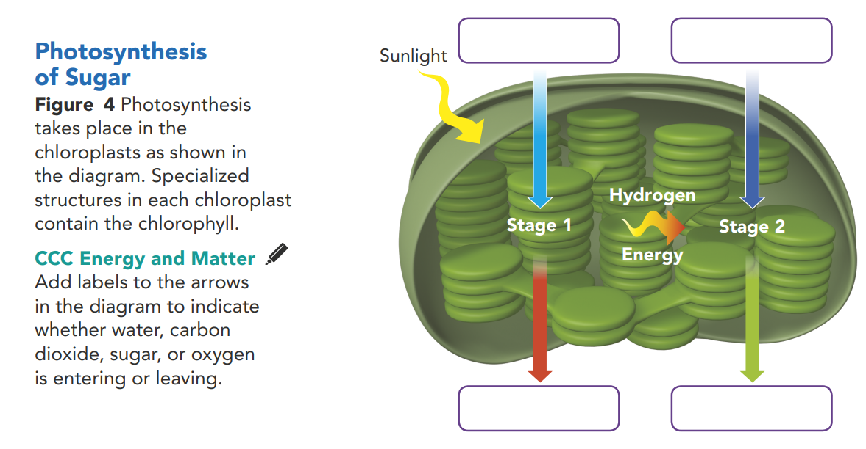
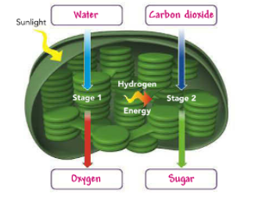
What is chlorophyll ?
The green photosynthetic pigment found in the chloroplasts of plants, algae, and some bacteria is chlorophyll.

Slide 12

Stages of Photosynthesis
Stage 1: Sunlight splits water molecules in the chloroplasts into hydrogen and oxygen.
Stage 2: The hydrogen combines with other atoms and the oxygen is released into the environment as a waste product.

Slide 13
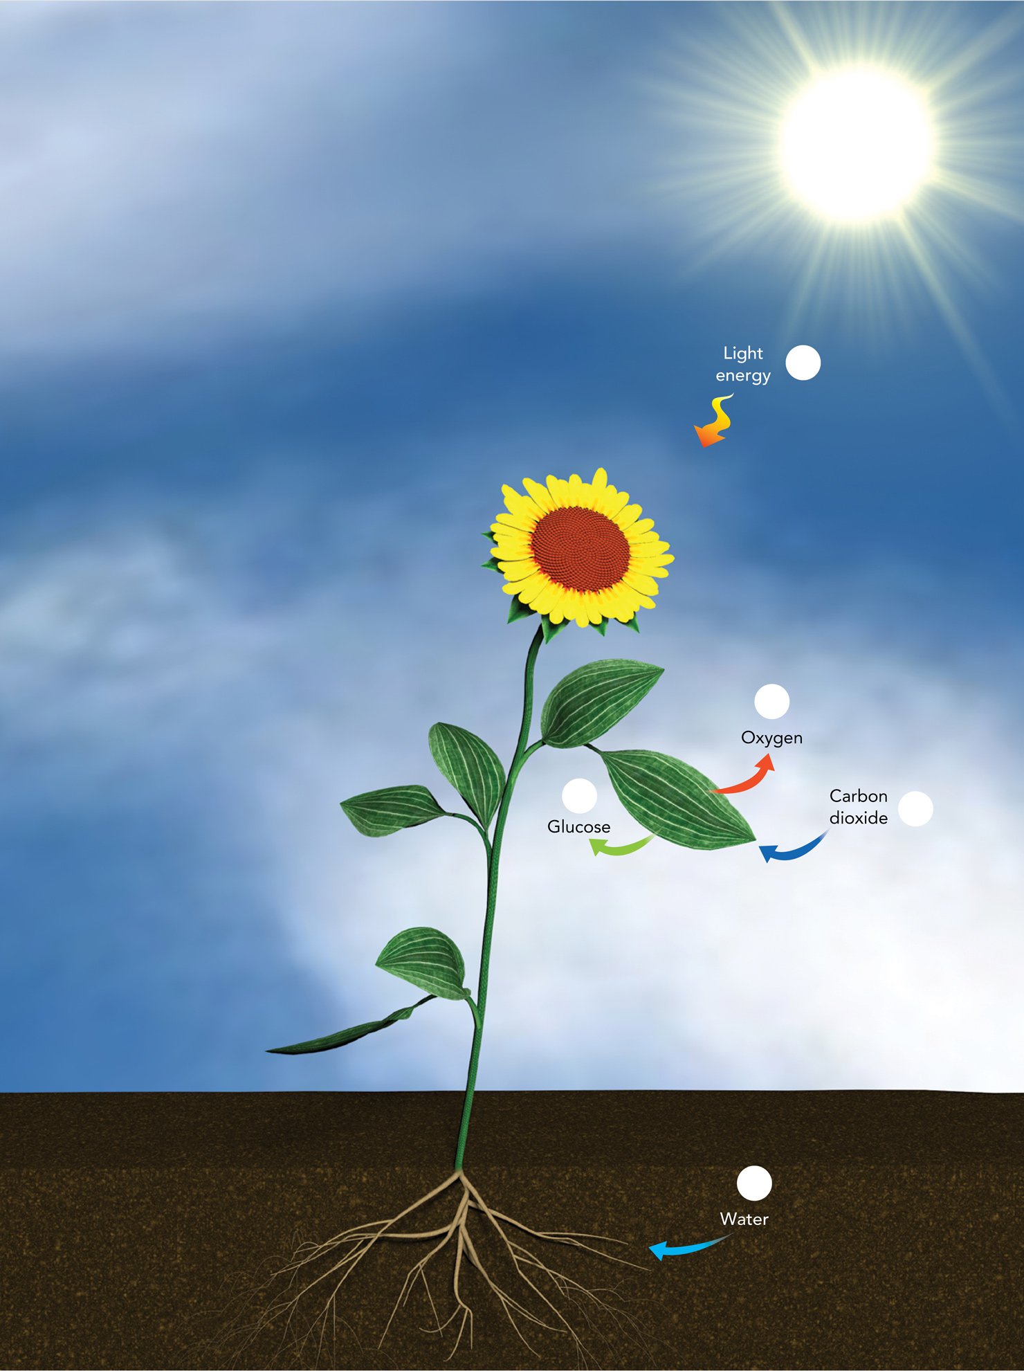
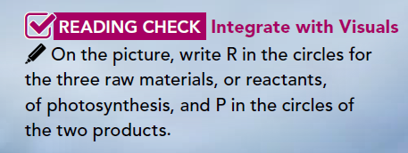
E
P
P
R
R

Slide 14
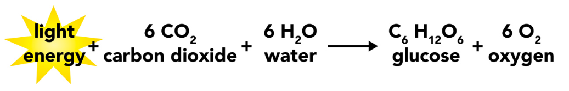
Expressing photosynthesis
1
Raw material or Reactants
Yields
Products

Slide 15
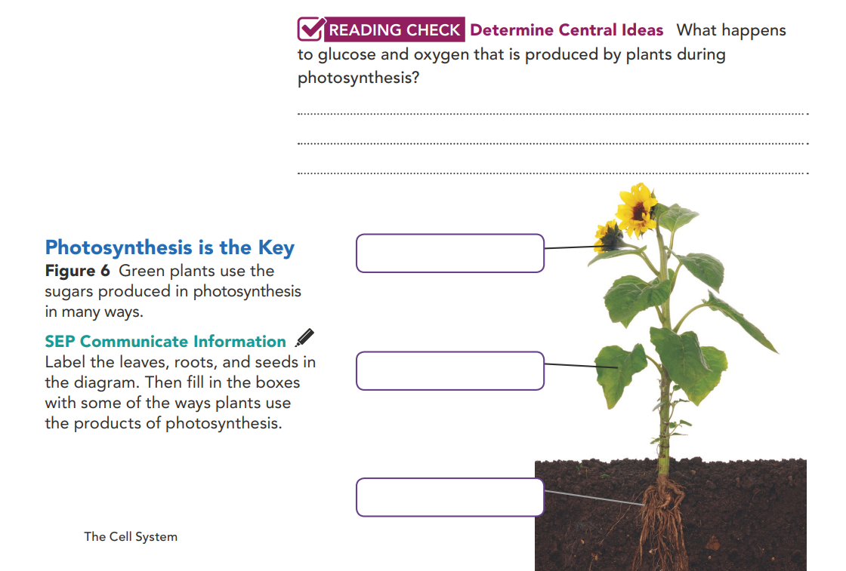
Plants use some of the glucose for growth and other functions, some to make other materials, such as cells walls, and some is stored for later use. Oxygen is released into the air.
Seeds, store energy
Leaves, build cell walls
Roots, store energy

Slide 16
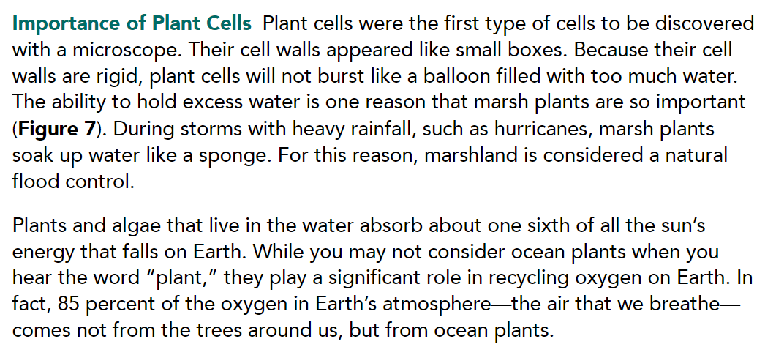
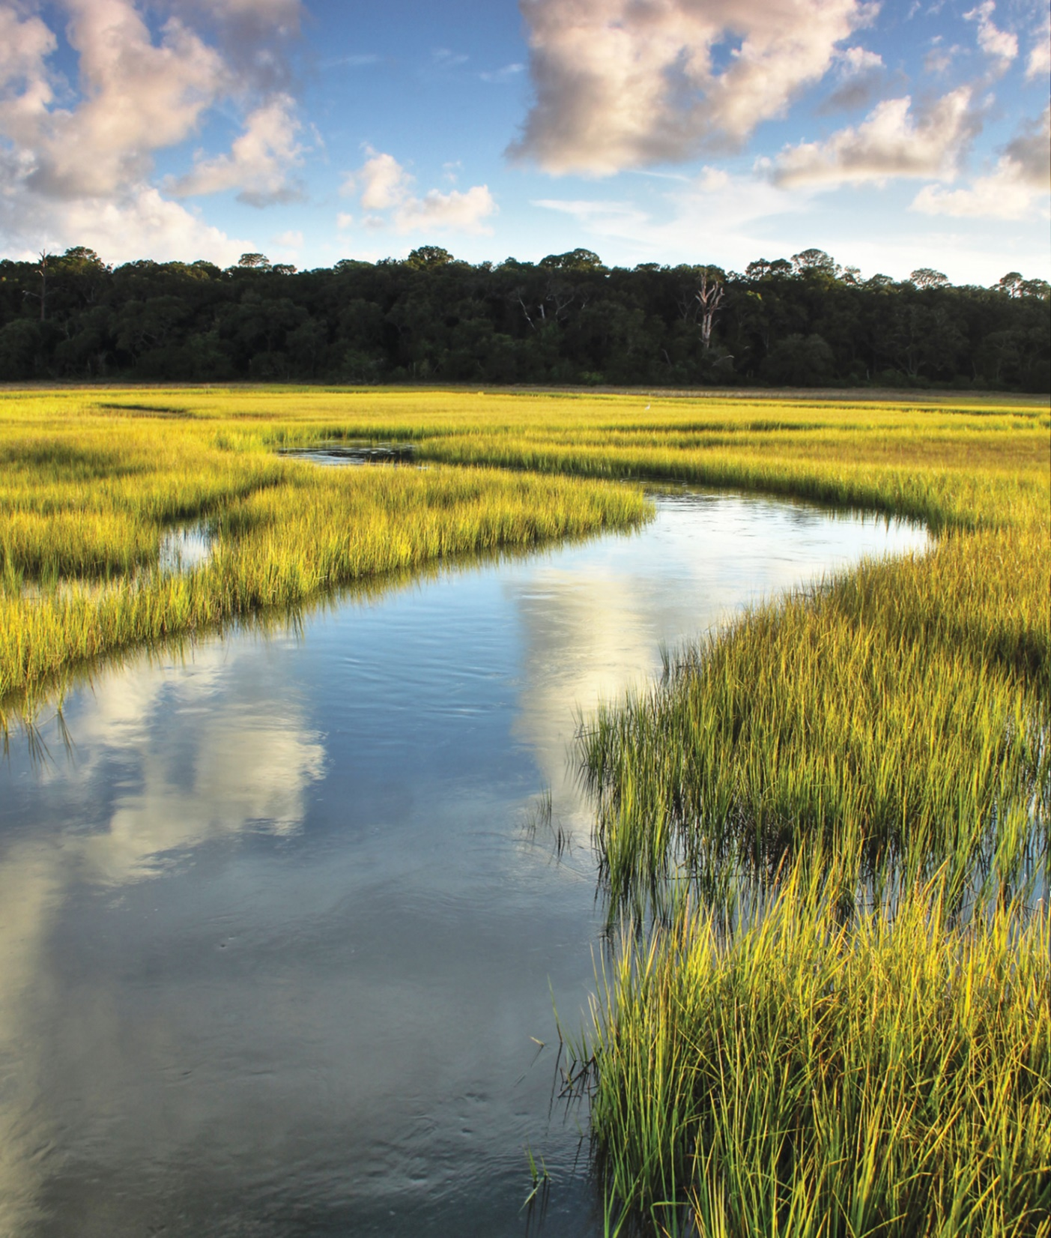

Slide 17
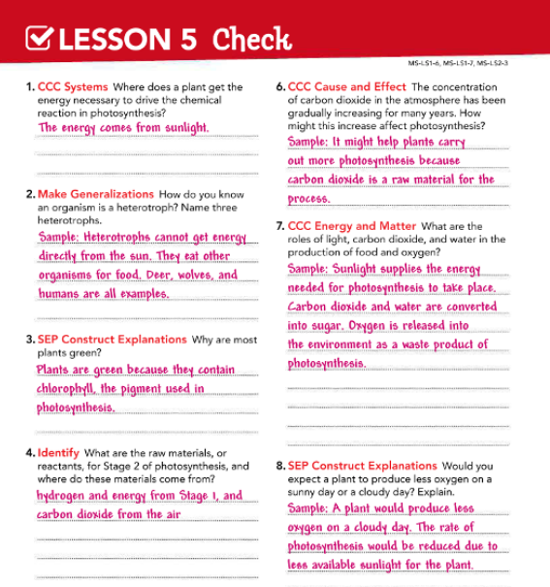
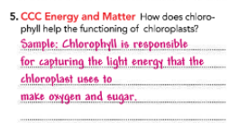

Slide 18

Thank You

