Slide 1
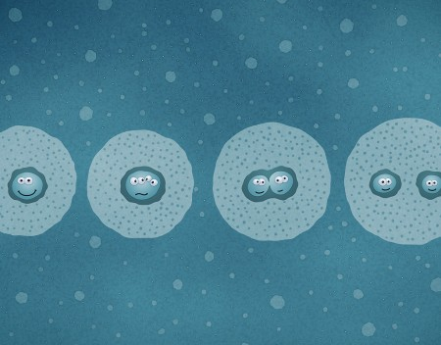
Ch1-Lesson 4
Cell Division

Slide 2
Objectives
To identify the steps of mitosis
To define interphase
To build a cell cycle model using paper plates

Slide 3
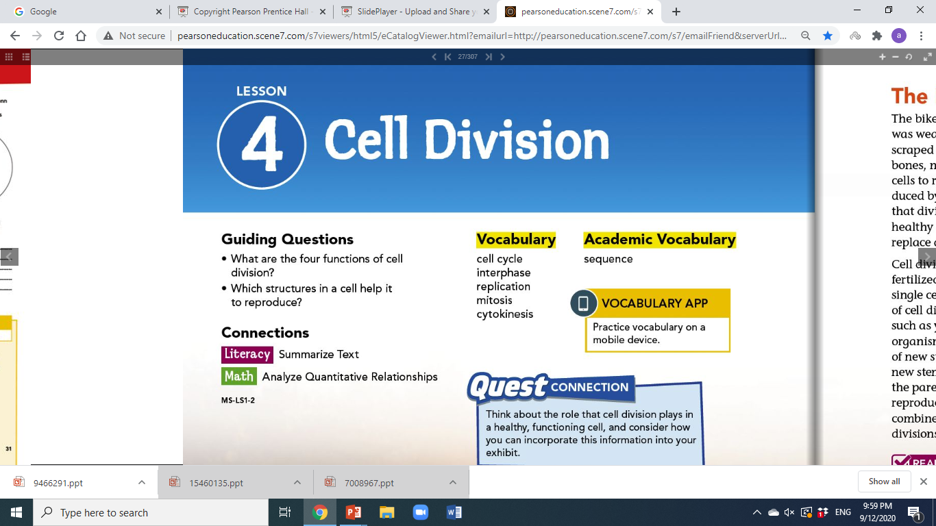

Slide 4
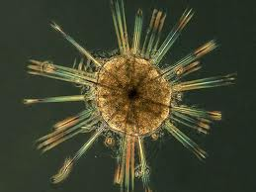
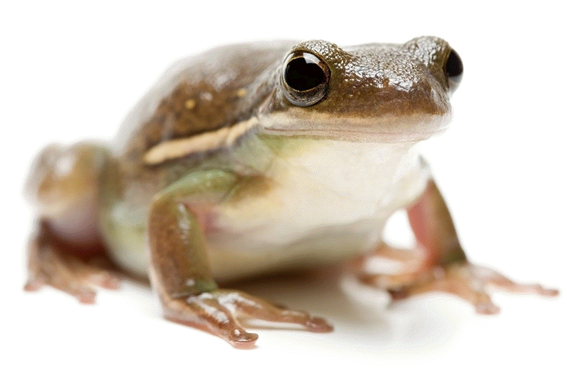
Why do Cells Divide?
Warm Up & Review…
Organisms that have only one cell are called…
unicellular
Organisms made of more than one cell are called…
multicellular
Unicellular organisms - cell division is ONLY for the purpose of reproduction
Multicellular organisms – use cell division for growth, development, repair and reproduction.

Slide 5


Slide 6
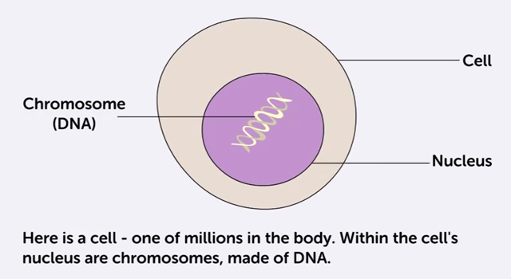

Slide 7
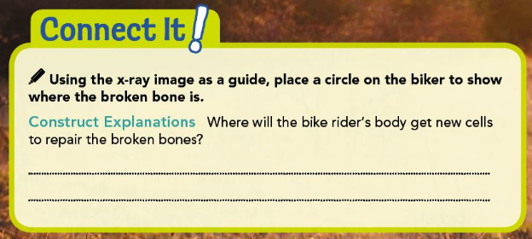
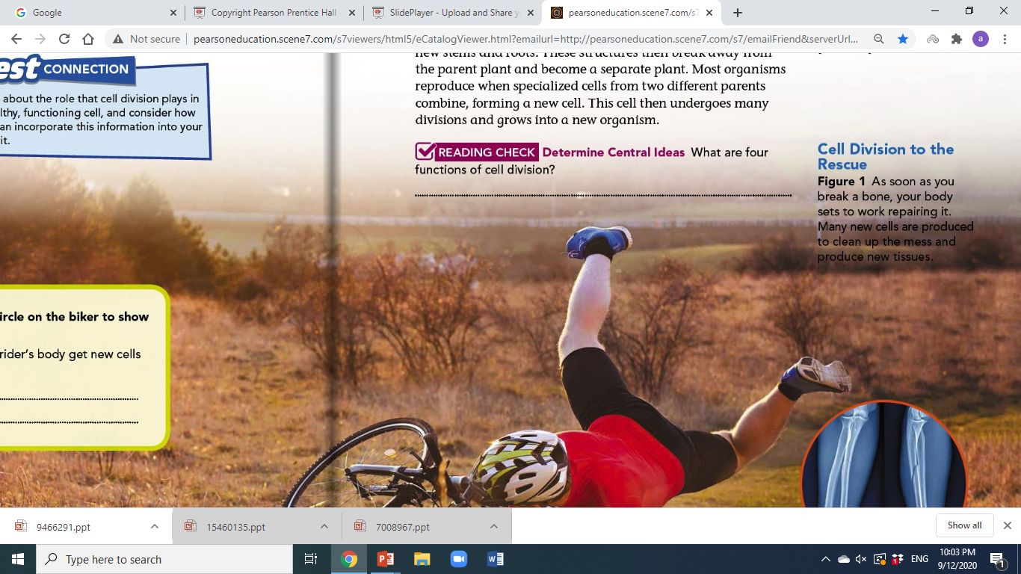
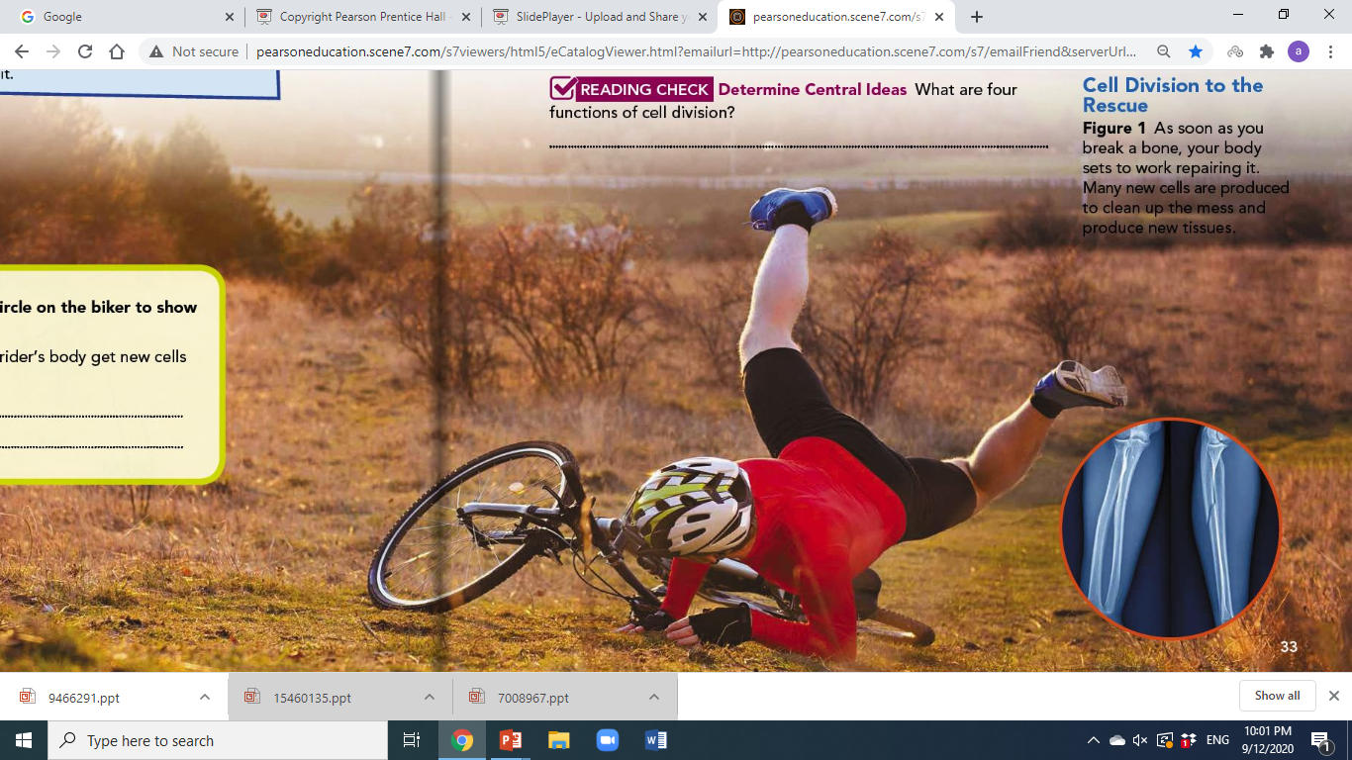
The new cells will come from existing cells, according to the cell theory.
Cells can only be produced by other cells.
The new cells will come from older cells that divide in two, over and over again, until there are enough healthy cells to restore full function.

Slide 8
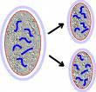
Cell Division
Cell Division is involved in growth, development and repair.
Through cell division a single cell becomes 2, and then they divide into 4 cells and so on.
Even when a person, animal or plant stops growing cell division still occurs because old cells need replaced with new ones.
Cells doesn’t live forever
Throat cells only last a few days

Slide 9
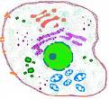
Cell Growth
A large organism (animal or plant) does not have bigger cells then a smaller organism, it simply has more cells.
Cells grow in size but there is a limit to how big they can grow. (do their jobs correctly)

Slide 10
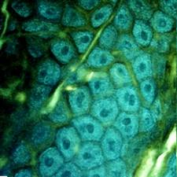
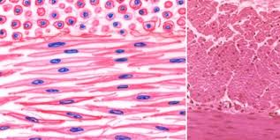
Cell Development
A Unicellular organism yeast reproduce by cell division
A multicellular organism starts as a single cell and grows into a larger one through cell division.
But as an organism develops each cell specializes and takes on a specific job.
Blood cells, muscle cells etc.
All cells have the same DNA and parts but they perform a specific job.
Skin Cells
Smooth muscle cells

Slide 11
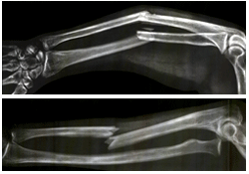
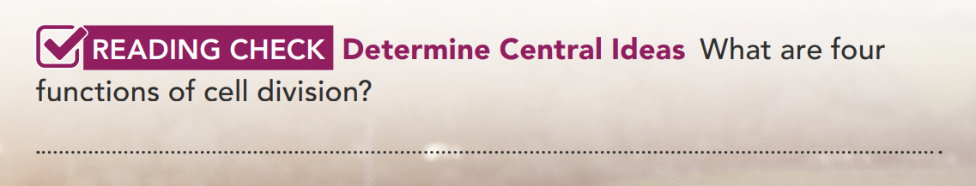
Cell Repair
If you have ever had a cut or broken bone, your body has repaired itself through cell division.
As cells age and die, they need to be replaced. Some cells last a long time and others wear out quickly
Skin cells- age very quickly
Brain cells- live very long and don’t get replaced often
Repair, replace, grow, and reproduce cells

Slide 12
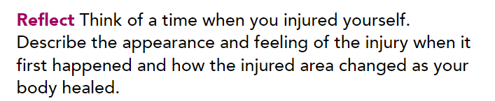

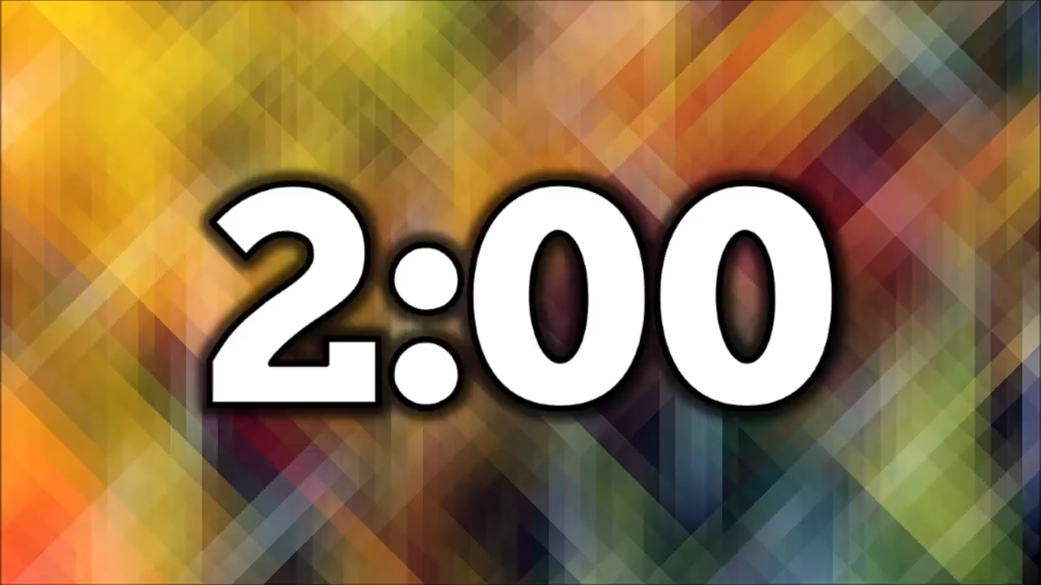

Slide 13
Question: Cell Division helps multicellular animals to ______.
A. get smarter
B. grow, develop, and get smarter
C. grow, develop, and repair
D. turn purple
E. reproduce

Slide 14
Question: Cell Division helps multicellular animals to ______.
A. get smarter
B. grow, develop, and get smarter
C. grow, develop, and repair
D. turn purple
E. reproduce

Slide 15
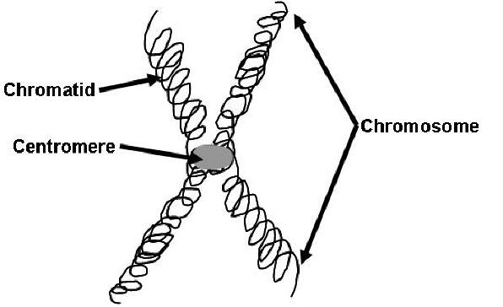
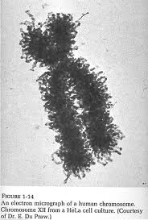
What part of the cell is involved in cell division?
DNA (Deoxyribonucleic Acid) - the chemical that contains information for an organism’s growth and function
Chromosomes- DNA contain into two chromatids held together by a centromere.

Slide 16
Question: DNA is wrapped around proteins to be made into_____.
A. Nucleotides
B. RNA
C. DNA
D. Ribosomes
E. Chromosomes

Slide 17
Question: DNA is wrapped around proteins to be made into_____.
A. Nucleotides
B. RNA
C. DNA
D. Ribosomes
E. Chromosomes

Slide 18

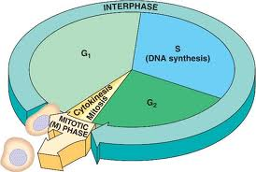
The Cell Cycle
The regular sequence of events in which the cell grows, prepares for division and divides to form two daughter cells is called cell division
Three main stages:
Interphase
Mitosis
Cytokinesis

Slide 19
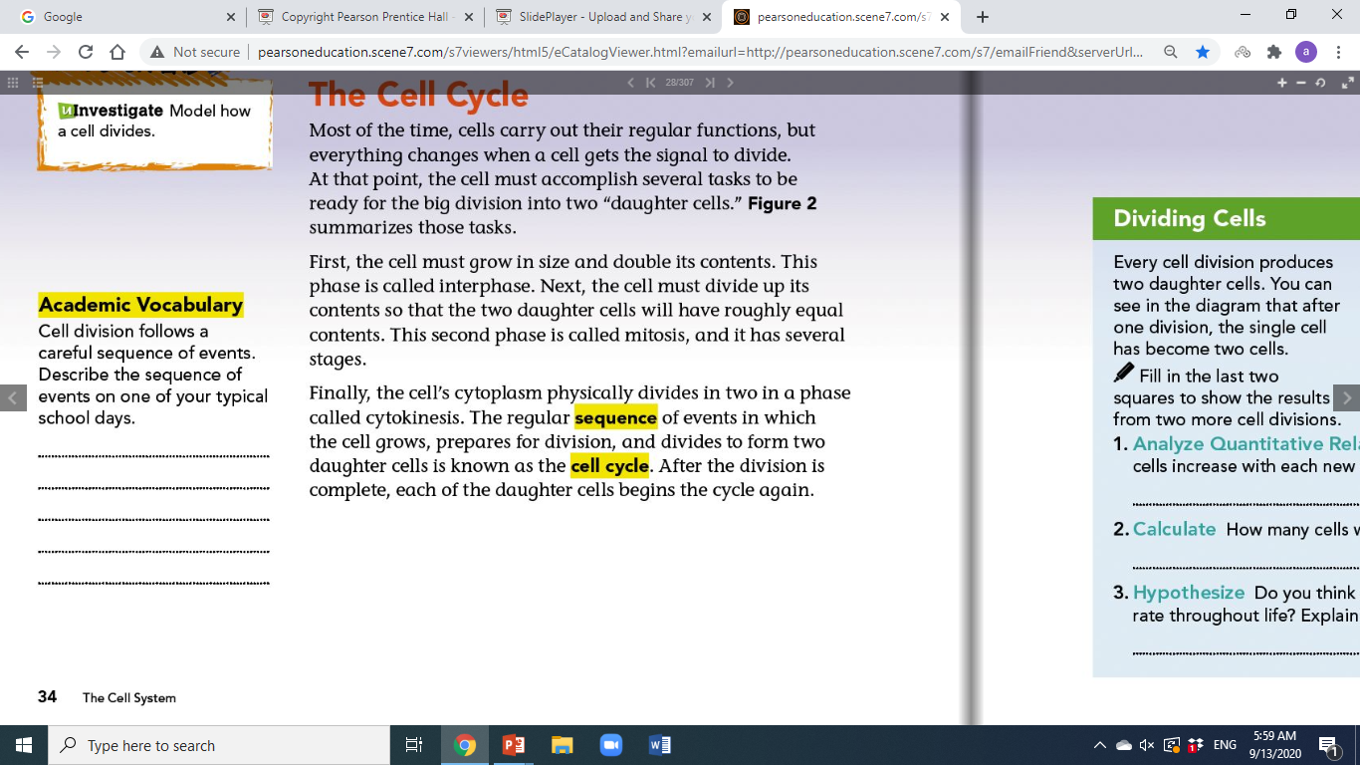
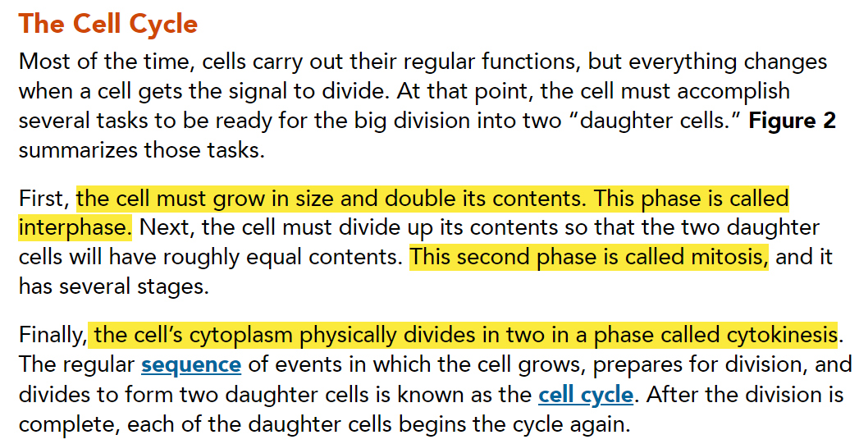
Waking up, getting ready for school, going to class, lunch, going to class, going home, and completing homework
Page 34

Slide 20
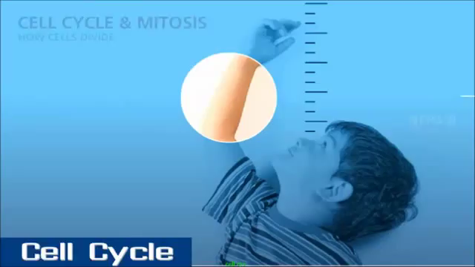

Slide 21
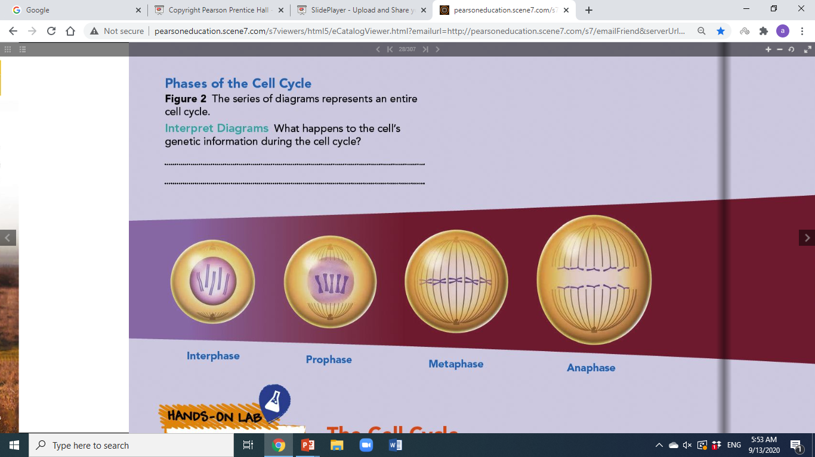
Page 34
Genetic information gets divided so that each daughter cell gets the same information.

Slide 22
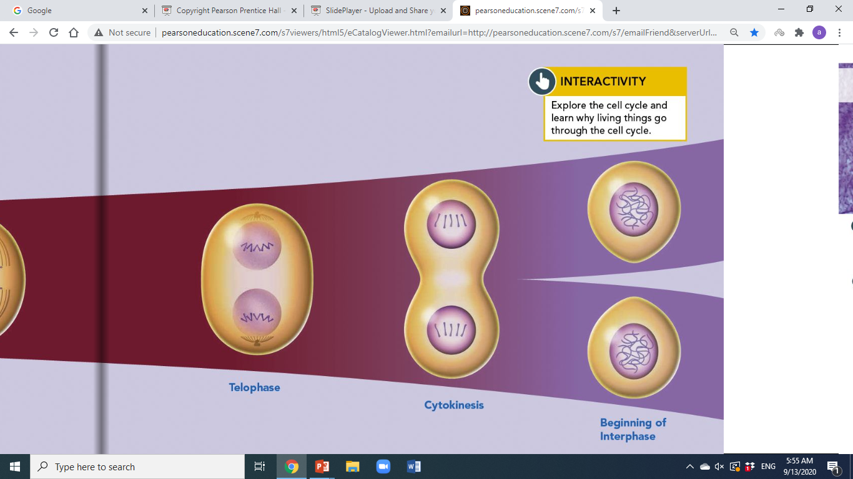
Page 35

Slide 23
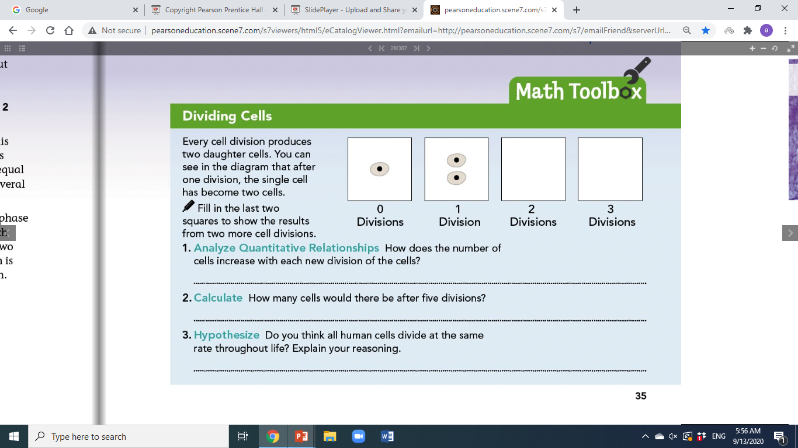


Page 35
The number of cells doubles each time.
32 cells
No, cells probably divide faster in children because children are growing quickly.

Slide 24
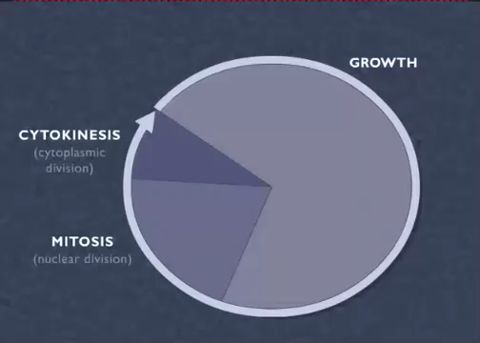
Interphase

Slide 25
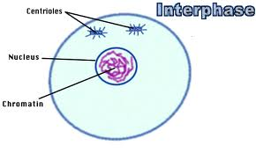
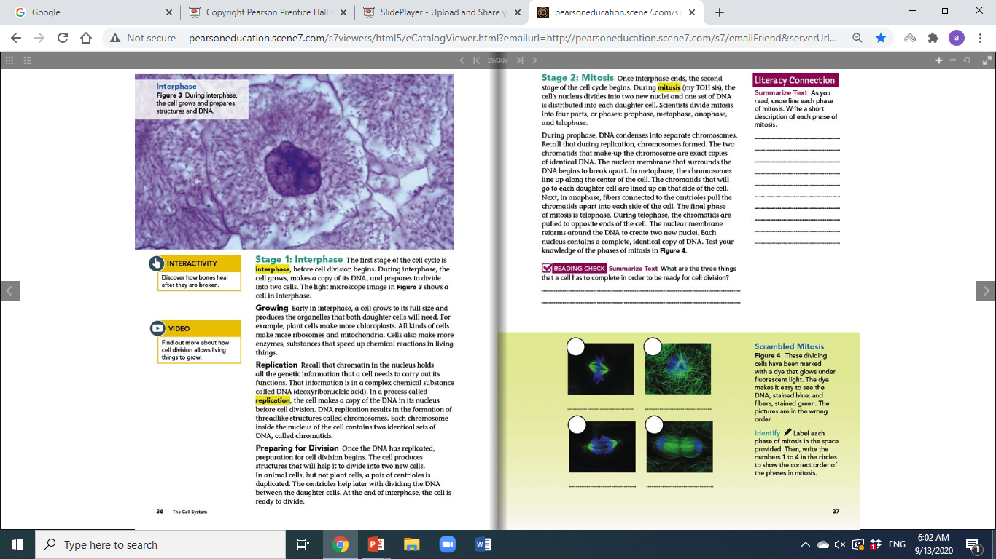
The Cell Cycle
Interphase- The cell grows in size and makes copy of its DNA (DNA duplicates exactly).
and prepares to grow into new cells

Slide 26
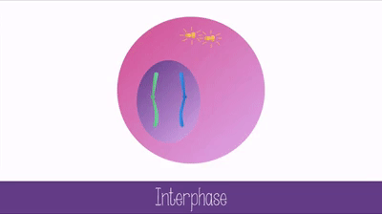
The Cell Cycle- Interphase
Growth - Cell grows to its full size and produce organelle needed both for daughter cells
(Ex. Ribosomes, Mitochondria, Chloroplast, Enzymes(substances that speed up chemical reactions in living things))
Replication- Cell makes copy of DNA (deoxyribonucleic acid) in its nucleus before cell division
Preparing for division-
Cell produce structures that will help it
to divide
(In animal Cell- pair of centrioles is duplicated.
Not in plant cell)

Slide 27
The Cell Cycle- Interphase
Stage 1: Interphase The first stage of the cell cycle is interphase, before cell division begins. During interphase, the cell grows, makes a copy of its DNA, and prepares to divide into two cells. The light microscope image in Figure 3 shows a cell in interphase.
Growing Early in interphase, a cell grows to its full size and produces the organelles that both daughter cells will need. For example, plant cells make more chloroplasts. All kinds of cells make more ribosomes and mitochondria. Cells also make more enzymes, substances that speed up chemical reactions in living things.
Replication Recall that chromatin in the nucleus holds all the genetic information that a cell needs to carry out its functions. That information is in a complex chemical substance called DNA (deoxyribonucleic acid). In a process called replication, the cell makes a copy of the DNA in its nucleus before cell division. DNA replication results in the formation of threadlike structures called chromosomes. Each chromosome inside the nucleus of the cell contains two identical sets of DNA, called chromatids.
Preparing for Division Once the DNA has replicated, preparation for cell division begins. The cell produces structures that will help it to divide into two new cells. In animal cells, but not plant cells, a pair of centrioles is duplicated. The centrioles help later with dividing the DNA between the daughter cells. At the end of interphase, the cell is ready to divide.

Slide 28
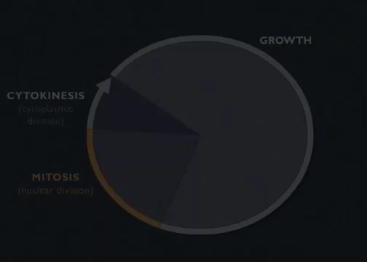
Mitosis

Slide 29
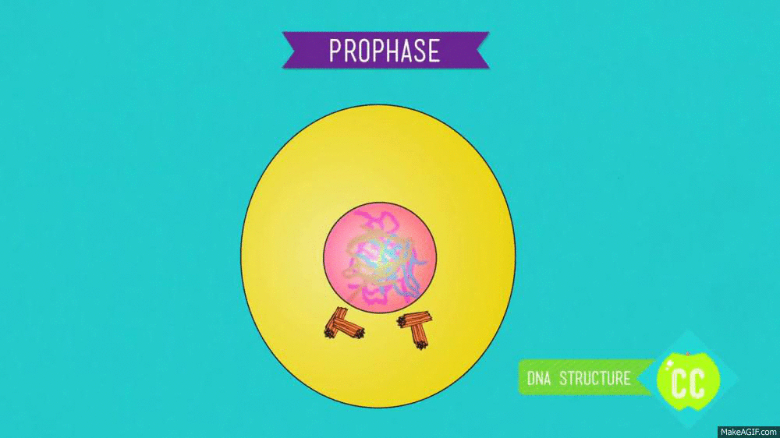
Cell Cycle Continued
2. Mitosis- Cell’s nucleus divides into two new nuclei and one set of DNA is distributed into each daughter cell.
Four steps
Prophase- During prophase, DNA condenses into separate chromosomes. Recall that during replication, chromosomes formed. The two chromatids that make-up the chromosome are exact copies of identical DNA. The nuclear membrane that surrounds the DNA begins to break apart.

Slide 30
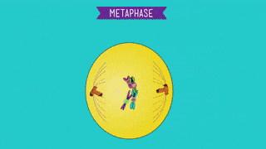
Cell Cycle Continued
2. Mitosis- Cell’s nucleus divides into two new nuclei and one set of DNA is distributed into each daughter cell.
Four steps
Metaphase - The chromosomes line up along the center of the cell. The chromatids that will go to each daughter cell are lined up on that side of the cell.

Slide 31
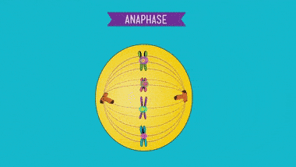
Cell Cycle Continued
2. Mitosis- Cell’s nucleus divides into two new nuclei and one set of DNA is distributed into each daughter cell.
Four steps
Anaphase - fibers connected to the centrioles pull the chromatids apart into each side of the cell. Chromatids split and are pulled to opposite sides of the cell.

Slide 32
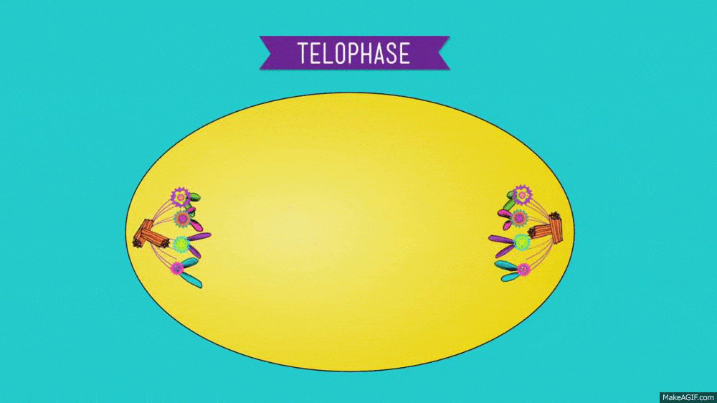
Cell Cycle Continued
2. Mitosis- Cell’s nucleus divides into two new nuclei and one set of DNA is distributed into each daughter cell.
Four steps
Telophase - During telophase, the chromatids are pulled to opposite ends of the cell. The nuclear membrane reforms around the DNA to create two new nuclei. Each nucleus contains a complete, identical copy of DNA.

Slide 33
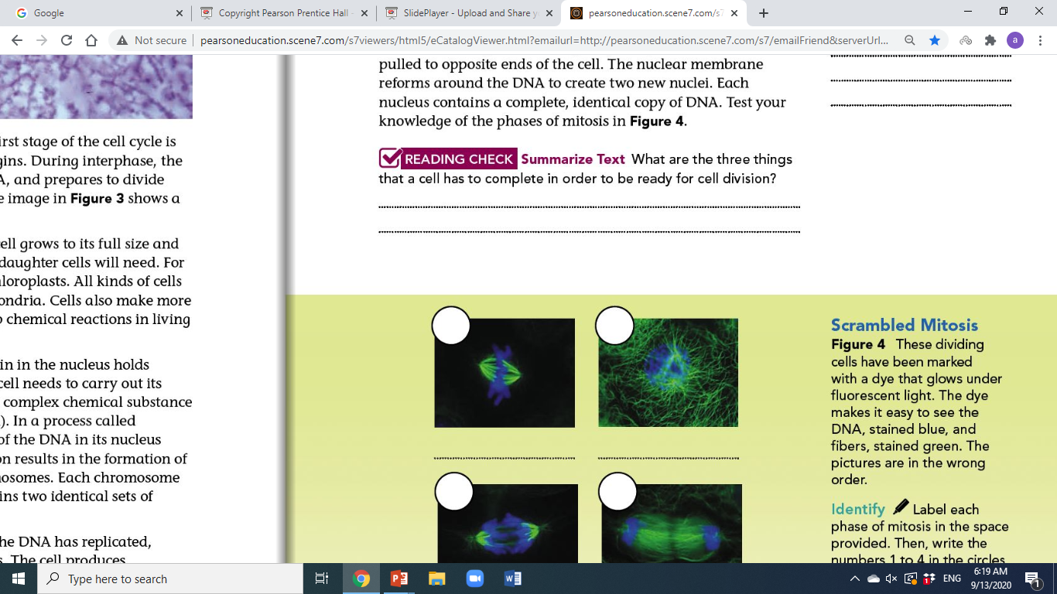
Page 37
Duplicate materials inside the cell, replicate DNA, prepare for the cell to divide (from centrioles in animal cells)

Slide 34
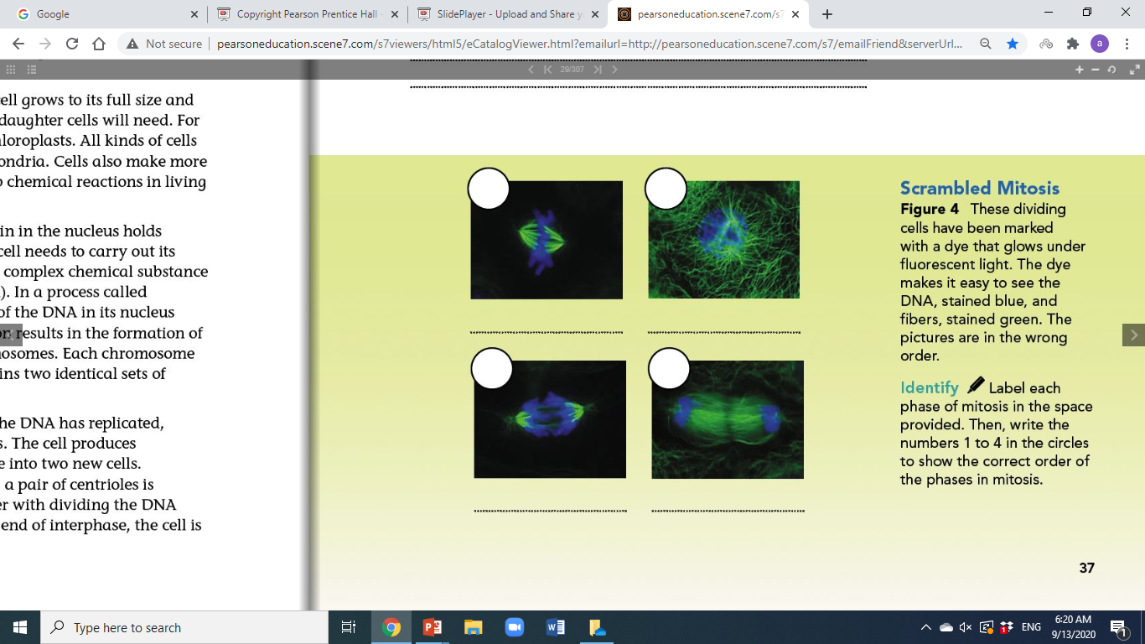
Page 37
2
1
metaphase
prophase
3
4
anaphase
telophase

Slide 35
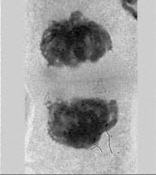
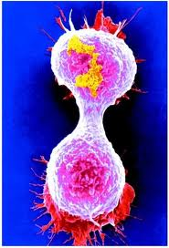
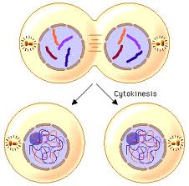
3. Stage 3: Cytokinesis: The final stage of the cell cycle is called cytokinesis. This stage completes the process of cell division. During cytokinesis, the cell's cytoplasm divides, distributing the organelles into each of the two new daughter cells. Cytokinesis usually starts at about the same time as telophase. When cytokinesis is complete, each daughter cell has the same number of chromosomes as the parent cell. Next, each cell enters interphase and the cell cycle begins again.

Slide 36
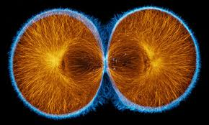
Cytokinesis
Animal Cells:
Cytokinesis in Animal Cells During cytokinesis in animal cells, the cell membrane squeezes together around the middle of the cell. The cytoplasm pinches into two cells. Each daughter cell gets about half of the organelles of the parent cell.

Slide 37
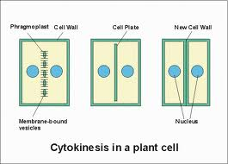
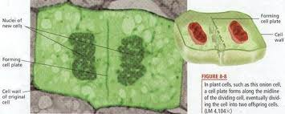
Cytokinesis
Plant Cells:
Cytokinesis is somewhat different in plant cells. A plant cell's rigid cell wall cannot squeeze together in the same way that a cell membrane can. Instead, a structure called a cell plate forms across the middle of the cell, as shown in Figure 5. The cell plate begins to form new cell membranes between the two daughter cells. New cell walls then form around the cell membranes.

Slide 38
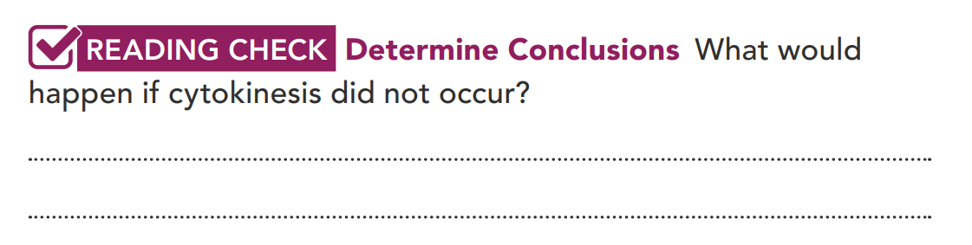
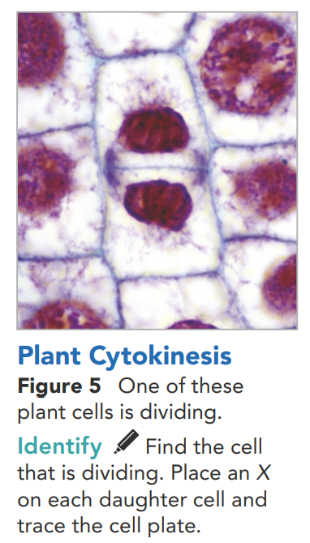
The cell would not divide into two cells.

Slide 39
Recap
Interphase- The cell is preparing to divide and doing its daily functions or jobs
Mitosis- Nucleus is preparing for Division and there are 4 phases- prophase, metaphase, anaphase, and telophase
Cytokinesis- The cytoplasm divides resulting in 2 identical cells.

Slide 40
Question: ________ is the part of the cell cycle during which the cell is not dividing and just carrying out its normal functions.
A. Prophase
B. Mitosis
C. Cytokinesis
D. Anaphase
E. Interphase

Slide 41
Question: ________ is the part of the cell cycle during which the cell is not dividing and just carrying out its normal functions.
A. Prophase
B. Mitosis
C. Cytokinesis
D. Anaphase
E. Interphase

Slide 42
Question: ________ is the division of the cytoplasm at the end of mitosis.
A. Prophase
B. Mitosis
C. Cytokinesis
D. Interphase
E. Anaphase

Slide 43
Question: ________ is the division of the cytoplasm at the end of mitosis.
A. Prophase
B. Mitosis
C. Cytokinesis
D. Interphase
E. Anaphase

Slide 44
Question: ________ is the phase of mitosis where the chromosomes first appear.
A. Metaphase
B. Prophase
C. Telophase
D. Anaphase
E. Interphase

Slide 45
Question: ________ is the phase of mitosis where the chromosomes first appear.
A. Metaphase
B. Prophase
C. Telophase
D. Anaphase
E. Interphase

Slide 46
Question: _________ is the part of mitosis where a new nuclear membrane forms and chromosomes turn threadlike.
A. Metaphase
B. Prophase
C. Telophase
D. Anaphase
E. Interphase

Slide 47
Question: _________ is the part of mitosis where a new nuclear membrane forms and chromosomes turn threadlike.
A. Metaphase
B. Prophase
C. Telophase
D. Anaphase
E. Interphase

Slide 48
Question: This is the phase of mitosis where the chromosomes line up in the middle.
A. Metaphase
B. Prophase
C. Telophase
D. Anaphase
E. Interphase

Slide 49
Question: This is the phase of mitosis where the chromosomes line up in the middle.
A. Metaphase
B. Prophase
C. Telophase
D. Anaphase
E. Interphase

Slide 50
Question: This is the phase in mitosis where the chromosomes separate and get pulled to opposite sides of the cell.
A. Metaphase
B. Prophase
C. Telophase
D. Interphase
E. Anaphase

Slide 51
Question: This is the phase in mitosis where the chromosomes separate and get pulled to opposite sides of the cell.
A. Metaphase
B. Prophase
C. Telophase
D. Interphase
E. Anaphase

Slide 52
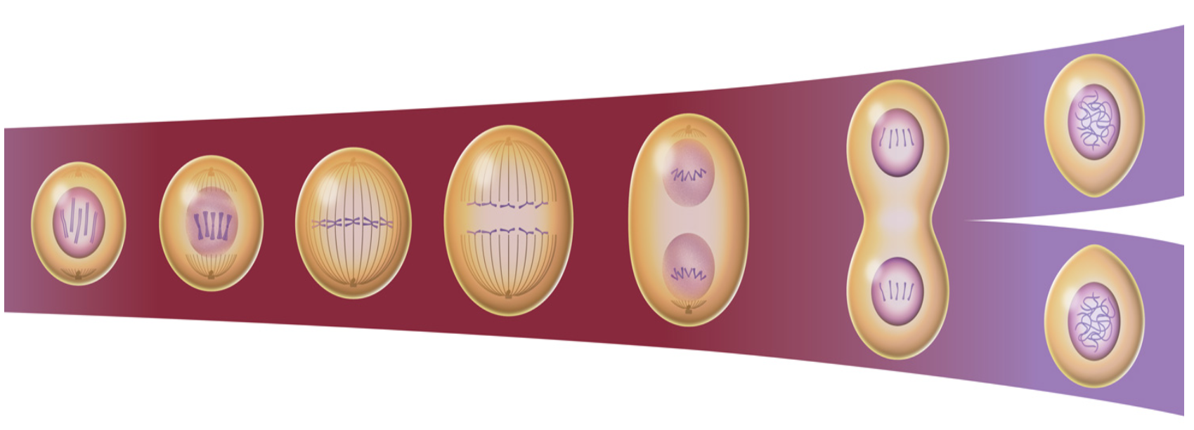
Name the different phases of the cell cycle
Interphase
Metaphase
Prophase
Telophase
Anaphase
Cytokinesis
Beginning of Interphase

Slide 53
Explain Why is it important for the cells in your body to go through the cell cycle?
2. Construct Explanations How does a plant cell accomplish cytokinesis?
3. CCC Patterns When you look at cells under a microscope, how can you recognize cells that are dividing?
Explain Phenomena Why does the cell need to replicate its DNA during interphase?
So our body can grow, replace damaged cells, and replace old cells to maintain life.
During cytokinesis, plant cells form a cell plate between the two daughter cells. Then, cell membrane and cell walls grow around the new cells.
The chromosomes are condensed, there are two nuclei visible, and the cell membrane is pinching the cell into two.
The cell replicates its DNA so that each daughter cell will have a complete set of DNA after cell division.

Slide 54
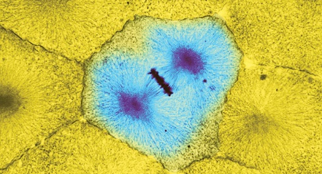
5. CCC Cause and Effect If a single-celled organism is unable to undergo cell division, what will happen to that organism?
6. SEP Interpret Data What is happening during this part of the cell cycle?
7. Form a Hypothesis What would happen to a cell that didn't replicate its DNA before cell division?
The organism will not be able to reproduce asexually. No new offspring can be created.
The cell is in metaphase. All of the chromosomes are lined up with one chromatid on each side of the cell.
The daughter cells would not have the same DNA as the parent cell, so they couldn’t function normally.

