Slide 1
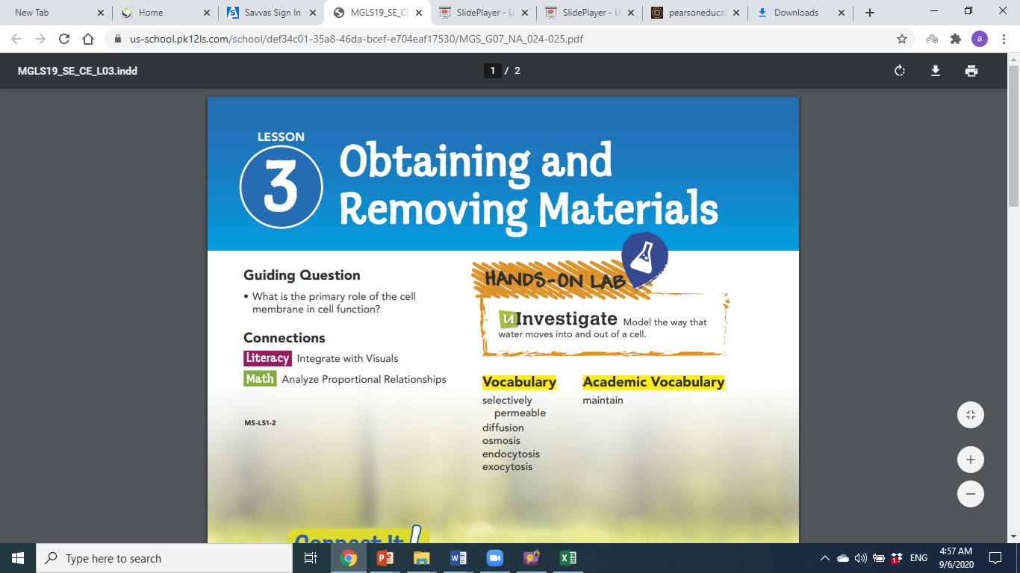

Open Pg. 24

Slide 2

Vision
The first and the highest quality educational investor and the most rapid spread
Mission
Providing a competitive international education with applied dimensions that build skill, instill value, and develop creativity in accordance with the constants of religion the national orientations in an attractive, educational environment that stimulates learning with a community knowledge-producing knowledge, producing generation

Slide 3


Slide 4

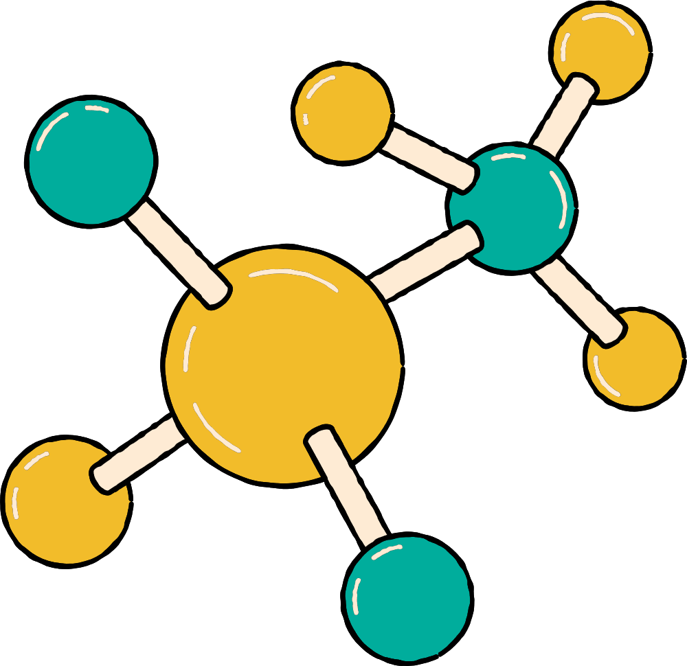
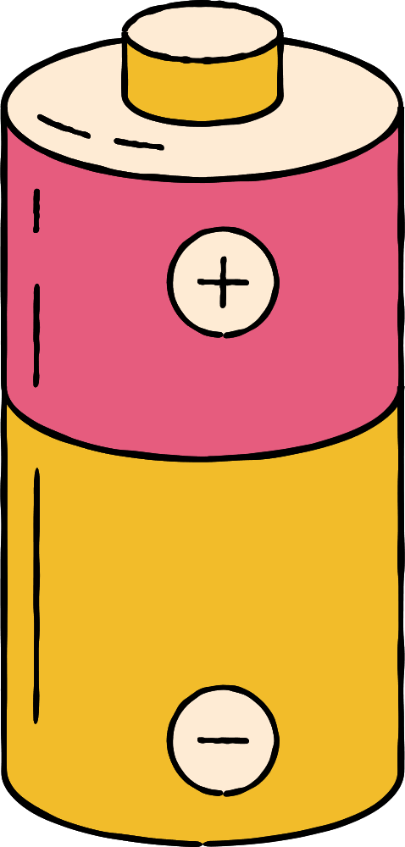



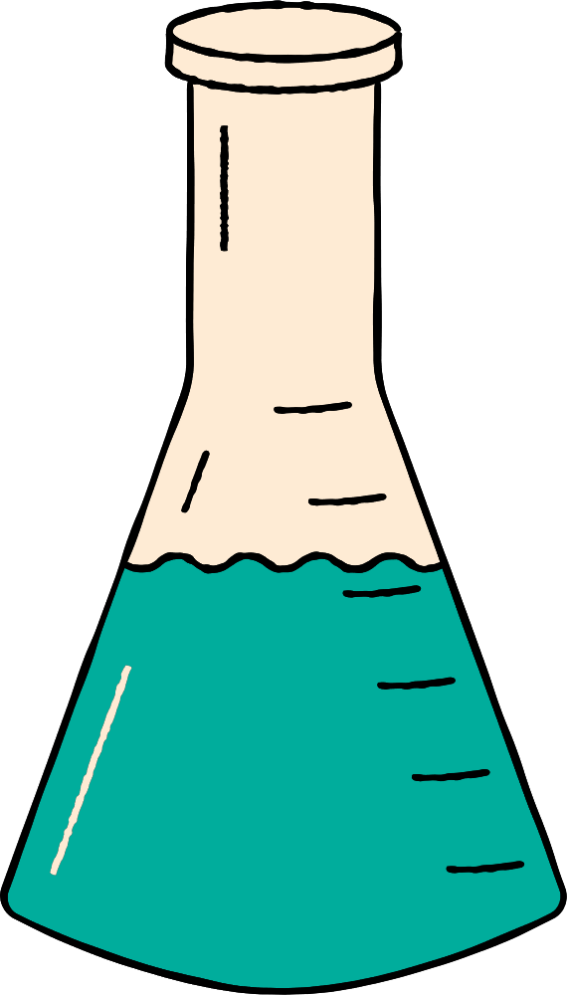




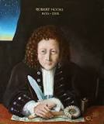




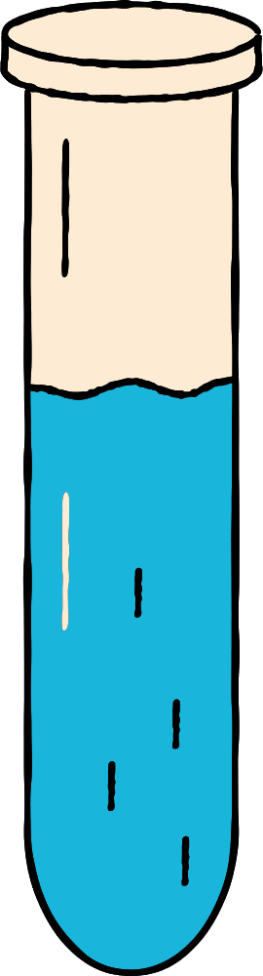
Scientist of the week
Robert Hooke
Initially discovered by Robert Hooke in 1665, the cell has a rich and interesting history that has ultimately given way to many of today's scientific advancements.

Slide 5
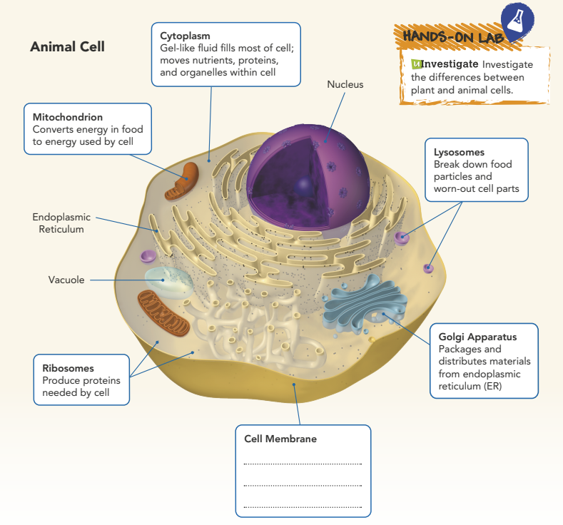
Looking at the picture guess what is Matter?
Al-Haqbana
Forms barrier;
Controls what goes in and out of cell
Notes:
Looking at the picture guess what is Matter?

Slide 6

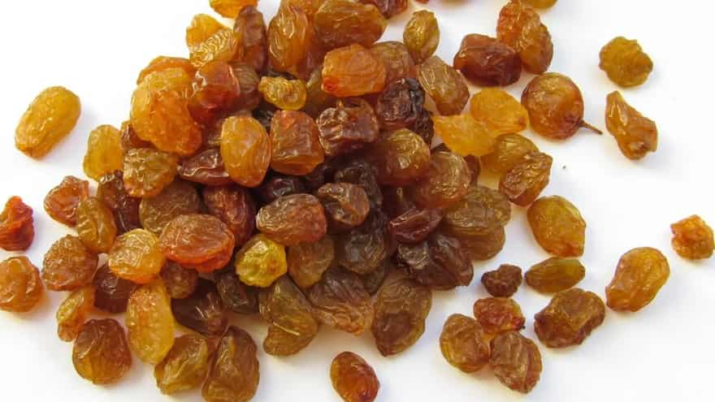
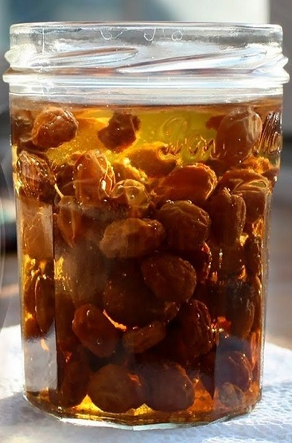
Hook Activity

Slide 7
GUIDING QUESTIONS
  • What is the primary role of the cell
  membrane in cell function?

Slide 8
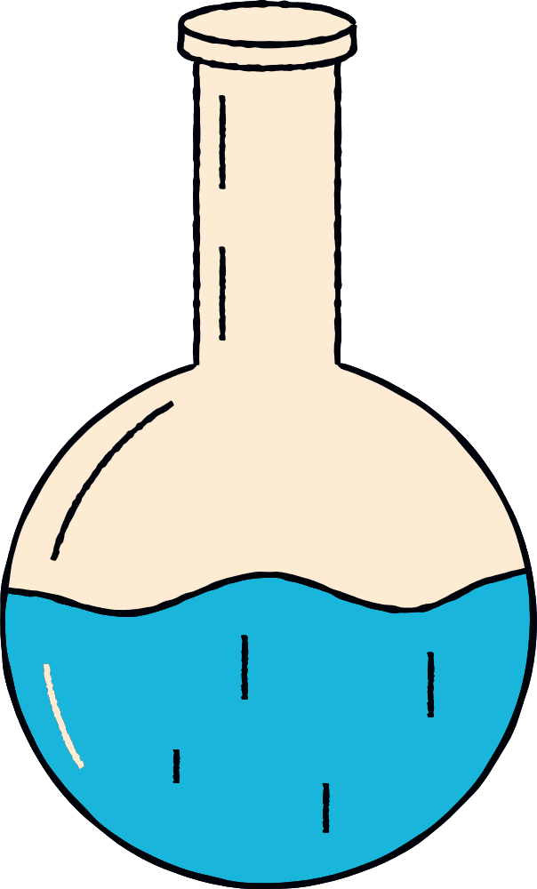

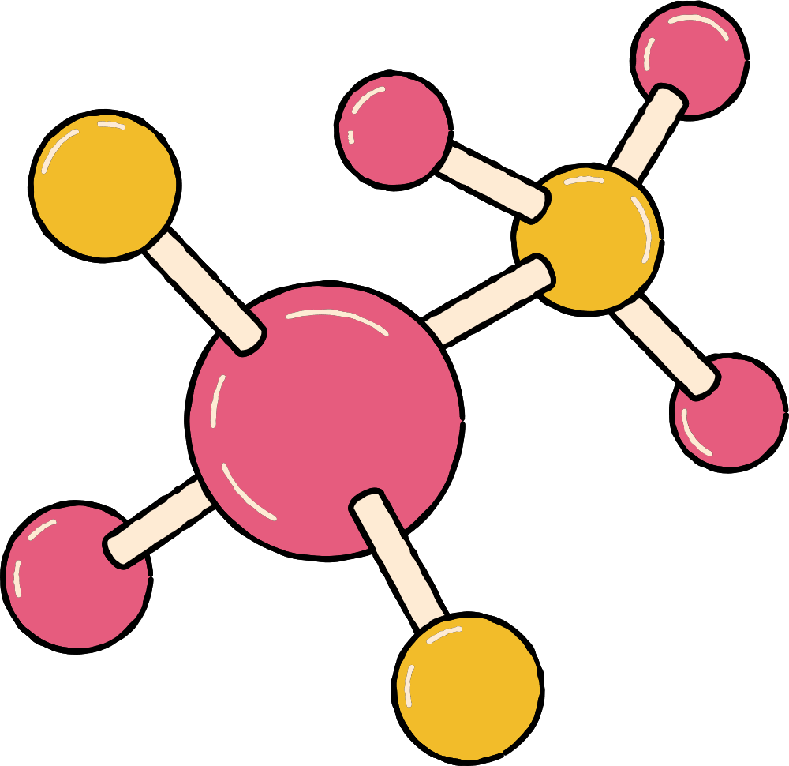



VOCABULARY
selectively
permeable
diffusion
osmosis
endocytosis
exocytosis

Slide 9
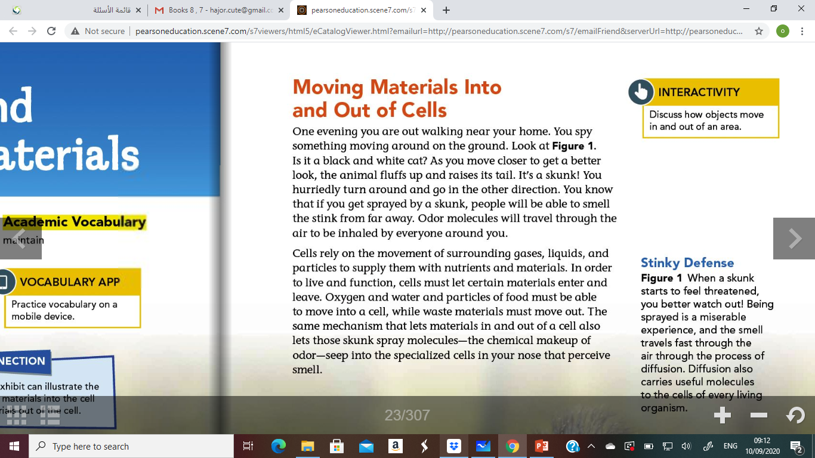
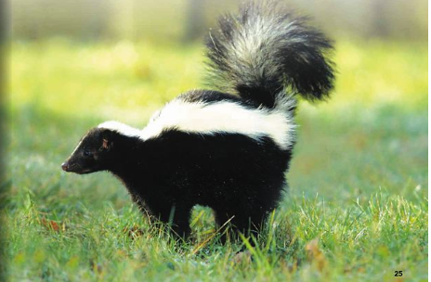

Slide 10

Page 24

Slide 11
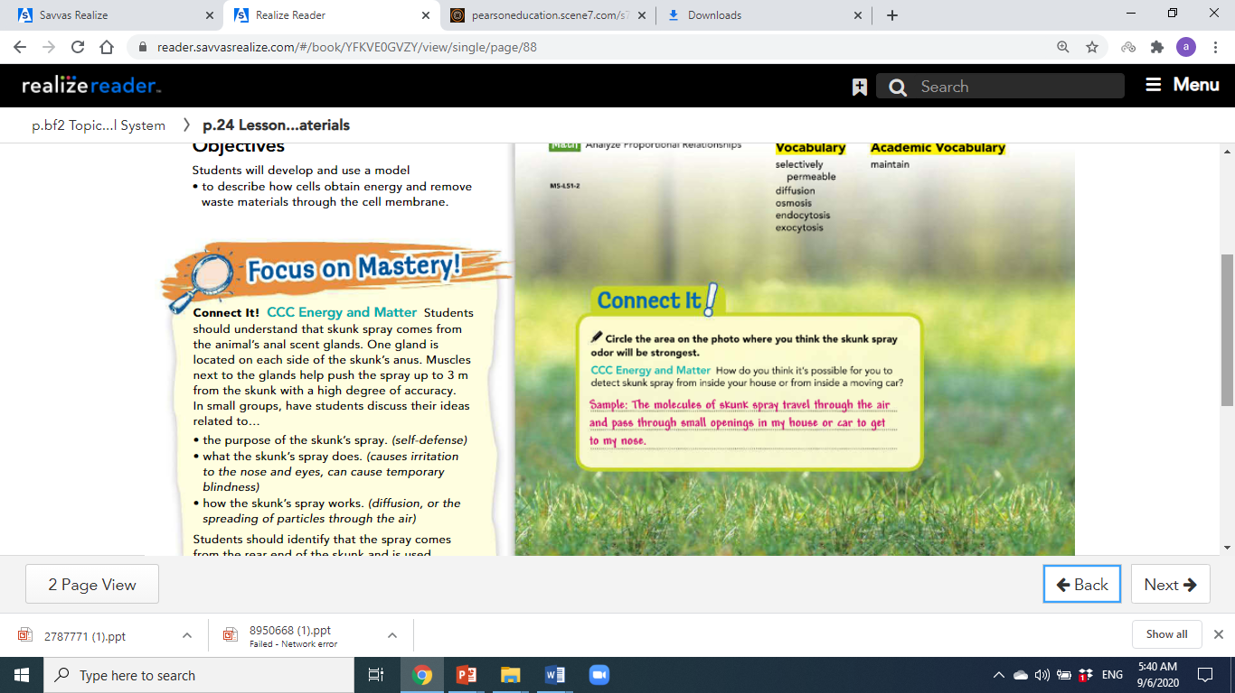
Page 24

Slide 12
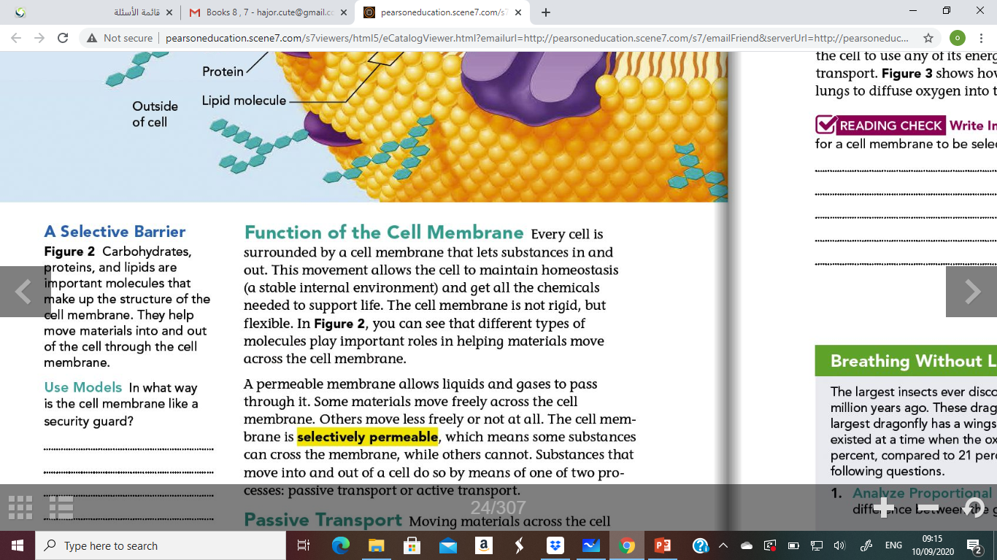
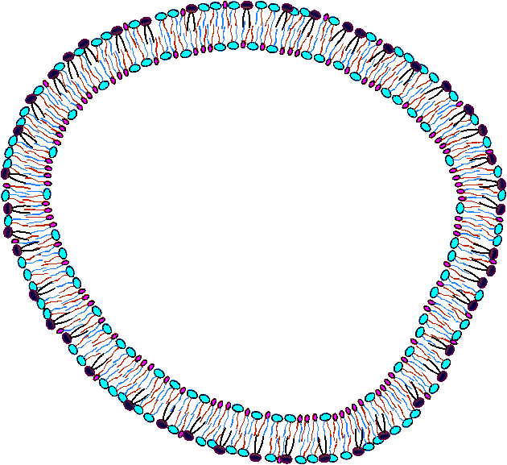
Cell Membrane

Slide 13
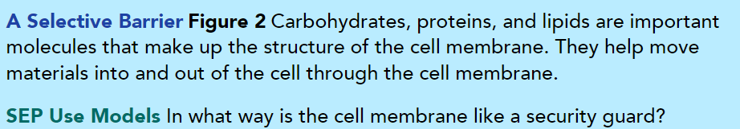
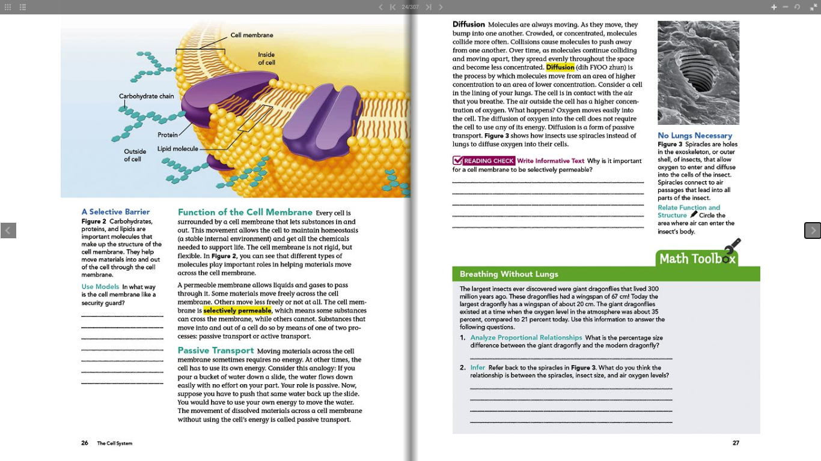
Cell Membrane
The cell membrane allows some materials and not others to pass in and out of the cell, just like a guard control which people can go into or leave a building.

Slide 14

The Movement of the substance in and out of the cell by 2 process :
1- Passive transport
2- Active transport

Slide 15
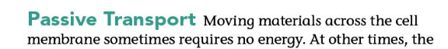
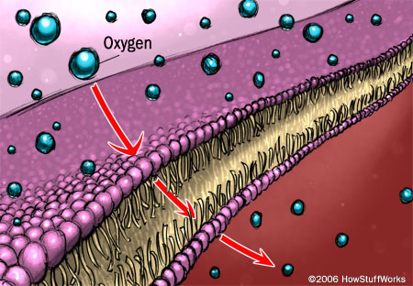

Slide 16
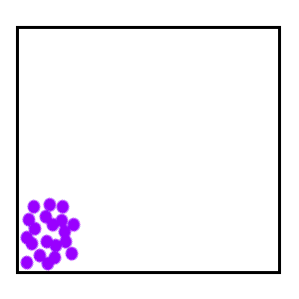
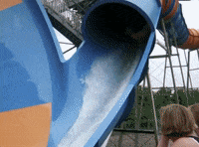
Passive Transport
Passive Transport: is movement across the cell membrane that does not require energy form the cell. Particles move along their concentration gradient. Does not require energy.

Slide 17
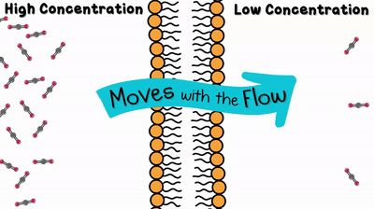
Passive Transport
Passive Transport:

Slide 18
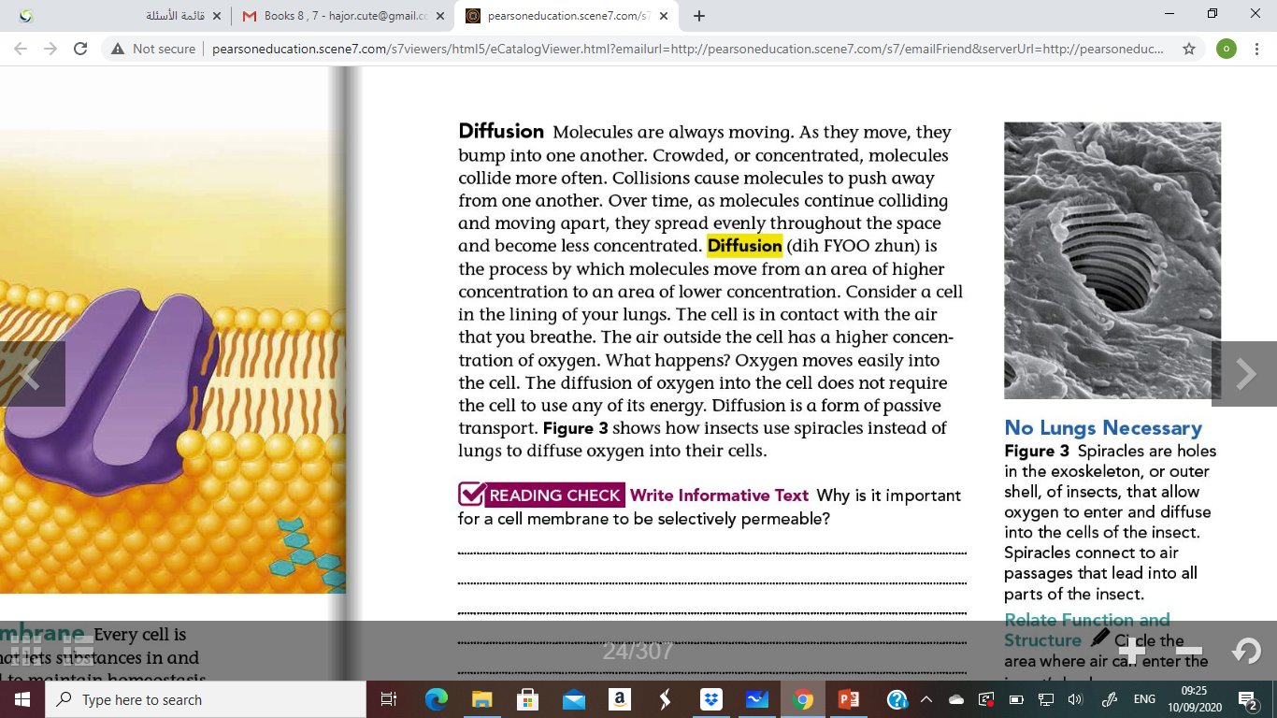
Passive Transport

Slide 19
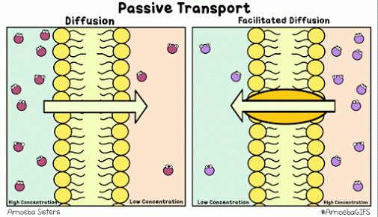
Passive Transport

Slide 20
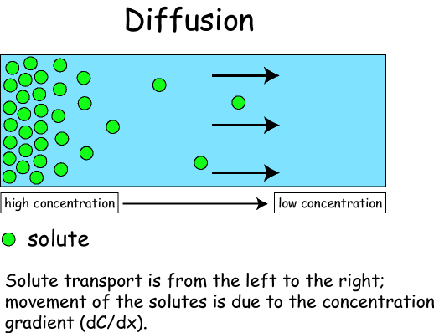
Diffusion
Diffusion: The movement of a substance from an area of high concentration to an area of low concentration.
If diffusion is allowed to continue, equilibrium will result.

Slide 21
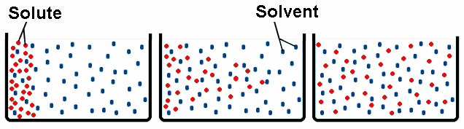
Interpret what is happening in this picture?
A B C

Slide 22
DIFFUSION
The movement of molecules from an area of high concentration to low concentration
  Concentration gradient = difference in concentration!
Eventually this leads to equilibrium
  Equal concentration throughout space

Slide 23
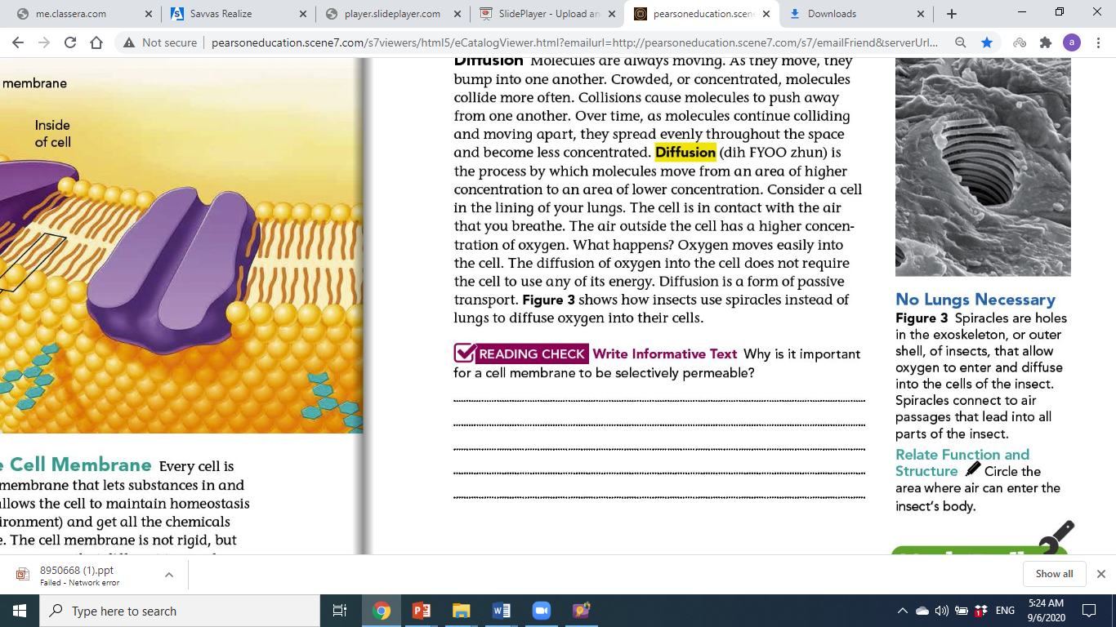
Page 27

Slide 24
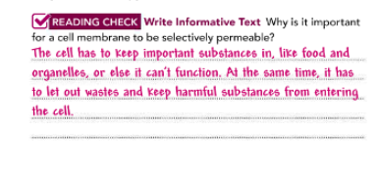
Page 27

Slide 25
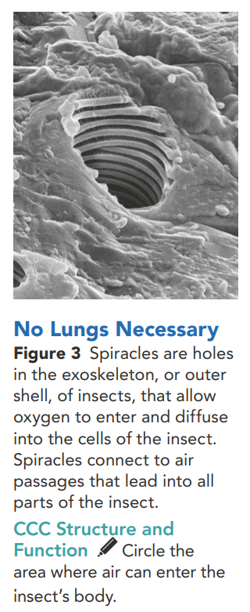

Slide 26
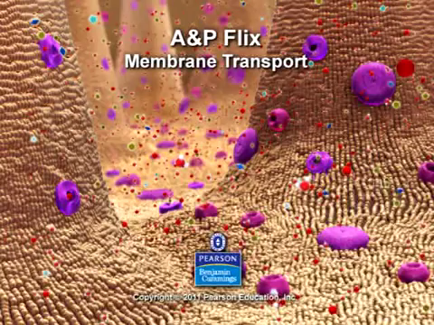

Slide 27
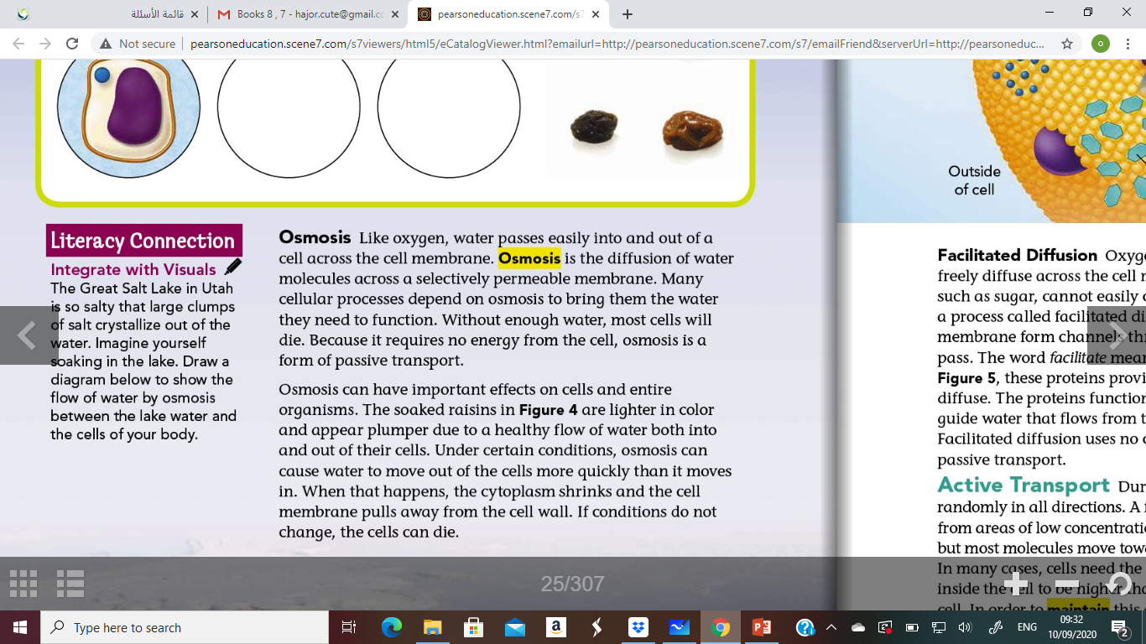
Page 27

Slide 28
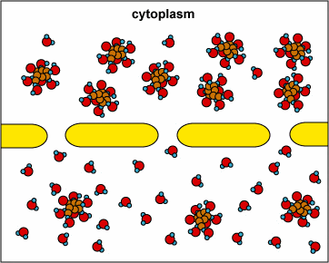
Osmosis
Osmosis: is the diffusion of water through a selectively permeable membrane along its concentration gradient.

Slide 29
The direction of water movement across the cell membrane depends on the relative concentrations of free water molecules in the cytoplasm and in the fluid outside the cell
Osmosis

Slide 30
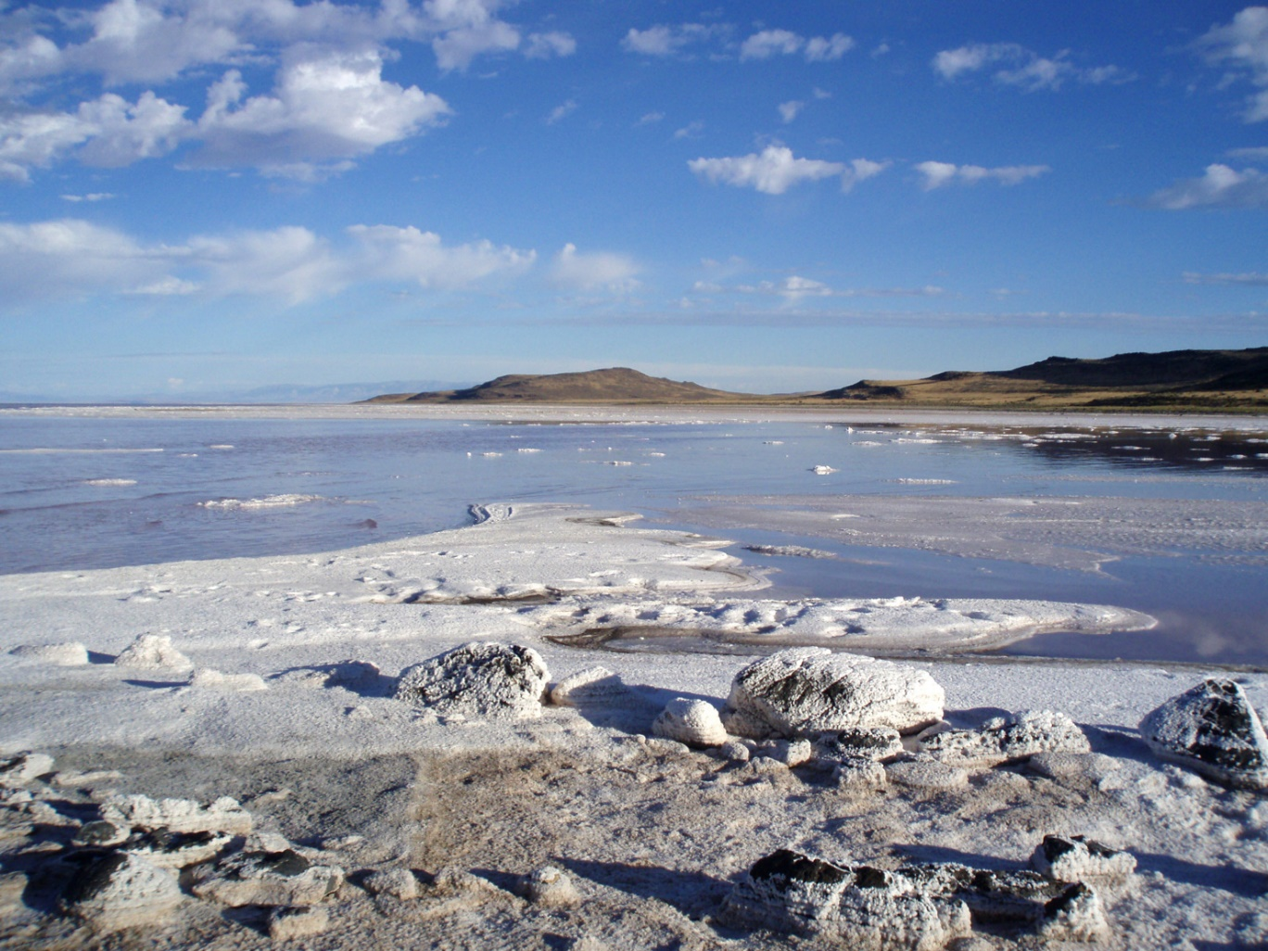
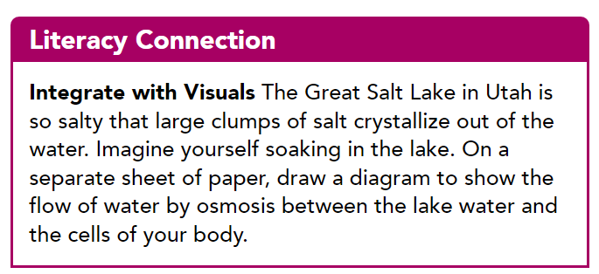

Slide 31
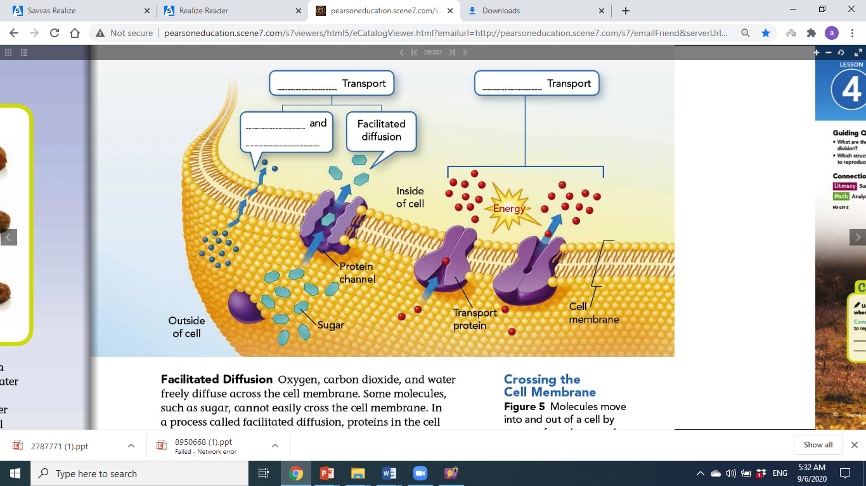
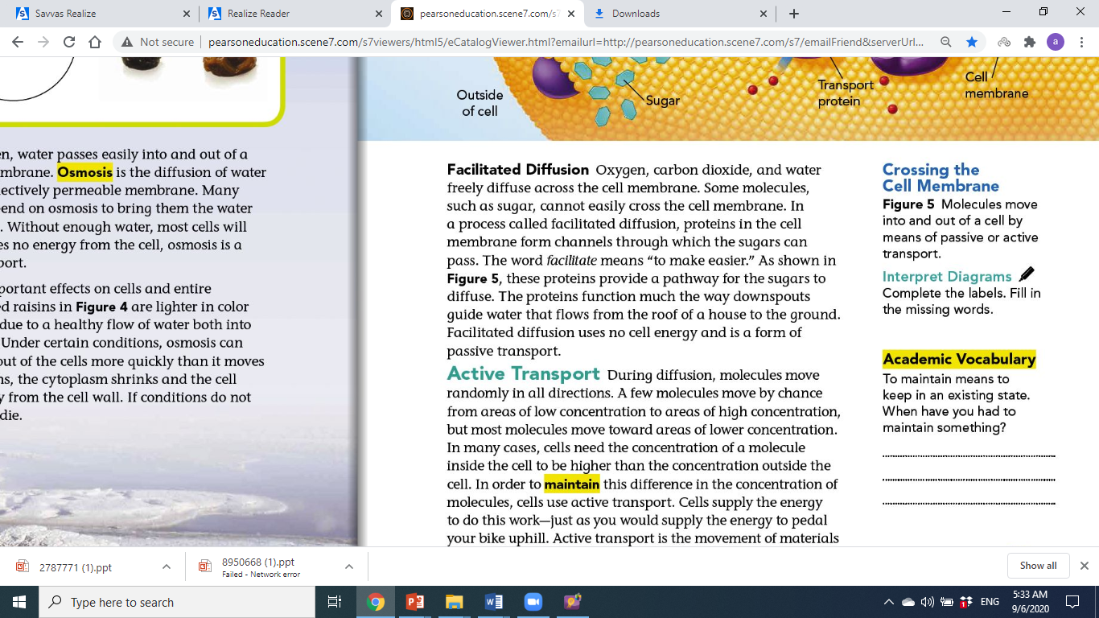
Page 29

Slide 32
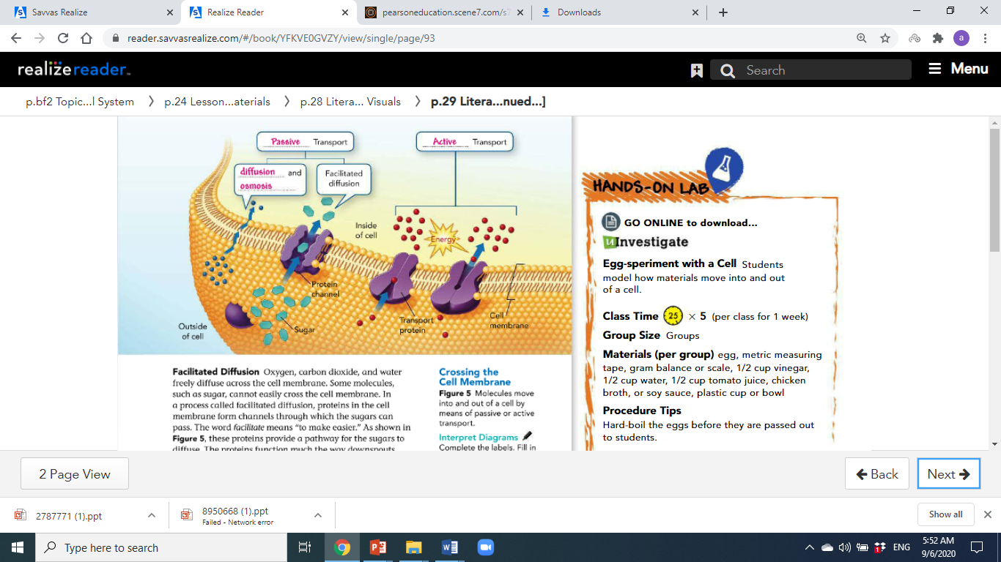
Page 29

Slide 33
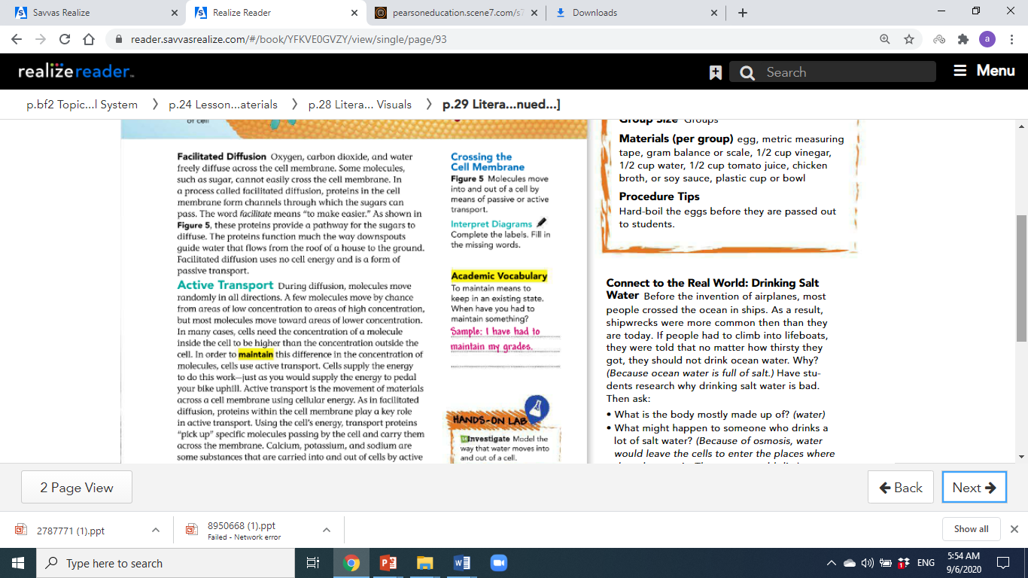
Page 29

Slide 34
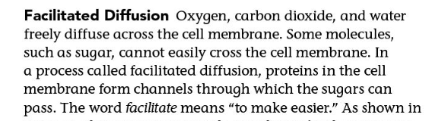
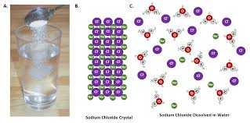
Page 27

Slide 35
H
H
H
H
O
O
H
O
O
H
H
O
H
H
O
H
H
H
O
H
O
O
H
H
O
H
H
H
H
O
H
H
O
H
O
H
H
H
H
O
Sugar Molecules

Slide 36
H
H
H
H
H
O
O
O
O
H
O
H
H
H
H
H
O
O
O
H
H
H
O
H
H
H
H
H
O
O
H
H
H
H
O
H
O
H
H
H
H
O
Sugar Molecules

Slide 37
H
H
H
H
O
H
O
O
O
H
H
H
H
O
H
O
O
H
H
O
O
H
H
H
H
H
H
O
H
H
H
O
H
O
O
H
H
H
H
H
H
O
Sugar Molecules

Slide 38
Sugar Molecules
H
H
H
H
O
O
O
H
H
H
O
H
H
O
H
H
H
O
O
O
H
H
H
H
O
H
O
O
H
H
H
H
H
H
H
O
O
O
H
H
H
O
H
H
H
H
O
H

Slide 39
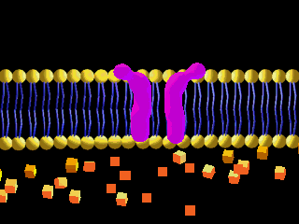
Facilitated Diffusion
Facilitated diffusion is a process in which Proteins in the cell membrane form channels through which sugar can pass

Slide 40
Facilitated Diffusion
Facilitated Diffusion uses no cell energy and is a form of Passive Transport.

Slide 41
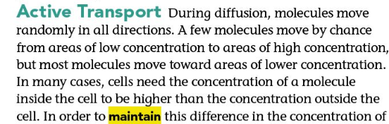
Facilitated Diffusion

Slide 42
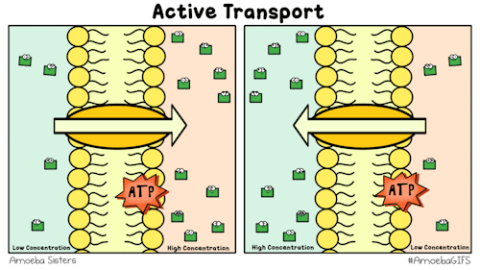
Facilitated Diffusion

Slide 43
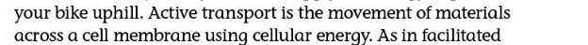
Facilitated Diffusion

Slide 44
Facilitated Diffusion
Assess your understanding :
T or F
Osmosis: is the diffusion of water through a selectively permeable membrane along its concentration gradient.

Slide 45
Facilitated Diffusion
Assess your understanding :
T or F
Diffusion: The movement of a substance from an area of low concentration to an area of high concentration.

Slide 46
Facilitated Diffusion
Assess your understanding :
T or F
Passive Transport: is movement across the cell membrane that does not require energy form the cell. Particles move along their concentration gradient. Does not require energy.

Slide 47
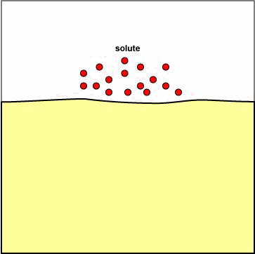
Active Transport
Cell need concentration of molecules inside the cell to be higher than outside the cell.
To maintain this difference the Cell uses Active transport

Slide 48
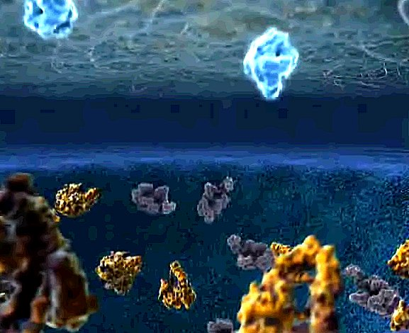
Moving Large Particles

Slide 49
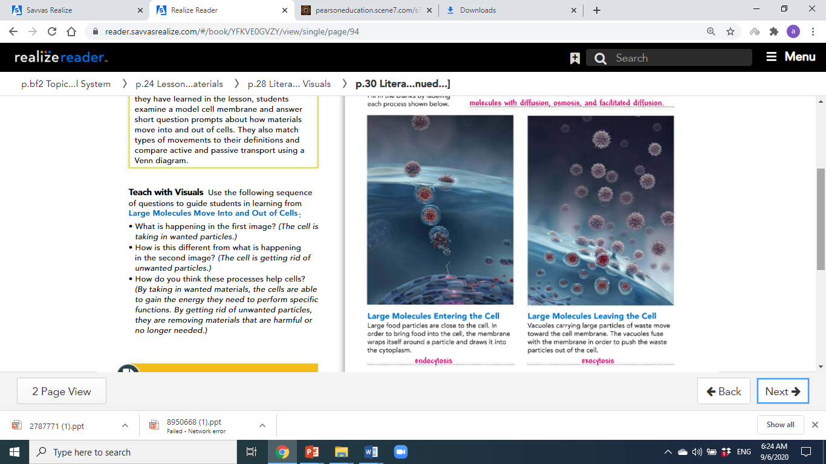
Endocytosis
Endocytosis: The cell membrane forms a pouch around a substance, that closes up and pinches off to form a vesicle.

Slide 50
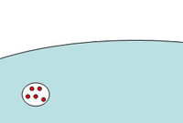
Exocytosis
Exocytosis: The movement of a substance by a vesicle to the outside of cell

Slide 51
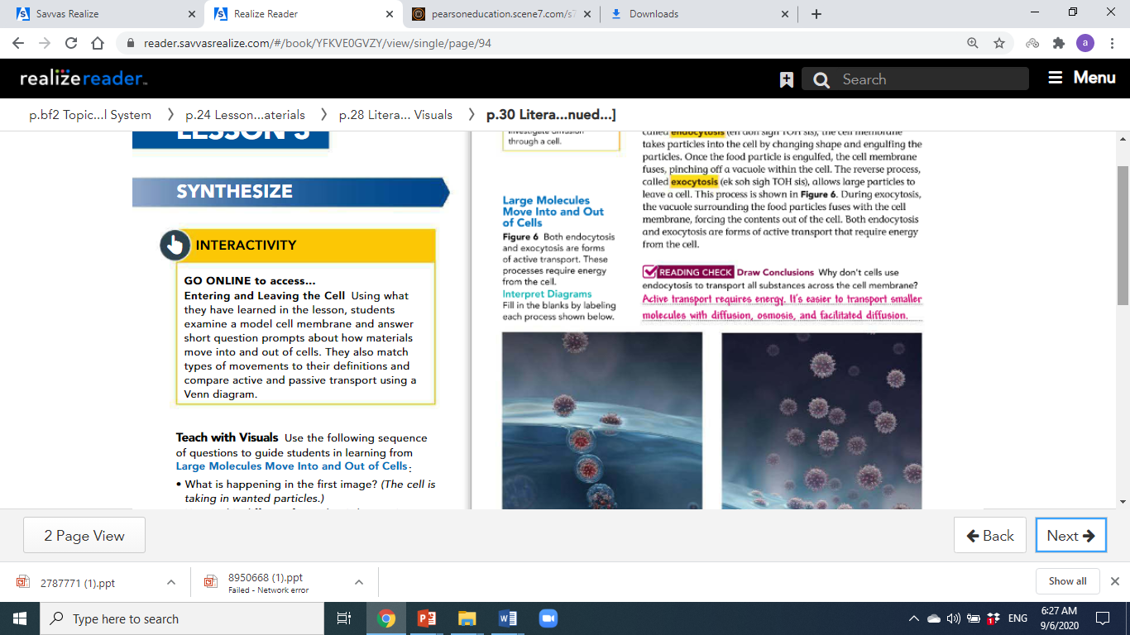

Page 30

Slide 52
Page 30

Slide 53
Page 30

Slide 54


Slide 55



Slide 56



Slide 57


Thank you

