Slide 1
SCIENCE SUBJECT FOR MIDDLE SCHOOL: T1 The Cell System
7th GRADE
L2 Cell Structure

Slide 2
Objective of this lesson:
• identify the parts of a cell, specifically the nucleus, chloroplasts, mitochondria, cell membrane, and cell wall.
• describe how each part of a cell contributes to the function of the cell as a whole.
• compare and contrast the structure and function of major parts of plant and animal cells.

Slide 3
TABLE OF CONTENTS
Pgs. 14, 15
Pgs. 16, 17
01
02
Pgs. 18, 19
Pgs. 20, 21
03
04
Parts of a Cell
Cell Wall
Cell Membrane
Pg. 22, 23
05
Cells Make Up an Organism
Lesson 2 Check
Organelles in the Cytoplasm
Golgi Apparatus
Lysosomes
Cells Working Together

Slide 4
Pgs. 14, 15
Parts of a Cell

Slide 5
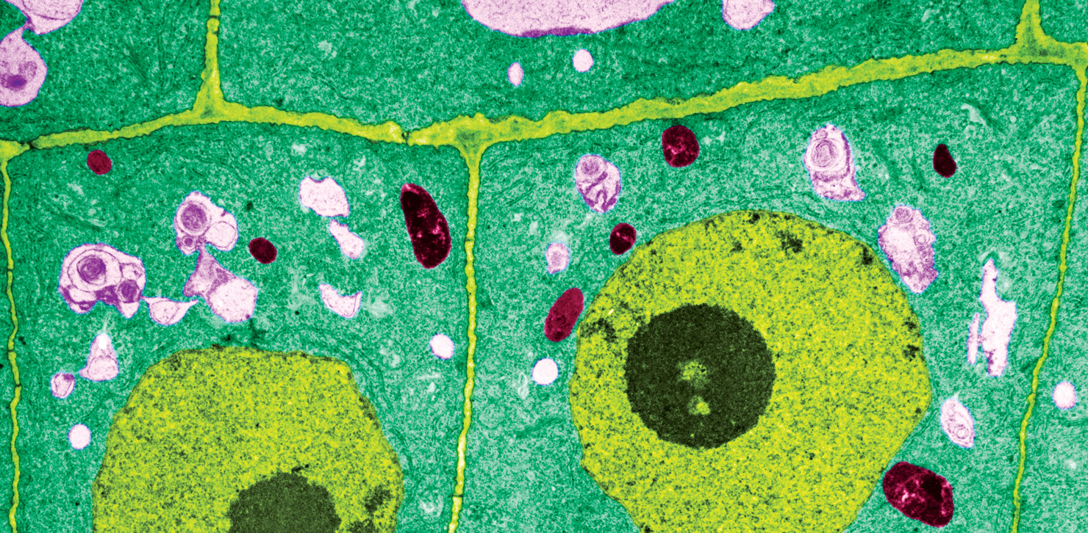

Slide 6
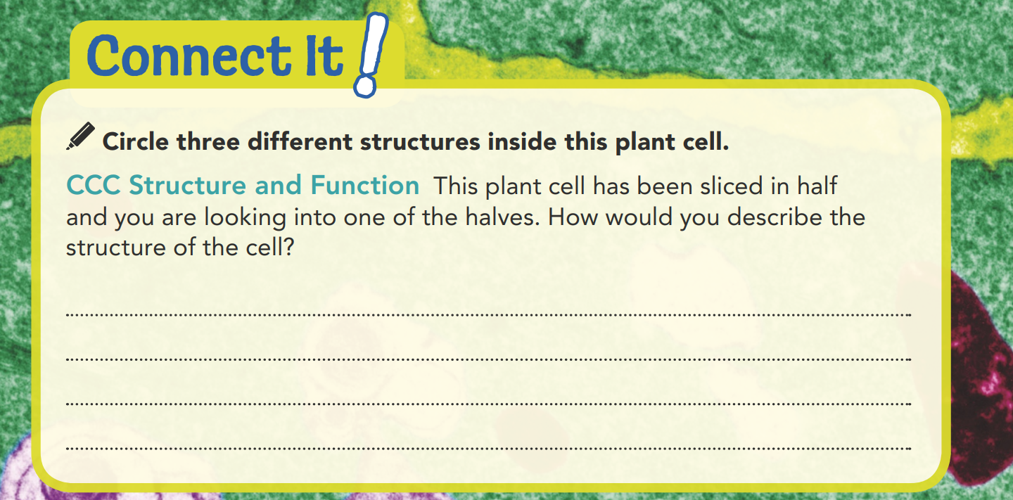
The cell has a boxy shape, it has a kind of case around it and lying in the cell is a round thing shaped like an egg with a dark round structure in it. There is also a wall separating it from other cells around it.

Slide 7
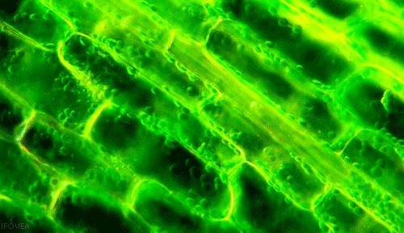
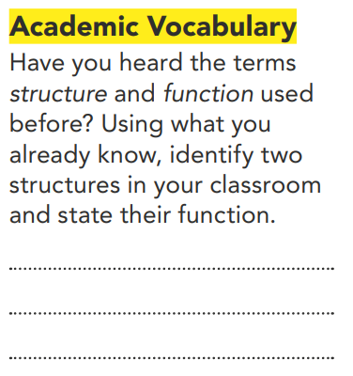
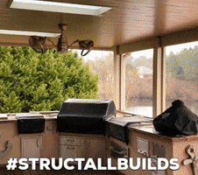
Parts of a cell
All things that you can see or touch are made up of smaller parts. Take, for example, a structure such as a house. Houses are one structure made of many parts, such wooden beams, glass windows, a roof with shingles or tiles, and other parts. They are usually filled with furniture, which makes using them easier and more comfortable. Cells are like houses in that they, too, have many parts. Just as a house without windows or a furnace might become too cold to use, cells cannot function properly without all their parts. Organelles are smaller parts that help the cells function. Form small groups and have them brainstorm other analogies for cells.
Chair – provides a place to sit. Ceiling – supports floor above.

Slide 8
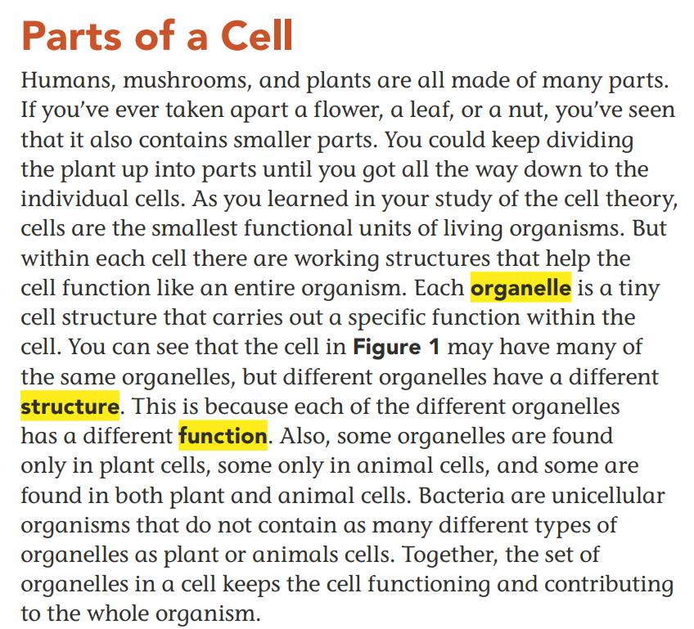
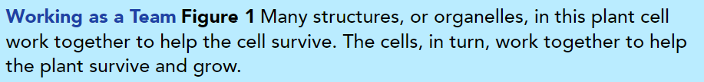
Parts of a Cell

Slide 9
Pgs. 16 ,17
Cell Wall
Cell Membrane

Slide 10
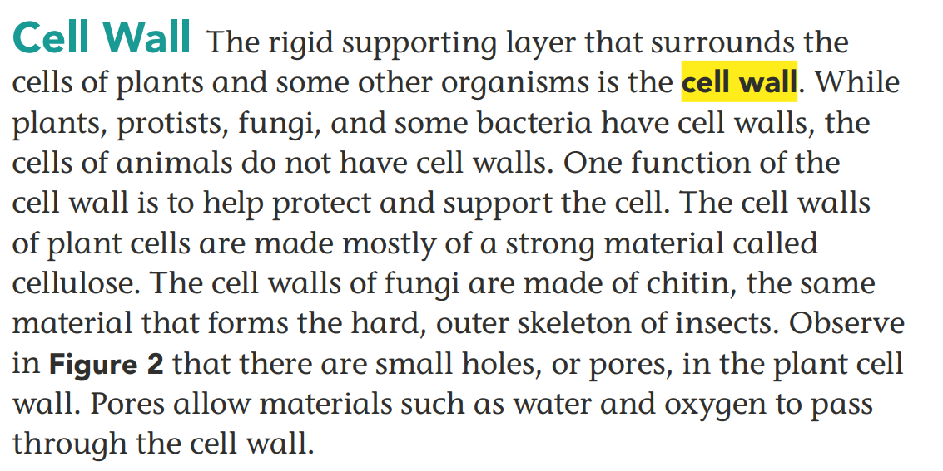
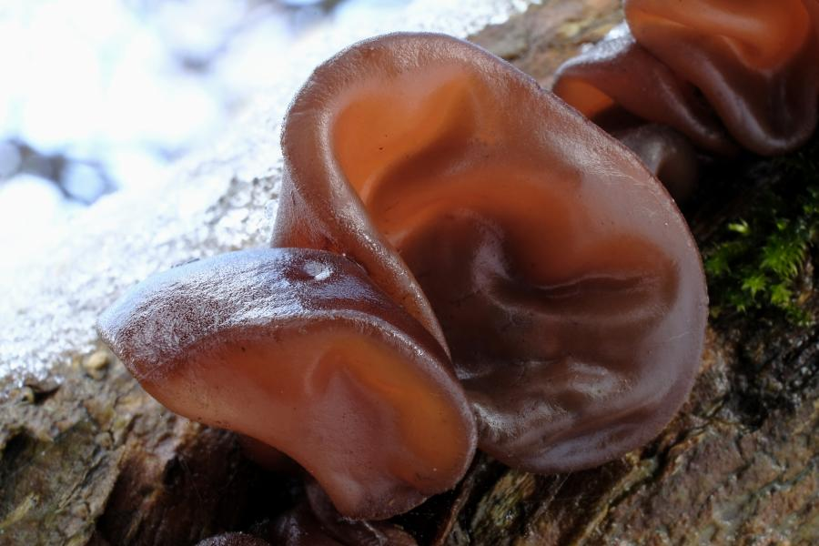
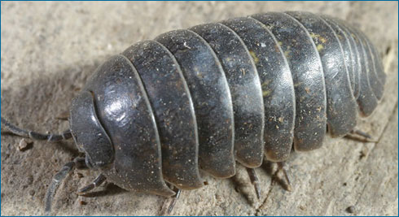

Slide 11
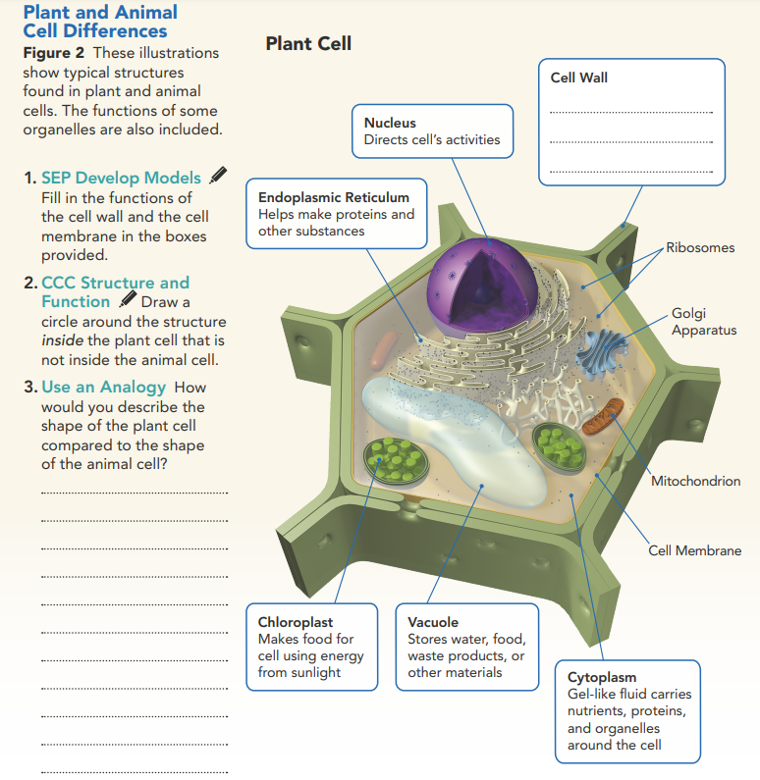
Protects and supports the cell
2. CCC Structure and Function Draw a circle around the structure inside the plant cell that is not inside the animal cell.

Slide 12
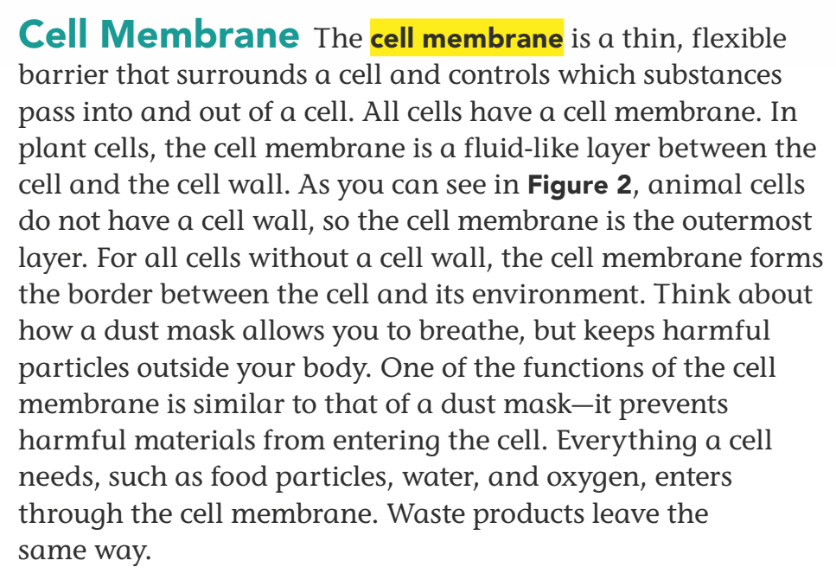
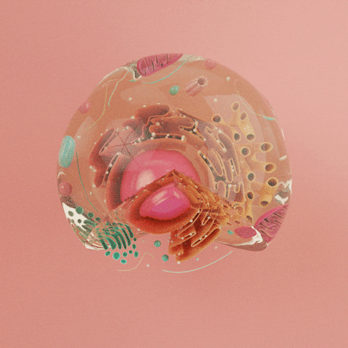
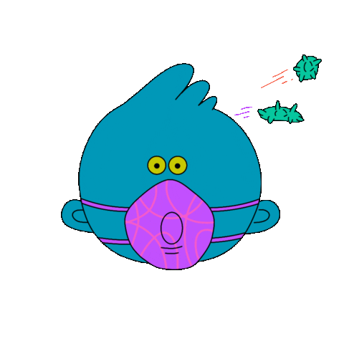

Slide 13
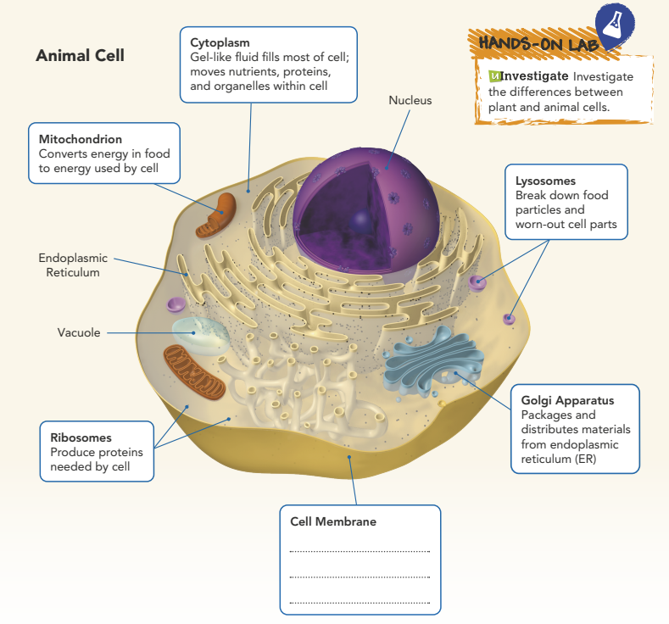
Forms barrier;
Controls what goes in and out of cell

Slide 14
Plant and Animal Cell Differences
3. Use an Analogy How would you describe the shape of the plant cell compared to the shape of the animal cell?
The plant cell is sort of shaped like a house and the pores are like doors and windows. The animal cell is round like an egg and its membrane holds and protects the structures inside just like an eggshell holds and protects the egg.

Slide 15
Pgs. 18, 19
Organelles in the Cytoplasm
Golgi Apparatus
Notes:
Activate Prior Knowledge
Most students will be familiar with the nucleus, or center, of a cell and where it’s located.
Ask:
• What organ in the human body is the nucleus like? (the brain)
Remind students of the guiding question, “How do the different parts of the cell help it function?”
Ask:
• How are the brain and the nucleus similar?
(The brain coordinates how the other organs operate. The nucleus directs the activities of the other parts of the cell.)

Slide 16
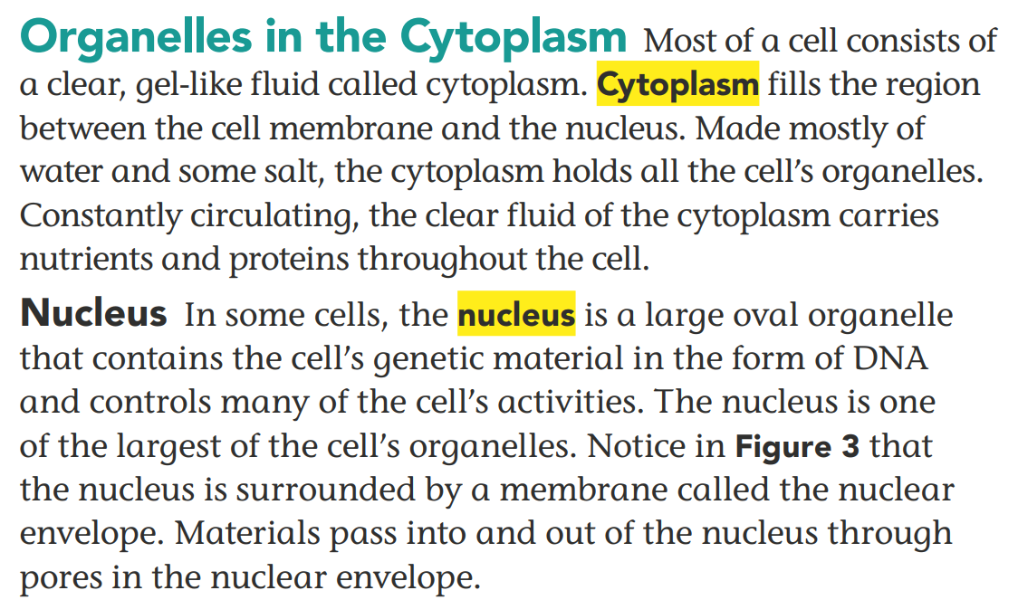
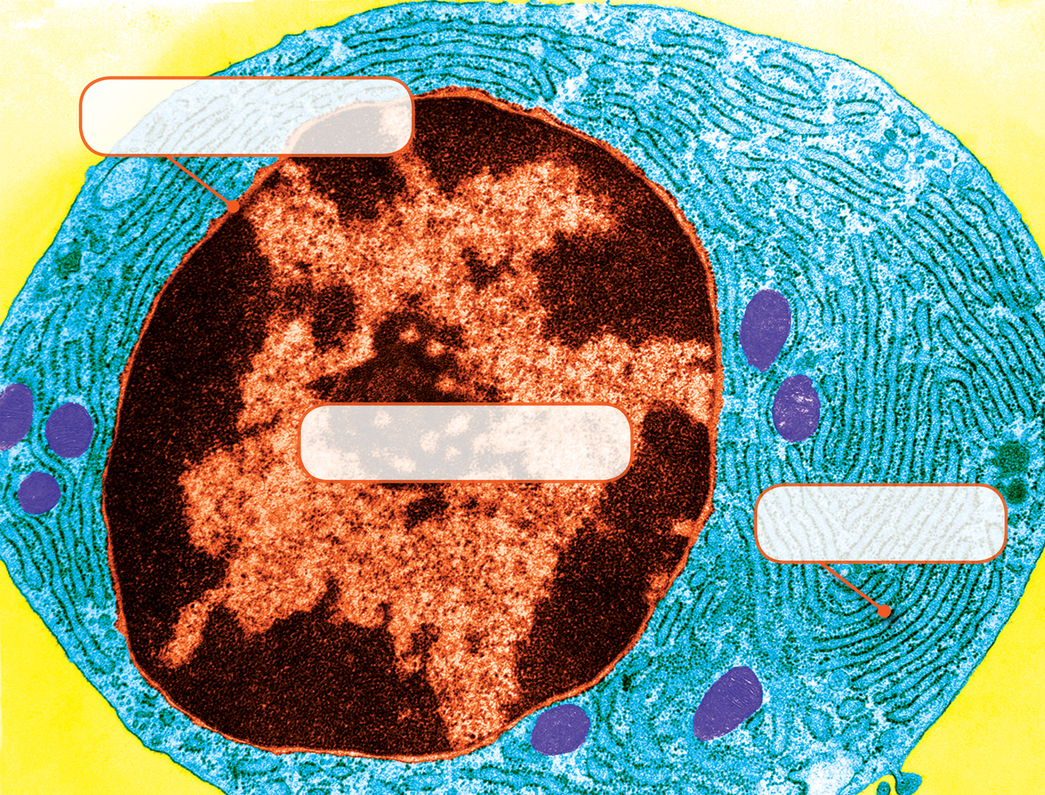
Nuclear envelope
Nucleus

Slide 17
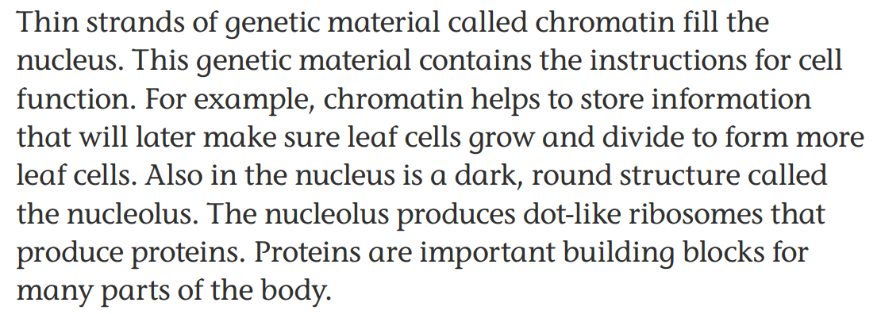
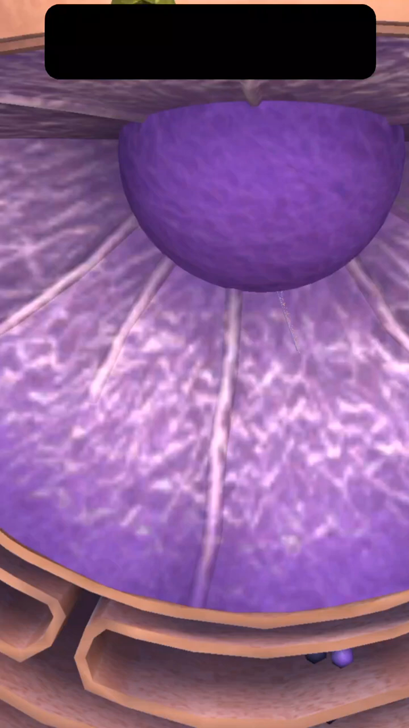

Slide 18


Slide 19
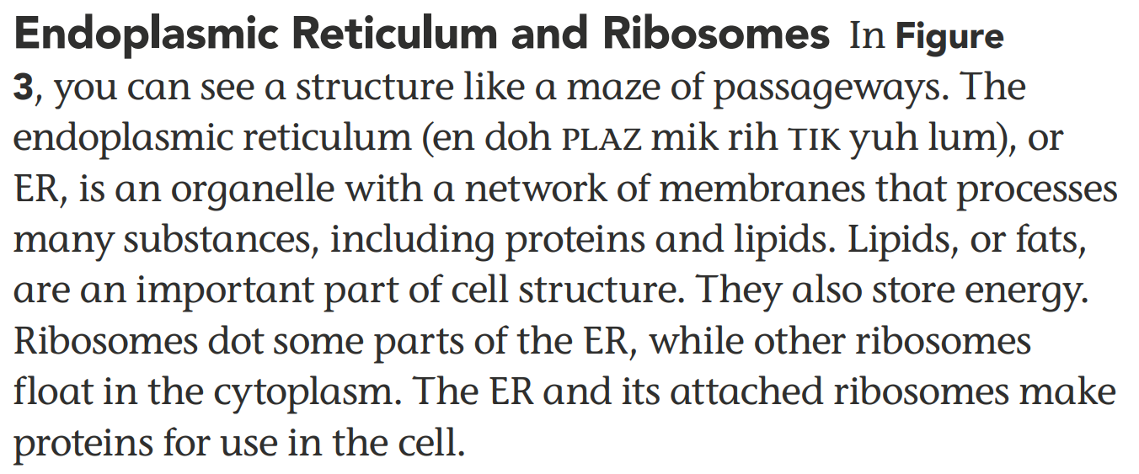
The Control Center of the Cell Figure 3 The nucleus acts as the control center of the cell. Folds of the endoplasmic reticulum (ER) surround the nucleus.
2. SEP Construct Explanations Why is the nucleus called the cell’s “control center”?
ER
The nucleus directs the cell’s activities. It contains chromatin, which stores information that helps a cell grow and divide to form new cells.
Notes:
Spark a Discussion Each cell has a nucleus, which tells it what to do and how to do it. In a way, it acts as the “brain” of the cell. Engage the class in a group discussion about the functions of the nucleus.
Ask:
• What is the nucleus? (an organelle)
• Where are the directions from the nucleus located? (in chromatin, thin strands of material that fill the nucleus)
• What other things can you think of that are similar to a nucleus? (Examples: the brains of animals, the leader in a democratic society, the teacher in a classroom, etc.)
Build a Cell Students will build a typical animal cell and then identify structures that are malfunctioning in a plant cell and an animal cell.

Slide 20
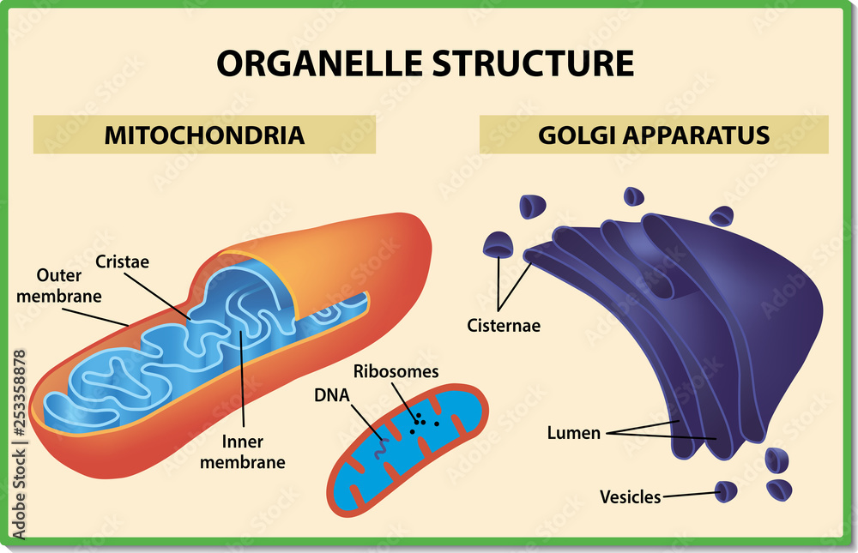
Golgi Apparatus As proteins leave the ER, they move to the Golgi apparatus, a structure that looks like flattened sacs and tubes. Considered the cell’s warehouse, the Golgi apparatus receives proteins and other newly formed materials from the ER, packages them, and distributes them to other parts of the cell or to the outside of the cell.
Mitochondria Floating in the cytoplasm are rod-shaped structures. Look again at Figure 2. Mitochondria (myt oh kahn dree uh; singular: mitochondrion) convert energy stored in food to energy the cell can use to live and function. They are the “powerhouses” of the cell.
= powerhouses of cell
= warehouse of cell

Slide 21
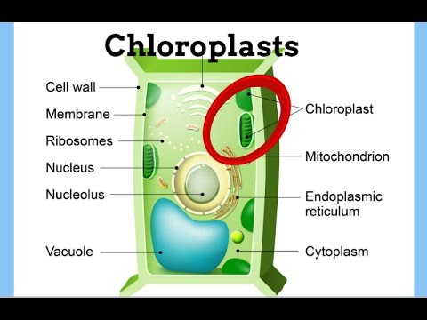
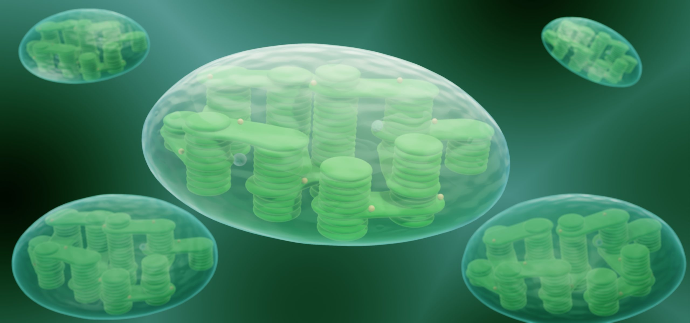
Chloroplasts The chloroplast is an organelle in the cells of plants and some other organisms that captures energy from sunlight and changes it to an energy form that cells can use in making food. The function of the chloroplast is to make food, in the form of sugar, for the cell. Cells on the leaves of plants typically contain many green chloroplasts. Animal cells do not have chloroplasts because animals eat food instead of making their own food from sunlight.

Slide 22
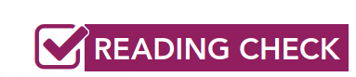
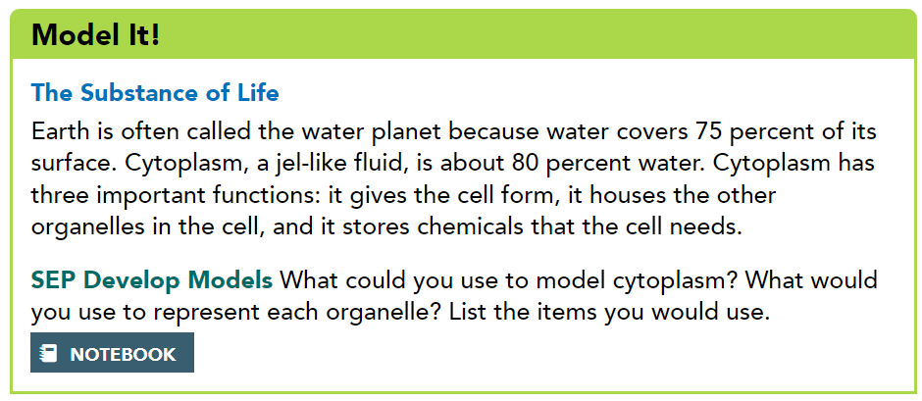
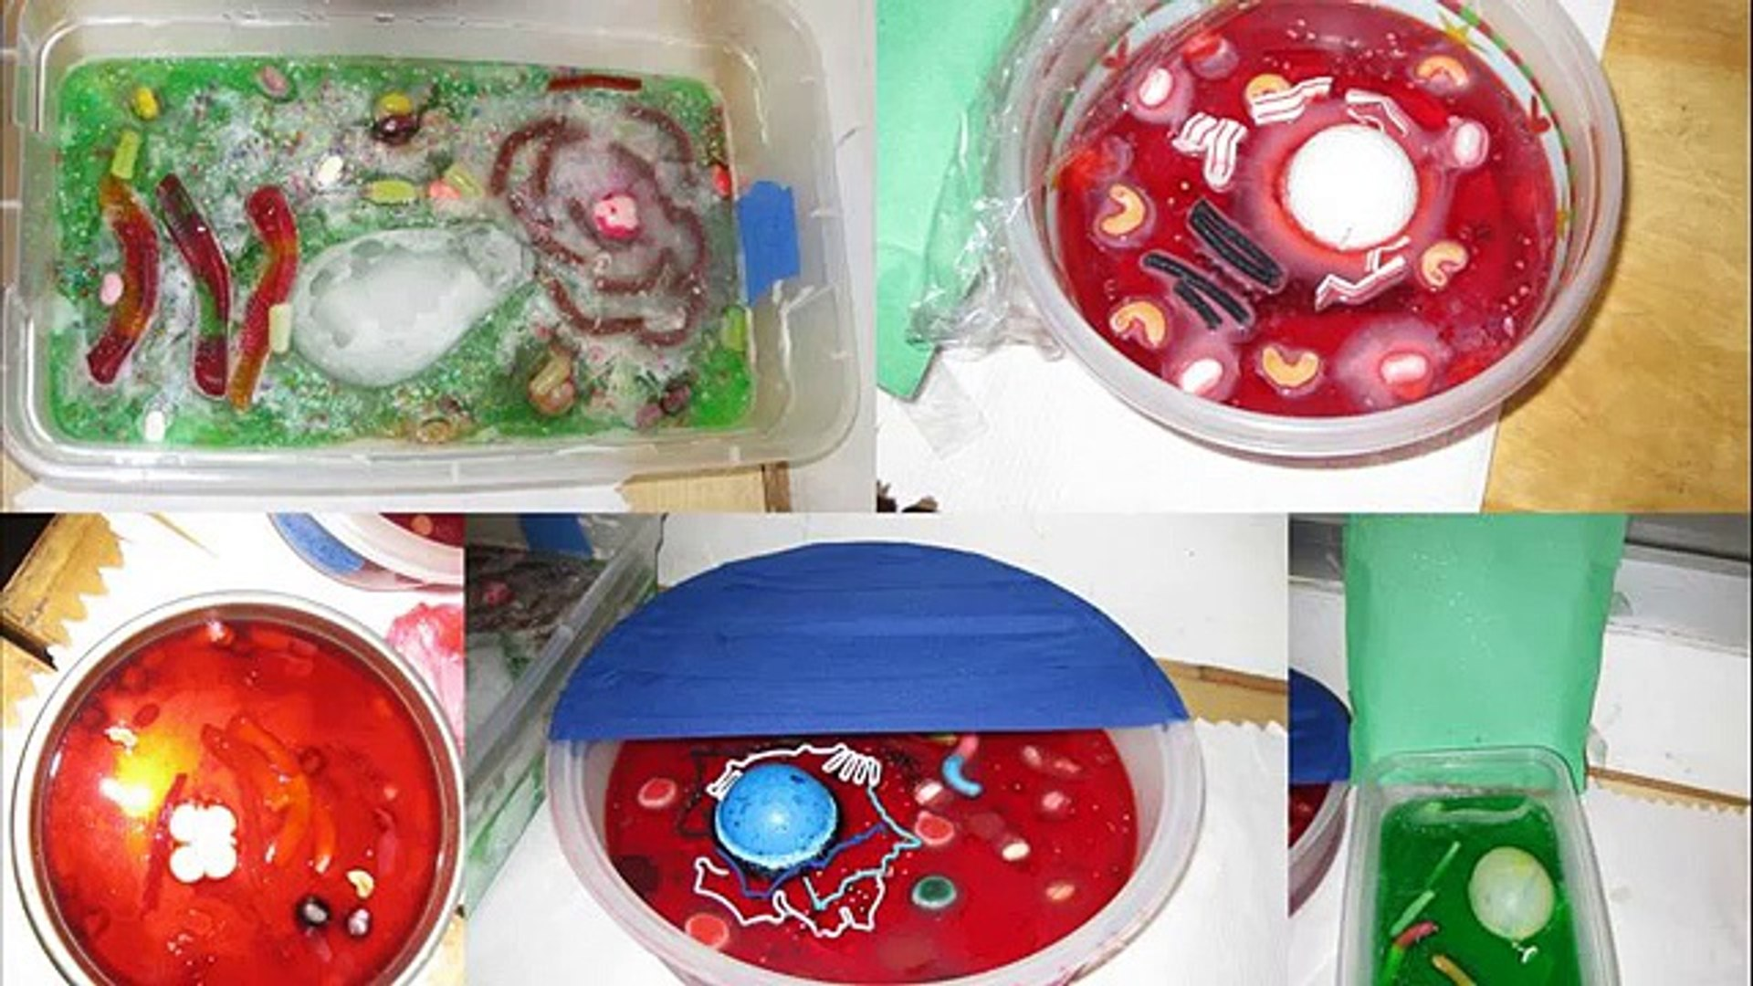
Determine Conclusions
Suppose there is a drought and a plant cannot get enough water. What happens to the cytoplasm and the organelles in the plant cells?
The water in the cytoplasm dries up, causing the plant to wilt. Organelles may not function as easily, or at all.
Notes:
Aside from the number of cells, some major differences between unicellular and multicellular organisms include their methods of diffusion and whether or not they have specialized functions.
Due to the number of cells, multicellular organisms are larger and more complex, and specialized cells enable more complex functions than unicellular organisms.
The four major functions that all cells perform include making energy, getting rid of waste, maintaining homeostasis, and reproducing.
The most likely result would be cell death.

Slide 23
Pgs. 20, 21
Lysosomes
Cells Working Together

Slide 24


Slide 25
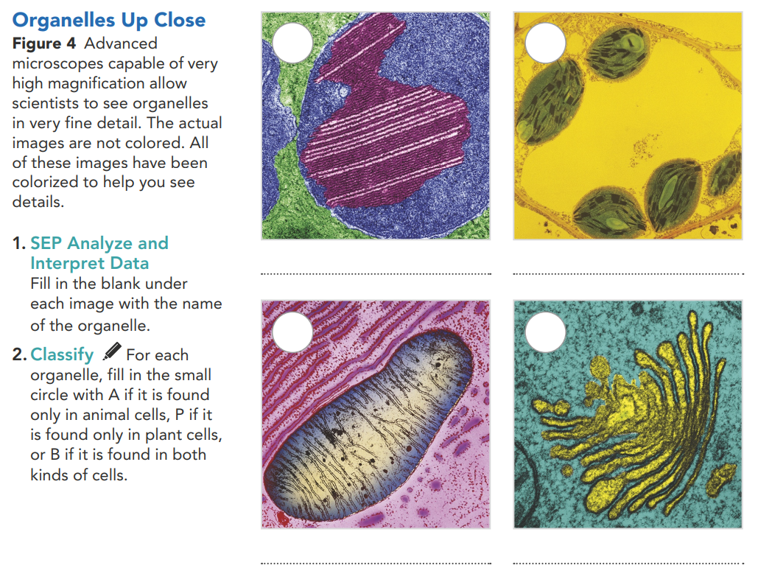
B
P
Nucleus
Chloroplast
B
B
Mitochondrion
Golgi apparatus

Slide 26
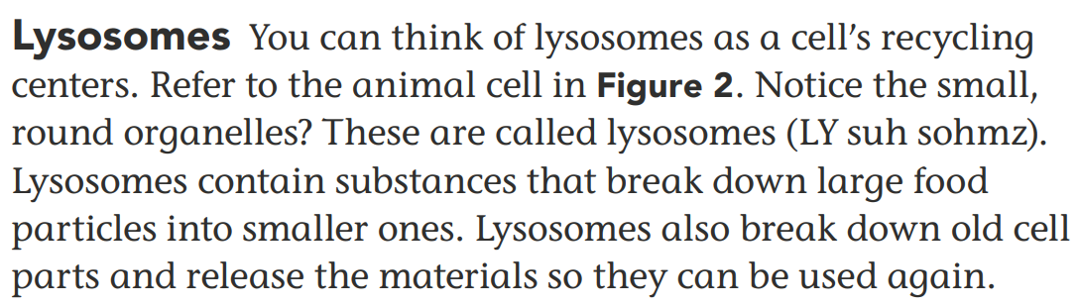
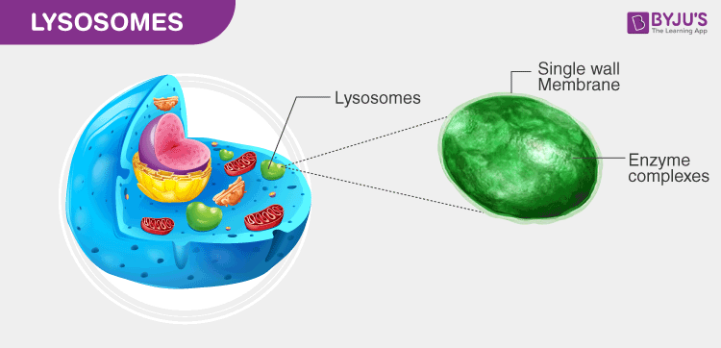
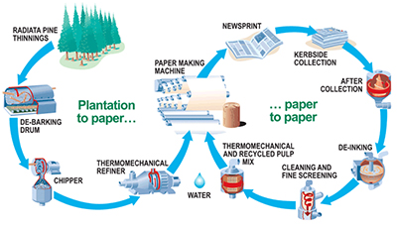
Lysosomes = cell’s recycling centers
So let us compare a recycling chart for paper products. It begins with trees being cut down and taken to a plant to be converted into paper. The paper is then manufactured into specific products, one of which is paper that will go to a store. The paper is bought by a student, who then uses it in the classroom, after which it is thrown into a recycling bin. The contents of the recycling bin are picked up and taken to a recycling plant, where they are broken down and washed to remove inks, glue, staples, and other things. The remaining material is turned into new paper products. Relate this recycling of paper to how lysosomes recycle the old material in a cell to make new cell parts.

Slide 27
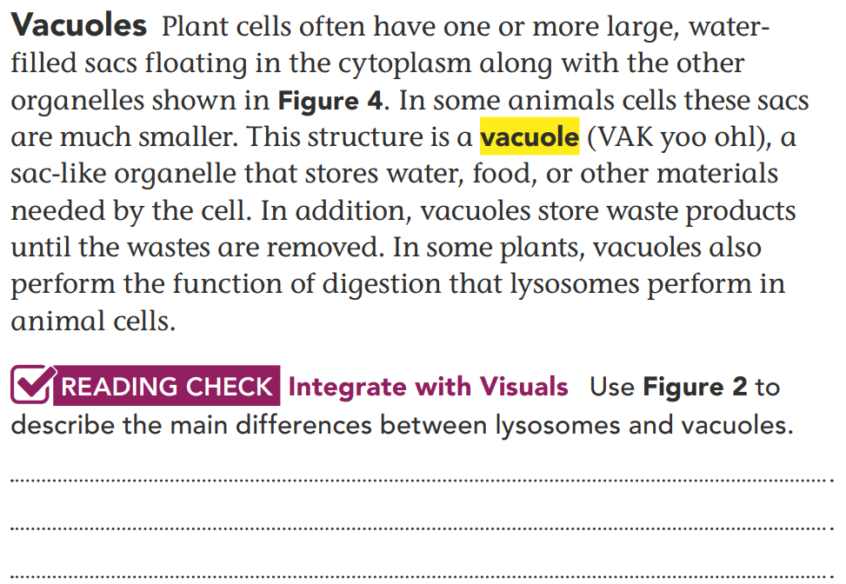
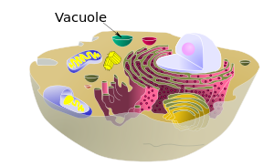
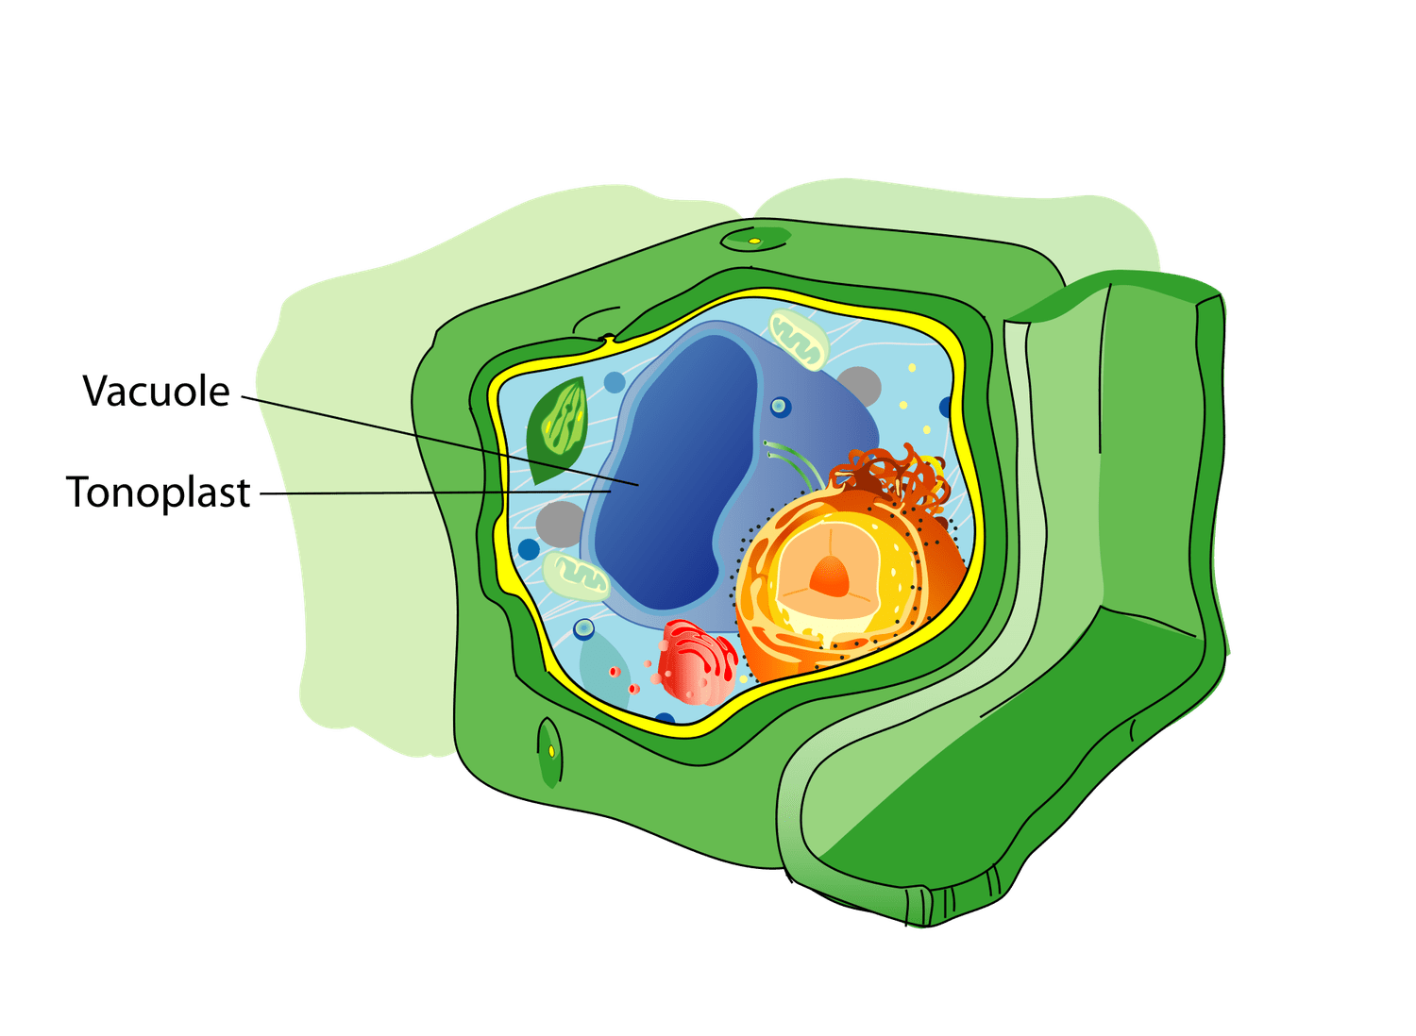
Lysosomes break down food particles and old cell parts for reuse; vacuoles store water, food, and waste products.
function of digestion

Slide 28
Cell membrane
Nucleus
Endoplasmic reticulum
Cytoplasm
Ribosomes
Mitochondria
Chloroplast
Cell wall
Large food vacuole
NO cell wall
No chloroplast
Small or no food vacuole
Plant Cell
Animal Cell

Slide 29
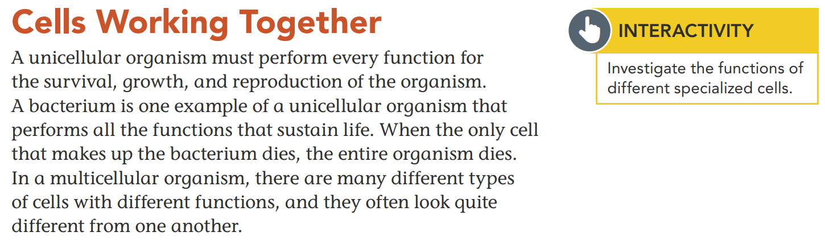

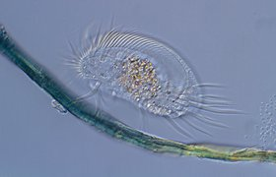
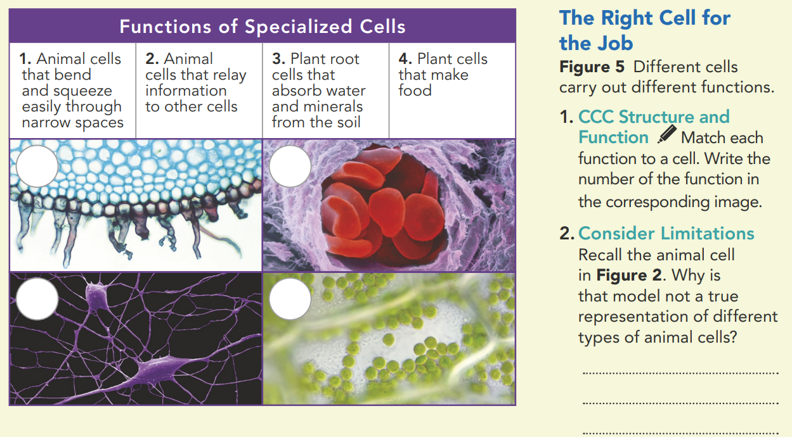

Notes:
Cells Working Together
Address Misconceptions
Many students may believe that there is only one type of cell or that the differences between cells are only those that can be found between plants and animals. In fact, there are many types of cells, each of which performs a different function. When cells perform the same or very similar functions, they often clump together. The heart is a clump of cells working together to perform a specific function. The same can be said of the brain and all the other organs in the body. When clumps of cells work with other clumps of cells, a system is formed. The respiratory system is made up of various clumps of cells working together to help organisms take in and use oxygen. The nervous system is made up of various clumps of cells that relay messages from the brain to other parts of the body and vice versa.
• What are other examples of systems in the human body? (digestive, circulatory, skeletal, muscular, integumentary, lymphatic, endocrine)

Slide 30
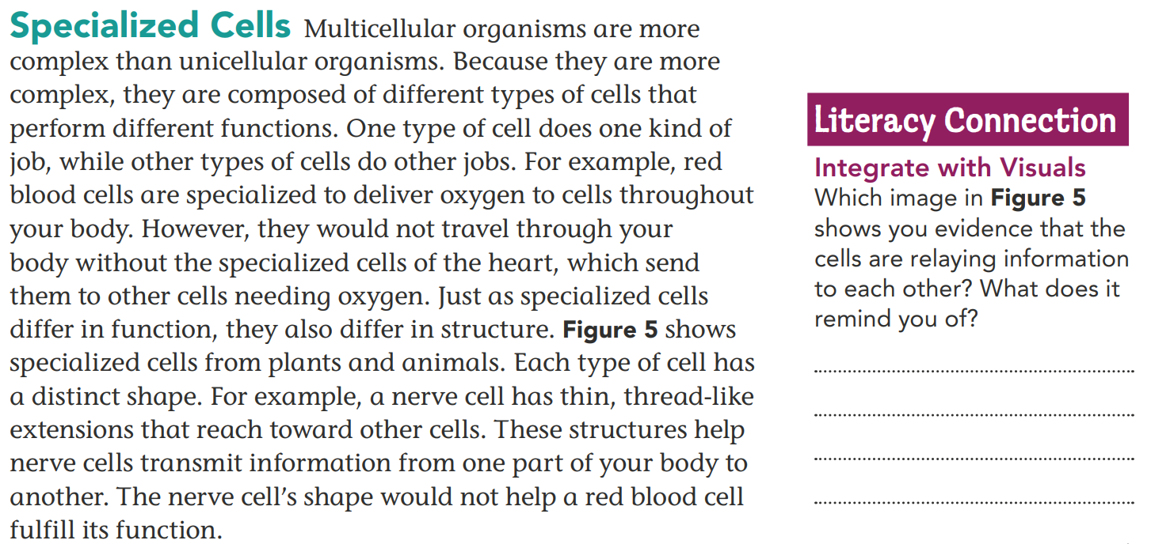
bottom left image, it reminds
me of a network, an interconnected system.

Slide 31
3
1
2
4
Different types of animal cells have different shapes to do, specific functions.

Slide 32
Cells Make Up an Organism
Lesson 2 Check
Pgs. 22,23

Slide 33
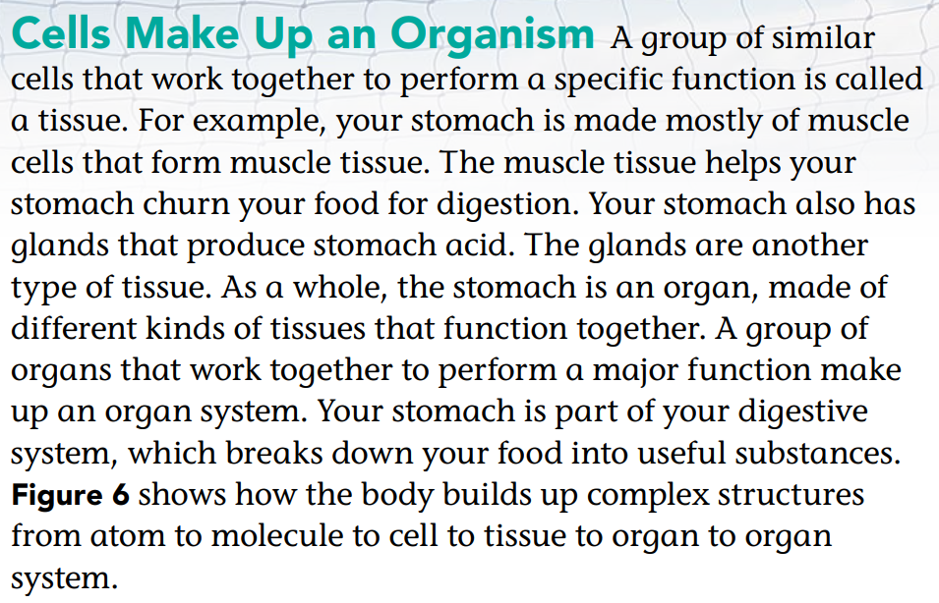
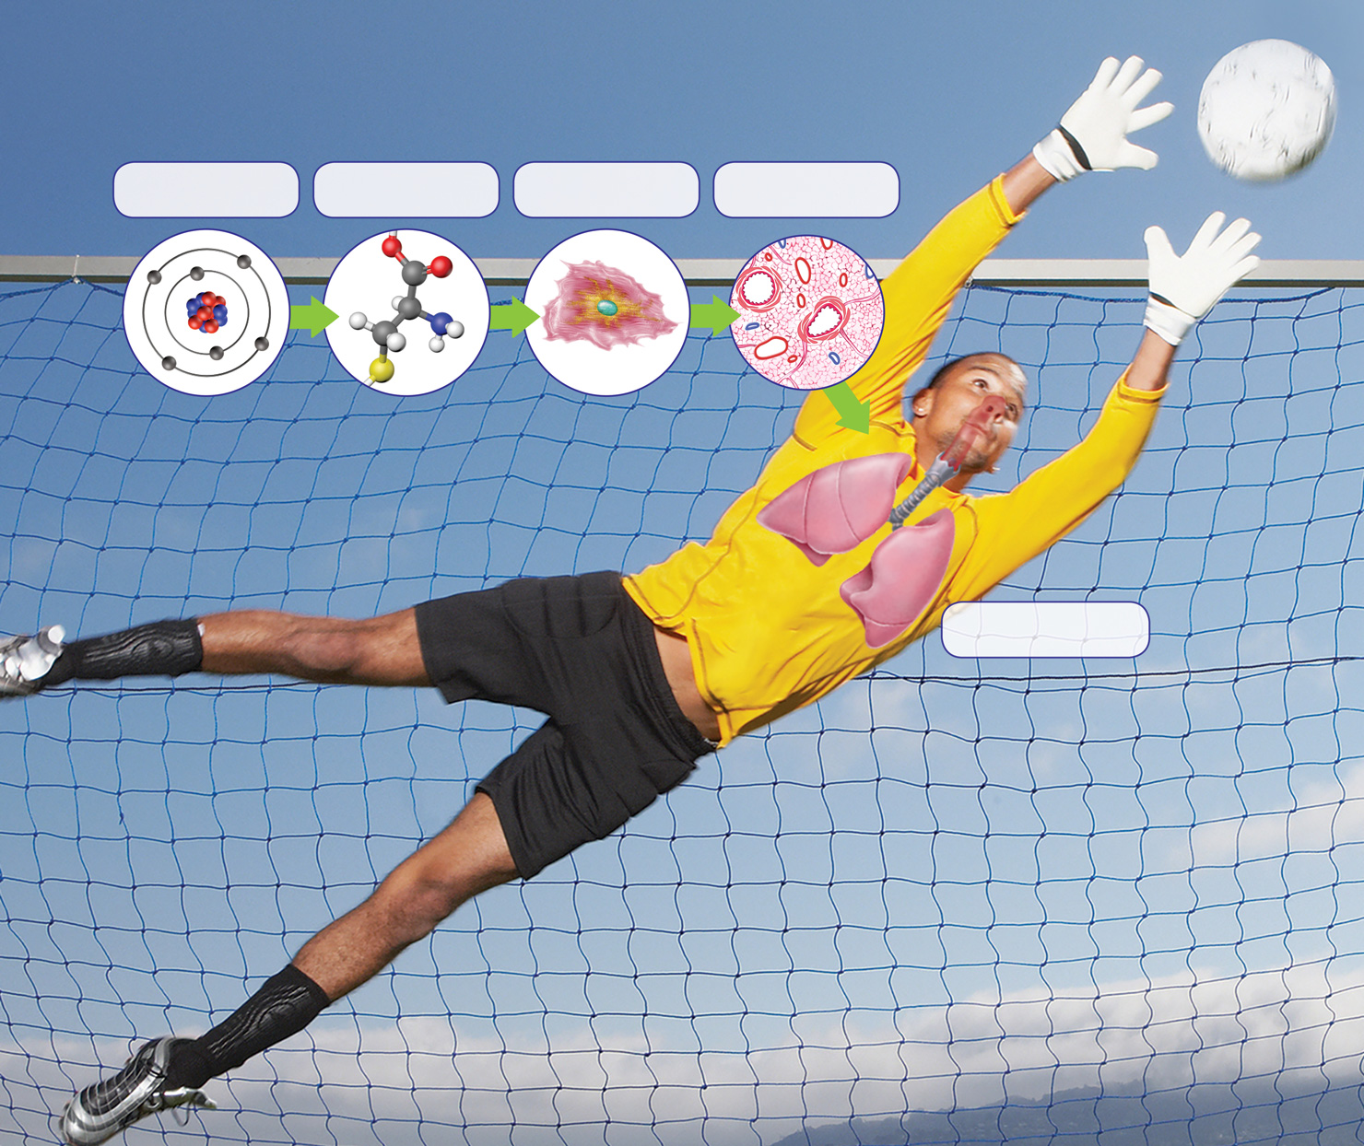
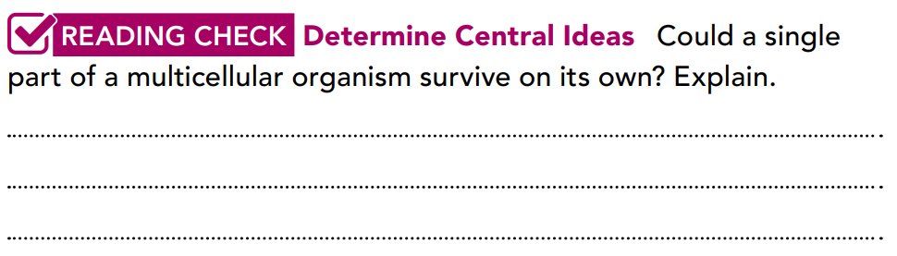
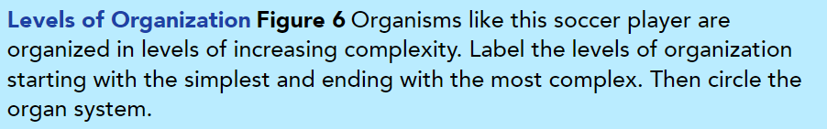
Atom
Molecule
Cell
Tissue
Organ
Each part of an organism performs a certain function. All parts work together to keep the whole organism alive. No part can survive on its own.

Slide 34
1. Interpret Photos What is the yellow structure, and what role does it play in a cell?
2. CCC Structure and Function Why do cells have so many different organelles and structures?
3. Compare and Contrast What are the main differences between cell walls and cell membranes?
4. Apply Concepts Are there more tissues or more organs in your body? Explain your reasoning.
It's a mitochondrion and it breaks down sugar to release energy for the cell.
Each structure performs a different function for the cell, such as storing
Information, assembling proteins, or providing energy.
Cell walls are found in plants but not animals. They are strong and support the cell. Cell membranes are in every cell and control what enters and leaves the cell.
There are more tissues than organs, because each organ contains multiple
kinds of tissues.

Slide 35
5. Determine Differences What are three differences between plant cells and animal cells?
Plant cells have a all wall, animal do not; plant cells have a chloroplast, animal cells do not; plant cells have larger vacuole(s) than some animal cells.

Slide 36
THANKS!

