Slide 1
SCIENCE SUBJECT FOR MIDDLE SCHOOL: T1 The Cell System
7th GRADE
L1 Structure and Function of Cells

Slide 2
Objective of this lesson:
• the components of cell theory.
• that cells are the basic unit of life.
• that cells of all living things extract energy from food, get rid of waste, and reproduce.

Slide 3
TABLE OF CONTENTS
Pgs. 4, 5
Pgs. 6, 7
01
02
Pgs. 8, 9
Pgs. 10, 11
03
04
Cells
Cell Structure
Cell Function
Cell Theory
Observing cells
Pg. 12
05
Assessment
Principles of Cell Theory
Microscopes
Magnification
Resolution

Slide 4
Pgs. 4, 5
Cells
Cell Structure
Cell Function

Slide 5
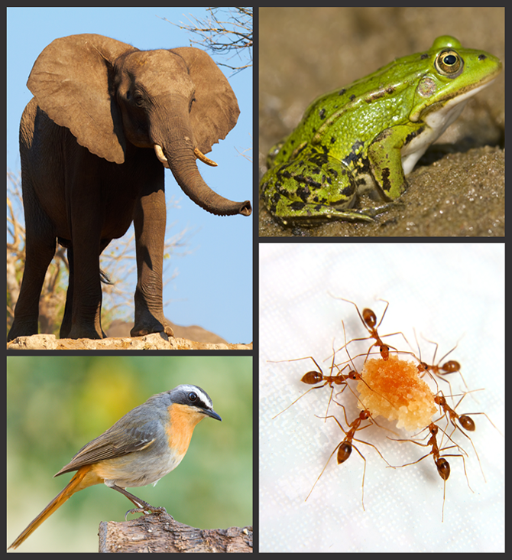
The Foundation of All Living Things
Look at the animals shown in the pictures. What do you and these animals have in common? What differences are there between you and these animals?

Slide 6
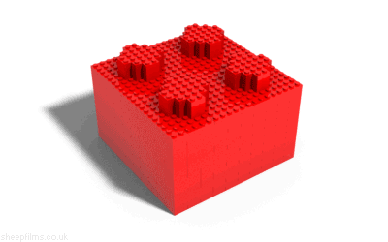
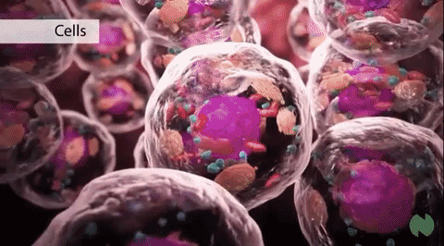
Cells
Cells are often described as the “building blocks of life.”
Now, think how they have used building blocks or other materials to make larger structures.

Slide 7
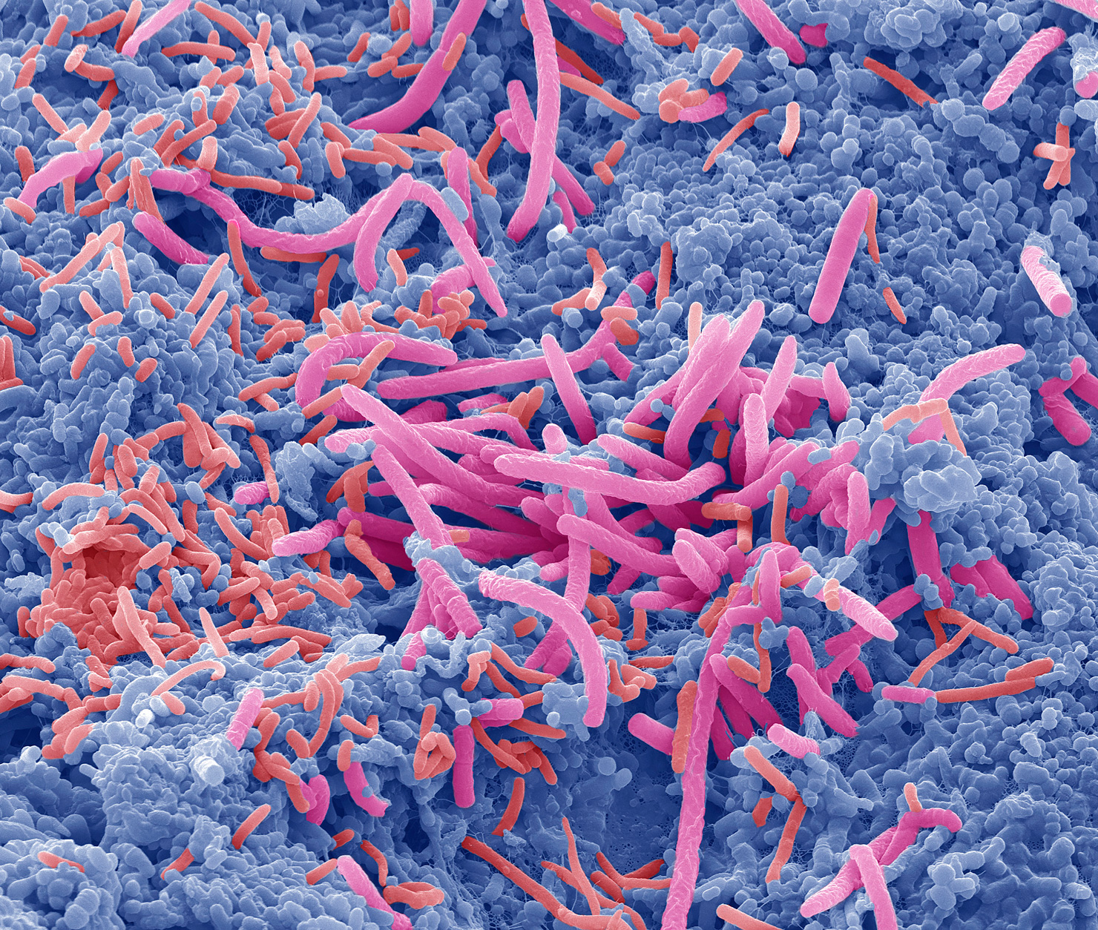
Cells Are Everywhere
Figure 1 Suppose you take a swab from someone’s tongue. This is what you might see under the microscope. These cells are all bacteria of different shapes and sizes and with different functions.
Notes:
Point out to students that the different colors in the photo can help them identify each structure. Explain that there are trillions of bacteria on Earth and that bacteria have only one cell.
Have small groups of students… describe the different shapes and sizes of the bacteria and how they are similar to and different from other living organisms with which students are familiar.
discuss whether they think bacteria have the same needs as other living organisms.

Slide 8
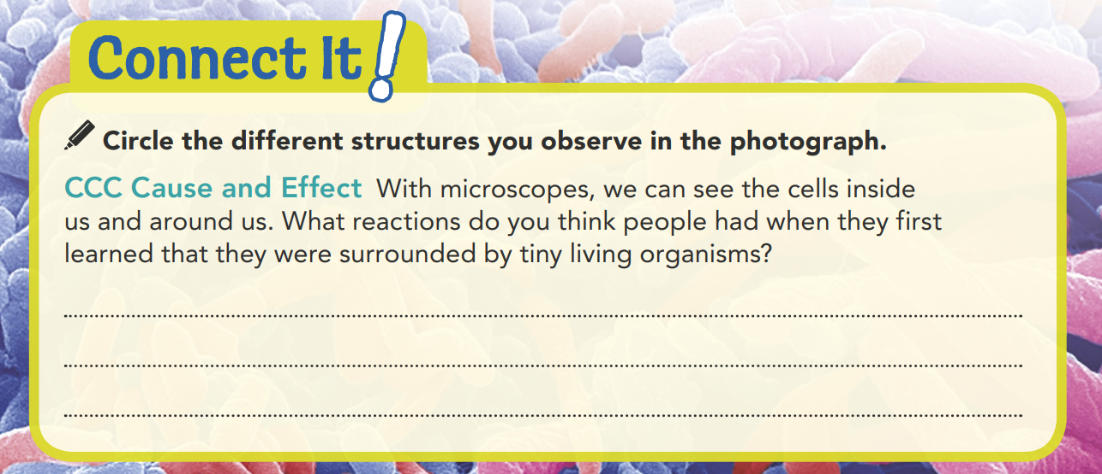
Some people might have been afraid and tried to wash the organisms off. Others might have thought the organisms were beautiful and tried to learn more about them.

Slide 9
Cells
What do a whale, a rose, bacteria, a ladybug, and you have in common? You are all living things, or organisms. All are made of cells, the basic unit of structure and function in living things. Cells form the parts of an organism and carry out its functions. The smallest organisms, such as the bacteria in Figure 1, are made of one cell, while the largest organisms may have trillions of cells.

Slide 10
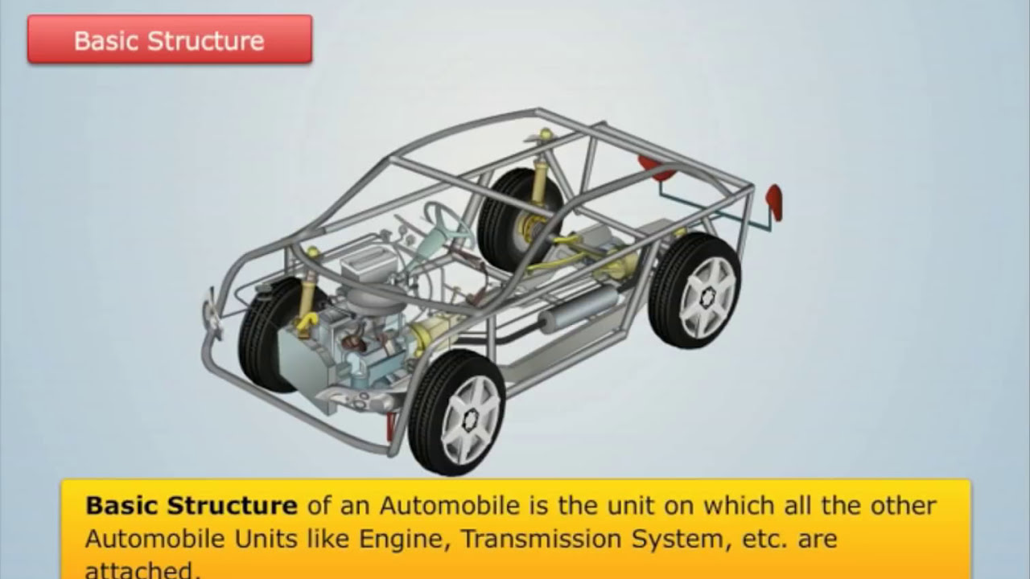
Cell Structure
The structure of an object refers to what it is made of and how its parts are put together. For example, the structure of a car depends on how materials such as plastic, metal, and rubber are arranged.
The structure of a living thing
is determined by the amazing
variety of ways its cells are
put together.

Slide 11


Cell Function
A single cell has the same needs as an entire organism.
For a cell to stay alive, it must perform biological functions.
Functions of a cell:
obtaining energy
bringing in nutrients and water
getting rid of wastes
Most organisms have bodies with many different cells that work together to help the organism to stay alive, grow, and reproduce.
For example, cells in your circulatory system move blood around your body. This blood provides you with fresh oxygen and removes the waste product carbon dioxide.
Cells in your heart pump blood to every part of you. Your body’s cells work together to keep you alive.
Notes:
Aside from the number of cells, some major differences between unicellular and multicellular organisms include their methods of diffusion and whether or not they have specialized functions.
Due to the number of cells, multicellular organisms are larger and more complex, and specialized cells enable more complex functions than unicellular organisms.
The four major functions that all cells perform include making energy, getting rid of waste, maintaining homeostasis, and reproducing.
The most likely result would be cell death.

Slide 12
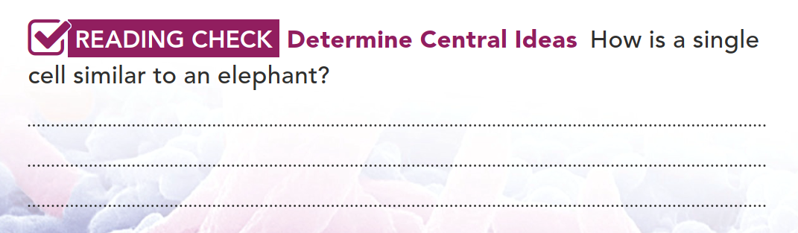
Both a cell and an elephant perform functions to stay alive. These functions include, getting nutrients and water and getting rid of wastes.

Slide 13
Pgs. 6 ,7
Cell Theory
Observing cells

Slide 14


Slide 15
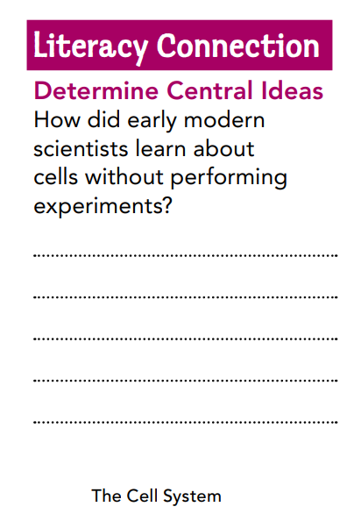
Cell Theory
It wasn't until the 1600s that scientists realized living organisms are made of cells. The invention of the microscope, an instrument that makes small objects look larger, made this discovery possible. The technology of the microscope led to new knowledge of how life is organized. As this technology improved over time, scientists were able to gather new information about cells and how they function.
Scientists put all these discoveries together to develop a theory about cells.
Observing Cells
In the mid-1600s, English scientist Robert Hooke built his own microscopes to learn about nature. He made drawings of what he saw when he looked at the bark of cork oak trees (Figure 2). Hooke thought that the empty spaces he observed in the tree bark looked like tiny rooms, so he named them "cells." Tree bark, however, contains only dead cells.
They gained
scientific knowledge
about cell function by observing through a microscope.

Slide 16
In 1674, Dutch businessman Anton van Leeuwenhoek (lay von hook) was the first person to observe living cells through a microscope. He saw many tiny organisms swimming and hopping around in a drop of pond water. He named them "animalcules," or little animals.
Early Cell Observations Figure 2 Hooke drew what he saw through his microscope in great detail. Draw a circle around one of Hooke's "cells.“
By 1838, Matthias Schleiden, a scientist working with plants, noticed that all plants are made of cells.
A year later, Theodor Schwann came to the conclusion that animals are made of animal cells.
The timeline in Figure 3 shows how the improvement of the microscope furthered the study of cells.
Before Schleiden and Schwann's suggestion that organisms are made up of cells, not much was known about the structure of organisms. These two scientists are credited with the development of the cell theory. Each scientist proposed a hypothesis, a possible answer to a scientific question. Their hypotheses, supported through the observations and experiments of other scientists, led to a theory about cells and all living things.
1839

Slide 17
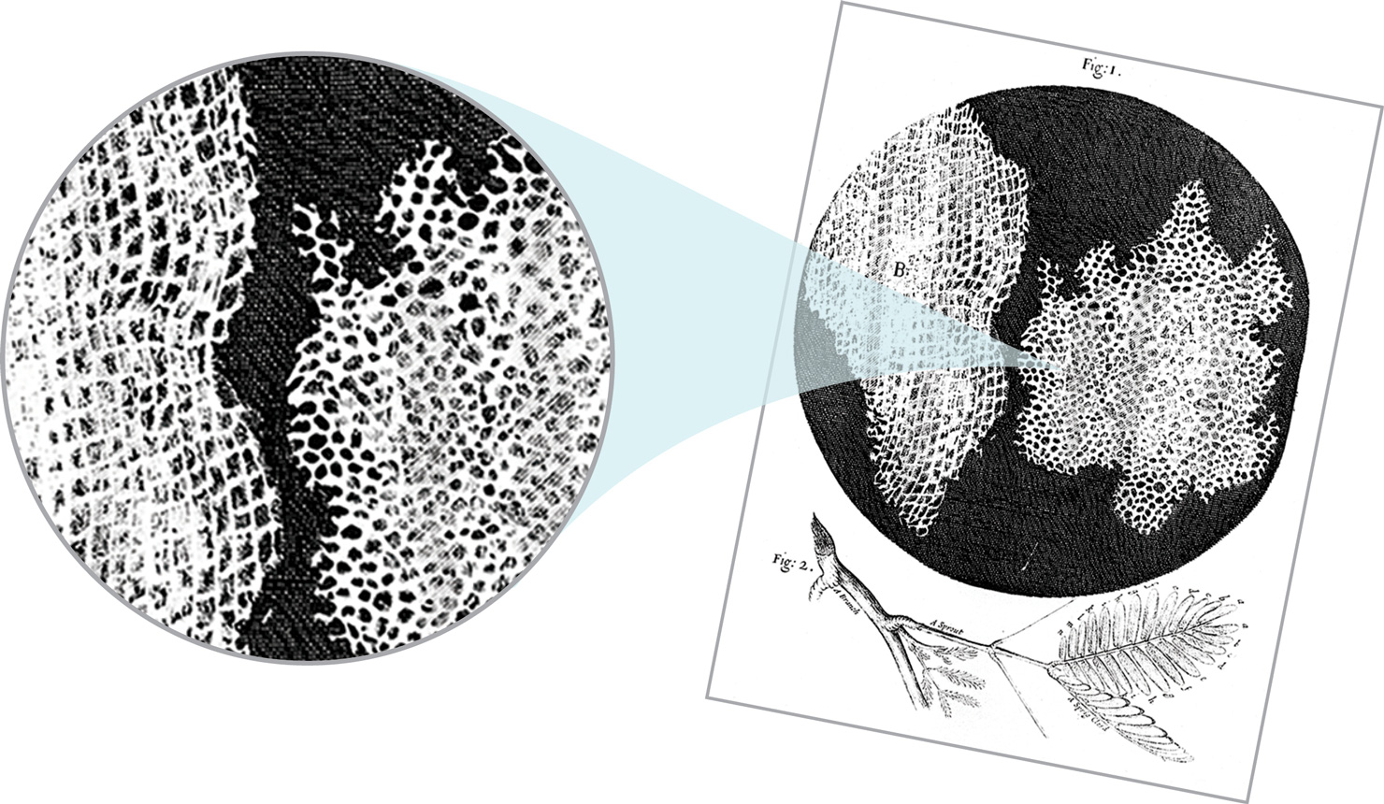

Slide 18
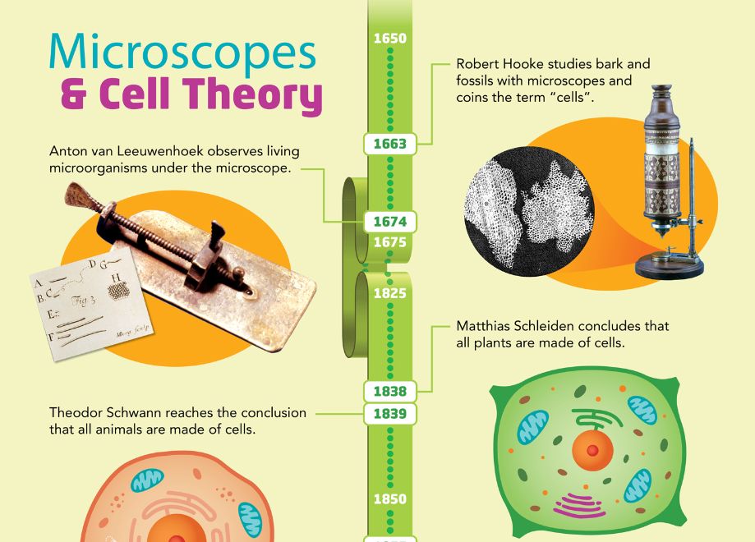

Slide 19
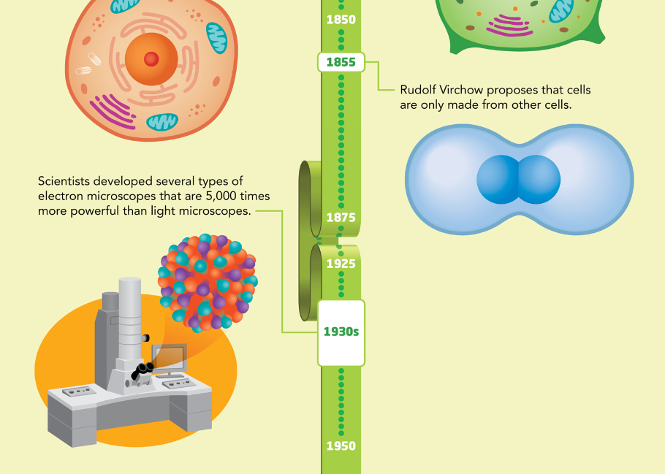
Infer Why didn't Robert Hooke recognize that cells are alive?
………………………………………………………………………………………………………………………………………………………………
He was looking at dead, empty cells, and his microscope
was not that powerful.

Slide 20
Pgs. 8, 9
Principles of Cell Theory
Microscopes

Slide 21
Principles of Cell Theory
One of the most important ideas in biology, cell theory is a widely accepted explanation of the relationship between cells and living things.
According to this theory:
• All living things are made of cells.
• Cells are the basic units of structure and function in living things.
• All new cells are produced from existing cells.
Even though living things differ greatly from one another, they are all made of one or more cells. Cells are the basic unit of life. Most cells are tiny.
But some, like those shown in Figure 4, can be surprisingly large.

Slide 22
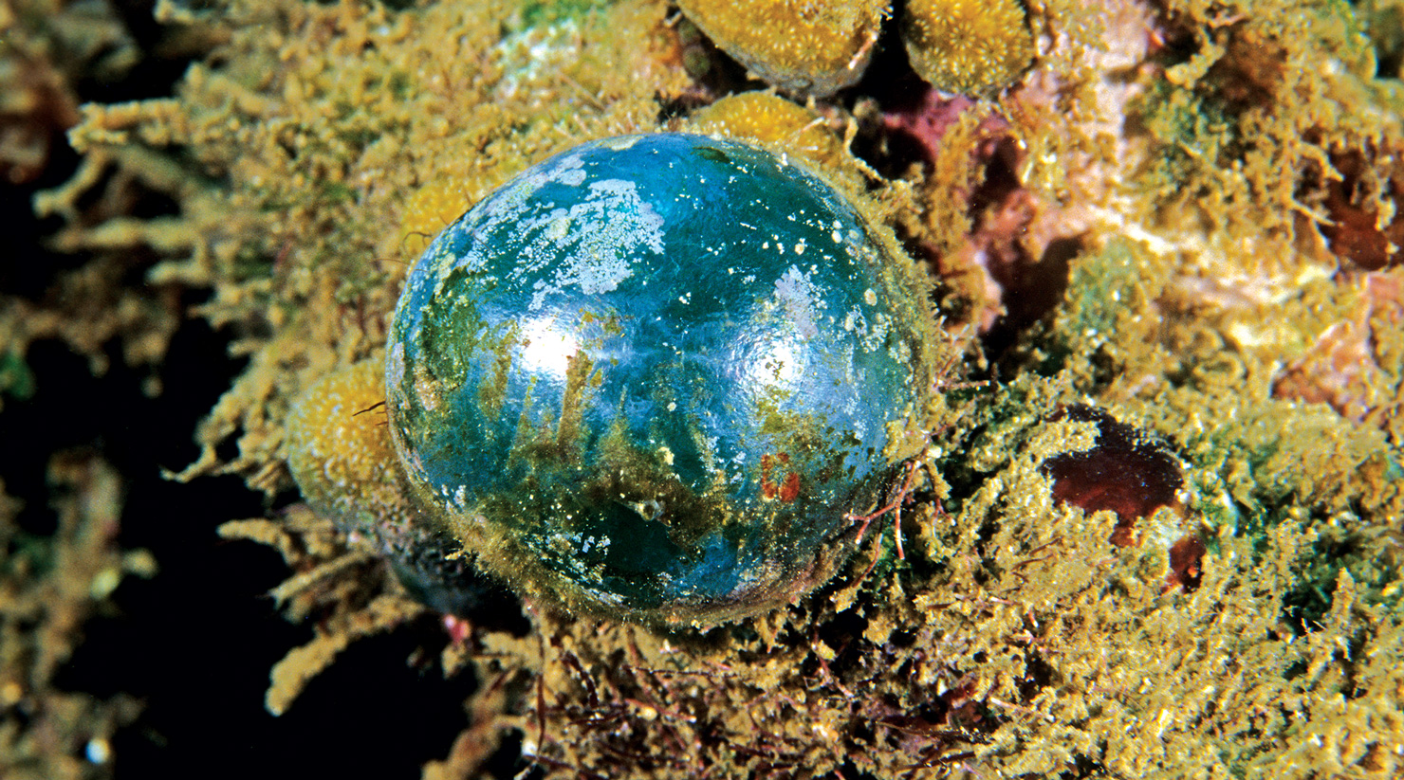
Giant Cells Figure 4 Bubble algae, or sea pearls, look like rubber balls. The
bubble shown in this life-sized photo is a single cell! Some scientists consider
eggs to be single cells as well. An ostrich egg is 15 cm long and a human egg is
about the size of the period at the end of this sentence.

Slide 23
Principles of Cell Theory
The cell theory holds true for all living things, no matter how big or how small they are.
Organisms can be made of one cell or of many cells.
We can study how one-celled organisms remove wastes to sustain life.
Then we can use this information to understand
how multi-celled organisms carry out the same task.
And, because all new cells are produced from
existing cells, scientists can study cells to learn
about growth and reproduction.
READING CHECK
Cite Textual Evidence
According to cell theory, how are bubble algae, or sea pearls, made?
…………………………………………………………………………………………………………………………………………………………………………………………..................
They are produced from existing cells.

Slide 24
Microscopes The cell theory could not have been developed without
microscopes. The microscopes we use today have the same function as those
used 200 years ago—to view tiny specimens. The advanced technology in the
modern microscope, however, provides far greater detail for much closer
observations. Light microscopes focus light through lenses to produce a
magnified image. Electron microscopes are more complex. To create an image,
electron microscopes use beams of electrons that scan the surface of the
specimen. Look at the two different images of the same cells in Figure 5. Both
types of microscopes do the same job in different ways, and both rely on two
important properties—magnification and resolution.

Slide 25
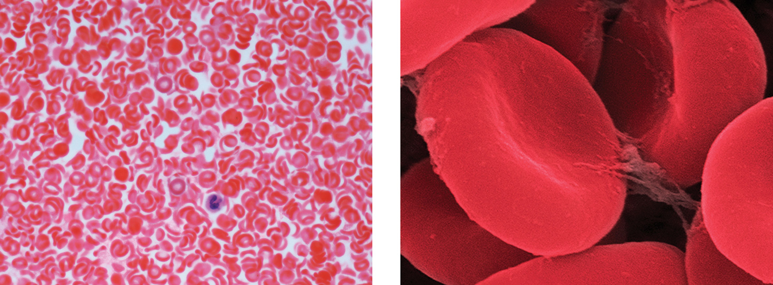
Different Views Figure 5 Red blood cells look very different when viewed using a light microscope (left) and an electron microscope (right).
Light Microscope
Electron Microscope

Slide 26
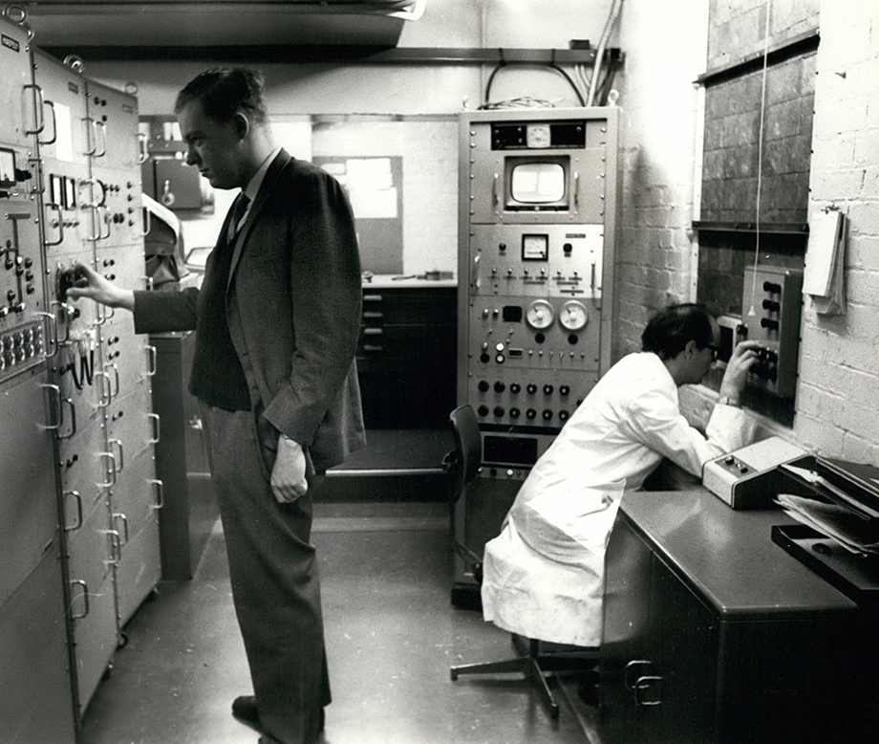
Microscopes and the Cell Theory
SEP Design Solutions How could scientists today use current technologies to further support the cell theory?
…………………………………………………………………………………………………………………………………………………………………………………………………………………………………………………
Technology today gives us a clearer and larger image that allows scientists to confirm that all living things are made up of one or more cells.
Notes:
Connect to the Real World: Public Health Explain to students that some kinds of bacteria, can lead to outbreaks of disease in homes, schools, businesses, and even entire communities. Many of the illnesses, such as E.coli and Salmonella, come from consuming tainted food. These outbreaks can be prevented by practicing good hygiene and following food safety guidelines.
Ask:
What are some ways you can use good hygiene to help prevent food-borne illnesses? (Sample: I can wash my hands before eating or handling food; I can cough and sneeze into my elbow and away from food and people.)
What are some ways you can make sure food is prepared safely? (I can make sure meat is cooked all the way through; I can make sure that vegetables are washed; I can make sure that other foods don’t touch surfaces where meat has been.)

Slide 27
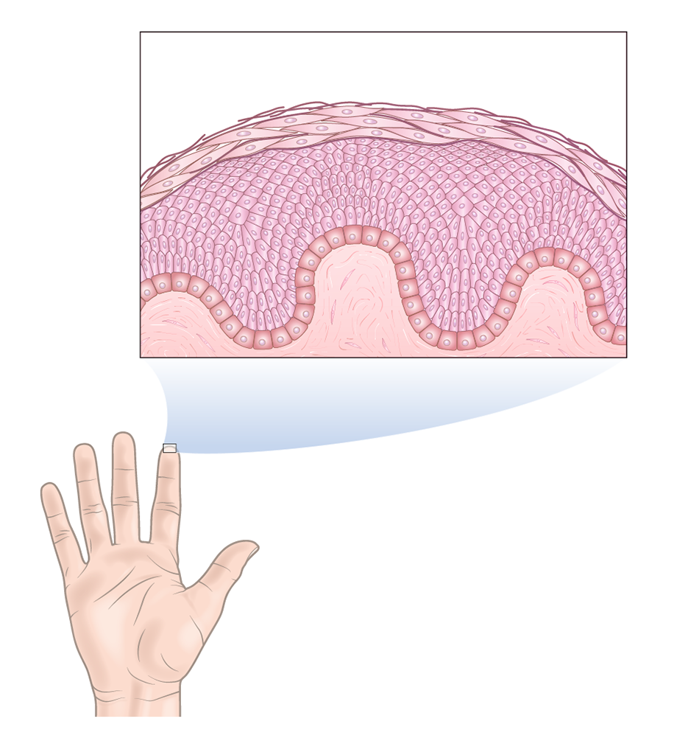
Need for the Microscope
Why is the microscope necessary for studying cells? Explain.
Notes:
Without the microscope it would be impossible to see most types of cells due to their small size. If we can not see them, we can not study them. Studying cells is necessary and important because organisms are composed of cells, cells are the basic unit of life, and new cells form from already existing cells.
As the magnification increases smaller details can be seen in the specimens.

Slide 28
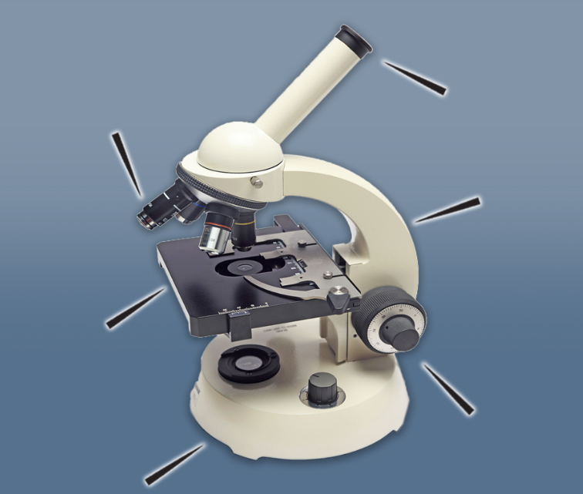
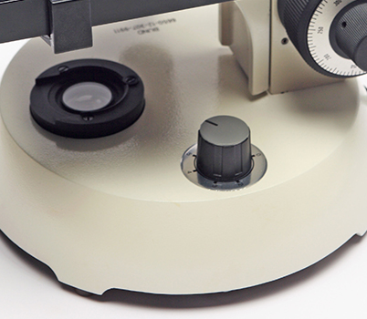
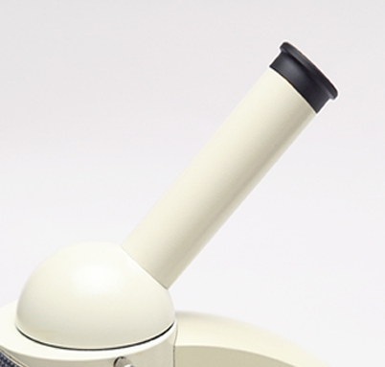
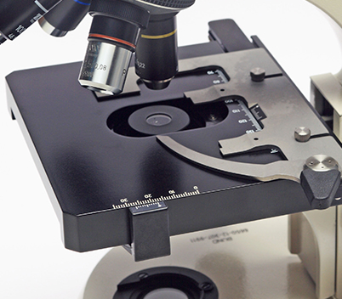
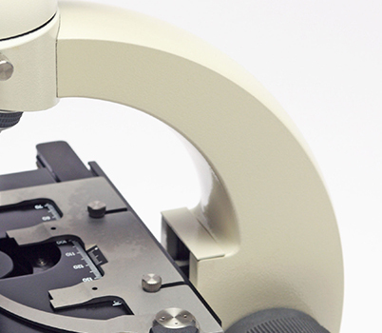
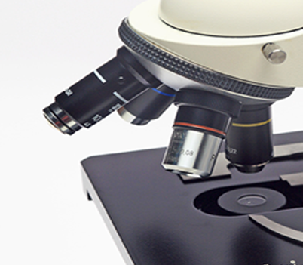
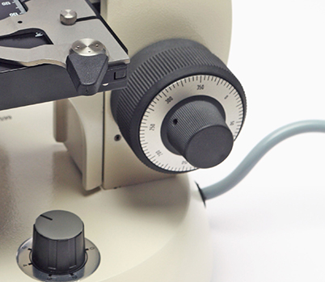
Click on the pointers to learn about the different parts of the microscope and their functions.
Objective Lens
These are the objective lenses. Most microscopes have three or four objective lenses. They range in power from 4x to 100x magnification.
The Base
The base is the bottom of the microscope. It provides a flat, stable surface that supports the microscope.
Arm
The arm connects the upper and lower parts of the microscope. When you carry the microscope it's best to carry it with one hand holding the arm and the other holding the base.
Stage
The stage plate is where you place the specimen that you intend to view.
Focus Knob
A close-up of the focus knob at the bottom part of the arm. The knob looks like a dial with numerical markings on it.
Eyecups
The eyecups are where you place your eyes to view the specimen below.

Slide 29
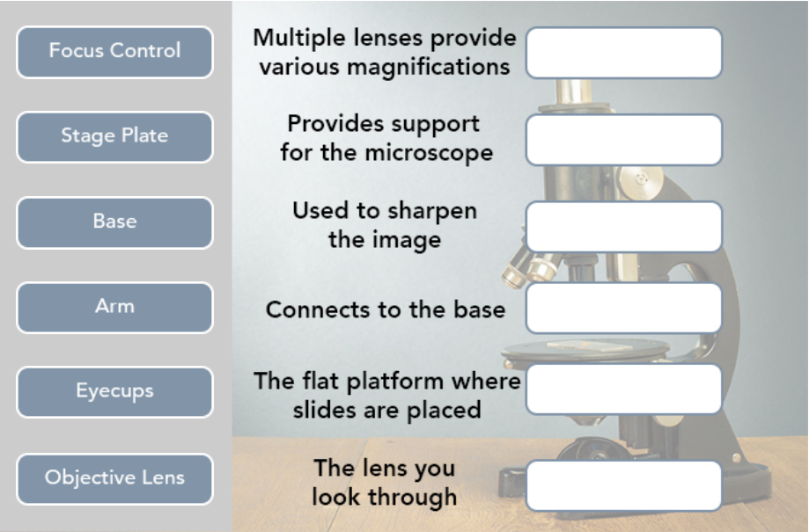
Microscope Parts
Drag and drop the microscope parts listed on the left to their definitions on the right.

Slide 30
Pgs. 10, 11
Magnification
Resolution

Slide 31
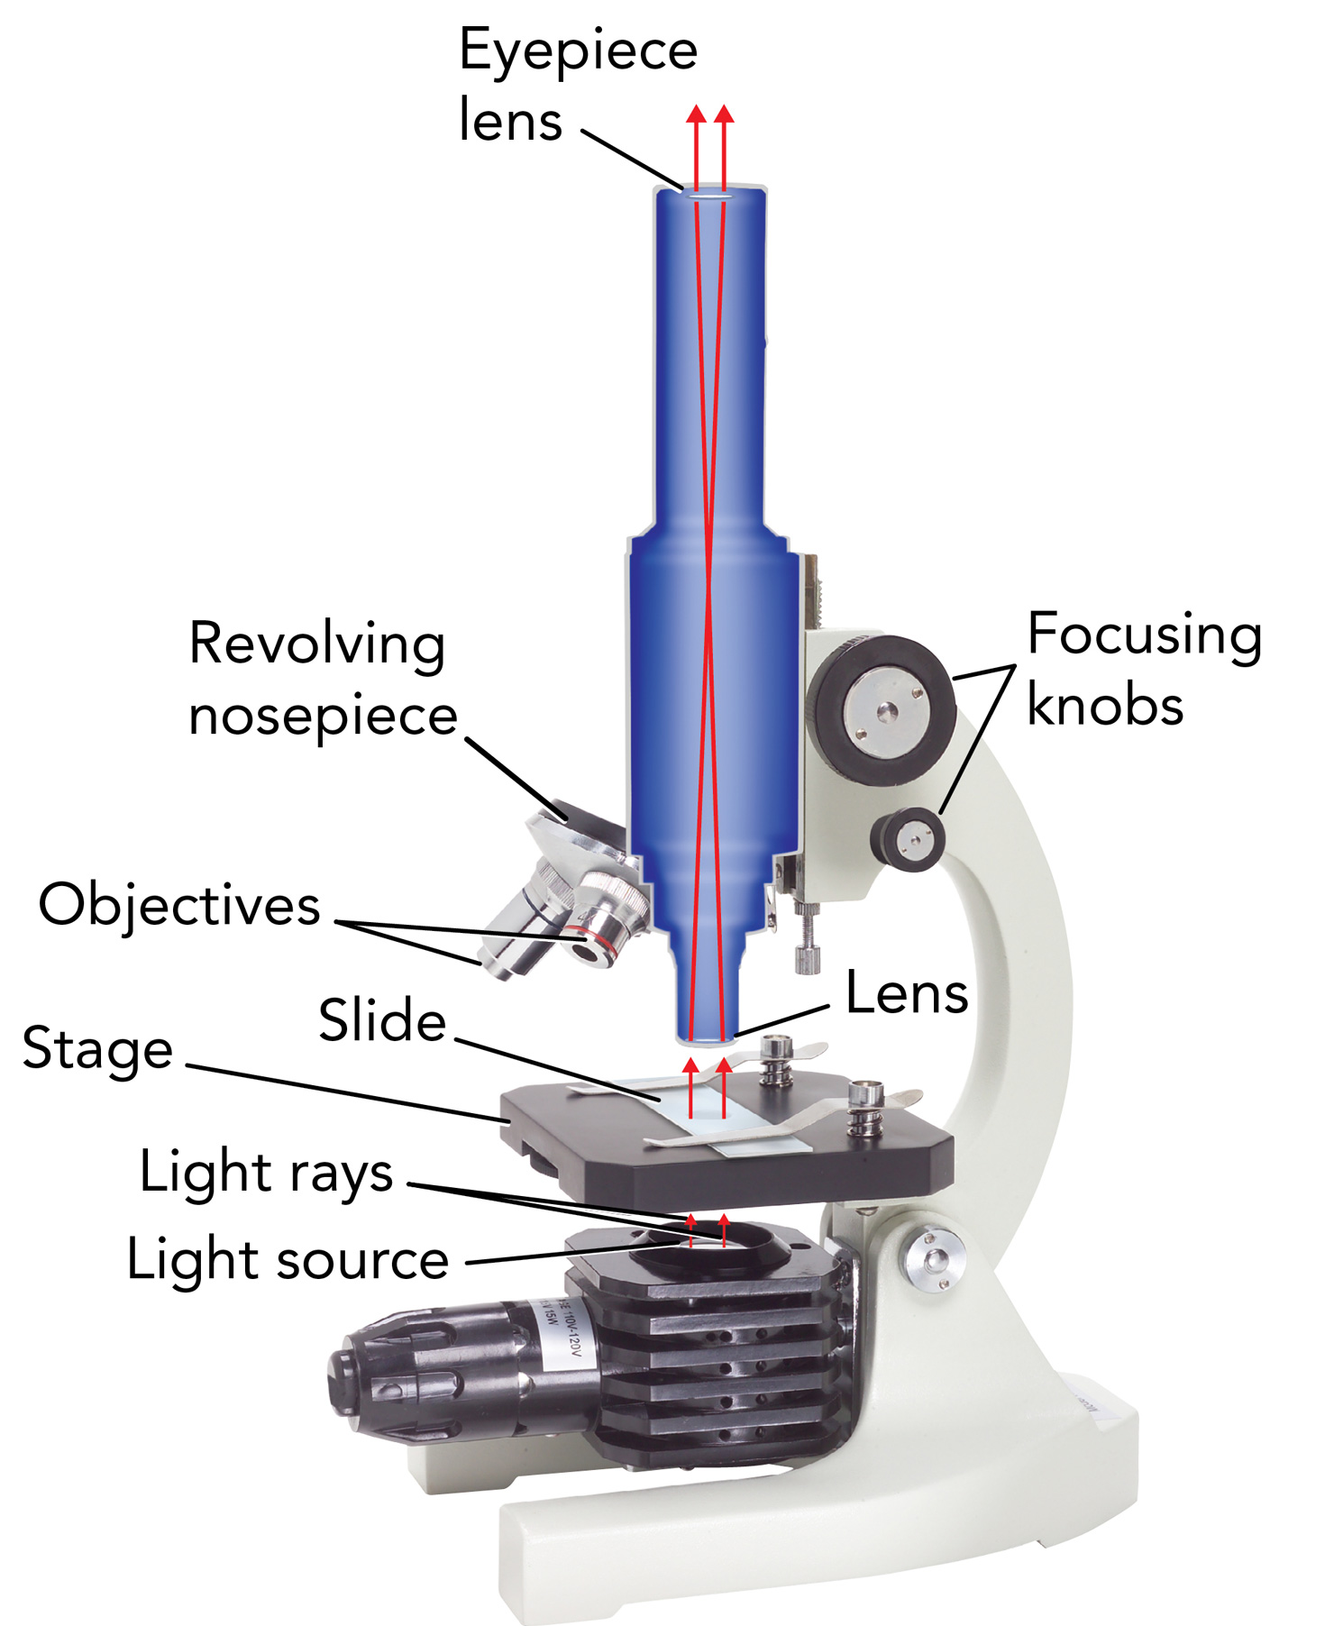
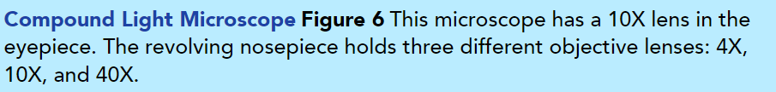
Magnification The compound light microscope you see in Figure 6 magnifies an image using two lenses at once. One lens is fixed in the eyepiece. A second lens, called the objective, is located on the revolving nosepiece. A compound microscope usually has more than one objective lens. Each objective lens has a different magnifying power. By turning the nosepiece, you select the lens with
the magnifying power you need. A glass rectangle called a slide holds a thin
sample to be viewed. A light shines up and passes through the slide and the
sample. The light then passes through the lens in the nosepiece and the eyepiece lens. Each lens magnifies the sample. Finally, the light reaches your eye and you get to see the sample in detail!

Slide 32
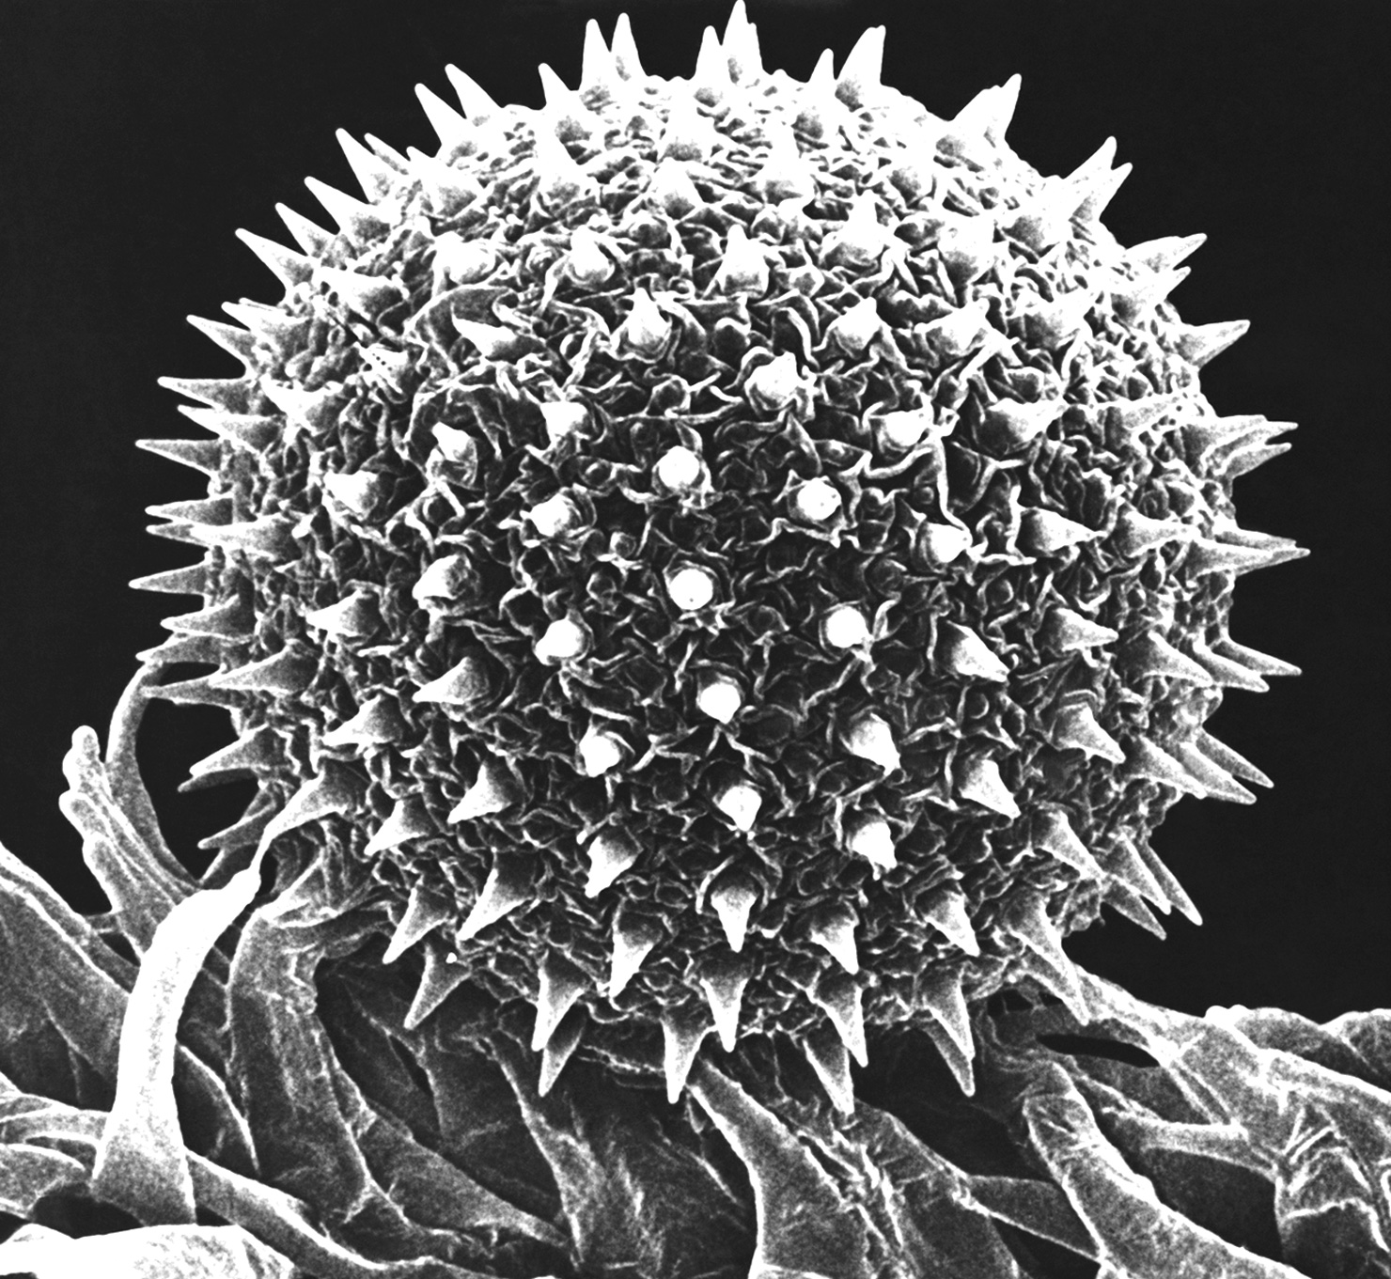
Resolution A microscope image is useful when it helps you to see the details of an object clearly. The higher the resolution of an image, the better you can distinguish two separate structures that are close together, for example. Better resolution shows more details. In general, for light microscopes, resolution improves as magnification increases. Electron microscopes provide images with great resolution and high magnification. As you can see in Figure 7, greater resolution and higher magnification makes it relatively easy to study tiny objects.

Slide 33
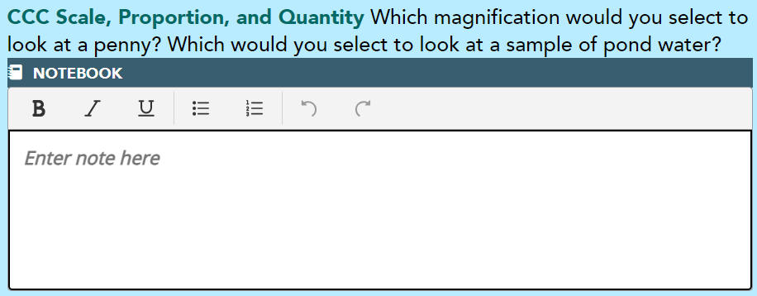
Penny – 4x; Pond water – 40x
Greater resolution shows greater detail. You can distinguish between different cells and perhaps even between parts of cells.
………………………………………………………………………………………………………………………………………………………………………………………………………………………………………………………………………………………………………………………………………………………………………………………………………………………………………………………………………………………………………………………………
I see spikes sticking out of the rough surface of the pollen grain.

Slide 34
Assessment Questions
Pg. 12

Slide 35
1. Identify What are three functions of all cells?
………………………………………………………………………………………………………………………………………………………………………………………………………………………………………………………………………………………………………………………………………………………
2. Describe What are the three key points of Cell theory?
………………………………………………………………………………………………………………………………………………………………………………………………………………………………………………………………………………………………………………………………………………………
3. CCC Patterns Scientists discover new kinds of life in the deep ocean every year. What does the cell theory tell them must be true about every new organism?
………………………………………………………………………………………………………………………………………………………………………………………………………………………………………………………………………………………………………………………………………………………
4. SEP Engage in Argument from Evidence Use evidence to explain how advancements in technology influenced cell theory.
………………………………………………………………………………………………………………………………………………………………………………………………………………………………………………………………………………………………………………………………………………………
obtaining energy; bringing in nutrients and water; getting rid of waste
Cells are the basic units of life; all living things are made up of cells; all new cells are produced by existing cells.
Every organisms is made up of cells and all its cells are produced by existing cells.
The invention and improvements of microscopes have allowed a deeper
understanding of cell function.

Slide 36
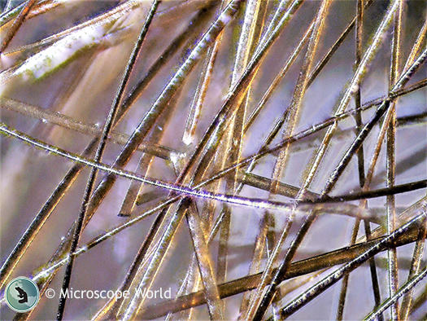
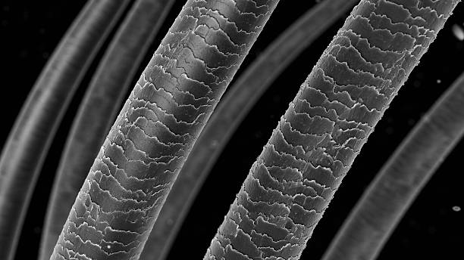
5. CCC Structure and Function Compare and contrast the structure and function of a unicellular organism to that of a multicellular organism.
6. SEP Use Models On a separate piece of paper, draw two circles of the same size. In the first circle, draw a small, simple picture of something that is big enough to see without magnification. In the second circle, draw it again under 5x magnification. If it is too big to fit in the circle, draw only the part of the object that fits inside.
Both organisms are made from the same basic unit of structure and function, a cell. A unicellular organism has.one cell that must perform all the functions necessary for the organism to survive. A multicellular organism has different cells with different functions and together they all keep the organisms alive.

Slide 37
7. Apply Scientific Reasoning Hooke and Van Leeuwenhoek made their discoveries around the same time. More than 150 years later, Schleiden, Schwann, and Virchow all made breakthroughs within a few years of each other. What are some possible reasons for the sudden development of the cell theory after such a long break?
It’s possible that microscope technology improved, which allowed the scientists to see cells more clearly. Or maybe after Schleiden made his discovery, that caught the interest of other scientists. Who went on to add new discoveries.

Slide 38
THANKS!

