Slide 1
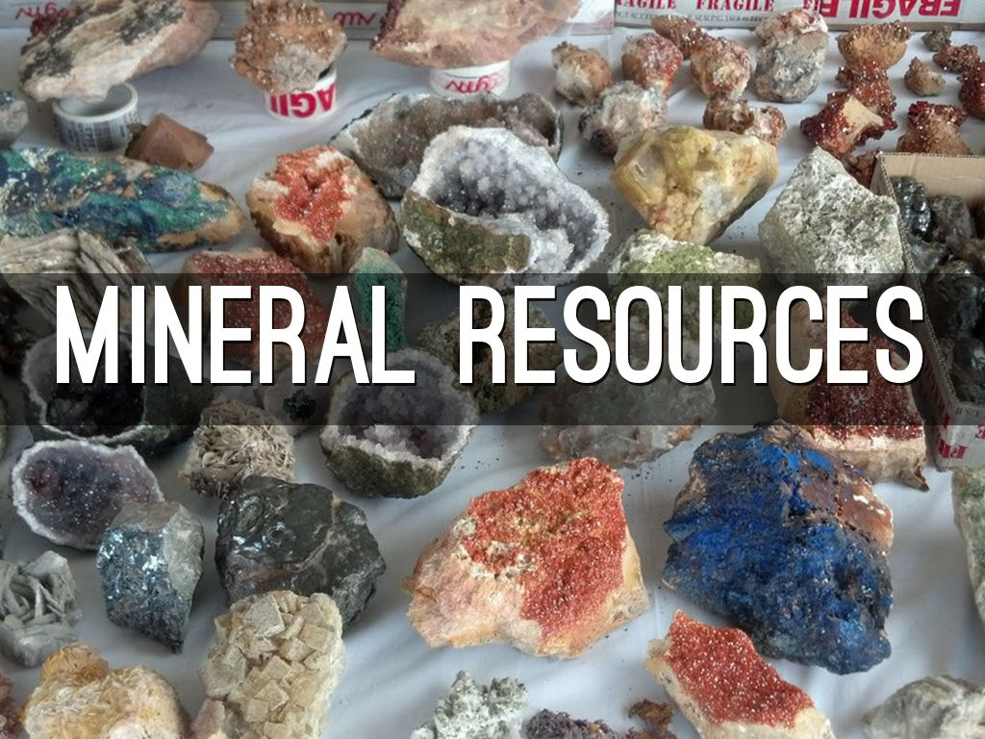
Page. 308

Slide 2
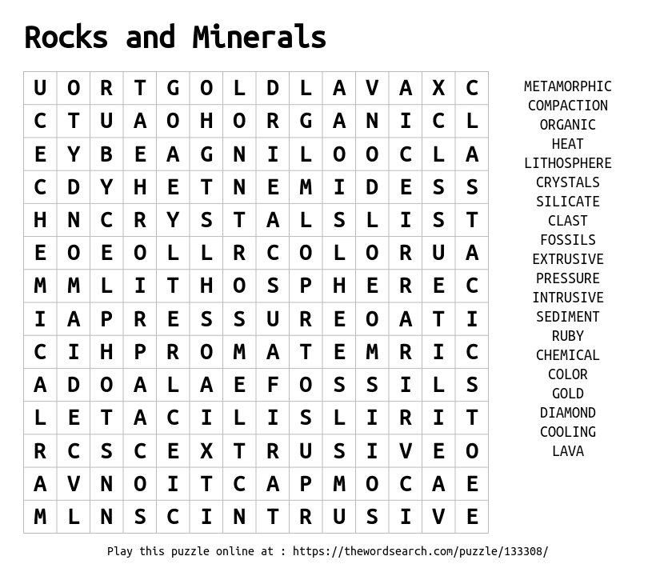

Slide 3
Guiding Questions
What are mineral resources?
What factors affect the distribution of minerals on Earth?

Slide 4
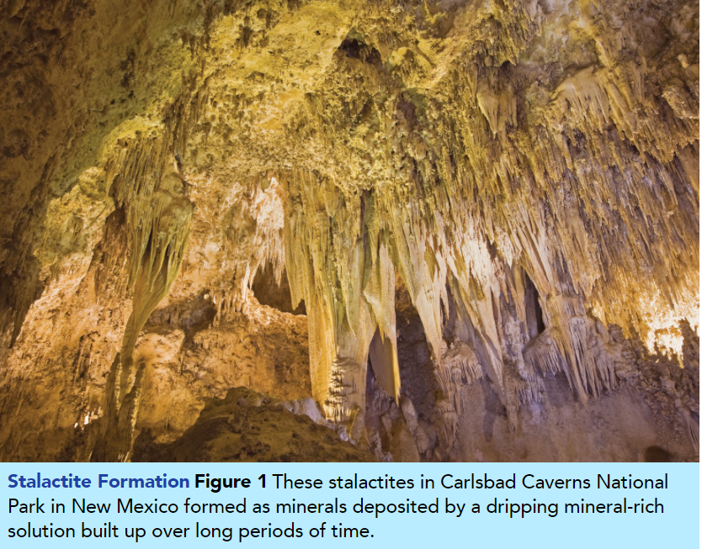
Circle some of the objects in the photo that you think contain minerals.
Pg 308

Slide 5
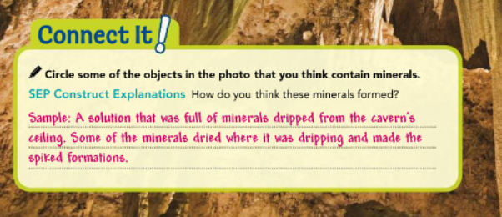

Slide 6
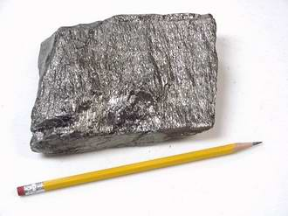
Minerals and Ores
You may think that minerals are only found in rocks. It’s true that rocks are made from minerals, but if you look around, you will probably see several other things that are made from minerals. Metals are made from one or more minerals. The graphite in a pencil is a type of mineral. Computers, smartphones, and other electronic devices are made with metals and other minerals, too. Even you contain minerals, such as the calcium-bearing minerals that make up your bones and teeth.
Pg 309

Slide 7
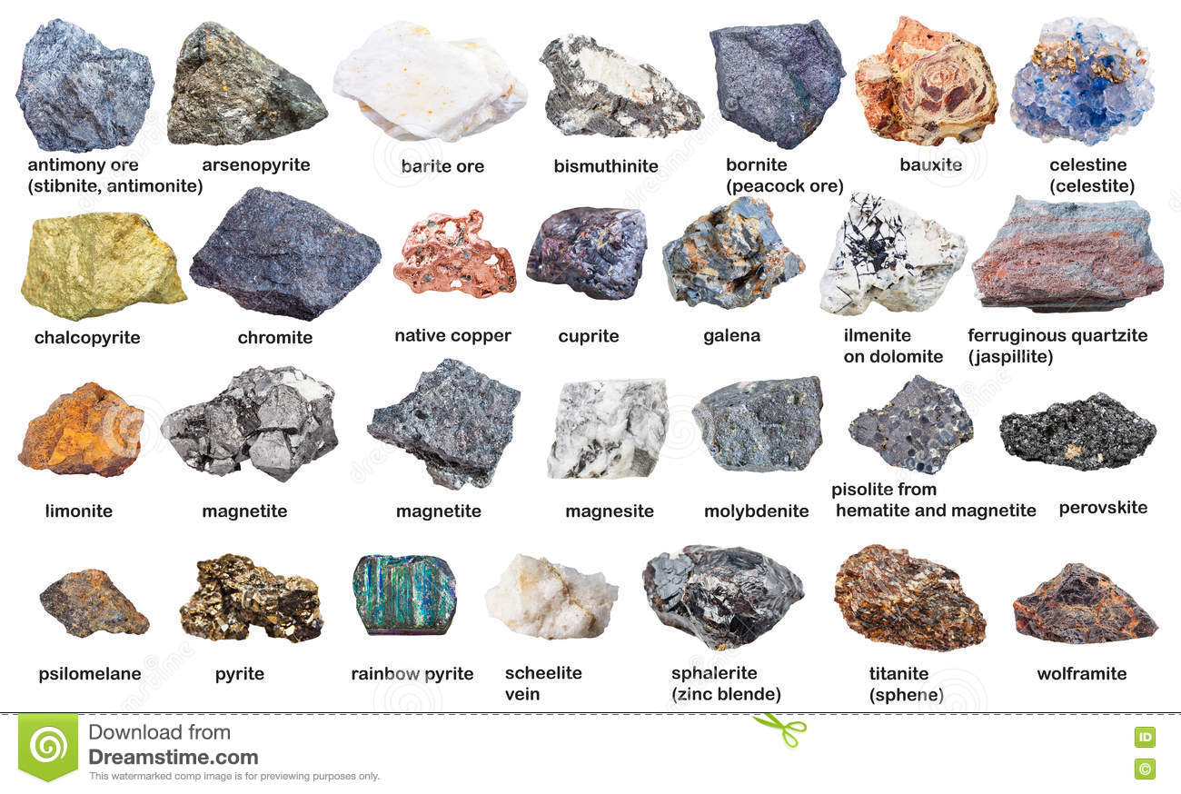
But what is a mineral?
A mineral is a solid substance that is non-living and made from a particular combination of elements.
There are over 5,000 named minerals on Earth. Gold, quartz, and talc are just a few examples.
When a mineral deposit is large enough and valuable enough for it to be extracted from the ground, it is known as ore.
People remove ore from the ground so they can use it or sell it to make money

Slide 8
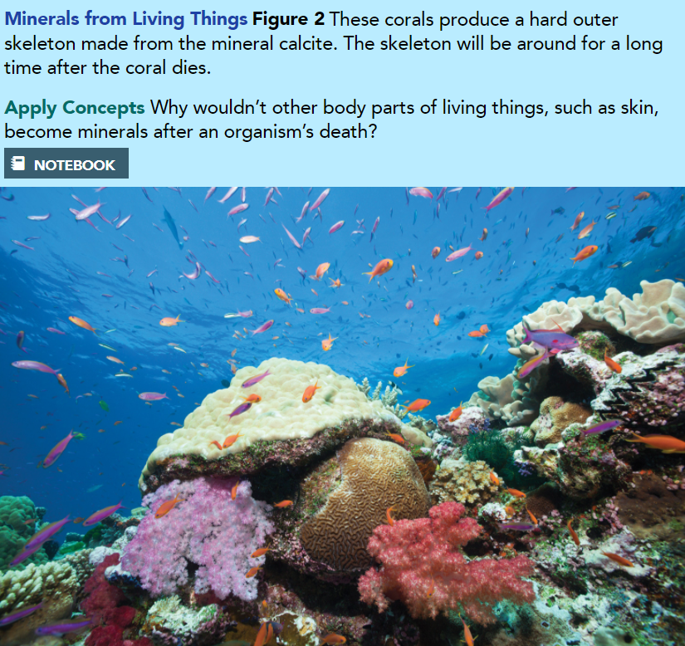
How Minerals Form
Minerals form in different ways. They can form from organic materials, from mineral-rich solutions, and from cooling magma and lava.
1.Organic Material Corals like the ones in Figure 2 create a hard outer skeleton that provides the coral with shape and protection. This skeleton is made from thin layers of calcium carbonate (also called calcite), a chemical compound similar to the shells of other sea animals. Once the coral is dead, the calcium carbonate skeleton is left behind. It may get buried and broken down into smaller fragments.
Pg 310

Slide 9
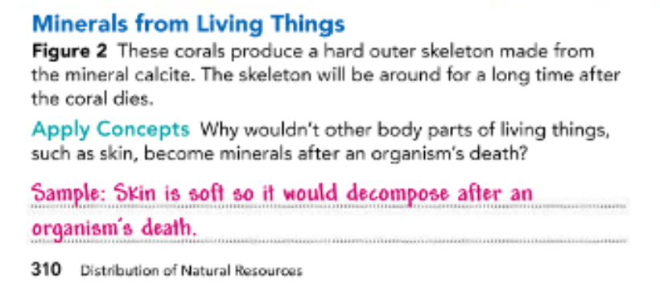

Slide 10
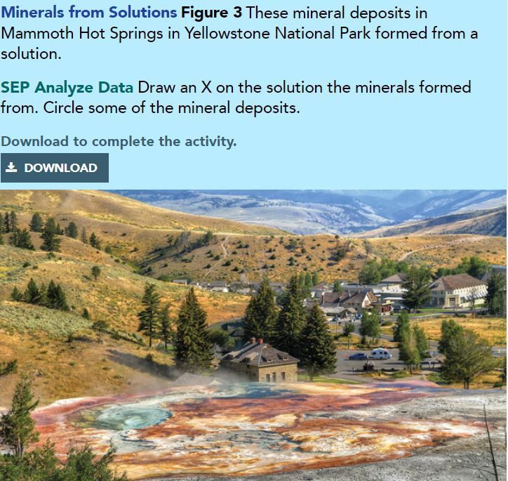
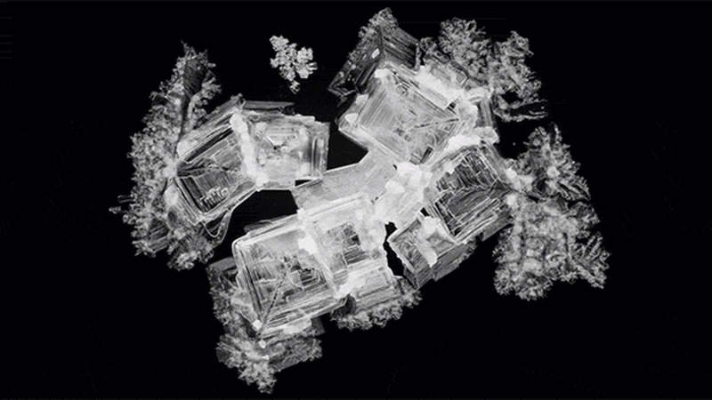
2.Solutions When water contains dissolved substances it is called a solution. In some cases, the elements in these solutions will crystallize to form a new mineral. This can happen within bodies of water and underground. One way this happens on Earth’s surface involves the process of evaporation. When the water evaporates, the elements and compounds that are left behind crystallize into new minerals such as salts. This is how the mineral formations in Figure 3 formed.
Pg 311

Slide 11
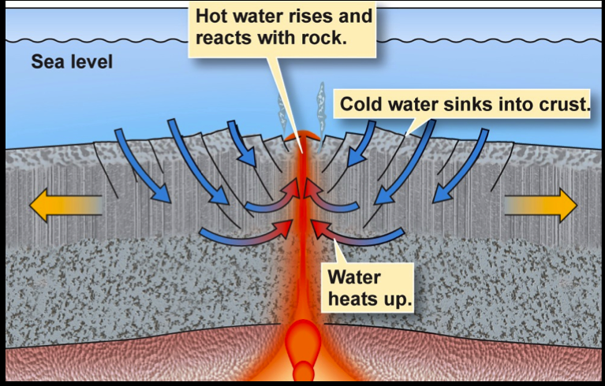
Another way that minerals form from solutions is through a process in which a warm solution flows through a crack in existing rock. Elements and compounds leave the solution as it cools and crystallize as minerals in the crack. These form veins of ores that are different from the surrounding rock.

Slide 12
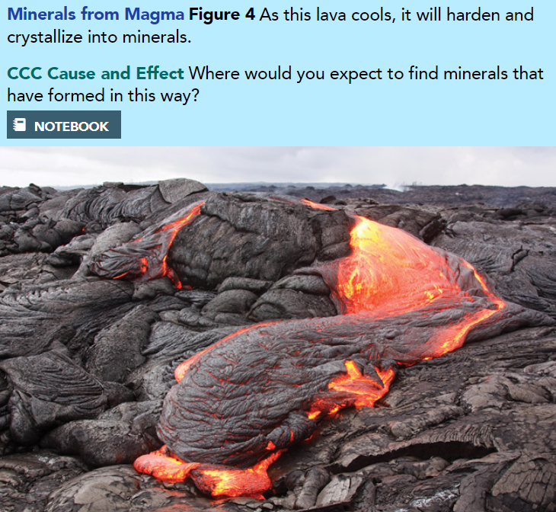
Magma and Lava
The molten and semi-molten rock mixture found beneath Earth’s surface is known as magma. In its molten, or melted state, magma is very hot. But when it cools, it hardens into solid rock. This rock is made from crystallized minerals. It may form beneath Earth’s surface or above Earth’s surface when magma (which is known as lava when it breaks the surface) erupts from the ground and then cools and hardens as is shown in Figure 4.
The types of minerals that form from magma and lava vary based on the materials and gases in the magma, as well as the rate at which it cools.

Slide 13
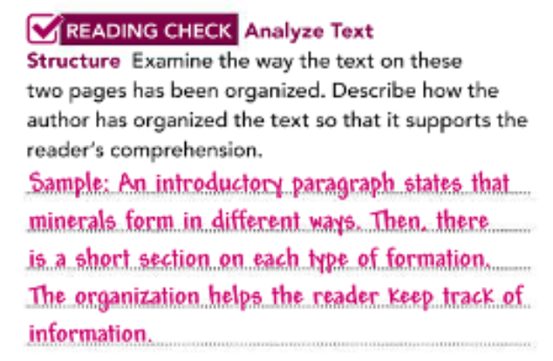

Slide 14
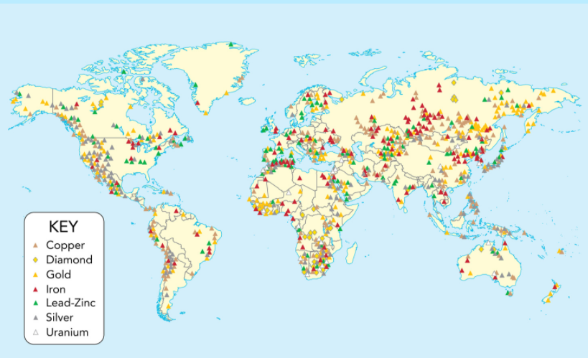
Distribution of Minerals
The distribution of mineral resources on Earth depends on how and when the minerals form. Common minerals, such as the ones that make up most of the rocks in Earth’s crust, are found roughly evenly distributed around the planet. Other minerals are rare because they only form as a result of tremendous heat and pressure near volcanic systems. Therefore, these minerals will only be found near subduction zones or other regions associated with volcanic activity. Other minerals may form from evaporation in the ocean or on land, such as in basins called playas. The map in Figure 5 shows how some minerals are distributed around the world.
Pg 312

Slide 15
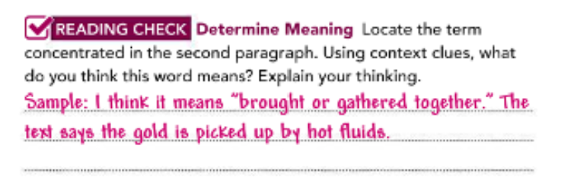

Slide 16
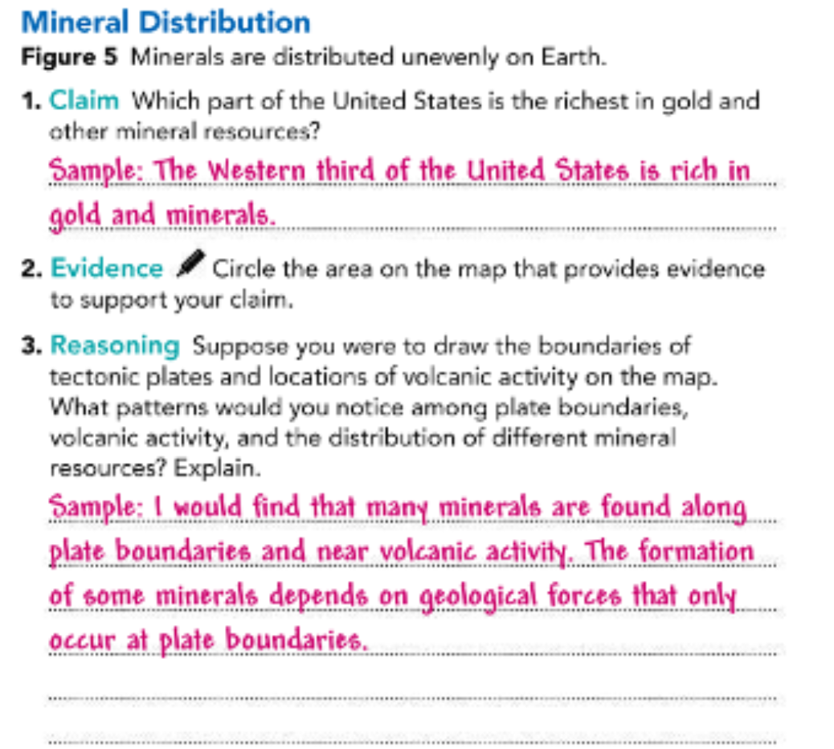

Slide 17
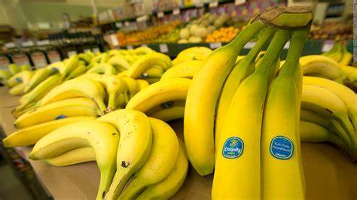
Humans and Minerals
Humans rely on minerals in many ways. They are used in the production of buildings, cars, electronics, and other materials we use every day. Jewelry, sculpture, and other works of art are often made with minerals, such as marble, jade, and emerald. Some minerals are easy and inexpensive to get. For instance, bananas are high in potassium. They are also plentiful, affordable, and easy to find in any grocery store.
Pg 314

Slide 18
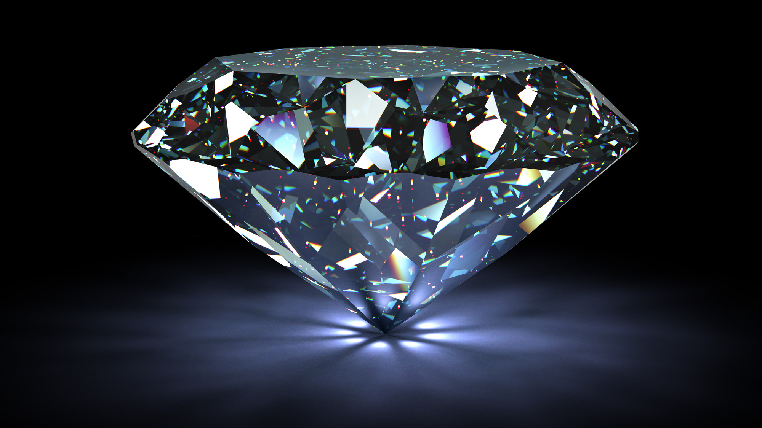
Other minerals, such as diamonds or benitoite (Figure 6), are rare and difficult to get. Many valuable minerals are removed from the ground by the process of mining. As more minerals are mined, there are fewer places to find them because they are a nonrenewable resource. In other words, once they have been removed from the ground, they will not grow back any time soon.

Slide 19
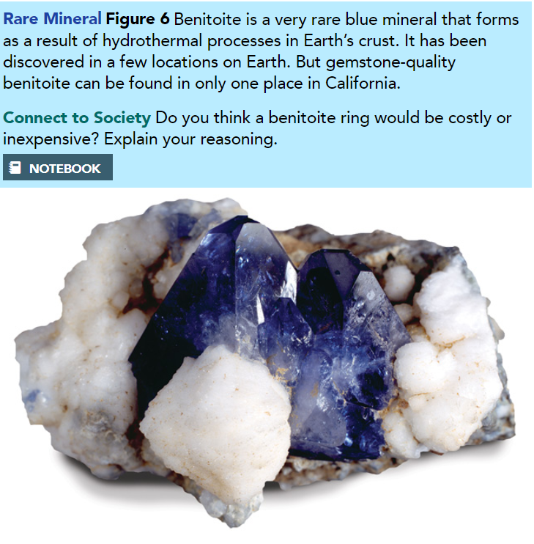
The push to find deposits of valuable minerals often encourages people to take big risks. Some mining practices can damage the environment. Mining is also very dangerous work. Mine collapses and explosions can result in injury or death. Additionally, some valuable minerals are located in parts of the world that are politically unstable. When companies attempt to mine for these minerals there, it can cause problems and danger for everyone involved.

Slide 20
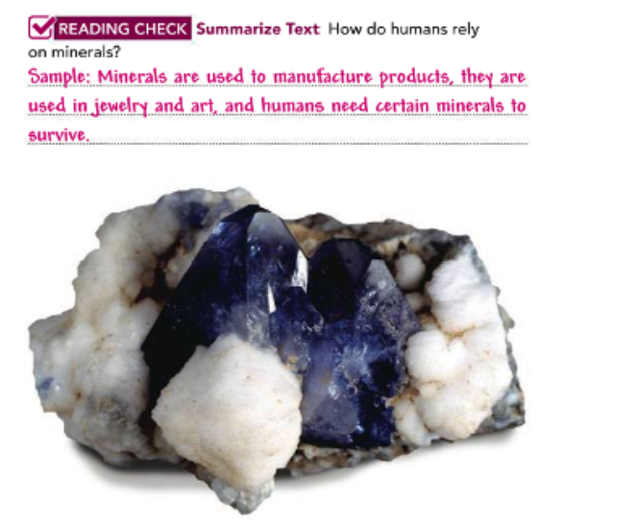

Slide 21
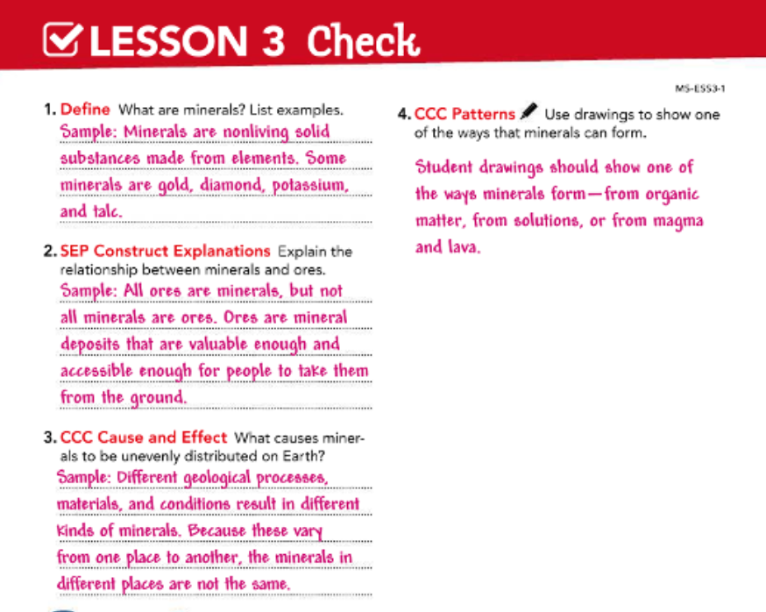
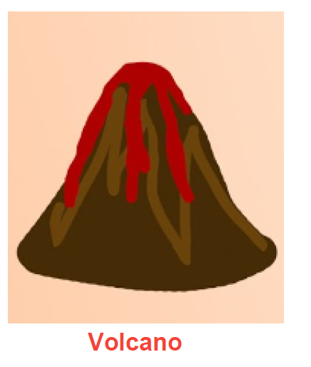

Slide 22


