Slide 1
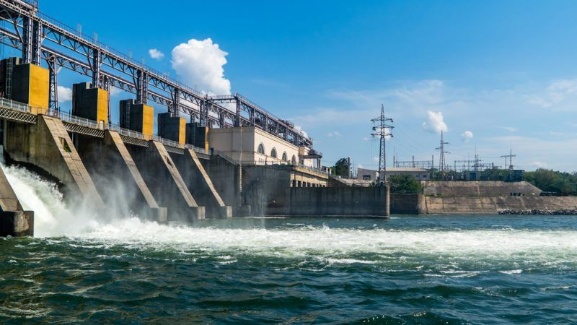
Lesson 2 Renewable Energy Resources
Pg. 300

Slide 2
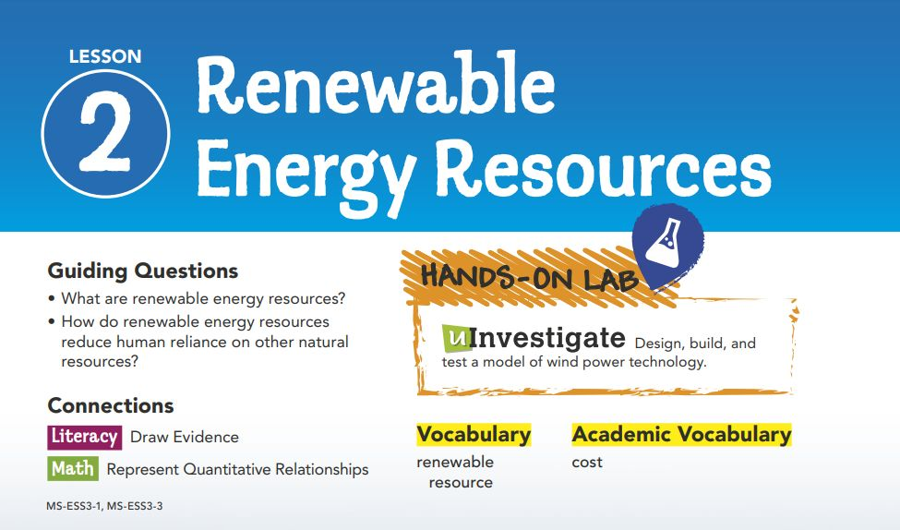

Slide 3
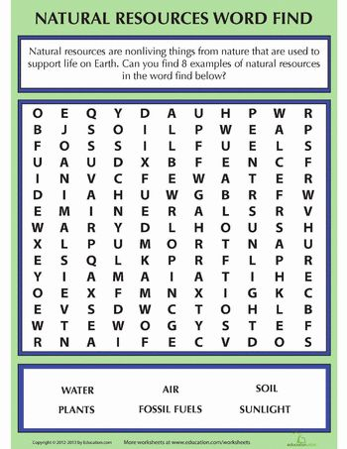

Slide 4
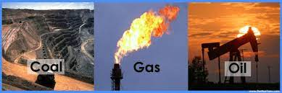
Reducing Fossil Fuel Usage
Pg. 301
The abundance of energy-rich fossil fuels has made it easy for humankind to justify using petroleum, coal, and natural gas.
However, there are both benefits and costs in terms of the short-term and long-term effects.
Even though they are nonrenewable and impact Earth's systems, it was easier and less expensive in the past to mine and drill for coal, oil, and gas than to harness other sources of energy.
Due to increased awareness of the consequences of mining and burning fossil fuels, as well as advances in technology, things are beginning to change in favor of alternative sources of energy.

Slide 5
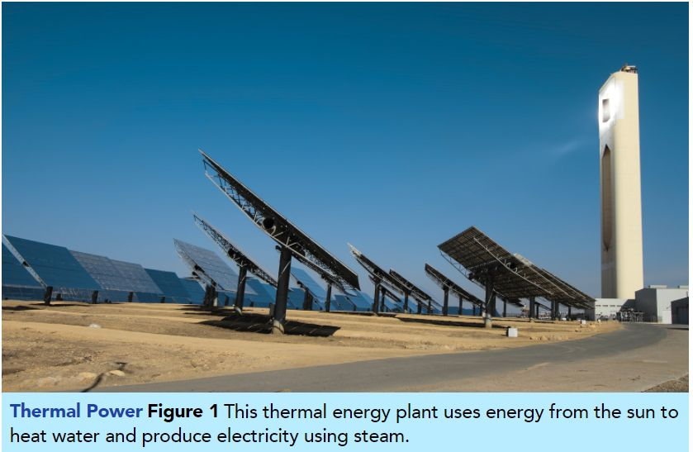
Alternative energy resources, such as the solar power tower in Figure 1, are considered renewable resources because we cannot run out of them. They are replaced by nature, or with a little help from us.

Slide 6
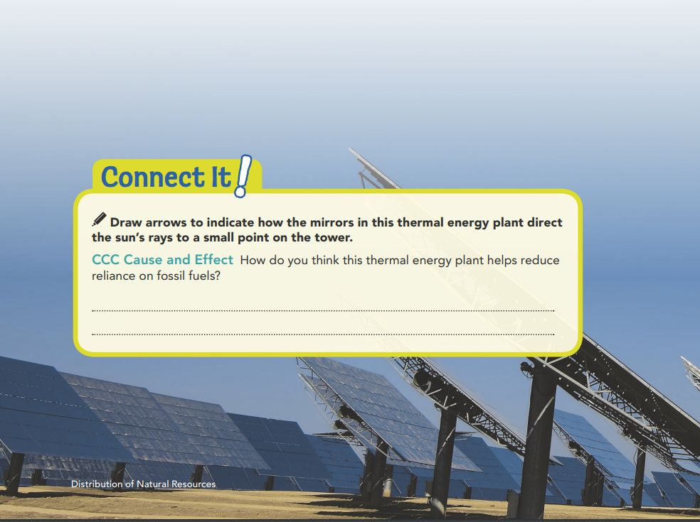
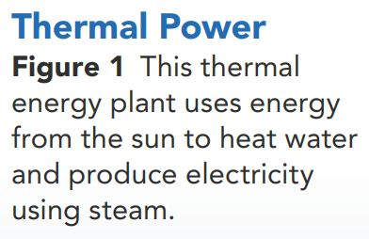
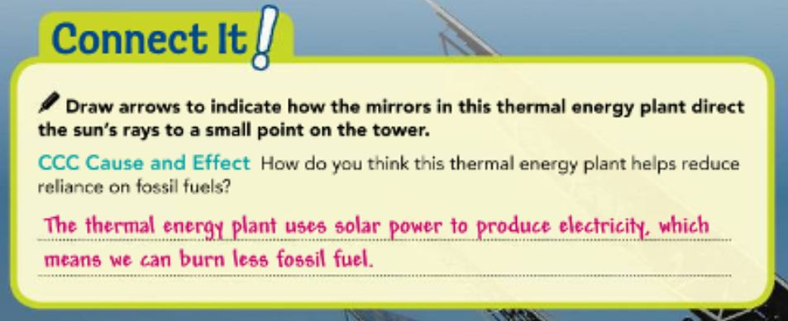
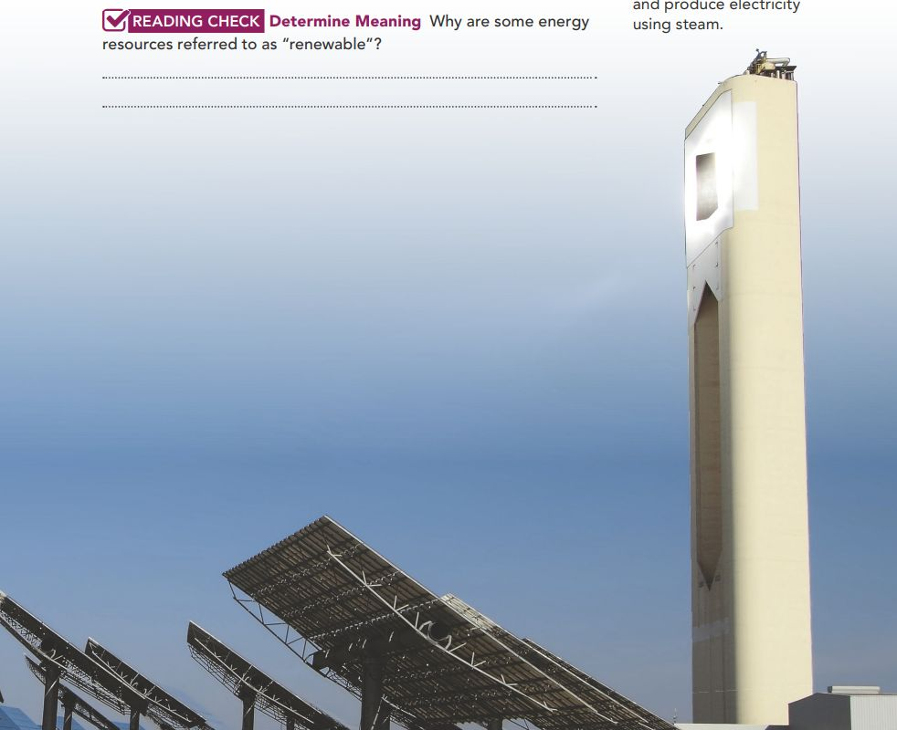
Pg. 300

Slide 7
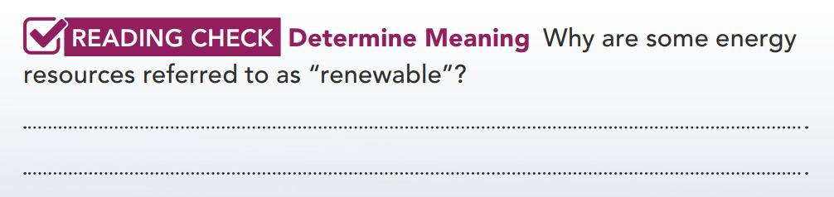
These are energy resources that are renewed by nature, so we do not run of them

Slide 8
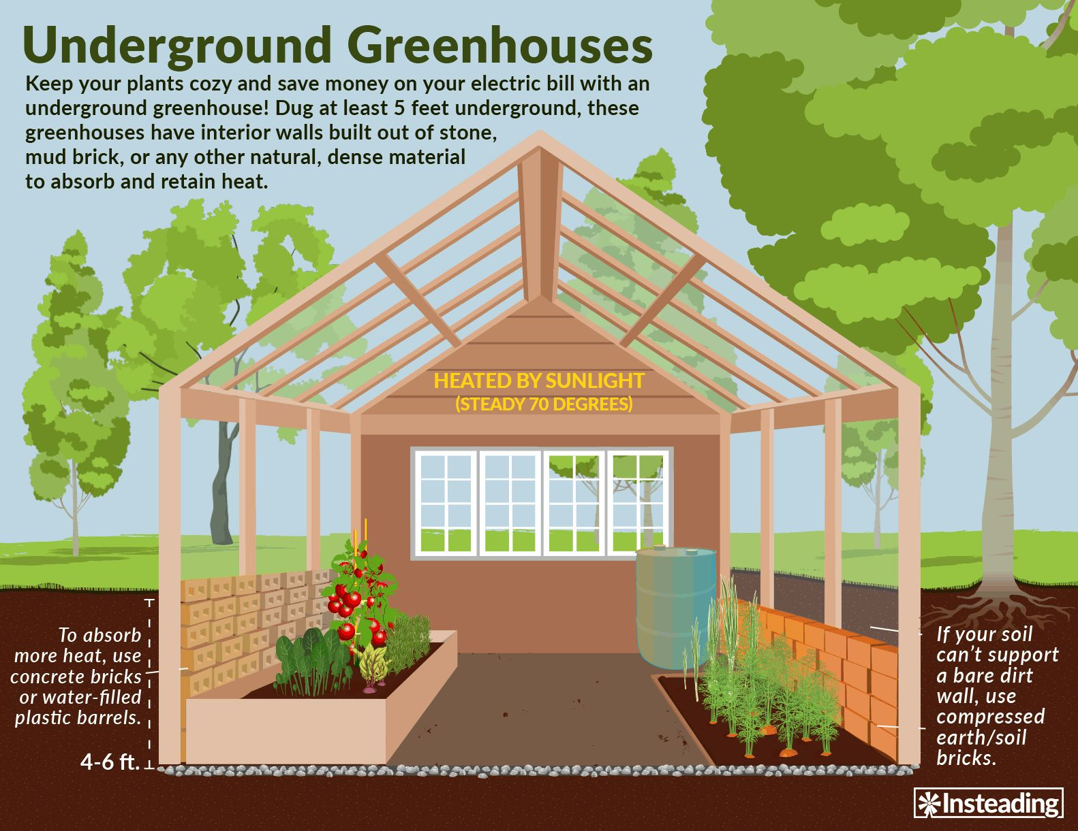
Alternative Sources of Energy
Pg. 302
Using renewable energy resources can reduce our dependence on nonrenewable and avoid some of the problems associated with them.
1.Solar Energy
One of the most basic types of solar energy is passive solar power. It involves letting sunlight pass through glass to heat a room or building to maximize its exposure to sunlight and retain that heat. A greenhouse is a good example of passive solar power.

Slide 9
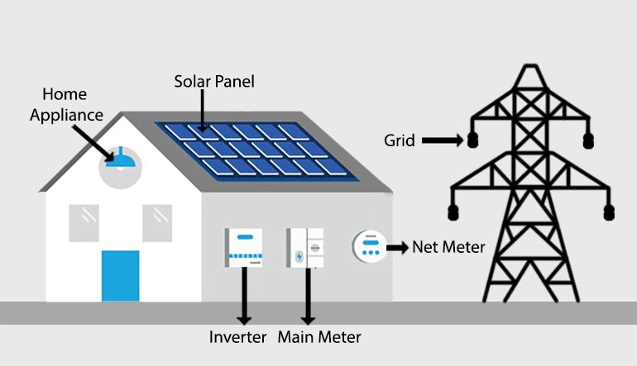
In an active solar power system, sunlight is captured by solar cells, which can power things as small as wristwatches or as large as entire cities. As shown in Figure 2, a solar (or photovoltaic) cell converts the energy from sunlight directly into electrical energy. Solar cells are not a new technology, but they are now much more efficient and less expensive than they were years ago.
Figure 2

Slide 10
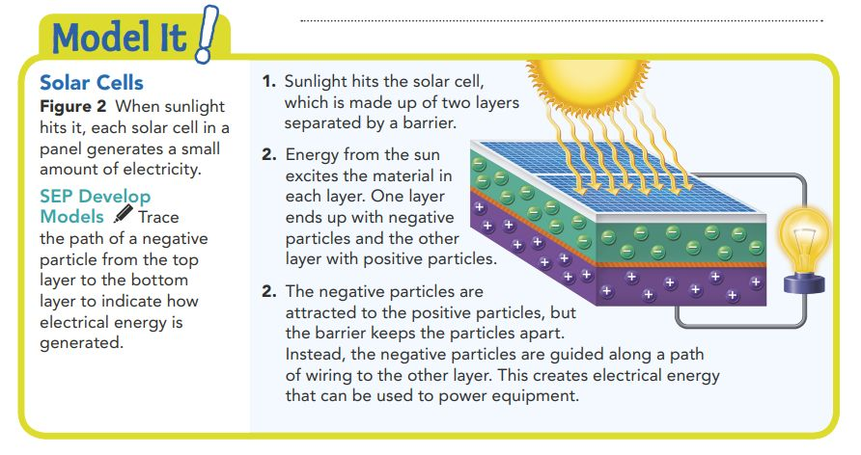
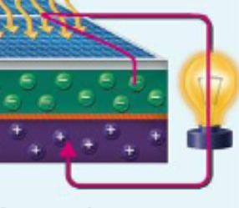

Slide 11
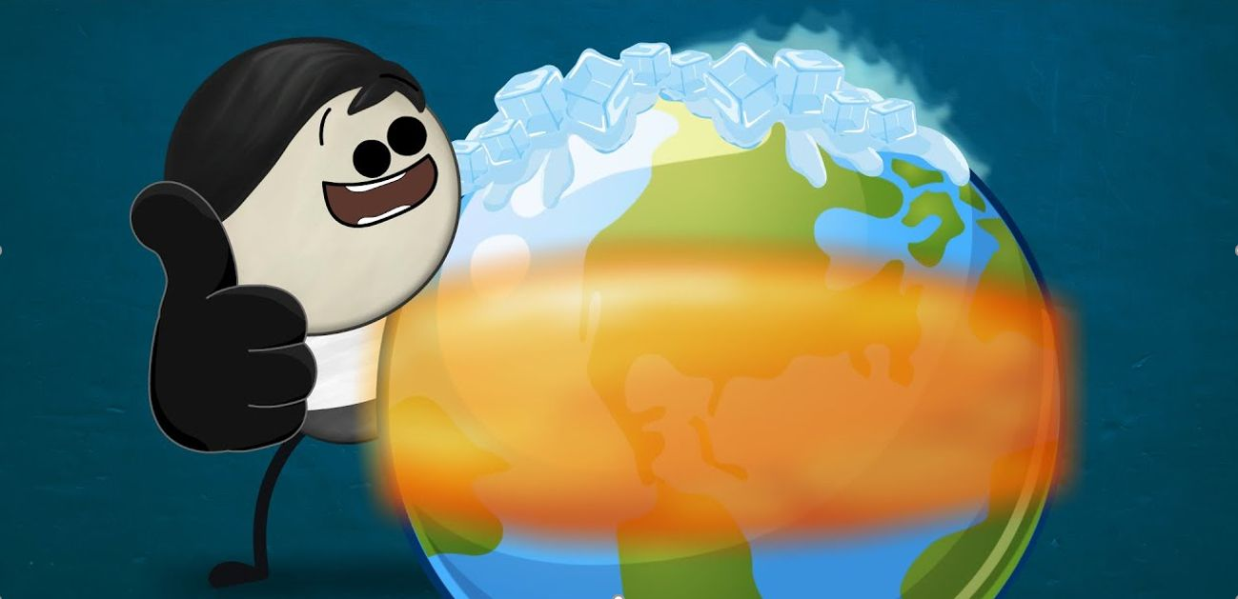

Though the sunlight is free, the costs of the initial investment can be high. Another drawback is the inconsistency of sunlight. More solar energy is available near the equator and in drier climates that do not experience many cloudy days. Additional technology must be used to store the electrical energy for use at night. Finally, not all places on Earth receive the same amount of sunlight throughout the year.

Slide 12
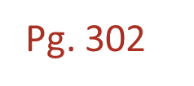
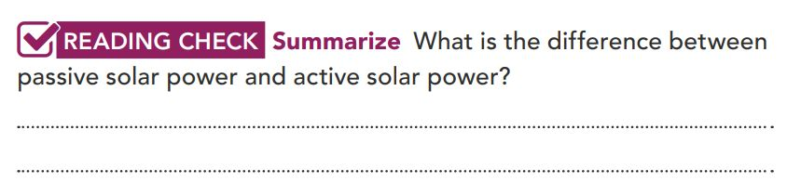
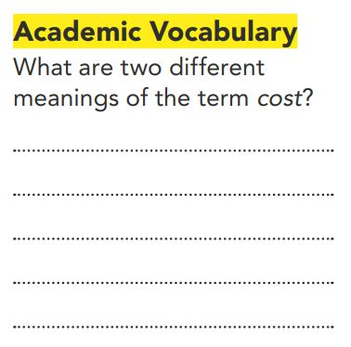
Active solar power directly generates electricity, while passive solar power uses the sun’s energy to heat things, like a room.
Cost can refer to how much money something is worth, or it can be a drawback or disadvantage to something.

Slide 13
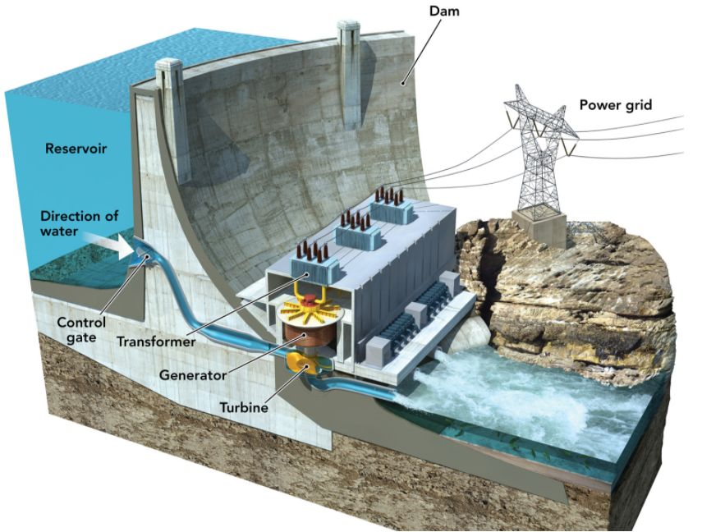
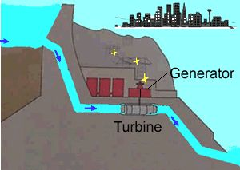
2.Hydroelectric Resources
Pg. 303
The sun’s energy drives the water cycle, which moves large volumes of water to higher elevations from lower elevations in the form of rain and snow. Gravity pulls water downhill, giving rivers, streams, waterfalls, and tides their movement. Turbines can convert the energy of moving water into electricity.

Slide 14
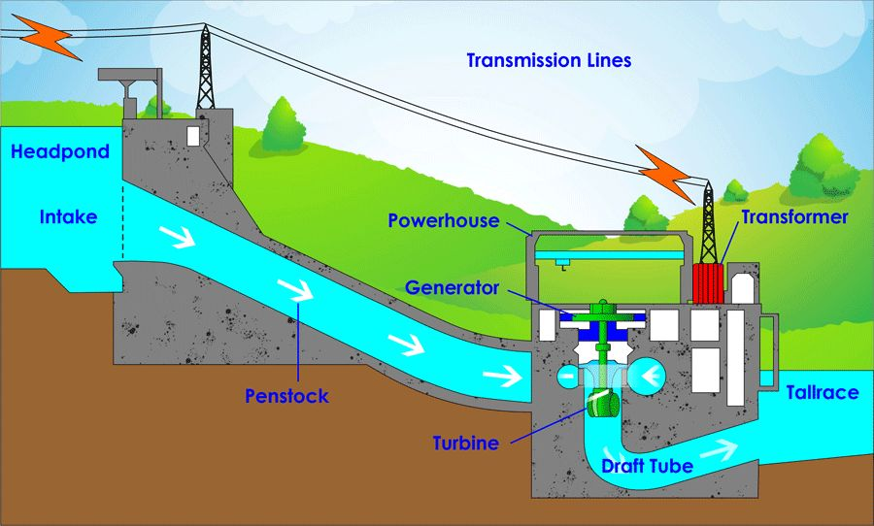
Hydroelectric dams restrict the natural flow of a river by controlling how much water passes through turbines, as shown in Figure 3. Hydroelectric dams can generate a great deal of power, but they disrupt natural processes such as migrations of fish. Dams also alter habitats by creating reservoirs above the dam and reducing the width and flow of the river below. Most importantly, a dam must be close to a source of moving water.

Slide 15
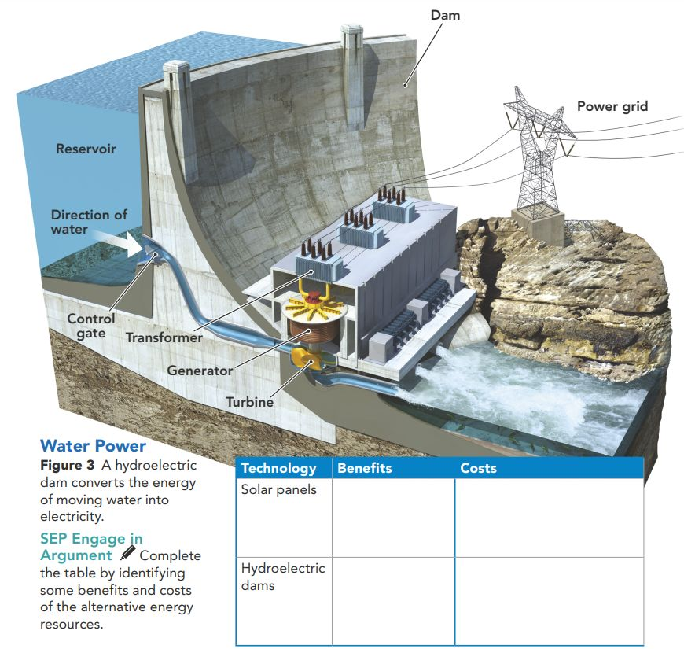
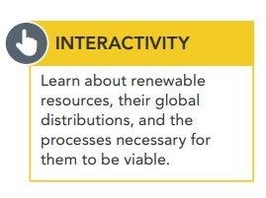
Renewable, no pollution
Expensive: inconsistent availability of sunlight
Renewable, controllable
Alter habitats and migrations; requires proximity to moving water.
Pg. 303

Slide 16
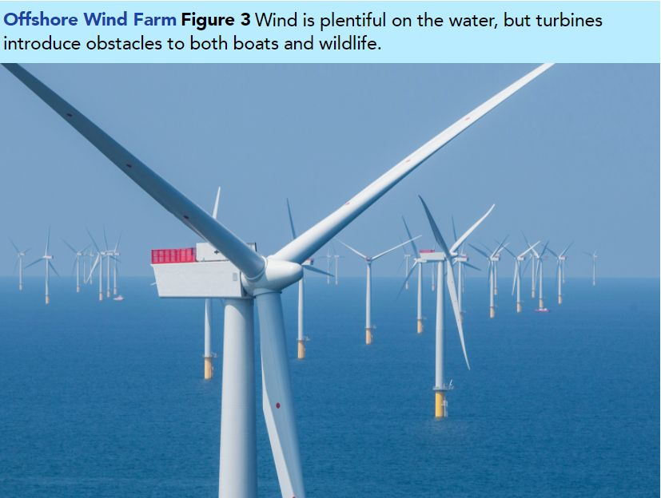
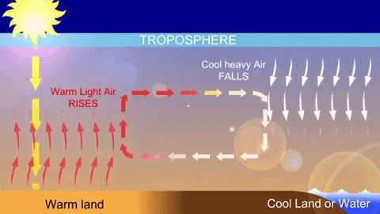
3.Wind Energy
Pg. 304
Like the water cycle, wind is powered by energy from sunlight. An area of Earth’s surface warms as sunlight is converted to thermal energy. Warm air rises and expands, allowing cooler, denser air to flow in to fill the void. We know this movement of air masses as wind. Just as turbines can be used to harness the energy in moving water, they can be used to harness the energy of wind. Land-based or offshore wind “farms” consist of multiple turbines (Figure 3).

Slide 17
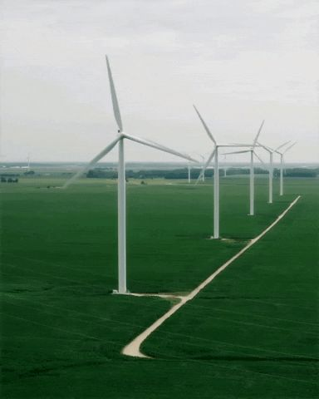
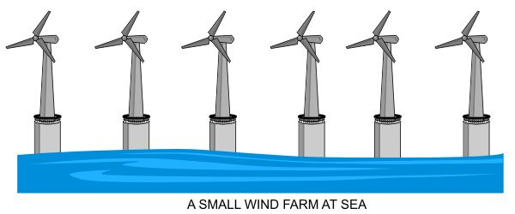
Wind farms do best in areas that receive a steady supply of wind. Some farms are found in valleys between mountains that channel and concentrate the wind. Others are found in the ocean, where land and sea breezes provide strong winds. The costs of constructing wind farms are considerable, and some people are concerned that large turbines threaten birds and spoil natural scenery. But wind power is already less expensive than coal power in many parts of the country, and it is the fastest-growing energy source in the world.

Slide 18
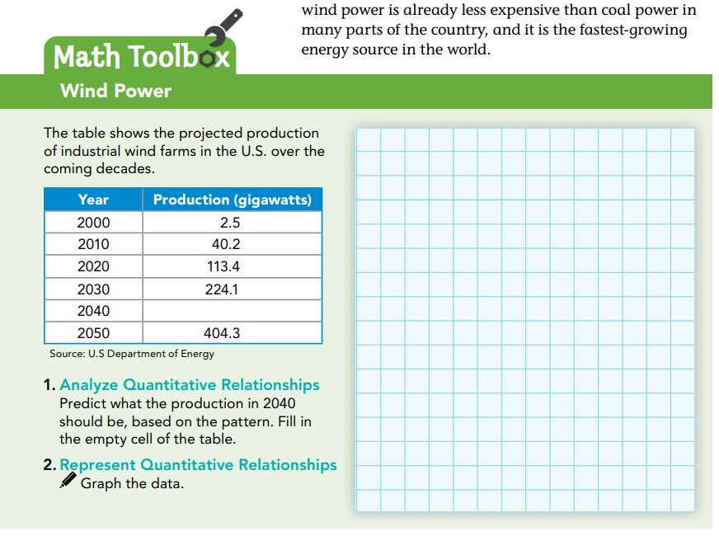
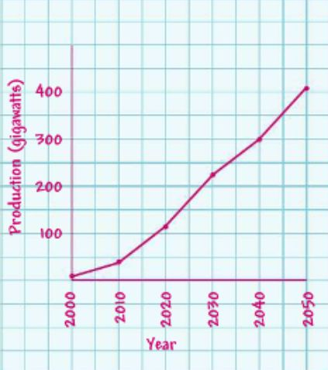
Pg. 304
300

Slide 19
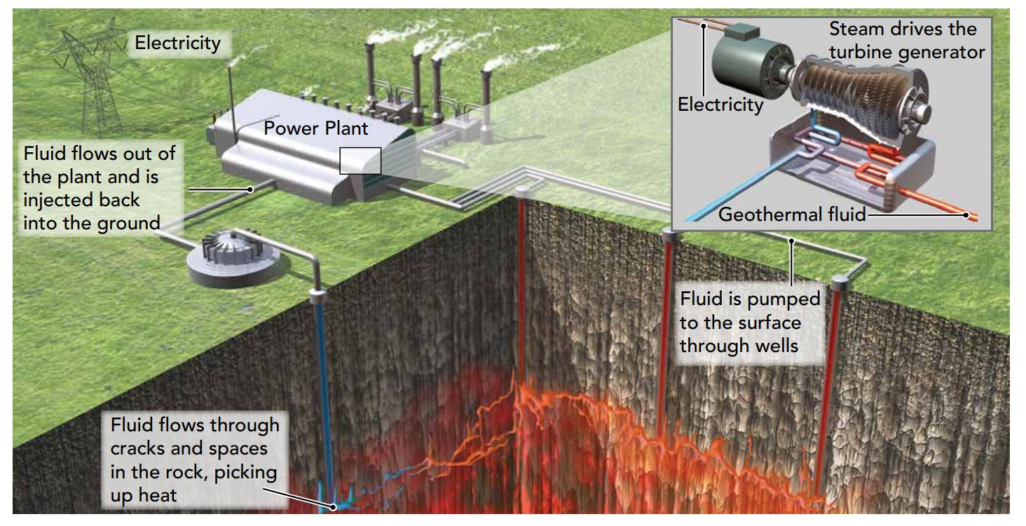
4.Geothermal Energy
Pg. 305
One renewable energy source not originating with the sun is geothermal energy. Deep below Earth’s surface, the rock of Earth’s crust is hot. In some places on Earth’s surface, this heat can be used on a small scale to warm homes. On a larger scale, geothermal energy plants (Figure 4) use this heat to generate electricity.

Slide 20
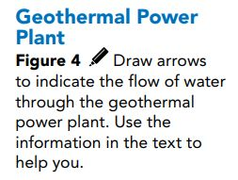
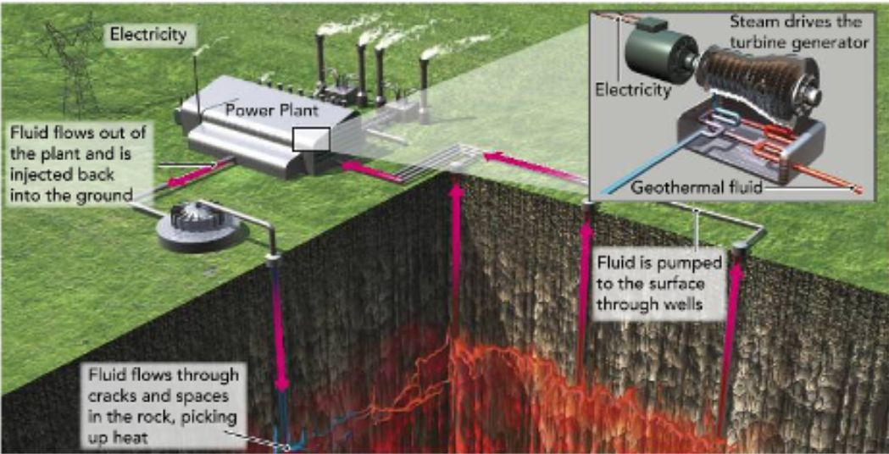
One of the biggest drawbacks is that geothermal reservoirs are not easy to find. The site must be located over a geothermal hot spot, where the rock is hot enough to continuously reheat pumped water. The best sites are near volcanic areas. While initial costs to construct the plant and drill the pipes are expensive, the power it can provide in the long run makes up for it.

Slide 21
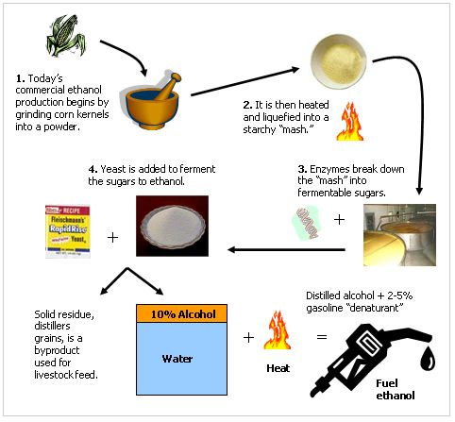
5.Bioenergy Resources
Pg. 305
Biomass such as wood, grasses, coconut husks, and other plant-based materials have been burned to produce light and heat for thousands of years. These resources are only limited by where they can grow.

Slide 22
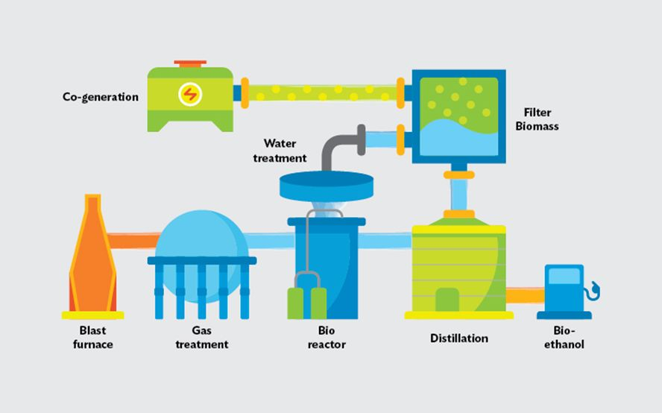
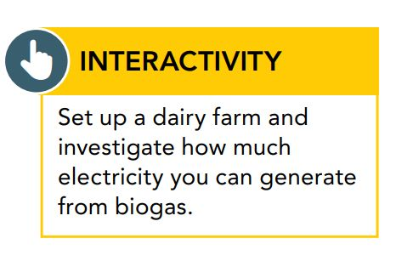
Scientists have developed ways to turn these resources into biofuels such as ethanol, which is usually made from corn or sugar cane, and biodiesel, which can be made from used cooking oil. Unfortunately, the energy that goes into producing these biofuels is often equal to or greater than the energy they yield. Also, burning biofuels is not much better for the atmosphere than burning fossil fuels.

Slide 23
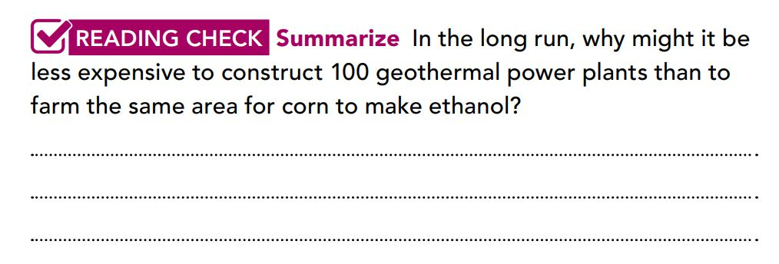
Making ethanol can take almost as much energy as the ethanol will yield. The initial cost of geothermal is high but the power output is greater and the costs decline over time.

Slide 24
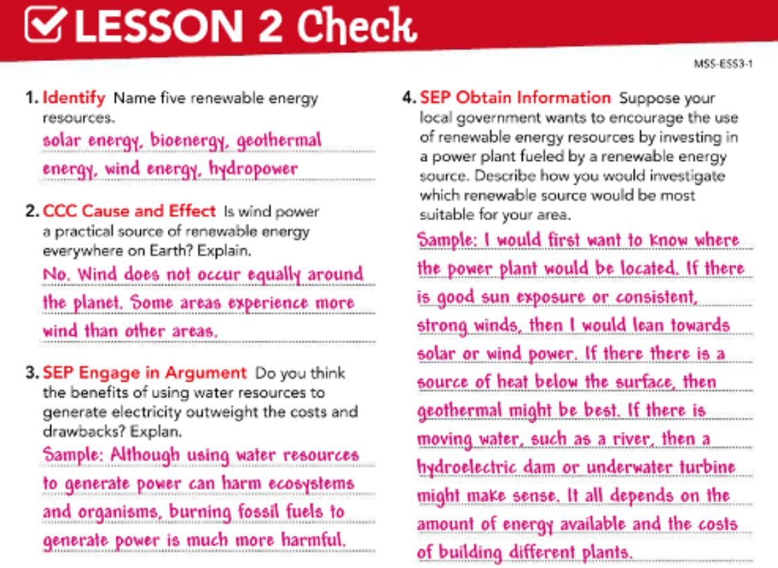
Pg. 306

Slide 25


