Slide 1
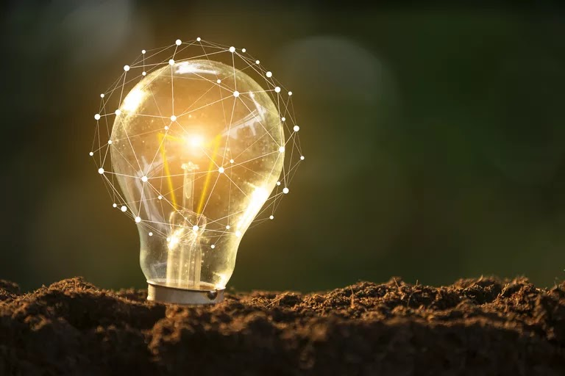
Topic 3 lesson 3
Other Forms of Energy
Page 108

Slide 2
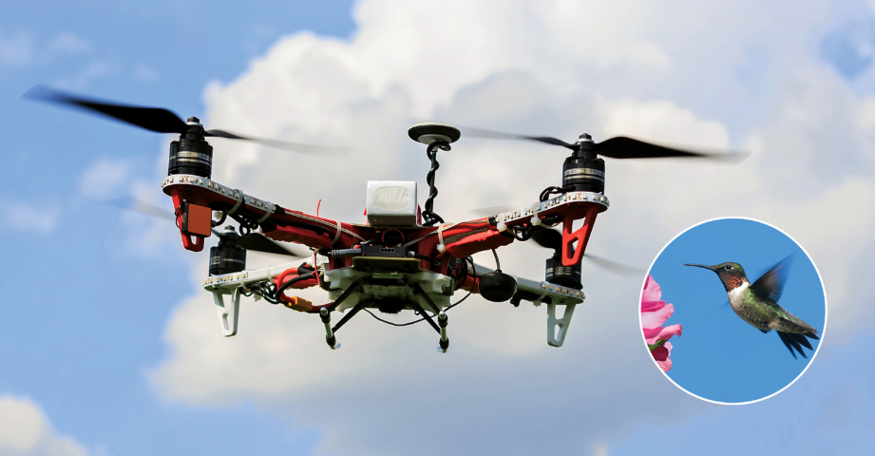
Circle and label the parts of the drone that are similar to the parts of the hummingbird.

Slide 3
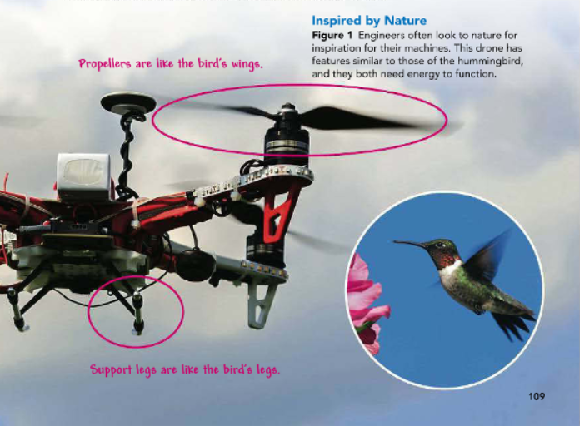

Slide 4
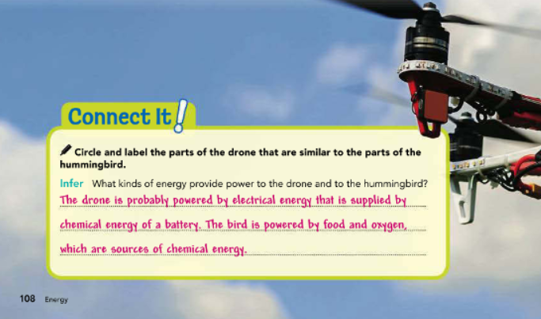

Slide 5

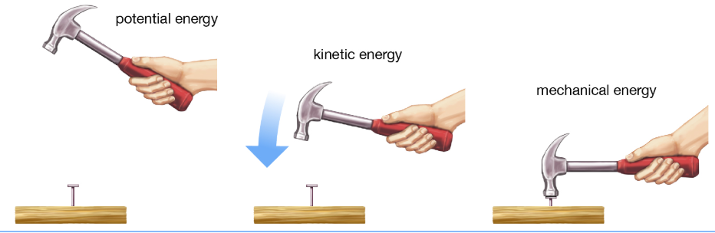
Determining Mechanical Energy
Mechanical is an adjective that refers to things that are or can be in motion, which covers just about any object we can think of, from particles all the way up to Earth itself. Mechanical energy is the energy an object has due to its motion, shape, position, or a combination of these factors.

Slide 6

An object’s mechanical energy equals the total of its kinetic and potential energy. For example, a train chugging uphill has energy, and much of that energy is energy of motion—kinetic energy. But a train that is sitting idle at the top of a hill also has energy—potential energy. By adding these two energy forms together, you can determine the train’s mechanical energy:
109

Slide 7
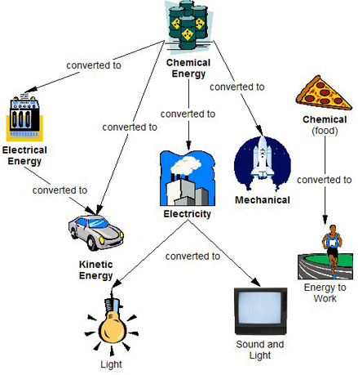
More Forms of Energy
Much of the energy that you observe is mechanical energy, but energy can take many other forms as well. Some other forms of energy are associated with tiny particles, such as atoms and molecules, that make up objects. These forms include nuclear energy, thermal energy, chemical energy, electric energy, and electromagnetic energy.

Slide 8
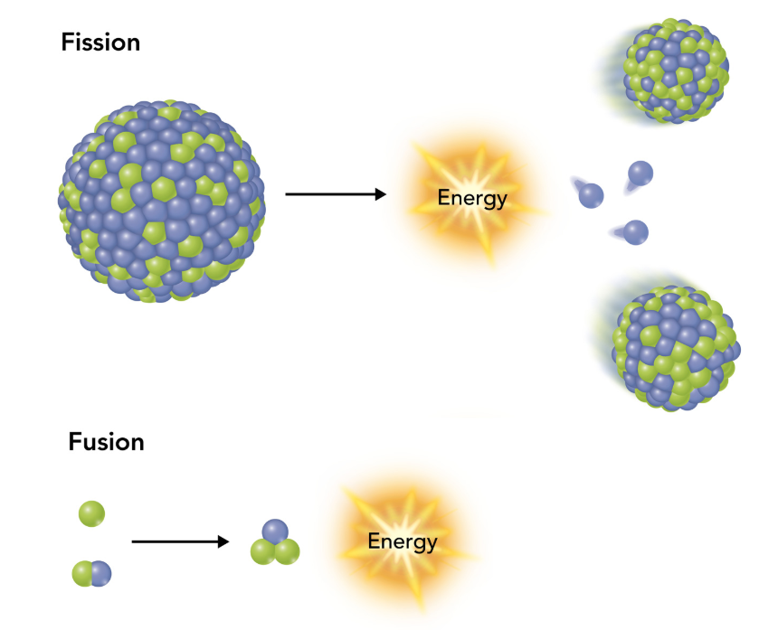
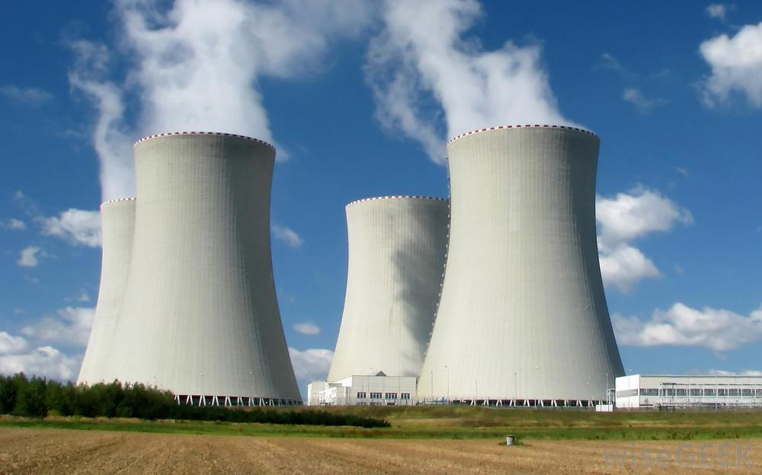
1.Nuclear Energy
All matter is made of particles called atoms. The center of the atom is called the nucleus (plural: nuclei). Nuclear energy is a type of potential energy stored in the nucleus. It can be released through a nuclear reaction. In one type of nuclear reaction, called fission, a nucleus splits into smaller fragments. When it breaks apart, it releases energy (Figure 2). If fission reactions are controlled, the release of energy can be used to generate electricity. Nuclear power plants harness nuclear energy for this purpose.
110

Slide 9


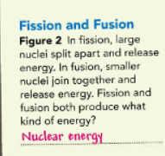
Fusion is another type of nuclear reaction. In fusion, small nuclei combine to form larger nuclei. One place that fusion happens is inside the sun. Some of the energy released by this reaction makes its way to Earth as light. Fusion releases more energy than fission, but the extremely high temperatures that are required to start a fusion reaction make it more difficult to use and control.
110

Slide 10
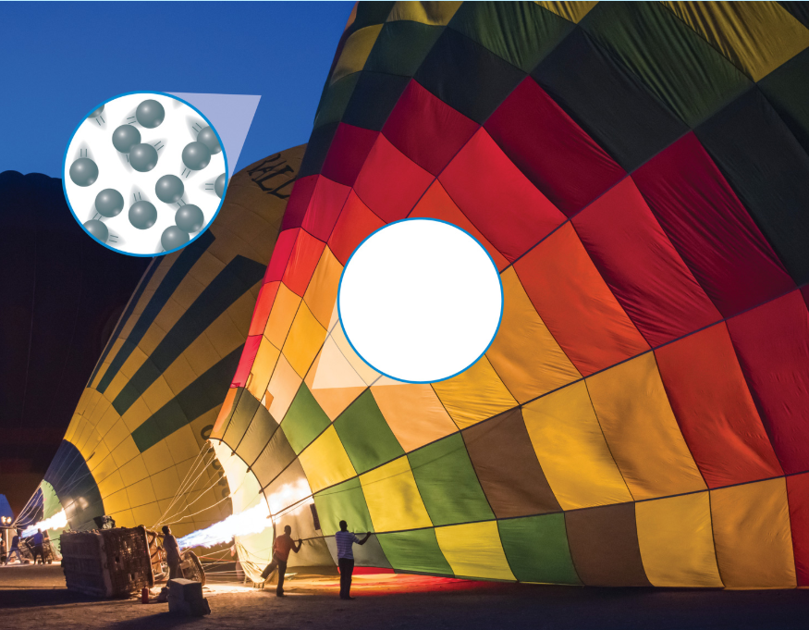
2.Thermal Energy
The total potential and kinetic energy of particles in an object is called thermal energy. Lots of particle movement means lots of kinetic energy, and that means a high temperature. Think of a pot of boiling water. The particles are moving very quickly, which results in a high temperature. This means the water has a lot of thermal energy. If the water is then put in the freezer, its kinetic energy will decrease. When its kinetic energy decreases, its thermal energy and temperature also decrease.

Slide 11
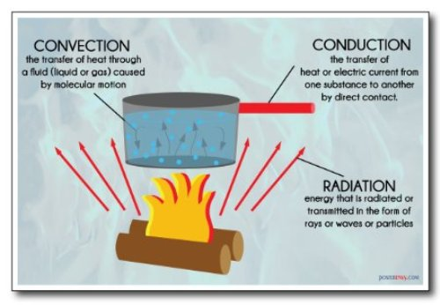


The transfer of energy into the thermal energy of an object is called heat. Heat flows from a hotter object to a cooler one through a combination of processes. These processes are called conduction, convection, and radiation. Most substances expand, or take up more space, when heated. When they lose heat, they contract and take up less space. The effect of heat allows a hot air balloon to rise. A flame heats the air inside the hot-air balloon, giving the particles more thermal energy (Figure 3). Since they have more thermal energy, they move faster and spread apart. The air in the balloon is then less dense than the air outside the balloon, so the balloon rises.

Slide 12
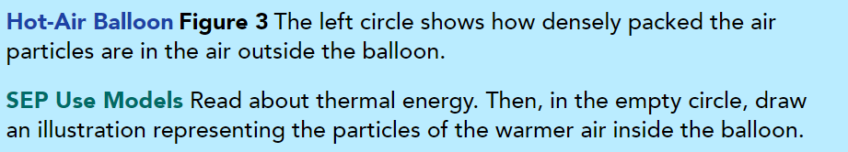
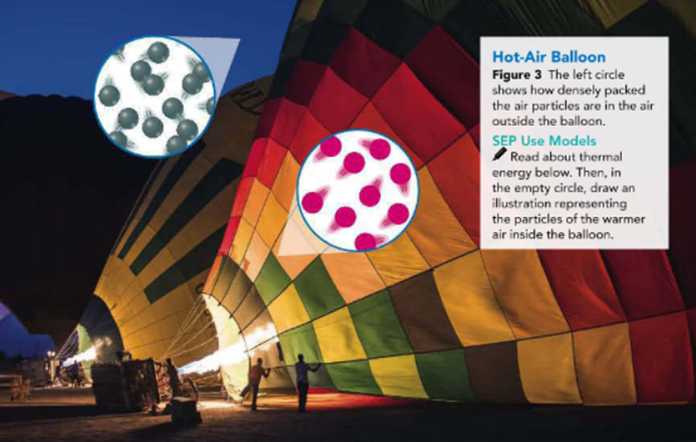

111

Slide 13
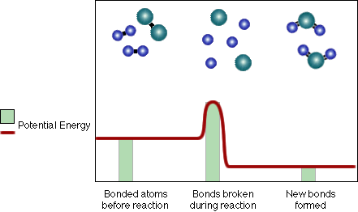
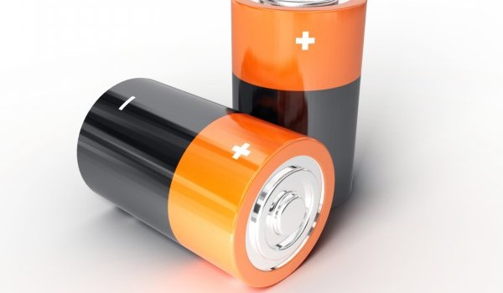
3.Chemical Energy
What type of energy is in the food you eat, in the cells of your body, and in the substances that make a light stick glow? It is called chemical energy. Chemical energy is a form of potential energy because it results from the relative positions of the particles within a material. The particles are held in those positions by chemical bonds. When these bonds are broken, energy is released.

Slide 14
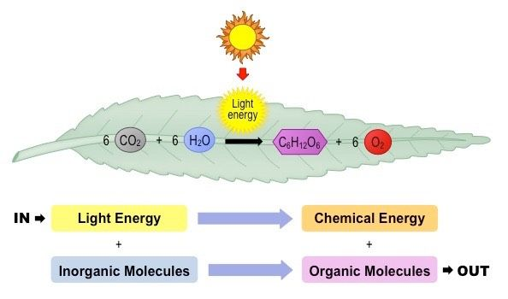
Plants produce a form of stored chemical energy when they perform photosynthesis. In this process, plants take in energy from sunlight. They also take in water and carbon dioxide. Plant cells break the bonds of water and carbon dioxide to produce sugars. Those sugars store chemical energy. The plant later breaks the bonds of the sugar to release the chemical energy on which it lives. Similarly, your body breaks bonds of sugar from your food. Energy is released when your body breaks bonds that hold the sugar molecules together. Your body uses that energy to power your cells.

Slide 15
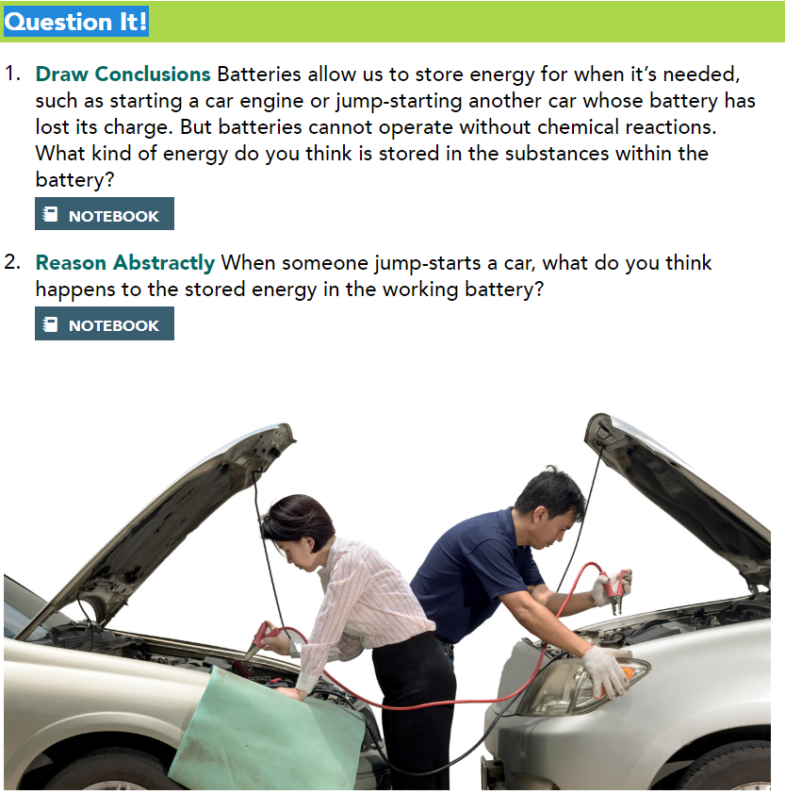
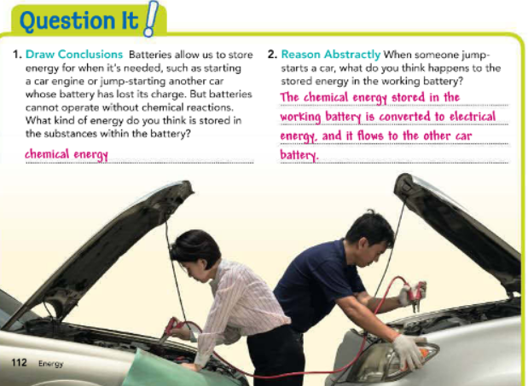
Petroleum, or oil, is another source of chemical energy. Oil is converted into gasoline and diesel fuel, which contain potential energy in the form of chemical bonds. When fuel is burned in engines, the energy in these fuels can be used to makes cars run.
112

Slide 16
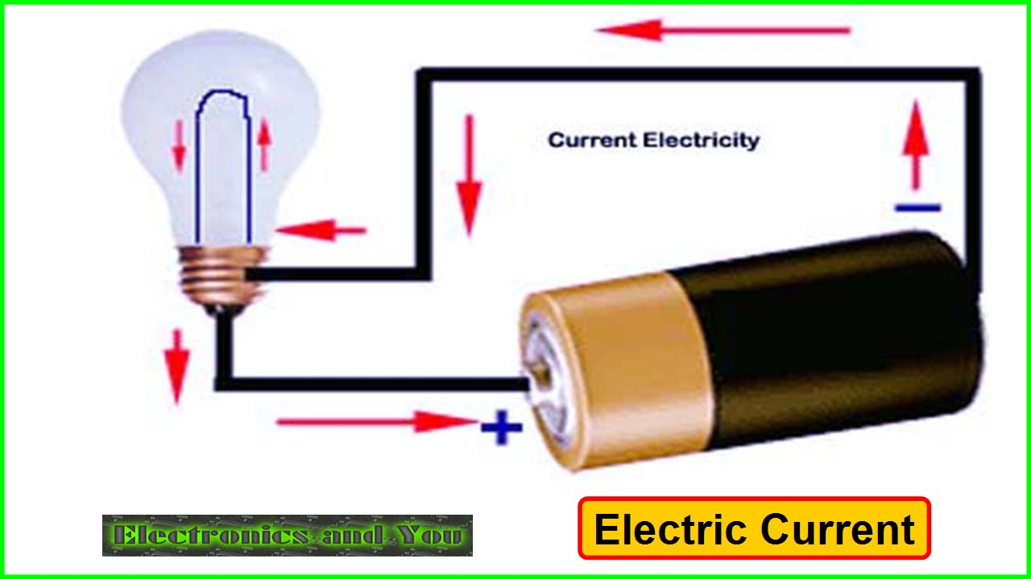
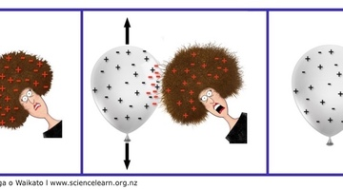
4.Electrical Energy
Electrical energy is the form of energy most of us use to power devices such as lights, computers, and audio systems. Electrical energy is the energy of electric charges. Different materials, and even particles, can have different charges. These differences in charge can result in the movement of electrical charge—a type of kinetic energy called electricity. When charges are not moving but are near one another, they have electric potential energy. This energy can be converted to electricity.

Slide 17
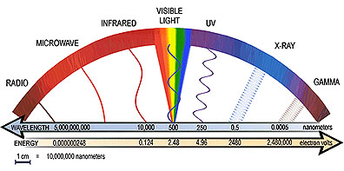
5.Electromagnetic Radiation
Visible light is one type of electromagnetic radiation. Electromagnetic radiation is a form of kinetic energy that travels through space in waves. It does not need a medium, such as air or water, to travel through. This is why you can see the stars even though outer space does not contain a medium. Our world has a wide variety of electromagnetic energy, from X-rays that produce images of bones to microwaves that heat leftover food or transmit signals between mobile phones and towers. Other types of electromagnetic radiation include ultraviolet (UV) waves, infrared (or heat) waves, and radio waves. Like other forms of kinetic energy, all types of electromagnetic radiation can transform into thermal energy when heating something.
https://www.youtube.com/watch?v=6Q1zy0x8q7M

Slide 18
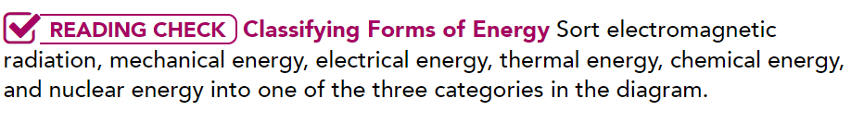
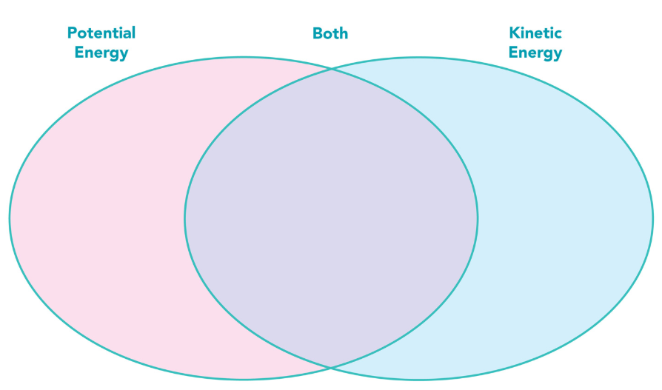

Slide 19
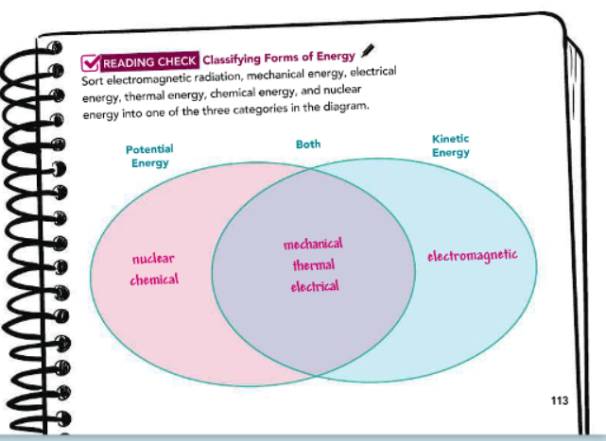

Slide 20
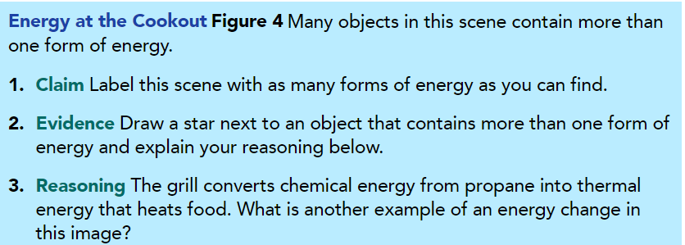
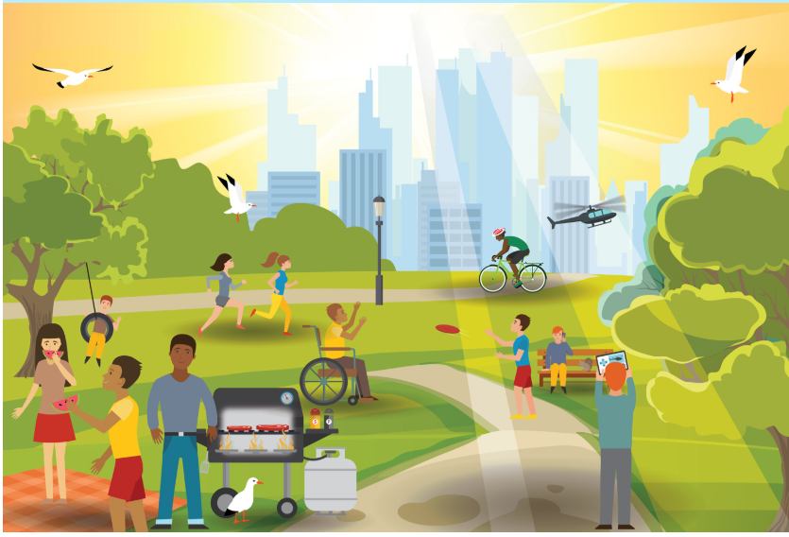

Slide 21
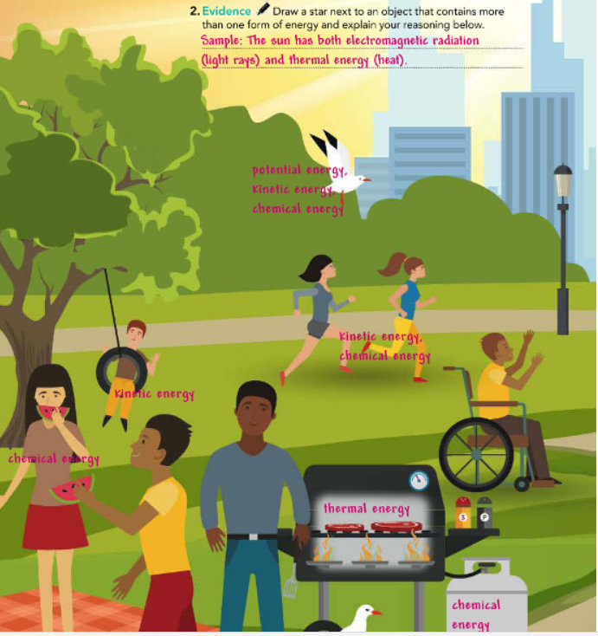
115

Slide 22
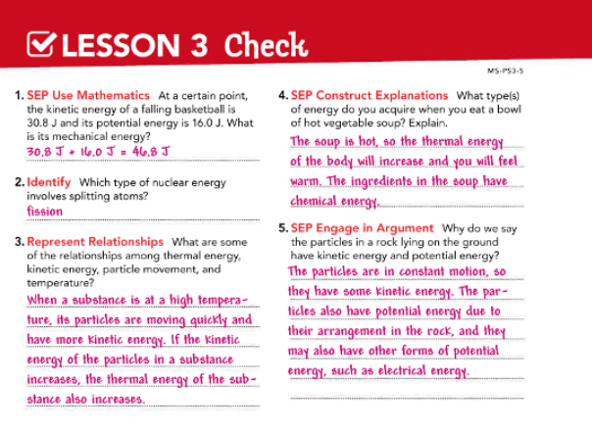

Slide 23


