Slide 1
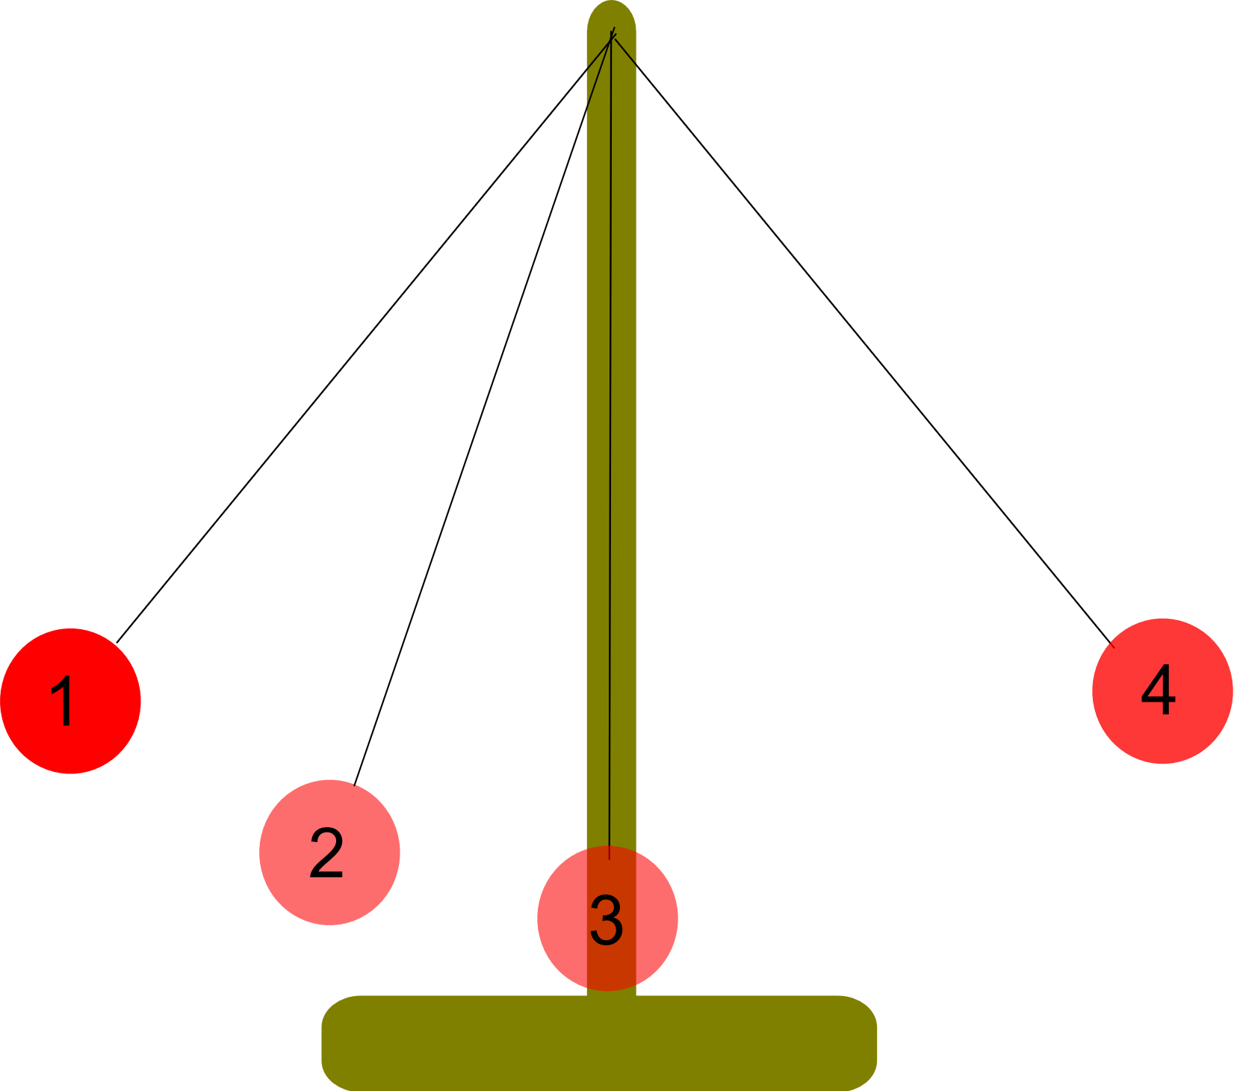
Topic 3
Lesson 2
Kinetic Energy and Potential Energy

Slide 2
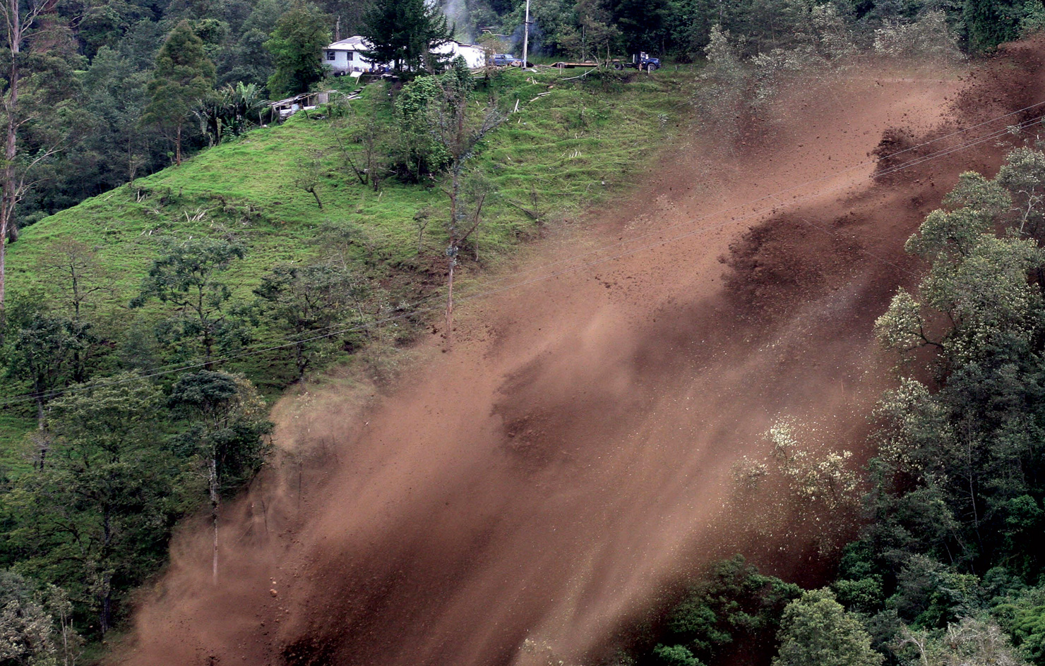
Kinetic Energy
Study the landslide shown in Figure 1. In this image, dirt and rocks are moving rapidly down the side of the hill.
As you read in Lesson 1, it takes energy to cause the motion you see in this photo.
When objects are in motion, they are demonstrating a certain kind of energy—kinetic energy.
Kinetic energy is the energy that an object possesses by virtue of being in motion.
Landslide! Figure 1
A landslide is a sudden movement of rock and soil. Before the landslide, all the rocks and soil were in place and not moving.
P.101

Slide 3
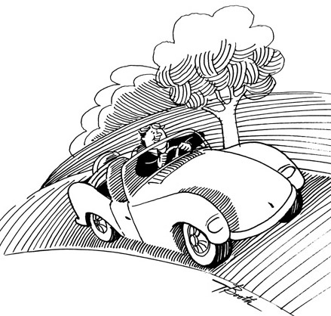
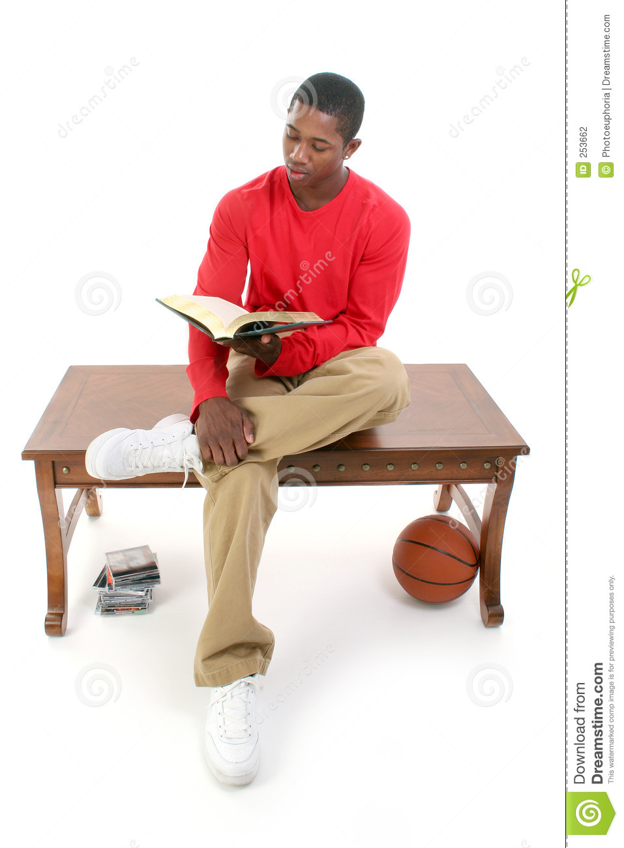
Examples of kinetic energy are all around us.
A car moving down a road exhibits kinetic energy. So does a runner participating in a race.
As you sit at your desk in school, you exhibit kinetic energy every time you turn a page in a book or type on a keyboard.

Slide 4
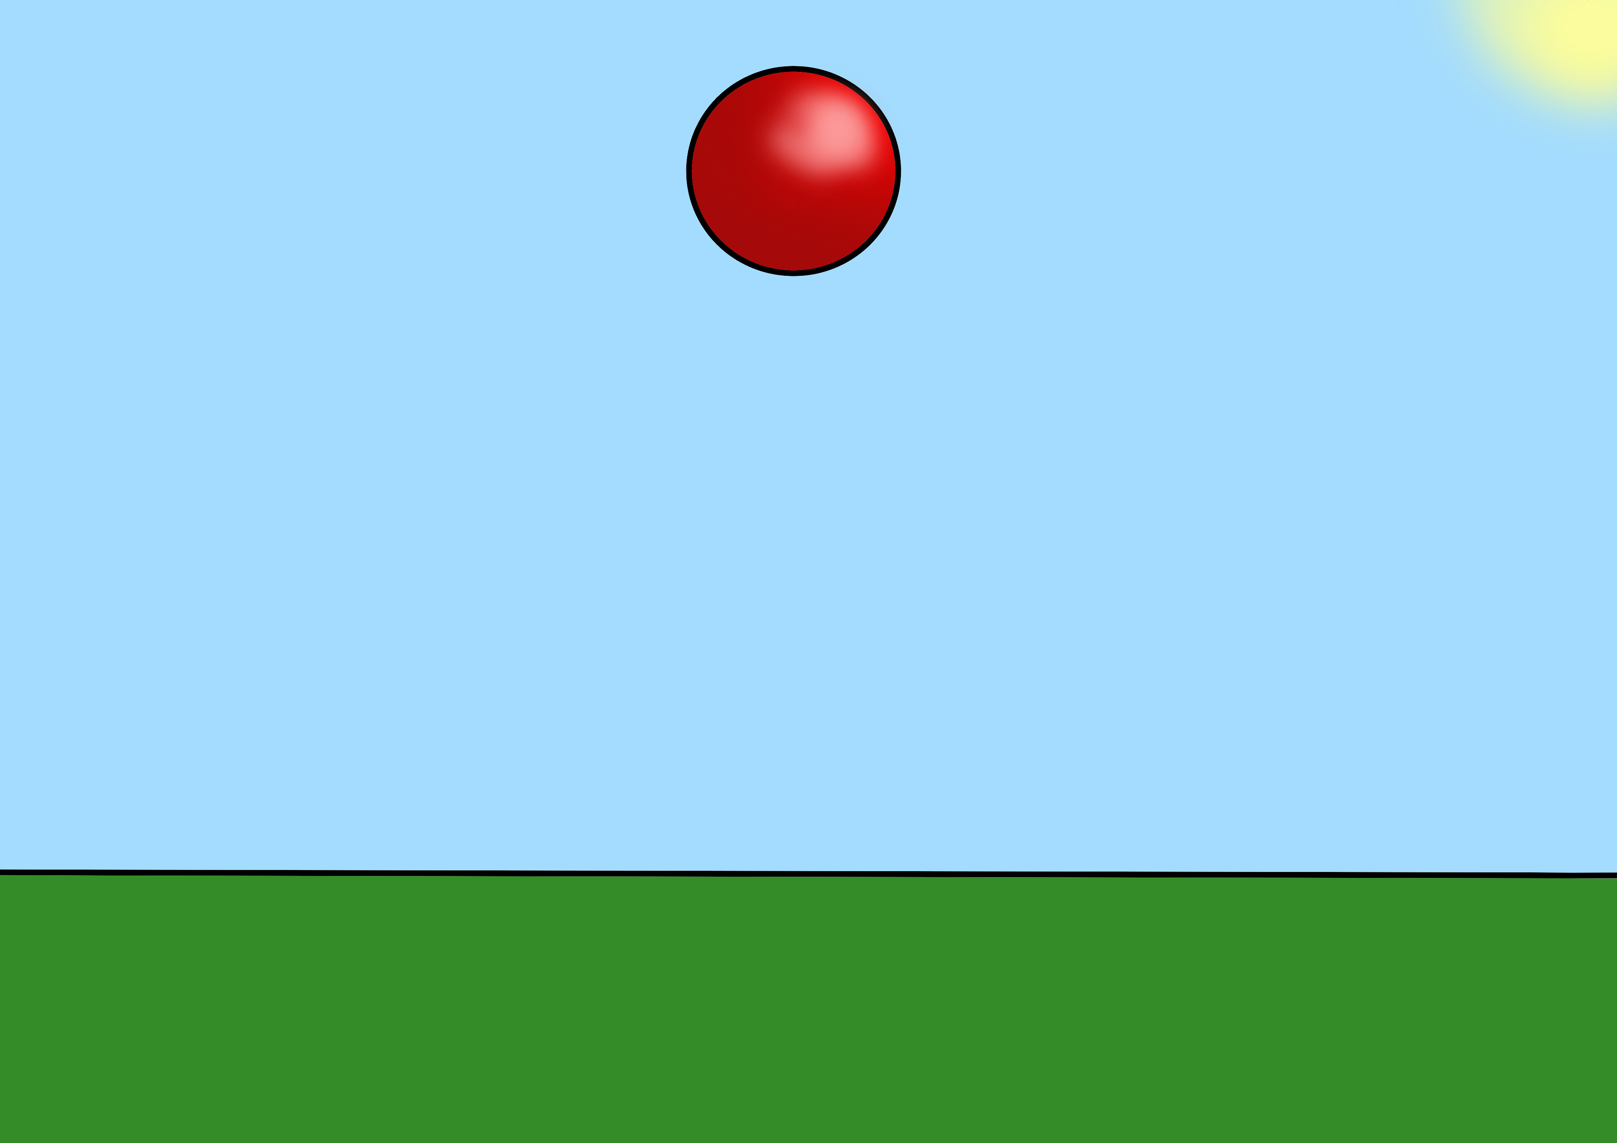
Factors Affecting Kinetic Energy
The kinetic energy of an object depends on both its speed and its mass.
The faster an object moves, the more kinetic energy it has.
For example, if a tennis ball moves at great speed, it has more kinetic energy than if the ball had been softly lobbed over the net.
Kinetic energy also increases as mass increases.
A wheelbarrow full of dirt has more kinetic energy than an empty wheelbarrow has, due to its greater mass.

Slide 5
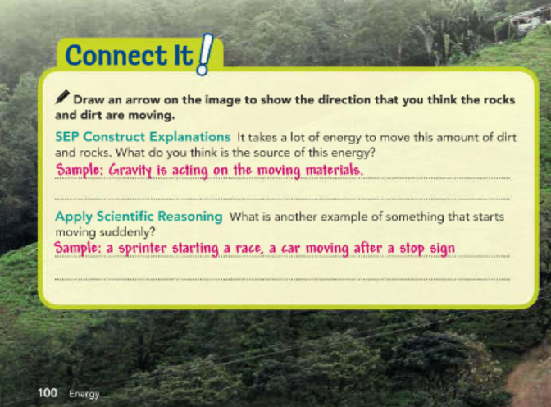
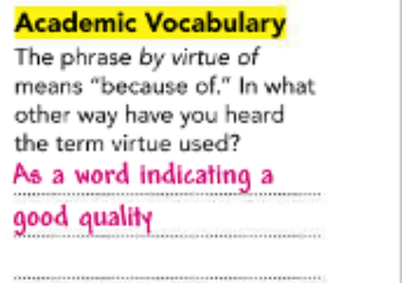

Slide 6
Calculating Kinetic Energy
Keeping in mind that the kinetic energy of an object depends on its mass and its speed, you can use the following equation to solve for the kinetic energy of an object:
The exponent “2” that follows “Speed” tells you that the speed is multiplied by itself first.
2
Kinetic energy=½×Mass×Speed
P.102

Slide 7

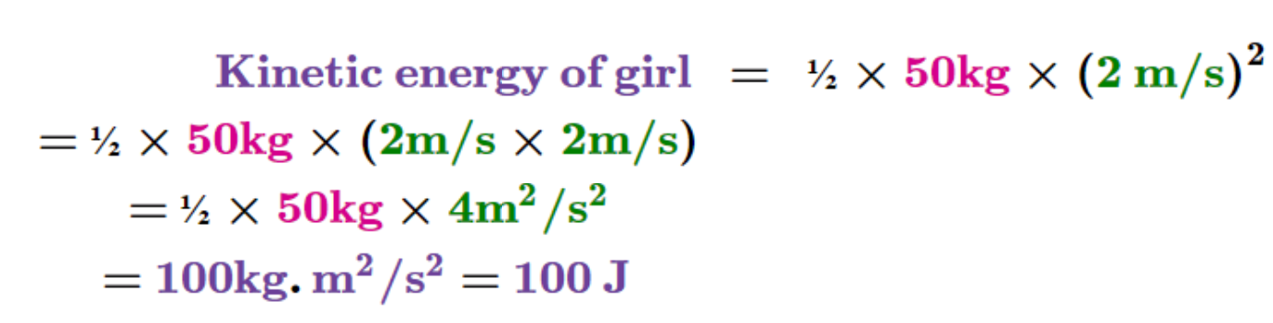
For example, suppose a girl with a mass of 50 kg is jogging at a speed of 2 meters per second (m/s). Note that1kg.m2/s2=1joule (J).

Slide 8
Potential Energy
Kinetic energy is easy to observe because there is motion involved.
But an object that is not moving may still have energy.
Some objects have energy simply as a result of their shapes or positions.
Energy that results from the position or shape of an object is called potential energy.
This type of energy has the potential to transform into kinetic energy, or, in other words, to do work.
Recall that work involves using force to move an object over a distance.
P.103

Slide 9
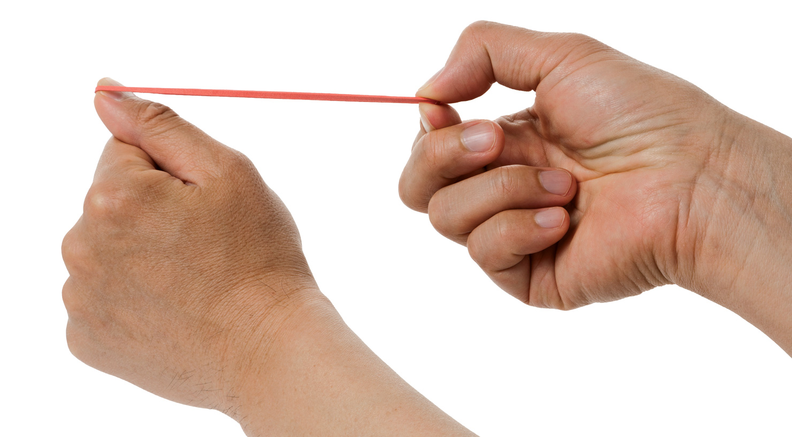
When you raise a bottle up to your mouth to take a drink of water, or when you stretch out a rubber band, you transfer energy to the object.
The energy you transfer is stored, or held in readiness by the object. It may be used later if the bottle is dropped or the rubber band is released (see Figure 2).
Stored-Up Energy Figure 2
This stretched rubber band is not moving, but it still contains energy—potential energy. Once the fingers that are stretching the rubber band release the band, what kind of energy will the rubber band have?

Slide 10
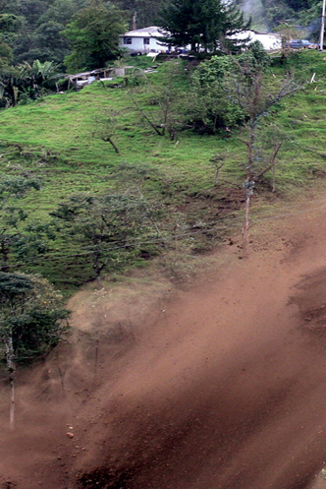
Look back again at the photo of the landslide at the beginning of the lesson.
You see the dirt and rocks moving, showing kinetic energy.
At some point before the photo was taken, however, the dirt and rocks were not yet moving.
At that stage, they held potential energy.

Slide 11
Gravitational Potential Energy
There are two types of potential energy directly related to kinetic energy.
One of these types is gravitational potential energy.
This type of potential energy is related to an object’s vertical position—how high it is above the ground.
The potential energy is stored as a result of the gravitational pull of Earth on the object.
P.104

Slide 12
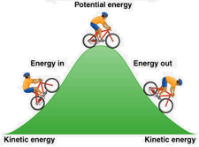
Gravitational Potential Energy
Gravitational potential energy can be measured by the amount of work needed to lift an object to a certain height.
Remember that work is equal to force multiplied by distance.
The force you use to lift the object is equal to its weight.
Weight is the force that gravity exerts on an object.
The distance you move the object is its height above ground level. You can calculate an object’s gravitational potential energy using this equation:
Gravitational potential energy=Weight × Height above ground

Slide 13
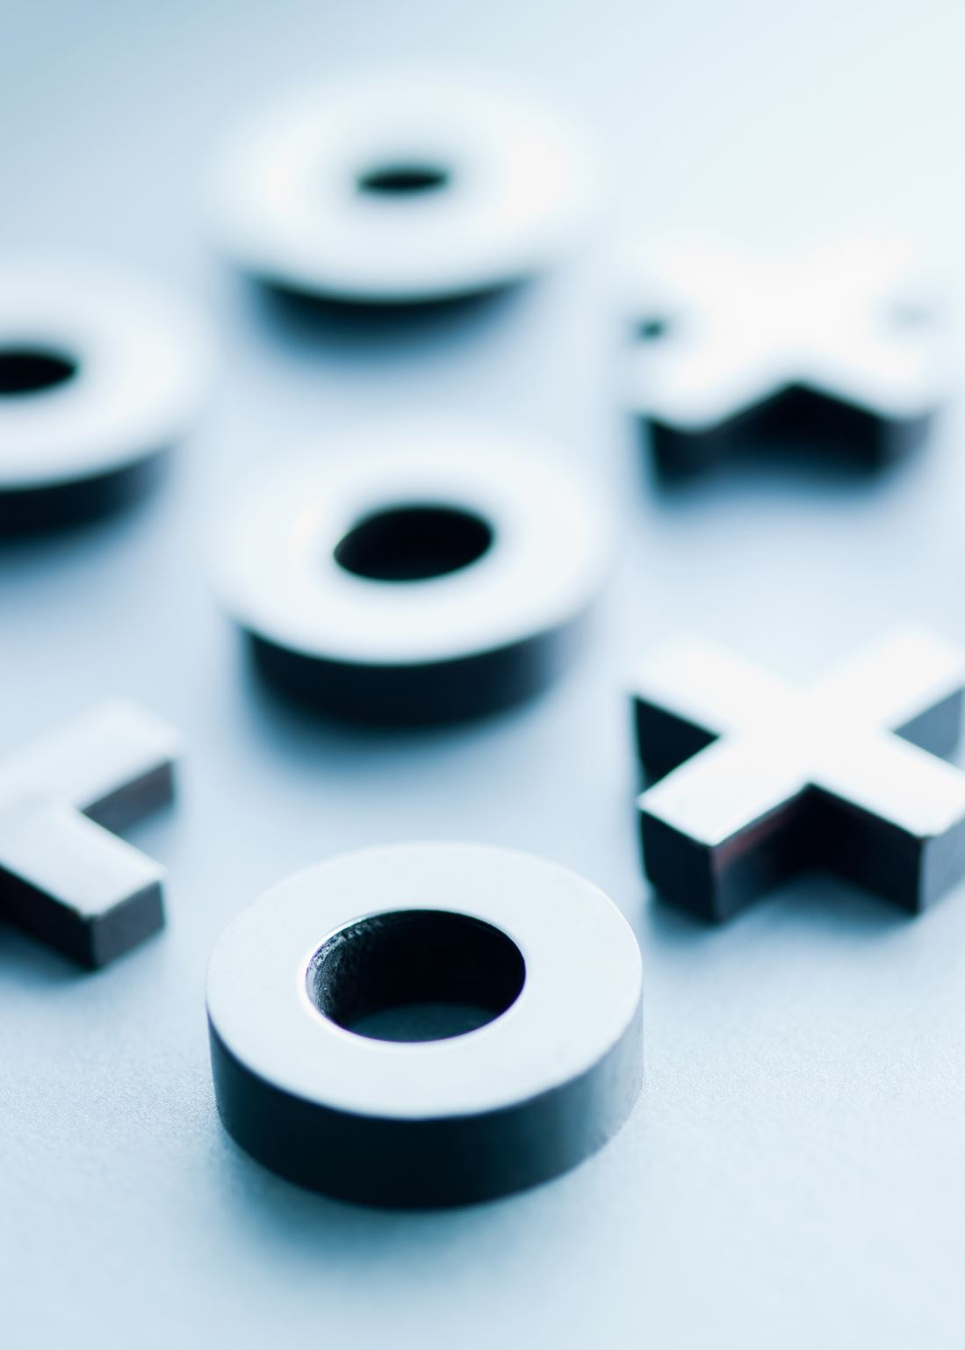
For example, suppose a cat has a weight of 40 newtons, which is about 9 pounds. The cat is lifted 2 meters off the ground.
You can calculate its potential energy:
Gravitational potential energy=40N×2m
=80N-m, or 80 J.

Slide 14
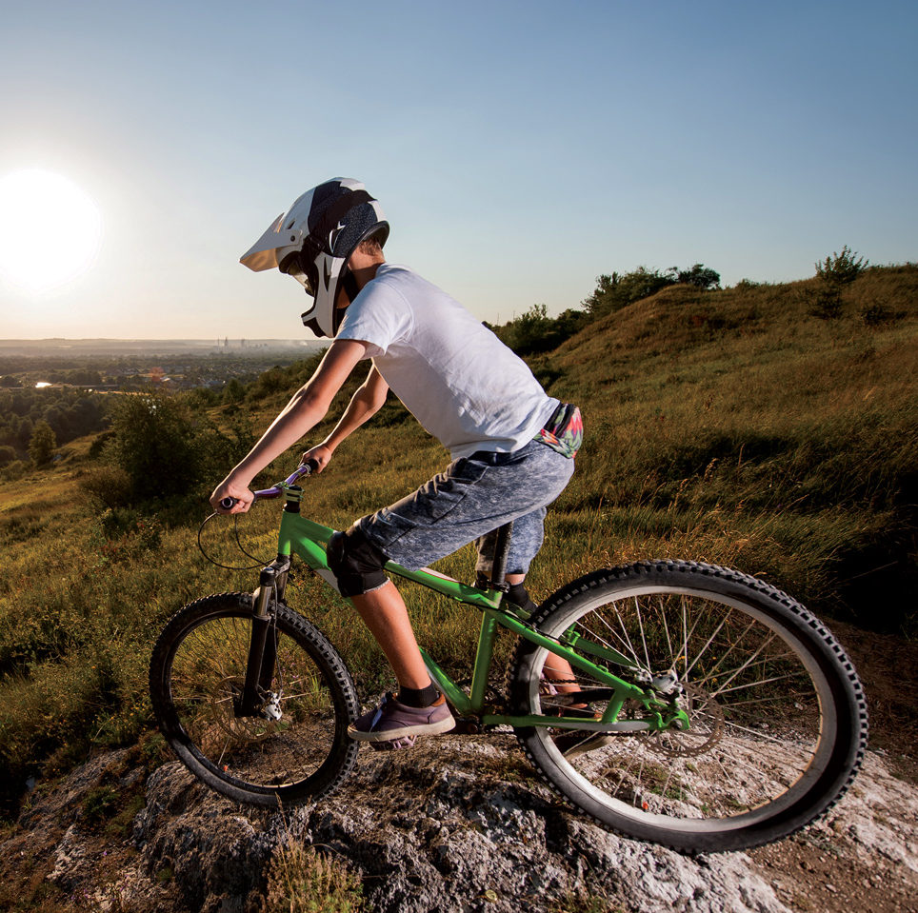
The energy of the cyclist at the top of hill shown in Figure 3 is another example of gravitational potential energy.
Gravitational Potential Energy Figure 3
A cyclist sitting still at the top of a hill displays gravitational potential energy. What makes it possible for the cyclist to have this type of energy?
Being at the top of the hill means he has a height above the ground level, so he has gravitational potential energy.

Slide 15
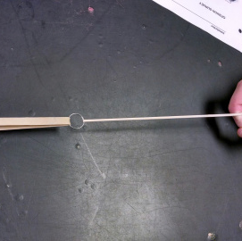
Elastic Potential Energy
Sometimes, an object has a different type of potential energy due to its shape.
Elastic potential energy is the energy associated with objects that can be compressed or stretched.
This type of potential energy can be stored in such items as rubber bands, bungee cords, springs, and an arrow drawn into a bow.
P.105

Slide 16
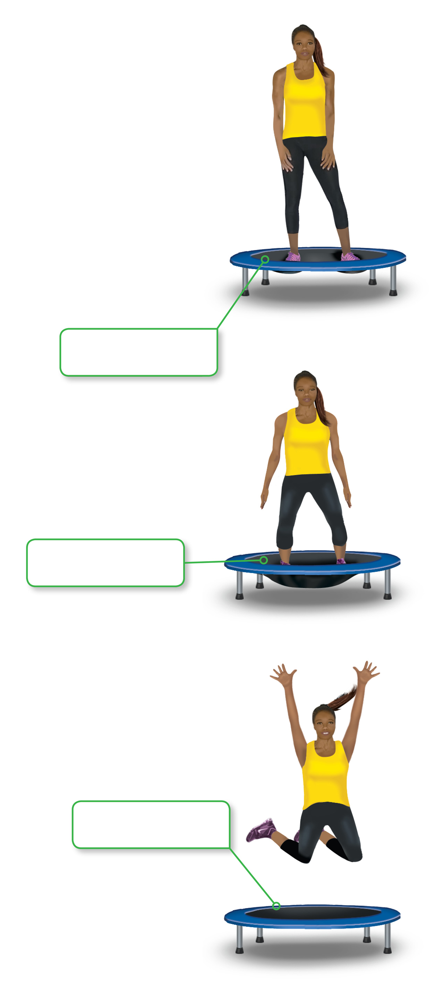
Trampolines also store elastic potential energy.
Take a look at Figure 4.
When the girl presses down on the trampoline, the trampoline changes shape.
The trampoline now has elastic potential energy.
When the girl jumps up off the trampoline, this stored energy is transferred from the trampoline to the girl, sending the girl upward.
During this energy transfer, the elastic potential energy of the trampoline is transformed into different types of energy.

Slide 17
Elastic Potential Energy Figure 4 The energy stored in a stretched object, such as a trampoline, is elastic potential energy. Rank the amount of elastic potential energy of the trampoline from greatest to least using the words most, medium and least. Write your answers in the boxes next to the images.
Explain your rankings of the trampoline’s potential energy.
Unstretched, the trampoline has no elastic potential energy. Stretched farthest, it has the maximum elastic potential energy.
medium
most
least

Slide 18
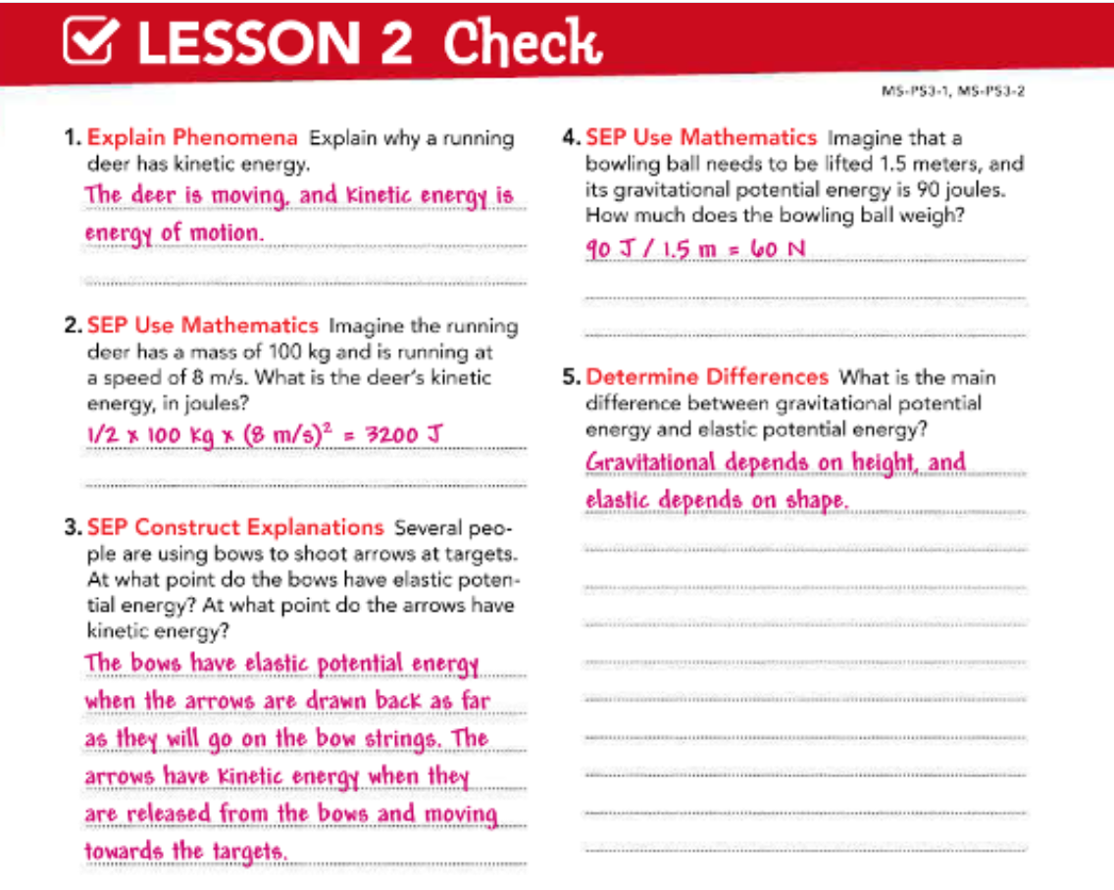
P.106
https://www.youtube.com/watch?v=Q0LBegPWzrg

Slide 19


