Slide 1

Topic 3 Lesson 1
Energy, Motion, Force, and Work

Slide 2
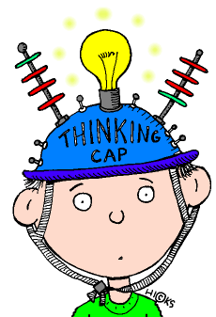
What is Energy?
Energy is the ability to do work or cause change.
You do work when you pick up your backpack.
P.91

Slide 3
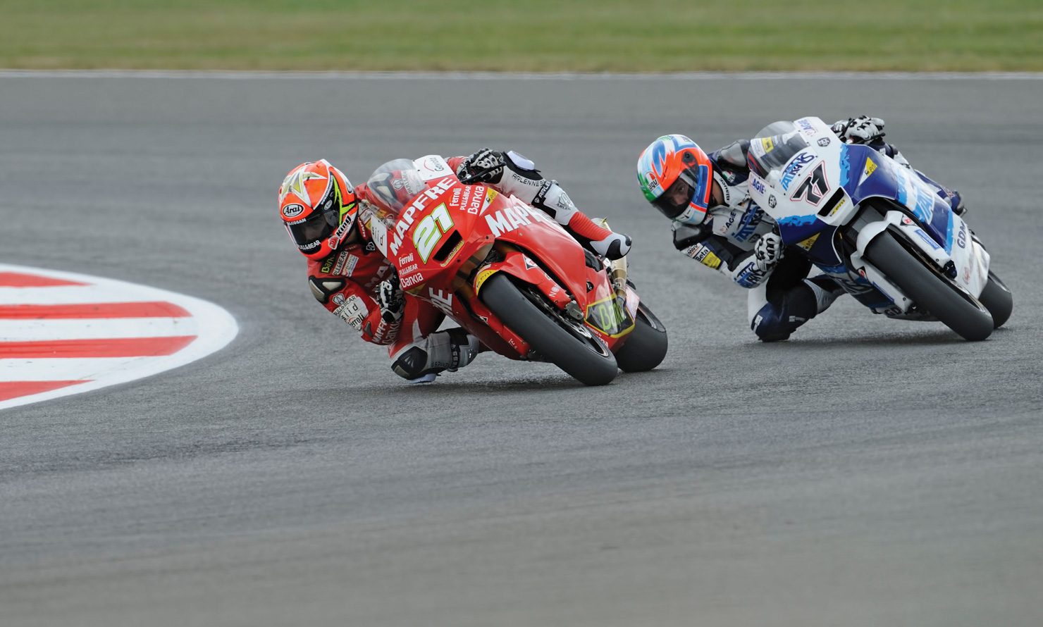
Motorcycles do work during a race, as in Figure 1.
The energy to do this work comes from fuel. As the fuel burns, it changes into other substances and releases energy.
Racing Around the Track Figure 1
Energy, motion, force, and work are all involved in a motorcycle race.

Slide 4

What are the different forms of Energy?
Energy comes in many forms.
Light, sound, and electricity are all forms of energy.

Slide 5
Energy can also be transferred from place to place.
For example, chemical energy is transferred from the food you eat to your body.
Energy from the sun is transferred to Earth in the form of electromagnetic radiation.
Energy is not something you can see directly.
You can, however, observe its effects.
When you touch something hot, you don’t see the energy, but you feel the heat.
You can hear the sound of a bass drum, but you can’t see the sound energy itself.

Slide 6
Energy and Motion
It takes energy for motion to occur.
An object is in motion if its position changes relative to another object.
A pitched ball would not speed toward home plate without energy supplied by the pitcher.
Energy supplied by food enables a racehorse to run around a track.
Energy stored in gasoline allows the motorcycles in Figure 1 to move at high speeds.
In each of these examples, the more energy that is used, the faster the object can move.

Slide 7

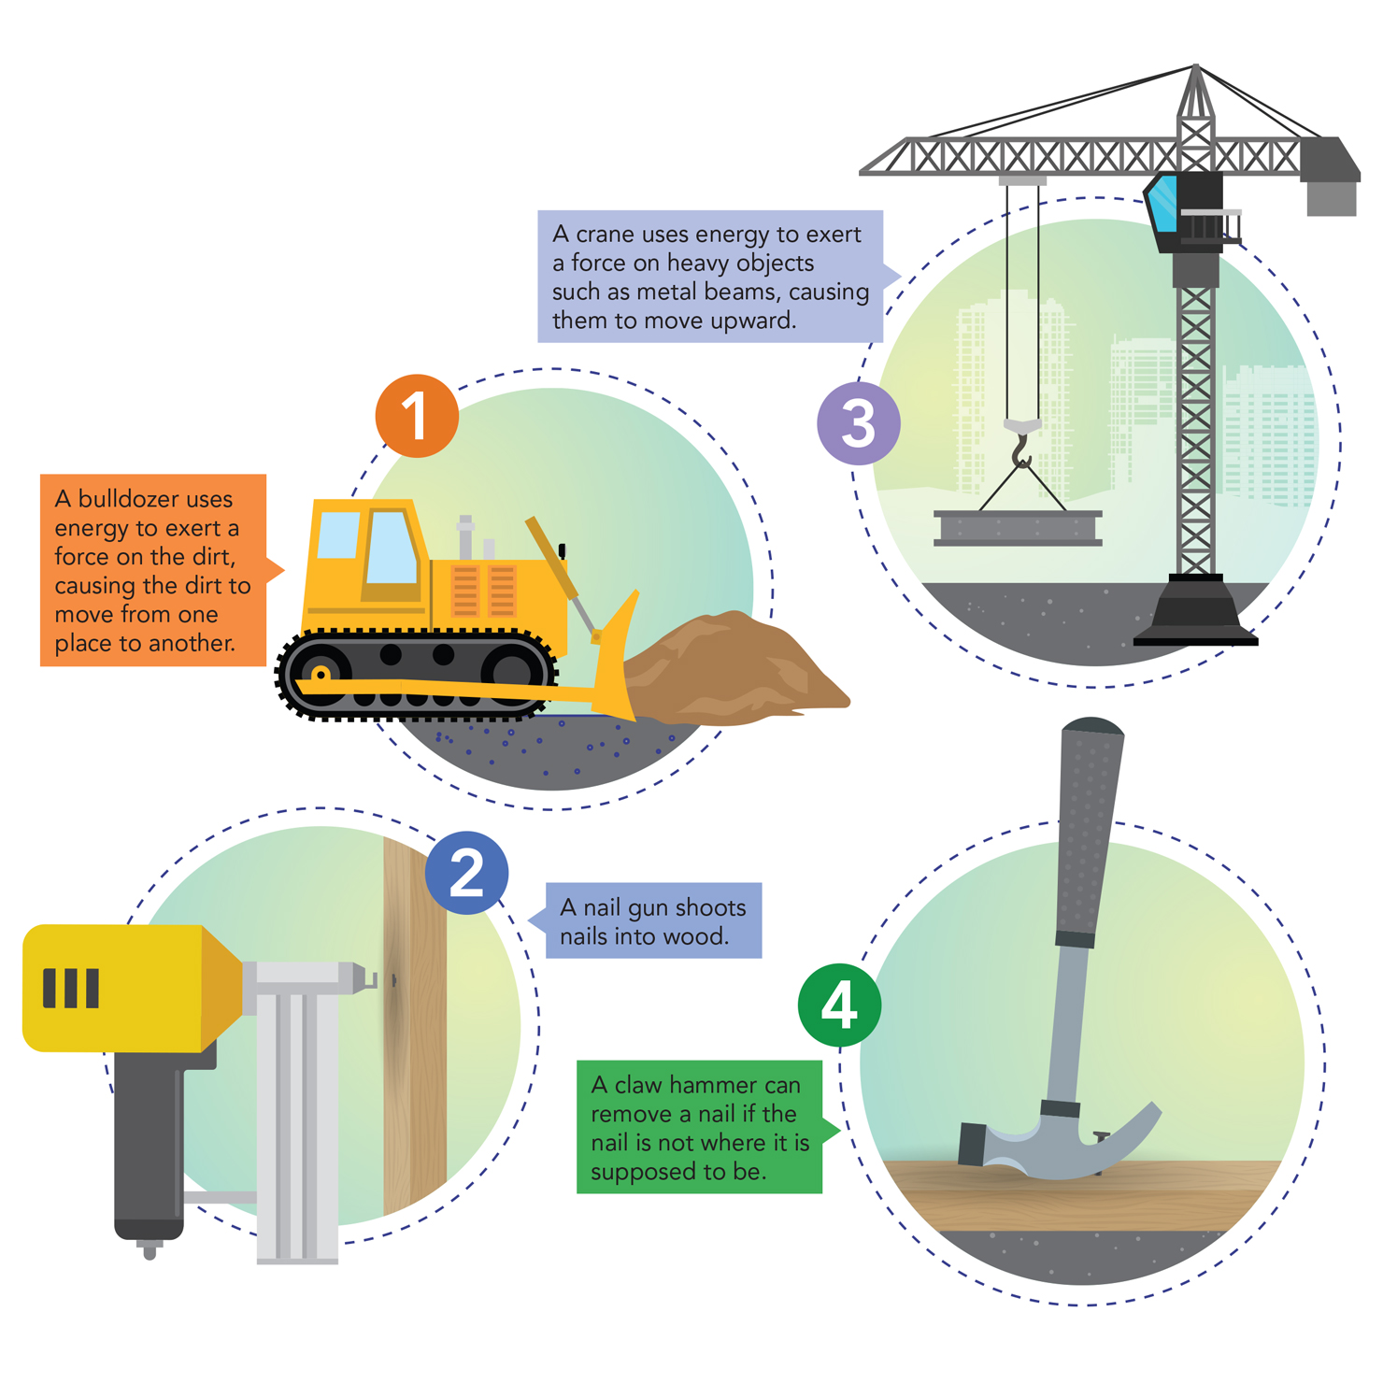
Energy and Force
The relationship between energy and motion also involves forces.
A force is a push or pull.
You can see many examples of this relationship on a construction site. Look at Figure 2 and study the examples of how energy is used to apply a force that causes motion.
P.92

Slide 8
Force Figure 2
When energy is used to apply force, objects can move.
CCC Energy and Matter Draw an arrow on each numbered picture to show the direction of the force being applied.
Then label each arrow with “push” or “pull” to identify the type of force being applied.

Slide 9
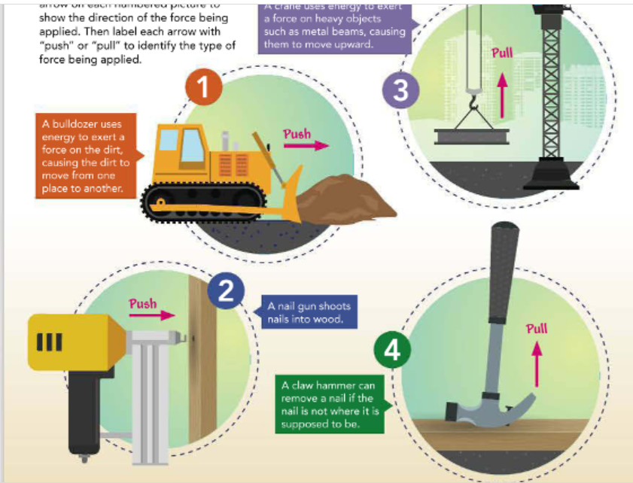

Slide 10
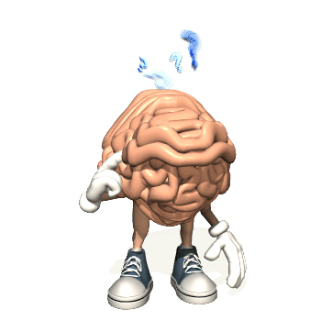
Explain How would you describe a force?
A force is a push or pull on an object.

Slide 11


Force and Work
You might think of “work” as a job, such as teaching, being a doctor, or bagging groceries at the local supermarket.
But the scientific meaning of work is much broader than that.
In scientific terms, you do work any time you exert a force on an object that causes the object to change its motion in the same direction in which you exert the force.
All of the machines on the previous page show work being done because the forces are being applied in the same direction as the motion shown.
P.93

Slide 12


You probably carry your books from one class to another every school day.
You know that you exert a force on the books as you carry them. However, you do very little work on them because of the direction of the force exerted.
When you carry an object while walking at constant speed in a straight line, you exert an upward force on the object.
Because the force is vertical and the motion is horizontal, you don’t do any work on the object itself.

Slide 13
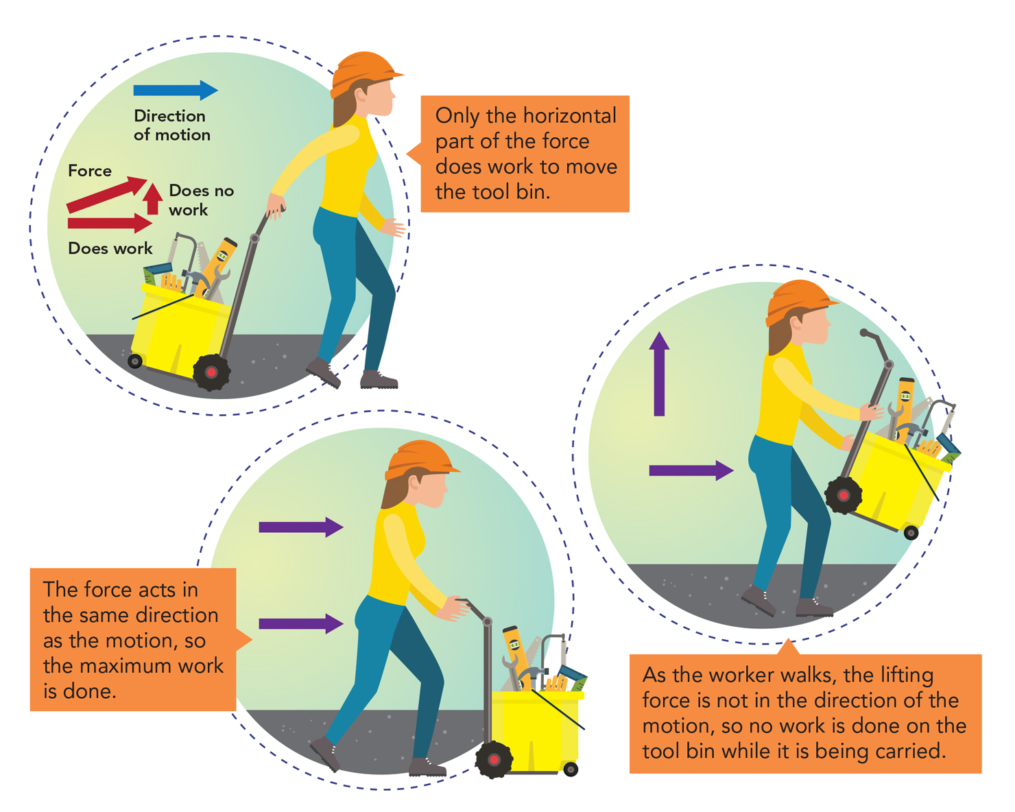
Figure 3 shows three different ways to move a tool bin. The weight of the bin is the same in each situation, but the amount of work varies. For a given force, the maximum amount of work is done when both the movement and the force are in the same direction.
Force, Motion, and Work Figure 3
The amount of work that you do on something depends on the direction of the applied force and the object’s motion. In the second and third pictures, label each arrow with “motion” or “force.”

Slide 14

Write a synonym for maximum.
Greatest, most.

Slide 15
Work Requires Motion
Imagine that you are trying to open a jar, and the lid is stuck.
You exert a lot of force on the lid, but it doesn’t move.
Are you doing work?
No. No matter how much force you exert, you don’t do any work if the lid does not move.
P.94

Slide 16

Figure 4 A girl struggles to open a jar, but the lid does not budge. Is the girl doing work?
Because work requires that a force moves something a certain distance, the girl is not doing work here.

Slide 17
Calculating Work
Suppose you bought a new painting for your room.
You have to carry the painting up four porch steps to the first floor and then up another flight of 12 steps to the second floor. (See Figure 5.)
Is it more work to lift the painting up 12 steps than four steps?
As you might guess, moving an object a greater distance requires more work than moving the same object a shorter distance.
The amount of work you do depends on both the amount of force you exert and the distance the object moves.

Slide 18
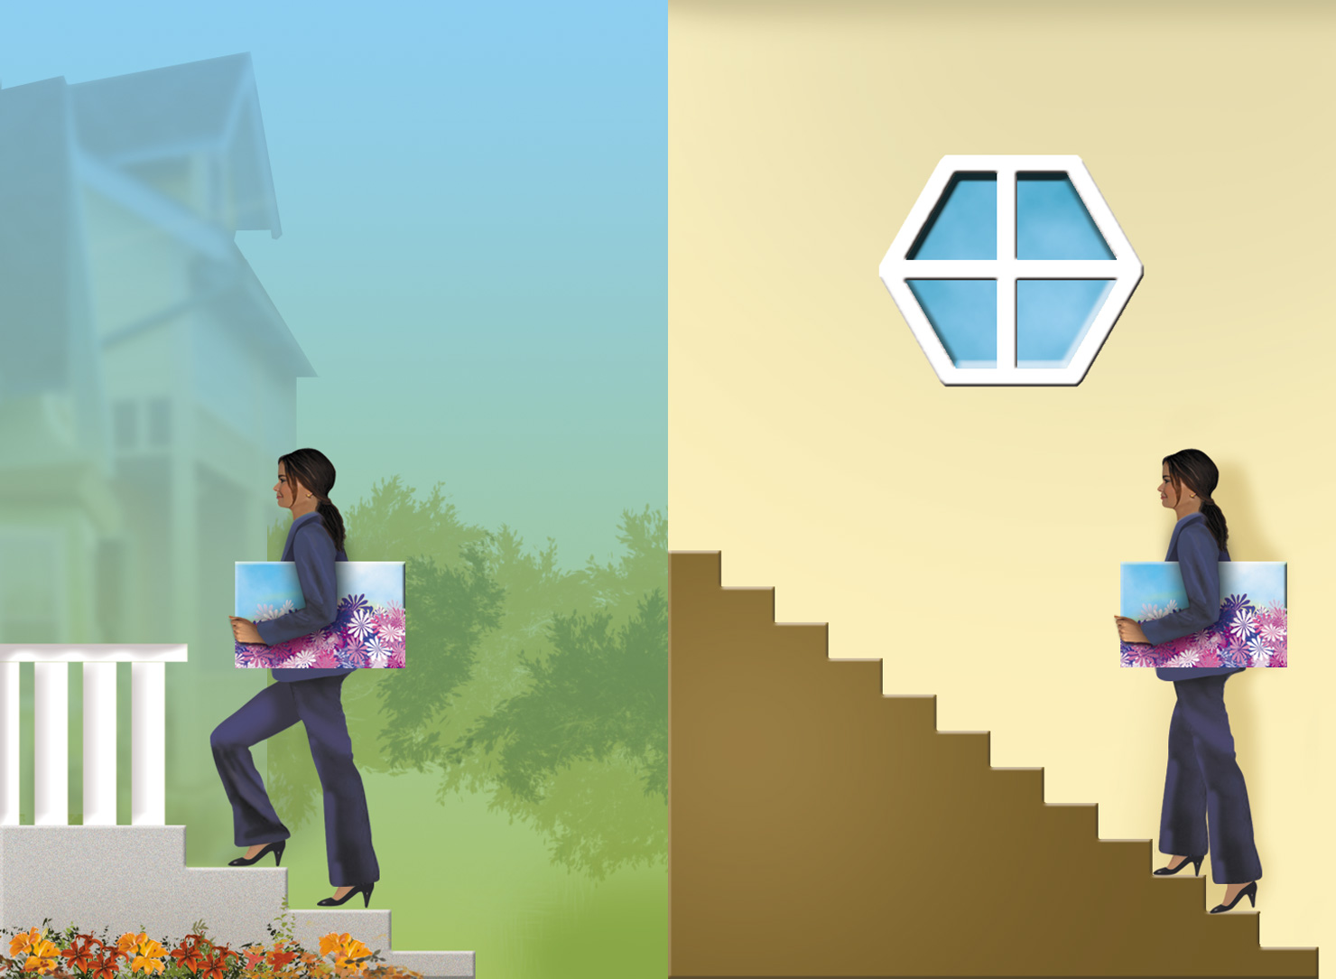
Figure 5 This person carries a painting up two sets of steps.
Predict Circle the image in which you think the person does more work.

Slide 19
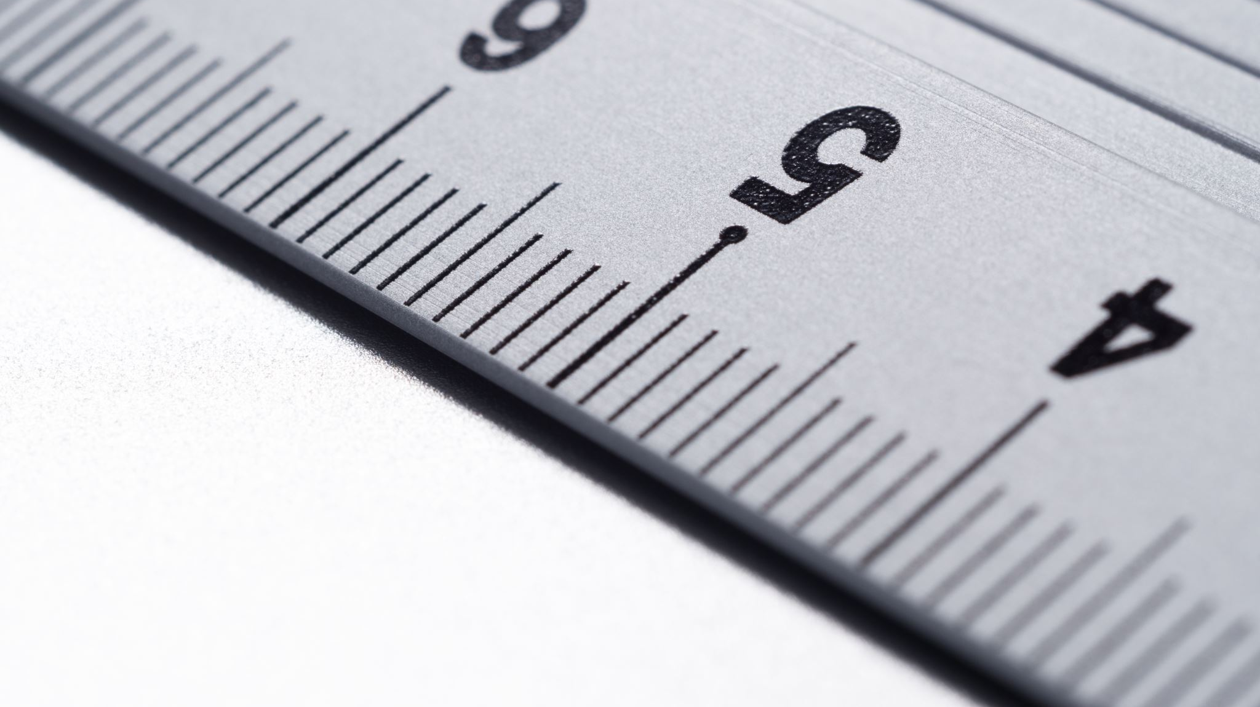
Calculating Work (cont.)
The amount of work done on an object is calculated by multiplying force times distance.
When force is measured in newtons and distance in meters, the SI unit of work is the newton-meter (N-m).
This unit is also called a joule (J).
One joule is the amount of work you do when you exert a force of 1 newton to move an object a distance of 1 meter.
Work=Force×Distance
P.95

Slide 20

What two factors affect how much work is done in any given action?
Force and Distance

Slide 21

How are force and work related?
Force can result in motion, which is required to do work.
This Photo by Unknown Author is licensed under CC BY-SA

Slide 22
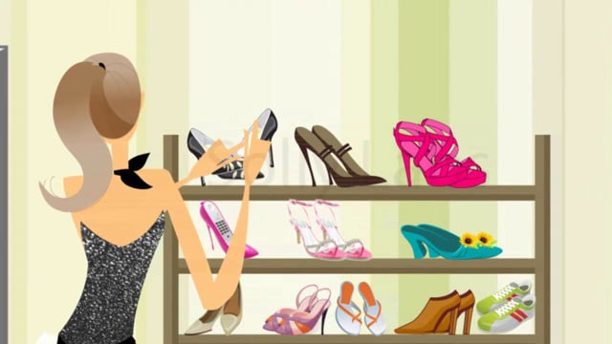
Work Related to Energy and Power
Did you pull your shoes from the closet this morning?
If so, then you did work on the shoes.
As you have read, work is done when a force moves an object in the direction of the force.
When an object moves, its position changes.
What causes change?
Recall that the ability to do work or cause change is called energy.
Energy is measured in joules—the same units as work.
P.96

Slide 23

When you do work on an object, some of your energy is transferred to that object.
Think about the plant shown in the Math Toolbox. When the gardener lifted the plant to the high shelf, she transferred energy to the plant.

Slide 24
If you carry a bag of groceries up a flight of stairs, the work you do is the same whether you walk or run.
The time it takes to do the work does not affect the amount of work you do on an object.
But something else—power—is affected.
Power is the rate at which work is done, and it equals the amount of work done on an object in a unit of times.

Slide 25
You can think of power in two main ways.
An object that has more power than another object does more work in the same amount of time.
It can also mean doing the same amount of work in less time.

Slide 26
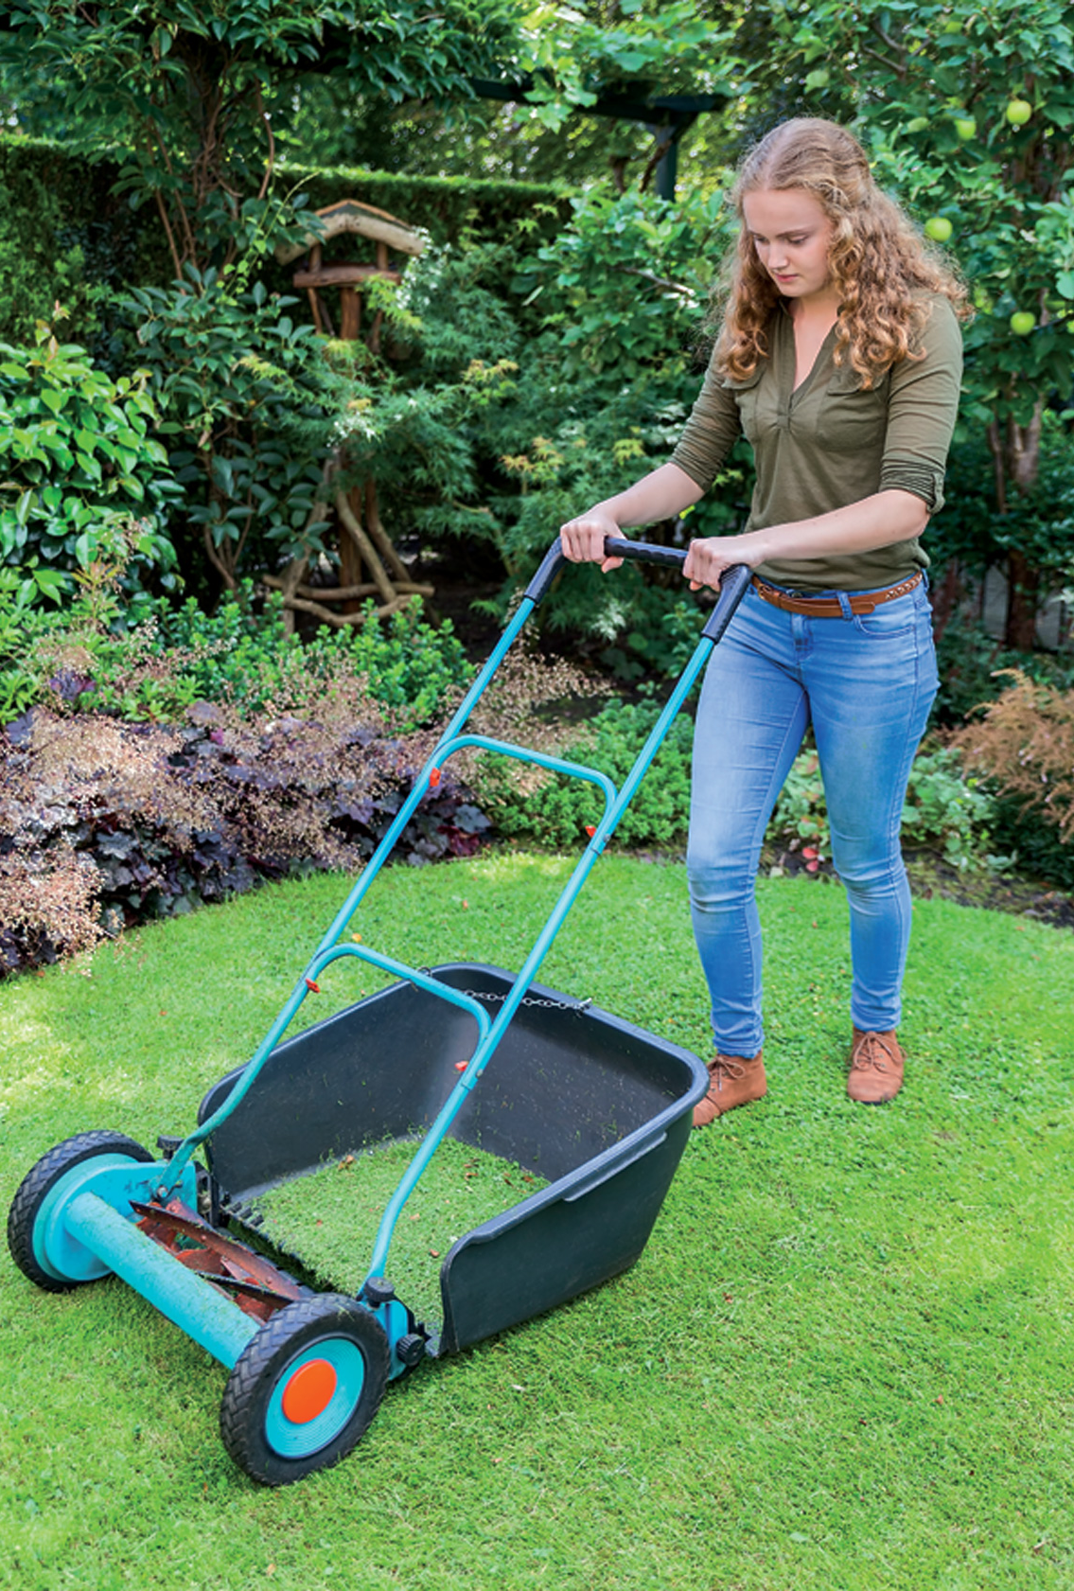
Look at Figure 6 for other examples that compare power.
Work and Power Figure 6
In each of these images, work is being done. For each image, give two examples of ways the people shown can increase the power being used.

Slide 27
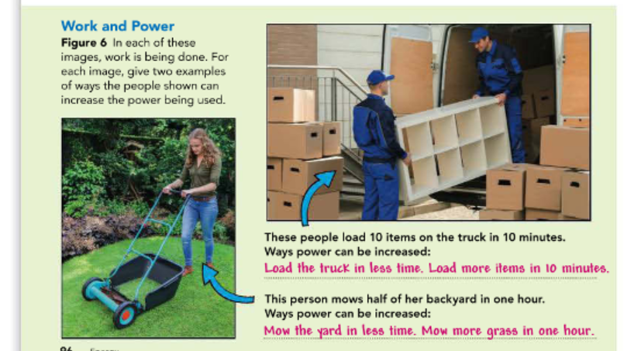

Slide 28
Calculating Power
All you need to know to calculate power is how much and how quickly work is being done.
Power is calculated by dividing the amount of work done by the amount of time it takes to do the work. This can be written as the following formula:
Power= Work
Time
Because work is equal to force times distance, you can rewrite the equation for power as follows:
Power=Force × Distance
Time
P.97

Slide 29
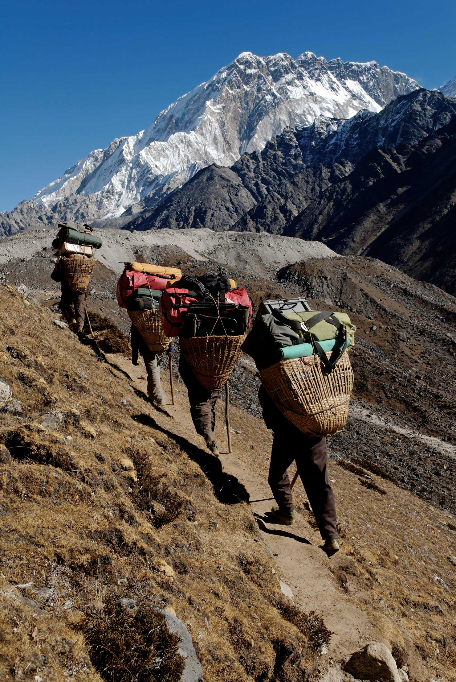
When work is measured in joules and time in seconds, the SI unit of power is the watt (W). One watt equals one joule per second (1 W = 1 J/s). Examine Figure 7 to learn more about calculating power.
Power Figure 7
Most climbers of the Himalayan Mountains would not make it to the peaks without the help of Sherpas.
SEP Use Mathematics Sherpas are natives of Nepal, and they carry heavy loads of equipment up the mountains for the climbers. Suppose one Sherpa uses a force of 980 N to move a load of equipment to a height of 20 meters in 25 seconds. How much power is used?

Slide 30

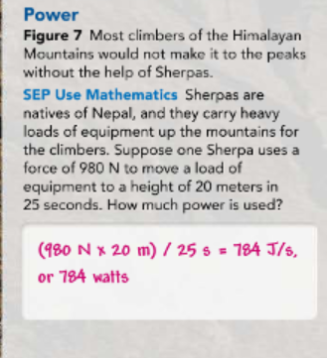

Slide 31
Power and Energy
Recall that power is the rate at which work is done. Power is also the rate at which energy is transferred, or the amount of energy transferred in a unit of time.
Power=Energy transferred
Time
For example, a 60-watt lightbulb transfers 60 joules of energy per second. Different machines have different amounts of power.
For instance, you can use either a rake or a leaf blower to remove leaves from your lawn (see Figure 8).
Each tool transfers the same amount of energy to the leaves when it moves leaves the same distance.
However, the leaf blower moves leaves faster than the rake.
The leaf blower has more power because it transfers the same amount of energy to the leaves in less time.
P.98

Slide 32
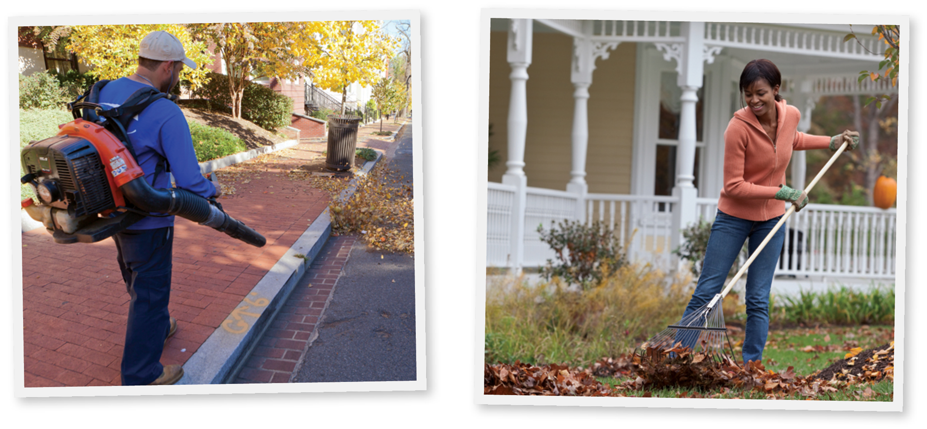
Different Types of Power Figure 8 Leaf blowers require gasoline for power, while rakes require power from your body.

Slide 33

What is the difference in power between a 60-watt lightbulb and a 100-watt lightbulb?
The 60-watt bulb transfers less energy per unit of time.

Slide 34
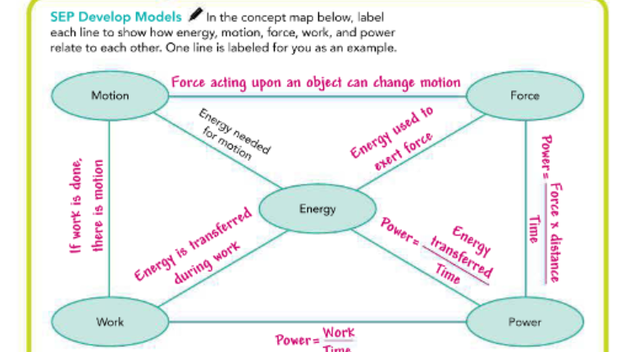

Slide 35
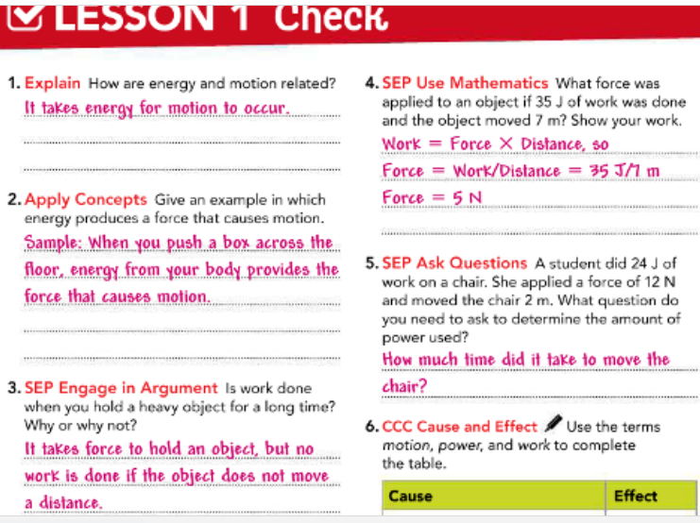
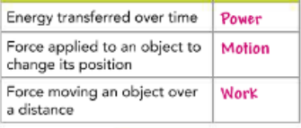

Slide 36


