Slide 1
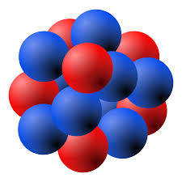
Topic 2 Lesson 3
Gas Behavior

Slide 2
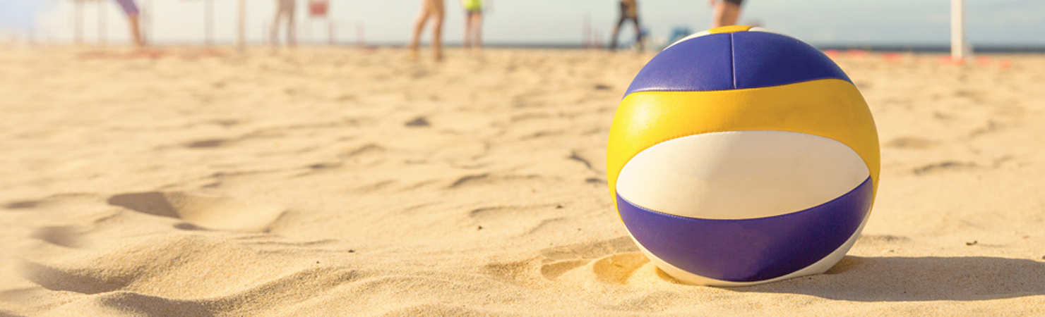
When a volleyball sits out in the sun, it becomes warmer and feels more firm.
Volleyball in the Sun Figure 1
The air pressure inside a volleyball increases as it warms in the sun.
What do you think happens to the particles of air inside the ball as it warms in the sun?
What do you think happens to a volleyball outside on a cold night?
P.66

Slide 3
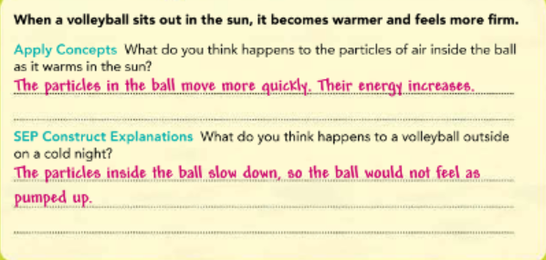

Slide 4

Pressure and Temperature of a Gas
Have you ever shaken a snow globe?
If so, you've seen how the fake snowflakes fly around.
They collide with each other and with the walls of the snow globe.
If you shake it more slowly, the snowflakes collide less frequently.
P.67

Slide 5
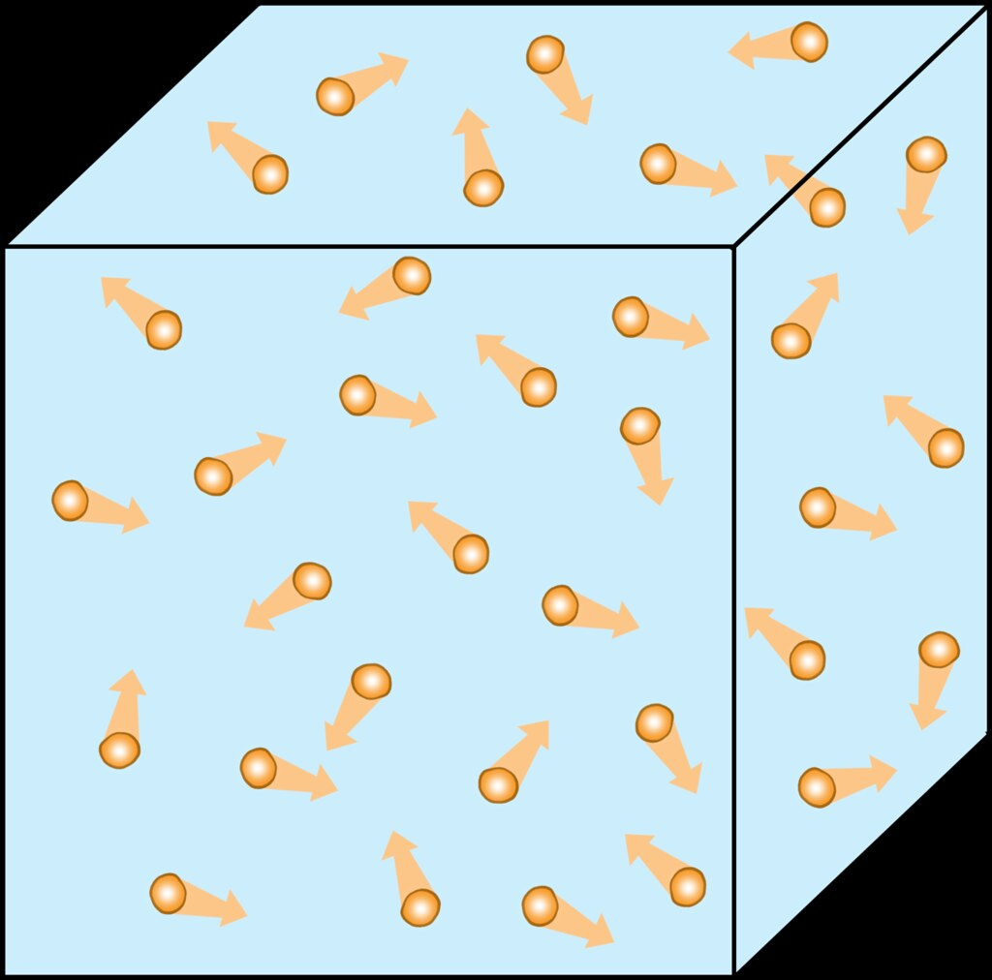
Gas particles in a container are a lot like the snowflakes in a snow globe.
The gas particles constantly collide with one another and with any walls that may contain them.
As a result, a gas pushes against the walls of its container.
The pressure of a gas is the force of its outward push (in Newtons) over an area (in square meters) of the walls of the container.
Pressure= Force/Area

Slide 6

Pressure is measured in units of pascals (Pa) or kilopascals (kPa) (1 kPa = 1,000 Pa).
The pressure of a gas can affect the physical properties of an object.
For example, the volleyball in Figure 1 feels firm when the pressure of the air inside of the ball is greater than the pressure of the air outside of the ball.
Because the air particles inside of the ball are tightly packed, there are more frequent collisions with its inner surface.
This results in a higher pressure.

Slide 7
Pressure and Temperature of a Gas (continued)
If you get a tiny hole in a pumped-up ball, air will slowly leak out, as shown in Figure 2.
Because the pressure inside the ball is greater than the outside air, the interior gas particles hit the inside of the ball more often.
Gas particles inside the ball exit more often than gas particles outside of the ball enter.
As a result, the pressure inside the ball drops until it is equal to the pressure outside.
P.68

Slide 8
Temperature also affects the pressure of a gas.
When you heat a gas, its particles move faster, so the temperature increases.
The particles will collide with the walls of their container with greater force and more frequency.
A greater force over the same area results in greater pressure.

Slide 9
In general, when the temperature of a gas at constant volume is increased, the pressure of the gas increases.
When the temperature is decreased while volume is constant, the pressure of the gas decreases.

Slide 10
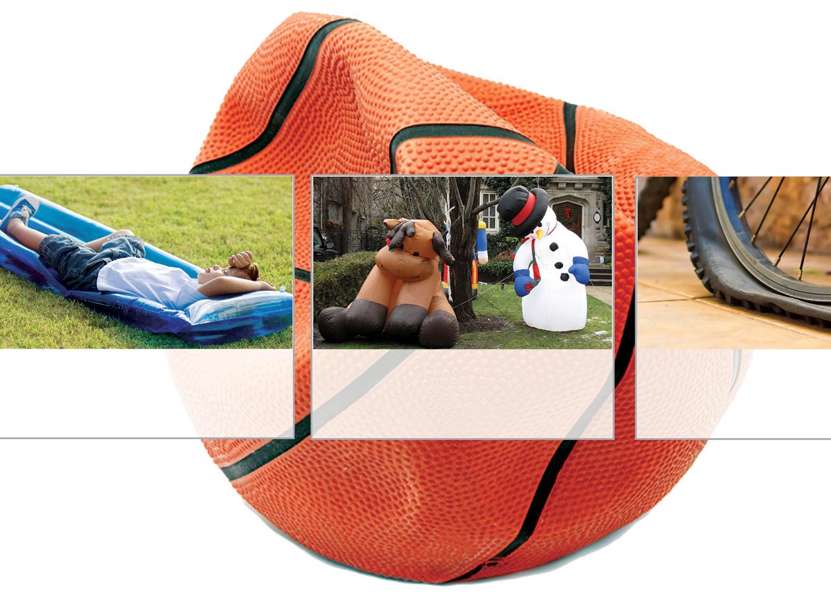
Pressure in a Basketball Figure 2
When a basketball leaks air, the pressure inside decreases. It loses its bounciness and becomes "flat."

Slide 11

How does particle motion affect pressure?
As the particles move faster, the pressure on the walls of the container increases.

Slide 12
Temperature and Volume
French scientist Jacques Charles examined the relationship between the temperature and volume of a gas.
He measured the volume of a gas at various temperatures in a container that could change volume. Because the volume was able to change, the pressure remained fairly constant.
P.69

Slide 13

Charles's Law
Charles discovered that when the temperature of a gas at constant pressure is increased, its volume increases.
He also discovered that when the temperature of a gas at constant pressure is decreased, its volume decreases.
This principle is called Charles's law.

Slide 14
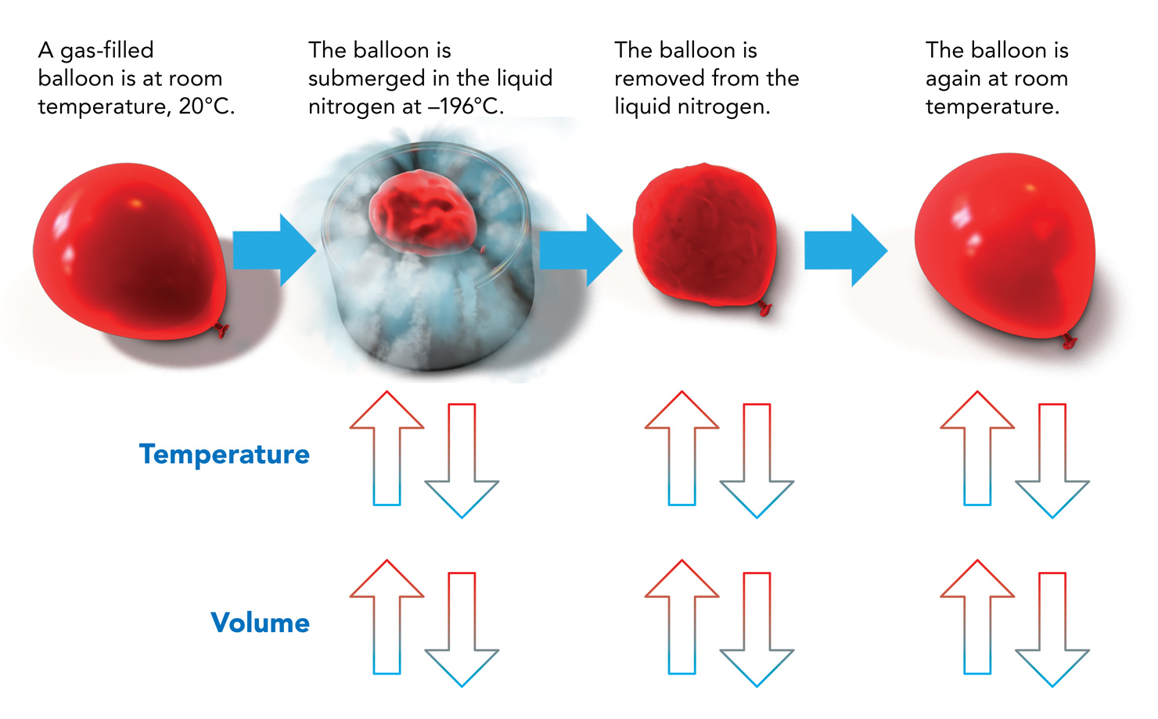
Figure 3 shows Charles's Law in action. A balloon is slowly lowered into liquid nitrogen at nearly -200Â°C and then removed. In the process, the pressure remains more or less constant.

Slide 15
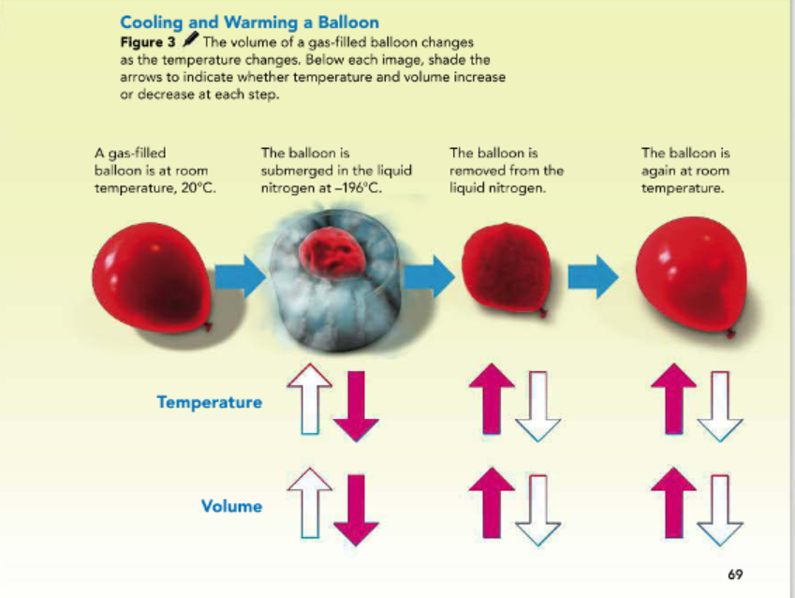

Slide 16

Directly Proportional Relationships
When a graph of two variables is a straight line passing through the origin, the variables are said to be directly proportional to each other.
The graph of Charles's Law shows that the volume of a gas is directly proportional to its kelvin temperature at constant pressure.
As one variable increases, the other increases at the same rate.
As one variable decreases, the other decreases at the same rate.
If the temperature of a gas were to decrease, what would happen to the volume of a gas?
It would also decrease.
P.70

Slide 17
Pressure and Volume
Suppose that you use a bicycle pump to inflate a tire, as shown in Figure 4.
By pressing down on the plunger, you force the gas inside the pump through the rubber tube and out of the nozzle into the tire.
What happens to the volume of air inside the pump cylinder as you push down on the plunger? What happens to the pressure?
P.71

Slide 18
Boyle's Law
In the 1600s, the scientist Robert Boyle carried out experiments to try to improve air pumps.
He measured the volumes of gases at different pressures.
Boyle's experiments showed that gas volume and pressure were related.

Slide 19
When the pressure of a gas at constant temperature is increased, the volume of the gas decreases.
When the pressure is decreased, the volume increases.
This relationship between the pressure and the volume of a gas is called Boyle's Law.
Boyle's Law describes situations in which the volume of a gas is changed.
The pressure changes in the opposite way.
For example, as the handle of a bike pump is pressed, it pushes the particles downward in the cylinder.
The volume in the cylinder becomes smaller, and particles leave through the tube.

Slide 20
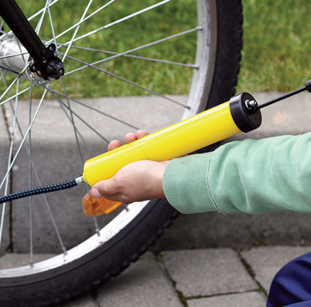
Filling a Bike Tire Figure 4 Pumping a bike pump causes an increase in gas pressure and a decrease in gas volume within the pump.

Slide 21
Inversely Proportional Relationships
Look at the graph that you made when graphing Boyle's Law in the Math Toolbox. Notice that the points lie on a curve and not a straight line.
This curved line is called a hyperbola.
When volume is low, pressure is high.
When pressure is high, volume is low.
As the volume of a gas increases at constant temperature, the pressure of the gas decreases at a different rate.
If you multiply the two variables - ”pressure and volume” - at any point on the curve, you will find that the product does not change.
This means that the two variables are inversely proportional to each other.
The graph for Boyle's Law shows that gas pressure is inversely proportional to volume at constant temperature.
P.73

Slide 22
Real-World Gas Behavior
Pistons are often used in machines in which gas is involved. Pistons move in response to the motion of the particles of gas.
For example, pistons in a car engine respond to pressure changes that occur when a mixture of fuel and air ignites.
The moving pistons help to turn the crankshaft, which connects to the wheels of the car. So the pistons drive the turning of the wheels, which allows the car to move.

Slide 23
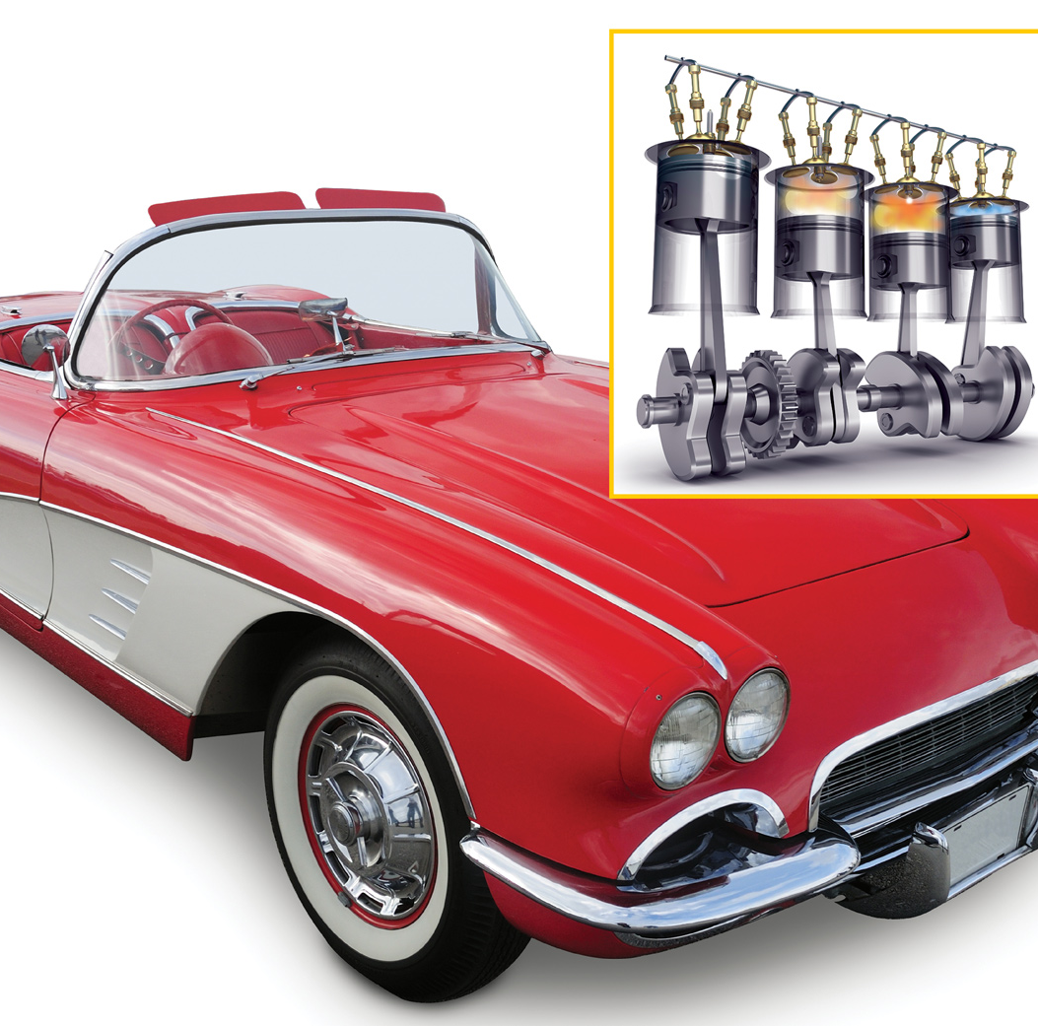
Figure 5 Pistons in car engines move up and down. This drives the turning of the wheels of the car.

Slide 24
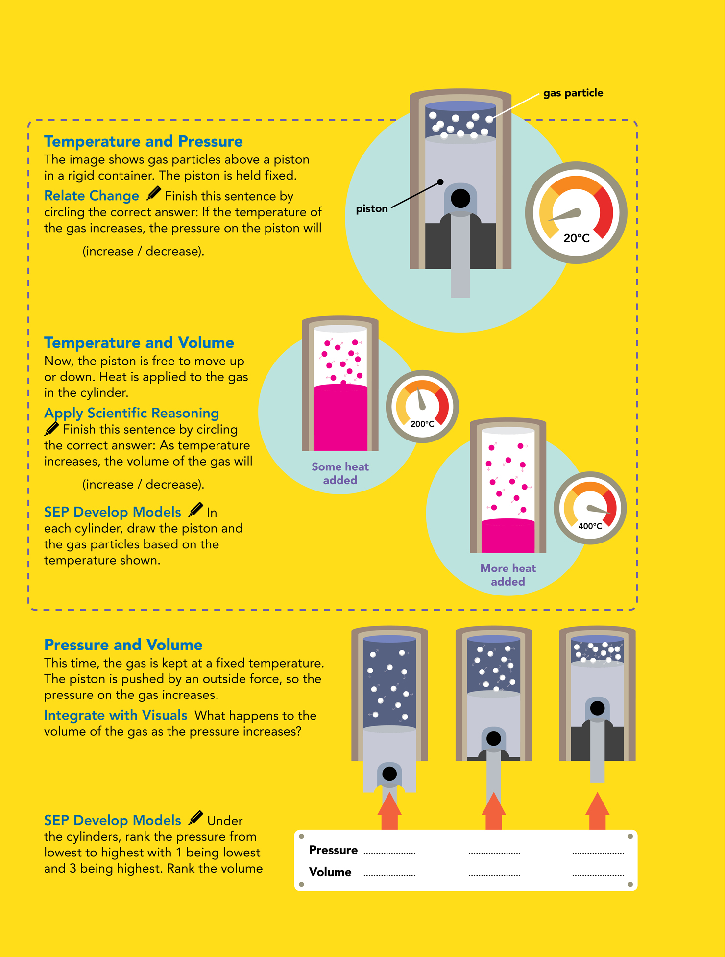
Figure 6 Use what you have learned about gas behavior to understand how temperature, pressure, and volume affect pistons.
P.74

Slide 25
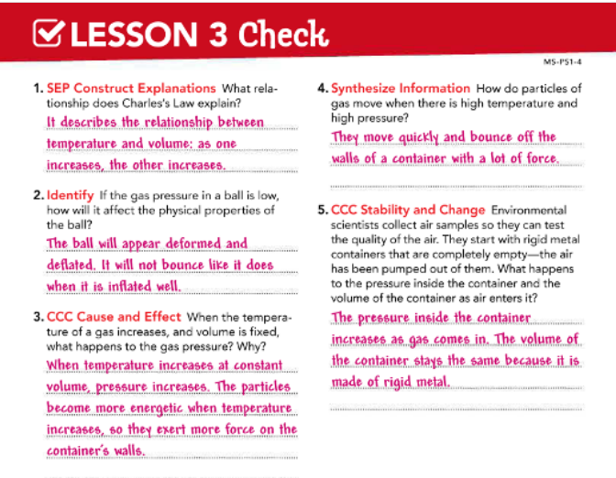

Slide 26



