Slide 1
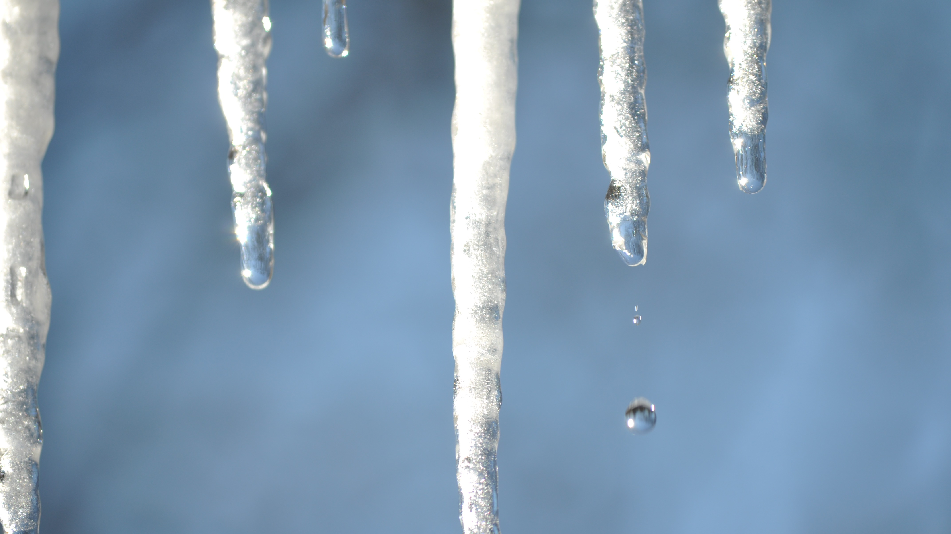
Topic 2 Lesson 2
Changes of State

Slide 2
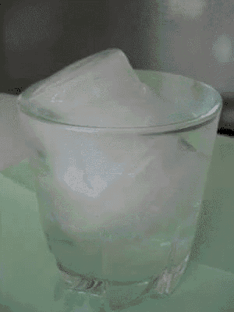
Thermal Energy and Temperature
You have seen substances change state.
For example, snow melts into liquid water, puddles of rain freeze in the cold, and boiling water becomes steam.
P.57

Slide 3


What do all of these changes have in common?
They involve a change in the thermal energy and temperature of the substance.
Thermal energy and temperature are related, but they are not the same thing.
You can understand them in terms of particles

Slide 4
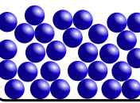
Thermal Energy
Particles have both kinetic energy and potential energy.
Kinetic energy is energy of motion, and potential energy is energy that is stored.
Thermal energy is the total kinetic and potential energy of all the particles in an object or substance.

Slide 5
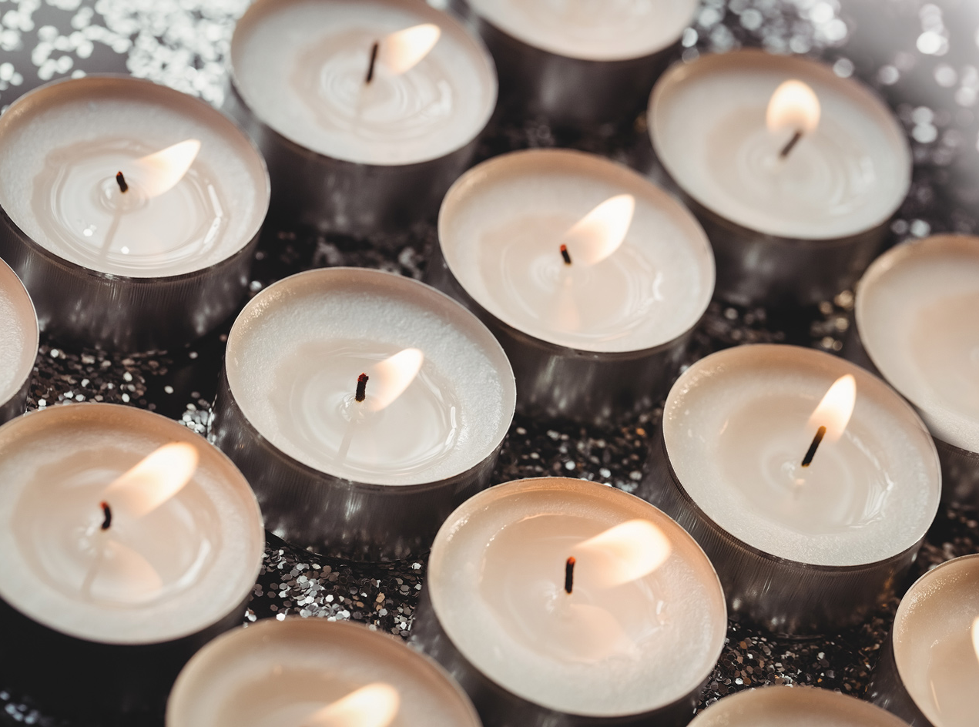
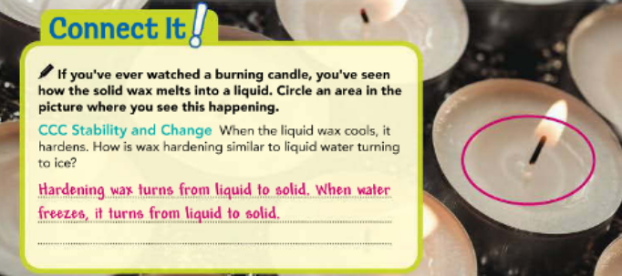
You can increase the thermal energy of a substance by heating it.
When you apply heat, you are transferring energy from the heat source to the substance.
If you add enough energy to the substance, it can become hot enough to change its state of matter, like the candle wax in Figure 1.

Slide 6
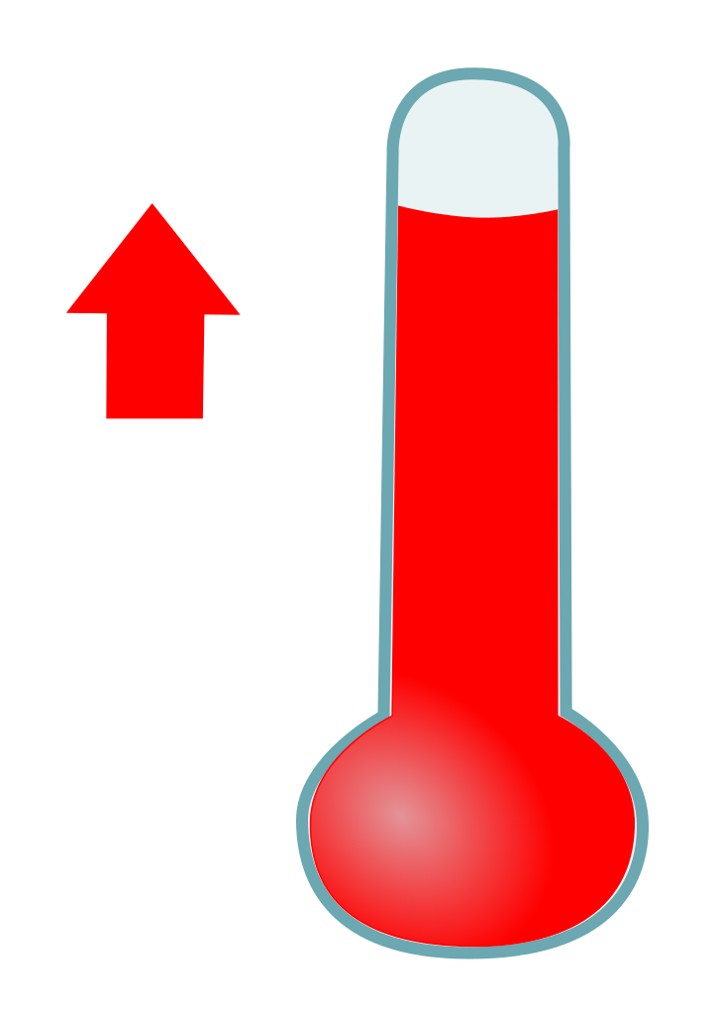
Temperature
Recall that all particles of matter are constantly moving.
Temperature is a measure of the average kinetic energy of the particles in an object or substance.
The faster the particles are moving, the greater their kinetic energy and the higher the temperature of the substance.

Slide 7
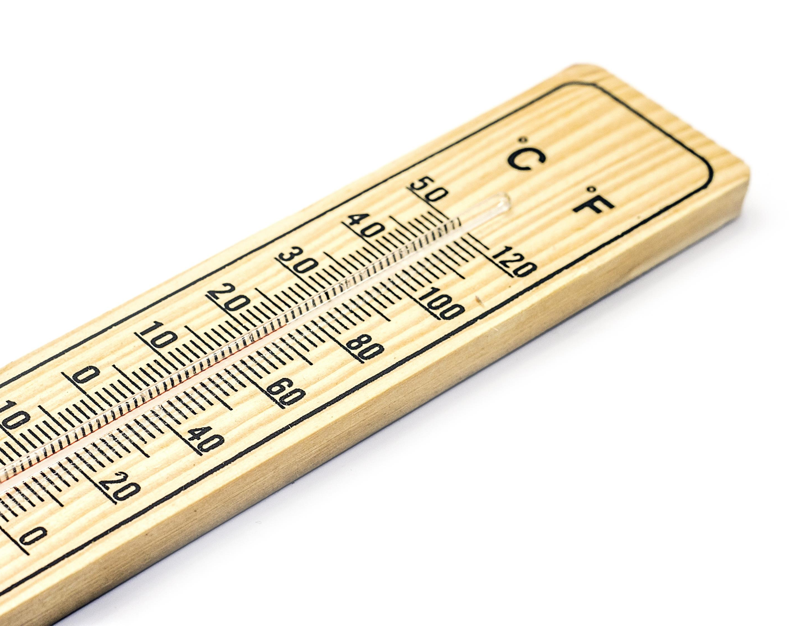
A thermometer measures temperature in degrees, such as degrees Celsius (°C) or degrees Fahrenheit (°F).
The thermometer registers a higher temperature when particles are moving faster.

Slide 8
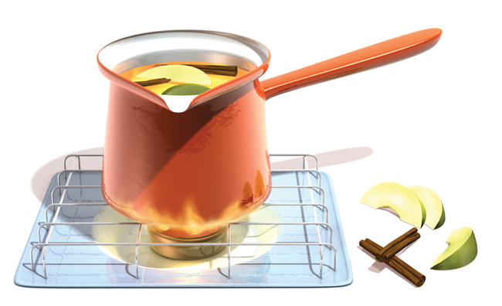
How do you make particles speed up?
Heat a substance, such as the cider in Figure 2, so that its thermal energy increases and its particles move faster.
As a result, the temperature of the substance will increase.
On the other hand, when a substance is cooled and its thermal energy decreases, its particles slow down. The temperature of the substance decreases.

Slide 9
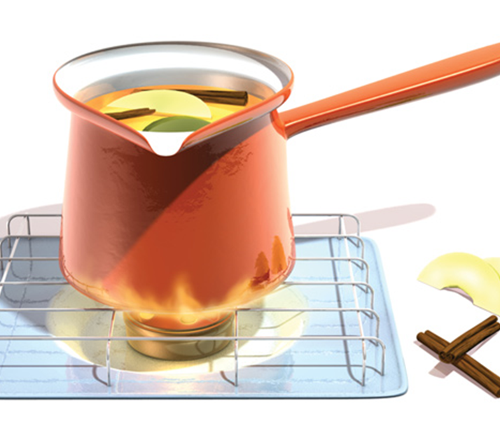
Draw an arrow on Figure 2 to show the direction of heat flow. Label the apple cider’s thermal energy as increasing or decreasing

Slide 10
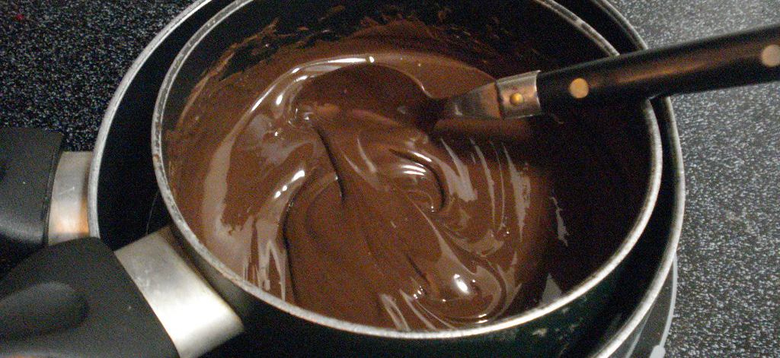
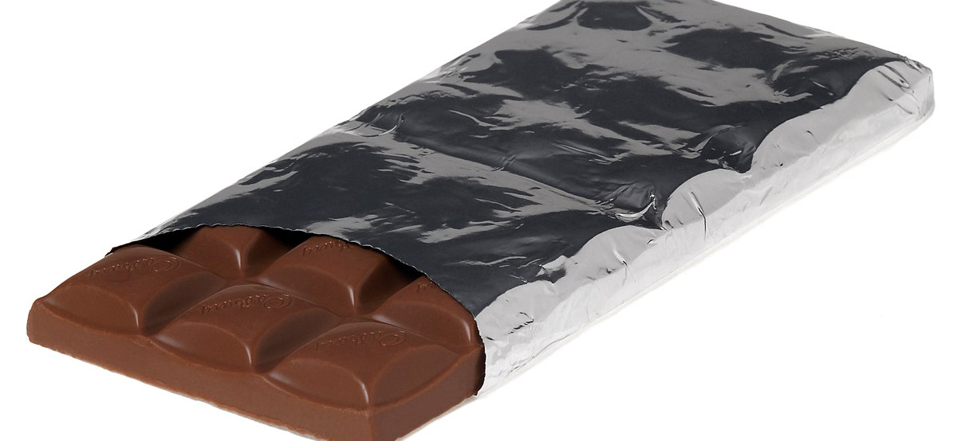
Changes of State Between Solid and Liquid
Have you ever let a bar of chocolate sit in a car too long on a hot day?
If so, you know what it looks like when the chocolate melts.
Some of the solid bar changes to liquid.
P.58

Slide 11
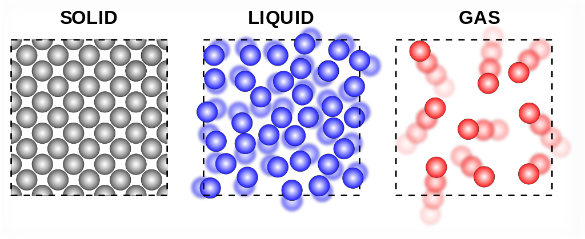
Melting
When the temperature of most solids increase enough, they change to liquid.
The change in state from a solid to a liquid is called melting.
This change of state involves an increase in thermal energy.
In general, particles of a liquid have more thermal energy than particles of the same substance in solid form.

Slide 12
In pure, crystalline solids, melting occurs at a specific temperature, called the melting point.
Figure 3 shows what happens to the temperature of an ice cube after it is taken from the freezer and left out at room temperature.
At first, the energy flowing from the environment into the ice makes the water molecules vibrate faster, raising the temperature of the ice cube.
At a solid’s melting point, its particles vibrate so fast that they break free from their fixed positions.
When the ice cube reaches the melting point of water, 0°C, its temperature stops increasing.
At this point, added energy continues to change the arrangement of the water molecules from ice crystals into liquid water as the ice melts.

Slide 13
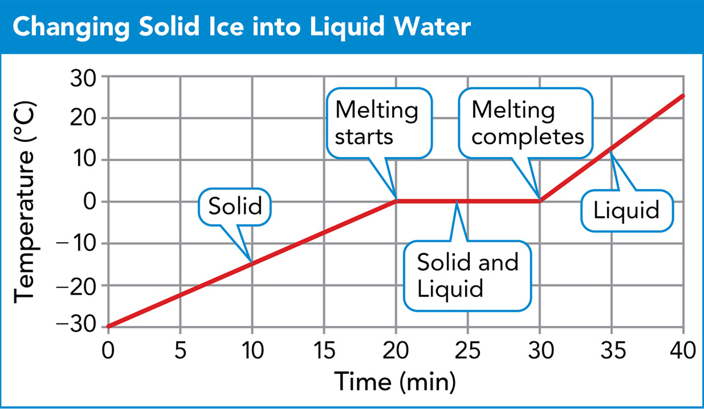

Slide 14
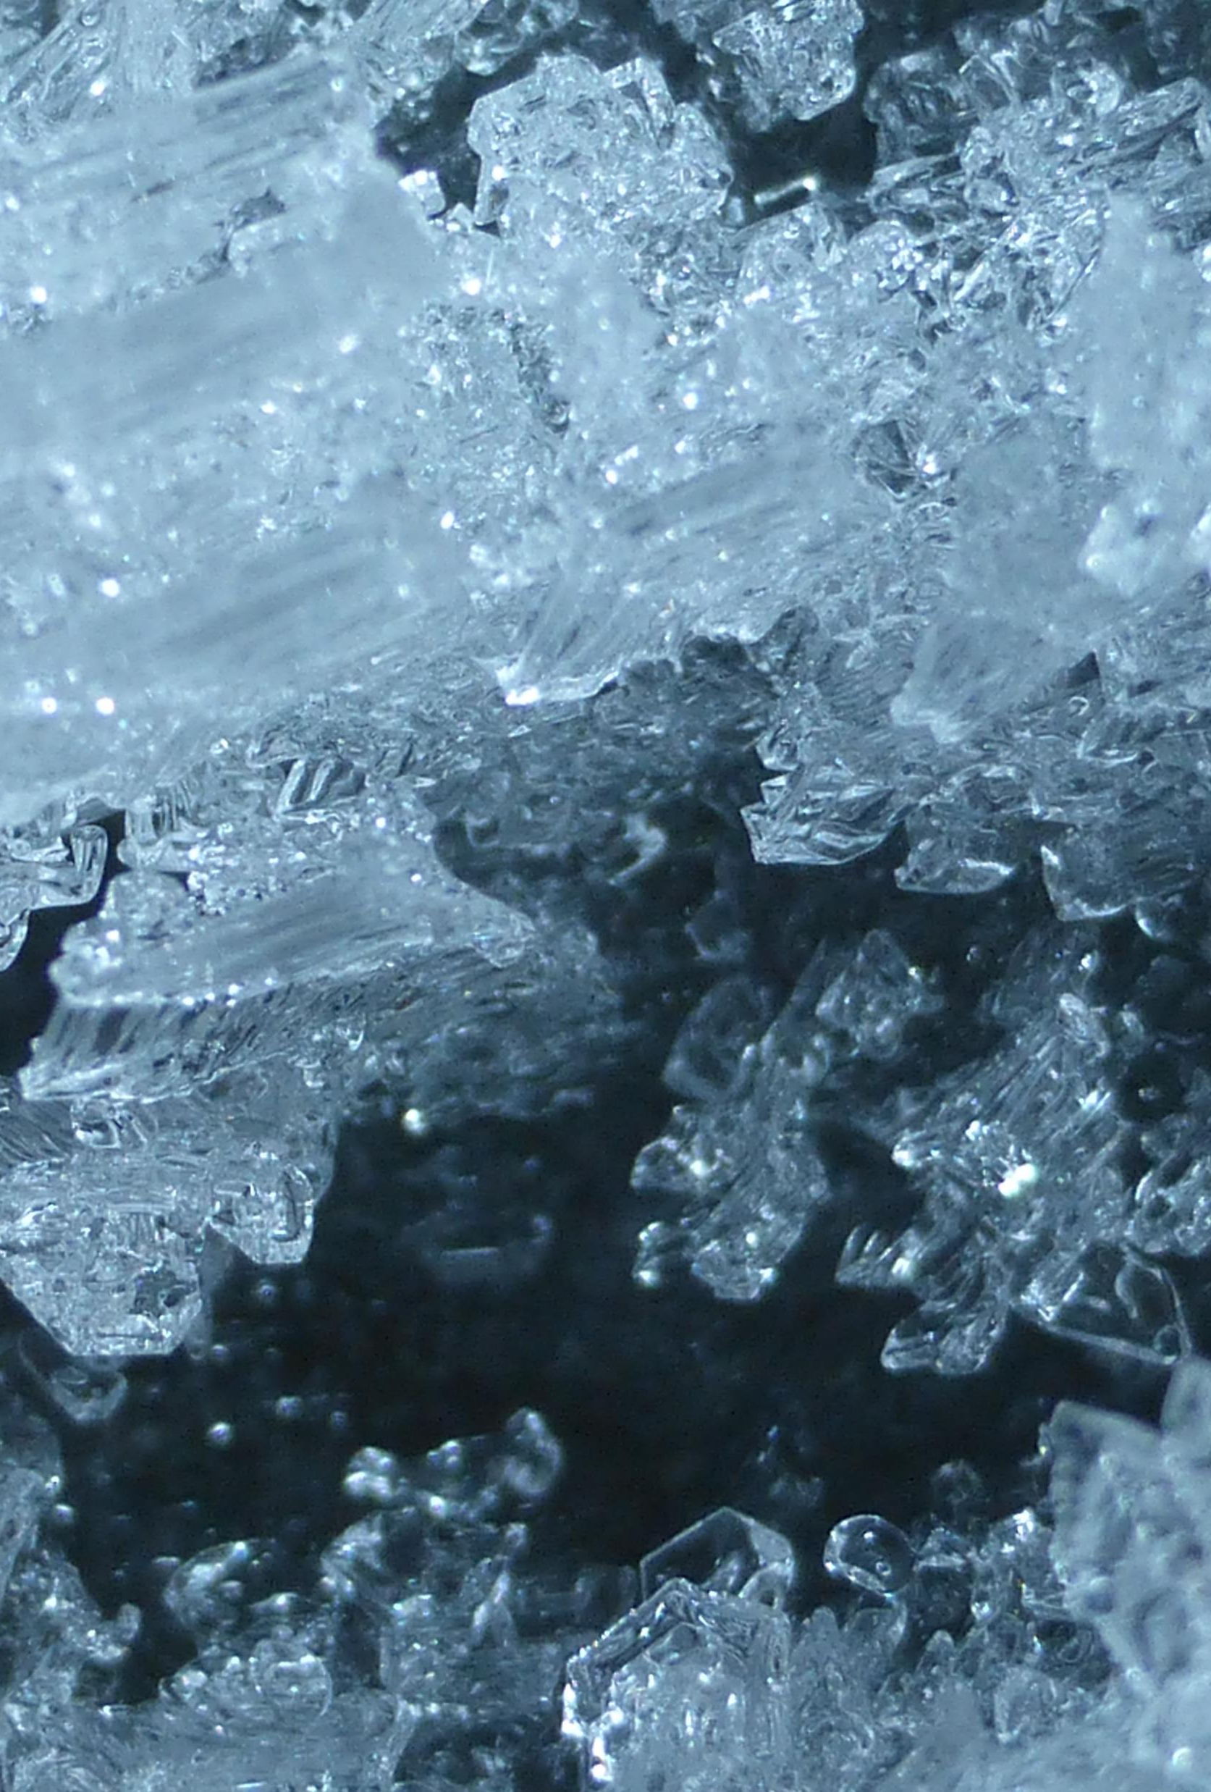
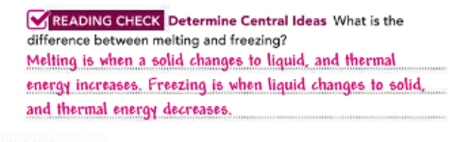
Freezing
You have probably seen many substances freeze.
When you put liquid water into a freezer, for example, it turns to solid ice.
The thermal energy of the liquid water decreases and the water molecules move more slowly.
At 0°C, the water molecules begin to become fixed in place, and the liquid water turns to solid ice.
P.59

Slide 15
Freezing is the change of state from a liquid to a solid. It is the reverse of melting.
Unlike water, some substances do not have to be cold to the touch in order to freeze.
For example, some types of wax freeze at 63°C, which is greater than the record high surface temperature of Earth ever recorded.

Slide 16
A substance’s freezing point is simply the temperature at which it changes from a liquid to a solid.
So, water’s freezing point is 0°C, and the special wax’s freezing point is 63°C.
At a liquid’s freezing point, its particles are moving so slowly that they begin to take on fixed positions.
It doesn’t matter how much of a substance there is—it will always have the same freezing point.

Slide 17
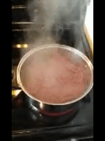
Changes of State Between Liquid and Gas
Why does a pot of hot soup create steam? How does fog form?
To answer these questions, you need to look at what happens when changes occur between the liquid and gas states.
P.60

Slide 18
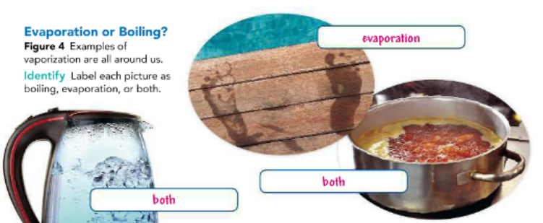

Evaporation and Boiling
The change in state from a liquid to a gas is called vaporization.
Vaporization occurs when the particles in a liquid gain enough energy to move independently and away from each other.
There are two main types of vaporization Boiling
Evaporation.

Slide 19
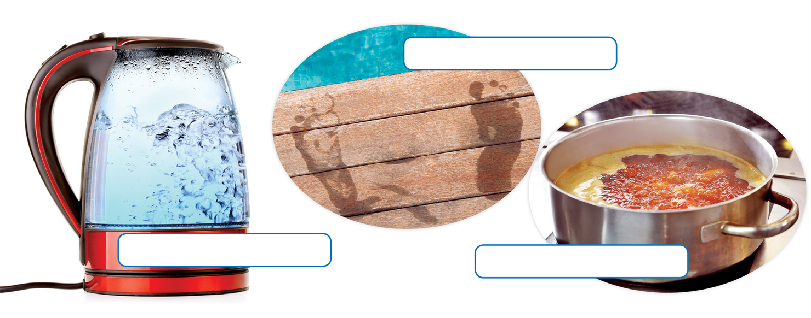
Vaporization that takes place both below and at the surface of a liquid is called boiling.
When soup boils, vaporized soup molecules form bubbles below the surface.
The bubbles rise and eventually break the surface of the liquid, as shown in Figure 4.
The temperature at which a liquid boils is called its boiling point. The boiling point of water is 100ºC at sea level.
As with melting and freezing points, boiling points are characteristic properties and can be used to identify unknown substances.
No matter how much of a substance you have, it will boil at the same temperature.

Slide 20
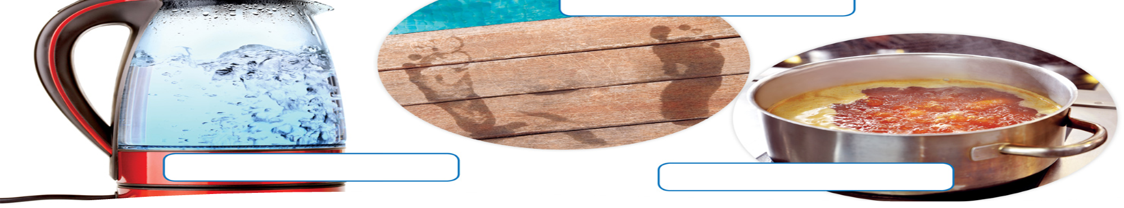
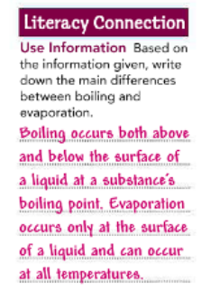
Evaporation or Boiling? Figure 4 Examples of vaporization are all around us. Identify Label each picture as boiling, evaporation, or both.

Slide 21
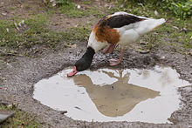
You know that a rain puddle eventually disappears from the ground as it changes from a liquid to a gas.
The puddle of water vaporizes, but why don’t we see the water boiling?
Because the temperature of the water in the puddle has not reached its boiling point, only the water particles on the surface of the puddle have enough energy to turn into a gas.
Energy is transferred to these particles from the sun's radiation and the surrounding air.

Slide 22
Vaporization that takes place only on the surface of a liquid is called evaporation.
The process continues until all of the particles evaporate and the puddle is gone.
While boiling occurs only at one temperature, evaporation can occur at all temperatures.

Slide 23
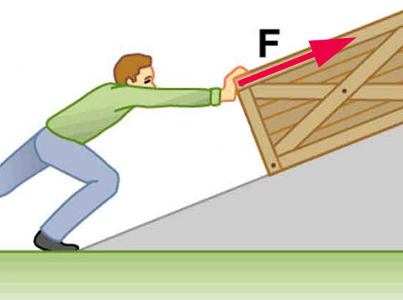
The Effect of Pressure
When you push on an object, you apply pressure to the object.
The pressure depends on the force you apply and the area over which you apply the force.
Pressure= Force/Area
P.61

Slide 24
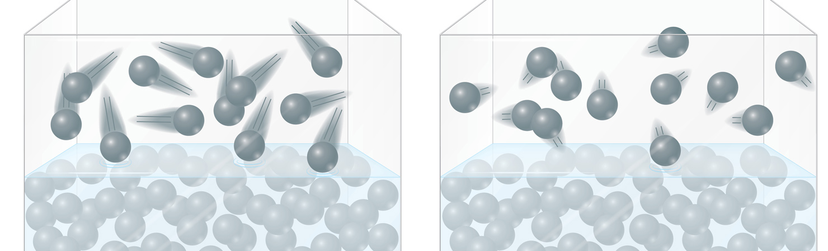
Gas particles constantly collide with one another and with any nearby surfaces.
As a result, a gas pushes on these surfaces. The pressure a gas applies is greater if its particles collide with a surface more often, as shown in Figure 5.
The air that surrounds you is constantly applying pressure to you.
This pressure, called atmospheric pressure, can affect how easily a liquid changes to a gas.

Slide 25
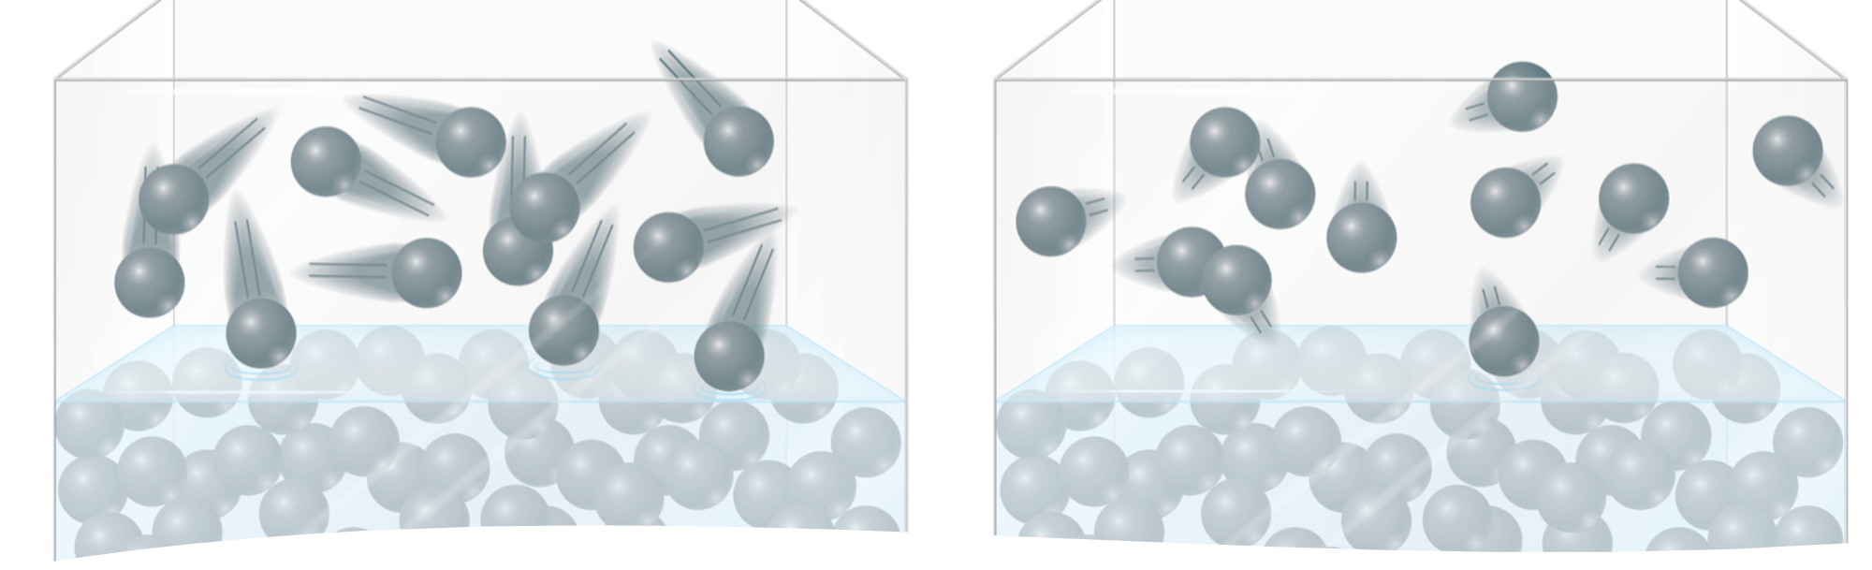
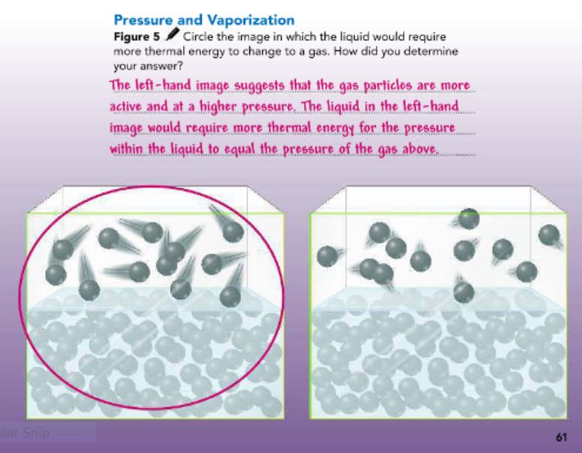
Figure 5 Which image shows a liquid that would require more thermal energy to change to a gas? How did you determine your answer?

Slide 26
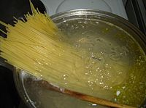
Think about boiling water to make pasta.
Atmospheric pressure is acting on the surface of the liquid water.
As the water is heated on the stove, the pressure inside of the liquid increases.
When the pressure inside of the liquid equals the atmospheric pressure, the liquid boils.

Slide 27
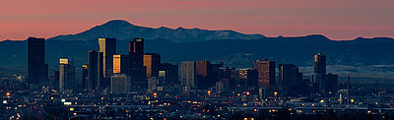
In locations high above sea level—such as Denver, Colorado—the atmospheric pressure is less because the air is less dense.
This means that it takes less thermal energy to get a liquid to boil in these locations.
In Denver, water boils at 95°C.

Slide 28

Condensation
The reverse of vaporization is condensation.
Condensation is the change in state from a gas to a liquid.
It occurs when particles in a gas lose enough thermal energy to change state.
You can observe condensation by breathing onto a window, as shown in Figure 6.
When warm water vapor in your breath reaches the cooler surface of the window, the water vapor condenses into liquid droplets.
P.62

Slide 29

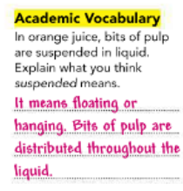
Have you ever wondered how fog forms?
Much like clouds in the atmosphere, fog forms (Figure 7) when water vapor in the air condenses into tiny liquid droplets.
Water vapor is a colorless gas that you cannot see.
The steam you see above a kettle of boiling water is not water vapor, and neither are clouds or fog.
What you see in those cases are tiny droplets of liquid water suspended in air.

Slide 30
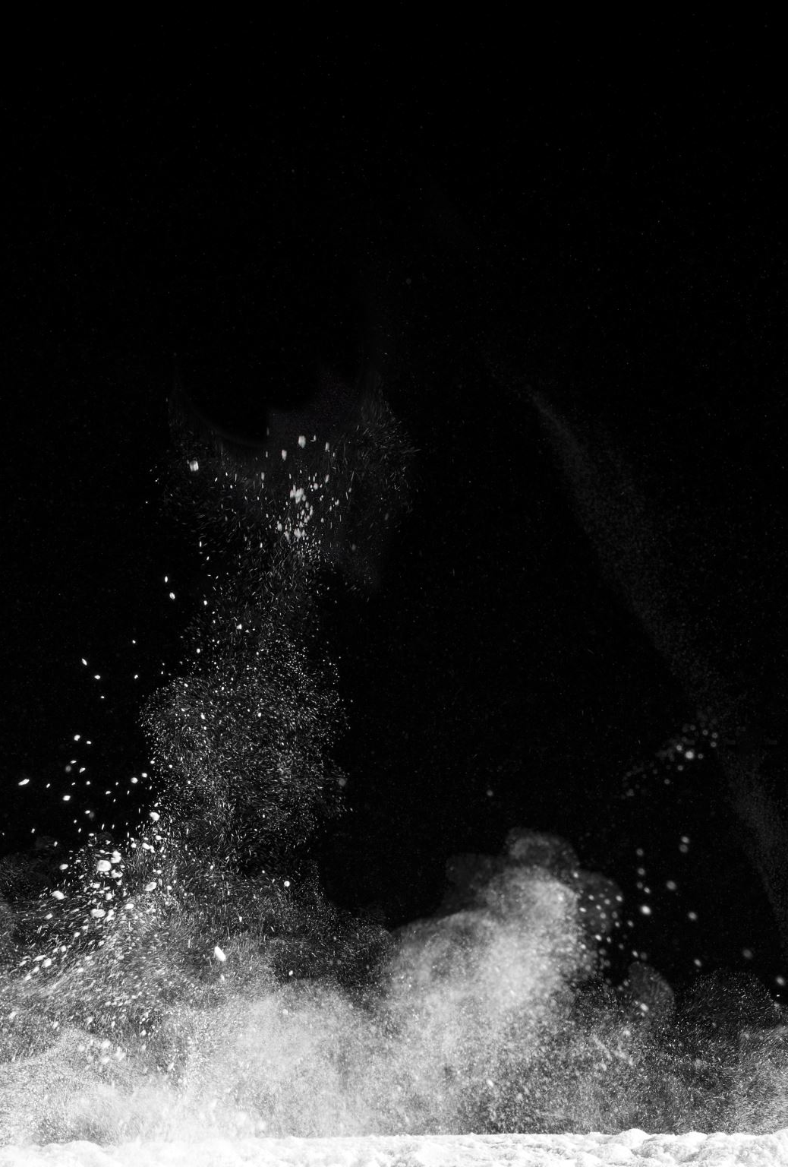
Changing State from Solid to Gas
In places where the winters are very cold, the snow may disappear even when the temperature stays well below freezing.
This change is the result of sublimation.
Sublimation occurs when the surface particles of a solid gain enough energy that they form a gas.
During sublimation, particles of a solid do not pass through the liquid state as they form a gas.
P.63

Slide 31
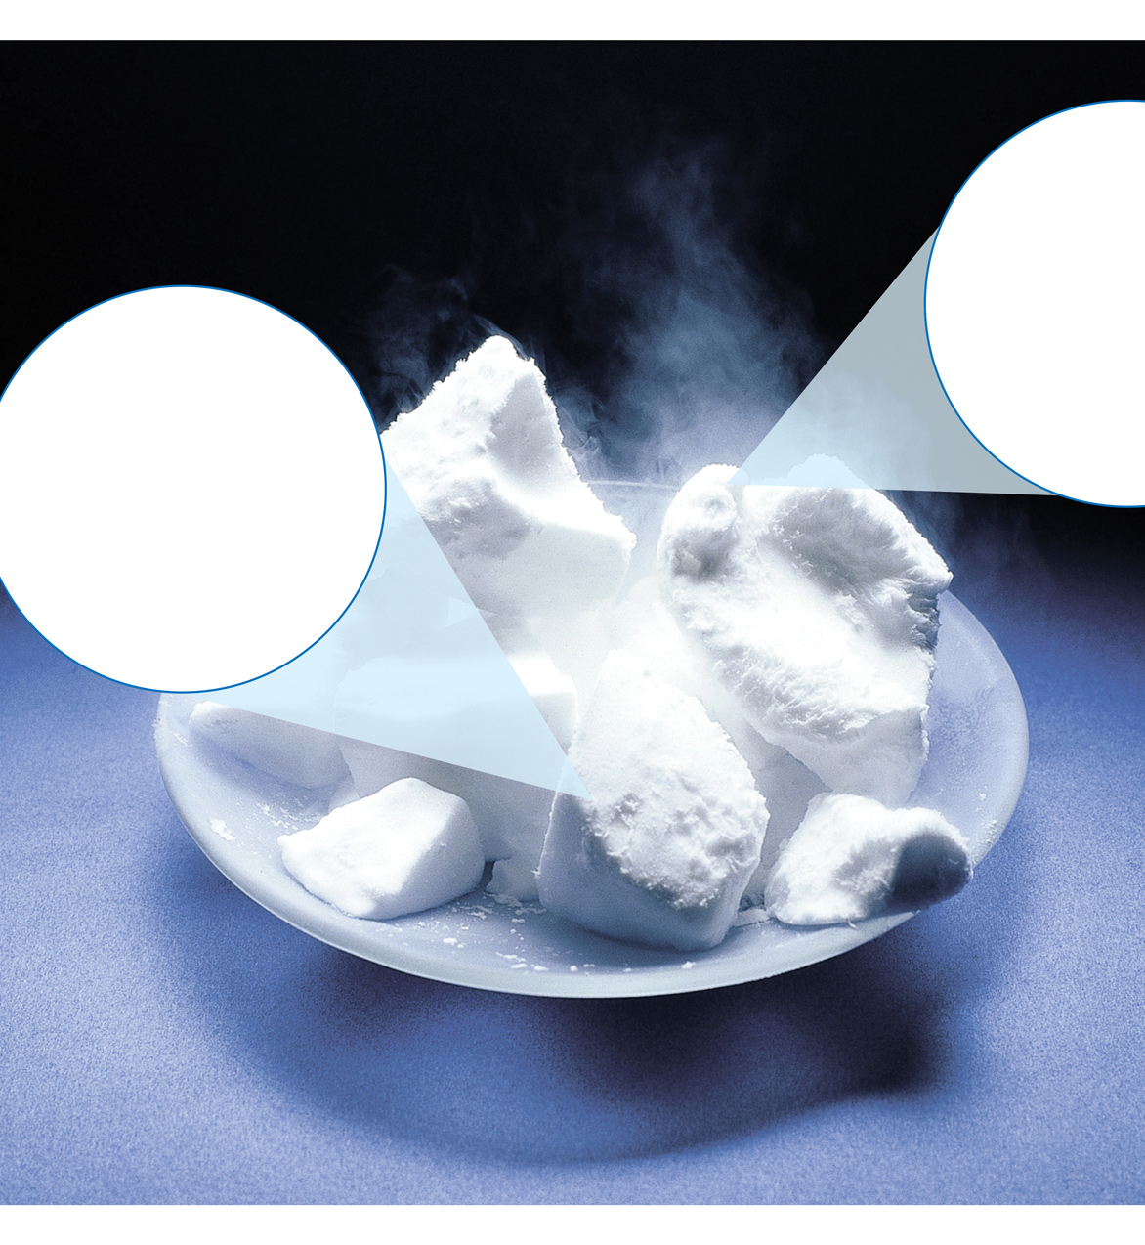
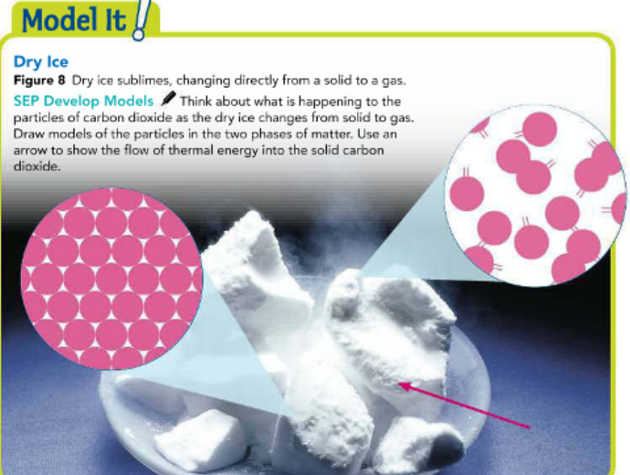
One example of sublimation occurs with dry ice, which is solid carbon dioxide.
At ordinary atmospheric pressures, carbon dioxide cannot exist as a liquid.
So instead of melting, solid carbon dioxide changes directly into a gas as shown in Figure 8.
As it sublimes, the carbon dioxide absorbs thermal energy from its surroundings.
For this reason, dry ice can be used to keep materials cold.

Slide 32
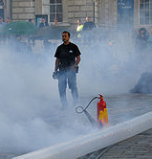
Some fog machines use dry ice to create fog in movies.
When dry ice becomes a gas, it cools water vapor in the nearby air.
The water vapor then condenses into a liquid, forming fog near the dry ice.

Slide 33
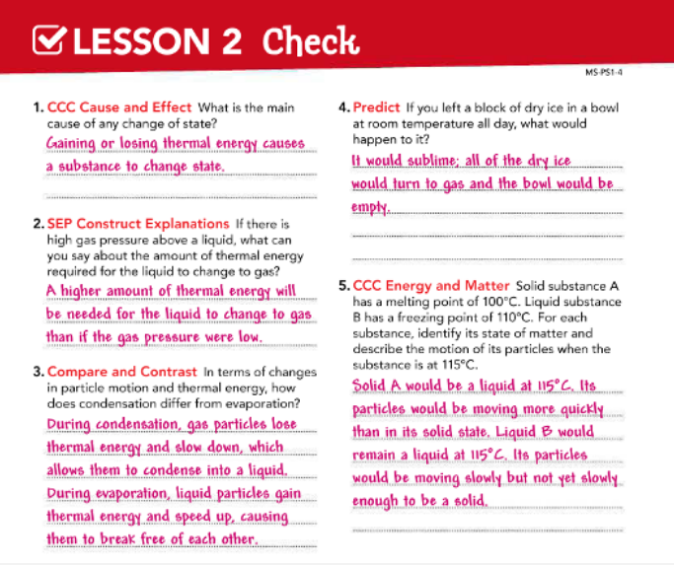

Slide 34
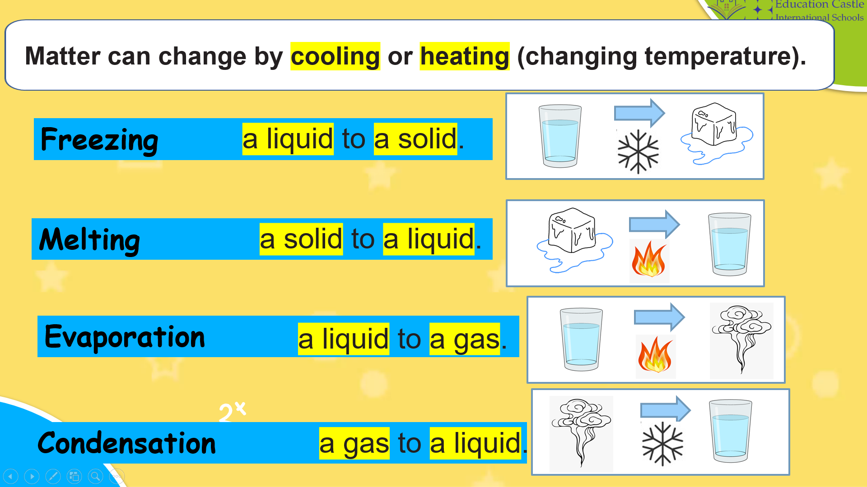

Slide 35
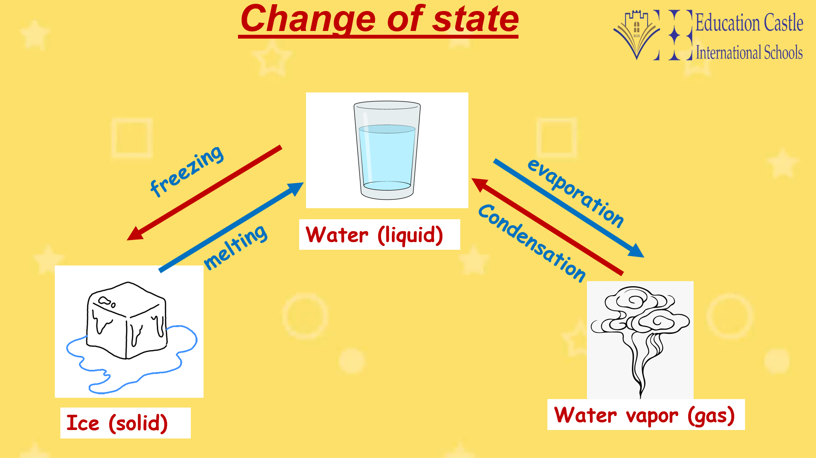

Slide 36


