Slide 1

Chapter: 2 Solids, liquids, and gases Lesson: 1 States of Matter
Open Pg. 46

Slide 2

Vision The first and the highest quality educational investor and the most rapid spread Mission Providing a competitive international education with applied dimensions that build skill, instill value, and develop creativity in accordance with the constants of religion the national orientations in an attractive, educational environment that stimulates learning with a community knowledge-producing knowledge, producing generation

Slide 3


Slide 4

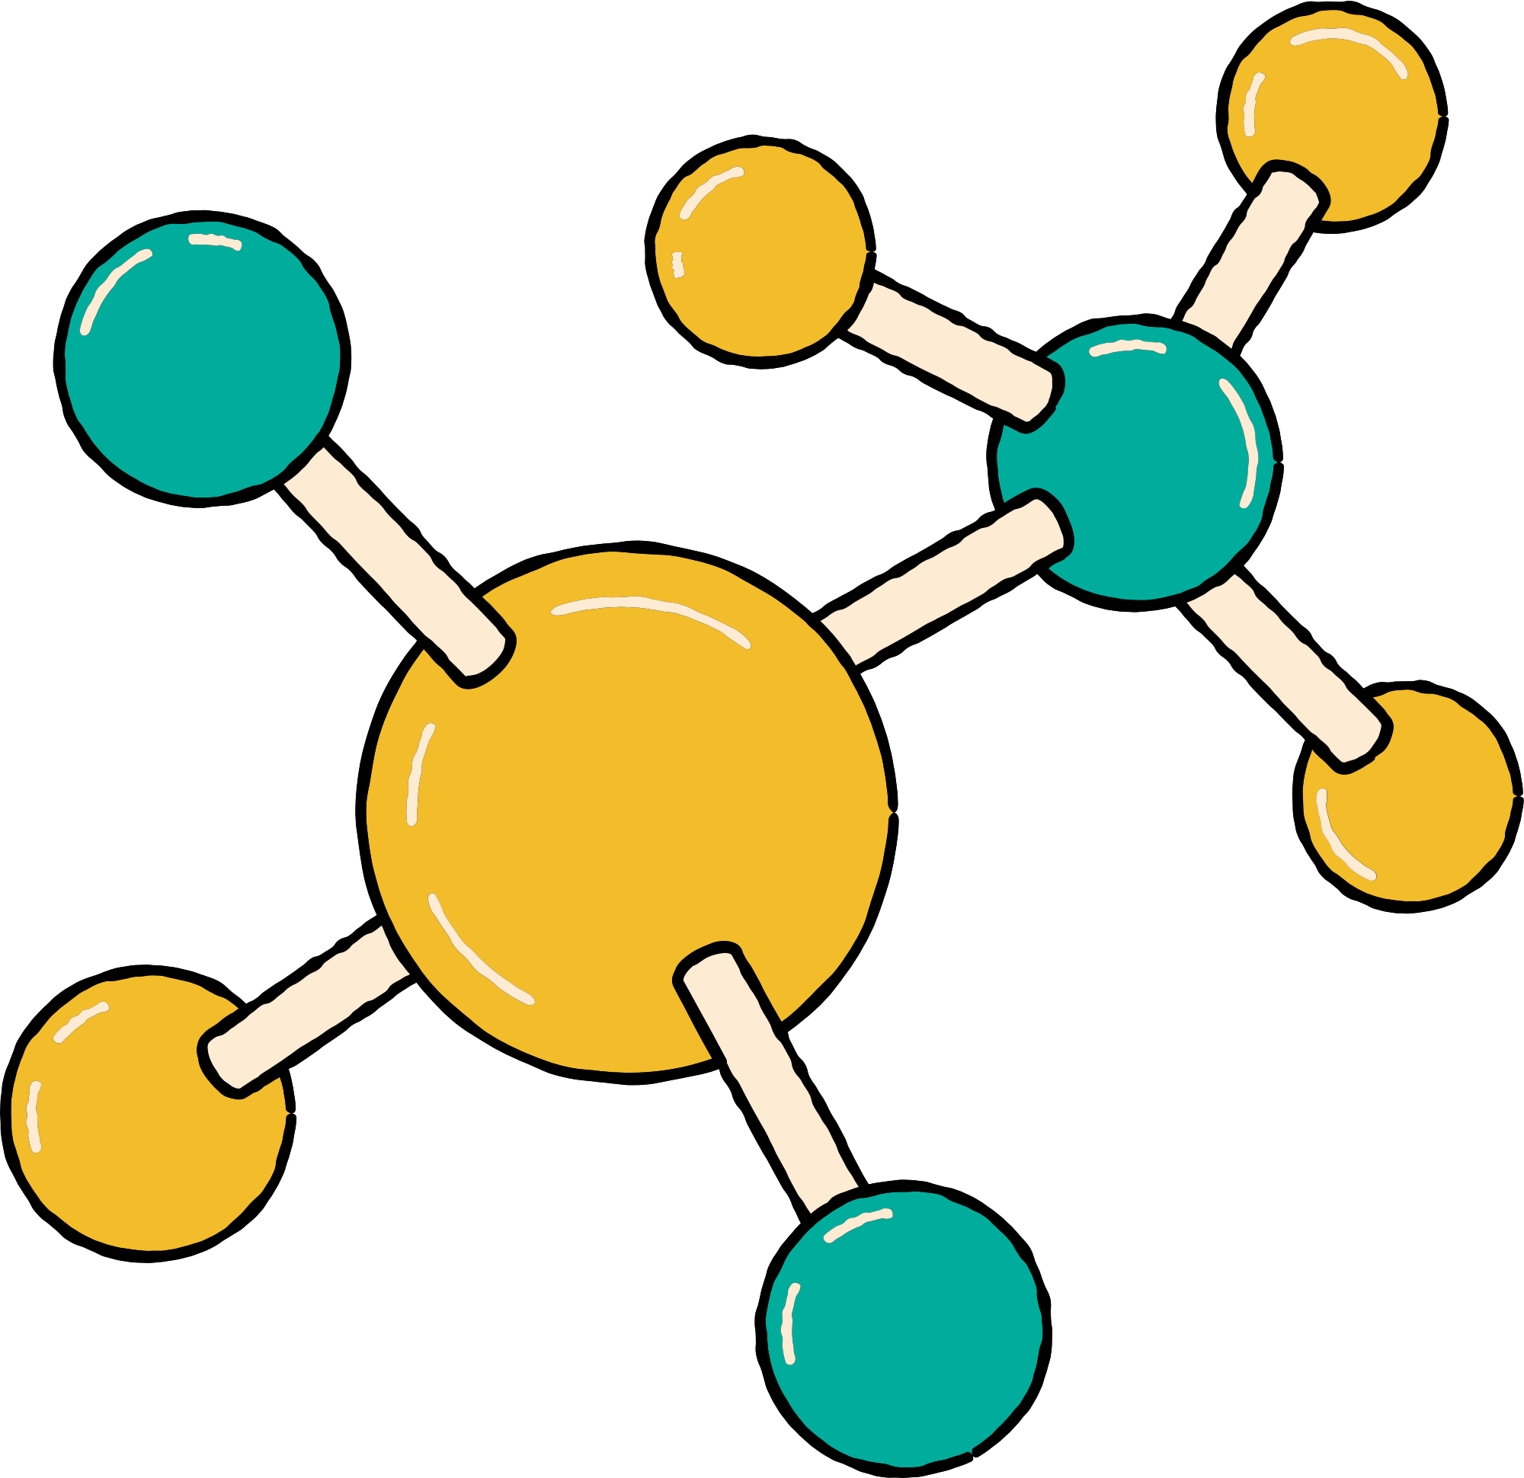









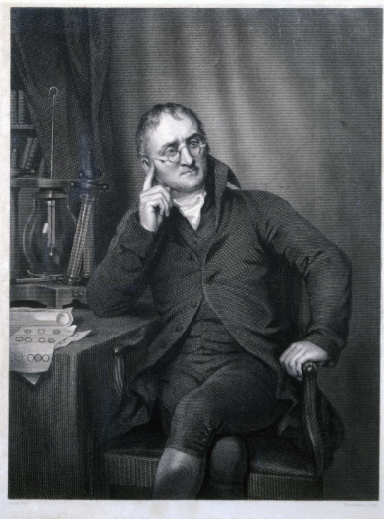





Scientist of the week
In 1808, chemist John Dalton suggested that something smaller called atoms make up the matter.

Slide 5

Looking at the picture guess what is Matter?
Al-Haqbana
Looking at the picture guess what is Matter?
Notes:
Looking at the picture guess what is Matter?

Slide 6

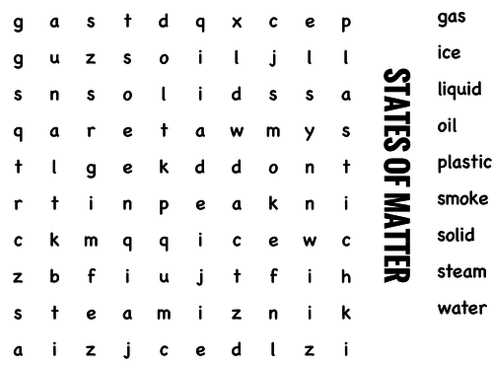
Hook Activity

Slide 7
GUIDING QUESTIONS
• What are the similarities and differences between solids. liquids and gases?
• What is the relationship between particle motion and state of matter?

Slide 8
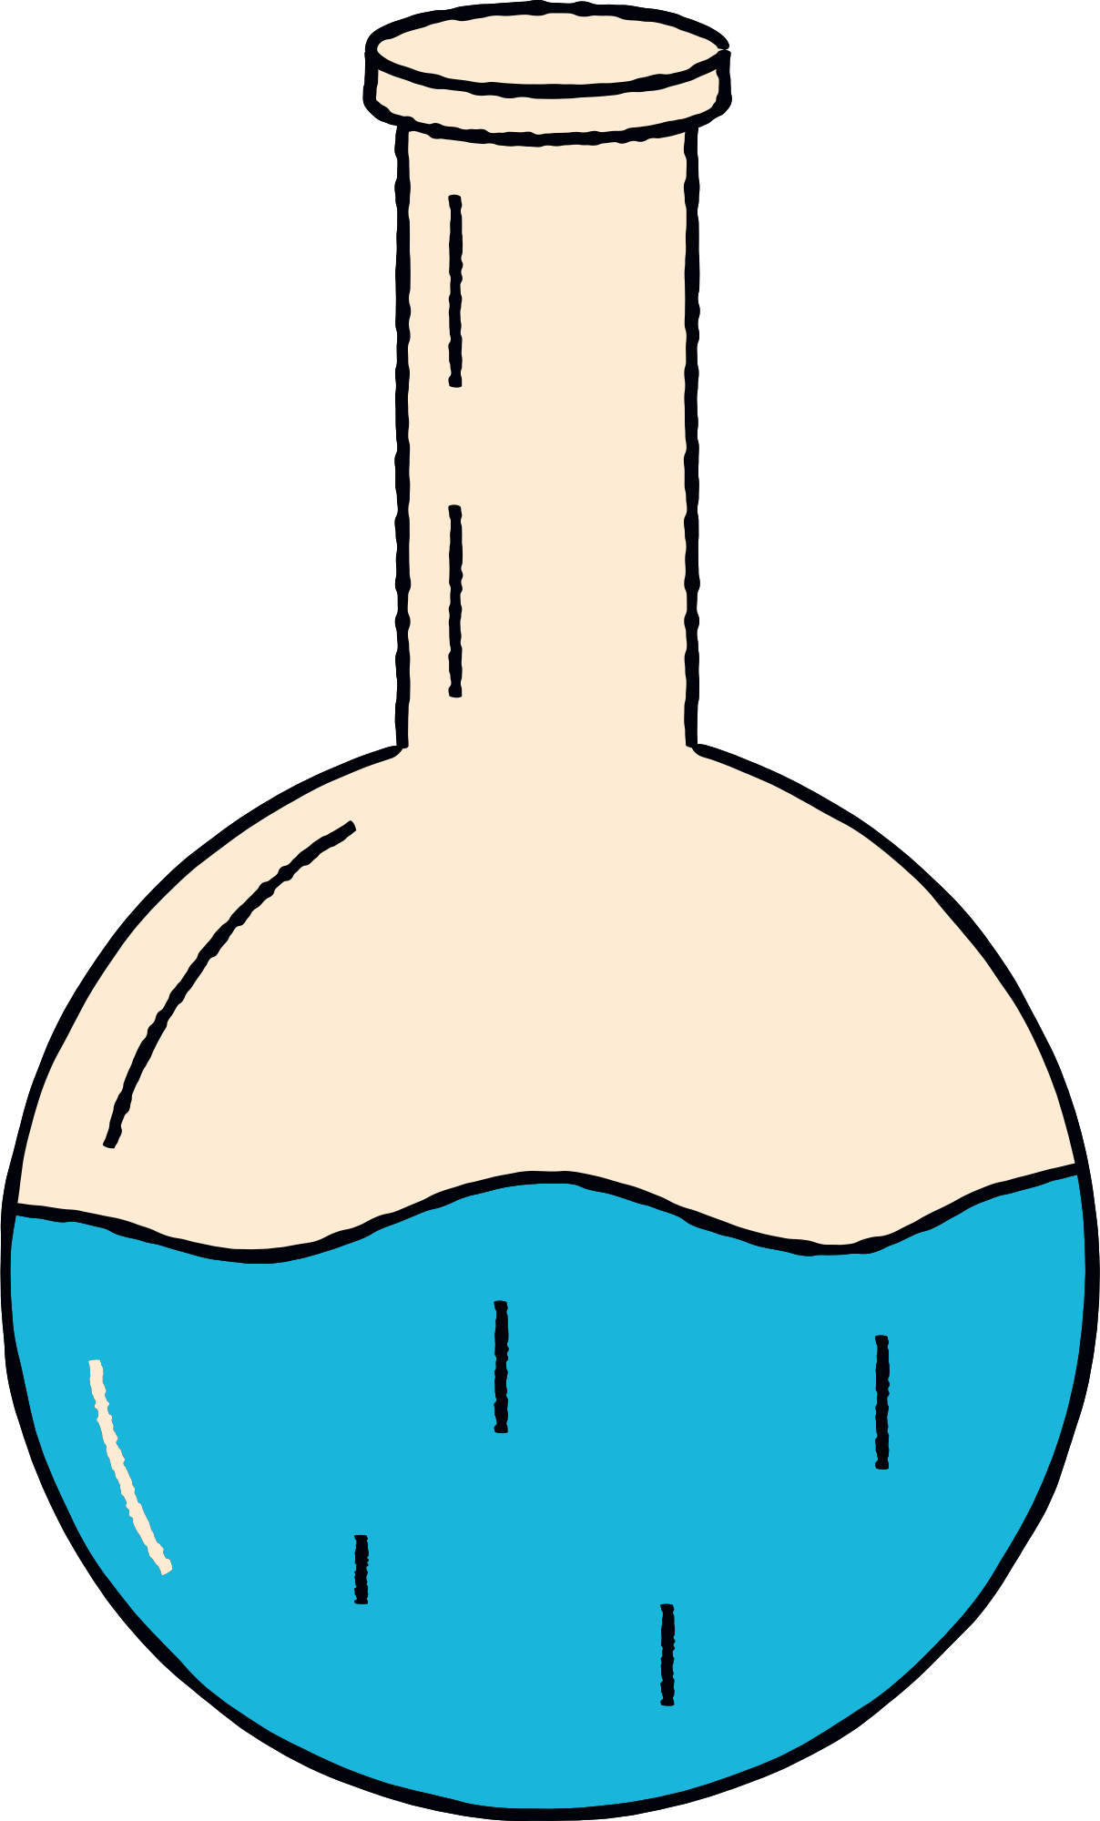

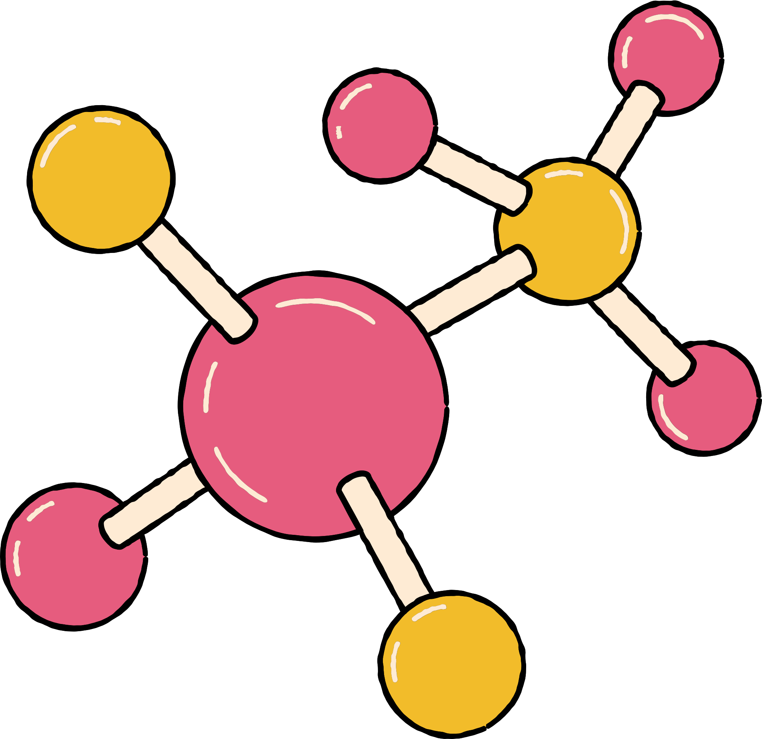



VOCABULARY
solid
liquid
surface tension
viscosity
gas

Slide 9
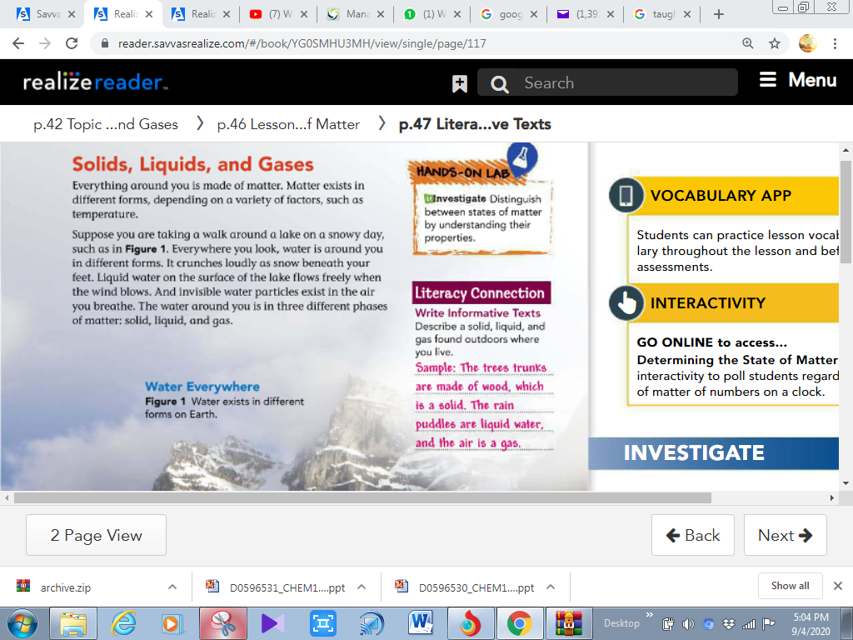
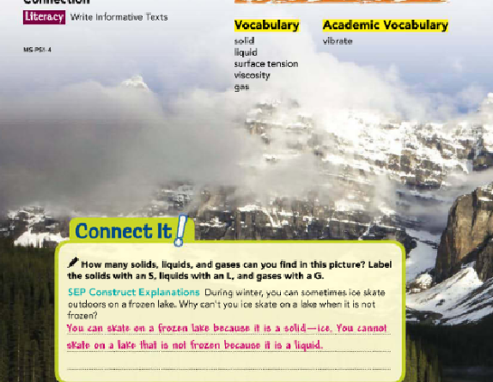

Slide 10
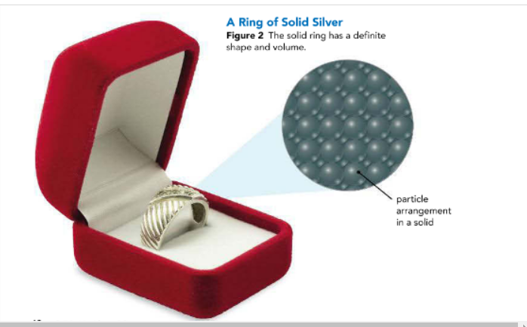
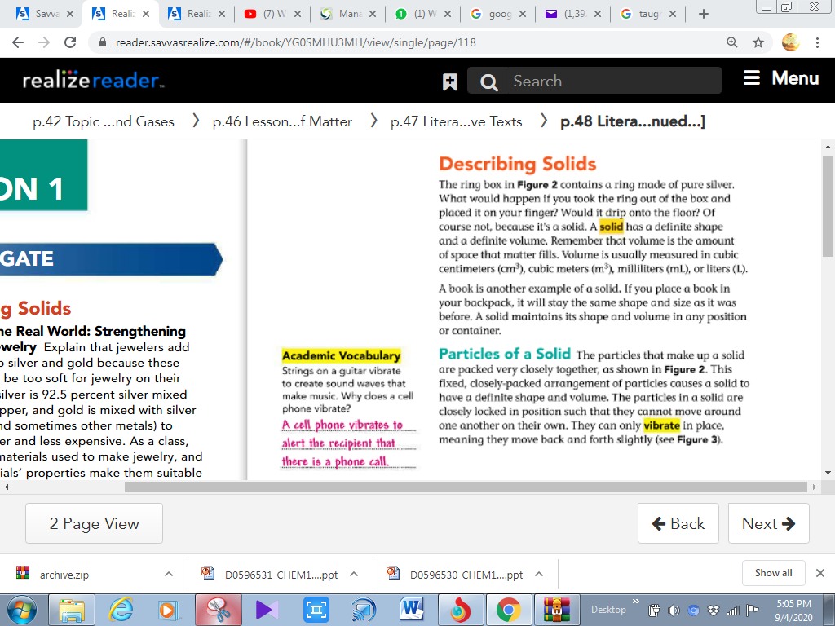

Slide 11
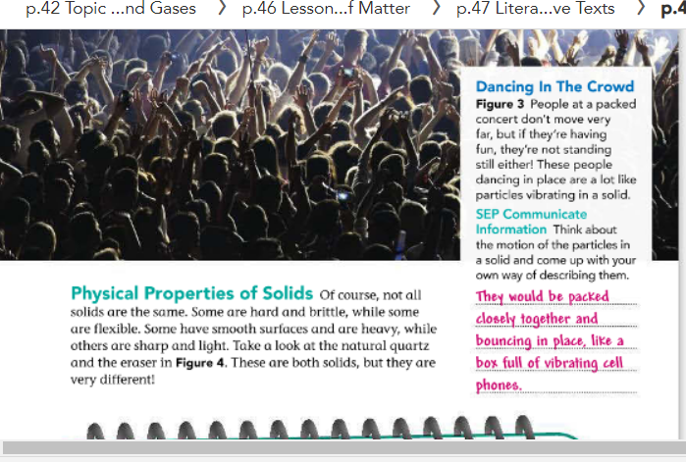

Slide 12
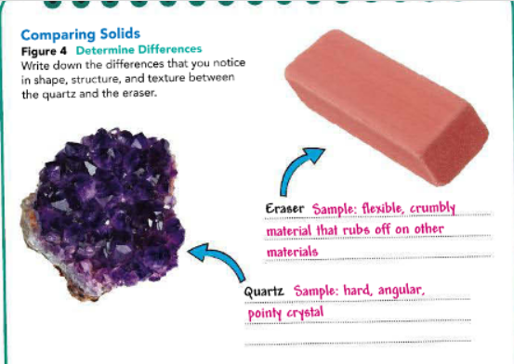

Slide 13
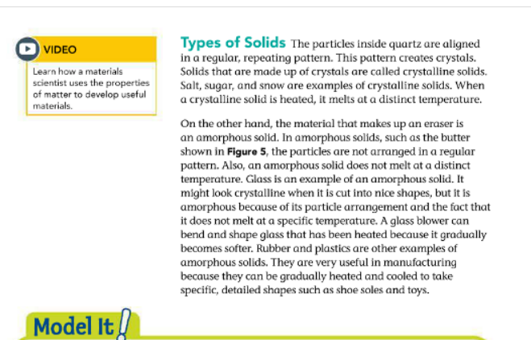
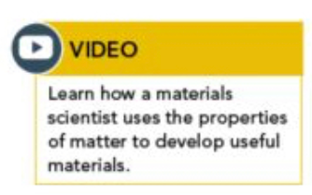
Notes:
https://www.savvasrealize.com/dashboard/program/cbee08e9-bd3a-31b1-b33b-e61761318cd5/25/tier/99910e23-3986-316c-a0b6-6daa436fa11b/26/lesson/857ce5bb-a3ba-38fc-a918-065a0273c867/26/lessonPlanner/cv/767690ad-2634-3835-80ac-222e9a1e6c18/27/nonscorable

Slide 14
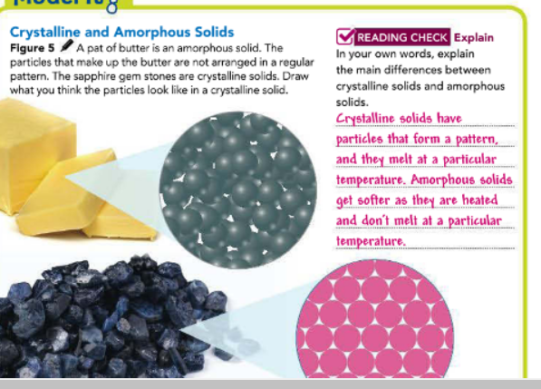

Slide 15
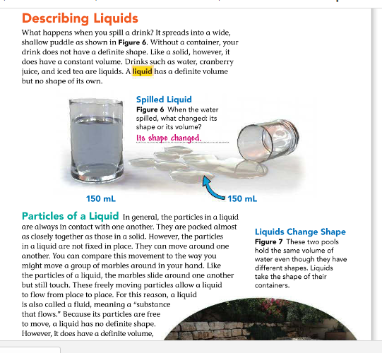

Slide 16
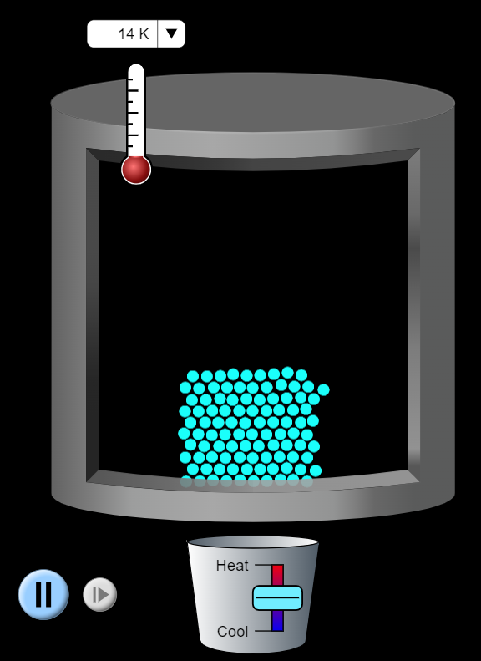


Slide 17
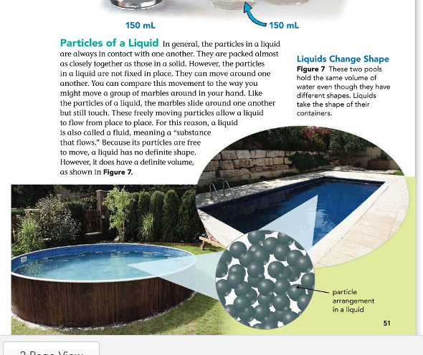

Slide 18
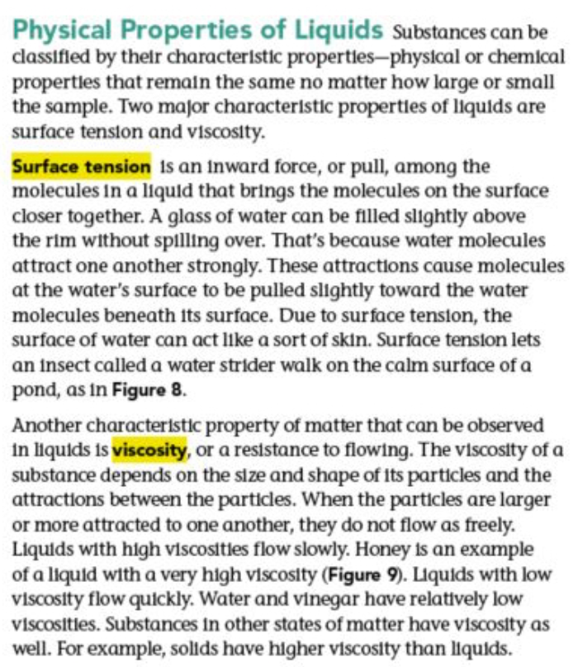
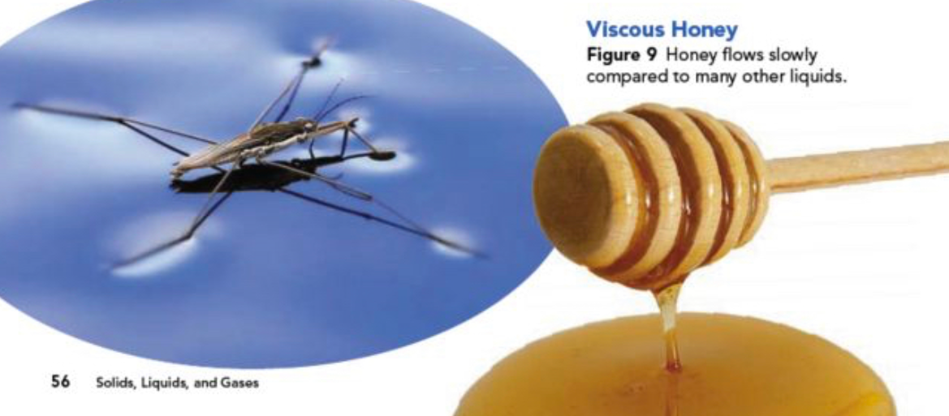

Slide 19
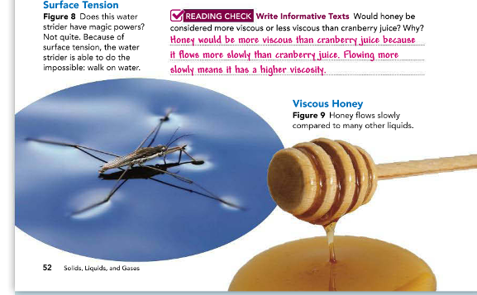

Slide 20
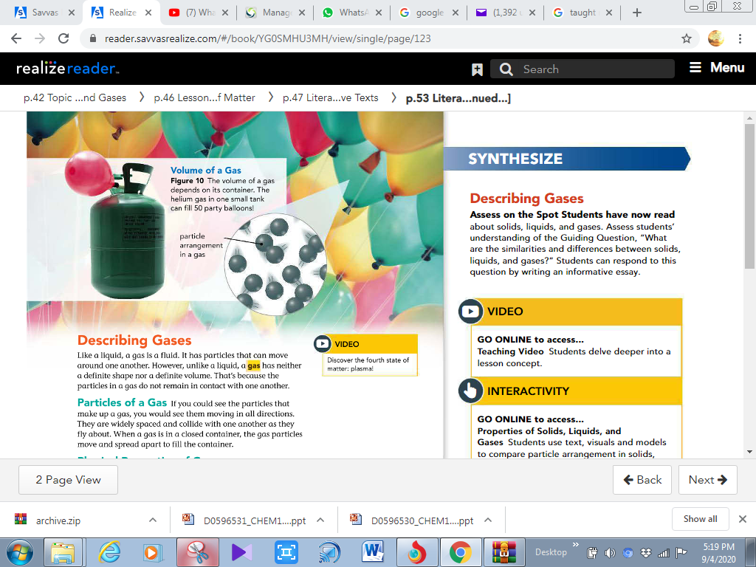

Slide 21
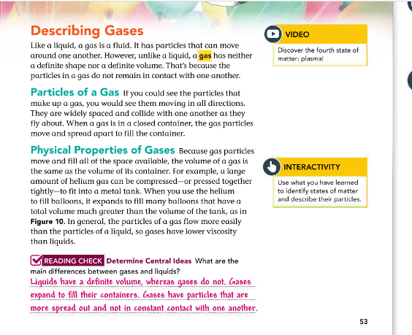

Slide 22
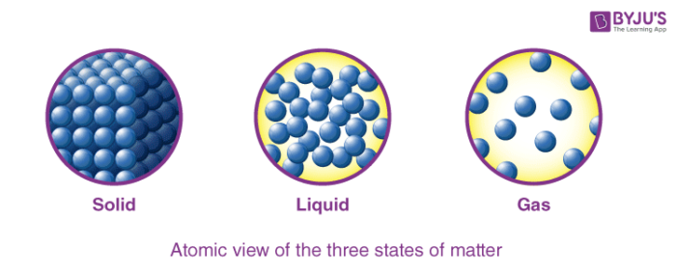
Copy Book

Slide 23
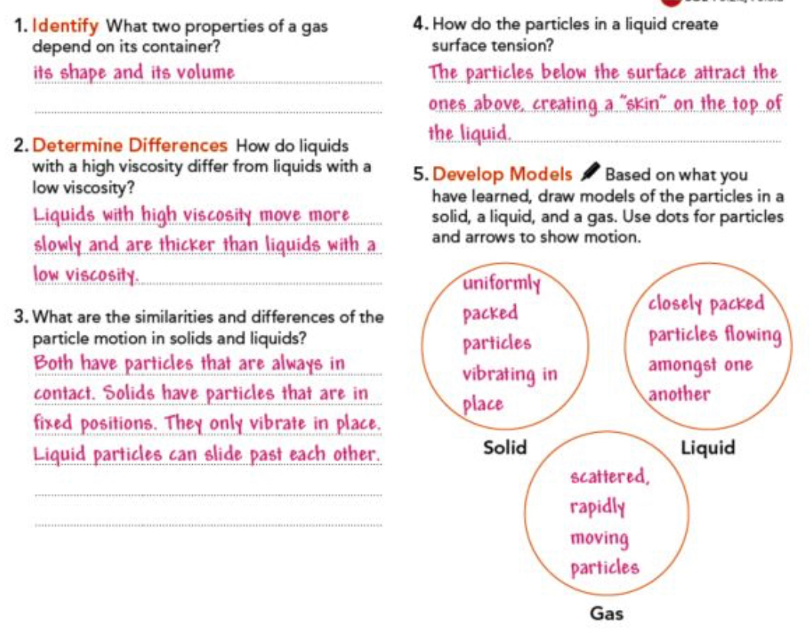


Slide 24



Slide 25



Slide 26


Slide 27
