Slide 1

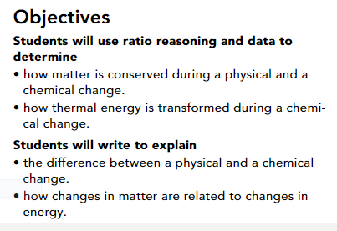
Guiding Questions
How are changes in matter related to changes in energy?
What is the difference between a physical change and a chemical change?

Slide 2
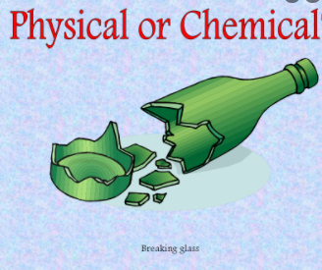
Physical Changes in Matter
A physical change alters the form or appearance of matter but does not turn any substance in the matter into a different substance.
If you accidentally drop a glass onto a hard floor, the glass may shatter. However, the chemical composition of the broken glass is still the same.
A substance that undergoes a physical change is still the same substance after the change

Slide 3
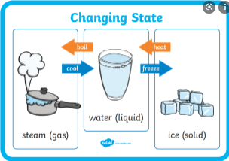
Changes of State
You have learned that most matter exists in three different states—solids, liquids, and gases.
Suppose you leave an ice cube in a glass and forget about it. When you come back, there is a small amount of water in the glass. The ice cube has undergone a physical change.
The solid water that made up the ice cube has melted into liquid water. A change in state, such as from a solid to a liquid or from a liquid to a gas, is an example of a physical change.

Slide 4
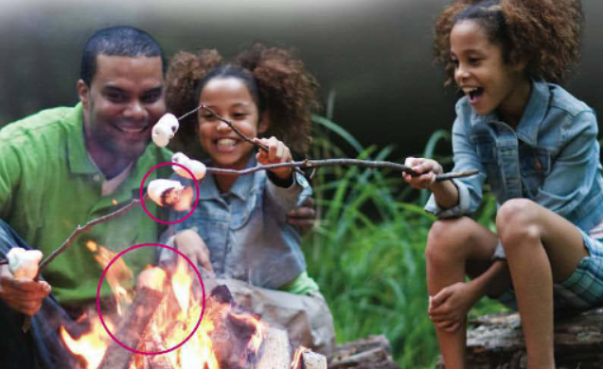
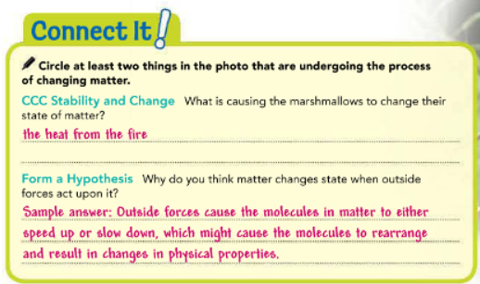

Slide 5
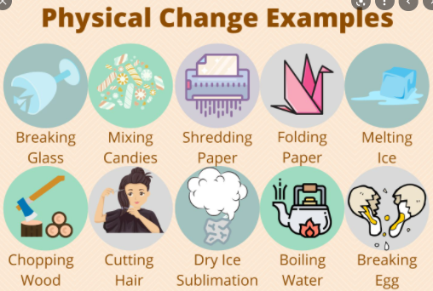
Changes in Shape or Form
When you combine two substances, how do you know if just a physical change occurred or whether you have created an altogether new substance? There are ways to figure it out. For example, imagine that you pour a teaspoon of sugar into a glass of water and stir until the sugar dissolves. If you pour the sugar solution into a pan and boil away the water, the sugar will remain as a crust at the bottom of the pan. The crust may not look exactly like the sugar before you dissolved it, but it’s still sugar. Therefore, dissolving is a physical change.
Other examples of physical changes include bending, crushing, breaking, and carving (Figure 2). Any change that alters only the shape or form of matter is a physical change. Methods of separating mixtures, such as filtration and distillation, also involve physical changes.22221

Slide 6
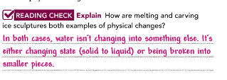
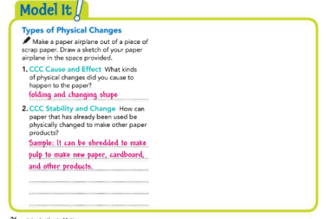

Slide 7
Chemical Changes in Matter
A change in matter that produces one or more new substances is a chemical change, or chemical reaction. In some chemical changes, a single substance breaks down into two or more other substances. For example, hydrogen peroxide breaks down into water and oxygen gas when it’s poured on a cut on your skin.
In other chemical changes, two or more substances combine to form different substances.

Slide 8
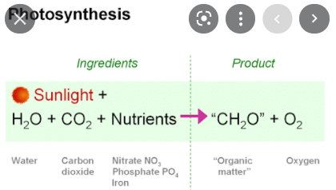
Chemical Changes in Matter
Photosynthesis is a natural chemical change that occurs in plants and other photosynthetic organisms. Several compounds are combined using energy from the sun to produce new substances.
Some chemical changes can be initiated and observed in the kitchen. If you have ever baked bread with help from yeast, you have seen a chemical reaction at work.

Slide 9
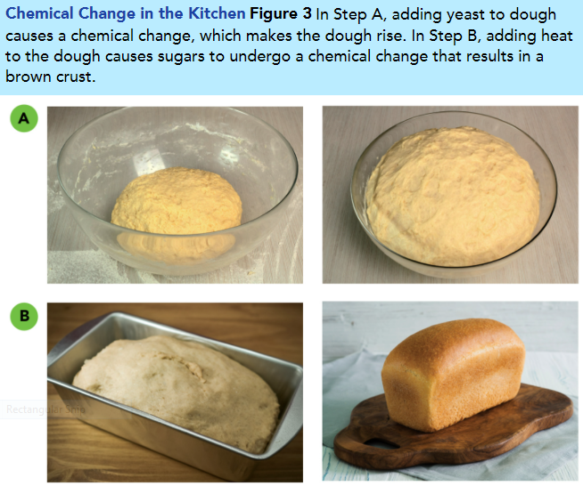
Chemical Changes in Matter
The yeast reacts with sugars in the mixture to produce bubbles of carbon dioxide, which make the dough rise (Figure 3A).
Another chemical reaction takes place on the surface of the bread. As heat is added, the sugars turn into a brown crust (Figure 3B).

Slide 10
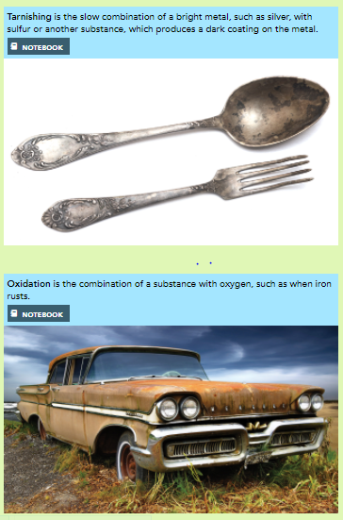
https://www.youtube.com/watch?v=ZlX39cTSnEM

Slide 11
Examples of Chemical Change
One common chemical change is the burning of natural gas on a gas stove. Natural gas is mostly made up of the compound methane (CH₄). When it burns, methane combines with oxygen in the air and forms new substances.
The new substances include carbon dioxide gas (CO₂) and water vapor (H₂O). Both of these substances can be identified by their properties, which are different from those of methane. Figure 4 describes some of the types of chemical changes.
https://www.youtube.com/watch?v=455bwPTZvY8

Slide 12
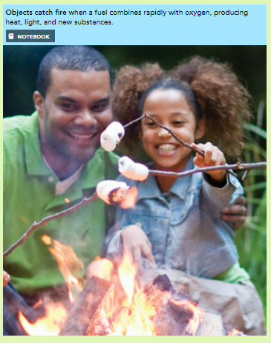
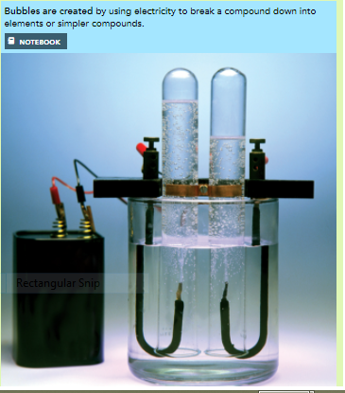

Slide 13
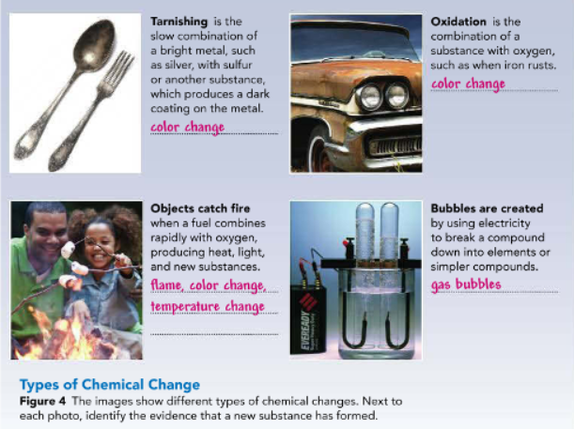

Slide 14
Conservation of Mass
When something such as a piece of paper burns, it may seem to lose mass or disappear. Scientists, however, have proved that this is false. In the 1770s, the French chemist Antoine Lavoisier measured mass both before and after a chemical change. His data showed that no mass was lost or gained during the change. The fact that matter is not created or destroyed in any chemical or physical change is called the law of conservation of mass. This law is also called the law of conservation of matter because mass is a measurement of matter.

Slide 15
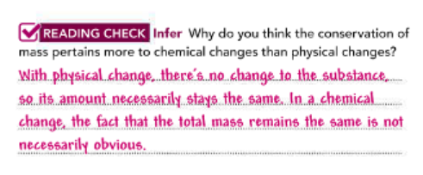

Slide 16
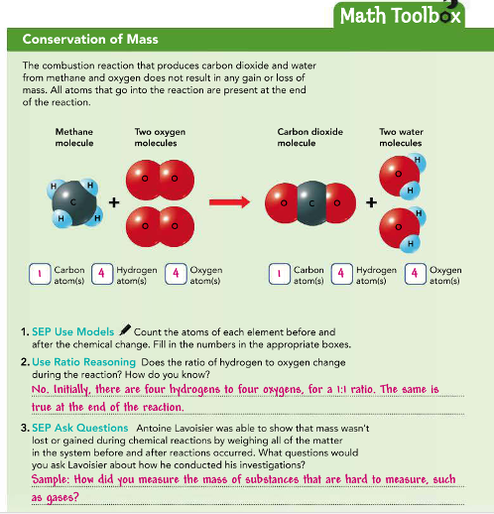

Slide 17
Energy and Matter Are Related
Do you have much energy for schoolwork today? In science, energy is the ability to do work or cause change. Any kind of change to matter involves a change in energy. Bending a paper clip or chopping an onion takes energy. When ice changes to liquid water, energy is absorbed from the matter around it.
Like matter, energy is conserved in a chemical change. Energy is never created or destroyed. It is only transformed.

Slide 18
Temperature and Thermal Energy
When you walk into a warm building on a cold winter day, you will immediately notice the difference between the cold outside and the warmth inside. We refer to the measure of how hot or cold something is as temperature. Temperature is related to the motion and energy of the particles of matter. The particles of gas in the cold outside air have less average energy of motion than the particles of air inside the warm building.

Slide 19
The total energy of the motion of all of the particles in an object is known as thermal energy. We usually talk about thermal energy in terms of how hot or cold something is, but thermal energy is not the same thing as temperature. Thermal energy naturally flows from warmer matter to cooler matter.

Slide 20
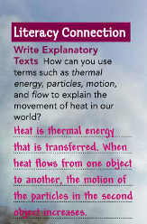

Slide 21
Thermal Energy and Changes in Matter
When matter changes, thermal energy is usually released or absorbed. For example, ice absorbs thermal energy from its surroundings when it melts, leaving the air around it feeling cold. That’s why coolers for food and drinks are filled with ice. The melting of ice is an endothermic change, or a change in which energy is absorbed. An exothermic change occurs when energy is released. Combustion is an exothermic change.

Slide 22
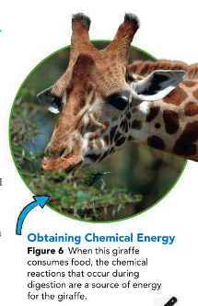
Chemical energy is stored in the chemical bonds between atoms. Foods, fuels, and even the cells in your body store chemicals. Burning fuels transforms chemical energy and releases some of it as thermal energy. When you ride a bike up a hill, chemical energy from food changes into the energy of your muscles’ motion, which your legs convert into mechanical energy through the bike’s pedals.

Slide 23
