Slide 1
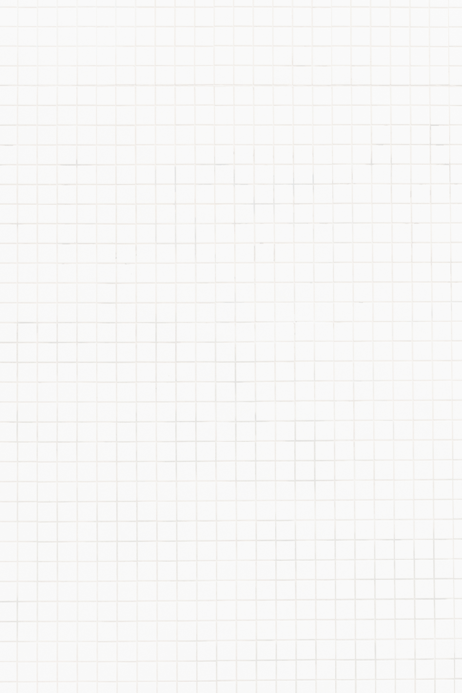
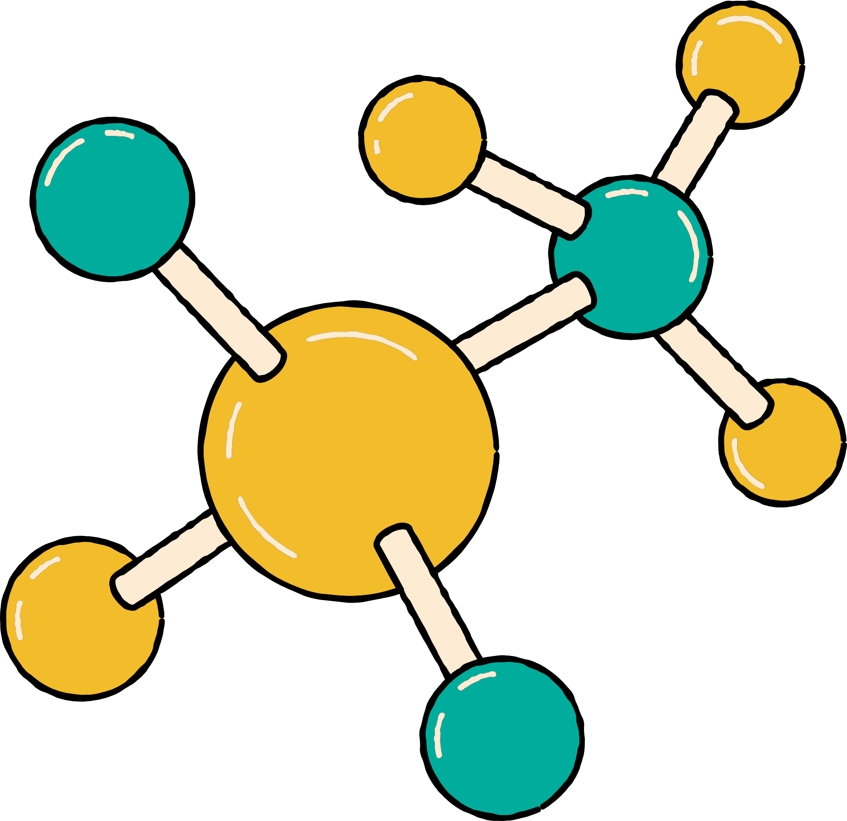
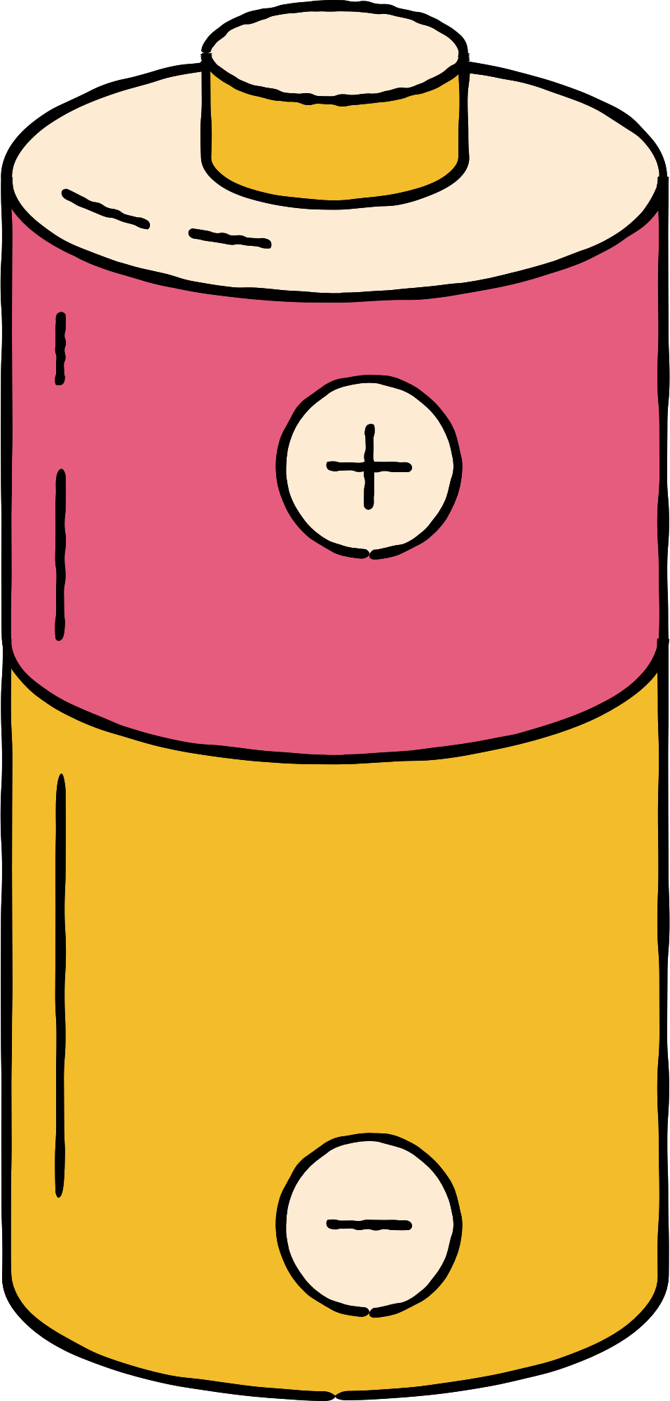



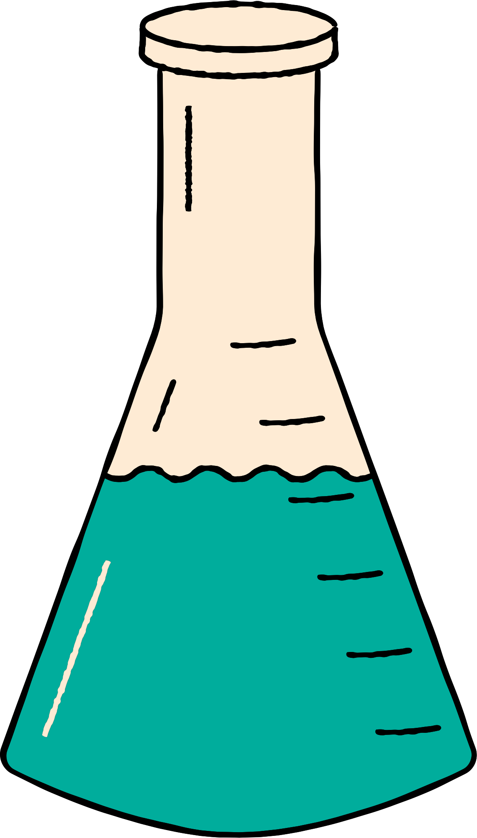





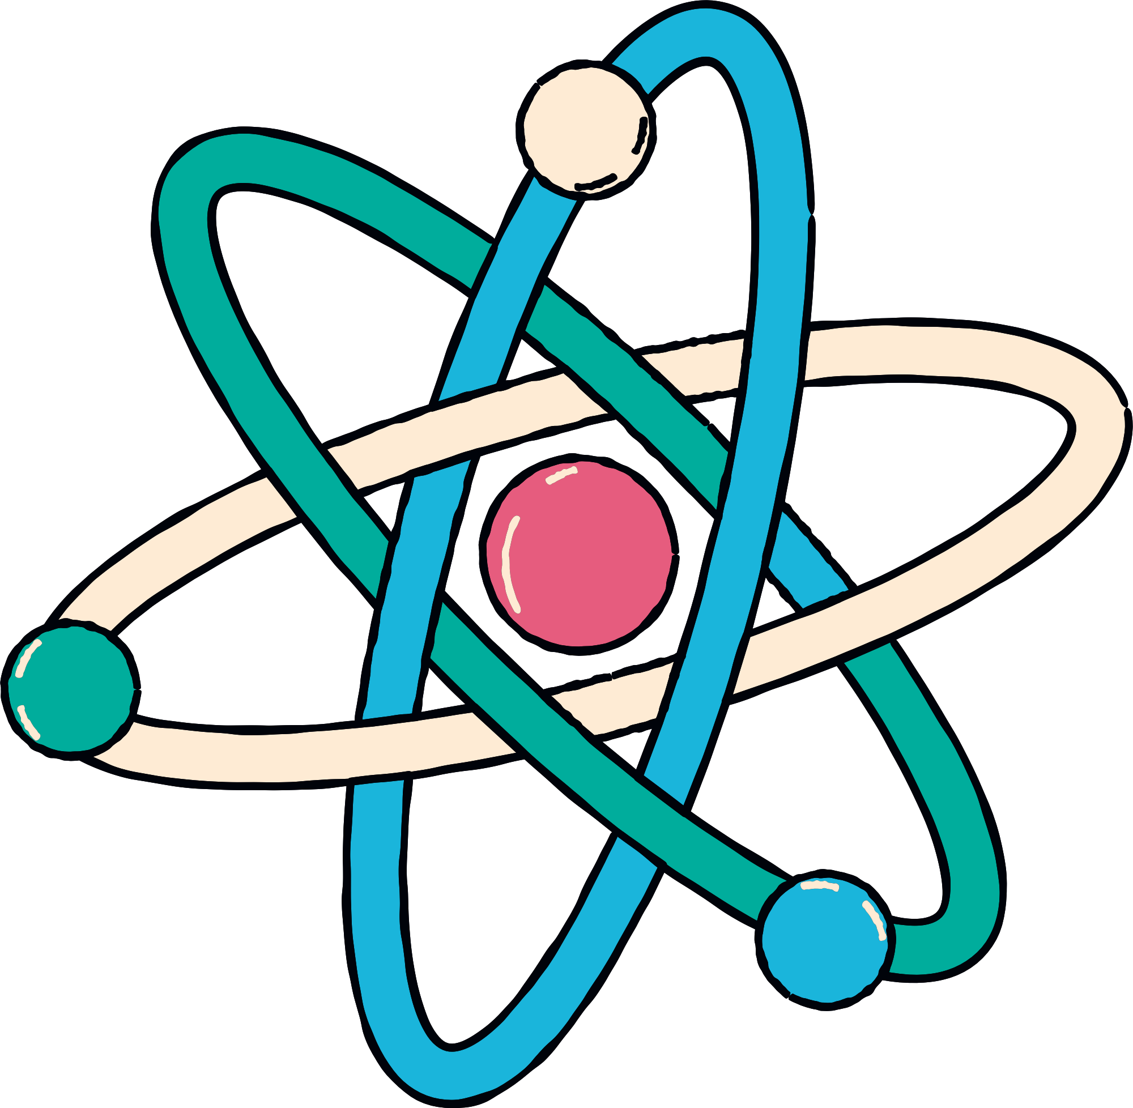
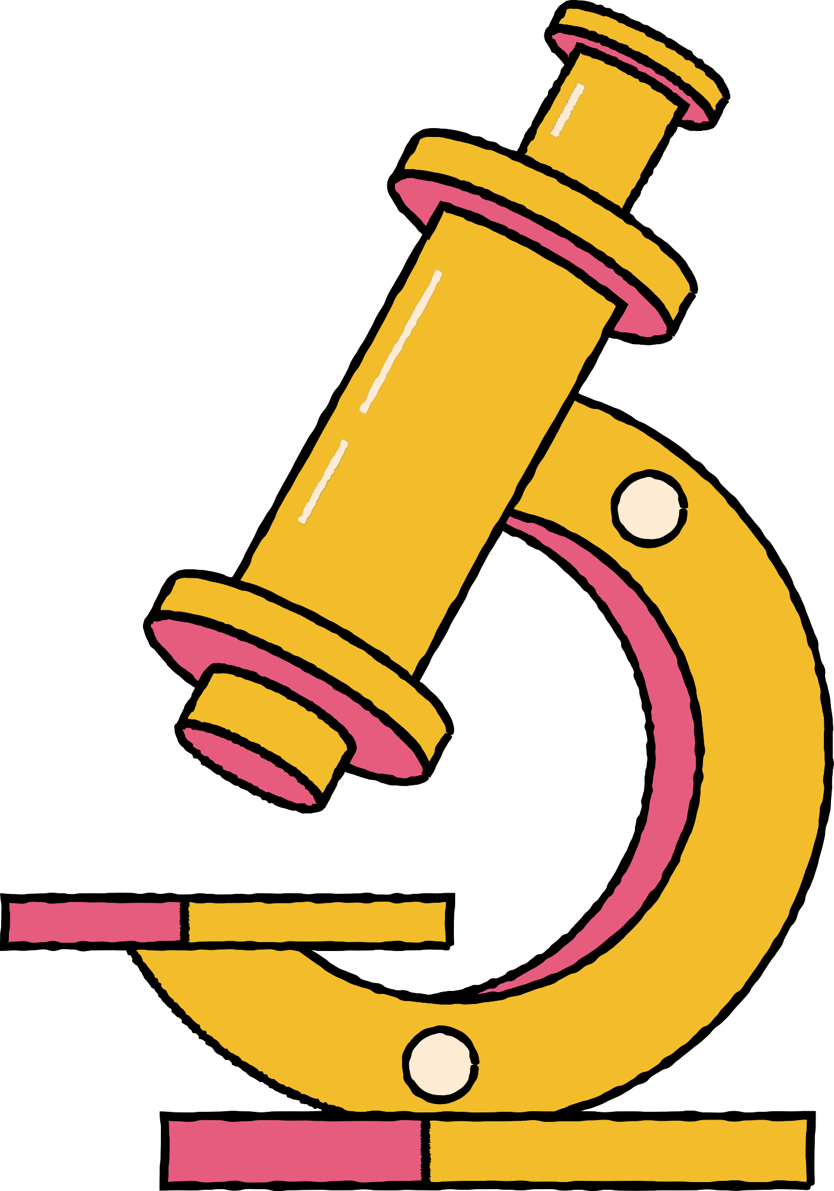
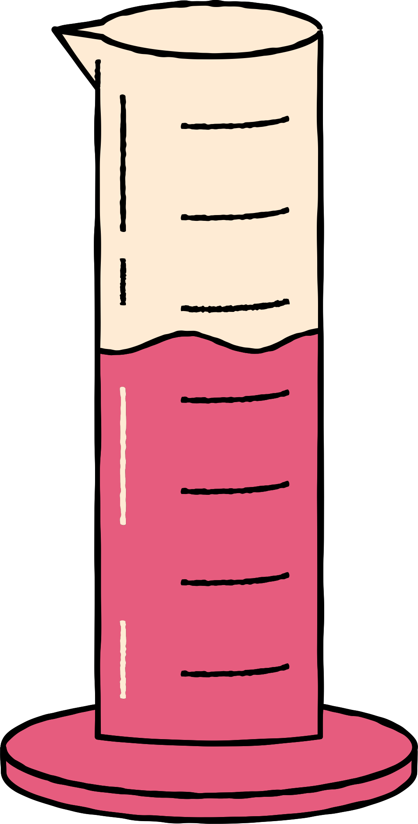
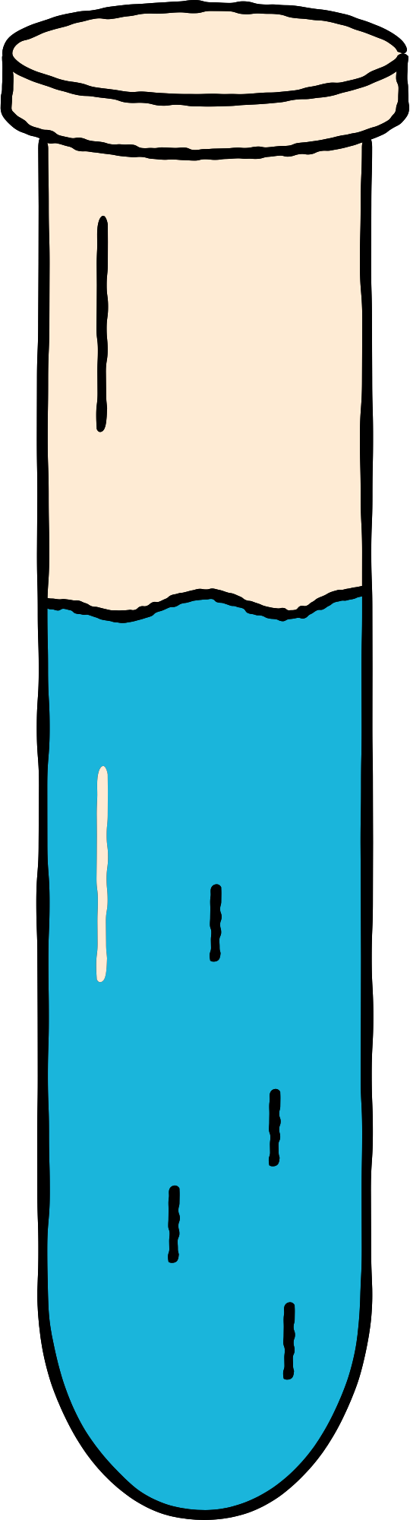
MEASURING MATTER
Gr 6

Slide 2

Vision The first and the highest quality educational investor and the most rapid spread Mission Providing a competitive international education with applied dimensions that build skill, instill value, and develop creativity in accordance with the constants of religion the national orientations in an attractive, educational environment that stimulates learning with a community knowledge-producing knowledge, producing generation

Slide 3
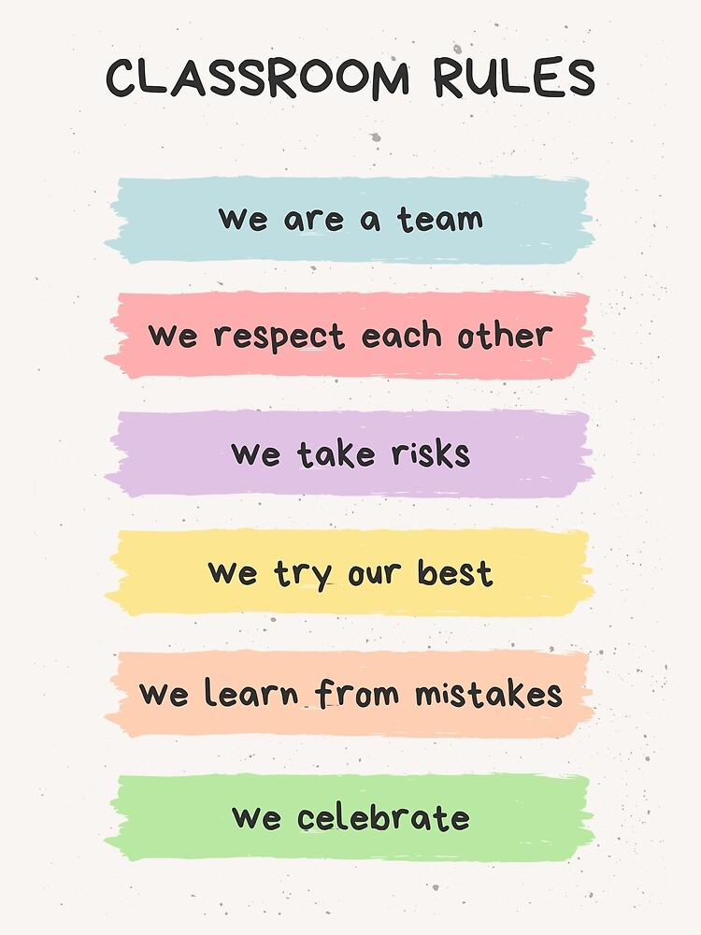

Slide 4
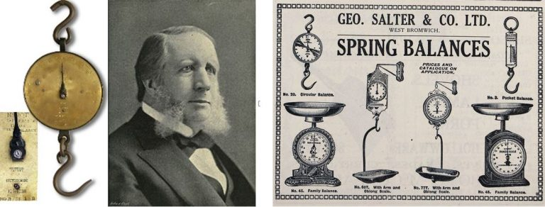
Scientist of the week
Salter is the leading brand in the UK consumer scales market and also occupies strong positions in a number of key international markets. Salter was founded in the late 1700s in Bilston, England, by Richard Salter. In 1897, Salter invented the first personal weighing scale.

Slide 5
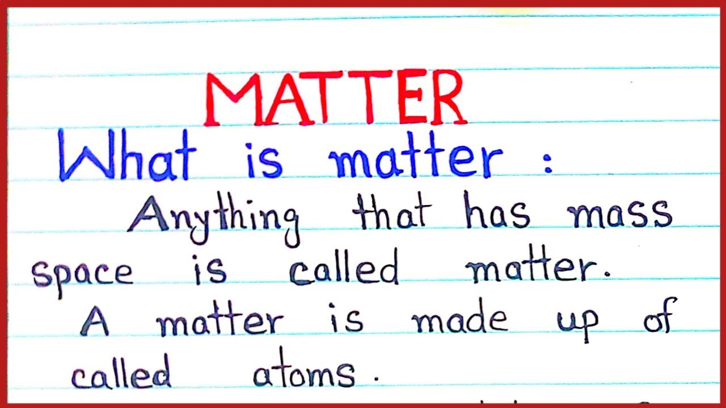
Looking at the picture guess what is Matter?
Al-Haqbana
What is Matter?
Notes:
Looking at the picture guess what is Matter?

Slide 6
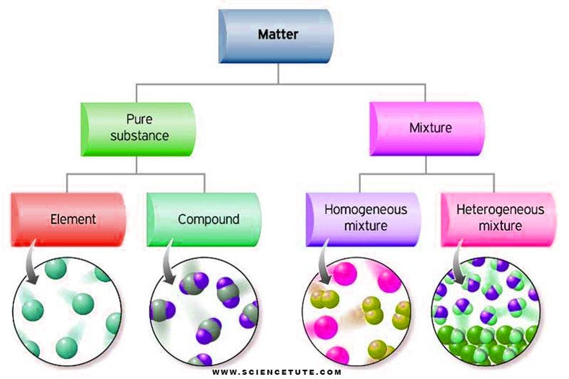
Looking at the picture guess what is Matter?
Al-Haqbana
Notes:
Looking at the picture guess what is Matter?

Slide 7

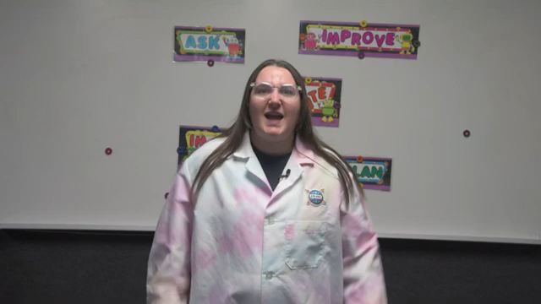
Hook Activity

Slide 8
GUIDING QUESTIONS
• How can matter be measured?
• What properties of matter can be
determined through measurement?

Slide 9
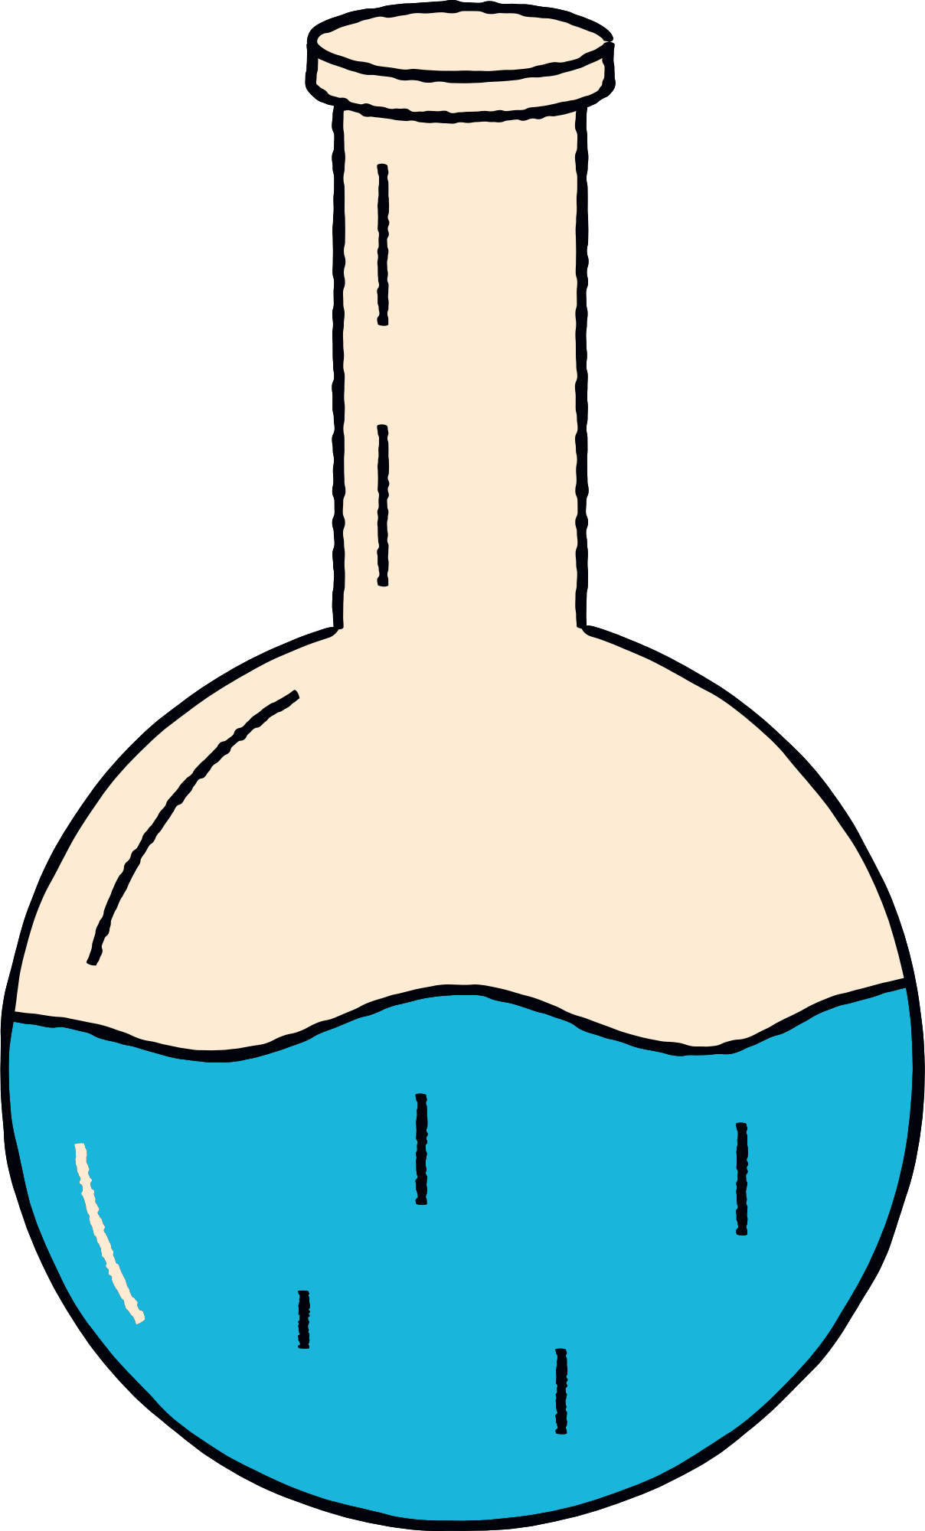

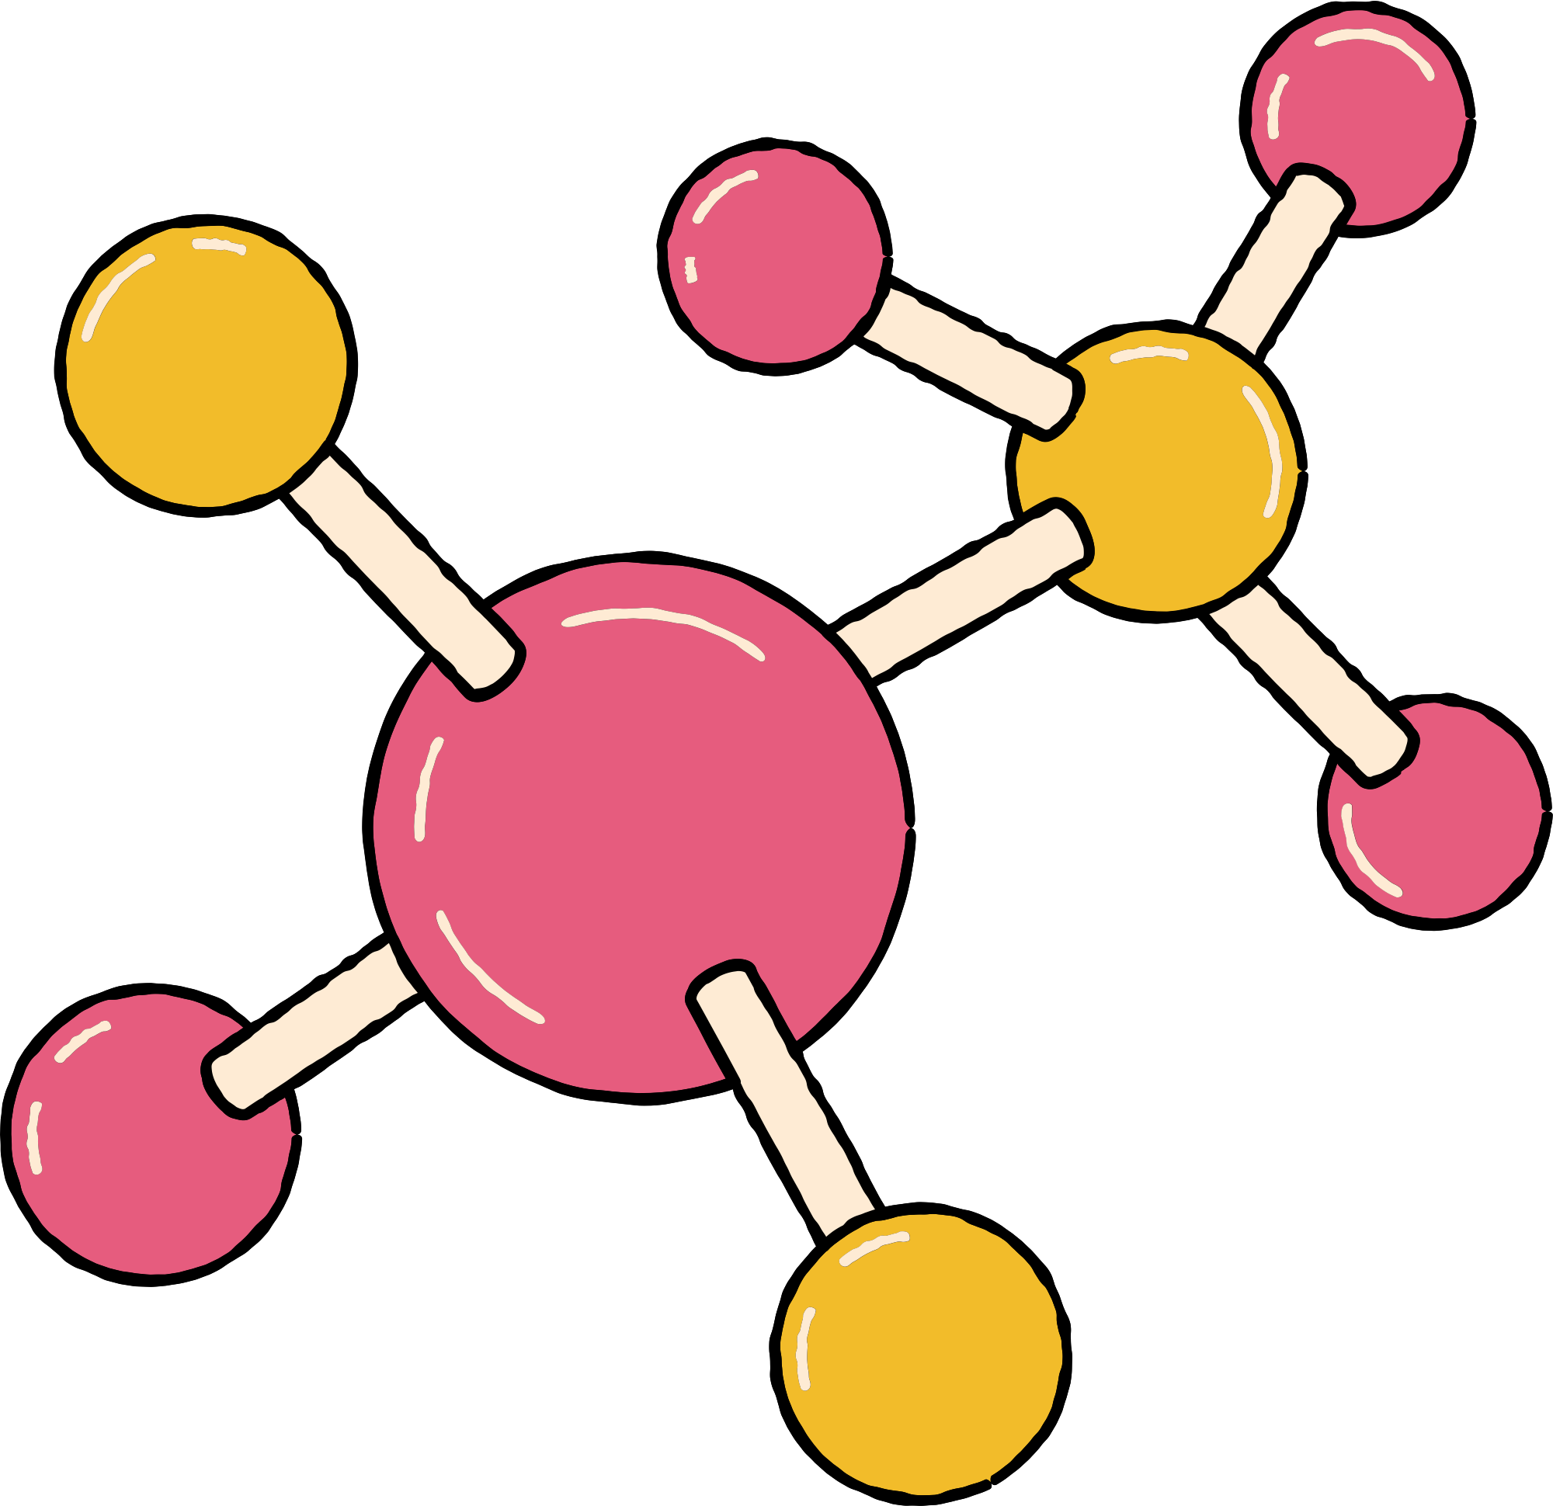



VOCABULARY
convert
Mass
volume
weight
density

Slide 10
MEASURING MATTER
Open Pg. 16

Slide 11
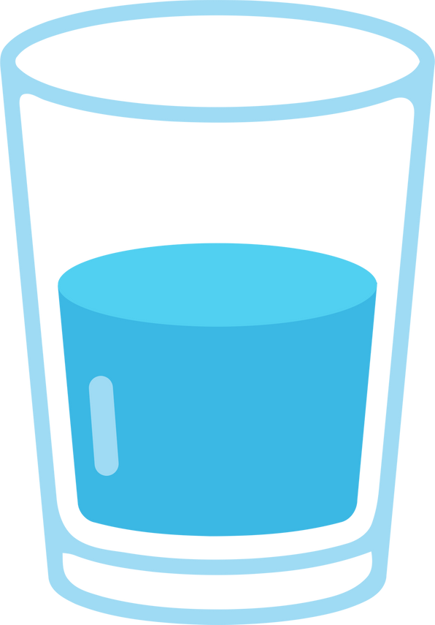

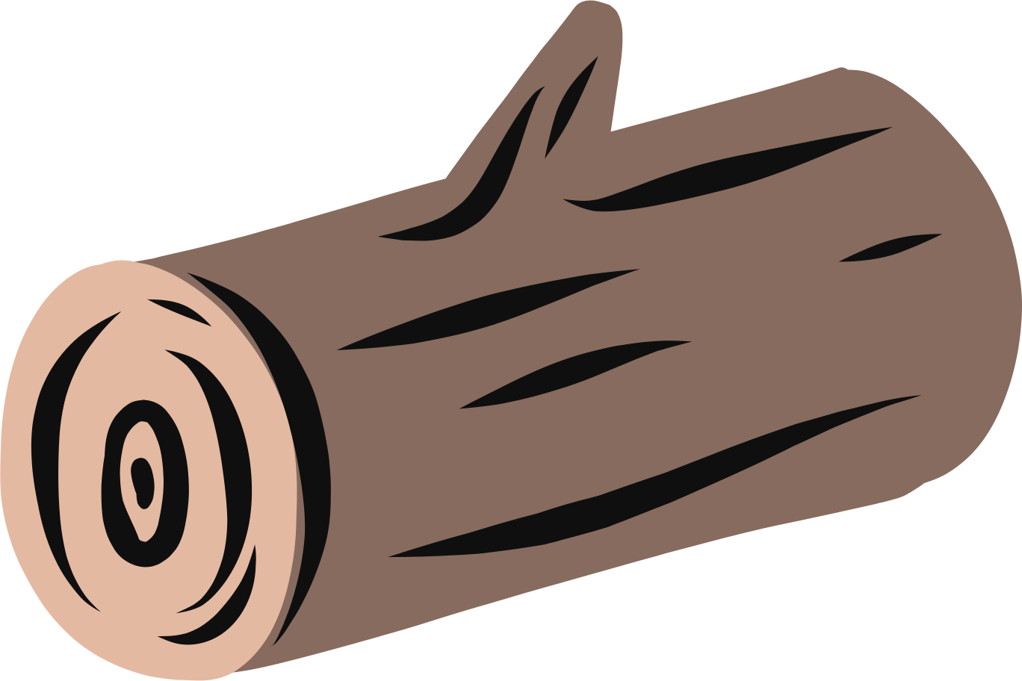
Expressing Weight, Mass,
and Volume
Recall that matter is anything that has mass and takes up space. Mass is the amount of matter in an object. An object’s mass does not change even if the force of gravity upon the object changes. The amount of space that matter occupies is called its volume. All forms of matter—solids, liquids, and gases—have volume. If we want to measure matter, such as the fruit in Figure 1, we need to measure both mass and volume.

Slide 12
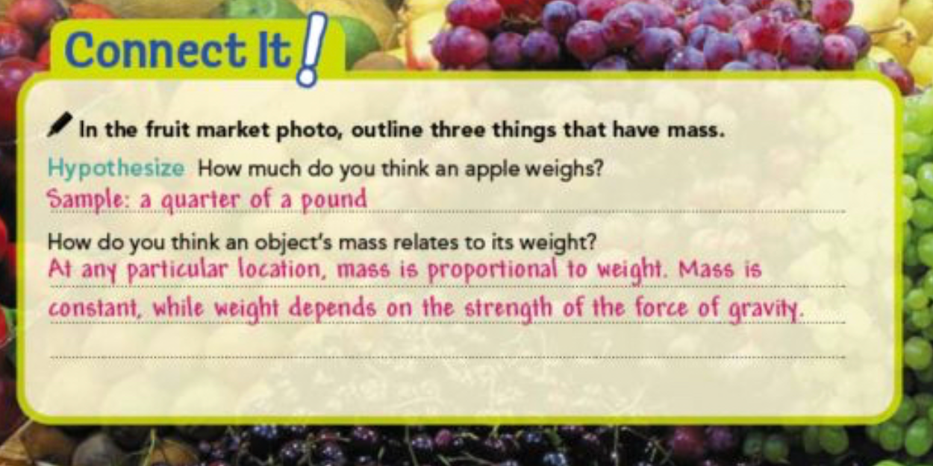
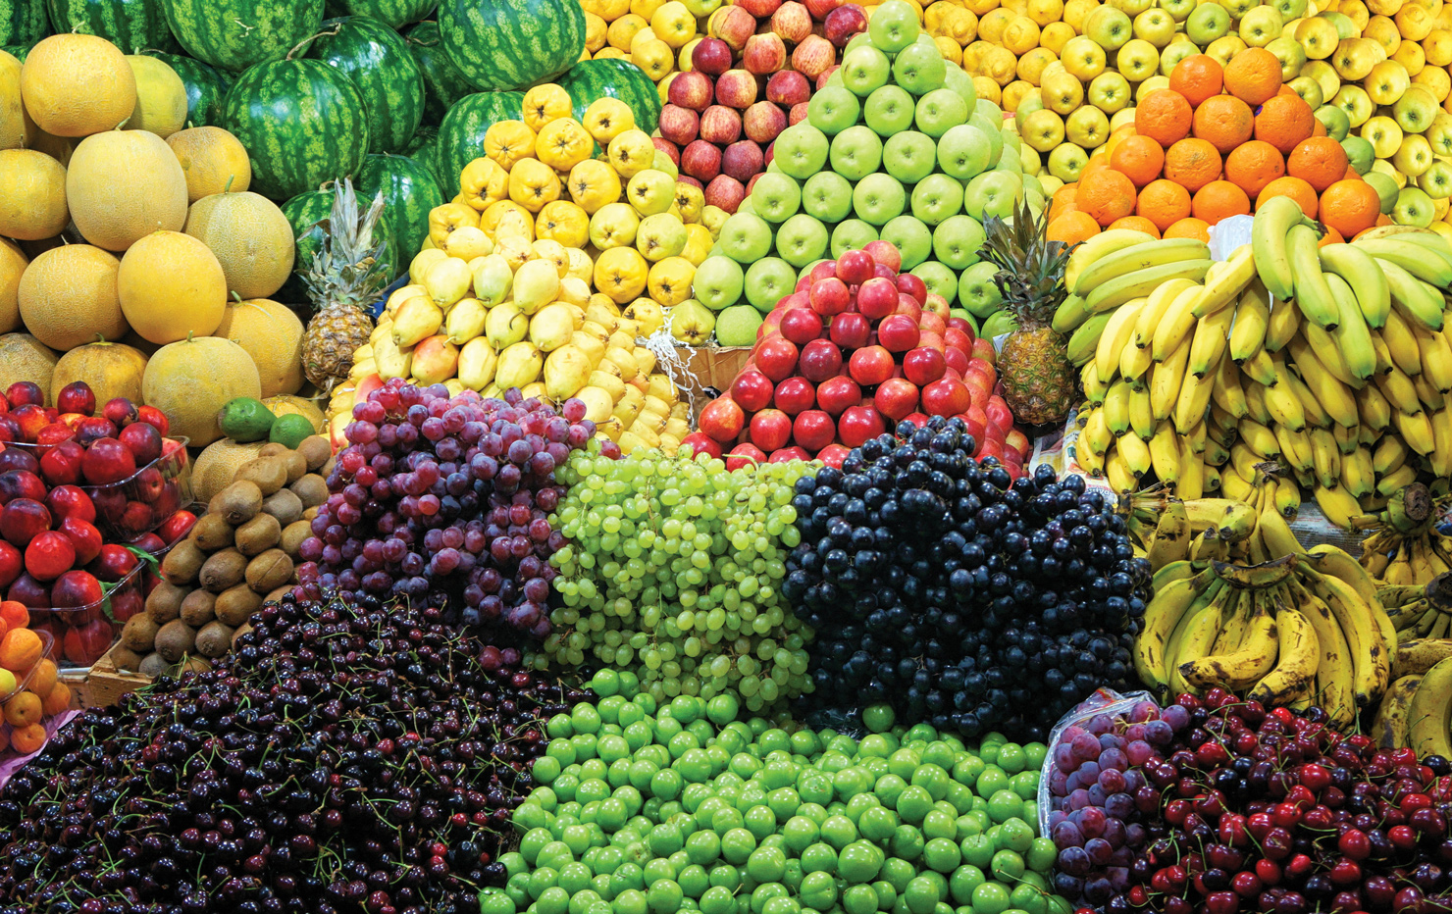

Slide 13
Weight
First, consider weight. Weight is a measure of the force of gravity on an object. The force of gravity depends on the mass of the planet or moon where the object is being weighed. Because the moon has much less mass than Earth, on the moon you would weigh about one sixth of what you weigh on Earth. Jupiter has much more mass than Earth. On Jupiter, you would weigh more than twice what you weigh on Earth.

Slide 14
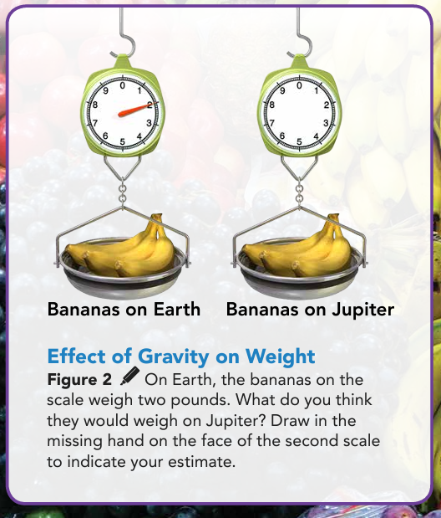
To find the weight of an object, you could place it on a scale like the ones shown in Figure 2. The object's weight pulls down on mechanisms inside the scale. These mechanisms cause beams or springs inside the scale to move. These movements are calibrated in such a way that the weight is displayed on the face of the scale.

Slide 15
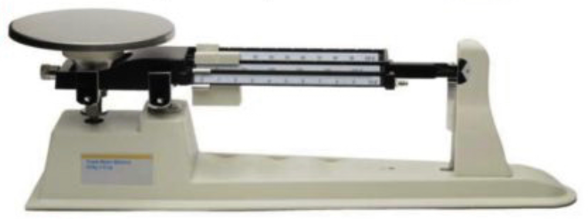
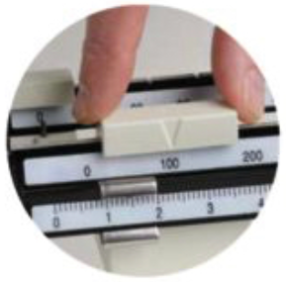
Triple-Beam Balance Scale
Figure 3 A mechanical scale is like a see-saw. An object of unknown mass is put on one side of the scale, and then weighted tabs are moved on the other side of the fulcrum the two sides are in balance. Gravity is acting on both sides with equal force. so it is not a factor in measuring mass this way.

Slide 16
Mass
Weight changes as the force of gravity changes. Even between different places on Earth, the force of gravity has slight variation, so your weight would as well. This means we need a of matter that is not affected by gravity. That's where mass comes in. Remember that mass does not change with location even if the force of gravity changes. For this reason, scientists prefer to describe matter in terms of mass rather than weight.

Slide 17
Mass
Scales that measure mass are designed to compare the known mass of an object to the unknown mass of another object (Figure 3). To measure mass, scientists use a system called the International System of Units (SI). The SI unit of mass is the kilogram (kg). In the United States, we tend to use pounds to measure weight. We can convert pounds to kilograms when the force of gravity at a location is known. If you weigh 130 pounds on Earth, your mass is about 60 kilograms, because a kilogram is equivalent to about 2.2 pounds. Sometimes, a smaller unit known as a gram (g) Is used to measure mass. There are 1,000 grams in a kilogram, or 0.001 kilograms in a gram.

Slide 18
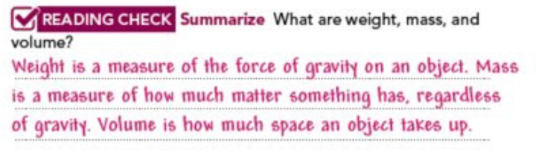
Mass

Slide 19
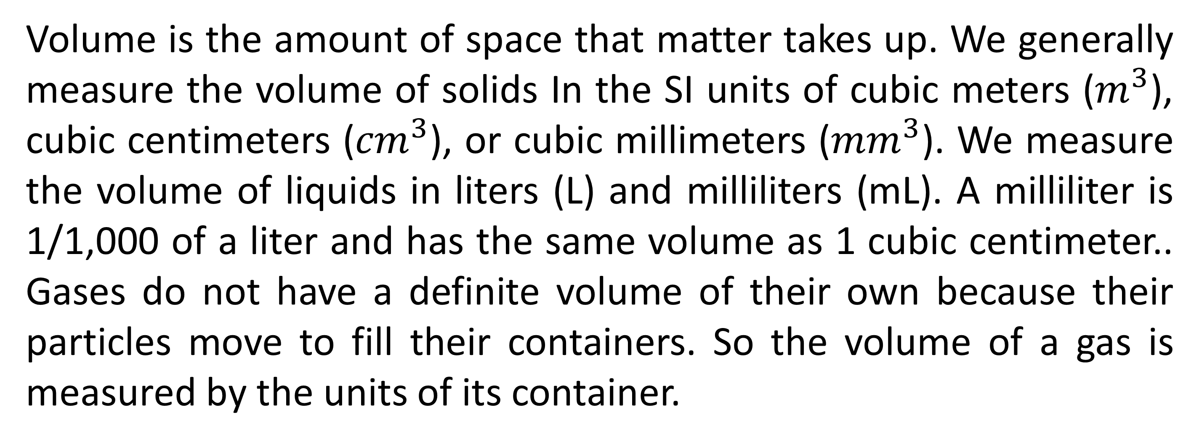
Volume
Volume is the amount of space that matter takes up. We generally measure the volume of solids In the SI units of cubic meters ($m^{3}$), cubic centimeters (${cm}^{3}$), or cubic millimeters (${mm}^{3}$). We measure the volume of liquids in liters (L) and milliliters (mL). A milliliter is 1/1,000 of a liter and has the same volume as 1 cubic centimeter.. Gases do not have a definite volume of their own because their particles move to fill their containers. So the volume of a gas is measured by the units of its container.

Slide 20
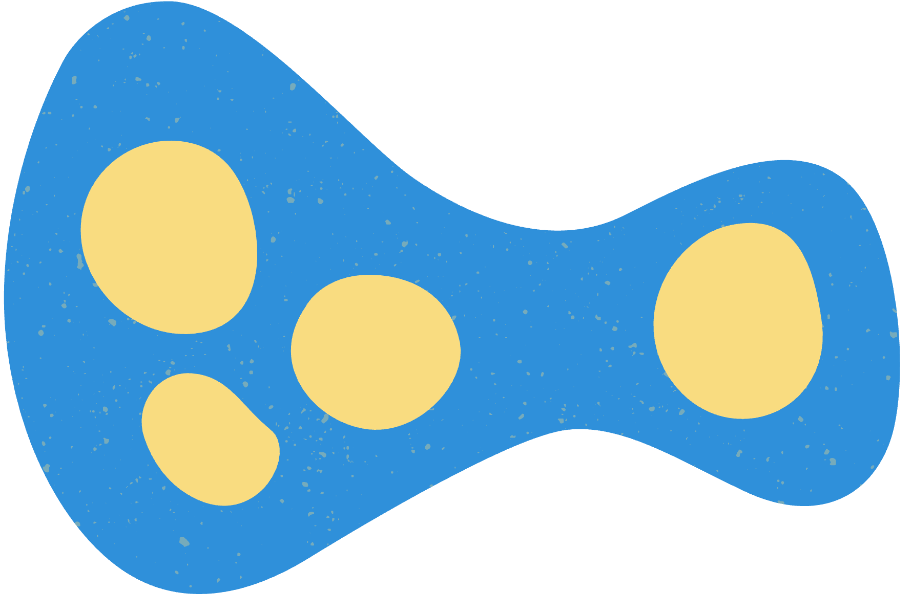
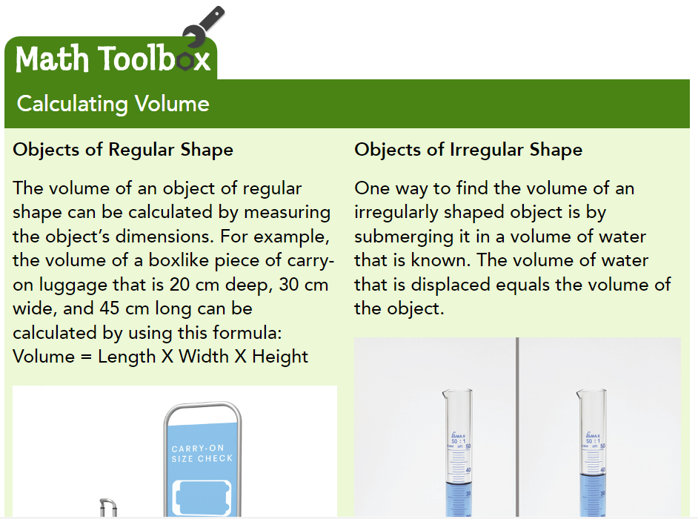
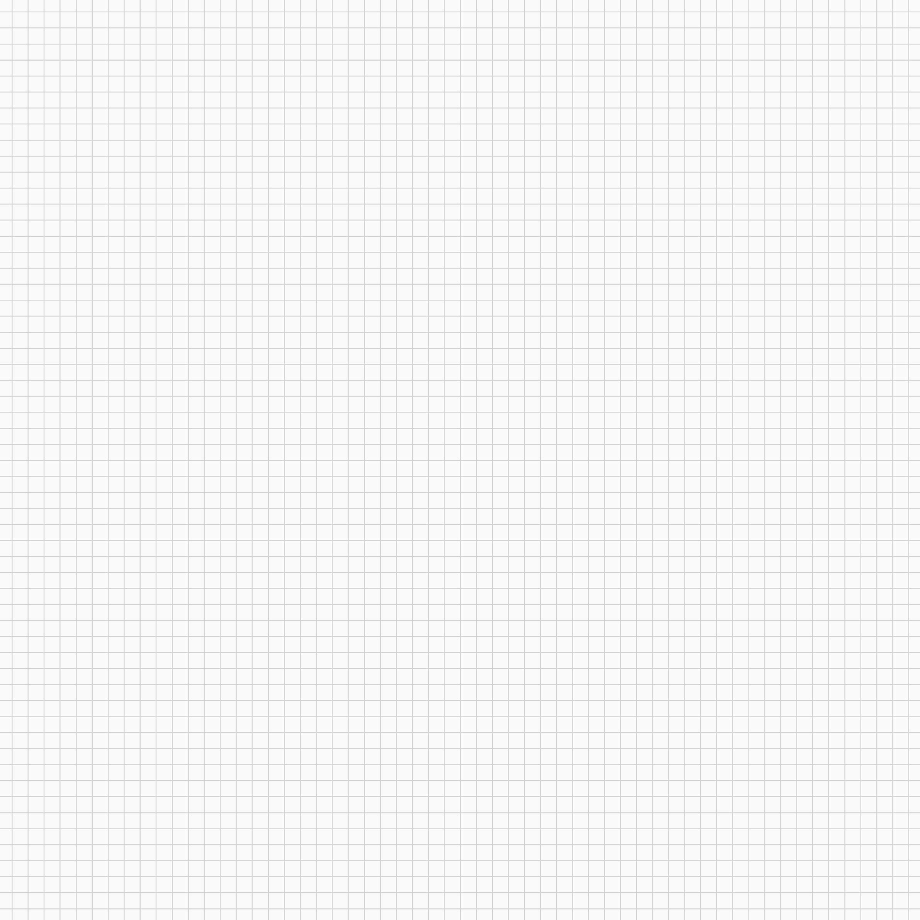
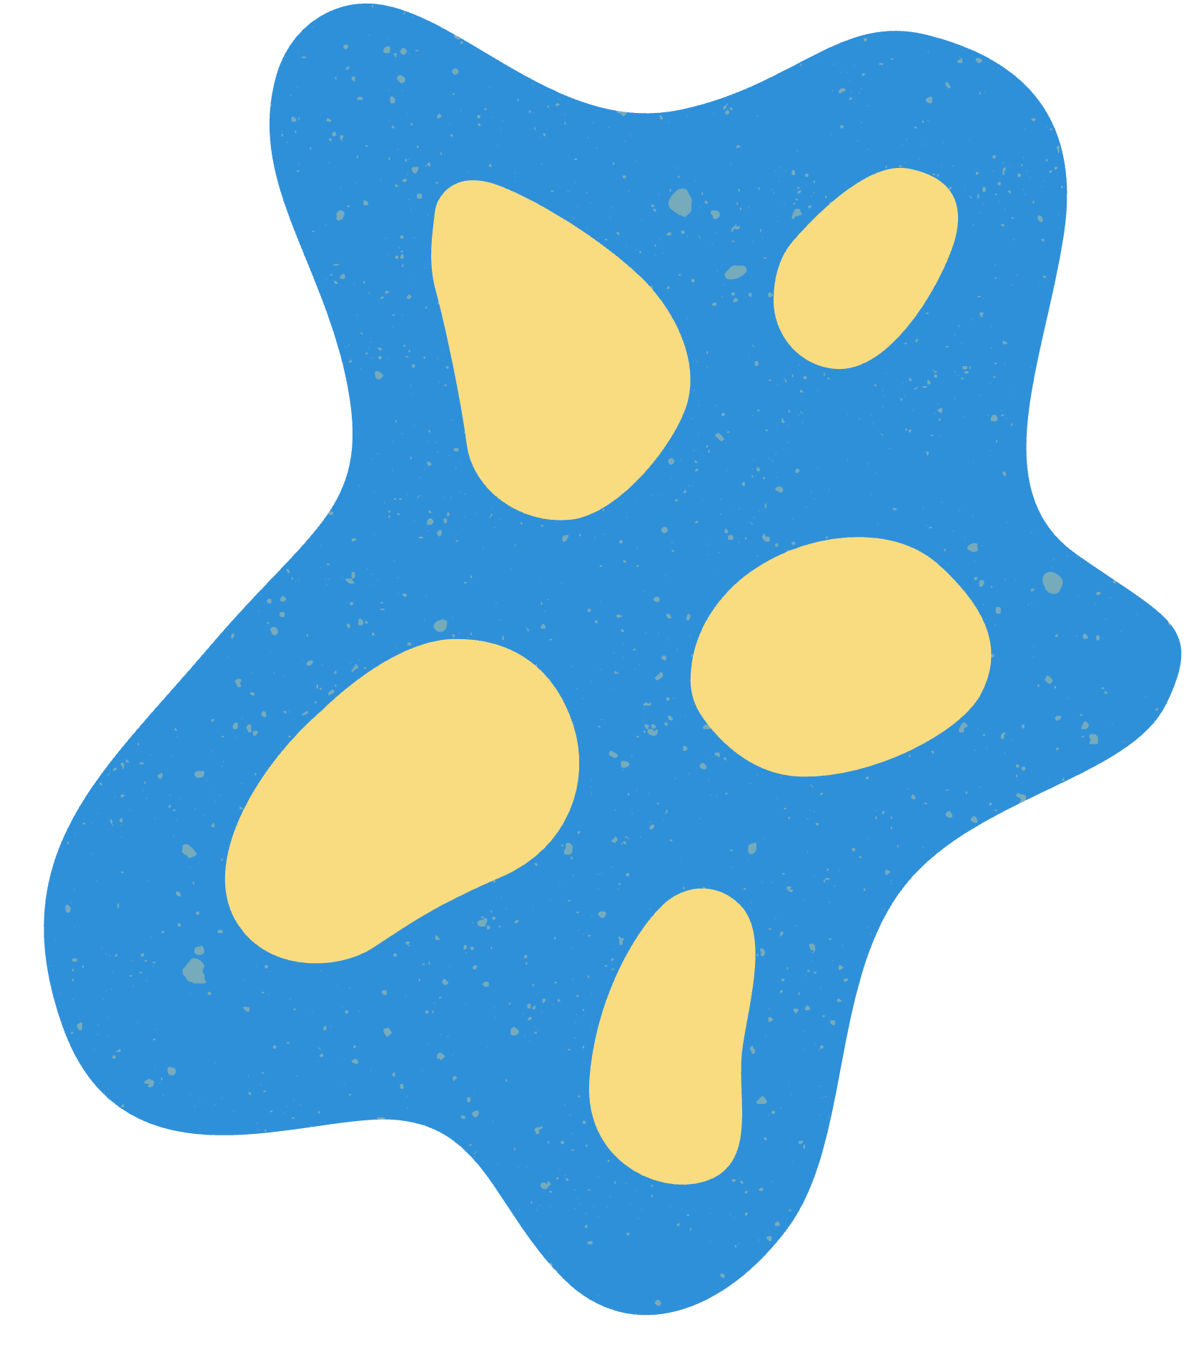

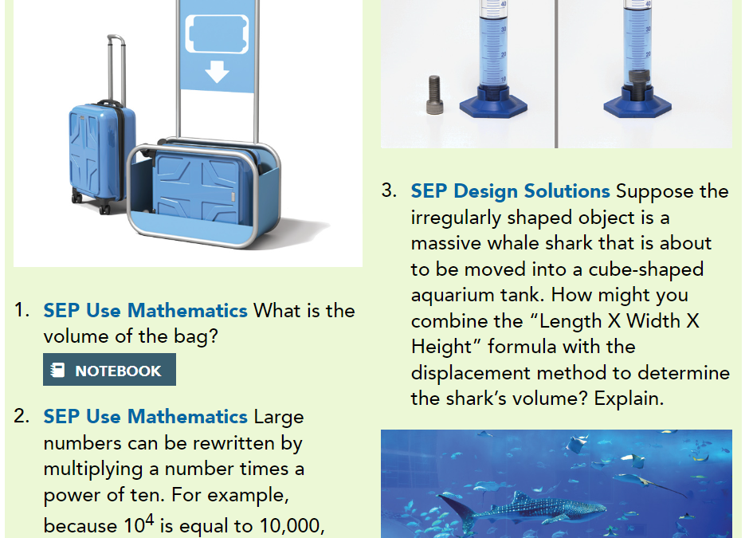
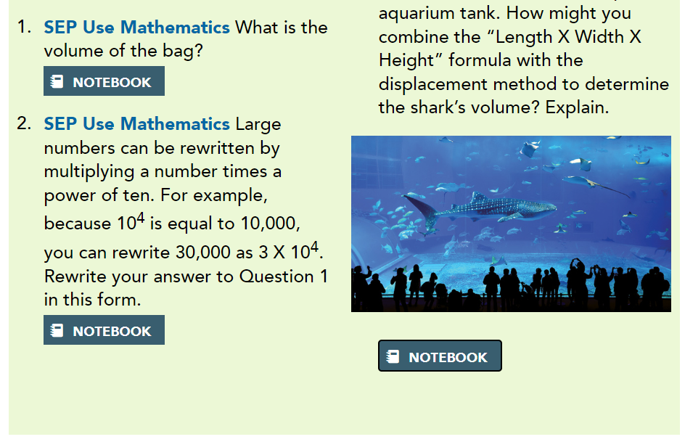
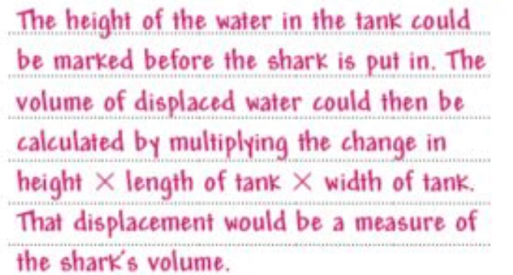


Notes:
https://www.savvasrealize.com/dashboard/program/cbee08e9-bd3a-31b1-b33b-e61761318cd5/22/tier/fa733b49-0077-31ca-a0da-453468fa7add/23/lesson/29c05e2c-d1e0-36c3-a971-3fde4f7f61e8/0/lessonPlanner/cv/981bbade-01ab-3fb0-945b-8c897c55b143/27/nonscorable?forceOriginalView=true

Slide 21
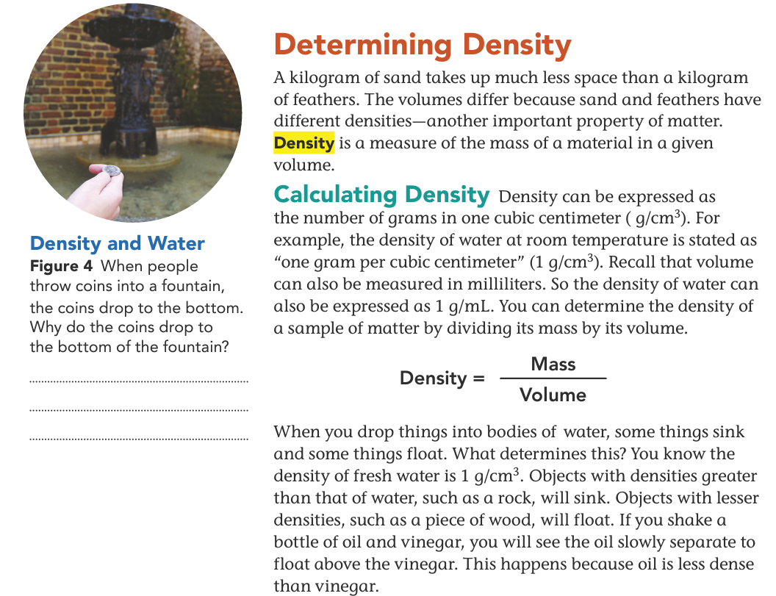
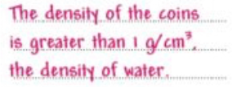

Slide 22
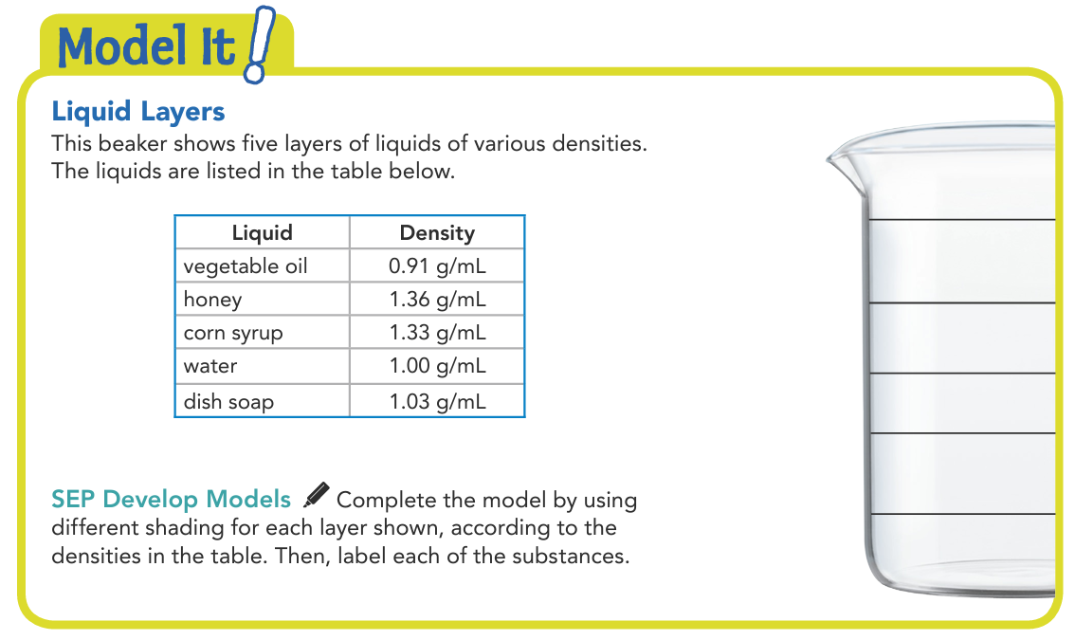
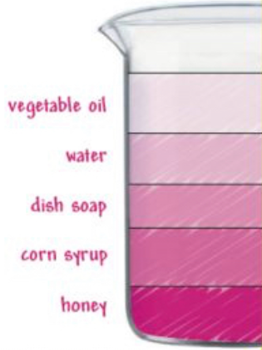

Slide 23
Density and Temperature
You know that mass is a physical property. Density is a function of mass and volume, so it too is a physical property. Note that increasing or decreasing the total amount of a given substance won't change its density. If you have 5 or 75 cubic centimeters of silver, they will both have the same density because they are both made of the exact same substance.

Slide 24
Density and Temperature
One factor that does affect density is temperature. In general, most substances become less dense as temperature increases and more dense as temperature decreases. This is why warm masses of air rise up from Earth's surface and cold air masses sink toward Earth's surface. Water also follows this general rule, but not always. Liquid water does expand, or get less dense, when it gets warmer. It condenses, or gets denser, as it gets colder. But when water cools below 4˚C, its density actually begins to decrease again, as you can see in the Math Toolbox.

Slide 25
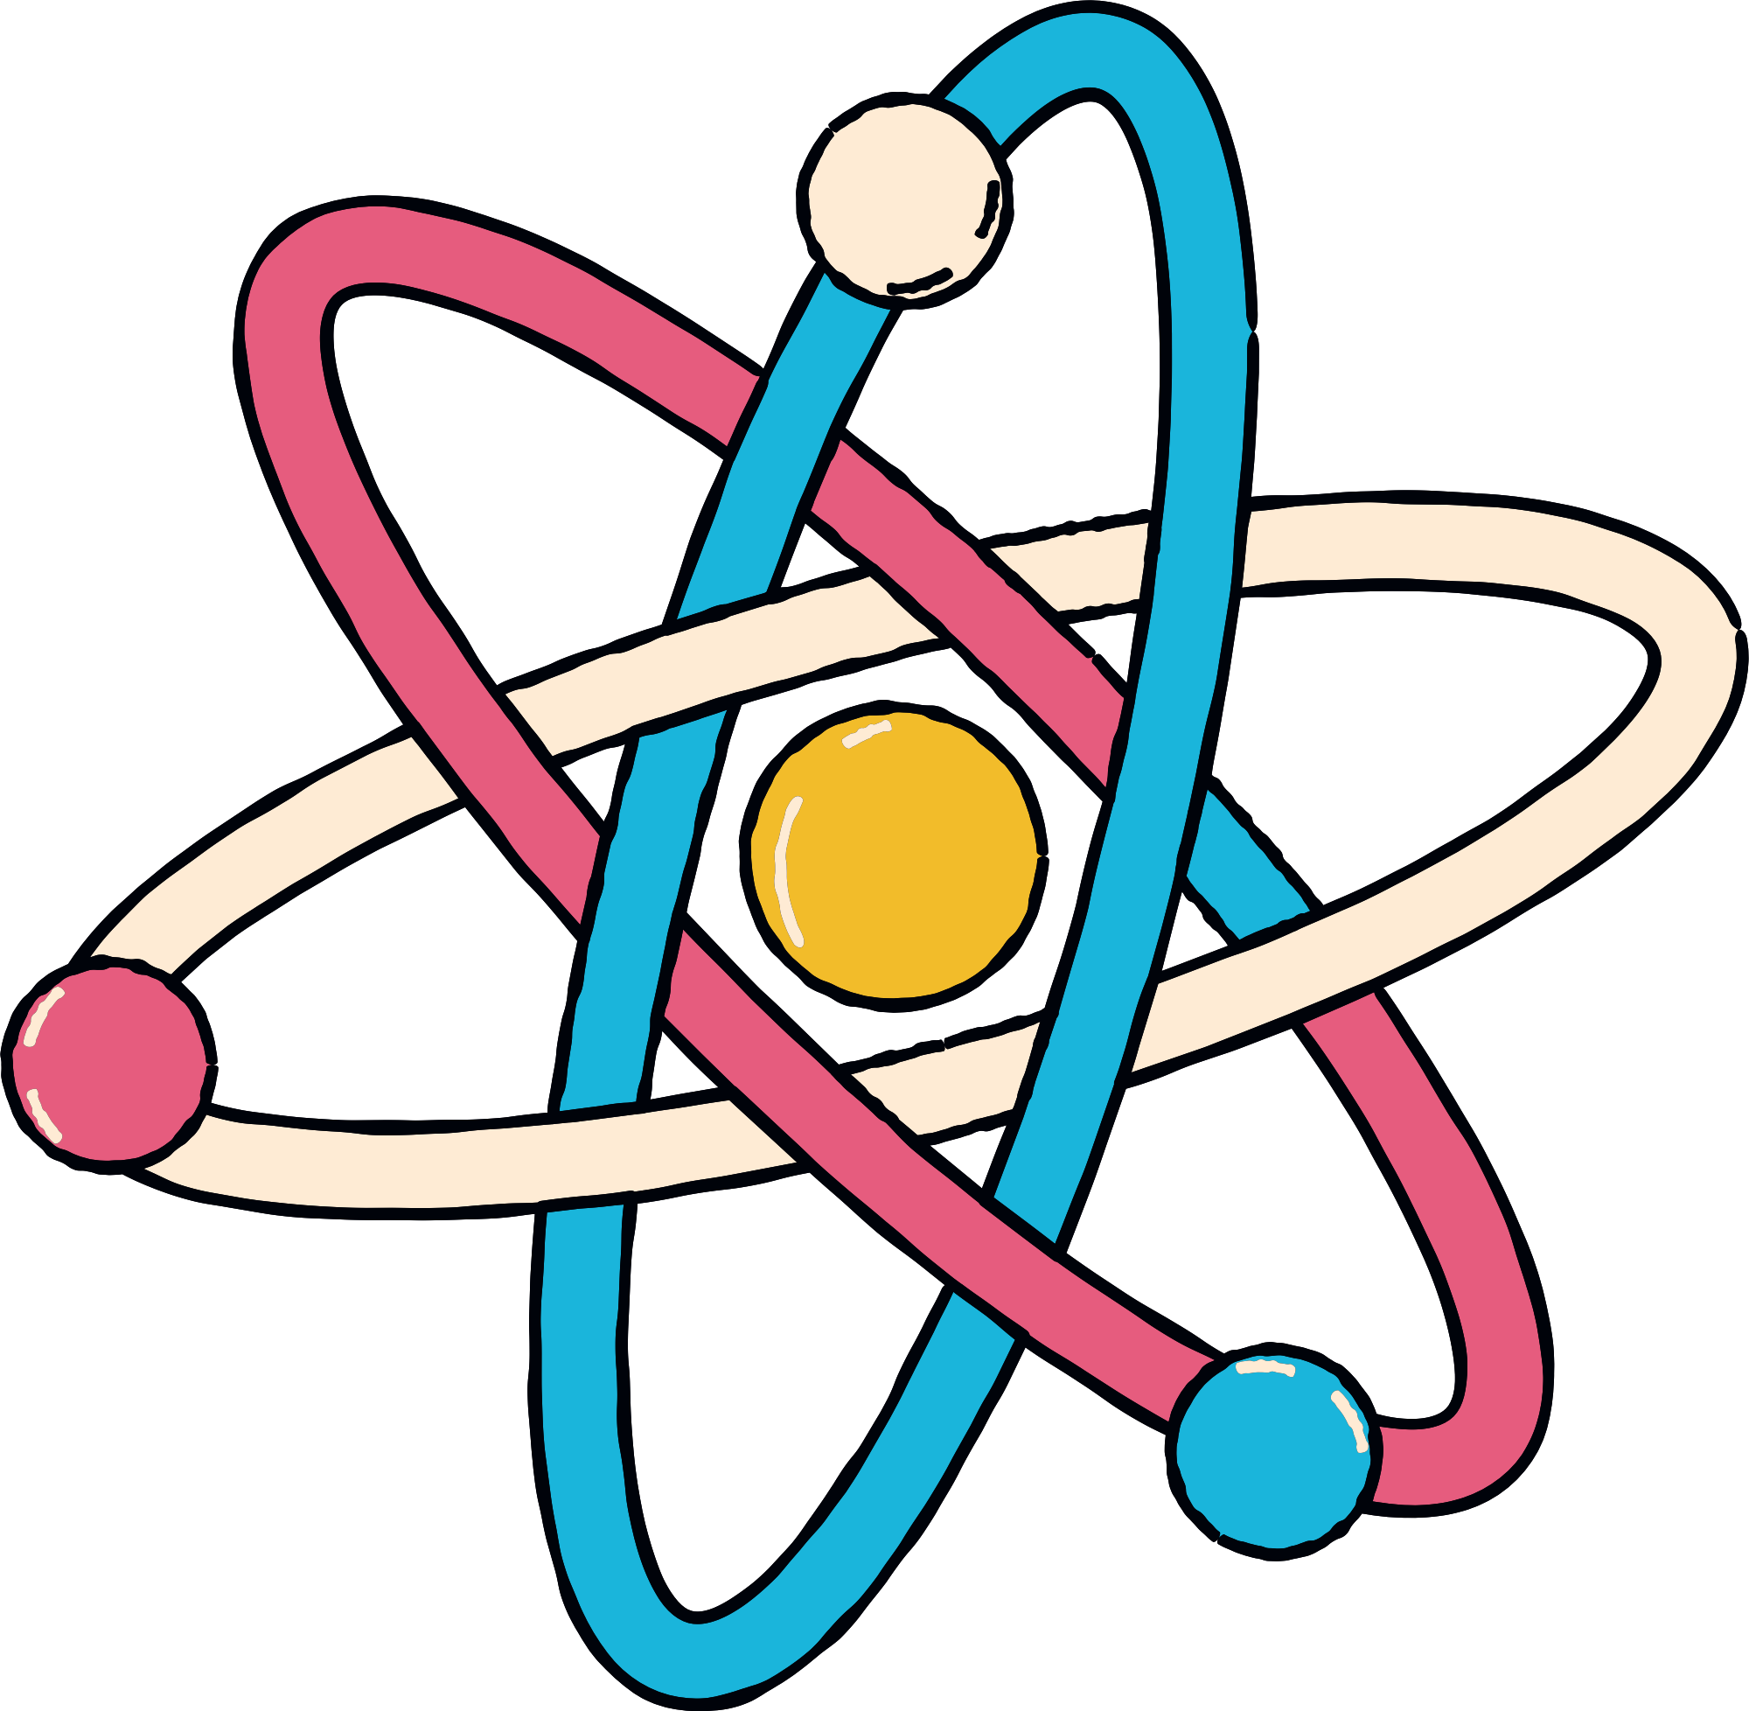
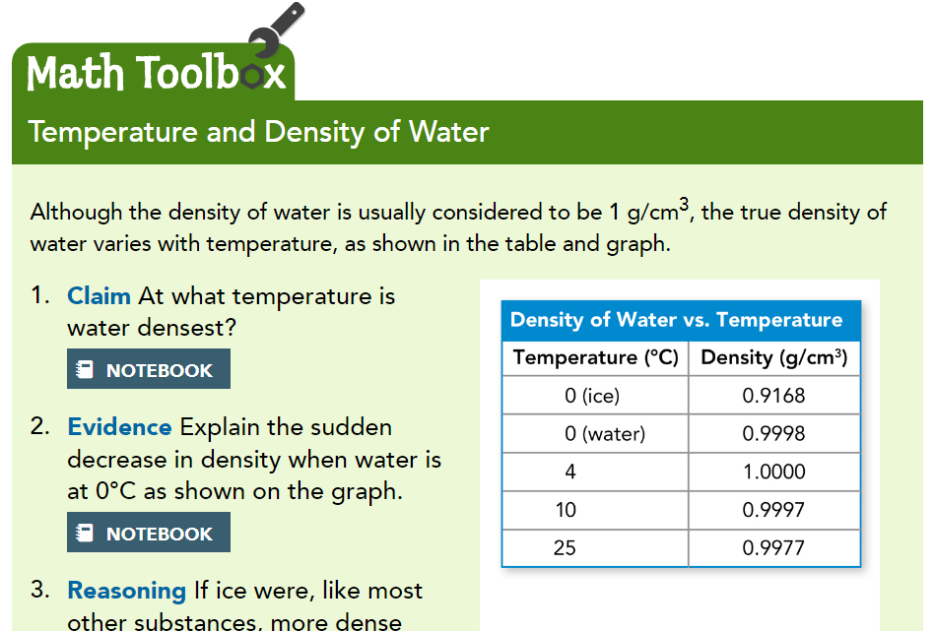



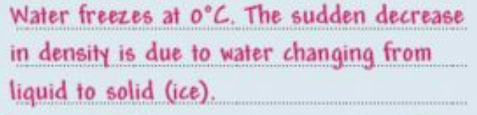
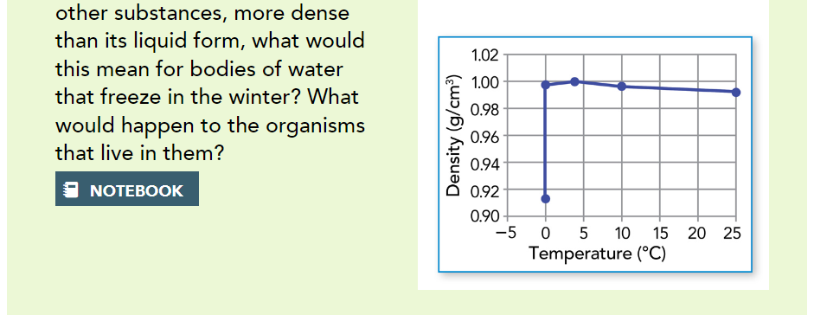
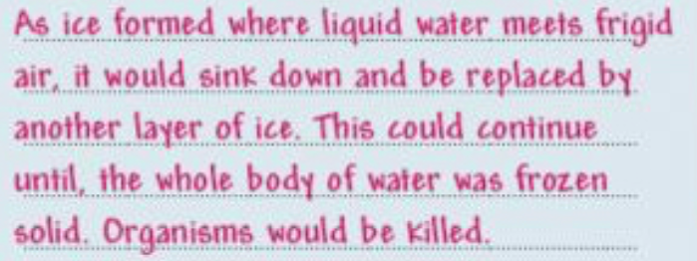


Slide 26
Using Density
Because density is an intrinsic property of matter, meaning that it does not change with the shape of an object, density can be used to identify substances. Imagine that you are looking for gold in stream beds in Alaska. You find an area where the gravelly streambed seems to be flecked with gold. First, you sort the gold-colored pieces from the other parts of the sediment. You set aside four of the largest pieces, hoping at least one of them will be valuable gold. You use a small digital scale and a graduated cylinder filled with water to measure the masses and volumes of each sample. Those data are shown below each sample in the Math Toolbox. If one of the samples has a density of 19.3 g/cm3, then you've found gold!

Slide 27
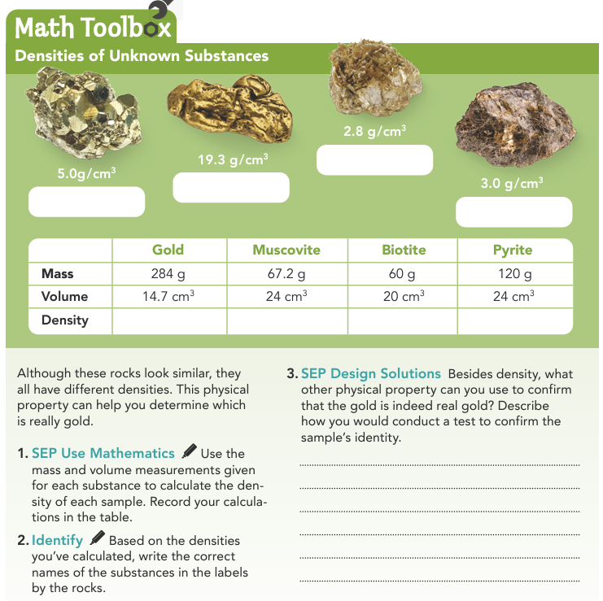








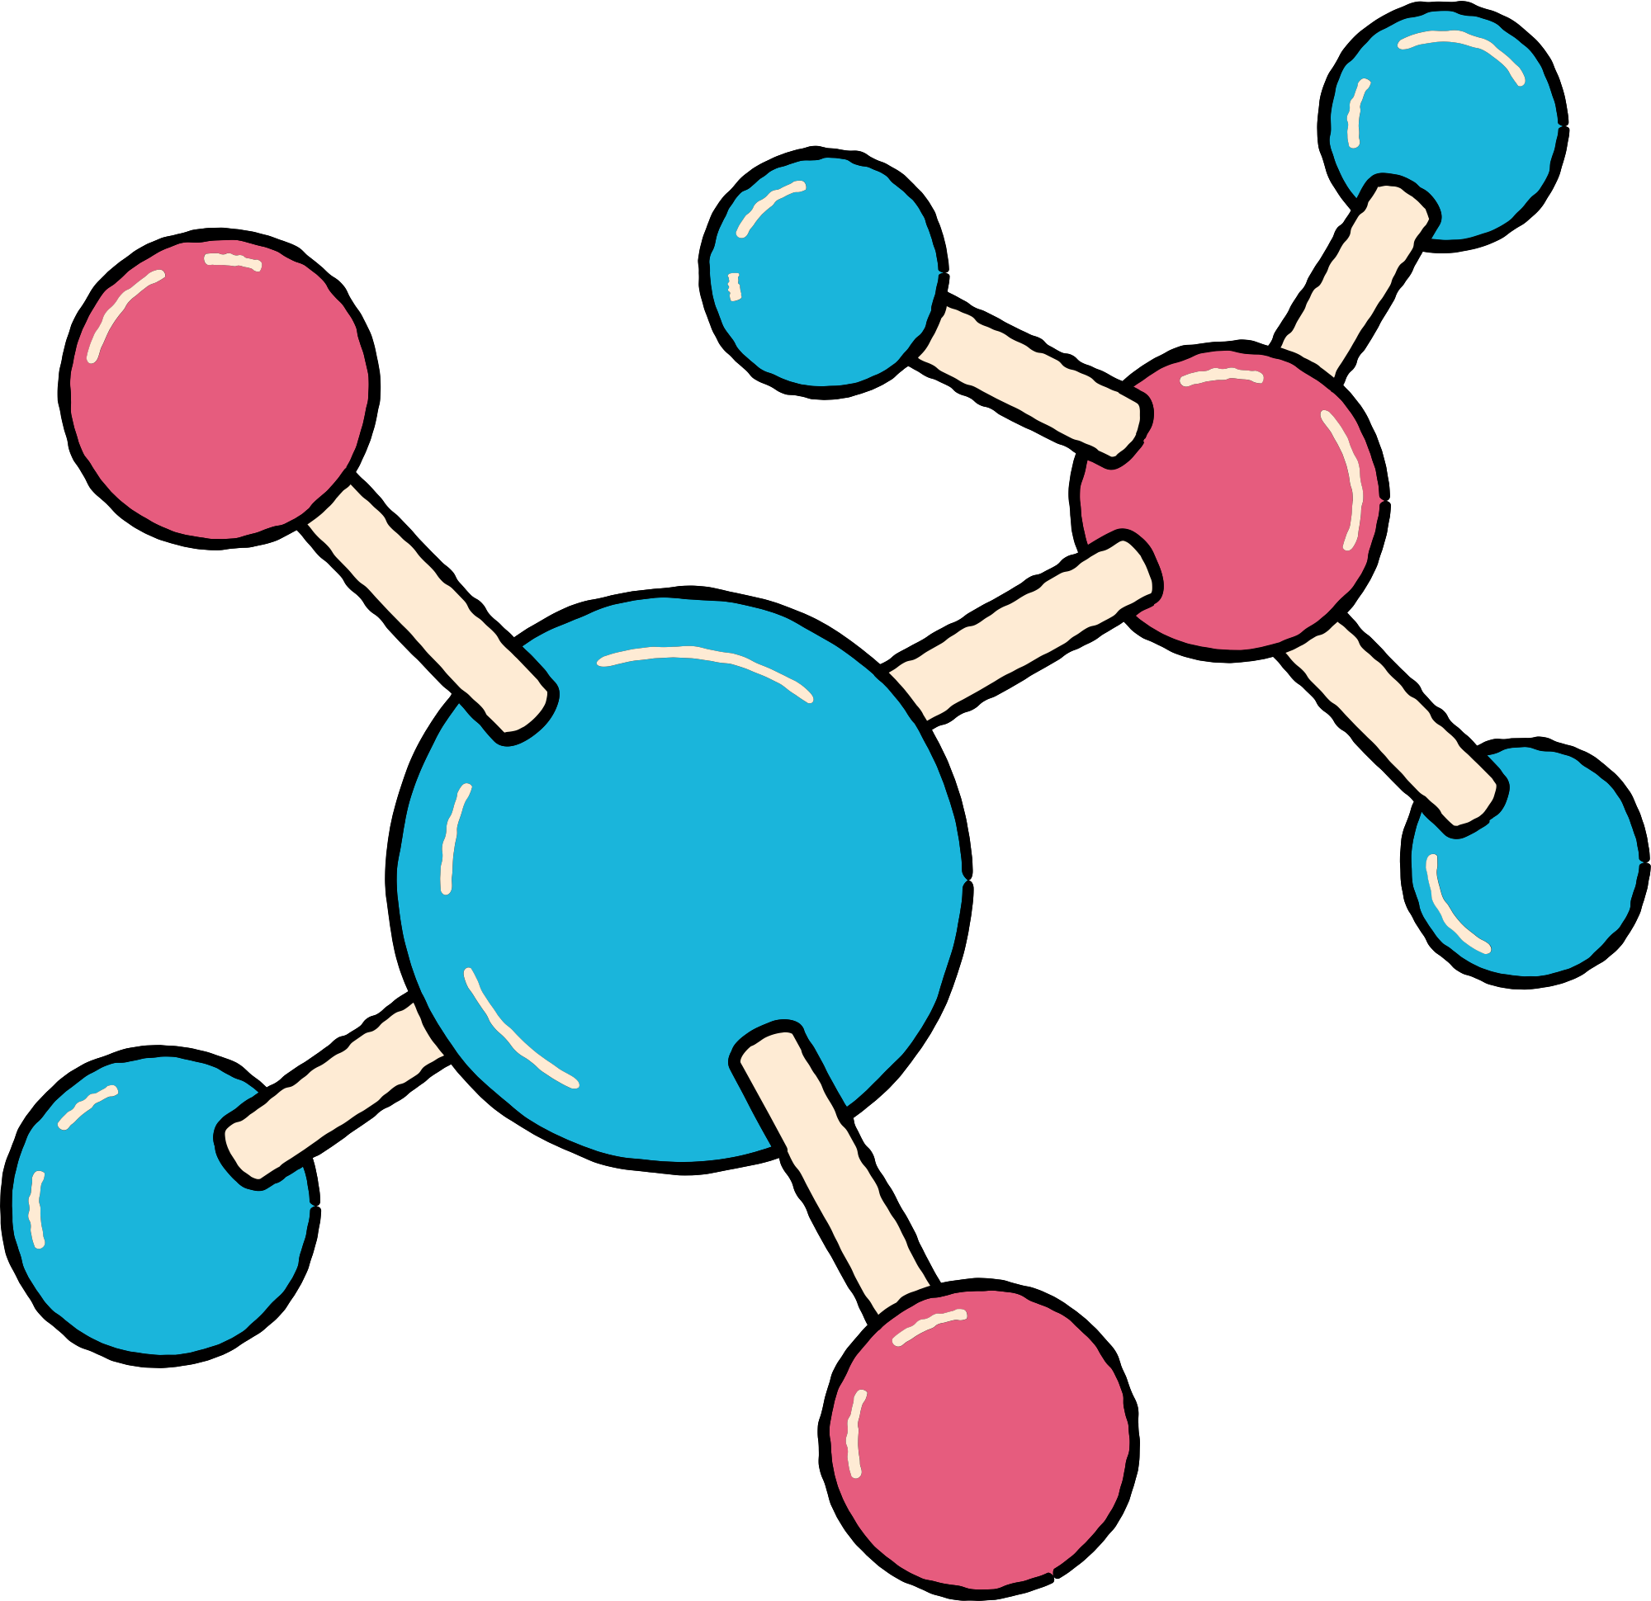
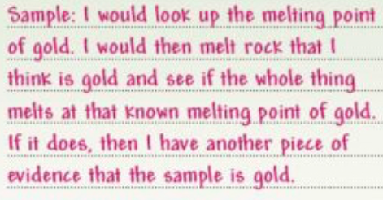
Work it out here:

Slide 28
Copybook Activation

Slide 29
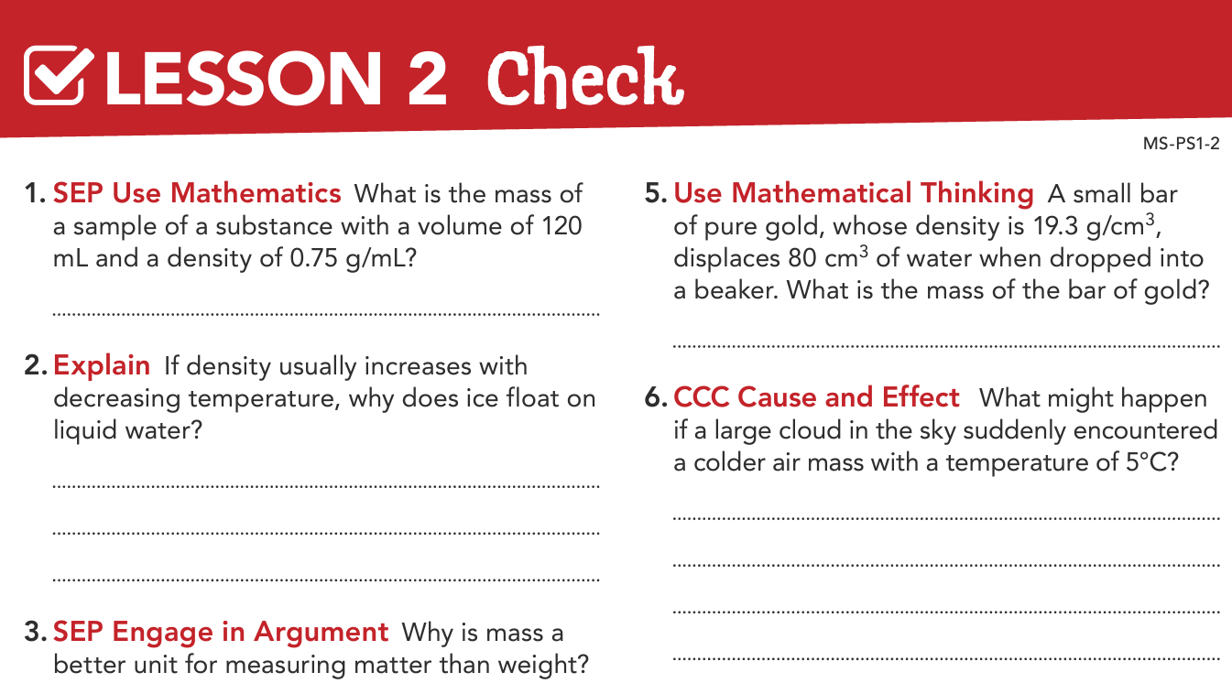


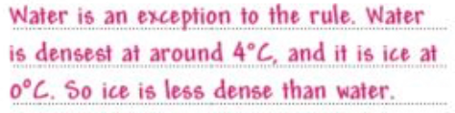
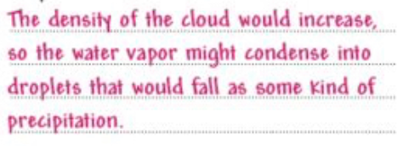

Slide 30
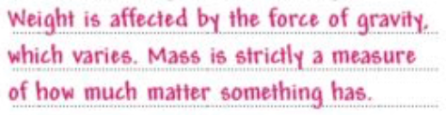
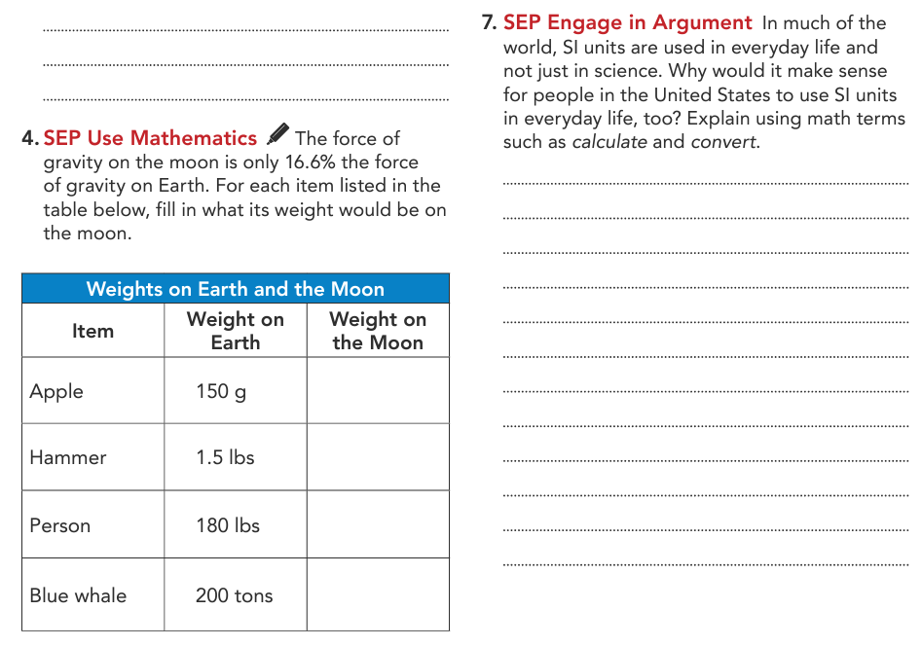
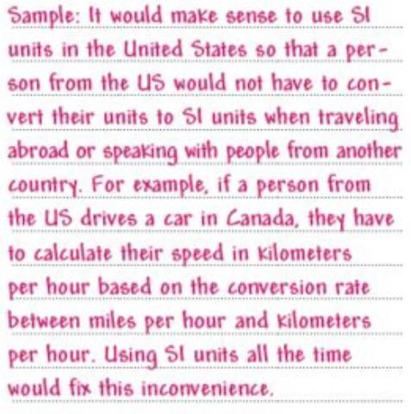
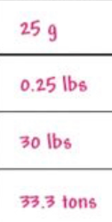

Slide 31



Slide 32



Slide 33


Thank you

Slide 34












