Slide 1

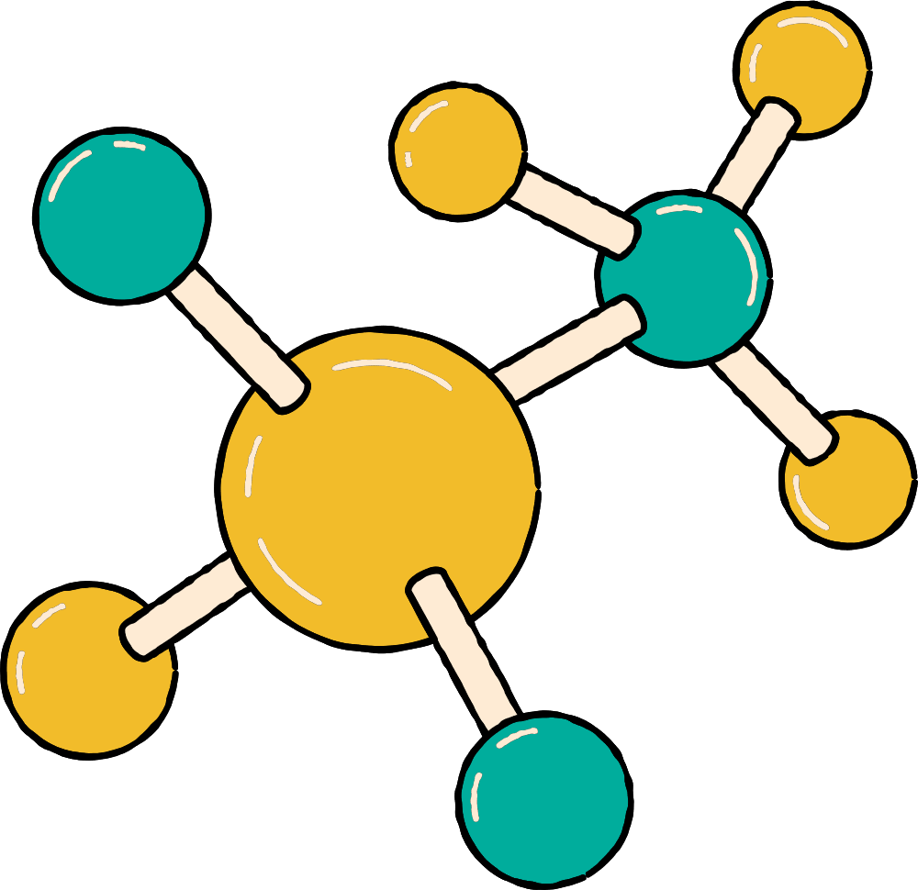
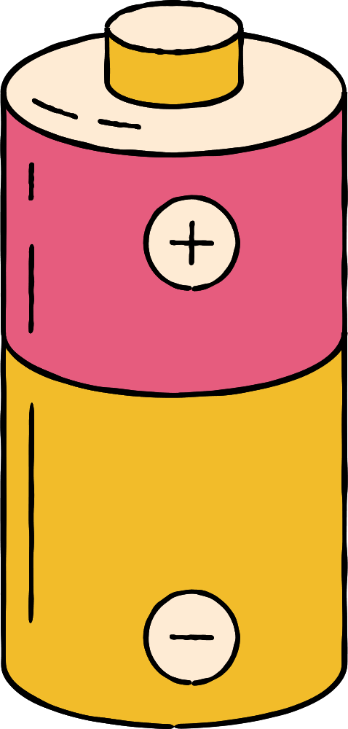



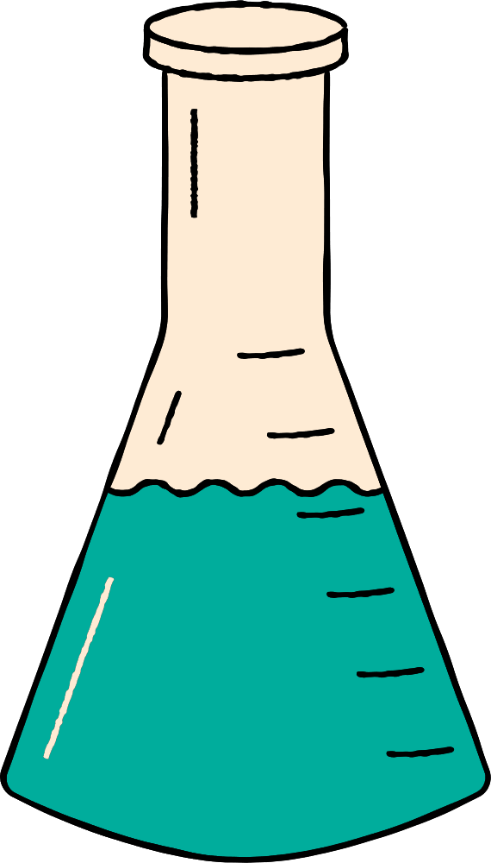





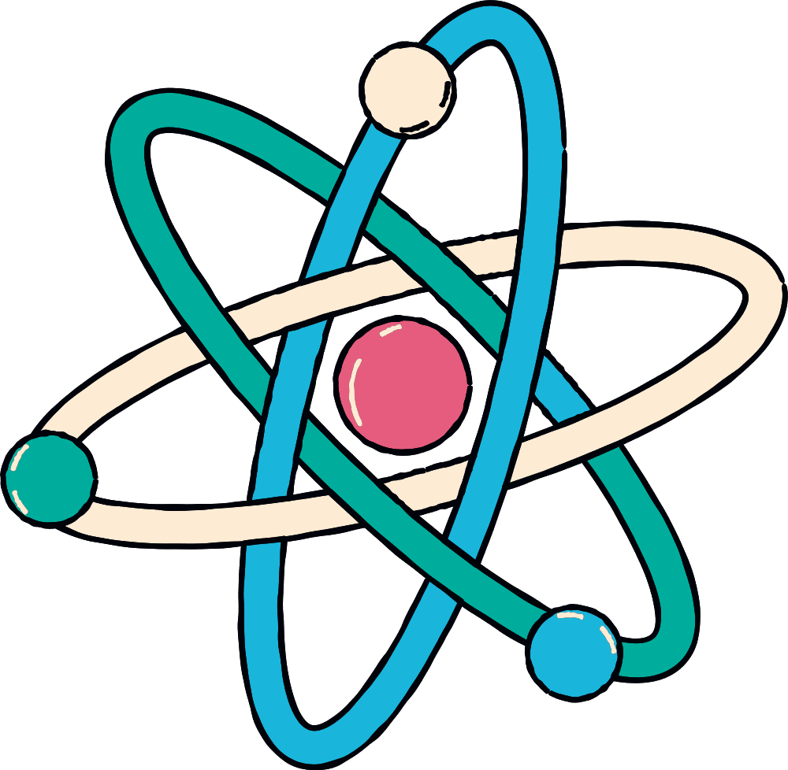


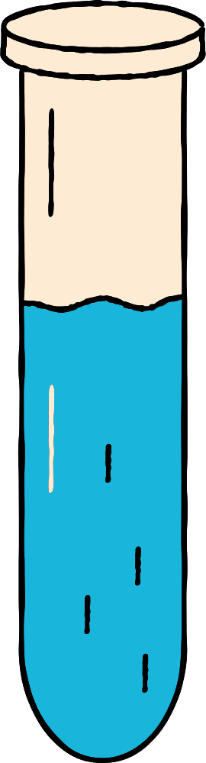
DESCRIBING AND CLASSIFYING MATTER
Gr 6

Slide 2

Vision
The first and the highest quality educational investor and the most rapid spread
Mission
Providing a competitive international education with applied dimensions that build skill, instill value, and develop creativity in accordance with the constants of religion the national orientations in an attractive, educational environment that stimulates learning with a community knowledge-producing knowledge, producing generation

Slide 3


Slide 4
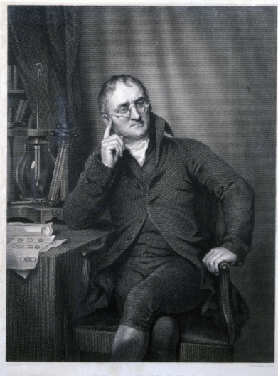
Scientist of the week
In 1808, chemist John Dalton suggested that something smaller called atoms make up the matter.

Slide 5
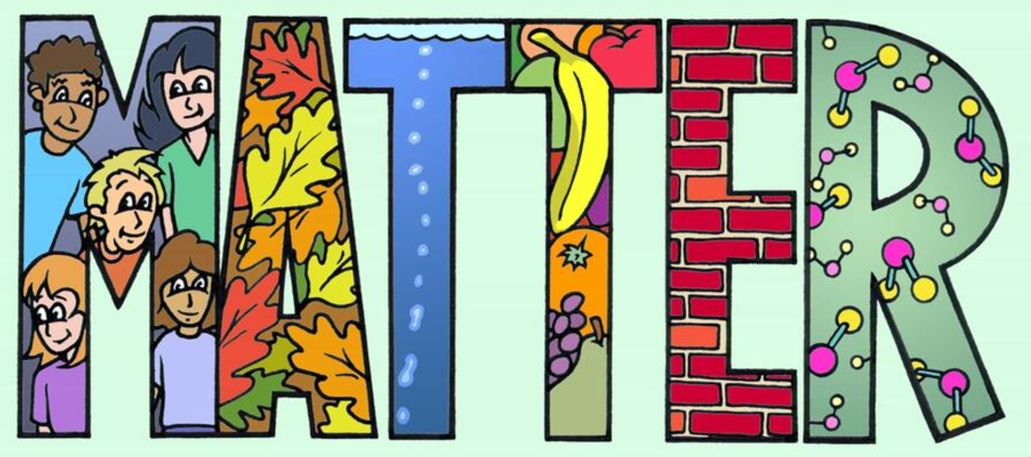
Looking at the picture guess what is Matter?
Looking at the picture guess what is Matter?
Notes:
Looking at the picture guess what is Matter?

Slide 6

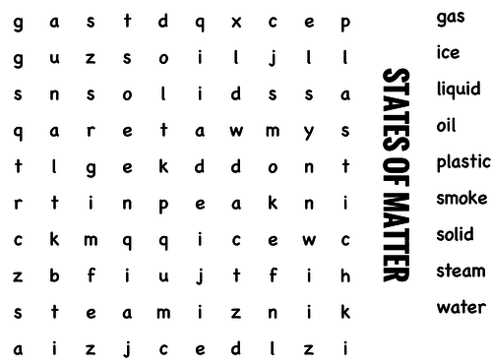
Hook Activity

Slide 7
GUIDING QUESTIONS
  What is matter made of?
  What properties describe matter? How can you classify different types of matter?

Slide 8
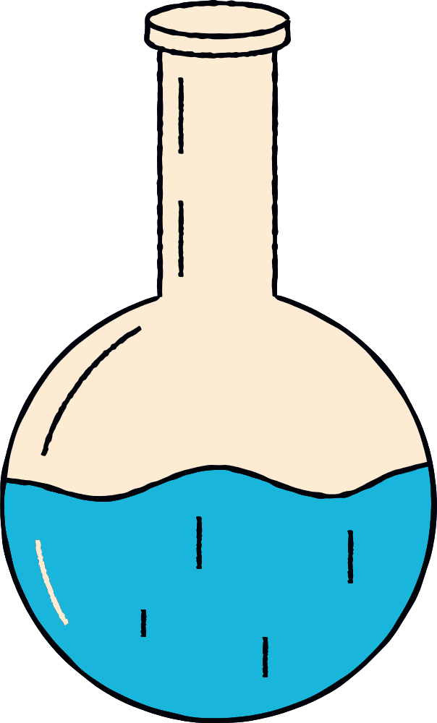

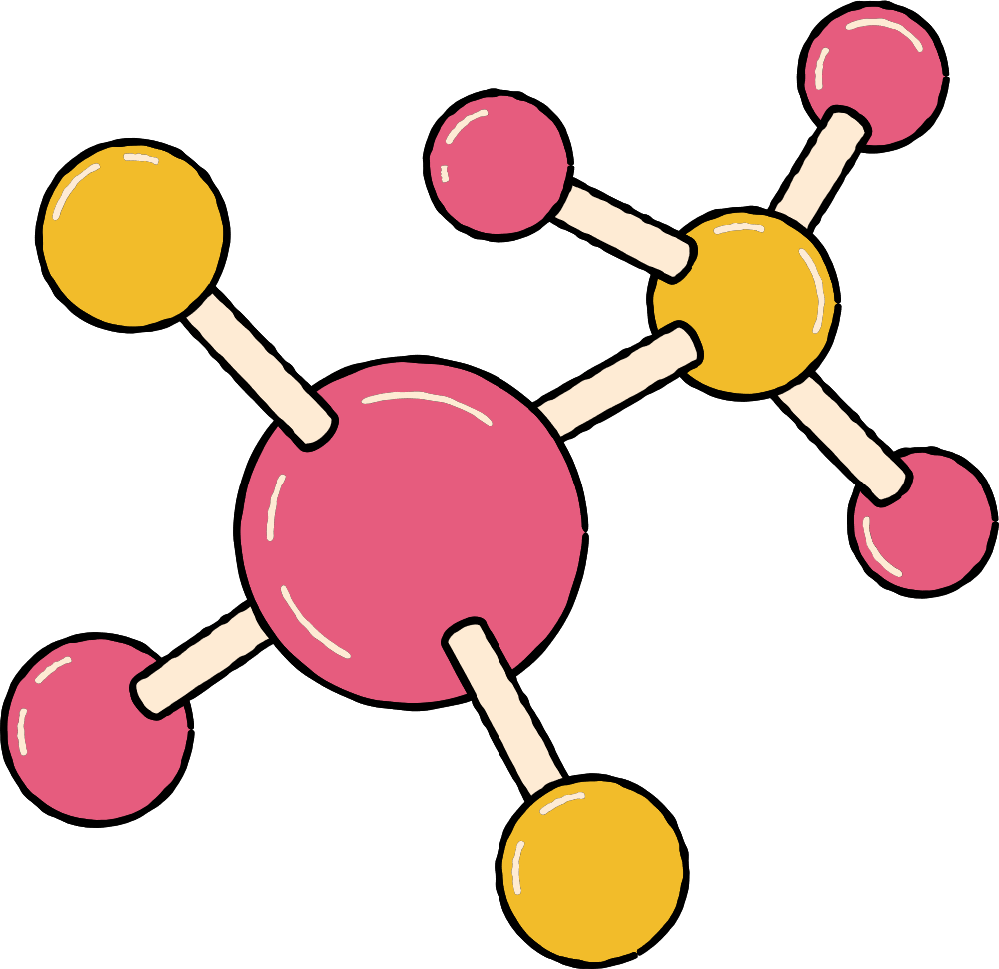



VOCABULARY
  matter
  substance
  physical property
  chemical property
  atom
  element
  molecule
  compound
  mixture

Slide 9
DESCRIBING AND CLASSIFYING MATTER
Open Pg. 6

Slide 10



MATTER
Anything that has mass and takes up space is matter. Wood, metal, paper, glass, cloth, plastic, and air are all matter. In fact, you are made of matter, too. We classify different types of matter by their properties. Some matter is visible, some is not.

Slide 11
MATTER
One of the first steps in classifying matter is to determine whether something is a substance—a single kind of matter that always has a specific makeup, or composition. For example, sodium chloride is a substance that we know as table salt. It is considered a pure substance because its composition is the same whether you’re looking at a single grain of salt or a boulder of salt taken from a salt mine.

Slide 12
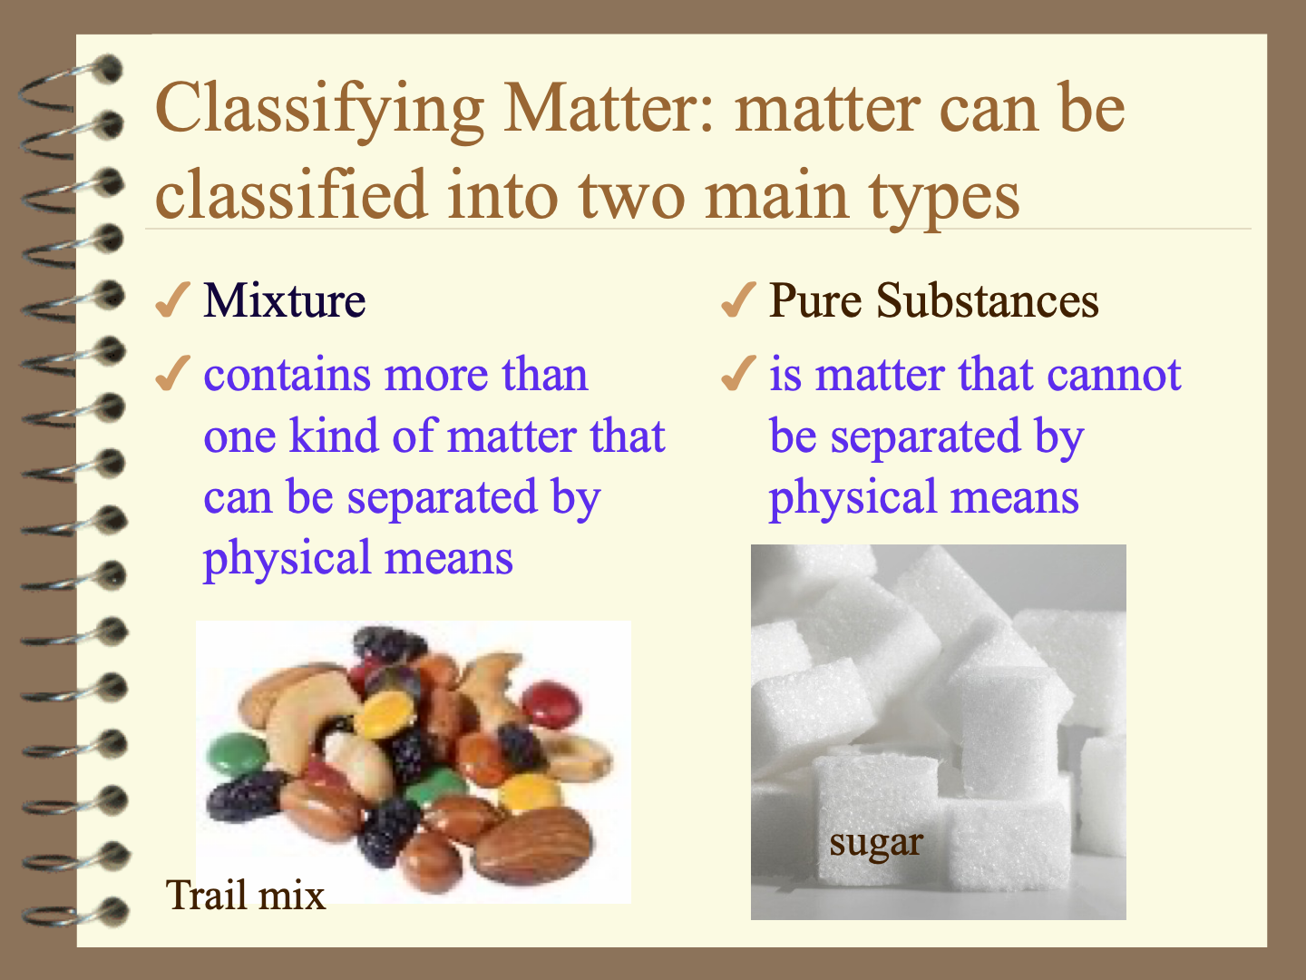

Slide 13
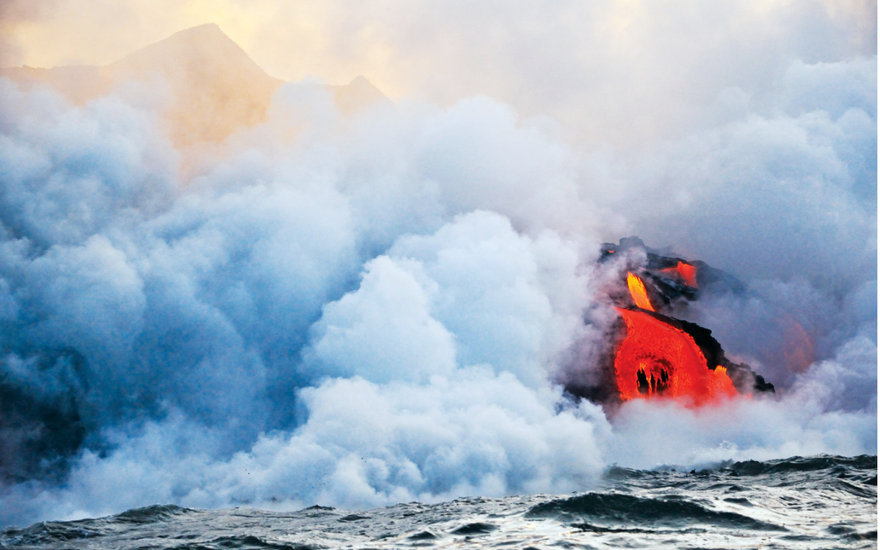
MATTER
Sea salt, on the other hand, which is formed when seawater evaporates, is not a pure substance. There are many other substances in seawater, and those substances are left behind with sodium chloride when the water evaporates.

Slide 14



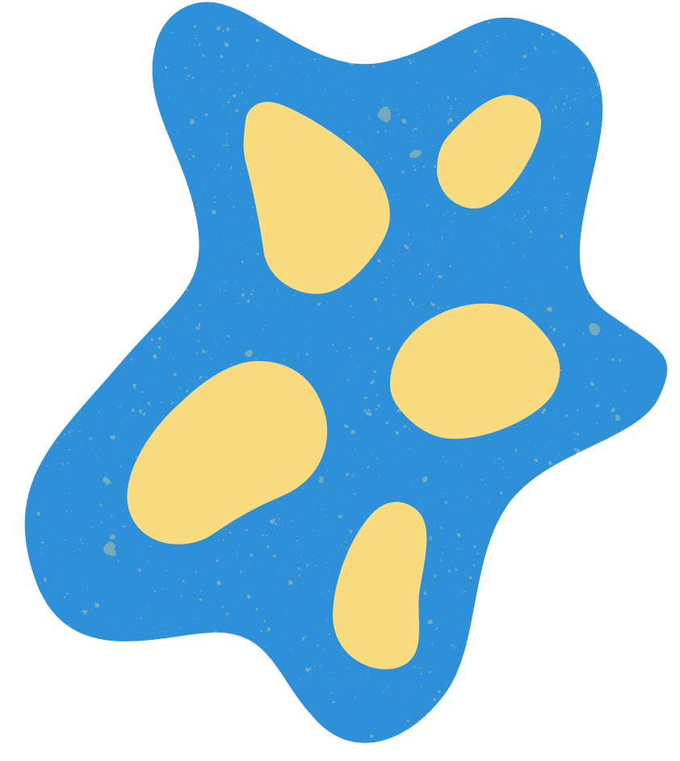

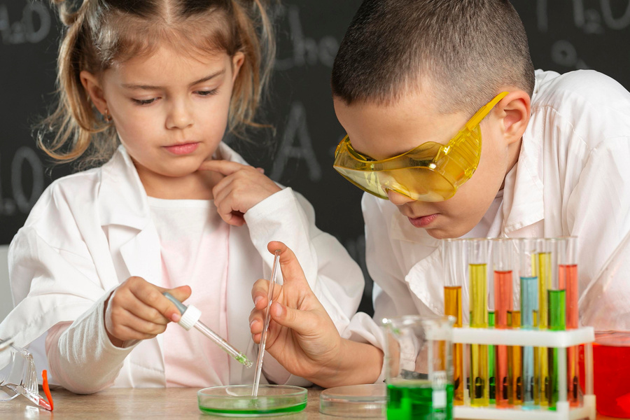

Matter Properties
Physical Properties
Chemical properties
Notes:
https://www.savvasrealize.com/dashboard/program/cbee08e9-bd3a-31b1-b33b-e61761318cd5/22/tier/fa733b49-0077-31ca-a0da-453468fa7add/23/lesson/29c05e2c-d1e0-36c3-a971-3fde4f7f61e8/0/lessonPlanner/cv/981bbade-01ab-3fb0-945b-8c897c55b143/27/nonscorable?forceOriginalView=true

Slide 15


Slide 16


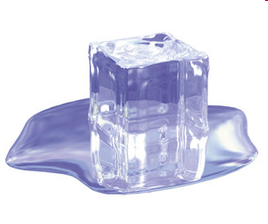
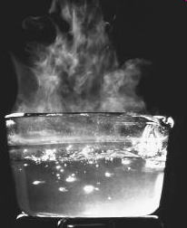

Physical Properties
DEFINTION
EXAMPLE,
is a characteristic that can be observed without changing the matter into another type of matter
gold melts at 1,064°C and boils at 2,856°C. It is an excellent conductor, meaning electricity moves through it very easily.
PROPERTIES
Gold also has a high luster, or shininess, and a distinctive color.
All of these characteristics are physical properties. They can be observed without changing the gold into something else.

Slide 17

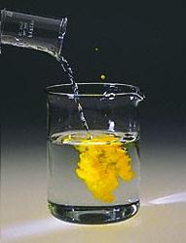
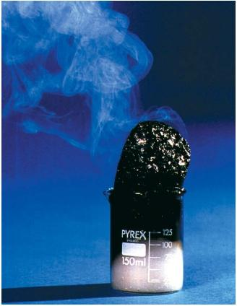
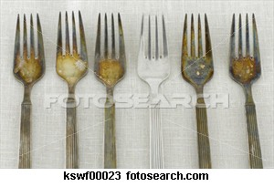
Chemical Properties
DEFINTION
EXAMPLE,
characteristics that describe something’s ability to become something else. d by combining or breaking apart substances.
, if you inject carbon dioxide gas into liquid water, some of the water will react with the carbon dioxide to produce carbonic acid.
PROPERTIES
This ability to react is a chemical property of water. Likewise, the ability of carbon dioxide to combine with water and become carbonic acid is a chemical property.

Slide 18
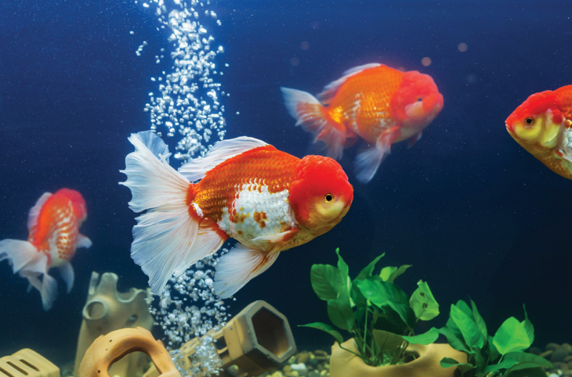
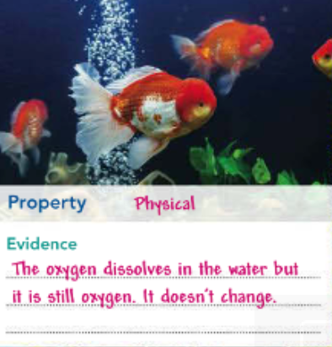
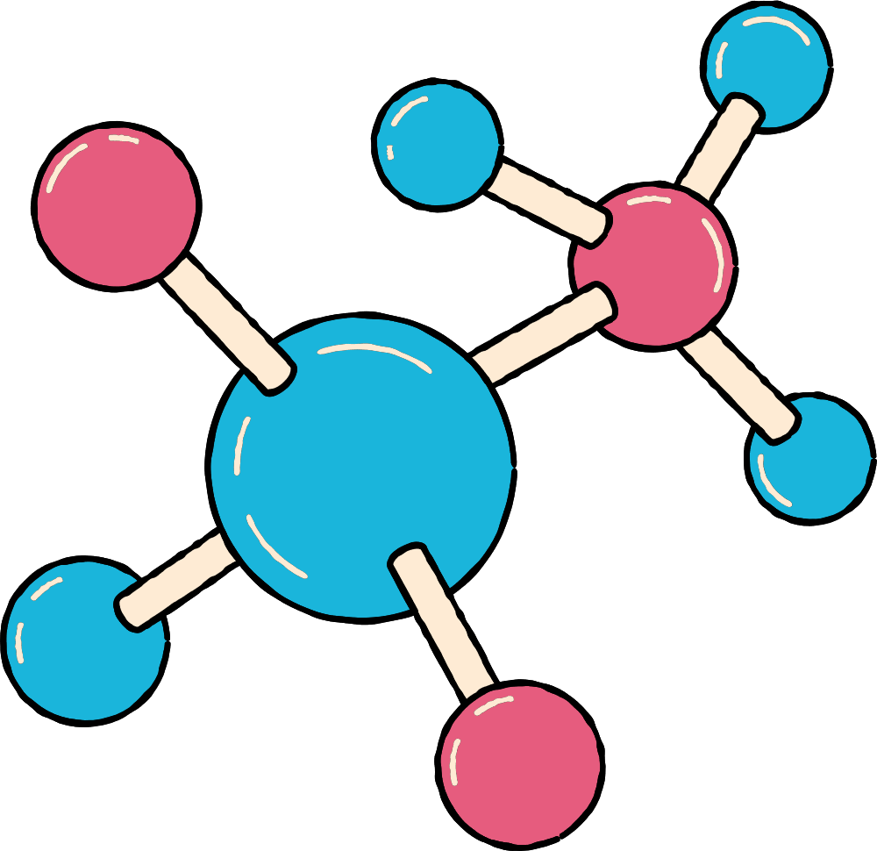
OXYGEN IS A SUBSTANCE THAT DISSOLVES IN WATER. FISH ABSORB OXYGEN FROM THE WATER. WHEN DISSOLVED OXYGEN LEVELS ARE LOW, IT CAN BE HARD FOR ORGANISMS TO SURVIVE

Slide 19

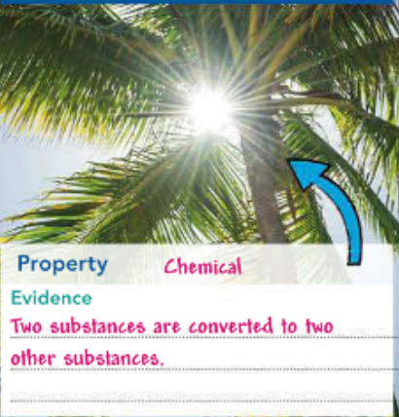
WATER AND CARBON DIOXIDE IN THE LEAVES OF THE COCONUT PALM TREE ARE CONVERTED TO OXYGEN AND SUGAR, THANKS TO THE ENERGY PROVIDED BY THE SUN

Slide 20
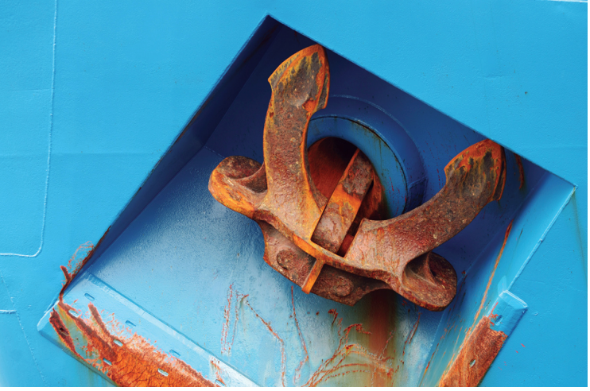
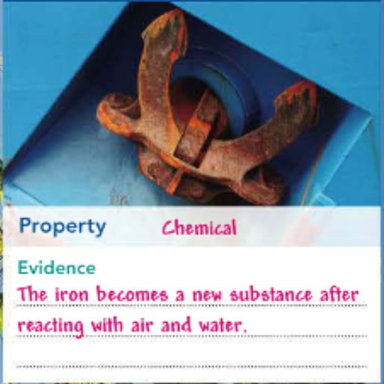
IF IRON IS EXPOSED TO AIR AND WATER, IT CAN RUST.

Slide 21
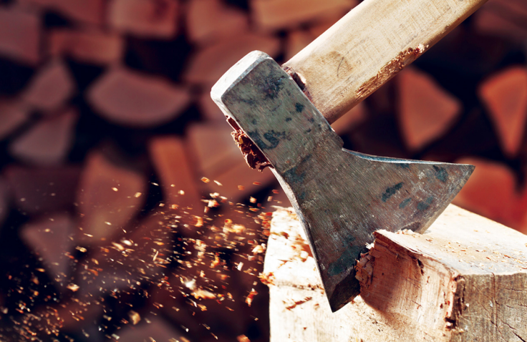
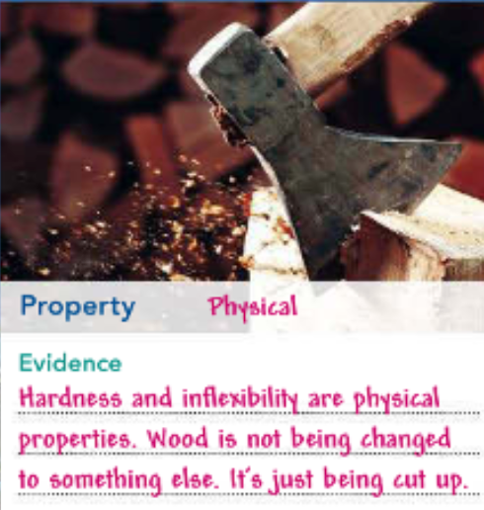
WOOD TENDS TO BE HARD AND RELATIVELY INFLEXIBLE, ESPECIALLY WHEN IT’S BEEN DRIED. THIS IS WHY WOOD IS AN EXCELLENT BUILDING MATERIAL.

Slide 22
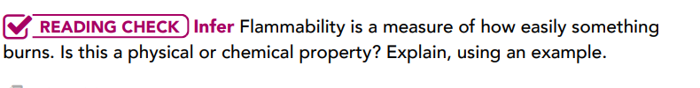
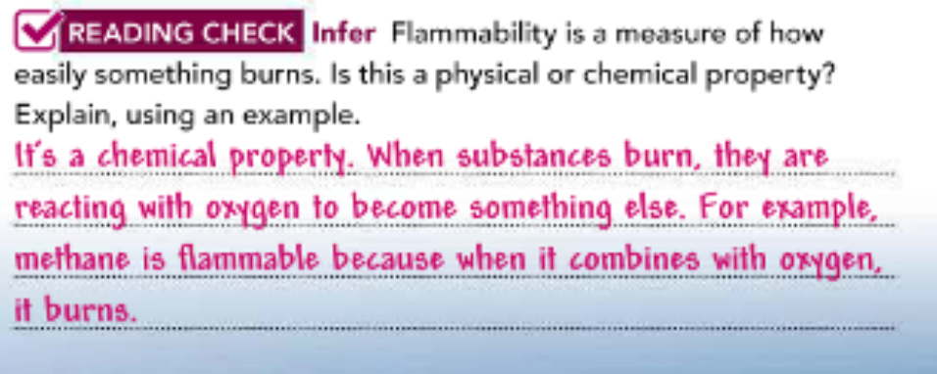

Slide 23
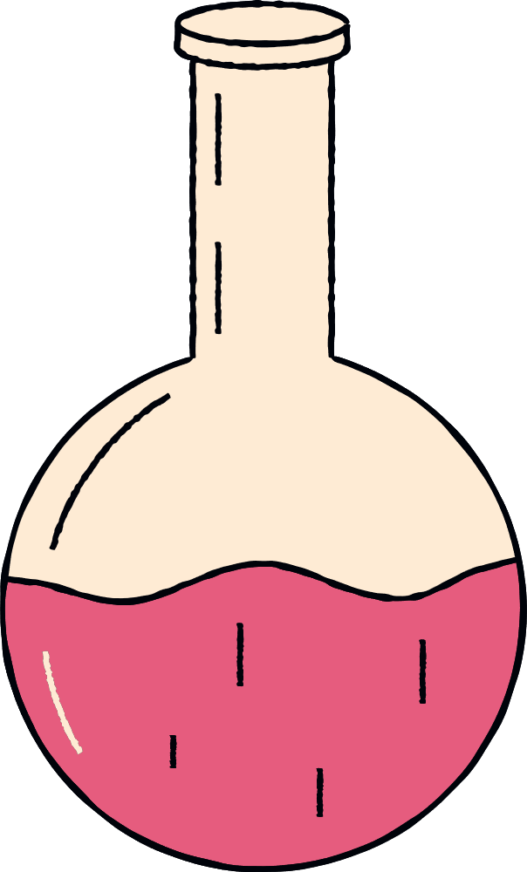
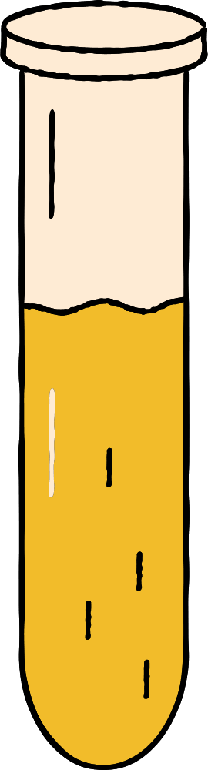
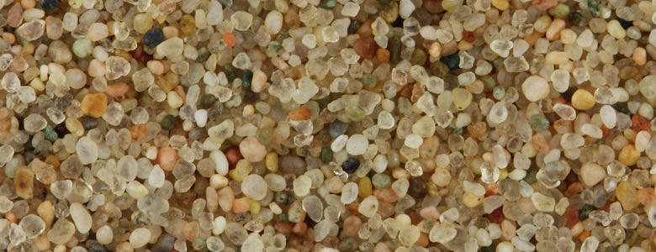
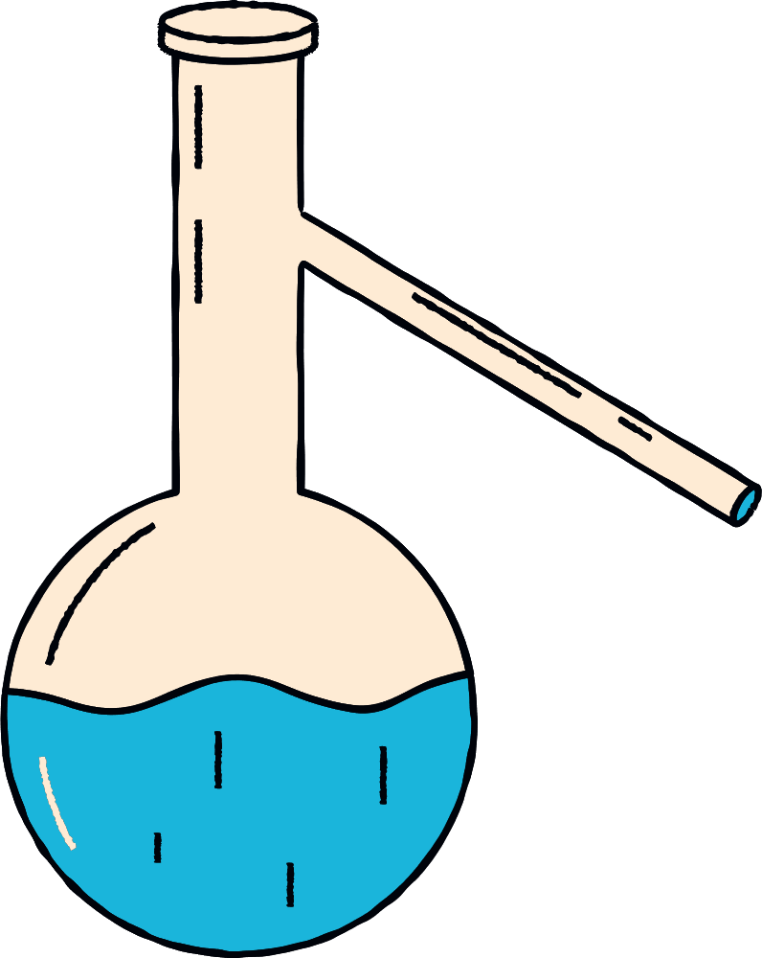
Components of Matter
There are a lot of tiny particles we can see, such as grains of sand. Have you ever wondered whether these tiny grains have even smaller particles inside? They do! The particle theory of matter explains that all matter is made up of very tiny particles called atoms.
.

Slide 24
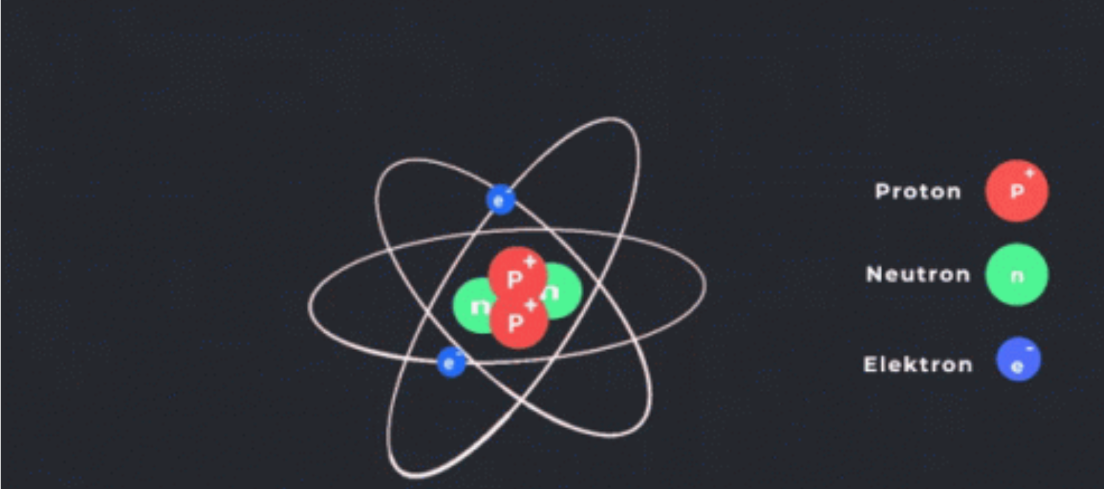
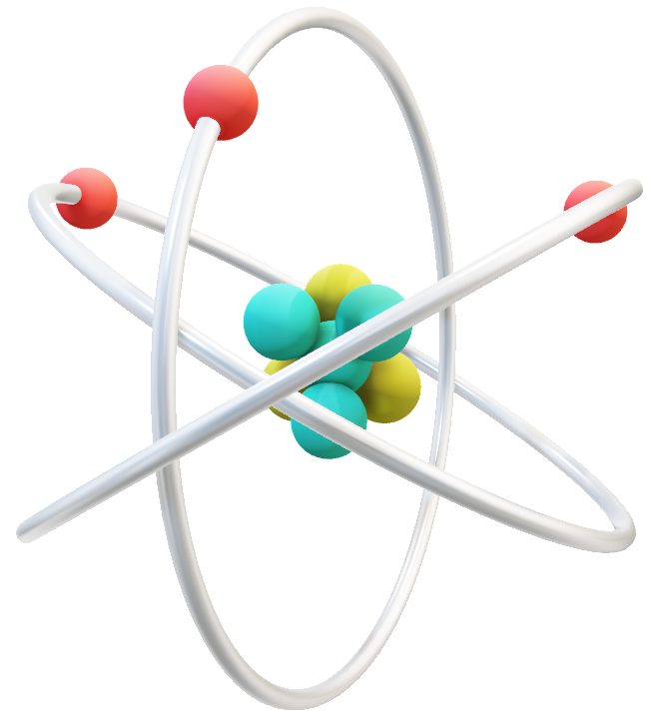
Atoms
An atom is the basic unit from which all matter is made. Different substances are made up of different types of atoms. But all atoms have the same basic structure. An atom has a positively charged center, or nucleus, containing smaller particles. Negatively charged particles circle around the nucleus and form a cloud of negative charge.

Slide 25
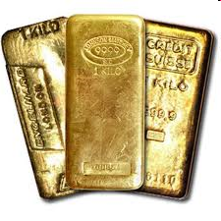
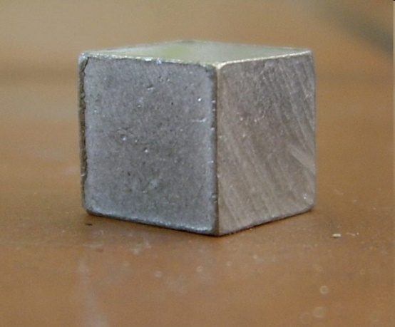
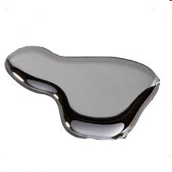
Elements
Substances that are made up of only one type of atom are called elements.
For instance, the element aluminum is made of only aluminum atoms, and no other pure substance has atoms like aluminum’s atoms.
Each element can be identified by its specific physical and chemical properties. You may already be familiar with some elements such as gold, oxygen, and carbon (Figure 3). These cannot be broken down into different substances. Elements are represented by one- or two-letter symbols, such as O for oxygen and Al for aluminum..
.

Slide 26
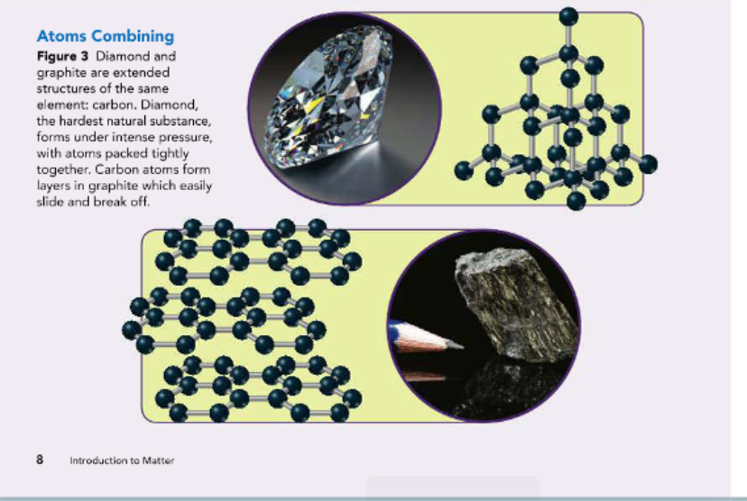

Slide 27

Molecules
Most atoms can combine with other atoms. When this happens, a chemical bond forms.
A chemical bond is a force of attraction between two or more atoms. Sometimes, atoms combine to form extended structures. One type of extended structure is a molecule.
A molecule is a group of two or more atoms held together by chemical bonds.

Slide 28
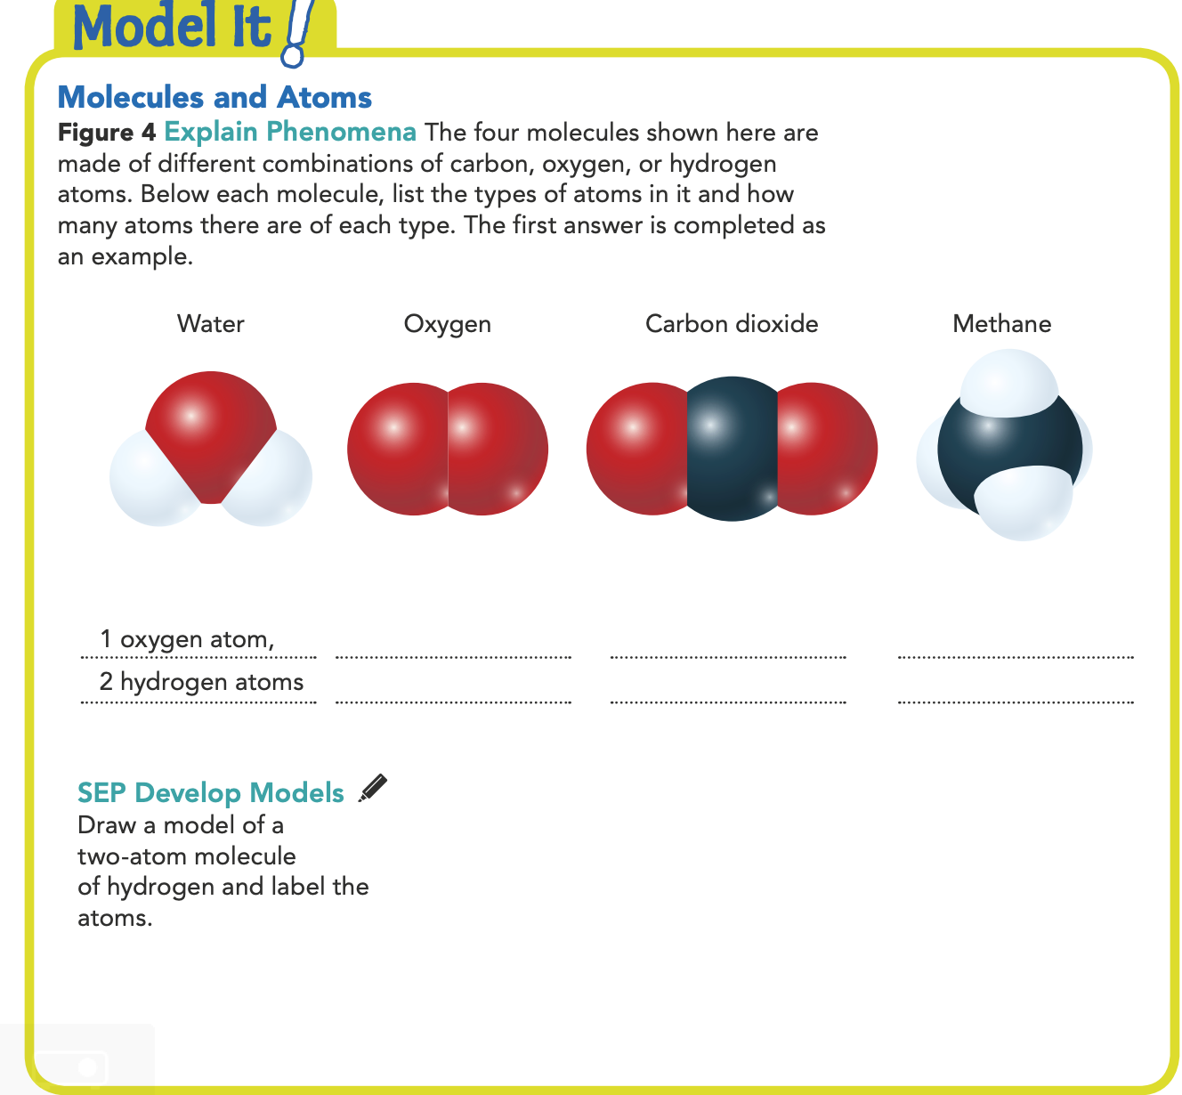
Molecules
A molecule of carbon dioxide, as shown in Figure 4 for example, is made up of a carbon atom chemically bonded to two oxygen atoms. Two atoms of the same element can also combine to form a molecule. For example, a hydrogen molecule is made up of two hydrogen atoms. Some large molecules are made of thousands of atoms!

Slide 29
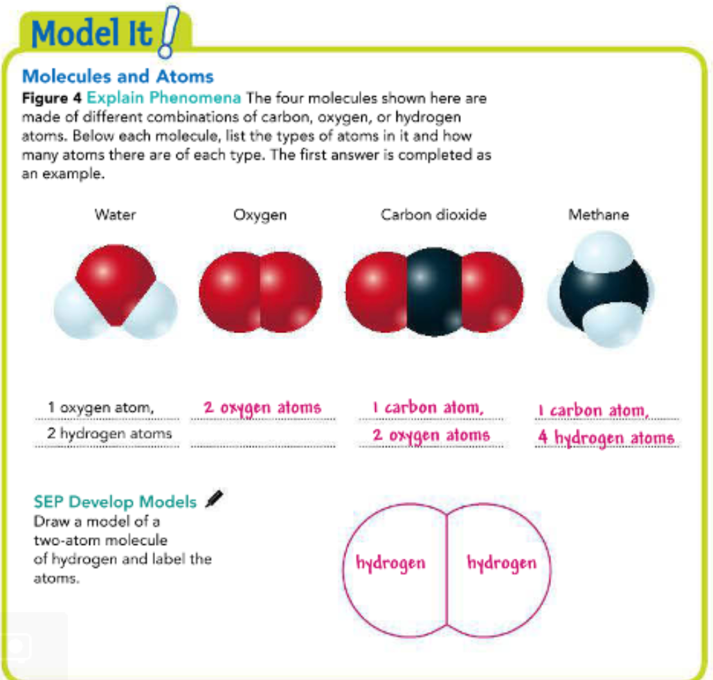
Molecules
A molecule of carbon dioxide, as shown in Figure 4 for example, is made up of a carbon atom chemically bonded to two oxygen atoms. Two atoms of the same element can also combine to form a molecule. For example, a hydrogen molecule is made up of two hydrogen atoms. Some large molecules are made of thousands of atoms!

Slide 30
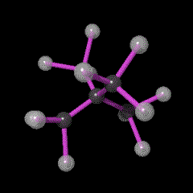
https://i.gifer.com/T5rA.gif
Compounds
When a molecule contains more than one element, it is called a compound.
A compound is a substance made of two or more elements that are chemically combined in a set ratio. A compound is represented by a chemical formula, which shows the elements in the compound and the ratio of atoms.

Slide 31
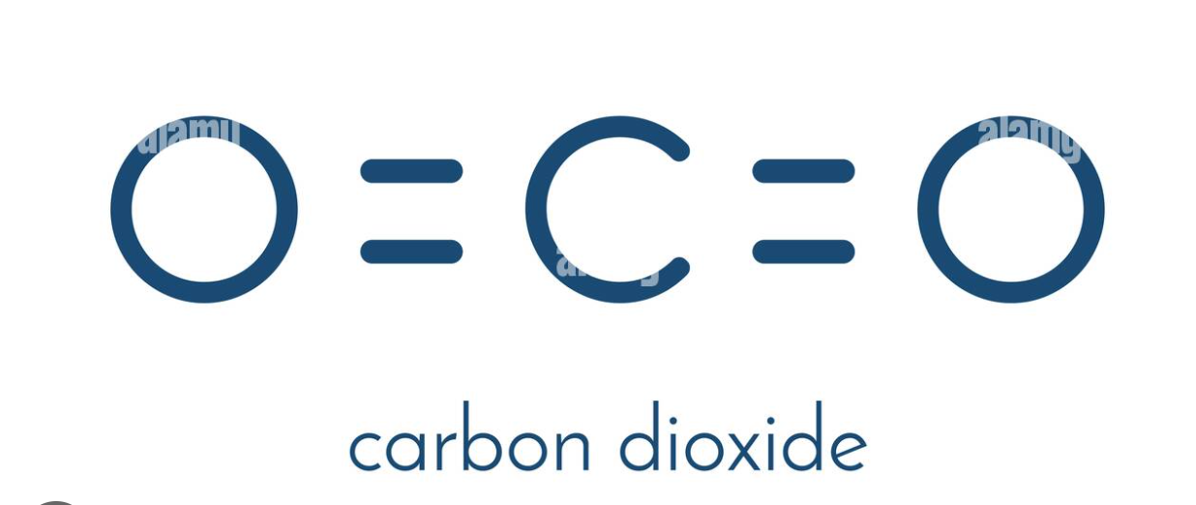
https://media.giphy.com/media/v1.Y2lkPTc5MGI3NjExeG1yd2YxYzd4dDRlc3FzNzduemsxemh6NWk3aG8yYndqbW8yOXN5biZlcD12MV9pbnRlcm5hbF9naWZfYnlfaWQmY3Q9cw/ZE5Az0w3YjlFJElRvG/giphy.gif
Compounds
For example, the chemical formula for carbon dioxide is CO₂. The subscript 2 tells you that every molecule of carbon dioxide contains two oxygen atoms. If there is no number after an element’s symbol, it is understood that the number is 1. In CO₂, there is one carbon atom. The ratio of carbon to oxygen is 1 to 2.

Slide 32
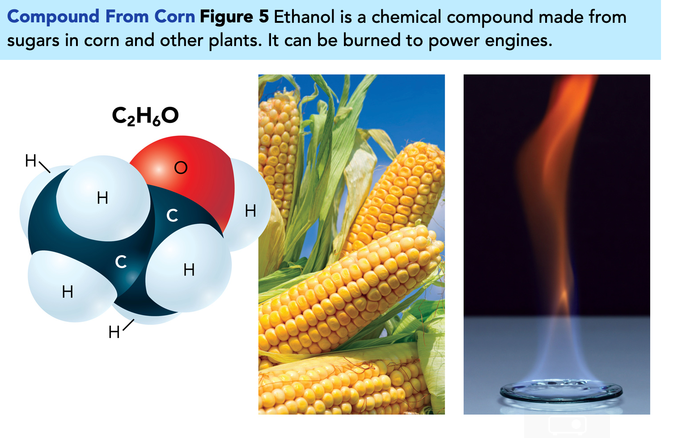
https://i.gifer.com/T5rA.gif
Compounds
When elements chemically combine, they form compounds with properties different from those of the individual elements. Ethanol, shown in Figure 5, is a compound that contains carbon, but because it also contains hydrogen and oxygen, and the molecule has a particular shape, it has different properties than the pure forms of carbon, hydrogen, and oxygen. There are many different compounds made of different combinations and configurations of those three elements..

Slide 33
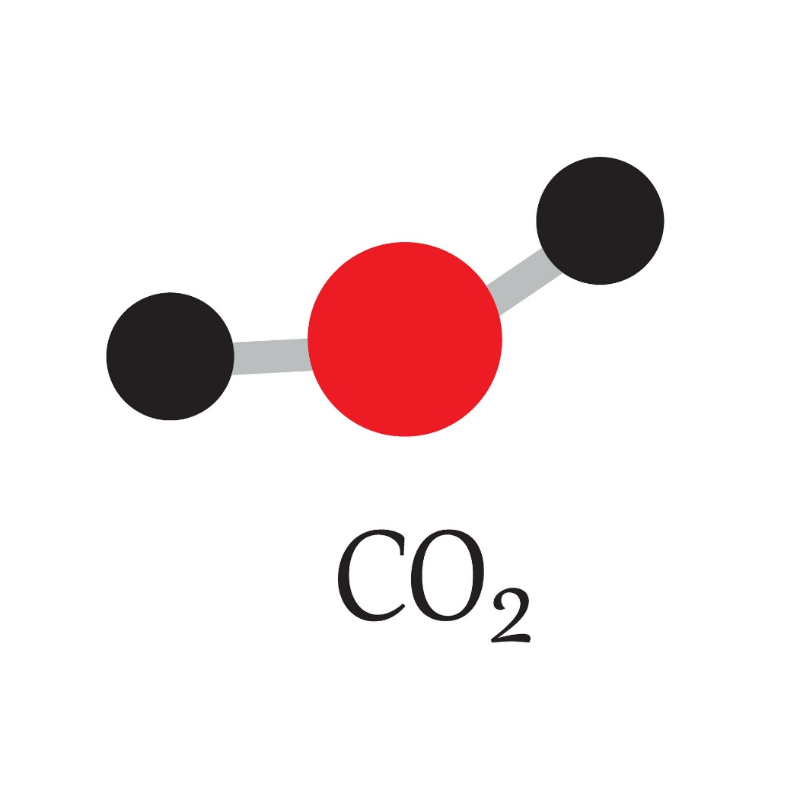
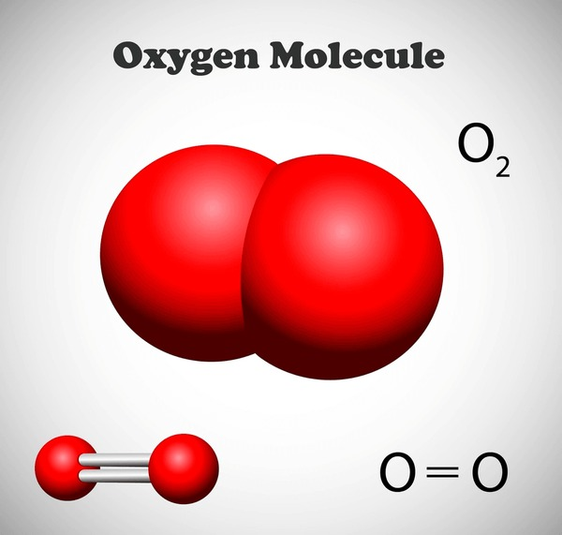
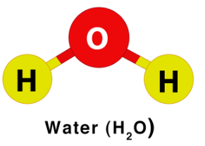
Copybook Activation
Molecules and Compounds
Carbon dioxide

Slide 34
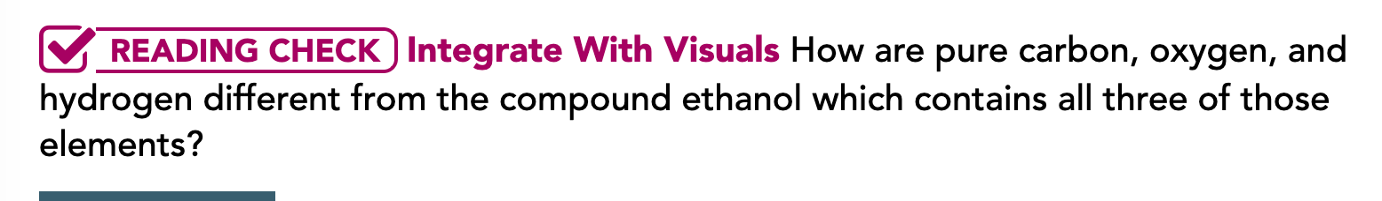
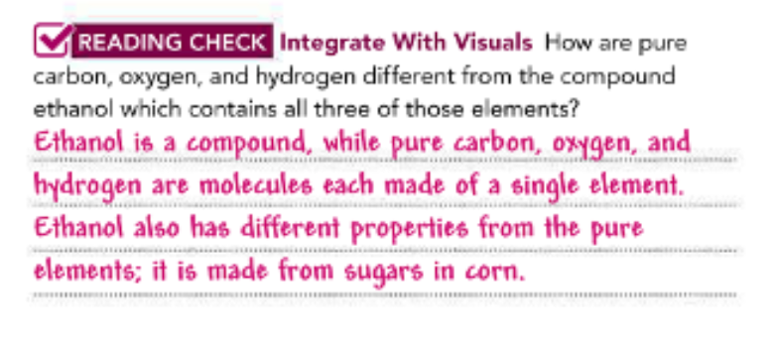

Slide 35
https://i.gifer.com/T5rA.gif
Types of Mixtures
You have learned that elements and compounds are substances. Most of the things found in nature, however, are not simple elements or compounds—they are mixtures.
A mixture is made up of two or more substances that are together in the same place, but their atoms are not chemically bonded.

Slide 36
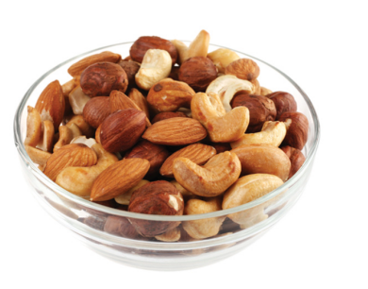
https://i.gifer.com/T5rA.gif
Types of Mixtures
Mixtures differ from compounds.
Each substance in a mixture keeps its own properties.
Also, the parts of a mixture are not necessarily combined in a set ratio.
Look at Figure 6A, which shows a bowl of mixed nuts.
They are mixed together, but they are not chemically bonded to each other.
This type of mixture is known as a heterogeneous mixture.

Slide 37
Types of mixtures
Heterogeneous mixture
The composition is uniform (same)
examples:
salt water
tap water
brass
Homogeneous Mixture
the composition is not uniform (different)
examples:
chicken noodle soup
mixed nuts
soil

Slide 38




A homogeneous mixture is different from a heterogeneous mixture. In a homogeneous mixture, it is difficult or impossible to see the different parts. Combining dry ingredients for baking results in a homogeneous mixture, as shown in Figure 6B. Air is another homogeneous mixture, made of gases rather than solids. You know that oxygen is present in the air because you are able to breathe, but you cannot pinpoint exactly where the oxygen is in the air. A solution is a liquid example of a homogeneous mixture. Salt water is an example of a solution. If you want to separate a mixture, you need to divide its parts according to their properties. This is possible because the substances in a mixture retain their own properties. The methods you can use to separate the parts of a mixture include distillation, evaporation, filtration, and magnetic attraction.

Slide 39

All mixtures can be separated
Methods to separate mixtures
1. Sorting
2. Filtering
3. Heating
4. Cooling
5. distillation

Slide 40


All mixtures can be separated
Magnetic attraction involves holding a magnet near a mixture to pull out anything that is attracted to the magnet, such as a metal.
Evaporation is a good way to separate dissolved or suspended substances from water. This is how sea salt is harvested from the ocean.

Slide 41


All mixtures can be separated
In filtration, a substance is passed through some kind of filter that allows fine particles, such as molecules of water, to pass through while filtering out larger particles.
Distillation involves separating liquids by boiling them. The liquid with the lower boiling point will vaporize first, leaving the other liquid behind.

Slide 42




Copybook Activation
Methods to separate mixtures
Magnetic Attraction
Evaporation
Filtration
Distillation

Slide 43


Slide 44

Make these Molecules and Compounds
Carbon dioxide
Science Lab

Slide 45

Pg. 14

Slide 46



Slide 47



