Slide 1
Topic3.Lesson 2 Speed, Velocity and Acceleration

Slide 2
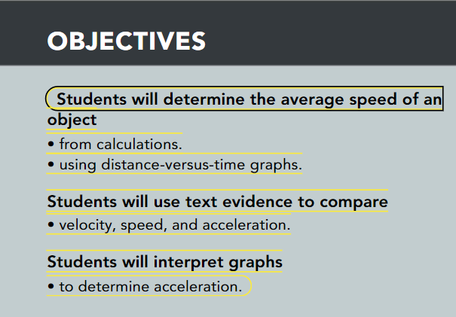
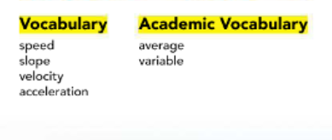

Slide 3






Push
Pull
Un/Balanced Force

Slide 4
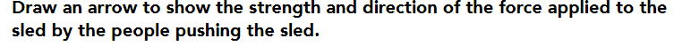
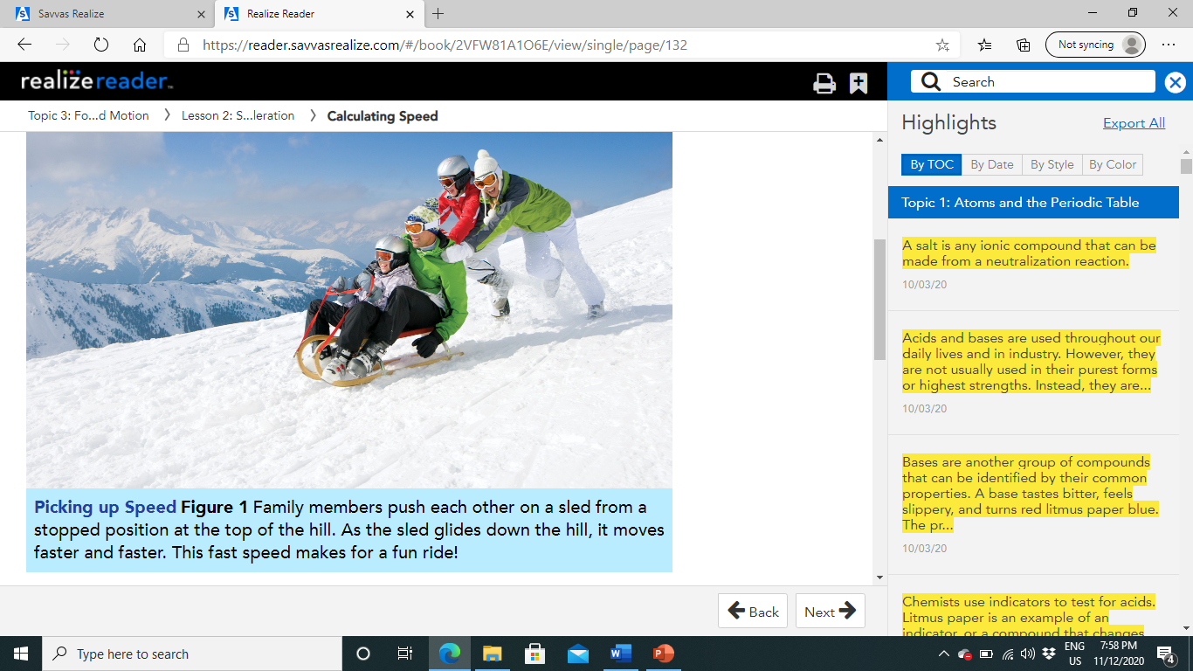

Slide 5

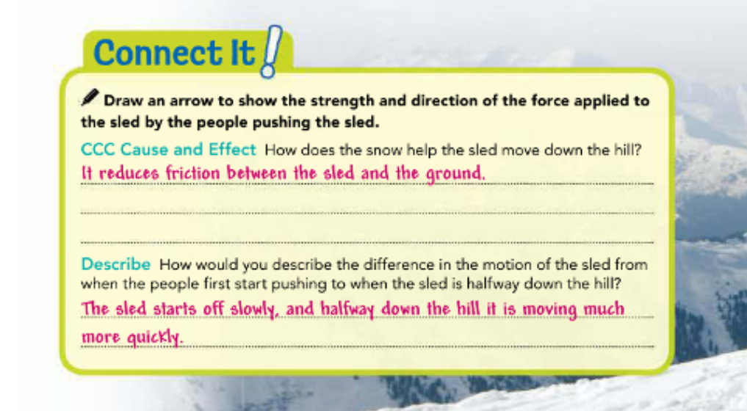
Pg.128

Slide 6
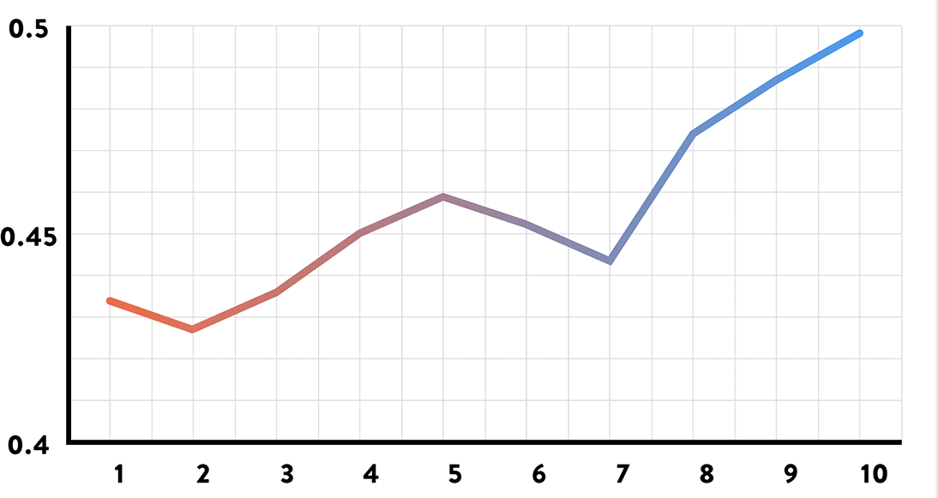
Calculating Speed:
You might describe the motion of the sled as slow when it starts moving and fast when it reaches the bottom of the hill.
By using these words, you are describing the sled's speed.
The speed of an object is the distance the object moves per unit of time.
Speed is a type of rate.
A rate tells you the amount of something that occurs or changes in one unit of time.

Slide 7
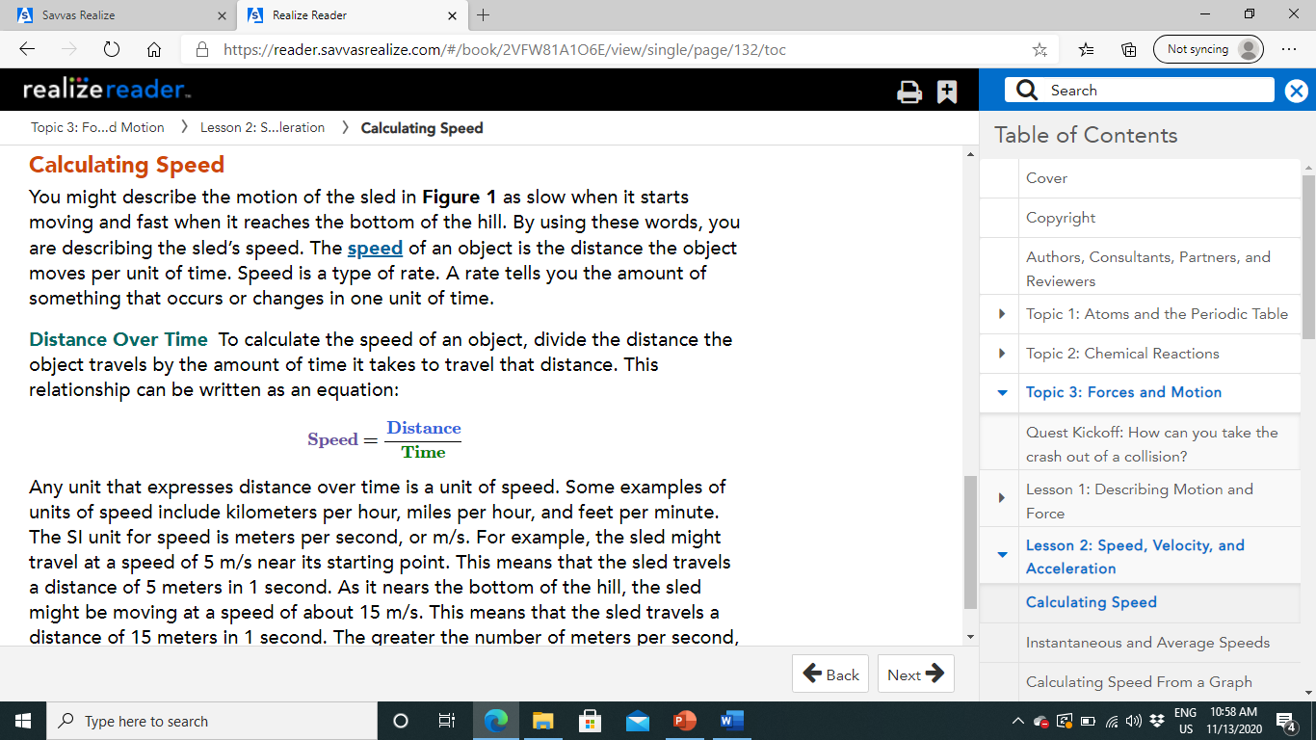
To calculate the speed of an object, divide the distance the object travels by the amount of time it takes to travel that distance. This relationship can be written as an equation: Any unit that expresses distance over time is a unit of speed. Some examples of units of speed include kilometers per hour, miles per hour, and feet per minute. The SI unit for speed is meters per second, or m/s.
How to calculate Speed?

Slide 8

For example, the sled might travel at a speed of 5 m/s near its starting point. This means that the sled travels a distance of 5 meters in 1 second. As it nears the bottom of the hill, the sled might be moving at a speed of about 15 m/s. This means that the sled travels a distance of 15 meters in 1 second. The greater the number of meters per second, the faster the speed at which the object is traveling.
How to calculate Speed?

Slide 9
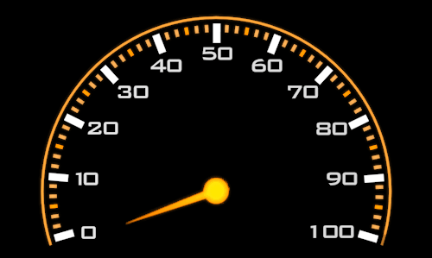
Instantaneous and Average Speeds:
The speed at a particular instant in time is called instantaneous speed.

Slide 10
Although you did not travel at the same speed for the whole trip, you did have an average speed throughout the trip.
To calculate average speed, divide the total distance traveled by the total time.
Average speed = Total distances
Total Time

Slide 11
suppose you drove a distance of 3 kilometers in 1 hour while in heavy traffic. Then, it took you 1 hour to drive 50 kilometers from one side of a city to the other. Finally, you traveled 211 kilometers on an interstate highway in 2 hours. Calculate the average speed of the car.
Total distance=3km+50km+211km=264km
Total time=1h+1h+2h=4h
Average speed=264km4h=66km/h

Slide 12
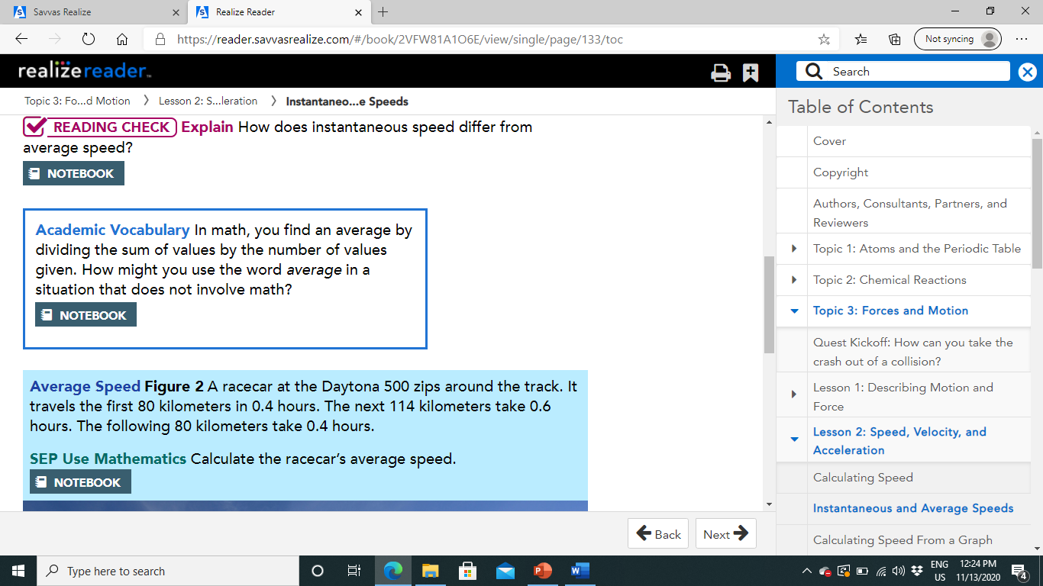
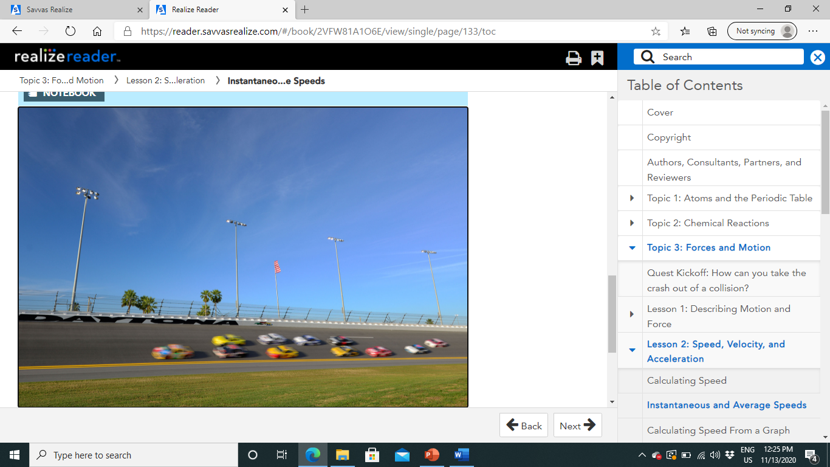
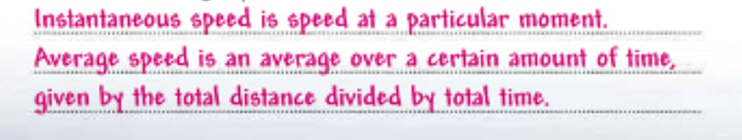
Pg.130

Slide 13
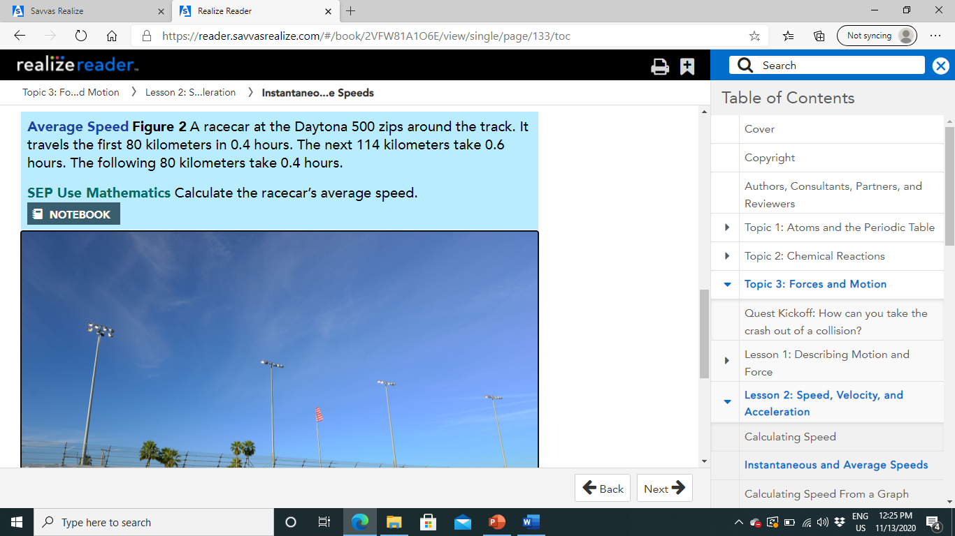
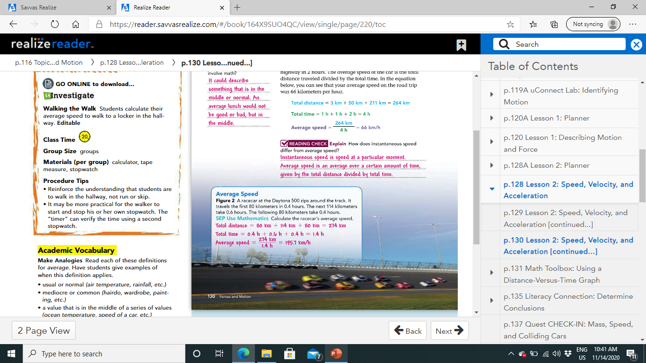
Pg.130

Slide 14
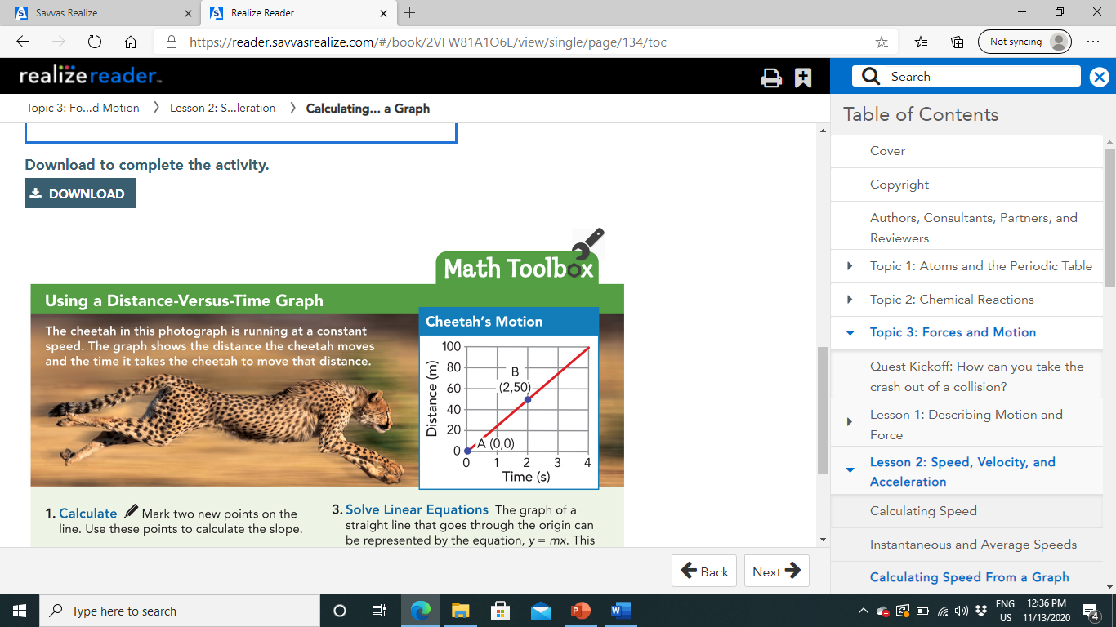
Calculating Speed From a Graph:

Slide 15
Calculating Speed From a Graph:
The graph here is a distance-versus-time graph.
Time is shown on the horizontal axis, or x-axis.
Distance is shown on the vertical axis, or y-axis.
A point on the line represents the distance an object has traveled during a given time period. (SPEED)
The x value of the point is time, and the y value is distance.
Y
X

Slide 16
Calculating Speed From a Graph:
The angle of a line on a graph is called slope.
The slope tells you how one variable changes in relation to the other variable in the graph.
In other words, slope tells you the rate of change.
You can calculate the slope of a line by dividing the rise by the run.
The rise is the vertical difference between any two points on the line.
The run is the horizontal difference between the same two points.
Slope=Rise / Run

Slide 17
The points in the graph show a rise of 50 meters and a run of 2 seconds.
To find the slope, divide 50 meters by 2 seconds. The slope is 25 meters per second.

Slide 18
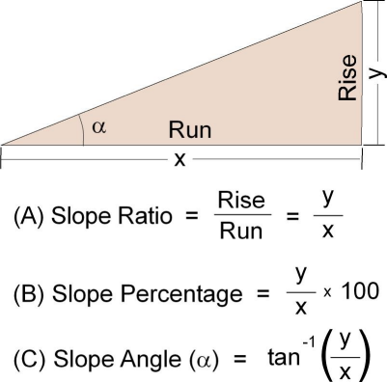
What do you notice about the units of slope?
On a distance-versus-time graph, the units of the slope of the line are the same as the units for speed.
Because speed is the rate that distance changes in relation to time, the slope of a distance-versus-time graph represents speed.

Slide 19
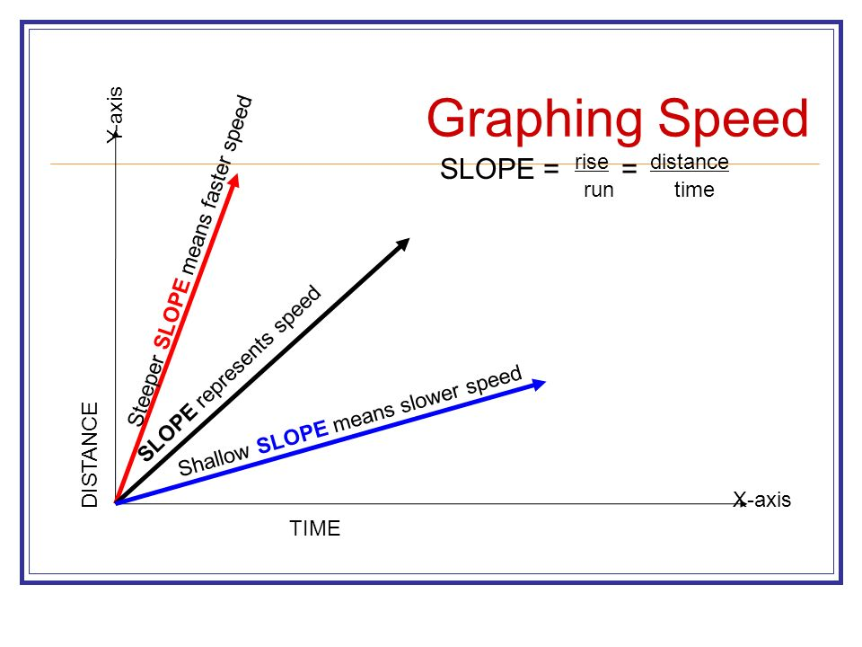
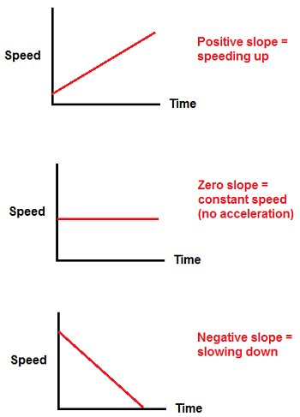
The steeper the slope is, the greater the speed.
A constant slope represents motion at constant speed.

Slide 20
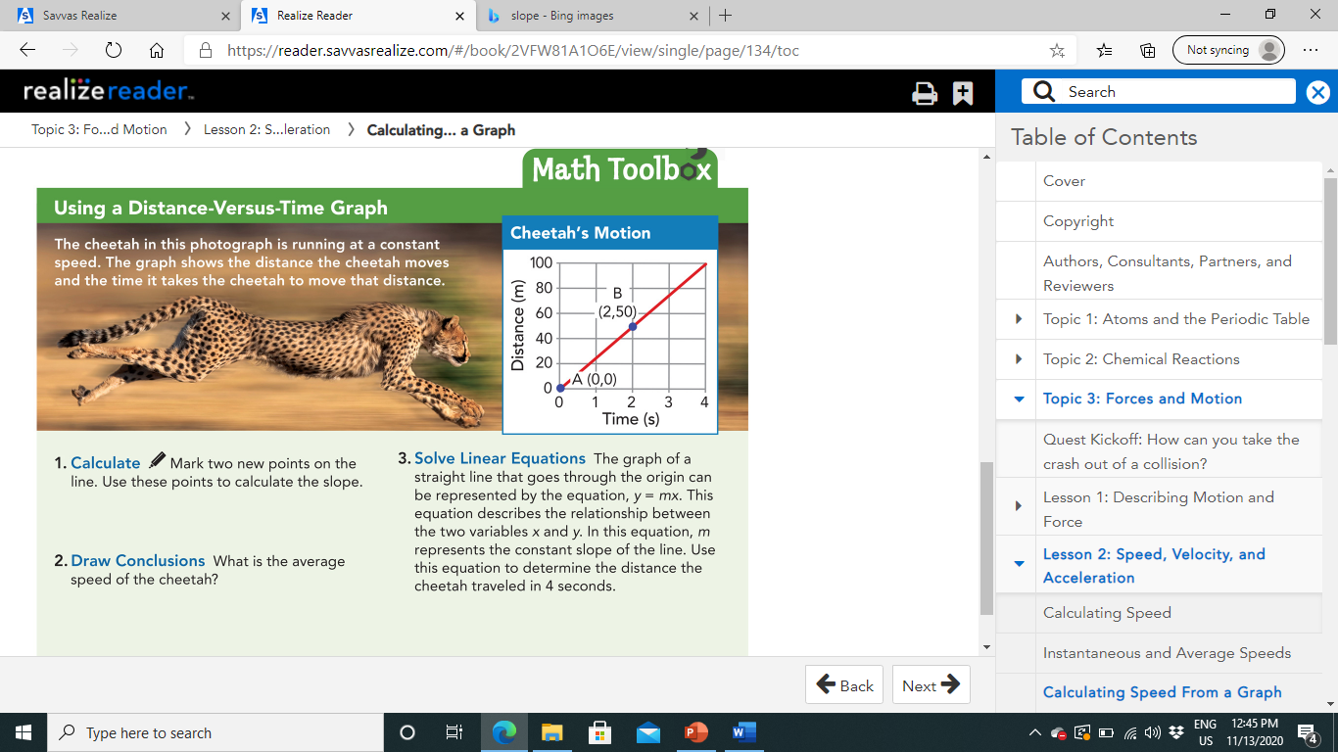
D(4,100)
C(1,25)
Slope=Rise/Run
Slope=(100-25)/(4-1)
Slope=75/3=25 m/s.
25 m/s.
Y=mx
Y=25*4=100m

Slide 21
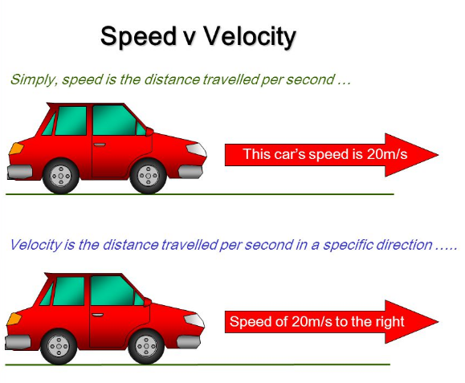
Describing Velocity:
To describe an object's motion, you also need to know its direction.
The speed at which an object travels in a given direction is called velocity.
In certain situations, describing the velocity of moving objects is important.
For example, air traffic controllers must keep close track of the velocities of aircrafts.
These velocities change as airplanes move overhead and on the runways.
An error in determining a velocity, either in speed or in direction, could lead to a collision

Slide 22
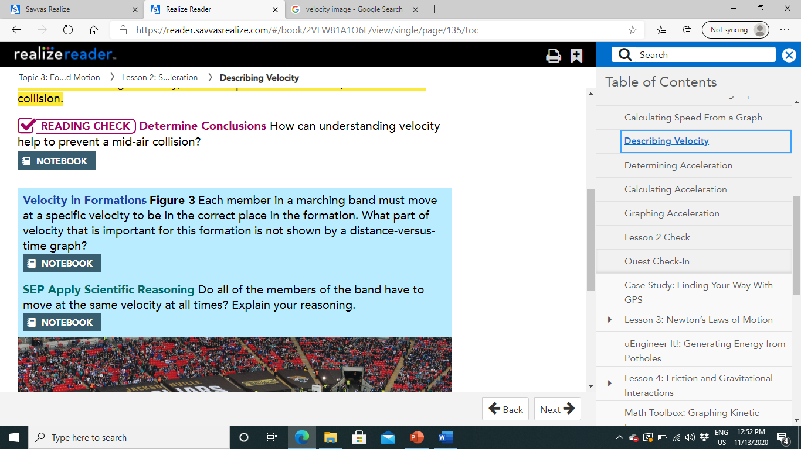
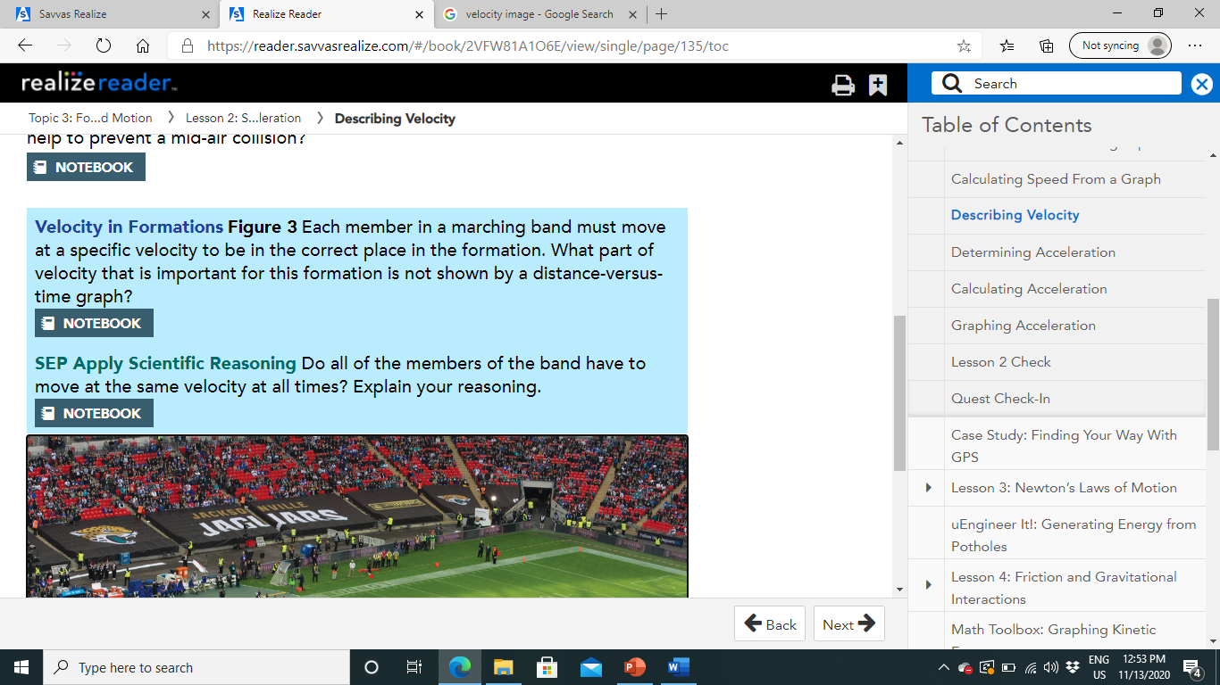
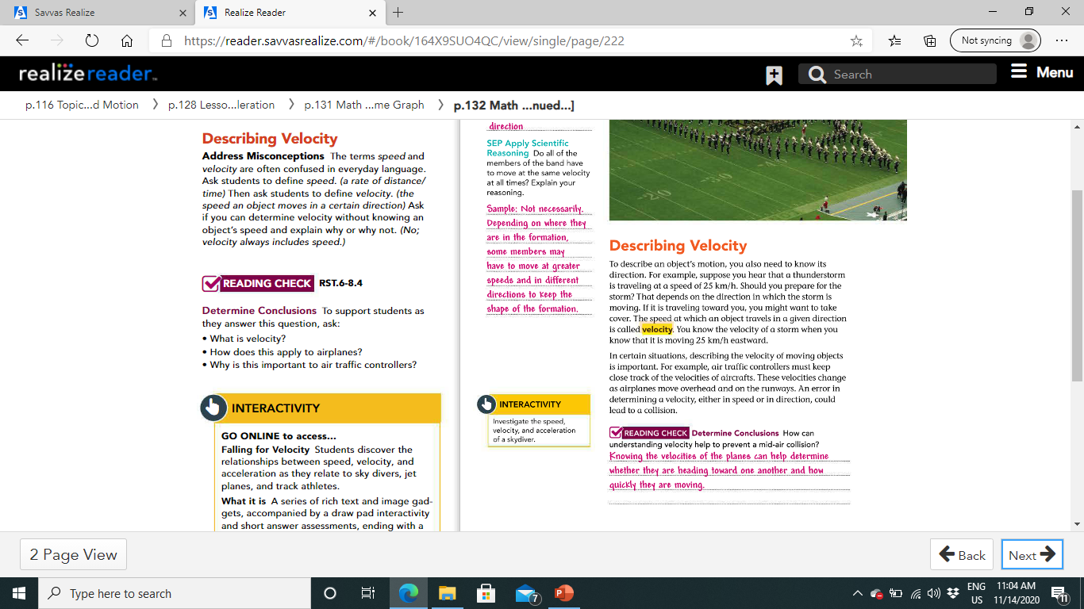
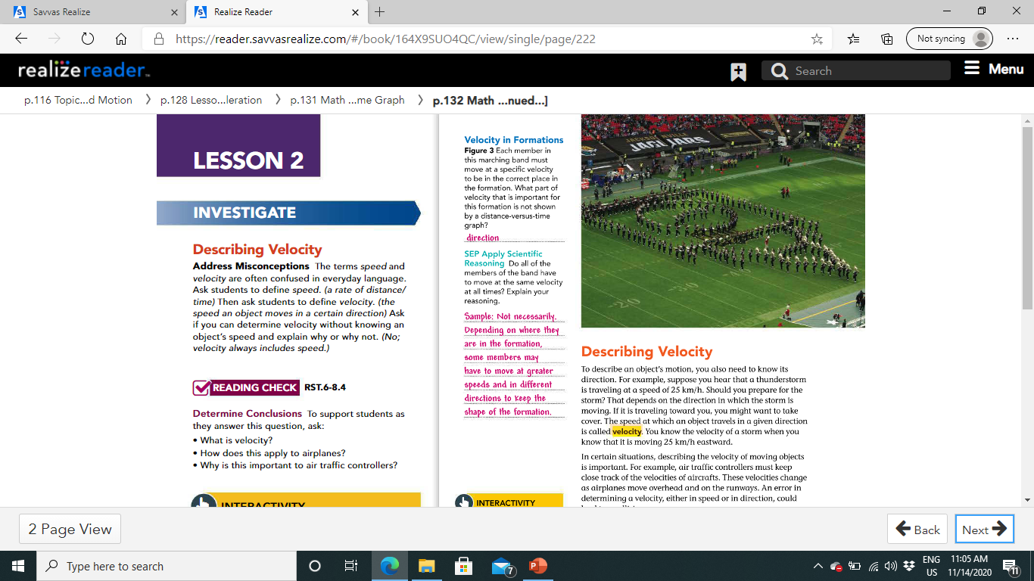
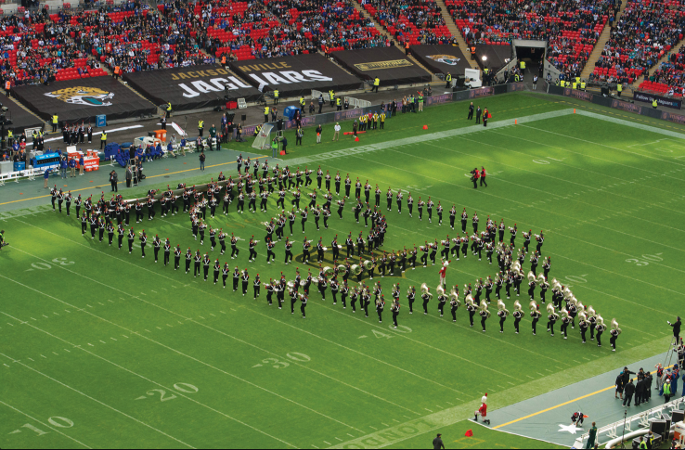
Direction
Pg.132

Slide 23
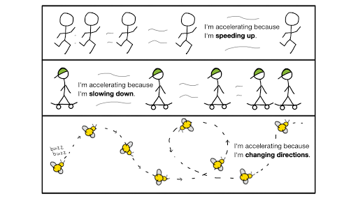
Determining Acceleration:
Speed and velocity are not the only ways to describe motion.
Scientists define acceleration as the rate at which velocity changes.
A change in velocity can involve a change in speed, direction, or both.
In science, when an object accelerates, it increases speed, decreases speed, or changes direction.

Slide 24
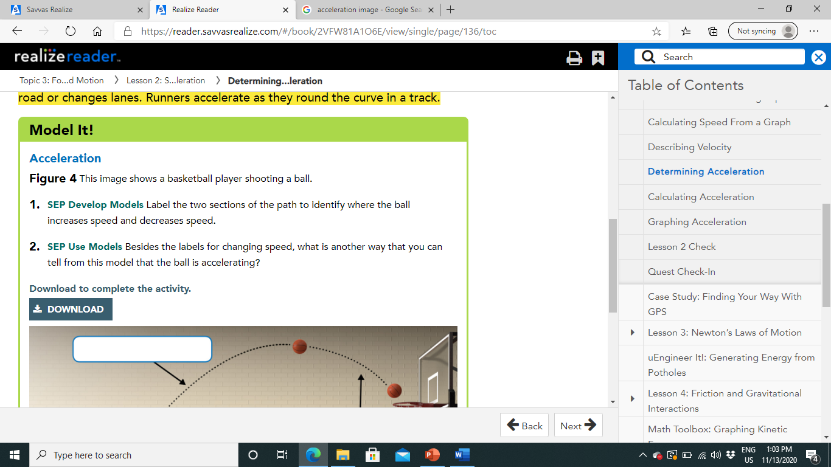
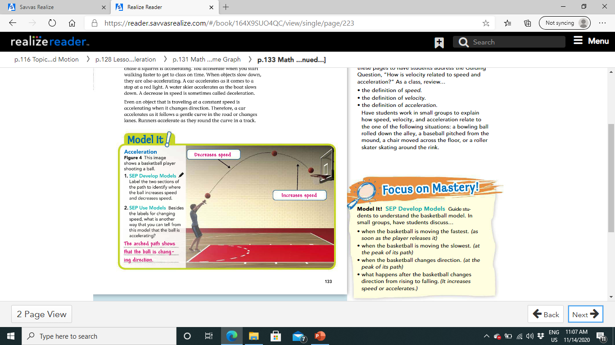
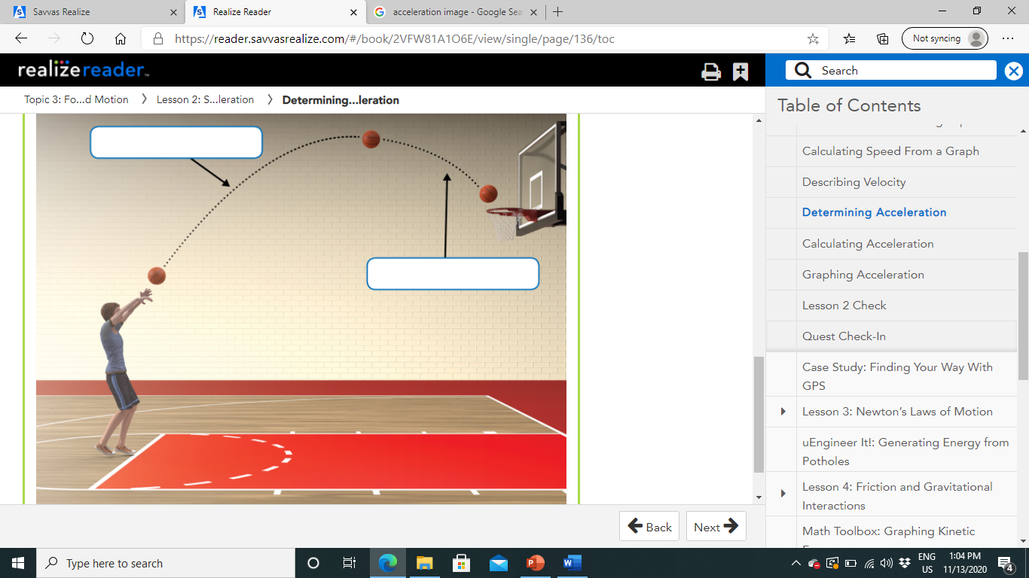
Pg.133

Slide 25

Calculating Acceleration:
If an object is not changing direction, you can describe its acceleration as the rate at which its speed changes.
To determine the acceleration of an object moving in a straight line, you calculate the change in speed per unit of time.
This is summarized by the following equation:
Acceleration= Final speed - Initial speed / Time
Since speed is measured in meters per second (m/s) and time is measured in seconds, acceleration is meters per second per second, or m/s2.
This unit is the SI unit for acceleration.

Slide 26
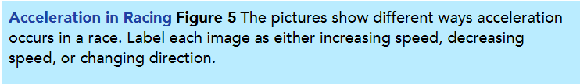
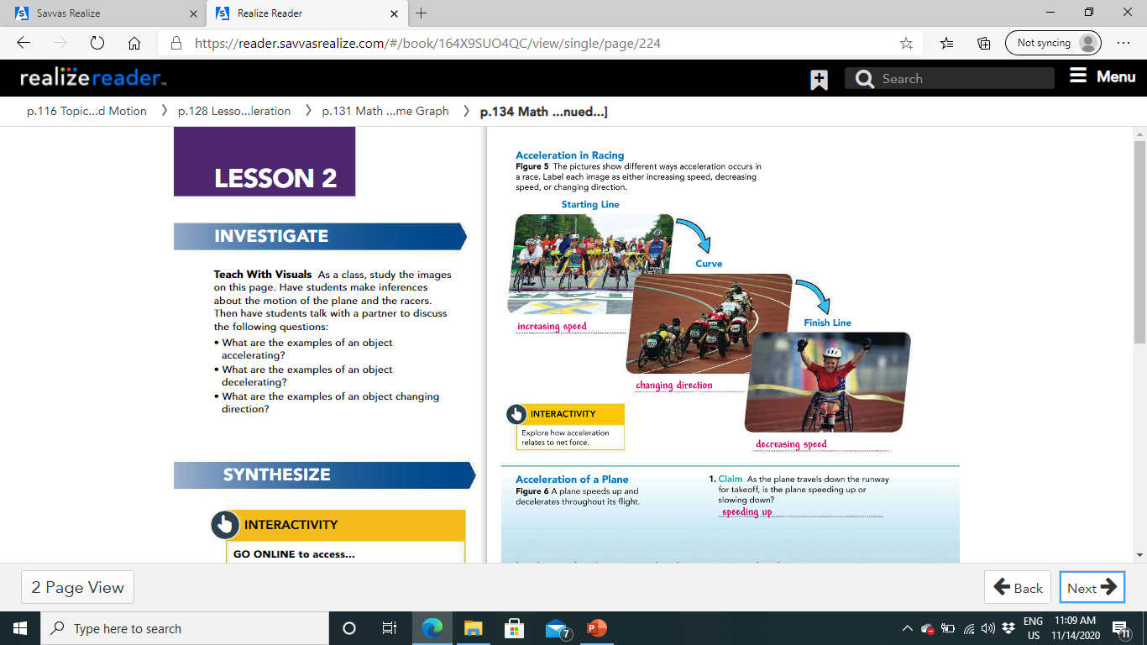
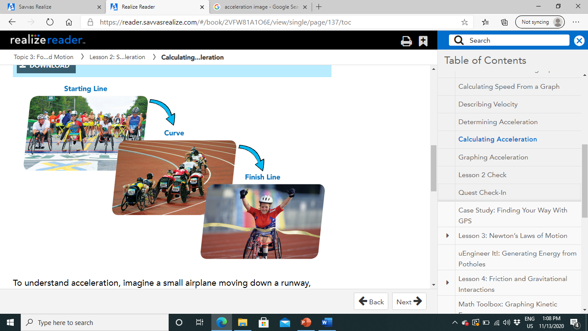
Pg.134

Slide 27
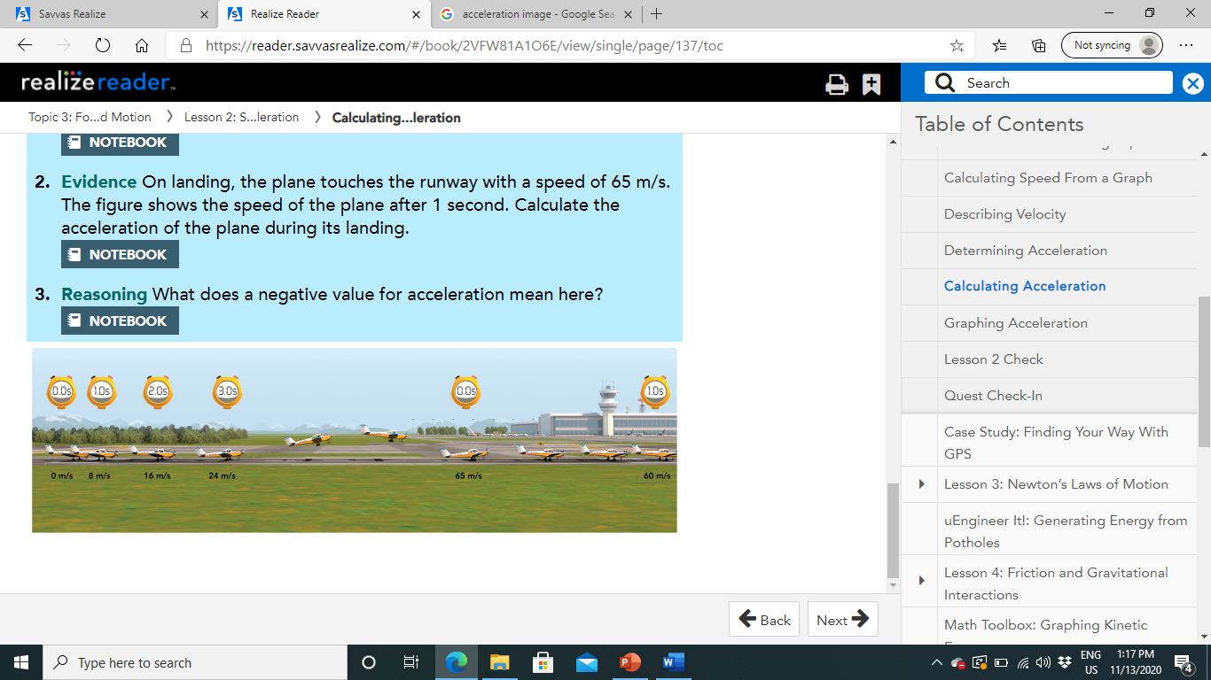
To understand acceleration, imagine a small airplane moving down a runway, preparing for takeoff.
the airplane's speed after each second of its acceleration.
To calculate the acceleration of the airplane during takeoff, you must first subtract the initial speed of 0 m/s from its final speed of 24 m/s.
Then divide the change in speed by the time, 3 seconds.
Acceleration=24m/3s.
The airplane accelerates at a rate of 8 m/s2.
This means that the airplane's speed increases by 8 m/s every second.
Notice in Figure 6 that after each second of travel during takeoff, the airplane's speed is 8 m/s greater than its speed in the previous second.

Slide 28
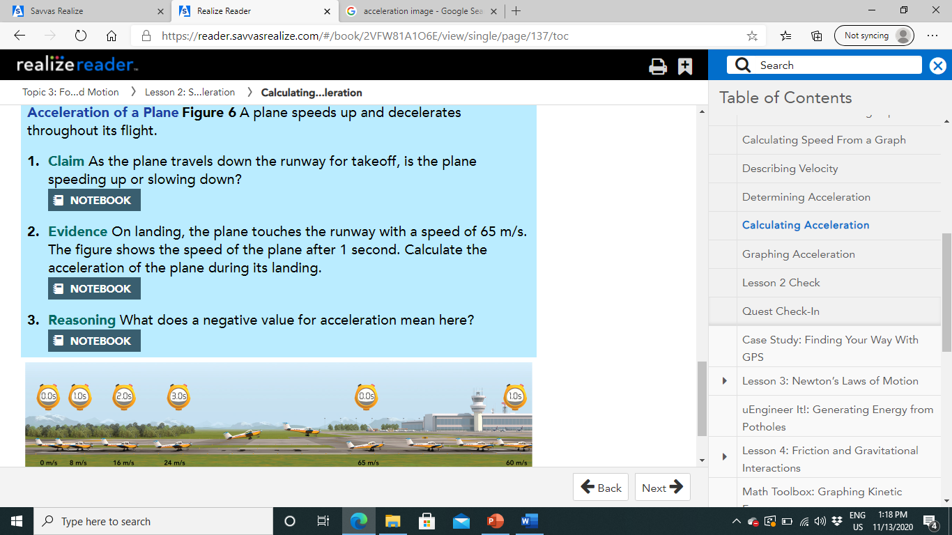
Pg.135
Speeding up
Acc. = (Final speed- initial speed) / Time
Acc.= (60-65) /1 =-5 m/s2
Means that the plane is deaccelerating or slowing down

Slide 29
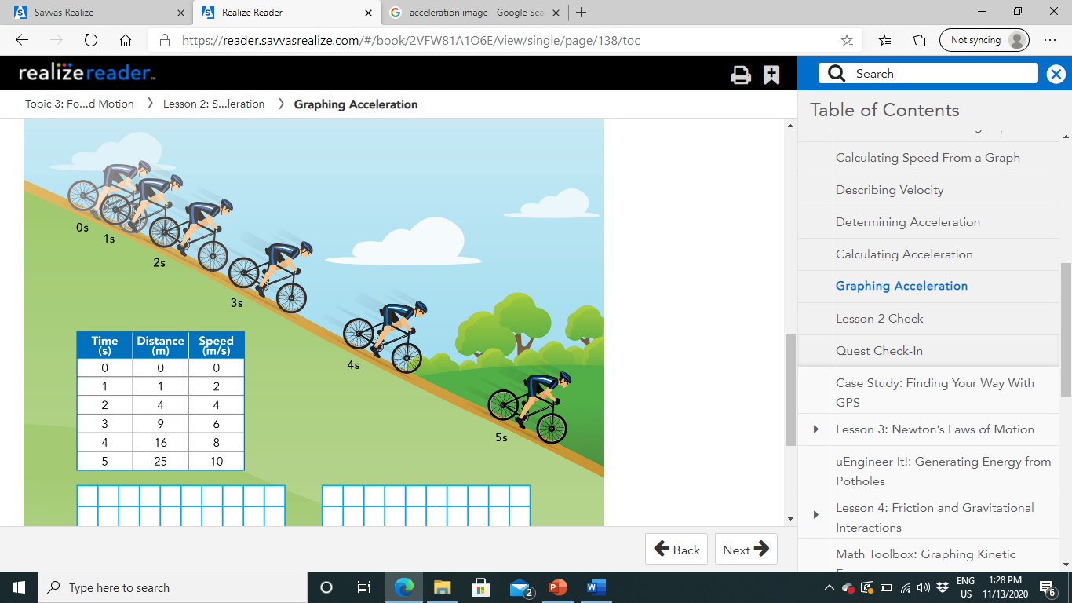
Graphing Acceleration:
Suppose you bike down a long, steep hill. At the top of the hill, your speed is 0 m/s.
As you start down the hill, your speed increases.
Each second, you move at a greater speed and travel a greater distance than the second before.
During the five seconds it takes you to reach the bottom of the hill, you are accelerating.
Use the data provided in Figure 7 to graph and analyze your motion on the accelerating bike.

Slide 30
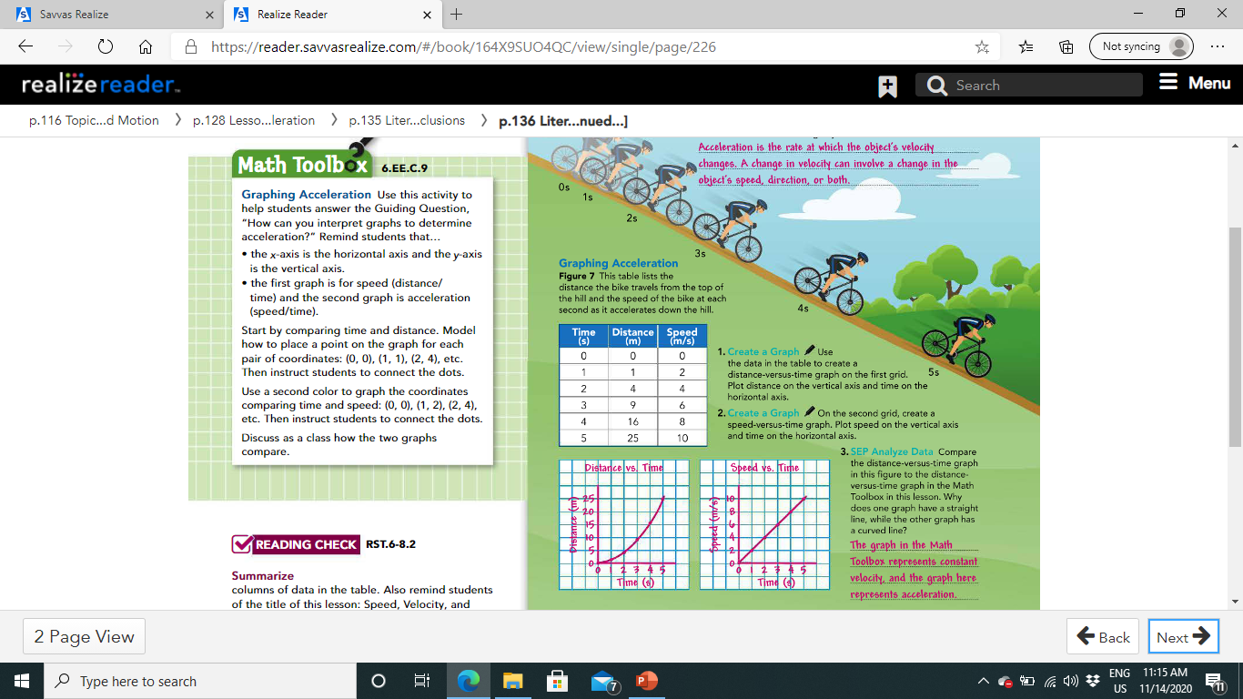

Slide 31
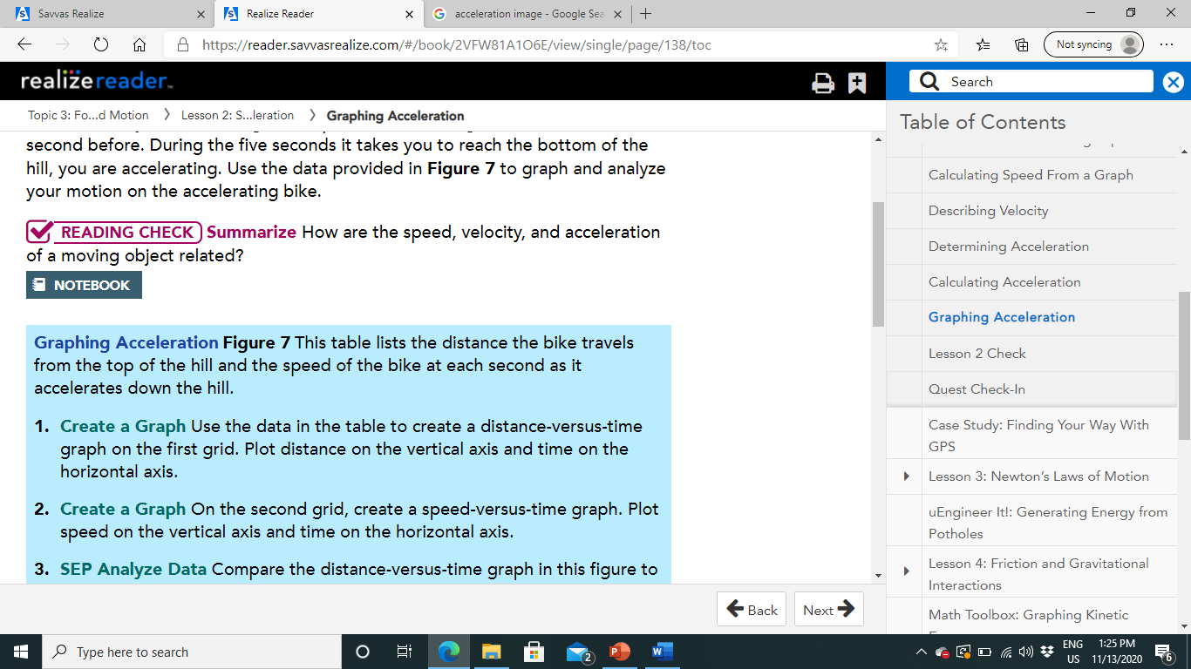

Slide 32
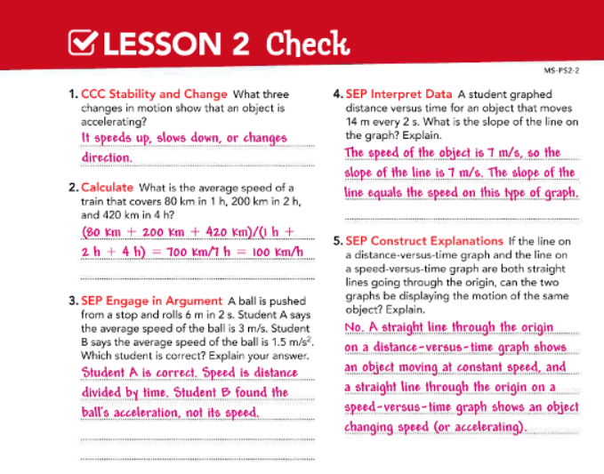

Slide 33
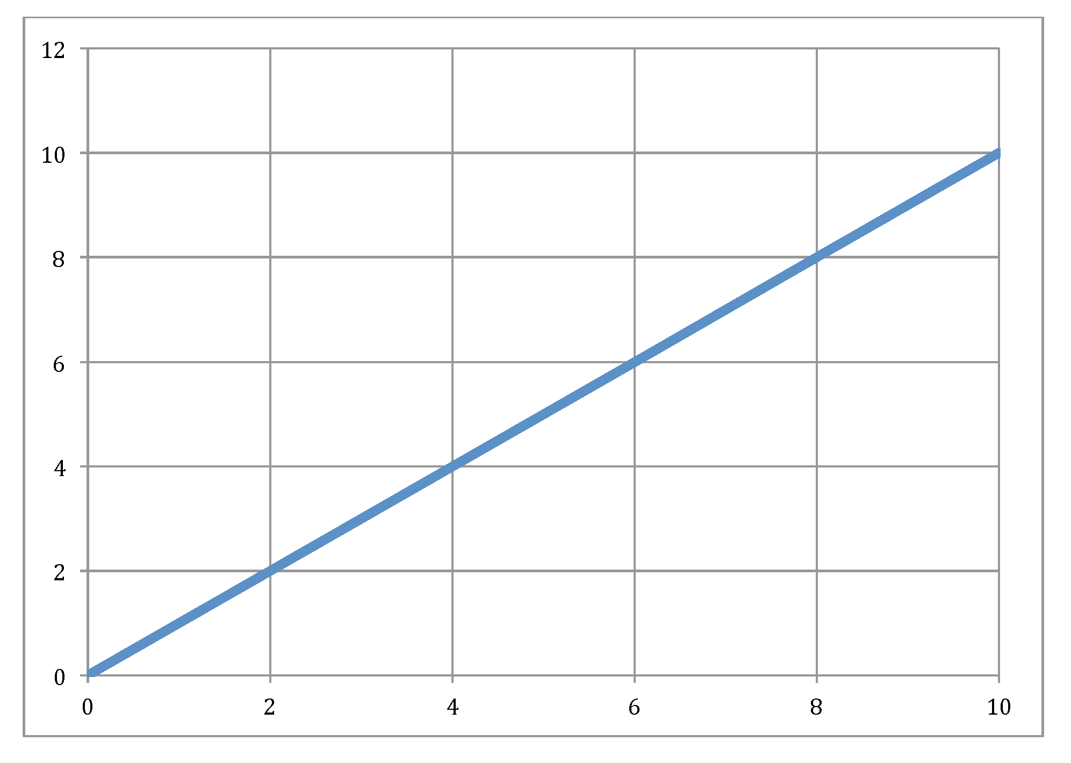

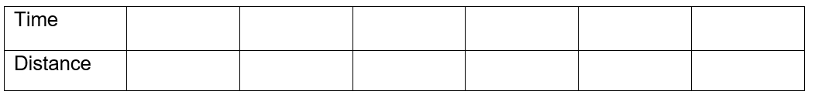

07/Dec/2023
Motion Graphs Interactivity
How can you use a graph to analyze motion?
Record Data and Observations
Part 1
From the interactivity, table for Experiment 1
Analyze and Conclude
Make Graphs: Plot a graph of the motion of the space probe from Experiment 1.
Distance (m)
Time (s)

Slide 34
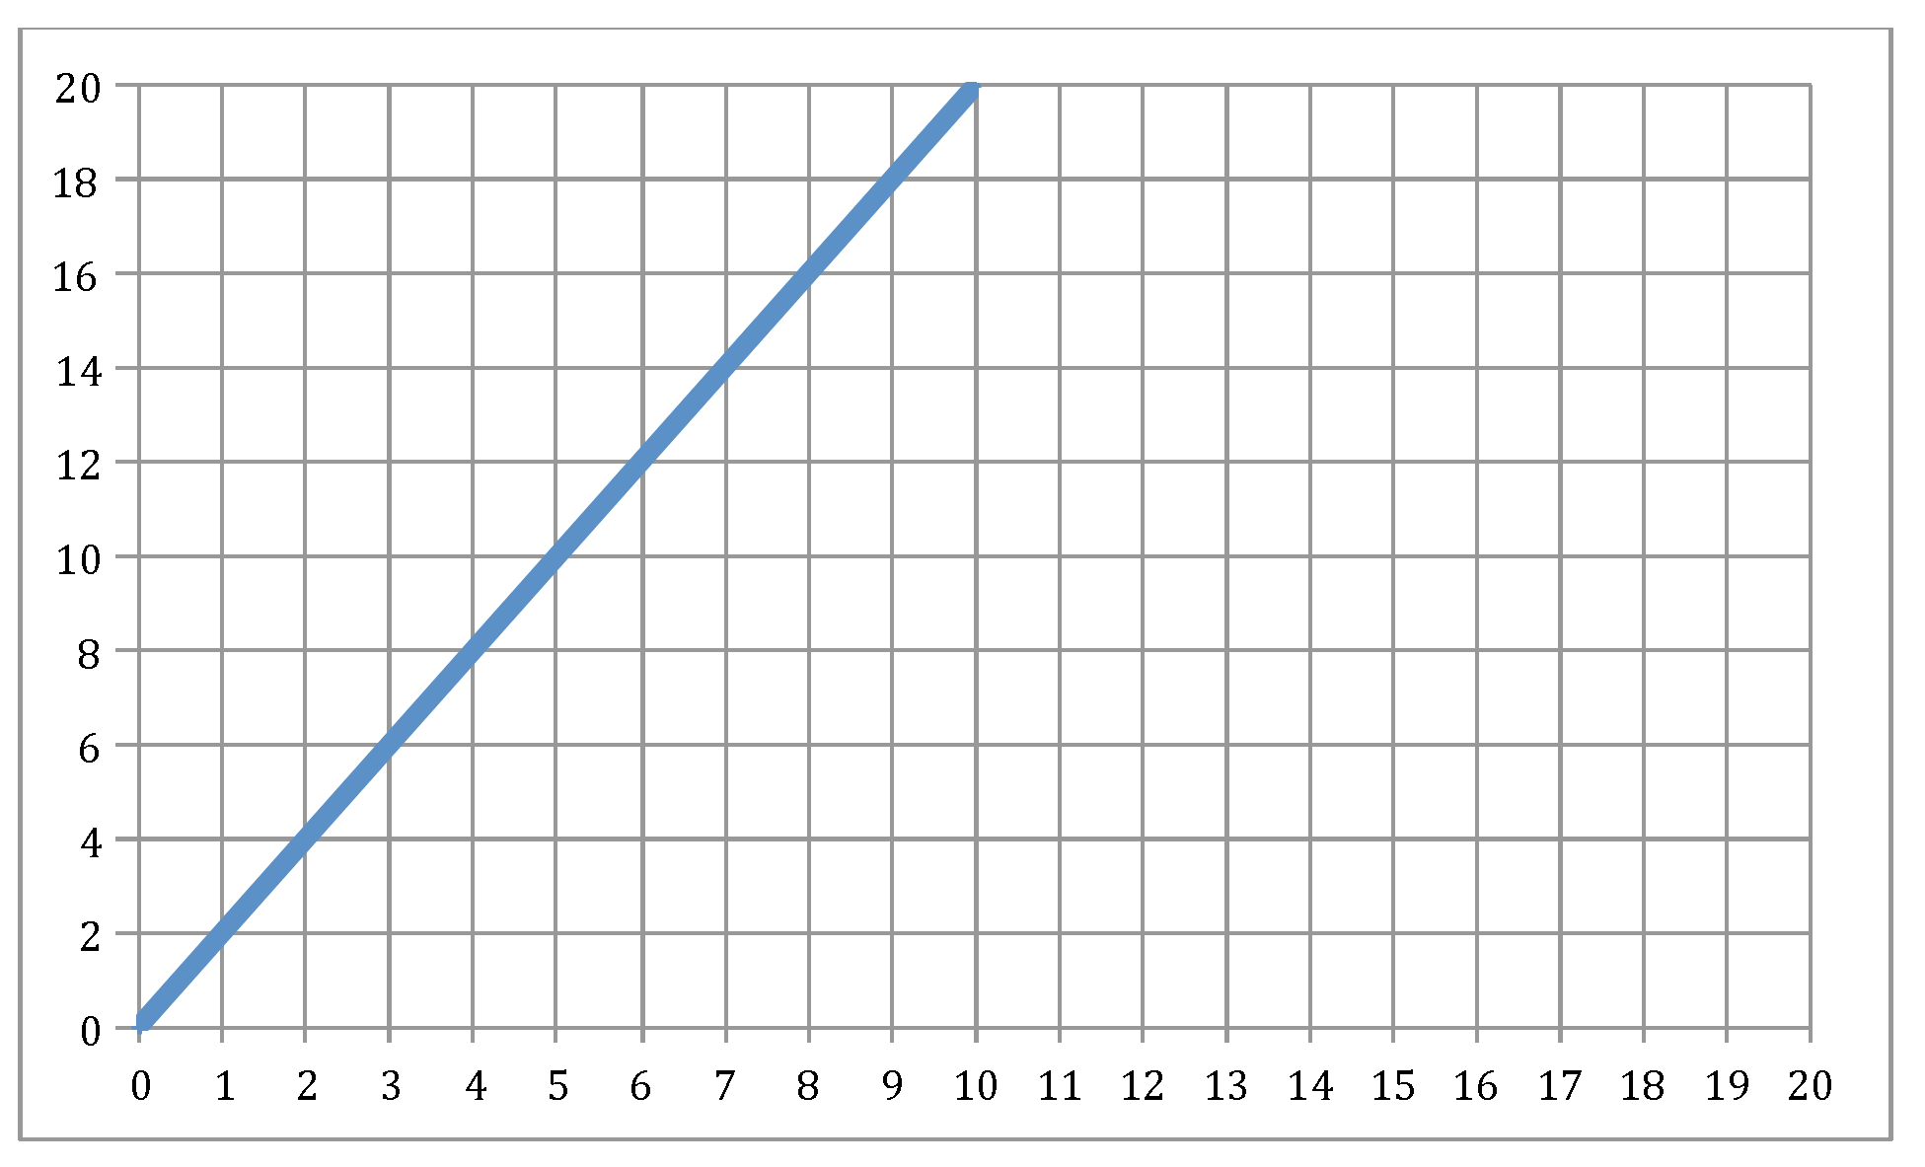

Analyze and Conclude
Make Graphs: Plot a graph of the motion of the space probe from Experiment 2.
Part 2
From the interactivity, table for Experiment 2
Distance (m)
Time (s)

Slide 35

Analyze and Conclude
Make Graphs: Plot a graph of the motion of the space probe from Experiment 3.
Part 3
From the interactivity, table for Experiment 3
Distance (m)
Time (s)

Slide 36
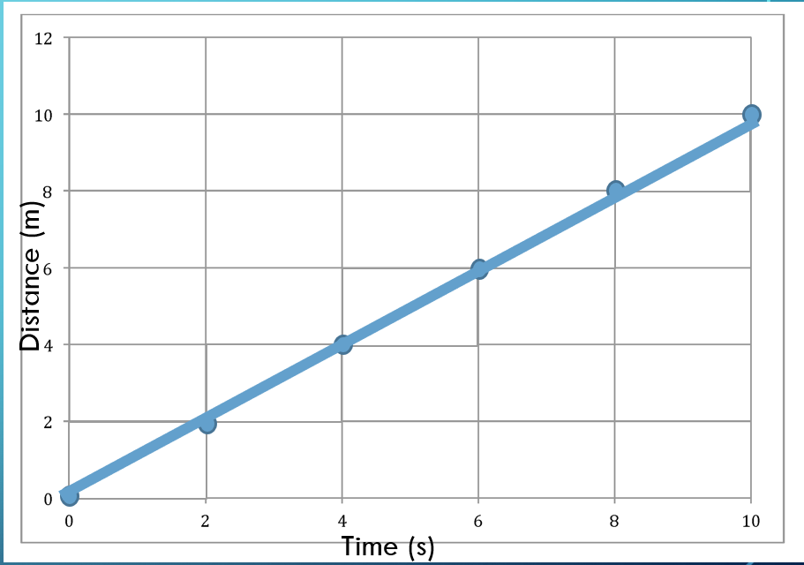
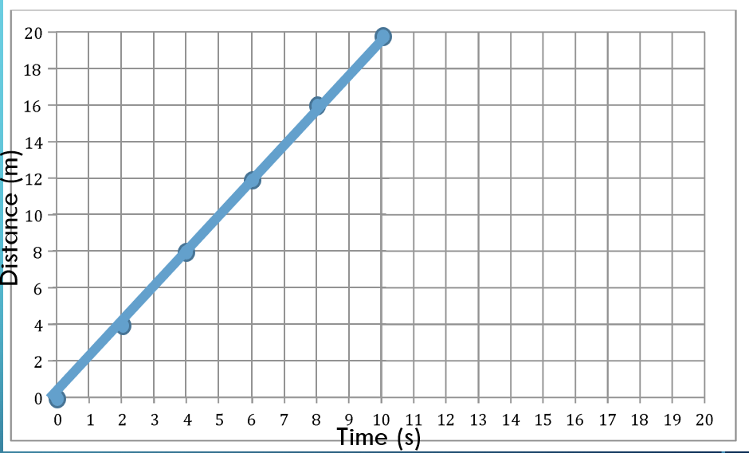
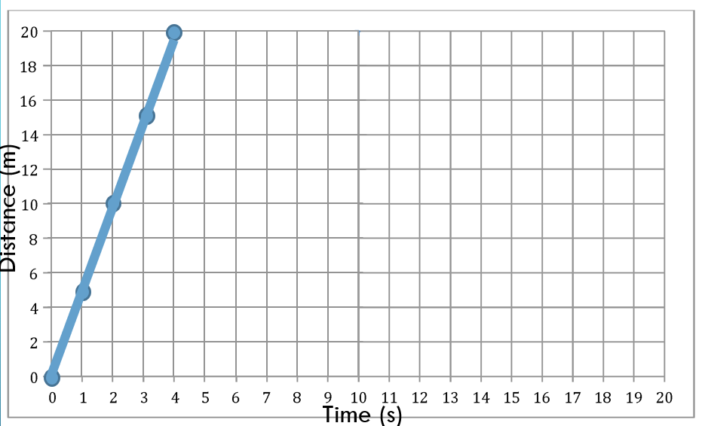
Analyze Graphs
Which graph shows the space probe moving the slowest? Which graph shows the space probe moving the fastest? Explain how the graphs show this information.
Experiment 1
The graph for Experiment 1 shows the space probe moving slowest. The graph for Experiment 3 shows the space probe moving fastest. The slope of a motion graph shows the speed of motion; the greater the slope, the faster the object is moving.
Experiment 2
Experiment 3

Slide 37
Use Mathematical Thinking If a space probe moves 20 m in 4 s, how fast is it moving?
Speed = Distance
time
Speed = 20m
4s
Speed = 5m/s

Slide 38


