Slide 1
Friction and Gravitational Interactions
topic 3 Lesson 4

Slide 2
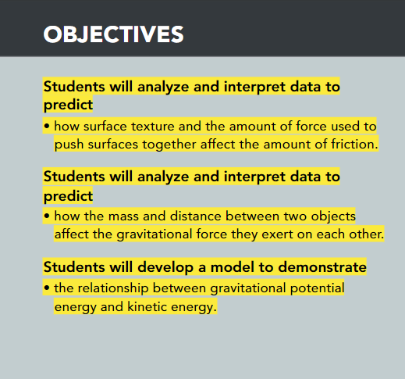
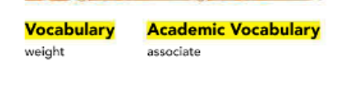

Slide 3
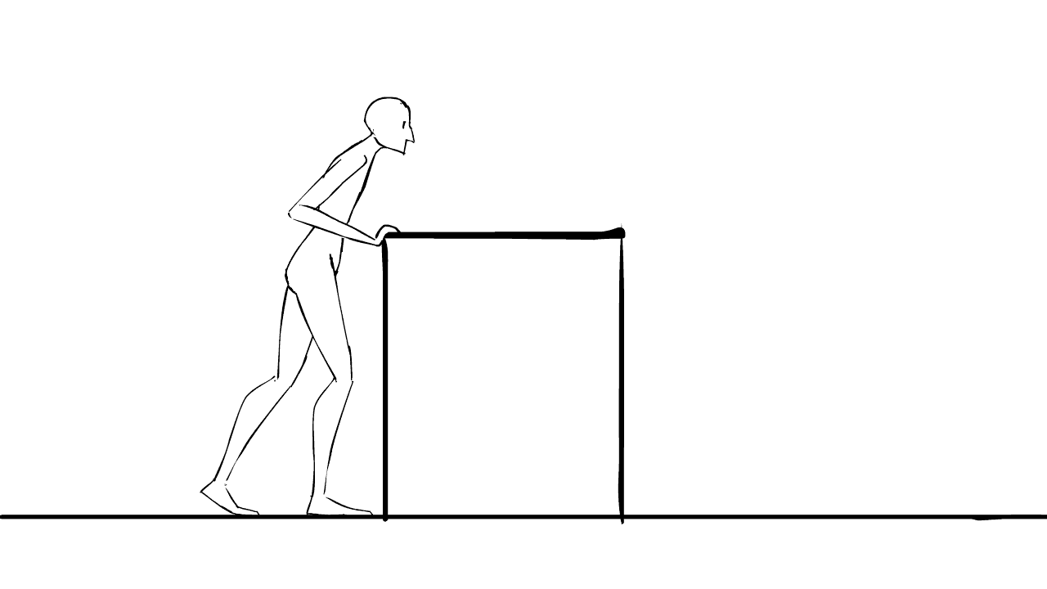
Do you remember, what is friction?
Recall that the force two surfaces exert on each other when they rub against each other is the contact force called friction.
For example, if you slide a book across a table, the surface of the book rubs against the surface of the table.
The resulting force is friction.
This force acts in a direction opposite to the motion of the book and eventually stops the book.

Slide 4
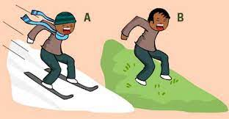
What are Factors That Affect Friction?

Slide 5
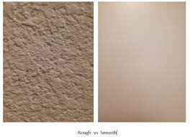
Two Factors:
1st factor: the types of surfaces involved
2nd factor: how hard the surfaces are pushed together affect the friction between two surfaces.
In general, smoother surfaces produce less friction than rougher surfaces.
Friction increases as surfaces push harder against each other.
Friction acts in a direction opposite to the direction of the object's motion.
Without friction or some other force acting in the opposite direction, a moving object will not stop until it strikes another object.

Slide 6
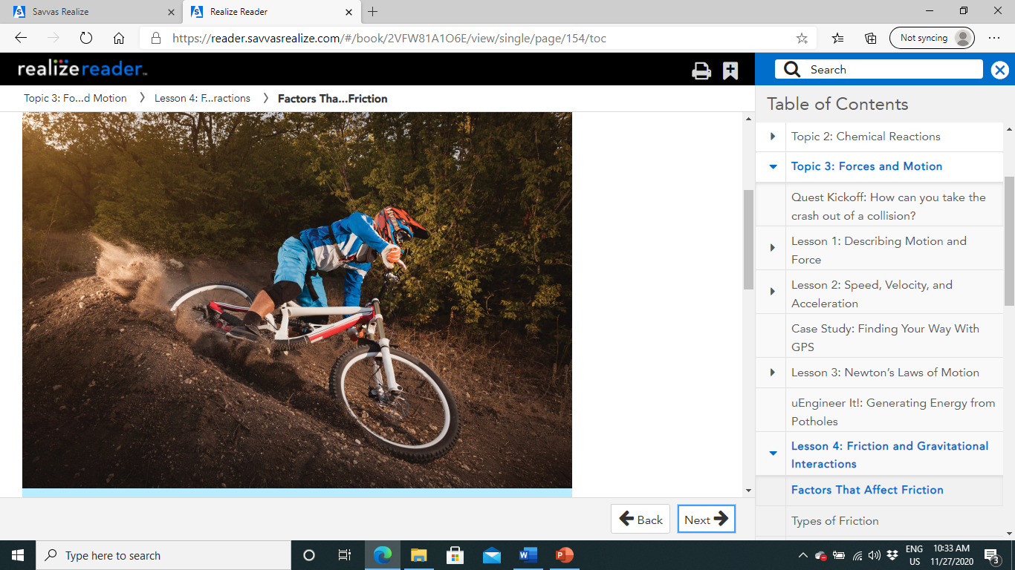
Two Factors:
The bicyclist in Figure 1 is using friction to slow his bicycle.
Have you ever examined the surface of a tire? The tread on the tire results in more friction between the tire and the ground.
A tire on a mountain bike has more tread on it than a regular bike tire, so a lot of friction is produced between a mountain bike tire and the ground.
In this instance, friction also occurs between the brake pads and the wheels.
This friction prevents the tire from turning.
The harder the bicyclist applies the brakes, the more quickly the bike will come to a stop.

Slide 7
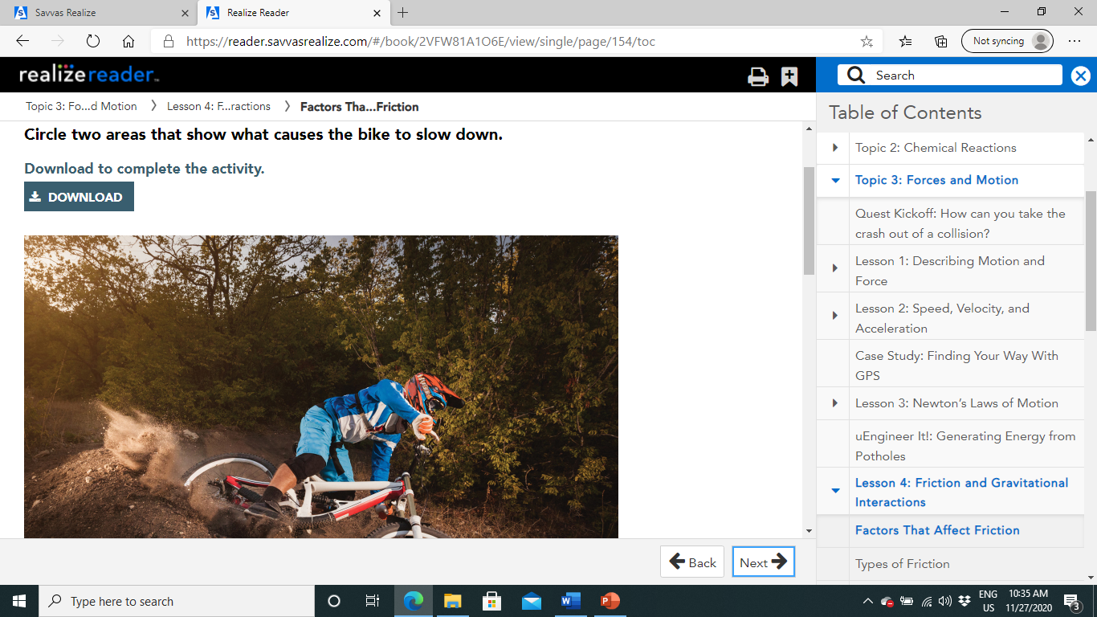
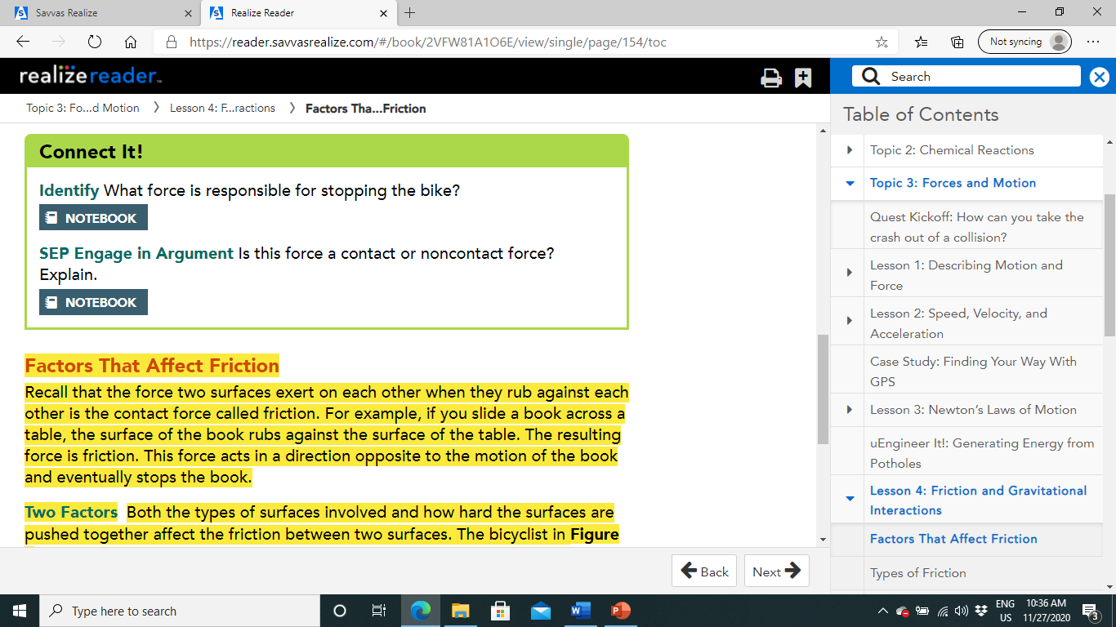
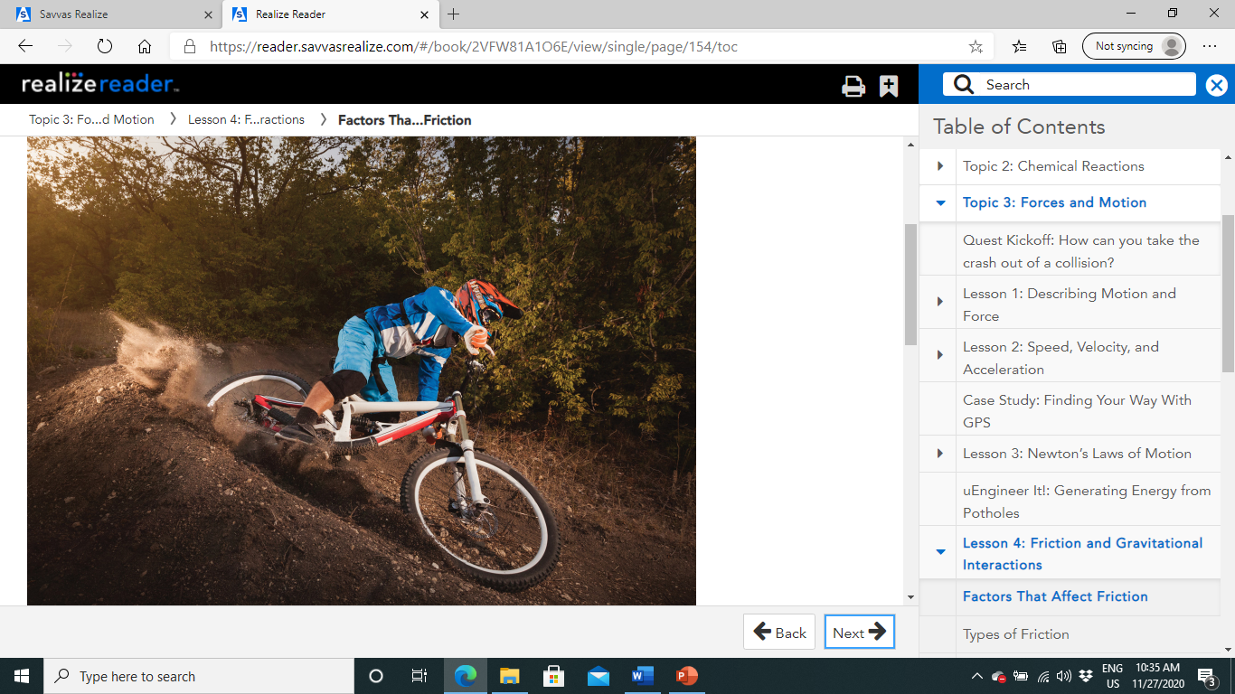
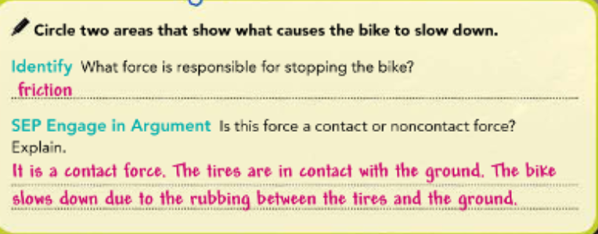

Slide 8
Types of Friction
Rolling Friction
Sliding Friction
Static Friction
Fluid Friction

Slide 9
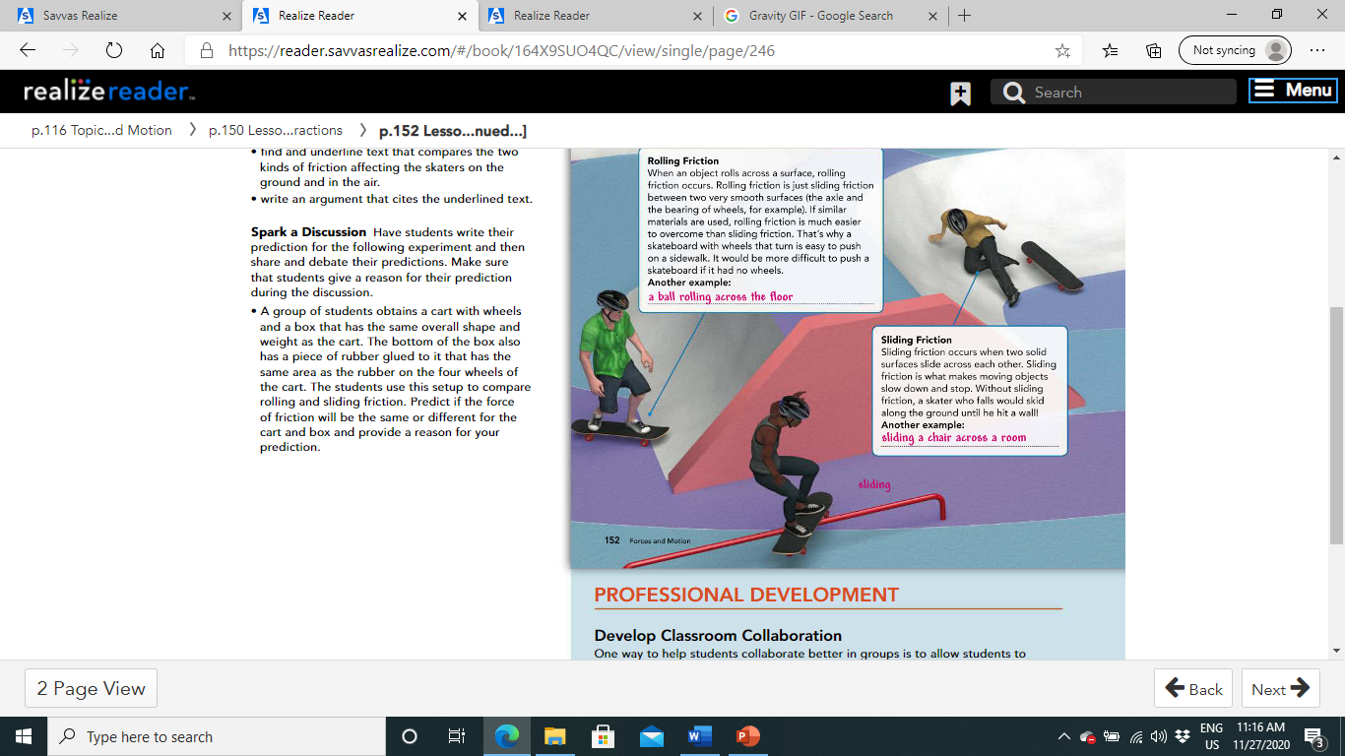
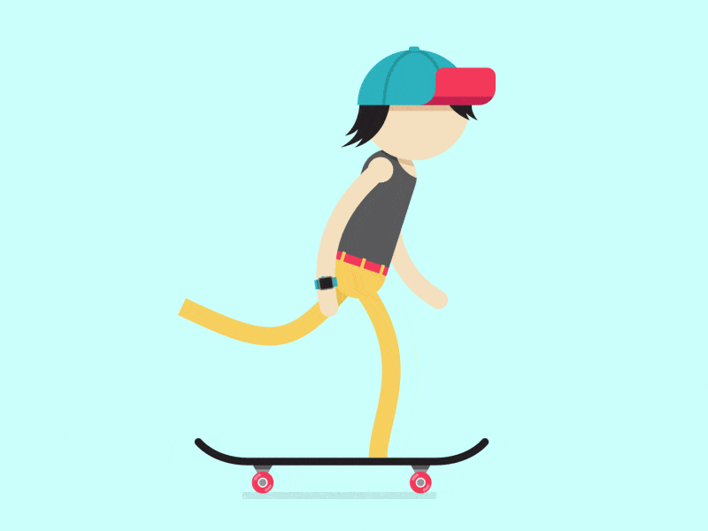

Slide 10
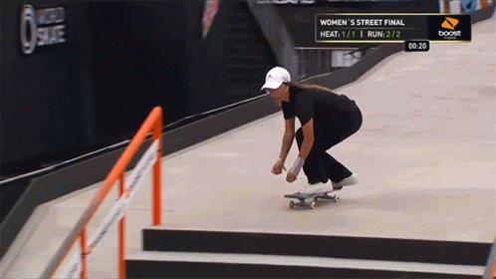

Slide 11
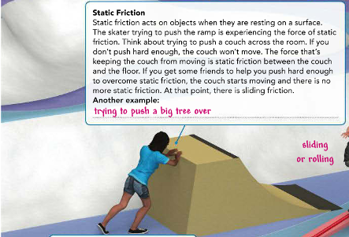
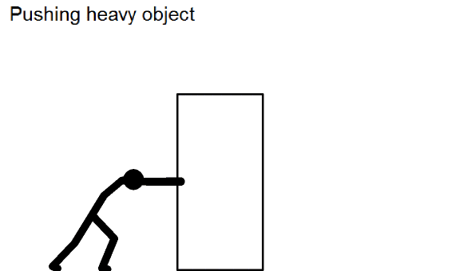

Slide 12
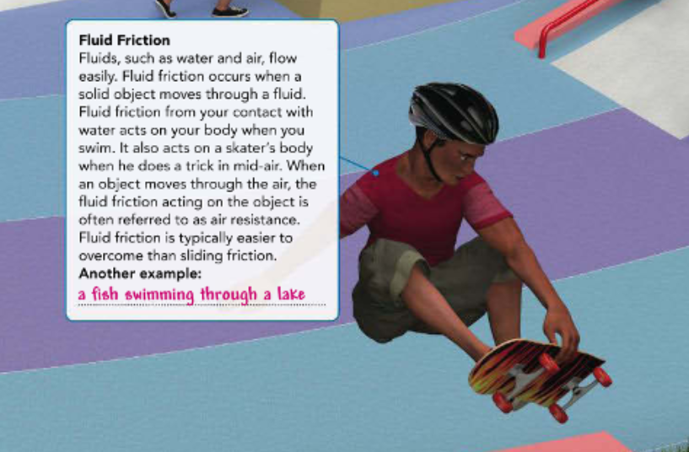
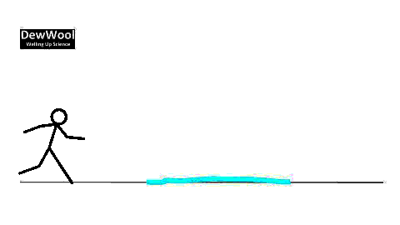

Slide 13
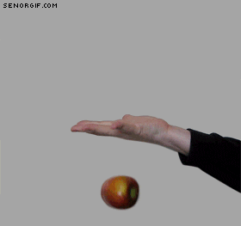
Gravity:
While friction is an example of a contact force, gravity is an example on a non-contact force.
Remember that gravity is a force that pulls objects toward each other.
but, How is gravity experienced on Earth?

Slide 14
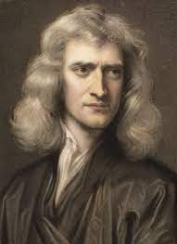
Factors That Affect Gravity:
How is gravity experienced on Earth?
You could name many examples.
A basketball player shoots a ball toward the basket, and the ball falls toward Earth.
Rain falls from the sky to Earth.
We are so familiar with objects falling that we may not think much about why they fall.
One person who thought about this was Sir Isaac Newton.
He concluded that a force called gravity acts to pull objects straight down toward the center of Earth.

Slide 15
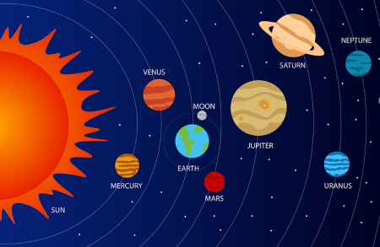
Universal Gravitation:
Newton realized that gravity acts everywhere in the universe, not just on Earth.
This law states that the force of gravity acts between all objects in the universe that have mass.
So, any two objects in the universe that have mass attract each other.

Slide 16
Universal Gravitation:
Newton realized that gravity acts everywhere in the universe, not just on Earth.
It is the force that causes the tides in Earth's ocean and keeps all the planets in our solar system orbiting around the sun.
On Earth, gravity is the force that makes the jumpers in Figure 3 fall toward the water.
Newton's realization is now called the law of universal gravitation.
This law states that the force of gravity acts between all objects in the universe that have mass.
So, any two objects in the universe that have mass attract each other.
You are attracted not only to Earth but also to your school desk, the other planets in the solar system, and the most distant star you can see.
Earth and the objects around you are attracted to you as well.
You can clearly see the gravitational effect of Earth on an object.
However, you do not notice the attraction between objects on Earth because these forces are extremely small compared to the attraction between the objects and Earth itself.

Slide 17
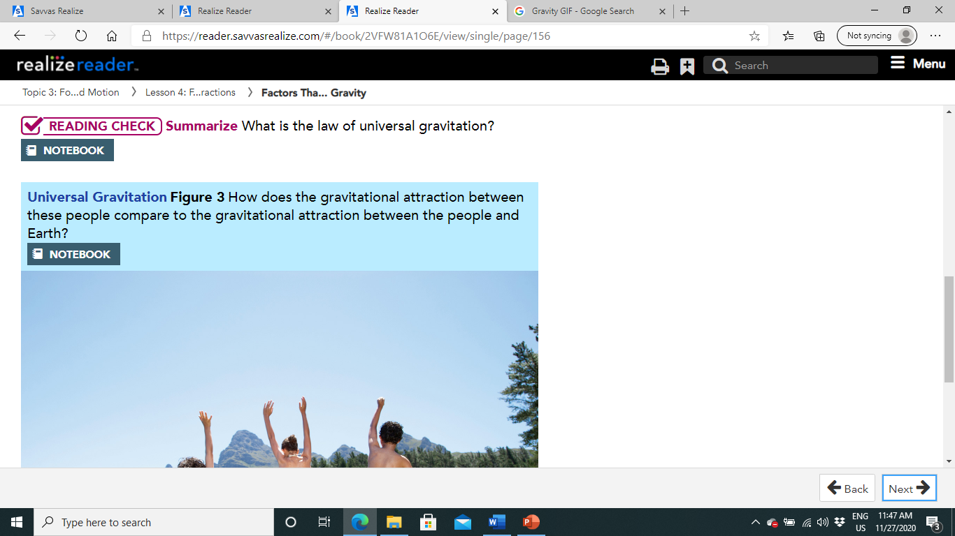
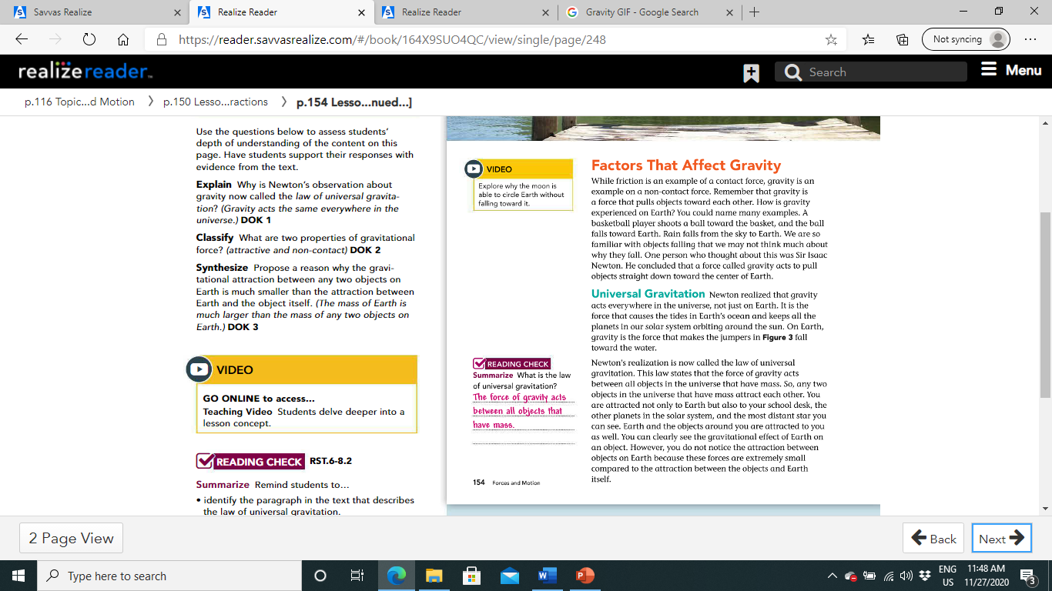
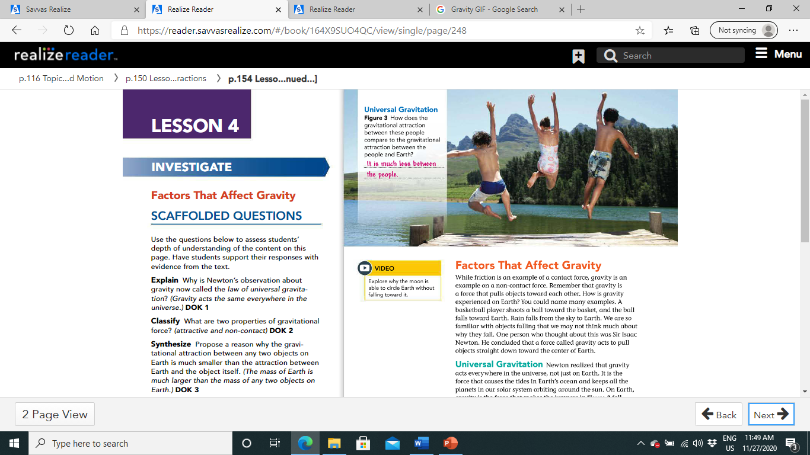
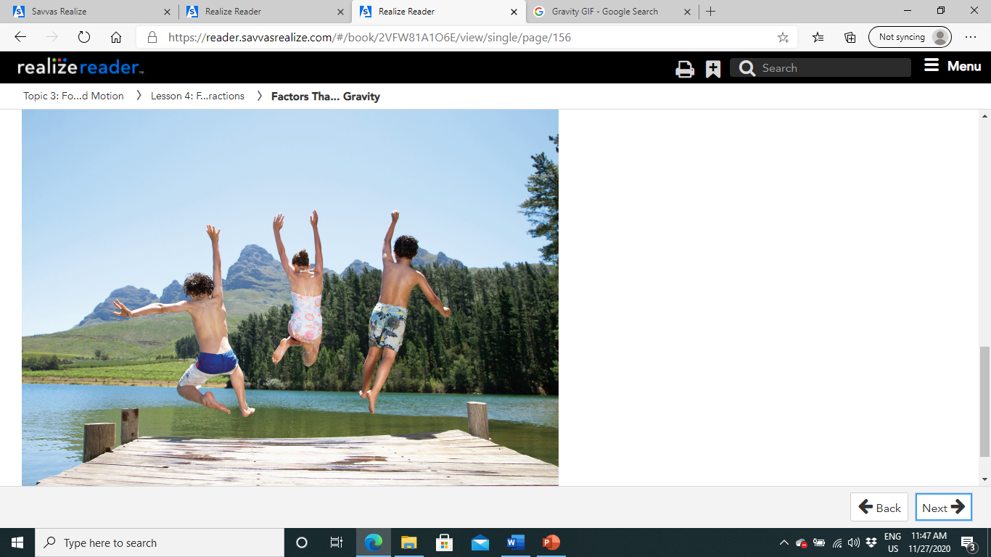
Pg.154

Slide 18
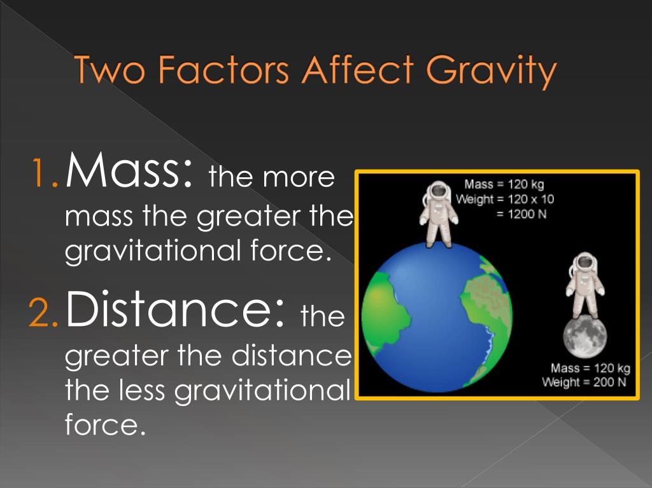
Factors Affecting Gravity:
What factors control the strength of the gravitational force between two objects?
These factors are the mass of each object and the distance between them.

Slide 19
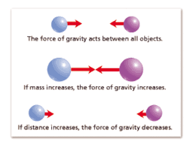
Factors Affecting Gravity:
The more mass an object has, the greater the gravitational force between it and other objects.
Earth's gravitational force on nearby objects is strong because the mass of Earth is so large.
Gravitational force also depends on the distance between the objects' centers.
As distance increases, gravitational force decreases.

Slide 20
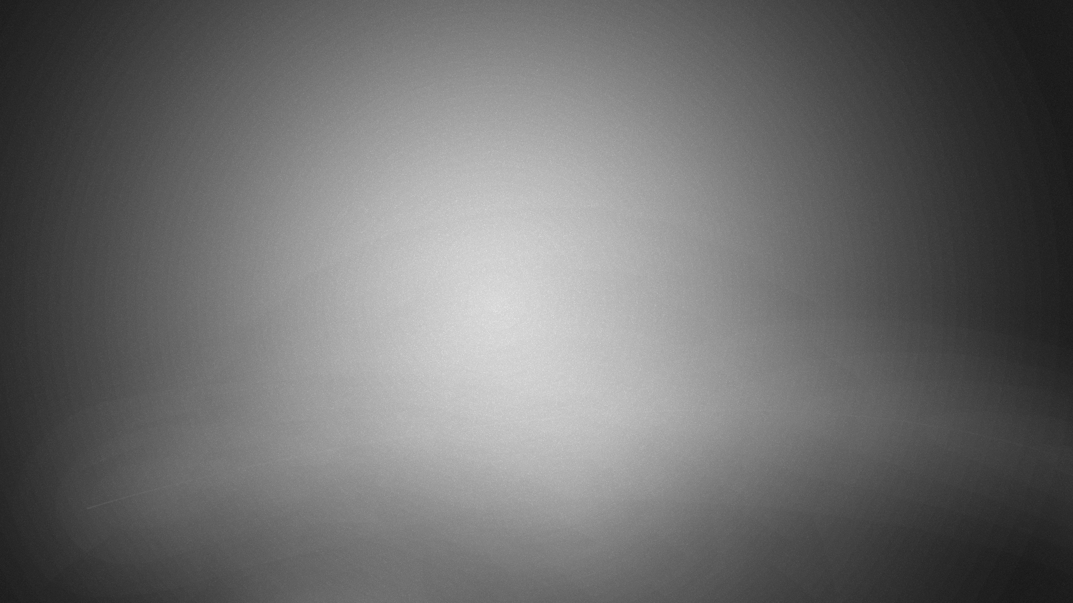
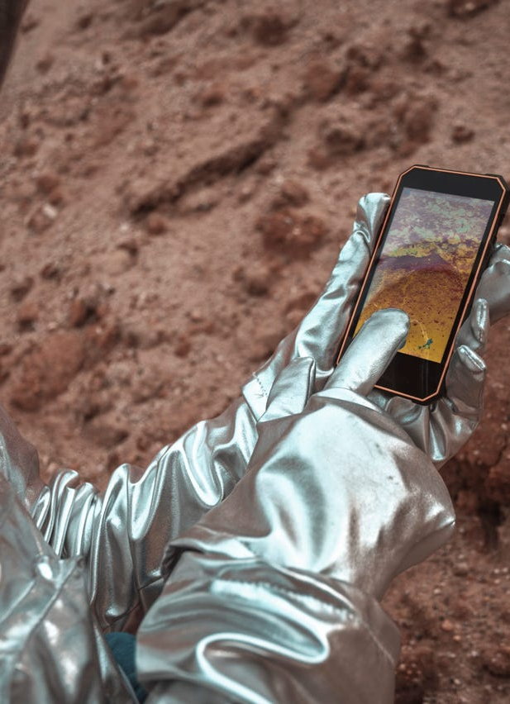
Factors Affecting Gravity:
What happens when you drop your cell phone?
You see your cell phone fall to Earth because Earth and your cell phone are close together.
If your cell phone were on the moon, Earth would not exert a visible gravitational attraction to it because Earth and the phone would be so far apart.
The phone would be visibly attracted to the moon instead.

Slide 21
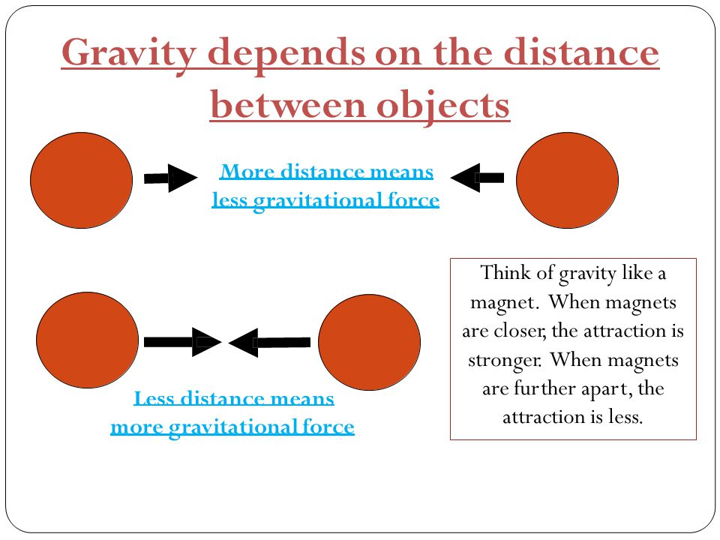
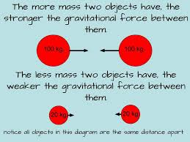

Slide 22
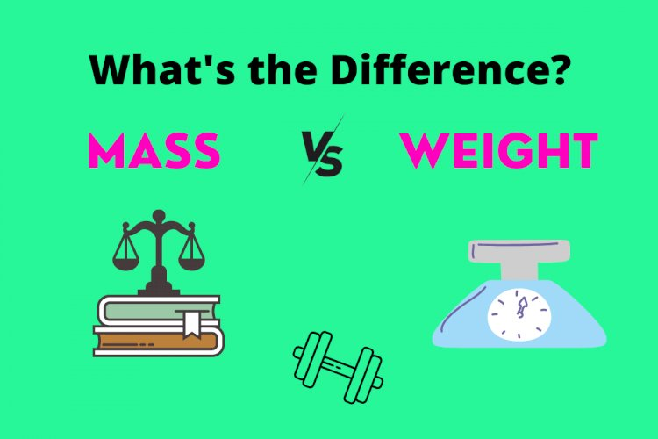
Weight and Mass:
Mass is sometimes confused with weight.
Mass is a measure of the amount of matter in an object.
Weight is a measure of the force of gravity on an object.

Slide 23
Weight and Mass:
weight is a measure of force, the SI unit of weight is a newton (N).
If you know the mass of an object in kilograms, you can calculate its weight on Earth using Newton's second law.
The acceleration due to gravity at Earth's surface is 9.8 m/s2.
The force is the weight of the object.
Net force=Mass x Acceleration
When you stand on a bathroom scale, it displays your weight “the gravitational force that Earth is exerting on you”.
On Earth, 1 pound equals 4.45 newtons.

Slide 24
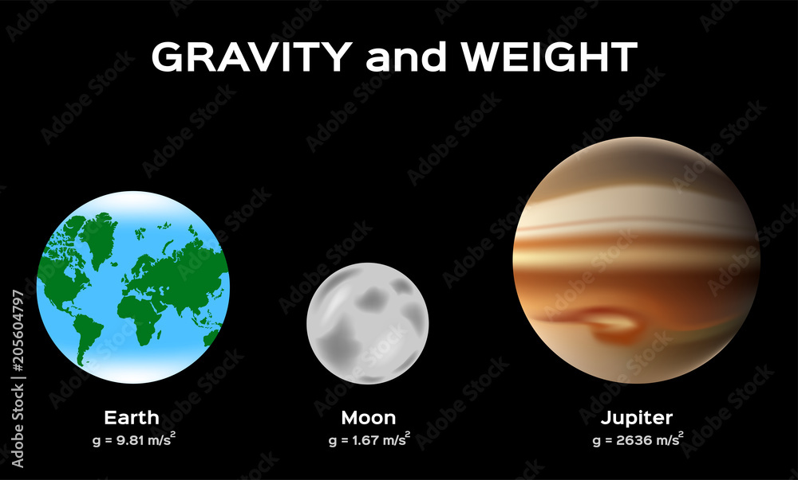
Weight and Mass:
If you could stand on the surface of Jupiter, which has a mass around 300 times the mass of Earth, your mass would remain the same, but your weight would increase.
This is because the gravitational force exerted on you is greater on Jupiter than on Earth.

Slide 25
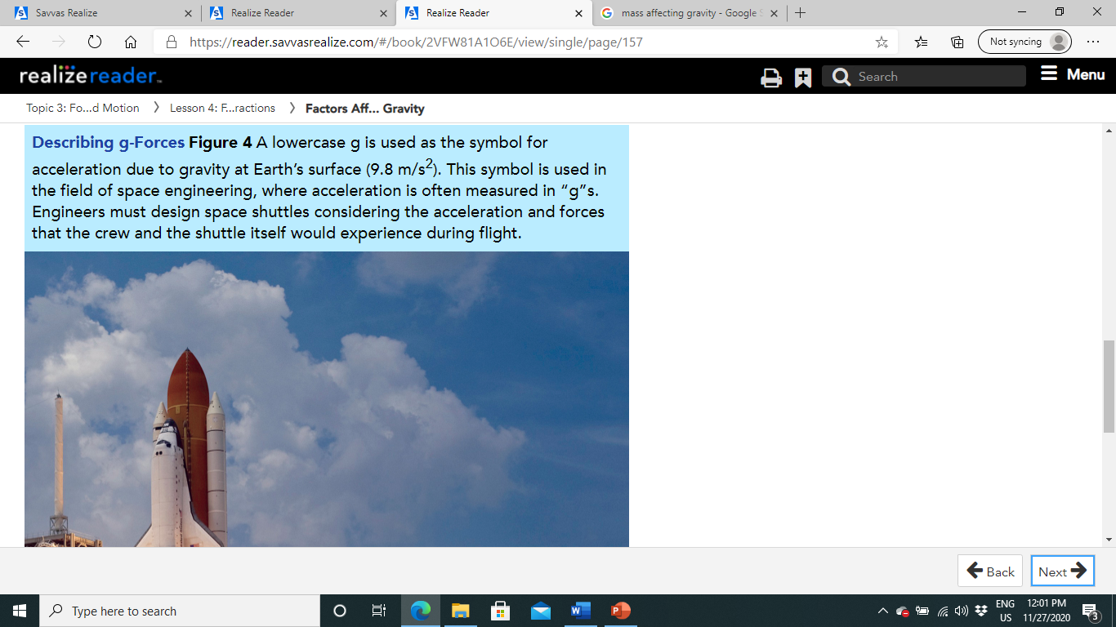
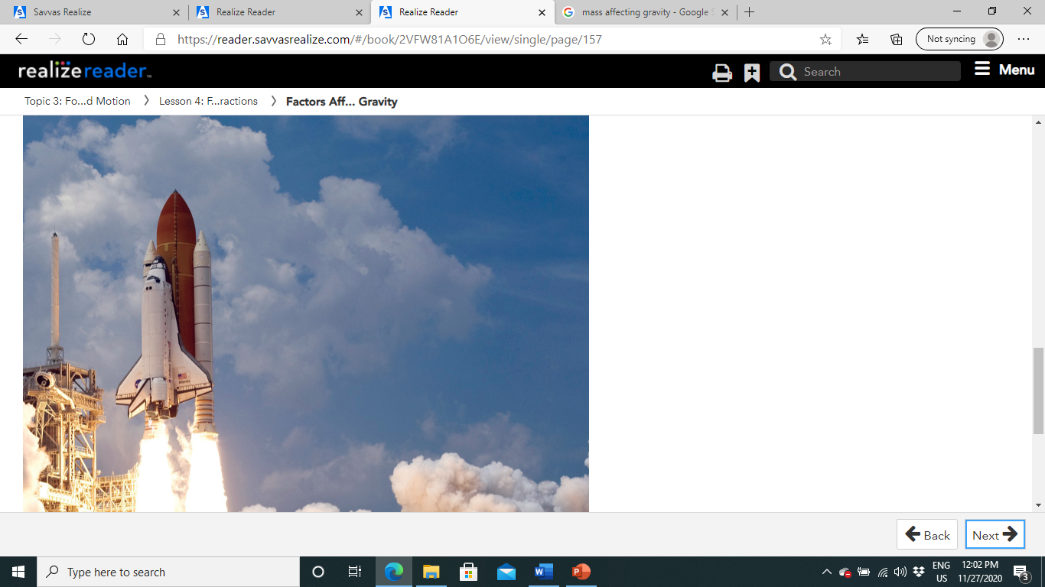
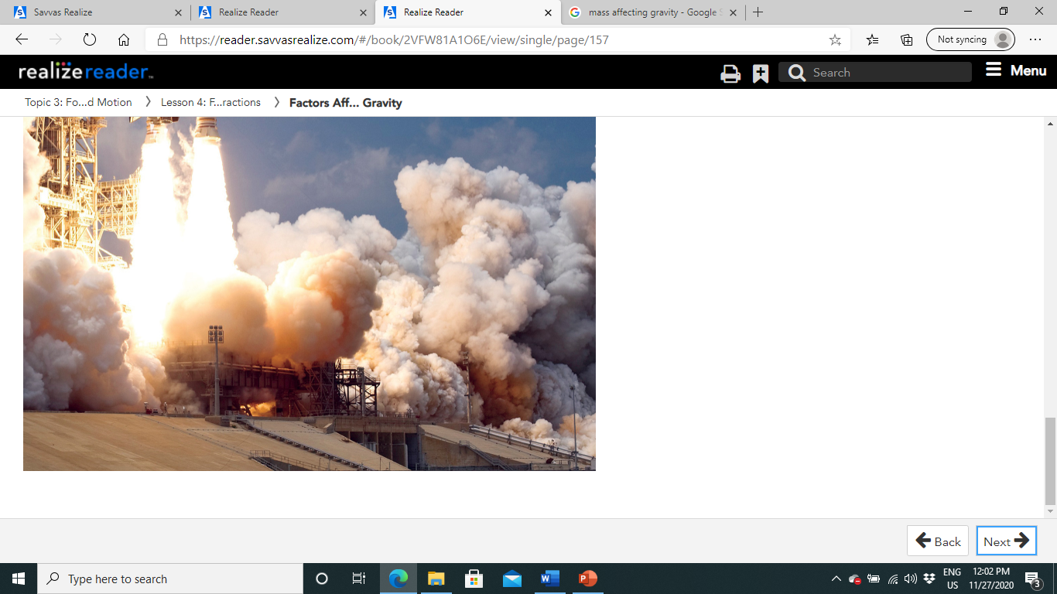

Slide 26
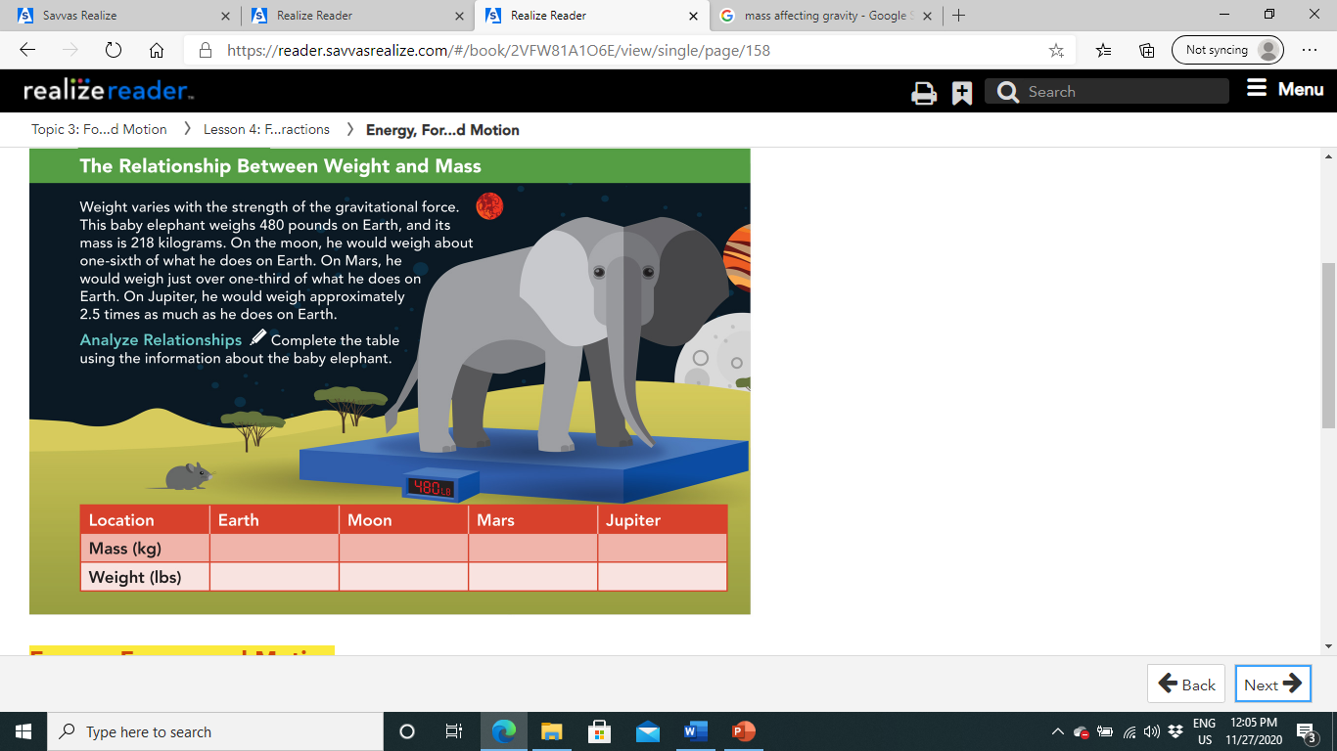
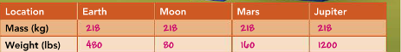
Pg.156

Slide 27
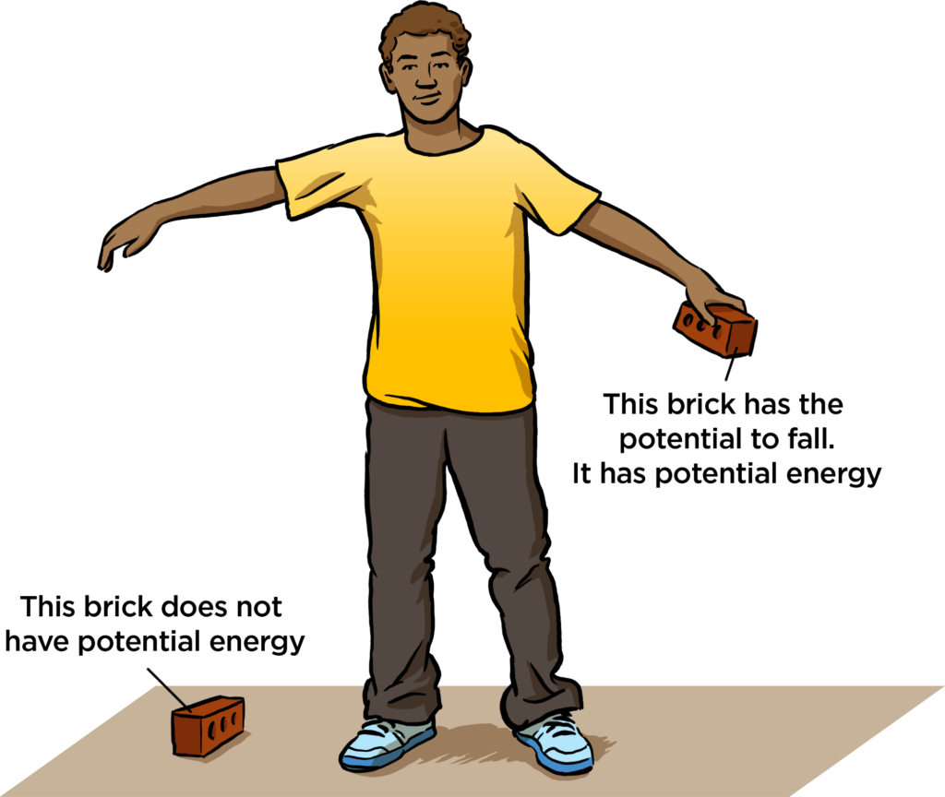
Energy, Forces, and Motion:
Gravitational Potential Energy:
As you know, the potential energy of an object is the energy stored in the object.
There are several different types of potential energy, based on different types of forces.
The type of potential energy that we associate with gravity is called gravitational potential energy.

Slide 28
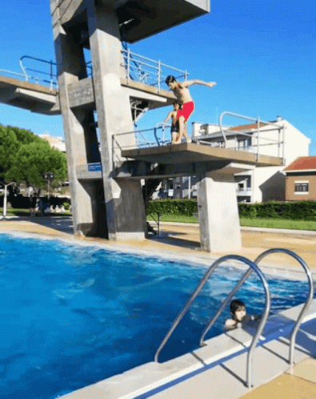
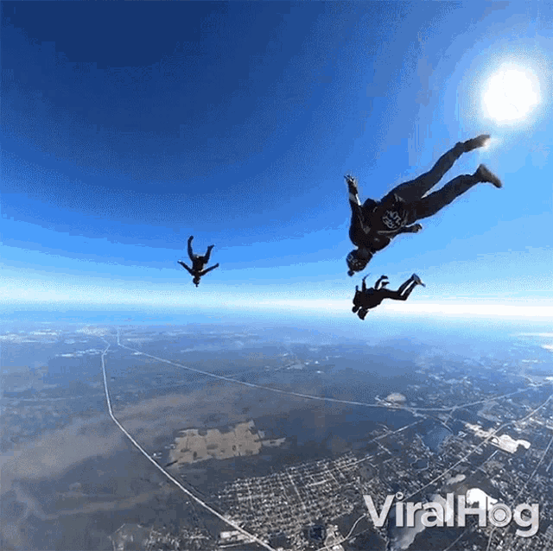
Energy, Forces, and Motion:
Gravitational Potential Energy:
On Earth, gravitational potential energy (GPE) is based on an object's position.
In general, the higher up an object is, the greater its GPE.
For example, as a diver climbs the ladder to a diving board, her GPE increases.
The GPE of a skydiver increases as he rides the helicopter to his jumping point.

Slide 29
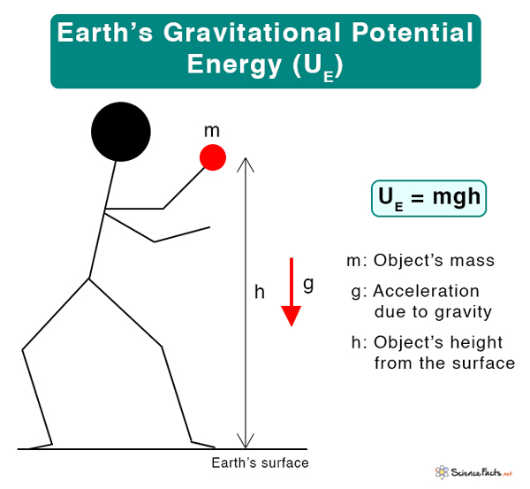
Energy, Forces, and Motion:
Gravitational Potential Energy:
You can calculate the GPE of an object on Earth based on the mass of the object, the acceleration due to gravity (9.8 m/s2), and the height of the object above Earth's surface.
Gravitational potential energy (GPE)=Mass x Acceleration due to gravity x Height

Slide 30
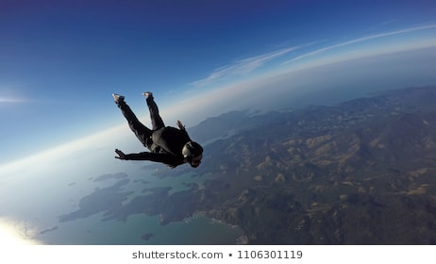
Forces and Motion:
When a skydiver jumps from a helicopter, a net force acts on his body as he falls.
This net force is a combination of gravity and friction.
Gravity pulls him down toward the ground, and fluid friction acts on him in the opposite direction as he falls through the air.
However, these forces are unbalanced, the force of gravity is stronger than the air resistance, so he accelerates downward.
Net force works on him as he falls, so his GPE transforms to kinetic energy, the energy of motion.
As a result, his speed increases throughout his fall.
As the skydiver accelerates, the force of air resistance increases until it is equal to the force of gravity.
At this point, the forces on the skydiver are balanced and he falls at a constant speed the rest of the way down.
This top speed is called terminal velocity.
It only takes about 15 seconds for skydivers to reach 99% of their terminal velocity of 195 km/h (122 mi/h)!
When skydivers open a parachute, air resistance increases.
This causes the forces acting on the skydiver to balance at a much slower terminal velocity.

Slide 31
