Slide 1
Topic 2 Lesson 1
Mixtures and Solutions
Textbook pg.68-75

Slide 2
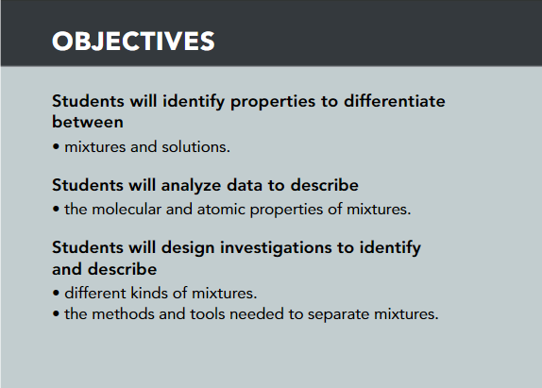
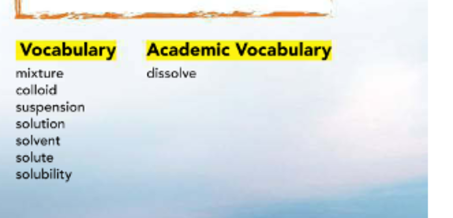

Slide 3
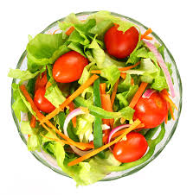
Types of Mixtures:
Most materials we encounter consist of more than one element or compound, so they are mixtures.
A mixture is made of two or more substances that are together in the same place, but their atoms are not chemically combined.
Mixtures differ from compounds.
Each substance in a mixture keeps its properties.

Slide 4
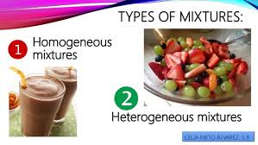
Types of Mixtures
Homogeneous
Heterogeneous

Slide 5
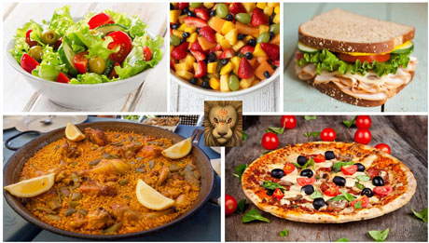
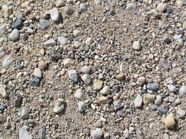
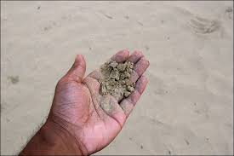
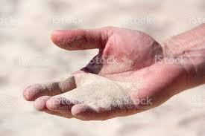
Heterogeneous Mixture:
Heterogenous mixture :is the mixture that features distinct components that can easily be seen and sorted.
A plate of spaghetti with meatballs and a bowl of salad are other examples of heterogeneous mixtures.
A characteristic of a heterogeneous mixture is that its components are not spread out evenly throughout the mixture.
One portion of a heterogeneous mixture may consist of a relatively even balance of different things, while another portion is mostly one thing or another. One handful of this sand, for example, could contain a fossilized shark tooth, while a hundred handfuls around it do not.

Slide 6
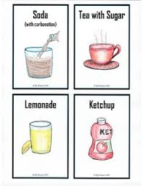
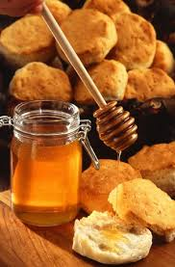
Homogeneous Mixture:
Other mixtures are more difficult to analyze.
Such homogeneous mixtures often look the same throughout the entire mixture.
Their different components are difficult to see and are spread out uniformly throughout the entire mixture.
Saltwater, honey, and soy sauce are examples of homogeneous mixtures that may be found in your kitchen.

Slide 7
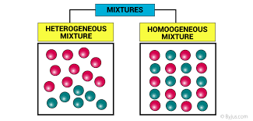

Slide 8
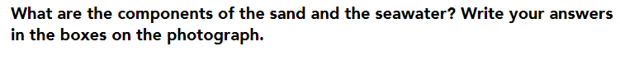
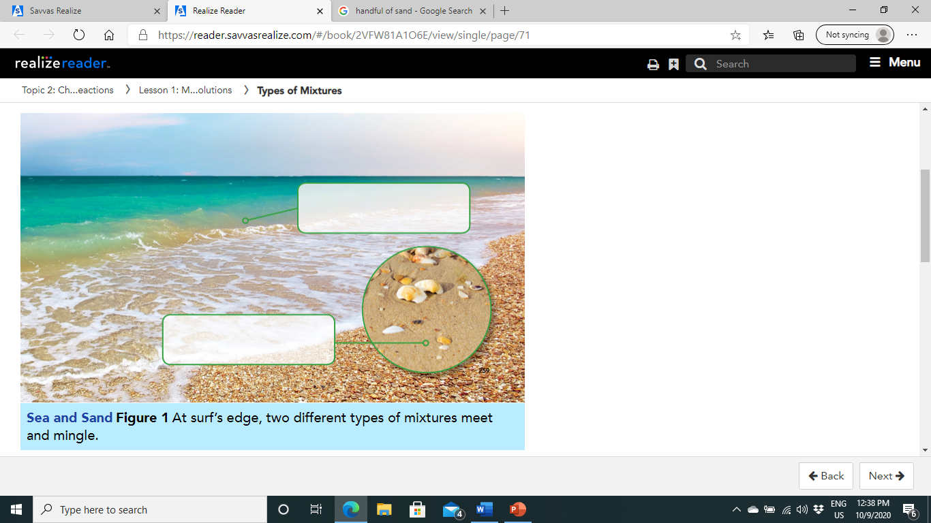
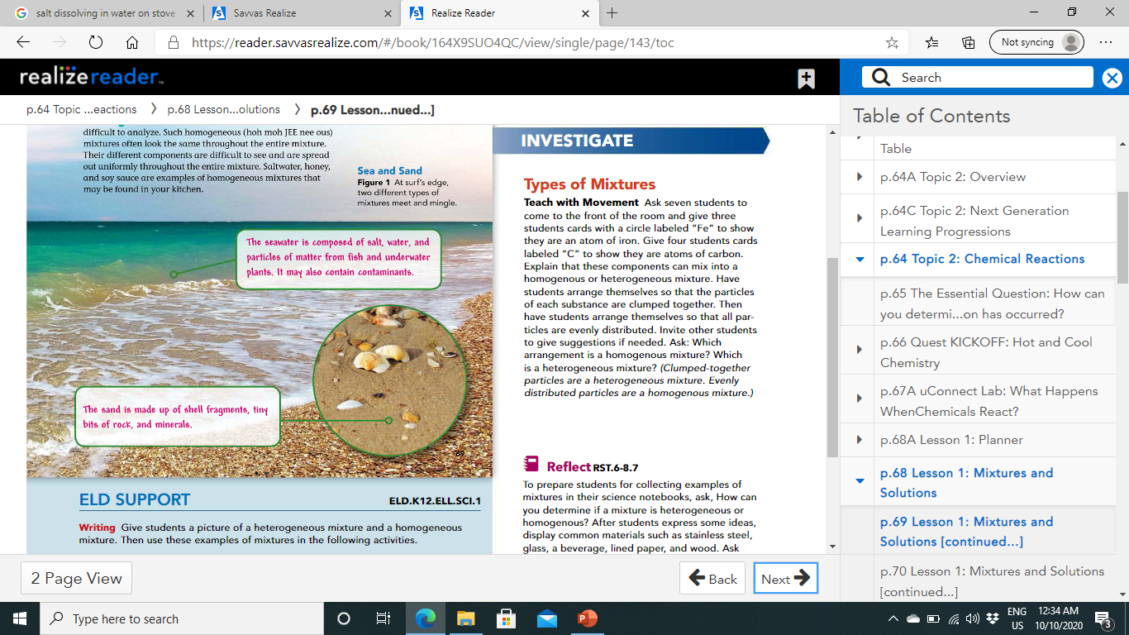
Pg.69

Slide 9
Separating Mixtures:
Remember that the individual components of a mixture keep their properties.
This means that the properties of the components in a mixture can be used to separate them.

Slide 10
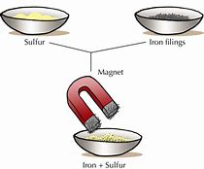
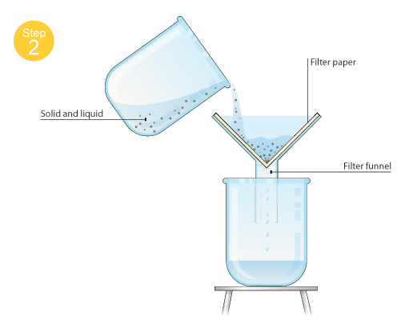
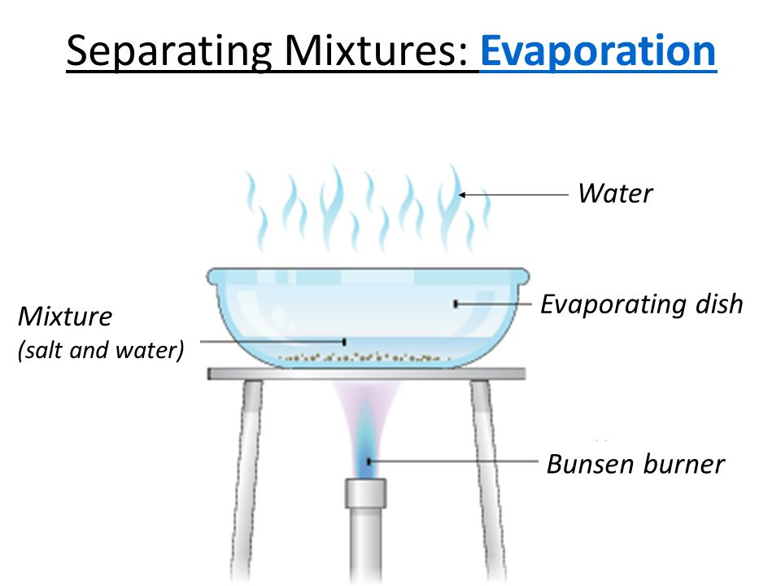
Mixtures that contain particles of different sizes, for example, can be filtered so the larger particles are removed from the mixture.
Mixtures that have magnetic components can be separated with a magnet.
Liquid mixtures can be heated until some components evaporate and others are left behind as solids.

Slide 11
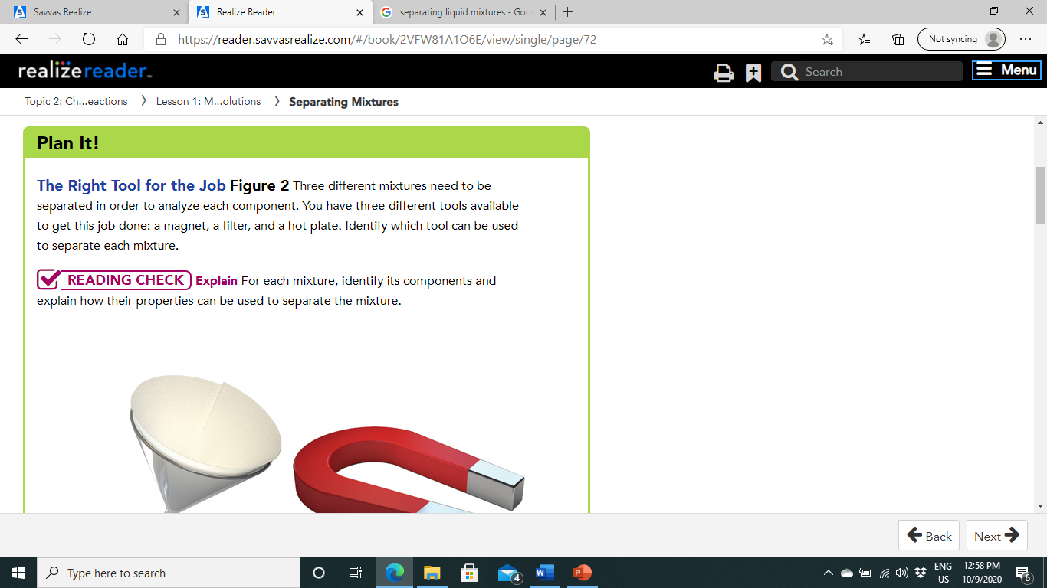
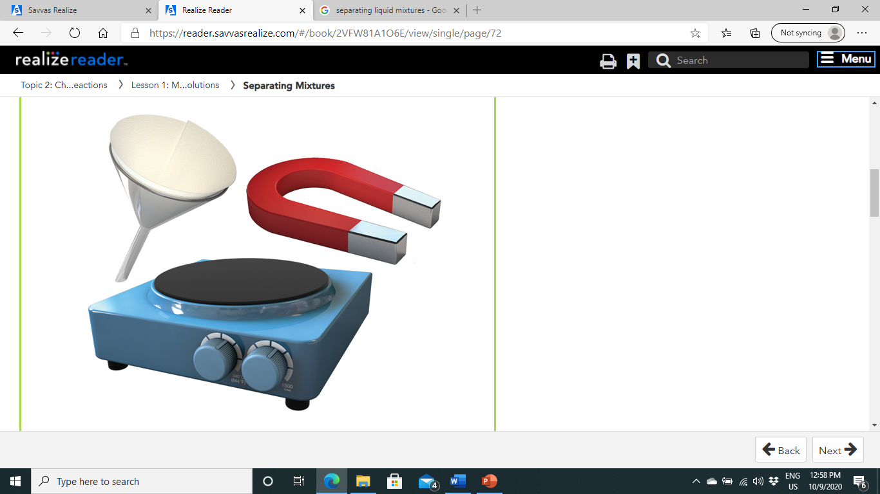
Pg.70

Slide 12
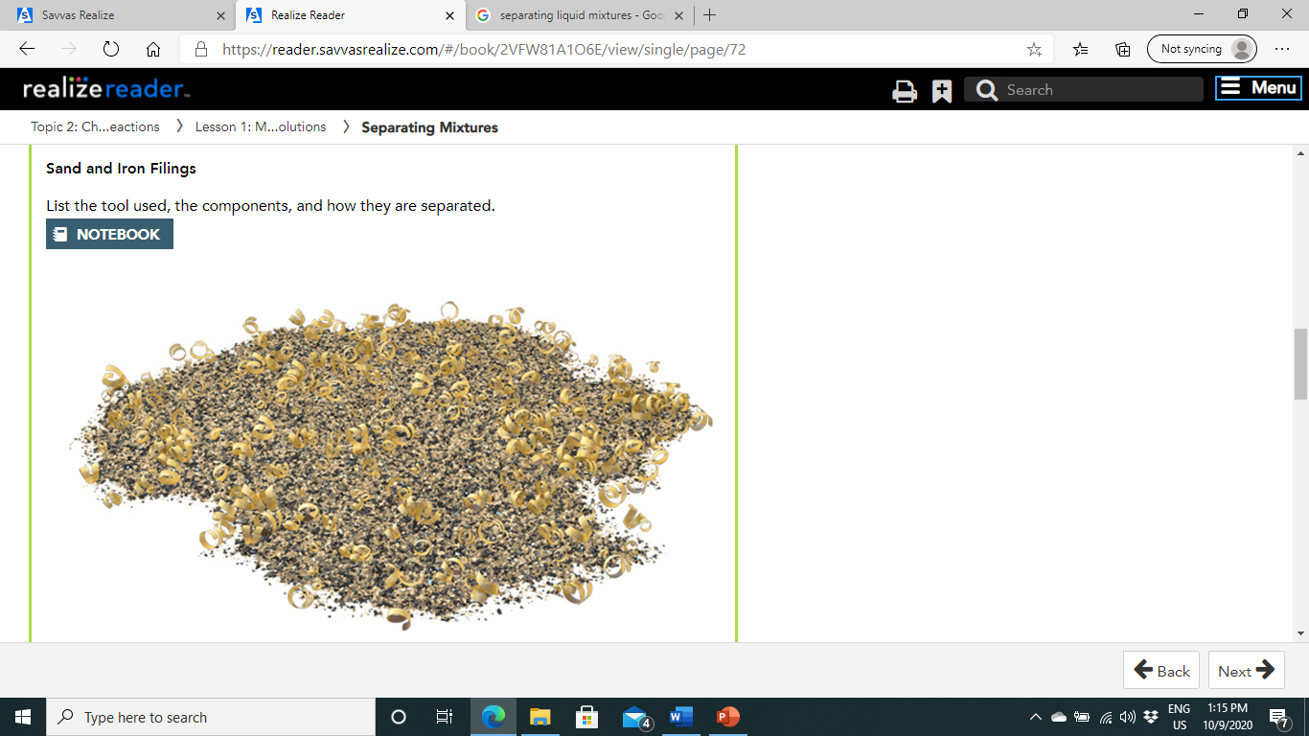
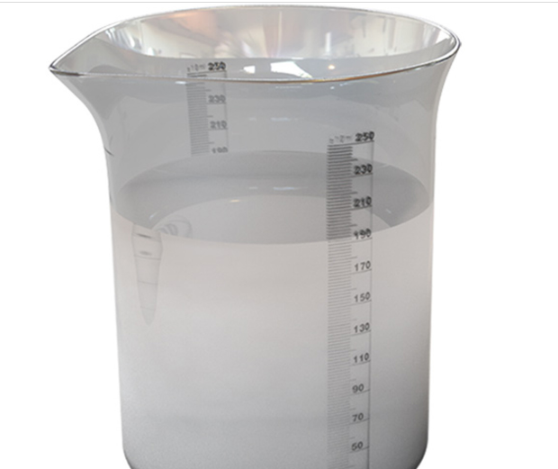
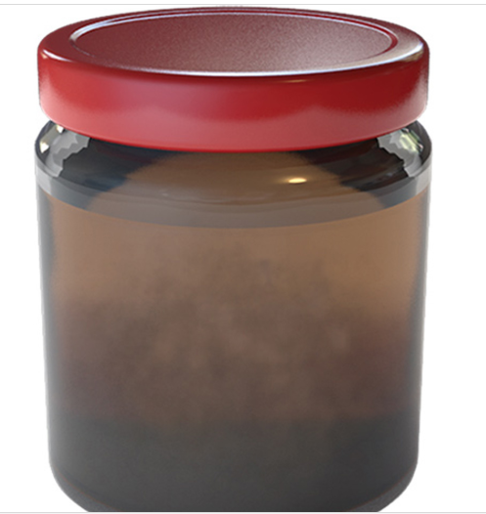
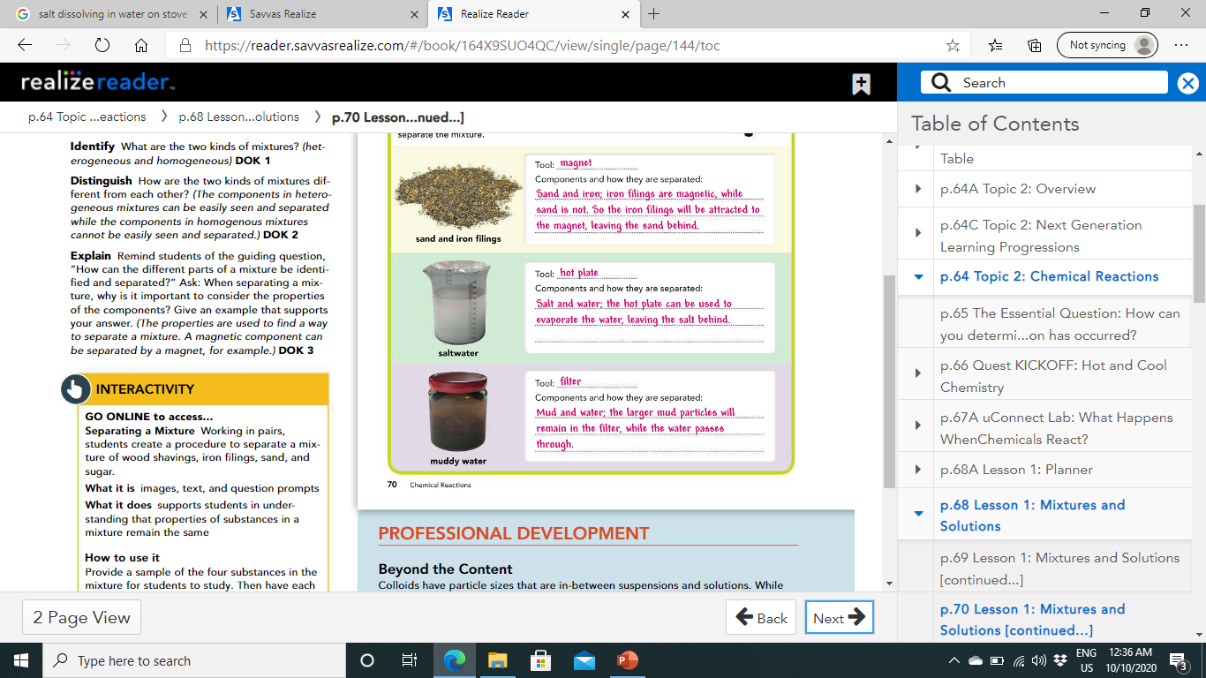
Pg.70
Mud water
Saltwater

Slide 13
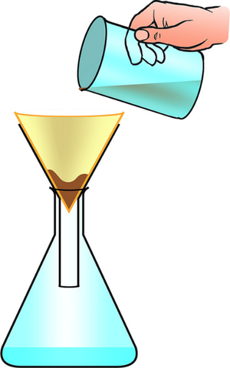
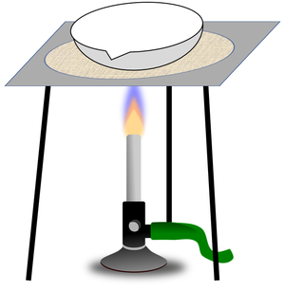
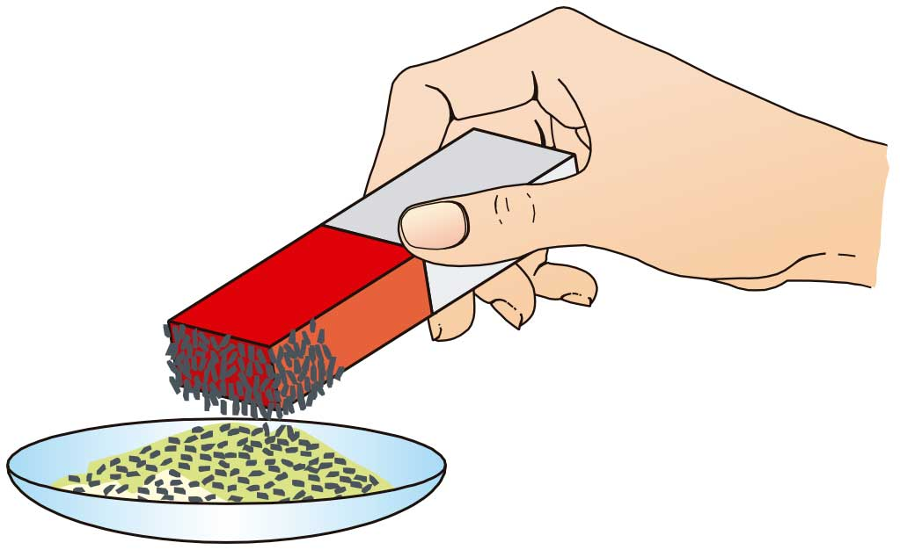
Separating Mixtures

Slide 14
Classifying Mixtures
Honey, oil-and-vinegar salad dressing, and milk are examples of different types of mixtures that may be found on your dinner table.
Colloids
Solutions
Suspensions
The three types are defined by the sizes of their particles and how the particles behave.

Slide 15
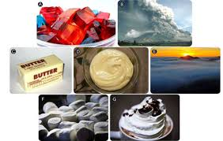
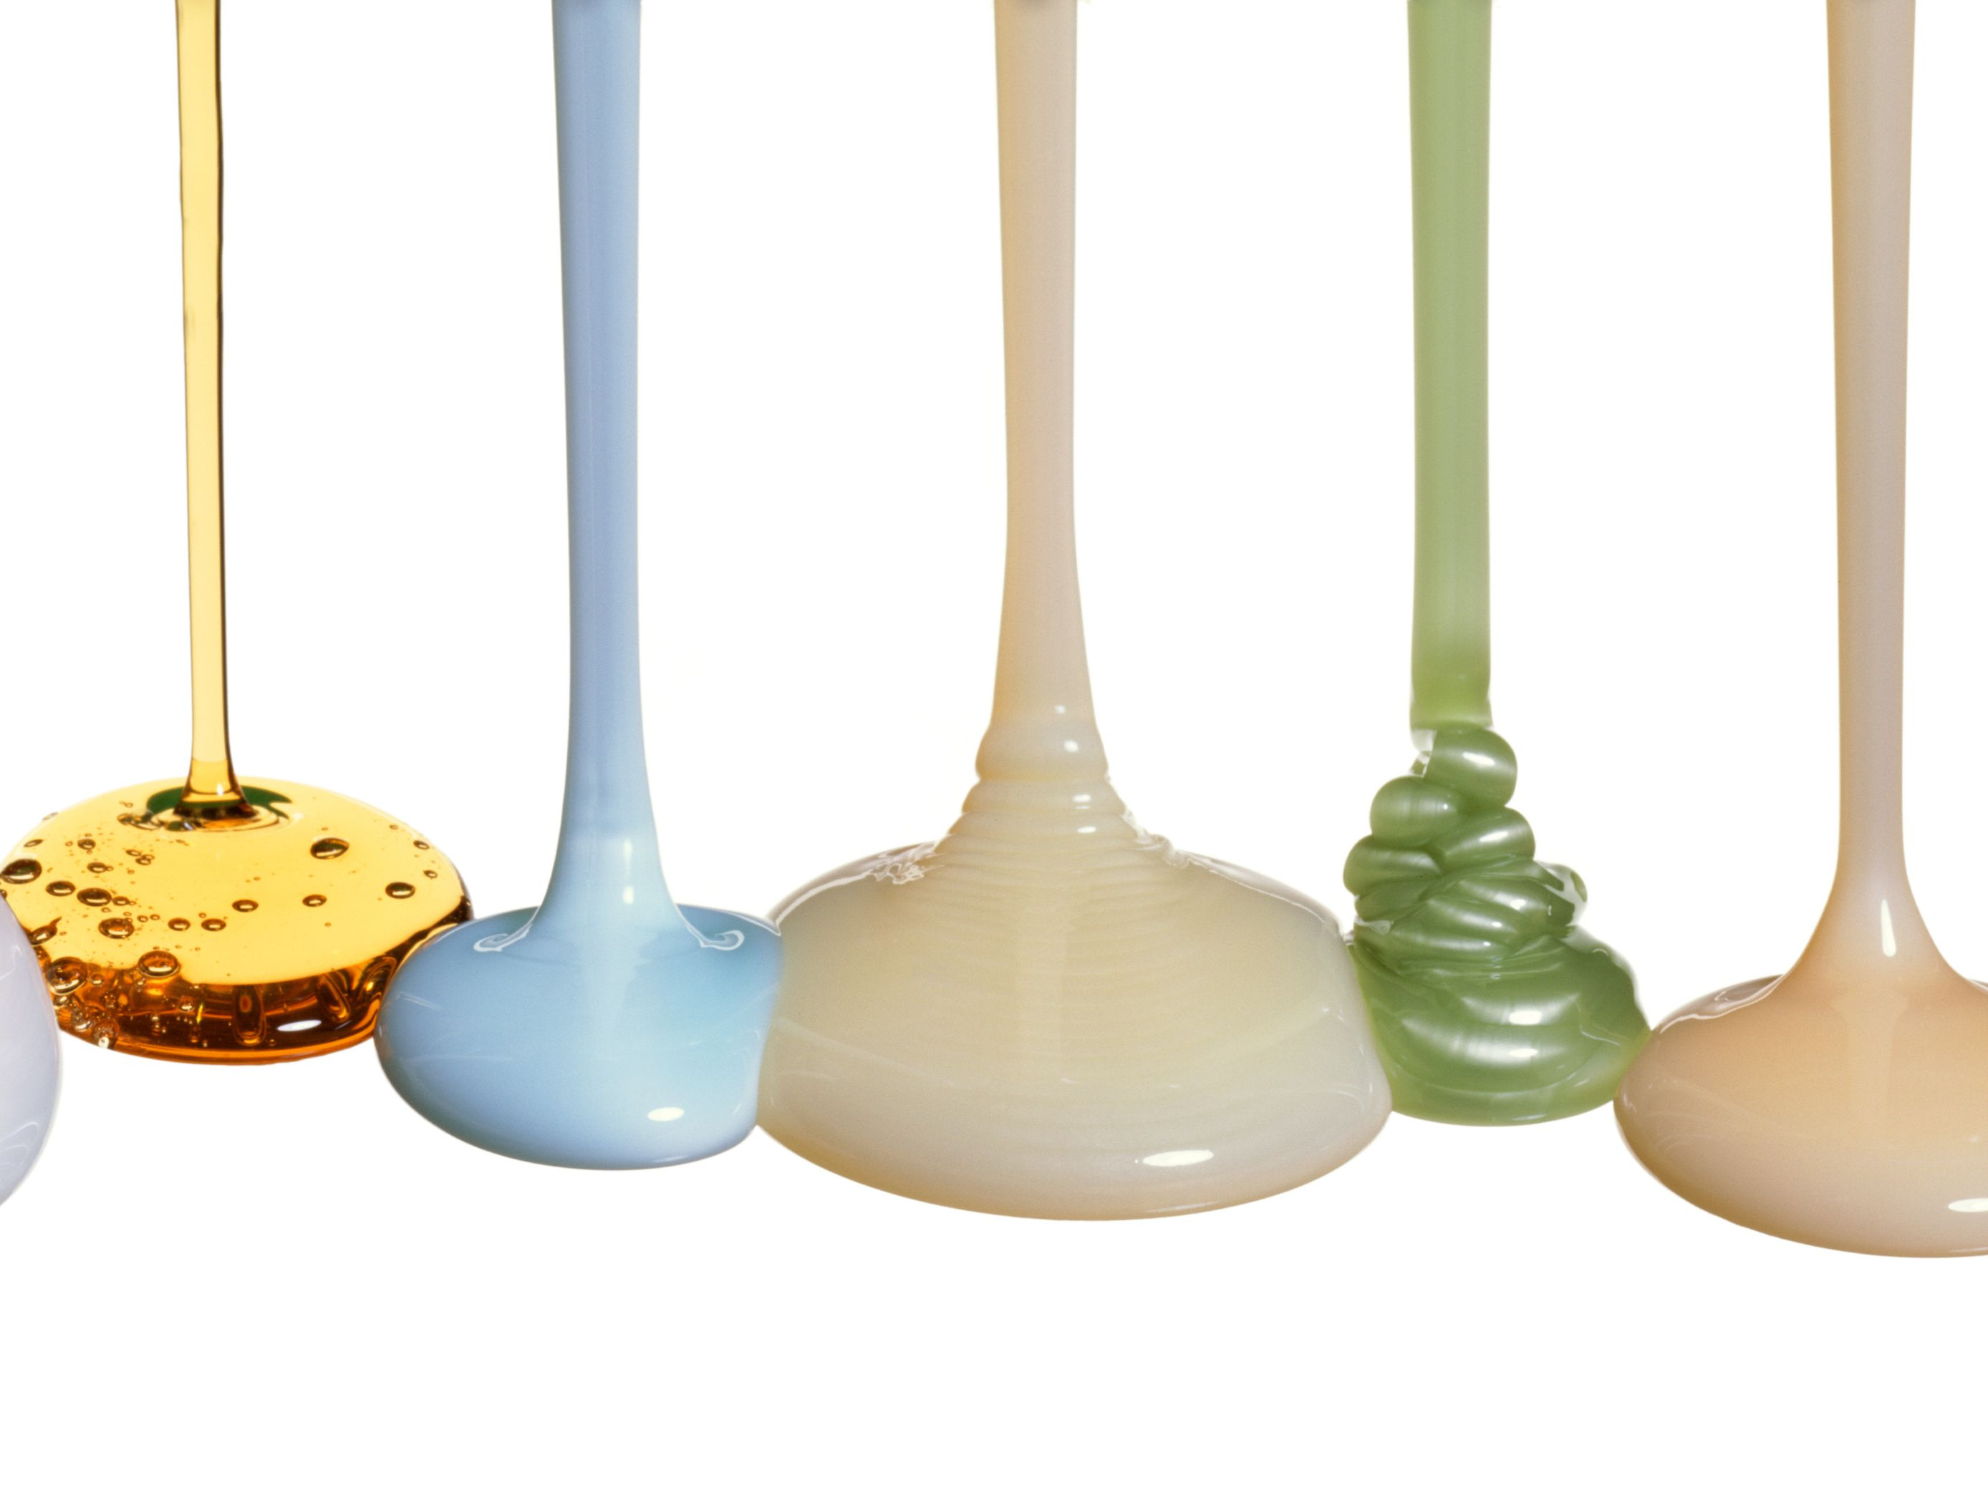
Colloid:
1. A colloid is a HETROGENOUS mixture containing small, undissolved particles that do not separate or settle out if the mixture is undisturbed.
The particles of a colloid are too small to be seen without a microscope, yet they are large enough to scatter a beam of light. This is why they are not clear.
EX: Milk, Paint, whipped cream, fog, and smoke are all colloids.

Slide 16
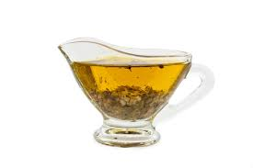
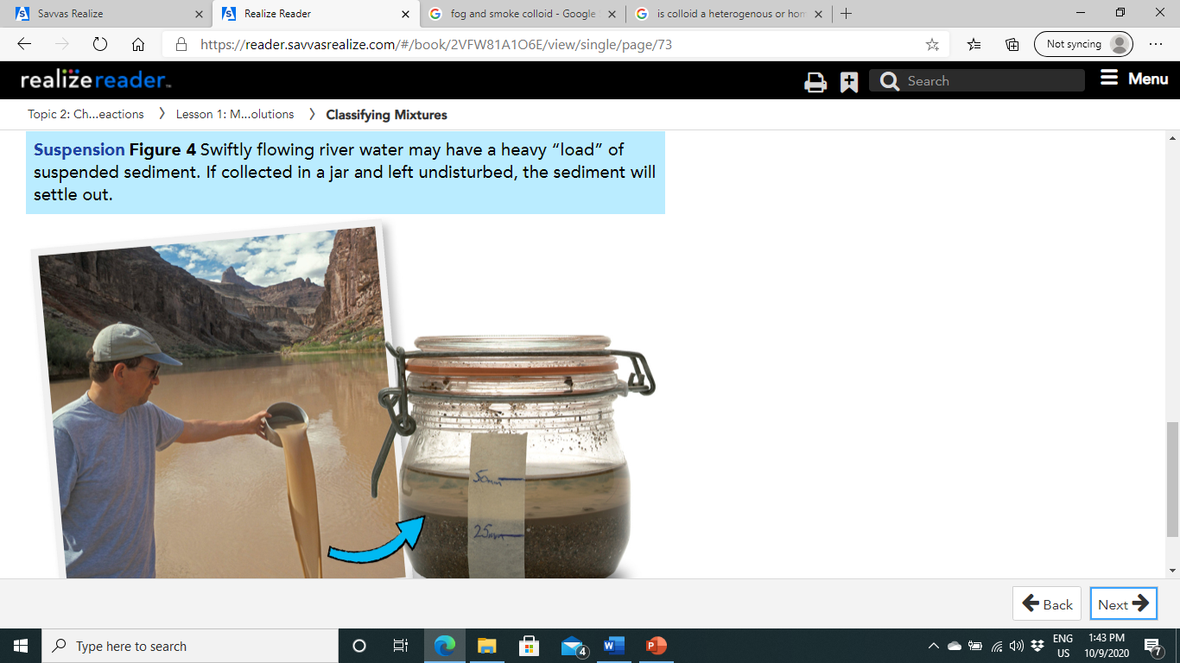
2. Suspension:
A suspension is a mixture with particles that can be seen and easily separated by settling or filtration.
For example, a bottle of oil-and-vinegar salad dressing will settle out into its constituent parts if left undisturbed.
Muddy river water.

Slide 17
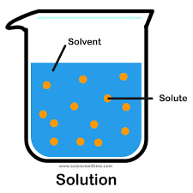
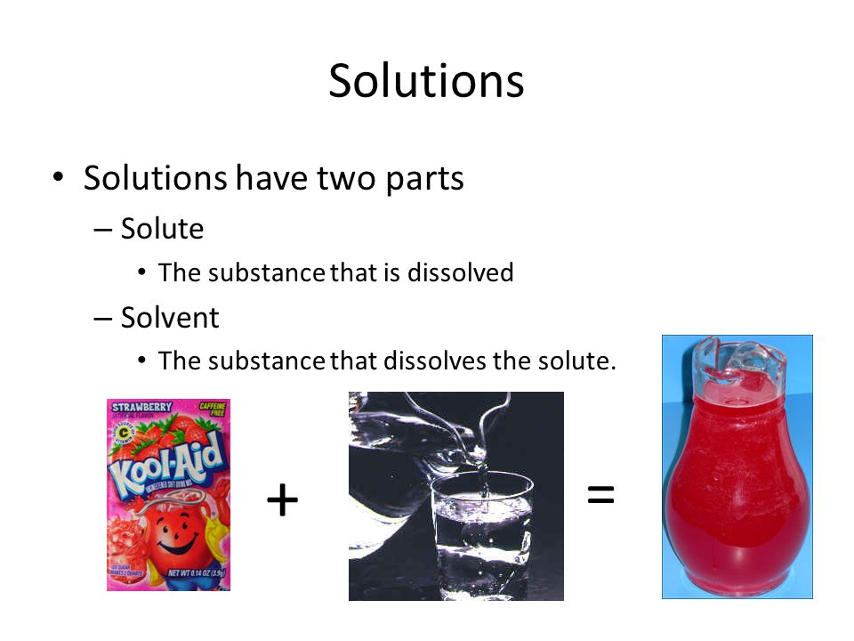
3. Solutions:
Grape juice is one example of a mixture called a solution.
A solution is a homogenous mixture of a solvent and one or more solutes.
The solvent is the part of the solution that is usually present in the largest amount.
It dissolves the other substances in the solution.
The solute is the substance that is dissolved by the solvent.
Whether a solution is a solid, liquid, or gas, it forms when particles of the solute become separated and surrounded by particles of the solvent.
This is what it means for a solute to dissolve. In grape juice, water is the solvent. Sugar and the other ingredients are the solutes.

Slide 18
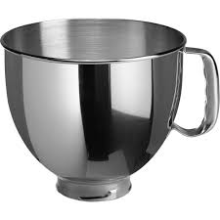
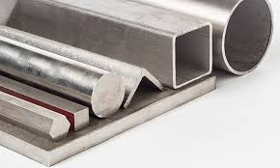
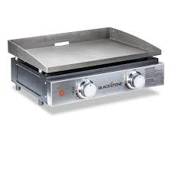
Air and stainless steel are other examples of solutions.
The air around us is a mixture of oxygen, nitrogen, and several other gases.
Since nitrogen gas makes up most of the air, nitrogen is the solvent.
Stainless steel is a solid solution made up of iron, chromium, and nickel.
Because a solution is a homogenous mixture, it has the same properties throughout the entire mixture

Slide 19
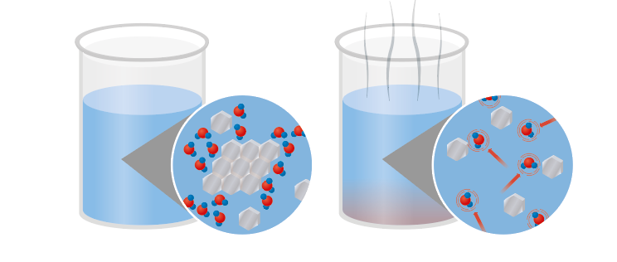
Molecular Solutes:
Molecular compounds, such as table sugar, break up into individual molecules in water.
The sugar molecules are polar like water.
The water molecules attract the sugar molecules, and the sugar molecules move away from one another. While the water molecules surround the sugar molecules, the chemical bonds do not break. Since polarity is so important to the dissolving process, most nonpolar molecules are not soluble in water.

Slide 20
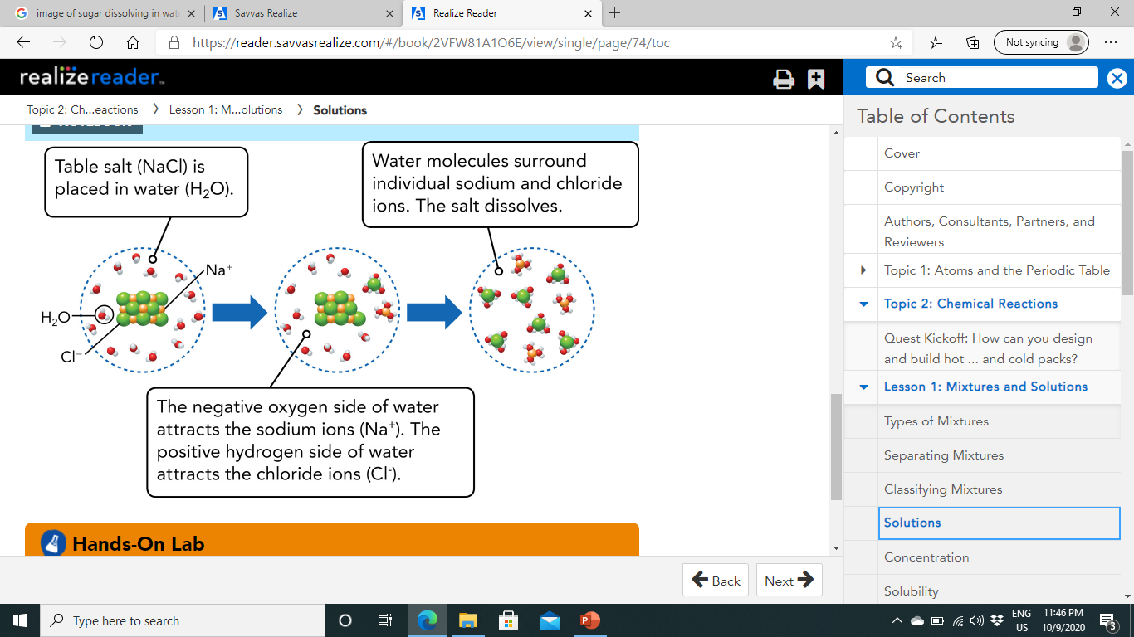
Ionic Solutes:
Table salt is mostly made up of an ionic compound called sodium chloride (NaCl). Sodium chloride is made of positively charged sodium ions and negatively charged chloride ions. These charges allow salt to dissolve in water.
Water is a polar molecule due to the arrangement of oxygen and hydrogen atoms. The oxygen side is slightly negative, while the hydrogen side is slightly positive. The attractions shown in Figure 5 are what make salt soluble in water.

Slide 21
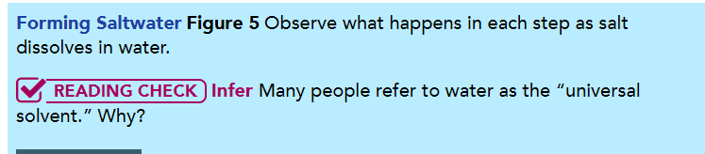
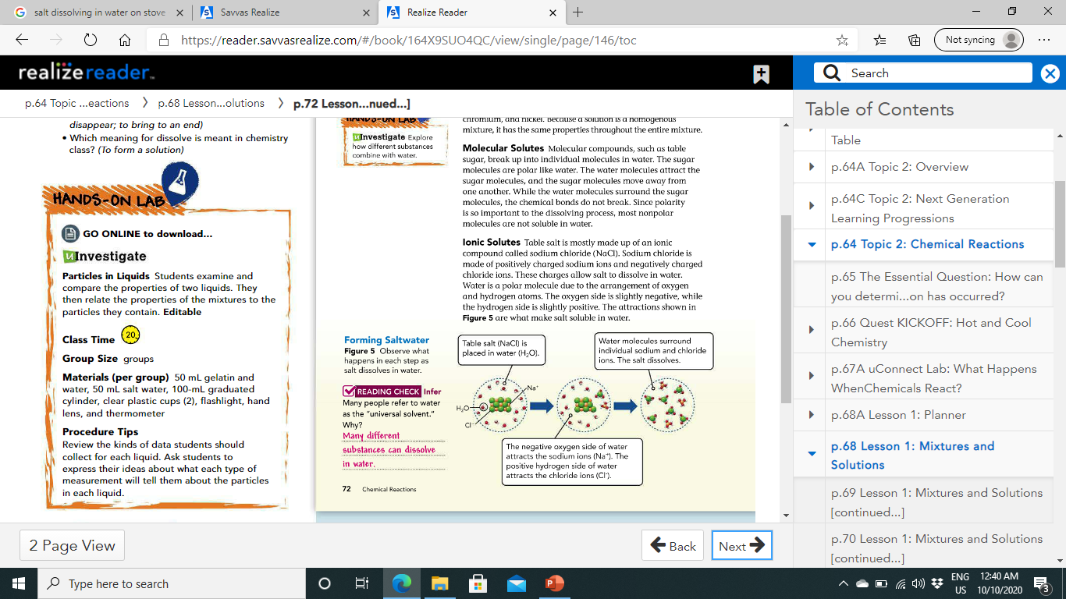
Pg.72

Slide 22
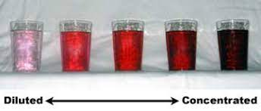
Concentration:
Concentration is a physical property.
The more the concentration, the more the boiling point, freezing point and the density of solution.
The saltiness, or salinity, of seawater is due to the concentration of the solute (sodium chloride) in the solvent (water).
A concentrated solution has a lot of solute.
A solution with little solute is a dilute solution.
Concentration increases by adding more solute or removing solvent.
For example, a cup of tea will become more concentrated, or stronger, if it's left to sit so some of the water evaporates. The tea will also be more concentrated if the teabag is allowed to steep longer.

Slide 23
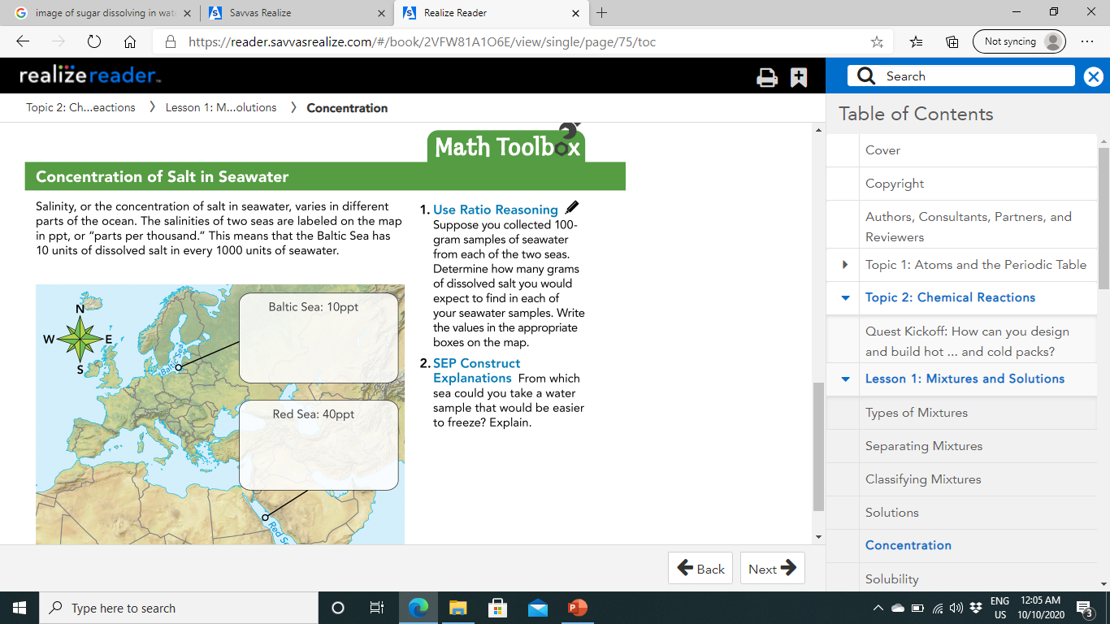
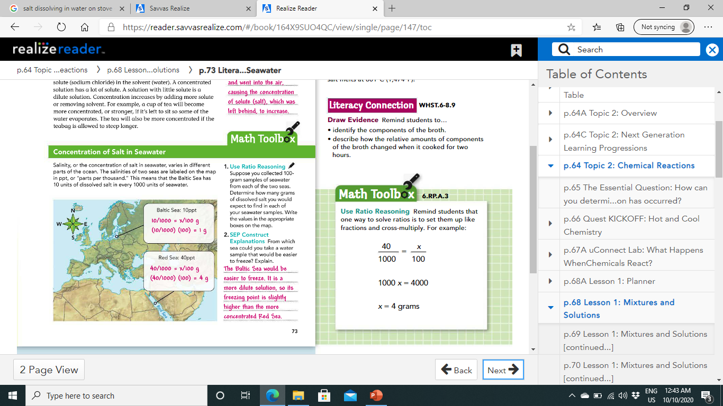
Pg.73

Slide 24
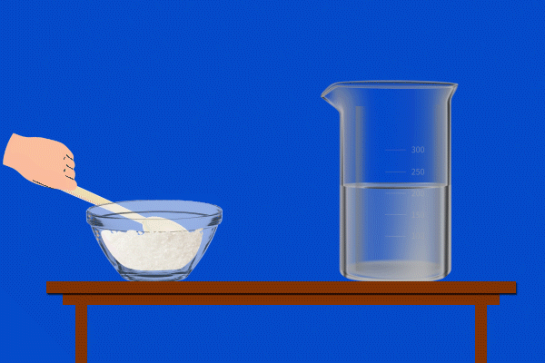
Solubility:
solubility, or the measure of how much solute will dissolve in a solvent, comes into play.
A solution that can no longer dissolve a solute is saturated.
The properties of the solute and solvent affect solubility, and temperature and pressure also play a role.

Slide 25
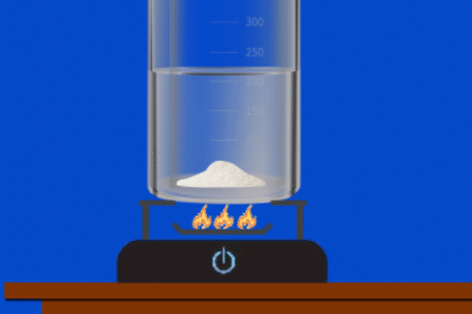
Temperature:
In general, raising the temperature of the solvent increases the solubility of a solid solute.
such as table salt, dissolve more easily if the solvent has a higher temperature.
BUT, WHY???
The higher temperature means the molecules of the solvent are moving faster. These more energetic particles can more easily break up the solid solute.
However, unlike most solids, gases become less soluble when temperature is increased (see Figure 6).
Gas particles are already separate from one another, so increasing the temperature increases the energy of the gas particles and causes them to escape from the liquid.

Slide 26
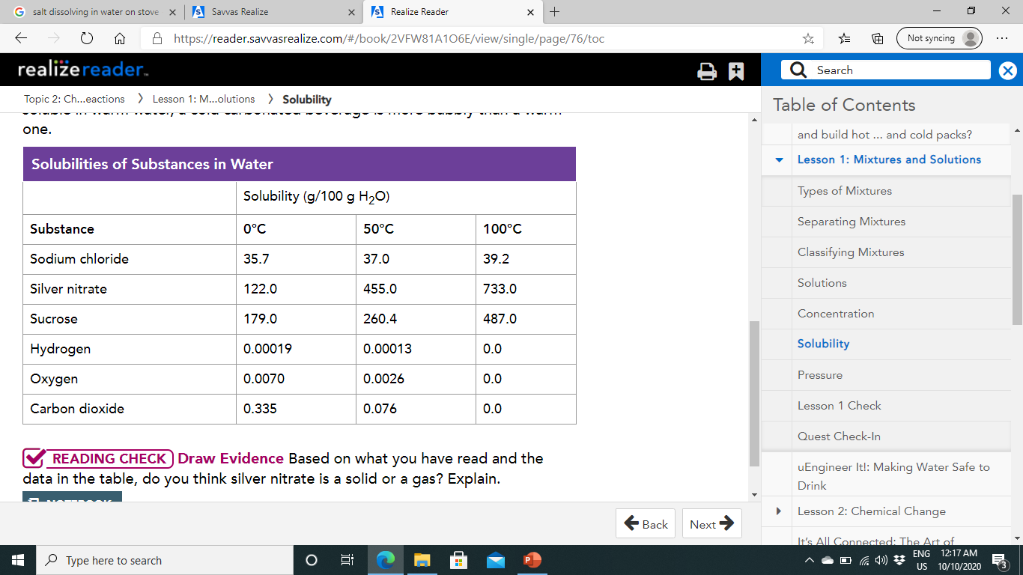
Solubility and Temperature:
Pg.72
Figure 6 As temperature increases, solids become more soluble, but gases become less soluble. Because carbon dioxide is less soluble in warm water, a cold carbonated beverage is more bubbly than a warm one.

Slide 27
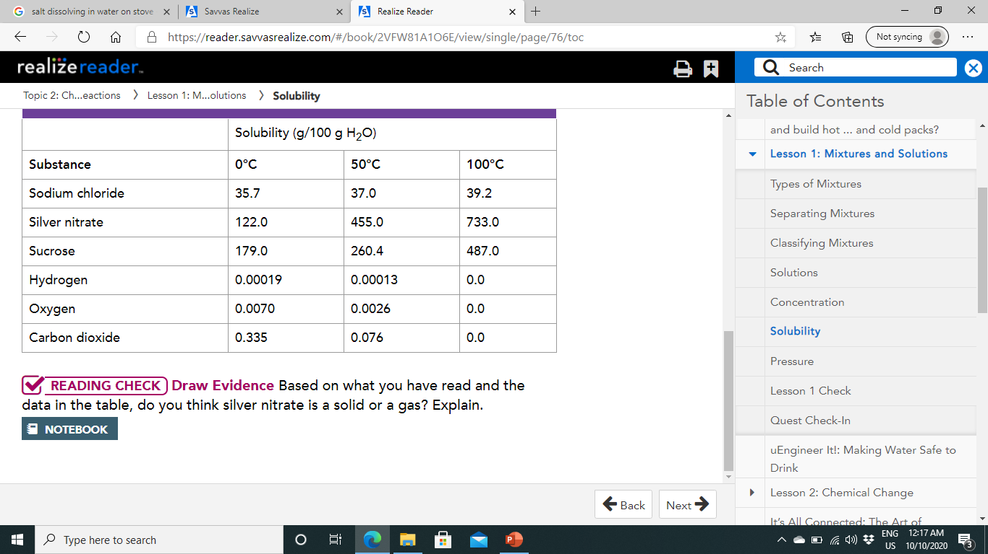
Solid

Slide 28

Pressure:
What is the problem?

Slide 29
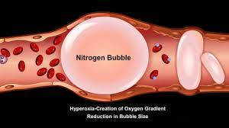
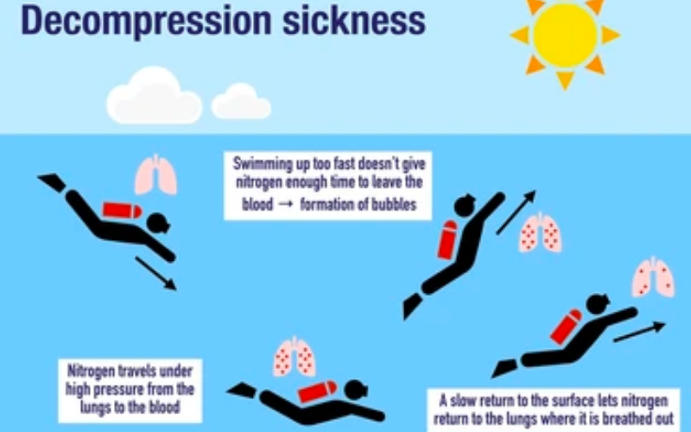
Pressure:

Slide 30
Pressure:
While pressure has little effect on the solubility of solids, it does affect the solubility of gases.
The solubility of a gaseous solute increases as pressure on the solution increases.
Scuba divers must learn the effects of pressure in order to avoid decompression sickness.
Under normal atmospheric pressure, nitrogen from the air is not soluble in blood.
However, under water, pressure increases as the diver swims deeper.
The air that enters his or her lungs becomes more pressurized. Deeper than 18 meters (60 feet), the pressure of the air inside the diver's lungs and the compression of other body tissues makes nitrogen soluble in his or her blood.
As with a can of soda, a sudden release of that pressure can cause bubbles of gas to come out of solution. If the diver swims upward too quickly, nitrogen would suddenly come out of the blood and get lodged in blood vessels.
The best way to avoid this painful condition is for the diver to swim up very slowly. That way, any dissolved nitrogen has time to leave the blood through the lungs.

Slide 31

H.W
page 76.Q.1-3

Slide 32
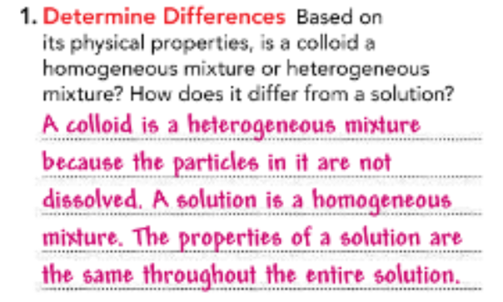
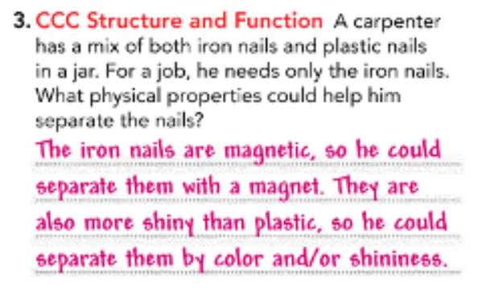

2.

