Slide 1

2nd Term
Week 9
Grade 8
TOPIC 8: CLIMATE
Lesson 3: Effects of a Changing Climate
Pgs. 406-413

Slide 2
OBJECTIVES:
Students will represent quantitative relationships to provide evidence to support:
how changes in global temperatures impact sea levels.
Students will use text evidence to support the author’s claims that:
sea levels are rising.
global temperatures and organisms’ adaptations are connected.
human actions impact climate change.

Slide 3

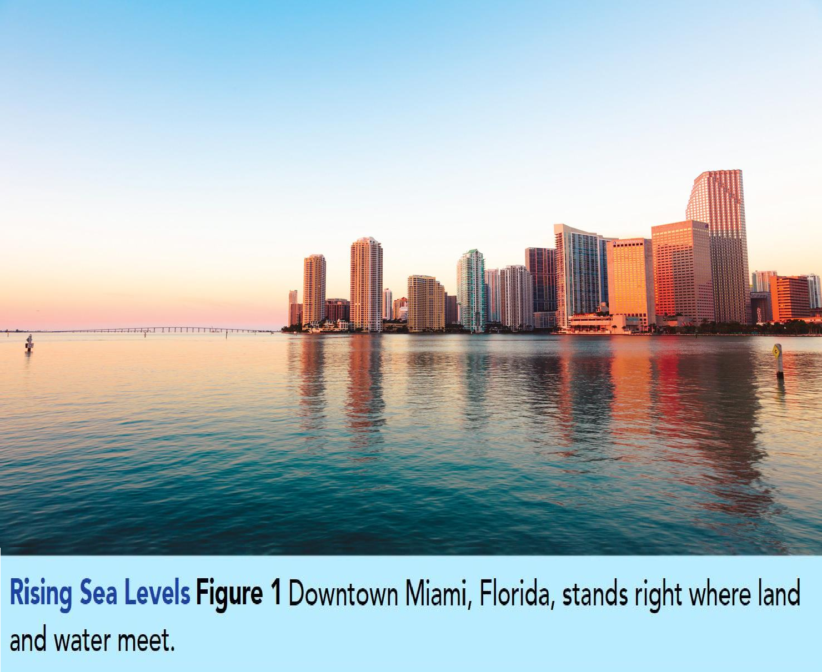
IMPACT OF RISING TEMPERATURES
PGS. 406-407
Look closely at the city’s coastline.
Imagine if the level of the water rose by three meters.
Draw a line where the new water level would be.
CCC Cause and Effect
How would the lives of the people in this city be affected if the water level
rose?
Future Sea Level Rise:
Top 10 Countries In Danger https://www.youtube.com/wat ch?v=boKd_Pb2HUA

Slide 4
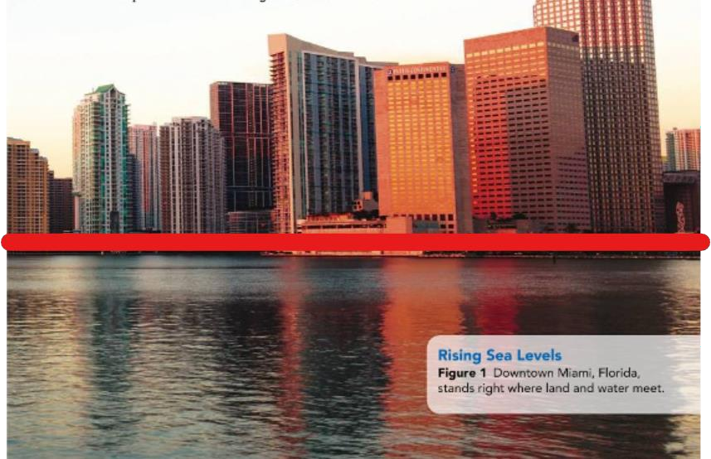
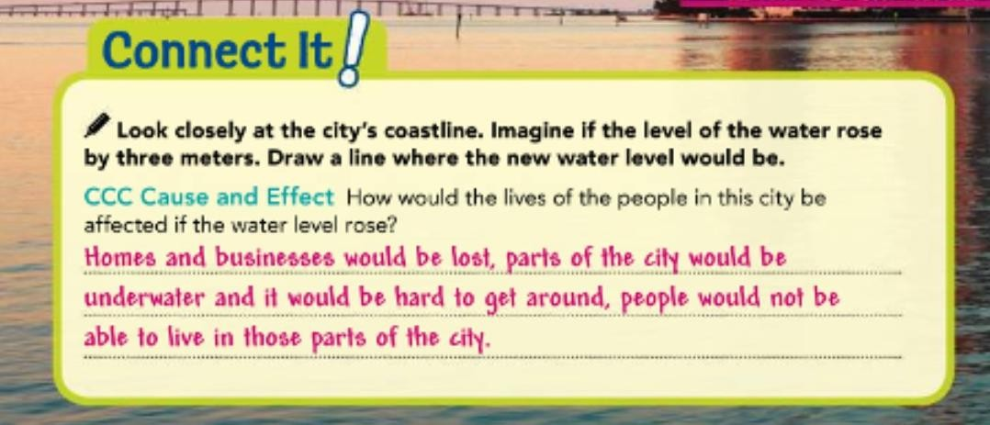
IMPACT OF RISING TEMPERATURES
PGS. 406-407
Look closely at the city’s coastline.
Imagine if the level of the water rose by three meters.
Draw a line where the new water level would be.
CCC Cause and Effect
How would the lives of the people in this city be affected if the water level
rose?

Slide 5

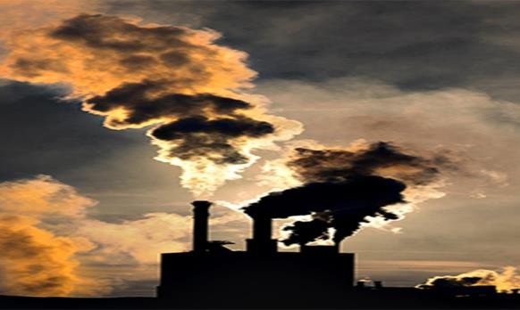




IMPACT OF RISING TEMPERATURES
PGS. 406-407
There is some argument among scientists about how much human activities have impacted global temperatures
Humans are vulnerable to the changes that are occurring and will continue to occur as a result of global warming.
Some climate models predict global temperatures will continue to rise several more degrees over the next century.
Rising sea levels around the world threaten people’s homes, businesses, and lives.
We can play an important role in Earth’s climate history by trying to reduce our impact on climate change and to minimize its effects.

Slide 6








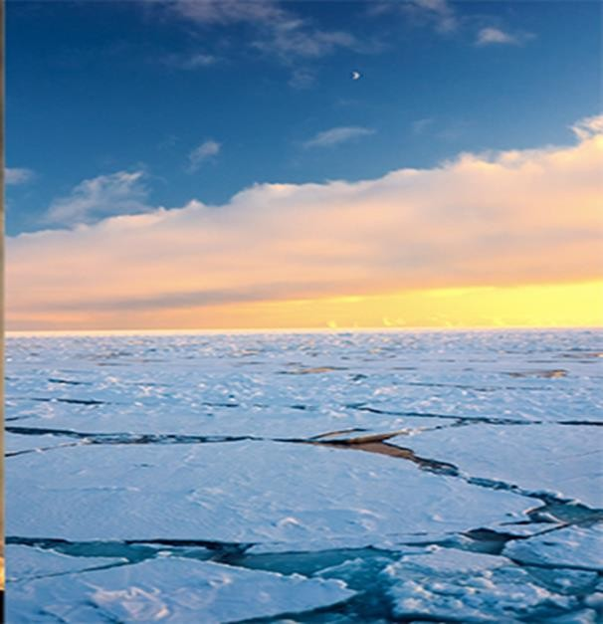
RISING SEA LEVELS
PGS. 408
29%
71%
Approximately 71 % of
Earth’s surface is covered with water.
water
land
Most of that water is oceans, but up to 2% of that water
is stored as
sea ice, glaciers, and
permanent snow.

Slide 7

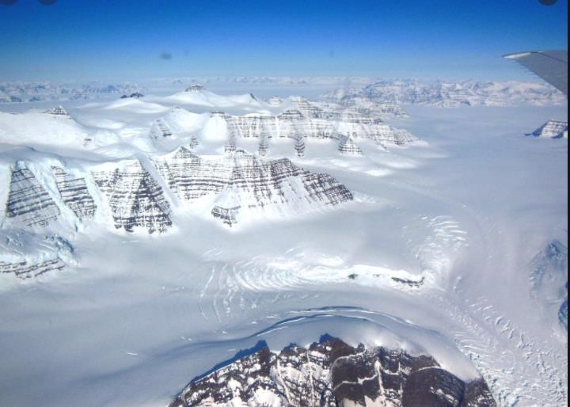
As global temperatures rise, so does the global sea level.
RISING SEA LEVELS
PGS. 408
The polar regions are particularly vulnerable to global warming!
because even slight increases in temperature cause huge areas of stored ice to melt
and flow into Earth’s oceans.
Glaciers are huge areas of ice in mountain regions, store fresh water in the form of solid ice.
Scientists observe not only that glaciers are retreating as temperatures rise, but the rate at which they melt is steadily increasing.
Melting glaciers carry massive amounts of fresh water and sediment from the land to the ocean.
Alaska’s glaciers have lost nearly 50 giga tons of ice each year since 2003.
Rising sea levels have devastating effects on coastal areas.
Why scientists are so worried about this glacier
https://www.youtube.com/watch?v=XRUxTFWWWdY

Slide 8
As global temperatures rise, so does the global sea level.
RISING SEA LEVELS
PGS. 408
The polar regions are particularly vulnerable to global warming!
because even slight increases in temperature cause huge areas of stored ice to melt and flow into Earth’s
oceans.
Glaciers, huge areas of ice in mountain regions, store fresh water in the form of solid ice.
Scientists studying glaciers over the past 50 years observe not only that glaciers are retreating as temperatures rise, but the rate at which they melt is steadily increasing.
Melting glaciers carry massive amounts of fresh water and sediment from the land to the ocean. Alaska’s
glaciers have lost nearly 50 gigatons of ice each year since 2003.
Rising sea levels have devastating effects on coastal areas.

Slide 9


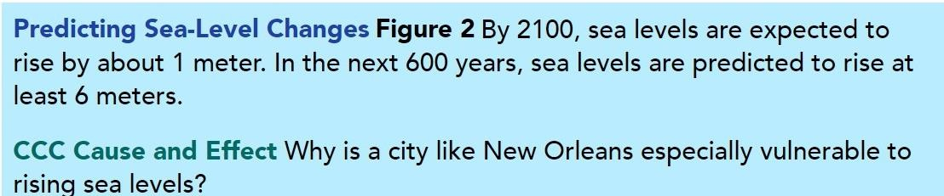
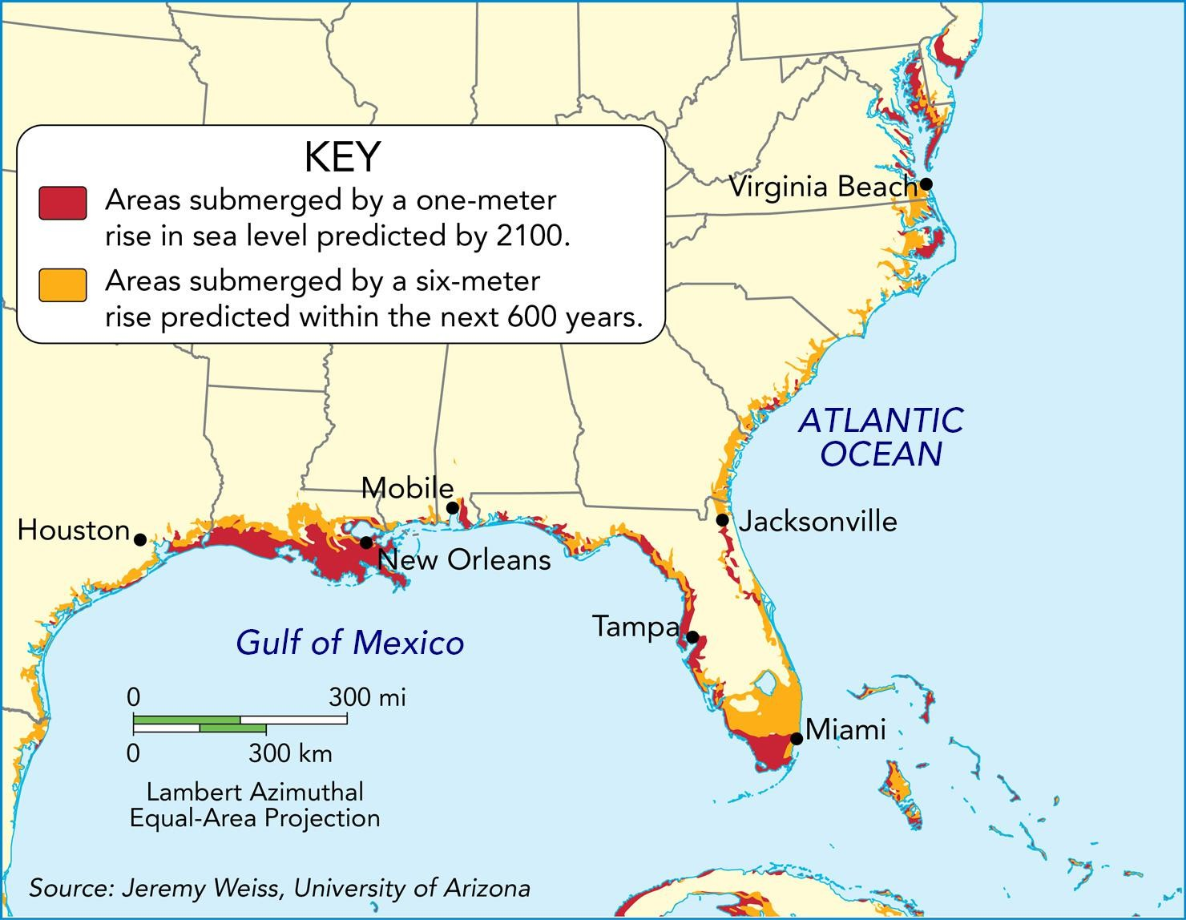
RISING SEA LEVELS
PGS. 408
In the past century, the global sea level has risen approximately 20 cm.
Low-lying land areas near the coast would be completely submerged in ocean water, resulting in habitat loss for humans and wildlife.
The map in Figure 2 illustrates areas in North America that would be completely submerged by rising sea levels over the next 100 years.
Scientists estimate Earth’s sea level has risen more than 120 meters since the last ice age, and will continue to rise.

Slide 10
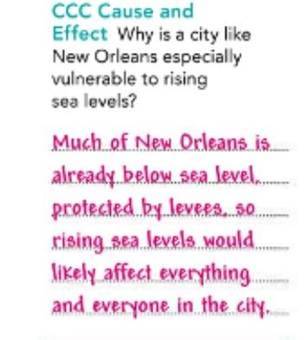
RISING SEA LEVELS
PGS. 408

Slide 11


Chain reactions by negative climate effects as a result of melting conditions in polar regions:
POLAR REGIONS UNDER THREAT
PGS. 409
Higher temperatures allow the atmosphere above the ice caps to hold more water vapor, which acts as a greenhouse gas.
The loss of reflective ice covering the northern ocean also allows solar energy to be absorbed by ocean waters, increasing temperatures even more.

Slide 12

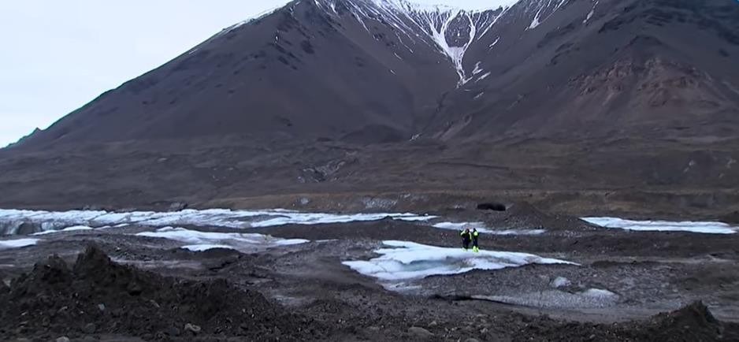

POLAR REGIONS UNDER THREAT
PGS. 409
Near Earth’s polar regions, a thin layer of soil supports plant life during the brief summer thaw, while the soil below, called permafrost, is frozen year- round.
As rising global temperatures melt permafrost, decomposing plant matter that has been covered for thousands of years releases carbon dioxide and methane gases.
The concentration of these greenhouse gases increases in the atmosphere, which further accelerates global warming.
Side-effects of global warming in
arctic and tundra climates:
Climate change in the Arctic
https://www.youtube.com/watch
?v=uIRMxDJZFK0

Slide 13
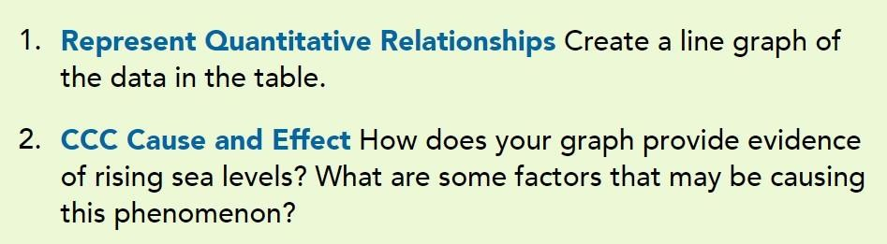
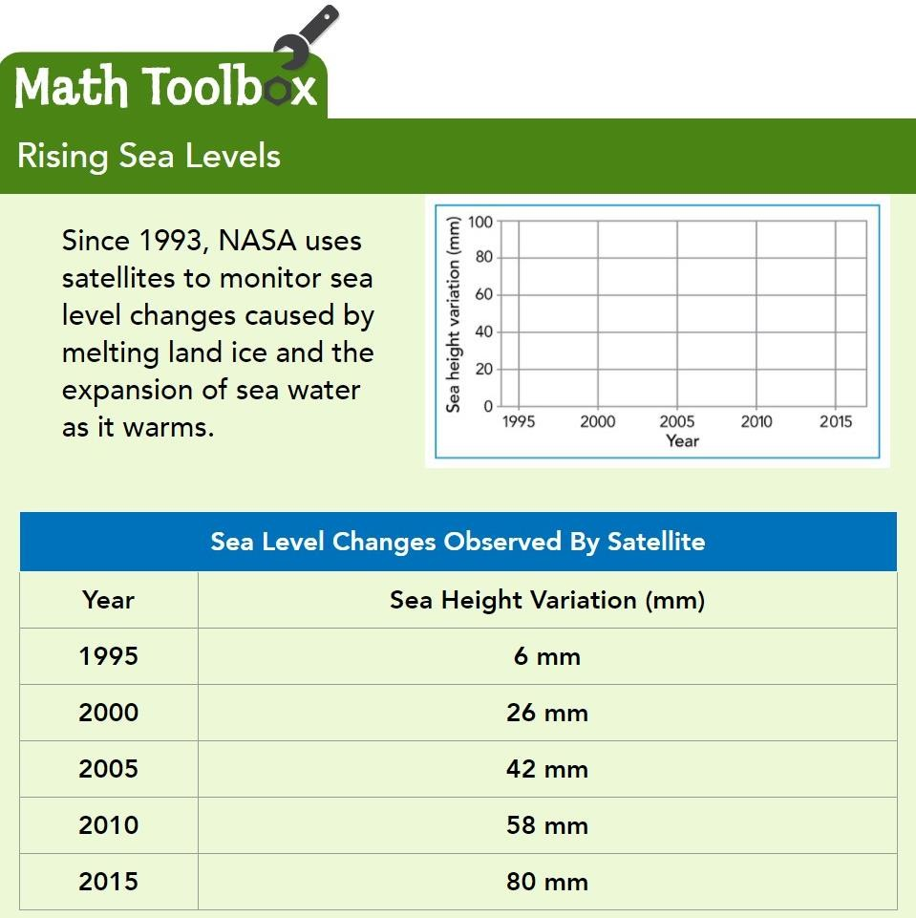
POLAR REGIONS UNDER THREAT
PGS. 409

Slide 14
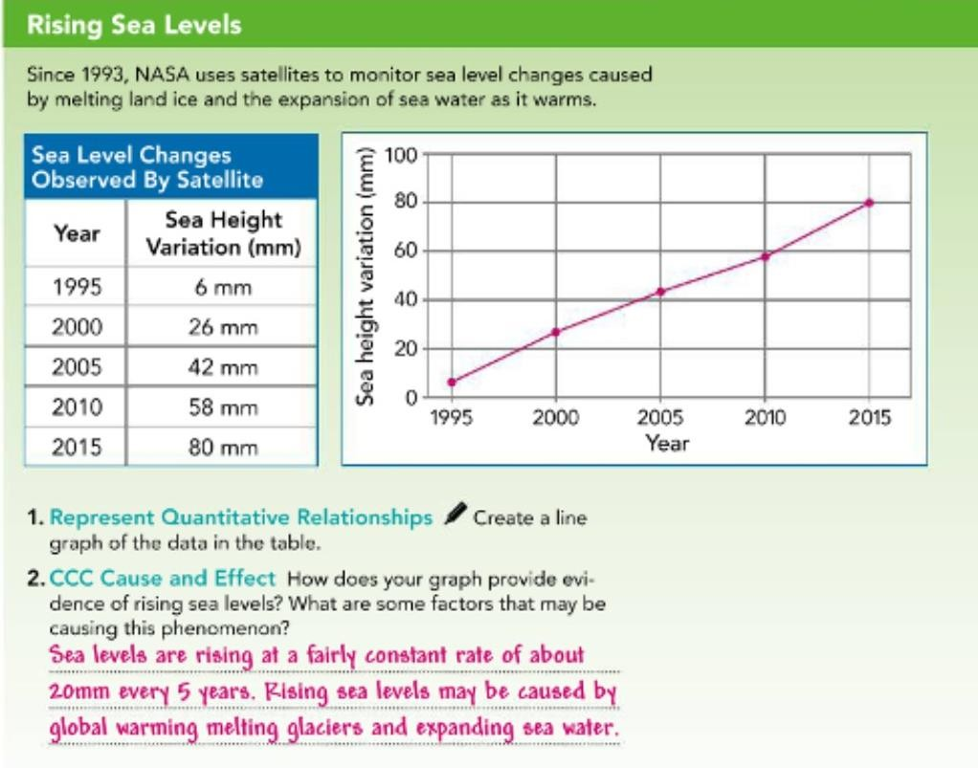
POLAR REGIONS UNDER THREAT
PGS. 409

Slide 15

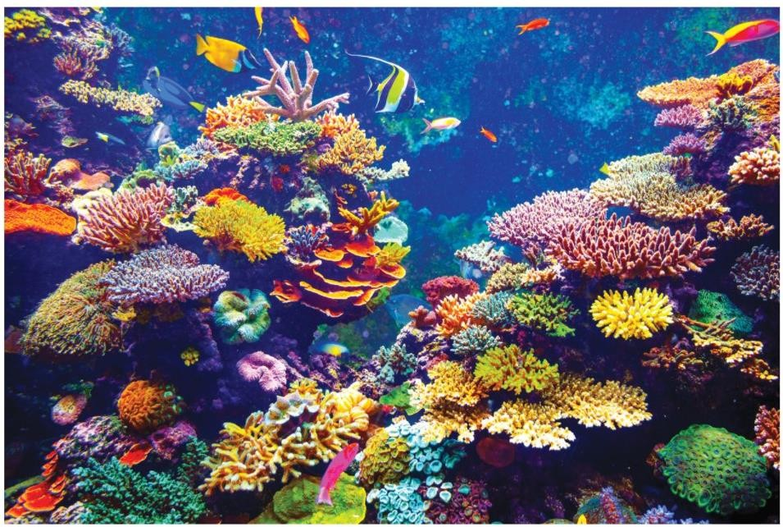
ADAPT OR PERISH
PGS. 410
As global warming accelerates, mass die-offs are
predicted.
Do you know why?
All living organisms have adaptations to survive in their environments.
These adaptations usually develop over very long periods of time as organisms thrive or perish.
When conditions in an environment change rapidly, organisms must adapt or move into new locations for food.

Slide 16


Global warming has a cascade effect
What does that mean?
ADAPT OR PERISH
PGS. 410
Scientists estimate 75 % of the world’s coral reefs are under
threat due to rising ocean temperatures.
Certain types of algae necessary for the survival of reef-building coral are affected by rising temperatures, causing coral to lose all its coloring in a process called bleaching.
Entire reefs can die off due to coral bleaching, resulting in the destruction of habitats and many more negative impacts.
An unforeseen chain of events caused by a disturbance in a system, on Earth’s organisms.
Cascading Effects https://www.y outube.com/ watch?v=XAw 6WF6yAnE

Slide 17


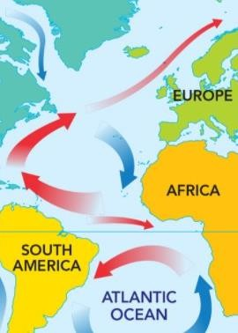


EXTREME WEATHER CHANGE
PGS. 410
Global warming refers to the overall warming of
Earth’s temperatures,
but it may not mean all areas of Earth experience warmer conditions.
Parts of Earth, such as Europe, could start to experience colder temperatures because of
disturbed ocean currents.
The world’s oceans act as a conveyor belt, circulating cold water
from the poles and warm water from the equator.
Due to melting ice, that process is gradually being disrupted, and
it could prevent ocean currents from stabilizing global climates.

Slide 18
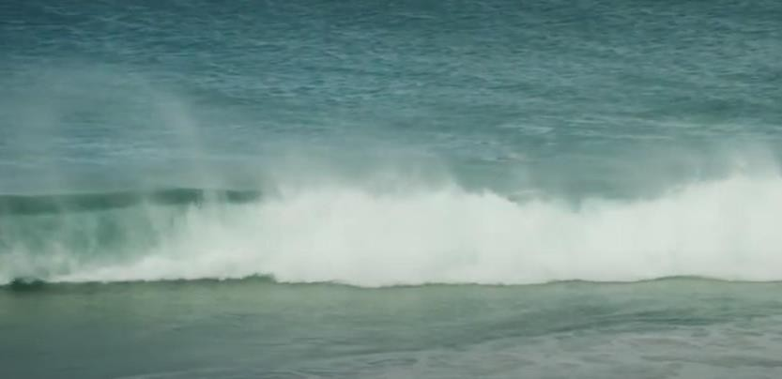
EXTREME WEATHER CHANGE
PGS. 410
Global climate changes also have cascading effects on regional weather patterns.
Warmer temperatures result in more energy and more water vapor in the atmosphere.
This can make heat waves hotter, flooding heavier, and severe storms more powerful.

Slide 19
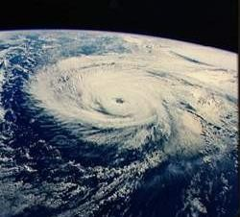
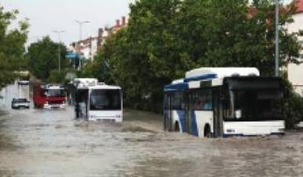
EXTREME WEATHER CHANGE
PGS. 410
Since the 1980s, scientists have measured an increase in both the frequency and intensity of hurricanes in the Atlantic Ocean.
If the trend continues, they predict hurricane potential will increase 20 % by 2100.
Extreme weather changes cause property damage, loss of life, and sometimes permanently alter the landscape.

Slide 20
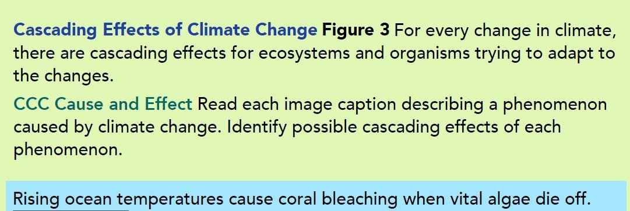
EXTREME WEATHER CHANGE
PGS. 410

Slide 21

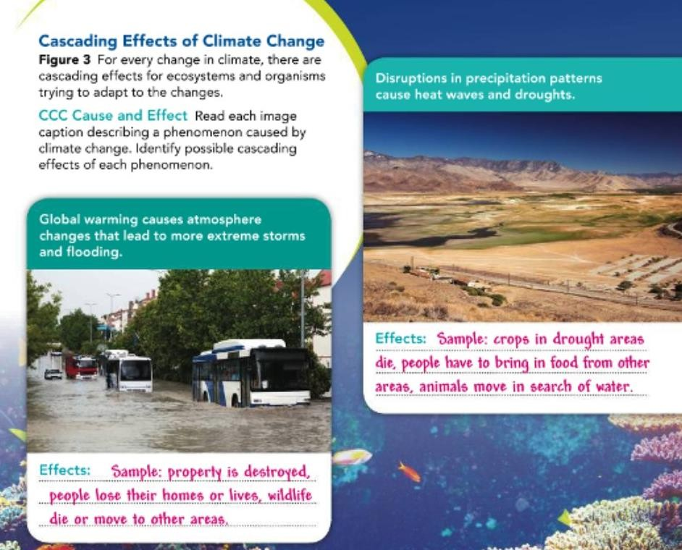
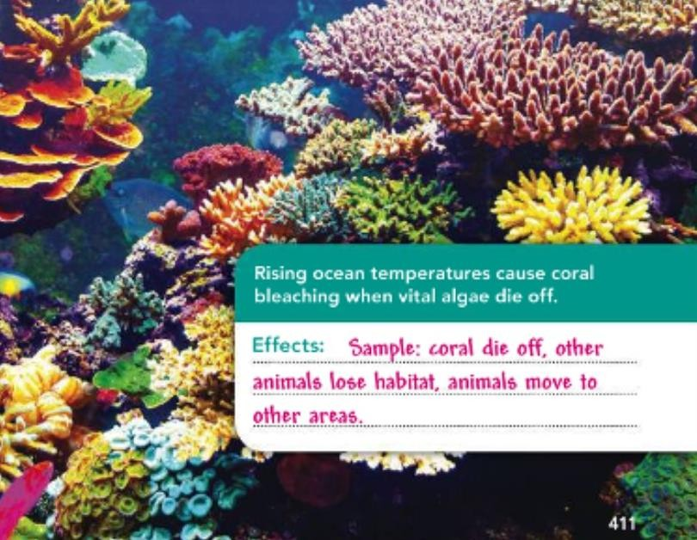
EXTREME WEATHER CHANGE
PGS. 410

Slide 22





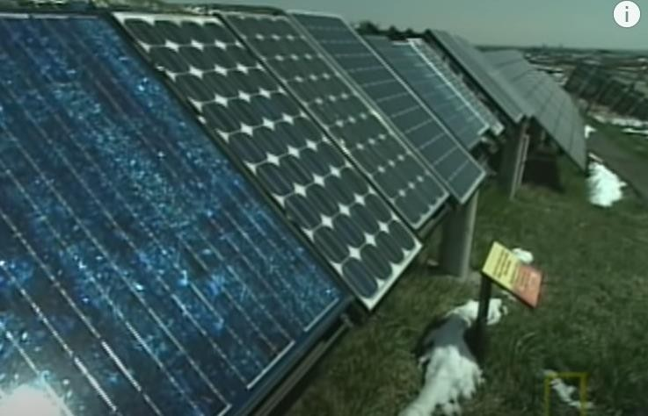
How can humans alter their behaviors to reduce or counteract the increasingly harmful effects of global warming?
DEALING WITH CLIMATE CHANGE
PGS. 412
Alternative Energy
Human activities require energy, and 91% of all greenhouse gases emitted by human activities comes from burning fossil fuels.
By developing alternative energy [= clean energy source that do
not come from fossil fuels],
we can reduce the mining and burning of fossil fuels.
This will greatly reduce the levels of greenhouse gases being released into the
atmosphere.
Alternative energy sources such as solar, wind,
geothermal, and tidal power do not require fossil fuels and have no greenhouse gas emissions.
Alternative Energy | National Geographic https://www.youtube.com
/watch?v=oIU5fFmDeSc

Slide 23





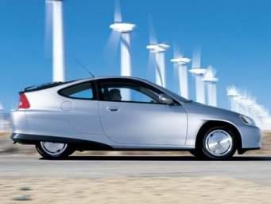
DEALING WITH CLIMATE CHANGE
PGS. 412
How can humans alter their behaviors to reduce or counteract the increasingly harmful effects of global warming?
2- Energy-Efficient Technologies
In the short term, these technologies might reduce emissions and
reliance on traditional forms of energy.
And for long-term solutions, engineers might develop technology that changes how we consume energy—from batteries powered by nitrogen in the air to new super-efficient hybrid cars.

Slide 24




ENGINEERING NEW SOLUTIONS
PGS. 413
Reducing carbon emissions may not be enough
to slow climate change.
3-Engineering New Solutions
Using nature as a guide, engineers are developing ways to remove carbon dioxide from the atmosphere.
This is done through using the natural process of photosynthesis to remove carbon dioxide from the air, or filtering carbon directly and storing it underground.
Other engineers are working on solutions to help deal with the effects of climate change by helping communities be less vulnerable to effects such as rising sea levels.

Slide 25
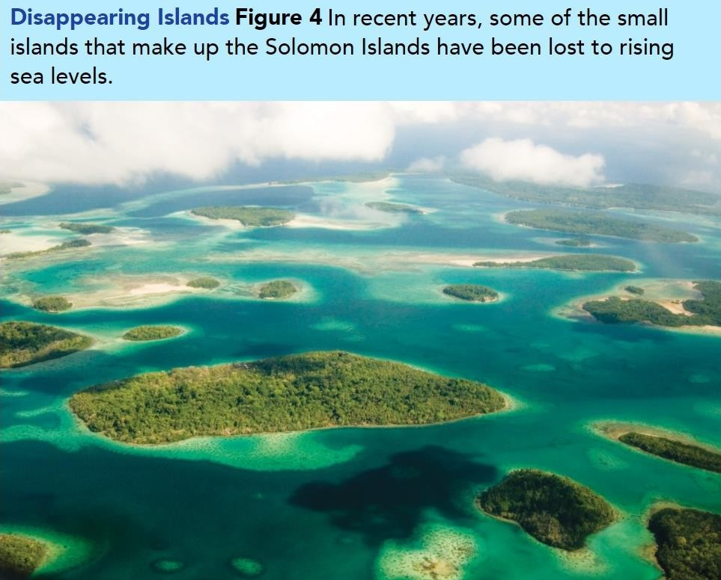




THE ROLE OF GOVERNMENT
PGS. 413
4-The Role of Government
Realizing that climate change is a global issue,
governments from nations around the world have been coming together to discuss evidence and make plans to wisely counteract global warming.
In 2012, the Solomon Islands (Figure 4) led the world by passing a comprehensive climate change policy in response to the challenges they are already facing.
Why Are Islands Disappearing Off The Face Of The Earth? https://www.youtube.com/watch?v= mYdBREXRXOk

Slide 26
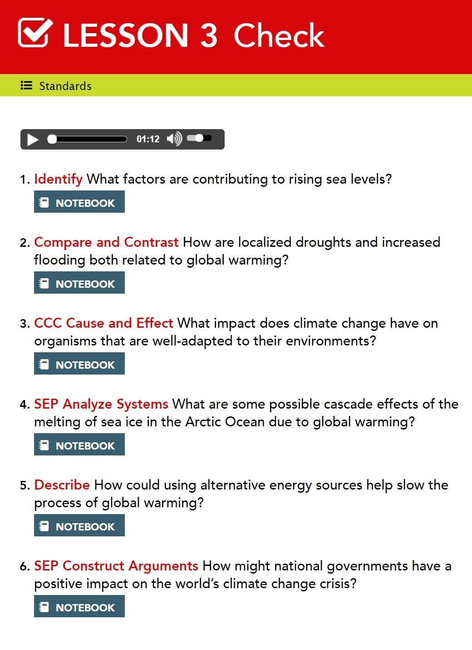

Slide 27
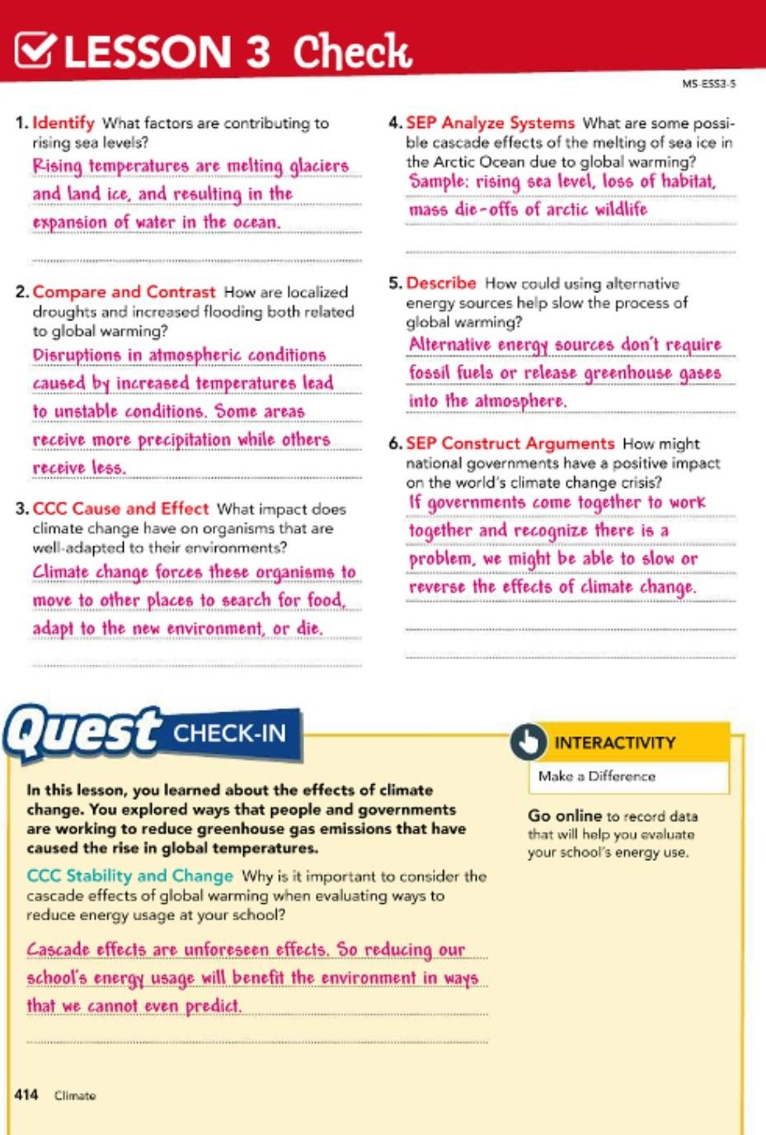

Slide 28


THANK YOU…

