Slide 1
Topic 7: Energy in The Atmosphere and Ocean
Grade 8
Lesson 3: Patterns of Circulation
in the Atmosphere
Pages 362 : 368

Slide 2
Objectives:
Students will identify and describe evidence that
    • global winds drive surface currents.
    • unequal heating and the rotation of Earth combine to produce the patterns of ocean circulation.
Students will cite textual evidence to support how ocean currents redistribute Earth’s energy by the motion of :
    • the Gulf Stream.
    • ocean currents that move in a loop around Earth’s bodies of water.

Slide 3
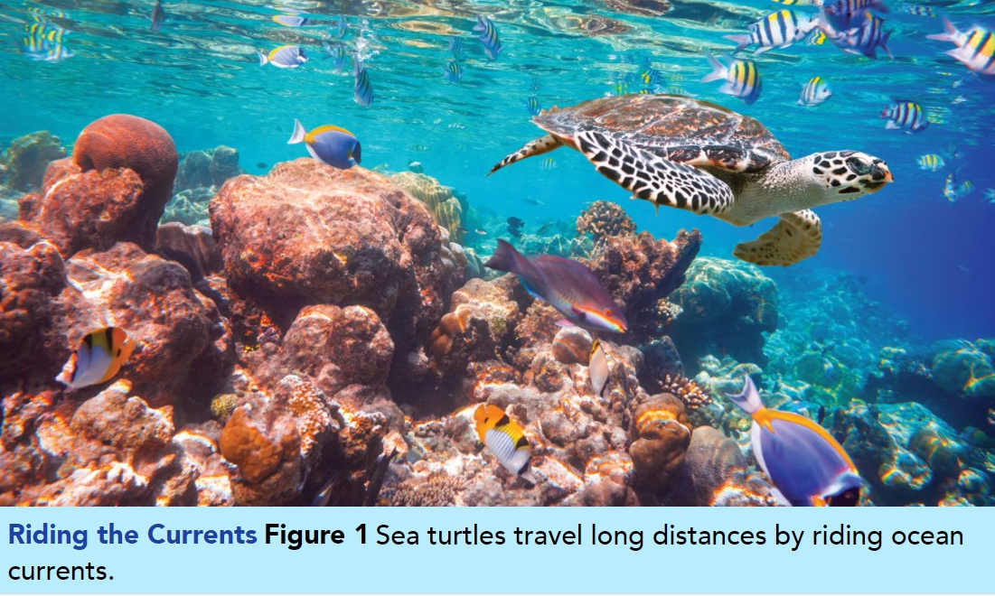
Surface Currents
Pgs. 362-363
Identify how you think ocean currents, water temperature, and weather might affect a sea turtle.
The East Australian Current & How could it affect living things?
https://www.youtube.com/watch?v=zstqK7dCdyU

Slide 4
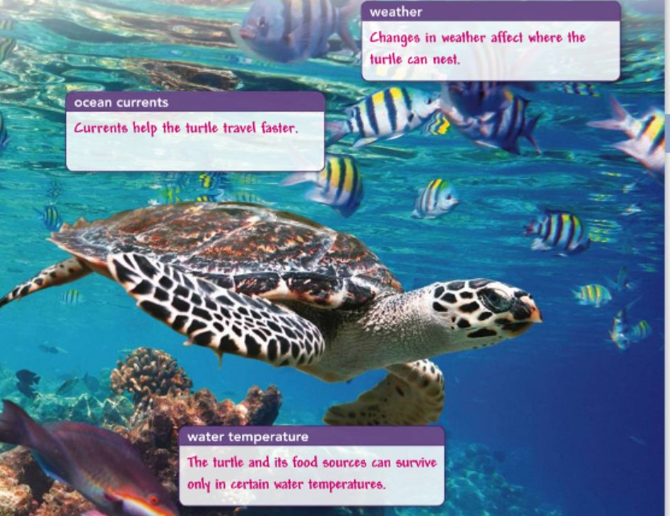

Slide 5
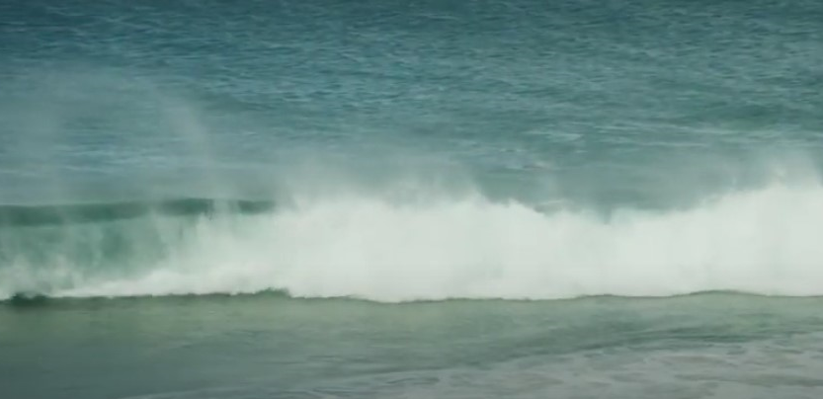
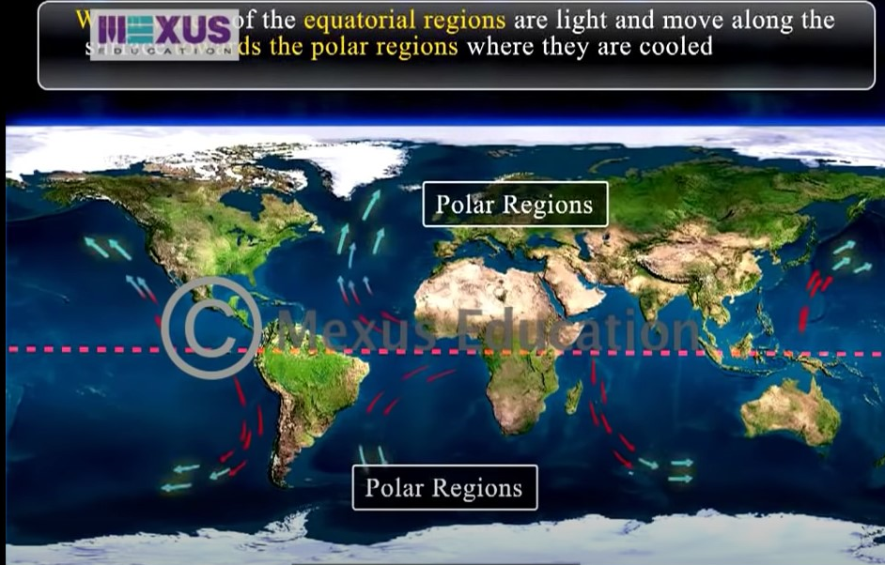
Surface Currents
Pgs. 362-363
Surface Currents
  Ocean water moves as waves. It also flows as currents.
  A current is a large stream of moving water that flows through the ocean.
  Both waves and currents can affect ocean ecosystems.
  Unlike waves, currents carry water from one place to another.
  Some currents move water deep in the ocean.
  Other currents, called surface currents, move water at the
  surface of the ocean.
They are driven mainly by global winds.
They follow Earth’s global wind patterns.
They move in circular patterns in the five major ocean basins.

Slide 6
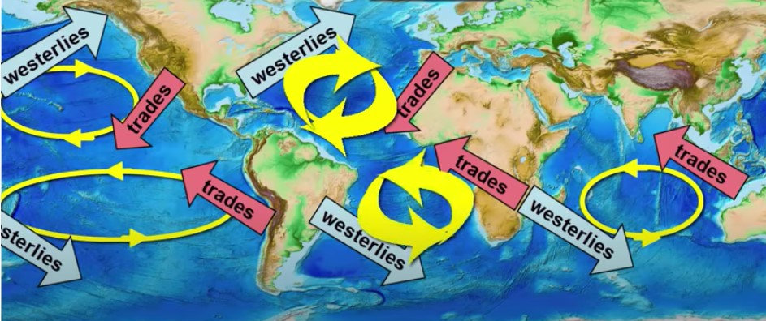
Surface Currents pg. 364
Remember:
Both combine to produce global wind belts
Factors Affecting Surface Currents
1- Global wind belts
2- Unequal heating and the rotation of Earth.
3- the Coriolis effect {as Earth rotates, the paths of global winds curve}
4- Winds push currents, but once the currents meet land,
they have to find a new path.
Also drive patterns of ocean circulation.
Warm currents moving away from the equator redistribute energy to keep temperatures moderate.
Cold currents move toward the equator to complete the circle
In the Northern Hemisphere, it causes the currents to curve to the right.
In the Southern Hemisphere, it causes the currents to curve to the left.
How do ocean currents work?
https://www.youtube.com/watch?v=p4pWafuvdrY

Slide 7
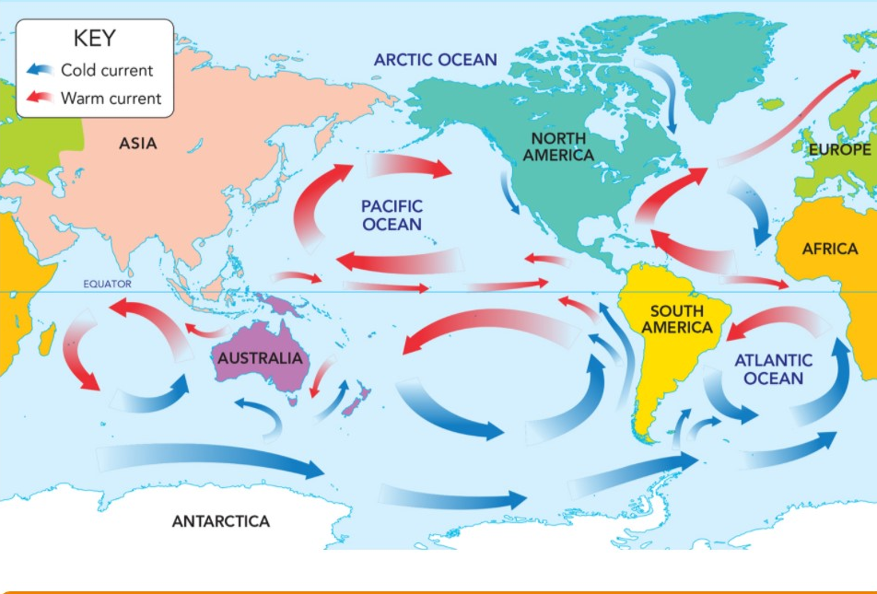
Surface Currents
pg. 365
Climate is the temperature and precipitation typical of an area over a long period of time.
  Effects on Climate {These currents have a great impact on local weather and climates. }
  The Gulf Stream is the largest and most powerful surface current in the North Atlantic Ocean.
    [It originates from the Gulf of Mexico and brings warm water up the east coast of North America and across the Atlantic.
    This large, warm current is caused by powerful winds from the west and is more than 30 kilometers wide and 300 meters deep.
    When the Gulf Stream crosses the Atlantic, it becomes the North Atlantic Drift.
  The Gulf Stream and other surface currents redistribute heat from the equator to the poles.

Slide 8
Surface Currents
pg. 365
  Effects on Climate
  When cold surface currents bring cold water, they cool the air above them.
  [Because cold air holds less moisture than warm air, it results in a cool and dry climate for the land areas.]
Gulf stream in Atlantic ocean
https://www.youtube.com/watch?v=UuGrBhK2c7U
Q. Why is England warmer and wetter than other countries at the same latitude, such as Canada and Russia?
As the North Atlantic Drift brings warm water to Northern Europe. The warm water radiates heat and brings warm temperatures and wet weather.

Slide 9
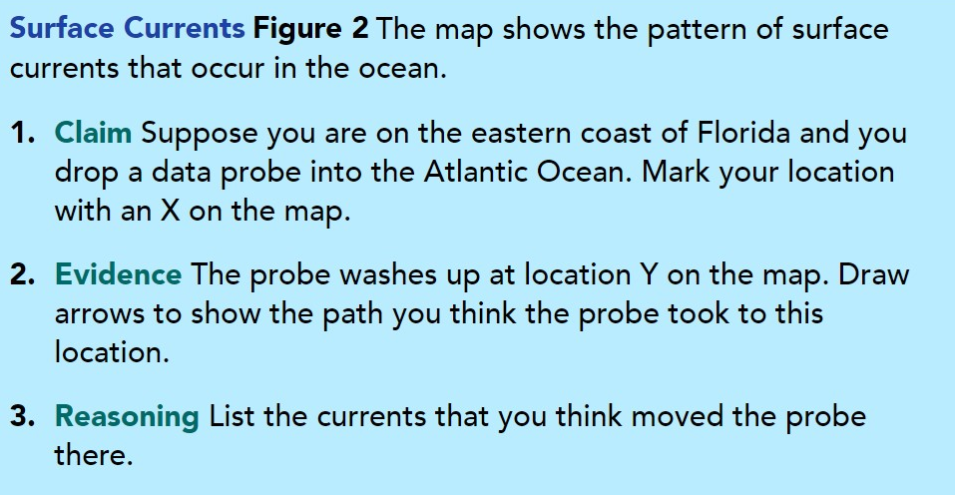
Surface Currents pg. 364-365

Slide 10
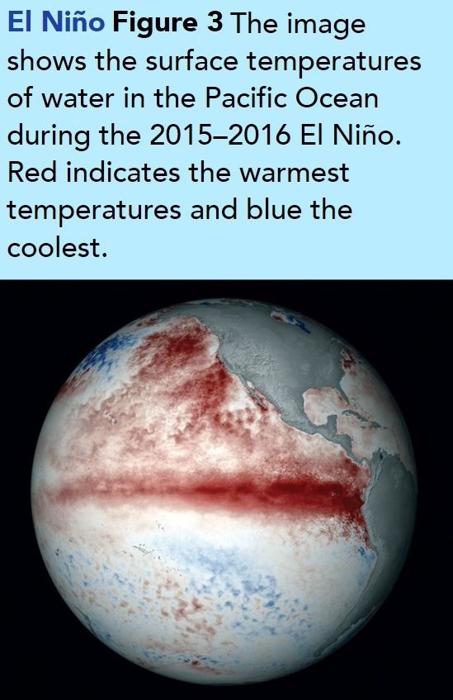
El Niño and La Niña pg. 366
Changes in wind patterns and ocean currents can have major impacts on weather conditions on nearby land.
El Niño
a climate event that occurs every two to seven years in the Pacific Ocean.
Near the Equator, winds usually blow east to west.
During El Niño;
  1- the winds along the Equator weaken and reverse direction.
  2- This allows warm, tropical water from the Pacific Ocean to flow east toward the South American coast and prevents the cold, deep water from moving to the surface.
It can last for one to two years.
El Niño’s effects on the atmosphere and ocean cause shifts in weather patterns.
The most recent El Niño in 2015 and 2016, increased rainfall and snowfall in California and caused flooding in California and Texas.
El Nino - What is it?
https://www.youtube.com/watch?v=WPA-KpldDVc

Slide 11
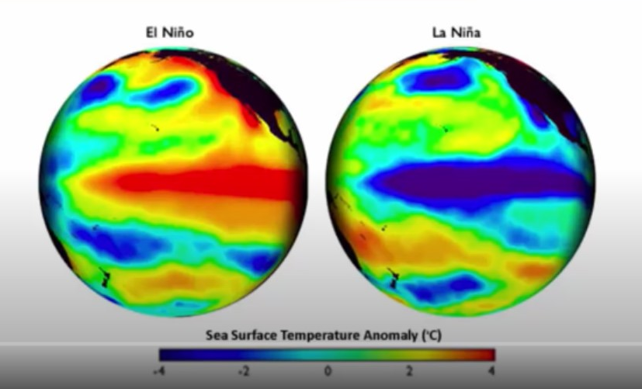
El Niño and La Niña pg. 366
Changes in wind patterns and ocean currents can have major impacts on weather conditions on nearby land.
La Niña
When surface waters in the eastern Pacific are colder than normal.
A La Niña event is the opposite of an El Niño event.
During a La Niña, stronger winds blow above the Pacific Ocean, causing more warm water to move west. This allows lots of cold water to rise to the surface.
This change in the ocean temperature affects weather all over the world.
La Niña can cause colder than normal winters and greater precipitation in the Pacific Northwest and the north central United States.
El Niño and La Niña
https://www.youtube.com/watch?v=wVlfyhs64IY

Slide 12
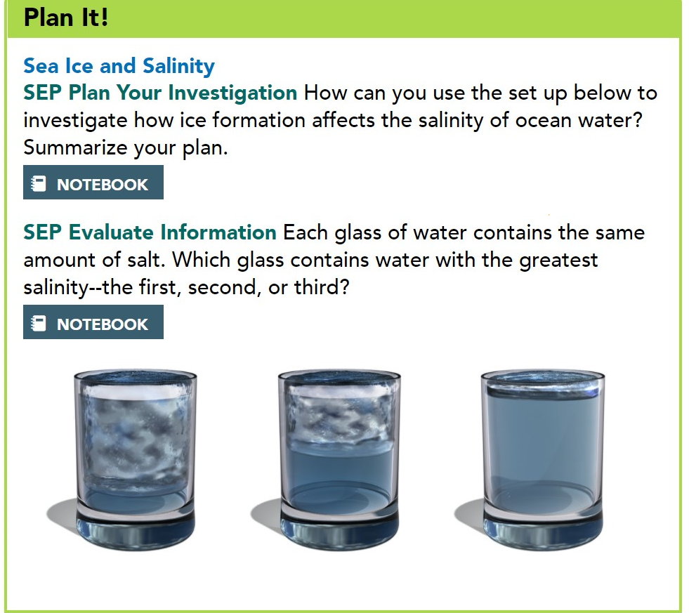
Deep Ocean currents
pg. 367
Deep currents are caused by differences in the density of ocean water.
Remember:
The density of ocean water varies with its temperature and salinity.
So;
Cold water or salty water
is denser.
So;
Dense water sinks, which drives deep ocean currents
Changes in salinity & in temperature
https://www.youtube.com/watch?v=C57P7ncqeQY

Slide 13
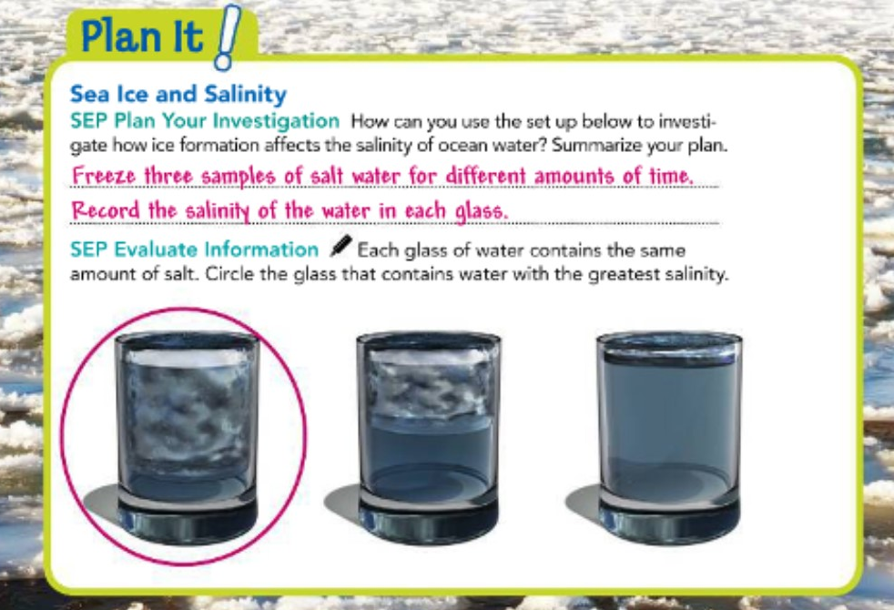
Deep Ocean currents
pg. 367

Slide 14
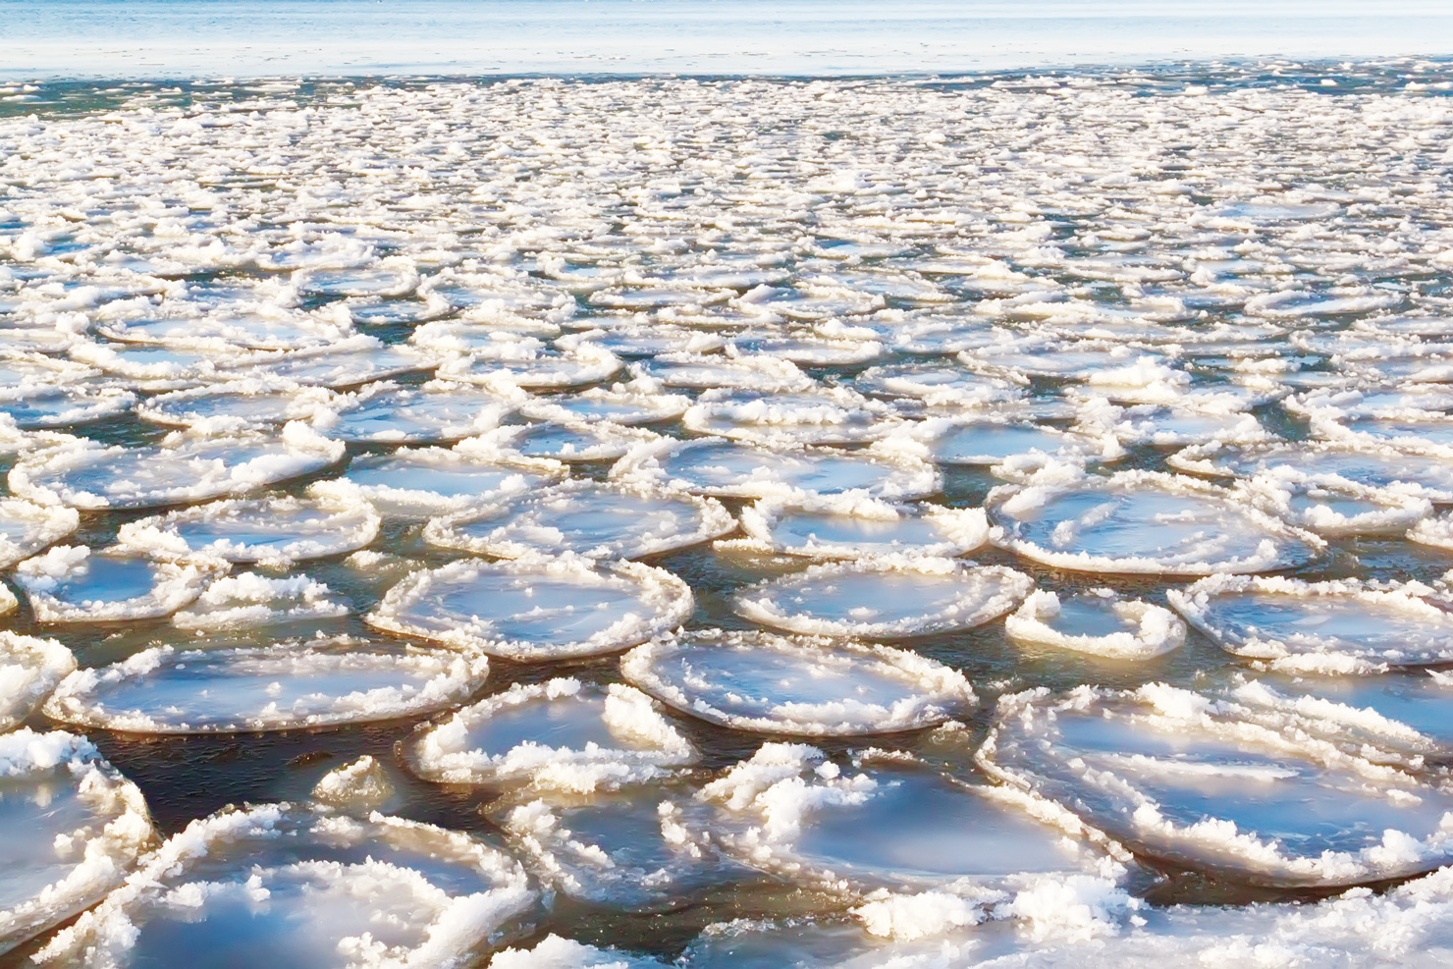
Deep Ocean currents
pg. 367
Deep currents are caused by differences in the density of ocean water.
Read
When a warm surface current moves from the equator toward one of the poles, it gradually gets denser because it both cools and becomes saltier as water evaporates.
As ice forms near the poles, the salinity of the water increases even further.
    {This is because the ice contains only fresh water,
    leaving the salts in the water. }
The cold salty water sinks and flows along the ocean floor as a deep current.
Like surface currents, deep currents are affected by the Coriolis effect, which causes them to curve.
Deep currents move and mix water around the world. They carry cold water from the poles toward the equator.
Deep currents flow slowly. They may take longer than 1,000 years to make one full trip around their ocean basins.
Sea Ice
Sea ice forms different shapes.
This ice is called pancake ice.

Slide 15
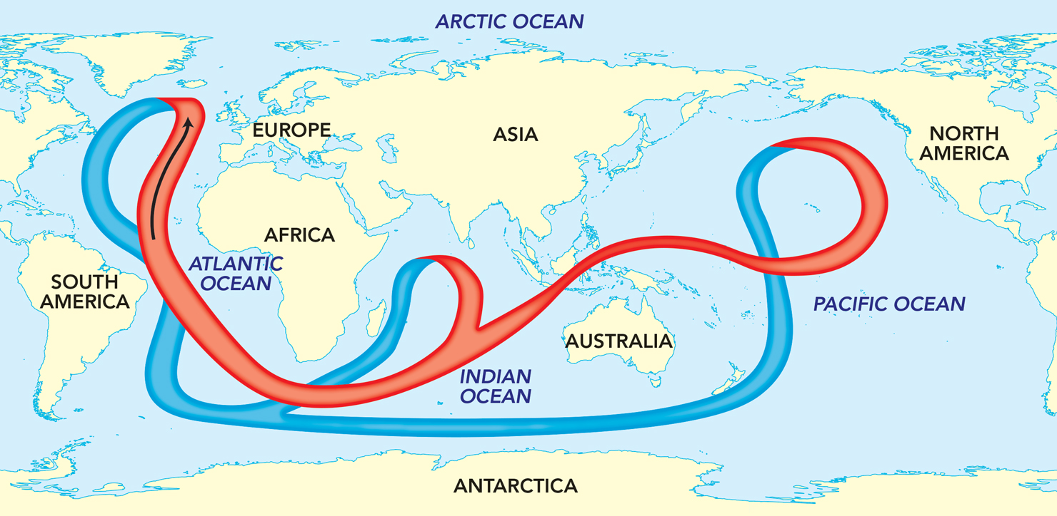
Global ocean conveyor
pg. 368
Ocean Currents (summary)
https://www.youtube.com/watch?v=ygI1B7h2j_0
The ocean currents move in a loop around Earth’s bodies of water.
The movement looks like a conveyor belt and results from density differences due to variations in temperature and salinity.
The movement of the currents circulates oxygen that is essential for marine life.
The ocean’s deep currents mostly start as cold water in the North Atlantic Ocean. This is the same water, called the North Atlantic Deep Water, that moved north across the Atlantic as part of the Gulf Stream.
It sinks and flows southward toward Antarctica. From there it flows northward into both the Indian and Pacific oceans.
There, deep cold water rises to the surface, warms, and eventually flows back along the surface into the Atlantic.
This system circulates water and transfers heat throughout the interconnected ocean basins and thus around Earth from the equator to the poles and back again.

Slide 16
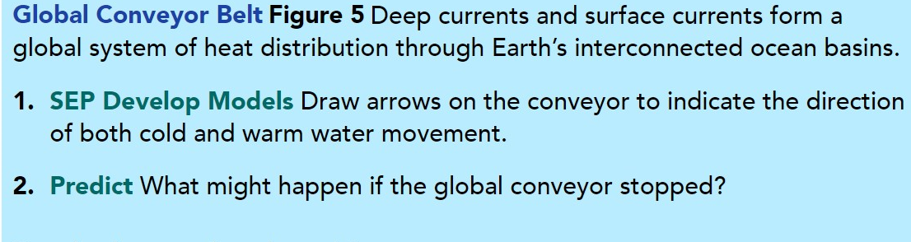
Global ocean conveyor
pg. 368

Slide 17
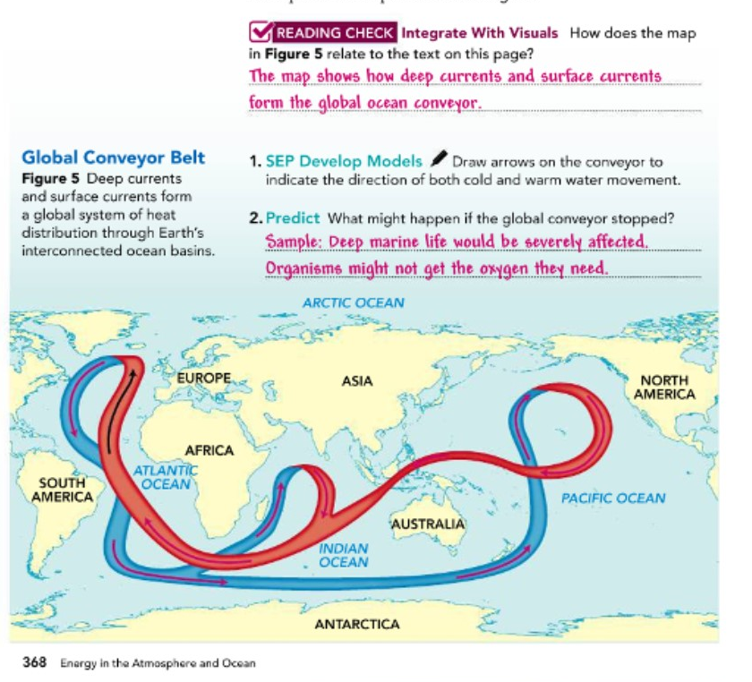
Global ocean conveyor
pg. 368

Slide 18
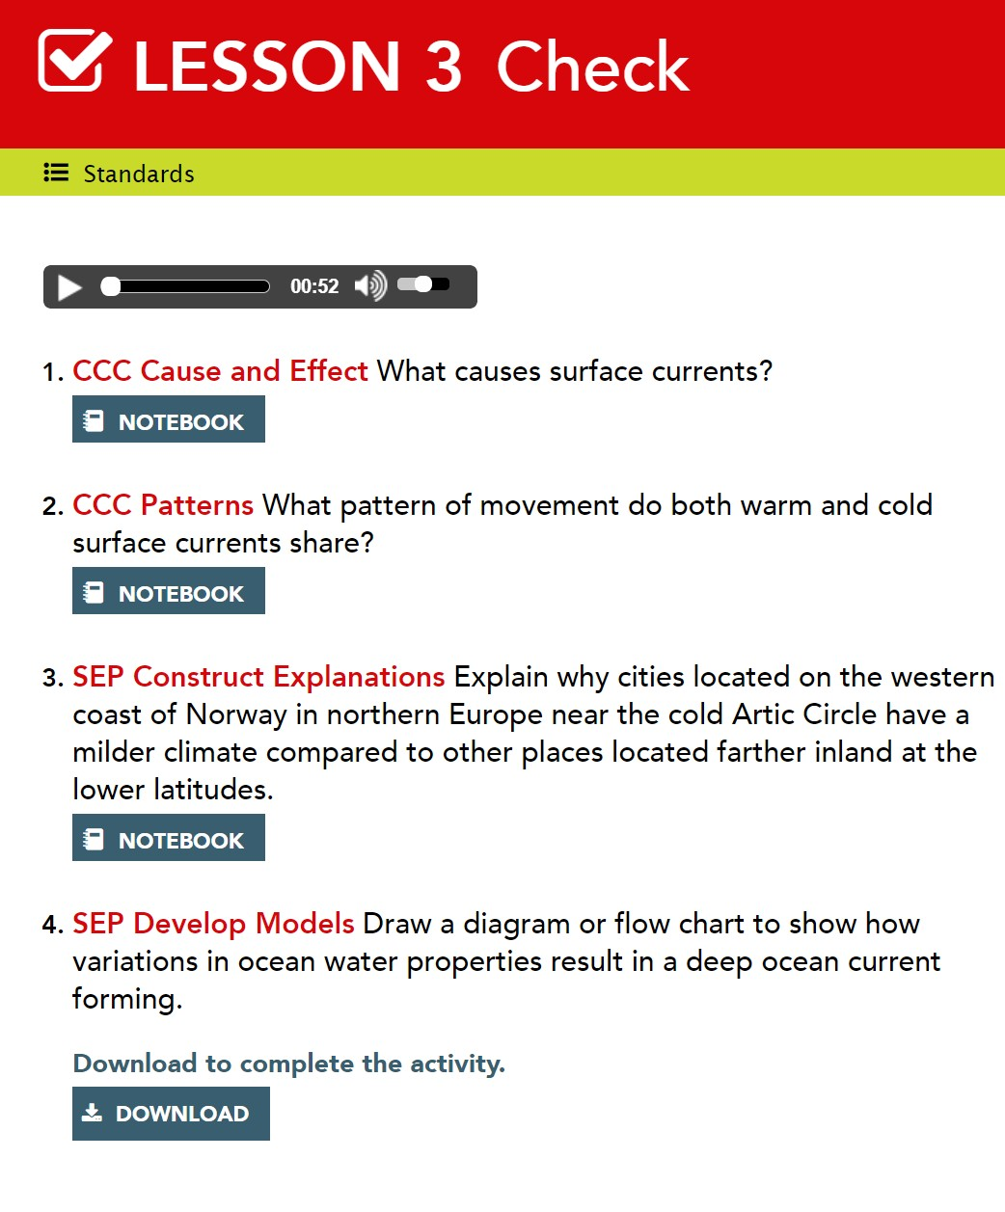
Lesson Check
pg. 369

Slide 19
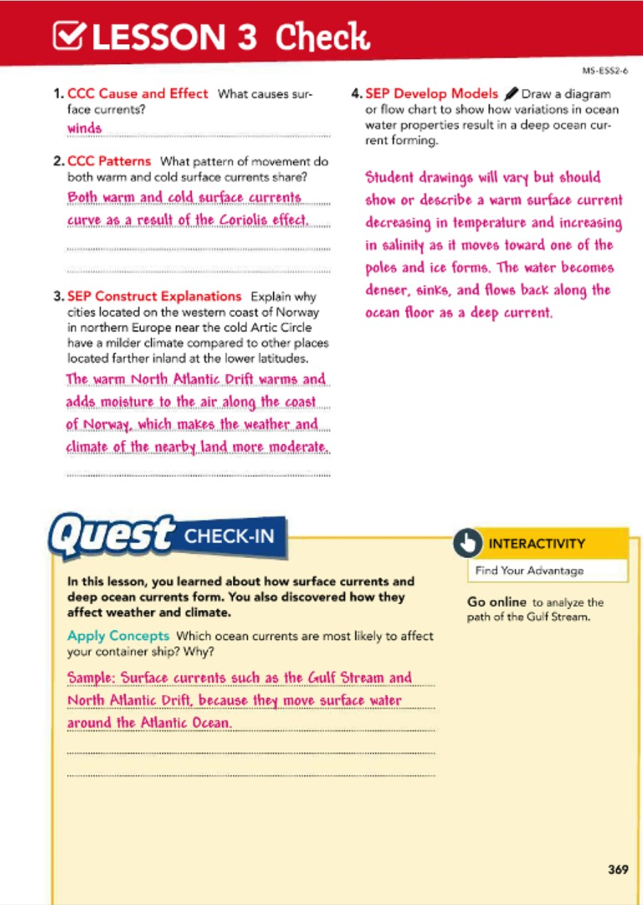
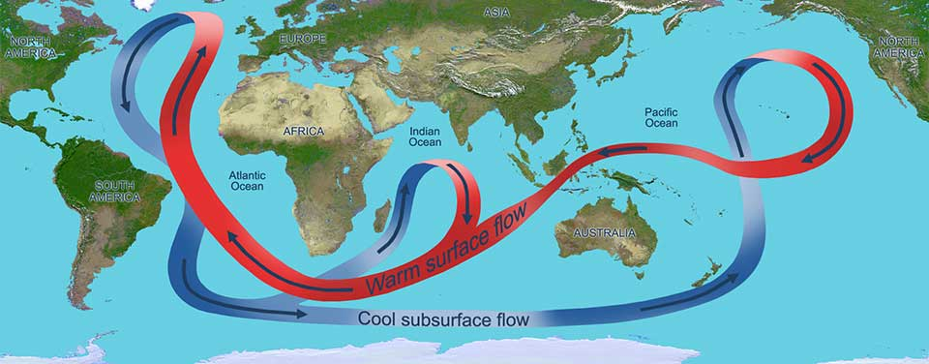
Lesson Check
pg. 369

Slide 20

Thank You…

