Slide 1
Topic 6: History of Earth
Grade 8
Lesson 2: Geologic Time Scale
Pages 312 : 317

Slide 2
Objectives:
Students will construct an explanation using reasoning to identify:
the purpose of the geologic time scale.
Students will identify and analyse evidence that
helps define and divide geologic time.
Earth evolved due to natural processes.

Slide 3
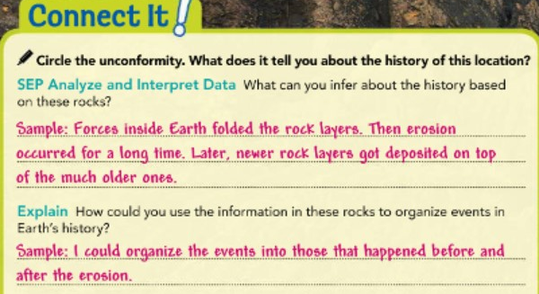
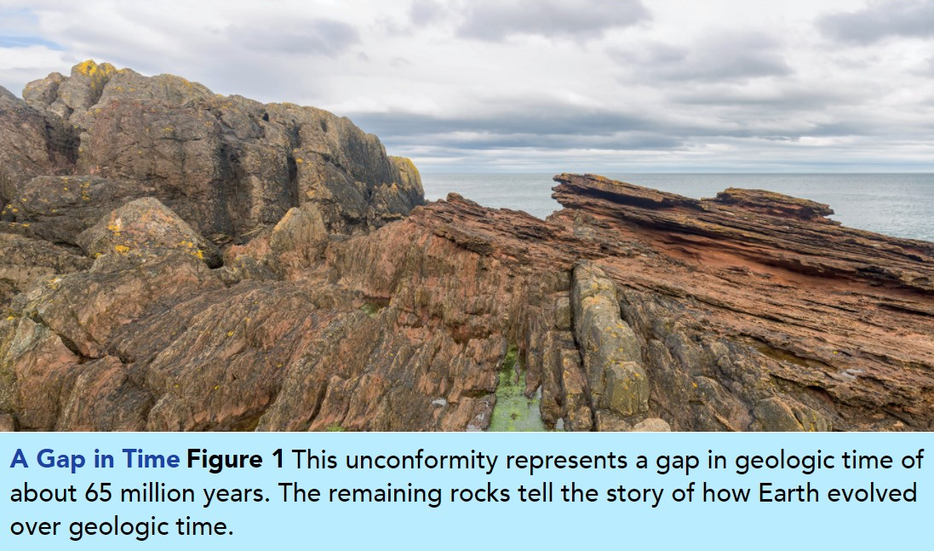
Circle the unconformity. What does it tell you about the history of this location?
Analyze and Interpret Data
What can you infer about the history based on these rocks?
Explain How could you use the information in these rocks to organize events in Earth’s history?

Slide 4
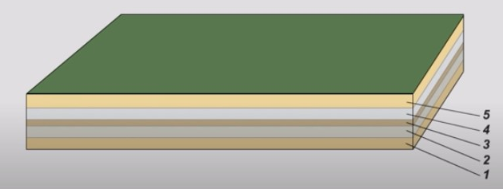
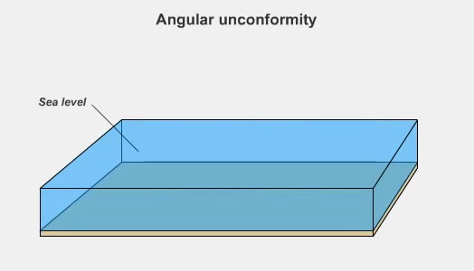
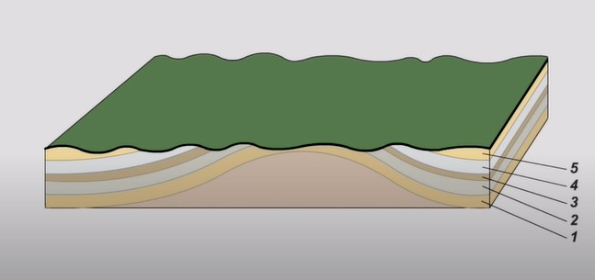
Do you remember what does unconformity mean?
Gaps in the Geologic Record
When rock layers erode, an older rock surface may be exposed. Then deposition begins again, building new rock layers.
The surface where new rock layers meet a much older rock surface beneath them is called an unconformity. An unconformity is a gap in the geologic record. It shows where rock layers have been lost due to erosion.

Slide 5
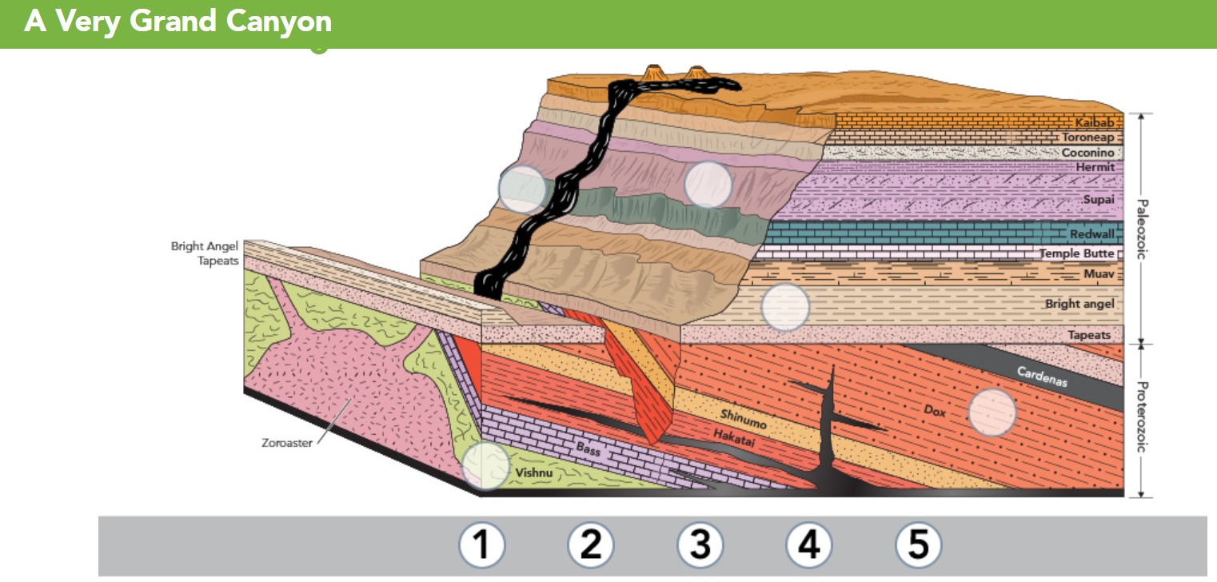
Interactivity
Label to show the relative ages of the rock layers.
Use 1 for the oldest layer and 5 for the youngest layer.

Slide 6
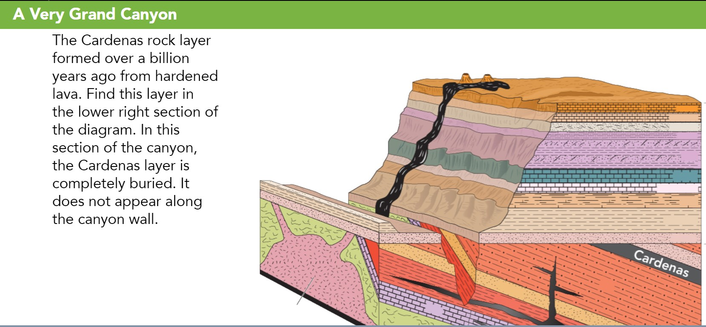
Interactivity

Slide 7
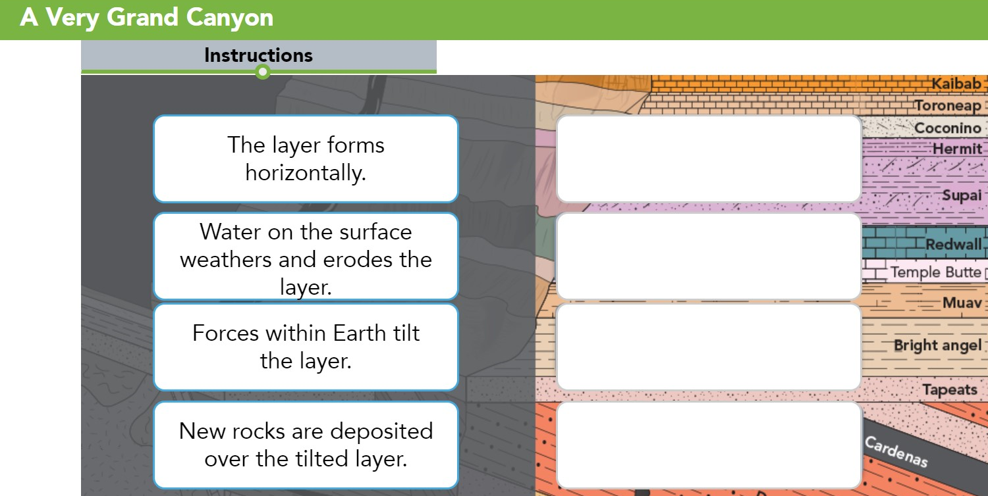
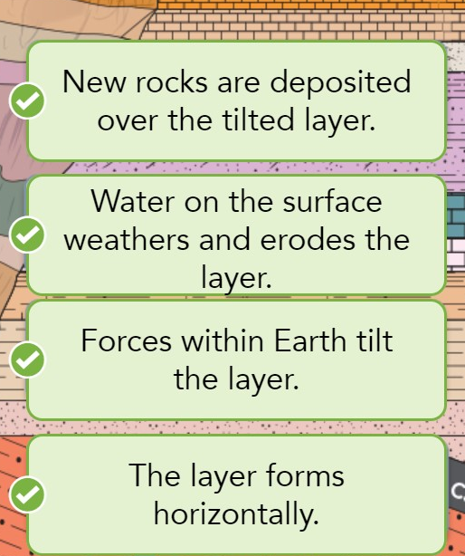
Interactivity
Rearrange the tiles to show the order of events that formed the Cardenas layer as it exists today.

Slide 8
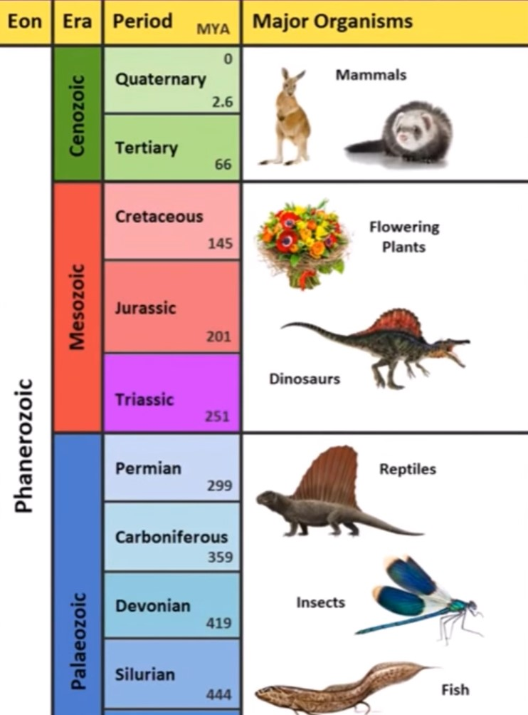
The Geologic Time Scale
To organize this vast number of years into manageable periods, scientists created the geologic time scale.
The geologic time scale is a record of the geologic events and the evolution of life forms as shown in the rock and fossil records.
It is a timeline [a model] of the relative order of events over a long period of time.
The Geologic Time Scale
https://www.youtube.com/watch?v=2KjqHfemon8&t=83s

Slide 9
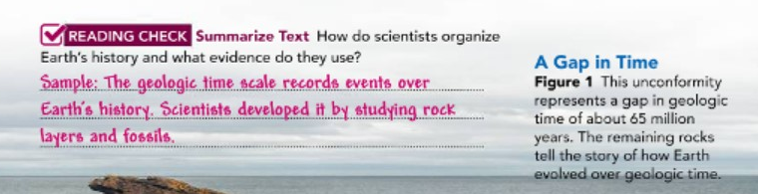
The Geologic Time Scale
Scientists developed the geologic time scale
1st - by studying rock layers and index fossils worldwide.
[They gathered evidence using methods of determining the relative ages of rocks, such as evidence from unconformities.]
Then, they used radioactive dating to help them determine the absolute age of the divisions in the geologic time scale.
READING CHECK Summarize [pg. 313]
How do scientists organize Earth’s history, and what evidence do they use?

Slide 10
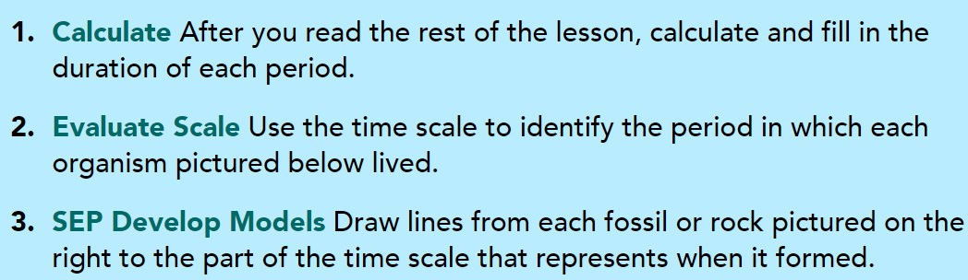
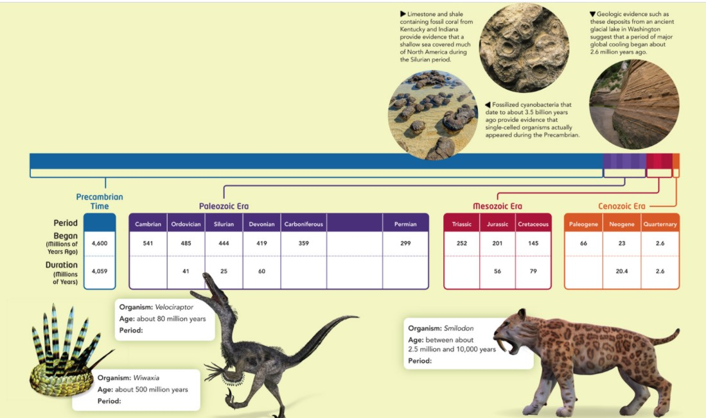
The Geologic Time Scale
Phanerozoic Eon | Geologic Time Scale with events
https://www.youtube.com/watch?v=MYKAyIXGN70&t=219s

Slide 11
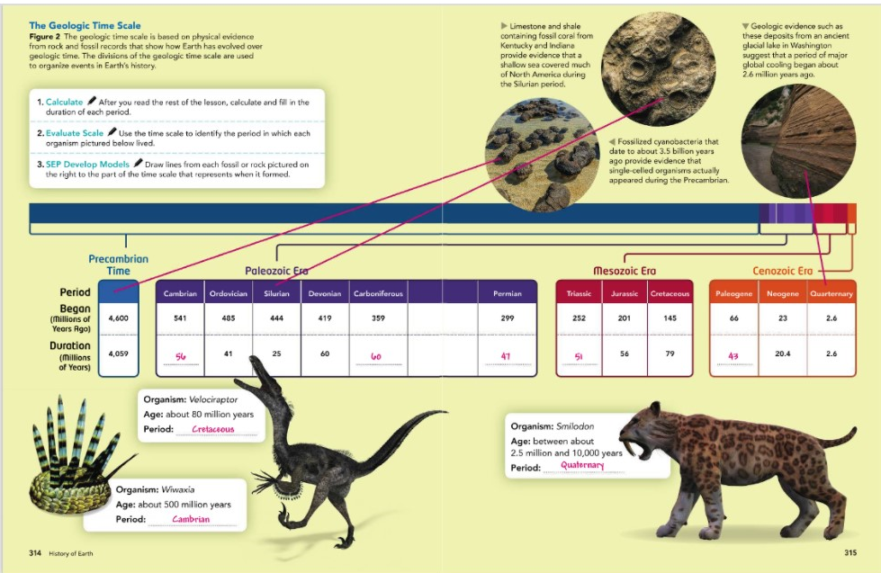

Slide 12
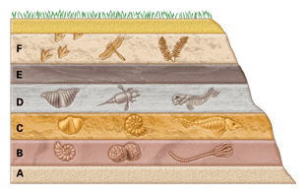
Dividing Geologic Time
As geologists studied the rock and fossil records, they found major changes in life forms at certain times.
Fossils are widely distributed in Earth’s rocks.
Most divisions of the geologic time scale depend on events in the history of life on Earth.

Slide 13
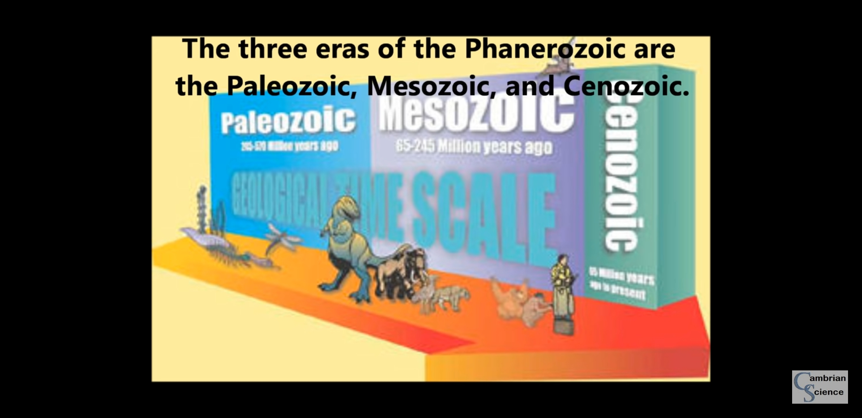
Precambrian and the present into three long units of time called eras. 1- During the Paleozoic era, life increased in complexity and Pangaea formed. 2- The Mesozoic era is defined by the dominance of dinosaurs and Pangaea breaking apart. 3- During the Cenozoic era, mammals evolved to become the dominant land animals and the continents moved to their present-day positions.

Slide 14

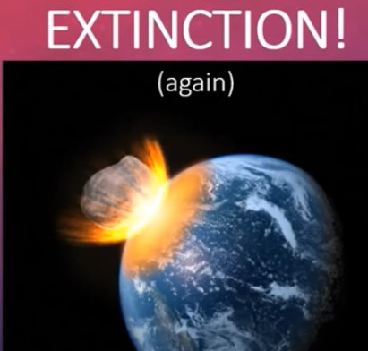
Eras are subdivided into units of geologic time called periods. The Mesozoic era includes three periods: 1- Triassic period, 2- Jurassic period, and 3- Cretaceous period.
Each period is defined by certain events.
For example, at the end of the Cretaceous period, major volcanic eruptions coincided with the impact on Earth of a huge asteroid.

Slide 15
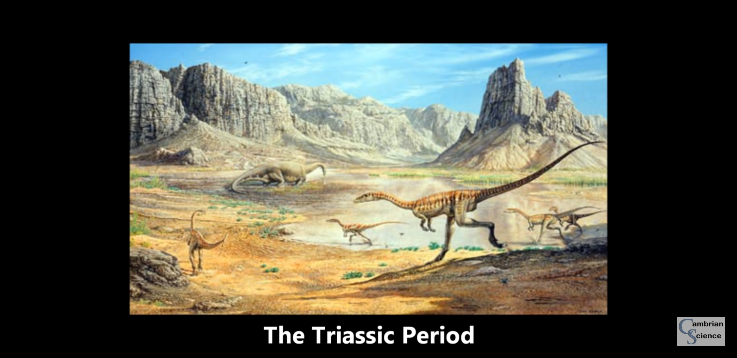
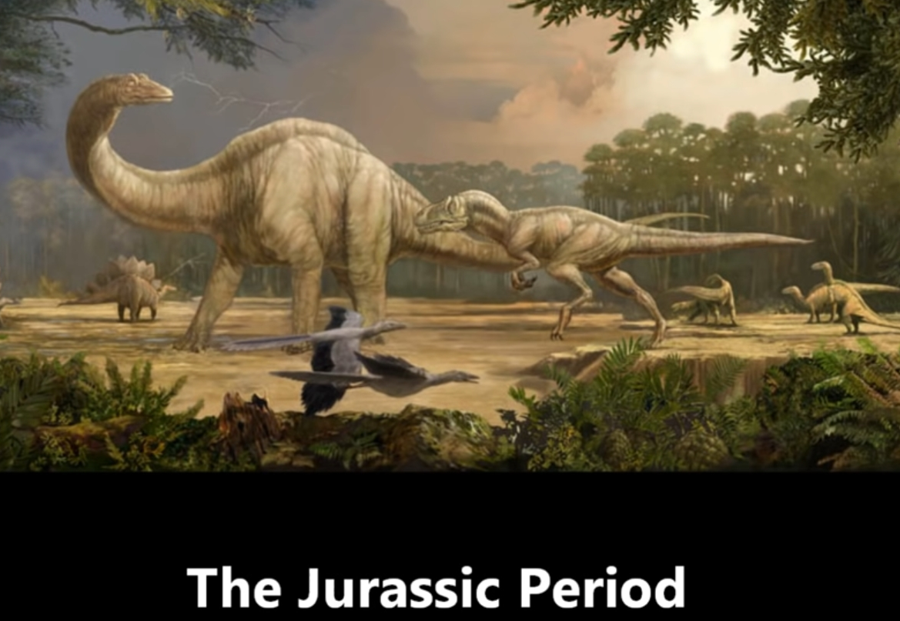
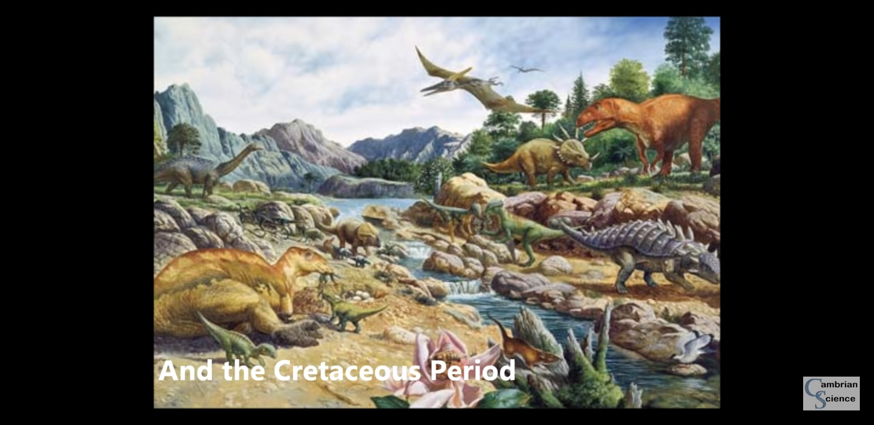
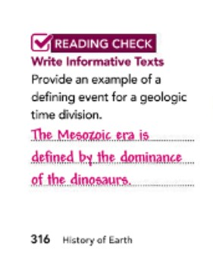

Slide 16
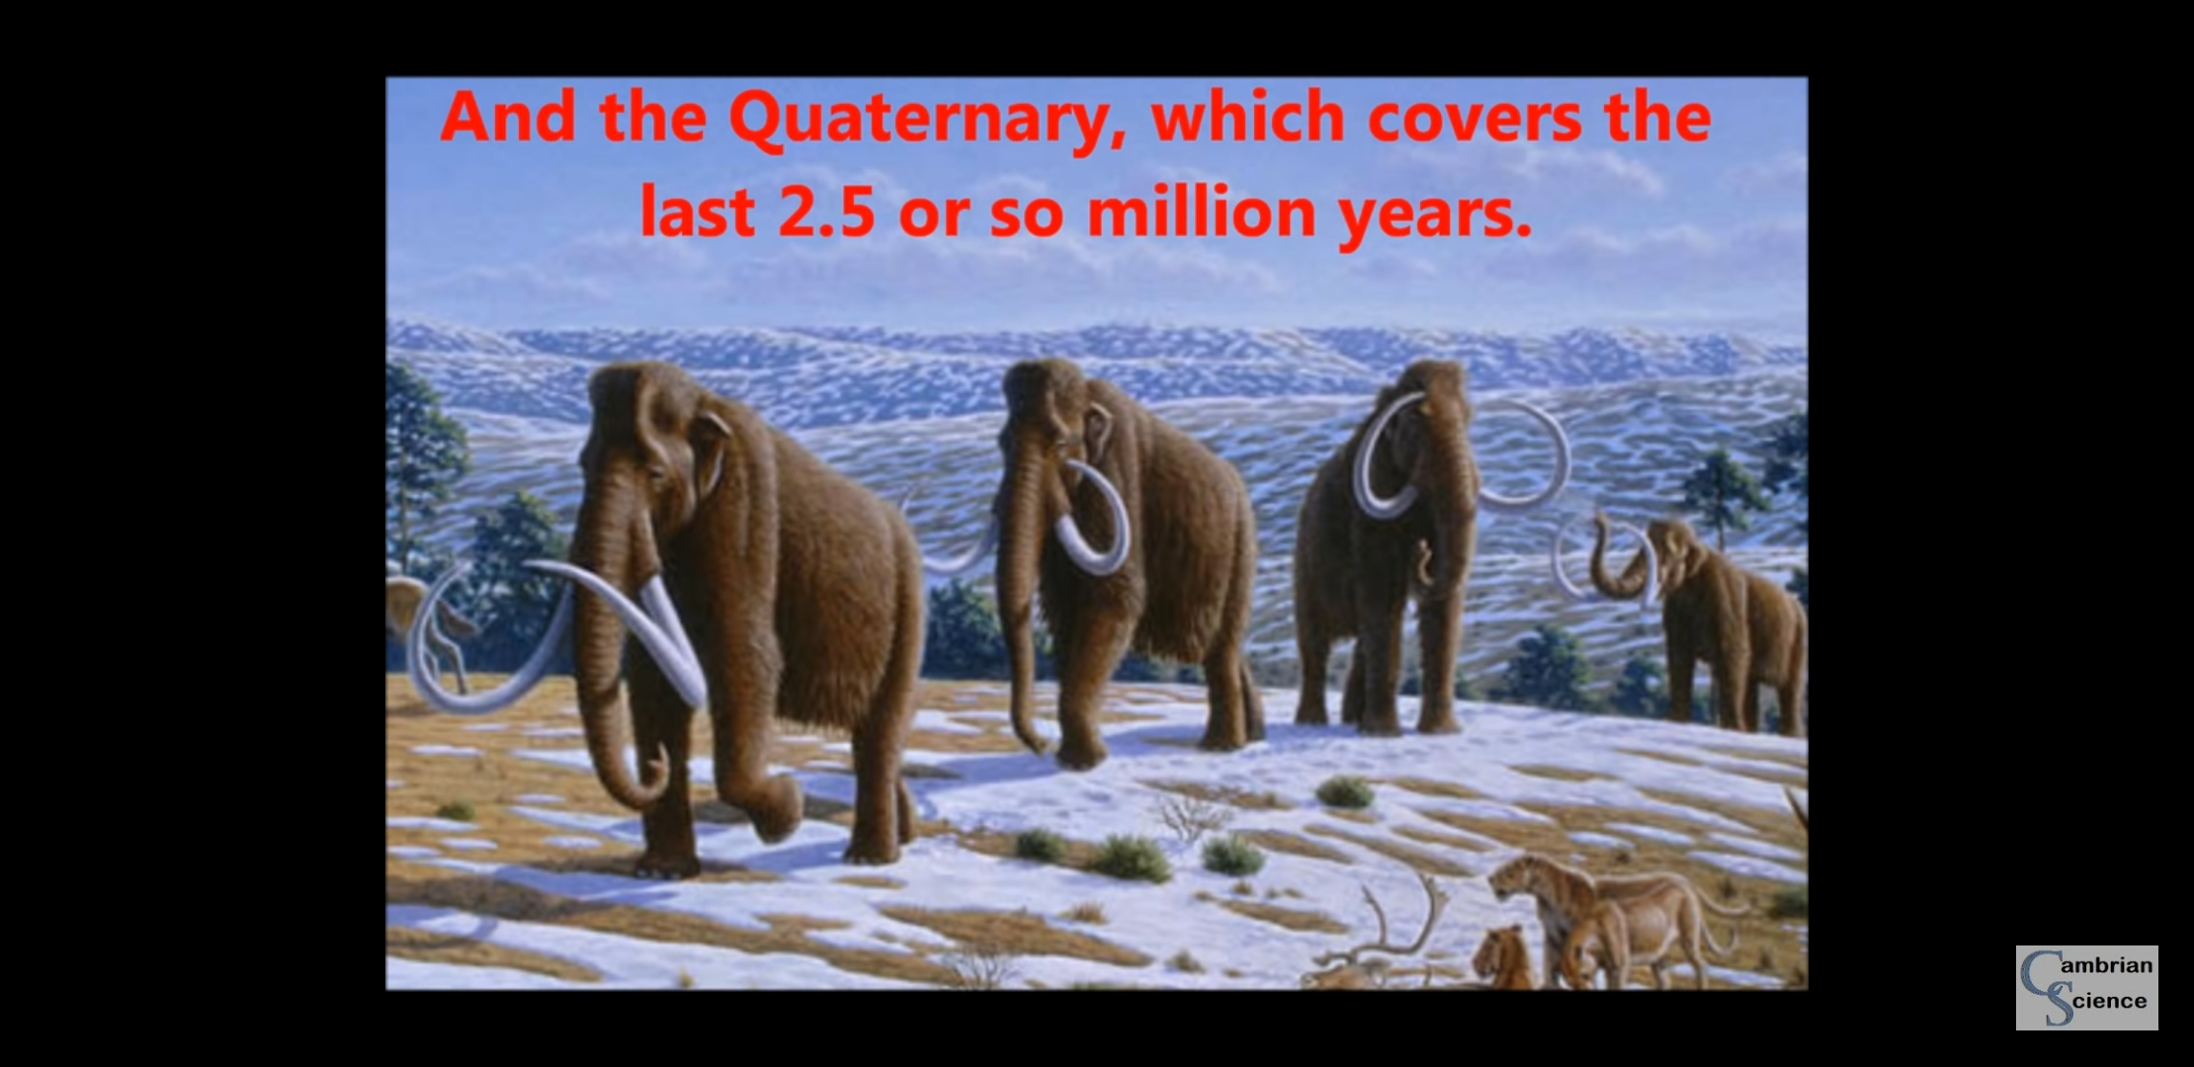
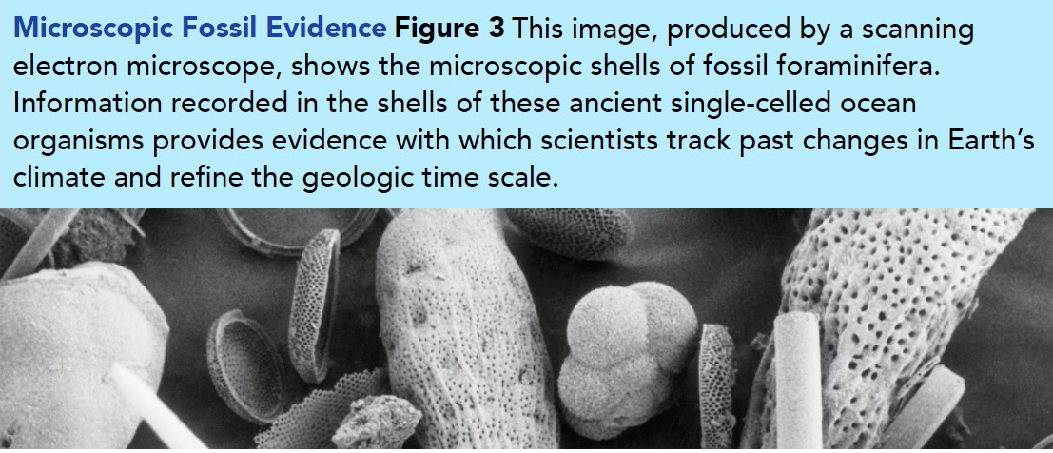
Refining Earth’s History
Our understanding of Earth’s history changes with each newly-discovered fossil (see Figure 3) or rock.
Geologists continually refine the geologic time scale. For example, geologists use the start of a period of major global cooling to mark the beginning of the Quaternary period. Recently, evidence from ocean floor sediments and other sources led scientists to move that boundary from 1.8 to 2.6 million years ago.
The new boundary, based on new physical evidence, more accurately reflects a major change in Earth’s climate.

Slide 17
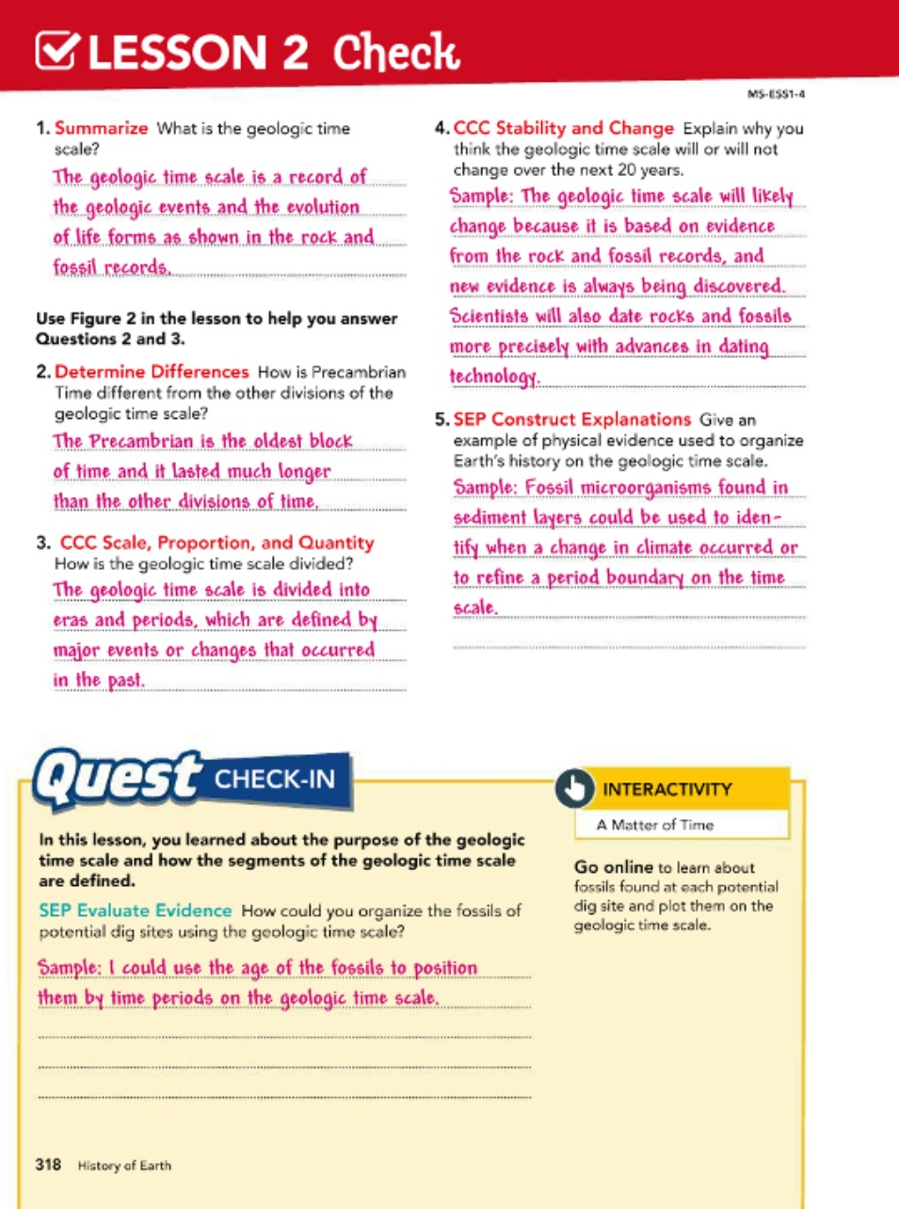

Slide 18

Good Luck…

