Slide 1
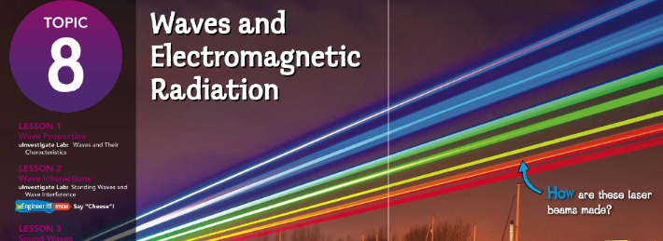

Pg:392
Guiding Questions
How can you use a simple model to describe a wave and its features?
How can you observe the properties of waves?
What kinds of patterns can you predict based on wave properties?
https://www.youtube.com/watch?v=AUBAMlMoI1g

Slide 2
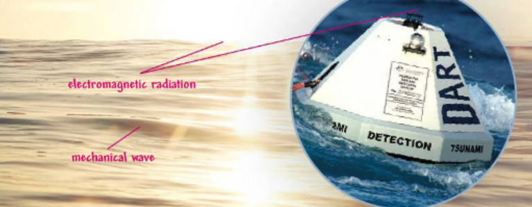
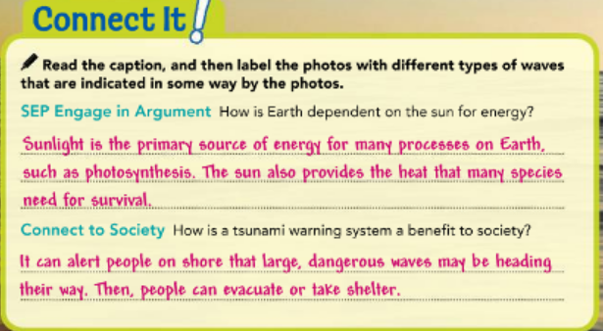
Types of Waves
Figure 1 shows several different types of waves at work. Ocean waves cause the buoy to bob in the water.
If a seafloor sensor detects a wave called a tsunami (soo NAH mee), it sends a signal to the buoy, which then sends a radio signal to a satellite orbiting Earth.
The signal gets relayed to scientists, who can then warn coastal communities. The sunlight that lights this scene is also made of waves.
Pg:393
World of Waves Figure 1
A tsunameter is a buoy anchored to the ocean floor. It detects extremely large waves called tsunamis and sends a radio signal to warn people.

Slide 3
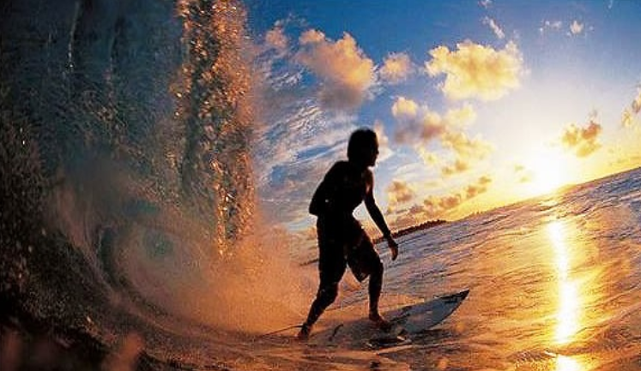
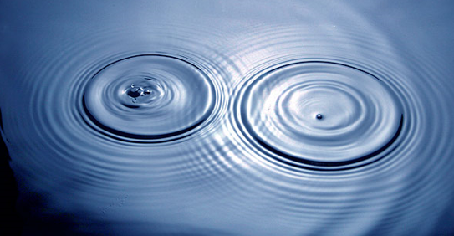
Types of Waves
When you think of a wave, you probably picture a surface wave on the ocean.
Actually, a wave is any disturbance that transfers energy from place to place. An ocean wave is one type of wave called a mechanical wave, meaning it moves through some type of matter.
The matter a wave travels through is called a medium.
A mechanical wave cannot travel through a vacuum, such as space.
Pg:393

Slide 4
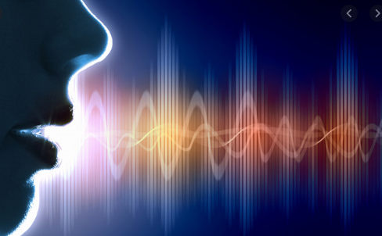
Types of Waves
Sound waves are another type of mechanical wave.
Sound can travel through the ocean, but it can also travel through a solid object, such as a piece of metal, or a gas, such as the air.
It cannot travel through a vacuum such as space.
Pg 393
https://www.youtube.com/watch?v=GkNJvZINSEY

Slide 5
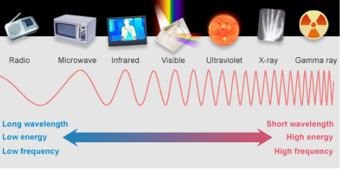
Types of Waves
Another type of wave is an electromagnetic wave.
This type of wave transfers electromagnetic radiation,
a type of energy.
Examples of electromagnetic radiation include visible light, radio waves, X-rays, and microwaves. Like a mechanical wave, electromagnetic waves transfer energy. However, electromagnetic waves are unique in that they can travel without a medium.
Pg 393
https://www.youtube.com/watch?v=VrZr4g3hYnE

Slide 6
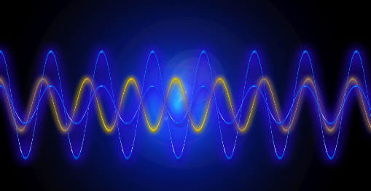
Transverse Waves
Waves can be classified by how energy is transmitted.
Energy is transmitted through a medium by mechanical waves. Electromagnetic waves are capable of transmitting energy through empty space.
Waves can also be classified by how the particles in a disturbance vibrate. A mechanical wave begins when a source of energy causes a medium to vibrate.
Pg 394

Slide 7

Pg 394
Transverse Waves
The direction of the vibration determines what type of mechanical wave is produced.
A transverse wave travels perpendicular (at right angles) to the direction of the source’s motion.
The person in Figure 2 is using his arms to make up-and-down vibrations in two ropes.
Each particle of the rope moves up and down. The direction of the waves he’s producing, though, is perpendicular to that up-and-down motion.
The energy travels toward the far ends of the ropes.

Slide 8
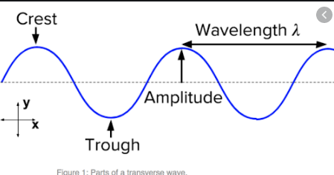
Transverse Waves
The curved shape of the rope indicates the main features of a transverse wave.
The high point of a wave is its crest, and the low point is the trough. Halfway between the crest and trough is the wave’s resting position.
The distance between the highest crest and the resting position marks the wave’s amplitude.
In general, the amplitude of a wave is the maximum distance the medium vibrates from the rest position.
Electromagnetic waves, such as sunlight, are also transverse waves.
Pg 394

Slide 9
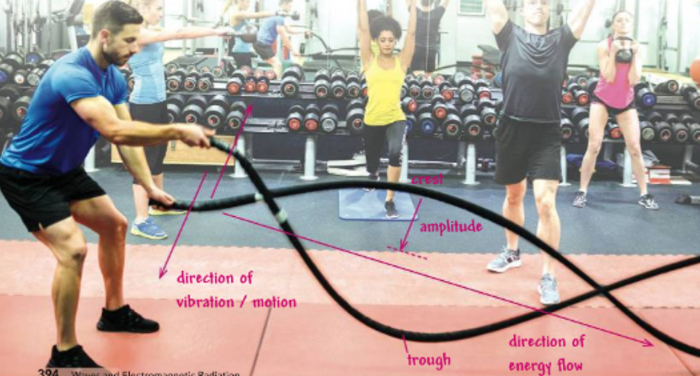
Transverse Waves Figure 2
Use arrows to indicate the direction the rope is vibrating and the direction energy is flowing. Label a crest and a trough, and indicate the amplitude.
Pg 394

Slide 10
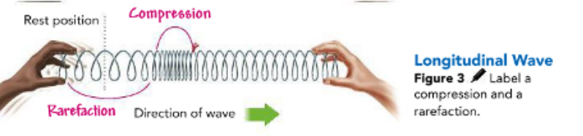
Longitudinal Waves
A wave that travels in the same direction as the vibrations that produce it is called a longitudinal wave. Sound is a longitudinal wave.
Sound travels from speakers when flat surfaces inside the speakers vibrate in and out, compressing and expanding the air next to them.
Pg 395
Figure 3 shows a longitudinal wave in a spring toy. When the left hand pulls on the toy, the result is a series of stretches and compressions.
Gaps between compressions are called rarefactions. Energy moves to the right along the toy.

Slide 11
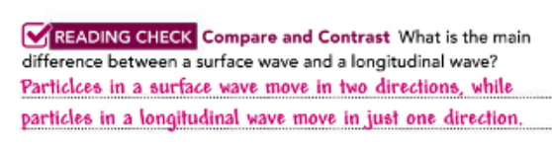
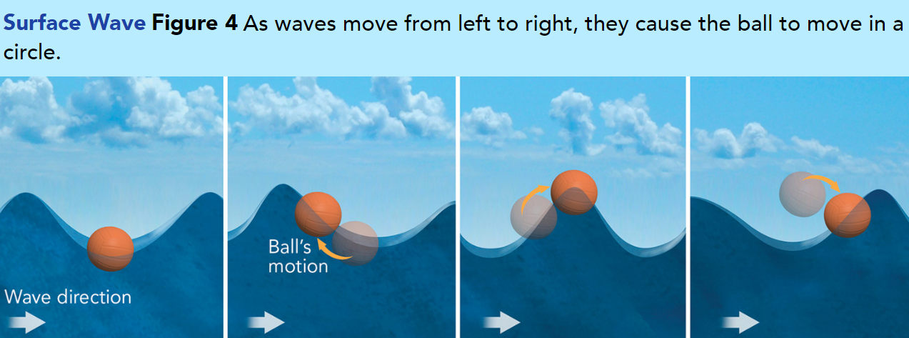
Surface Waves
Combinations of transverse and longitudinal waves are called surface waves. For example, an ocean wave travels at the surface of water.
The up-and-down and back-and-forth movements combine to make each particle of water move in a circle, as shown in Figure 4.
Pg 395

Slide 12
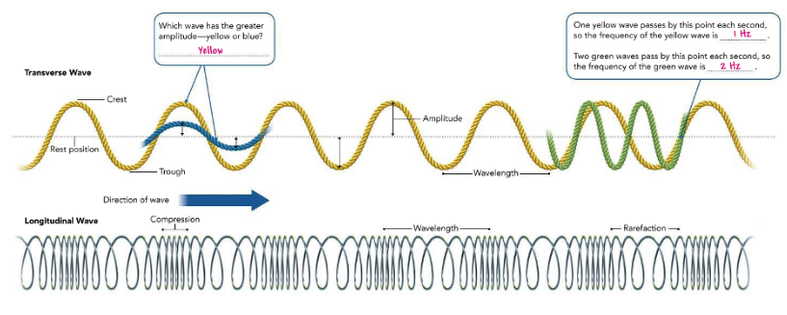
Properties of Waves
Pg 396
All waves have three other properties: wavelength, frequency, and speed. These properties are all related to one another.
Wavelength
all waves have three other properties: wavelength, frequency, and speed. These properties are all related to one another.
All waves have amplitude, wavelength, frequency, and speed. After you read about these properties, answer the questions on the image.

Slide 13
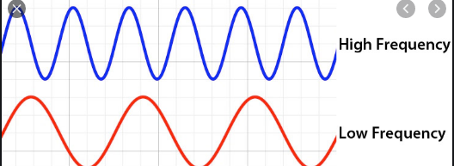
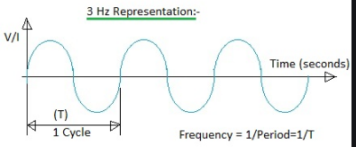
Frequency
The number of times a wave repeats in a given amount of time is called its frequency.
For example, if you make waves on a rope so that one wave passes by a point every second, the frequency is
1 wave per second.
Frequency is measured in units called hertz (Hz). A wave that occurs every second has a frequency of 1 Hz. If two waves pass by in a second, the frequency is 2 Hz.
Pg 396

Slide 14
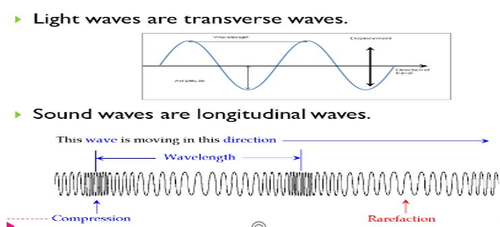
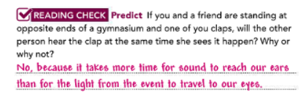
Pg 397
Speed
The speed of a wave is determined by the distance it travels in a certain amount of time. Different waves have different speeds.
For instance, a light wave travels almost a million times faster than a sound wave travels through air! Waves also travel at different speeds through different materials.
For example, light travels faster through water than through glass.
Sound travels more than three times faster through water than through air.

Slide 15
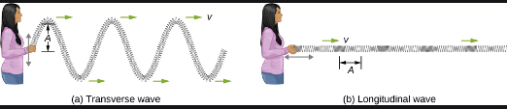
Wave Energy
Waves transmit energy from place to place.
The amount of energy they transmit depends on how much energy was input by the original source of the vibration.
Faster vibrations transmit more energy.
Larger amplitude vibrations also transmit more energy
In mathematical terms, a wave’s energy is directly proportional to frequency. When the frequency of the wave doubles, the energy also doubles.
So, if you shake a rope up and down twice as fast, you transmit twice as much energy down the length of the rope.
Pg 398

Slide 16
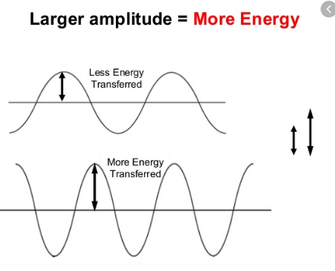
Wave Energy
Mathematically, a wave’s energy is also proportional to the square of its amplitude.
For instance, if you shake a rope to make waves and then move your hand three times as high with each shake, the wave energy increases by a factor of 3 times 3, or nine! Like other forms of energy, a wave’s energy is measured in units called joules (J).
Pg 398

Slide 17
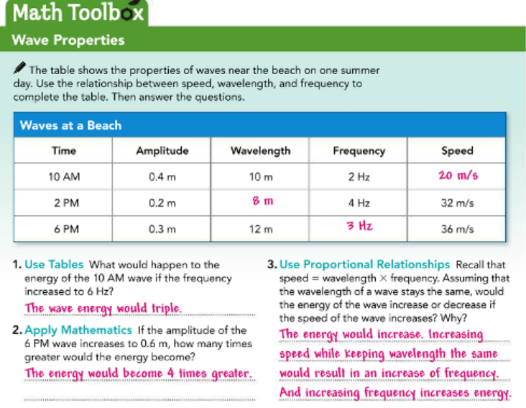
Pg 398
Wave Energy
To calculate a wave’s speed,
divide the distance it travels by the time it takes to travel that distance.
You can also find a wave’s speed if you know its wavelength and frequency—just multiply wavelength times frequency.
Wave speed=Wavelength×Frequency
https://www.youtube.com/watch?v=RVyHkV3wIyk

Slide 19
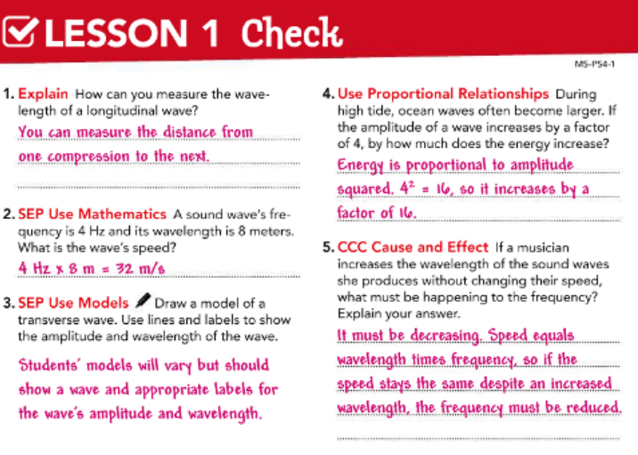
Pg 399

Slide 20


