Slide 1
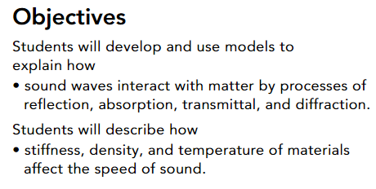
Pg.412
Topic 8: Waves and Electromagnetic Radiation
Lesson 3: Sound Waves
Guiding Questions
How are sound waves reflected, transmitted, or absorbed by materials?
What factors affect the speed of sound waves?
https://www.youtube.com/watch?v=bSA4gfiahNw

Slide 2

Pg.413
The Behavior of Sound
All sound waves begin with a vibration.
Look at the woman in Figure 1.
When she hits a drum or a cymbal with her drumstick, the drum or cymbal vibrates rapidly, disturbing the air particles around the drum set.
When the drum or cymbal moves away from its rest position, it creates a compression by pushing air particles together.
When it moves back toward its rest position, it creates a rarefaction by causing air particles to spread out.
.
Making Waves Figure 1
The vibrations caused by hitting drums and cymbals generate sound waves.
https://www.youtube.com/watch?v=OWETRP_eabg

Slide 3
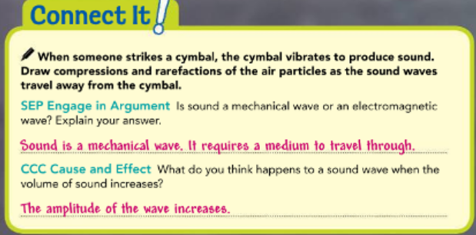
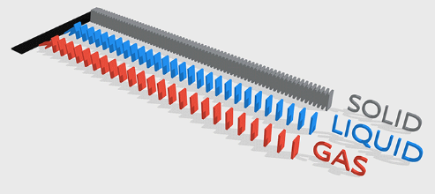
The Behavior of Sound
Pg.413
sound waves are mechanical waves that require a medium through which to travel
In the case of the drummer and the drum set, the compressions and rarefactions that are created travel through the air.
Sound waves, however, travel more easily through liquids and solids.
When you set a glass down on a table, for example, the sound waves that are generated travel first through the glass and the table and then are released into the air.
https://www.youtube.com/watch?v=BFWLb_MKyRE
https://www.youtube.com/watch?v=WqnF-VPfGPw

Slide 4
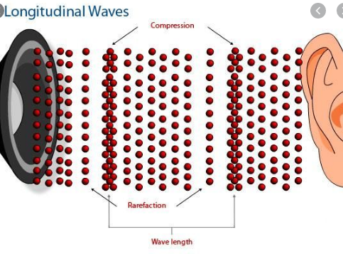
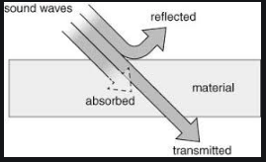
The Behavior of Sound
Pg.413
Sound waves are also longitudinal—they travel in the same direction as the vibrations that produce them.
Like other types of mechanical waves, sound waves can be reflected, transmitted, absorbed, and diffracted.
https://www.youtube.com/watch?v=3uOjWNvRs1s

Slide 5
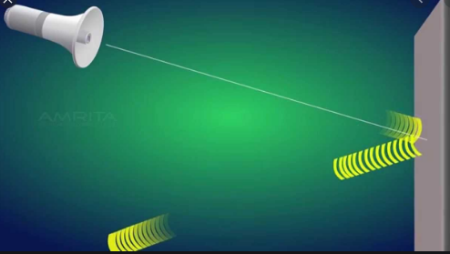
Pg.414
Reflection and Transmission
Like other mechanical waves, sound waves that pass through a surface are called transmitted waves.
Sound waves that bounce off a surface are called reflected waves.
When a sound wave travels through the air and comes into contact with a solid surface, such as a wall, a portion of the wave passes through the surface. Most of the wave, however, is reflected away from the surface.
https://www.youtube.com/watch?v=_H1abPcHFwk

Slide 6
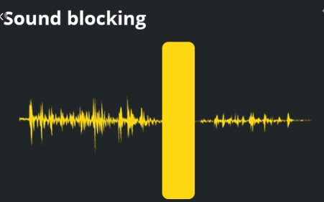
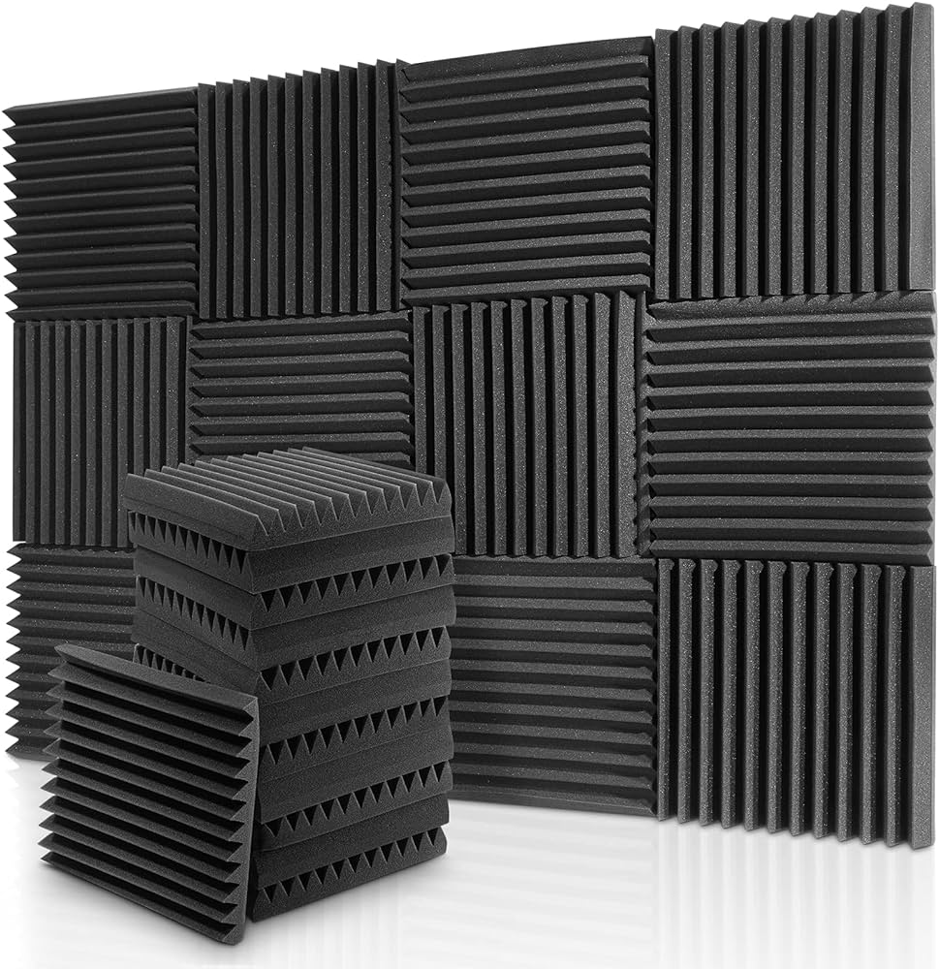
Absorption
Have you ever been to a concert in a large indoor theater? If so, you may have noticed panels on the walls. Most large theaters have acoustic panels to help with sound absorption.
Sound absorption describes the process of sound waves striking a surface and quickly losing energy. The energy is converted to thermal energy in the surface.
Acoustic panels in theaters are porous, meaning they are full of small holes, and they absorb a portion of the sound waves.
In the case of a theater, absorption of sound waves improves the listening experience for people at the concert. More sound energy is absorbed than reflected, so the audience does not experience as much interference from reflected sound waves.
Pg.414

Slide 7
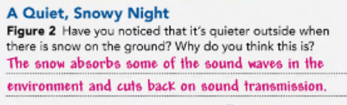
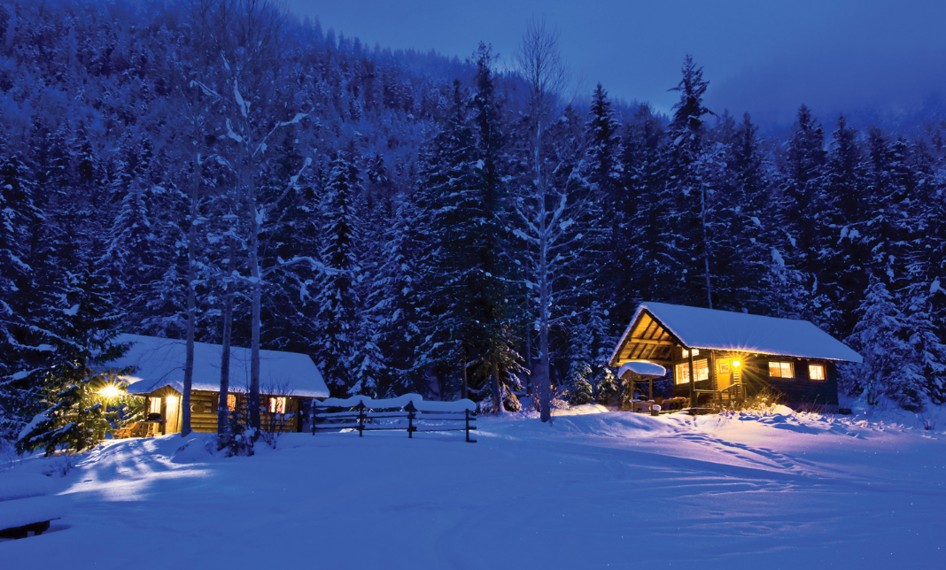
Pg.414
Absorption
See Figure 2 for another example of absorption. Any material with a porous surface can act as a sound absorber.
https://www.youtube.com/watch?v=59Rs135rzHk

Slide 8
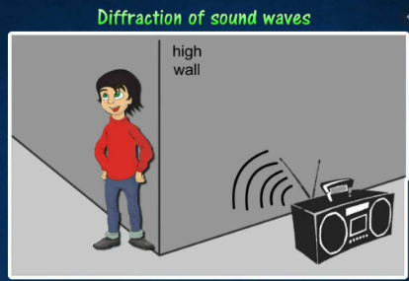
Pg.415
Diffraction
It is usually easy to hear someone talking if they are in the same room as you, but you can also hear people in other rooms nearby. Why is this?
You can hear them because sound waves can bend around the edges of an opening, such as a doorway.
This is called sound diffraction. Sound waves, like water waves, spread out after passing through an opening.

Slide 9
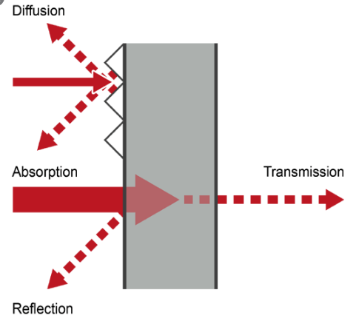

Pg.415
Diffraction
How much sound waves are transmitted, reflected, absorbed, or diffracted depends greatly upon the medium through which they travel.
If sound waves travel through air and hit a solid surface, such as a concrete wall, much of the energy in the waves is reflected back toward the source.
If the surfaces they hit are softer or more porous, then more sound waves will be absorbed.
Sound waves will be diffracted around corners and through passageways between hard surfaces.
https://www.youtube.com/watch?v=-5fn_xTkU-Q&t=1s

Slide 10
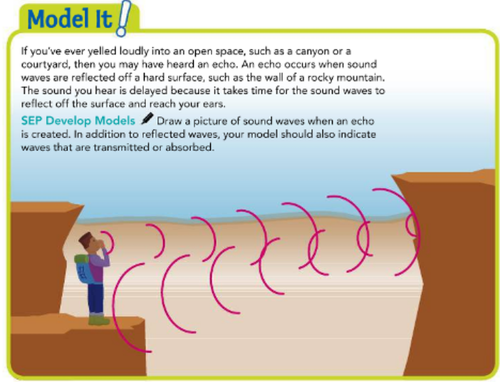
Pg.415

Slide 11
Factors Affecting the Speed of Sound
Pg.416
As you have read, sound waves are mechanical waves that require a medium through which to travel.
The characteristics of the medium have an effect on the speed of the sound waves traveling through them.
The main factors that affect the speed of sound are compressibility, stiffness, density, and temperature.

Slide 12
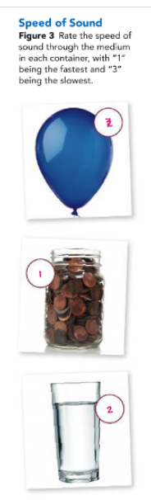
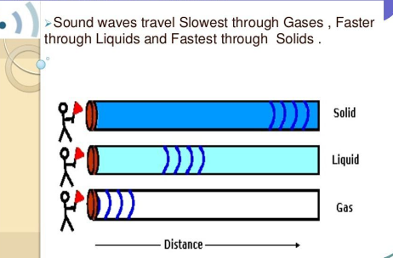
Stiffness
In general, sound waves travel faster in materials that are harder to compress. This is because of how efficiently the movement of one particle will push on another. Think of the coins, water, and air in Figure 3.
Solids are less compressible than liquids, which are less compressible than gases. Therefore, sound waves travel fastest in solids and slowest in gases.
Pg.416
For solids, stiffness is also important. Sound travels faster in stiffer solids, such as metals, than in less rigid solids, such as pudding.

Slide 13
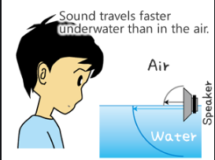
Density
The density of the medium also affects the speed of sound waves.
Density refers to how much matter or mass there is in a given amount of space.
The denser the material, the more mass it has in a given volume, so the greater its inertia.
Objects with greater inertia accelerate less from an energy disturbance than objects with less inertia, or less massive objects.
Therefore, in materials of the same stiffness, sound travels more slowly in the denser material.
Pg.416
https://www.youtube.com/watch?v=yF4cvbAYjwI

Slide 14
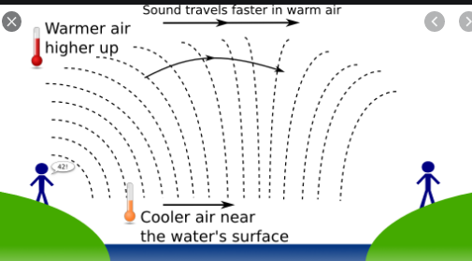
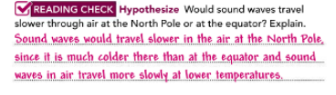
Pg.412
Temperature
The temperature of a medium also affects the speed at which sound waves travel through it, though in more complicated ways.
For solids, an increase in temperature reduces the stiffness, so the sound speed decreases.
For fluids, such as air, the increase in temperature reduces the density, so the sound speed generally increases.
https://www.youtube.com/watch?v=3Br66N7QHpM

Slide 15
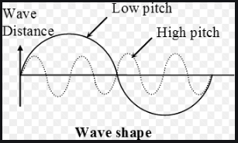
https://www.youtube.com/watch?v=wEL87lznGrg&t=98s
Pg.417
Loudness and Pitch
How might you describe a sound? You might call it loud or soft, high or low. When you turn up the volume of your speakers, you increase the loudness of a sound.
When you sing higher and higher notes, you increase the pitch of your voice.
Loudness and pitch depend on different properties of sound waves.

Slide 16
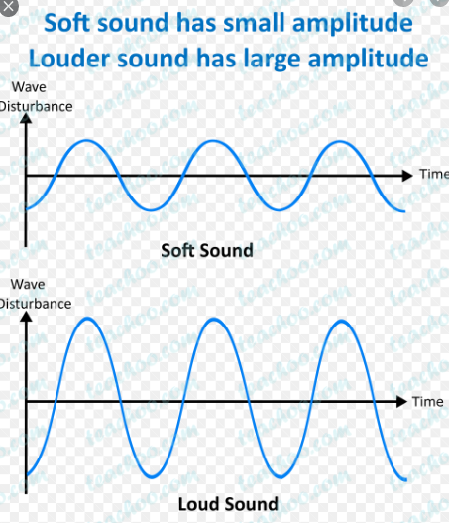
Factors Affecting Loudness
You use the term loudness to describe your awareness of the energy of a sound.
How loud a sound is depends on the energy and intensity of the sound waves. If someone knocks lightly on your front door, then you might hear a quiet sound. If they pound on your door, then you hear a much louder sound. Why?
The pounding transfers much more energy through the door than a light knock does. That’s because a hard knock on a door produces a much greater amplitude in the sound waves than a softer knock does.
Increased energy results in greater intensity of the waves.
Pg.417
https://www.youtube.com/watch?v=wEL87lznGrg

Slide 17
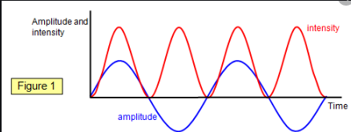
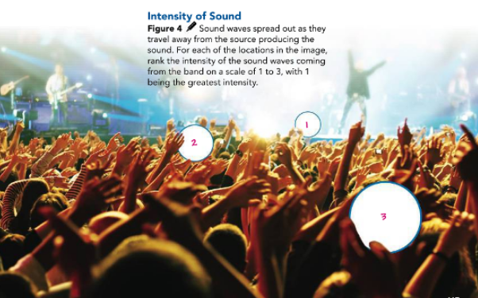
Intensity is the amount of energy a sound wave carries per second through a unit area.
The closer the sound wave is to its source, the more energy it has in a given area.
As the sound wave moves away from the source, the wave spreads out and the intensity decreases.
Pg.417

Slide 18
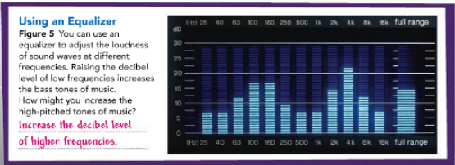
Measuring Loudness
So, how do our ears differentiate between a light knock and a hard knock on a door?
Loudness can be measured by a unit called a decibel (dB). The greater the decibels of the sound, the louder that sound seems to a listener.
The loudness of a sound you can barely hear, such as a pin dropping to the floor, is about 0 dB. When someone lightly taps on your door, the loudness is about 30 dB. But if someone pounds on your door, that loudness might increase to 80 dB! Sounds louder than 100 dB, such as the sound of a chainsaw, can cause damage to people’s ears, especially if they are exposed to the sounds for long periods of time.
Music technicians use equalizers to change the loudness levels of different frequencies of sound, as in Figure 5.
Pg.418
https://www.youtube.com/watch?v=LPWbwHtORJE

Slide 19
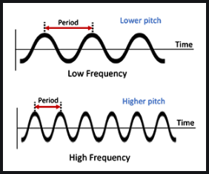
Factors Affecting Pitch
Have you ever heard someone describe a note on a piano as “high-pitched” or “low-pitched”?
The pitch of a sound refers to how high or low the sound seems.
Pitch depends upon the frequency of the sound waves.
Sound waves with a high frequency have a high pitch, and waves with a low frequency have a low pitch.
Pg.419

Slide 20
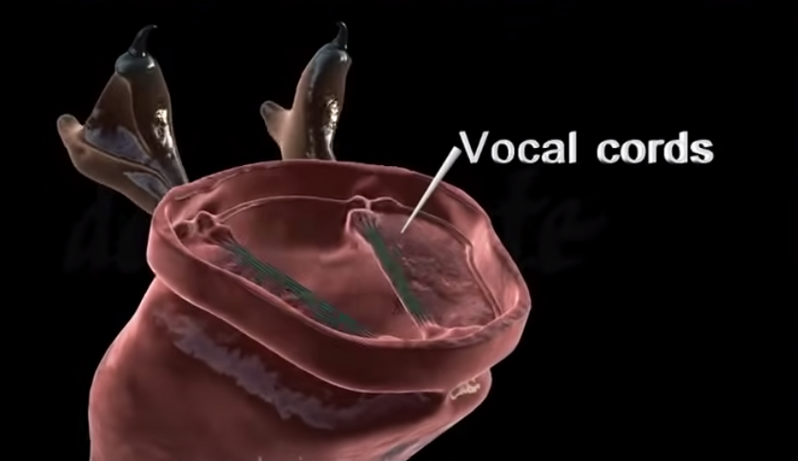
Factors Affecting Pitch
Pg.418
The frequency of a sound wave depends upon how fast the source of the sound is vibrating.
For example, when people speak or sing, the air from their lungs moves past their vocal cords and makes the cords vibrate, producing sound waves.
When vocal cords vibrate more quickly, they produce higher-frequency sound waves with higher pitches. When vocal cords vibrate more slowly, they produce lower-frequency sound waves with lower pitches.

Slide 21
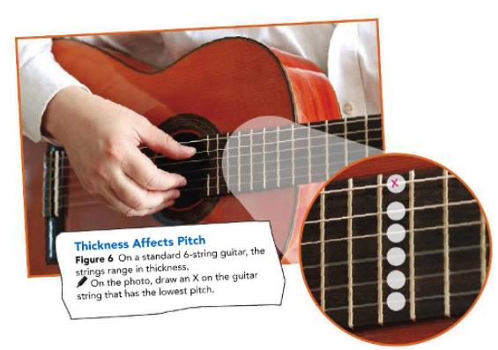
Factors Affecting Pitch
Pg.419
Guitars produce sound when someone strums or plucks their strings.
If you’ve ever studied a guitar, then you may have noticed that its strings vary in thickness. The thicker strings of a guitar vibrate more slowly than the thinner strings do, and so the thicker strings have a lower frequency, and therefore a lower pitch, than the thinner strings (Figure 6).
https://www.youtube.com/watch?v=yMLTF_0PAQw

Slide 22
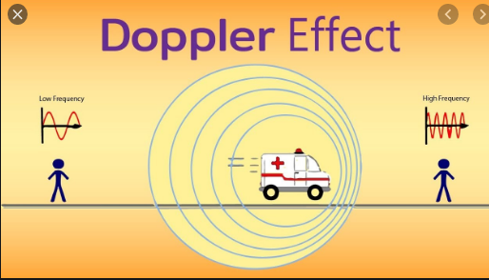
The Doppler Effect
Have you ever had a loud motorcycle drive by you and heard the pitch of the engine noise change?
Change in pitch occurs because the movement of the source of the sound causes a sound wave to either compress or stretch.
As the motorcycle approaches, the peaks of the emitted sound waves are scrunched together.
When the peaks are closer together, the sound waves have a higher frequency.
As the motorcycle moves away, the peaks of the emitted sound waves are spread out. The sound waves then have a lower frequency.
https://www.youtube.com/watch?v=rbcvPEXiWWo
Pg.420

Slide 23
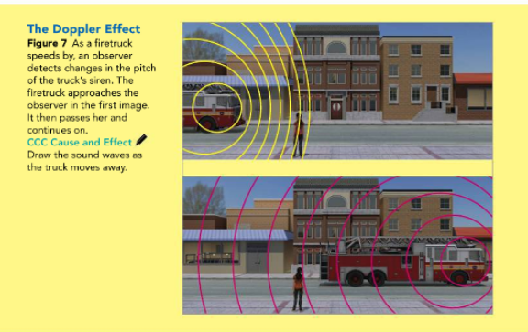
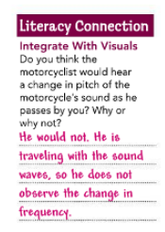

Pg.420
The Doppler Effect
A change in frequency is perceived by a listener as a change in pitch.
This change in frequency (and therefore, in pitch) of the sound wave in relation to an observer is called the Doppler effect.
Figure 7 shows the Doppler effect when a firetruck rushes by a person on the sidewalk.

Slide 24
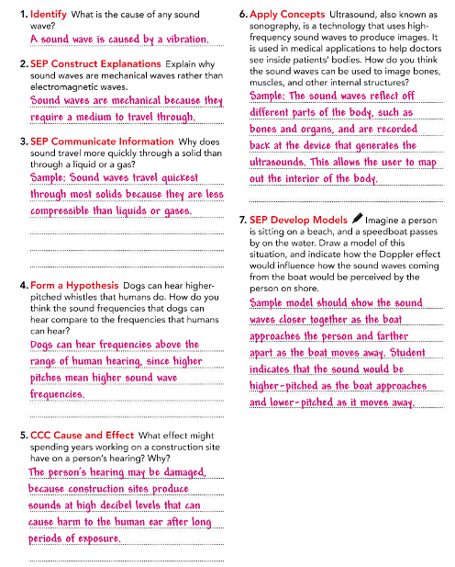
Lesson Check
Pg.421
https://www.youtube.com/watch?v=ZTsLLBo8lNQ

