Slide 1

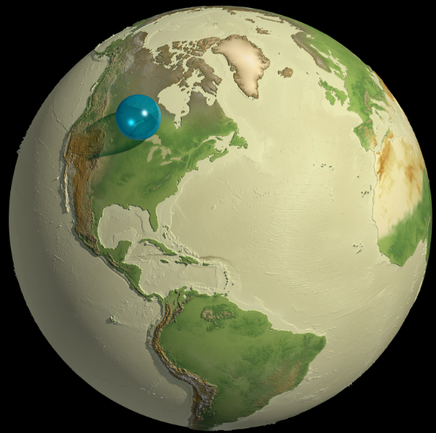
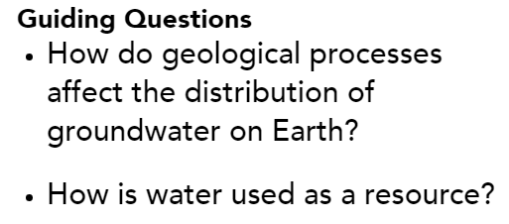
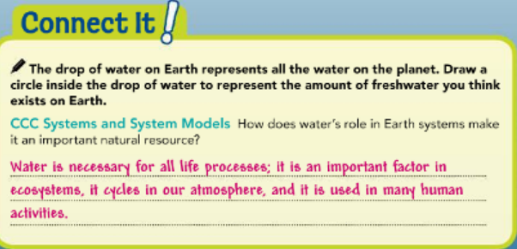

Slide 2
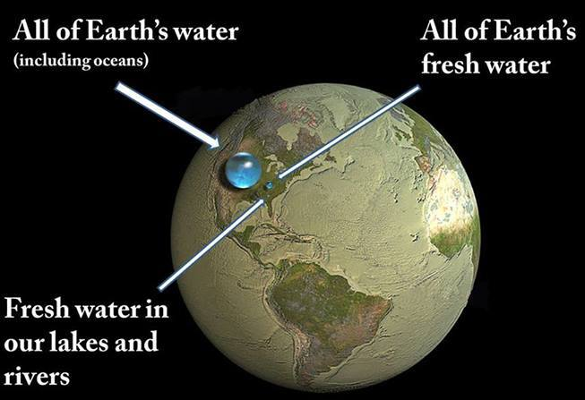
Water on Earth pg:319
Although Earth is known as the water planet, the water that living things rely on represents only a fraction of the planet’s total water supply (figure1)Most water on Earth is salt water.
Freshwater is only found on the surface of our planet as surface ice or water, or within Earth’s crust as groundwater.
A Drop to Drink Figure 1
If all of the water on Earth were collected, it would form a sphere about 1,380 kilometers (860 miles) across.
https://www.youtube.com/watch?v=w0Mh6X3ZYNY

Slide 3
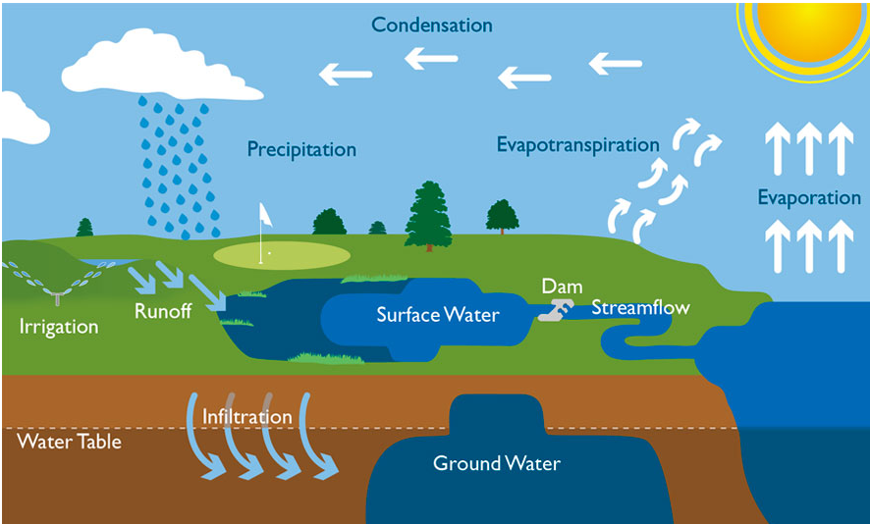
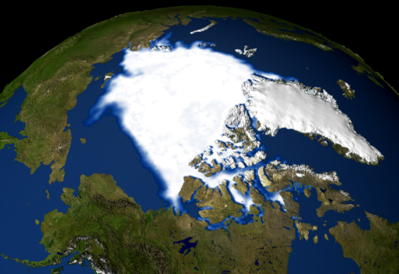
Water on Earth pg:319
The water cycle circulates water through Earth’s ocean and other bodies of water, on and below its surface, and in the atmosphere.
A tiny amount of the freshwater on Earth is in the atmosphere, and a fair amount of water is contained underground as groundwater. But most freshwater is locked up as ice at the poles and in glaciers.
A very small amount of the water on the surface of the planet is immediately available for human use in lakes and rivers.

Slide 4
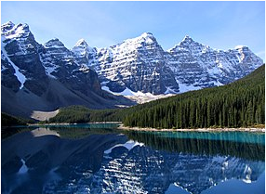
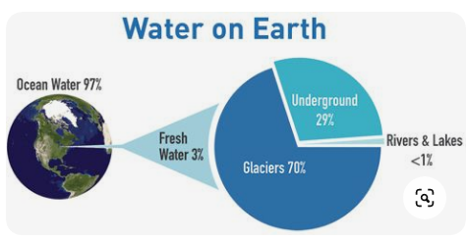
Surface Water pg 320
Surface water is freshwater found on top of Earth’s land surface. Some surface water is found as moisture on top of the soil. In colder regions, this water remains frozen as permafrost.
Most surface water is found in lakes, rivers, and streams, as well as swamps and marshes.
Surface water, however, is not evenly distributed across Earth.
Precipitation, which depends on factors such as atmospheric patterns and temperature, determines where surface water forms.
Because humans require accessible water, most people live around or near sources of surface water, such as lakes and rivers.
https://www.youtube.com/watch?v=6WMp9mZ5OS4

Slide 5
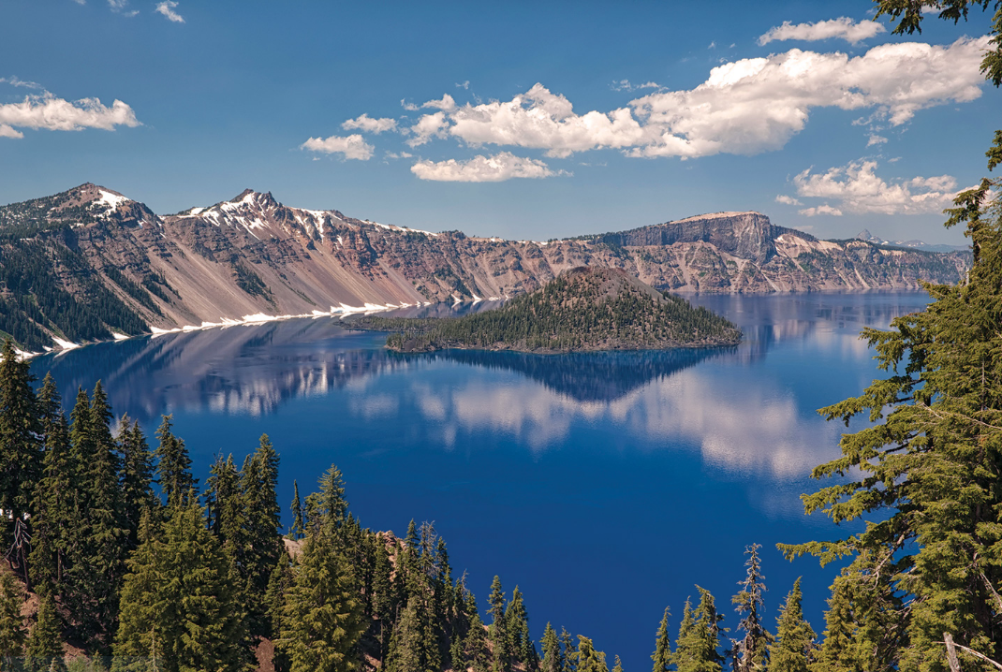
Surface Water pg 320
Most of the surface water on Earth is found in lakes. Lakes form through various geological processes when water fills in depressions in Earth’s surface, as in Figure 2.
These can occur as a result of erosion, the movement of tectonic plates, and retreating glaciers.
Some lakes form when a river’s path erodes away an area or a dam blocks a river’s flow.
All rivers begin as a small flow of water caused by gravity.
Runoff from rain or melting ice collects and flows downhill following the least resistant path.
These small flows of water form streams, which combine and grow to form larger rivers and river systems.

Slide 6
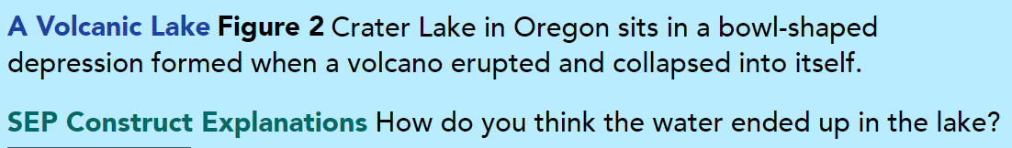
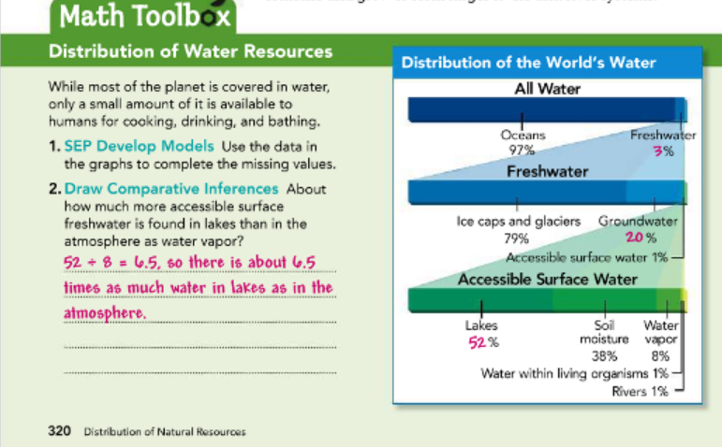
Pg 320
Answer: The lake probably formed as rain and snow accumulated in the depression.

Slide 7
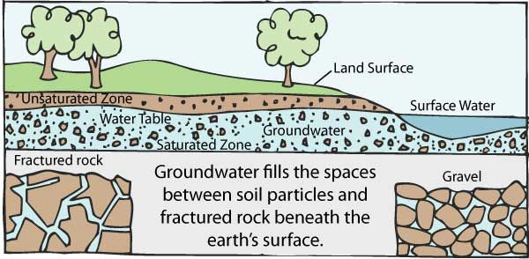
Groundwater pg 321
As with surface water, groundwater is not evenly distributed across Earth (Figure 3).
The presence of groundwater depends on the type of rock layers in Earth’s crust.
Groundwater forms when gravity causes water from precipitation and runoff to seep into the ground and fill the empty spaces between these rocks.
Some rocks are more porous, or have more empty spaces in which water can collect.
https://www.youtube.com/watch?v=zyHtkDCwQUw

Slide 8
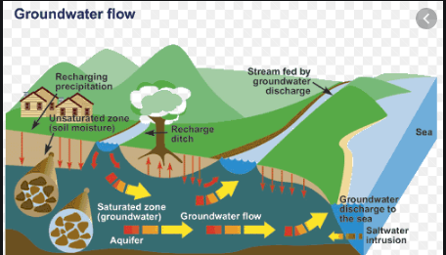
Groundwater pg 321
Once water reaches a dense layer of bedrock that is not porous, it will spread out horizontally.
The volume of porous rock that can contain groundwater is called an aquifer. Wells are drilled into aquifers to access the water.
Deep groundwater reservoirs can take hundreds or thousands of years to accumulate, especially in arid regions where there is little rainfall or surface water to supply the aquifer.

Slide 9
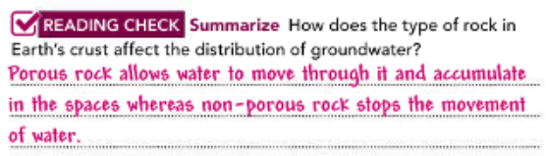
Groundwater pg 321
New studies of Earth’s mantle reveal there may be many oceans’ worth of water locked hundreds of kilometers below the surface in mineral formations.
This groundwater may take millions of years to exchange with surface water through the movement of tectonic plates and mantle convection.

Slide 10
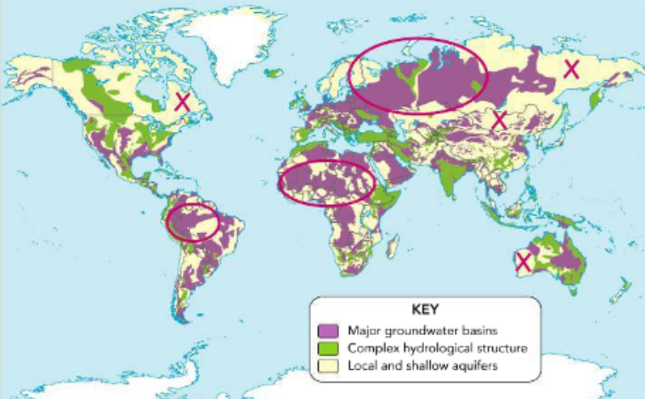
Distribution of Groundwater Figure 3 Pg: 321
Groundwater is especially important in areas that do not have immediate access to rivers or lakes for sources of freshwater.
SEP Use Models Indicate the areas on the map with the greatest groundwater resources with a circle. Indicate the areas with the least groundwater resources with an X.

Slide 11
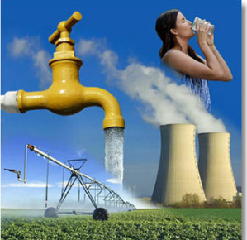
Human Impacts pg 322
Humans rely on water not only to live and grow, but also for agriculture and industry. Water is needed to produce our food, manufacture products, and carry out many chemical reactions.
The distribution of water resources is a result of past and current geologic processes such as the water cycle, plate tectonics, and the formation of rock.
These processes take time, and in some areas humans are depleting water resources faster than they can be replenished.
The human impact on water distribution is already a cause of social and economic conflict in some areas.

Slide 12
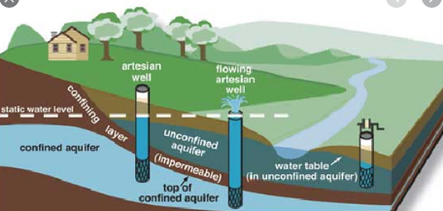
Using Water pg:322
Humans use surface water, which often involves changing its natural path, such as with dams. This affects the amount of water that continues to flow and the ecology of the area.
Humans access groundwater resources by digging wells in aquifers. But if more water is removed from an aquifer or other groundwater source than is replenished through the water cycle, water shortages can occur.
As with surface water, pollution can enter groundwater supplies and impact the quality of the water. Study the effects of water scarcity in Figure 4.
Literacy Connection
Support Author’s Claim Highlight the text that support the claim that human activity can cause water shortages.

Slide 13
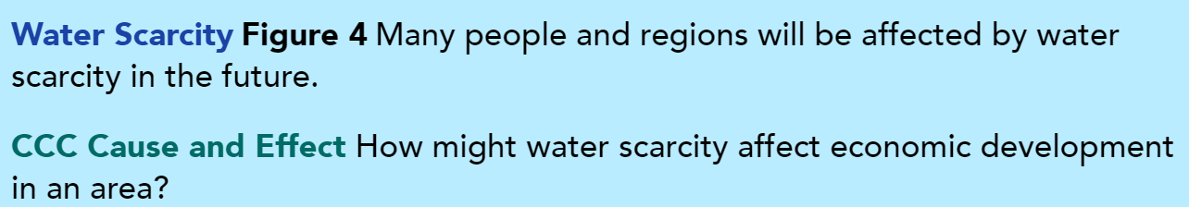
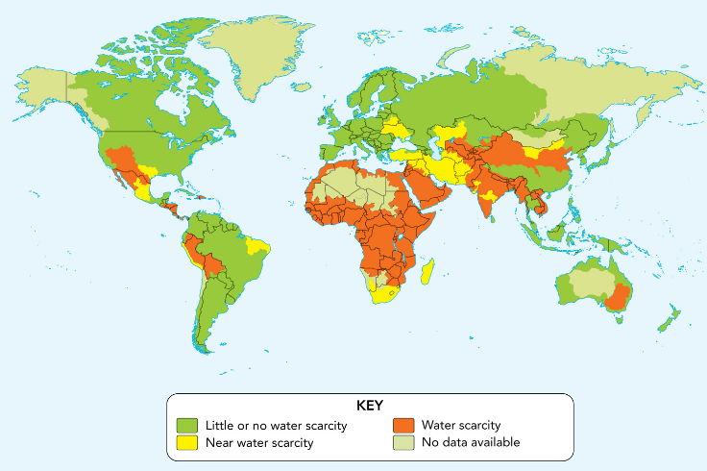
Answer: Water scarcity would make it hard for industries or businesses to make product

Slide 14
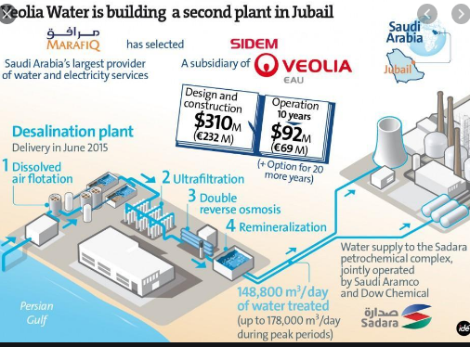
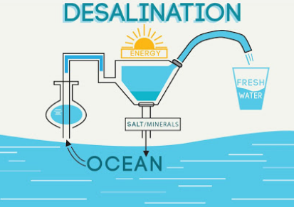
Desalination pg: 323
In the future, humans may look to technology and the ocean to meet their water needs.
The process of desalination removes salt and minerals from saltwater to make freshwater.
Today, desalination plants around the world are costly and require a lot of energy to distill saltwater.
We may eventually use solar energy to convert ocean water into freshwater.
https://www.youtube.com/watch?v=mUtYUTTC_Bg

Slide 15
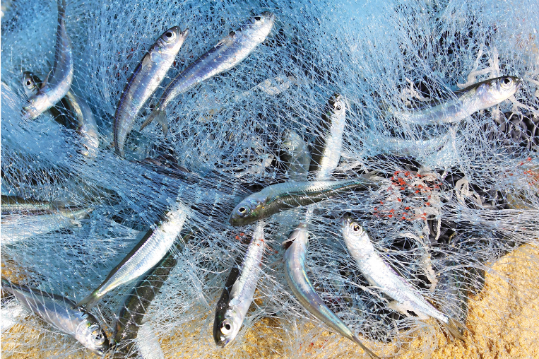
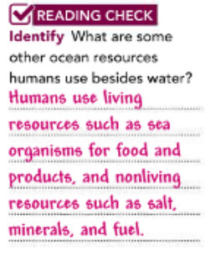
Other Water Resources pg: 323
Humans rely on the ocean to provide a number of other important resources besides water, such as sea organisms for food and other products (Figure 5).
The ocean also provides salt, minerals, and fuels.
Living resources like fish are replenished through a natural cycle.
However, overfishing can result in severe reductions or complete collapses of ocean ecosystems and the resources they provide.
In addition, pollution and global climate change can have serious impacts on the living resources we rely on from the ocean.
Using Ocean Resources Figure 5
If too many of these fish are caught, then fewer will survive to produce new generations.

Slide 16
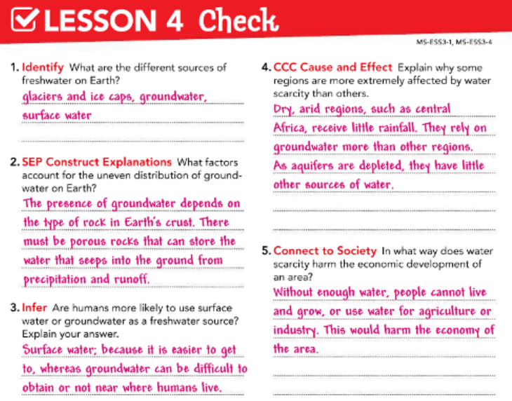

Slide 17
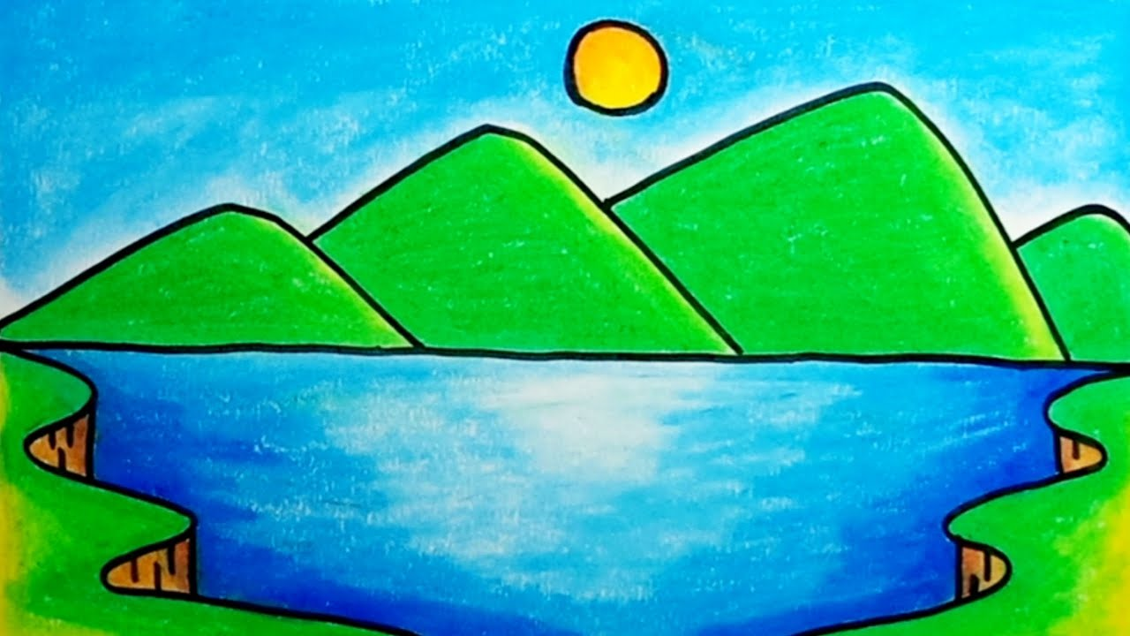
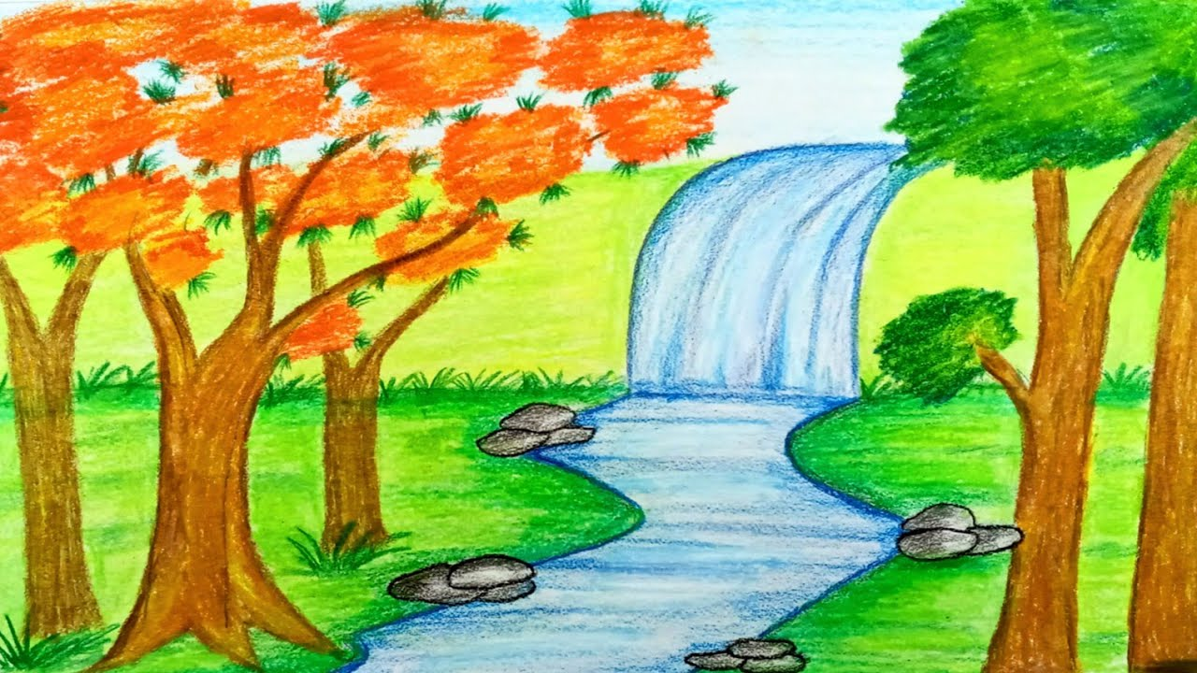
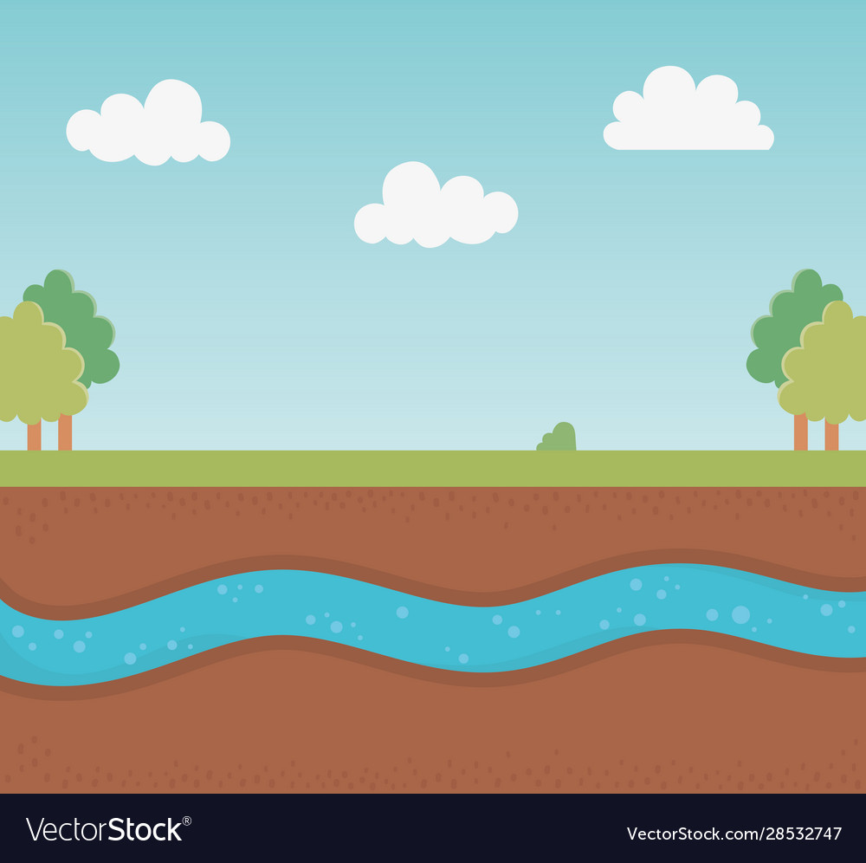
Fresh water
Stream
River
Lake
Ground Water

Slide 18
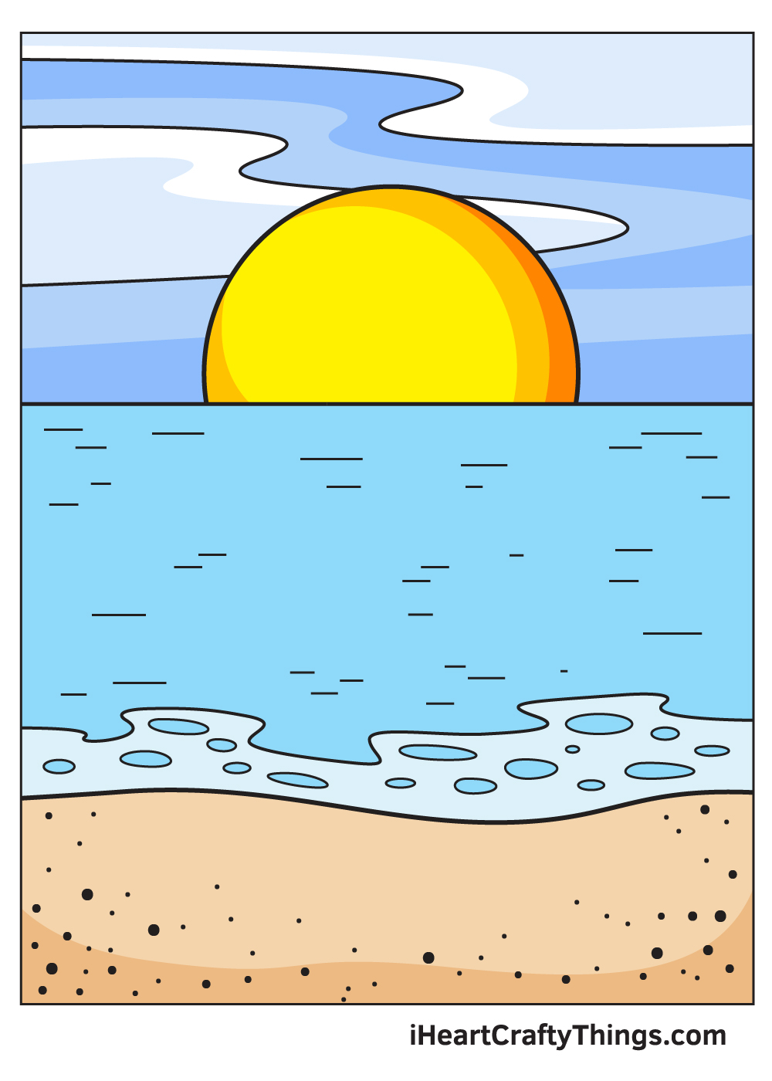
Salt water

Slide 19


