Slide 1


Objective : Students will identify and describe the difference between renewable and nonrenewable resources
Guiding Questions
What are nonrenewable resources?
What factors affect the distribution of nonrenewable energy resources?
How has human activity impacted the distribution of fossil fuels?

Slide 2
Natural Resources
We all rely on natural resources to survive.
A natural resource is anything occurring naturally in the environment that humans use. We need air to breathe, water to drink, soil in which to grow plants to eat, sunlight to make those plants grow, and other natural resources.
Renewable Resources-For example, sunlight and wind are available daily at most places on Earth.
Other renewable resources can be reused , but it may require some care or planning. For example, wood from trees is a renewable resource
as long as some trees are spared to reproduce and make the next generation of trees.

Slide 3
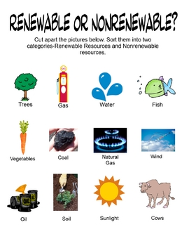

Slide 4

Other resources are nonrenewable resources, which cannot be replaced. This may be because there is a finite amount of the resource on Earth and we don’t have a way to make more of it. The element silver, for example, cannot be made from other substances. The amount of silver on Earth is set. Other resources are considered nonrenewable because it takes very long periods of time for them to form.

Slide 5
.
Classify Pick one of the materials
you identified in the photo and
explain whether you think the
resource is limited or unlimited
Iron and other metals are limited resources. There is a finite amount of them on Earth, and a finite amount that can accessed.

Slide 6
Fossil Fuels
The sources of energy commonly called fossil fuels include coal, petroleum, and natural gas. Fossil fuels are the energy-rich substances made from the preserved remains of organisms. The chemical energy in fossil fuels can be converted to other forms by burning them.
The energy stored in these compounds originally arrived on Earth as sunlight. Photosynthetic organisms such as algae, moss, grasses, and trees converted sunlight into carbon-based compounds. When animals ate the plants, they absorbed some of those compounds. Under certain conditions involving high temperatures and pressures, the remains of these organisms were transformed into new materials, including solid coal, liquid petroleum, and methane gas.
Coal
Coal is formed from the remains of plants that died long ago in and around swampy areas. Coal is used in water and air purification systems, as well as medical equipment such as kidney dialysis devices. Coal is used to make steel from iron ore. Coal is also an essential ingredient in carbon fiber, an extremely durable and lightweight material.
Burning coal in coal-fired power plants accounts for about 30 percent of the electricity produced in the United States. Coal has long been used as a fuel because it has twice as much energy per unit of mass as wood. So, when coal can be mined at a large scale, it can be an efficient source of energy.

Slide 7
Coal (continued)
Unfortunately, burning coal produces pollutants and causes millions of deaths each year from health problems. Coal mining also requires large mines to be dug into the ground, or the removal of mountaintops or other surface layers to access coal beds. Removing coal causes great damage to the surrounding environment.
READING CHECK Determine Central Ideas
What is the original source of the energy contained in coal? Explain.
The Energy in coal originally came from the sun, which the plants used in the process of photosynthesis.

Slide 8
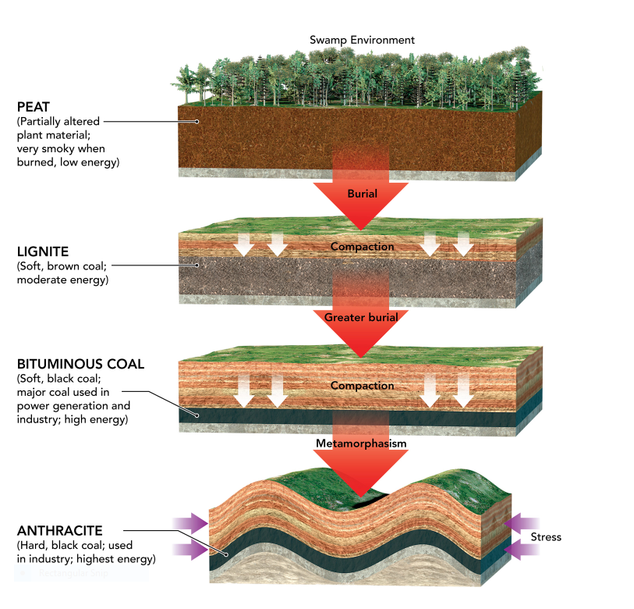
Coal Formation
Plants are buried over time, they compacted and buried even more. The heat and pressure change plant to coal.

Slide 9
Oil
What we commonly refer to as oil is scientifically known as petroleum, from the Latin terms petra (rock) and oleum (oil). Petroleum is made of the remains of small animals, algae, and other organisms that lived in marine environments hundreds of millions of years ago. Oil deposits form when these remains become trapped underground and are subject to high pressure and temperature.
Because it is a liquid and can be processed into different fuels, petroleum is especially useful for powering engines in automobiles, ships, trains, and airplanes. Petroleum also has many important industrial uses, such as making plastics, lubricants, and fertilizers. Petroleum is also the basis for synthetic fibers, such as rayon and nylon. Many cosmetic and pharmaceutical products such as petroleum jelly and tar shampoos that treat dandruff, contain forms of petroleum.
As with coal, burning oil and natural gas emits carbon dioxide. Oil can also be spilled, which can be disastrous for wildlife and water quality

Slide 10
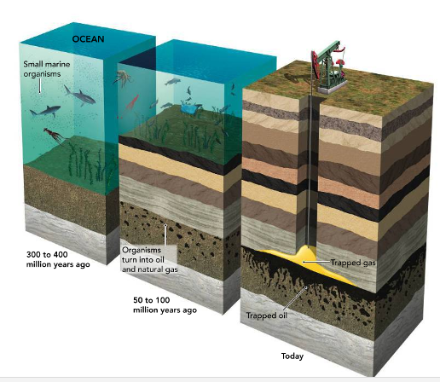
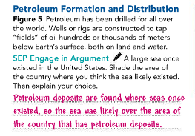
Petroleum Formation and Distribution

Slide 11

Natural Gas
* Formed from the same processes that produce oil and found in the same locations,
natural gas is trapped in pockets within layers of rock deep below Earth’s surface.
A drill can tap the trapped gas, and then pipelines carry the gas for processing and
transport.
Burning petroleum and coal releases more carbon dioxide than burning natural gas.
the gas itself is a powerful greenhouse gas that contributes to global warming.
This means any leaks of natural gas from wells, pipelines, and other structures pose
a pollution problem.

Slide 13
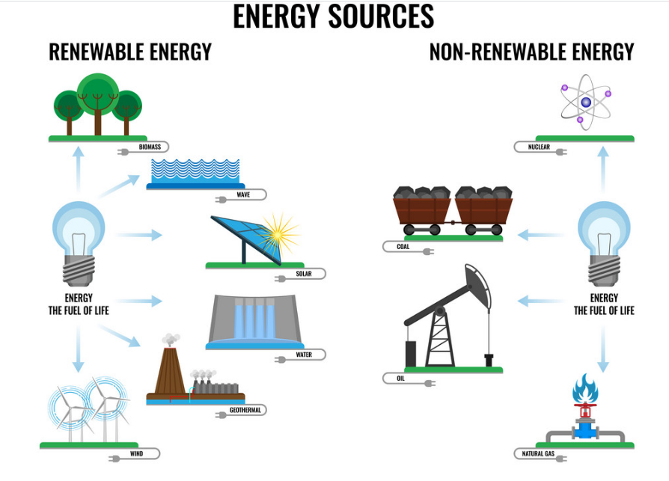

Slide 14
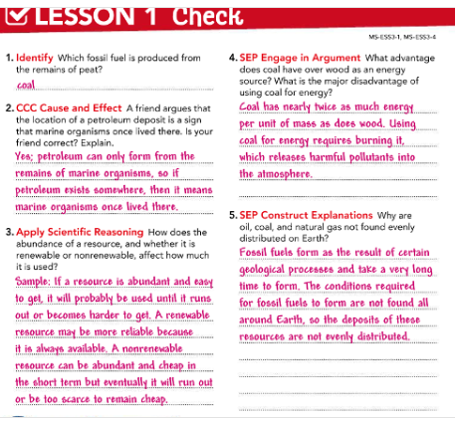

Slide 15


