Slide 1

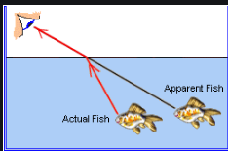
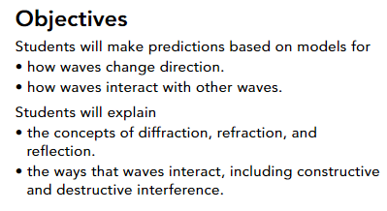
Guiding Questions
How do waves interact with different materials?
How do waves interact with each other?
pg. 402

Slide 2
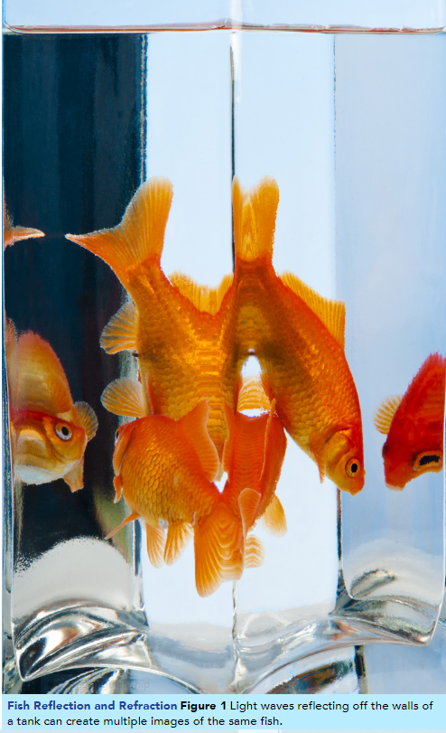
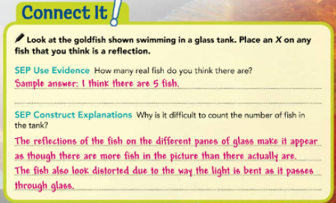
Reflection, Refraction, and Absorption
pg. 403
If you’ve ever been to the beach, you’ve seen how different kinds of waves move. Some ocean waves crash into rocks or piers, while others reach the shore smoothly.
Rays of sunlight hit the surface of the water, and some bounce off while others pass through.
In general, when waves encounter different media, they are either reflected, transmitted, or absorbed.

Slide 3
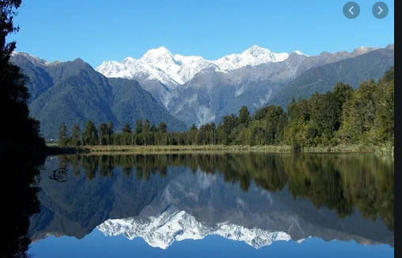
Reflection, Refraction, and Absorption
pg. 403
Reflection - The bouncing back of an object or a wave when it hits a surface through which it cannot pass.
Some waves are completely blocked by an obstruction, but their energy is not absorbed or converted to another form of energy. These types of waves bounce off, or reflect from, those obstructions.
https://www.youtube.com/watch?v=skGmQC87Bvg

Slide 4
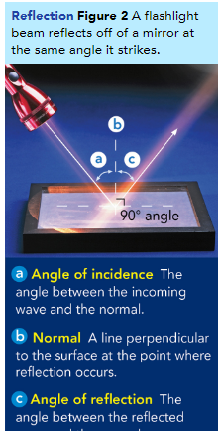
Reflection, Refraction, and Absorption
pg. 403
.
In a reflection, the wave bounces off and heads in a different direction. The law of reflection states that the angle of incidence equals the angle of reflection.
This means that the angle at which the wave strikes the material will match the angle at which the reflected wave bounces off that material, as shown in Figure 2.
Light reflecting from a mirror is the most familiar example of reflection. The echo of a voice from the walls of a canyon is another example
wave and the normal.

Slide 5
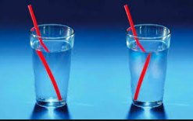
Reflection, Refraction, and Absorption
pg. 403
Refraction
The bending of waves as they enter a new medium at an angle, caused by a change in speed.
Imagine riding a bike down a smooth asphalt road. When you turn off the road onto a dirt path, the transition can be jarring. You might have to grip the handlebars hard to keep the bike going straight as each wheel is on a different surface.

Slide 6
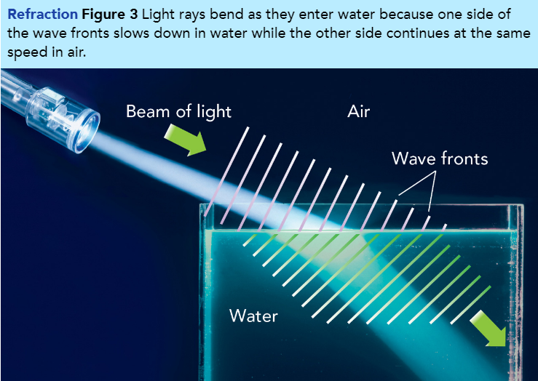
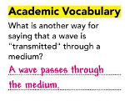
Reflection, Refraction, and Absorption
pg. 404
Refraction When light waves are transmitted from one medium into another, they also bend in different directions.
This bending is due to refraction, or the bending of waves due to a change in speed.
When a wave enters a new medium at an angle other than perpendicular, it changes direction.
For instance, when light is directed at water at an angle, as in Figure 3, the light slows down and bends downward.
The wave bends toward the normal, the imaginary line that runs perpendicular from the boundary between the two media.
https://www.youtube.com/watch?v=X3BYFv-CaJM
https://www.youtube.com/watch?v=OrobTDEYs2M

Slide 7
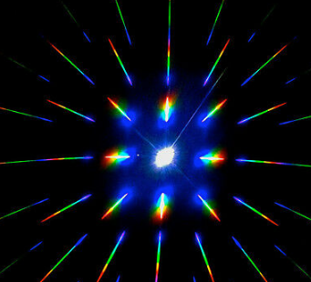
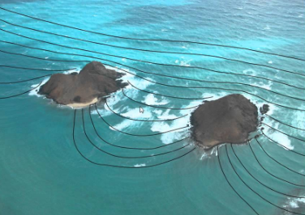
Reflection, Refraction, and Absorption
pg. 405
The bending or spreading of waves as they move around a barrier or pass through an opening.
Diffraction
Did you ever wonder how you can hear someone speaking even if they are around the corner of a building or doorway? This is an example of diffraction.
Waves don’t only travel in straight lines. They are also bend around objects.
You can observe diffraction with water waves as well as sound waves.
Water waves can diffract around a rock or an island in the ocean. Because tsunami waves can diffract all the way around an island, people on the shores of the entire island are at risk.
https://www.youtube.com/watch?v=-mNQW5OShMA

Slide 8
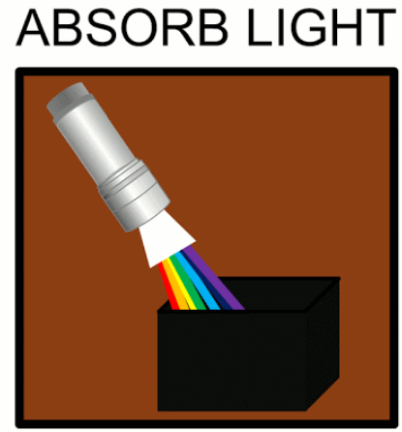
Reflection, Refraction, and Absorption
pg. 405
Absorption
The process by which an object takes in, or absorbs, light.
When you think of something being absorbed, you might think of how a paper towel soaks up water. Waves can be absorbed by certain materials, too.
In absorption, the energy of a wave is transferred to the material it encounters. When ocean waves reach a shoreline, most of their energy is absorbed by the shore.
https://www.youtube.com/watch?v=2vLoIBJMY2Y

Slide 9
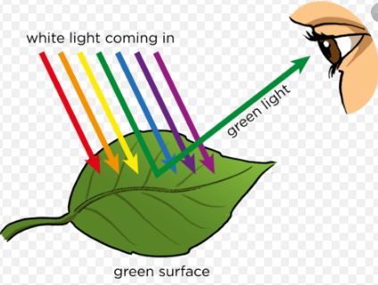
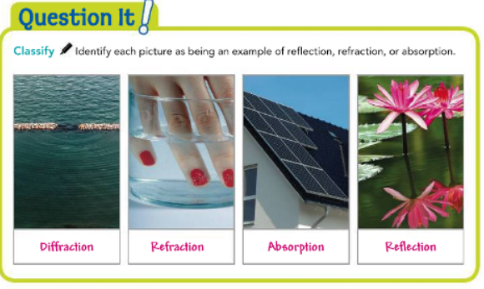
Reflection, Refraction, and Absorption
pg. 405
When light waves encounter the surface of a different medium or material, the light waves may be reflected, refracted, or absorbed.
What happens to the waves depends on the type of material they hit. Light is mostly absorbed by dark materials, such as the surface of a parking lot, and mostly reflected by light materials, such as snow.

Slide 10
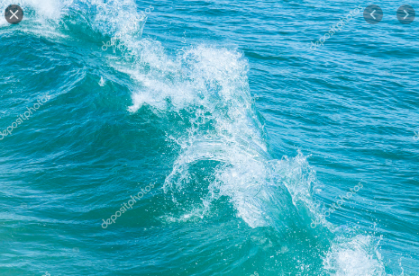
Wave Interference
pg. 406
Interference
The interaction between waves that meet.
Have you ever seen two ocean waves collide from opposite directions so they momentarily form a bigger, hill-like shape before continuing in their original directions?

Slide 11
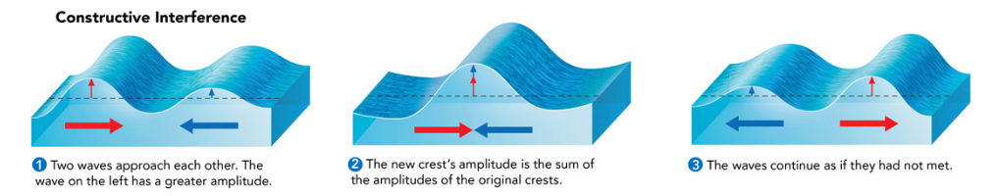
Wave interference are two types.
pg. 406
Wave Interference
Constructive Interference and
Destructive Interference
Constructive Interference When two waves combine to form a wave with a smaller amplitude than either original wave had, this is called destructive interference.
Destructive interference occurs when the crest of one wave overlaps the trough of another wave. If the crest has a larger amplitude than the trough of the other wave, the crest ″wins,″ and part of it remains.
If the original trough has a larger amplitude than the crest of the other wave, the result is a trough. If a crest and trough have equal amplitudes, they cancel each other out, as shown in Figure 4.
Destructive interference is used in noise-canceling headphones to block out distracting noises in a listener′s surroundings.
https://www.youtube.com/watch?v=CAe3lkYNKt8

Slide 12
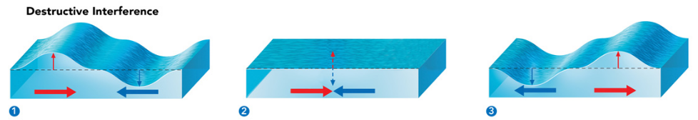
Wave Interference
Destructive Interference
pg. 407
When two waves combine to form a wave with a smaller amplitude than either original wave had, this is called destructive interference.
Destructive interference occurs when the crest of one wave overlaps the trough of another wave. If the crest has a larger amplitude than the trough of the other wave, the crest ″wins,″ and part of it remains.
If the original trough has a larger amplitude than the crest of the other wave, the result is a trough. If a crest and trough have equal amplitudes, they cancel each other out, as shown in Figure 4.
Destructive interference is used in noise-canceling headphones to block out distracting noises in a listener′s surroundings.

Slide 13


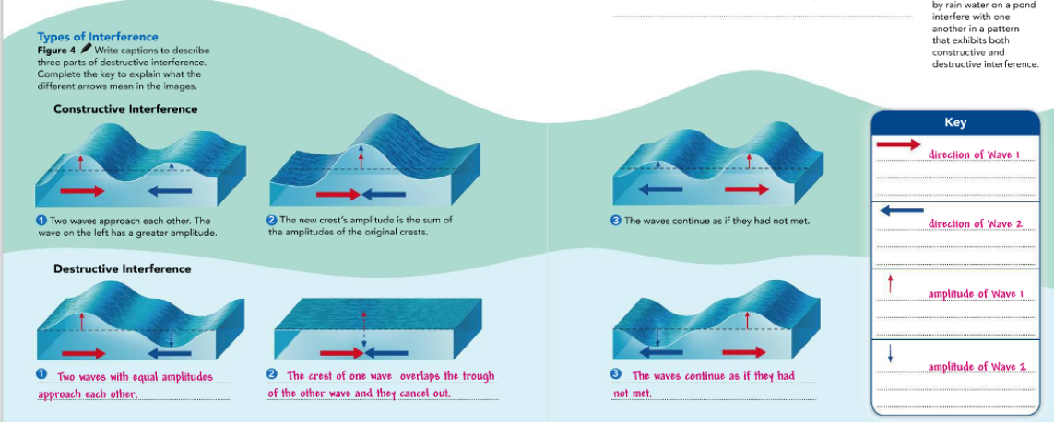
Wave Interference
pg. 407
Interfering Waves Figure 5
Ripples created by rain water on a pond interfere with one another in a pattern that exhibits both constructive and destructive interference

Slide 14
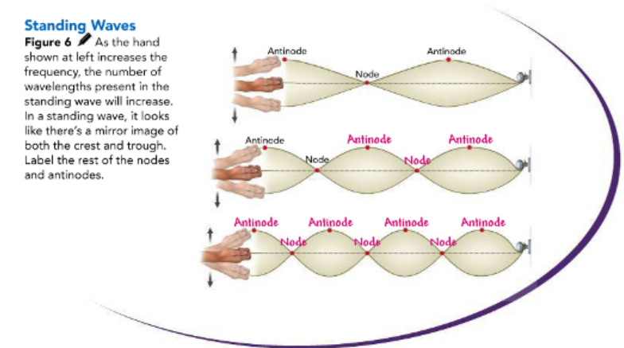
Wave Interference
Standing wave
pg. 408
A wave that appears to stand in one place, even though it is two waves interfering as they pass through each other.
Standing Waves
Look at the rope setup in Figure 6. The rope is tied to a doorknob, and someone shakes the free end. This motion can generate standing waves.
A standing wave is a wave that appears to stand in one place. Standing waves are produced by two waves interfering with each other as they travel in opposite directions.
Standing waves on the rope appear when an incoming wave and wave reflected from the doorknob have just the right frequency to interfere as shown.
https://www.youtube.com/watch?v=LvYbfGruLCo
https://www.youtube.com/watch?v=ieheeeKTbac

Slide 15
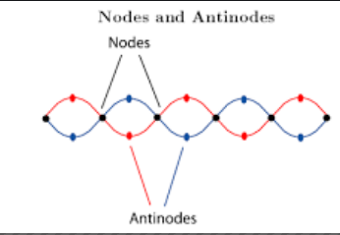
Wave Interference
pg. 408
Standing wave
In a standing wave, destructive interference between the two colliding waves produces points with zero amplitude, called nodes.
The nodes are always evenly spaced along the wave. Points of maximum amplitude on a standing wave are called antinodes.
Antinodes always occur halfway between two nodes. The frequency and wavelength of the interfering waves determine how many nodes and antinodes the standing wave will have.
When seen in real life, the antinodes appear to pulse in and out from the rope’s rest position while the nodes appear motionless.

Slide 16
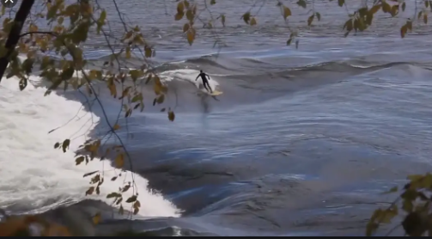
Wave Interference
pg. 408
Standing wave
Standing waves can sometimes appear on lakes when the wind and pressure around them are just right. The water appears to have a node in the center of the lake, and the water wave rolls around that node.

Slide 17
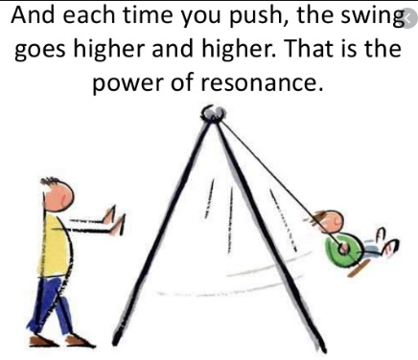
Wave Interference
pg. 409
Resonance
The increase in the amplitude of a vibration that occurs when external vibrations match an object’s natural frequency.
Think about the last time you swung on a swing at a playground. You may have noticed that it is difficult to get yourself going.
Once you are in motion, you can pull on the chains of the swing and pump your legs at the right time to keep yourself swinging.
The swing has a natural frequency, and your actions match that frequency to create greater amplitudes in your motion.
https://www.youtube.com/watch?v=MIgQrHW53Lw

Slide 18
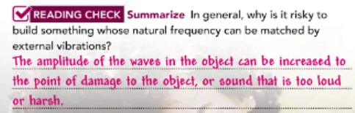
Wave Interference
pg. 409
Resonance
Most objects have at least one natural frequency of vibration. Standing waves occur in an object when it vibrates at one of these natural frequencies.
If a nearby object vibrates at the same frequency, it can cause resonance.
.
When engineers build a bridge, they have to make sure that bridge supports are not placed at potential nodes for a standing wave.
https://www.youtube.com/watch?v=wvJAgrUBF4w

Slide 19

Wave Interference
Musical Resonance Figure 7
The types of wood and construction techniques used to make a guitar affect aspects of its sound, including its resonance.
pg. 409
Resonance
Understanding the resonance of different materials is also useful for people who build guitars, violins, or other wood-based stringed instruments.
If the wood in a guitar, such as the one in Figure 7, resonates too much with a certain note, it may sound too loud when that particular note is struck.
Likewise, if the wood does not resonate with any particular note, the instrument may lack volume or “presence” and sound dull.

Slide 20

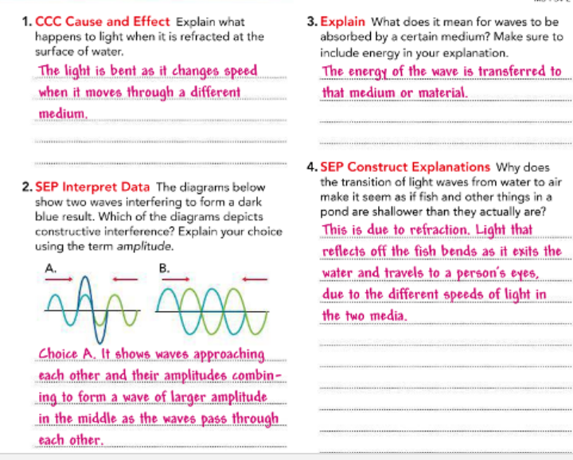
pg. 410

Slide 21


