Slide 1
Topic 3 Lesson 4 Factors influencing growth

Slide 2
Objectives
Students will describe the cause-and-effect relationship for
• environmental factors that influence an organism’s growth.
• genetic factors that influence an organism’s growth.
Students will construct explanations to identify
• methods to stimulate plant growth.
Students will identify the mechanisms that factor and control
• plant growth.
• animal growth.

Slide 3

Lab Activity

Slide 4
Lab Activity
Analyze and Interpret Data
Cause and Effect Did rotating the seed affect root growth? If so, what was the effect?
Analyze Data Did the results of your experiment provide evidence to support your hypothesis? Why or why not?
Construct Explanations Use the evidence obtained from your investigation to construct an explanation for how an environmental factor affects plant growth. What environmental factor did the plant root growth respond to?
Yes, there was an effect. The roots grew downward again.
My original hypothesis was supported because the direction of the root growth changed when the seed was turned.
The stimulus that the plant root growth responded to was gravity. My evidence supports the explanation that gravity affects the direction that plant roots grow; the roots will grow toward gravity, even if the plant is turned.

Slide 5
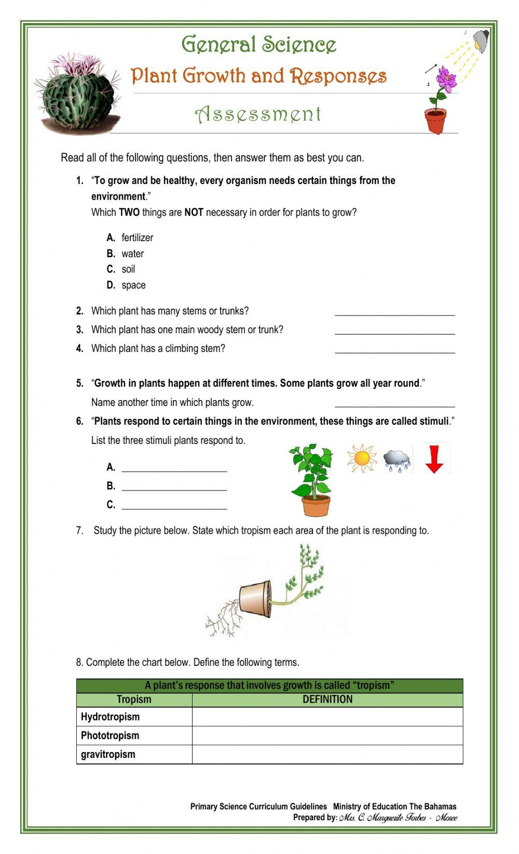
Notes:
https://www.liveworksheets.com/lc1493797gc

Slide 6
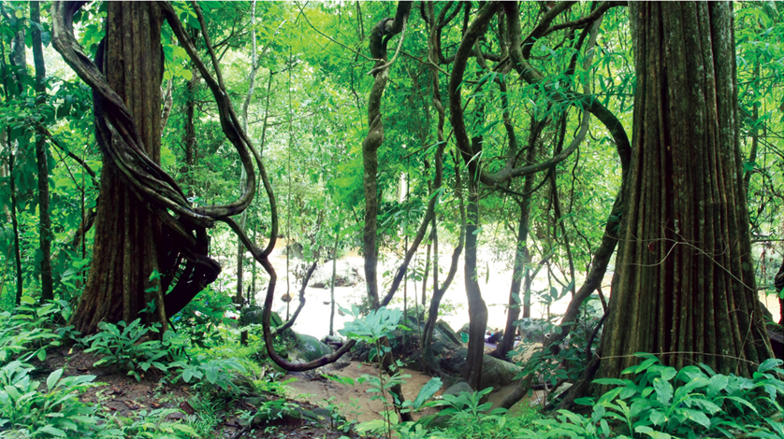
Growth and Development of Organisms
The way organisms grow and develop, and the size they reach, varies from species to species. Several factors influence how organisms grow. For example:
→ Some are determined by the genetic characteristics that are passed from parent to offspring during reproduction.
→ Other factors occur outside of the organism and can be related to their access to needed resources
→ The conditions in their environment
→ Their responses to other stimuli.
Healthy plants inherit traits that determine
successful growth, but if the conditions
around them are not ideal, the plants may
not grow or develop normally. To increase
their odds for survival, plants and animals
have changed over time. These changes
are a result of adapting to stimuli in the
environment. The vines in Figure 1, for
example, grow in response to their environment. Vines have evolved to grow around larger trees and other structures as a means of accessing sunlight and gaining space for further growth.

Slide 7
Reading Check
Vines are plants that can use other structures, such as trees, for support. Circle a vine in the picture and draw an arrow to show the direction of its growth.
How do you think the vine was able to grow up the tree?
__________________________________________________________________________________________________________________________________
Construct Explanations Why do you think the vine used the tree to grow?
__________________________________________________________________________________________________________________________________

Slide 8
Reading Check
Vines are plants that can use other structures, such as trees, for support. Circle a vine in the picture and draw an arrow to show the direction of its growth.
How do you think the vine was able to grow up the tree?
As it grows from the ground, it slowly wrapped itself around the tree, attaching itself to the tree as it grew in an upward direction.
Construct Explanations Why do you think the vine used the tree to grow?
It probably used the tree because it is not strong enough to grow tall and get access to sunlight or other resources it needs.

Slide 9
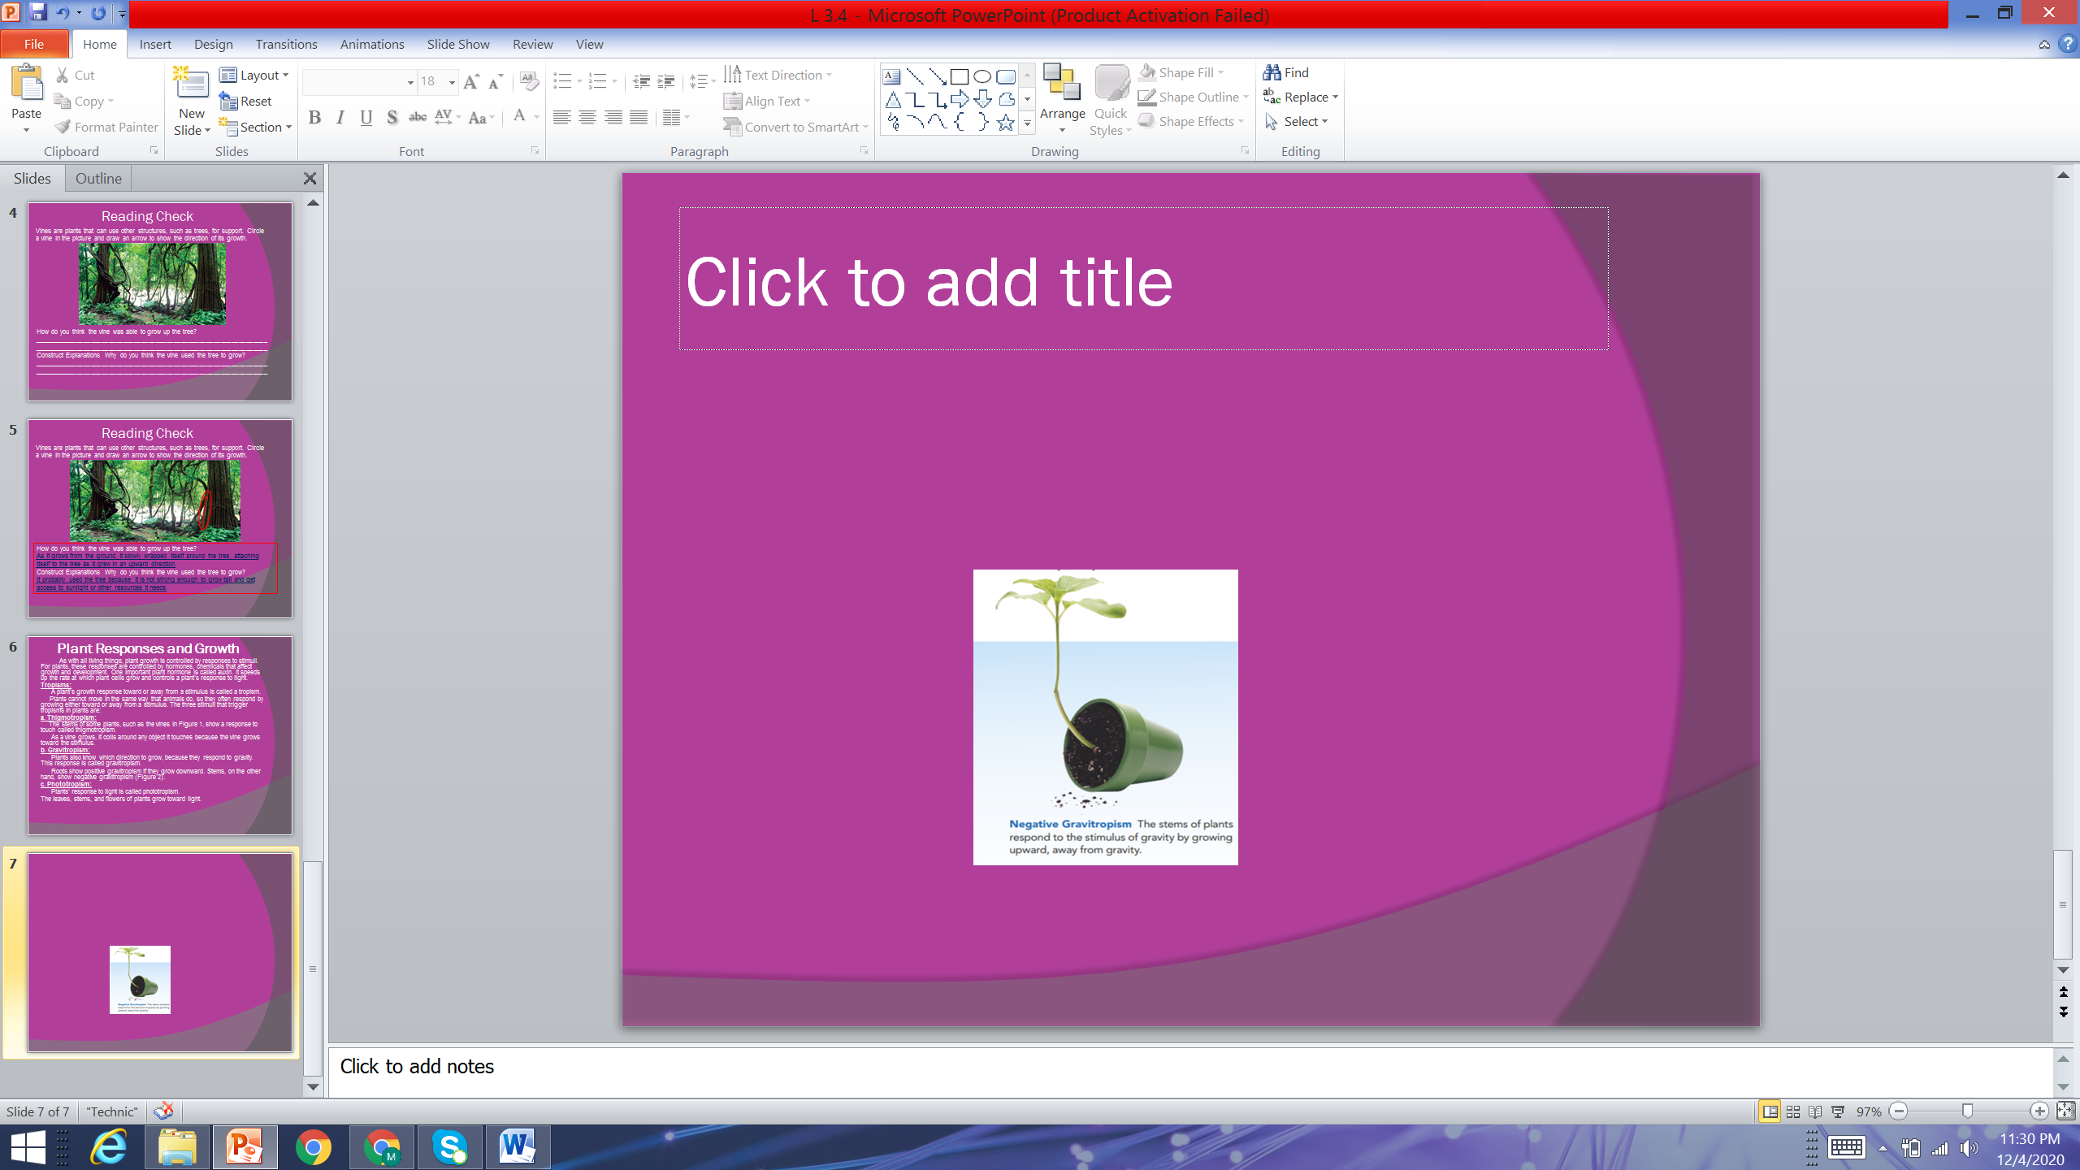
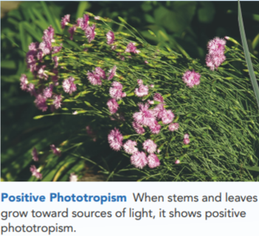
Plant Responses and Growth
As with all living things, plant growth is controlled by responses to stimuli. For plants, these responses are controlled by hormones, chemicals that affect growth and development. One important plant hormone is called auxin. It speeds up the rate at which plant cells grow and controls a plant's response to light.
Tropisms: A plant's growth response toward or away from a stimulus is called a tropism.
Plants cannot move in the same way that animals do, so they often respond by growing either toward or away from a stimulus.
The three stimuli that trigger tropisms in plants are:
Thigmotropism: The stems of some plants, such as the vines in Figure 1,
show a response to touch called thigmotropism.
As a vine grows, it coils around any object it touches
because the vine grows toward the stimulus.
b. Gravitropism:
Plants also know which direction to grow, because they
respond to gravity. This response is called gravitropism.
Roots show positive gravitropism if they grow downward.
While stems show negative gravitropism (Figure 2).
c. Phototropism:
Plants' response to light is called phototropism.
The leaves, stems, and flowers of plants grow toward light.

Slide 10
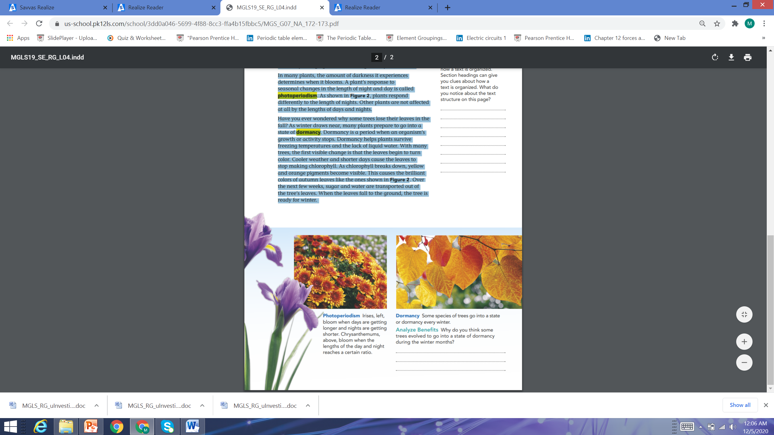
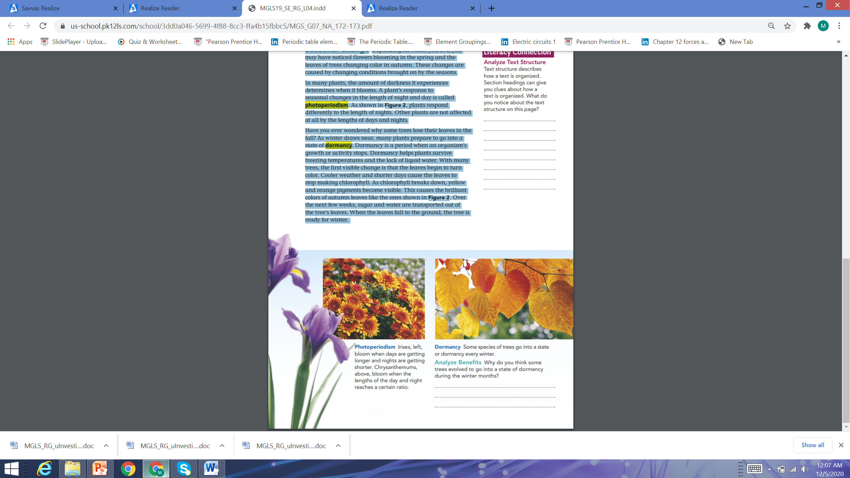
Seasonal Change:
Depending on where you live, you may have noticed flowers blooming in the spring and the leaves of trees changing color in autumn. These changes are caused by changing conditions brought on by the seasons. In many plants, the amount of darkness it experiences determines when it blooms.
Photoperiodism:
A plant’s response to seasonal changes in the
length of night and day is called photoperiodism.
As shown in Figure 2, plants respond differently
to the length of nights. Other plants are not affected
at all by the lengths of days and nights.
Dormancy:
Dormancy is a period when an organism’s growth
or activity stops. As winter draws near, many plants
prepare to go into a state of dormancy. Dormancy
helps plants survive freezing temperatures and the
lack of liquid water. With many trees, the first visible
change is that the leaves begin to turn color. Cooler
weather and shorter days cause the leaves to stop
making chlorophyll. As chlorophyll breaks down,
yellow and orange pigments become visible. This
causes the brilliant colors of autumn leaves like the
ones shown in Figure 2. Over the next few weeks,
sugar and water are transported out of the tree’s
leaves. When the leaves fall to the ground, the tree
is ready for winter.

Slide 11
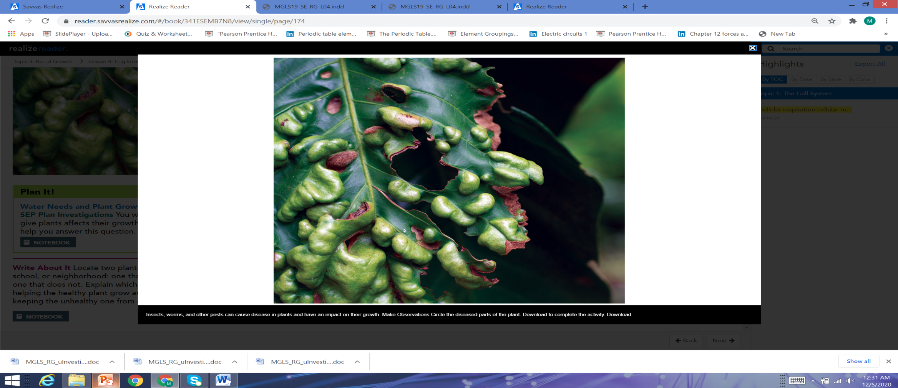
Environmental Conditions
In ideal conditions, a plant will reach a certain maximum size that is normal for its species. However, in some cases, plants do not get enough of the resources they need, so they do not grow as large as they normally would. A lack of sunlight, for instance, may keep a plant from growing to full size or weaken its structure. In addition to sunlight, plants need nutrient-rich soil and water to grow. Soil contains the nutrients a plant needs to carry out its life processes. Nutrient-poor soil may result from an area being overly crowded with plants. Competition for the nutrients in the soil may mean that few plants get the nutrients they need. Similarly, if a plant does not receive enough
water, it will not grow to a healthy size.
Diseases like the one shown in Figure 3
can impact plant growth as well.
Reading Check:
Insects, worms, and other pests can cause
disease in plants and have an impact on
their growth. Circle the diseased parts of
the plant.

Slide 12
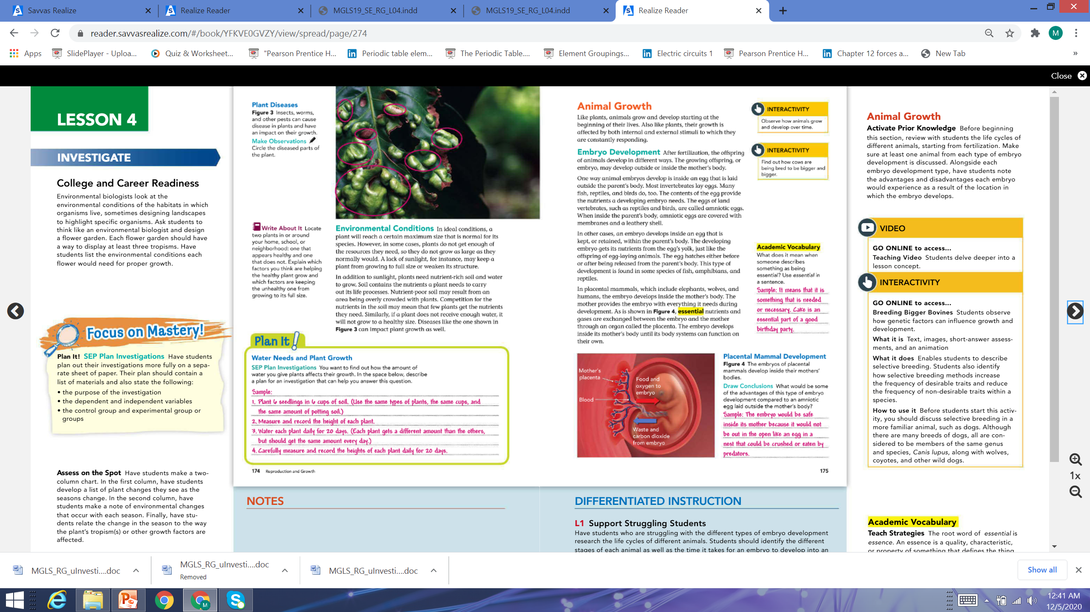
Environmental Conditions
In ideal conditions, a plant will reach a certain maximum size that is normal for its species. However, in some cases, plants do not get enough of the resources they need, so they do not grow as large as they normally would. A lack of sunlight, for instance, may keep a plant from growing to full size or weaken its structure. In addition to sunlight, plants need nutrient-rich soil and water to grow. Soil contains the nutrients a plant needs to carry out its life processes. Nutrient-poor soil may result from an area being overly crowded with plants. Competition for the nutrients in the soil may mean that few plants get the nutrients they need. Similarly, if a plant does not receive enough
water, it will not grow to a healthy size.
Diseases like the one shown in Figure 3
can impact plant growth as well.
Reading Check:
Insects, worms, and other pests can cause
disease in plants and have an impact on
their growth. Circle the diseased parts of
the plant.

Slide 13
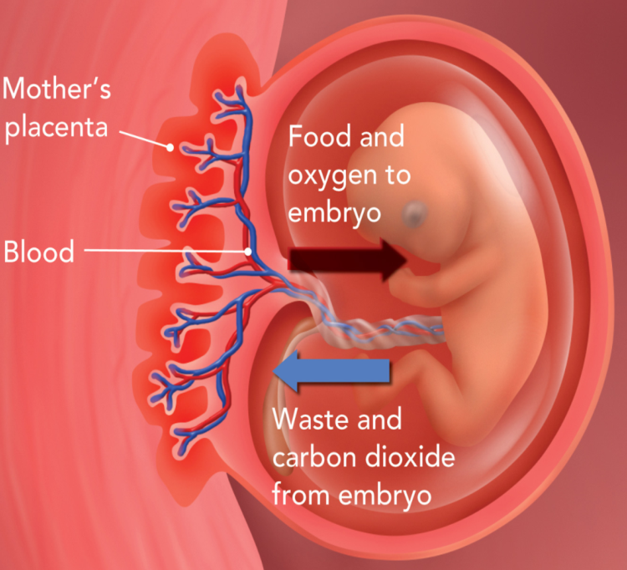
Animal Growth
Like plants, animals grow and develop starting at the beginning of their lives. Also like plants, their growth is affected by both internal and external stimuli to which they are constantly responding.
Embryo Development: After fertilization, the offspring of animals develop in different ways. The growing offspring, or embryo, may develop in following different ways:
Outside mother's body: One way animal embryos develop is inside an egg that is laid outside the parent's body. Most invertebrates lay eggs. Many fish, reptiles, and birds do, too. The contents of the egg provide the nutrients a developing embryo needs. The eggs of land vertebrates, such as reptiles and birds, are called amniotic eggs. When inside the parent's body, amniotic eggs are covered with membranes and a leathery shell.
Outside mother's body:
This can occur in two ways: 1. In some cases, an embryo develops inside an egg that is kept, or retained, within the parent's body. The developing embryo gets its nutrients from the egg's yolk, just like the offspring of egg-laying animals. The egg hatches either before or after being
released from the parent's body. This type of development is found
in some species of fish, amphibians, and reptiles.
2. In placental mammals, which include elephants, wolves,
and humans, the embryo develops inside the mother's body. The
mother provides the embryo with everything it needs during
development. As is shown in Figure 4, essential nutrients and
gases are exchanged between the embryo and the mother through
an organ called placenta. The embryo develops inside its mother's
body until its body systems can function on their own.

Slide 14
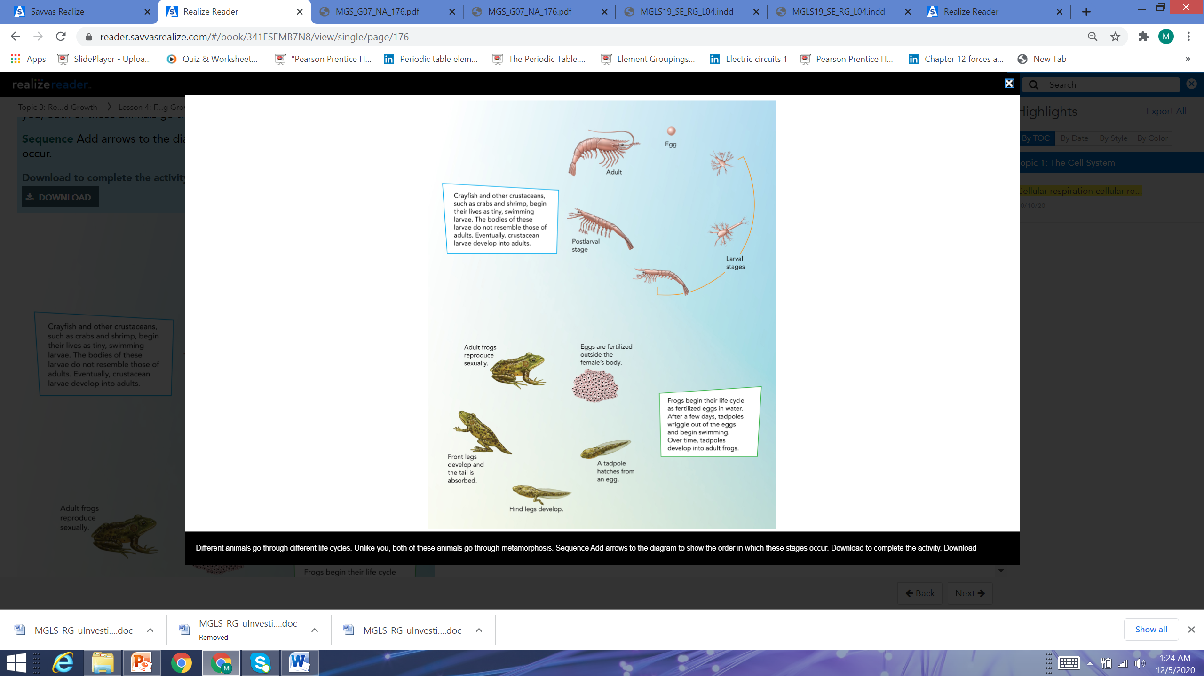
Life Cycles Vs Metamorphosis
Life cycle: Many young animals, including most vertebrates, look like small versions of adults from the time they are born.
Metamorphosis:
Other animals go through the process of metamorphosis, or major body changes, as they grow & develop into adults (Figure 5).

Slide 15
Factors affecting growth:
Animal growth and development are affected by two type of factors:
External factors
Internal factors.

Slide 16
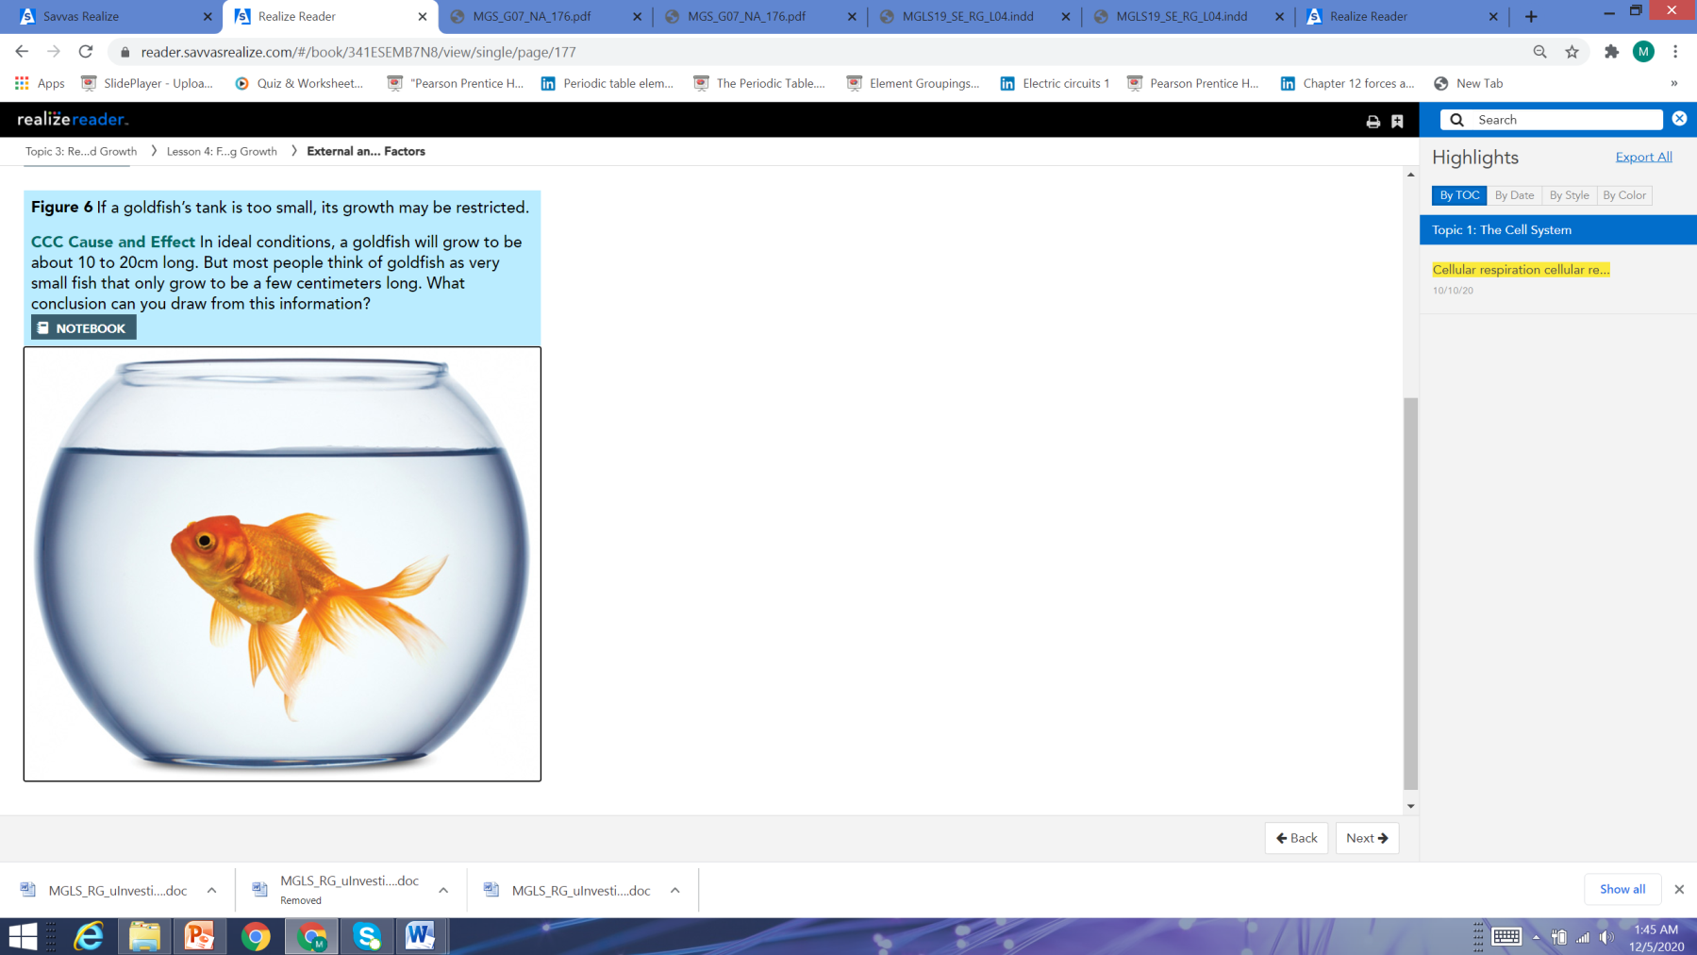
External factors
External factors, on the other hand, are the environmental conditions that an animal may or may not have any control over.
Environmental conditions:
Access to resources and exposure to
diseases and parasites can also affect the
growth and development of animals. If
animals do not receive the nutrition they
need during development or if they become
sick, they may not reach their full adult size.
Space is another resource that can affect
animal growth. For example, the growth of
some species of fish, such as goldfish like
the one in Figure 6, is affected by how large
a body of water they live in. If its living space
is not large enough, it will not reach its full
adult size.

Slide 17
Internal Factors
Internal factors include genetic and hormonal characteristics that are part of an organism's life processes.
Genes:
The genes an offspring inherits from its parents are a major factor in how it develops and grows. In your own classroom, you can probably observe how students’ heights vary. Part of these differences is due to the genes your classmates inherited from their parents. Children usually grow up to be about the same height as their parents. Hormones:
Another internal factor that influences growth and development are the hormones that are naturally produced by animals’ bodies. For instance, male animals produce greater amounts of testosterone than female animals. In many animal species, the production of testosterone in male animals results in males growing to be larger than females.

Slide 18
Reading Check
How is your life cycle different from the animals that undergo metamorphosis?
____________________________________________________________________________________________________________________________________________________________________________________________________________
In ideal conditions, a goldfish will grow to be about 10 to 20cm long. But most people think of goldfish as very small fish that only grow to be a few centimeters long. What conclusion can you draw from this information?
____________________________________________________________________________________________________________________________________________________________________________________________________________

Slide 19
Reading Check
How is your life cycle different from the animals that undergo metamorphosis?
When we are born, we look like an adult. Organisms that undergo metamorphosis do not look like an adult of the same species.
In ideal conditions, a goldfish will grow to be about 10 to 20cm long. But most people think of goldfish as very small fish that only grow to be a few centimeters long. What conclusion can you draw from this information?
Most people probably do not provide their pet goldfish with enough space to develop and grow to a healthy size.

Slide 20
Learning check

Slide 21
Why do you think some trees evolved to go into a state of dormancy during the winter months?
______________________________________________________________________________________________________

Slide 22
Why do you think some trees evolved to go into a state of dormancy during the winter months?
It helps them conserve energy during the winter months when resources and sunlight are limited.

Slide 23
What would be some advantages of this type of embryo development compared to an amniotic egg laid outsider the mothers’ body?
________________________________________________________________________________________________________________________________________________________________________

Slide 24
What would be some advantages of this type of embryo development compared to an amniotic egg laid outsider the mothers’ body?
The embryo would be safe inside its mother because it would not be out in open like an egg in a nest that could be crushed by

Slide 25
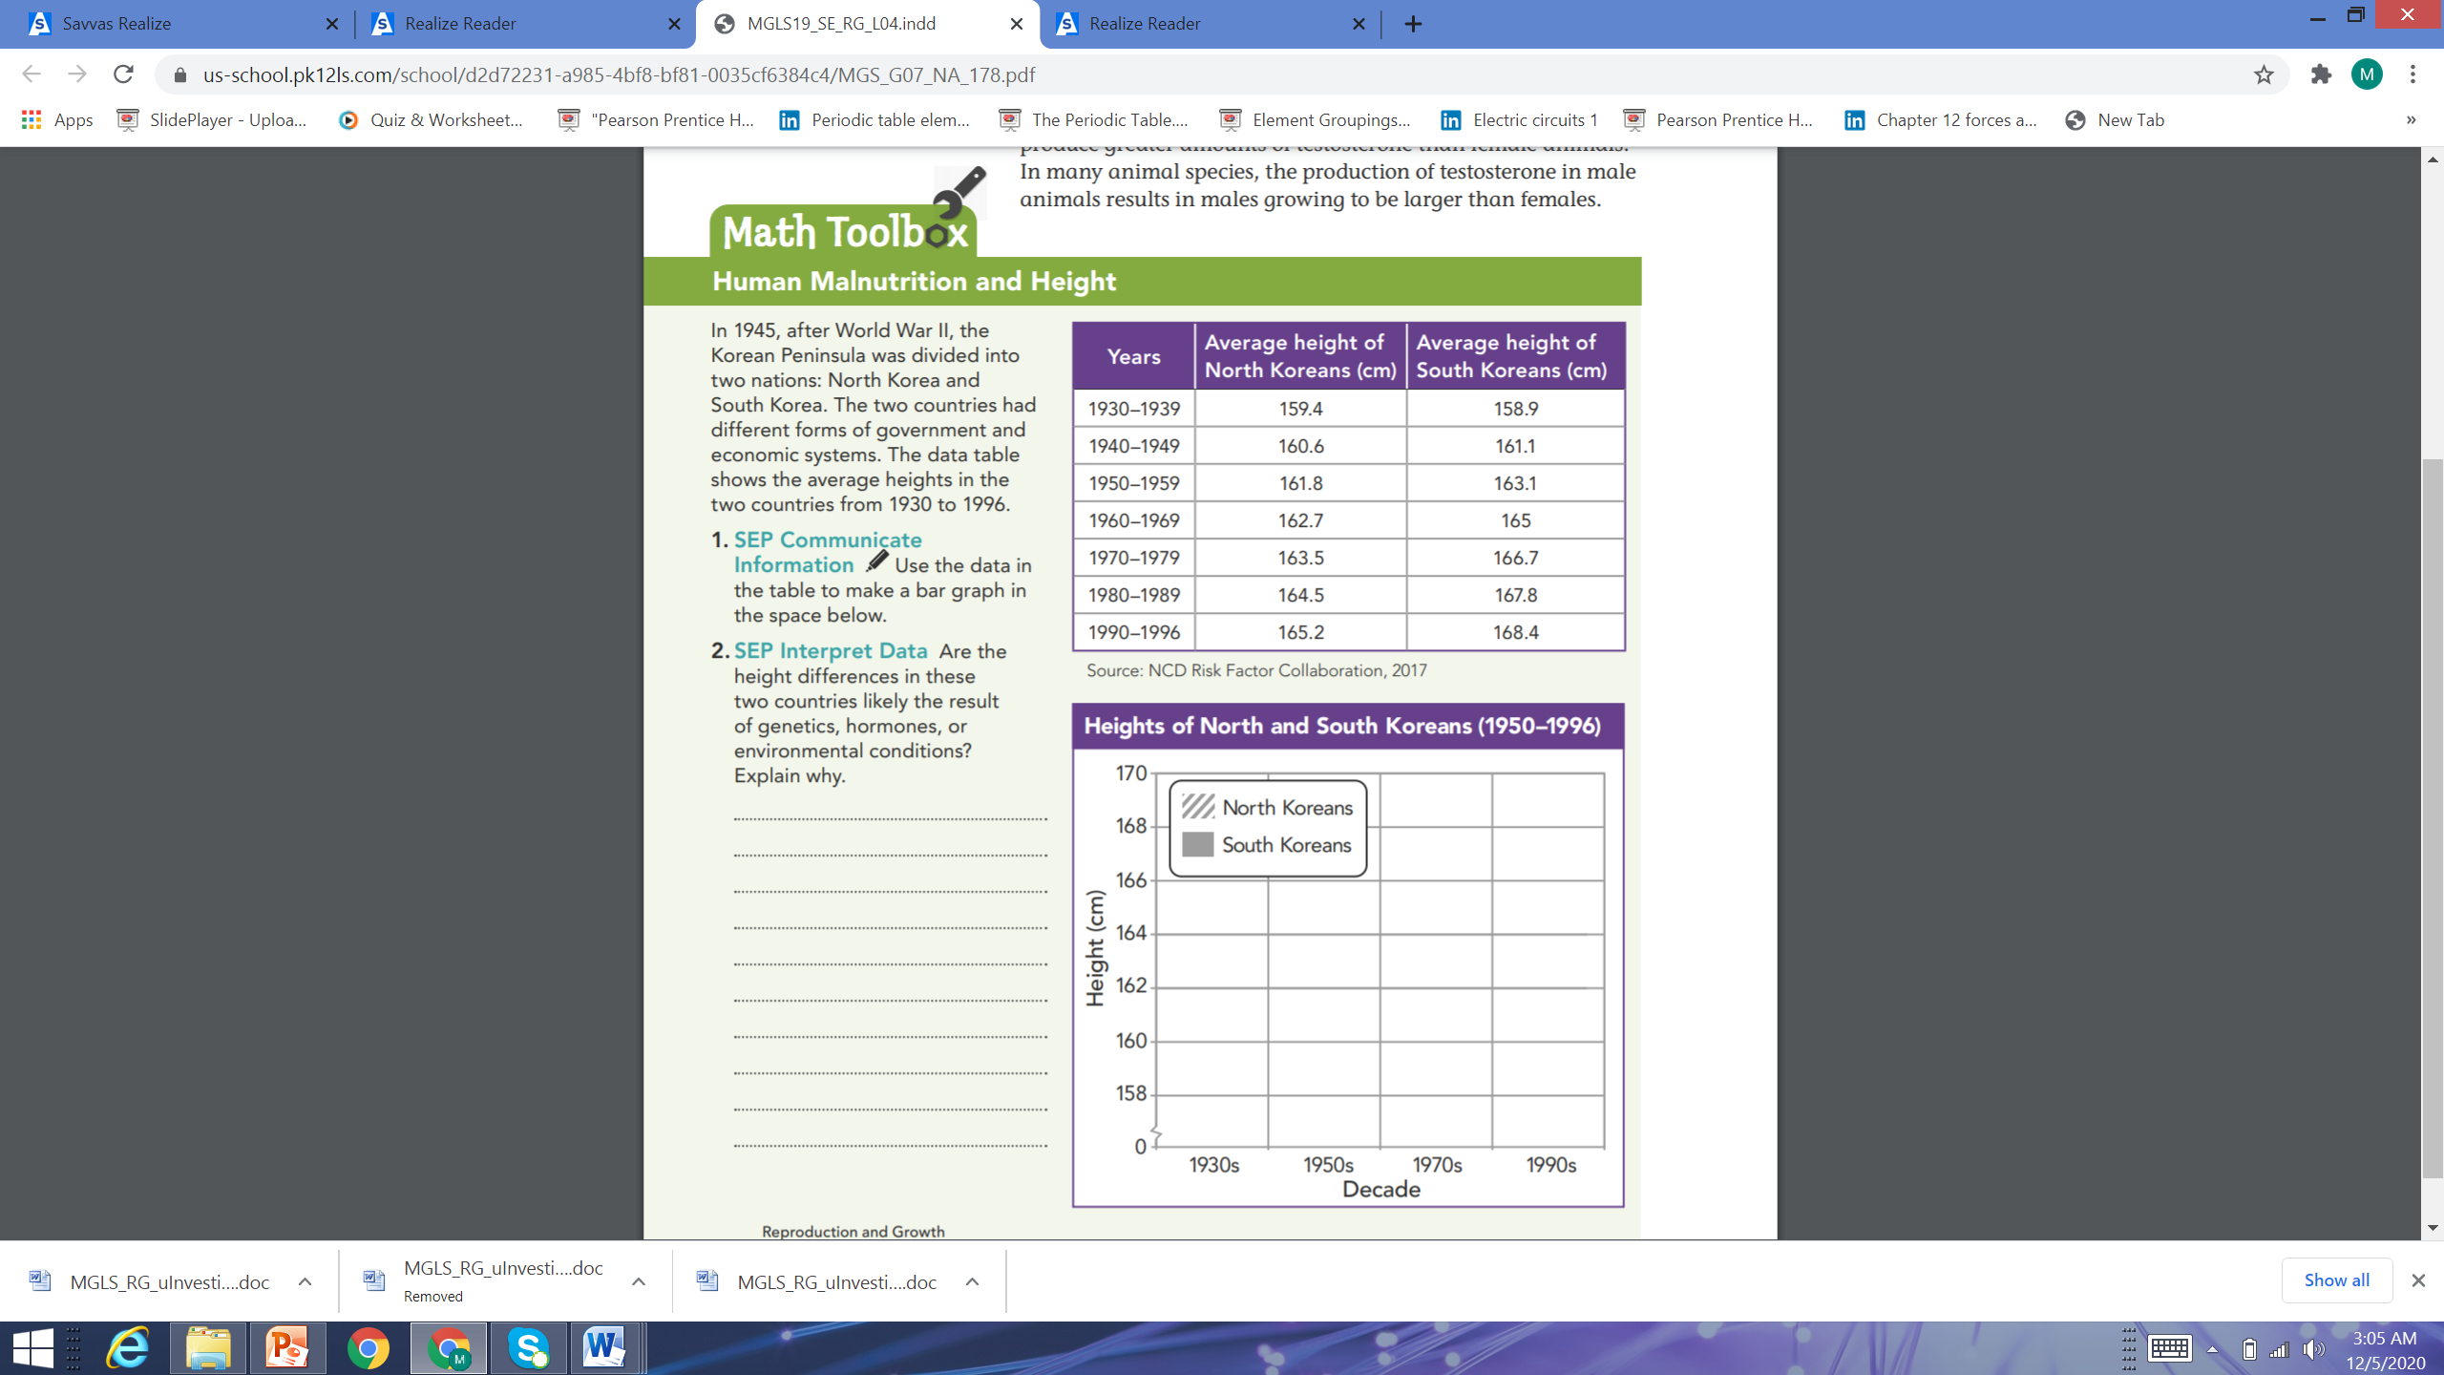

Slide 26
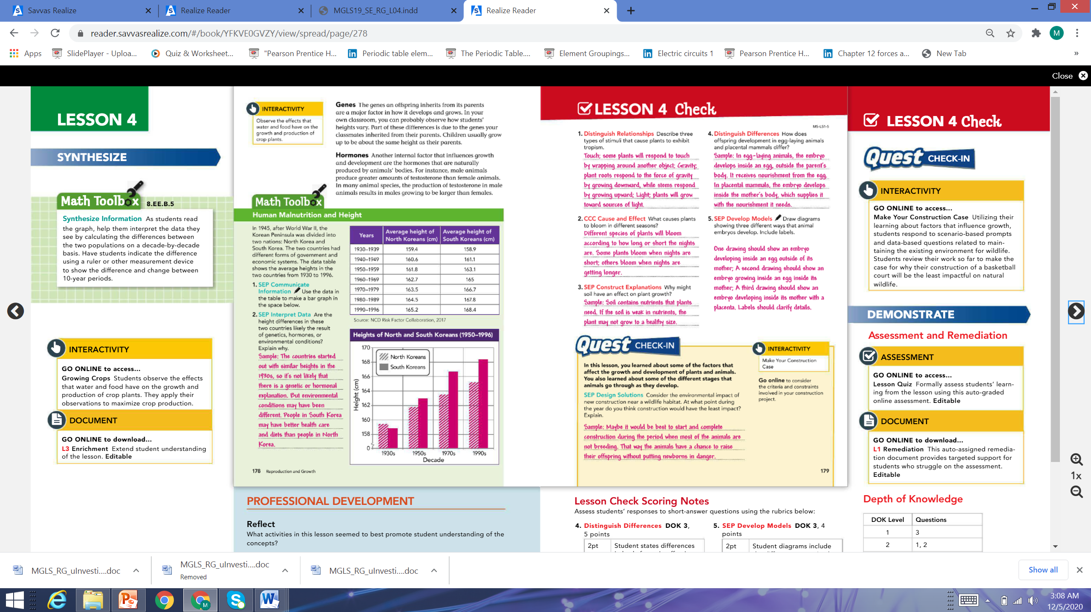

Slide 27
