Slide 1
CH1 L5
Page 48
Acids and Bases

Slide 2
Vocabulary Words
Acid
Corrosive
Indicator
Base
Neutralization
Salt

Slide 3
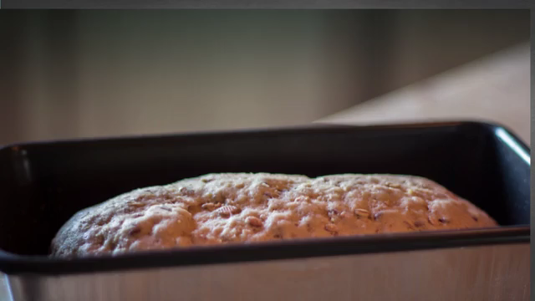
Baking soda and vinegar reaction (video)

Slide 4
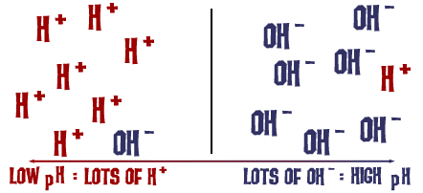

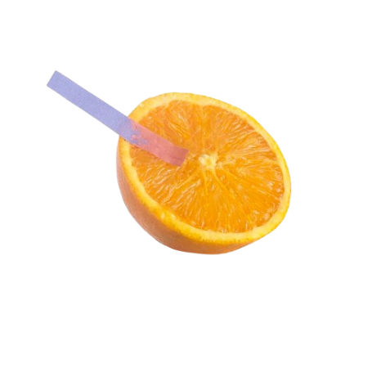
What are Acids?
An acid is a compound that reacts with metals and carbonates
Tastes sour
Turns blue litmus paper red
Almost all acids contain the element hydrogen as a positively- charged ion of a single hydrogen atom.

Slide 5
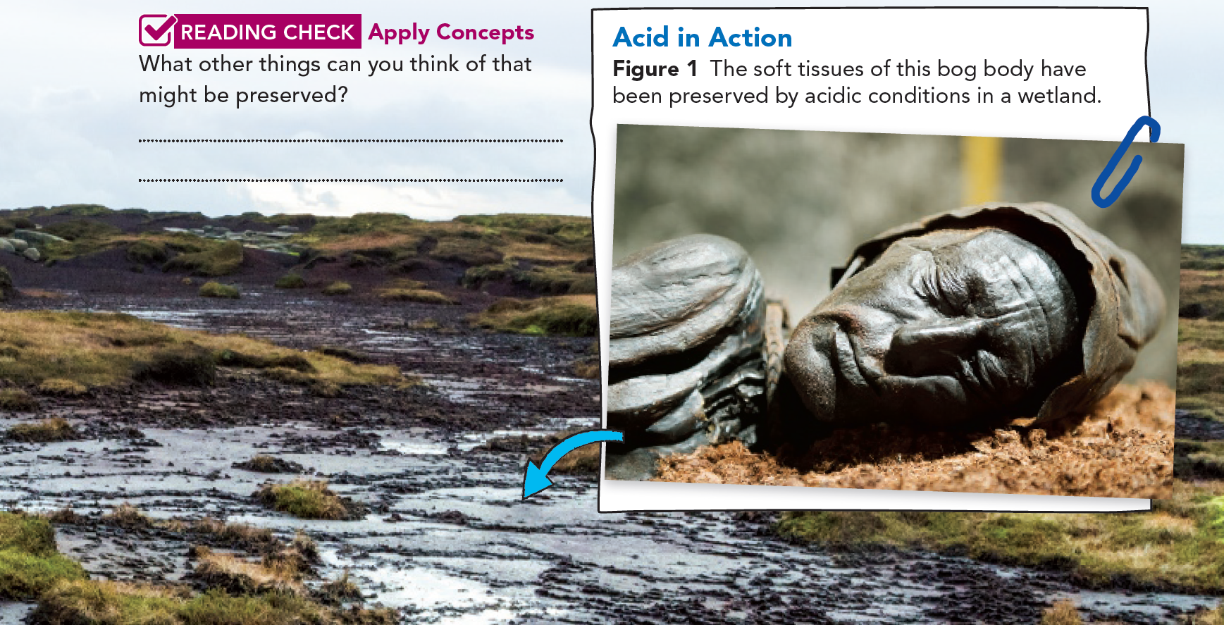
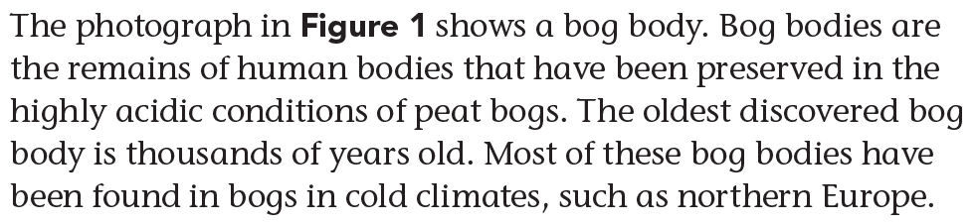
Some foods, mummies, fossils in rocks, etc.

Slide 6
How do conditions in bogs preserve human bodies?
They naturally pickle the bodies.
The lack of oxygen in the water and the cold temperatures of regions such as northern Europe cause the acids to saturate body tissues before they decay.
As a result, the organs, hair, and skin are all preserved.
The acids dissolve the bones of the bog bodies, but details such as fingerprints and tattoos are still visible on some of the bodies.
And to think, the bog acids that preserved the body in the photo are about the same strength as the vinegar found in most kitchens!

Slide 7
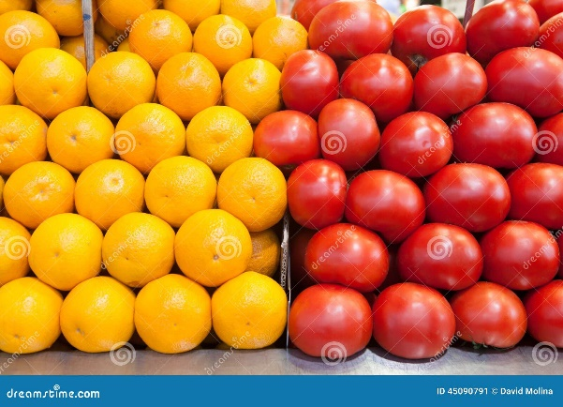
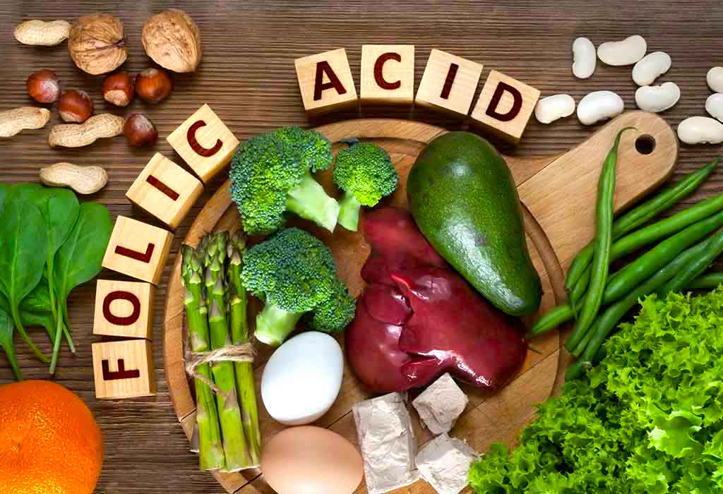
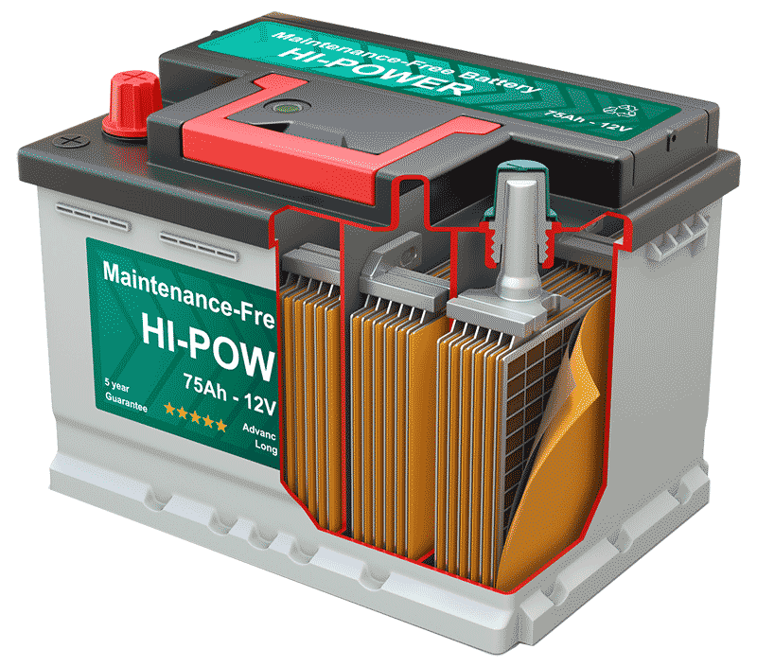
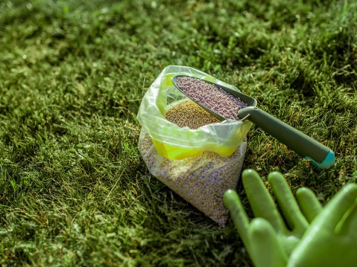
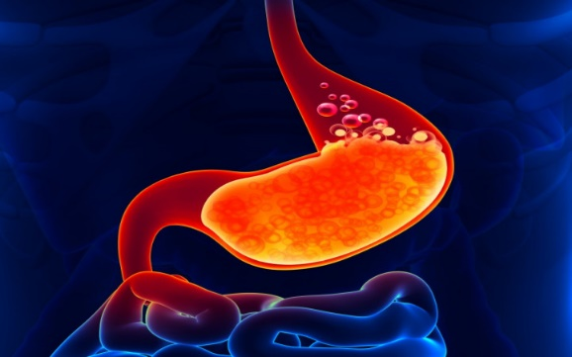
Different types of Acids
Acids are an important part of our lives.
Folic acid, found in green, leafy vegetables, is important for human cell growth.
Hydrochloric acid in your stomach helps with digestion.
Phosphoric acid is an ingredient in plant fertilizers.
Sulfuric acid drives many types of batteries, giving it the nickname “battery acid”.
Oranges and tomatoes also contain acids.

Slide 8
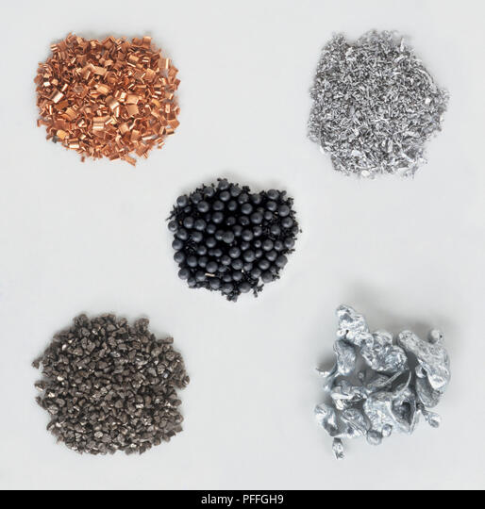


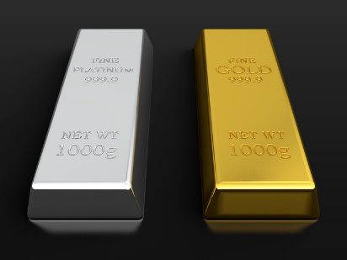
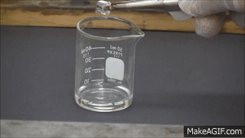
Reaction with Metals
Acids react with certain metals to produce hydrogen gas.
A few metals, such as platinum and gold, do not generally react with acids, but most other metals, such as aluminum, zinc, and iron, do.
When they react, the metals seem to disappear in the solution.
This is one reason acids are described as corrosive, meaning they “wear away” other materials.

Slide 9
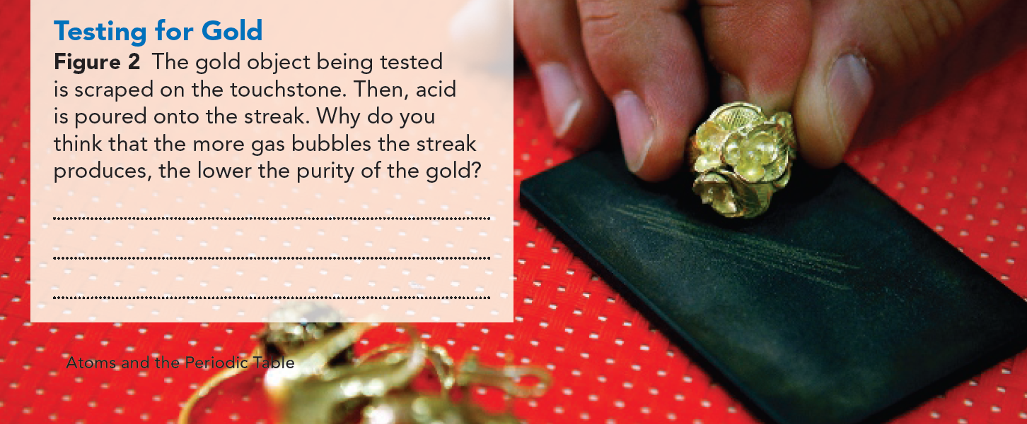
Because gold does not react with acid, other metals are present in a lower purity gold, and they cause the reaction.

Slide 10

Reaction with Carbonates
Acids also react with carbonate ions.
Carbonate ions contain carbon and oxygen atoms bonded together with an overall negative charge (${CO}_{3}^{−2}$).
One product of the reaction of an acid with a carbonate is carbon dioxide, a common gas.
Geologists use this property of acids to identify rocks.
For example, if acid poured on a rock's surface produces carbon dioxide gas, then the rock may be made of limestone.
Objects that contain carbonate ions include limestone, seashells, eggshells, and chalk. Therefore, they can all be affected by acid.

Slide 11
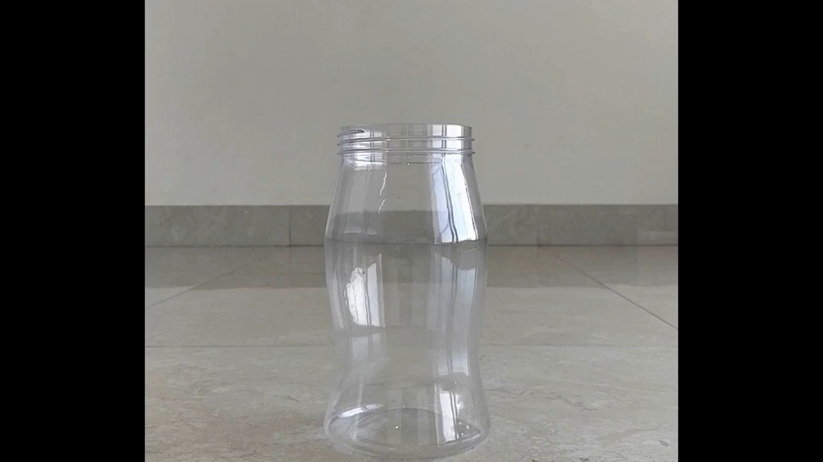
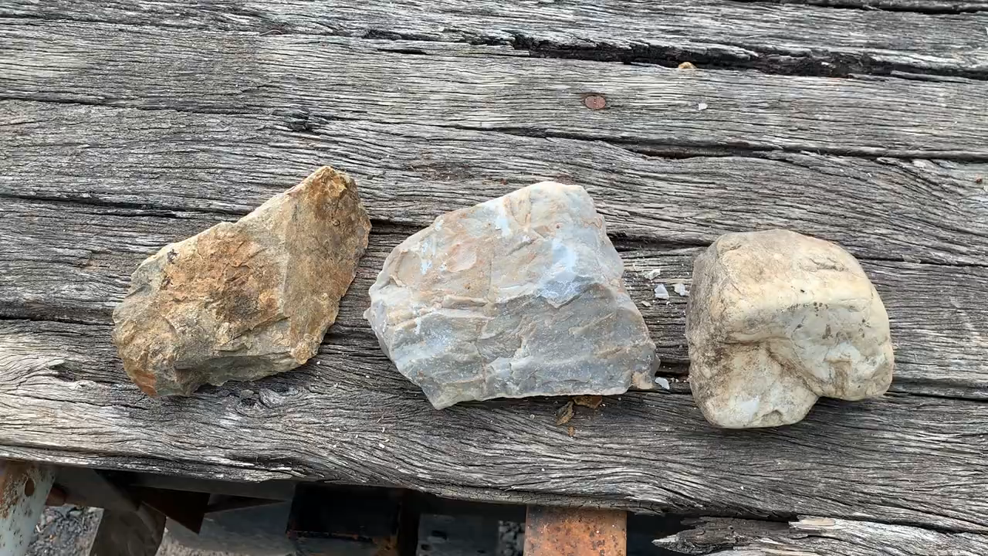

Slide 12
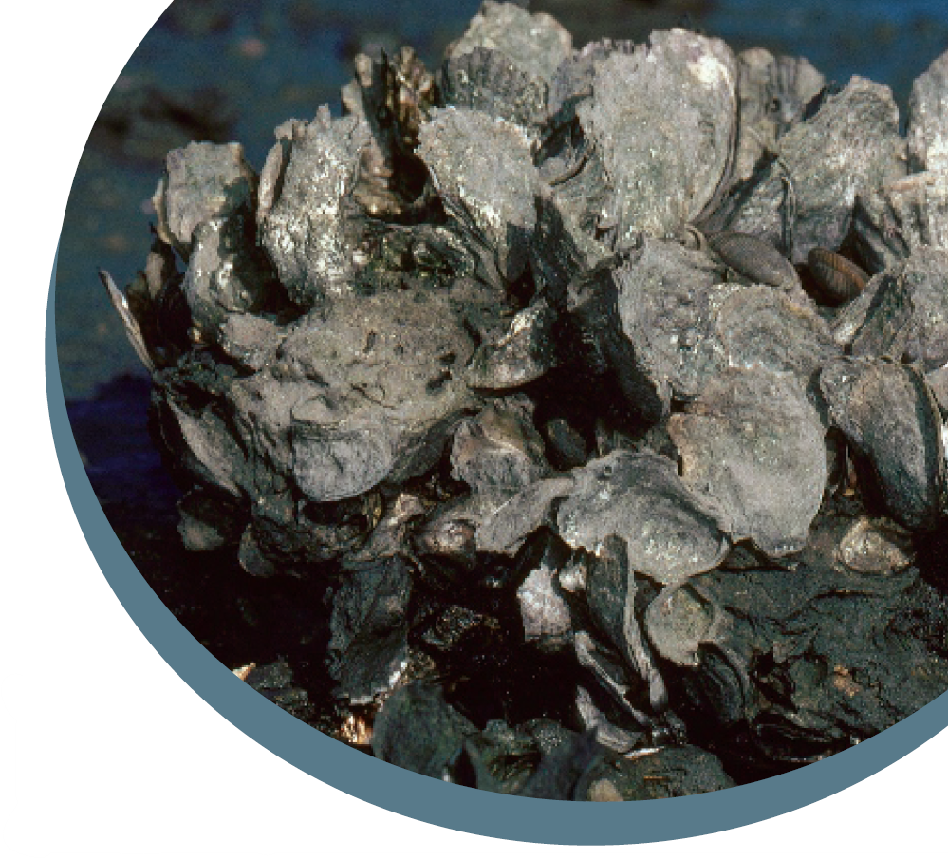
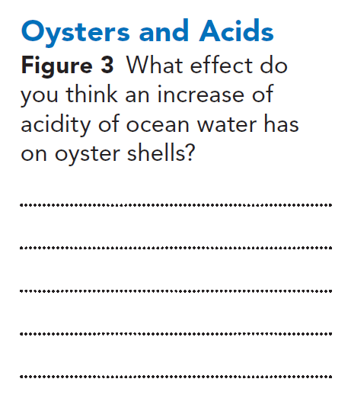
The acid reacts is with the carbonate ions in the shells, dissolving them and causing them to grow more slowly.

Slide 13
Sour Taste
If you've ever tasted a lemon, you've had firsthand experience with the sour taste of acids.
Citrus fruits, such as lemons, grapefruit, and oranges, all contain citric acid.
Many other foods, such as olives and tomatoes, also contain acids.
Although sour taste is a characteristic of many acids, it is not one you should use to identify a compound as an acid.
It is not safe to taste unknown chemicals.

Slide 14
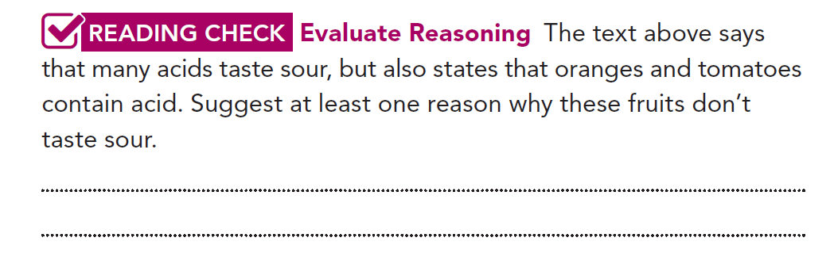
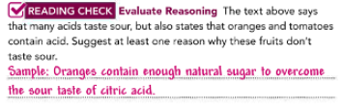

Slide 15
Indicator
A compound that changes color in presence of acids and bases is called Indicator.

Slide 16
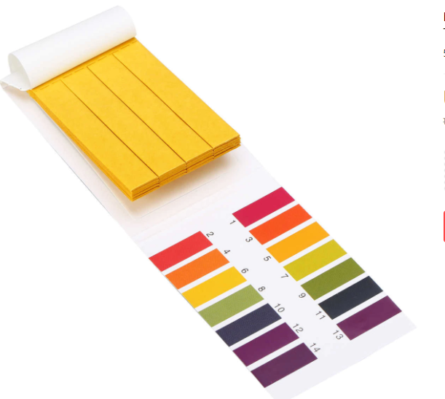
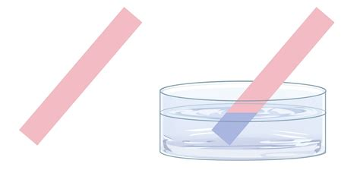
Litmus Paper
Litmus is a natural indicator.
Acids turn blue litmus paper red
Bases turn red Litmus paper blue.

Slide 17
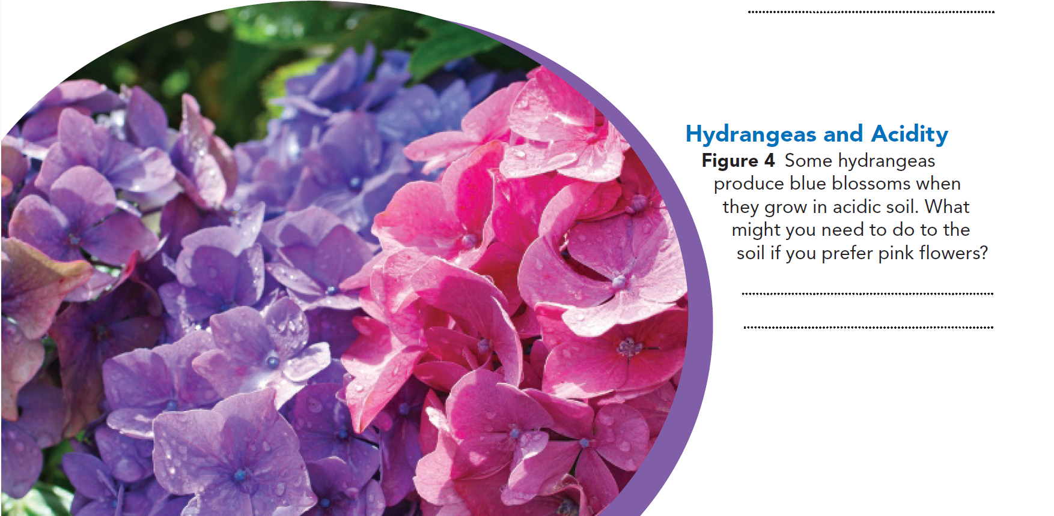
Make the soil less acidic.

Slide 18
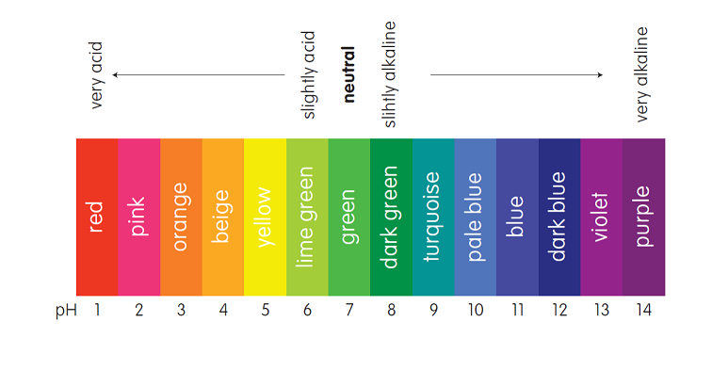
Ph scale or (Universal indicator)

Slide 19

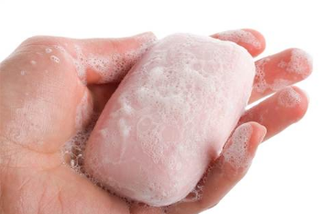
What are bases?
A base tastes bitter
feels slippery
turns red litmus paper blue
The properties of bases are often described as the opposite of the properties of acids.
Bases are more likely to accept a proton.

Slide 20
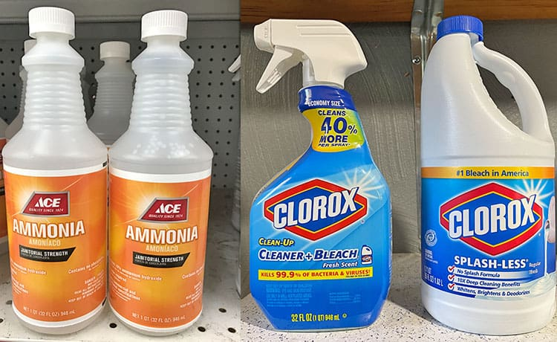
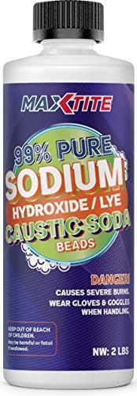
Uses of bases
Bases have many uses.
Ammonia is a base and is used in fertilizers and household cleaners.
Sodium hydroxide is used in some drain cleaners.

Slide 21
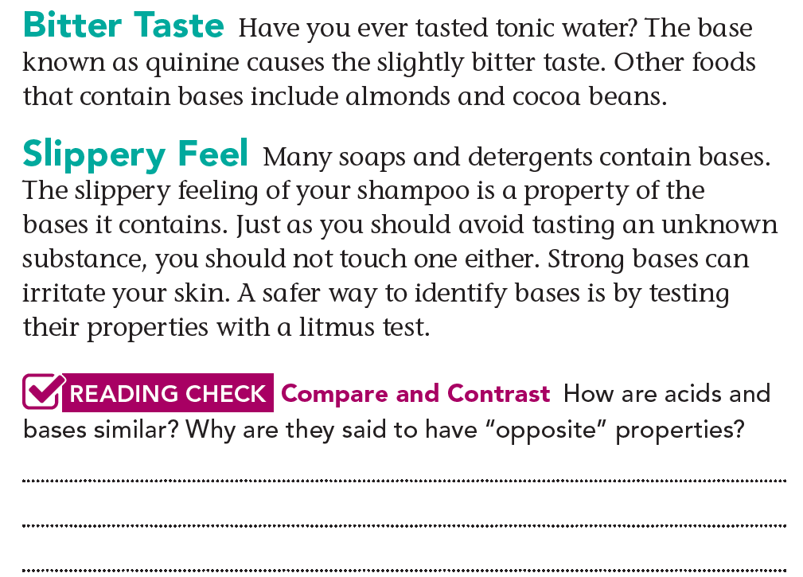

Although acids and bases are both compounds, they have different tastes and textures, and they have effects on indicators.

Slide 22
Neutralization
The reaction between an acid and a base is called a neutralization reaction.
The reason for this reaction is because acids give off or donate protons, while bases take in or accept protons.
The results of a neutralization reaction are not always neutral.
The final result depends on the volumes, concentrations, and strengths of the reactants.

Slide 23
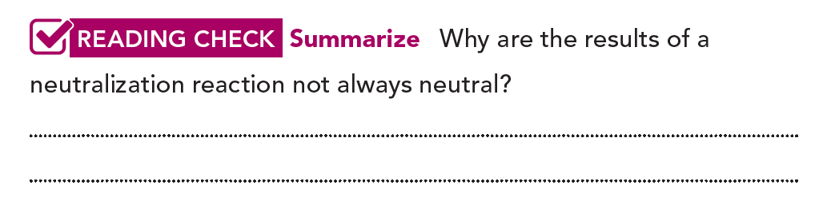
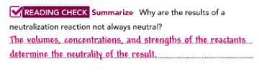

Slide 24
What are salts?
A salt is any ionic compound that can be made from a neutralization reaction.

Slide 25
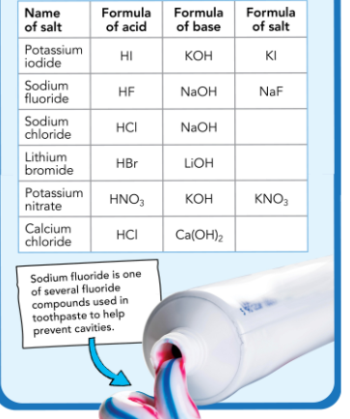
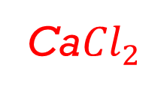
Common salts
NaCl
LiBr
Ca${Cl}_{2}$

Slide 26
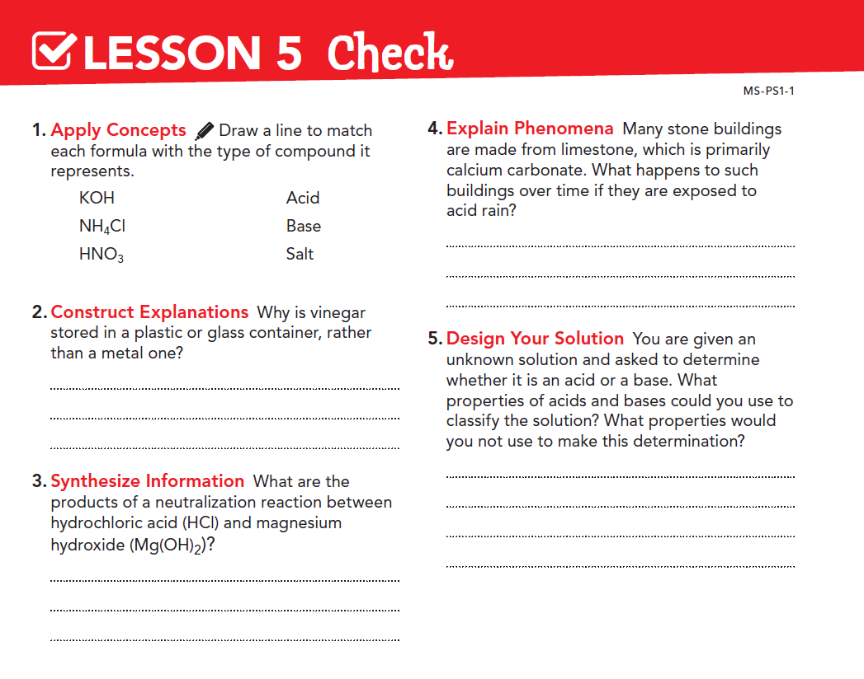

Slide 27
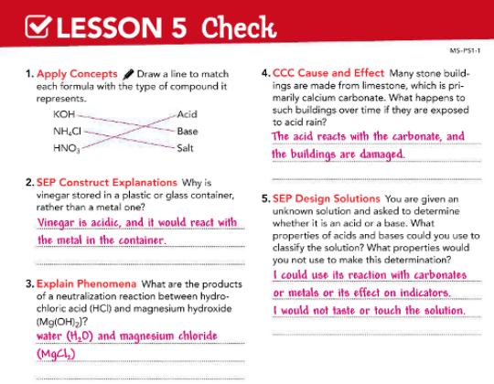

Slide 28

Thank you

